Slide 1
Biblical Principles of Stewardship
“It is required in stewards that a
man be found faithful.”
(I Corinthians 4:2)

Slide 2
Worldliness / Carnality “A focus on the desires of the flesh”
Envy
Jealousy
Covetousness
Greed
Temporal values
Focus on self and selfish desires
“I, brethren, could not speak unto you as unto spiritual, but as unto carnal, even babes in Christ…for whereas there is among you envying, and strife, and division, are ye not carnal…”

Slide 3
“Love not the world…know ye not that the friendship of the world is enmity with God? Whosoever therefore will be a friend of the world is the enemy of God…The carnal mind is enmity against God: for it is not subject to the Law of God, neither indeed can be. So then they that are in the flesh cannot please God.”

Slide 4
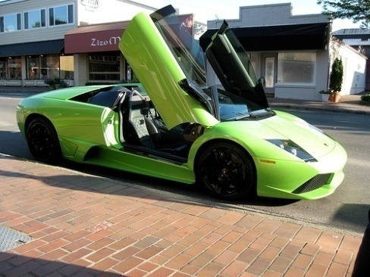
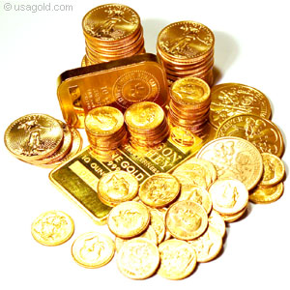
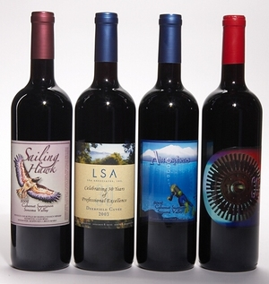
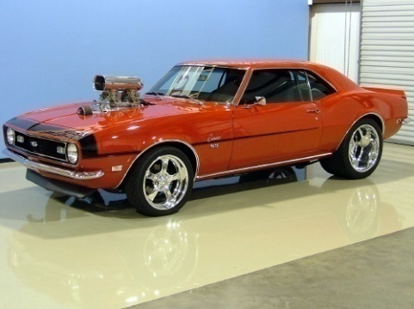

Slide 5
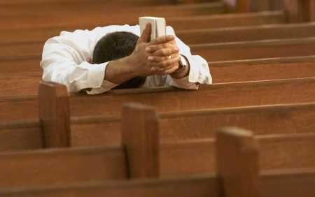
Spirituality “A focus on pleasing God and serving others”
Mark 12:41-44
Luke 8:16-18; 12:15-21, 35-48; 16:10-13
Acts 20:35
Romans 12:1-2, 6-8
I Corinthians 4:2; 6:12-20
II Corinthians 8:5-15
Ephesians 4:28
I Timothy 6:6-19
I Peter 4:10-11
Practicing Biblical stewardship should be the goal of every believer.
Stewardship is our responsibility and accountability.
“So then every one of us must give an account of himself to God.”

Slide 6
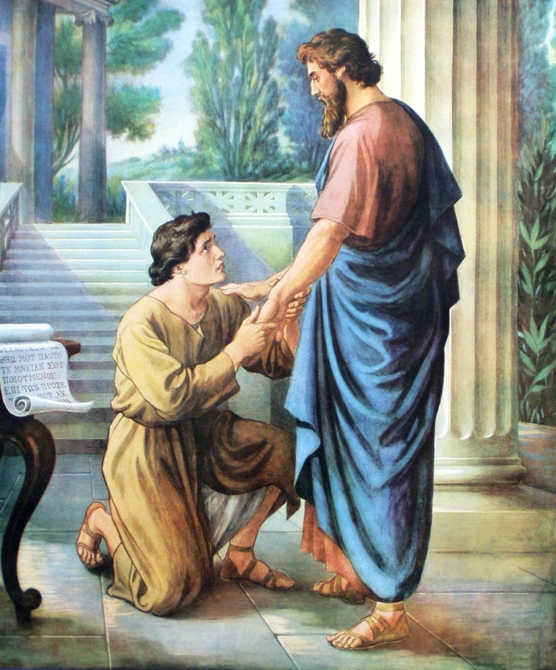
Stewardship
“Let a man so account of us, as the ministers of Christ and stewards.”
Steward (oikonomos) = “The overseer of an estate, managing servant.”
Pastors are called Bishops (overseers) of the church and its ministries.
Every Christian is a steward of God’s estate.

Slide 7
Steward was a slave who was in charge of the master’s house – Matthew 25:14-30
Steward was in charge of other staff and ran the whole operation in the master’s absents – (Joseph Genesis 39-40)
Steward though in authority over others was still his master’s slave – “Servants of the Lord Jesus Christ…”
Steward owned nothing, but was put in trust of his masters wealth and possessions – Luke 19:11-27

Slide 8
Steward was (humble) and sought only to glorify the master – Matthew 6:1; II Corinthians 9:12-13
Steward desired only to please the master instead of receiving honor from others – Colossians 3:17; I Thessalonians 2:1-6
Stewards focused their time and abilities on advancing the master’s kingdom not their own – Matthew 6:33 “But seek ye first the kingdom of God…”

Slide 9
Steward recognizes that every thing they have – body, material goods, time, abilities and talents has been given to them by God – Deuteronomy 8:18; I Chronicles 29:12; Psalms 24:1; 50:12; I Corinthians 6:19-20; 12:4-6
Steward is to be faithful in the care and management of all that God has entrusted to him – Matt. 25:14-30; Luke 12:13-48; 16:10-13; I Corinthians 4:1-2; Ephesians 5:15-17

Slide 10
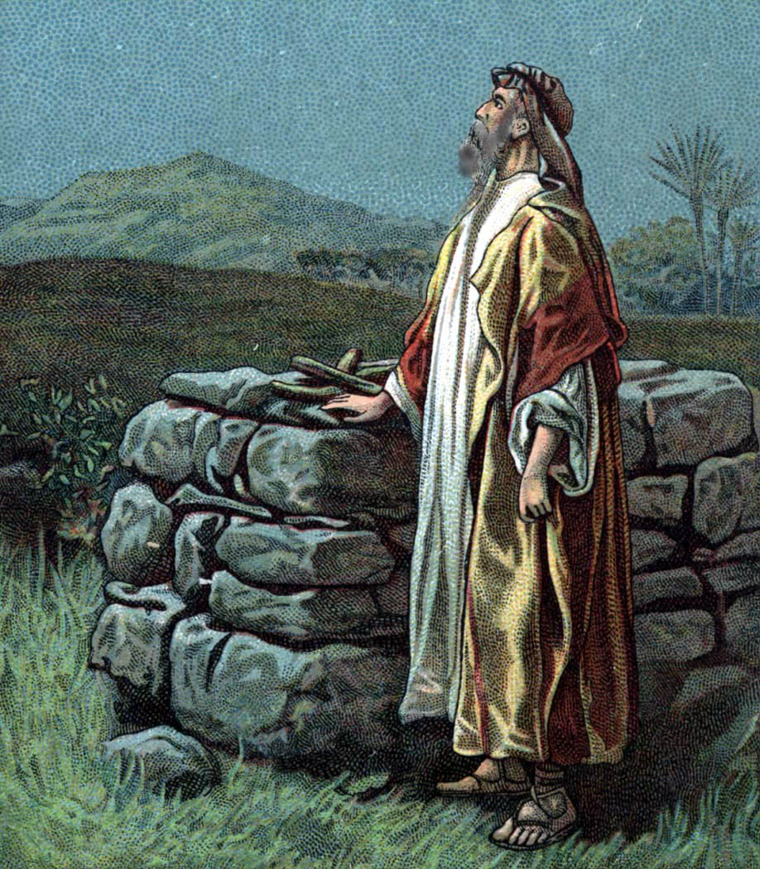
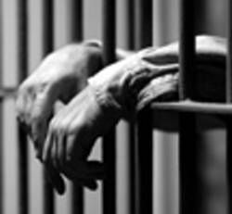
Lordship
If Christ is going to be Lord over the believer’s life, ownership of all they possess must be given back to God (Romans 6-8)
What a Christian possesses will soon possess him – I John 2:15-17; Colossians 3:1-2; II Timothy 2:3; Matthew 13:22-23

Slide 11
Motivation of a faithful steward
His motivation centers on the master’s wishes and plans not his own personal objectives and preoccupations (self) – “Lord, what wilt thou have me to do.”
His desire is to oversee the master’s resources according to the master’s wishes and plans -

Slide 12
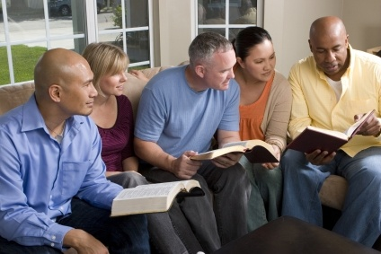
The believer’s stewardship
God’s Word – I Corinthians 4:1-2
God’s wealth – Luke 16:1-15
God’s people – Heb. 13:7, 17
God’s gifts – I Peter 4:10-11
God’s possessions – I Chronicles 28:1
God’s house (Church) – I Timothy 3:8-15
God’s ministries – II Corinthians 6:4

Slide 13
A stewards attitude towards money and material things indicates the level of their spiritual maturity (Luke 16:10-13; I Timothy 6:6-10)
The greatest battle a steward will ever face is the decision whether to serve God or money –Matthew 6:19-33
There is no middle ground in your allegiance – “Ye cannot serve God and mammon.”
The condition of a stewards heart is revealed by his perspective on and use of material things – “As man thinketh in his heart so is he.”

Slide 14
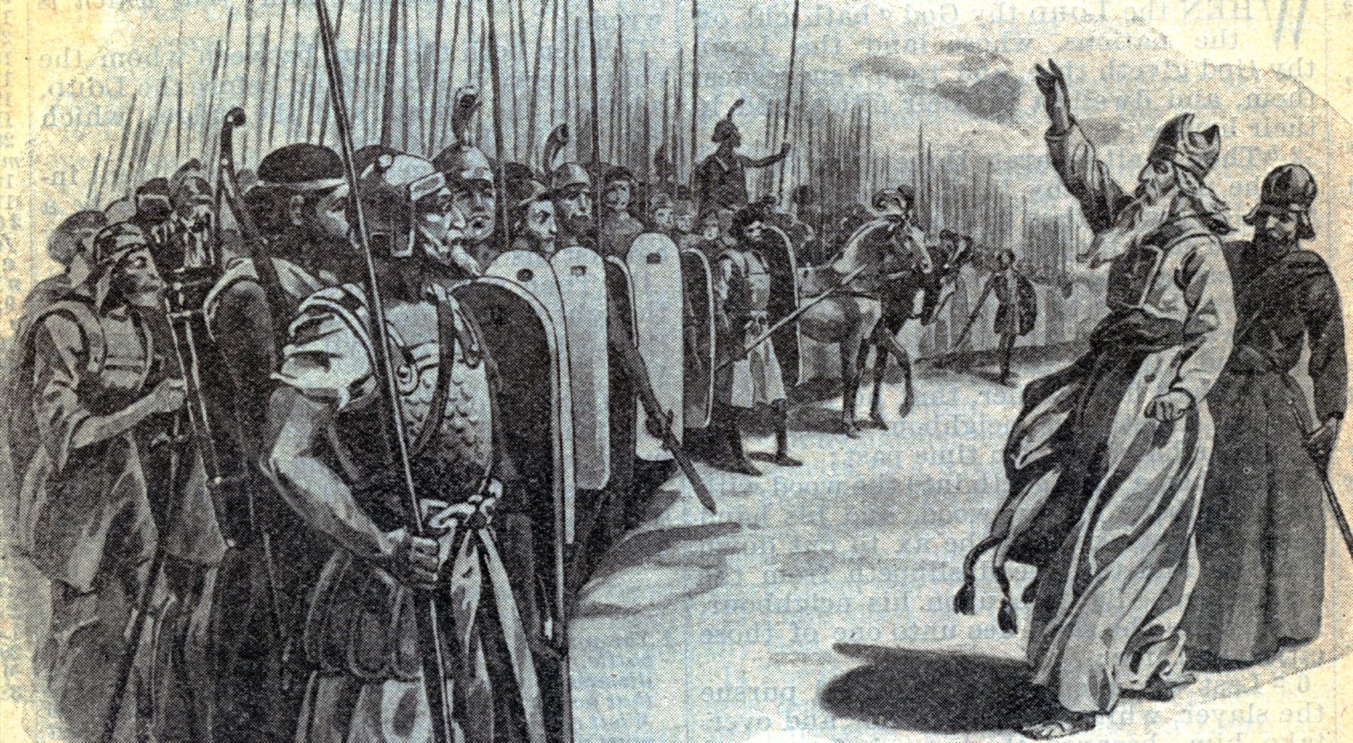
“No man that warreth entangleth himself with the affairs of this life; that he may please Him who hath chosen him to be a soldier.”

Slide 15
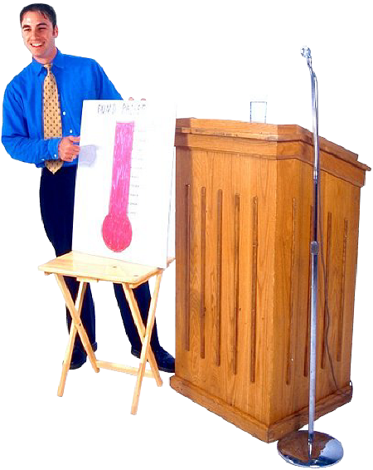
Stewards perspective on giving
Motive is to express love for the Lord -
II Corinthians 8:5-8
Giving to the Lord is simply returning what is already His – I Chronicles 29:14; Luke 16:19-21
Not giving to the Lord robs God and insures leanness to your soul – Malachi 1:7-10; 3:8-11
Giving should be done with excitement and cheerfulness – II Corinthians 8:11-12

Slide 16
Giving is to be sacrificial / faith giving – Leviticus 22:24
Giving is to be done out of personal determination – II Corinthians 8-9
Give on a regular basis – I Corinthians 16:1-4
Give in response to special needs – Acts 4:34
Give generously to your spiritual leaders – I Timothy 5:17-18

Slide 17
Give to poor, needy and sick – Matthew 25:31-46
Give to widows and orphans – James 1:27
Give to your enemies – Romans 12:20-21
Giving advances the Kingdom of God - II Corinthians 10:15-16
Giving results in receiving true riches – Luke 16:10-15
Giving results in receiving blessings from the Lord – Proverbs 11:24; 19:17; 22:9; 28:27

Slide 18
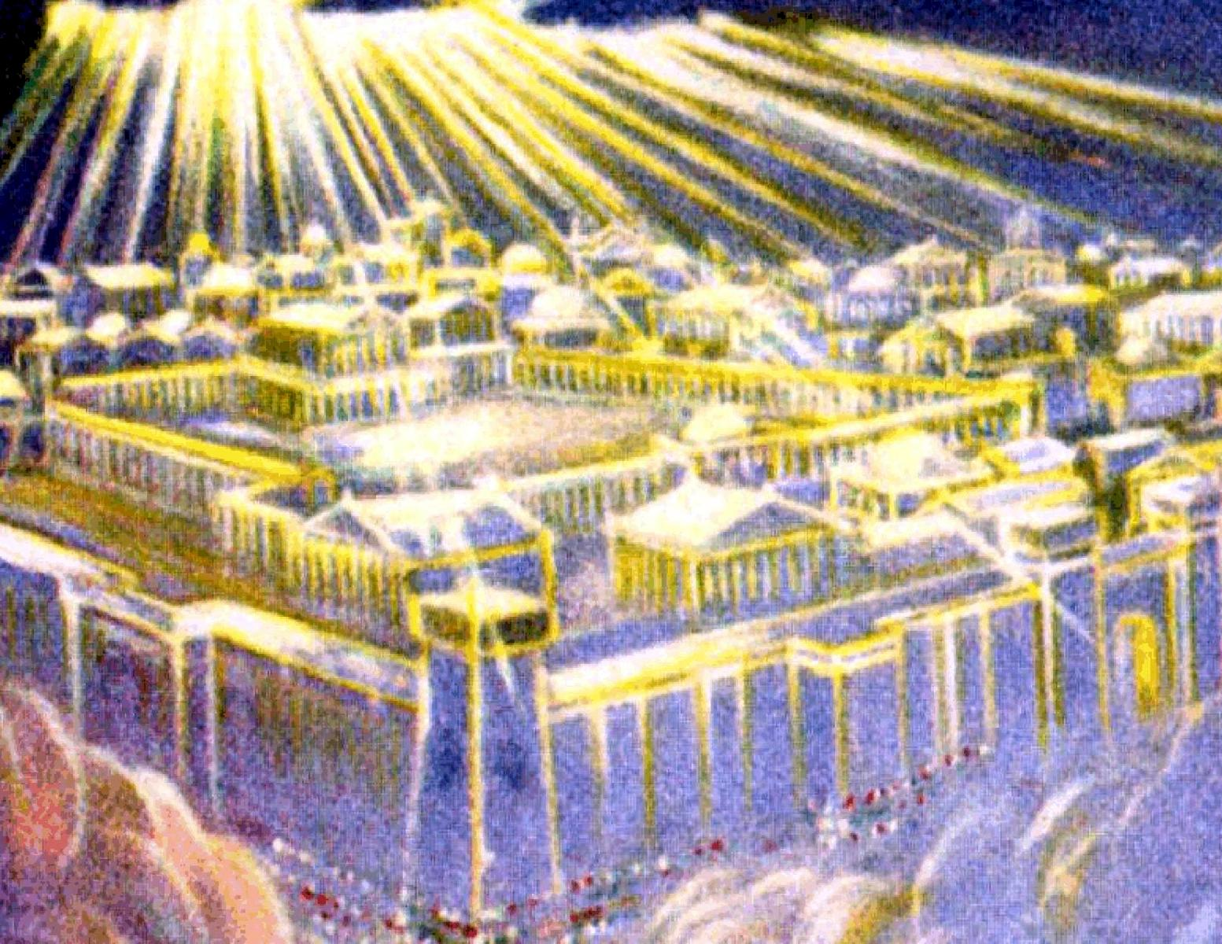
Giving is of greater value then receiving – Acts 20:35
Giving will be rewarded – “Give and it shall be given you.”

Slide 19
Contentment and Stewardship
Contentment brings freedom from stress, fear and anxiety – Luke 3:10-14
Contentment allows you the freedom to enjoy the things you have – Hebrews 13:5
Contentment produces freedom from envy – III John 9-11
Contentment permits one to discern God’s will – Exodus 2:13-21
Contentment produces godliness – I Timothy 6:6
Contentment must be learned – Philippians 4:11

Slide 20
Covetousness and Stewardship
Will distract you from seeking first the Kingdom of God – Luke 12:13-34
Will cause you to become discontent and run ahead of the Lord – Joshua 7:19-26
Will discourage your commitment to the Lord – I Timothy 6:6-12
Will defile your moral sense of right and wrong – I Peter 2:1-15; I Corinthians 5:10-11

Slide 21
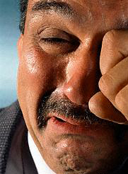
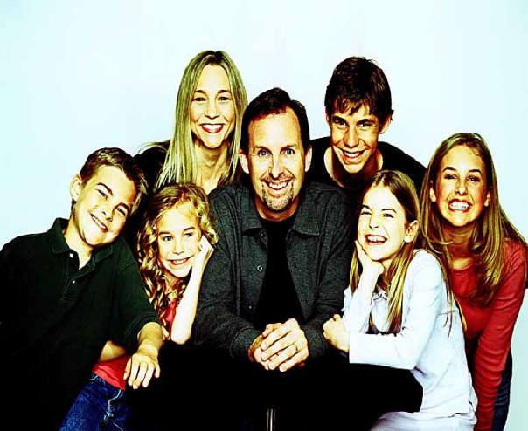
“There is he that maketh himself rich, yet he hath nothing, there is he that maketh himself poor, yet he hath great riches.” (Proverbs 13:7)

Slide 22
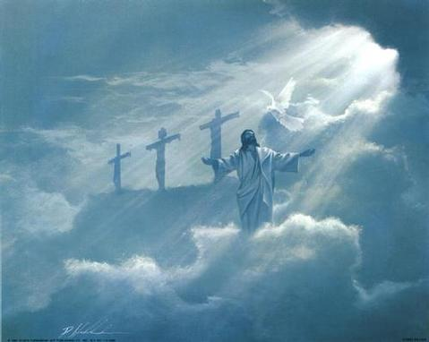
Becoming a faithful steward
Acknowledge the Lordship of Christ – James 4:13-16
Study your Bible – II Timothy 2:15
Memorize Scripture – Psalm 119:11
Meditate on Scripture – Psalm 1:1-3
Attend church faithfully – Hebrews 12:24-25
Look with anticipation and preparation for the Lord’s return – I John 2:28-3:2

Slide 23
Purpose to live a pure life – Daniel 1:8
Yield your body to the Lord – Romans 6:12-13
Recognize that you are the temple of God’s Holy Spirit – I Corinthians 6:19-20
Present your self to God as a living sacrifice – Romans 12:1-2
Give evidence to others that you belong to God – I Corinthians 16:19-20
Keep sin confessed – Proverbs 28:13
Keep your conscience clear – Acts 24:16

Slide 24
“These things have I spoken unto you, that my joy might remain in you, and that your joy might be full.” (John 15:11)

