Slide 1
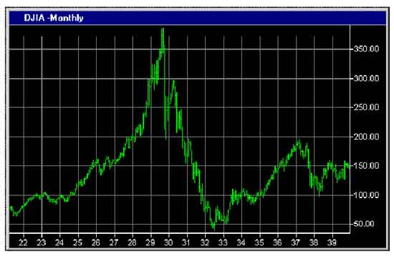
Financial Freedom
(Part 10)
What does it mean to be
financially free?
“And ye shall know the truth and the truth shall make you free.” (John 8:32)

Slide 2
Review:
Biblical principles of Stewardship
What the Bible teaches about borrowing
The sting of interest
Establishing scriptural convictions
Developing a giving spirit
What it means to be financially free

Slide 3
Importance of living on a budget
Making a choice to serve God rather
than money or material possessions
Reasons for lack of funds
Establishing the tithe as a weekly
reminder that everything we have
belongs to God
Giving to meet the needs of others
Knowing who not to give money to
The Law of the Harvest

Slide 4
“I will purpose to work towards gaining and maintaining financial freedom according to Biblical principles.”
“I hereby acknowledge that any funds that I have or will receive are from God’s hand and must be earned and managed according to the principles of His Word.”

Slide 5
“I accept full responsibility for the financial problems and pressures that I am facing. I realize that many of these are God’s reproof for violating His financial principles. I will learn the reason for these reproofs and take the proper Scriptural steps to resolve them.”
“From this point on I will purpose to faithfully pay my tithe to my local Church.”

Slide 6
“From this point on I will purpose in my heart to be open to the promptings of
the Holy Spirit in the area of giving.”
“I will prayerfully consider how the Law of the Harvest applies to my personal finances.”

Slide 7
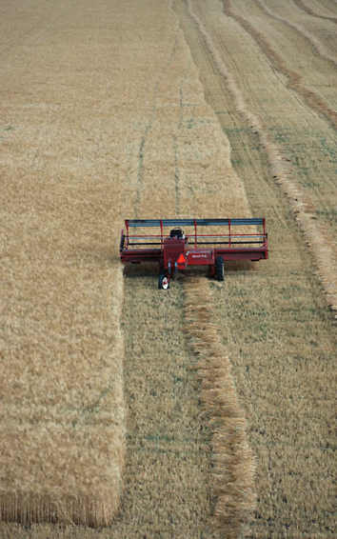
Galatians 6:7-9
We reap what we sow
We reap where we sow
We reap in proportion to what we sow
We reap in another season than which we sow

Slide 8
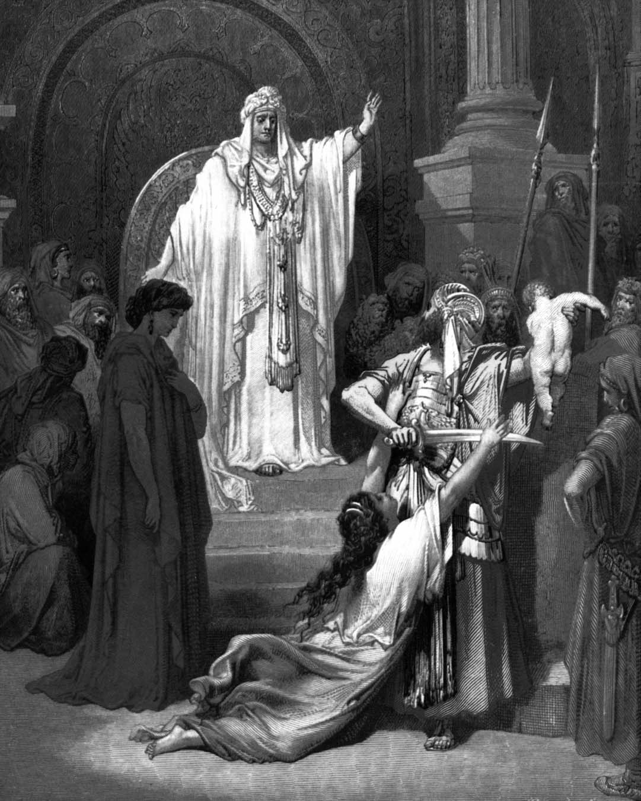
The Wisdom of Solomon Concerning Finances “Violations of God’s Word bring financial loss.” (Proverbs)

Slide 9
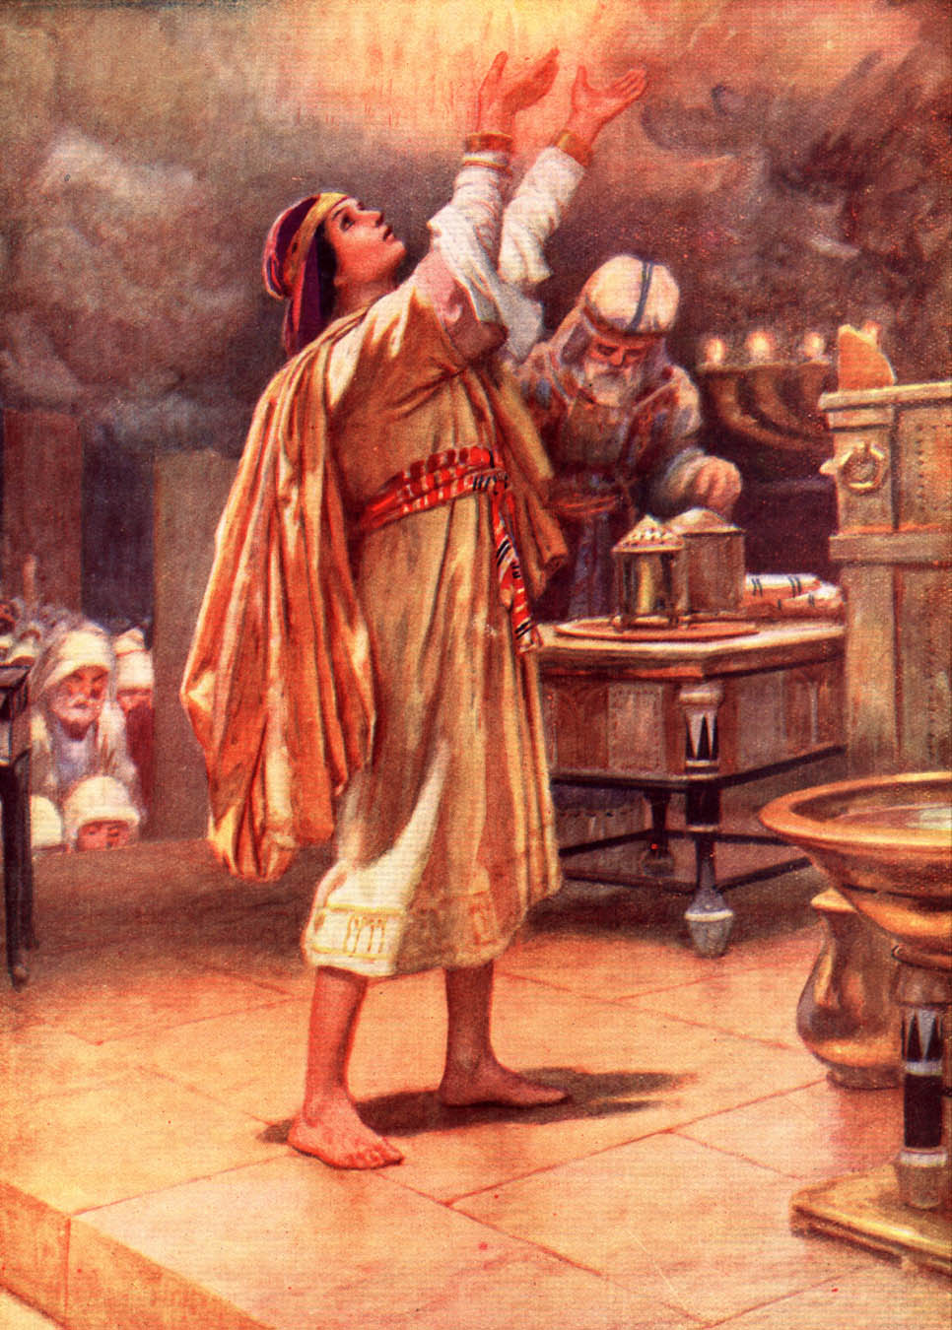
“I have given thee a wise and understanding heart; so that there was none like thee before thee, neither after thee shall any arise like unto thee…”

Slide 10
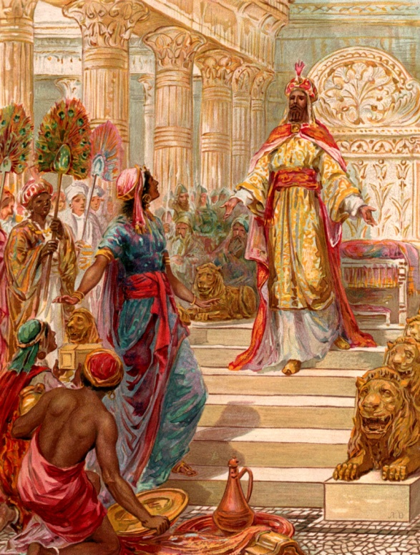
“Bow down thine ear, and hear the words of the wise, and apply thine heart unto my knowledge. For it is a pleasant thing if thou keep them within thee; That thy trust may be in the Lord.
I have made known to thee this day, even to thee. Have not I written to thee excellent things in counsels and knowledge, that I might make thee know the certainty of the words of truth, that thou mightest answer the words of truth to them that send thee.”

Slide 11
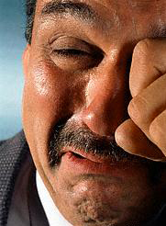
“The blessing of the LORD, it maketh rich, and he addeth no sorrow with it.” Proverbs 10:22

Slide 12
Being immoral (Proverbs 5:3-13)
“Lest strangers be filled with thy welath; and thy labors be in the house of a stranger. And thou mourn at the last, when thy flesh and thy body are consumed.”

Slide 13
Spending too much time sleeping (Proverbs 6:10-11)
“Yet a little sleep, a little slumber, a little folding of the hands to sleep: So shall thy poverty come as one that traveleth, and thy want as an armed man.”

Slide 14
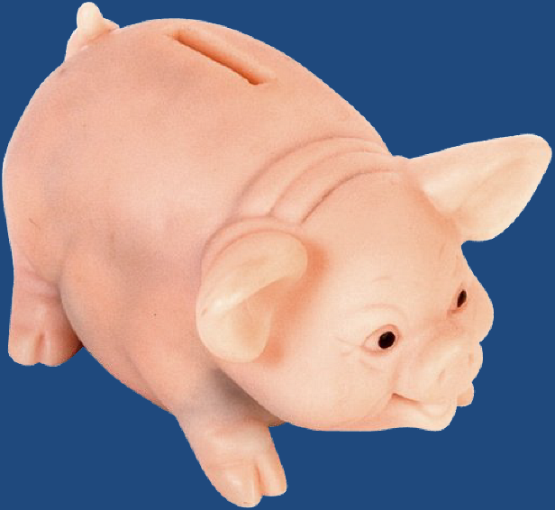
A Good Housewife (Proverbs 31:10-31)

Slide 15
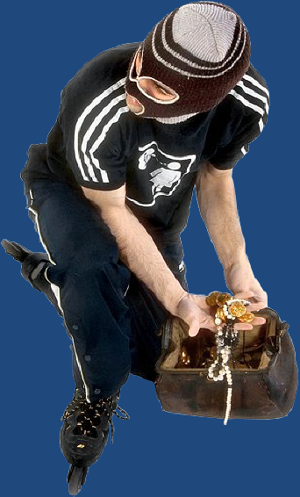
Getting money by doing evil (Proverbs 10:3)
“The Lord will not suffer the soul of the righteous to famish: but he casteth away the substance of the wicked.”

Slide 16
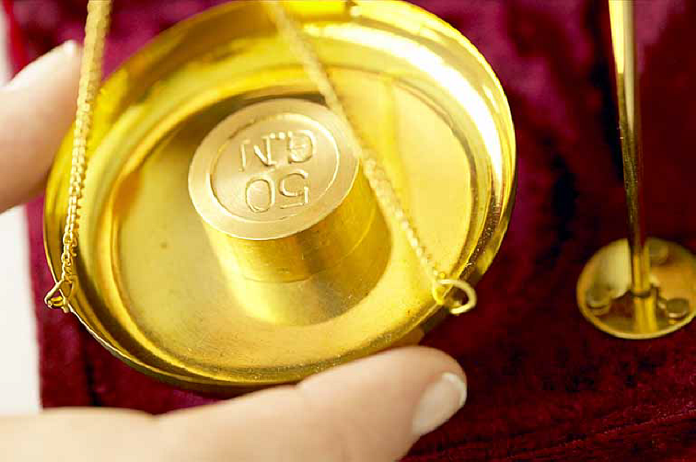
“A false balance is an abomination to the Lord: but a just weight is his delight.” – 11:1
“Divers weights, and divers measures, both of them are alike abomination to the Lord.” – 20:10

Slide 17
Failing to be diligent (Proverbs 10:4)
“He becometh poor that dealeth with a slack hand.”

Slide 18
Co-signing (Proverbs 6:1-5)
“Thou art snare with the words of thy mouth, thou art taken with the words of thy mouth…Deliver thyself as a roe from the hand of the hunter, and as a bird from the hand of the fowler.”

Slide 19
Having a stingy attitude (Proverbs 11:24)
“There is that withholdeth more than is meet, but it tendeth to poverty.”

Slide 20
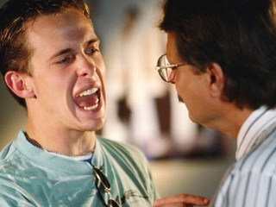
Provoking your family to anger (Proverbs 11:29)

Slide 21
“He that is greedy of gain troubleth his own house.” – 15:27
“Better is a dinner of herbs where love is, than a stalled ox and hatred therewith.” – 15:17
“Better is a dry morsel, and quietness therewith, than a house full of sacrifices with strife.” – 17:1

Slide 22
Getting money without labor (Proverbs 13:11)

Slide 23
“Wealth gotten by vanity shall be diminished: but he that gathereth by labor shall increase.” – 13:11
“The desire of the slothful killeth him; for his hands refuse to labor.” – 21:25
“In all labor there is profit.” – 14:23
“A good name is rather to be chosen than great riches.” 22:1
“By humility and the fear of the Lord are riches, and honor and life.” 22:4

Slide 24
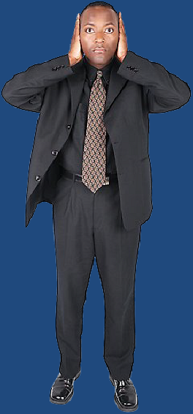
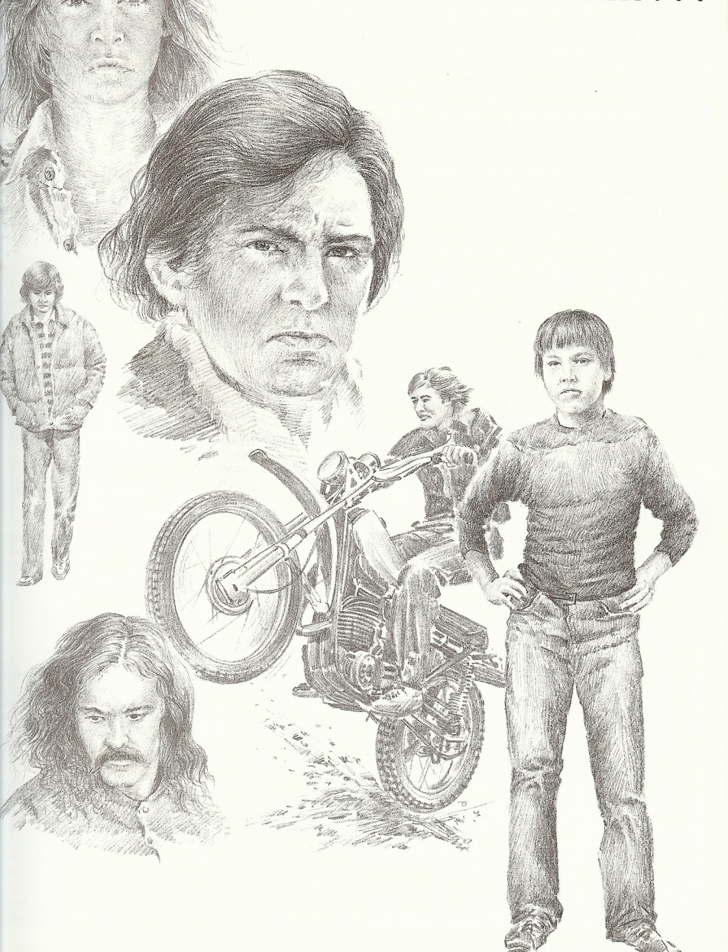
Refusing to listen to reproofs (Proverbs 13:18)

Slide 25
“Poverty and shame shall be to him that refuseth instruction, but he that regardeth reproof shall be honoured.” – 13:18
“Turn you at my reproof…Because I have called, and ye refused…Ye have set at nought all my counsel, and would none of my reproof: I also will laugh at your calamity; I will mock when your fear cometh…Then shall they call upon me, but I will not answer; they shall seek me early, but they shall not find me.” – 1:23-28

Slide 26
Talking too much (Proverbs 14:23)

Slide 27
“In all labor there is profit: but the talk of the lips tendeth only to penury (impoverishment).” - 14:23
“Be not thou envious against evil men, neither desire to be with them. For their heart studieth destruction, and their lips talk of mischief.” 24:1-2
“The mouth of the foolish is a rod of pride.” – 14:3
Mouth = 50 times
Lips = 42 times

Slide 28
Being slothful (Proverbs 19:15)

Slide 29
“Slothfulness casteth into a deep sleep; and an idle soul shall suffer hunger.” – 19:15
“The slothful man hideth his hand in his bosom, and will not so much as bring it to his mouth again.” – 19:24
“He that is slothful in his work is brother to him that is a great waster.” – 18:9
“Drowsiness shall clothe a man with rags.” – 22:21
“Go to the ant, thou sluggard: consider her ways, and be wise.” – 6:6

Slide 30
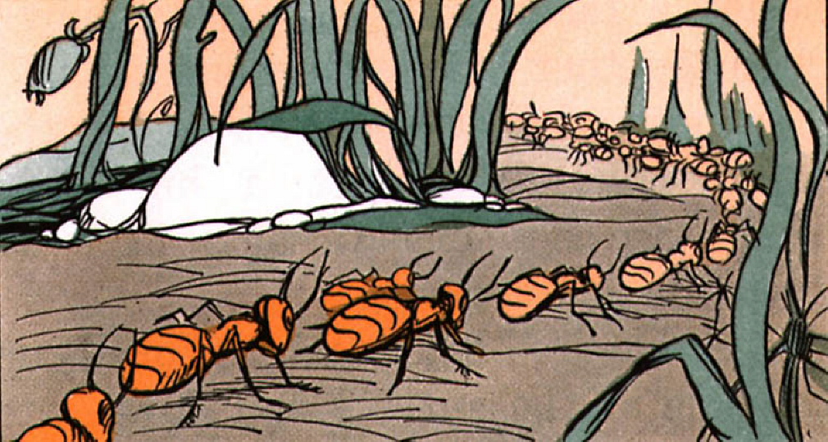

Slide 31
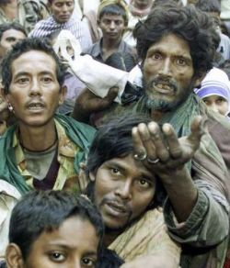
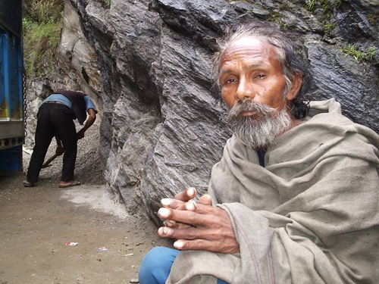
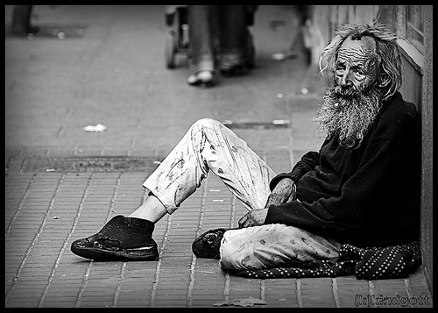
Rejecting the cry of the poor (Proverbs 21:13)

Slide 32
“Whosoever stoppeth his ears at the cry of the poor, he also shall cry himself, but shall not be heard.” – 21:13
“There is he that scattereth, and yet inceaseth; and there is he that withholdeth more than is meet, but tendeth to poverty.” – 11:24
“The righteous considereth the cause of the poor: but the wicked regardeth not to know it.” – 29:7
“There is a generation, whose teeth are as swords, and their jaw teeth as knives, to devour the poor from off the earth, and the needy from among men.” - 30:14

Slide 33
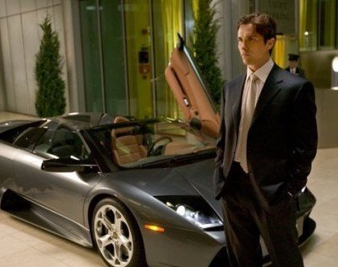
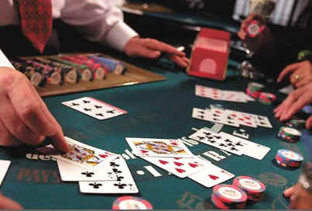
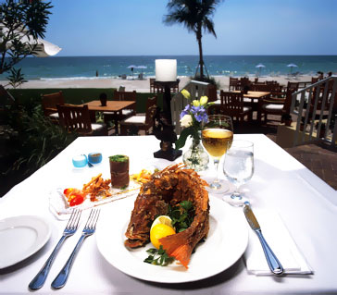
Loving Pleasure (Proverbs 21:7)

Slide 34
“Labor not to be rich. Wilt thou set thine eyes upon that which is not? For riches certainly make themselves wings; they fly away as an eagle toward heaven. Eat thou not the bread of him that hath an evil eye, neither desire thou his dainty meats. For as he thinketh in his heart, so is he: Eat and drink, saith he to thee; but his heart is not with thee. The morsel which thou hast eaten shall thou vomit up.” – 23:4-8

Slide 35
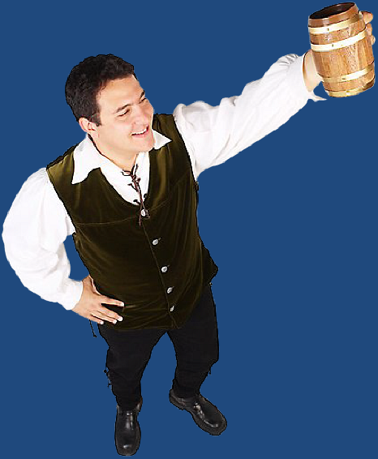
Loving wine (Proverbs 21:17)

Slide 36
“Look not thou upon the wine when it is red, when it giveth his colour in the cup, when it moveth itself aright. At the last it biteth like a serpent, and stingeth like an adder.” – 23: 31-32
“Wine is a mocker, and strong drink is raging and whosoever is deceived thereby is not wise.” – 20:1
“It is not for kings to drink wine, nor for princes strong drink. Lest they drink and forget the law, and pervert the judgment.” – 31:4-5
“Be not among winebibbers.” -23:20
Notes:
31:

Slide 37
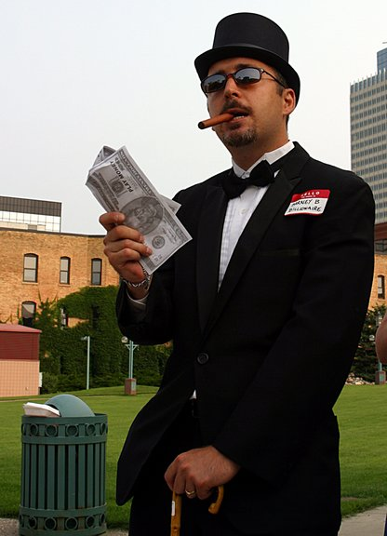
Giving to the rich (Proverbs 22:16)

Slide 38
“Wealth maketh many friends.” – 19:4
“The poor is hated even of his own neighbor: but the rich hath many friends.” – 14:20
“Envy not the oppressor, and choose none of his ways – 3:31
“There shall be no reward to the evil man; the candle of the wicked shall be put out.” – 24:20
“The rich man’s wealth is his strong city, and as a high wall in his own conceit.” 18:11
“He that hasteth to be rich hath an evil eye, and considereth not that poverty shall come upon him.” – 28:22

Slide 39
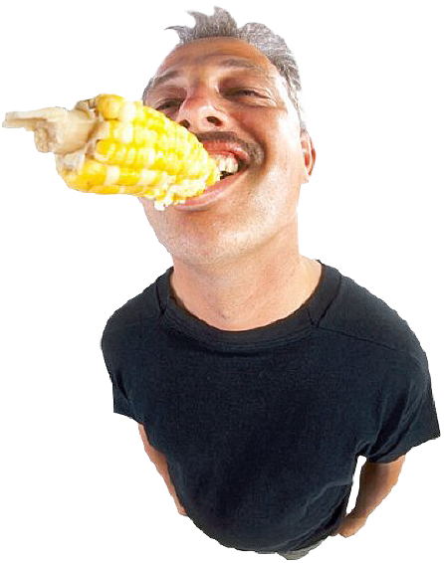
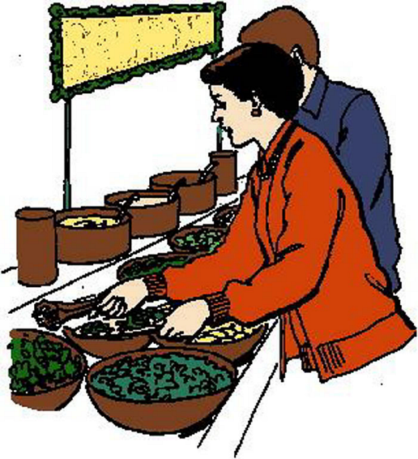
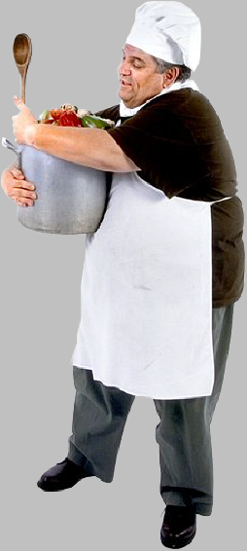
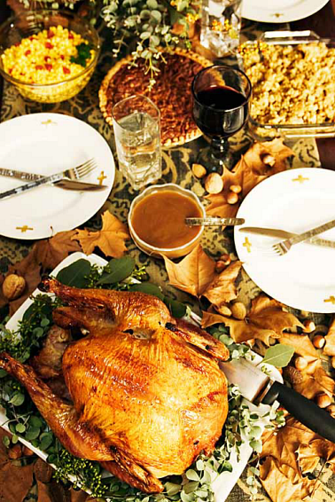
Overeating (Proverbs 23:21)

Slide 40
“Glutton shall come to poverty.” – 23:21
“Be not among riotous eaters of flesh.” – 23:20
“Put a knife to thy throat, if thou be a man given to appetite.” – 23:2

Slide 41
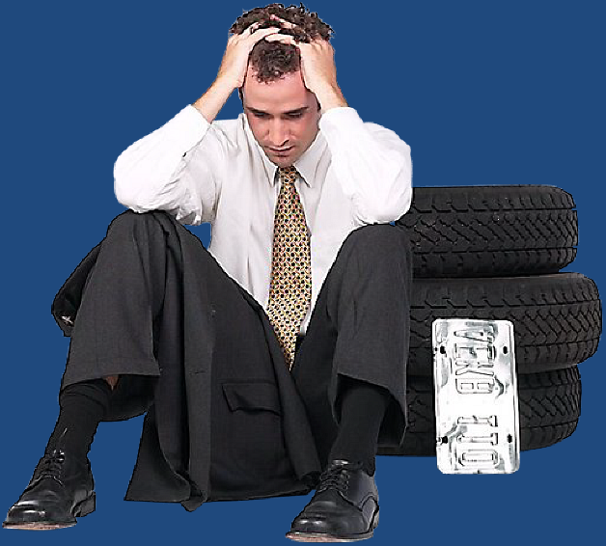
Charging usury on loans (Proverbs 28:8)
“He that by usury and unjust gain increaseth his substance, he shall gather it for him that will pity the poor.”

Slide 42
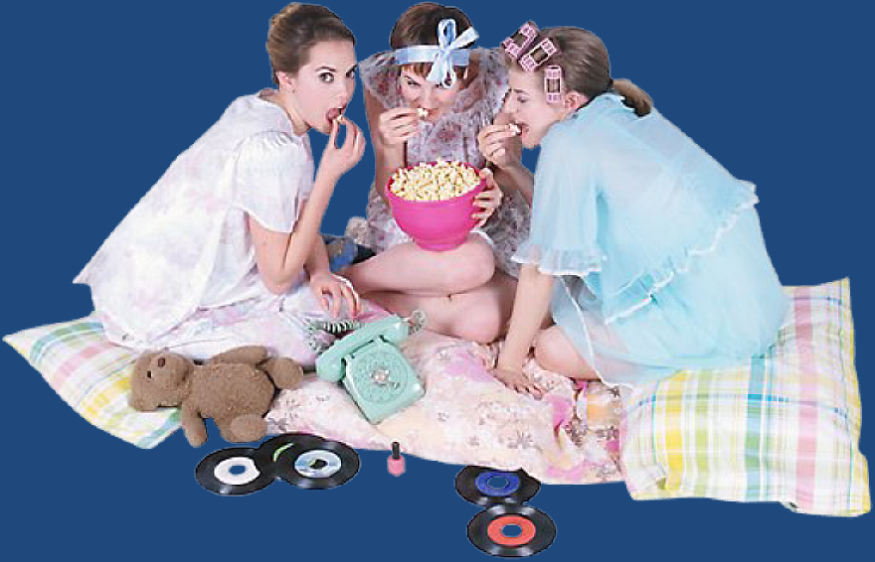
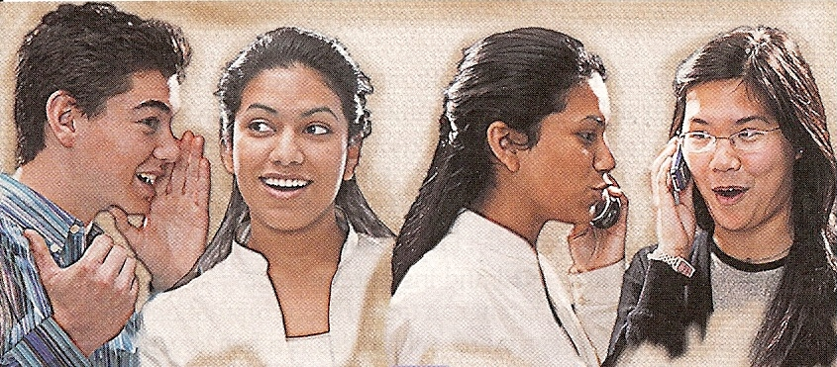
Following vain persons (Proverbs 28:19)

Slide 43
“He that followeth vain persons is void of understanding.” – 12:11
“My son when sinners entice thee, consent thou not…cast in thy lot among us; let us all have one purse. My son, walk not thou in the way with them; refrain thy foot from their path. For their feet run to evil…So are the ways of every one that is greedy of gain.” – 1:10-19

Slide 44
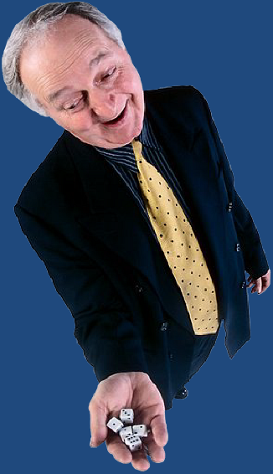
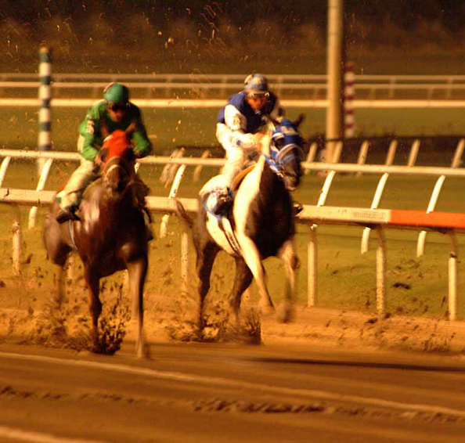
Trying to get rich quick (Proverbs 28:20, 22)

Slide 45
Review:
Being immoral – 5:3-10
Spending too much time sleeping – 6:11
Getting money by doing evil – 10:3
Failing to be diligent – 10:4
Co-signing – 11:15
Having a stingy attitude – 11:24
Provoking your family to anger – 11:29
Getting money without labor – 13:11

Slide 46
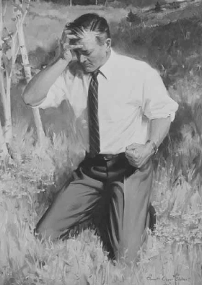
Refusing to listen to reproofs – 13:18
Talking too much – 14:23
Being slothful – 19:15
Rejecting the cry of the poor – 21:13
Loving pleasure – 21:17
Loving wine – 21:17
Giving to the rich – 22:16
Overeating – 23:21
Charging usury – 28:8
Following vain persons – 28:19
Trying to get rich quick – 28:22

