Slide 1
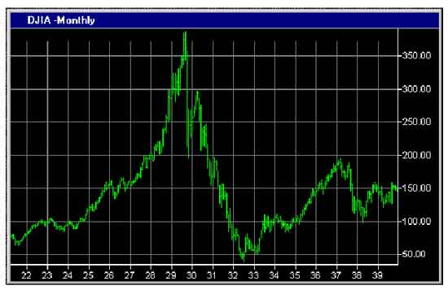
Financial Freedom (Part 1)
What does it mean to be
financially free?
“And ye shall know the truth and the truth shall make you free.” (John 8:32)

Slide 2
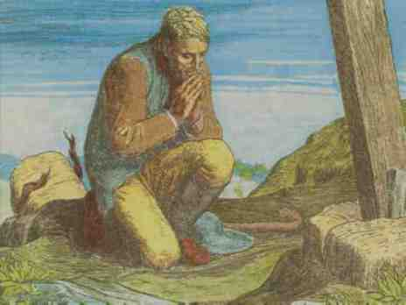
Scriptural Convictions (I Corinthians 16:13-14)
God alone is sovereign and must be the Lord of my life.
The Bible is His inspired Word and my final authority of faith and practice.
My purpose in life is to seek God with my whole heart.
I will build my goals around His priorities.
My body is the temple of the living God and must not be deviled by lust.

Slide 3
I will submit my self to and honor God ordained authority.
My Church must teach the foundational truths of Scripture.
I will be faithful in my attendance and support of my local church through my tithes and offerings.
My children and grandchildren belong to God, and it is my responsibility to teach them Scriptural principles, Godly character, and basic convictions.
My activities must never weaken the faith and convictions of another brother in Christ.

Slide 4
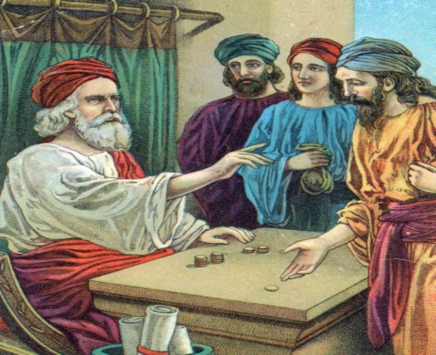
My marriage is a life-long commitment to God and my marriage partner.
Wife - I will respect my husband and submit to his authority.
Husband – I will love and cherish my wife.
My affections must be set on things above, not on the things of this world.
My money is a trust (stewardship) from God and must be earned and managed according to Scriptural principles.

Slide 5
The Pastor’s and Father’s Responsibility
Teach Biblical convictions – (Titus 1:9)
Biblical convictions protects the Church, families and children from –
Destructive influences – (Philippians 3:18-19)
Wrong desires – (I John 2:15)
False philosophies – (Colossians 2:8)
Evil companions – (Proverbs 1-2)

Slide 6
Financial Bondage
Insecurity – Building our lives around that which can be taken from us (Job 1-2).
Fear – Occurs when we become aware of all the possible ways in which we could lose our most cherished possessions (Proverbs 23:5).
Anxiety – Physical and emotional tension which results when we think about our financial problems (Philippians 4:6).

Slide 7
Loss of sleep – Worry over financial cares (Psalms 4:8).
Ungratefulness – Financial cares and concerns decrease our ability to appreciate and enjoy the things God has provided for us (Psalms 26:7).
Envy – Desiring to have what someone else has (Titus 3:3).
Enslavement – Believing one can borrow his way to financial freedom (Proverbs 22:7).

Slide 8
Disillusionment – When money and material things do not fulfill our dreams (Ecclesiastes 5:1-16).
Bitterness – Money and possessions become more important than our love for God (Hebrews 12:15).
Bitterness towards God
Bitterness towards others

Slide 9
Personal Commitment “I will purpose to work towards gaining and maintaining financial freedom according to Biblical principles.”

Slide 10
Basic Factors of Financial Freedom (Matthew 6:19-34)

Slide 11
Financial Freedom is Knowing how to Receive Provisions from the Lord
“Beware that thou forget not the Lord thy God…and thou say in thine heart, my power and the might of mine hand hath gotten me this wealth. But thou shalt remember the Lord thy God: for it is He that giveth thee power to get wealth…” (Deuteronomy 8:11-18)

Slide 12
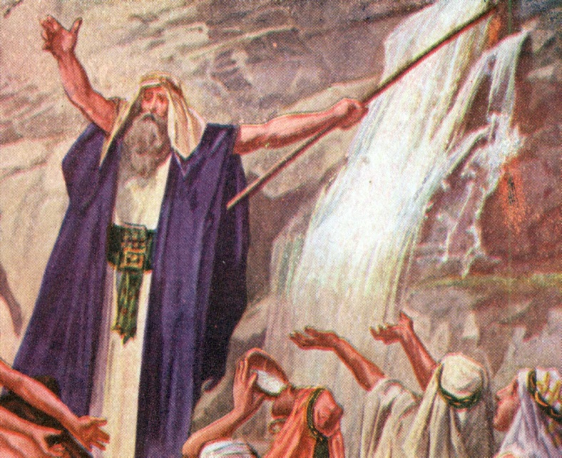
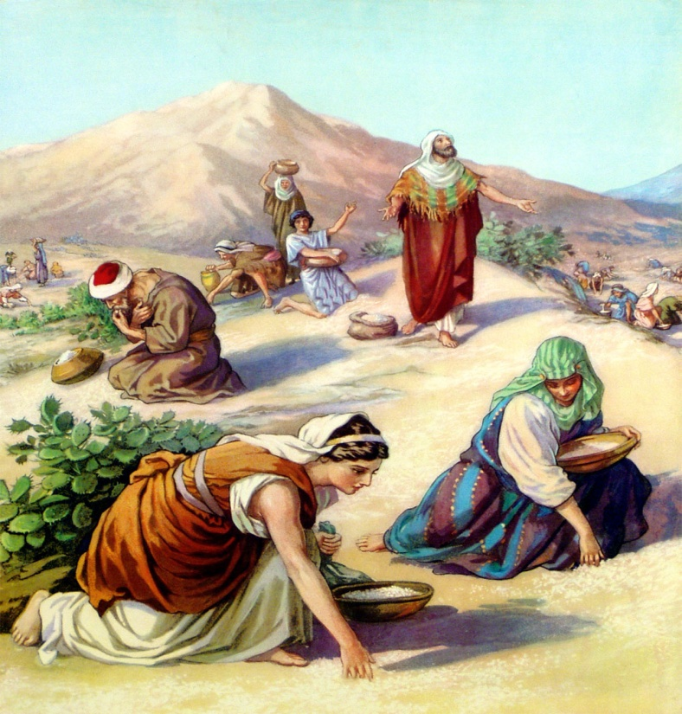
“But my God shall supply all of your need according to his riches in glory by Christ Jesus. Now unto God and our Father be glory for ever and ever. Amen!” “Behold, he smote the rock, that the waters gushed out, and the streams overflowed; can He give bread also? Can He provide flesh for His people?”

Slide 13
Receiving through prayer – (Philippians 4:6)
Receiving through diligent labor – (II Thessalonians 3:12)
Receiving through being resourceful – (Proverbs 31:13)

Slide 14
Receiving through faith – (Matthew 6:30)
Receiving through seeking first the Kingdom
of God and His righteousness –
(Matthew 6:33)

Slide 15
Financial Freedom is Knowing how to Manage Money
Learning how to save money – (Proverbs 6:6)
Building sales resistance – (Proverbs 20:14)
Looking for the best buys – (Proverbs 31:16)
Not wasting money – (Haggai 1:6)
Leaning contentment – (I Timothy 6:6)

Slide 16
Resisting impulse buying – (I John 2:16)
Paying bills on time – (Proverbs 3:28)
60% of Americans do not pay off their
credit cards every month
Keeping accurate banking records –
(I Corinthians 4:2)

Slide 17
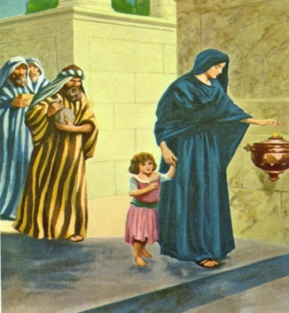
Financial Freedom is Developing a Giving Spirit
Giving activates the work of God in your financial affairs – “Give and it shall be given unto you…” (Luke 6:38)
Giving must begin with tithes and offerings – (Malachi 3:10)
Note: No Christian can afford to neglect tithing – (I Corinthians 16:2)
By giving you are investing treasures in heaven – (Matthew 3:10)
Giving increases your love for the Lord – (Matthew 6:21)

Slide 18
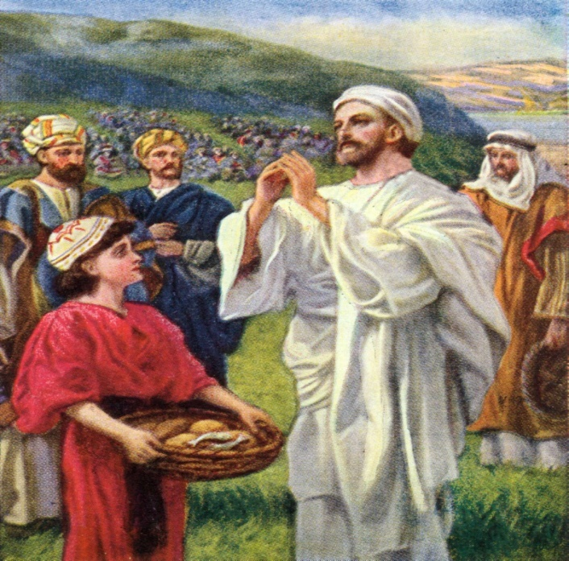
Giving to the poor (the necessities of life) – (Proverbs 19:17)
Giving to the fatherless and widows – (James 1:27)
Giving to Christians in need – (Romans 12:13)
Notes:
-

Slide 19
Loaning Money to Friends or Relatives “Am I helping them?” (Luke 6:30-38)
If you loan money to a friend or relative
The relationship will be strained.
The relationship may be destroyed.
One party will be the master and the other party the servant – (Proverbs 22:7)

Slide 20
Cosigning for a Loan “Am I helping them?” (Proverbs 6:1-2)
If you cosign for a friend or relative
Be ready to repay the loan

