Slide 1
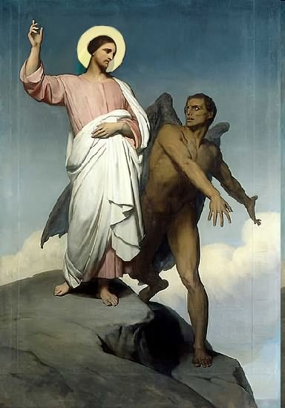

Slide 2
Topics to be studied
His existence
His origin
His fall
His personality
His names
His activities (Part 6)
His location – present and future
Our victory over him

Slide 4
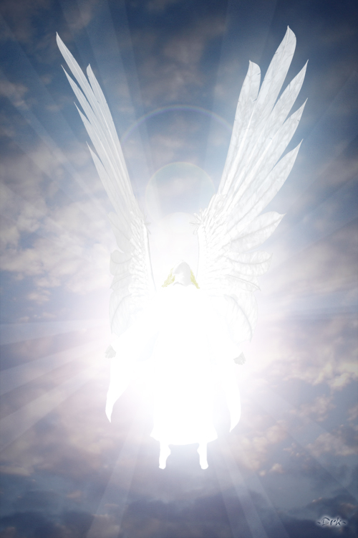
How does Satan imitate God?

Slide 5
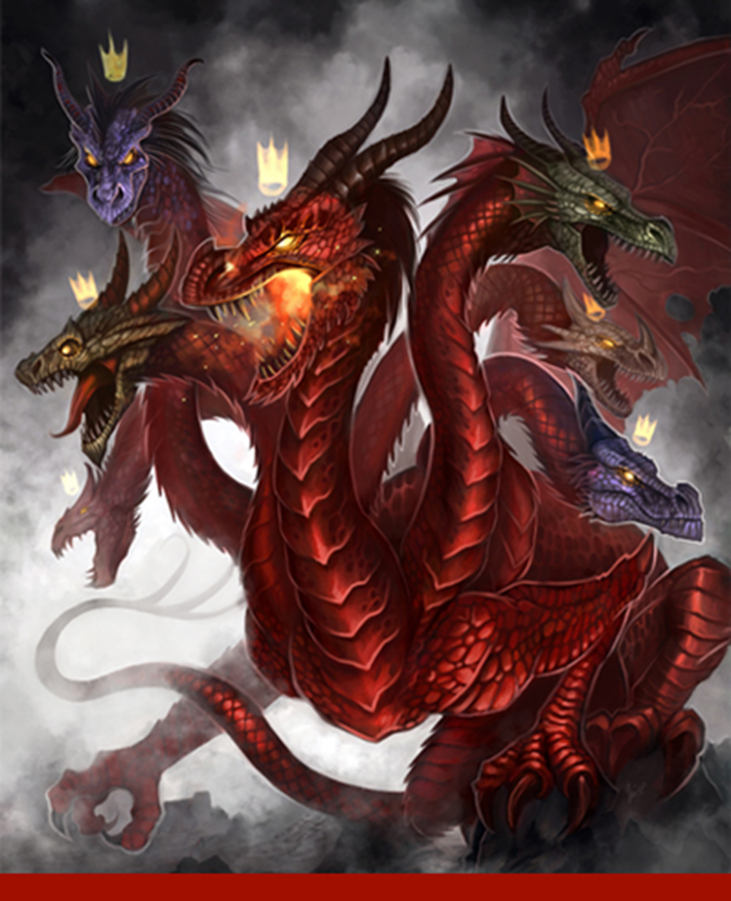
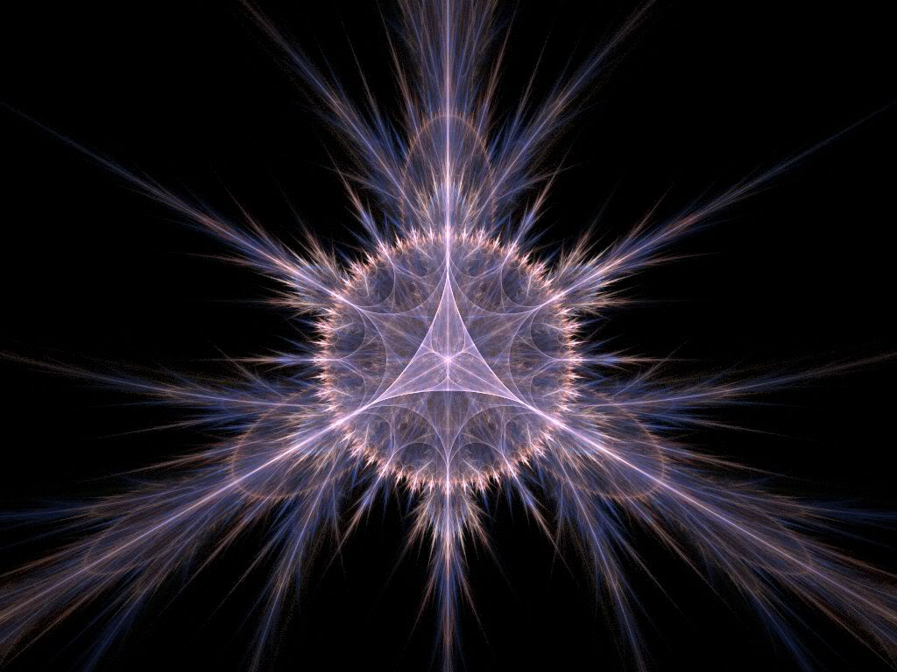
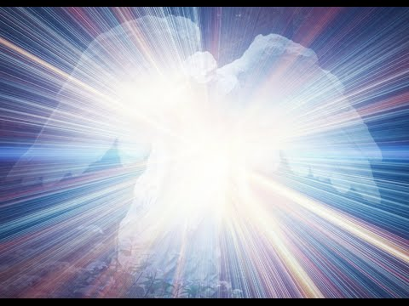
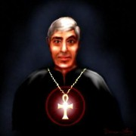
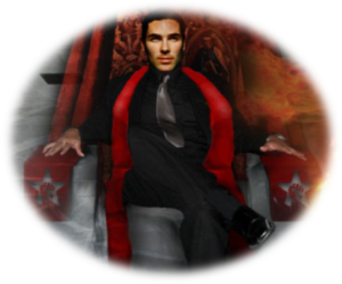
Satan has a false trinity

Slide 6
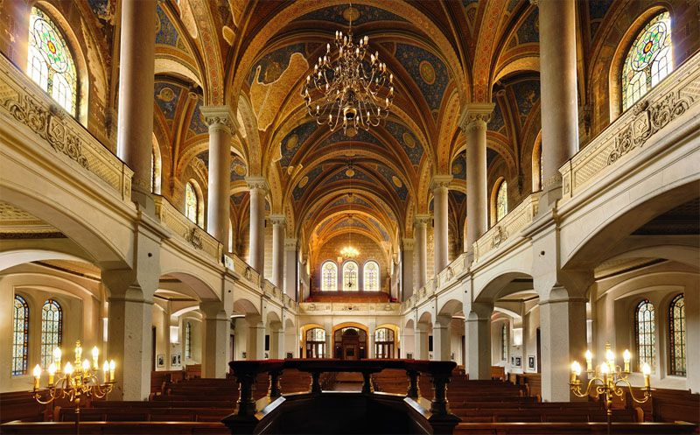
He has his synagogues
"I know thy works, and tribulation, and poverty, (but thou art rich) and I know the blasphemy of them which say they are Jews, and are not, but are the synagogue of Satan." (Rev. 2:9)

Slide 7
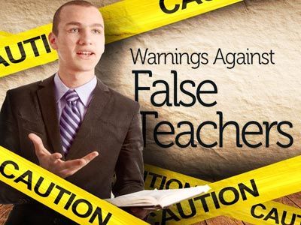
Satan has prophets and teachers

Slide 8
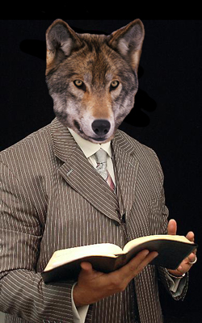
(2 Peter 2:1) “But there were false prophets also among the people, even as there shall be false teachers among you, who privily shall bring in damnable heresies, even denying the Lord that bought them, and bring upon themselves swift destruction.”

Slide 9
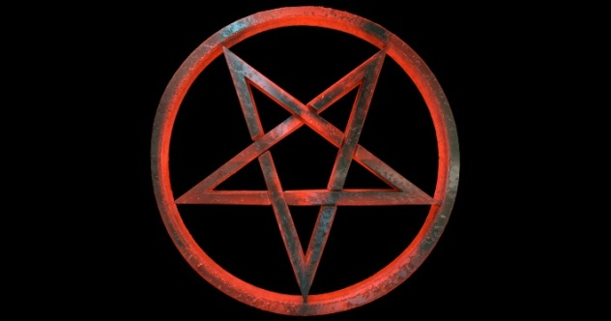
Satan has his doctrines

Slide 10
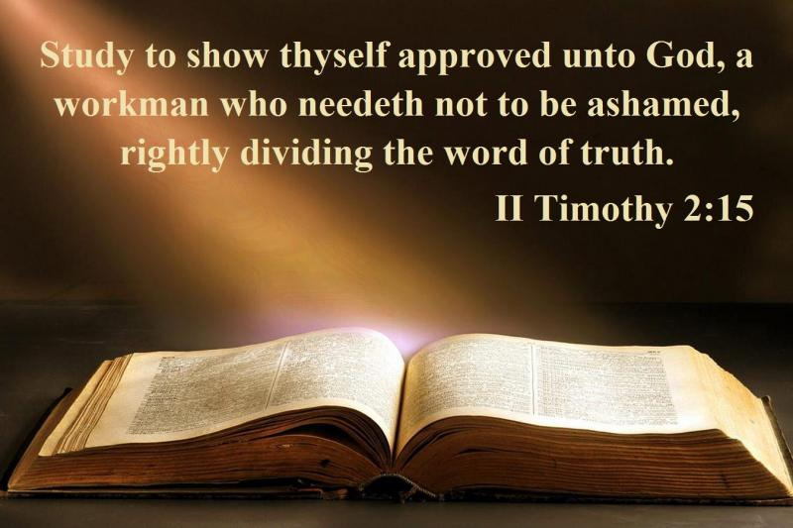
"Now the Spirit speaketh expressly, that in the latter times some shall depart from the faith, giving heed to seducing spirits, and doctrines of devils" (1 Tim. 4:1)
Satanic doctrine would be any teaching contrary to the Bible!

Slide 11
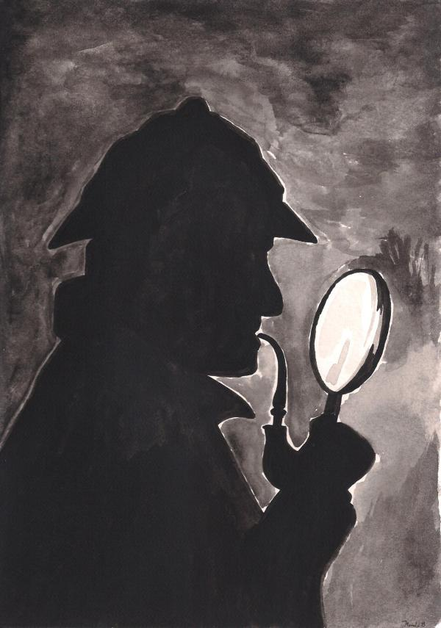
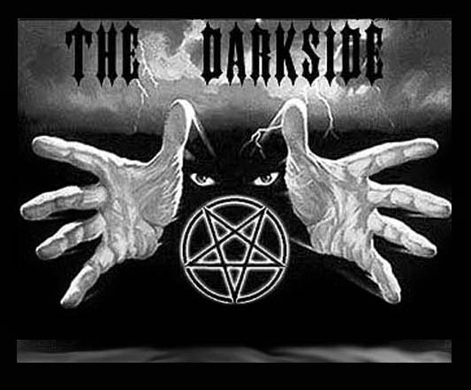
Satan has his mysteries
"For the mystery of iniquity doth already work: only he who now letteth will let, until he be taken out of the way.”
(2 Thess. 2:7)

Slide 12
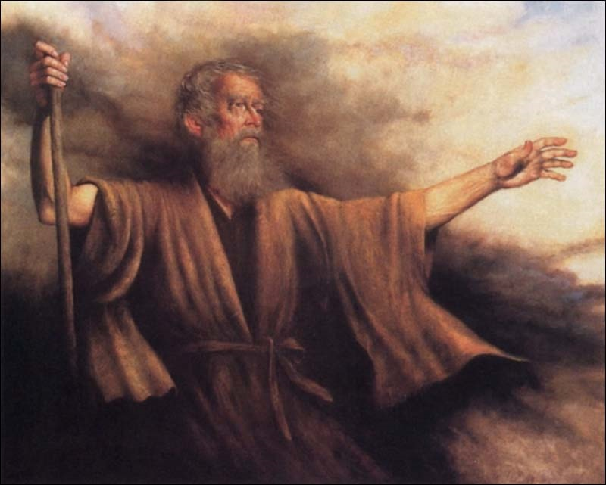
Biblical Warning Concerning Occult Involvement (Deuteronomy 18:9-13)
“When thou art come into the land which the LORD thy God giveth thee, thou shalt not learn to do after the abominations of those nations. There shall not be found among you any one that…For all that do these things are an abomination unto the LORD: and because of these abominations the LORD thy God doth drive them out from before thee. Thou shalt be perfect with the LORD thy God.”

Slide 13
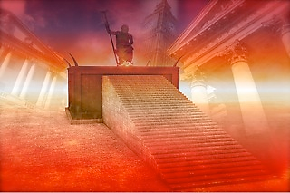
Satan has a throne

Slide 14
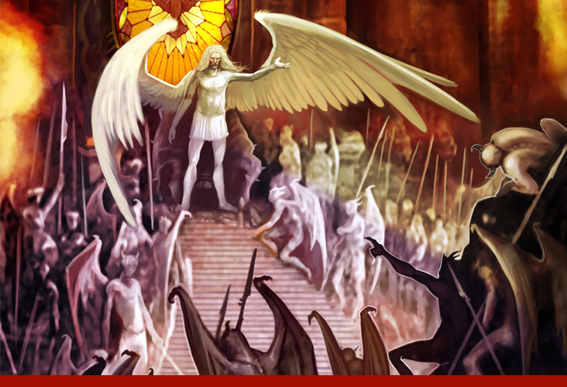
"I know thy works, and where thou dwellest, even where Satan’s seat is: and thou holdest fast my name, and hast not denied my faith, even in those days wherein Antipas was my faithful martyr, who was slain among you, where Satan dwelleth." (Rev. 2:13)

Slide 15
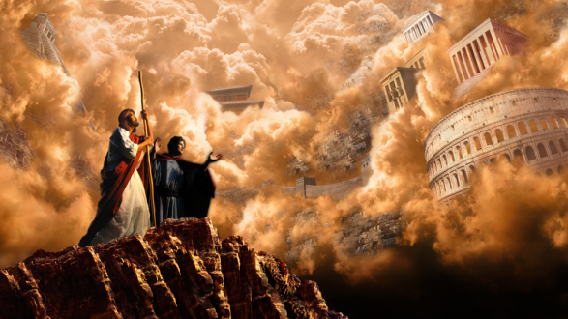
Satan has his kingdoms

Slide 16
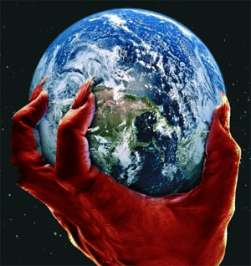
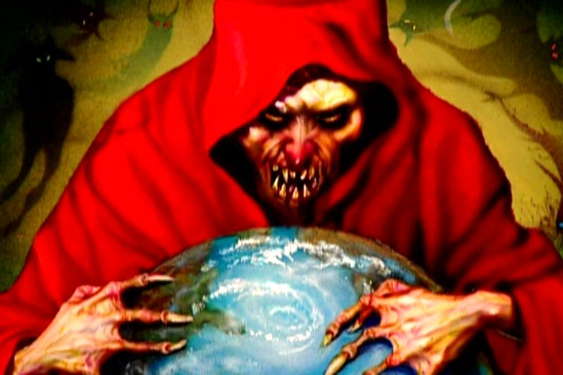
II Cor. 4:4 “In whom the god of this world hath blinded the minds of them which believe not, lest the light of the glorious gospel of Christ, who is the image of God, should shine unto them.”
Eph 2:2 “Wherein in time past ye walked according to the course of this world, according to the prince of the power of the air, the spirit that now worketh in the children of disobedience.”
John 14:30 “Hereafter I will not talk much with you: for the prince of this world cometh, and hath nothing in me.”

Slide 17
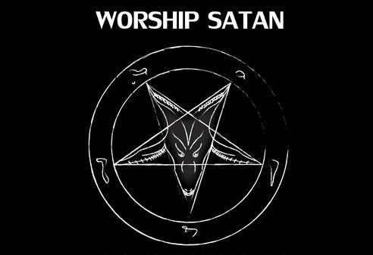
Satan desires Worshipers

Slide 18
“All these things will I give thee, if thou wilt fall down and worship me.”

Slide 19
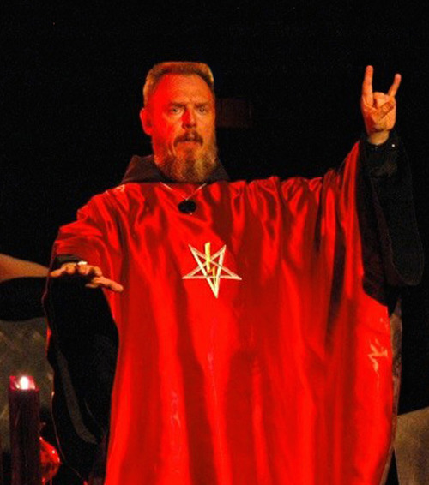
Satan has his Worshipers

Slide 20
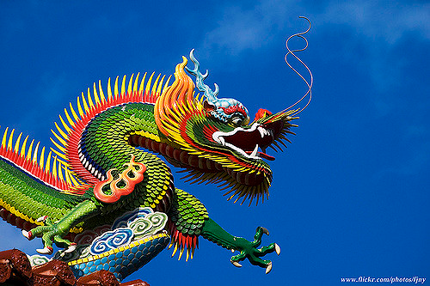
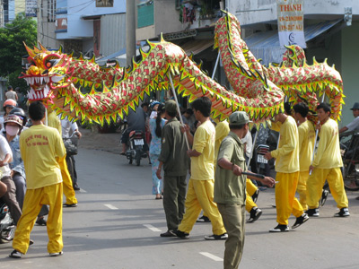
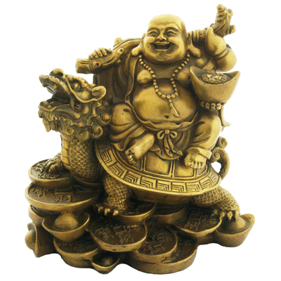
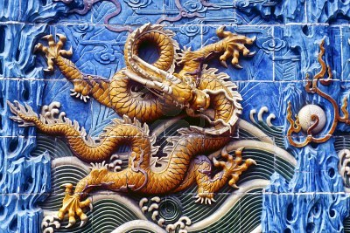
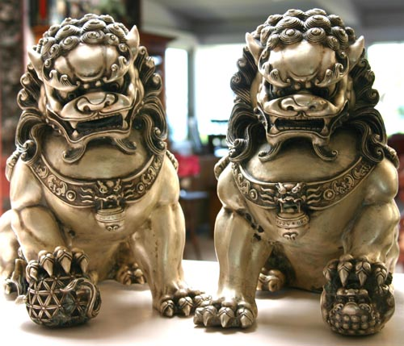
"And they worshipped the dragon which gave power unto the beast: and they worshipped the beast, saying, Who is like unto the beast? who is able to make war with him?" (Rev. 13:4)

Slide 21
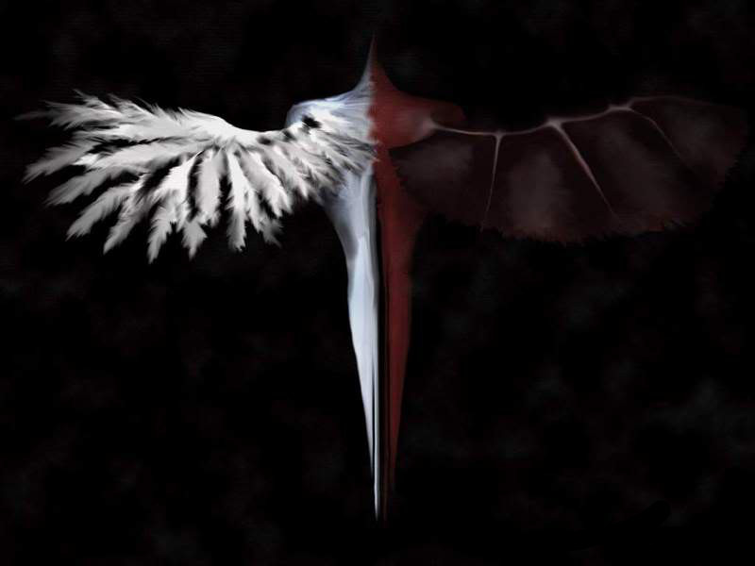
Satan has Ministers

Slide 22
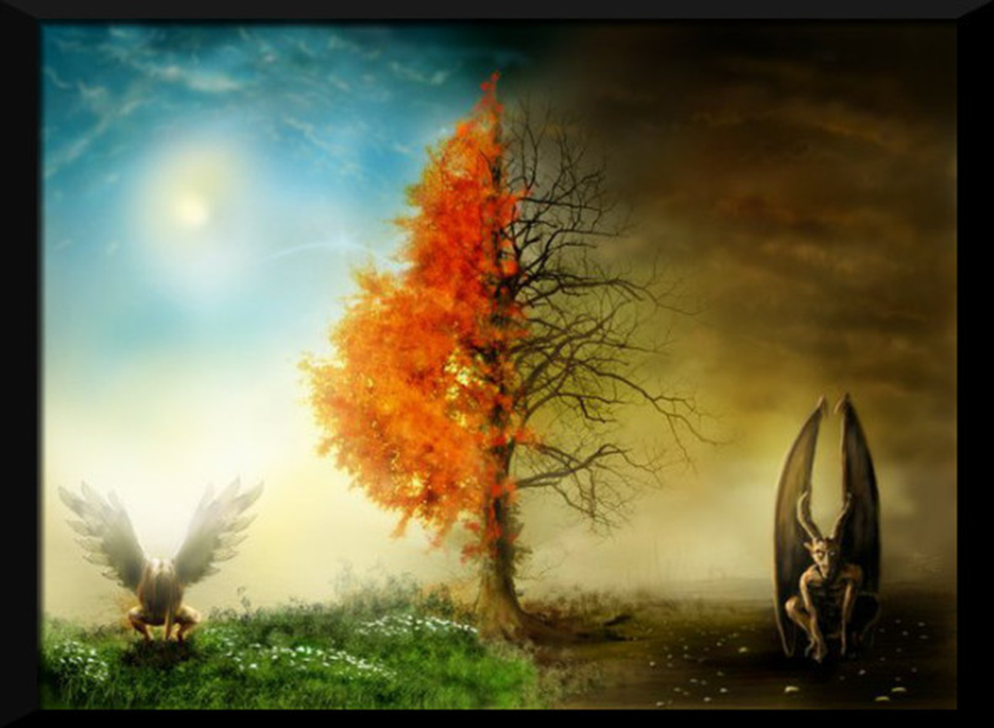
Angel of Light
Ruler of Darkness
“Therefore it is no great thing if his ministers also be transformed as the ministers of righteousness; whose end shall be according to their works.”
(2 Cor. 11:15)

Slide 24
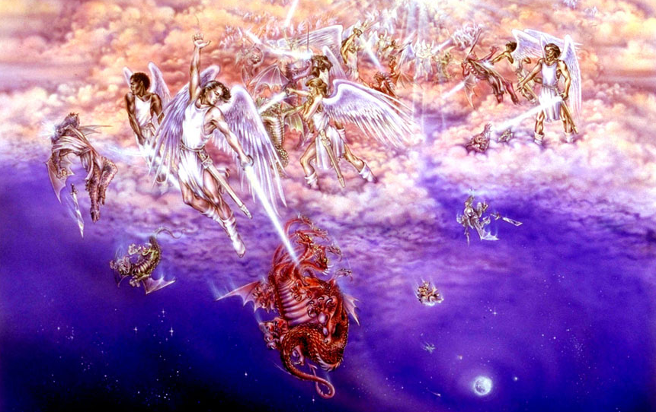
Satan has Angels
"And there was war in heaven: Michael and his angels fought against the dragon; and the dragon fought and his angels."
(Rev. 12:7)

Slide 25
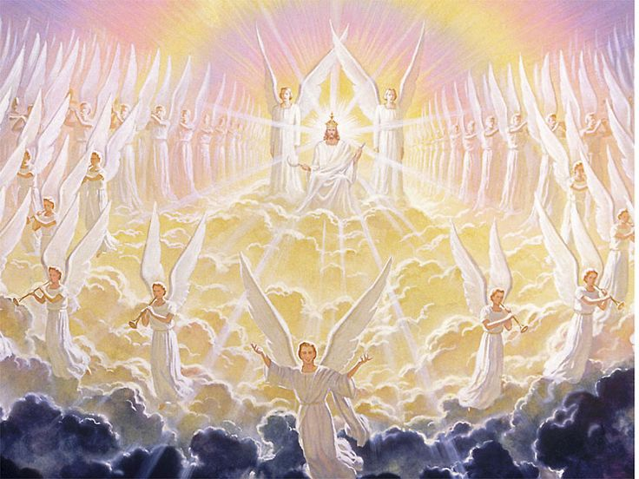
God has Angels
273 reference to angels in the Word of God
Created by Jesus Christ – John 1:1-3
Glorify God – Colossians 1:16
They are Spirit beings which are invisible (Colossians 2:18) and visible (Hebrews 13:2)
They are innumerable – Hebrews 12:22
They are ministers of God – Psalms 148:2
They obey God’s commandments – Psalms 103:20

Slide 26
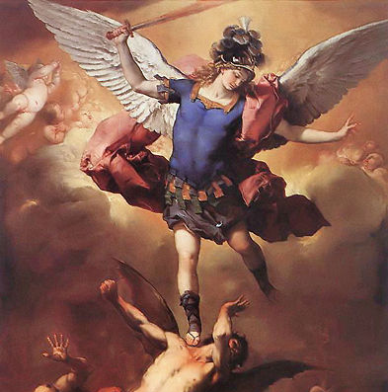
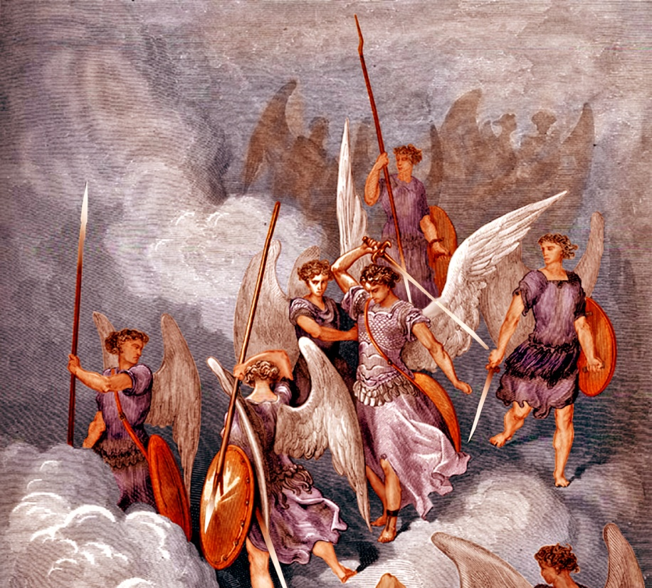
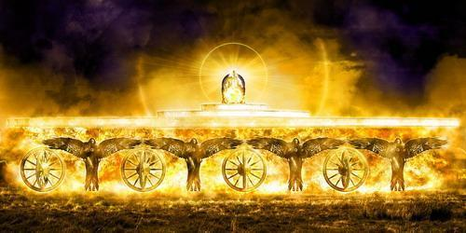
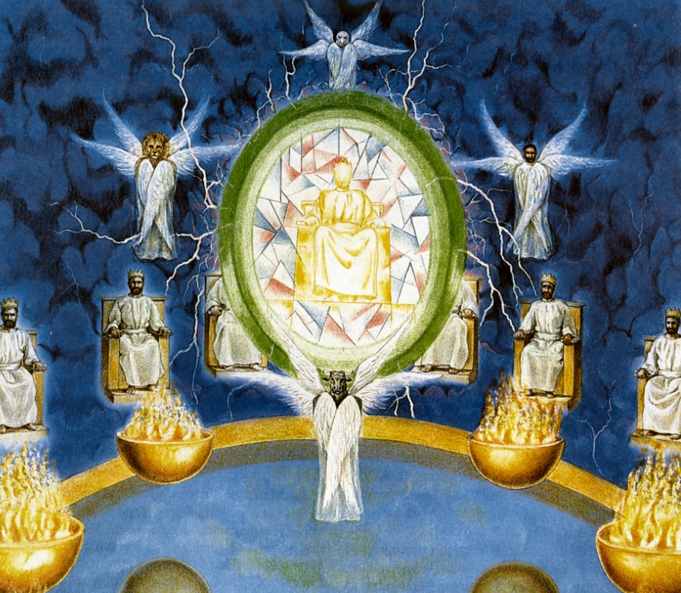
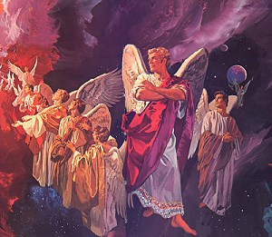
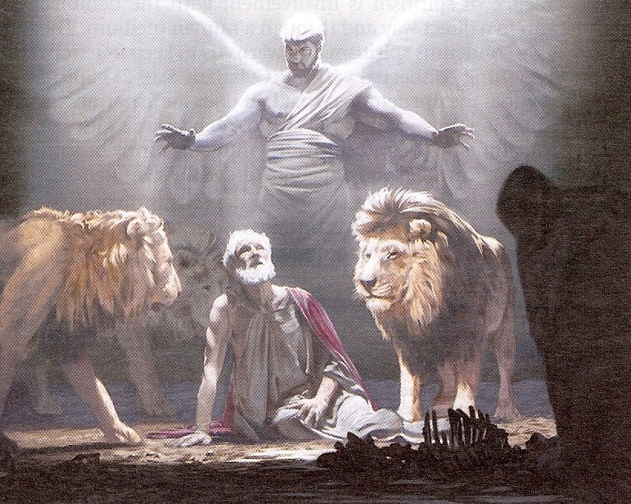
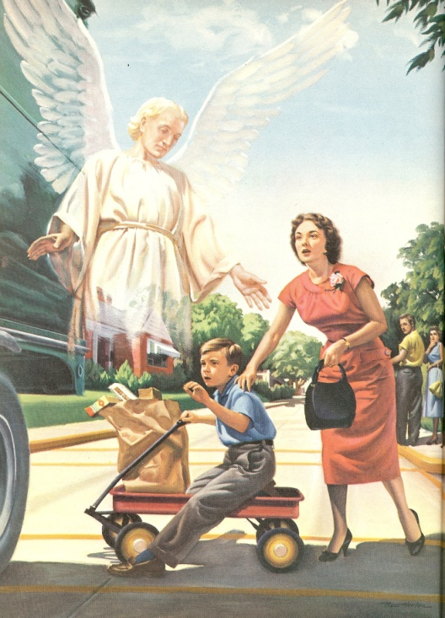
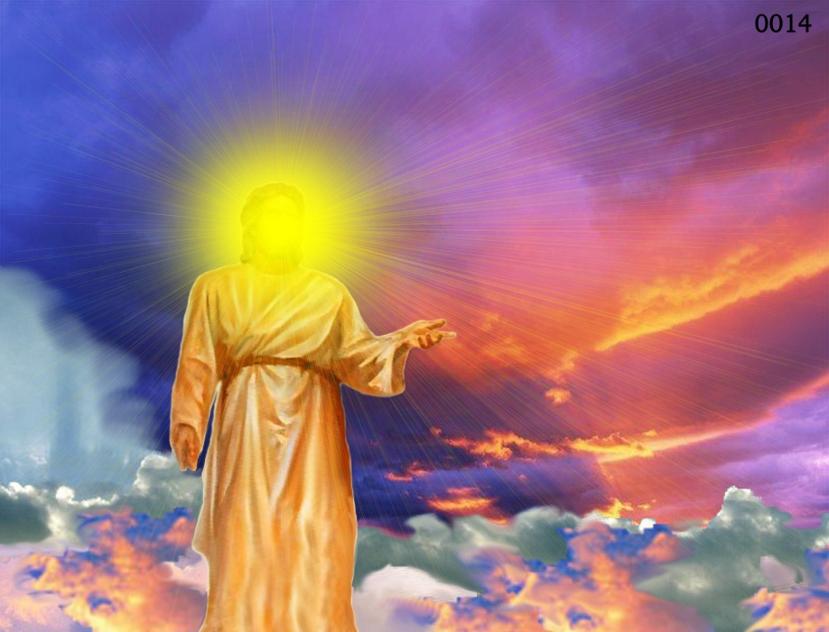
Archangels – Michael and Gabriel
Cherubim's – Ezekiel 1:4-28
Seraphim’s - Isaiah 6:1-7
Ruling angels – I Peter 3:22
Guarding angels – Hebrews 1:14
Angel of the Lord – Zechariah 3:1-10

Slide 27
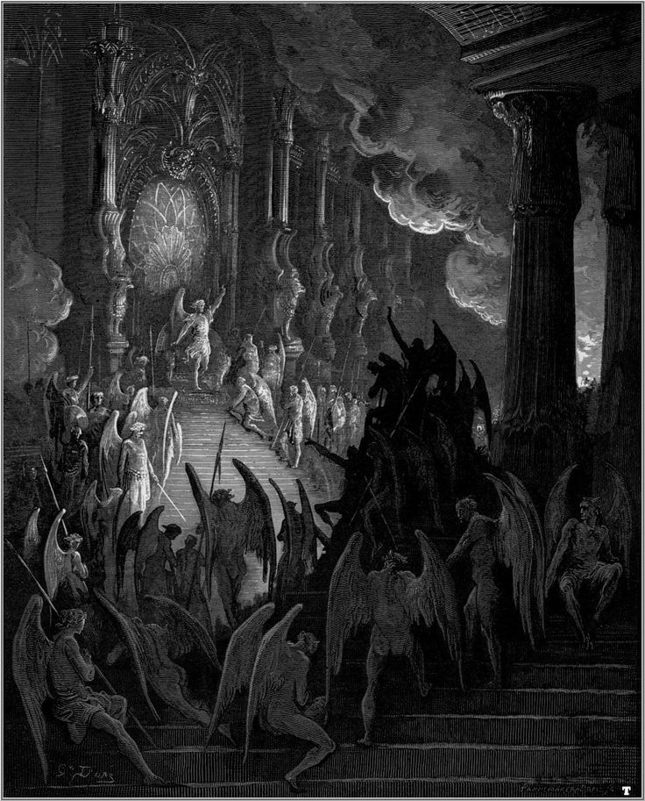
Satan’s Angels

Slide 28
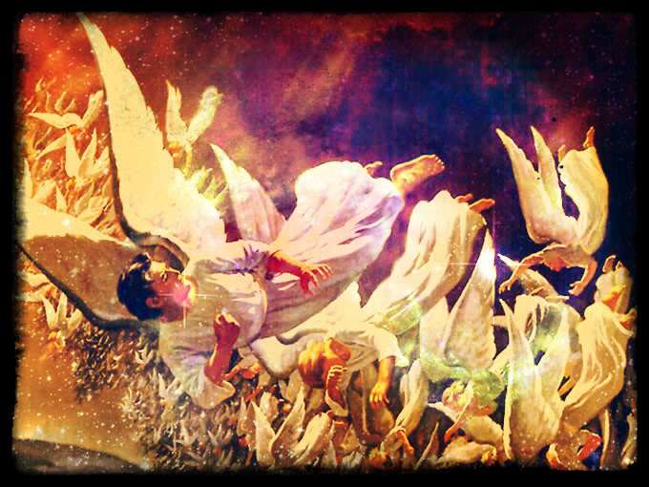
When Satan rebelled against God, the rebellion was not just Satan alone. As many as a third of all the Angels rebelled against God – (Ezek. 28; Isa. 14)
Like Satan they had free will and chose to leave God and follow Satan – (Rev. 12)
These rebellious (fallen angels) are known as demons, evil spirits or unclean spirits.

Slide 29
“Tail drew a third part of the stars of heaven, and did cast them to the earth…”
Stars of heaven = Fallen angels
1/3 followed Satan in his rebellion
Isaiah 14:12-15; Ezekiel 28:12-16; II Peter 2:4; Jude 6

Slide 30
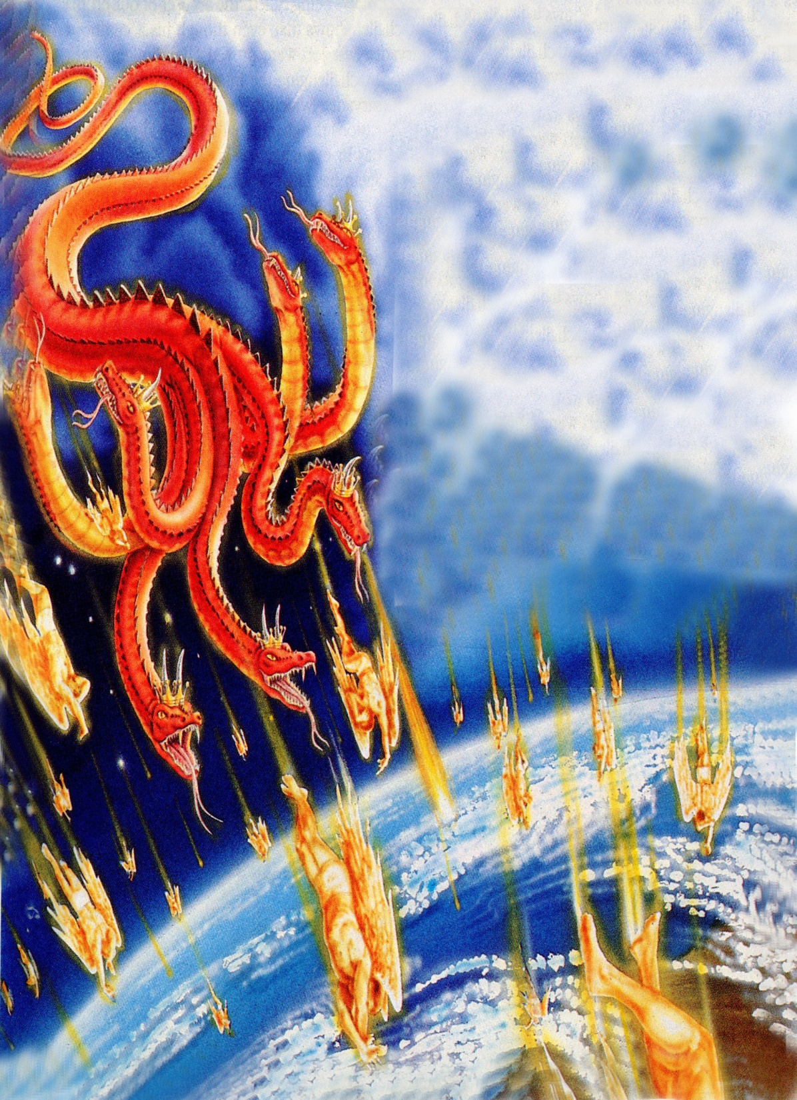
“And did cast them to the earth…”

Slide 31
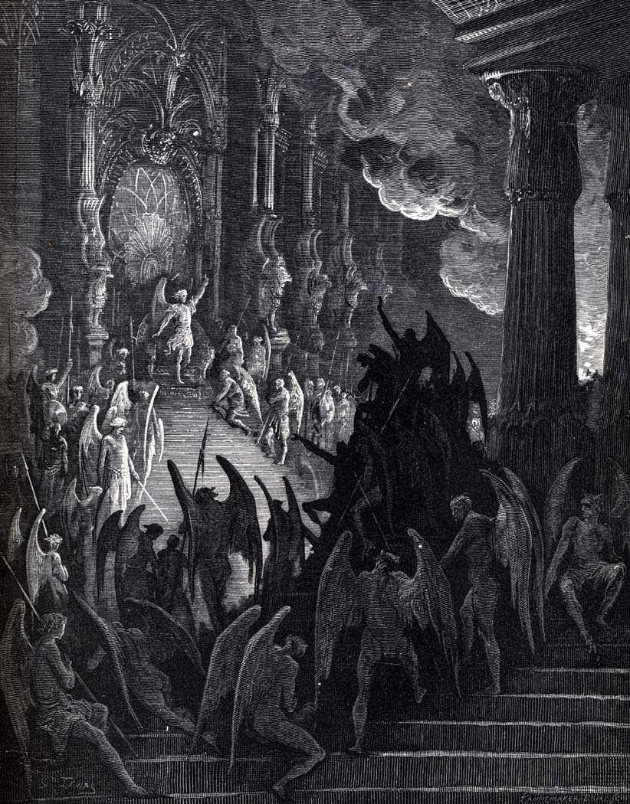
These Demons now serve Satan and, hate God and all people.
They enjoy and want to cause pain, misery and suffering to people and many times in the Bible they are the cause of physical and mental illnesses –
Matt. 4:24, 12:22, 17:14-18; Luke 7:21

Slide 32
Demons can still 'posses' people today and want to cause harm and damage in any way they can.
Through the power of God, and in the name of Jesus people, can be healed and demons can be driven out - Rev. 12:11 “And they overcame him by the blood of the Lamb, and by the word of their testimony.”
Jesus has total power over demons - Matt. 28:18 “And Jesus came and spake unto them, saying, All power is given unto me in heaven and in earth.”
Matt. 10:1 “And when he had called unto him his twelve disciples, he gave them power against unclean spirits, to cast them out, and to heal all manner of sickness and all manner of disease.”

Slide 33
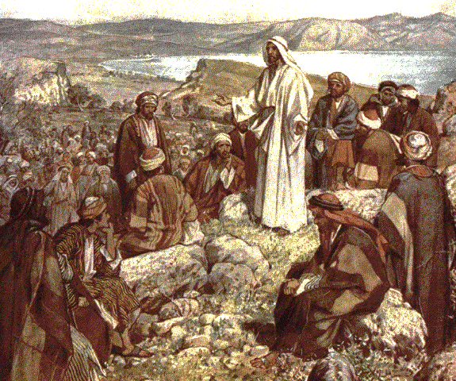
(Luke 10:17-20)
“And the seventy returned again with joy, saying, Lord, even the devils are subject unto us through thy name. And he said unto them, I beheld Satan as lightning fall from heaven. Behold, I give unto you power to tread on serpents and scorpions, and over all the power of the enemy: and nothing shall by any means hurt you. Notwithstanding in this rejoice not, that the spirits are subject unto you; but rather rejoice, because your names are written in heaven.”

Slide 34
Satan and his demons can bless those who serve them and promote their cause
“Behold, these are the ungodly, who prosper in the world; they increase in riches. Verily I have cleansed my heart in vain, and washed my hands in innocency. For all the day long have I been plagued, and chastened every morning. If I say, I will speak thus; behold, I should offend against the generation of thy children. When I thought to know this, it was too painful for me; Until I went into the sanctuary of God; then understood I their end. Surely thou didst set them in slippery places: thou castedst them down into destruction. How are they brought into desolation, as in a moment! they are utterly consumed with terrors. As a dream when one awaketh; so, O Lord, when thou awakest, thou shalt despise their image. Thus my heart was grieved, and I was pricked in my reins. So foolish was I, and ignorant.” (Psalms 73:12-22)

Slide 35
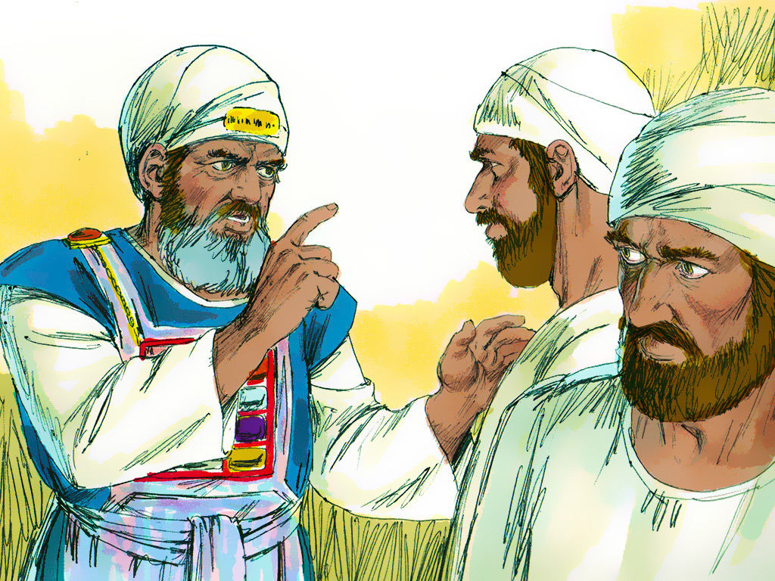
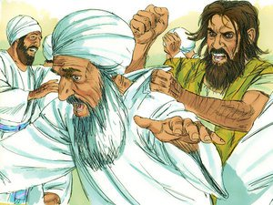
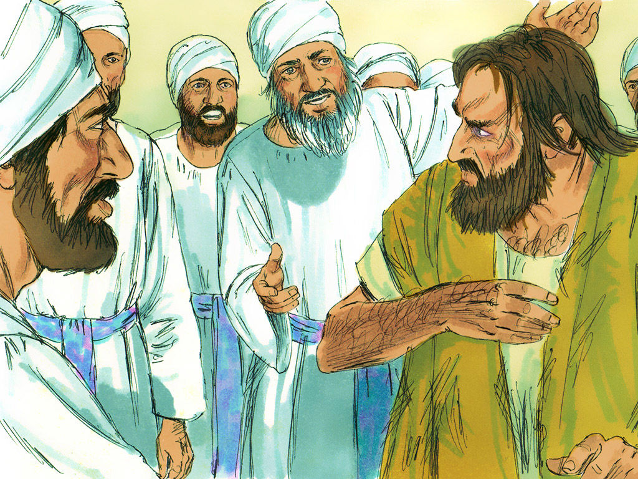
In the Bible, demons knew who Jesus was - “And the evil spirit answered and said, Jesus I know, and Paul I know; but who are ye?”
Acts 19:13-16

Slide 36
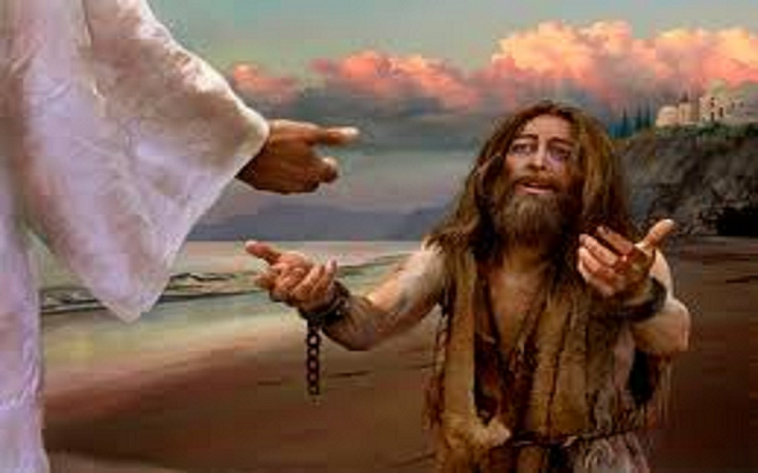
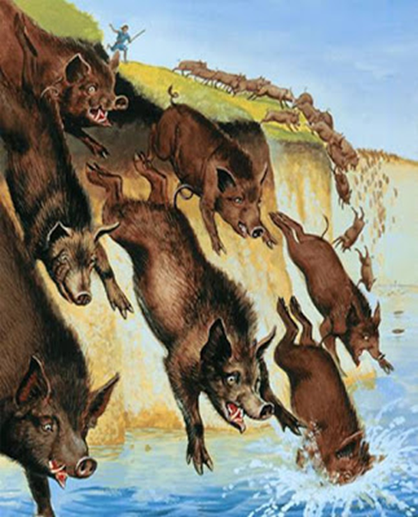
The Demoniac of Gadara (Luke 8:26-36)

Slide 37
The Bible makes it very clear that not every illness (physical or mental) is caused by demons/evil spirits/unclean spirits.
Sickness of chastisement - 1 Cor. 11:30 “For this cause many are weak and sickly among you, and many sleep.”
Sickness unto the glory of God - John 11:4 “When Jesus heard that, he said, This sickness is not unto death, but for the glory of God, that the Son of God might be glorified thereby.”
Sickness because of the fall - Mankind is now subject to diseases, sickness, illnesses and deterioration – Phil. 2:27 “For indeed he (Epaphroditus) was sick nigh unto death: but God had mercy on him.”
Sickness unto death - Gen. 3:19 “In the sweat of thy face shalt thou eat bread, till thou return unto the ground; for out of it wast thou taken: for dust thou art, and unto dust shalt thou return.”

Slide 38
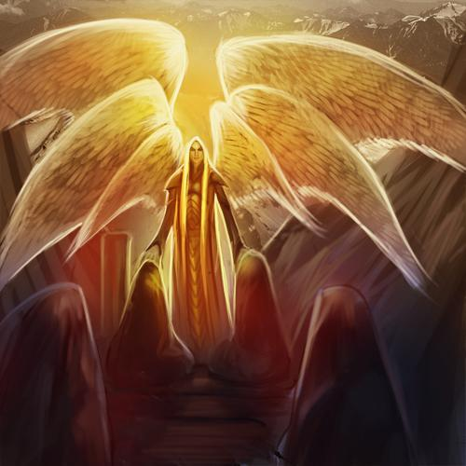
Satan the Prince of Demons
This title is found in Matthew 12:24 and Luke 11:15, and obviously shows his authority over all other demons.

Slide 39
Demons were once God's Angels but now thy are the enemies of God and mankind
Physical Disease – Matt. 9:32-33; I Cor. 11:30
Mental Disorders – Mark 5:4-5; Luke 9:37-42
Moral Impurity – Lev. 18; Deut. 18
False Doctrine – I Tim. 4:1; Rev. 2:2, 14
Rulers over Nations - Daniel speaks of the Prince of Persia and the Prince of Greece as being demons he was fighting against – Dan. 10
Spiritual warfare – Eph. 6:10-18

Slide 42
Our Spiritual Warfare is Against “Principalities” –
Note: The concept of principalities is understood by the Greek word arche meaning chief or ruler. These principalities are ruling demon spirits possessing executive authority or governmental rule in the world.
Our Spiritual Warfare is Against "Powers”-
Note: The Greek word for "powers" is exousia which means derived or conferred authority, the warrant or right to do something, or delegated influences of control.
Our Spiritual Warfare is Against “Rulers of Darkness” – “Men loved darkness rather than light, because their deeds were evil.”
Our Spiritual Warfare is Against “Spiritual Wickedness in Heavenly Places” -
Note: The Greek word for wickedness is ponēria and means total depravity.
Note: Since Satan is the “prince of the power of the air”, these wicked spirits, in high places, are often understood to be the collective organization of all of Satan's wicked demon spirits.

Slide 43
Warfare (strateia) - To carry on hostilities; to engage in battle; to contend, to strive; to be in a state of hostile contention - II Cor. 10:3-6; I Tim. 1:18; II Tim. 2:1-3; James 4:1-2; I Peter 2:11
Fight (agonizomai) - To gain control through struggle; to attempt to defeat; subdue or destroy in order to gain victory - I Cor. 9:26; I Tim. 6:12; II Tim. 4:7
Wrestle (pale) - To struggle in hand to hand combat with an opponent in an attempt to throw or force him to the ground - Eph. 6:10-18

Slide 44
Strive (sunathleo) - To make great effort to do ones best; strenuous exertion; earnest effort - I Cor. 9:24-25; II Tim. 2:5
Soldier (stratiotes) - One engaged in military service; one who fights for a specified cause - II Tim. 2:3-4
Contend (epagonizomai) - To hold firm to the truth; to strive in debate - Jude 3-9

Slide 45
Understanding Strongholds
“Casting down imaginations, and every high thing that exalteth itself against the knowledge of God, and bringing into captivity every thought to the obedience of Christ; And having in a readiness to revenge all disobedience, when your obedience is fulfilled.”
(II Corinthians 10:3-6)
“For though we walk in the flesh, we do not war after the flesh: For the weapons of our warfare are not carnal, but mighty through God to the pulling down of strong holds.”

Slide 46
II Corinthians 10:3-6
Stronghold
“False Ideas” (John 8:44)
Ground
Surrendered (Eph. 4:27)
Pride of Life

Slide 47
Three Ways “Ground” is Surrendered to Satan
Immorality
Temporal Values
Bitterness

Slide 48
II Corinthians 10:3-6
Stronghold
“False Ideas”
(John 8:44)
Ground
Surrendered
(Eph. 4:27)
Pride of Life
Immorality
(I Thess. 4:1-8)
Bitterness
(Heb. 12:15)
Temporal Values
(I Tim. 6:10)

Slide 49
Satan has a false trinity
Satan has his synagogues
Satan has prophets and teachers
Satan has his doctrines
Satan has his mysteries
Satan has a throne
Satan has a kingdom
Satan has worshipers
Satan has ministers
Satan has angels

