Slide 1
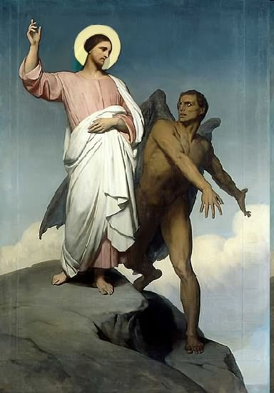

Slide 2
Topics to be studied
His existence
His origin
His fall
His personality
His names
His activities (Part 5)
His location – present and future
Our victory over him

Slide 4
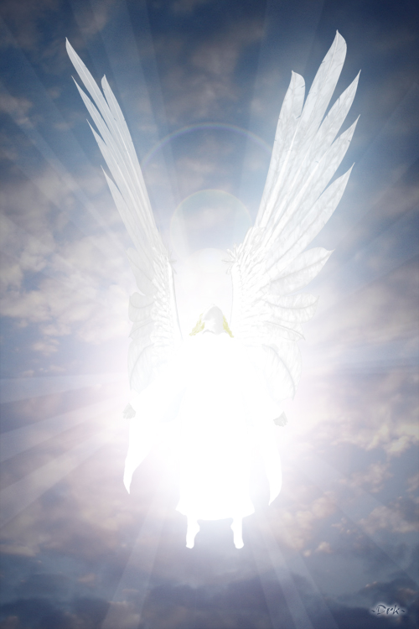
How does Satan imitate God?

Slide 5
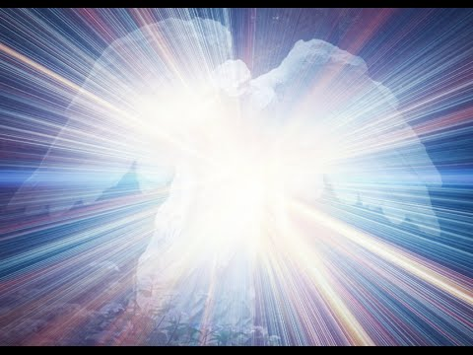
Satan has a false trinity

Slide 6
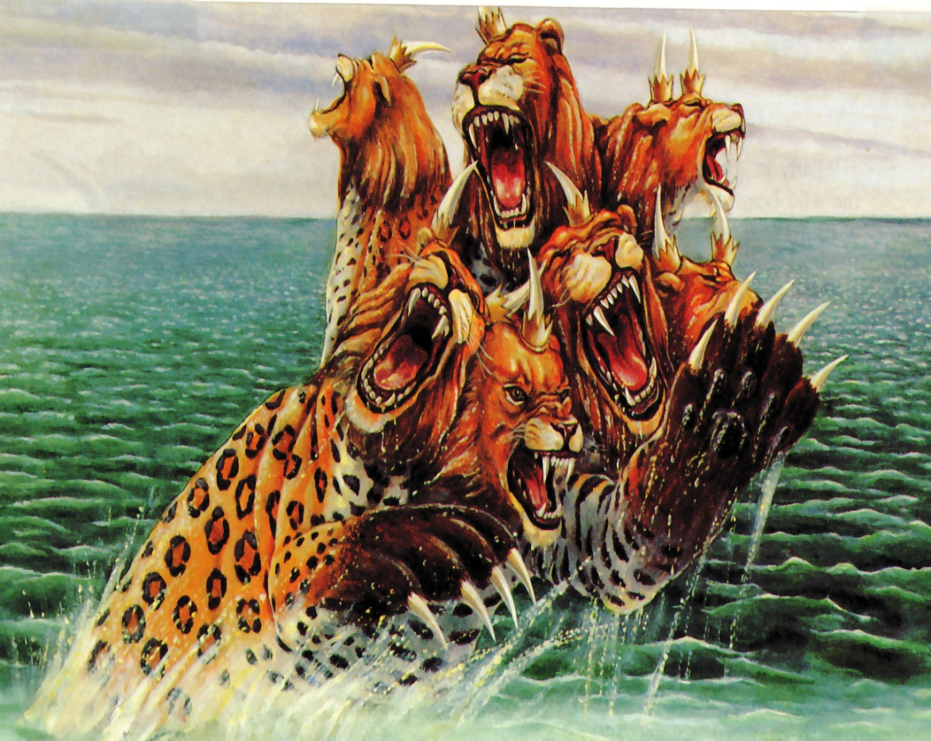
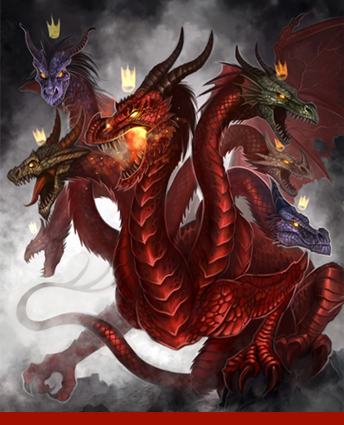
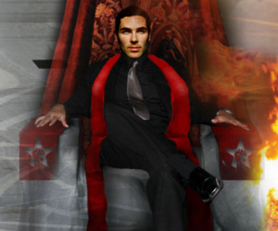
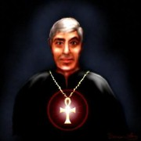
In this terrible trinity. Satan assumes the part of the Father; the antichrist is likened to the Son; and the false prophet is assigned the role of the Holy Spirit.

Slide 7
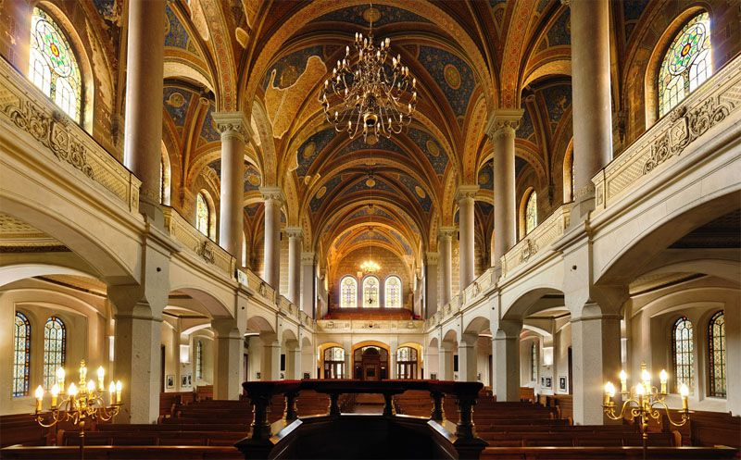
He has his synagogues
"I know thy works, and tribulation, and poverty, (but thou art rich) and I know the blasphemy of them which say they are Jews, and are not, but are the synagogue of Satan" (Rev. 2:9)

Slide 8
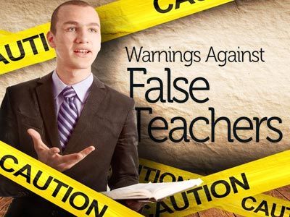
Satan has prophets and teachers

Slide 9
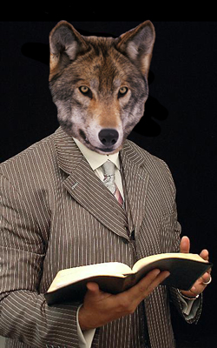
(2 Peter 2:1) “But there were false prophets also among the people, even as there shall be false teachers among you, who privily shall bring in damnable heresies, even denying the Lord that bought them, and bring upon themselves swift destruction.”

Slide 10
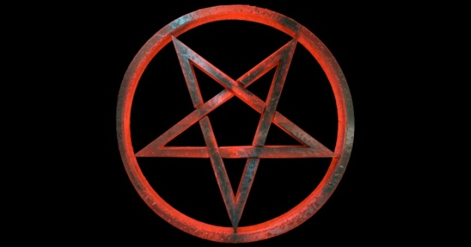
Satan has his doctrines

Slide 11
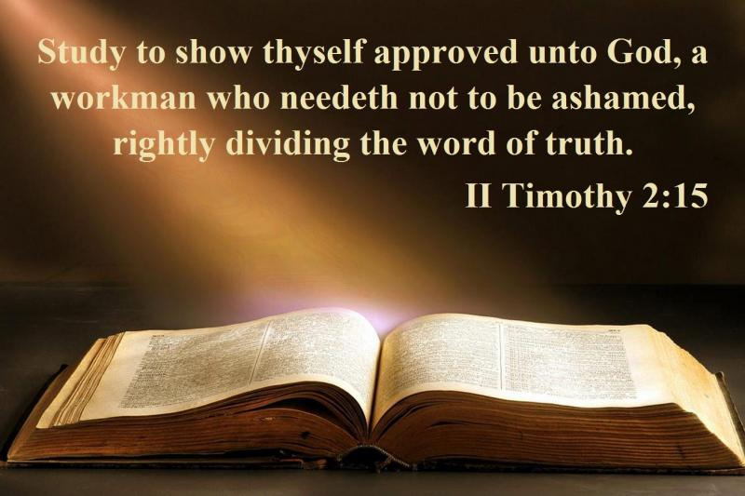
"Now the Spirit speaketh expressly, that in the latter times some shall depart from the faith, giving heed to seducing spirits, and doctrines of devils" (1 Tim. 4:1)
Satanic doctrine would be any teaching contrary to the Bible!

Slide 12
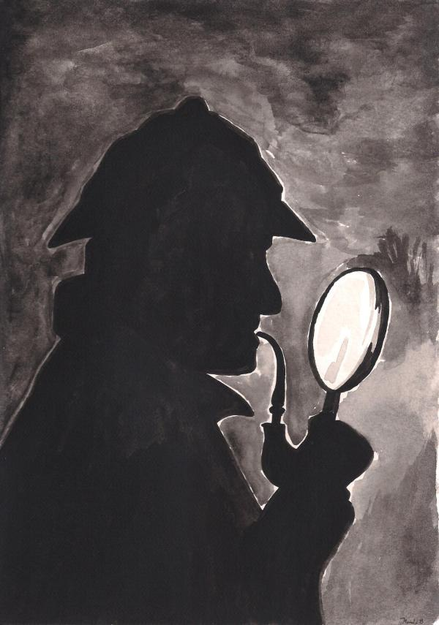
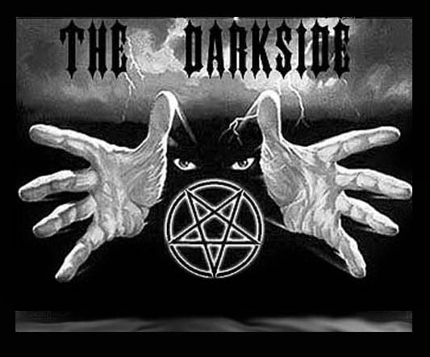
Satan has his mysteries
"For the mystery of iniquity doth already work: only he who now letteth will let, until he be taken out of the way“
(2 Thess. 2:7).

Slide 13
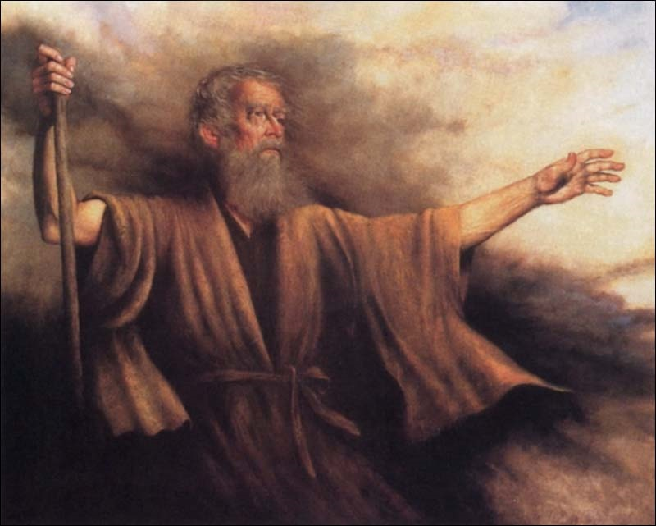
Biblical Warning Concerning Occult Involvement (Deuteronomy 18:9-13)
“When thou art come into the land which the LORD thy God giveth thee, thou shalt not learn to do after the abominations of those nations. There shall not be found among you any one that…For all that do these things are an abomination unto the LORD: and because of these abominations the LORD thy God doth drive them out from before thee. Thou shalt be perfect with the LORD thy God.”

Slide 14
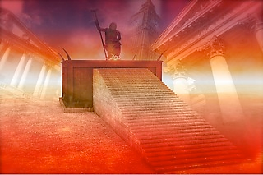
Satan has a throne

Slide 15
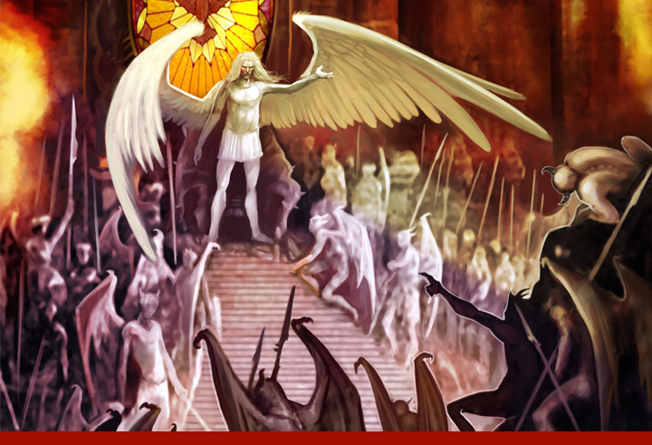
"I know thy works, and where thou dwellest, even where Satan’s seat is: and thou holdest fast my name, and hast not denied my faith, even in those days wherein Antipas was my faithful martyr, who was slain among you, where Satan dwelleth." (Rev. 2:13)

Slide 16
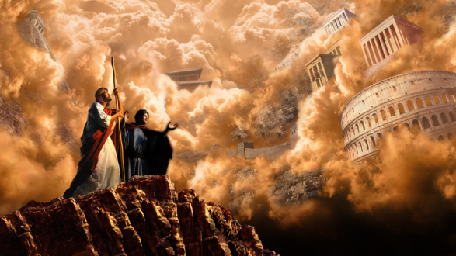
Satan has his kingdoms

Slide 17
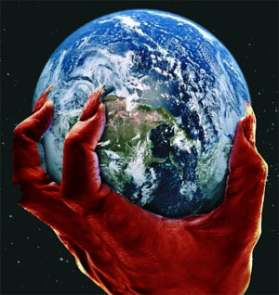
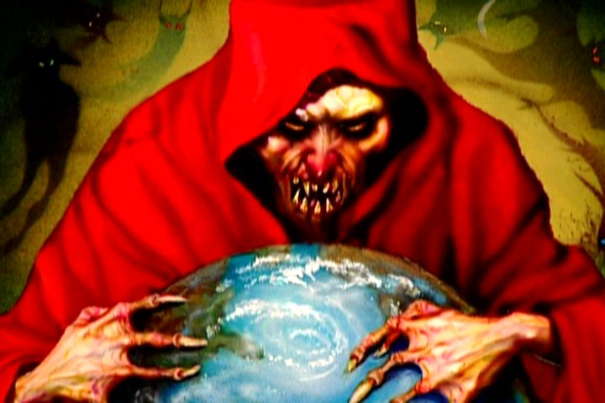
II Cor. 4:4 “In whom the god of this world hath blinded the minds of them which believe not, lest the light of the glorious gospel of Christ, who is the image of God, should shine unto them.”
Eph 2:2 “Wherein in time past ye walked according to the course of this world, according to the prince of the power of the air, the spirit that now worketh in the children of disobedience.”
John 14:30 “Hereafter I will not talk much with you: for the prince of this world cometh, and hath nothing in me.”

Slide 18
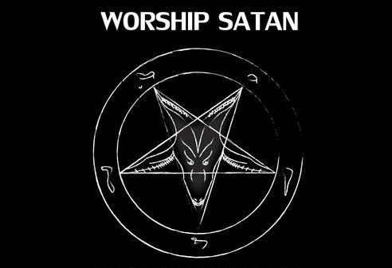
Satan desires worshipers

Slide 19
“All these things will I give thee, if thou wilt fall down and worship me.”

Slide 20
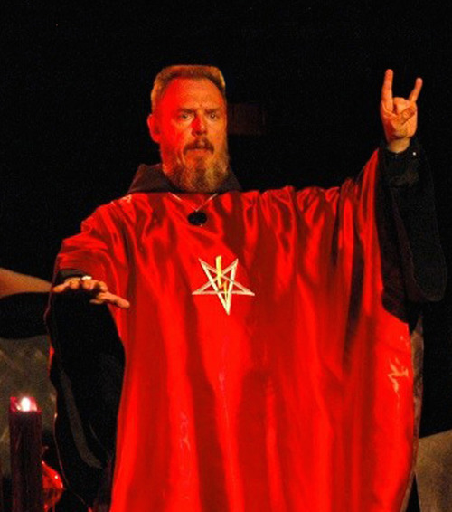
Satan has his worshipers

Slide 21
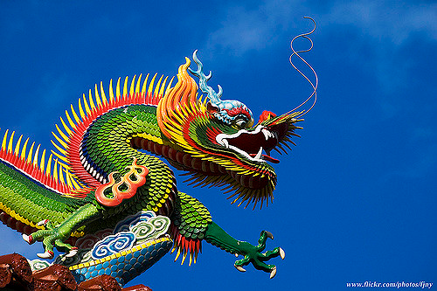
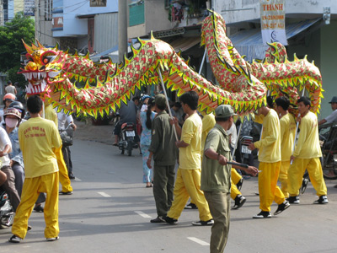
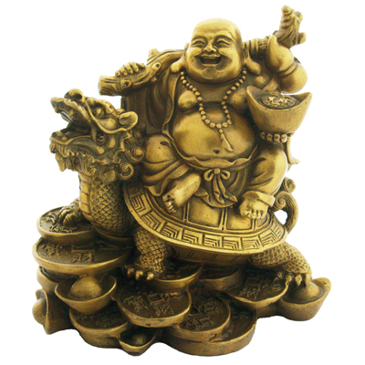
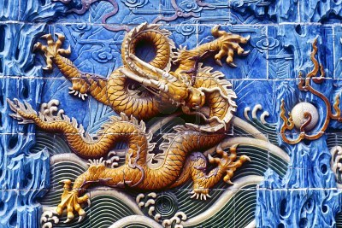
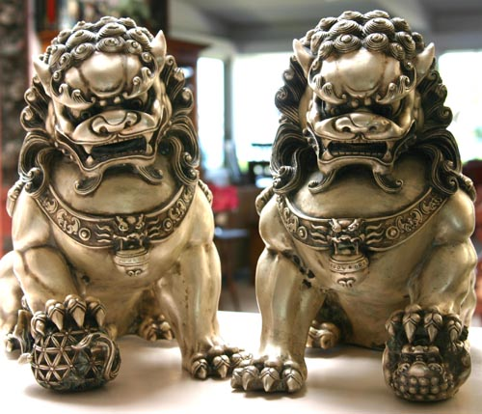
"And they worshipped the dragon which gave power unto the beast: and they worshipped the beast, saying, Who is like unto the beast? who is able to make war with him?" (Rev. 13:4)

Slide 23
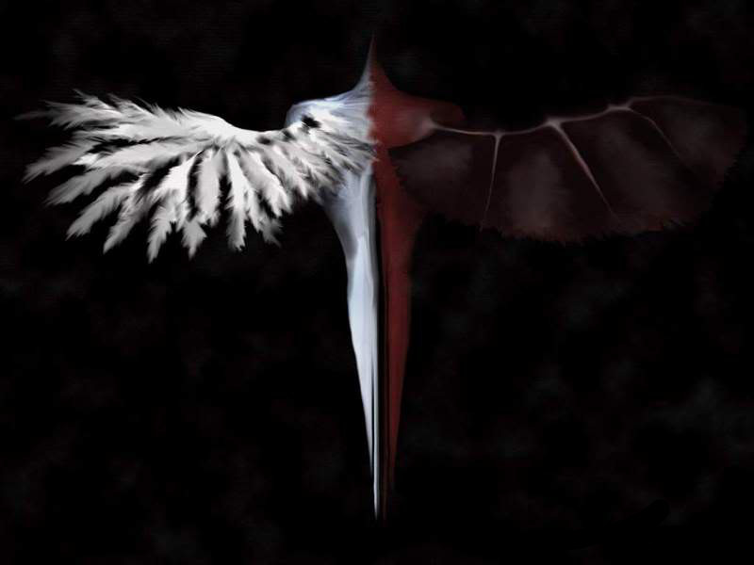
Satan has ministers

Slide 24
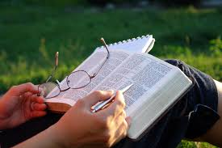
God has ministers
Ministers of the word
For they are God's ministers
Ministers by whom ye believed
Ministers of Christ
Who also hath made us able ministers of the new testament
But in all things approving ourselves as the ministers of God
His ministers
Who hath enabled me, for that he counted me faithful, putting me into the ministry
For the perfecting of the saints, for the work of the ministry

Slide 25
But we will give ourselves continually to prayer, and to the ministry of the Word
They had fulfilled their ministry
The ministry, which I have received of the Lord Jesus
The firstfruits of Achaia have addicted themselves to the ministry
Therefore seeing we have this ministry, as we have received mercy, we faint not
Hath given to us the ministry of reconciliation
For the perfecting of the saints, for the work of the ministry
Take heed to the ministry which thou hast received
He counted me faithful, putting me into the ministry
Giving no offence in any thing, that the ministry be not blamed

Slide 26
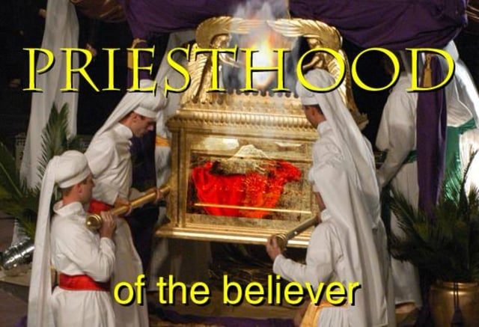

Slide 27
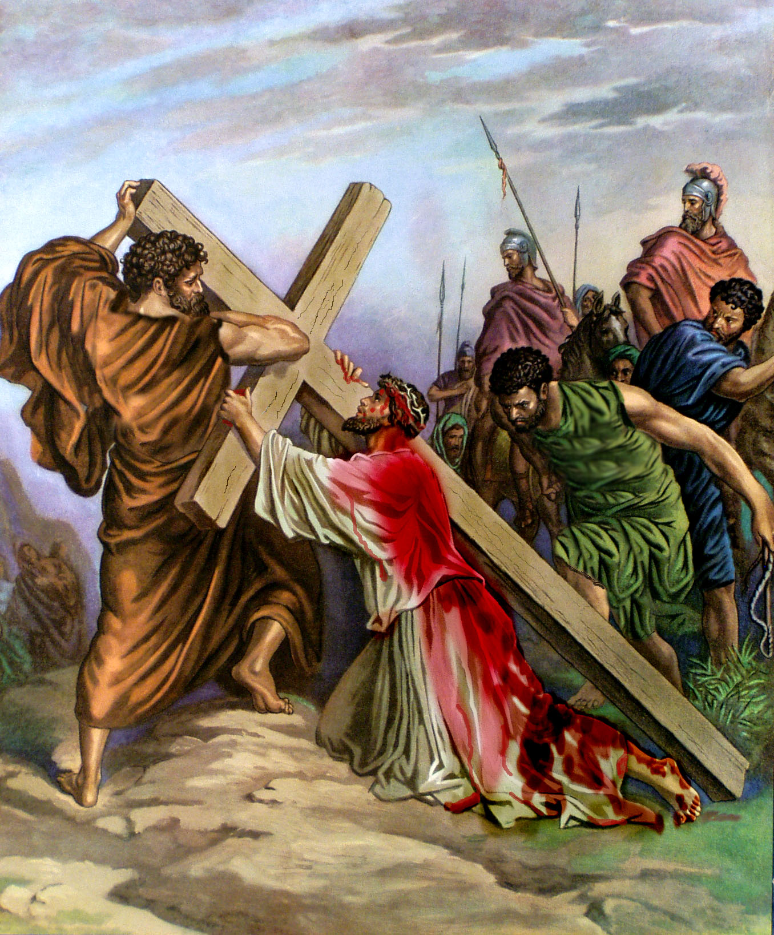
“Unto him that loved us, and washed us from our sins in his own blood.”

Slide 28
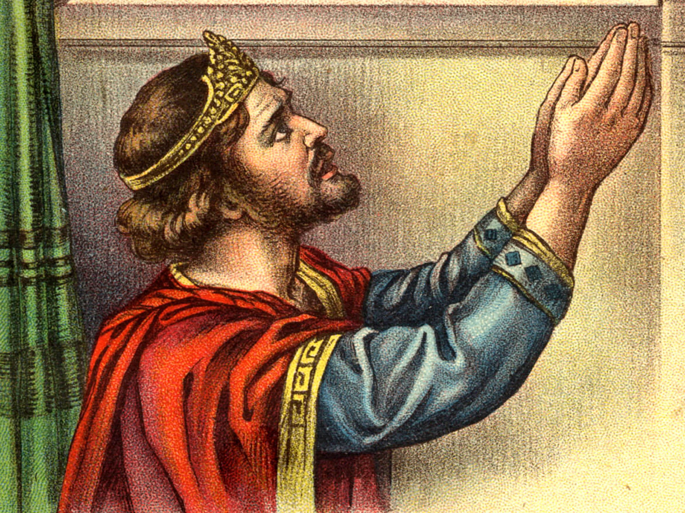
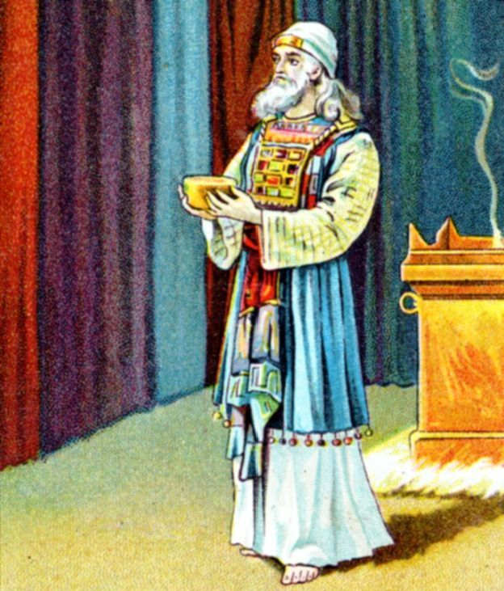
“And hath made us kings and priests unto God and his Father.”

Slide 29
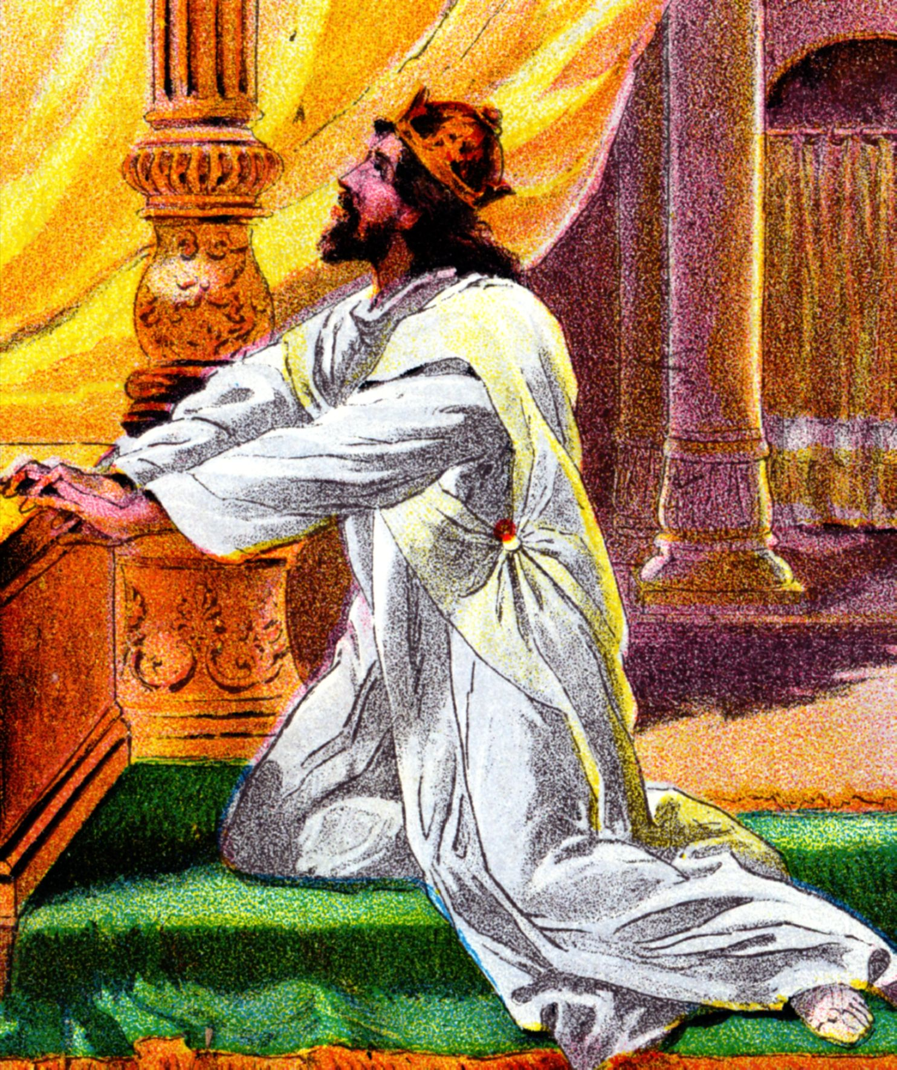
“It is an abomination to kings to commit wickedness: for the throne is established by righteousness…It is not for kings to drink wine; nor for princes strong drink: Lest they drink and forget the law, and pervert judgment.”

Slide 30
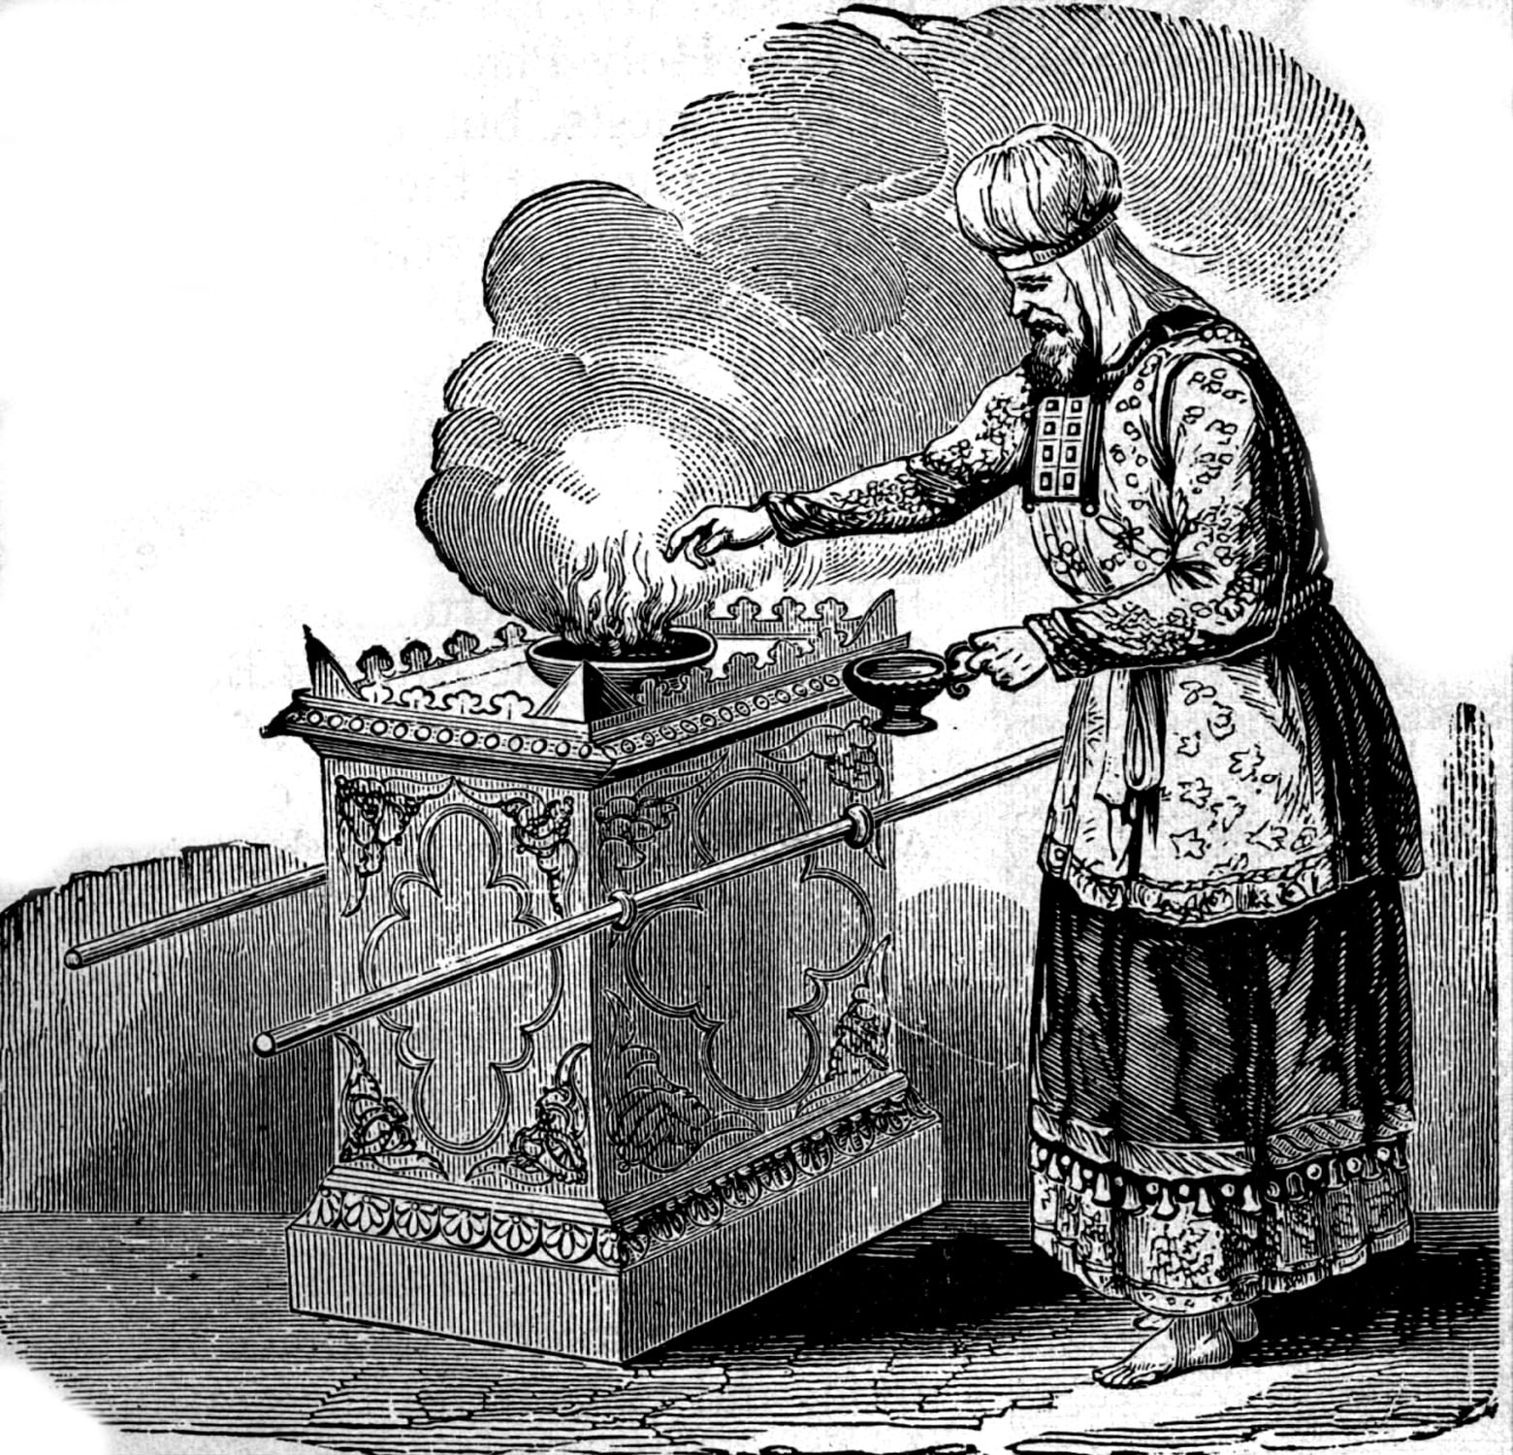
“But ye are a chosen generation, a royal priesthood, a holy nation, a peculiar people; that ye should show forth the praises of him who hath called you out of darkness into his marvelous light. Which in time past were not a people, but are now the people of God.”

Slide 31
Angel of Light
Ruler of Darkness

Slide 32
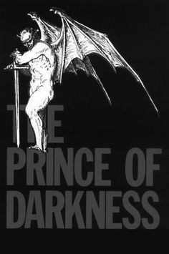
(Ephesians 6:12) “For we wrestle not against flesh and blood, but against principalities, against powers, against the rulers of the darkness of this world, against spiritual wickedness in high places.”

Slide 33
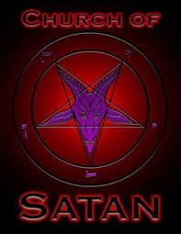
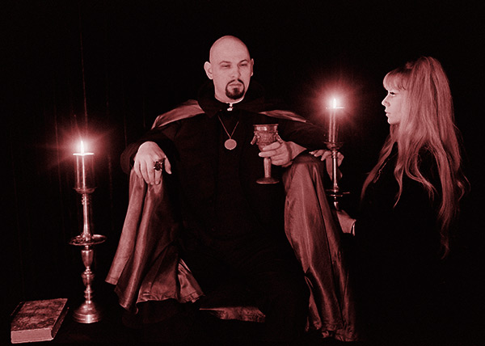
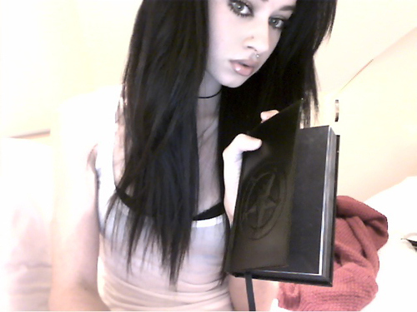
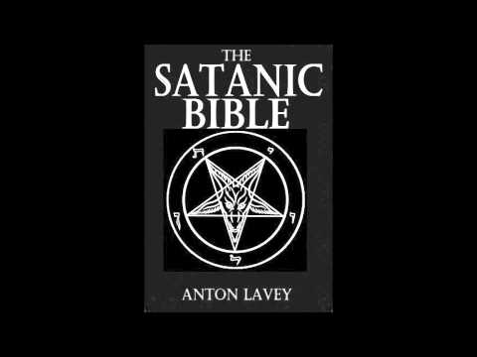
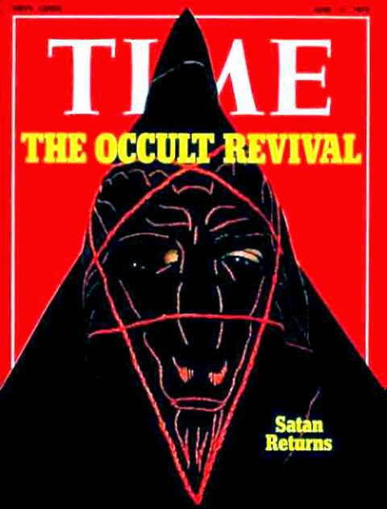
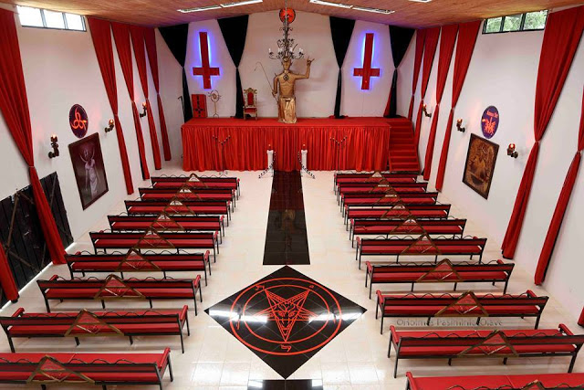

Slide 34
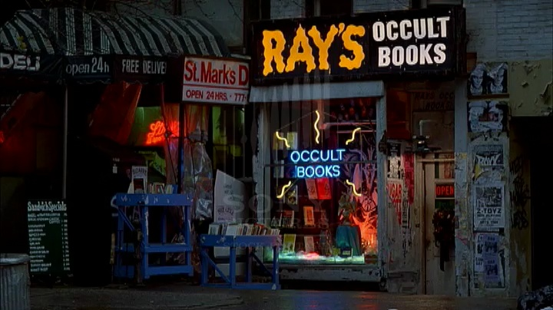
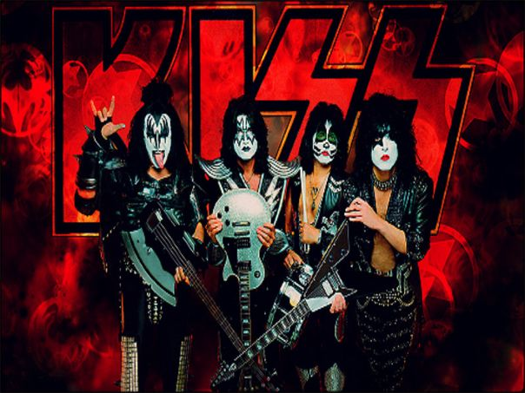

Slide 35
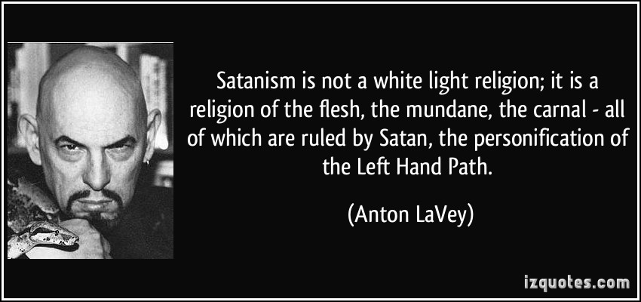

Slide 37
(2 Corinthians 11:2-14; 22-12:1) “For I am jealous over you with godly jealousy: for I have espoused you to one husband, that I may present you as a chaste virgin to Christ. But I fear, lest by any means, as the serpent beguiled Eve through his subtilty, so your minds should be corrupted from the simplicity that is in Christ. For if he that cometh preacheth another Jesus, whom we have not preached, or if ye receive another spirit, which ye have not received, or another gospel, which ye have not accepted, ye might well bear with him.

Slide 38
For I suppose I was not a whit behind the very chiefest apostles. But though I be rude in speech, yet not in knowledge; but we have been throughly made manifest among you in all things. Have I committed an offence in abasing myself that ye might be exalted, because I have preached to you the gospel of God freely? I robbed other churches, taking wages of them, to do you service. And when I was present with you, and wanted, I was chargeable to no man: for that which was lacking to me the brethren which came from Macedonia supplied: and in all things I have kept myself from being burdensome unto you, and so will I keep myself.

Slide 39
As the truth of Christ is in me, no man shall stop me of this boasting in the regions of Achaia. Wherefore? because I love you not? God knoweth. But what I do, that I will do, that I may cut off occasion from them which desire occasion; that wherein they glory, they may be found even as we. For such are false apostles, deceitful workers, transforming themselves into the apostles of Christ. And no marvel; for Satan himself is transformed into an angel of light. Therefore it is no great thing if his ministers also be transformed as the ministers of righteousness; whose end shall be according to their works.

Slide 40
Are they Hebrews? so am I. Are they Israelites? so am I. Are they the seed of Abraham? so am I. Are they ministers of Christ? (I speak as a fool) I am more; in labours more abundant, in stripes above measure, in prisons more frequent, in deaths oft. Of the Jews five times received I forty stripes save one. Thrice was I beaten with rods, once was I stoned, thrice I suffered shipwreck, a night and a day I have been in the deep; In journeyings often, in perils of waters, in perils of robbers, in perils by mine own countrymen, in perils by the heathen, in perils in the city, in perils in the wilderness, in perils in the sea, in perils among false brethren;

Slide 41
In weariness and painfulness, in watchings often, in hunger and thirst, in fastings often, in cold and nakedness. Beside those things that are without, that which cometh upon me daily, the care of all the churches. Who is weak, and I am not weak? who is offended, and I burn not? If I must needs glory, I will glory of the things which concern mine infirmities. The God and Father of our Lord Jesus Christ, which is blessed for evermore, knoweth that I lie not. In Damascus the governor under Aretas the king kept the city of the Damascenes with a garrison, desirous to apprehend me: And through a window in a basket was I let down by the wall, and escaped his hands.”

Slide 44
“Beware of false prophets, which come to you in sheep's clothing, but inwardly they are ravening wolves.”

Slide 46
“But evil men and seducers shall wax worse and worse, deceiving, and being deceived.” (2 Tim. 3:13)

Slide 48
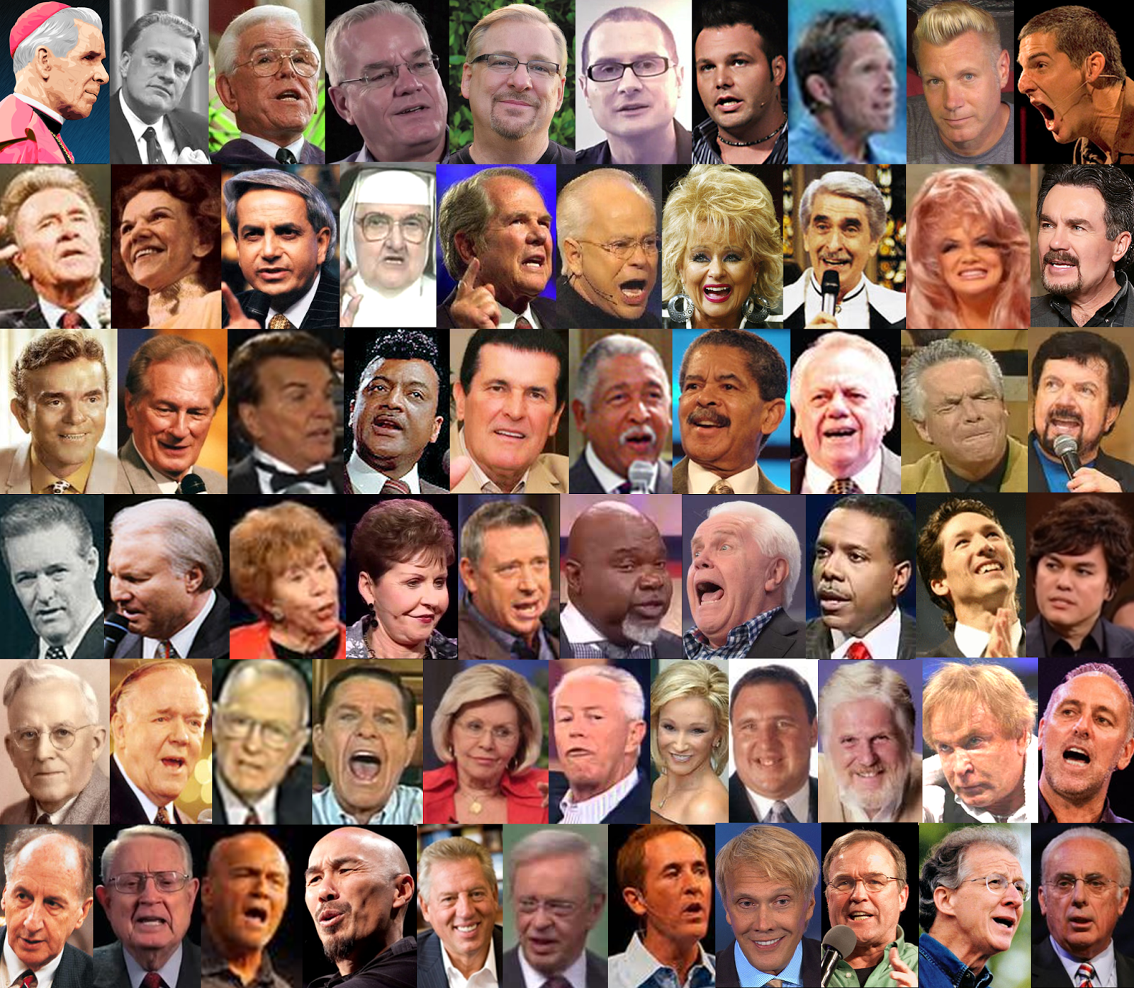

Slide 49
How to discern false prophets and teachers
“Beloved, believe not every spirit, but try the spirits whether they are of God: because many false prophets are gone out into the world.” (1 John 4:1)

Slide 50
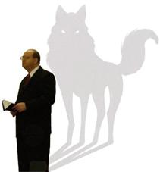
False prophets and teachers can be detected by their words
“Now I beseech you, brethren, mark them which cause divisions and offences contrary to the doctrine which ye have learned; and avoid them. For they that are such serve not our Lord Jesus Christ, but their own belly; and by good words and fair speeches deceive the hearts of the simple.” (Romans 16:17-18)

Slide 51
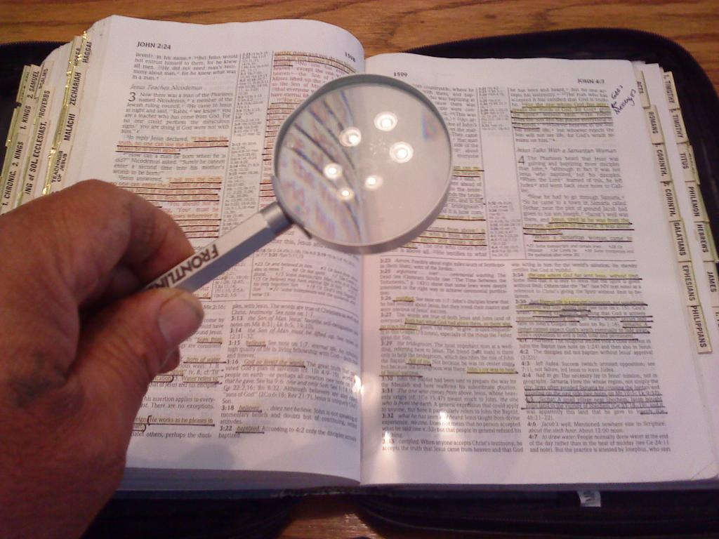
“These were more noble than those in Thessalonica, in that they received the word with all readiness of mind, and searched the scriptures daily, whether those things were so.” (Acts 17:11)

Slide 52
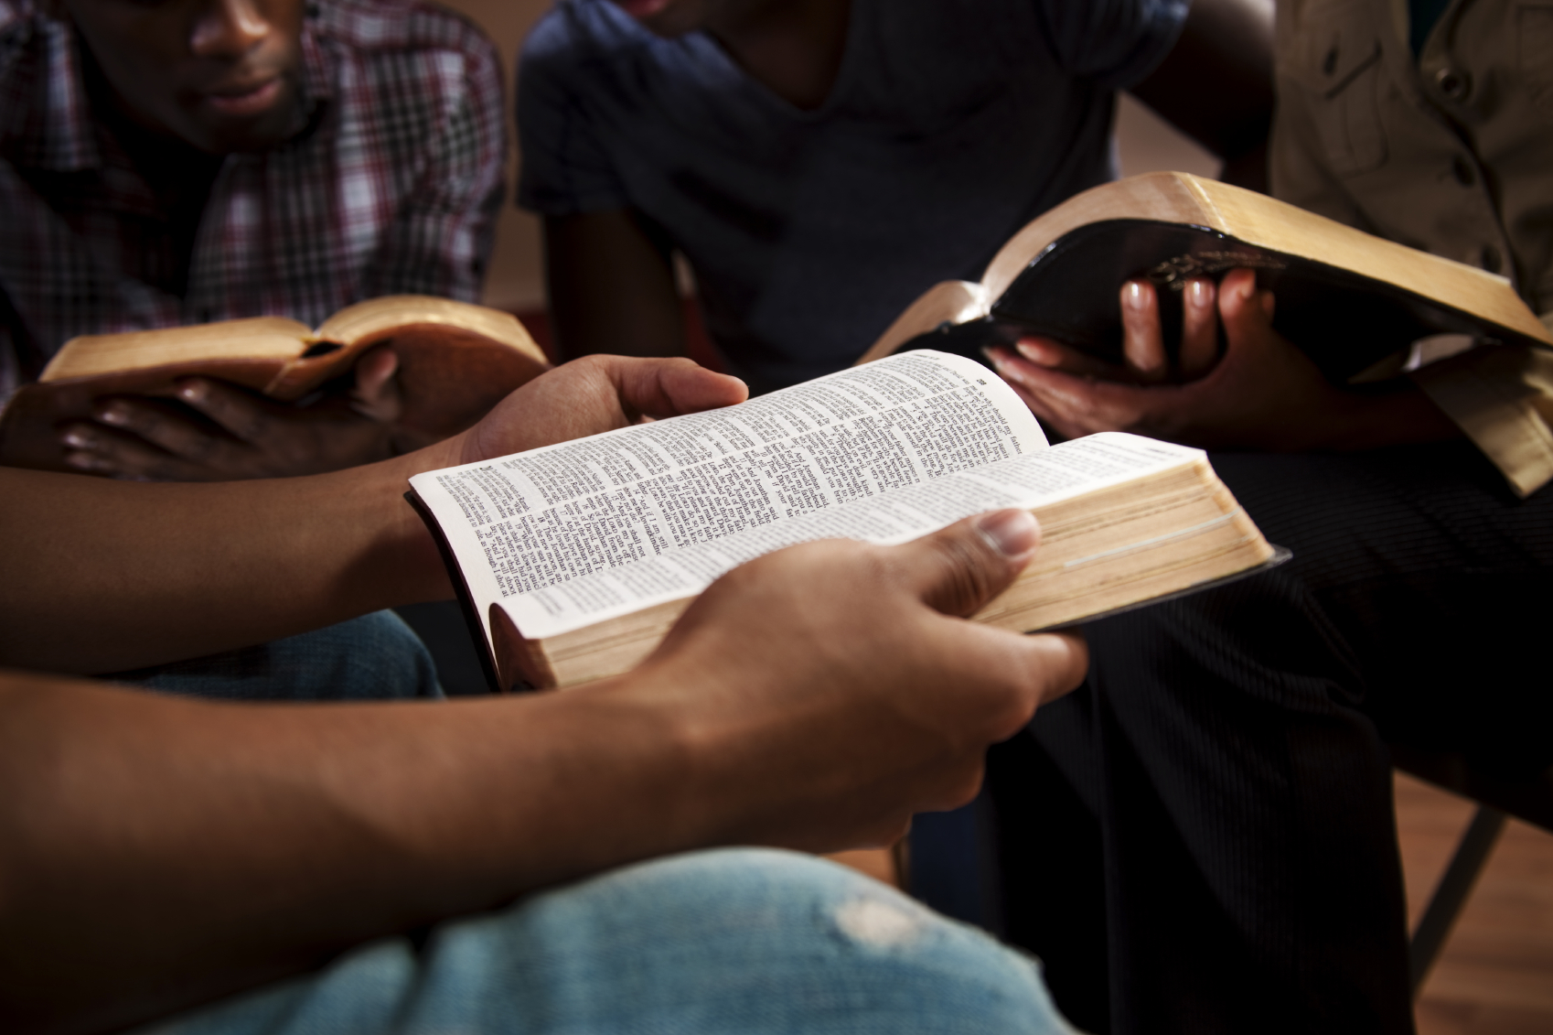

Slide 54
False prophets and teachers can be detected by their fruits
“Beware of false prophets, which come to you in sheep's clothing, but inwardly they are ravening wolves. Ye shall know them by their fruits. Do men gather grapes of thorns, or figs of thistles? Even so every good tree bringeth forth good fruit; but a corrupt tree bringeth forth evil fruit. A good tree cannot bring forth evil fruit, neither can a corrupt tree bring forth good fruit. Every tree that bringeth not forth good fruit is hewn down, and cast into the fire. Wherefore by their fruits ye shall know them.” (Matthew 7:15-20)

Slide 55
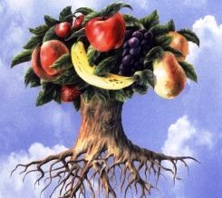
The proof of the root is in the fruit.
Good trees produce good fruit, and rotten trees, rotten fruit.
A dependable assessment of those who would be our spiritual teachers is what is the fruit of their lives and teaching.

Slide 56
1. The first category of the fruits of the false teacher is their doctrine - (Jeremiah 23:16-17,21,25; Ezekiel 13:2-10; 1 Kings 22:8, 13; 2 Timothy 4:3-4; 2 Peter 2:1; 1 John 4:2-3)
“But there were false prophets also among the people, even as there shall be false teachers among you, who privily shall bring in damnable heresies.”
Mainly, they tell people precisely what they want to hear (1 Kings 22:8, 13; 2 Timothy 4:3-4).

Slide 57
2 Peter 3:16 “As also in all his epistles, speaking in them of these things; in which are some things hard to be understood, which they that are unlearned and unstable wrest, as they do also the other scriptures, unto their own destruction.”
“Wrest” = To twist or pervert
Ezek. 22:28 “And her prophets have daubed them with untempered morter, seeing vanity, and divining lies unto them, saying, Thus saith the Lord GOD, when the LORD hath not spoken.”

Slide 58
2. The second category of the fruits of the false teachers is the effect of their teaching in the lives of men -
They attempt to lead men away from the truth of the gospel (Acts 13:8)
Their teachings lead to a rejection of God’s Word, a rejection of biblical authority, exalting of their teaching above Scripture – Matt. 15:9 “But in vain they do worship me, teaching for doctrines the commandments of men.”
Results in division among the saints (Jeremiah 23:2, 14)
Leads to a life of sensuality (2 Peter 2:2)
Goal is to deceive naive Christians with false doctrine (Mark 13:22)

Slide 59
This is also evident from the pastoral epistles where Paul speaks of the need of sound doctrine (1 Tim. 4:6; 2 Tim. 4:3; Tit. 1:9; 2:1)

Slide 60
3. Third there is the fruit of the false teachers as evidenced in their own moral character – They are distinguished by:
Their pride (2 Peter 2:10)
Their greed (Jeremiah 8:10; Titus 1:11; 2 Peter 2:3,14)
Their immorality (Jeremiah 23:11,14; 2 Peter 2:14)
They are men dominated by the flesh (2 Peter 2:10,12; 3:3)
They prey upon young and the weak (2 Timothy 3:6-7; 2 Peter 2:14,13)
While they profess to know God, by their works they deny Him (Matthew 7:22-23; 2 Timothy 3:5; Titus 1:16)
While they delight in having authority, they refuse to submit to it themselves (2 Peter 2:10)

Slide 61
They do not meet the qualifications set forth in 1 Timothy 3 and Titus 1 -

Slide 62
Parachurch organizations are Christian faith-based organizations that work outside and across denominations to engage in social welfare and evangelism, independent of church oversight.

Slide 63
(1 Thessalonians 5:12-13) “And we beseech you, brethren, to know them which labour among you, and are over you in the Lord, and admonish you; And to esteem them very highly in love for their work's sake. And be at peace among yourselves.”

Slide 64
“Now as Jannes and Jambres withstood Moses, so do these also resist the truth: men of corrupt minds, reprobate concerning the faith. But they shall proceed no further: for their folly shall be manifest unto all men, as theirs also was. But thou hast fully known my doctrine, manner of life, purpose, faith, longsuffering, charity, patience.” (2 Timothy 3:8-10)

Slide 65
Do you know the character of your spiritual teachers?
“For this cause left I thee in Crete, that thou shouldest set in order the things that are wanting, and ordain elders in every city, as I had appointed thee: If any be blameless, the husband of one wife, having faithful children not accused of riot or unruly. For a bishop must be blameless, as the steward of God; not selfwilled, not soon angry, not given to wine, no striker, not given to filthy lucre; But a lover of hospitality, a lover of good men, sober, just, holy, temperate; Holding fast the faithful word as he hath been taught, that he may be able by sound doctrine both to exhort and to convince the gainsayers.” (Titus 1:5-9)

Slide 66
“And let these also first be proved; then let them use the office of a deacon, being found blameless.” (1 Tim. 3:10)

Slide 68
(1 Corinthians 4:1-2, 14-21) “Let a man so account of us, as of the ministers of Christ, and stewards of the mysteries of God. Moreover it is required in stewards, that a man be found faithful…I write not these things to shame you, but as my beloved sons I warn you. For though ye have ten thousand instructors in Christ, yet have ye not many fathers: (Paul founded the church at Corinth) for in Christ Jesus I have begotten you through the gospel. Wherefore I beseech you, be ye followers of me. For this cause have I sent unto you Timotheus, who is my beloved son, and faithful in the Lord, who shall bring you into remembrance of my ways which be in Christ, as I teach every where in every church.”

Slide 69
“Now some are puffed up, as though I would not come to you. But I will come to you shortly…What will ye? shall I come unto you with a rod, or in love, and in the spirit of meekness?”

Slide 70
“For the time will come when they will not endure sound doctrine; but after their own lusts shall they heap to themselves teachers, having itching ear.” (2 Tim. 4:3)
“For they loved the praise of men more than the praise
of God.”
(John 12:43)

Slide 71
“Today we can celebrate that the principles of justice and equality under the law won. This a huge milestone for our nationwide journey for equality for all, and loving couples across this country can finally have their love and unions recognized.”
Records reviewed by The New York Times show more than $4.5 million in current state and federal tax owed by Sharpton.

Slide 72
(Luke 6:26) “Woe unto you, when all men shall speak well of you! for so did their fathers to the false prophets.”
(John 15:18-19) “If the world hate you, ye know that it hated me before it hated you. If ye were of the world, the world would love his own: but because ye are not of the world, but I have chosen you out of the world, therefore the world hateth you.”

Slide 78
Satan offered Jesus a Prosperity Gospel
Prosperity cannot be a proof of God's favor, since it is what
the devil promises to those who worship him.

Slide 80
Joel Osteen net worth now stands at 55 million. He owns a 10.5 million dollar house. It is 17,000 square foot, with 6 bedrooms, 6 bathrooms, 3 elevators, 5 fireplaces, a guest house and a pool house.

Slide 81
Five Extremely Wealthy Preachers Under Federal Investigation

Slide 83
Gal. 6:7 “Be not deceived.”
1 Cor. 15:33 “Be not deceived.”
1 Cor. 6:9 “Be not deceived.”
Luke 21:8 “Be not deceived.”

Slide 85
“In whom the god of this world hath blinded the minds of them which believe not, lest the light of the glorious gospel of Christ, who is the image of God, should shine unto them.”

Slide 87
Satan has a false trinity
Satan has his synagogues
Satan has prophets and teachers
Satan has his doctrines
Satan has his mysteries
Satan has a throne
Satan has a kingdom
Satan has worshipers
Satan has ministers

