Slide 1
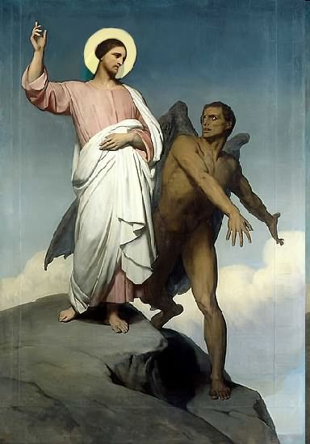

Slide 2
Topics to be studied
His existence
His origin
His fall
His personality
His names
His activities
His location – past, present and future
Our victory over him

Slide 6
1 John 5:4-5 - For whatsoever is born of God overcometh the world: and this is the victory that overcometh the world, even our faith. Who is he that overcometh the world, but he that believeth that Jesus is the Son of God?
Romans 6:14 - For sin shall not have dominion over you: for ye are not under the law, but under grace.
Romans 8:37 - Nay, in all these things we are more than conquerors through him that loved us.
2 Corinthians 2:14 - Now thanks be unto God, which always causeth us to triumph in Christ.
Philippians 4:13 - I can do all things through Christ which strengtheneth me.

Slide 7
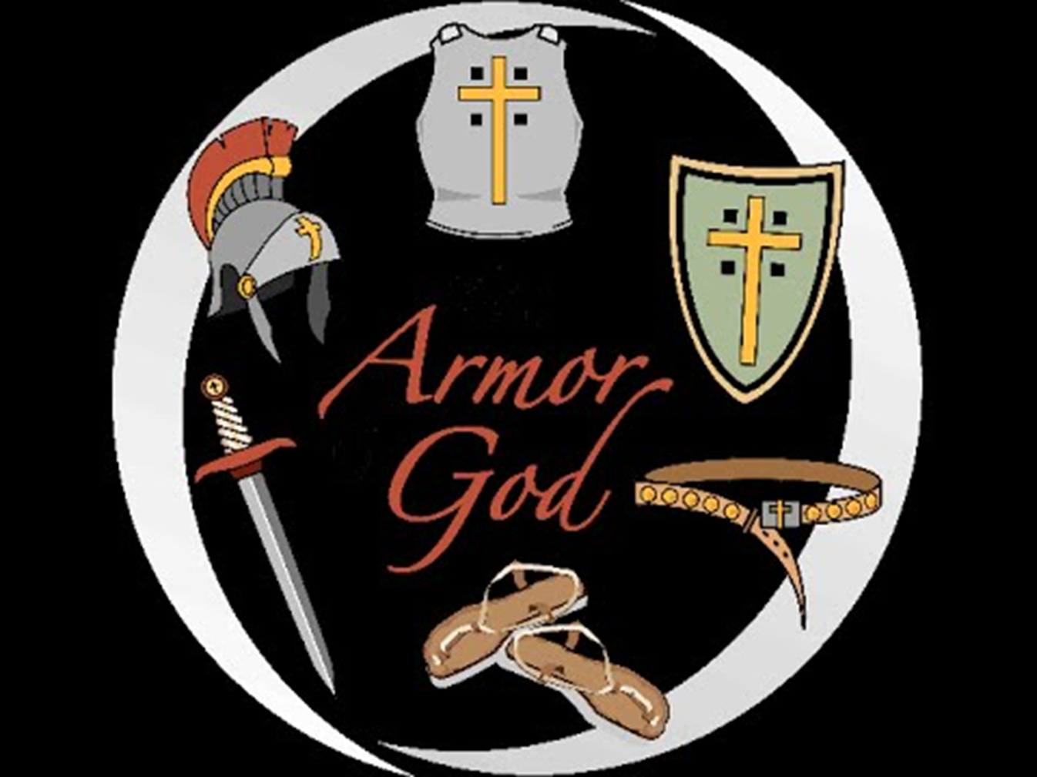
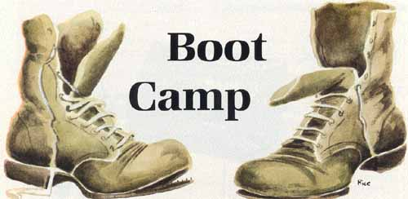
HOW TO PUT ON YOUR ARMOR AND WEAPONS
(Part 2)

Slide 10
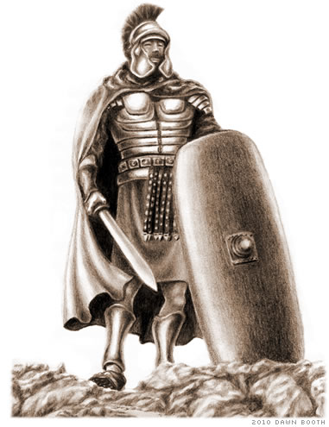
The spiritual armor of the Christian is compared to the physical armor of a soldier; however, it’s very different nature.
A soldier must expend a great amount of time and energy in order to put on his armor and take up his weapons.
Similarly, a Christian puts on each piece of armor through precise disciplines in the Christians life.

Slide 11
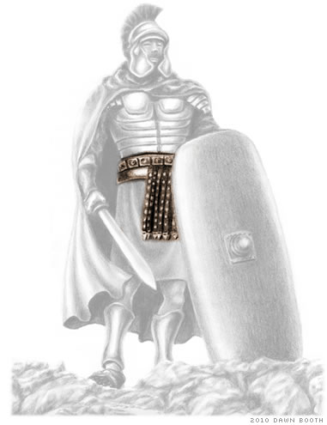
“Stand therefore, having your loins girt about
with truth.”

Slide 12
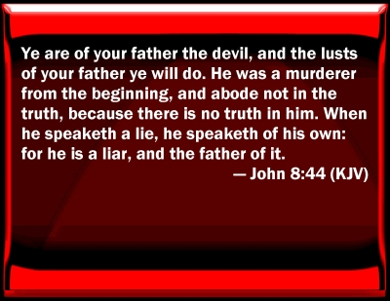

Slide 13
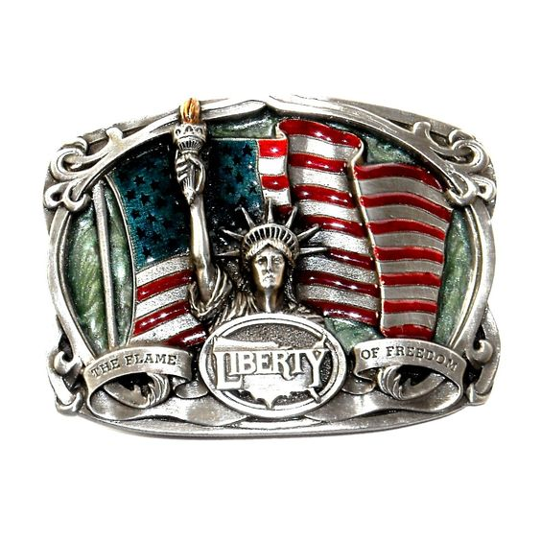

Slide 14
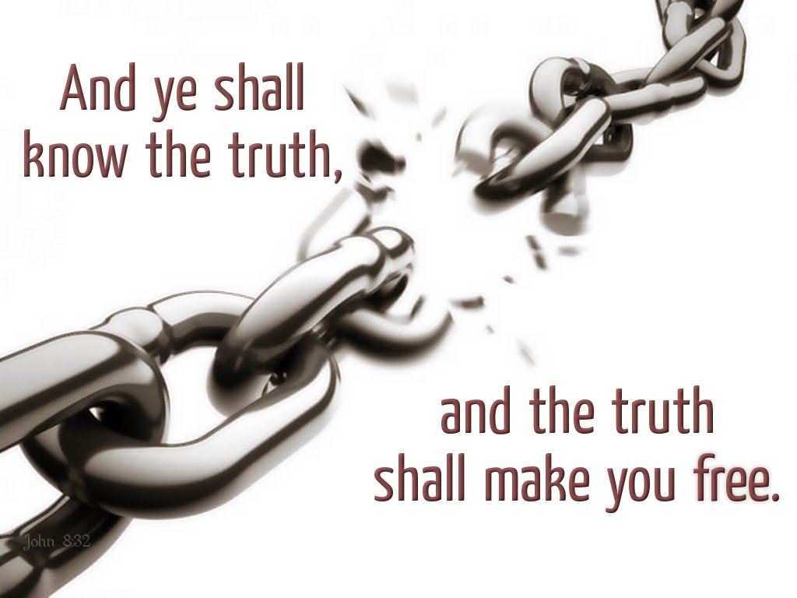
Peter had this picture in mind when he wrote, “... Gird up the loins of your mind ...” - I Peter 1:13
Truth is also a means of freedom, as Jesus said, “... Ye shall know the truth, and the truth shall make you free.” - John 8:32

Slide 15
THE DISCIPLINE RELATED TO THE BELT OF TRUTH
The best way to guard ourselves from Satan’s lies is to have a daily program of reading and studying God’s Truth – Isaiah 58:2
By engrafting Scripture into our mind, will, and emotion, we will be able to think God’s thoughts after Him – James 1:21
Meditation on Scripture is the way to engraft God’s Word into our lives so we can walk in God’s ways and experience His power and blessing upon our lives – Psalms 119:15

Slide 16
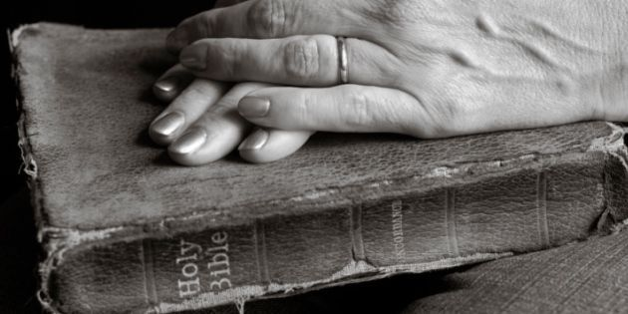
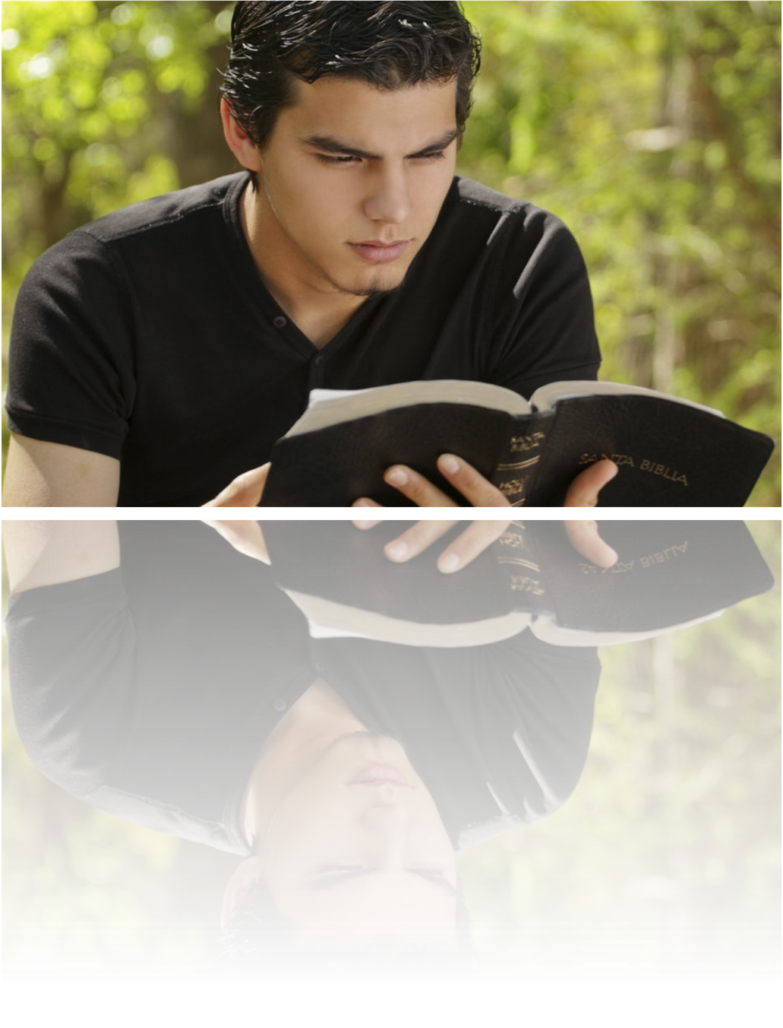
By engrafting Scripture into our mind, will, and emotion, we will be able to think God’s thoughts after Him – James 1:21
Meditation on Scripture is the way to engraft God’s Word into our lives so we can walk in God’s ways and experience His power and blessing upon our lives – Psalms 119:15

Slide 17
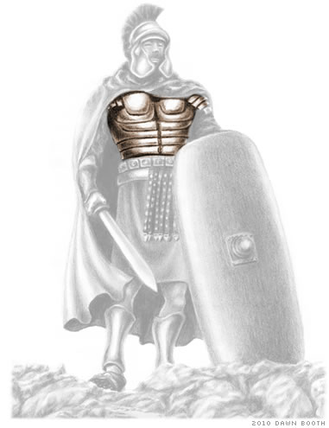
“And having on the breastplate of righteousness.”

Slide 18
The Roman warriors who directly engaged the enemy wore a plate of armor around the central part of their bodies to protect their vital organs.
In the same way, Christians are directed by God to guard “...their hearts with all diligence; for out of them are the issues of life.” - Proverbs 4:23

Slide 19
The plate armor was heavy and restricted motion; however, the protection it gave was necessary for the soldier’s survival.

Slide 20
THE DISCIPLINE RELATED TO THE BREASTPLATE OF RIGHTEOUSNESS
Purpose of heart to live righteously - Dan. 1:8 “But Daniel purposed in his heart that he would not defile himself.”
Development of Biblical convictions – “steadfast unmovable”
Commitment to live according to God’s righteousness commandments - Deut. 6:25 “And it shall be our righteousness, if we observe to do all these commandments before the LORD our God, as he hath commanded us.”

Slide 21
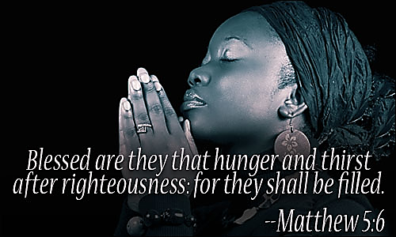

Slide 22
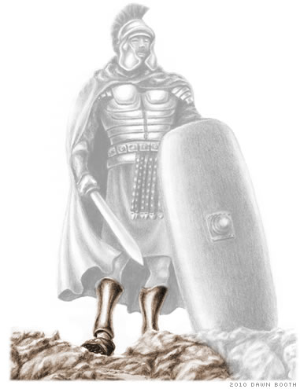
“And your feet shod with the preparation of the gospel of peace.”

Slide 23
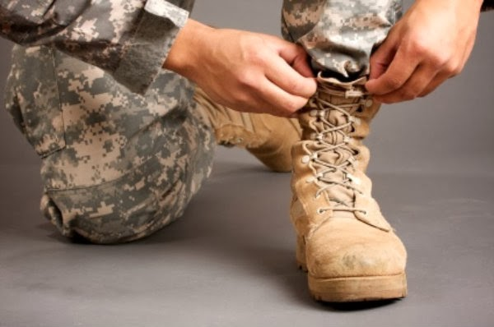
A Solider and his Army could never advance and conqueror the enemy with bare feet
(Romans 10:14-15) “How then shall they call on him in whom they have not believed? and how shall they believe in him of whom they have not heard? and how shall they hear without a preacher? And how shall they preach, except they be sent? as it is written, How beautiful are the feet of them that preach the gospel of peace, and bring glad tidings of good things!”

Slide 24
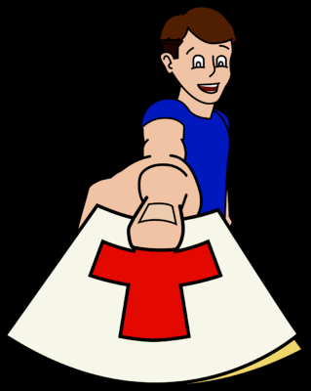
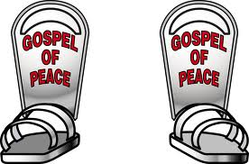
THE DISCIPLINE RELATED TO THE SHOES OF THE GOSPEL
Realize that it’s the gospel message that Satan opposes – Matt. 13:39
Put on every day the “shoes of the gospel of peace” – Rom. 13:12
Always be prepared to share the gospel – “Preparation” - The word implies readiness and constant vigilance.
It’s the gospel that advances Christ kingdom – “And this gospel of the kingdom shall be preached in all the world for a witness unto all nations.”

Slide 25
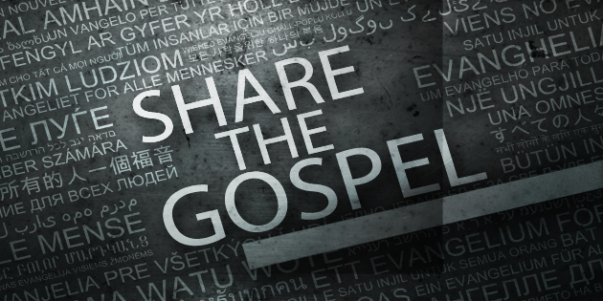

Slide 26
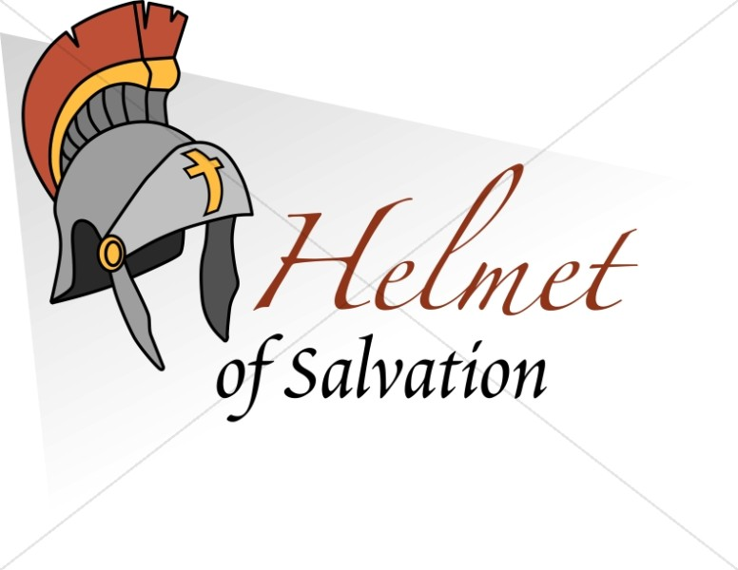

Slide 27
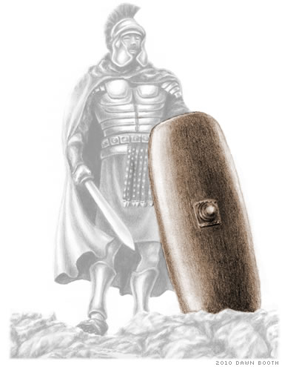
“Above all, taking the shield of faith, wherewith ye shall be able to quench all the fiery darts of the wicked.”

Slide 28
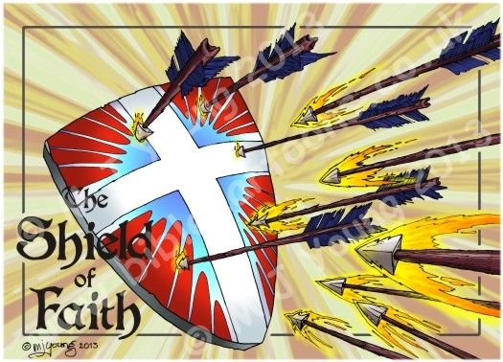

Slide 29
Romans shields came in various sizes and shapes, but they all had the same purpose: to protect the warrior from the deadly spears, arrows, and swords of the enemy.
Even with the other pieces of armor, a soldier had vulnerable parts and needed the added protection of a shield to stop or deflect what would otherwise be lethal blows.
The Romans shields were designed to inter-lock with one another.
With this feature, soldiers interlocked their shields over their heads and advanced toward the walled cities of the enemy.
The fiery darts that came down upon them from the soldiers on the wall were thus ineffective.

Slide 30
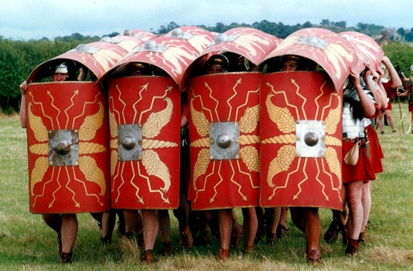
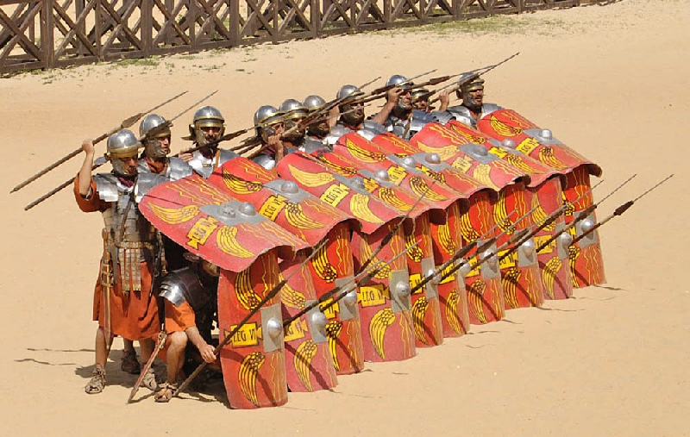

Slide 31
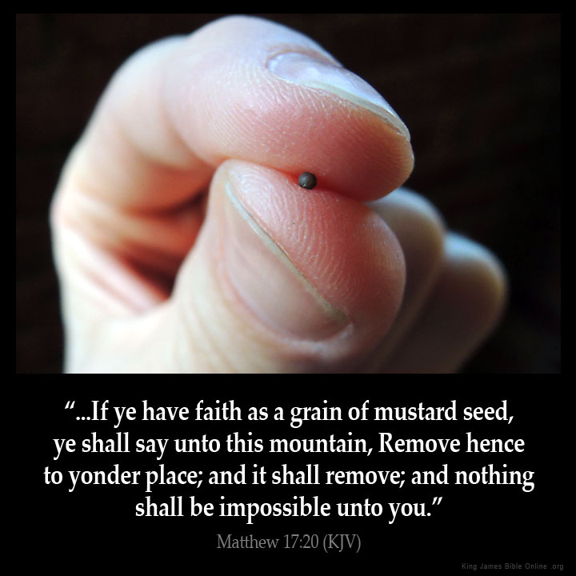
THE DISCIPLINE RELATED TO THE SHIELD OF FAITH
SHIELD OF FAITH
“Faith cometh by hearing and hearing by the Word of God”
Read God’s Word every day – Acts 17:11
Hid it in your heart – Psalm 119
Ask God to increase your faith – Luke 17:5
Start trusting God – “mustard seed”

Slide 32
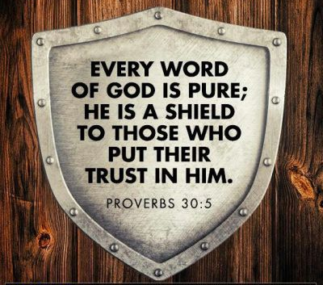
Satan is the adversary of the believer - I Peter 5:8
He watches for opportunity to cast his darts - 2 Cor. 2:11
It takes spiritual discernment to anticipate and deflect these assaults – Heb. 5:11-14
Such discernment comes through Scripture.
Jesus promised to reward openly those who secretly spend time with Him in His Word - Matt. 6:6
In Isaiah 58, God promises good judgment to those who fast and seek Him.

Slide 33
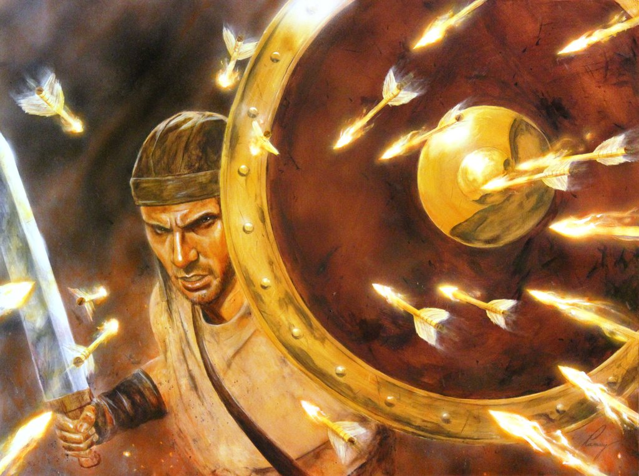
“Above all, taking the shield of faith, wherewith ye shall be able to quench all the fiery darts of the wicked.”
(Eph. 6:16)

Slide 34
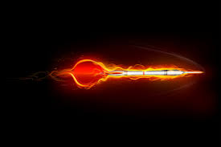
Deception

Slide 35
Temptation

Slide 37
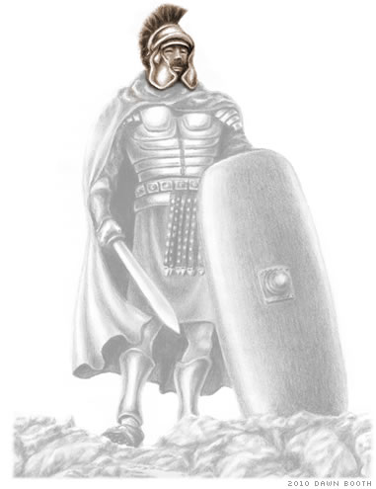
“And take the helmet
of salvation.”

Slide 38
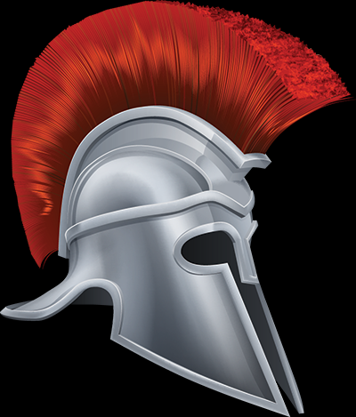
In hand-to-hand combat, it was a distinct advantage for a soldier to have a helmet which protected not only his head, but also his face and eyes.
A blow to the uncovered head would immediately disable the soldier; therefore, this was one of the most important pieces of armor.

Slide 39
What is the helmet of Salvation?
1 Thess. 5:8 “But let us, who are of the day, be sober, putting on the breastplate of faith and love; and for an helmet, the hope of salvation.”
Romans 8:24-25 “For we are saved by hope: but hope that is seen is not hope: for what a man seeth, why doth he yet hope for? But if we hope for that we see not, then do we with patience wait for it.”
Helmet of Salvation is the assurance of Salvation! – “And I give unto them eternal life, and they shall never perish…”

Slide 40
THE DISCIPLINE RELATED TO THE HELMET OF SALVATION
One of Satan’s most devastating tactics is to cause us to doubt our salvation thus disabling us with fear – 365 “fear nots”
If he can bring doubt to our minds, we will take our focus off the power and protection of the Lord and lose our will to sustain the battle – “O thou of little faith, wherefore didst thou doubt?”
Claim the promises of God – Rom. 4:20 “He staggered not at the promise of God through unbelief; but was strong in faith, giving glory to God.”
Start living a godly life – Titus 2:12
Stop listen to the Devil – James 4:7

Slide 41
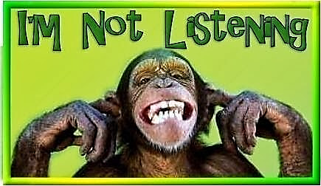

Slide 42
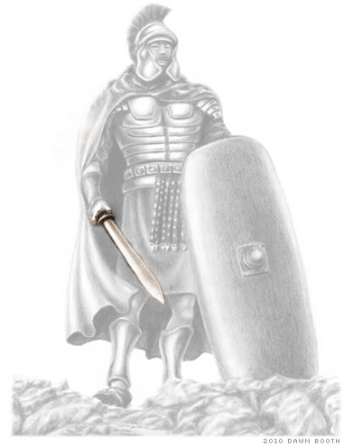
“And the sword of the Spirit, which is the Word of God.”

Slide 43
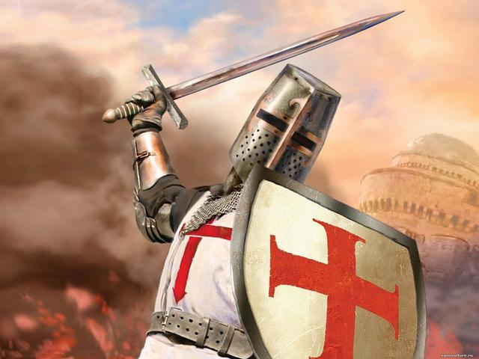
The first five pieces of armor are defensive; however, the sword is to be used as an offensive weapon.
The effectiveness of the sword depended on the hardness of the metal and the sharpness of the edges.
It also depended on the soldiers ability to use it effectively.
The two-edged sword was essential in battle because the soldier could wield it at the enemy in either direction.

Slide 44
THE DISCIPLINE RELATED TO THE SWORD OF THE SPIRIT
The sword of the Spirit is the Word of God – Heb. 4:12
The Greek term used in this verse for “word” is not logos but rhema.
A rhema is Scripture which the Holy Spirit gives to us for a particular situation.
Jesus demonstrated how to use rhemas when He was tempted in the wilderness.
With each temptation, He quoted a verse of Scripture from the Old Testament logos.

Slide 45
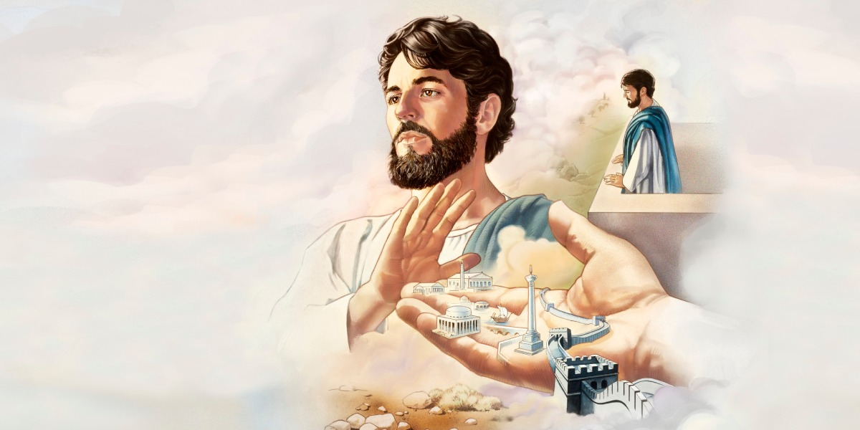
“Then saith Jesus unto him, Get thee hence, Satan: for it is written.”

Slide 46
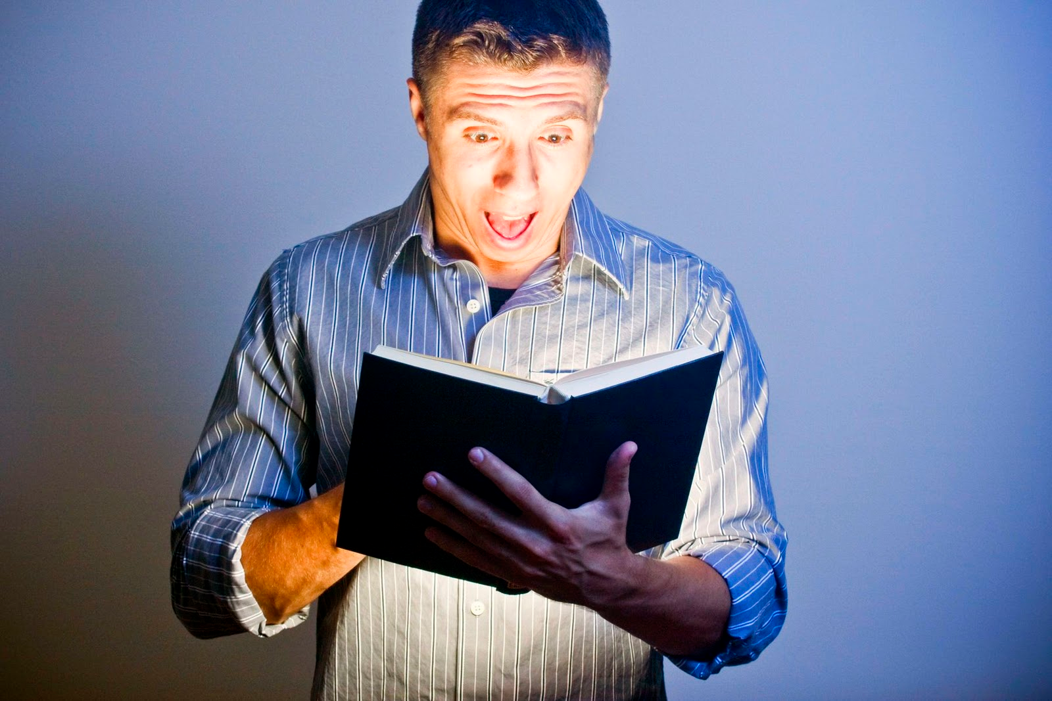
The disciplines of reading, meditating, and memorizing Scripture will provide the basis of turning Logos into a Rhema from the Holy Spirit.
Rhema (ῥῆμα in Greek) literally means an "utterance, a spoken word, a living voice, a message, a revelation"
A wise exercise in Spiritual warfare would be to match Rhemas with the deceptions and temptations that Satan brings to you.
Rhema
Logos

Slide 48
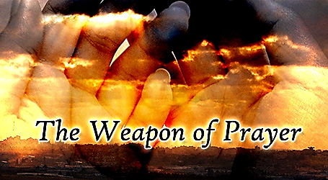

Slide 49
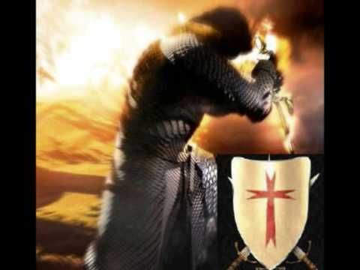
“Praying always with all prayer and supplication in the Spirit, and watching thereunto with all perseverance and supplication for all saints.”

Slide 50
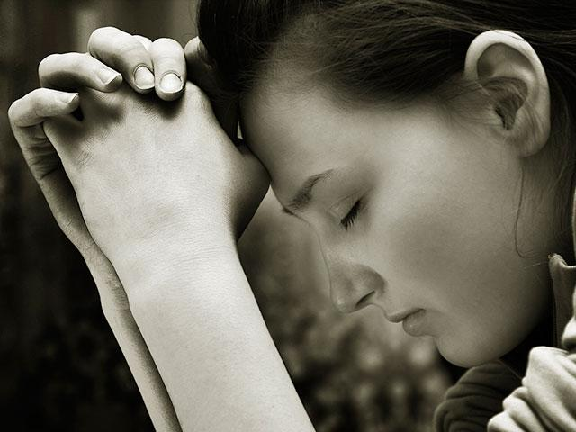
Our second offensive weapon is prayer.
“...The effectual fervent prayer of a righteous man availeth much” [makes much power available] - James 5:16
The power and influence of prayer is extensive: “Praying always with all prayer and supplication in the Spirit, and watching thereunto with all perseverance and supplication for all saints; And for me, that utterance may be given unto me, that I may open my mouth boldly, to make known the mystery of the gospel.” - Ephesians 6:18-19

Slide 51
THE DISCIPLINE RELATED TO FERVENT PRAYER
Satan is a hinderer of the saints - 1 Thess. 2:18
Satan will, therefore, do all he can to hinder Christians from engaging in prayer (see Isa. 58).
Fervent prayer for the salvation of unbelievers and for the strengthening of Christians damages Satan’s kingdom.
We can, however, be more than conquerors if we turn Satan’s temptations into signals for prayer – “Praying always.”
Prayer and fasting weakens Satan’s power – Isa. 58:6, 8-9

Slide 52
“Is not this the fast that I have chosen? to loose the bands of wickedness, to undo the heavy burdens, and to let the oppressed go free, and that ye break every yoke?...Then shall thy light break forth as the morning, and thine health shall spring forth speedily: and thy righteousness shall go before thee; the glory of the LORD shall be thy rereward. Then shalt thou call, and the LORD shall answer; thou shalt cry, and he shall say, Here I am.”

Slide 53
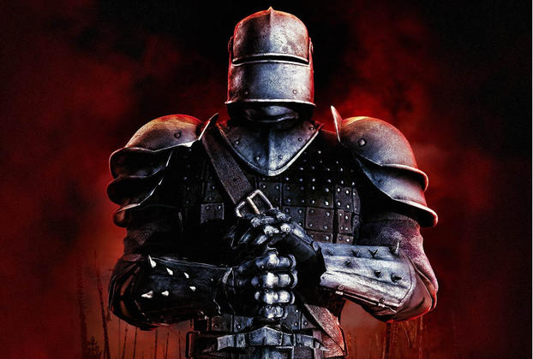
Determine for whom you will pray whenever you are tempted, and prayer will become an offensive weapon against Satan.

Slide 54
