Slide 1
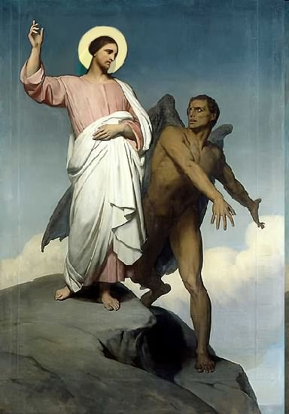

Slide 2
Topics to be studied
His existence
His origin
His fall
His personality
His names
His activities
His location – present and future
Our victory over him

Slide 3
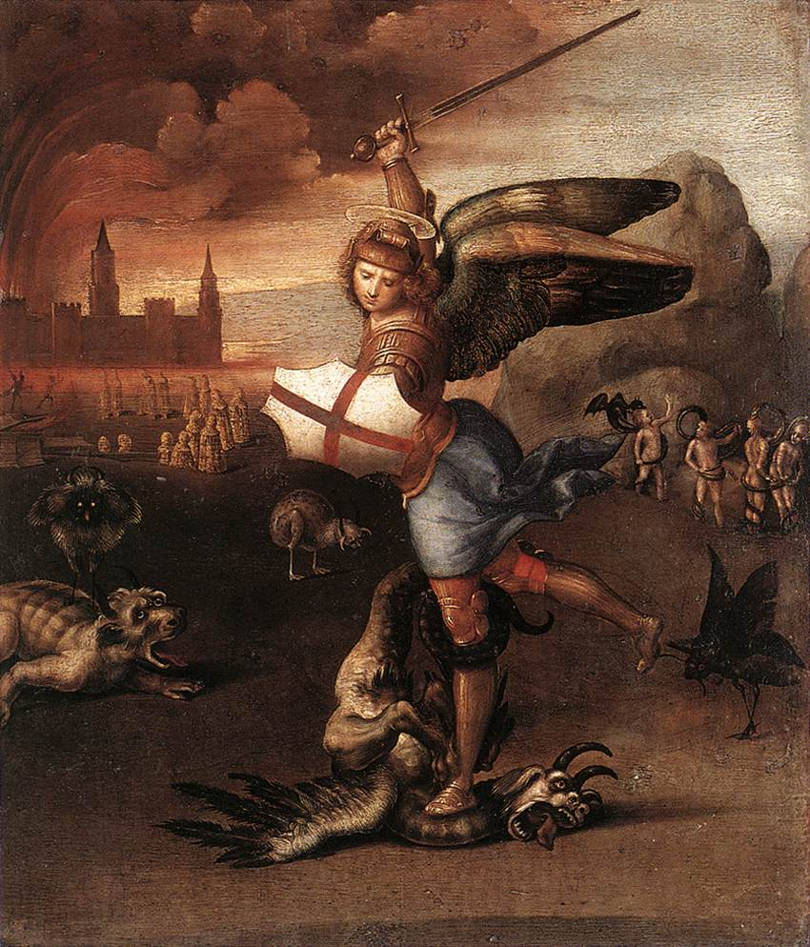
The Personality of Satan
Is Satan a person or a force?
Although he has persuaded many people that he doesn't exist, Satan very definitely is a real person and the source of every kind of moral and spiritual evil in the world.

Slide 4
He is called by various names in the Bible, including - Satan (meaning “adversary”—Job 1:6; Romans 16:20), the Devil (meaning “slanderer”—Matthew 4:1; 1 Peter 5:8), Lucifer (Isaiah 14:12), the Serpent (2 Corinthians 11:3; Revelation 12:9), and many others.
The existence of Satan as a personal being is proved by the fact that the Lord Jesus Christ recognized him as a person.
Jesus referred to him frequently by name (Luke 10:18; Matthew 4:10) and called him “the prince of this world” (John 12:31; 14:30; 16:11).

Slide 5
The apostle Paul called Satan the “god of this world” (2 Corinthians 4:4) and “the prince of the power of the air” (Ephesians 2:2).
The apostle John said, “The whole world is under the control of the evil one” (1 John 5:19) and that Satan “leads the whole world astray” (Revelation 12:9).
These could hardly be descriptions of an impersonal force or a mere personification of evil.

Slide 6
Satan possesses a body

Slide 7
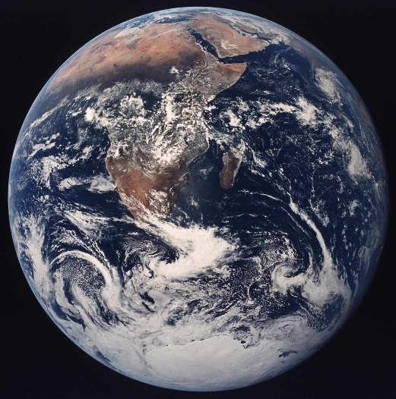
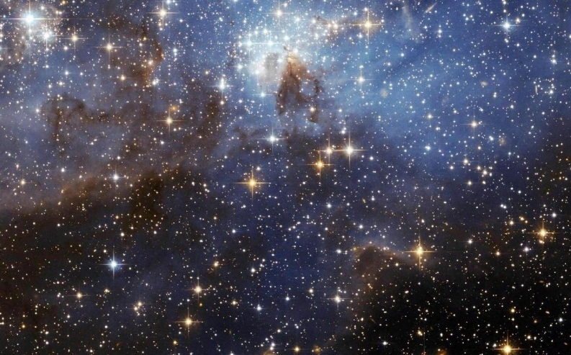
The Scriptures teach that, before man and the world were created, God had created an “innumerable company of angels” (Hebrews 12:22), a heavenly host of spiritual beings of great strength and intelligence.
Satan is a real person with a real body.
In 1 Corinthians 15 the Apostle Paul distinguishes between heavenly bodies and earthly bodies.
"All flesh is not the same flesh: but there is one kind of flesh of men, another flesh of beasts, another of fishes, and another of birds. There are also celestial bodies, and bodies terrestrial; but the glory of the celestial is one, and the glory of the terrestrial is another" (1 Cor. 15:39-40).
Terrestrial = Earthly
Celestial = Heavenly

Slide 8
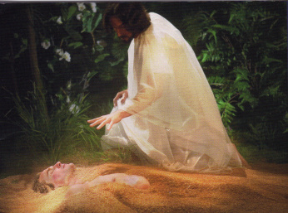
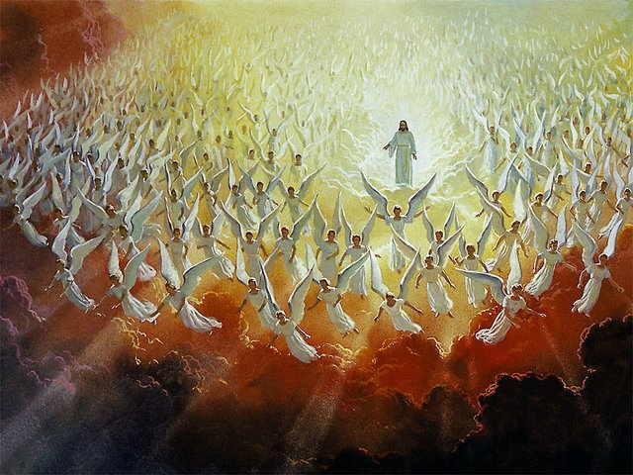
Terrestrial
Celestial

Slide 9
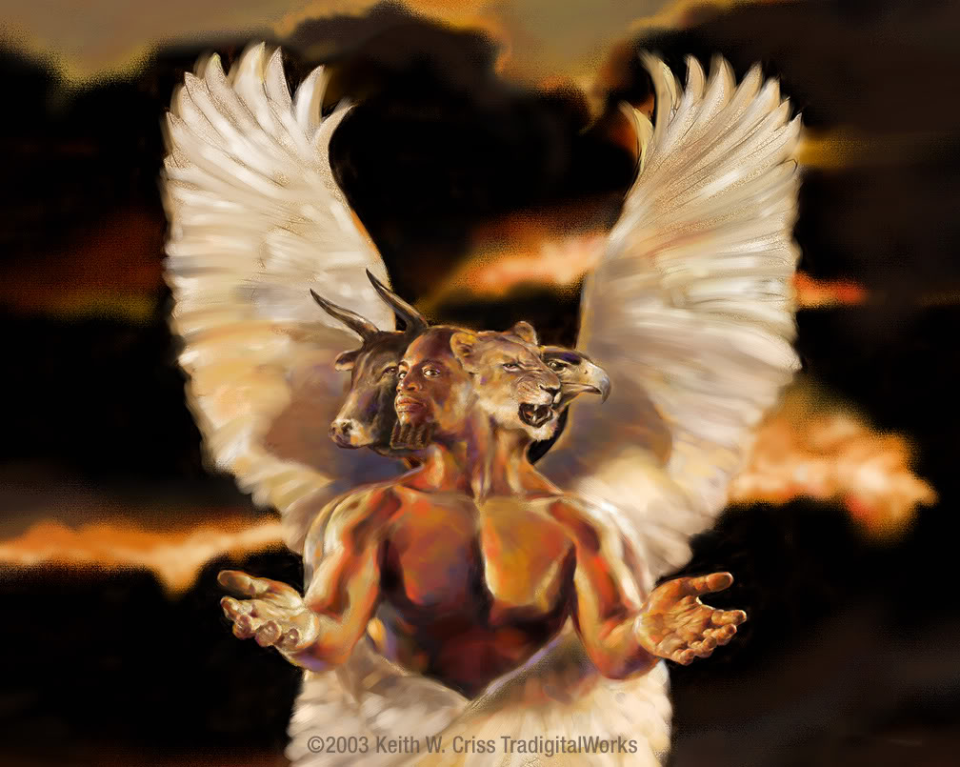
The highest of these celestial beings are the cherubim, who are attendants at the very throne of God, and the “anointed cherub” was originally Satan himself (Ezekiel 28:14).

Slide 10
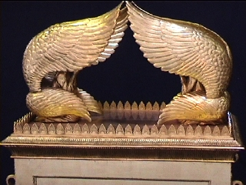

Slide 11
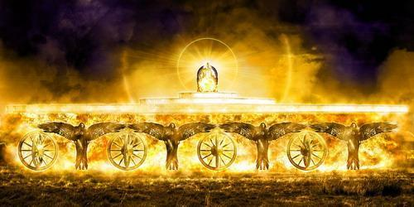
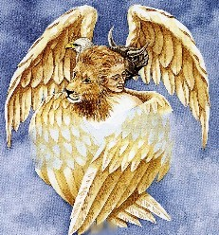
Four Living Creatures “Cherubims” (Ezekiel 10:15-20)

Slide 12
“Every one had four faces, and every one had four wings…And as they went, I heard the noise of their wings, like the noise of great waters, as the voice of the Almighty…”
“Their rings were high that they were dreadful; and their rings were full of eyes round about them. And when the living creatures went, the wheels went by them.”

Slide 13
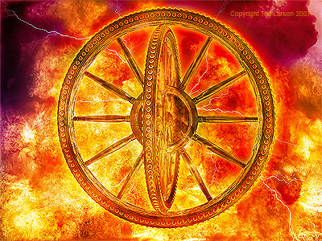
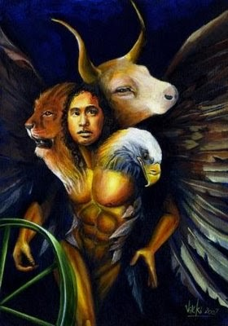

Slide 14
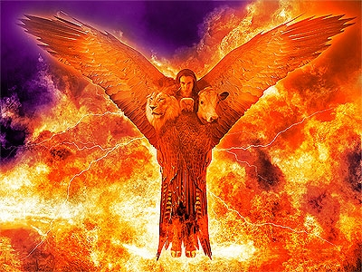
Lucifer was “full of wisdom and perfect in beauty.”
God did not create Lucifer as an evil being.
The angels, like man, were created with a free will.
They were fully able to reject God’s will and rebel against His authority if they chose.

Slide 15
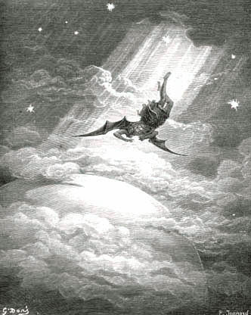
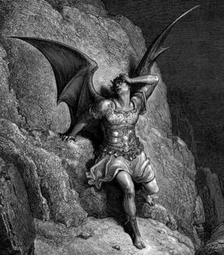
Satan a Fallen Star (angel) Five foolish and fatal “I will’s” of the devil (Isaiah 14:12-14)
I will ascend into heaven
I will exalt my throne above the stars of God
I will sit also upon the mount of the congregation, in the sides of the north
I will ascend above the heights of the clouds
I will be like the most High

Slide 16
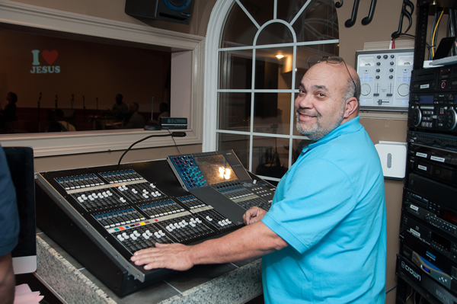

Slide 17
“His tail drew a third part of the stars of heaven, and did cast them to the earth…”
Stars of heaven = angels
1/3 followed Satan in his rebellion
Isaiah 14:12-15; Ezekiel 28:12-16; II Peter 2:4; Jude 6

Slide 18
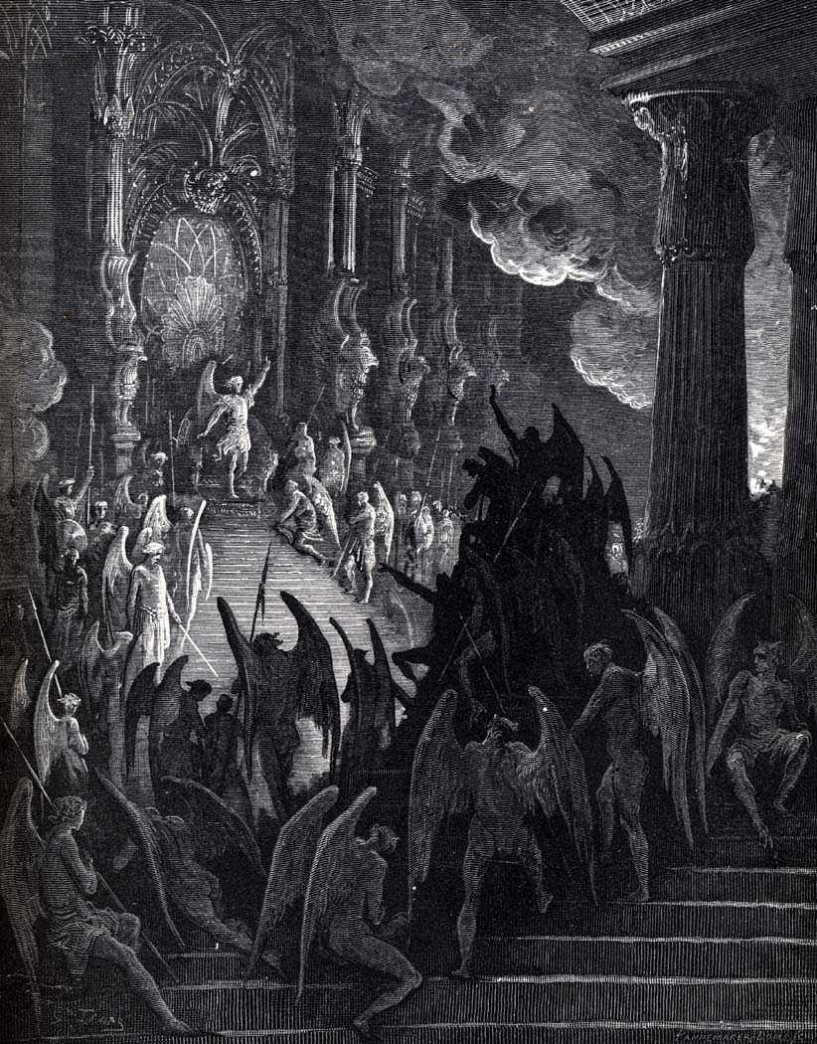

Slide 19
Paul warns about the devil and his wicked (but highly organized) cohorts
"Put on the whole armour of God, that ye may be able to stand against the wiles of the devil. For we wrestle not against flesh and blood, but against principalities, against powers, against the rulers of the darkness of this world, against spiritual wickedness in high places." (Eph. 6:11-12)

Slide 20
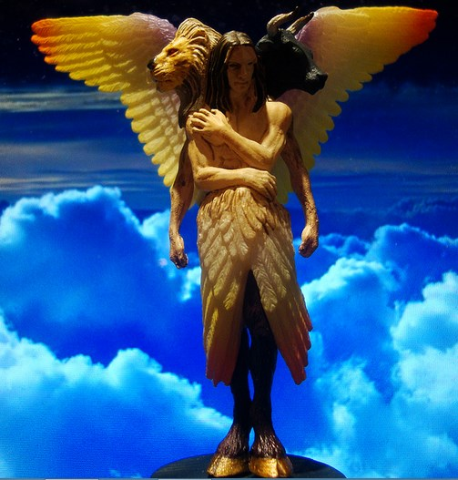
The basic sin, of both man and angels, is the sin of pride (I John 2:16).
Satan’s “I will’s” (Isaiah 14:13,14) could hardly be seen as the actions or motivations of an impersonal force.
Jesus also told us – “He was a murderer from the beginning, and abode not in the truth, because there is no truth in him. When he speaketh a lie, he speaketh of his own: for he is a liar, and the father of it.”(John 8:44)

Slide 21
It is crucial that Christians recognize the reality of Satan – He is our personal enemy (Matt. 13:39).
We must understand that we must “Be sober, be vigilant; because your adversary the devil, as a roaring lion, walketh about, seeking whom he may devour.” (1 Peter 5:8)

Slide 22
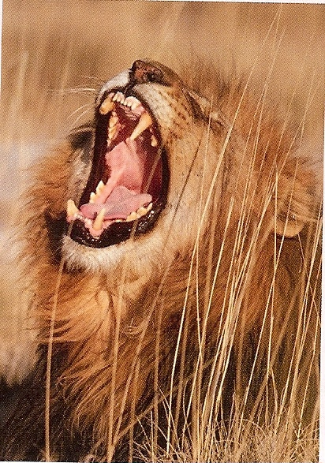
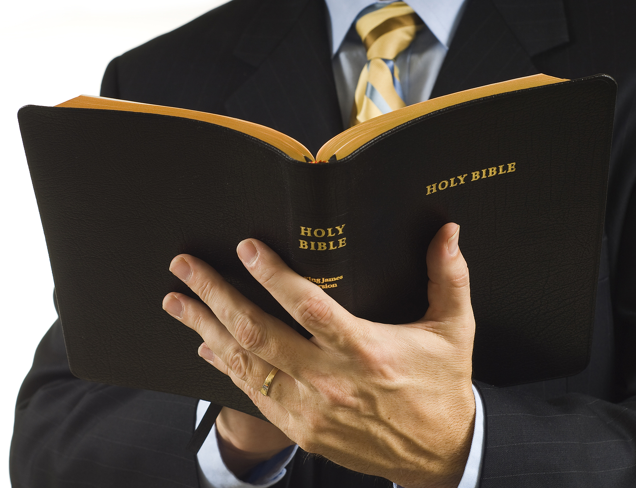
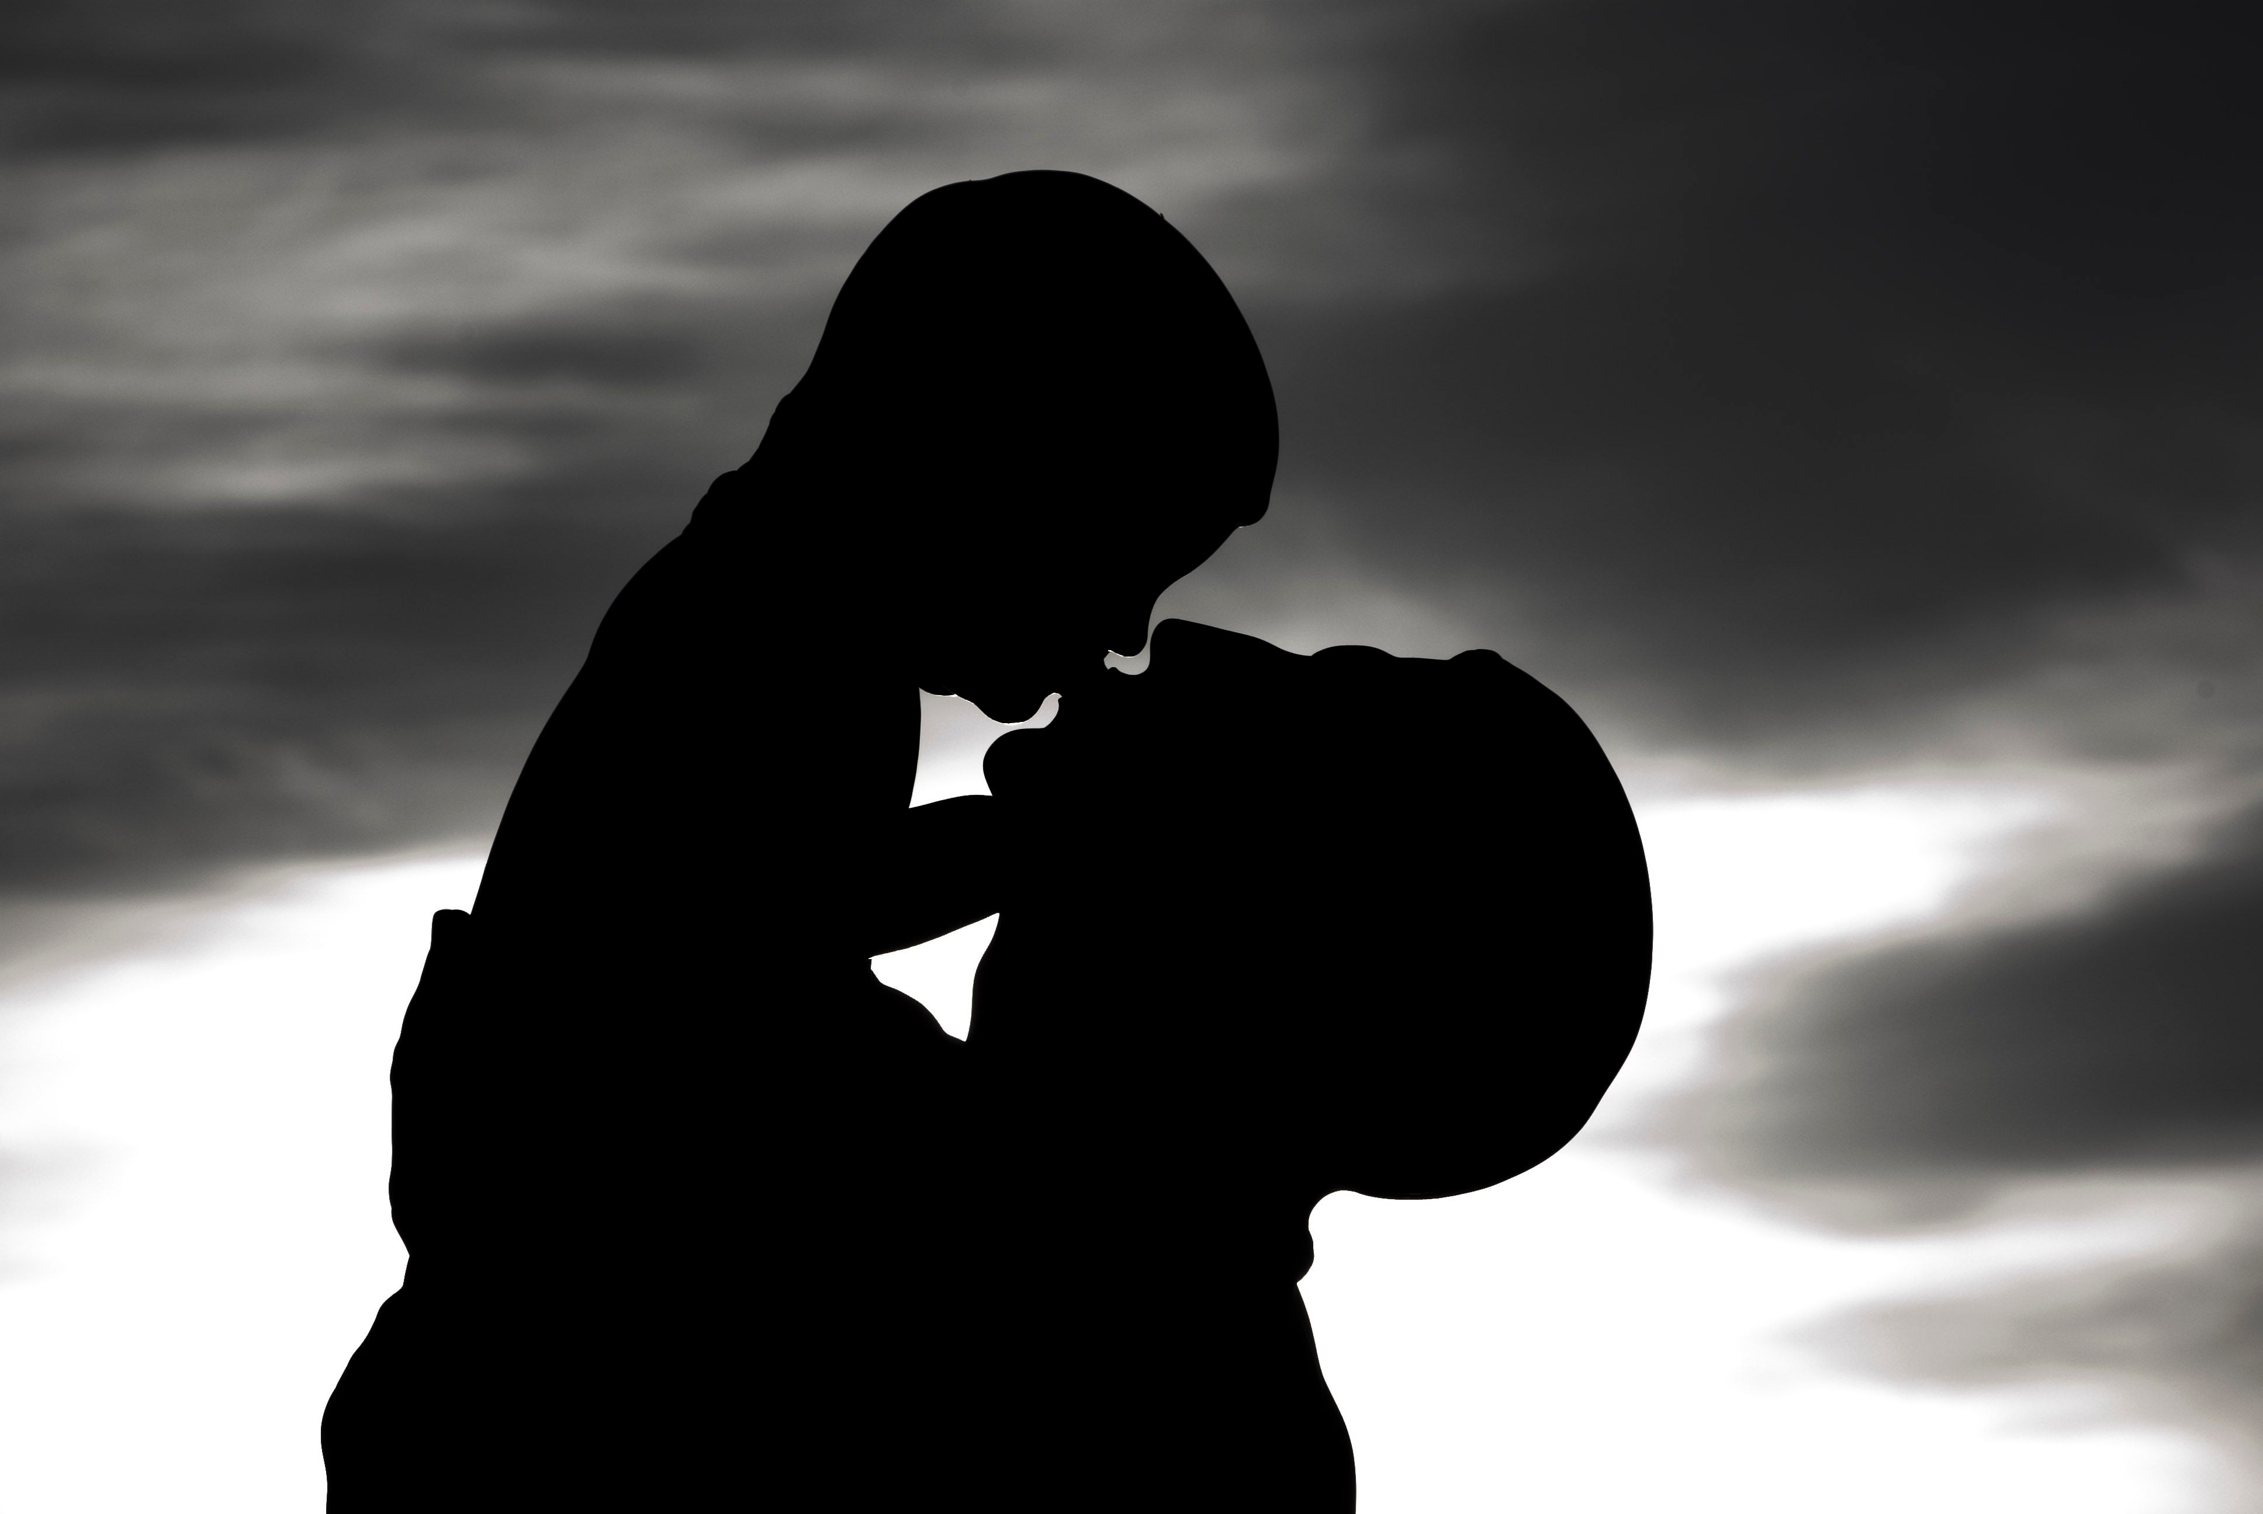
God Almighty
(I Timothy 6:15)
Satan
Destruction (John 10:10)
God Given
Authority
(Romans 13:1)
“Be sober, be vigilant; because your adversary the devil, as a roaring lion,
walketh about, seeking whom he may devour.” (I Peter 5:8)
I Corinthians 11:3
Colossians 3:18

Slide 23
It is impossible to overcome sin and temptation from the devil by ourselves, but Scripture tells us how to be strong – “Be strong in the Lord and in the power of his might…”
We need to put on the whole armor of God and withstand Satan’s deceptions and temptations (Ephesians 6:13).
We will study in detail our victory over Satan in a future message!

Slide 24
Satan possesses great intelligence
"Lest Satan should get an advantage of us: for we are not ignorant of his devices." (2 Cor. 2:11).
"But I fear, lest by any means, as the serpent beguiled Eve through his subtilty, so your minds should be corrupted from the simplicity that is in Christ." (2 Cor. 11:3)

Slide 25
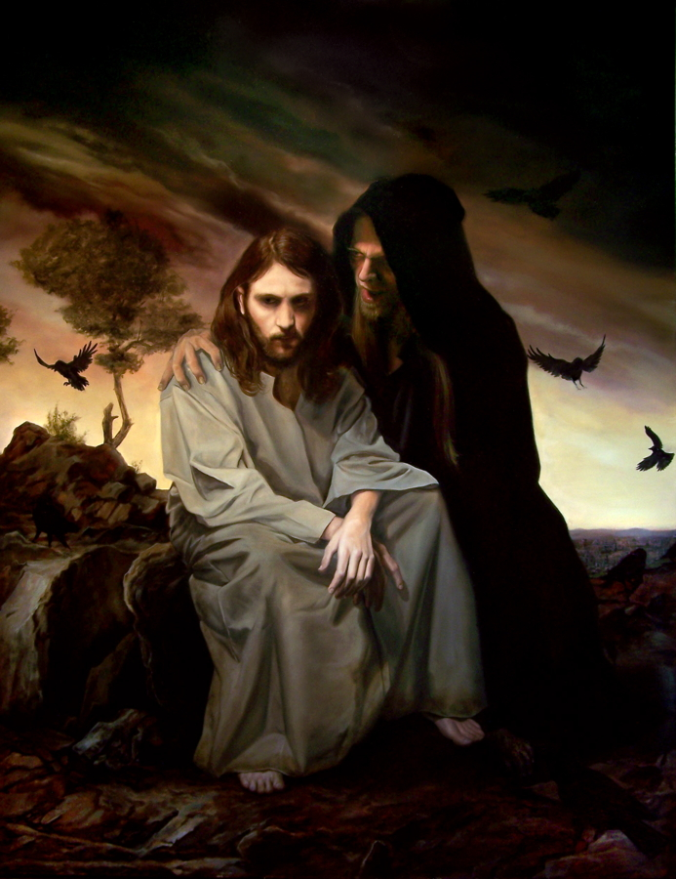
The Temptation of Christ Proves Satan’s Intelligence
"Then was Jesus led up of the Spirit into the wilderness to be tempted of the devil. And when he had fasted forty days and forty nights, he was afterward an hungered. And when the tempter came to him, he said, If thou be the Son of God, command that these stones be made bread. But he answered and said, It is written, Man shall not live by bread alone, but by every word that proceedeth out of the mouth of God.”

Slide 26
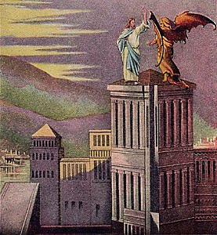
“Then the devil taketh him up into the holy city, and setteth him on a pinnacle of the temple, and saith unto him, If thou be the Son of God, cast thyself down: for it is written, He shall give his angels charge concerning thee: and in their hands they shall bear thee up, lest at any time thou dash thy foot against a stone. Jesus said unto him, It is written again, Thou shalt not tempt the Lord thy God.”

Slide 27
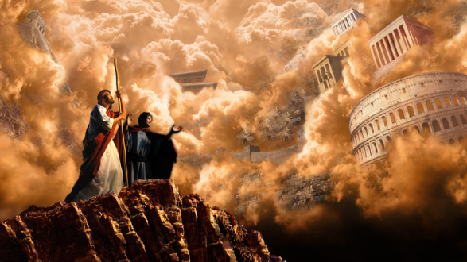
“Again, the devil taketh him up into an exceeding high mountain, and sheweth him all the kingdoms of the world, and the glory of them; and said unto him, All these things will I give thee, if thou wilt fall down and worship me.”

Slide 28
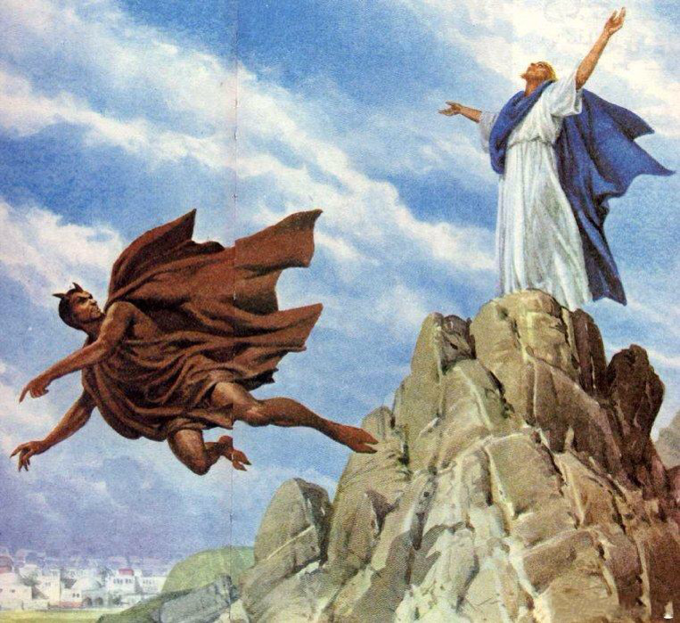
“Then said Jesus unto him, Get thee hence, Satan: for it is written, Thou shalt worship the Lord thy God, and him only shalt thou serve. Then the devil leaveth him.”

Slide 29
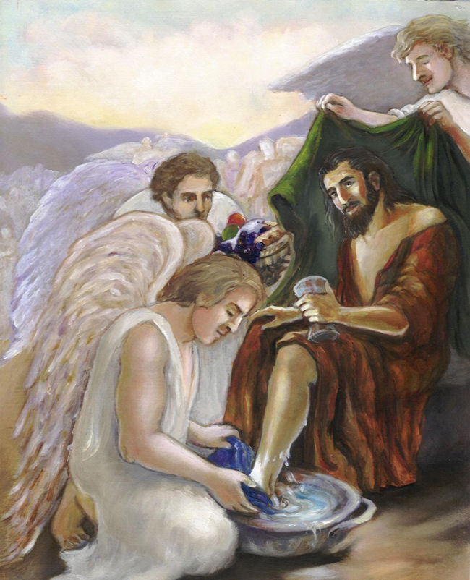
“And, behold, angels came and ministered unto him.” (Matt. 4:1-11)

Slide 30
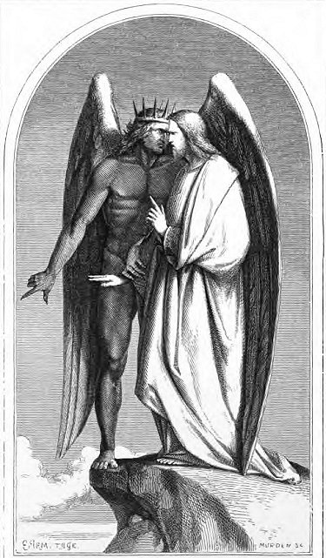
The Devil Knows the Bible
We often are reminded of how Jesus quoted Scripture to refute the devil, quoting three times from the book of Deuteronomy.
But it is sometimes overlooked that here in this same passage, the devil also quoted Scripture.

Slide 31
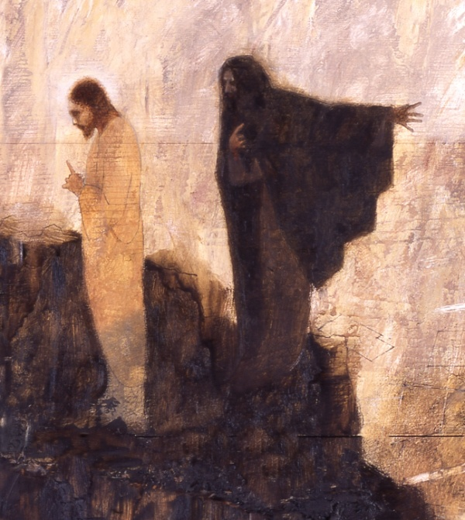
"And saith unto him, If thou be the Son of God, cast thyself down: for it is written, He shall give his angels charge concerning thee: and in their hands they shall bear thee up, lest at any time thou dash thy foot against a stone"

Slide 32
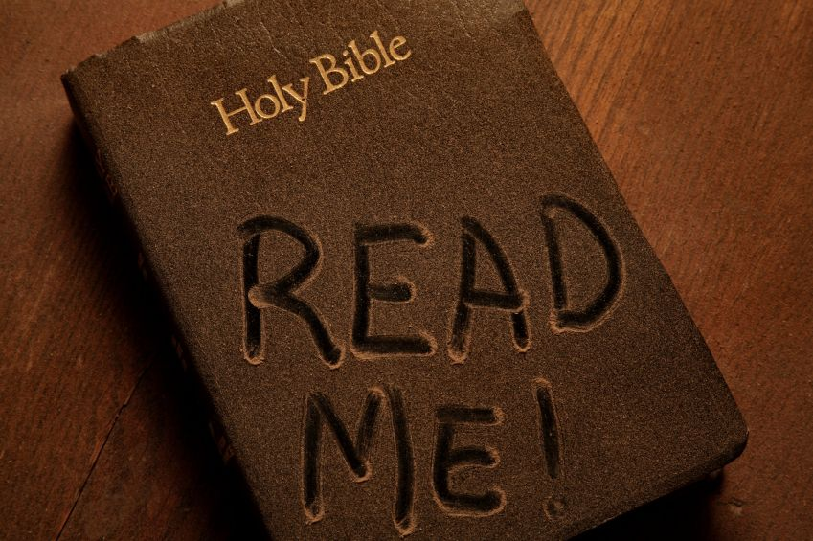
This quote was taken from Psalm 91:11-12. To be sure, he took it completely out of context and twisted it. How was Satan able to do this? Well, apparently he had memorized Psalm 91. Most Christians have never even read that Psalm, but Satan, committed it to memory.

Slide 33
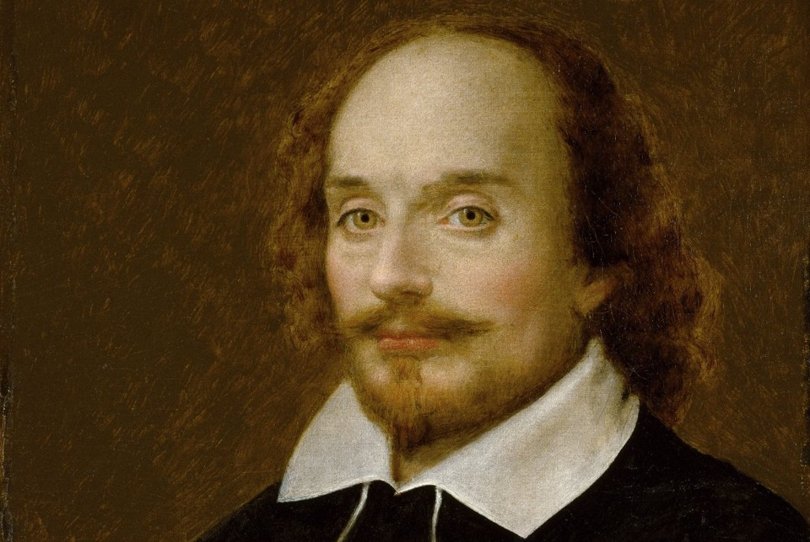
Shakespeare was right when he said, “The devil doth quote scripture."

Slide 34
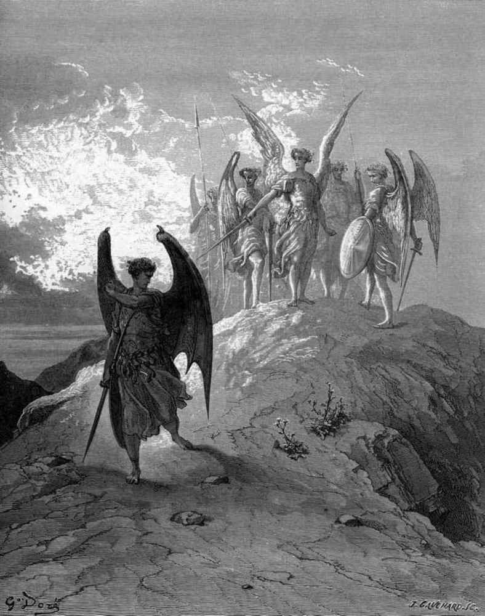
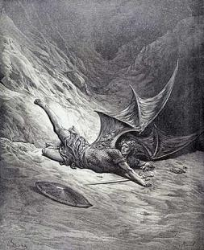
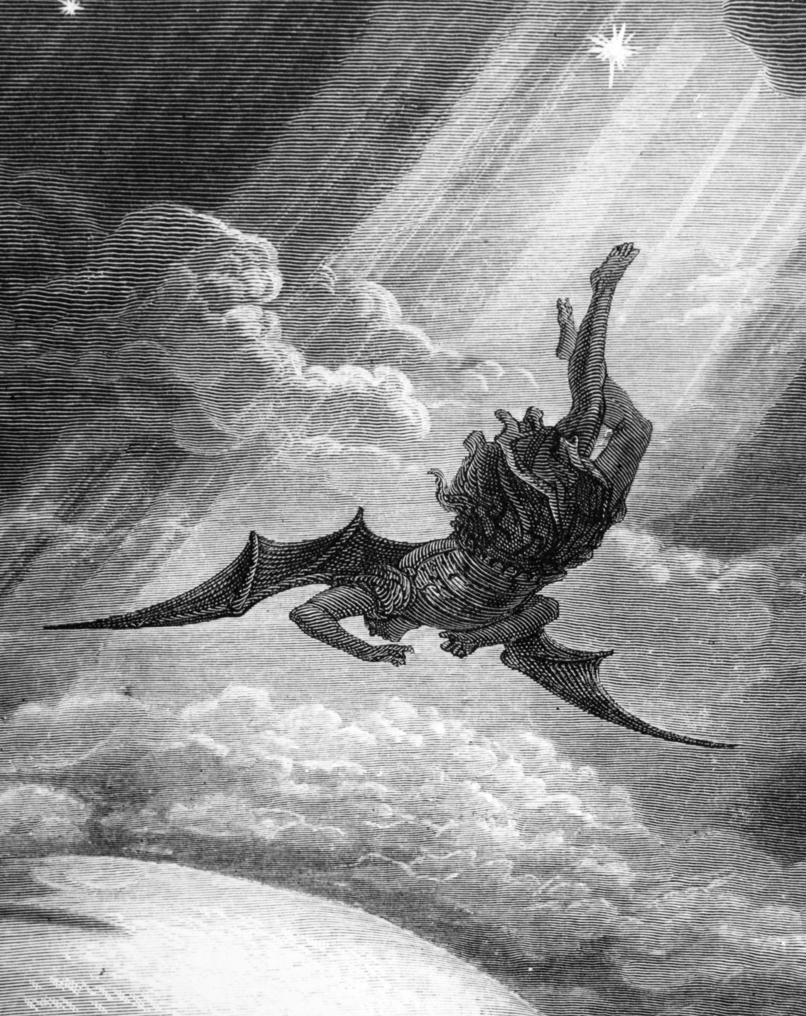
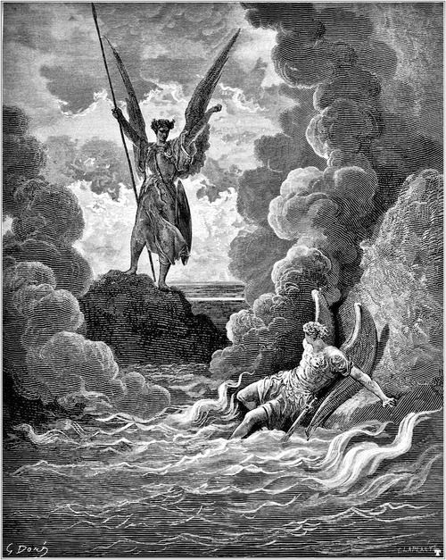
(Revelation 12:12) "Therefore rejoice, ye heavens, and ye that dwell in them. Woe to the inhabiters of the earth and of the sea! for the devil is come down unto you, having great wrath, because he knoweth that he hath but a short time."

Slide 35
Satan will be thrown out of heaven during the middle of the tribulation and will come down to earth, "having great wrath, because he knoweth that he hath but a short time." How does he know this? The apparent answer is that he has carefully read the ninth chapter of Daniel.

Slide 36
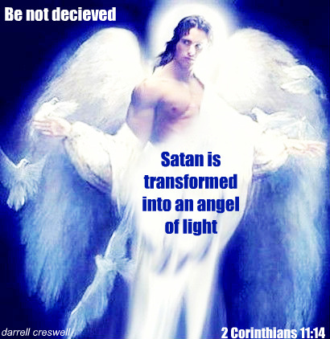
If I were the devil, I’d read the Bible. I could then twist the Scriptures in such a way as to mislead saints and sinners alike.

Slide 37
Satan possesses a will
Paul instructs Timothy that in dealing with backslidden Christians to be gentle but firm, that “They may recover themselves out of the snare of the devil, who are taken captive by him at his will." (2 Tim. 2:26)

Slide 38
Six snares of the Devil
1. The snare of pride: I Tim. 3:6-7
2. The snare of riches: I Tim. 6:6-12, 17-19
3. The snare of idolatry: Judges 8:27
4. The snare of spiritual apathy: II Tim. 2:26
5. The snare of the fear of man: Prov. 29:25
6. The snare of immorality: Proverbs 7:21-27

Slide 39
Satan possesses emotions
Desire - "And the Lord said, Simon, Simon, behold, Satan hath desired to have you, that he may sift you as wheat." (Luke 22:31)
Pride - "Not a novice, lest being lifted up with pride he fall into condemnation of the devil." (1 Tim. 3:6)
Wrath - "Therefore rejoice, ye heavens, and ye that dwell in them. Woe to the inhabiters of the earth and of the sea! for the devil is come down unto you, having great wrath, because he knoweth that he hath but a short time." (Rev. 12:12)

Slide 40
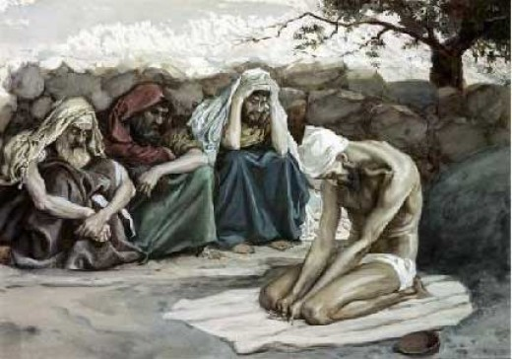
Satan systematically subjected the Old Testament patriarch Job to fiery trials in an attempt to break him.

Slide 41
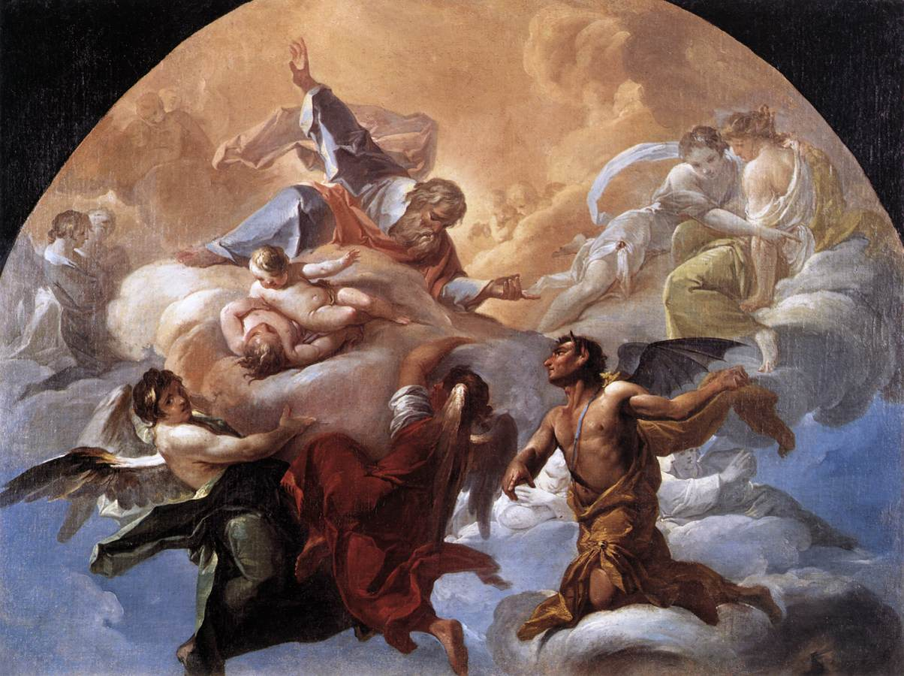
Satan attacked Job in seven areas of life (Job 1-2)

Slide 42
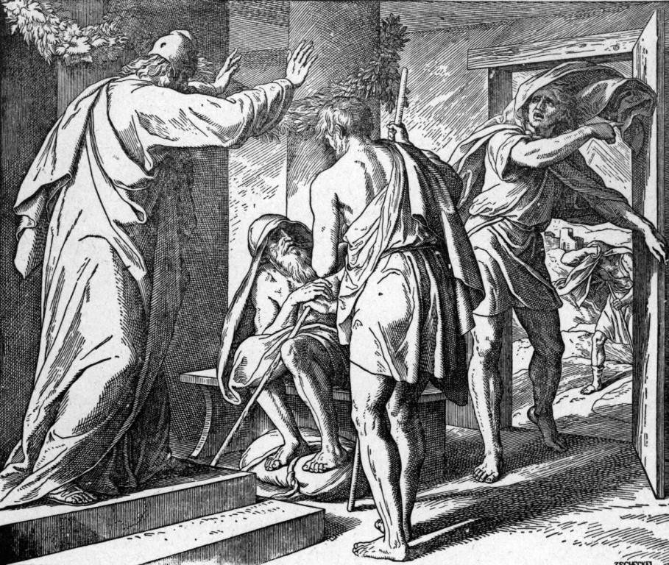
Attacked his job (Ox, servants) Job 1:14, 17

Slide 43
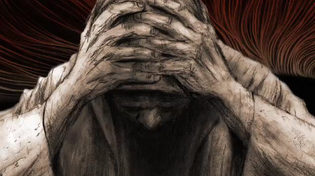
Attacked his wealth (sheep) Job 1:16

Slide 44
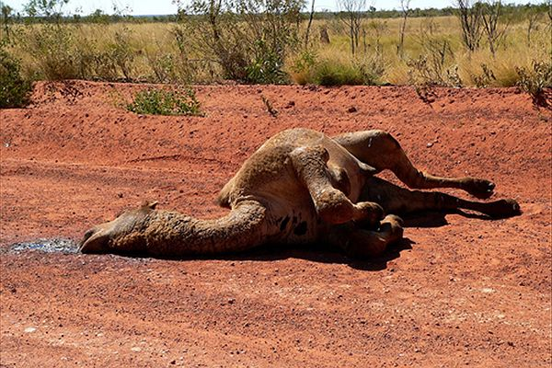
Attacked his transportation (camels) Job 1:3

Slide 45
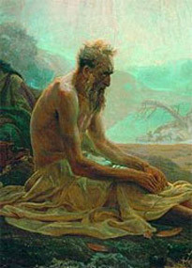
Attacked his family Job 1:18-19

Slide 46
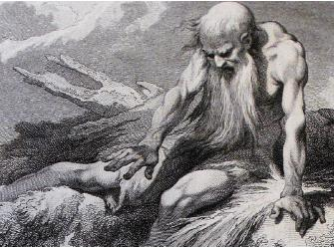
Attacked his health Job 2:7

Slide 47
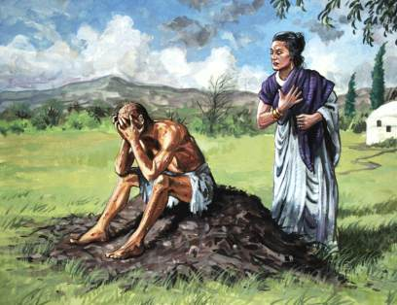
Attacked his marriage Job 2:8-9

Slide 48
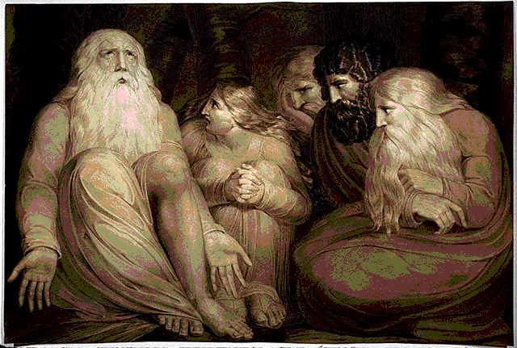
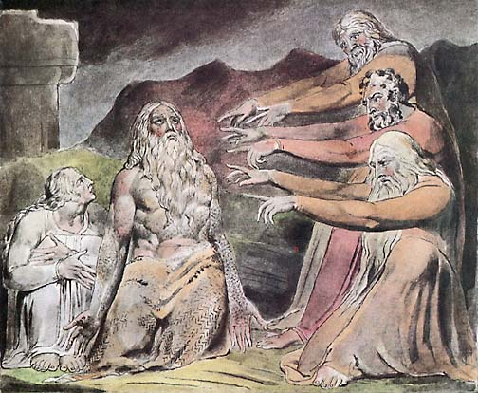
Attacked his friendships Job 5:11

Slide 49
“But he knoweth the way that I take: when he hath tried me, I shall come forth as gold.” Job 23:10

Slide 50
Satan possesses great organizational ability The Bible speaks of Satan’s synagogues, doctrines, and deep things
"Now the Spirit speaketh expressly, that in the latter times some shall depart from the faith, giving heed to seducing spirits, and doctrines of devils." (1 Tim. 4:1)
"I know thy works, and tribulation, and poverty, (but thou art rich) and I know the blasphemy of them which say they are Jews, and are not, but are the synagogue of Satan." (Rev. 2:9)
"But unto you I say, and unto the rest in Thyatira, as many as have not this doctrine, and which have not known the depths of Satan, as they speak; I will put upon you none other burden." (Rev. 2:24)

Slide 51
Remember that it was the devil that organized and led the first rebellion against God. Revelation 12:4 indicates that he persuaded one-third of heaven’s angels to march with him.
"And his tail drew the third part of the stars of heaven, and did cast them to the earth."

Slide 52
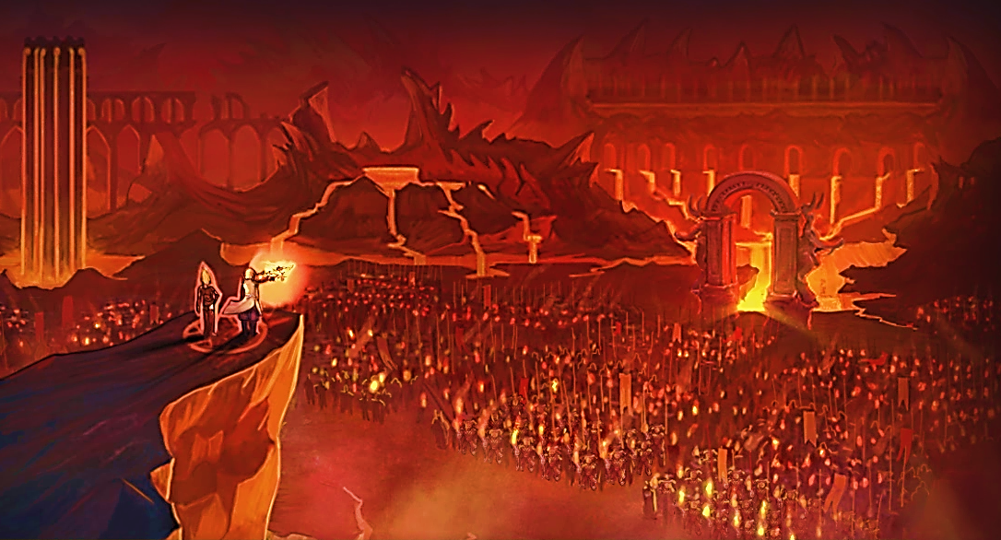
Satan will organize and lead the last and final rebellion against God

Slide 53
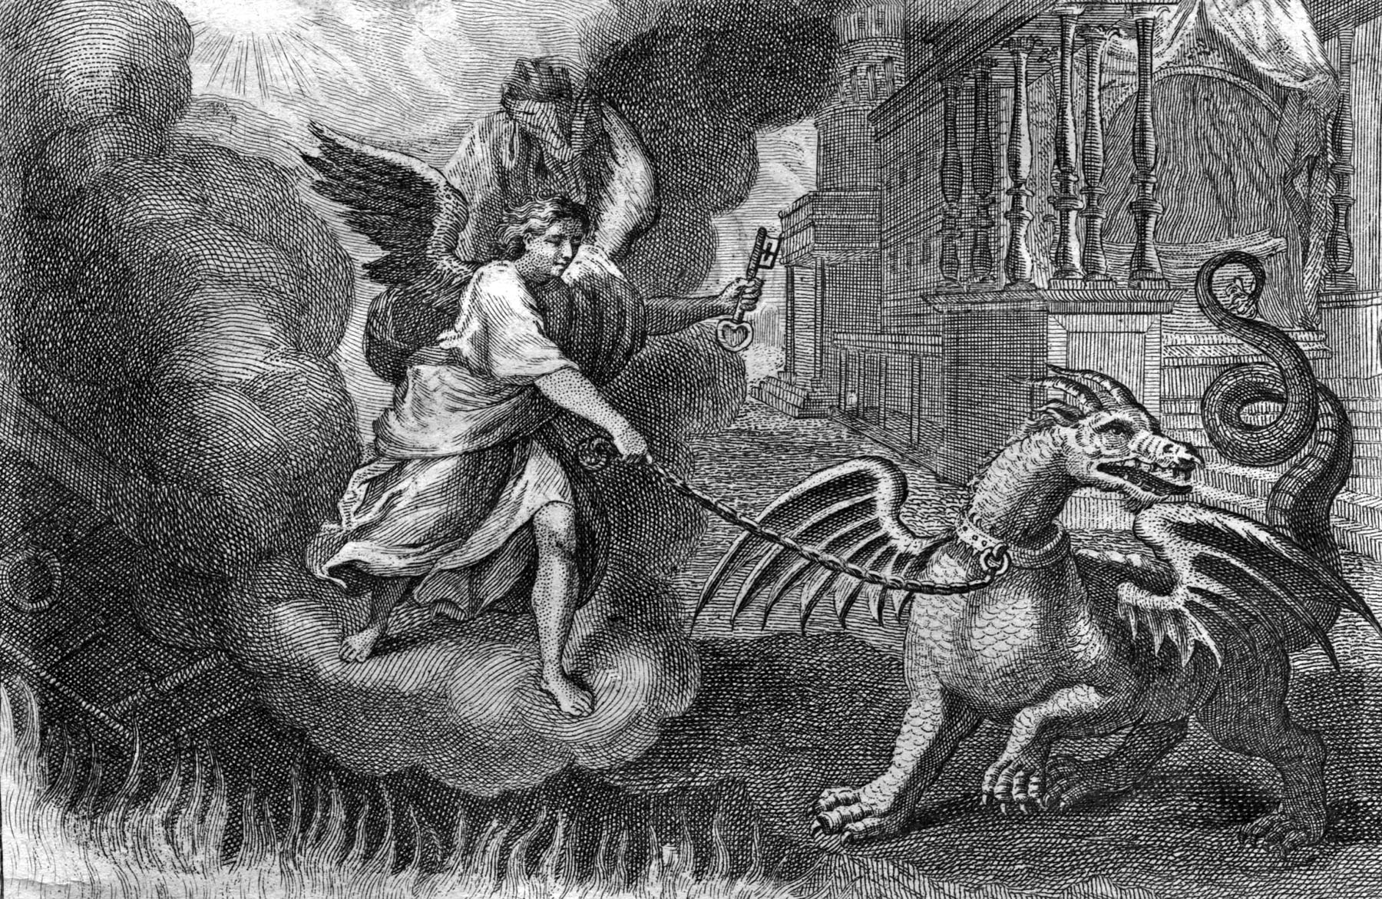
“And he laid hold on the dragon, that old serpent, which is the Devil, and Satan...”

Slide 54
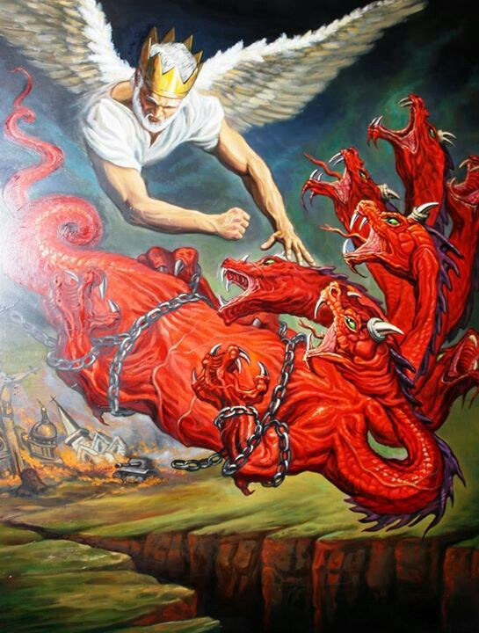
“…and bound him a thousand years. And cast him into the bottomless pit…”

Slide 55
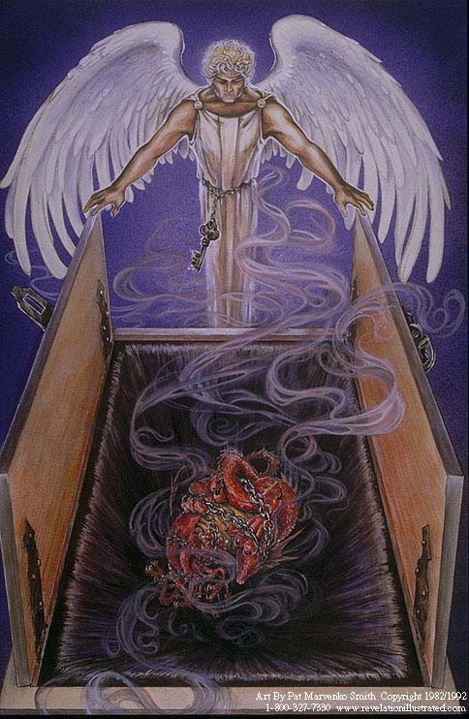
“And shut him up, and set a seal upon him, that he should deceive the nations no more, till the thousand years should be fulfilled.”

Slide 56
"And when the thousand years are expired, Satan shall be loosed out of his prison, and shall go out to deceive the nations which are in the four quarters of the earth, Gog and Magog, to gather them together to battle: the number of whom is as the sand of the sea. And they went up on the breadth of the earth, and compassed the camp of the saints about, and the beloved city: and fire came down from God out of heaven and devoured them." (Rev. 20:7-9)

Slide 57
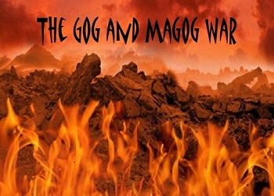
Who is Gog and Magog?

Slide 58
Gog – 9 times
Magog – 5 times
Eze 38:2 Son of man, set thy face against Gog, the land of Magog, the chief prince of Meshech and Tubal, and prophesy against him,
Eze 39:6 And I will send a fire on Magog, and among them that dwell carelessly in the isles: and they shall know that I am the LORD.
Re 20:8 And shall go out to deceive the nations which are in the four quarters of the earth, Gog and Magog, to gather them together to battle: the number of whom is as the sand of the sea.
Gog = A symbolic name for some future Antichrist ruler.
Magog = A barbarous northern nation or region.
1Ch 5:4 The sons of Joel; Shemaiah his son, Gog his son, Shimei his son,
Eze 38:2 Son of man, set thy face against Gog, the land of Magog, the chief prince of Meshech and Tubal, and prophesy against him,
Eze 38:3 And say, Thus saith the Lord GOD; Behold, I am against thee, O Gog, the chief prince of Meshech and Tubal:
Re 20:8 And shall go out to deceive the nations which are in the four quarters of the earth, Gog and Magog, to gather them together to battle: the number of whom is as the sand of the sea.

Slide 59
“Meshech and Tubal”
Meshech = who is drawn by force
Tubal = world of confusion
Magog second son of Japheth
Meshech sixth son of Japheth
Tubal fifth son of Japheth

Slide 62
(Ezekiel 38, 39) “Son of man, set thy face against Gog, the land of Magog, the chief prince of Meshech and Tubal, and prophesy against him…And say, Thus saith the Lord GOD; Behold, I am against thee, O Gog, the chief prince of Meshech and Tubal…And thou shalt come up against my people of Israel, as a cloud to cover the land; it shall be in the latter days, and I will bring thee against my land that the heathen may know me, when I shall be

Slide 63
sanctified in thee, O Gog, before their eyes…And it shall come to pass at the same time when Gog shall come against the land of Israel, saith the Lord GOD, that my fury shall come up in my face…Therefore, thou son of man, prophesy against Gog, and say, Thus saith the Lord GOD; Behold, I am against thee, O Gog, the chief prince of Meshech and Tubal…And it shall come to pass in that day, that I will give unto Gog a place there of graves in Israel. And I will send a fire on Magog, and among them that dwell carelessly in the isles: and they shall know that I am the LORD.”

Slide 66
“And they went up on the breadth of the earth, and compassed the camp of the saints about, and the beloved city: and fire came down from God out of heaven, and devoured them.” (Revelation 20:9)

Slide 68
The Names of Satan gives insight into his evil character.

Slide 69
Satan (adversary): used some fifty-two times
The devil (slanderer): used thirty-five times
The prince of the power of the air
The God of this age
The king of death
The prince of this world
The ruler of darkness
Leviathan (one who dwells in the sea of humanity)
Lucifer (light bearer, shining one)
A roaring lion

Slide 70
Abaddon (Destruction)
Angel of the bottomless pit
King of the bottomless pit
Anointed Cherub
Evil one
Father of lies
Lawless one
Old Serpent
Adversary
Thief
A murderer

Slide 71
The dragon
The deceiver
Apollyon (destroyer)
Beelzebub (prince of demons)
Belial (vileness, ruthlessness)
The wicked one
The tempter
The accuser of the brethren
An angel of light
A liar
The enemy

Slide 72
(1 John 4:4) “Ye are of God, little children, and have overcome them: because greater is he that is in you, than he that is in the world.”

