Slide 1
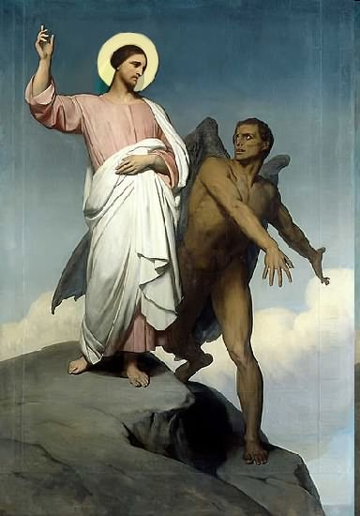

Slide 2
Topics to be studied
His existence
His origin
His fall
His personality
His names
His activities (Part 21)
His location – present and future
Our victory over him

Slide 4
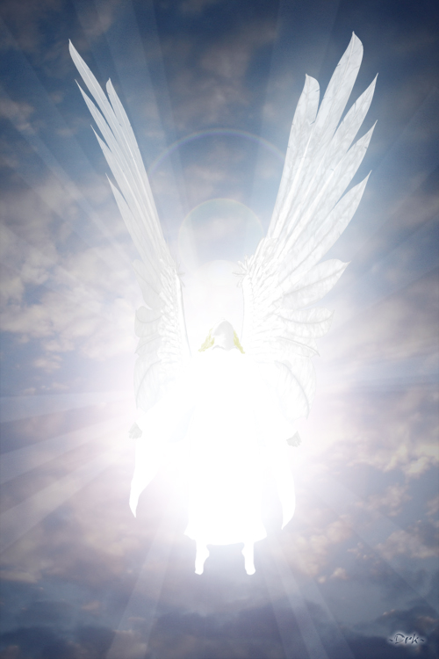
Satan imitates God?

Slide 5
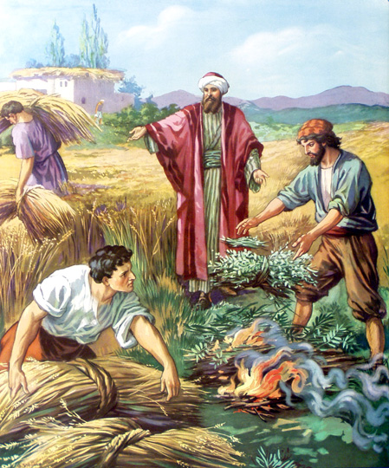
Matthew 13:24-42
Satan sows tares among God’s wheat

Slide 6
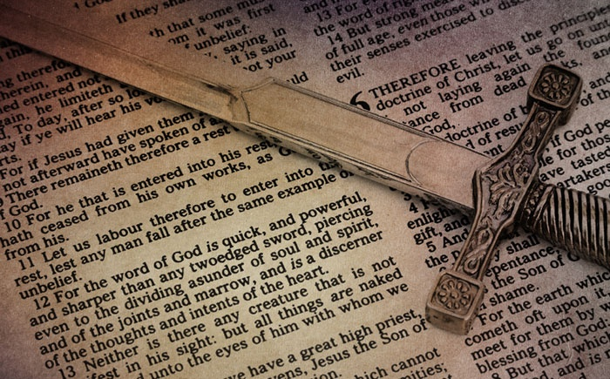
Satan perverts the Word of God
“For we are not as many, which corrupt the word of God.”
(2 Cor. 2:17)

Slide 7
Satan lays snares for men
“And that they may recover themselves out of the snare of the devil, who are taken captive by him at his will.”
(2 Tim. 2:26)

Slide 8
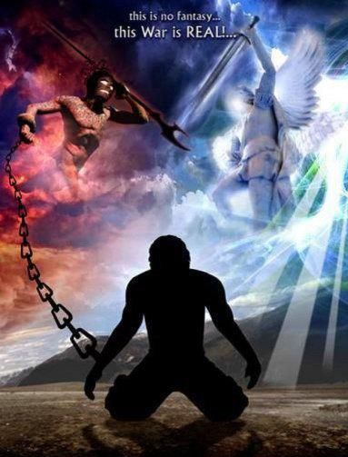
Satan hinders the work of the ministry
(1 Thessalonians 2:17-18) “But we, brethren, being taken from you for a short time in presence, not in heart, endeavoured the more abundantly to see your face with great desire. Wherefore we would have come unto you, even I Paul, once and again; but Satan hindered us.”

Slide 9
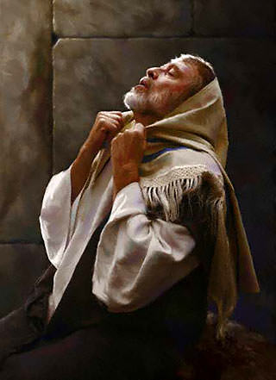
Satan resists the prayers of God’s servants
“Then said he unto me, Fear not, Daniel: for from the first day that thou didst set thine heart to understand, and to chasten thyself before thy God, thy words were heard, and I am come for thy words. But the prince of the kingdom of Persia (Satan) withstood me one and twenty days: but lo, Michael, one of the chief princes, came to help me; and I remained there with the kings of Persia.” (Dan. 10:12-13)

Slide 10
Satan blinds men from the truth of God’s Word
“Having the understanding darkened, being alienated from the life of God through the ignorance that is in them, because of the blindness
of their heart.”
(Eph. 4:18)

Slide 11
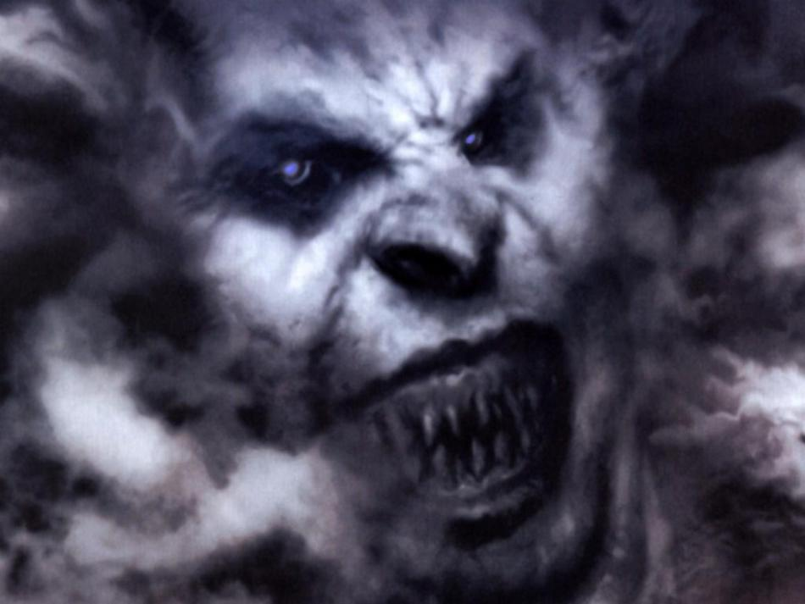
How Satan Steals the Word of God from Human Hearts
"When any one heareth the word of the kingdom, and understandeth it not, then cometh the wicked one, and catcheth away that which was sown in his heart. This is he which received seed by the way side." (Matt. 13:19)
“The thief cometh not, but for to steal, and to kill, and to destroy.” (John 10:10)

Slide 12
Matthew Chapter 13

Slide 13
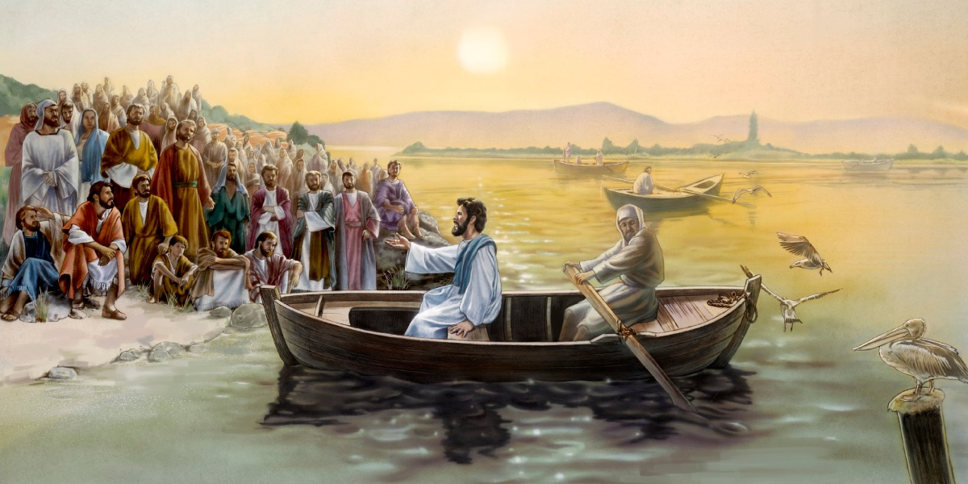
“And great multitudes were gathered together unto him, so that he went into a ship, and sat; and the whole multitude stood on the shore…”

Slide 14
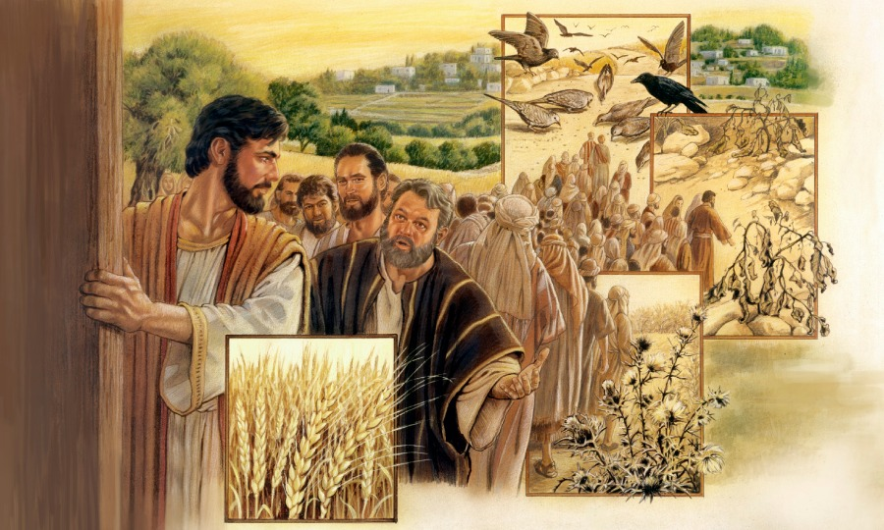
“And he (Jesus) spake many things unto them in parables, saying, Behold, a sower went forth to sow…”

Slide 15
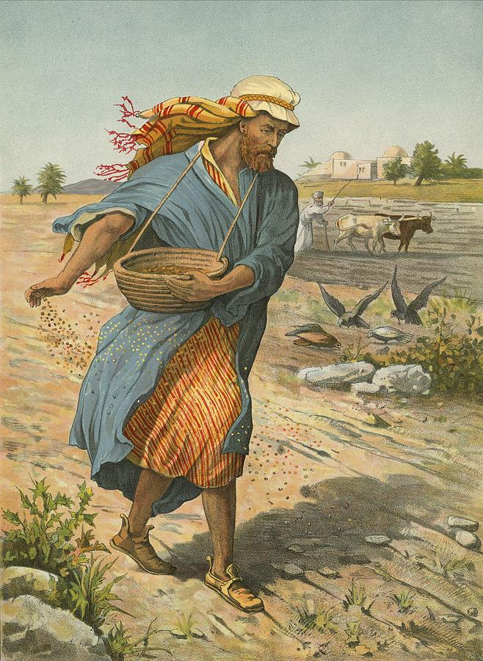
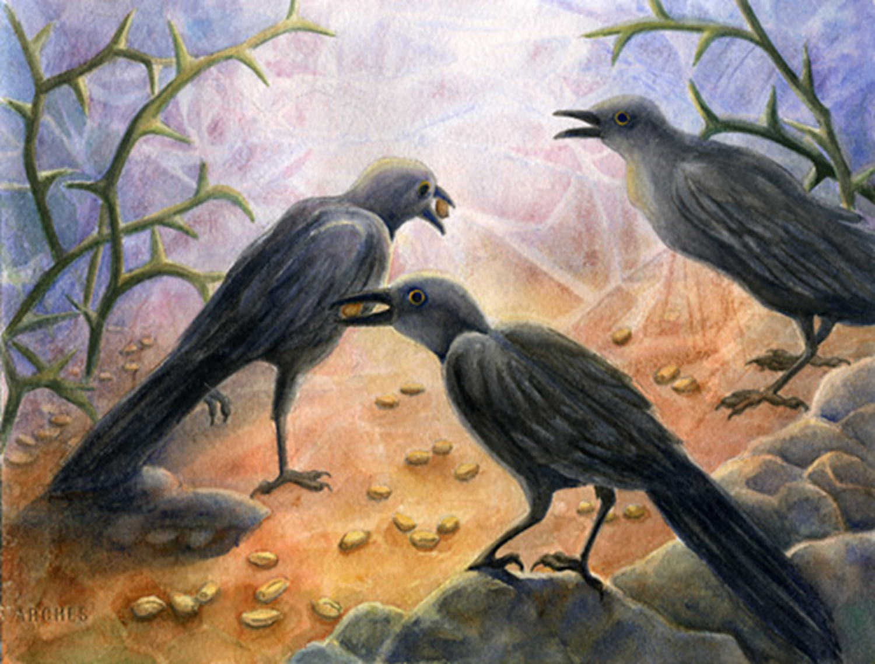
“And when he sowed, some seeds fell by the way side, and the fowls came and devoured them up.”

Slide 16
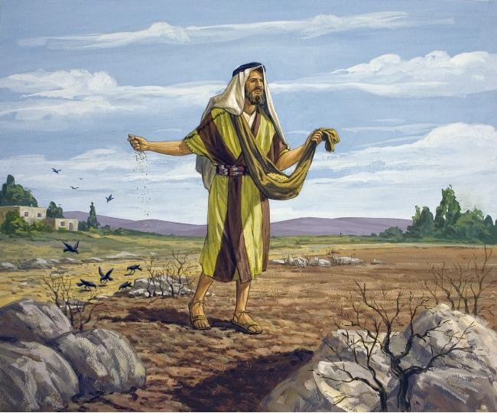
“Some fell upon stony places, where they had not much earth: and forthwith they sprung up, because they had no deepness of earth: And when the sun was up, they were scorched; and because they had no root, they withered away…”

Slide 17
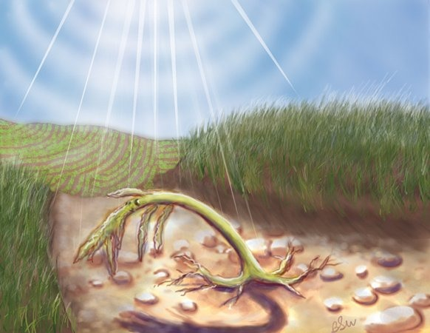

Slide 18
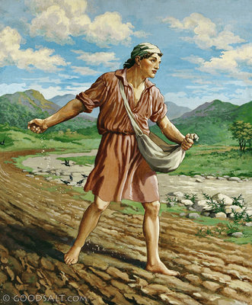
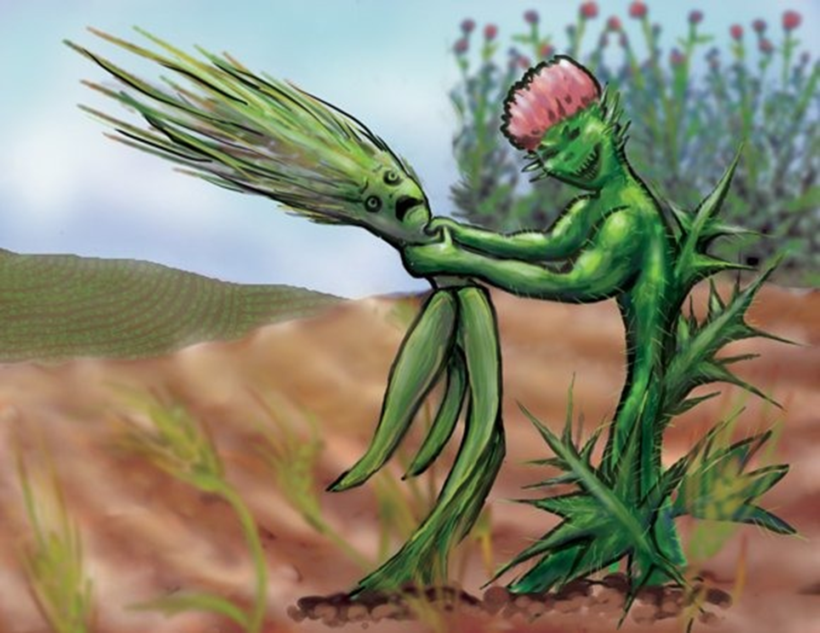
“And some fell among thorns; and the thorns sprung up, and choked them…”

Slide 19
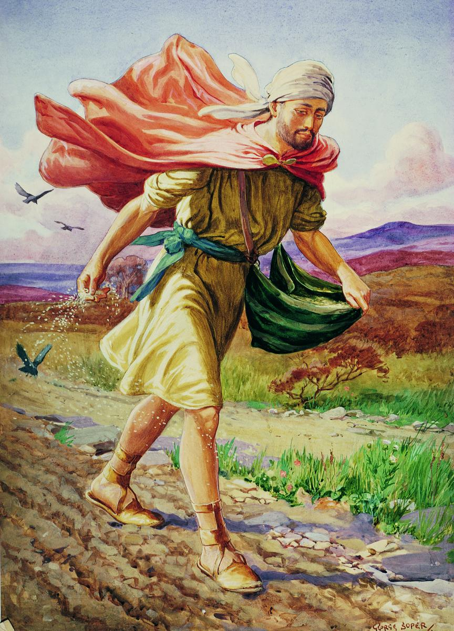
“But other fell into good ground, and brought forth fruit, some an hundredfold, some sixtyfold, some thirtyfold.”

Slide 20
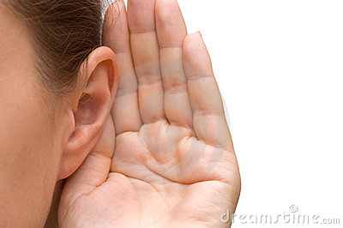
(Matthew 13:18) “Hear ye therefore the parable of the sower.”

Slide 21
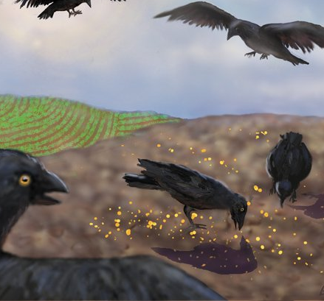
“Hear ye therefore the parable of the sower. When any one heareth the word of the kingdom, and understandeth it not, then cometh the wicked one, and catcheth away that which was sown in his heart. This is he which received seed by the way side.” (Matthew 13:18-19)

Slide 22
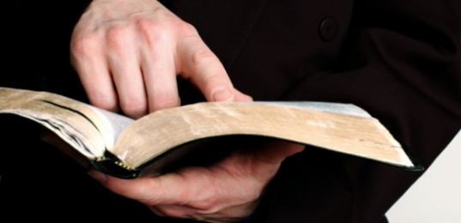
(Matthew 13:19) “When any one heareth the word of the kingdom, and understandeth it not, then cometh the wicked one, and catcheth away that which was sown in his heart. This is he which received seed by the way side.”

Slide 23
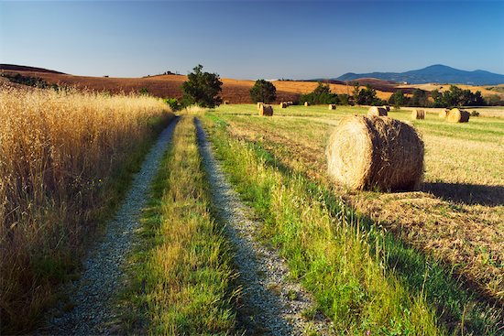
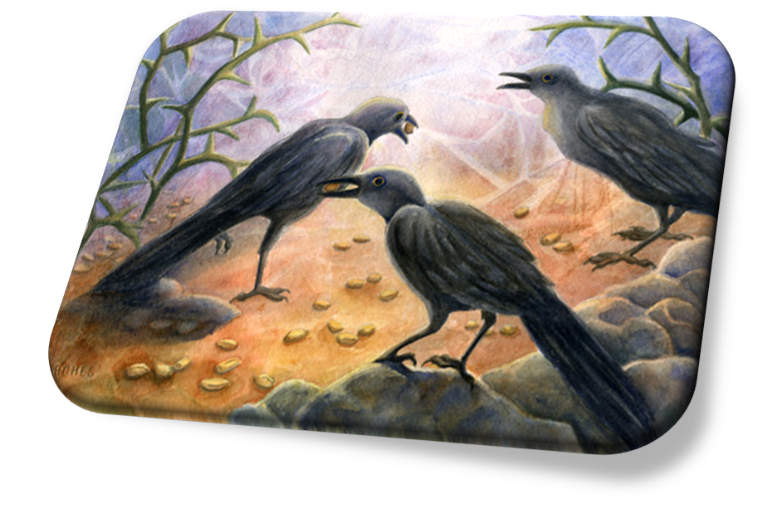
How Satan seals the Word of God from our hearts
“And when he sowed, some seeds fell by the way side,
and the fowls came and devoured them up.”

Slide 24
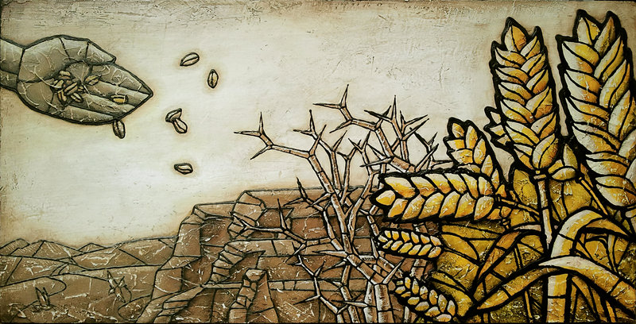
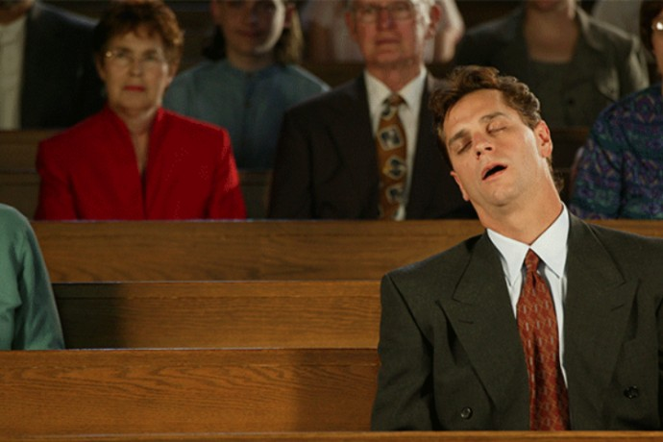
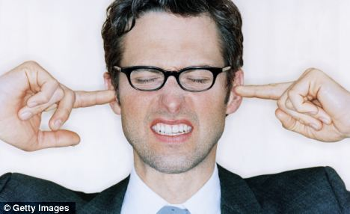
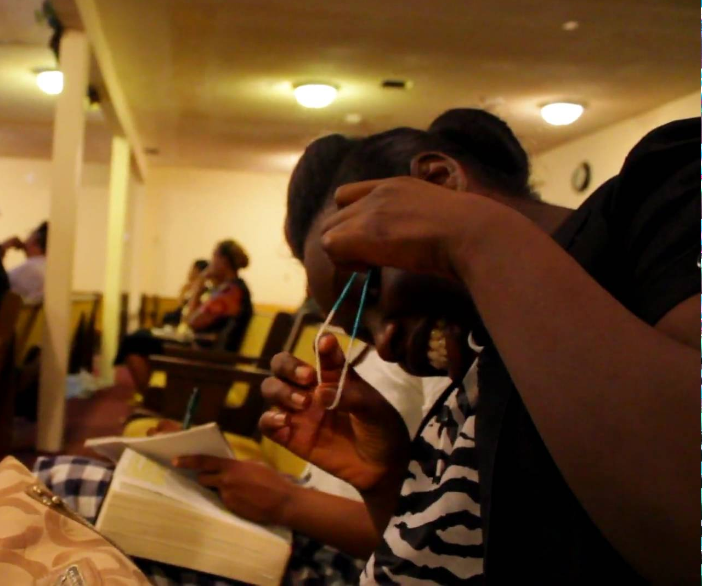
Way Side Soil

Slide 25
The consequence of unconfessed sin is a hard heart
“Son of man, thou dwellest in the midst of a rebellious house, which have eyes to see, and see not; they have ears to hear, and hear not: for they are a rebellious house.” (Ezek. 12:2)

Slide 26
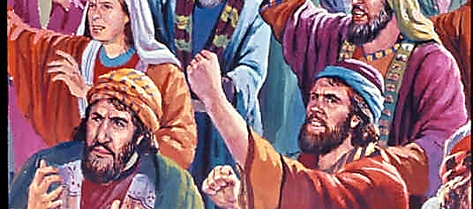
The Provocation

Slide 27
A hard heart of provocation
Psalm 95:8 “Harden not your heart, as in the provocation, and as in the day of temptation in the wilderness.”
Hebrews 3:8 “Harden not your hearts, as in the provocation, in the day of temptation in the wilderness.”
Hebrews 3:15 “While it is said, To day if ye will hear his voice, harden not your hearts, as in the provocation.”

Slide 28
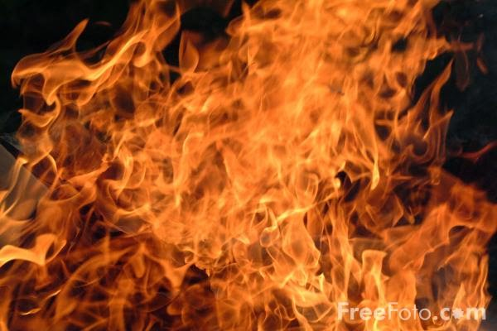
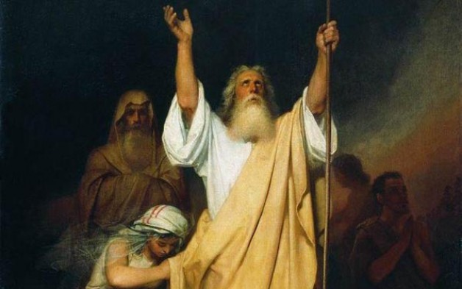
The Provocation
Provocation = The rebellion against God in the wilderness
(Numbers 11:1-2) “And when the people complained, it displeased the LORD: and the LORD heard it; and his anger was kindled; and the fire of the LORD burnt among them, and consumed them that were in the uttermost parts of the camp. And the people cried unto Moses; and when Moses prayed unto the LORD, the fire was quenched.”

Slide 29
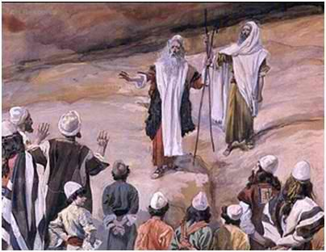
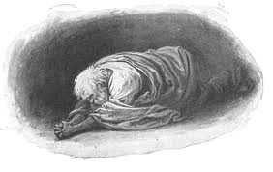
“And all the congregation lifted up their voice, and cried; and the people wept that night. And all the children of Israel murmured against Moses and against Aaron: and the whole congregation said unto them, Would God that we had died in the land of Egypt! or would God we had died in this wilderness! And wherefore hath the LORD brought us unto this land, to fall by the sword, that our wives and our children should be a prey? Were it not better for us to return into Egypt? And they said one to another, Let us make a captain, and let us return into Egypt. Then Moses and Aaron fell on their faces before all the assembly of the congregation of the children of Israel.” (Numbers 14:1-5)

Slide 30
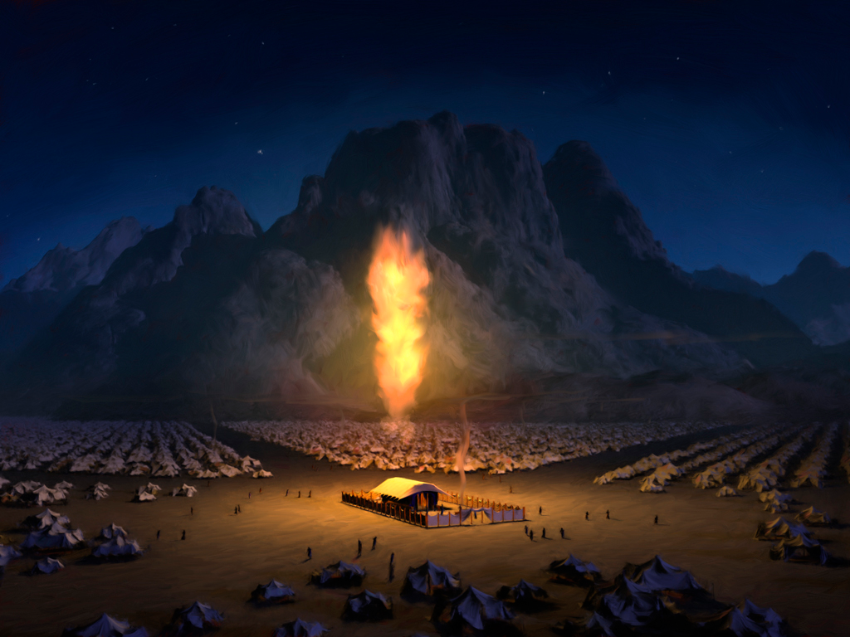
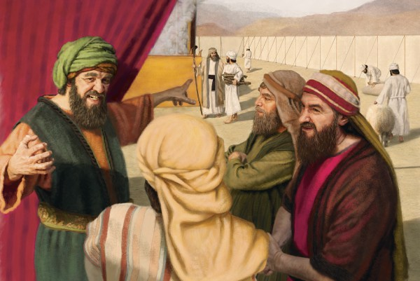
“But all the congregation bade stone them with stones. And the glory of the LORD appeared in the tabernacle of the congregation before all the children of Israel. And the LORD said unto Moses, How long will this people provoke me? and how long will it be ere they believe me, for all the signs which I have shewed among them? I will smite them with the pestilence, and disinherit them, and will make of thee a greater nation and mightier than they.” (Numbers 14:10-12)

Slide 31
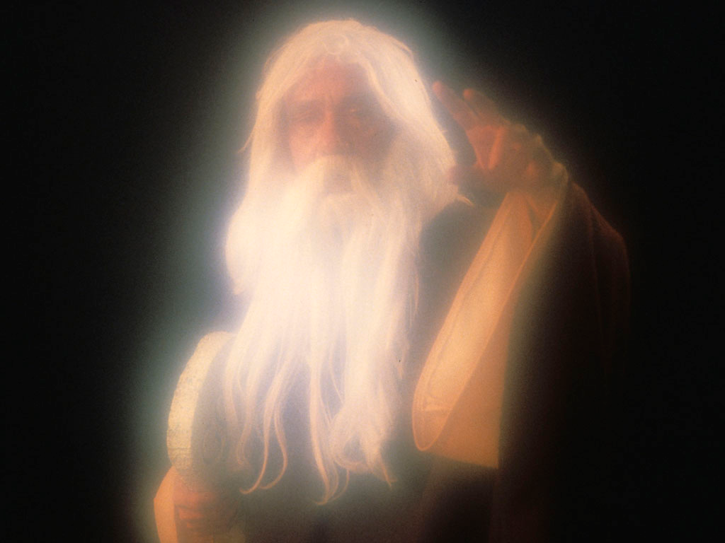
“And now, I beseech thee, let the power of my Lord be great, according as thou hast spoken, saying, The LORD is longsuffering, and of great mercy, forgiving iniquity and transgression, and by no means clearing the guilty, visiting the iniquity of the fathers upon the children unto the third and fourth generation. Pardon, I beseech thee, the iniquity of this people according unto the greatness of thy mercy, and as thou hast forgiven this people, from Egypt even until now. And the LORD said, I have pardoned according to thy word.” (Numbers 14:17-20)

Slide 32
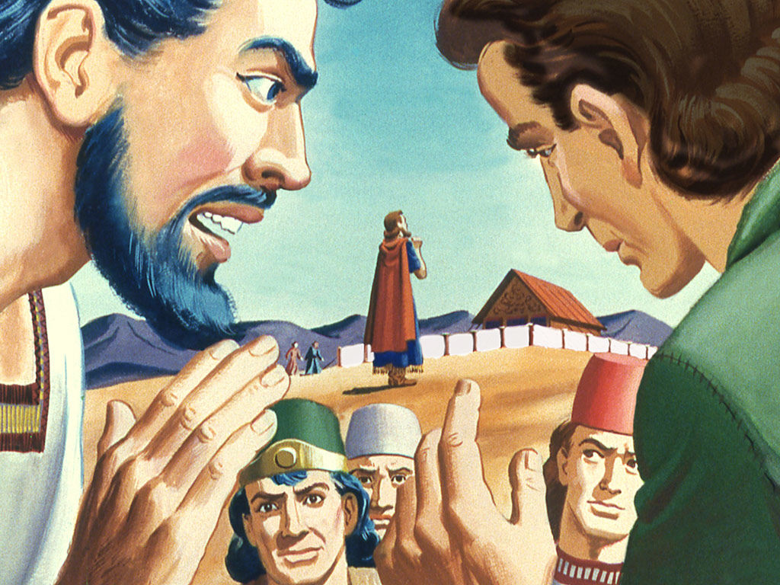
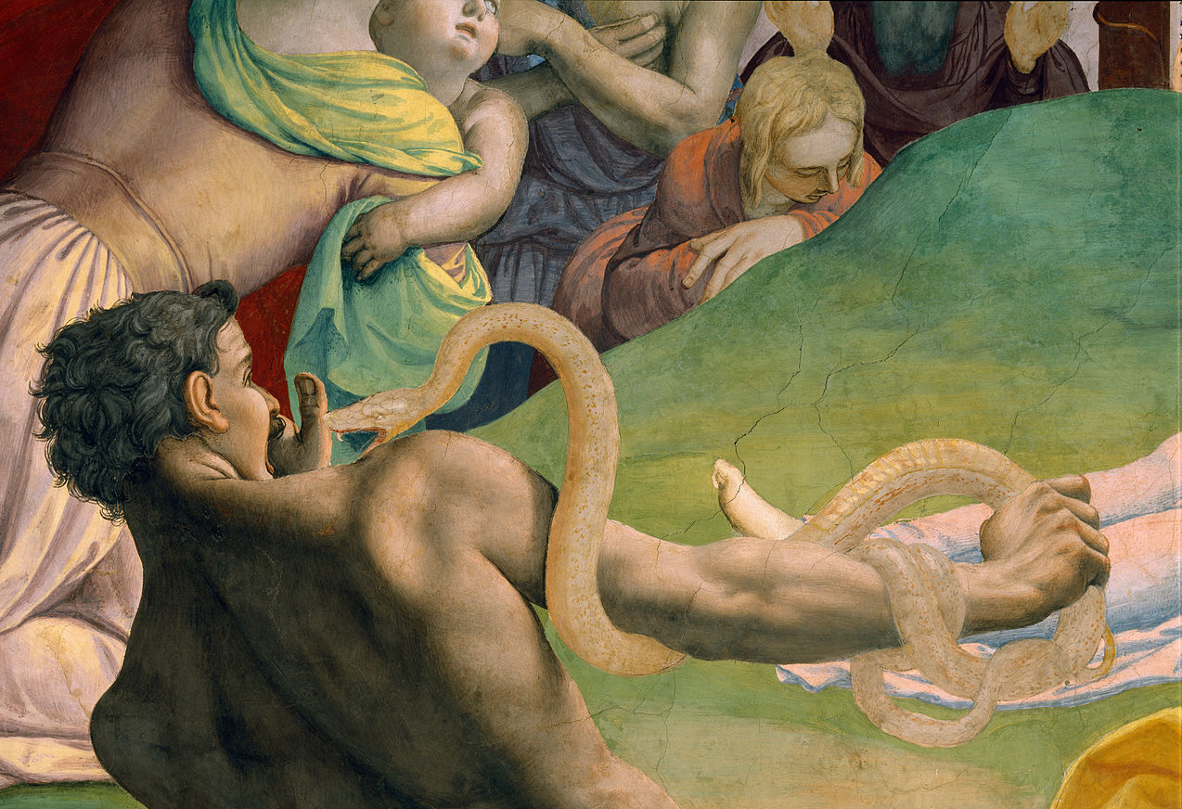
“And they journeyed from mount Hor by the way of the Red sea, to compass the land of Edom: and the soul of the people was much discouraged because of the way. And the people spake against God, and against Moses, Wherefore have ye brought us up out of Egypt to die in the wilderness? for there is no bread, neither is there any water; and our soul loatheth this light bread. And the LORD sent fiery serpents among the people, and they bit the people; and much people of Israel died.” (Numbers 21:4-6)

Slide 33
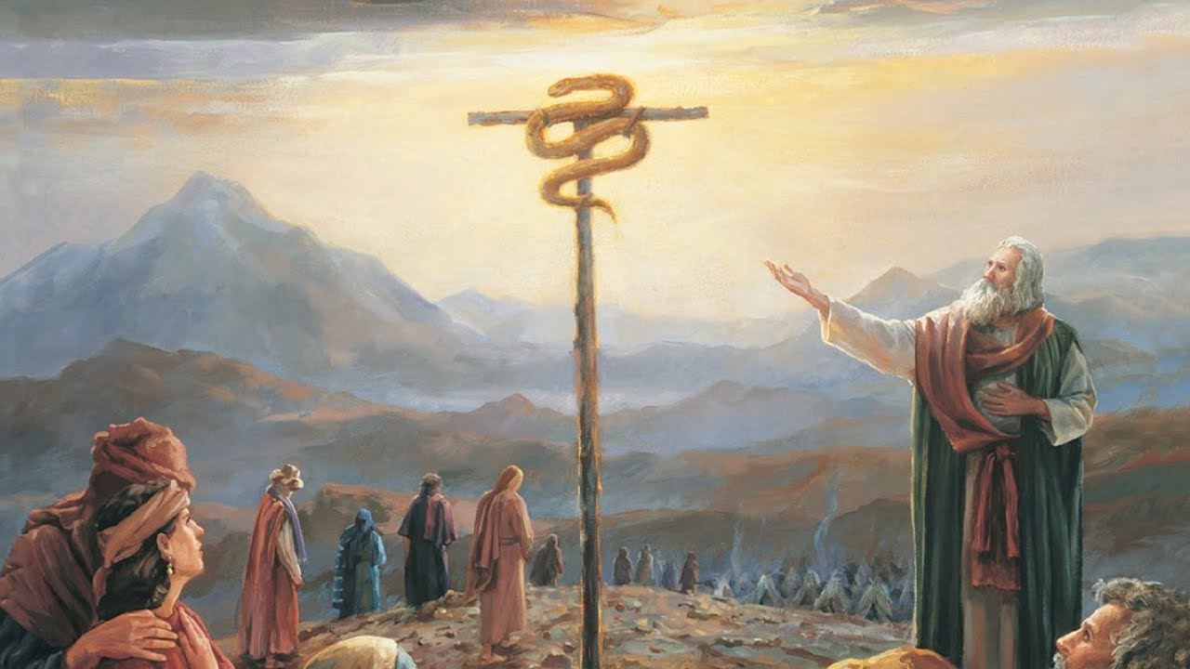
“Therefore the people came to Moses, and said, We have sinned, for we have spoken against the LORD, and against thee; pray unto the LORD, that he take away the serpents from us. And Moses prayed for the people. And the LORD said unto Moses, Make thee a fiery serpent, and set it upon a pole: and it shall come to pass, that every one that is bitten, when he looketh upon it, shall live. And Moses made a serpent of brass, and put it upon a pole, and it came to pass, that if a serpent had bitten any man, when he beheld the serpent of brass, he lived.” (Numbers 21:7-9)

Slide 36
Hardness of heart is a provocation against God
What are the evidence of a hard
and rebellious heart towards the Lord?
Pride – Jer. 50:31
Self-will – Deut. 1:43
Stubbornness – 1 Sam. 15:23
Unconfessed sin – 1 John 1:9
Unrepentant sin – Job 42:9
Bitterness – Heb. 12:15
Unwillingness to clear your conscience – Acts 24:16

Slide 37
8. Unwillingness to admit faults and failures (sin) - 2 Cor. 6:11-13
9. Godly counsel, concern and advice is rejected – Exod. 7:22-23
10. Unable to love any one except yourself – Matt. 24:12
11. Not happy about any ones success except your own – Rom. 12:15
12. Don’t feel bad about the sinful things you do – I Tim. 4:2
13. You are attracted to others who have a hard rebellious heart – Phil. 3:17-19
14. Uncomfortable around spiritual minded believers – Jam. 4:4
15. Closes your ears to the preaching of God’s Word – Acts 28:27

Slide 39
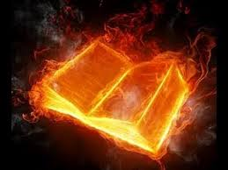
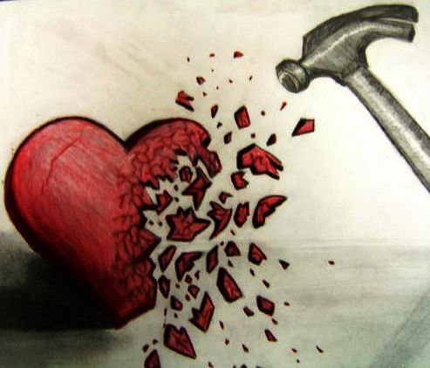
“Is not my word like as a fire? saith the LORD; and like a hammer that breaketh the rock in pieces?” (Jeremiah 23:29)

Slide 40
How do you keep your heart from becoming
hard and rebellious against the Lord?
1. Humble your self – “Humble yourself…Confess your faults one to another…”
2. Die to Self – “If any man will come after me, let him deny himself…”
3. Yielded to God’s will – “Yield yourselves unto God…”
4. Confess sin – “If we confess our sin…”
5. Repentant of sin – “Repent therefore of this thy wickedness…”
6. Forgive – “Forgive, and ye shall be forgiven…”
7. Clear your conscience – “Always have a conscience void of offence…”

Slide 41
(Proverbs 4:23-27) “Keep thy heart with all diligence; for out of it are the issues of life. Put away from thee a froward mouth, and perverse lips put far from thee. Let thine eyes look right on, and let thine eyelids look straight before thee. Ponder the path of thy feet, and let all thy ways be established. Turn not to the right hand nor to the left.”

Slide 42
Hardness of Heart:
A Condition You May Have and Not Even Know it!
Quote: I used to think people with hard hearts were God-haters or, at the least, people in rebellion to Him. That’s what I used to think until the day the Lord showed me I had
a hard heart.
“Search me, O God, and know my heart: try me, and know my thoughts: And see if there be any wicked way in me, and lead me in the way everlasting.”

Slide 43
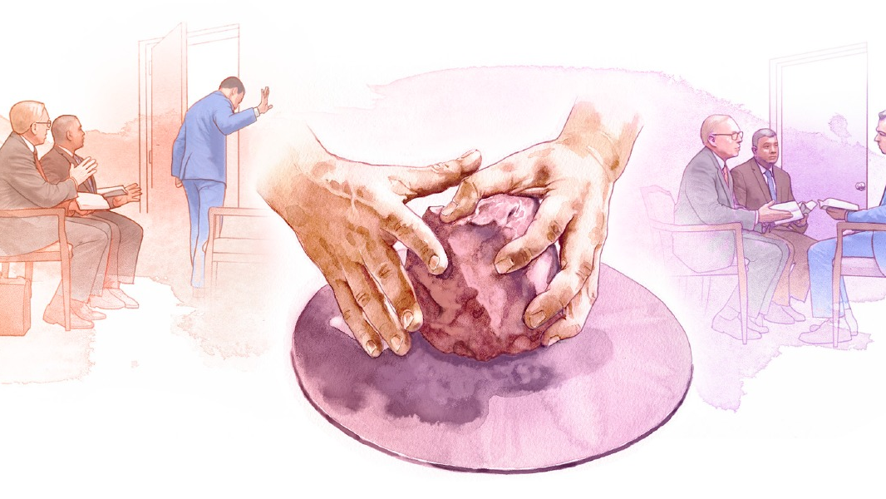
What kind of heart do you have?
Jeremiah 18:6
“Behold, as the clay is in the potter's hand, so are ye in mine hand, O house of Israel.”
Psalm 95:8
“Harden not your heart”
Eph. 4:32
“Be tenderhearted”

Slide 44
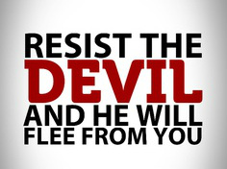
Don’t let Satan Steal the Word of God out of your Heart

