Slide 1
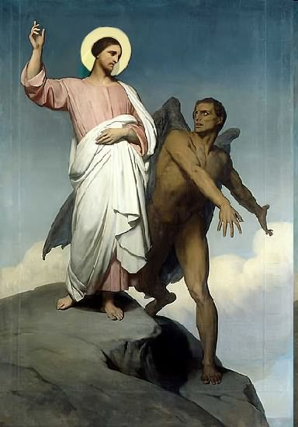

Slide 2
Topics to be studied
His existence
His origin
His fall
His personality
His names
His activities (Part 19)
His location – present and future
Our victory over him

Slide 4
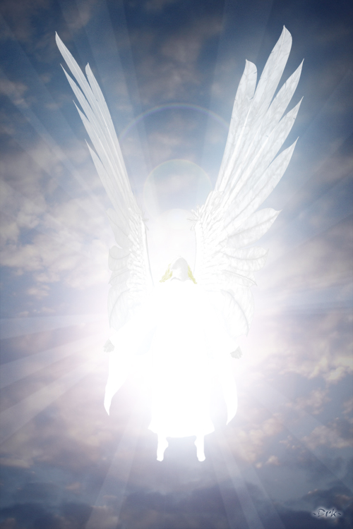
Satan imitates God?

Slide 5
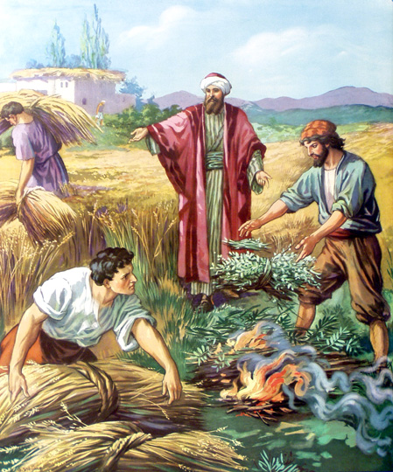
Matthew 13:24-42
Satan sows tares among God’s wheat

Slide 6
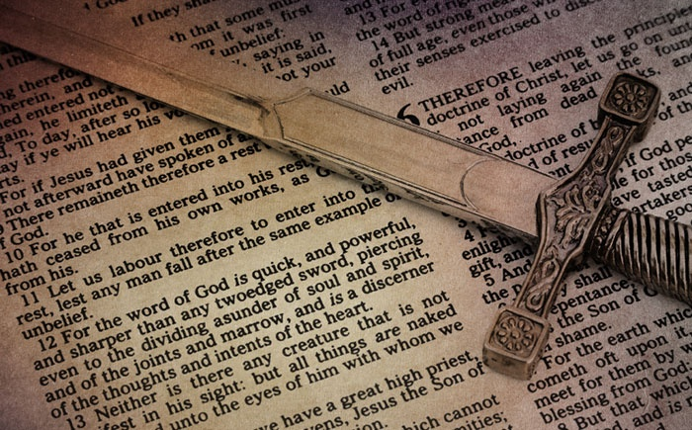
Satan perverts the Word of God
“For we are not as many, which corrupt the word of God.”
(2 Cor. 2:17)

Slide 7
Satan lays snares for men
“And that they may recover themselves out of the snare of the devil, who are taken captive by him at his will.”
(2 Tim. 2:26)

Slide 8
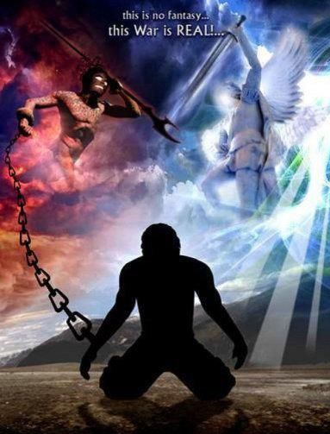
Satan hinders the work of the ministry
(1 Thessalonians 2:17-18) “But we, brethren, being taken from you for a short time in presence, not in heart, endeavoured the more abundantly to see your face with great desire. Wherefore we would have come unto you, even I Paul, once and again; but Satan hindered us.”

Slide 9
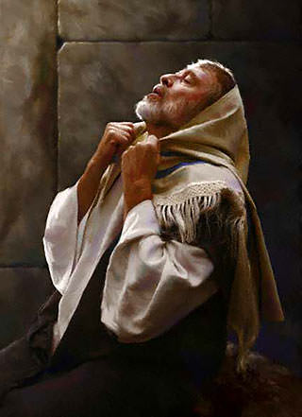
He resists the prayers of God’s servants

Slide 10
“Yet heard I the voice of his words (Angel vs. 5), and when I heard the voice of his words, then was I in a deep sleep on my face, and my face toward the ground. And, behold, an hand touched me, which set me upon my knees and upon the palms of my hands. Then said he unto me Fear not, Daniel: for from the first day that thou didst set thine heart to understand, and to chasten thyself before thy God (three weeks of fasting and prayer vs. 2-3), thy words were heard, and I am come for thy words. But the prince of the kingdom of Persia (Satan) withstood me one and twenty days: but lo, Michael, one of the chief princes, came to help me; and I remained there with the kings of Persia.” (Dan. 10:9-13)

Slide 12
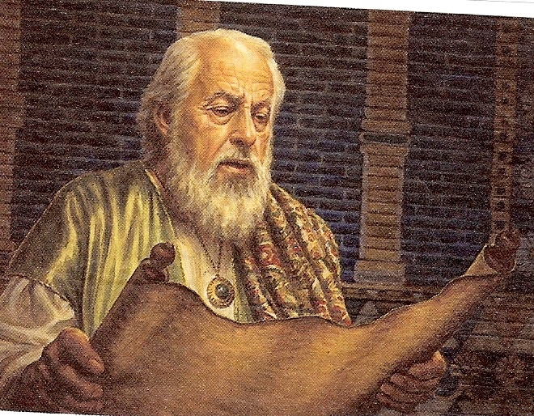
The Vision of the Seventy Weeks
Daniel 9:24-27

Slide 13
“Seventy weeks are determined upon thy people and upon thy holy city, to finish the transgression, and to make an end of sins, and to make reconciliation for iniquity, and to bring in everlasting righteousness, and to seal up the vision and prophecy, and to anoint the most Holy. Know therefore and understand, that from the going forth of the commandment to restore and to build Jerusalem unto the Messiah the Prince shall be seven weeks, and threescore and two weeks: the street shall be built again, and the wall, even in troublous times. And after threescore and two weeks shall Messiah be cut off, but not for himself: and the people of the prince that shall come shall destroy the city and the sanctuary; and the end thereof shall be with a flood, and unto the end of the war desolations are determined. And he shall confirm the covenant with many for one week: and in the midst of the week he shall cause the sacrifice and the oblation to cease, and for the overspreading of abominations he shall make it desolate, even until the consummation, and that determined shall be poured upon the desolate.”

Slide 14
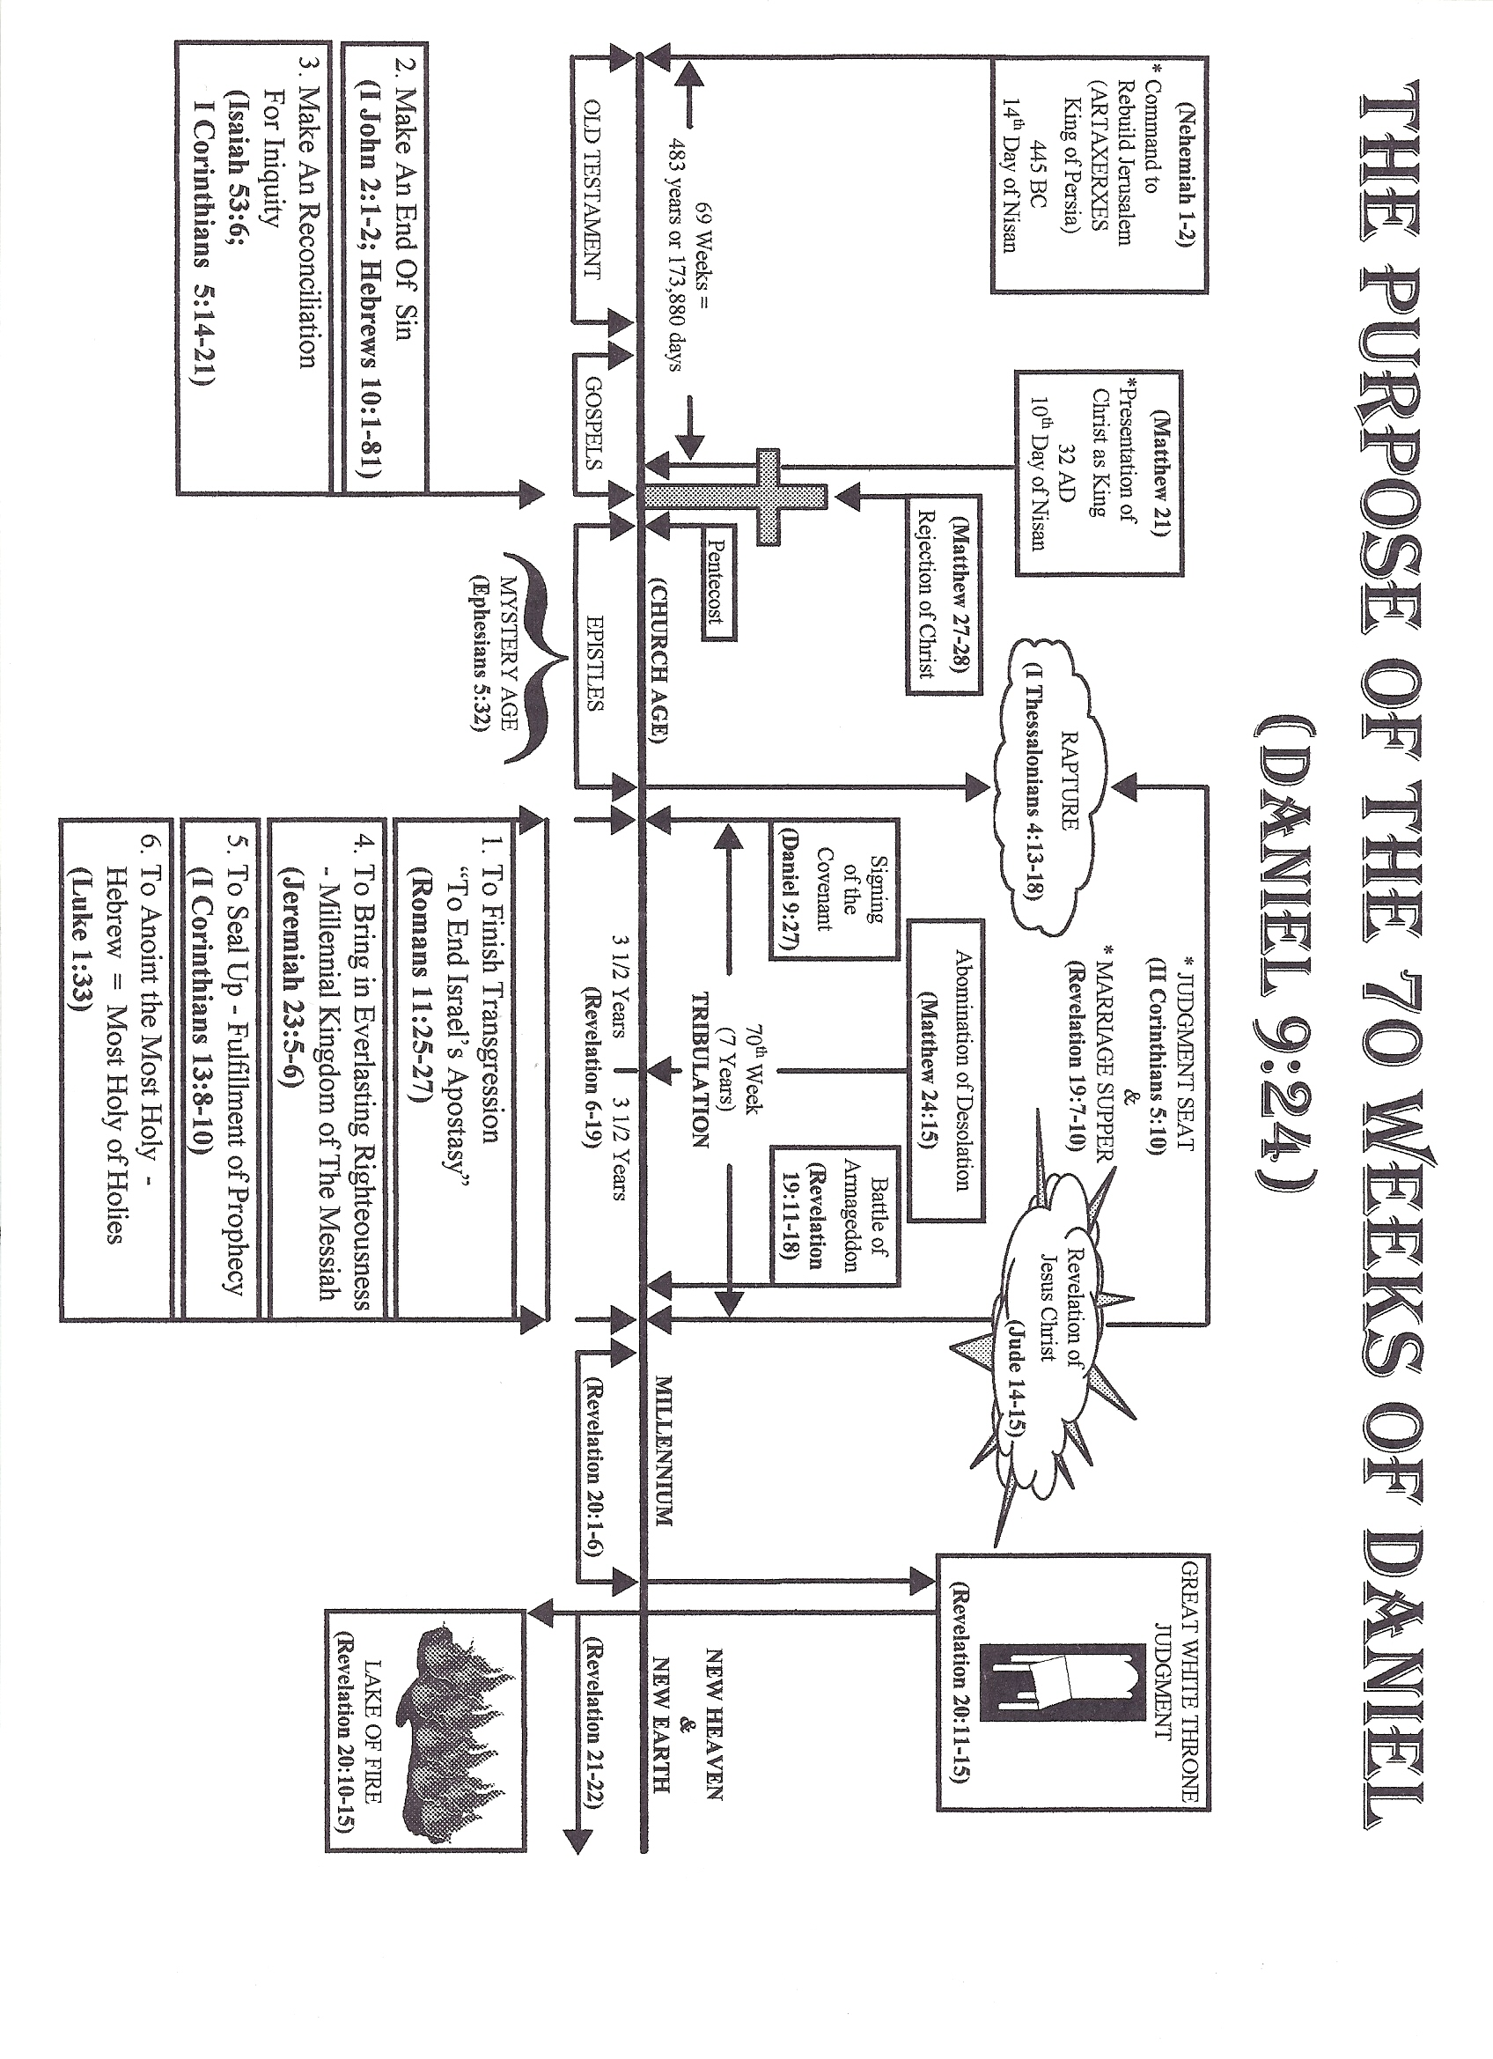

Slide 15
More Visions of End
Time Events
Daniel 10:1-14

Slide 16
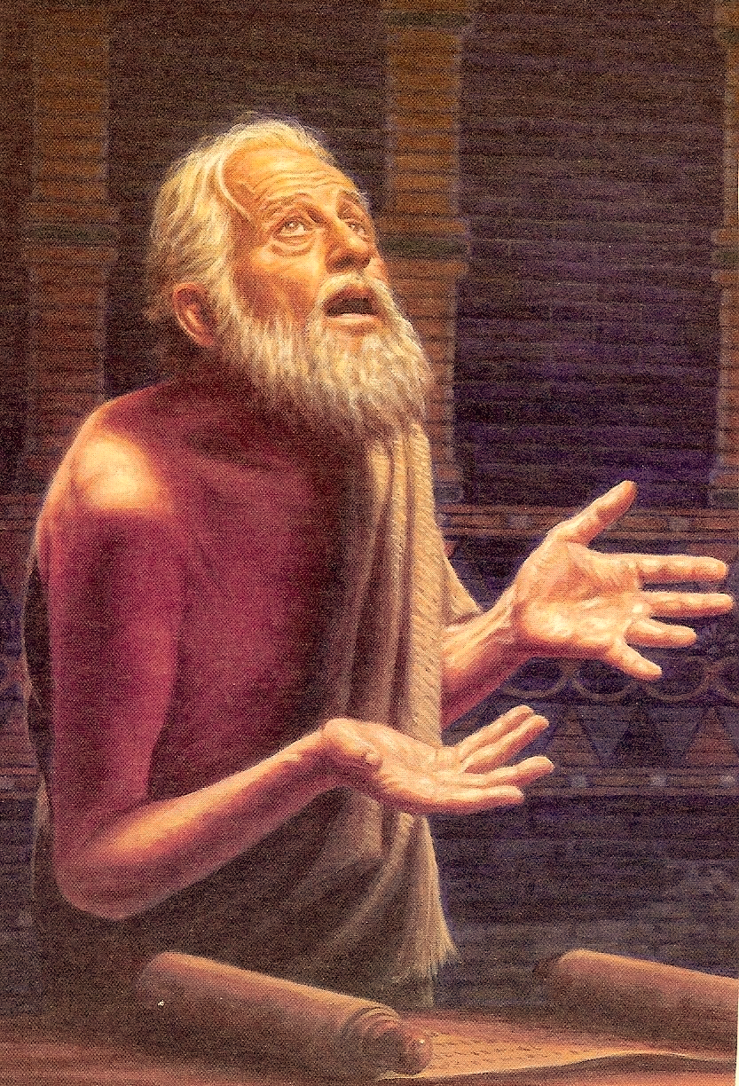
“In the third year of Cyrus king of Persia a thing was revealed unto Daniel, whose name was called Belteshazzar; and the thing was true, but the time appointed was long: and he understood the thing, and had understanding of the vision.”

Slide 17
“In those days I Daniel was mourning three full weeks. I ate no pleasant bread, neither came flesh nor wine in my mouth, neither did I anoint myself at all, till three whole weeks were fulfilled.”

Slide 18
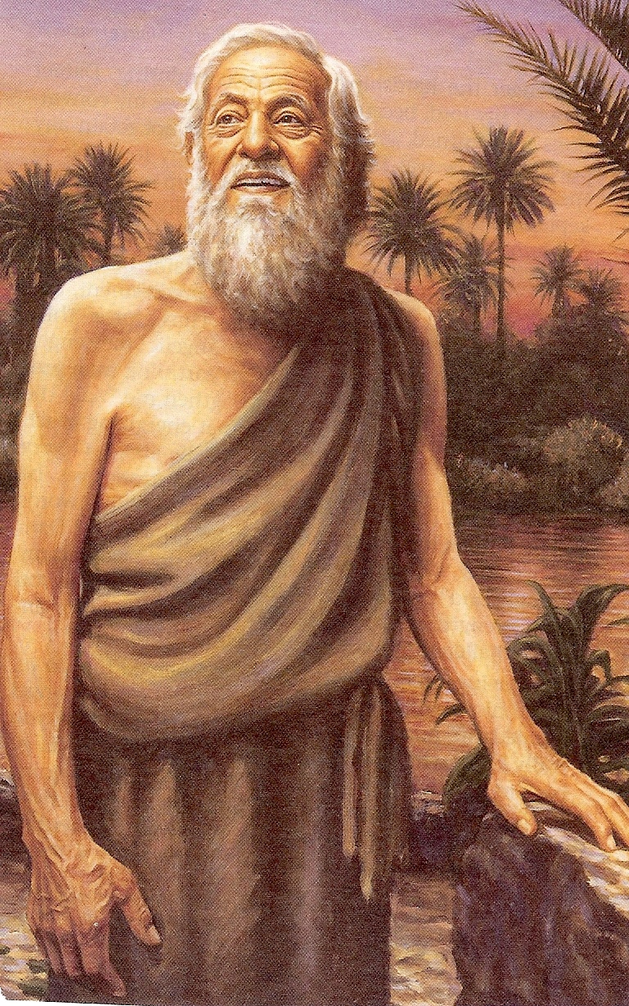
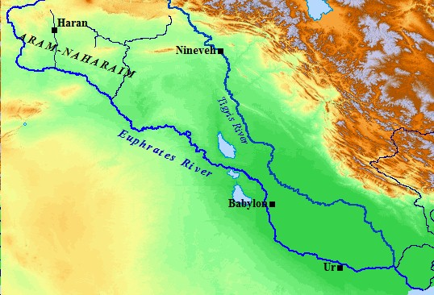
“And in the four and twentieth day of the first month, as I was by the side of the great river, which is Hiddekel (Tigris River).”

Slide 19
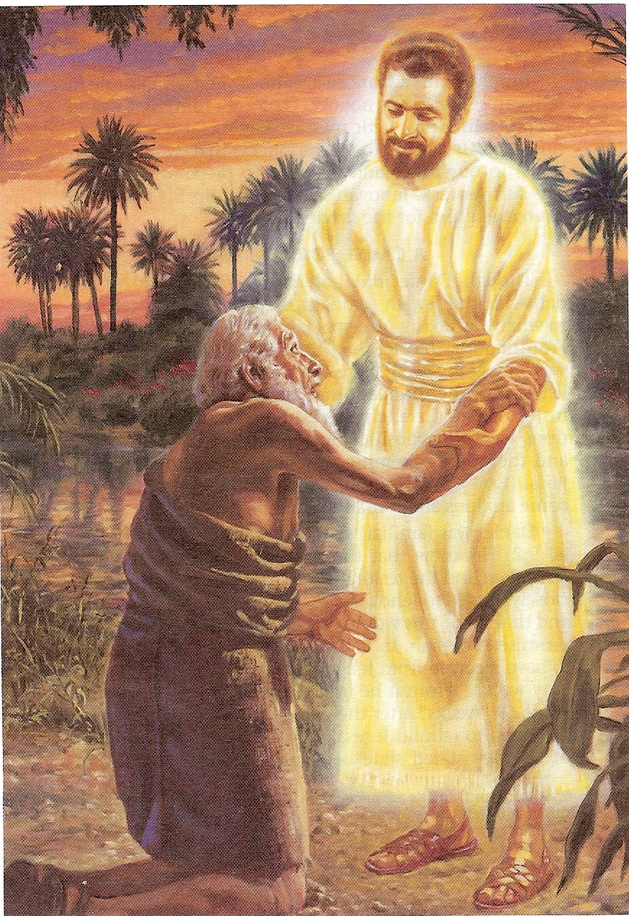
“Then I lifted up mine eyes, and looked, and behold a certain man clothed in linen, whose loins were girded with fine gold. His body also was like the beryl, and his face as the appearance of lightning, and his eyes as lamps of fire, and his arms and his feet like in color to polished brass, and the voice of his words like the voice of a multitude.”

Slide 20
“And I Daniel alone saw the vision: for the men that were with me saw not the vision; but a great quaking fell upon them, so that they fled to hide themselves. Therefore I was left alone, and saw this great vision, and there remained no strength in me: for my comeliness was turned in me into corruption, and I retained no strength.”

Slide 21
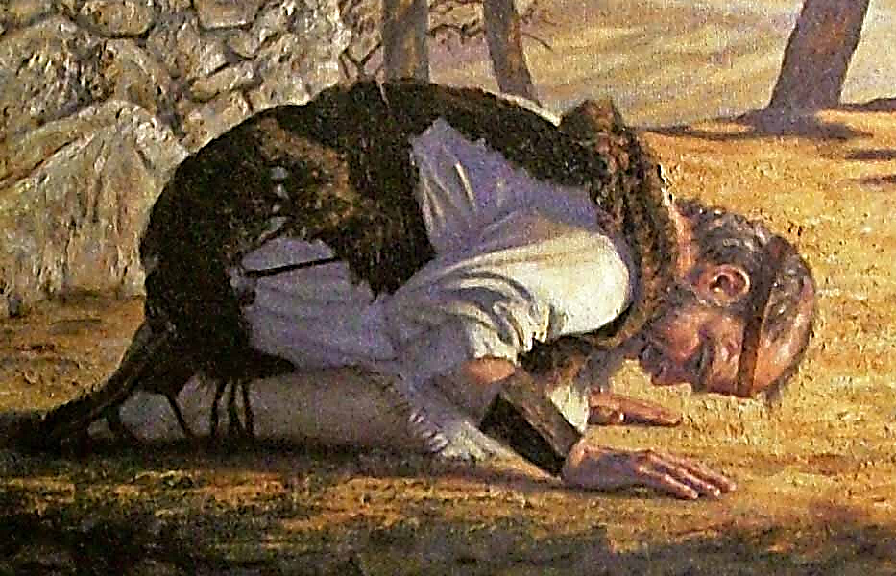
“Yet heard I the voice of his words: and when I heard the voice of his words, then was I in a deep sleep on my face, and my face toward the ground.”

Slide 22
“And he said unto me, O Daniel, a man greatly beloved, understand the words that I speak unto thee, and stand upright: for unto thee am I now sent. And when he had spoken this word unto me, I stood trembling.”

Slide 23
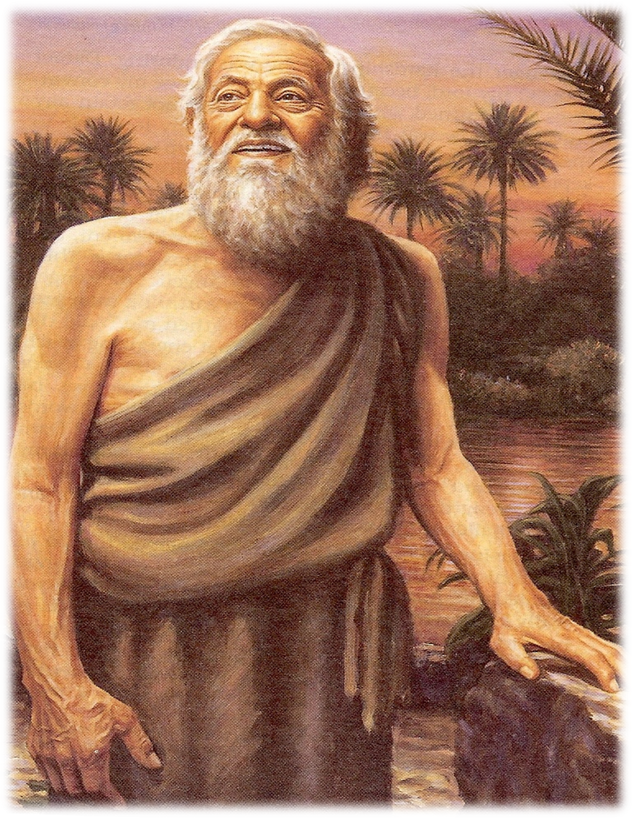
“Then said he unto me, Fear not, Daniel: for from the first day that thou didst set thine heart to understand, and to chasten thyself before thy God, thy words were heard, and I am come for thy words.”

Slide 24
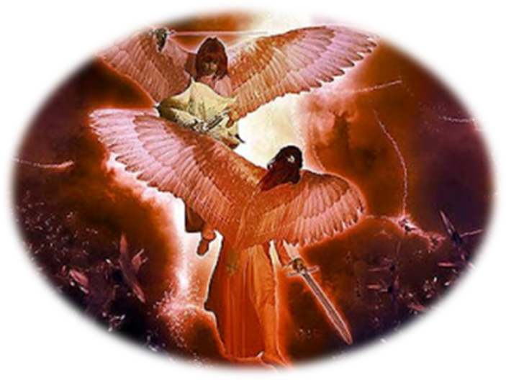
“But the prince of the kingdom of Persia (Satan) withstood me one and twenty days: but, lo, Michael, one of the chief princes, came to help me.”

Slide 25
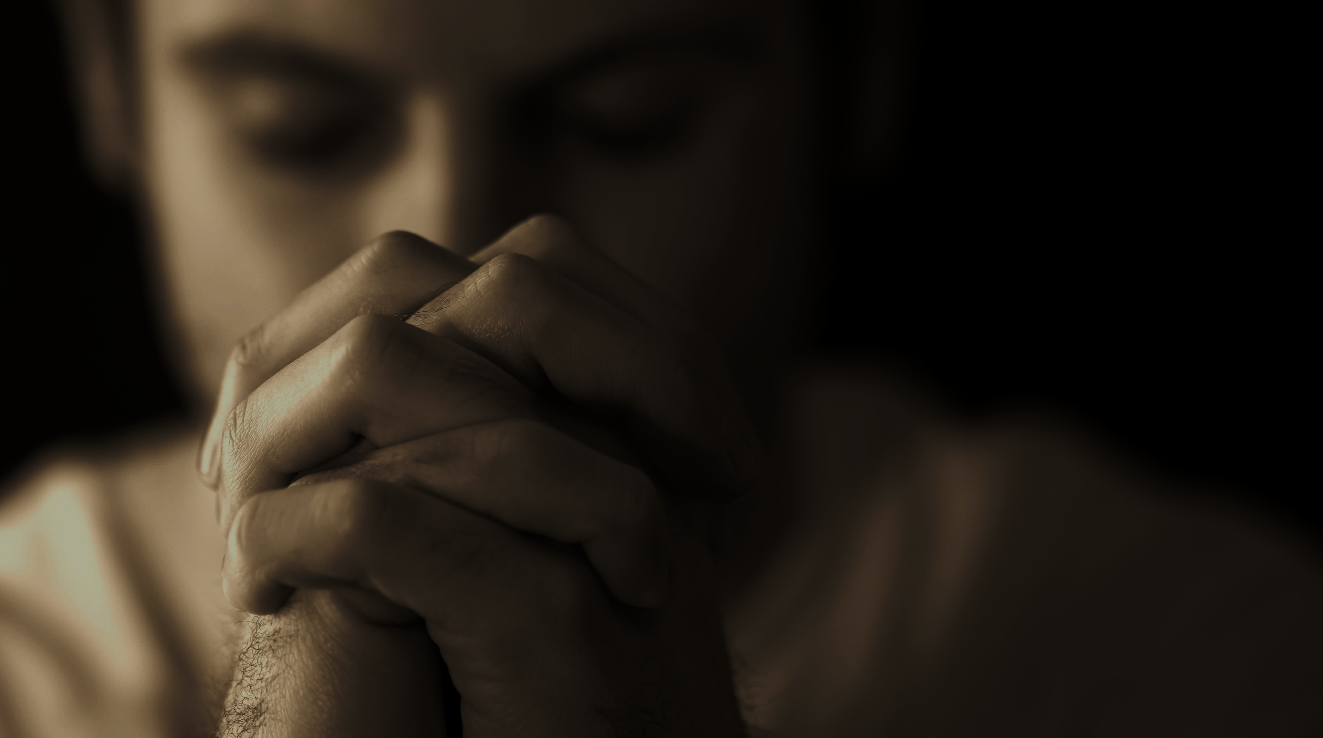
Satan hates prayer
“The effectual fervent prayer of a righteous man availeth much…” James 5:16
Effectual - That which is capable of or successful in producing a desired effect.
Fervent - Intensely passionate; having or showing great emotion or zeal.

Slide 26
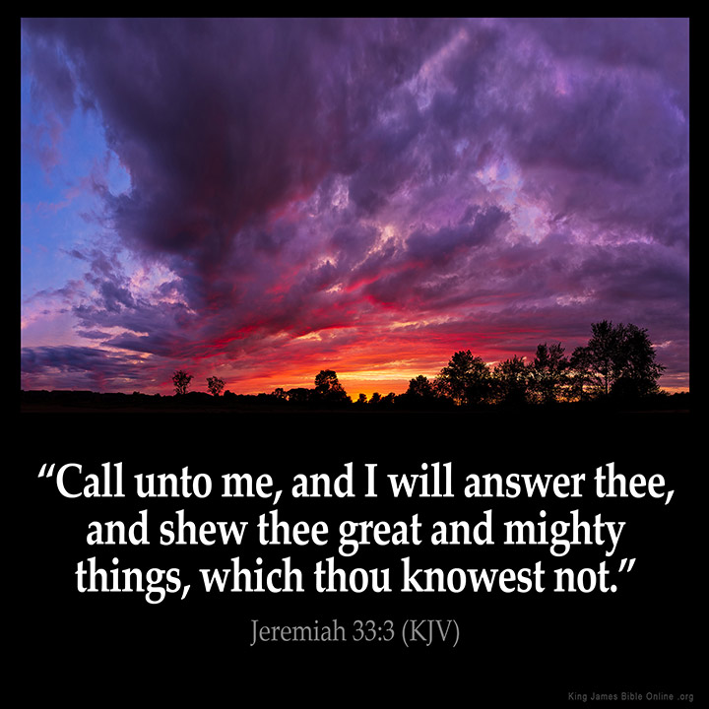

Slide 27
Excerpts from Jesus teachings on prayer
“And when thou prayest, thou shalt not be as the hypocrites are: for they love to pray standing in the synagogues and in the corners of the streets, that they may be seen of men. Verily I say unto you, they have their reward. But thou, when thou prayest, enter into thy closet, and when thou hast shut thy door, pray to thy father which is in secret; and thy Father which seeth in secret shall reward thee openly.”
“But when ye pray, use not vain repetitions…”
“Pray for them that despitefully use you and persecute you.”
“Pray ye therefore the Lord of the harvest, that he will send forth labourers into his harvest.”

Slide 28
“Watch and pray, that ye enter not into temptation.”
“What things soever ye desire, when ye pray, believe that ye receive them and ye shall have them.”
“When ye pray say…Our father which art in heaven…”
“Howbeit this kind (of demon) goeth not out but by prayer and fasting.”
“And all things, whatsoever ye shall ask in prayer, believing ye shall receive…ask and it shall be given unto you, seek and ye shall find, knock and the door shall be open unto you…”
“Men ought always to pray and not to faint.”
“Watch ye therefore and pray always.”

Slide 29
The focus of the early church (Acts. 2:41-42)
1) Doctrine – Immersed themselves in the Word of God
Bible reading
Study of Scripture
Meditation on Scripture
Memorization of Scripture
2) Fellowship – Faithful church attendance / spiritual; encouragement of each other
3) Breaking of Bread – Purification of ones life (confession of sin) and the refocusing of ones life on the importance of waking with God and seeking the things which are above
4) Prayer – Seeking God

Slide 30
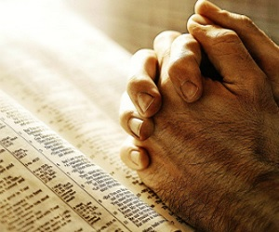
20 reasons our prayers are not answered “Then shall they cry unto the LORD, but he will not hear them: he will even hide his face from them at that time, as they have behaved themselves ill in their doings.” (Mic. 3:4)

Slide 31
1) Bitterness – Mark 11:25-26
2) An Ungrateful Heart – I Thess. 5:16-19
3) Unbelief – James 1:6-7
4) Selfishness – James 4:1-3
5) Disobedience – I John 3:22
6) Not asking others to pray for you – Matthew 18:19
7) Idols – Ezekiel 14:2-5
8) Neglecting the poor and needy – Proverbs 21:13
9) Lack of reconciliation - Matthew 5:23-24
10) Not wanting to wait on God for the answer – Isa. 30:18

Slide 32
11) Wrong motives – Matthew 6:5-6, James 4:3
12) Not praying according to the will of God – I John 5:14-15
13) Judgmental and critical spirit – Matthew 7:1-5, 7
14) Not being persistent in prayer – Luke 18:1-7; Ephesians 3:18
15) Stinginess in giving – Proverbs 3:9-10
16) Not praying in Jesus name - John 14:13-14; 15:16; 16:23,24
17) Iniquity – Isaiah 59:2; Ps. 66:18
18) Not being a child of God – Matt. 7:7-11
19) Bad relationship between husband and wife – I Peter 3:7
20) Unconfessed / Unrepentant sin – James 4:3

Slide 33
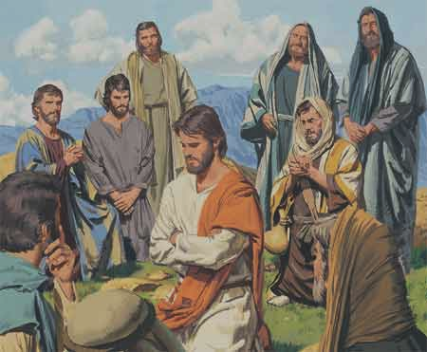
“And it came to pass, that, as he was praying in a certain place, when he ceased, one of his disciples said unto him, Lord, teach us to pray, as John also taught his disciples.” (Luke 11:1)

Slide 34
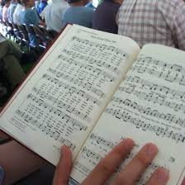
Teach me to Pray Lord

Slide 35
Teach me to pray, Lord, teach me to pray; This is my heart-cry day unto day; I long to know Thy will and Thy way; Teach me to pray, Lord, teach me to pray. Living in Thee, Lord, and Thou in me, Constant abiding, this is my plea; Grant me Thy power, boundless and free, Power with men and power with Thee.

Slide 36
Power in prayer, Lord, power in prayer! Here ’mid earth’s sin and sorrow and care, Men lost and dying, souls in despair; O give me power, power in prayer! Living in Thee, Lord, and Thou in me, Constant abiding, this is my plea; Grant me Thy power, boundless and free, Power with men and power with Thee.

Slide 37
My weakened will, Lord, Thou canst renew; My sinful nature Thou canst subdue; Fill me just now with power anew; Power to pray and power to do! Living in Thee, Lord, and Thou in me, Constant abiding, this is my plea; Grant me Thy power, boundless and free, Power with men and power with Thee.

Slide 38
Teach me to pray, Lord, teach me to pray; Thou art my pattern day unto day; Thou art my surety, now and for aye; Teach me to pray, Lord, teach me to pray. Living in Thee, Lord, and Thou in me, Constant abiding, this is my plea; Grant me Thy power, boundless and free, Power with men and power with Thee.

Slide 39
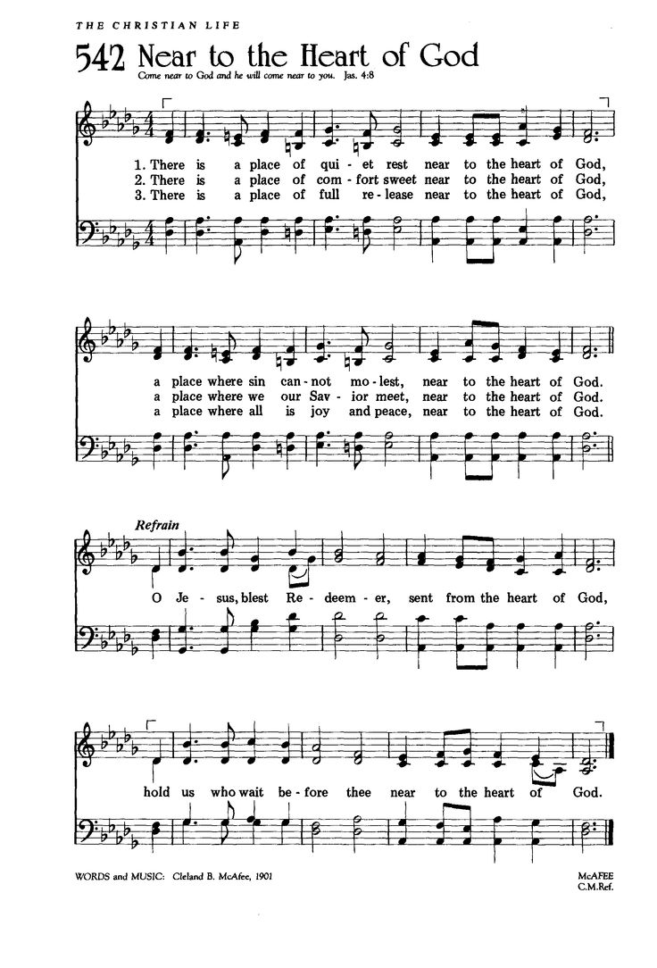
Near to the Heart of God

Slide 40
There is a place of quiet rest, Near to the heart of God; A place where sin cannot molest, Near to the heart of God. Refrain: O Jesus, blest Redeemer, Sent from the heart of God; Hold us, who wait before Thee, Near to the heart of God.

Slide 41
There is a place of comfort sweet, Near to the heart of God; A place where we our Savior meet, Near to the heart of God. O Jesus, blest Redeemer, Sent from the heart of God; Hold us, who wait before Thee, Near to the heart of God.

Slide 42
There is a place of full release, Near to the heart of God; A place where all is joy and peace, Near to the heart of God. O Jesus, blest Redeemer, Sent from the heart of God; Hold us, who wait before Thee, Near to the heart of God.

Slide 43
What is the difference between a Christian that prays and a Christian that is devoted to prayer?
A Christian that prays – Prays about what he does
A Christian that prays – Try’s to fit prayer in to his schedule
A Christian that prays – Prays when problems arise
A Christian that prays – May or may not show up when the church announces a special time of prayer
A Christian that prays – Ask God to bless what he is doing
A Christian that prays – Is frustrated by financial shortfalls
A Christian that prays – Becomes weary and tired when they pray
A Christian that prays – Does things within his means
A Christian that prays – Is involved in the work of men
A Christian that is devoted to prayer – Does things by prayer
A Christian that is devoted to prayer – Makes prayer a priority
A Christian that is devoted to prayer – Always prays
A Christian that is devoted to prayer – Always shows up for prayer meetings
A Christian devoted to prayer – Ask God to enable him to do what He is blessing
A Christian devoted to prayer – Is challenged by financial shortfalls and spends time in prayer and fasting
A Christian that is devoted to prayer – Becomes energized when they pray
A Christian that is devoted to prayer – Does things by faith beyond his means
A Christian that devoted to prayer – is involved in the work of God

Slide 44
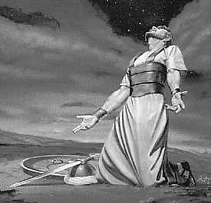
“Evening, and morning, and at noon, will I pray, and cry aloud: and he shall hear my voice.” (Psalm 55:17)

