Slide 1
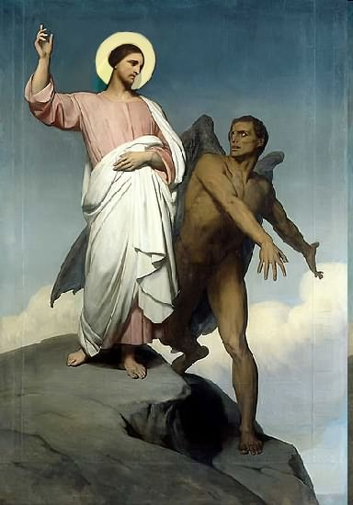

Slide 2
Topics to be studied
His existence
His origin
His fall
His personality
His names
His activities (Part 17)
His location – present and future
Our victory over him

Slide 4
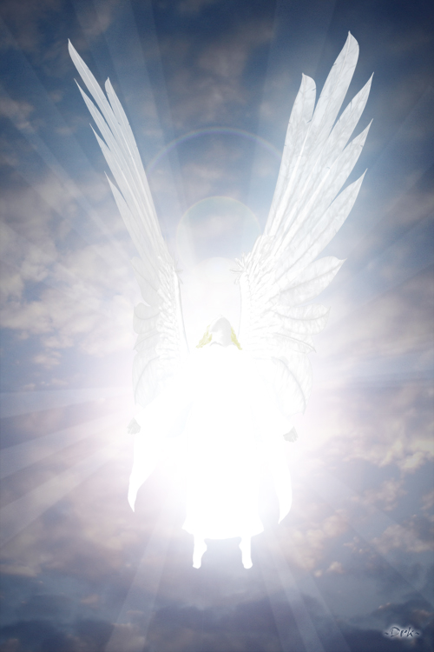
Satan imitates God?

Slide 5
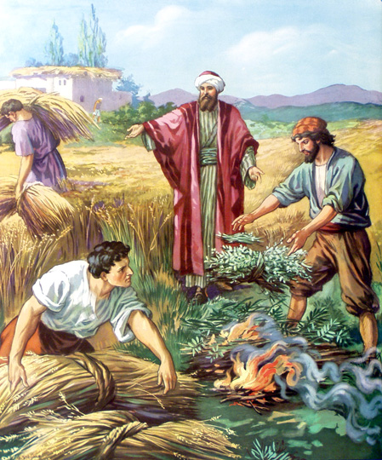
Matthew 13:24-42
Satan sows tares among God’s wheat

Slide 6
Satan perverts the Word of God

Slide 7
Satan lays snares for men

Slide 8
"And that they may recover themselves out of the snare of the devil, who are taken captive by him at his will." (2 Tim. 2:26) "Moreover he must have a good report of them which are without; lest he fall into reproach and the snare of the devil." (1 Tim. 3:7)

Slide 10
Discernment to see, identify and avoid the snares of the Devil – I Tim. 3:6-7; II Tim. 2:1-4, 2:22-3:5
The Devil is a cunning hunter - “Be sober, be vigilant; because your adversary the devil, as a roaring lion, walketh about, seeking whom he may devour.”
Job said “…snares are round about thee…” “The snare is laid for him in the ground, and a trap for him in the way…”
Our enemy the Devil is a skilled trapper and has ensnared many men and women in his “traps” to their own destruction –
Solomon said “Snares are in the way…as fish are taken in an net, and as birds are caught in the snare; so are the sons of men snared in a evil time, when it falleth suddenly upon them…”

Slide 11
Satan is a thief and has come to – “…steal, kill and destroy…”
Satan is our “enemy” – “our enemy is the devil…” (Matt. 13:39)
Satan is the “fowler” (One who entangles or snares) –“Surely he (the Lord) shall deliver thee from the snare of the fowler…our soul is escaped as a bird out of the snare of the fowler: the snare is broken and we have escaped…”

Slide 12
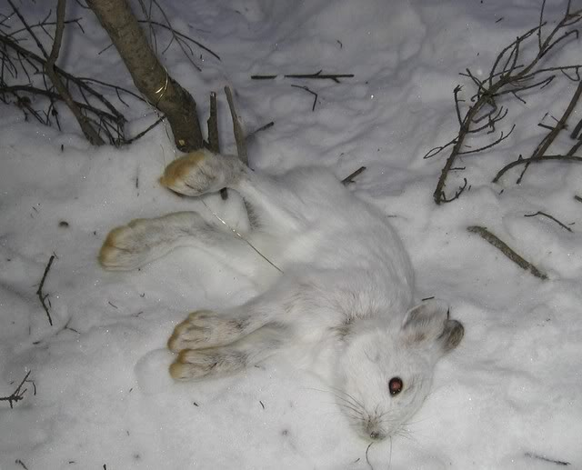
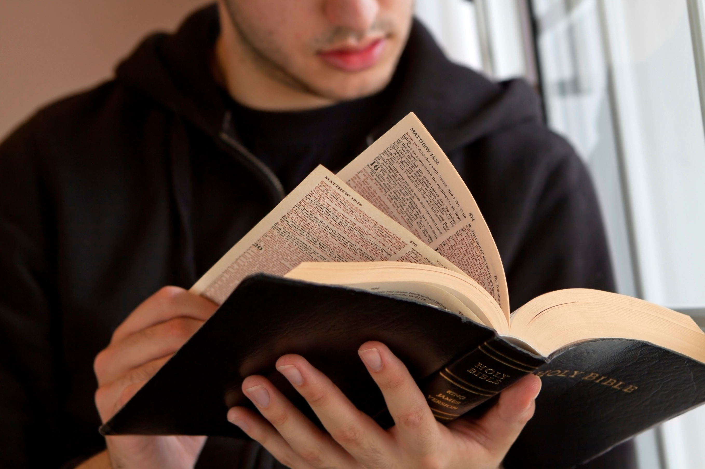
We must become men and women of “discernment” (Heb. 5:14) who can see the “snares” of the Devil, identify them, and avoid his “traps” “The Law of the Lord is a fountain of life, to depart from the snares of death…the fear of the Lord is a fountain of life, to depart from the snares of death…”

Slide 13
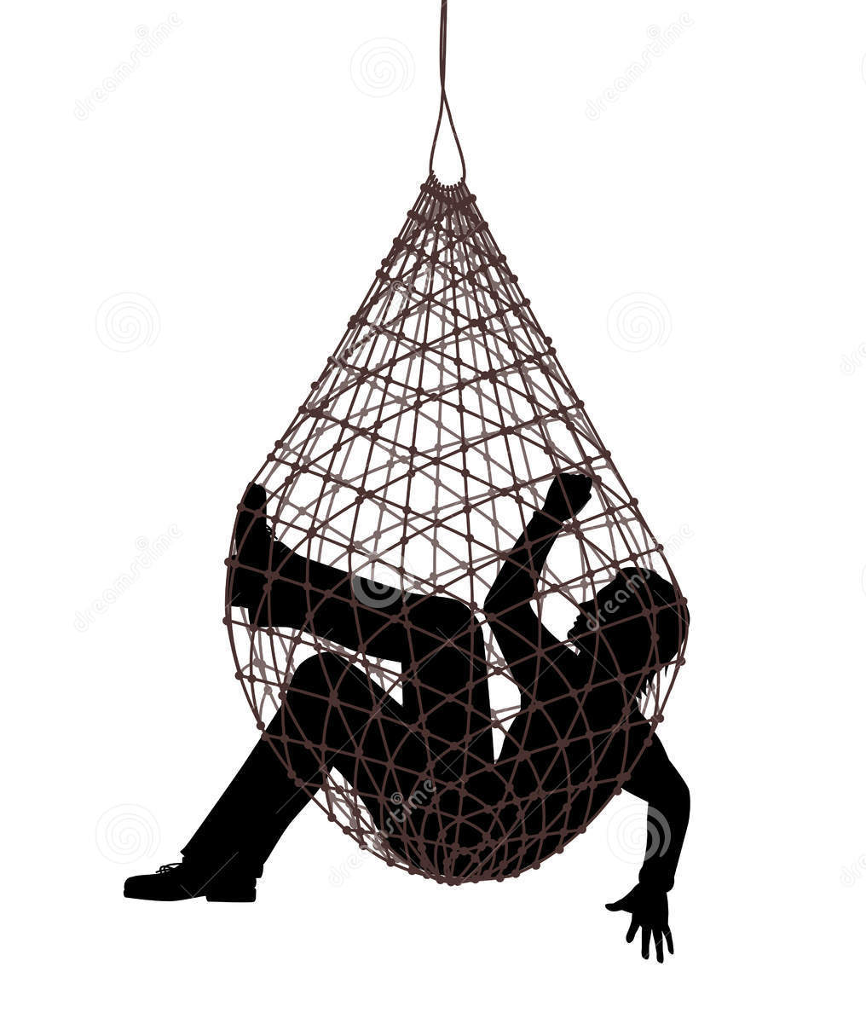
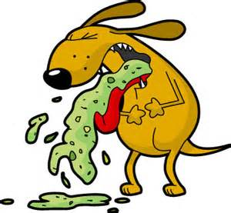
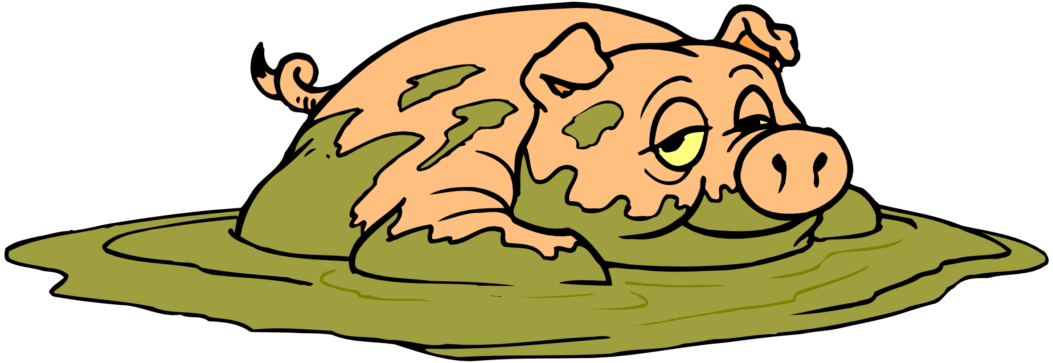
We must avoid becoming entangled in Satan’s snares – “After they have escaped the pollutions of the world through the knowledge of the Lord and Savior Jesus Christ, they are again entangled (snared) therein, and overcome, the latter end is worse with them than the beginning…”
(2 Peter 2:20)

Slide 14
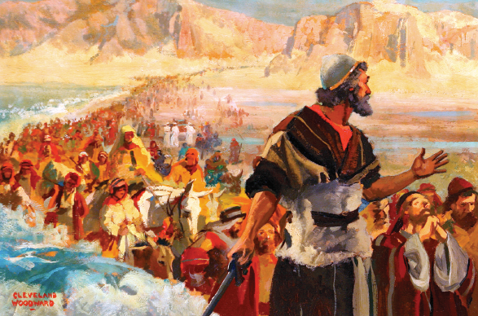
Upon entering the promise land the Lord said to his chosen people “These nations shall be snares and traps unto you…”

Slide 15
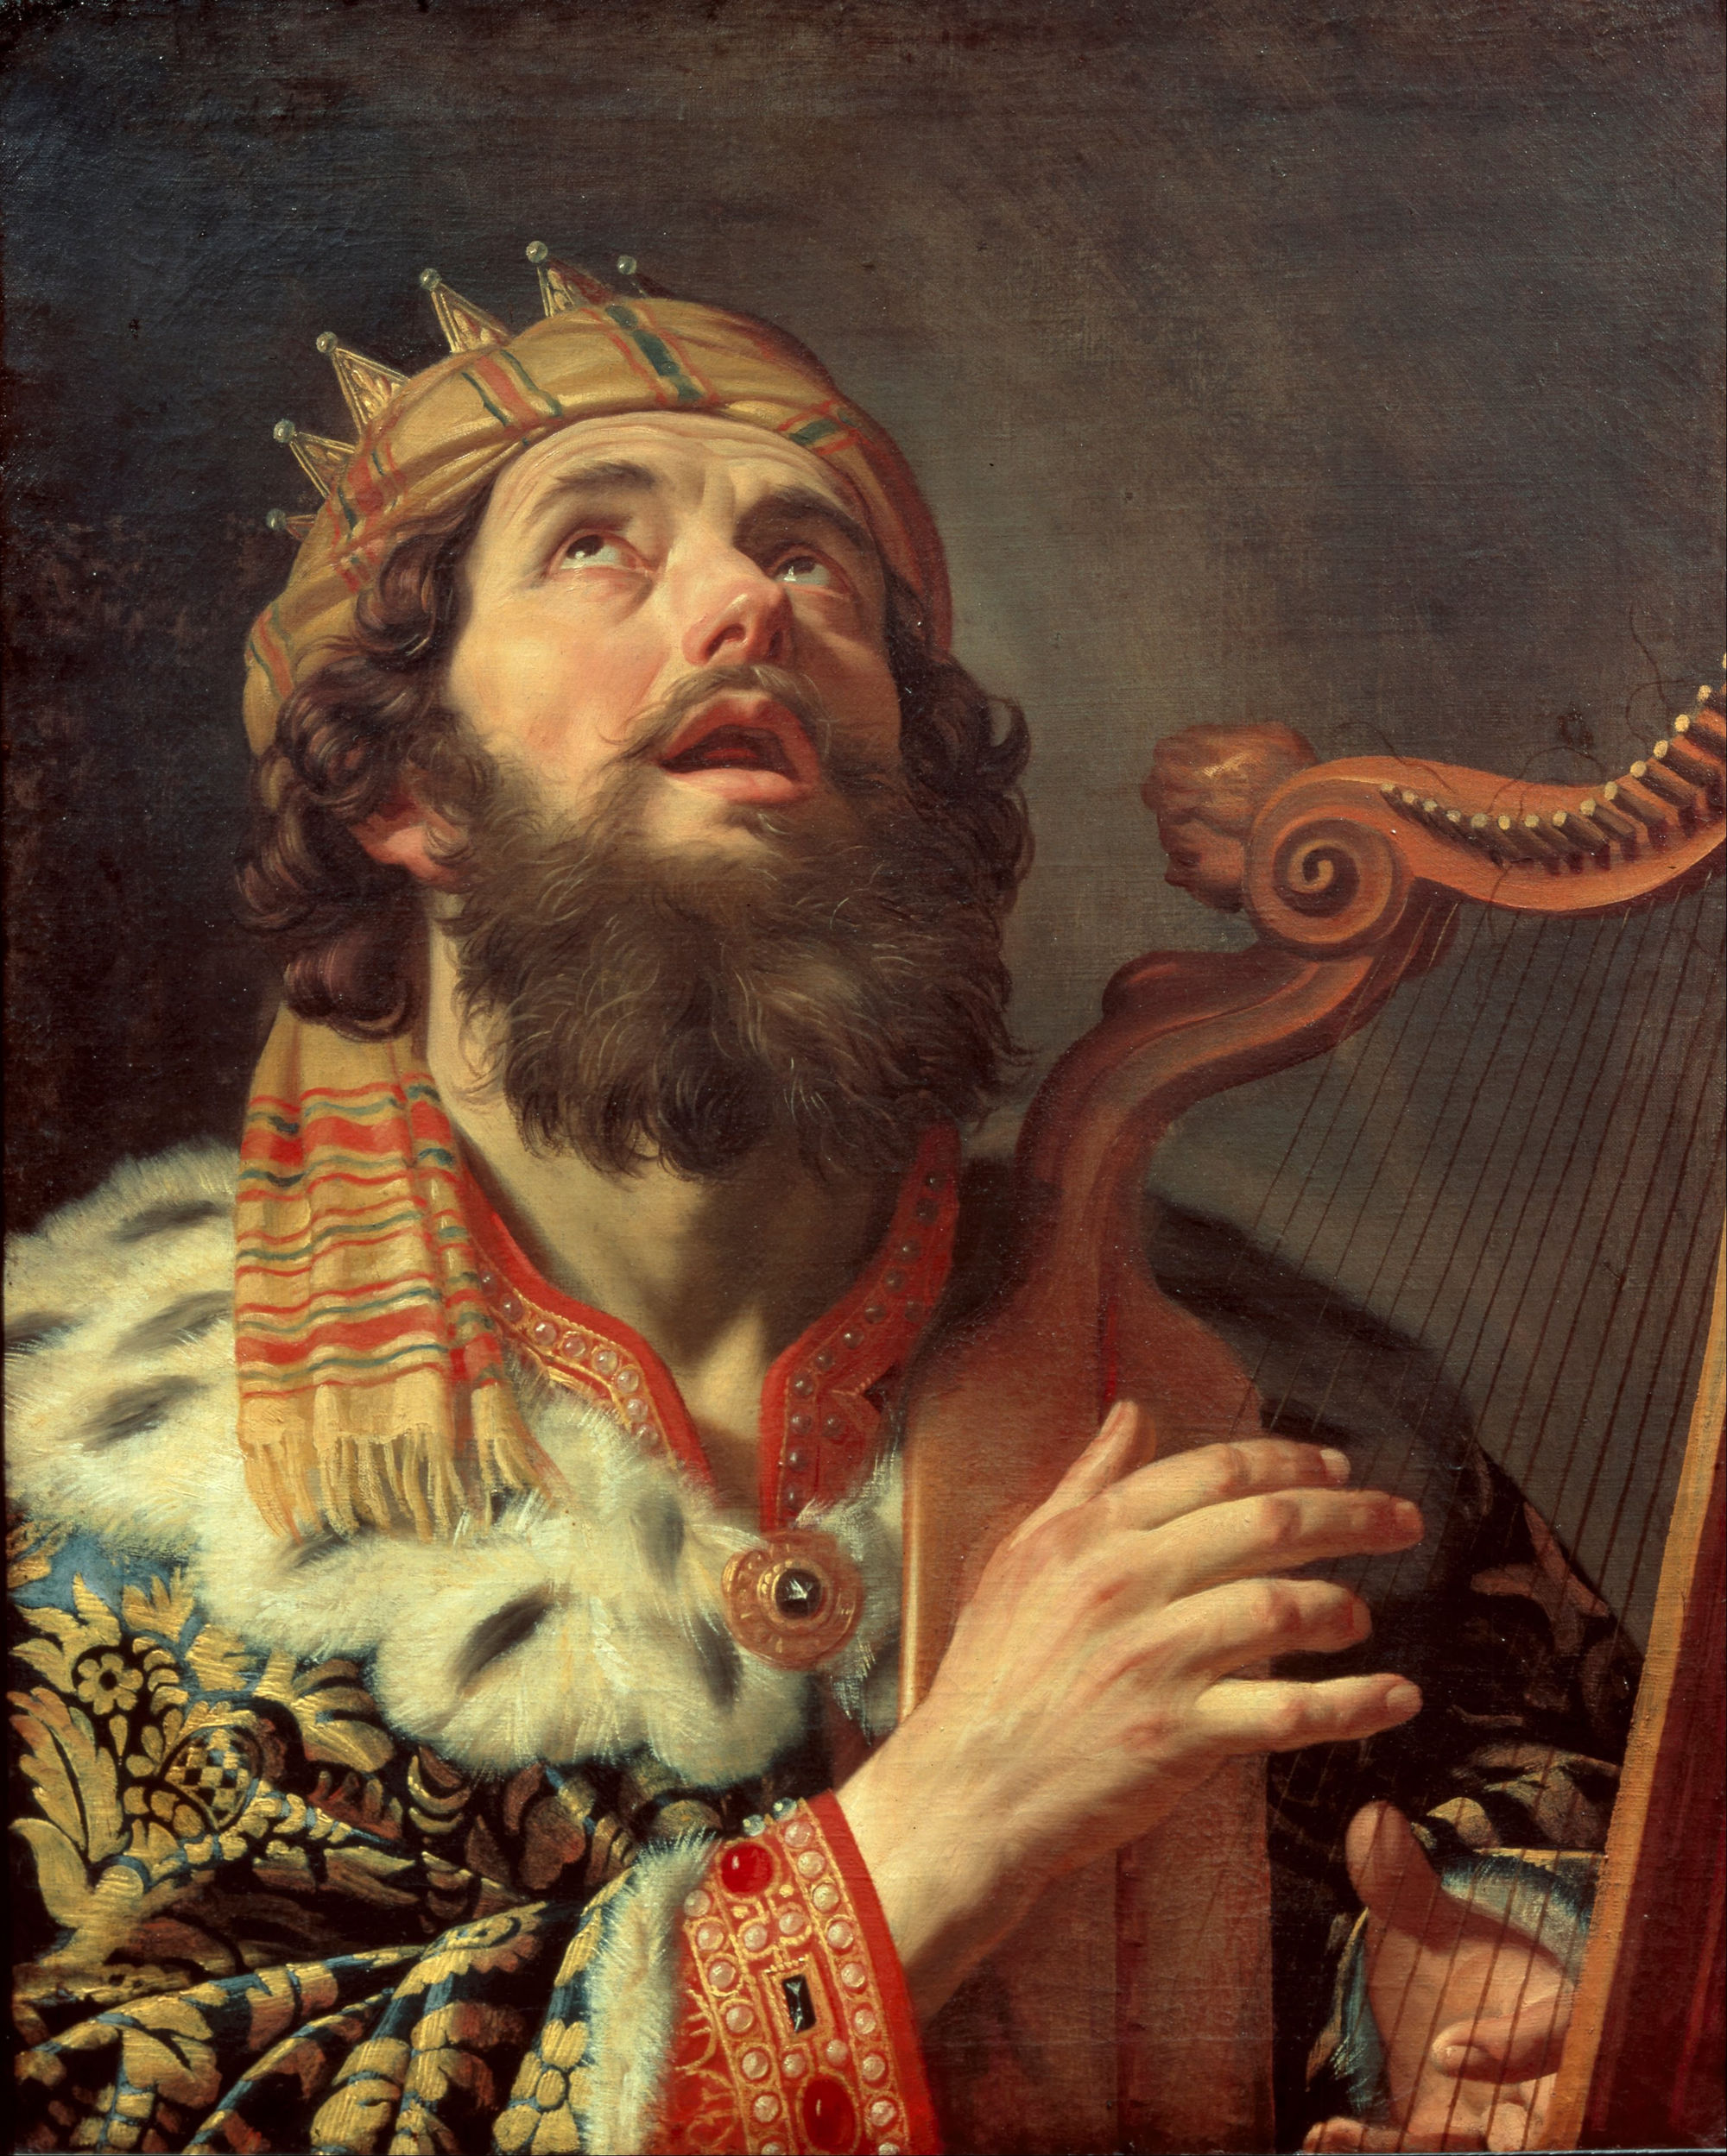
David said – “My enemies seek after my life…they lay snares for me…they seek my hurt…they encourage themselves in this evil matter (laying of snares) they lay snares privately, they say; who shall see them…”

Slide 16
May David’s prayer be our prayer “Keep me from the snares which they have laid for me…” (Psalm 141:9)

Slide 17
It is critical that this discernment be developed early in your Christian life “I have written unto you young men because you are strong and the word of God abides in you and you have overcome the wicked one…” “Submit yourselves therefore to God. Resist the devil, and he will flee from you.” (James 4:7)

Slide 18
Six snares of the Devil

Slide 19
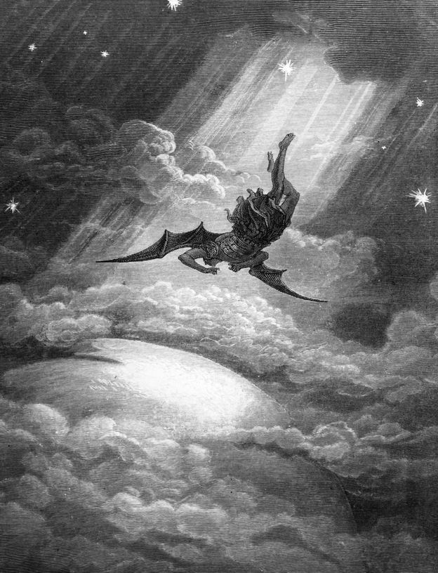
1. The snare of pride: 1 Tim. 3:6-7
The snare of pride was the iniquity of Lucifer – Isa. 14:12-15; Ezek. 28:10-15
Note: Satan is the originator of pride, and pride is definitely one of his most effective snares – “Perfect until iniquity (pride) was found in him…I will be like the most high…”
Jesus said – “I beheld Satan as lightning fall from heaven…” (Luke 10:18)

Slide 20
The snare of pride is a terrible sin that will destroy a man “Pride goeth before destruction…a mans pride shall bring him low…”
Selected Scriptures: Prov. 8:13; 11:2; 13:10; 14:3; 16:18; 29:23; I John 2:16; James 4:6, 10; I Pet. 5:6; Col. 3:12; I Tim. 6:4

Slide 21
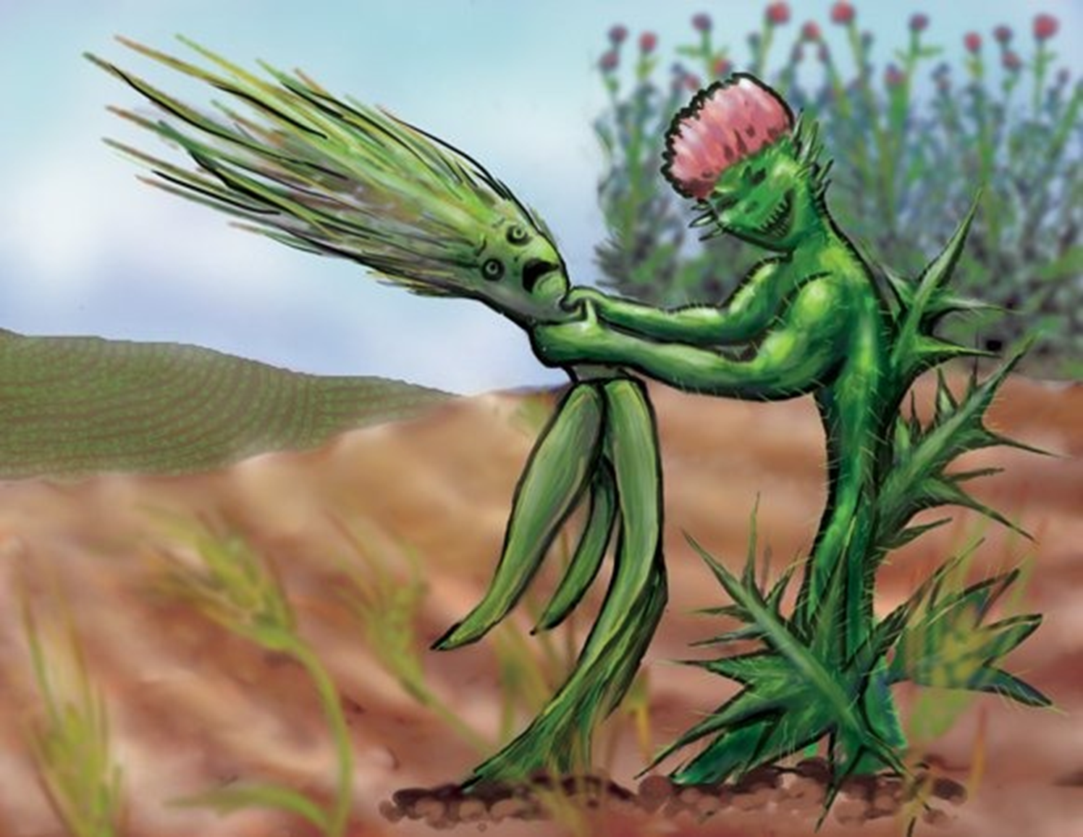
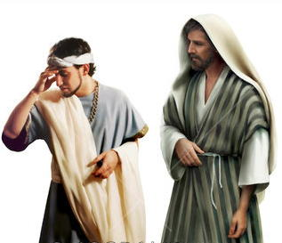
2. The snare of riches: 1 Tim. 6:6-12, 17-19
The snare of riches will keep a man from being saved – Mark 10:23-27
The snare of riches will keep a believer from serving the Lord – “No man can serve two masters…you can not serve God and money…The cares of this world and the deceitfulness of riches choke the word and he becometh unfruitful…”

Slide 22
It’s possible for a person to be rich and not love money, but such a one is rare – I John 2:16-17
“Beware of covetousness…set your affection on things above not on things on the earth…look not on the things that are seen, but on the things that are not seen. For the things which are seen are temporal, but the things which are not seen are eternal…”

Slide 23
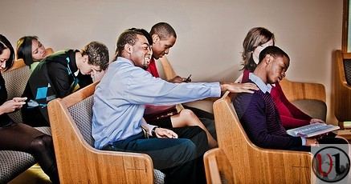
3. The snare of spiritual apathy – 2 Tim. 2:26
The word “Recover” “Awake up” “…that they may recover (awake) themselves out of the snare of the devil…”
The snare of spiritual apathy has been used effectively by Satan to hinder spiritual growth and the spread of the Gospel – 1 Cor.15:34 “Awake to righteousness, and sin not; for some have not the knowledge of God: I speak this to your shame.”

Slide 24
The snare of spiritual apathy is a snare that we must “recover” ourselves out of every day
“It is high time to awake out of sleep…” (Rom. 13:11)
“Awake to righteousness and sin not…” (1 Cor. 15:34)
“Awake thou that sleepest …” (Eph. 5:14)

Slide 25
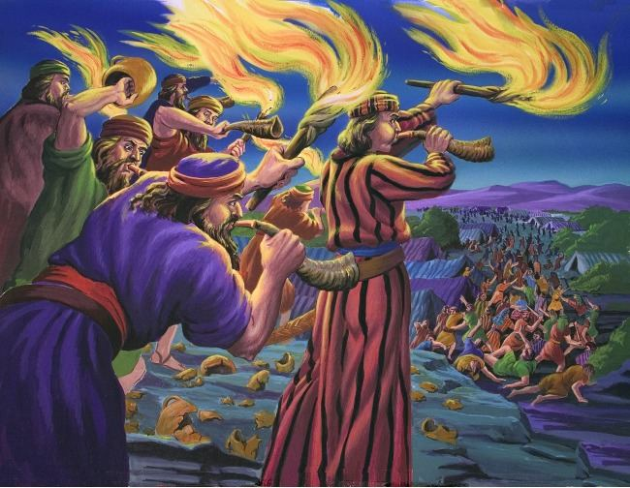
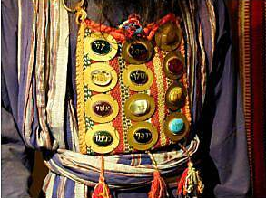
4. The snare of idolatry: Judges 8:27
(Judges 8:27) “And Gideon made an ephod thereof, and put it in his city, even in Ophrah: and all Israel went thither a whoring after it: which thing became a snare unto Gideon, and to his house.”

Slide 26
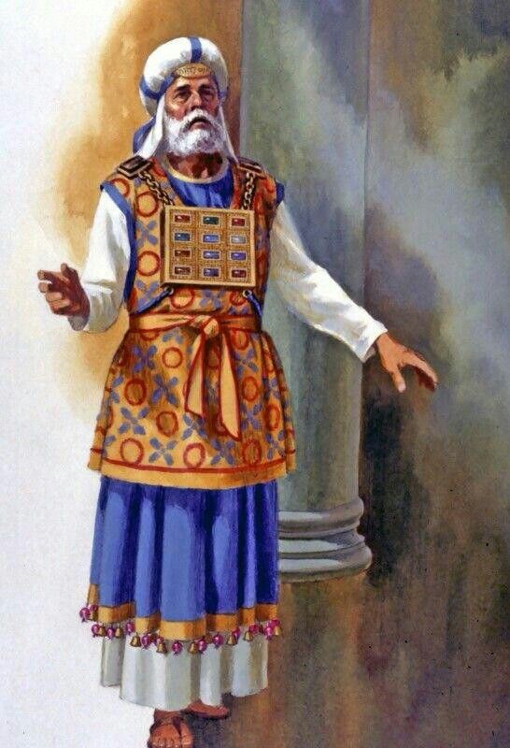
Ephod
On the outside of the breastplate and placed in gold settings were twelve precious stones in four rows of
three stones each.
On each of the stones was inscribed the name of one of the tribes of Israel, in the order of their births, as was the case with the onyx stones on the shoulders. (see Exod. 28:10)
The order and names of the stones are listed in (Exod. 28:17-20).

Slide 27
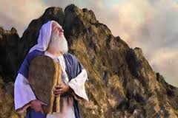
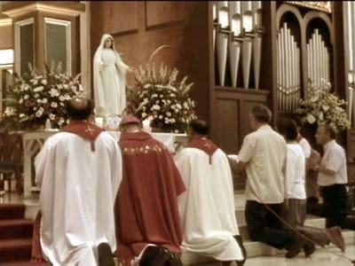
“Thou shalt have no other gods before me. Thou shalt not make unto thee any graven image, or any likeness of any thing that is in heaven above, or that is in the earth beneath, or that is in the water under the earth: Thou shalt not bow down thyself to them, nor serve them: for I the LORD thy God am a jealous God.” (Exodus 20:3-5)

Slide 28
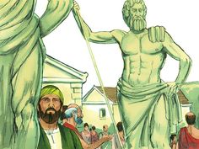
“Now while Paul waited for them at Athens, his spirit was stirred in him, when he saw the city wholly given to idolatry.” (Acts 17:16)

Slide 29
The snare of idolatry can also be when anything or anyone takes the place of God in our lives – 1 Cor. 10:14 “Wherefore, my dearly beloved, flee from idolatry.”
Note: To put anything above God in our thinking, living, planning, or in our love is to become idolatrous – Col. 3:5 “Mortify therefore your members which are upon the earth; fornication, uncleanness, inordinate affection, evil concupiscence, and covetousness, which is idolatry.”

Slide 30
“Demas hath forsaken me, having loved this present world.” (2 Tim. 4:10)

Slide 31
The snare of idolatry is a very serious snare that must be avoided “Keep yourselves from idols…”
1 Thess. 1:9 “For they themselves shew of us what manner of entering in we had unto you, and how ye turned to God from idols to serve the living and true God.”
2 Cor. 6:16 “And what agreement hath the temple of God with idols? for ye are the temple of the living God; as God hath said, I will dwell in them, and walk in them; and I will be their God, and they shall be my people.”
(see Rom. 1:18-21)

Slide 32
5. The snare of the fear of man: Prov. 29:25
The snare of the fear of man is being more concerned about what man thinks of you then what God thinks of you – Reputation:

Slide 33
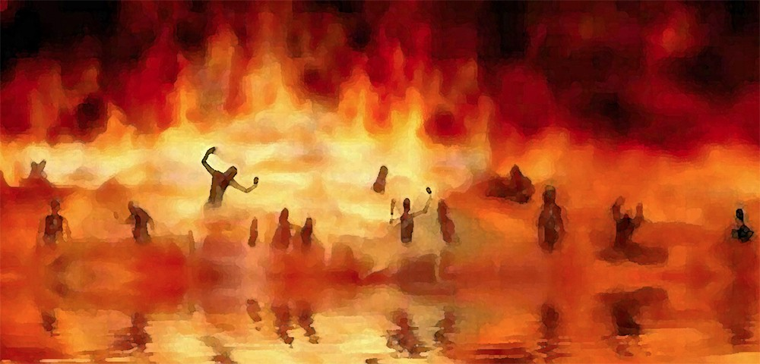
Unsaved “Fear not them which kill the body but are not able to kill the souls: but rather fear him which is able to destroy both soul and body in hell..”

Slide 34
Saved Fear of man cause us to be ineffective in our service for Christ – “Do I seek to please men? For if I yet pleased men, I should not be the servant of Christ…”

Slide 35
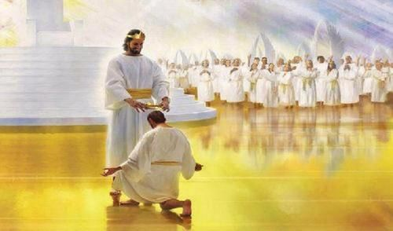
Two important truths to remember
Remember Jesus’ example – “He made himself of no reputation…”
Remember God’s promise – “The sufferings of this present time are not worthy to be compared with the glory which shall be revealed in us…”

Slide 36
The snare of the fear of man is being unwilling to suffer for the cause of Christ
“They rejoiced that they were worthy to suffer shame for his name…If so be that we surer with him, that we may be glorified with him…For unto you it is given on the behalf of Christ not only to believe on him but to suffer for his sake…That I may know him and the power of his resurrection and the fellowship of his suffering…We suffer reproach because we trust in the living god who is the savior of all men…If we suffer we shall reign with him…All that live godly in Christ Jesus shall suffer persecution…”

Slide 37
The snare of fear of man will only be conquered by our love for Christ “There is no fear in love; but perfect love casteth out fear: because fear hath torment. He that feareth is not made perfect in love.” (1 John 4:18)

Slide 38
6. The snare of immorality – Proverbs 7:21-27
How does a man or woman become ensnared in immorality?
(Read Proverbs 2, 5, 6-7)

Slide 39
Ignorance - “simple” … “void of understanding” – 7:7
Refusal to listen to parents – 6:20-24, 7:24-25
Placing your self in the place of temptation – 5:8, 7:8-9
Not guarding your eyes – 6:25 “Lust not after her beauty…”
Listening to flattery – 2:16, 7:21
Allurement of her eyelids – 6:25
Engaging in sensual talk – “…drip as a honey comb” – 5:3
Touching and kissing – 7:13
Perfume – 7:17
Provocative dress – 7:10

Slide 40
There are so many immoral snares that must be detected an avoided

Slide 41
What are the consequences of being ensnared in immorality – Prov. 2, 5-6, 7
“You will head down the paths of death from which there is no return…then end of it is bitter and sharper then a two-edged sword…steps take hold of hell…flesh and body are consumed…financial loss (brought to a piece of bread)…wound and dishonor you will get and your reproach shall not be wiped away…”

Slide 42
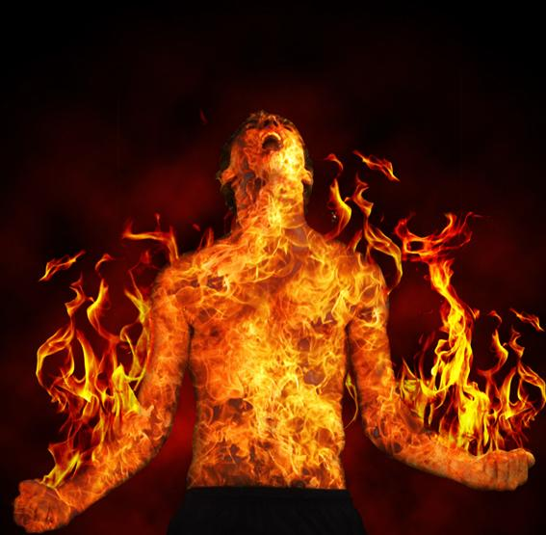
“Can a man take fire to his bosom and
his cloths not be burned?”
“Can one walk on hot coals
and
his feet not be burned?”

Slide 43
Pride
Riches
Spiritual apathy
Idolatry
The fear of man
Immorality

