Slide 1
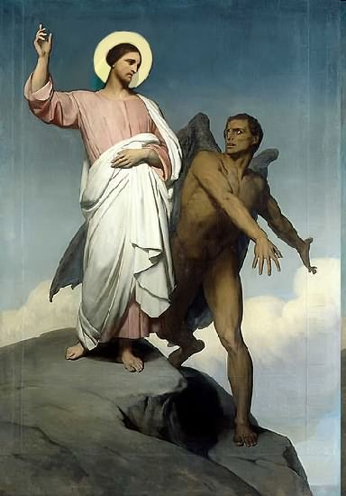

Slide 2
Topics to be studied
His existence
His origin
His fall
His personality
His names
His activities
His location – past, present and future
Our victory over him

Slide 3
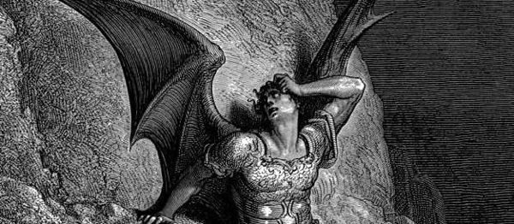
Often a twofold accusation are hurled at the Bible Believing Christian by those who are Unbelievers concerning the existence of Satan. "All right, if your God is so wise and good, then why did he create the devil, and if he is so powerful, why doesn’t he destroy the devil?" A simple scriptural answer to these two questions is.
“He didn’t.”
“He will.”

Slide 4
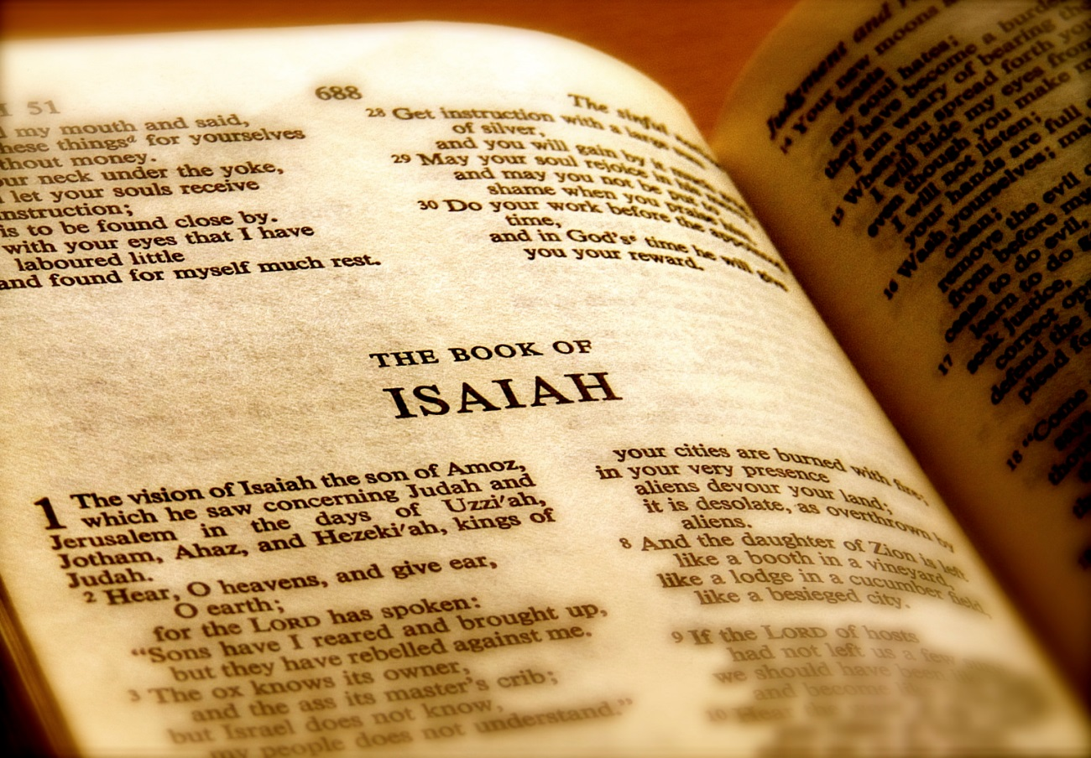
There are two important passages in the Word of God concerning the origin and fall of the devil.

Slide 5
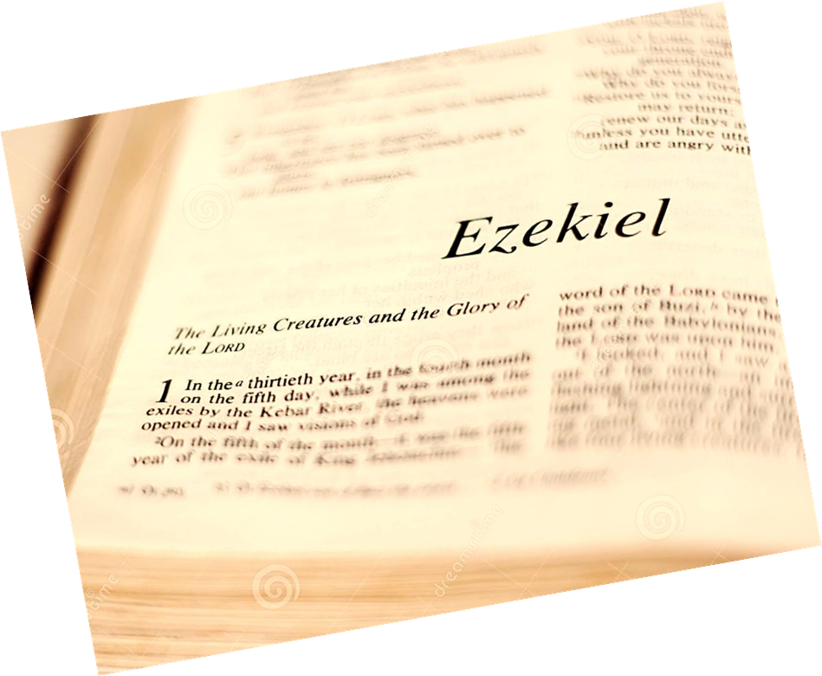
Satan’s origin and fall as recorded by Ezekiel

Slide 6
Ezekiel predicts coming judgment upon the city of Tyre in chapters 26, 27 and the first part of chapter 28. This has already been fulfilled, for the city was destroyed by Nebuchadnezzar in 573 B.C., and later destroyed by Alexander in 332 B.C. But during the second half of chapter 28, the prophet goes beyond the earthly scene, and describes for us the creation and judgment of a fallen, vile and evil nonhuman creature.

Slide 7
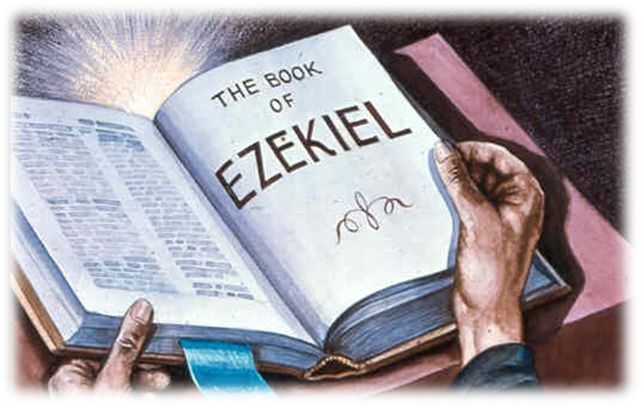
28:12-19

Slide 8
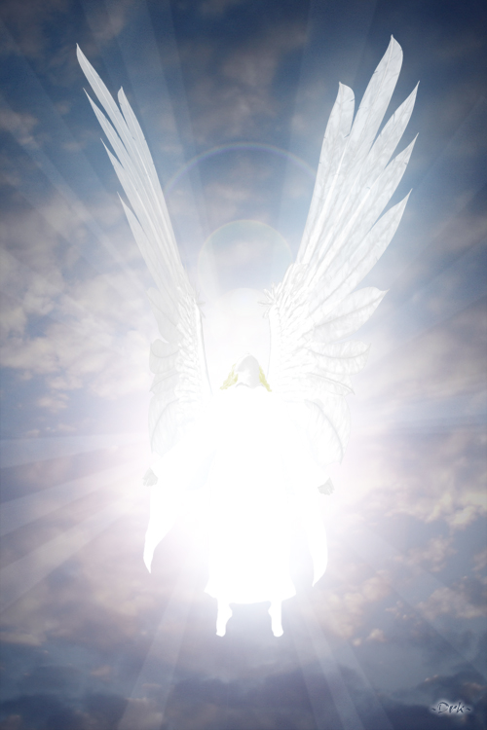
"Son of man, take up a lamentation upon the king of Tyrus, and say unto him, Thus saith the Lord God; Thou sealest up the sum, full of wisdom, and perfect in beauty.”

Slide 9
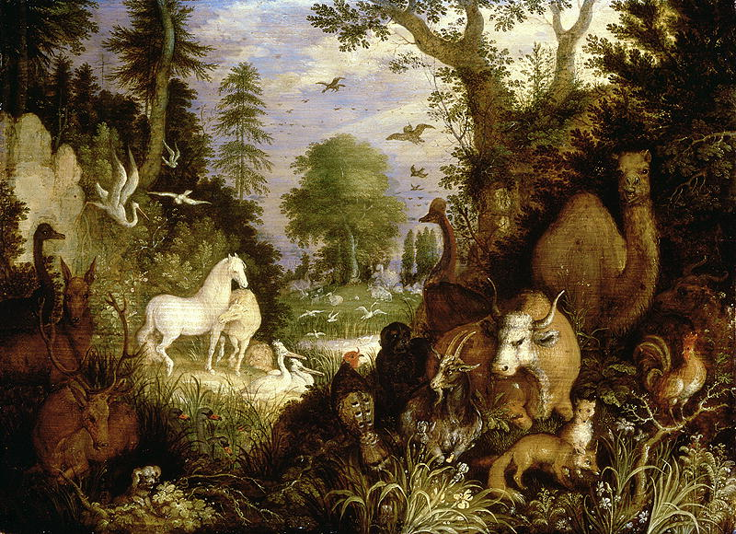
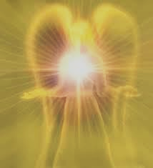
“Thou hast been in Eden the garden of God.”

Slide 10
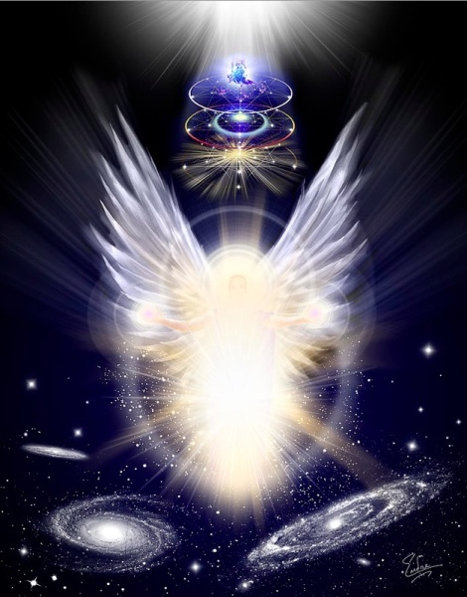
“Every precious stone was thy covering, the sardius, topaz, and the diamond, the beryl, the onyx, and the jasper, the sapphire, the emerald, and the carbuncle, and gold.”

Slide 11
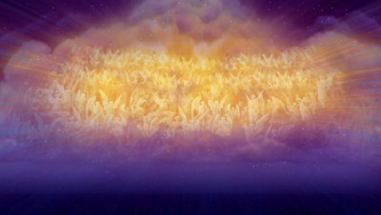
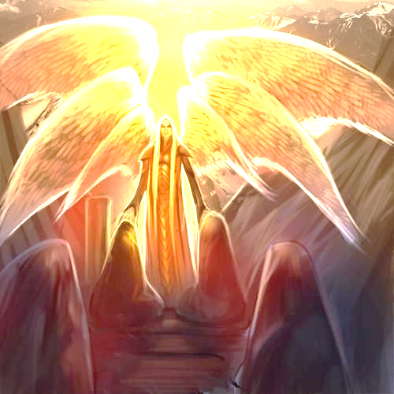
“The workmanship of thy tabrets and of thy pipes was prepared in thee in the day that thou wast created.”

Slide 12
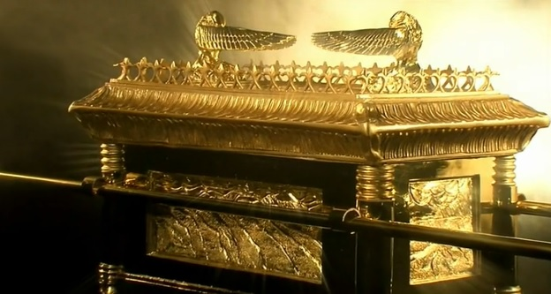
“Thou art the anointed cherub that covereth; and I have set thee so.”

Slide 13
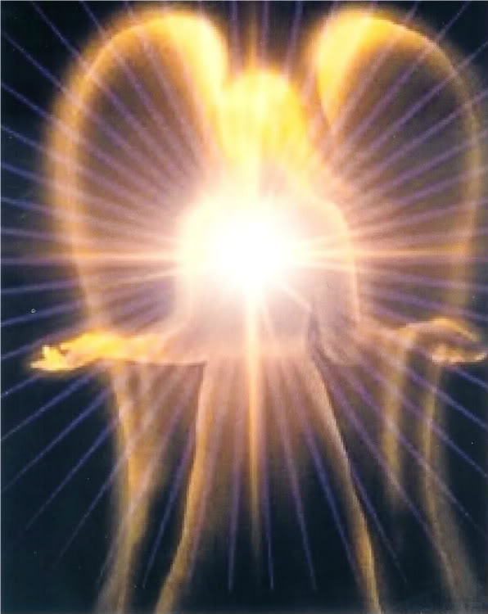
“Thou wast upon the holy mountain of God; thou hast walked up and down in the midst of the stones of fire.”

Slide 14
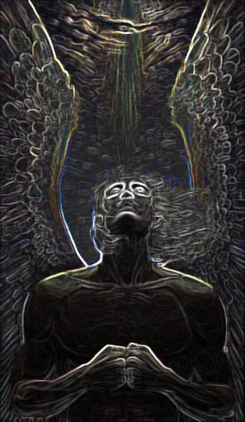
“Thou wast perfect in thy ways from the day that thou wast created, till iniquity was found in thee.”

Slide 15
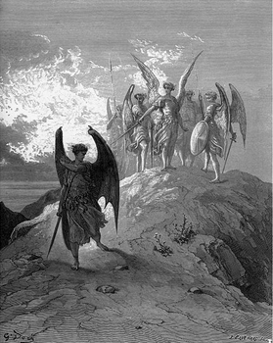
“By the multitude of thy merchandise they have filled the midst of thee with violence, and thou hast sinned: therefore I will cast thee as profane out of the mountain of God: and I will destroy thee, O covering cherub, from the midst of the stones of fire.”

Slide 16
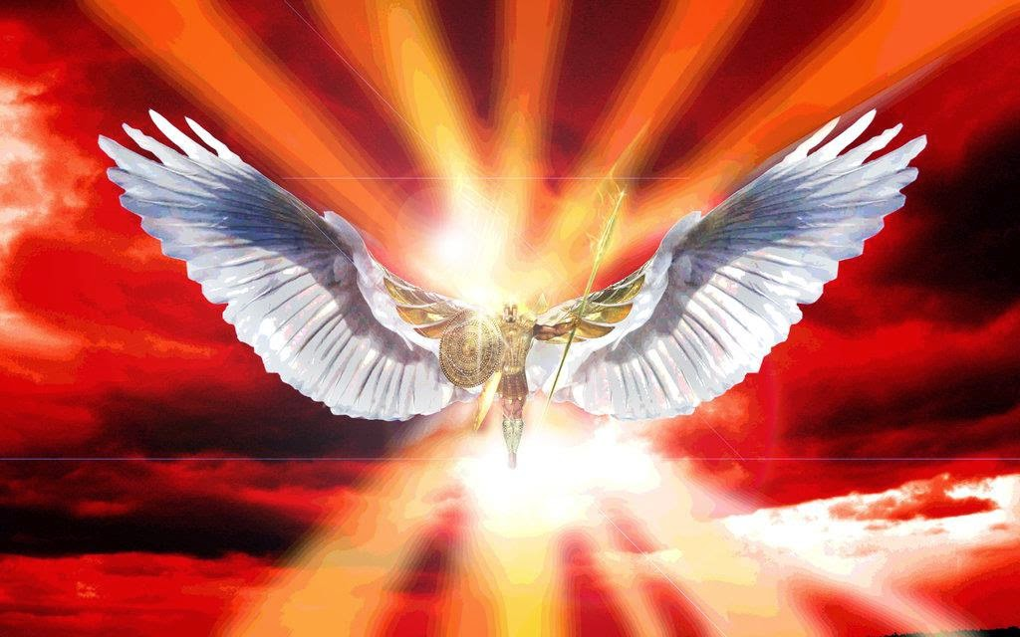
“Thine heart was lifted up because of thy beauty, thou hast corrupted thy wisdom by reason of thy brightness.”

Slide 17
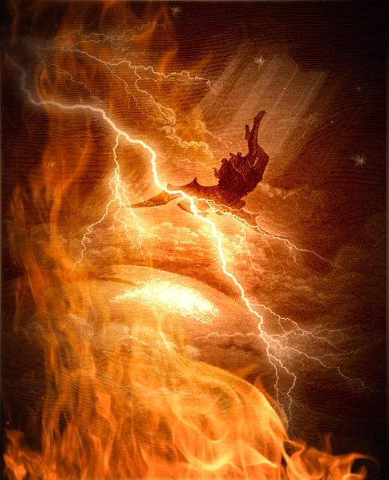
“I will cast thee to the ground, I will lay thee before kings, that they may behold thee.”

Slide 18
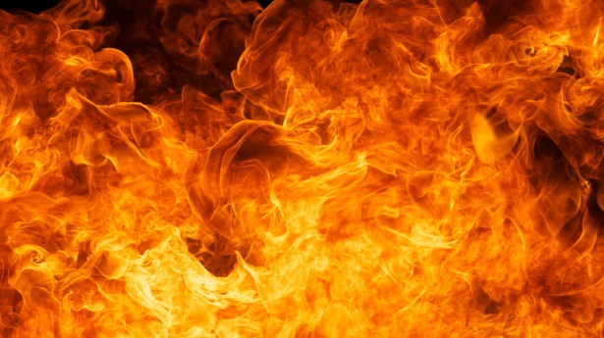
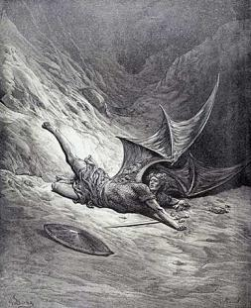
“Thou hast defiled thy sanctuaries by the multitude of thine iniquities, by the iniquity of thy traffick; therefore will I bring forth a fire from the midst of thee, it shall devour thee, and I will bring thee to ashes upon the earth in the sight of all them that behold thee. All they that know thee among the people shall be astonished at thee: thou shalt be a terror, and never shalt thou be any more.”

Slide 19
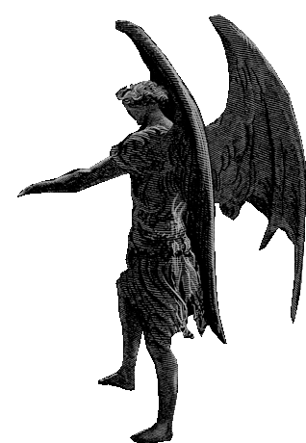
Satan is not human
"Thou...[art] full of wisdom, and perfect in beauty." (v. 12)
No human being is ever described in these terms, but rather the contrary.
Note the following Scriptures

Slide 20
"For there is no man that sinneth not" (1 Ki. 8:46)
"Who can say, I have made my heart clean, I am pure from my sin?" (Prov. 20:9)
"The heart is deceitful above all things, and desperately wicked" (Jer. 17:9)
"For there is not a just man upon earth, that doeth good and sinneth not" (Eccl. 7:20)
"All we like sheep have gone astray" (Isa. 53:6)
"But we are all as an unclean thing, and all our righteousnesses are as filthy rags; and we all do fade as a leaf, and our iniquities like the wind, have taken us away" (Isa. 64:6)

Slide 21
"For all have sinned and come short of the glory of God" (Rom. 3:23)
"But the scripture hath concluded all under sin" (Gal. 3:22)
"For in many things we offend all" (Jas. 3:2)
"If we say that we have no sin, we deceive ourselves and the truth is not in us" (1 John 1:8)
"If we say that we have not sinned, we make him a liar, and his word is not in us" (1 John 1:10)
Ezekiel cannot possibly be referring to any human being.

Slide 22
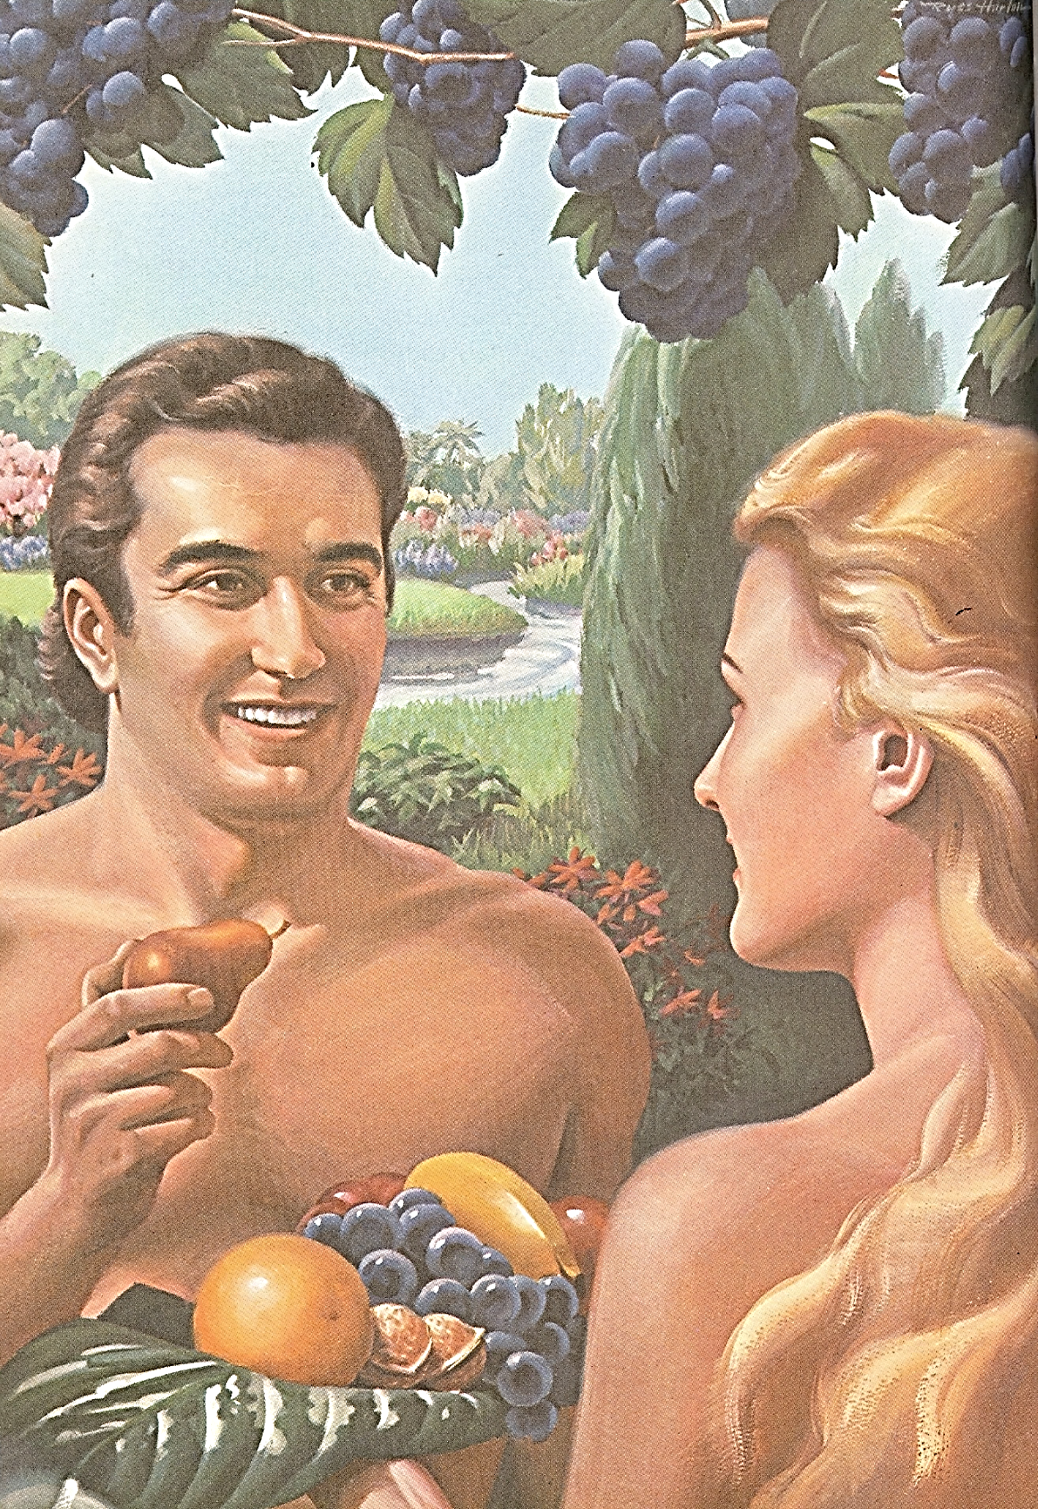
"Thou hast been in Eden, the garden of God."
Some have speculated that Ezekiel had Adam in mind here, but the Genesis account nowhere speaks of Adam’s clothing being “covered with every kind of precious stone," and then fitted in "beautiful settings of gold."

Slide 23
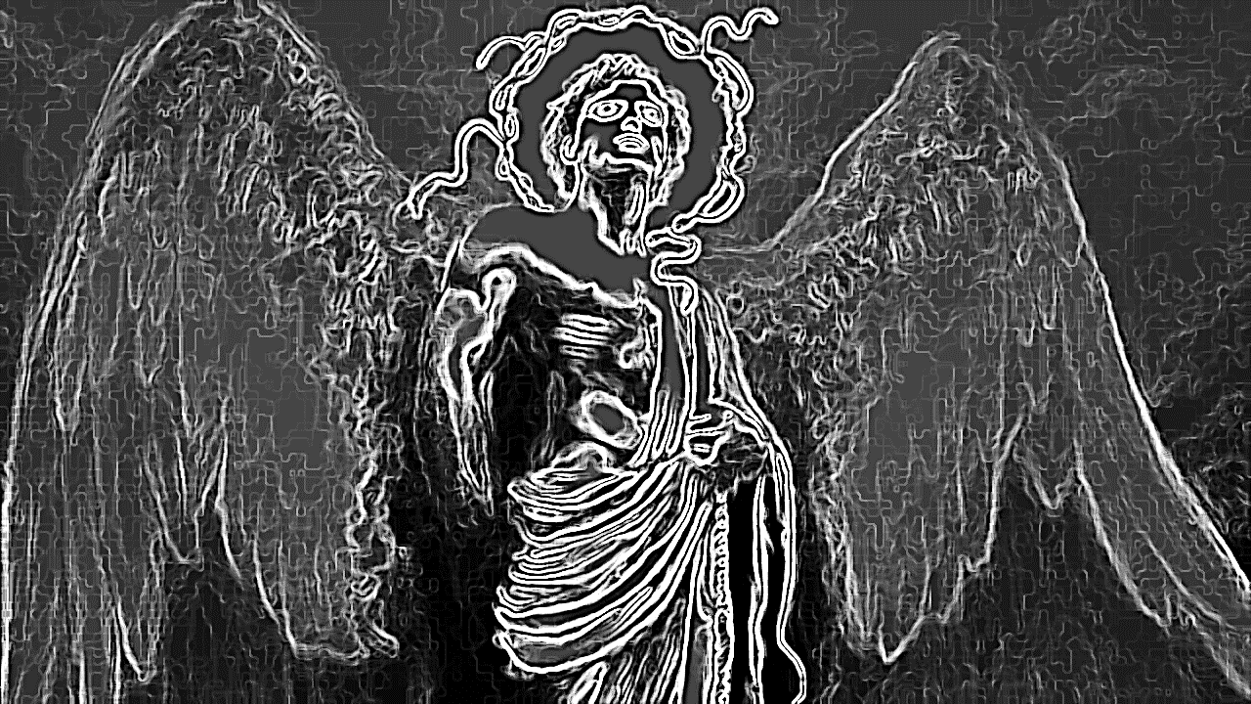
“…the workmanship of thy tabrets and of thy pipes was prepared in thee in the day that thou wast created.”

Slide 24
Dr. J. Dwight Pentecost writes: "Musical instruments were originally designed to be means of praising and worshipping God. It was not necessary for Lucifer to learn to play a musical instrument in order to praise God. If you please, he had a built-in pipe organ, or, he was an organ. That’s what the prophet meant when he said, ‘the workmanship of thy tabrets and of thy pipes....’ Lucifer, because of his beauty, did what a musical instrument would do in the hands of a skilled musician, bring forth a psalm of praise to the glory of God. Lucifer didn’t have to look for someone to play the organ so that he could sing the doxology—he was a doxology."

Slide 25
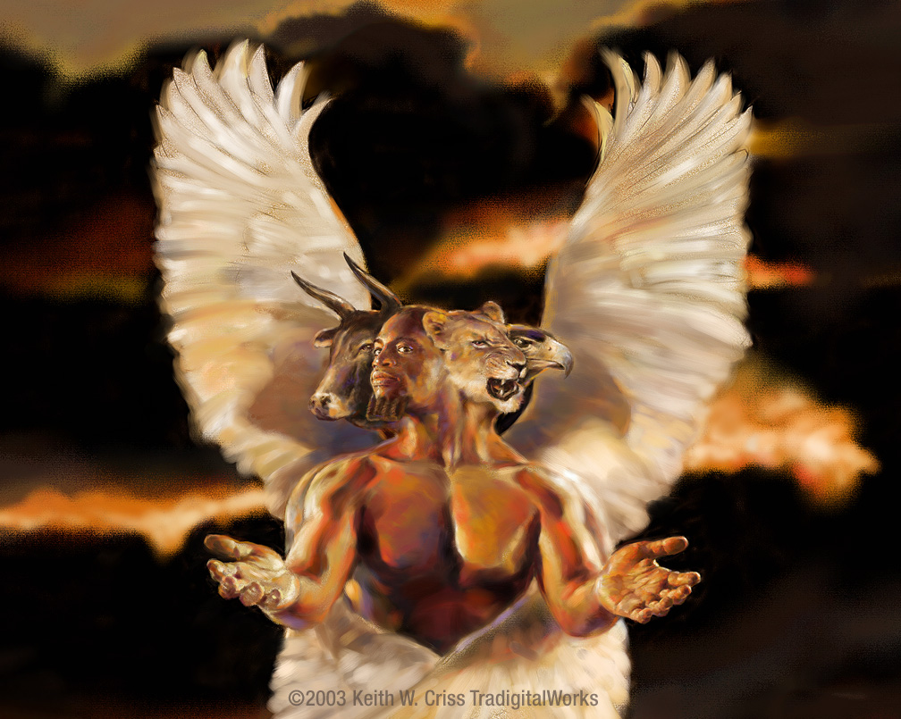
“Thou art the anointed cherub that covereth; and I have set thee so; thou wast upon the holy mountain of God; thou hast walked up and down in the midst of the stones of fire.”
The word cherub is
singular for cherubim.

Slide 26
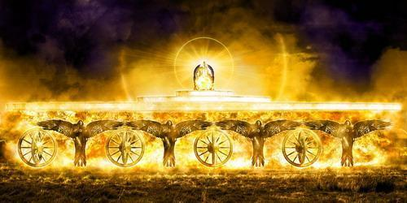
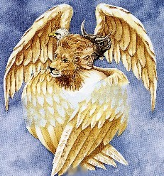
Four Living Creatures “Cherubims” (Ezekiel 10:15-20)

Slide 27
“Every one had four faces, and every one had four wings…And as they went, I heard the noise of their wings, like the noise of great waters, as the voice of the Almighty…”
“Their rings were high that they were dreadful; and their rings were full of eyes round about them. And when the living creatures went, the wheels went by them.”

Slide 28
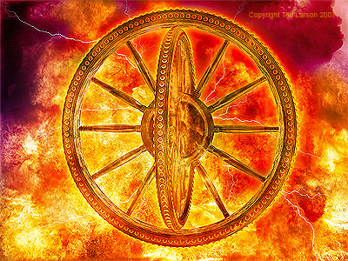
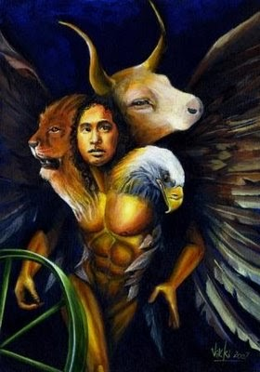

Slide 29
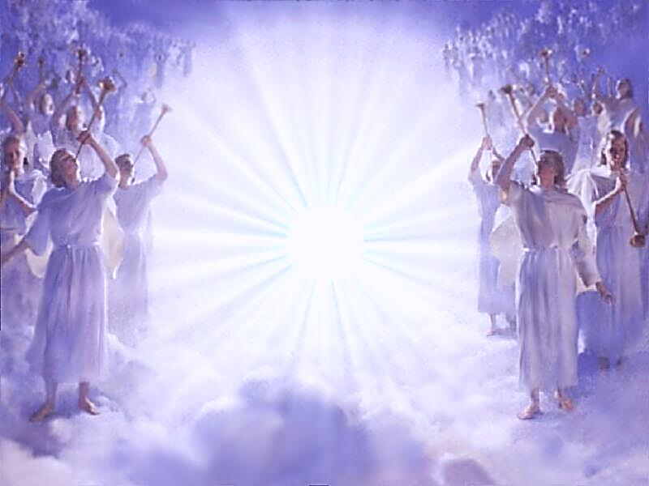
“Thou art the anointed cherub.”

Slide 30
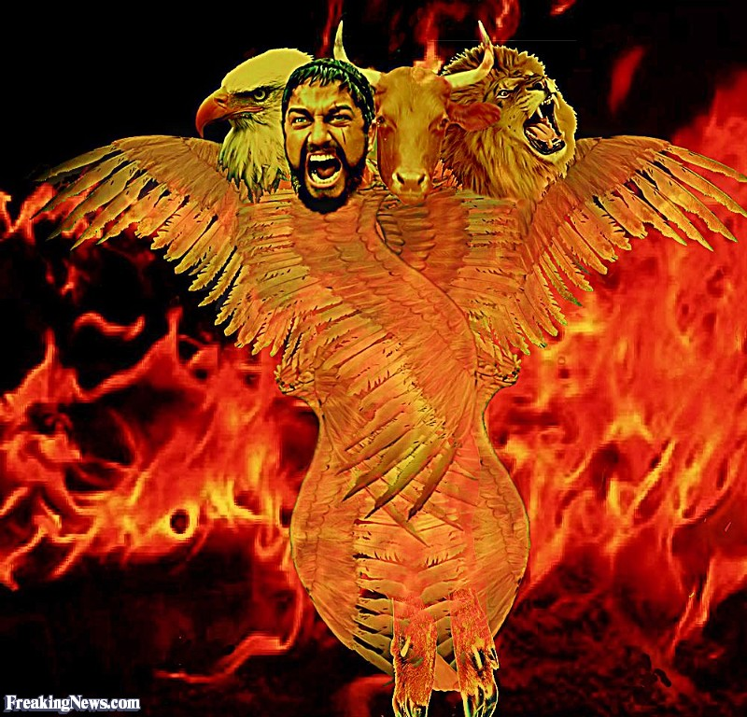
“Thou art the anointed cherub that covereth…”

Slide 31
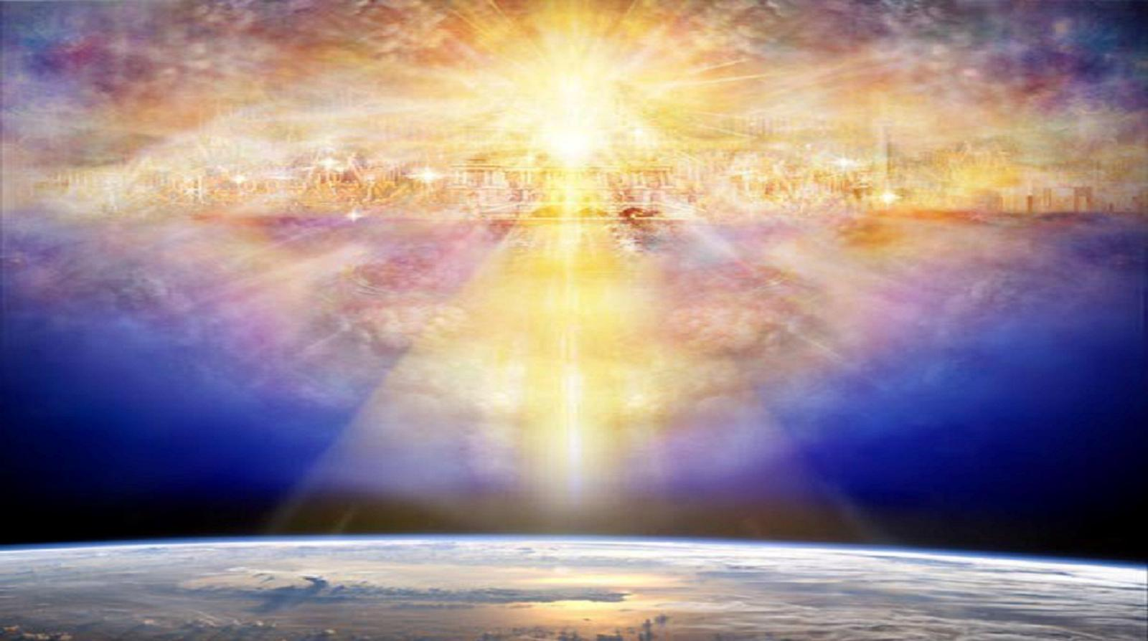
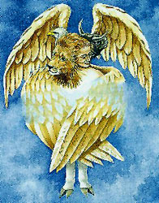
“…thou wast upon the holy mountain of God.”

Slide 32
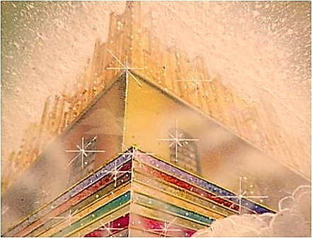
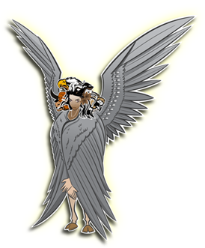
“…thou hast walked up and down in the midst of the stones of fire.”

Slide 33
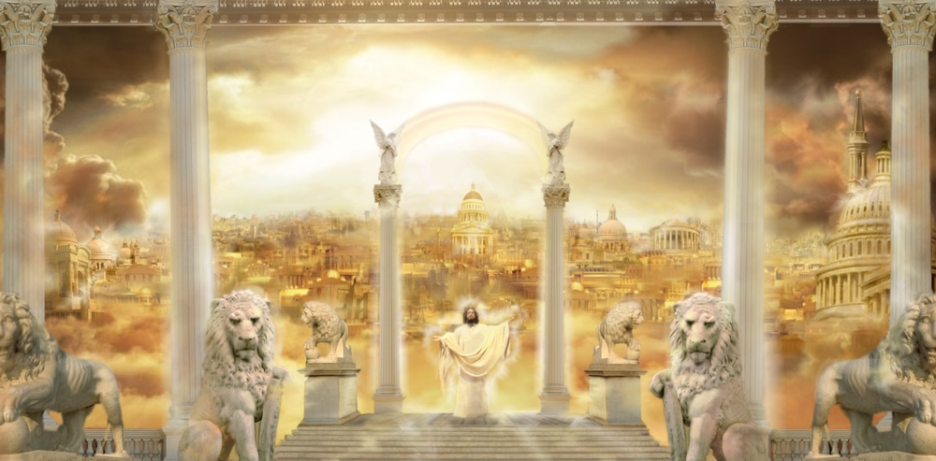
(Revelation 21) “Having the glory of God: and her light was like unto a stone most precious, even like a jasper stone, clear as crystal. And the building of the wall of it was of jasper: and the city was pure gold, like unto clear glass. And the foundations of the wall of the city were garnished with all manner of precious stones. The first foundation was jasper; the second, sapphire; the third, a chalcedony; the fourth, an emerald;

Slide 34
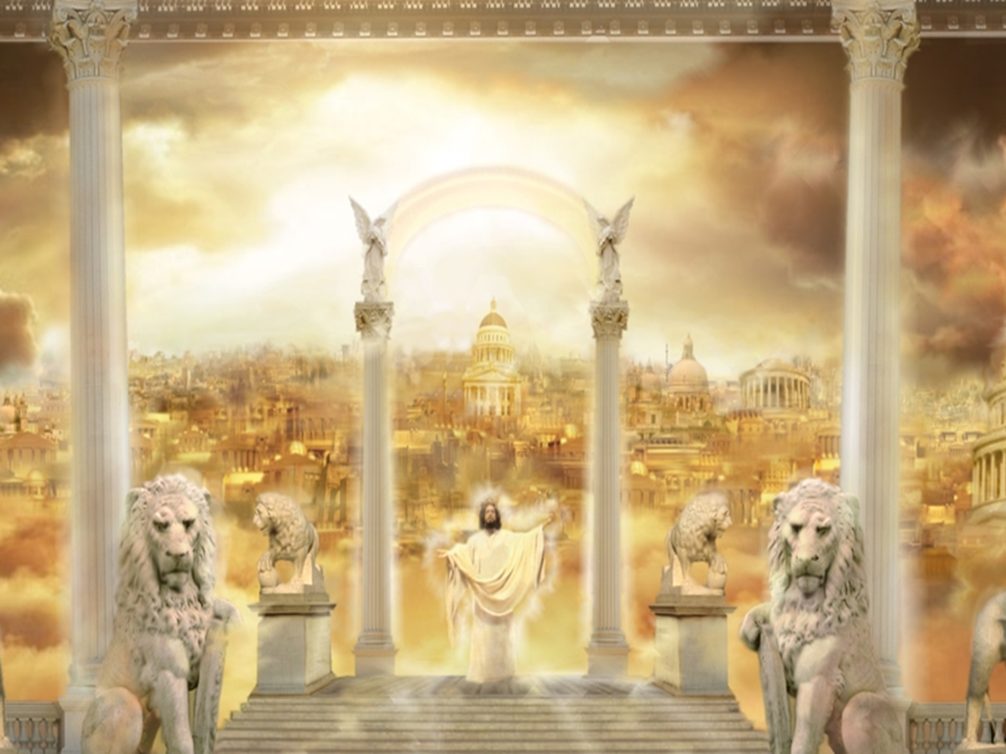
The fifth, sardonyx; the sixth, sardius; the seventh, chrysolite; the eighth, beryl; the ninth, a topaz; the tenth, a chrysoprasus; the eleventh, a jacinth; the twelfth, an amethyst. And the twelve gates were twelve pearls; every several gate was of one pearl: and the street of the city was pure gold, as it were transparent glass.”

Slide 35
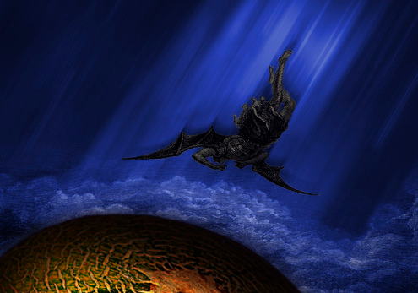
The Fall of the Anointed Cherub

Slide 36
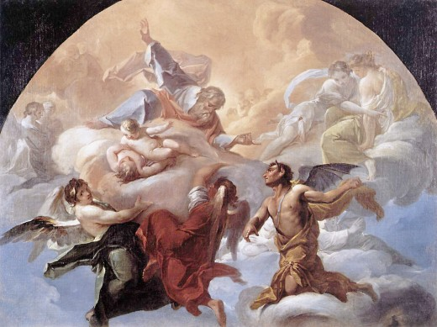
“Thou wast perfect in thy ways from the day that thou wast created, till iniquity was found in thee. By the multitude of thy merchandise they have filled the midst of thee with violence, and thou hast sinned.”

Slide 37
“I will cast thee as profane out of the mountain of God: and I will destroy thee, O coveting cherub, from the midst of the stones of fire.”

Slide 38
“Thine heart was lifted up because of thy beauty, thou hast corrupted thy wisdom by reason of thy brightness.”

Slide 39
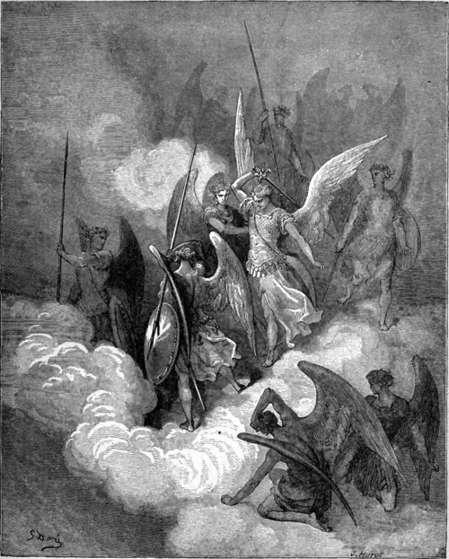
“I will cast thee to the ground, I will lay thee before kings, that they may behold thee.”

Slide 40
“Thou hast defiled thy sanctuaries by the multitude of thine iniquities, by the iniquity of thy traffick."
Sanctuaries – A consecrated thing or place, especially a place of worship, a chapel, a hallowed place, a holy place, a sanctuary.
Traffick - To deal or trade in something illegal. To peddle, merchandise.

Slide 41
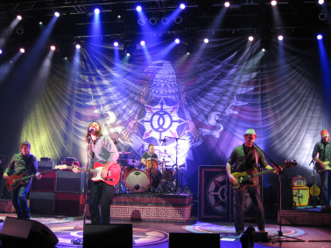

Slide 42
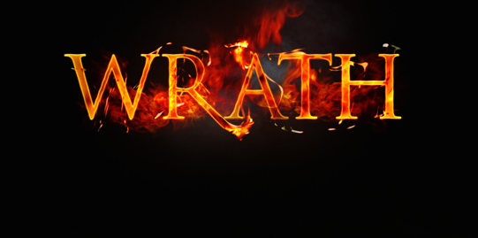
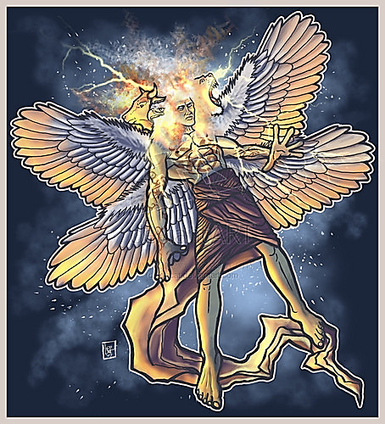

Slide 43
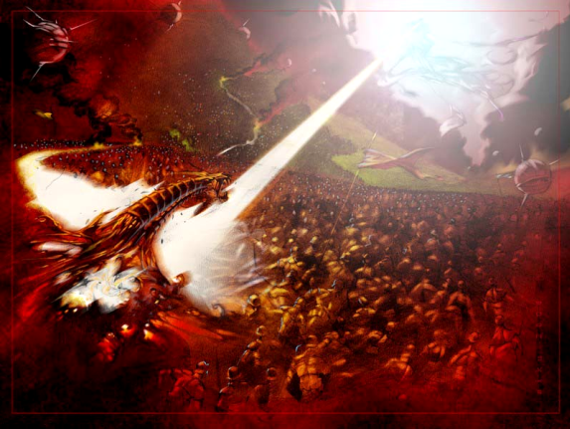
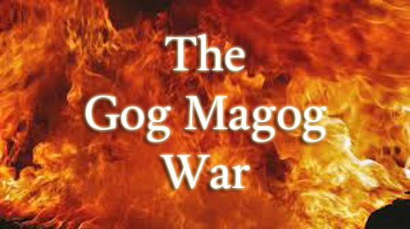
“And I will bring thee to ashes upon the earth in the sight of all them that behold thee. All they that know thee among the people shall be astonished at thee.”

Slide 44
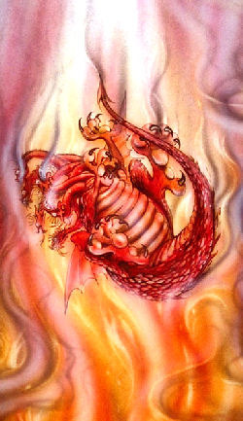
“Therefore will I bring forth a fire from the midst of thee, it shall devour thee.”

Slide 45
(Revelation 20:10)
“And the devil that deceived them was cast into the lake of fire and brimstone, where the beast and the false prophet are, and shall be tormented day and night for ever and ever.”

Slide 46
“Thou shalt be a terror, and never shalt thou be any more."

Slide 47
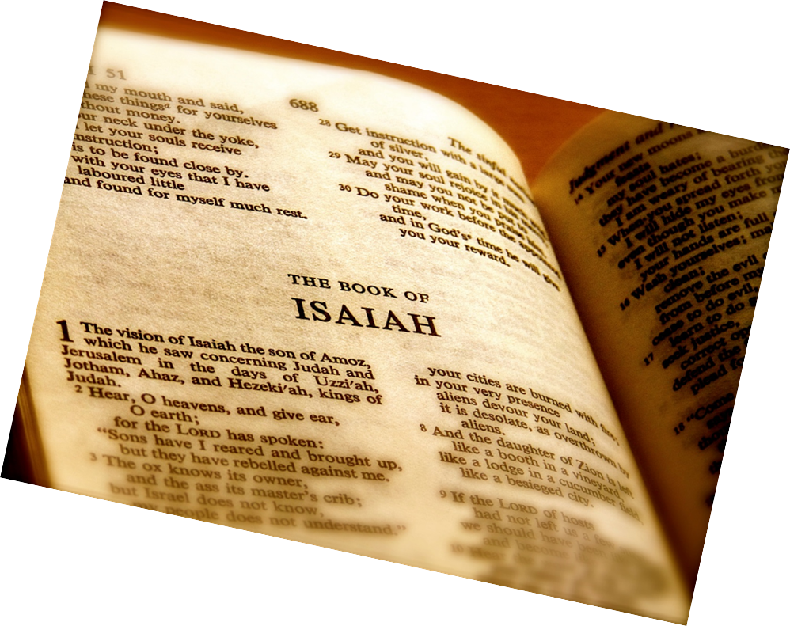
Satan’s origin and fall as recorded by Isaiah (Isaiah 14:12-14)

Slide 48
"How art thou fallen from heaven, O Lucifer, son of the morning! how art thou cut down to the ground, which didst weaken the nations! For thou hast said in thine heart, I will ascend into heaven, I will exalt my throne above the stars of God: I will sit also upon the mount of the congregation, in the sides of the north: I will ascend above the heights of the clouds; I will be like the most High."

Slide 49
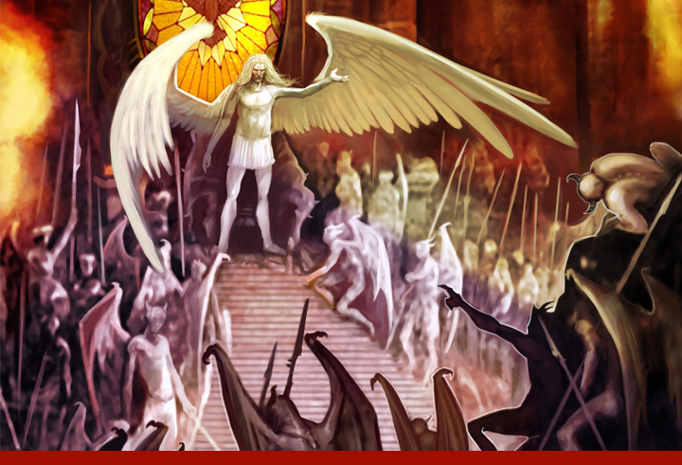
“How art thou fallen from heaven, O Lucifer, son of the morning!”

Slide 50
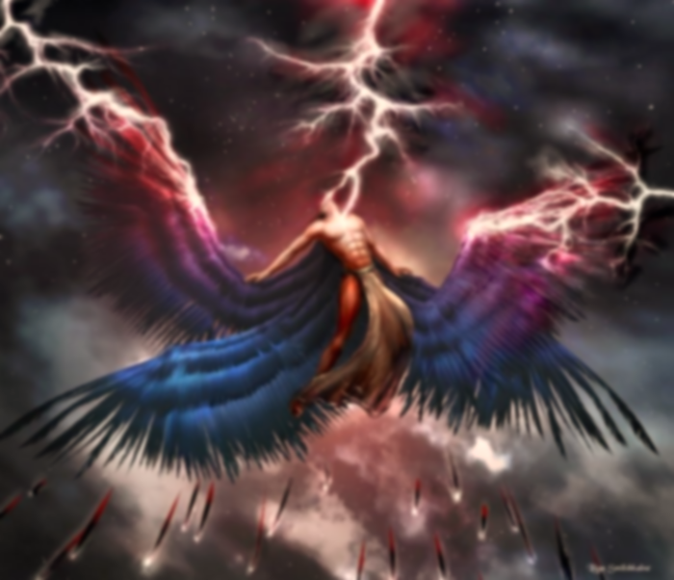
“And he said unto them, I beheld Satan as lightning fall from heaven.”
(Luke 10:18)

Slide 51
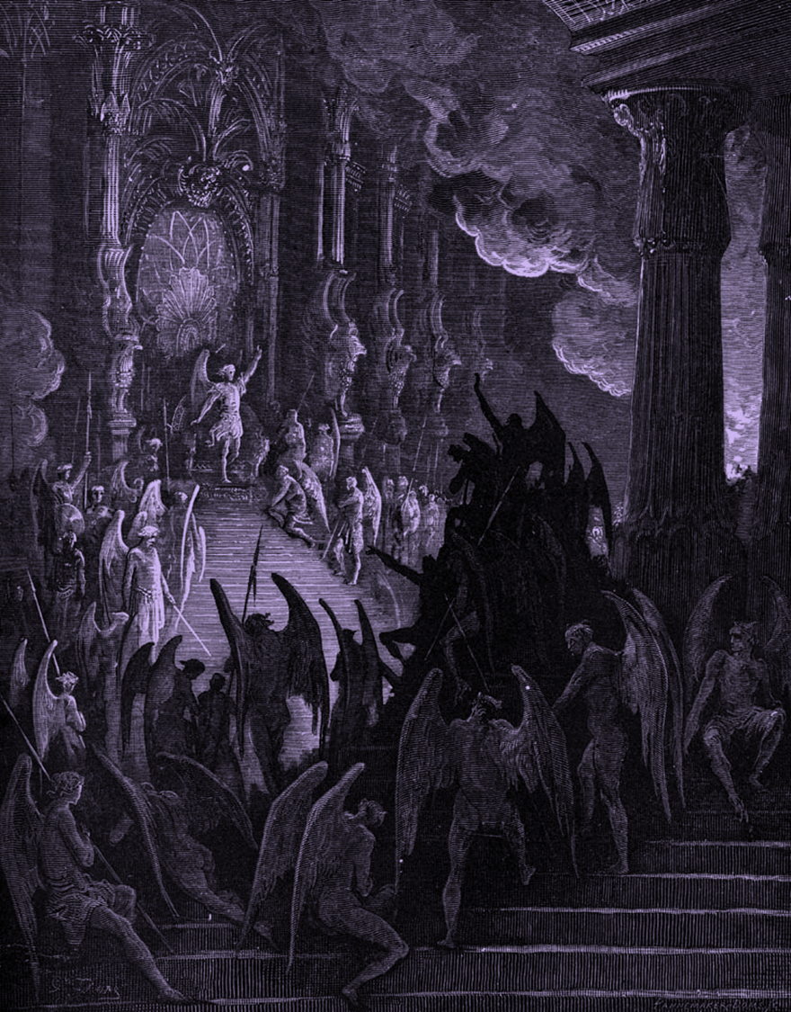
“Tail drew a third part of the stars of heaven, and did cast them to the earth…”
Stars of heaven = Fallen angels
1/3 followed Satan in his rebellion
Isaiah 14:12-15; Ezekiel 28:12-16; II Peter 2:4; Jude 6

Slide 52
Lucifer
"shining one, light bearer"

Slide 53
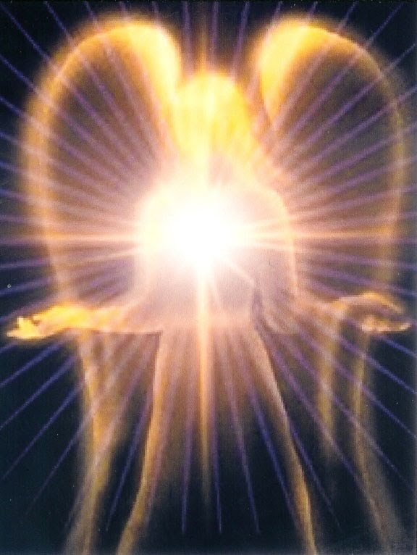
“And no marvel; for Satan himself is transformed into an angel of light.” (2 Cor. 11:14)

Slide 54
“How art thou cut down to the ground, which didst weaken the nations!”

Slide 55
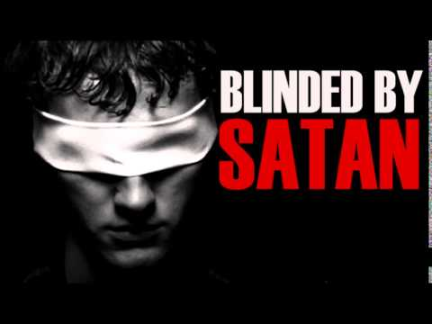
(2 Cor. 4:4) “In whom the god of this world hath blinded the minds of them which believe not, lest the light of the glorious gospel of Christ, who is the image of God, should shine unto them.”

Slide 56
“For thou hast said in thine heart…”
I will ascend into heaven - Obviously Satan had the third heaven in mind here, the very abode of God.
I will exalt my throne above the stars of God - A reference to angels. Satan desired the worship of angels.
I will sit also upon the mount of the congregation, in the sides of the north - Lucifer sought to enter God’s "executive office" somewhere in the north and sit on his throne.
I will ascend above the heights of the clouds - This may well refer to that special Shekinah glory of God.
I will be like the most High - He wanted to be like El-Elyon. This name literally means, "the strongest strong one."

Slide 57
(Isaiah 14:15-17) “Yet thou shalt be brought down to hell, to the sides of the pit. They that see thee shall narrowly look upon thee, and consider thee, saying, Is this the man that made the earth to tremble, that did shake kingdoms; That made the world as a wilderness, and destroyed the cities thereof; that opened not the house of his prisoners?”

Slide 58
“…never shalt thou [be] any more.”

