Slide 1
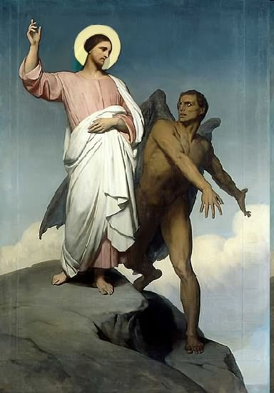

Slide 2
Topics to be studied
His existence
His origin
His fall
His personality
His names
His activities (Part 11)
His location – present and future
Our victory over him

Slide 4
Satan imitates God?

Slide 5
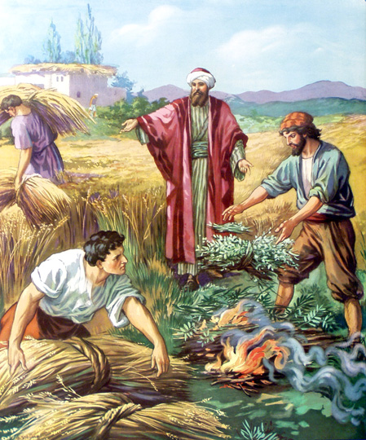
Matthew 13:24-42
Satan sows tares among God’s wheat

Slide 6
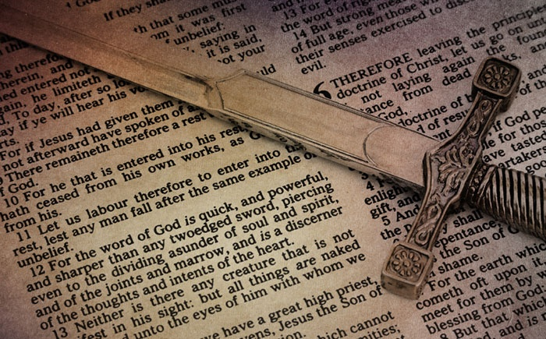
Satan perverts the Word of God (Part 1)

Slide 7
“Then said Jesus to those Jews which believed on him, If ye continue in my word, then are ye my disciples indeed; And ye shall know the truth, and the truth shall make you free…Ye are of your father the devil, and the lusts of your father ye will do. He was a murderer from the beginning, and abode not in the truth, because there is no truth in him. When he speaketh a lie, he speaketh of his own: for he is a liar, and the father of it.” (John 8:31-32, 44)

Slide 8
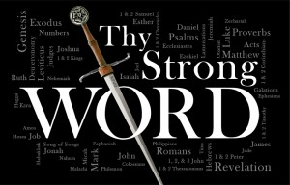
1 John 2:14
“I have written unto you, fathers, because ye have known him that is from the beginning. I have written unto you, young men, because ye are strong, and the word of God abideth in you, and ye have overcome the wicked one.”

Slide 9
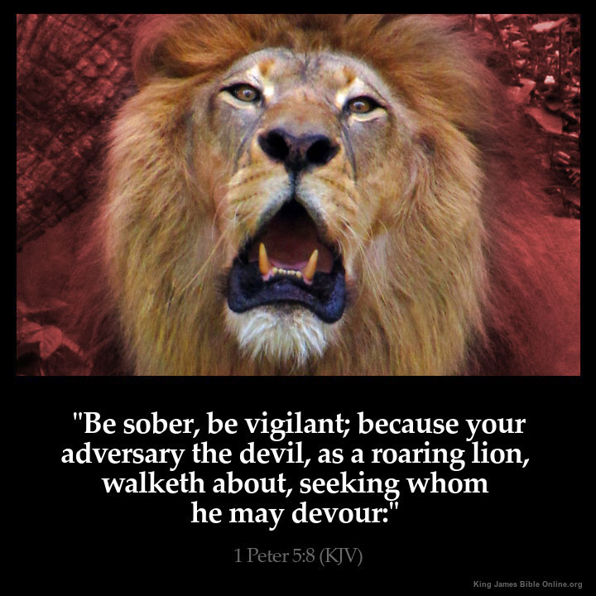

Slide 10
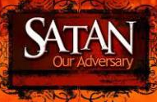
There are many things that Satan hates
He hates God – that’s for sure.
He hates anything that has to do with God
He hates God’s people
He hates YOU – who are made in the image of God
Most of all, Satan HATES the Word of God, the Bible
He hates every word, every line, every chapter, every page!
As a matter of fact, Satan hates just about everything and every one – he is a hater!

Slide 11
Why Satan hates the Word of God
1. Because GOD wrote it “All Scripture is given by inspiration of God”
2. Because it is true “Thy Word is Truth”
3. Because it saves souls (1 Peter 1:23)
4. Because it changes lives (John 8:32)
5. Satan is a LIAR and the father of lies (John 8:44)
6. Satan can’t stand the truth, because everything he does is based upon deception (2 Thess. 2:8-11)
7. And the truth of the Bible exposes him for who he is and how he operates

Slide 12
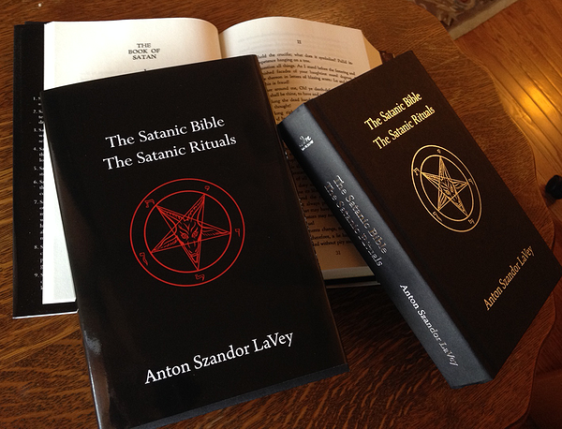
As an imitator of God he has even published his own bible

Slide 13
Satan is limited in his attack against the Bible
1. Satan cannot destroy the Word of God, so he seeks to twist it, corrupt it, pervert it, change it, and ruin it (2 Peter 3:16)
2. He has been doing that since he Garden of Eden (Gen 3:1-3), and he is not giving up!
3. As a matter of fact, he is stepping up his attack on the Bible more and more as we get closer to the end (2 Timothy 2:13)
4. If there is one thing we need to be aware of, it is Satan’s tactics, his devices, how he attacks the Bible (2 Cor. 2:11)

Slide 14
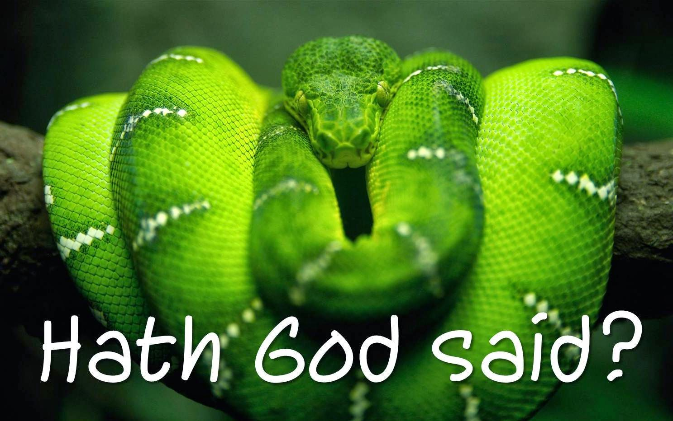
How Satan perverts the Word of God
1. Causing it to be mistranslated.
2. Causing it to be misinterpreted.
3. Causing it to be taken out of context.
4. Overstressing one side of a doctrine and ignoring the other side.
5. Understressing certain doctrines.

Slide 15
Satan doesn’t want you to believe in the perseveration of the inspired Scriptures
(2 Peter 3:16-18) “As also in all his epistles, speaking in them of these things; in which are some things hard to be understood, which they that are unlearned and unstable wrest, as they do also the other scriptures, unto their own destruction. Ye therefore, beloved, seeing ye know these things before, beware lest ye also, being led away with the error of the wicked, fall from your own stedfastness. But grow in grace, and in the knowledge of our Lord and Saviour Jesus Christ. To him be glory both now and for ever. Amen.”
(2 Corinthians 2:17) “For we are not as many, which corrupt the word of God: but as of sincerity, but as of God, in the sight of God speak we in Christ.”

Slide 16
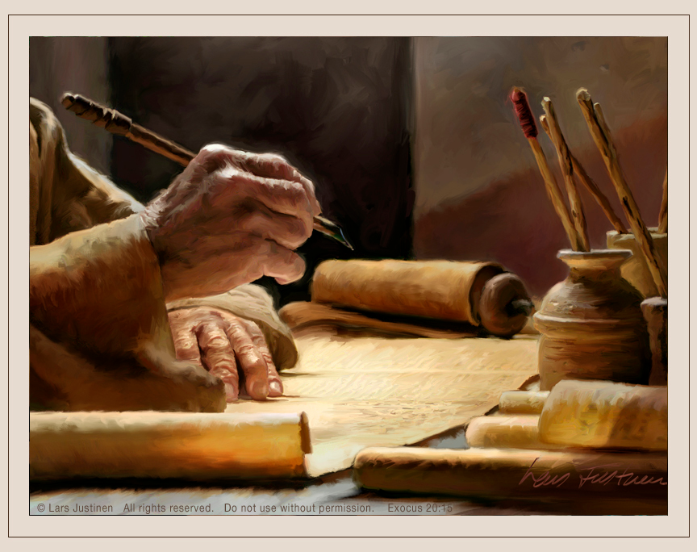
The Bible is the only book on earth written by God
“Holy men of God spake as they were moved by the Holy Spirit…The Lord gave the word and great was the company of those that published it…”

Slide 17
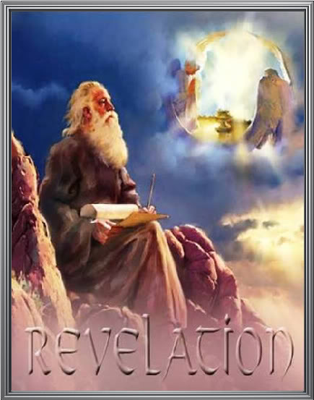
God breathed out His words to men over a period of about 1500 year.
Approximately 40 specially chosen and prepared men of God wrote down the Holy Scriptures in both the Old and New Testaments.
39 books in the Old Testament
27 books in the New Testament

Slide 18
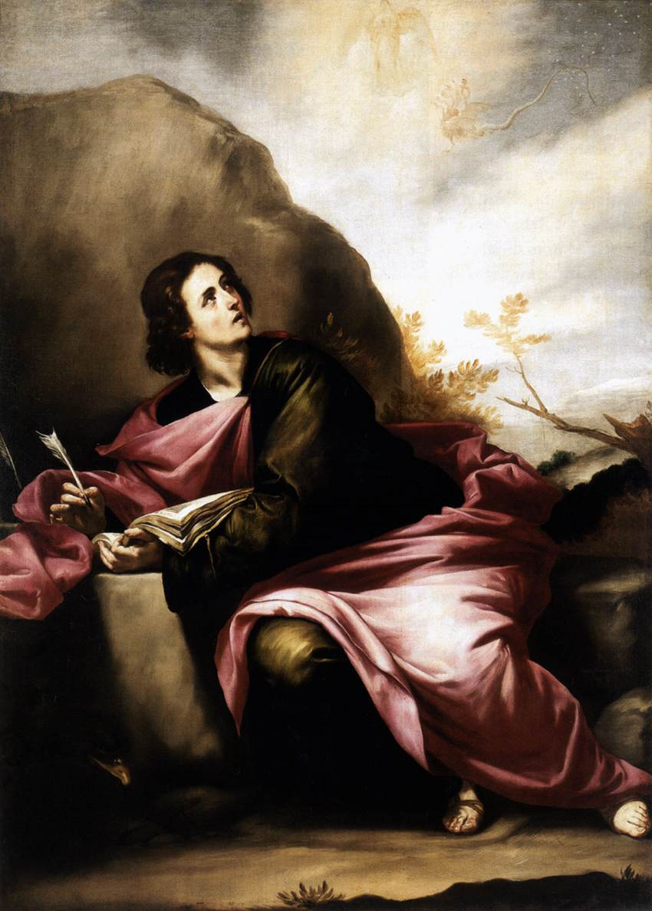
How Did God Write the Bible?
Revelation – (Rev. 1:1) (From God to Man)
Note: Ten times in the New Testament the Bible is referred as “The revelation of God…”
“Revelation of the mysteries of God…Revelation of the Lord Jesus Christ…Revelation of the will of God…Revelation of the knowledge of God…Revelation of the righteousness judgments of God…”

Slide 19
Paul the penman of 14 of the 27 New Testament books said
“But I certify you, brethren, that the gospel which was preached of me is not after man. For I neither received it of man, neither was I taught it, but by the revelation of Jesus Christ…” (Gal. 1:12-13)
“How that by revelation he made known unto me the mystery. Whereby when ye read, ye may understand my knowledge in the mystery of Christ. Which in other ages was not made known unto the sons of men, as it is now revealed unto his holy apostles and prophets by the Spirit…” (Eph. 3:3-4)

Slide 20
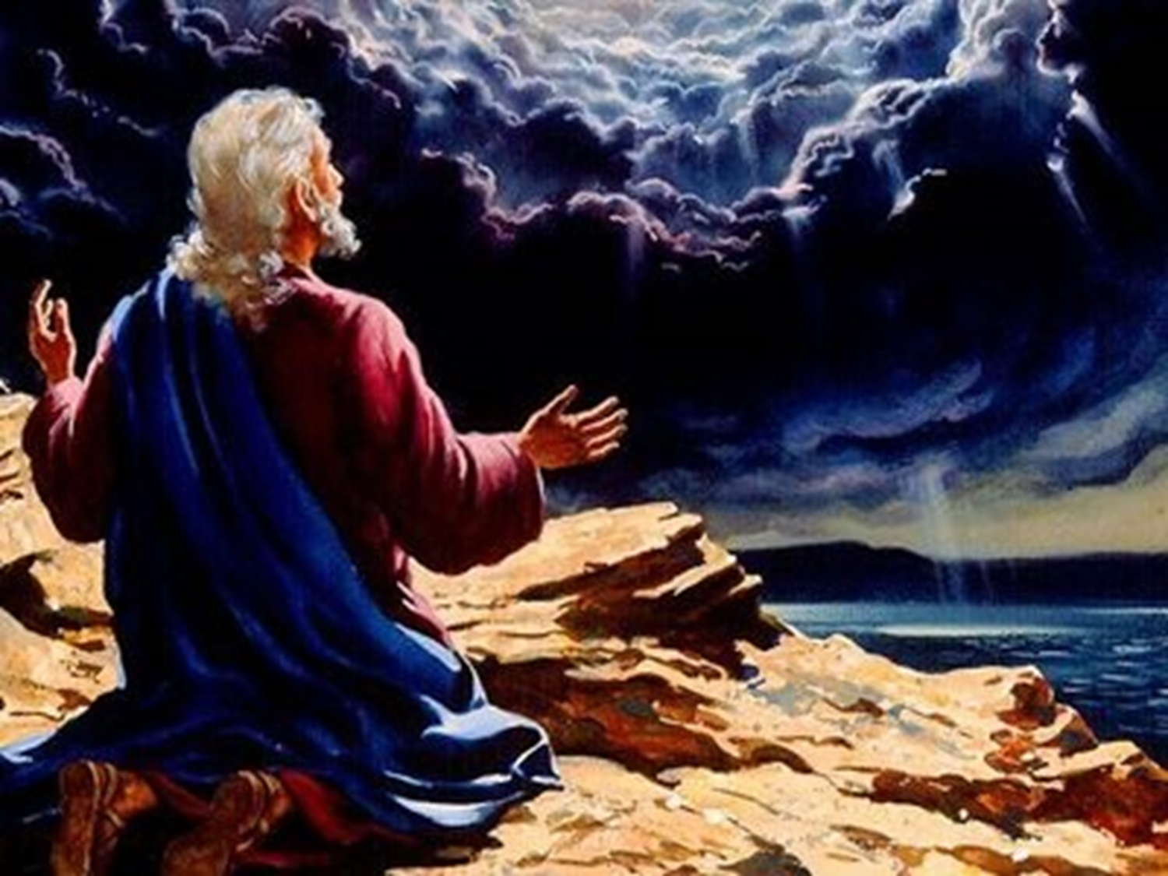
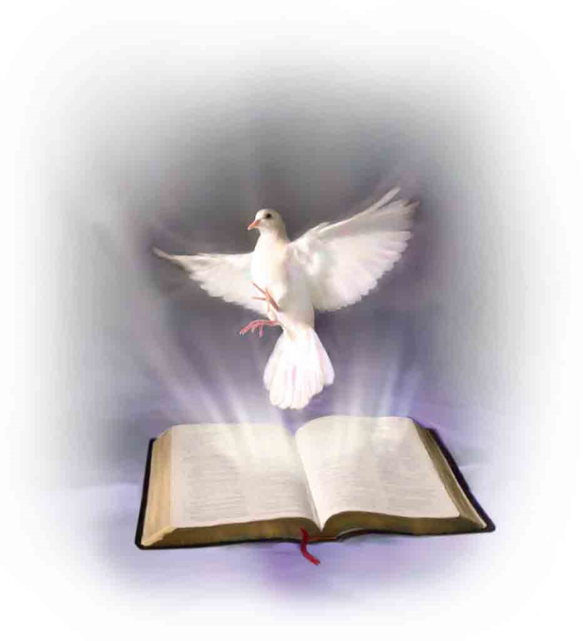

Slide 21
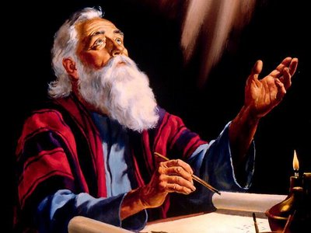
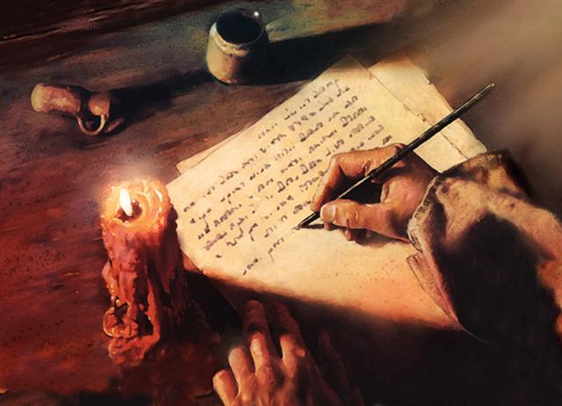
Inspiration – (From man to paper)
II Tim. 3:16 “All scripture is given by inspiration of God.”
“The inspiration of the Almighty giveth them understanding.” Job 32:8

Slide 22
We believe in the plenary inspiration of the Bible –
Plenary inspiration = Full/Complete “All the Bible is inspired, every word is breathed out by God…” (From Gen. 1:1 – Rev. 22:21)
Jesus said - “Man shall not live by bread alone, but by every word that proceedeth out of the mouth of God…”
Solomon said – “Every word of God is pure…” (Prov. 30:5)

Slide 23
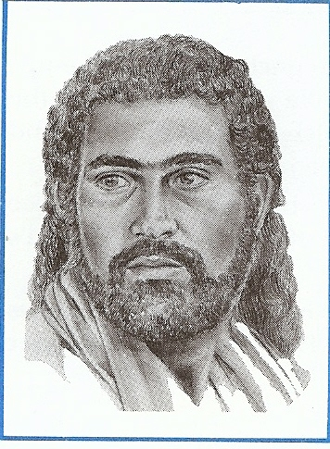
Referring to the writings of David the Apostle Luke said – “This Scripture (writings) which the Holy Ghost by the mouth of David spake…”

Slide 24
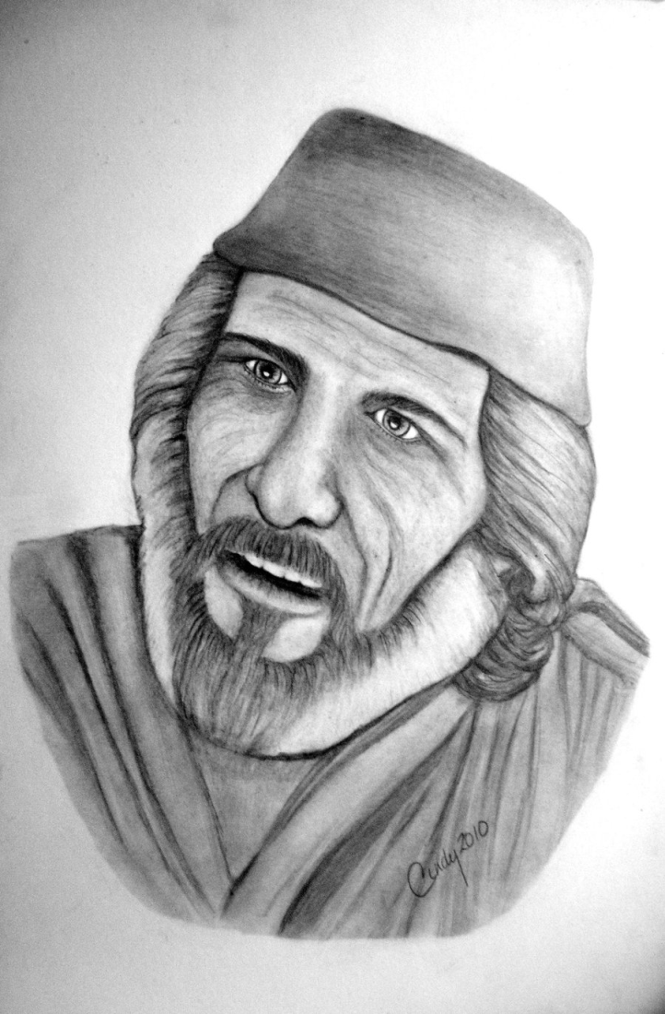
Samuel
“The Spirit of the Lord spake by me, and his word was in my tongue…”

Slide 25
“Now the Spirit speaketh expressly, that in the latter times some shall depart from the faith, giving heed to seducing spirits, and doctrines of devils.” (I Tim. 4:1)

Slide 26
“You don’t have the inspired, infallible, inerrant, preserved Word of God.”

Slide 27
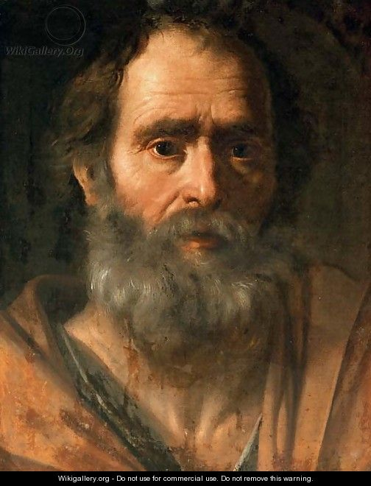
“We have also a more sure word of prophecy…Knowing this first, that no prophecy of the scripture is of any private interpretation. For the prophecy came not in old time by the will of man: but holy men of God spake as they were moved by the Holy Ghost.”

Slide 28
“But there were false prophets also among the people, even as there shall be false teachers among you, who privily shall bring in damnable heresies.” (II Peter 1:19-2:1)

Slide 29
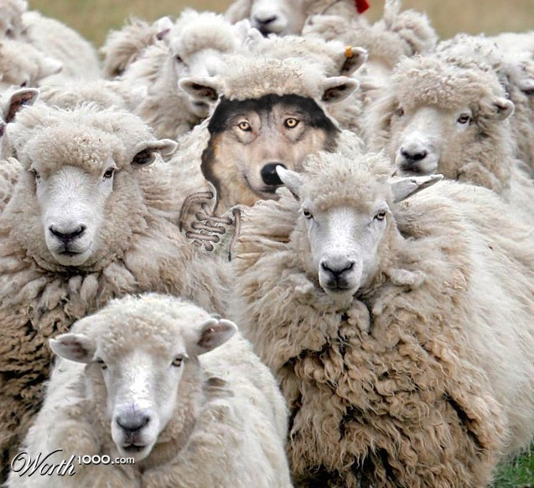
1 John 3:7 “Let no man deceive you.”

Slide 30
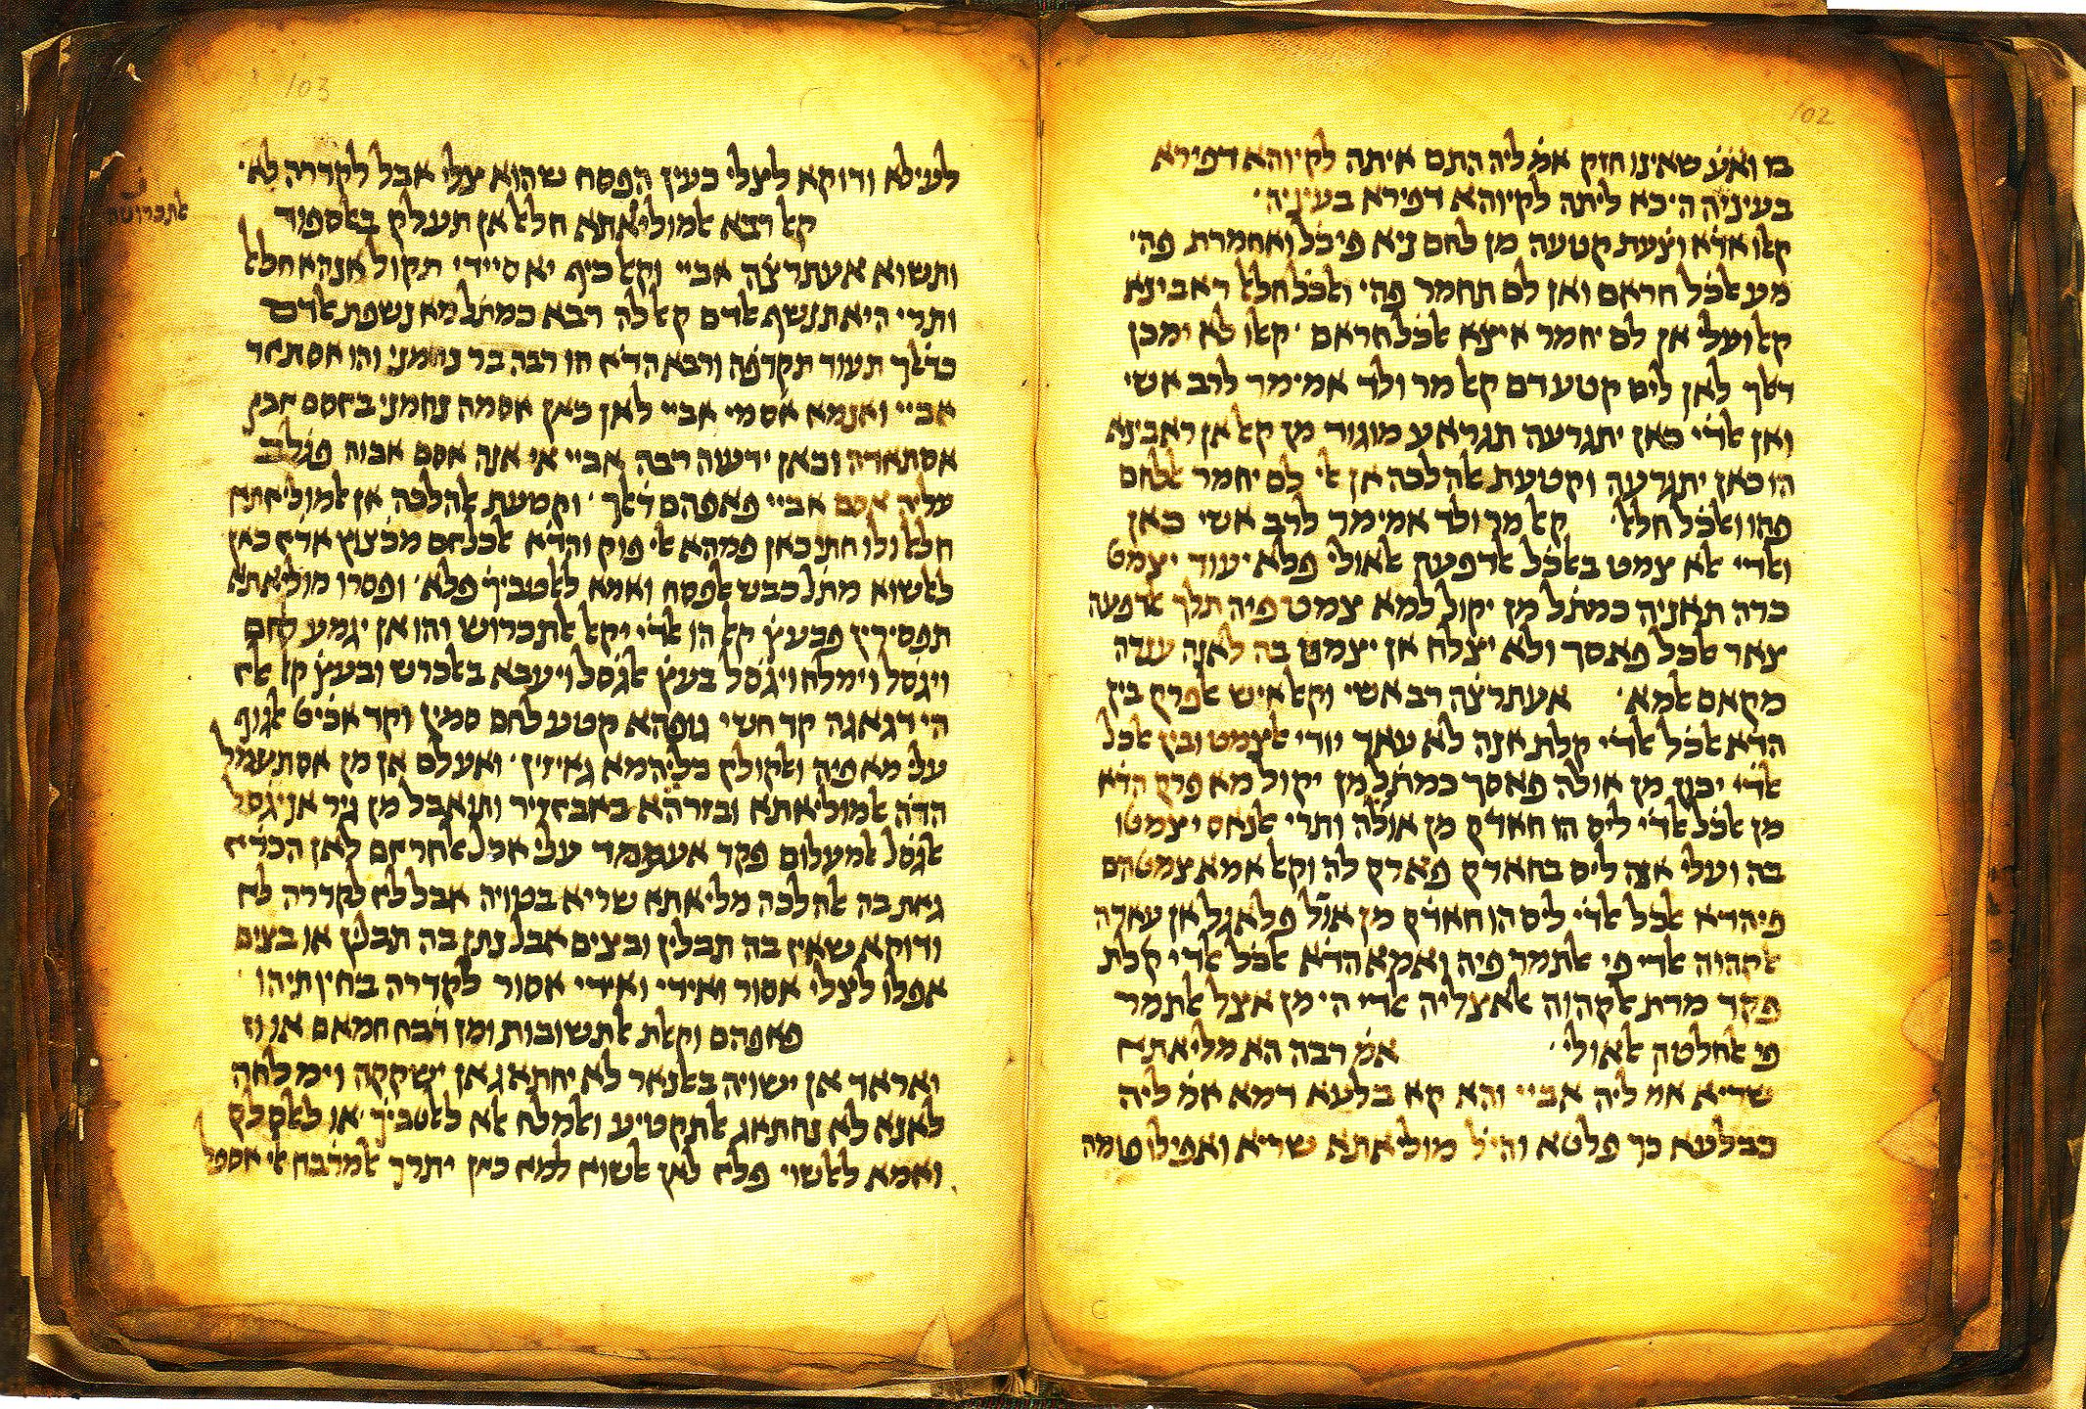
This word in the KJV would be better translated
The better manuscripts read as follows
The more ancient manuscripts don’t include this verse
The more ancient manuscripts add this verse
The best manuscripts disagree with the KJV
The KJV doesn’t have a accurate translation of this verse
This word really doesn't mean ___________ it means ____________
The Textus Receptus is inferior to the Westcott and Hort Text
There is very little difference between the Textus Receptus and the Westcott and Hort Text
The words in the KJV are archaic
The KJV is to hard to understand
The KJV has been Revised many times

Slide 31
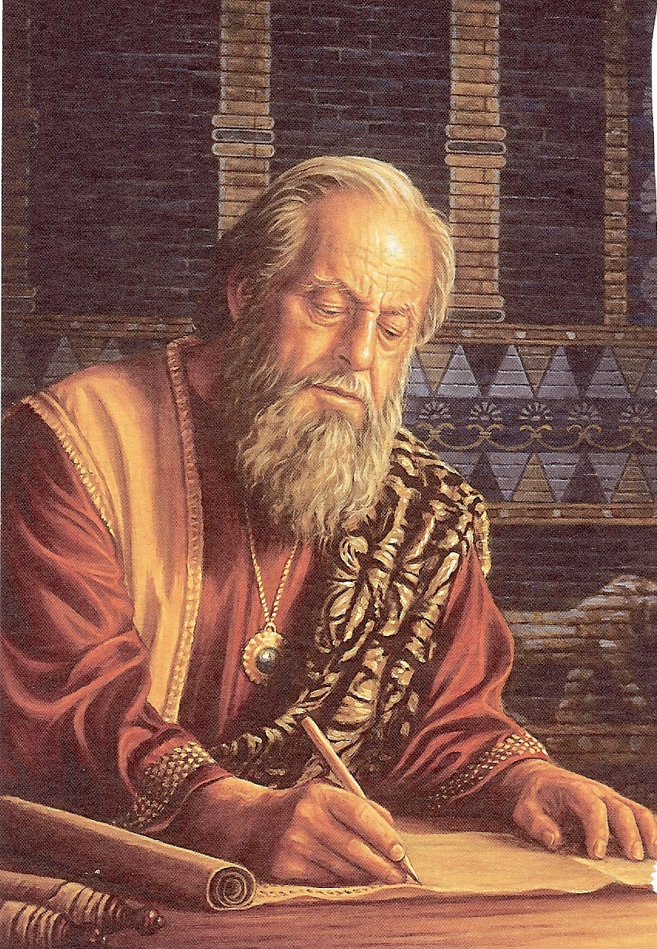
At FBC we believe in the verbal inspiration of the Bible -
Verbal inspiration has to do with the actual formation and use of the words themselves.
The “Verbal” concept of inspiration contends that the Spirit of God guided the holy writers to record the very words of God.
God used the background, personalities, talents of the holy writers.
Divine supervision was present so that the exact messages (word) that God intended was recorded in the Scriptures.

Slide 32
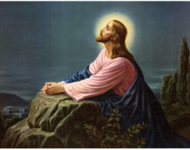
Jesus
“For I have given unto them thy words which thou gavest me; and they have received them…It is the spirit that quickeneth; the words that I speak unto you, they are spirit and they are life…”

Slide 33
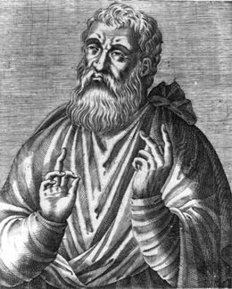
“I am writing to persuade you that you have not understood anything of the Scriptures, I will remind you that the Psalms were dictated to David by the Holy Spirit…”
Justin Martyr

Slide 34
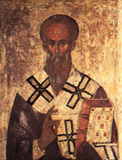
Clement of Rome
“Take up the epistle of the blessed Apostle Paul. What did he write to you at the time when the gospel first began to be preached? Truly, under the inspiration of the Spirit he wrote to you…”

Slide 35
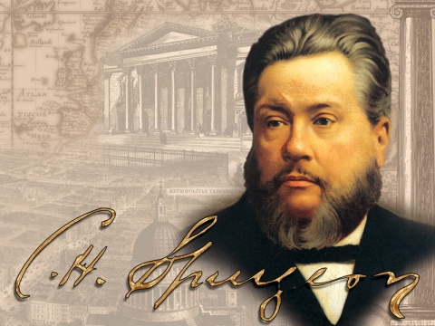
Spurgeon
“The Bible is the writing of the living God: Each letter was penned with an Almighty finger; each word in it dropped from the everlasting lips; each sentence was dictated by the Holy Spirit…”

Slide 36
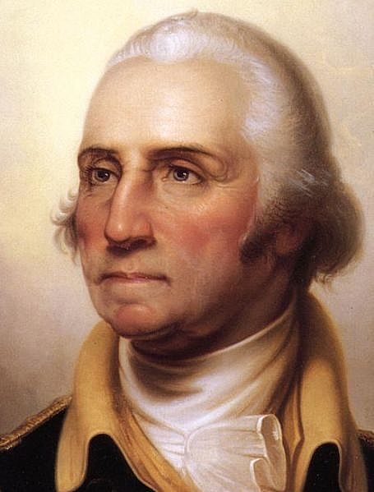
George Washington
“It is impossible to rightly govern the world without God and the Bible…”

Slide 37
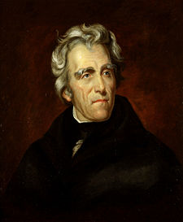
Andrew Jackson
“That book, sir is the rock on which our republic rest…”

Slide 38
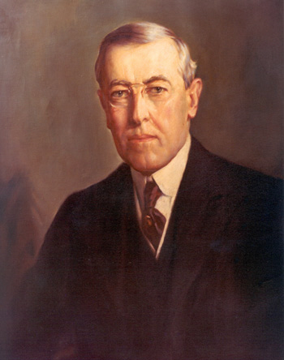
Woodrow Wilson
“The Bible is the word of life. It is a picture of the human heart displayed for all ages and all sorts of conditions of men. I feel sorry for the men who do not read the Bible every day. I wonder why they deprive themselves of its strength and pleasures.”

Slide 39
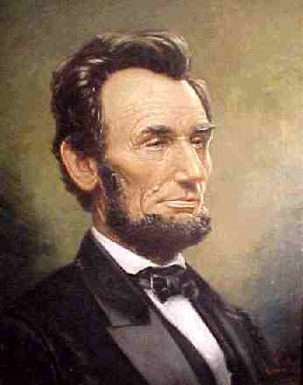
Abraham Lincoln
“I believe the Bible is the best gift God has ever given to man. All the good from the Savior of the world is communicated to us through this book…”

Slide 40
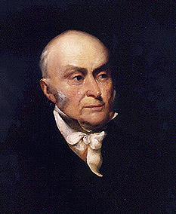
John Quincy Adams
“So great is my veneration for the Bible that the earlier my children begin to read it the more confident will be my hope that they will prove useful citizens of their country and respectable members of society. I have for many years made it a practice to read through the Bible once every year…”

Slide 41
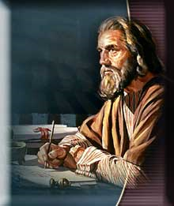
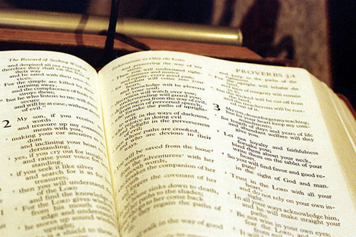
The word “Scripture” means – The actual writings of God.
We believe in the word-for-word inspiration of Scripture.
We do not believe that God simply inspired “thoughts” or “concepts” –

Slide 42
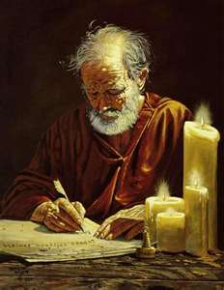
Paul
“Which things also we speak (Scripture) not in the words which man’s wisdom teacheth, but (the words) which the Holy Ghost teacheth…”

Slide 43
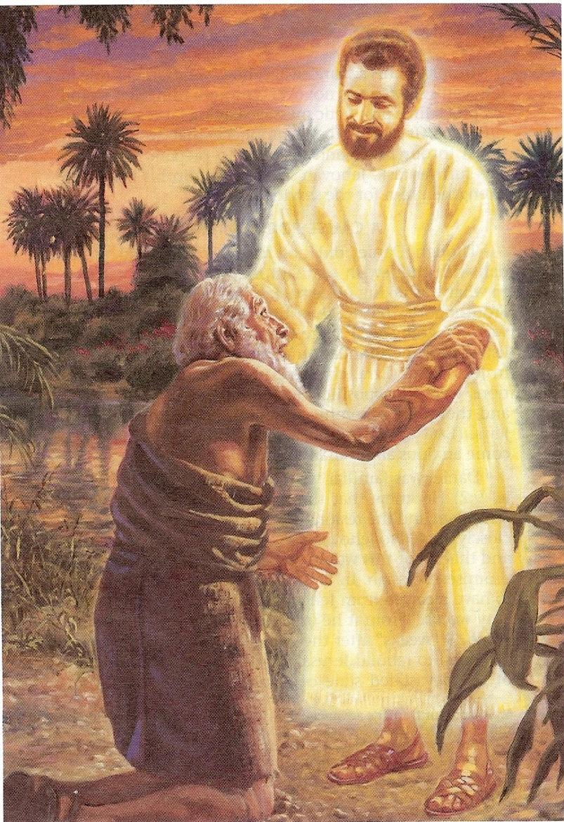
Daniel
“I Daniel was grieved in my spirit in the midst of my body, and the visions of my head troubled me. I came near unto one of them (angel) that stood by, and asked him the truth of all this. So he told me, and made me know the interpretation of the things…I was astonished at the vision, but none understood it…And I heard but I understood not: Then said I O my Lord what shall be the end of these things? And he said, go thy way Daniel for the words are closed up and sealed till the time of the end…”

Slide 44
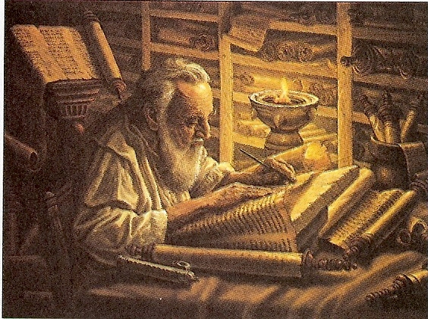
How could Daniel put the thoughts or concepts of God into his own words if he did not understand what he was writing?
God had to dictate to him every word!!!

Slide 45
“The statutes of the LORD are right, rejoicing the heart: the commandment of the LORD is pure, enlightening the eyes.” (Psalm 19:8)

Slide 46
Jesus – “Sanctify them through thy truth: thy word is truth…”
Isaiah said – “His word shall not return unto Him void, but it shall accomplished that which He pleases, and it shall prosper in the thing whereto he sent it…”
Jeremiah said – “Is not my word like a fire? Saith the Lord; and like a hammer that breaketh the rock in pieces…”
David said – “How shall a young man cleanse his way? By taking heed thereto according to thy word…”
Peter said – “As new born babes, desire the sincere milk of the word that ye may grow thereby…”
Hebrews says – “For the word of God is quick and powerful and sharper than any twoedged sword…”

Slide 47
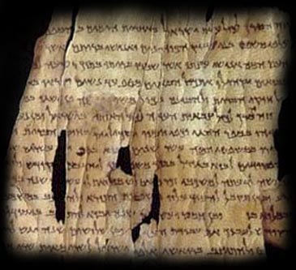
“All (plenary) Scripture (verbal) is given by inspiration of God…”

Slide 48
Inspiration
Literally, it means “God-breathed” and expresses the concept of exhalation by God.
More accurately, it emphasizes that Scripture is the product of the breath of God.
The Scriptures are not something breathed into by God, rather, the Scriptures have been breathed out by God.

Slide 49
“And the LORD God formed man of the dust of the ground, and breathed into his nostrils the breath of life; and man became a living soul.” (Gen. 2:7)

Slide 50
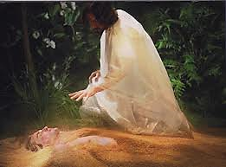

Slide 51
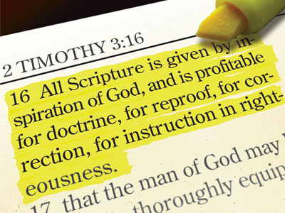
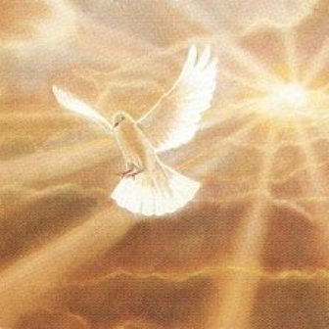
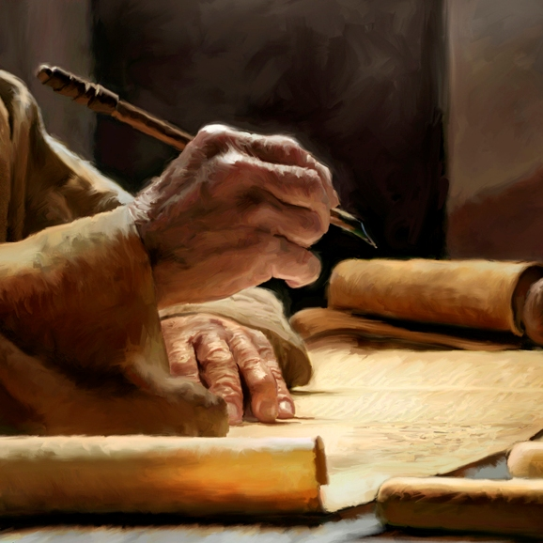

Slide 53
Is inspiration still going on today?
“Thou shalt not add thereto nor diminish from it…add thou not unto his words…if any man shall add unto these things, God shall add unto him the plagues that are written in this book. And if any man shall tak away from the words of the book of this prophecy, God shall take away his part out of the book of life and out of the holy city from the things which are written in this book…”

Slide 54
Liberals – take away from the Word of God
Legalist – add to the Word of God
Literalist – accept the Word of God as the Word of God
Satan’s attack has always been and always will be against the Word of God.
He wants us to believe that we do not possess the very words of God – “Yea hath God said…ye shall not surely die…”
We have the Word of God – “More sure word of prophecy” (See II Peter 1:16-21)

Slide 55
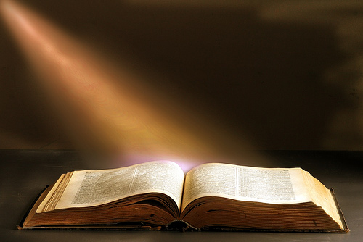
“We have also a more sure word of prophecy; whereunto ye do well that ye take heed, as unto a light that shineth in a dark place.”
The word "sure"
confident in what one thinks or knows
having no doubt that one is right
free from doubt as to the reliability
convinced
fully persuaded
positive
assured
certain beyond question

Slide 56
God has promised to preserve His Word for all generations?
What does the Bible say about preservation – Ps. 12:6-7; 33:11; 100:5; 119:89; Isa. 40:8 I Peter 1:25
“The words of the Lord are pure words: as silver tried in a furnace of earth, purified seven times. Thou shalt keep them, O Lord, thou shalt preserve them from this generation forever…The counsel of the Lord standeth forever, the thoughts of his heart to all generations…His truth endureth to all generations…forever, O Lord, thy word is settled in heaven, thy faithfulness is unto all generations…The grass withereth, the flower fadeth, but the word of our God shall stand forever…but the word of the Lord endureth forever…”

Slide 57
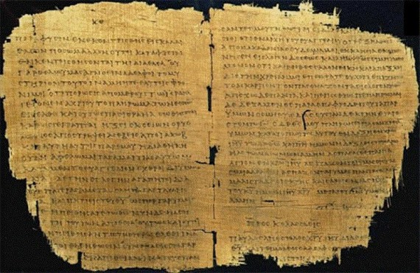
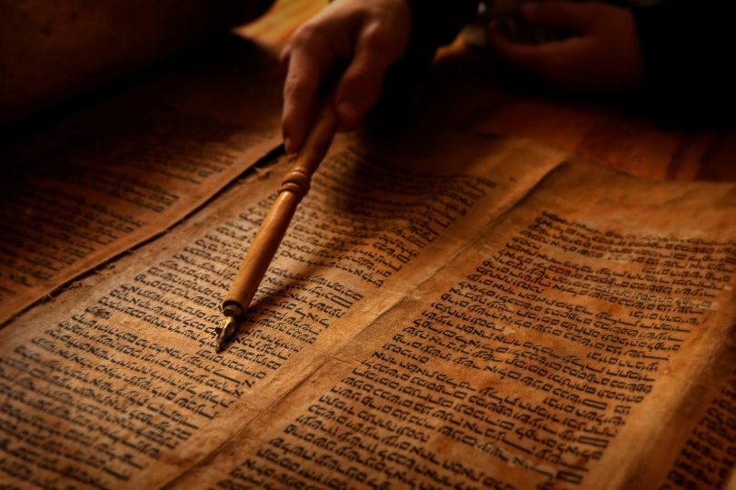
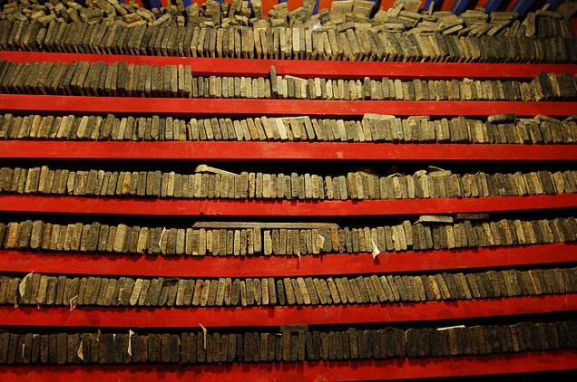
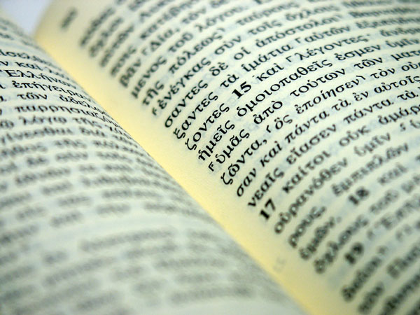
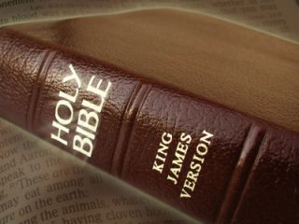
You can’t have Preservation without Inspiration
Over 5000 copies
TR Majority Text
KJV
Original Autographs

Slide 58
What did Jesus say about inspiration – John 17:17 ; John 5:46-47; Luke 16:31; Matt. 4:4
“Thy word is truth…For had ye believed Moses ye would have believed me: for he wrote of me. But if ye believe not his writings, how shall ye believe my words…And he said unto him, if they hear not Moses and the prophets, neither will they be persuaded, though one rose from the dead…Man shall not live by bread alone, but by every word that proceedeth out of the mouth of God.”

Slide 59
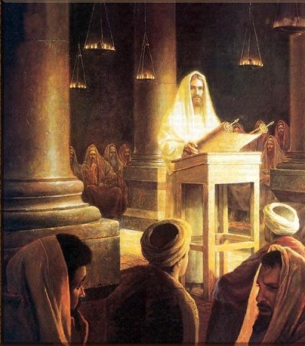
Over and over again in the teaching and preaching ministry of the Lord Jesus he quoted from the Old Testament Scriptures – “It is written”
35 direct Old Testament references quoted by Christ in his teaching and preaching.

Slide 60
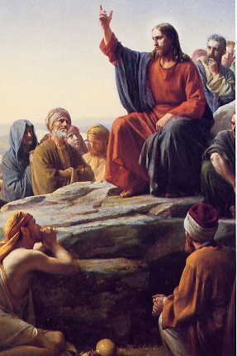
Not only did Jesus quote the Old Testament Scriptures he often referred to the stories of the Old Testament as actual events that happened -
Creation, marriage, flood, destruction of Sodom, Lots wife, Jonah, repentance of the city of Nineveh, healing of Naaman’s leprosy, the brazen serpent etc.

Slide 61
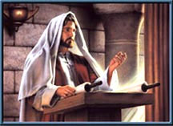
What did Jesus say about preservation?
Matt. 4:4; 5:18, 24:35; Luke 16:17; John 10:35
“For verily I say unto you. Till heaven and earth pass, one jot or one tittle shall in no wise pass from the law, till all be fulfilled…Heaven and earth shall pass away but my words shall not pass away…It is easier for heaven and earth to pass, than one tittle of the law to fail...The scriptures cannot be broken…”

Slide 63
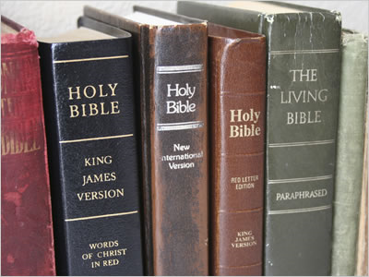
Next week In What Version Has God Preserved His Word?
450 Versions of the English Bible

