Slide 2
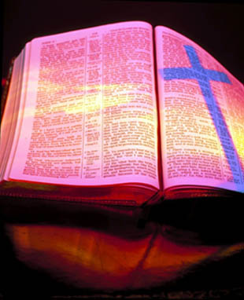
Revelation 1:1-19 The Vision of the Glorified Christ

Slide 3
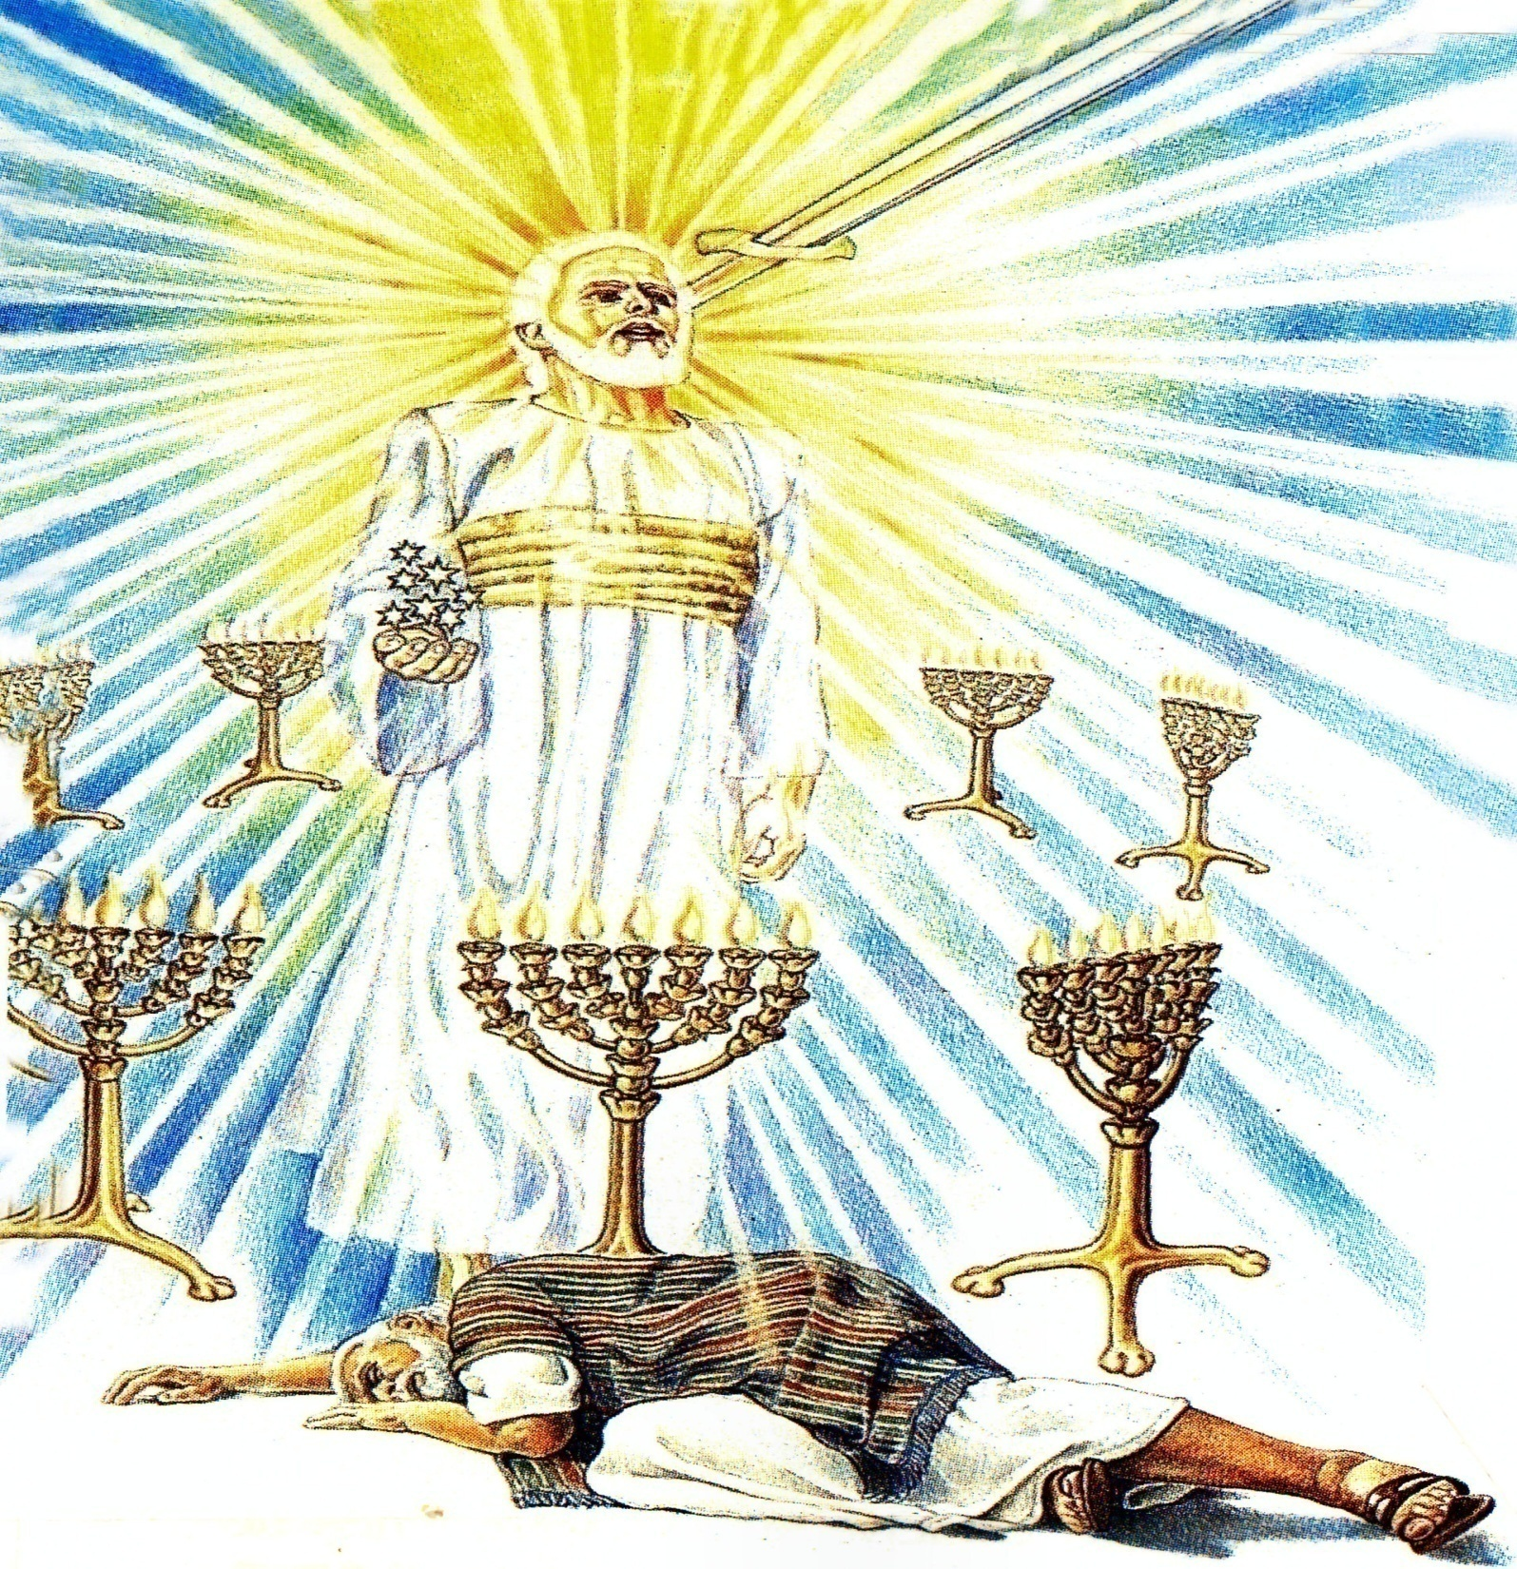

Slide 4
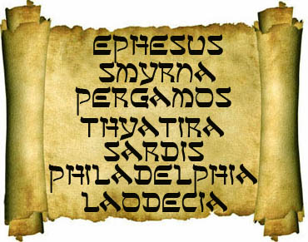
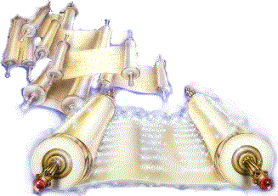
“What thou seest, write in a book, and send it unto the seven churches which are in Asia; unto Ephesus, and unto Smyrna, and unto Pergamos, and unto Thyatira, and unto Sardis, and unto Philadelphia, and unto Laodicea.”

Slide 5
Revelation 2:1-7 The Church at Ephesus

Slide 7
Revelation 2:8-11
“The Church at Smyrna”

Slide 9
Revelation 2:12-17
“The Church at Pergamos”

Slide 11
Revelation 2:18-29
“The Church at Thyatira”

Slide 12
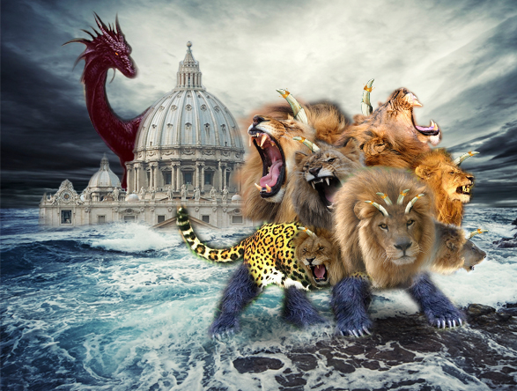
The Church that Became Pagan

Slide 13
Revelation 3:1-6
“The Church at Sardis”

Slide 14
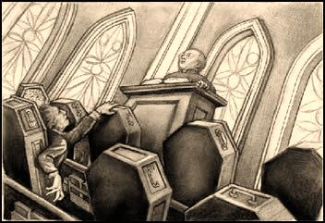
The Spiritually Dead Church
“…thou hast a name that thou livest, and art dead.”

Slide 15
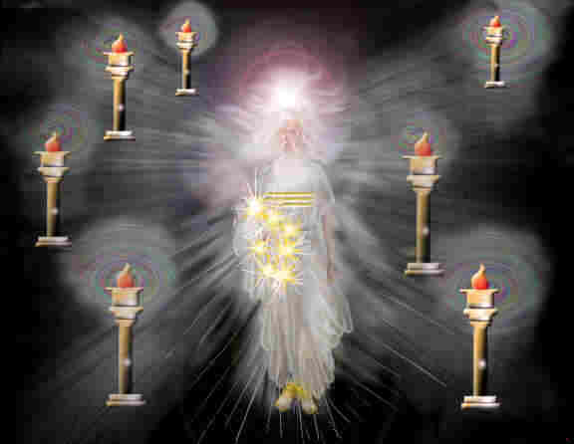
Signs of Christ’s Return (Church age)
Ephesus – Fundamental - A.D. 30-100
Smyrna – Persecuted – A.D. 100-312
Pergamos – Worldly – A.D. 312-606
Thyatira – Pagan – A.D. 606-1520 (Dark Ages)
Sardis – Spiritually Dead – A.D. 1520-1750
Philadelphia – Revival – A.D. 1750-1900
Laodicea – Apathy – A.D. 1900-Rapture

Slide 16
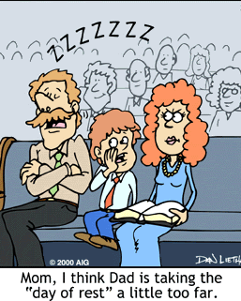

Slide 17
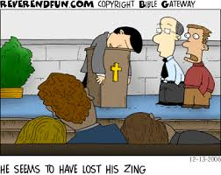

Slide 20
“And unto the angel of the church in Sardis write; These things saith he that hath the seven Spirits of God, and the seven stars; I know thy works, that thou hast a name that thou livest, and art dead.”

Slide 21
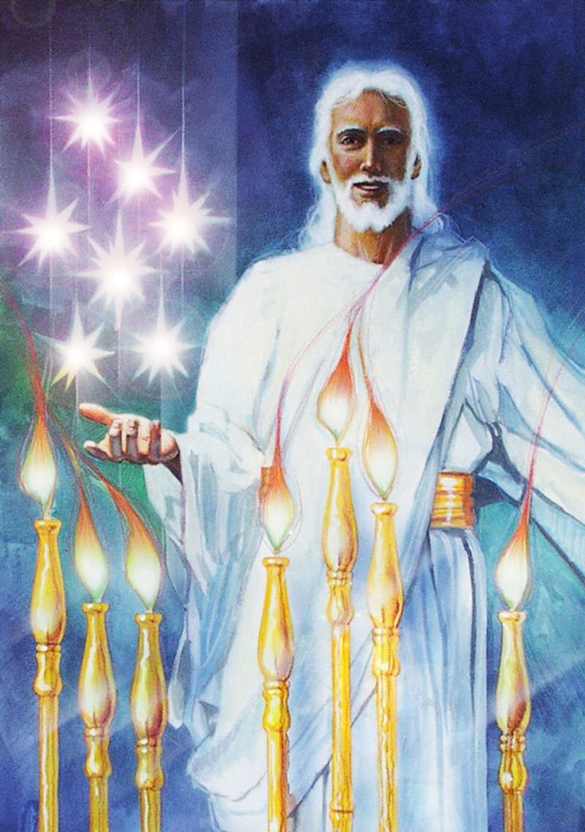
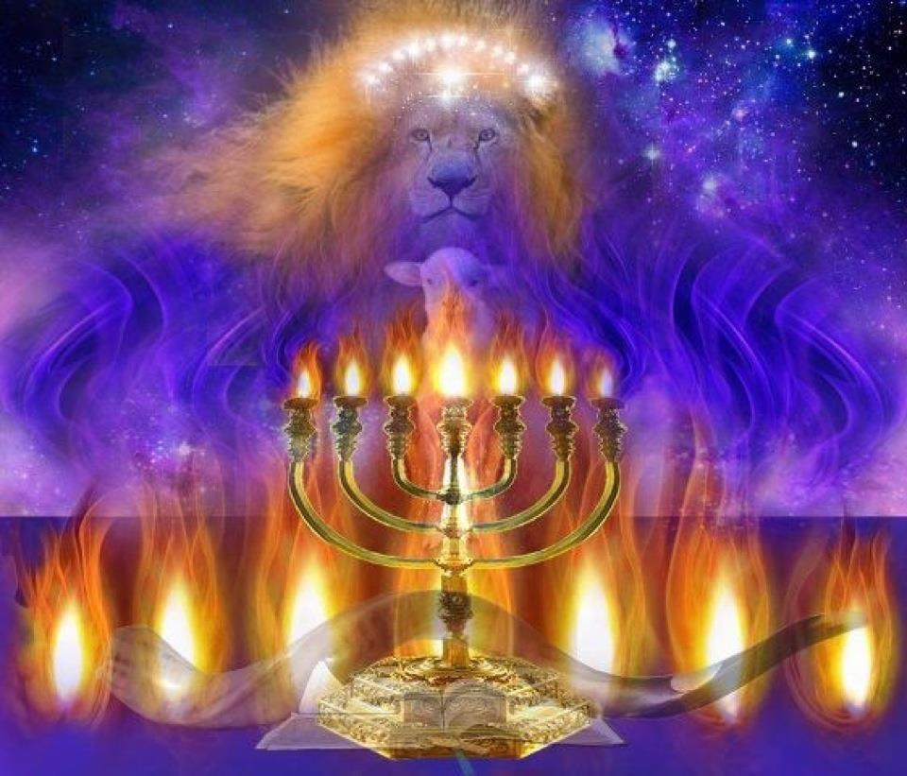
Seven Spirits of God
Revelation 1:4
“John to the seven churches which are in Asia: Grace be unto you, and peace, from him which is, and which was, and which is to come; and from the seven Spirits which are before his throne.”
Seven Stars
Revelation 1:16
“And he had in his right hand seven stars…”
Revelation 1:20
“The mystery of the seven stars which thou sawest in my right hand…the seven stars are the angels of the seven churches.”

Slide 22
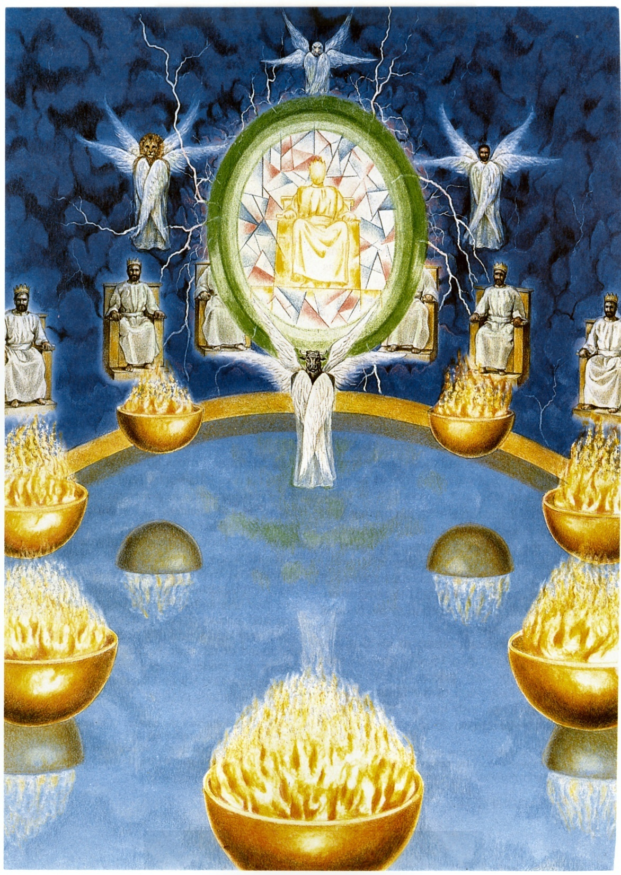
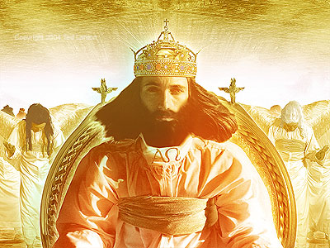
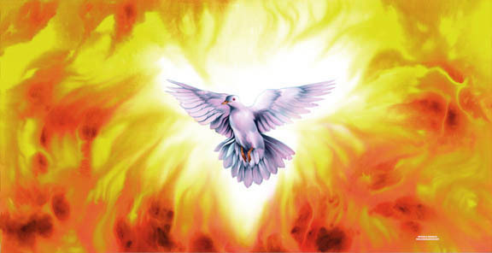
(Revelation 4:1-11)
“These things saith he that hath the seven Spirits of God…”

Slide 23
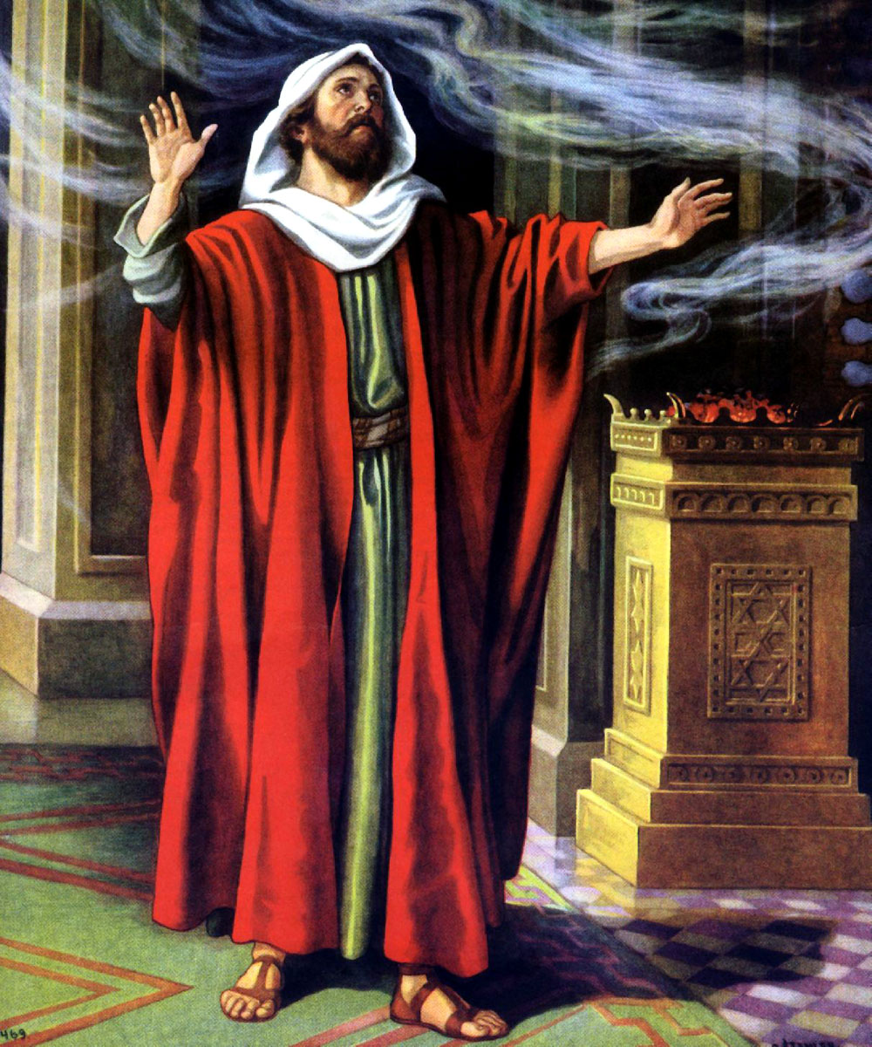
Isaiah's teaching on the sevenfold ministry of the Holy Spirit (Isaiah 11:1-2)

Slide 24
1. The Spirit of the Lord
“For there are three that bear record in heaven, the Father, the Word, and the Holy Ghost: and these three are one.”
(I John 5:7)

Slide 25
2. The Spirit of Wisdom
“Which things also we speak, not in the words which man’s wisdom teacheth, but which the Holy Ghost teacheth; comparing spiritual things with spiritual…”

Slide 26
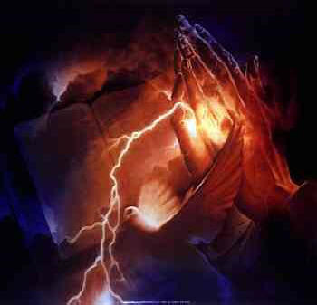
John 14:26 “But the Comforter, [which is] the Holy Ghost, whom the Father will send in my name, he shall teach you all things, and bring all things to your remembrance, whatsoever I have said unto you.”

Slide 27
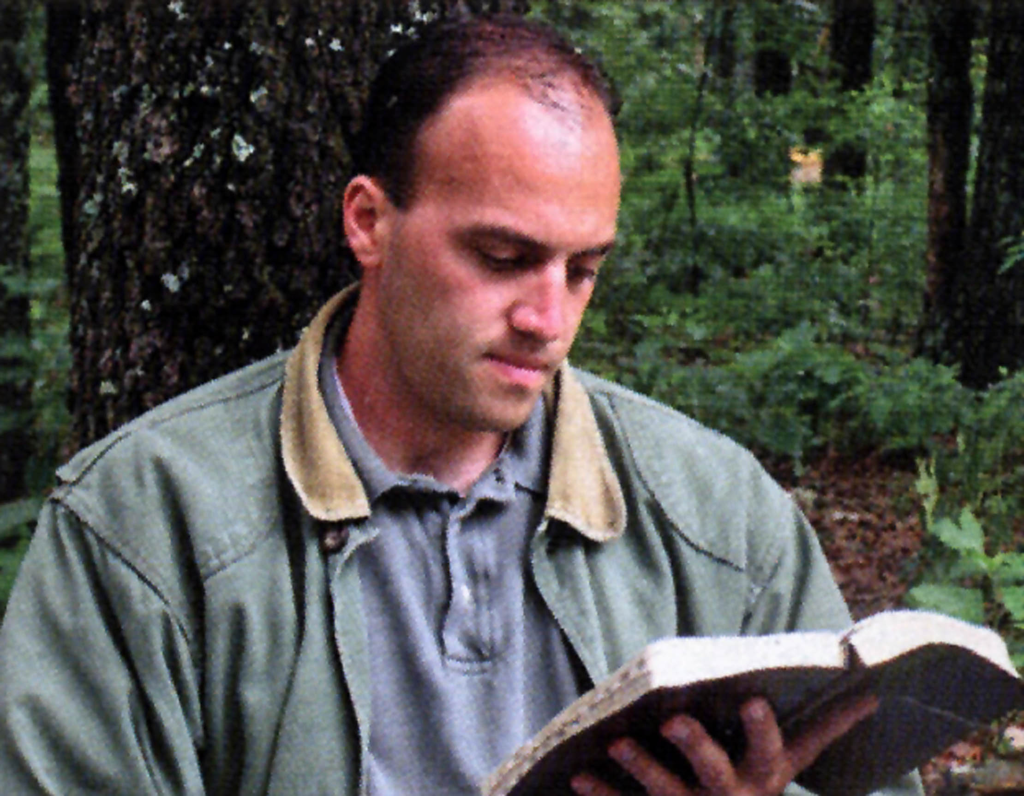
3. The Spirit of Understanding
“We have received, not the spirit of the world, but the Spirit which is of God; that we might know the things that are freely given to us of God…But the natural man receiveth not the things of the Spirit of God: for they are foolishness unto him: neither can he know them, because they are spiritually discerned…”

Slide 28
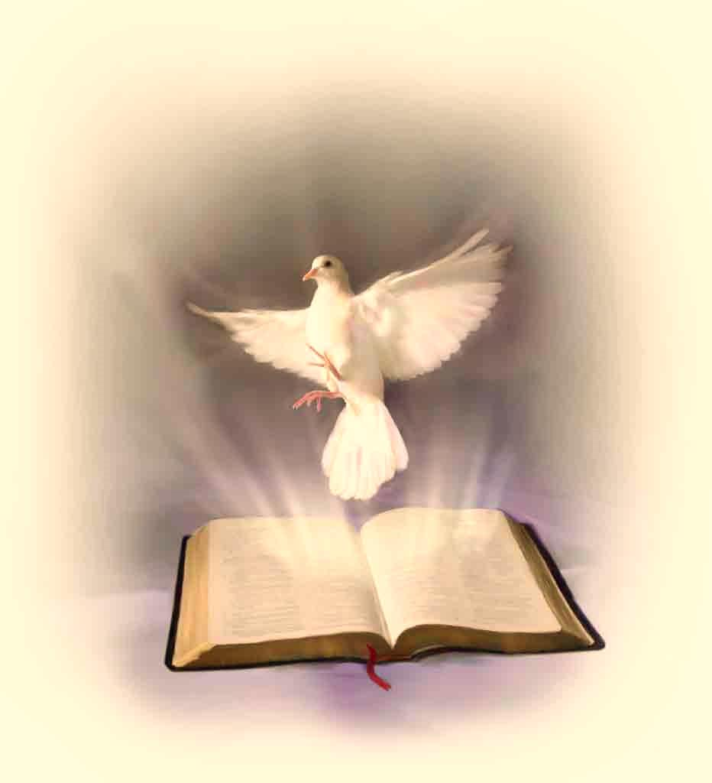
Ephesians 1:17-18 “That the God of our Lord Jesus Christ, the Father of glory, may give unto you the spirit of wisdom and revelation in the knowledge of him: The eyes of your understanding being enlightened.”

Slide 29
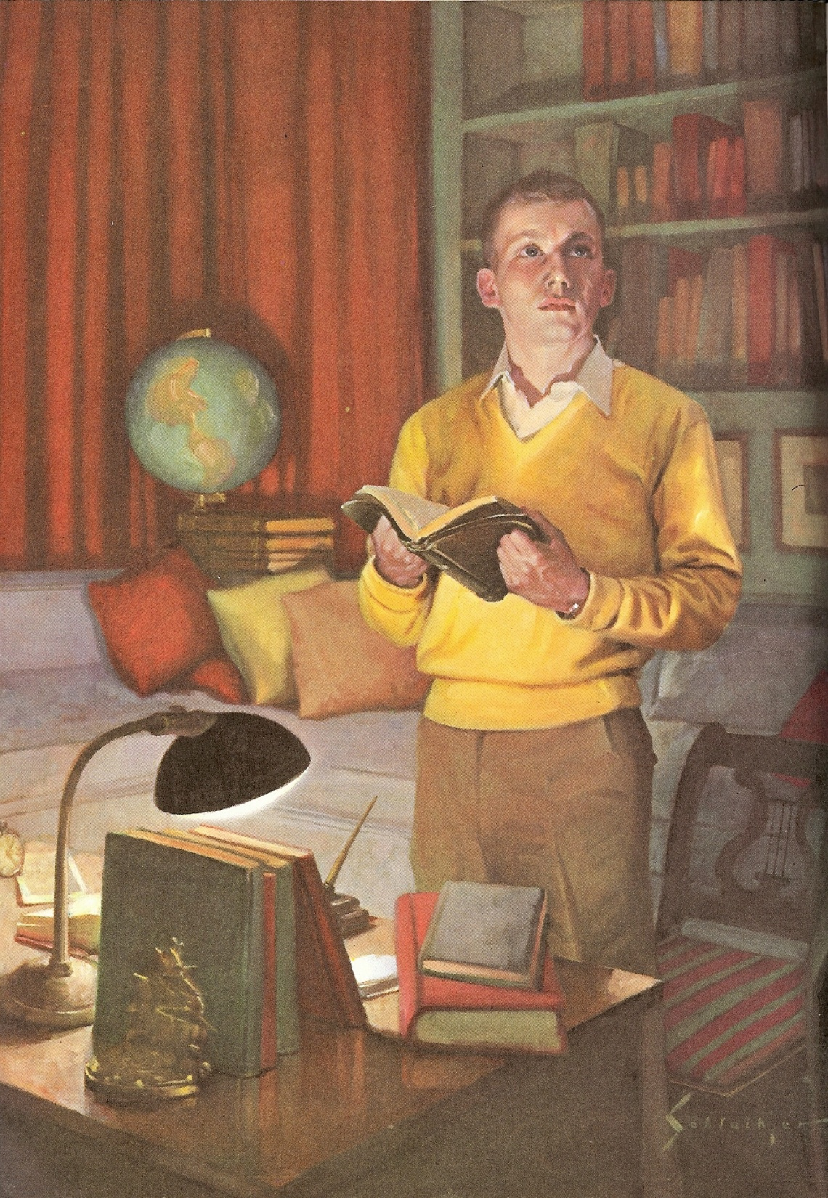
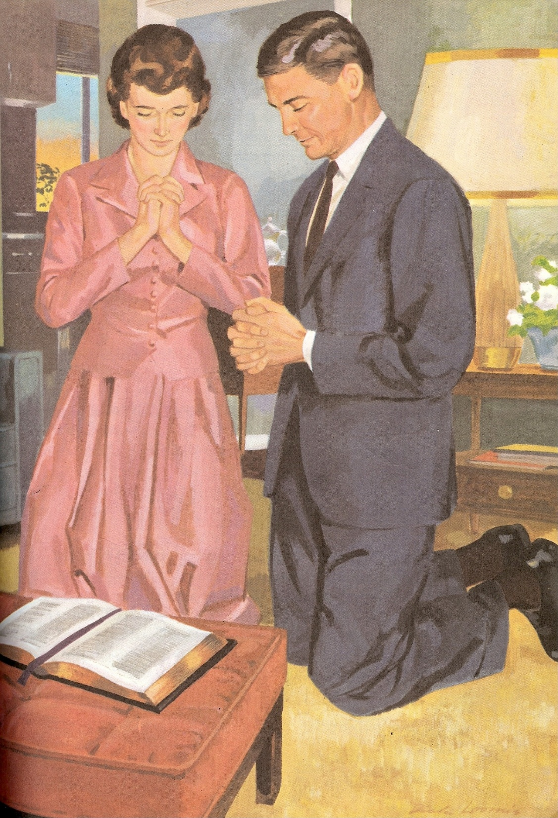
4. The Spirit of Counsel
“For God hath revealed them unto us by His Spirit: for the Spirit searcheth all things, yea, the deep things of God…the things of God knoweth no man, but the
Spirit of God…”

Slide 30
Isiah 40:13 “Who hath directed the Spirit of the LORD, or being his counsellor hath taught him?”

Slide 31
5. The Spirit of Might
“That he would grant you, according to the riches of his glory, to be strengthened with might by his Spirit in the inner man.”

Slide 32
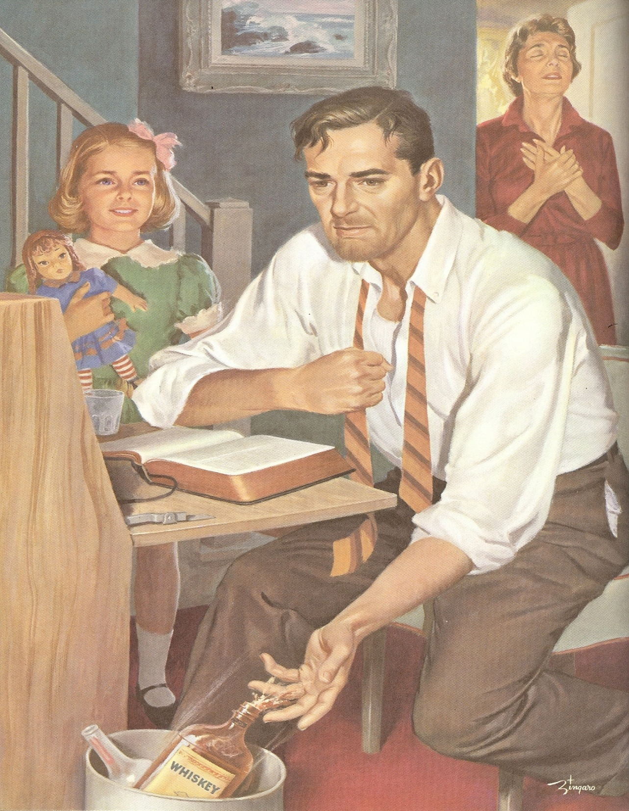
II Cor. 5:17 “Therefore if any man be in Christ, he is a new creature: old things are passed away; behold, all things are become new.”

Slide 33
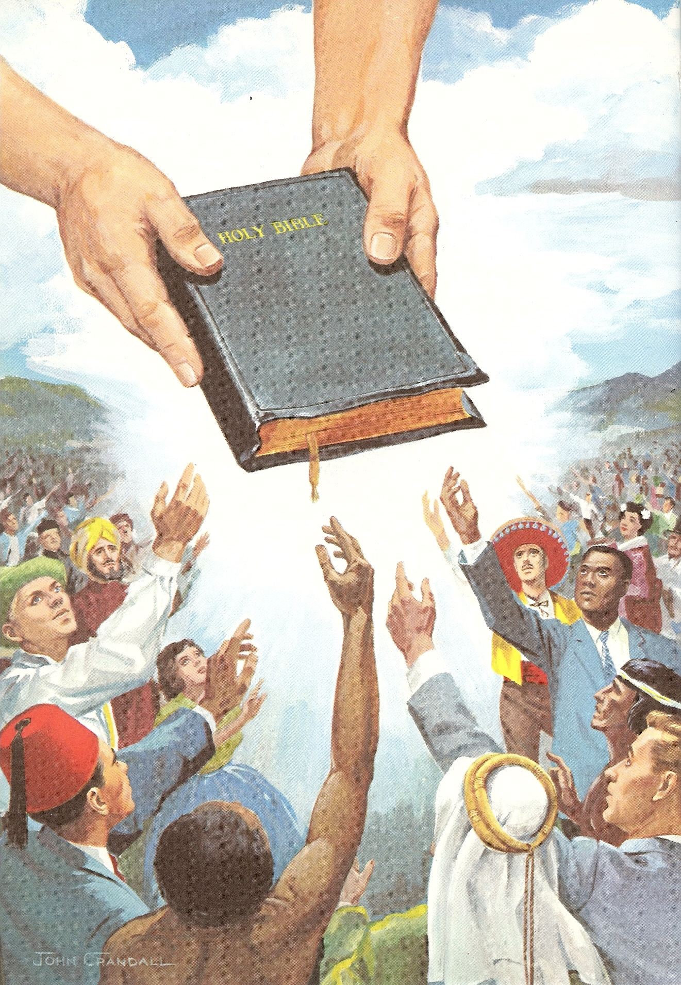
6. The Spirit of Knowledge
“For to one is given by the Spirit…the word of knowledge…”

Slide 34
I Corinthians 2:10-13
“But God hath revealed them unto us by his Spirit: for the Spirit searcheth all things, yea, the deep things of God. For what man knoweth the things of a man, save the spirit of man which is in him? even so the things of God knoweth no man, but the Spirit of God. Now we have received, not the spirit of the world, but the spirit which is of God; that we might know the things that are freely given to us of God. Which things also we speak, not in the words which man's wisdom teacheth, but which the Holy Ghost teacheth; comparing spiritual things with spiritual.”

Slide 35
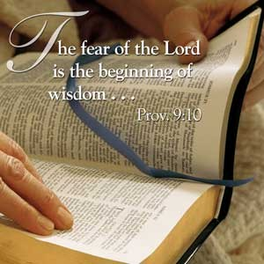
7. The Spirit of the Fear of the Lord

Slide 36
Proverbs and the “Fear of the Lord”
The fear of the LORD is the beginning of knowledge.
Then shalt thou understand the fear of the LORD, and find the knowledge of God.
The fear of the LORD is to hate evil: pride, and arrogancy, and the evil way, and the froward mouth, do I hate.
The fear of the LORD prolongeth days: but the years of the wicked shall be shortened.
In the fear of the LORD is strong confidence: and his children shall have a place of refuge.

Slide 37
The fear of the LORD is a fountain of life, to depart from the snares of death.
Better is little with the fear of the LORD than great treasure and trouble therewith.
The fear of the LORD is the instruction of wisdom; and before honour is humility.
By the fear of the LORD men depart from evil.
The fear of the LORD tendeth to life: and he that hath it shall abide satisfied; he shall not be visited with evil.
By humility and the fear of the LORD are riches, and honour, and life.
Let not thine heart envy sinners: but be thou in the fear of the LORD all the day long.

Slide 38
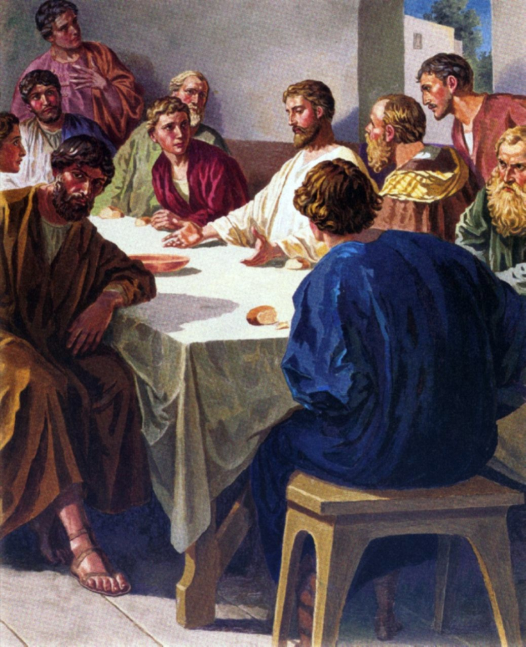
The teachings of Jesus concerning the sevenfold ministry of the Holy Spirit (John 14:16-27)

Slide 39
1. The Comforter Verse 16

Slide 40
2. The Spirit of Truth Verse 17

Slide 41
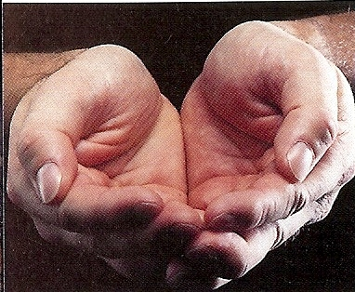
3. The Personal Presence of Christ Verse 18-20
“I will not leave you comfortless: I will come to you…ye in me and I in you…”

Slide 42
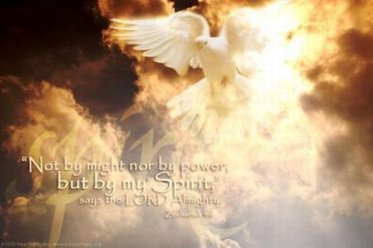
4. The Manifestation of Christ in the Believer Verse 21-22
“I will love him, and will manifest myself to him…”

Slide 43
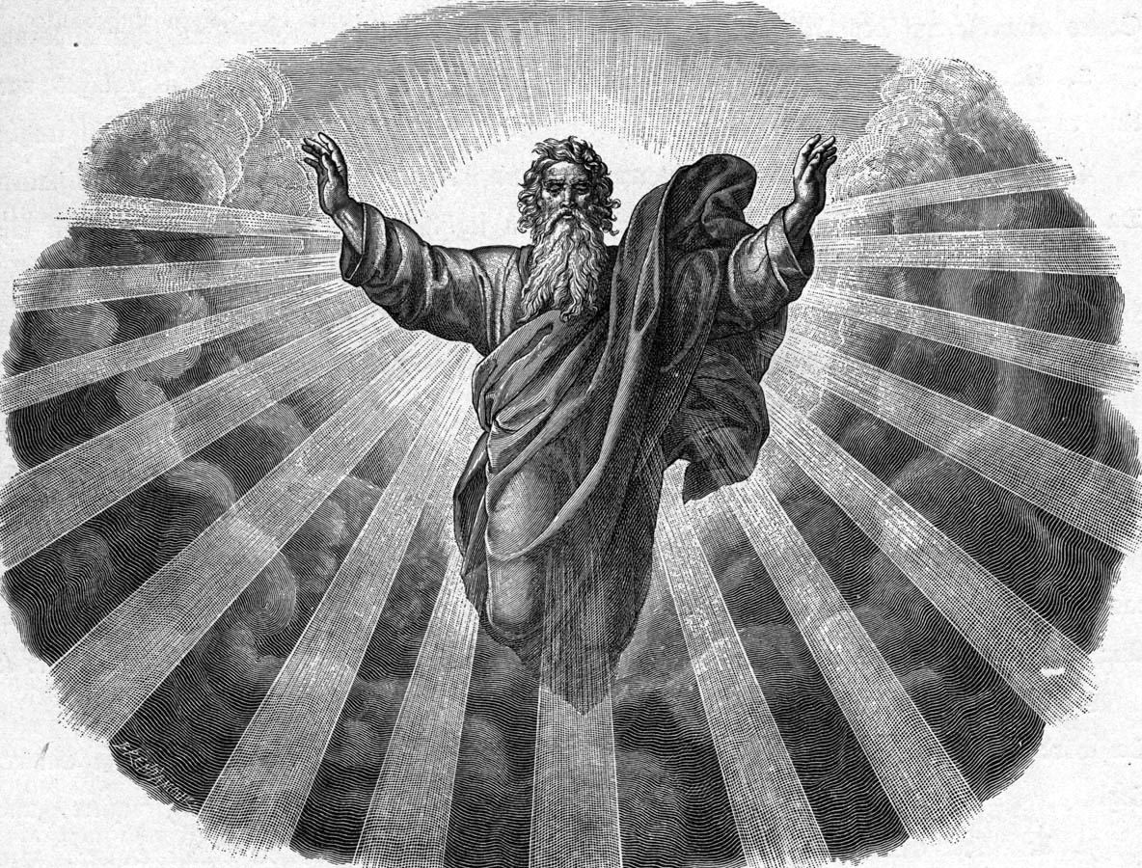
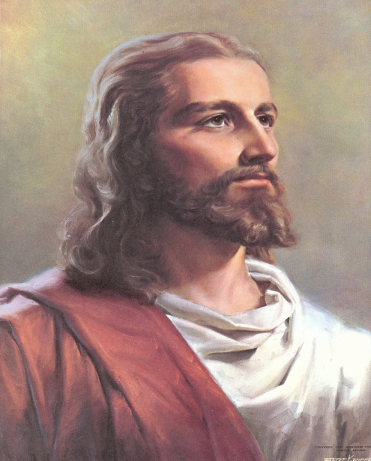
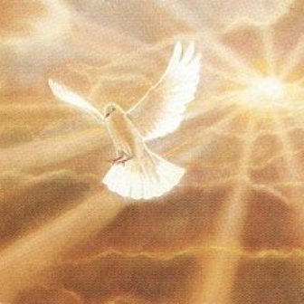
5. The Abiding Presence of the Trinity Verse 23-24
“We will make our abode with him…”

Slide 44
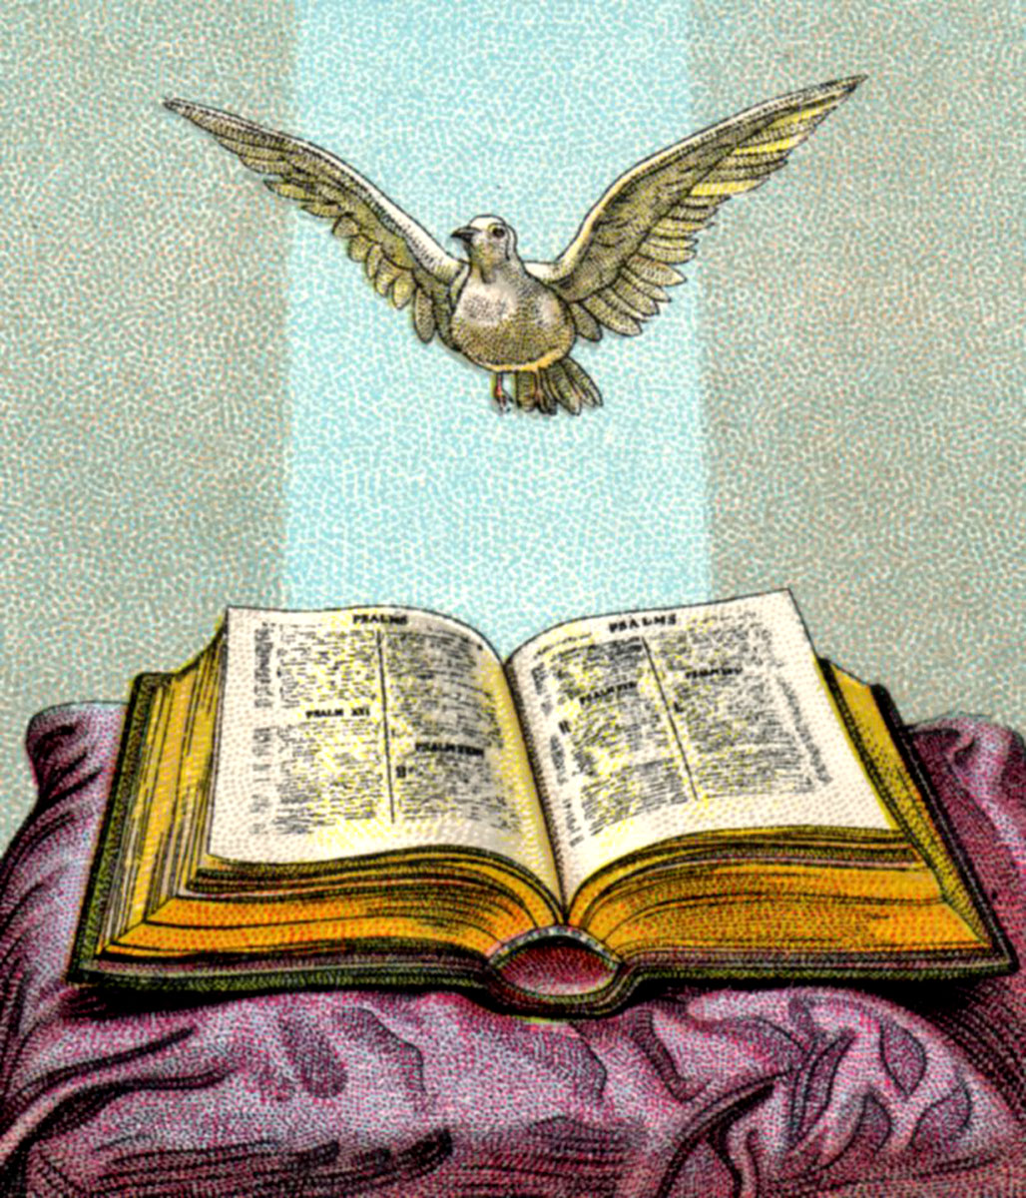
6. The Teacher Verse 25-26
“He shall teach you all things, and bring all things to your remembrance…”

Slide 45
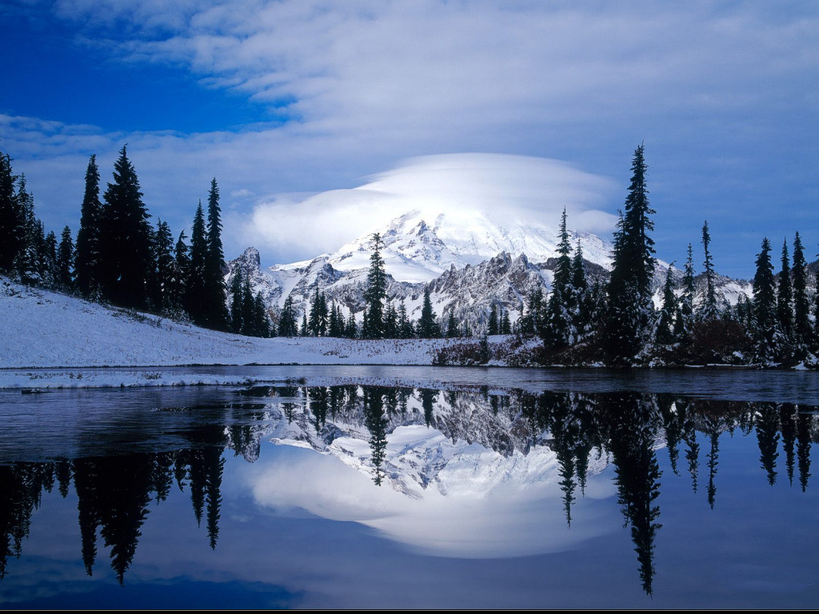
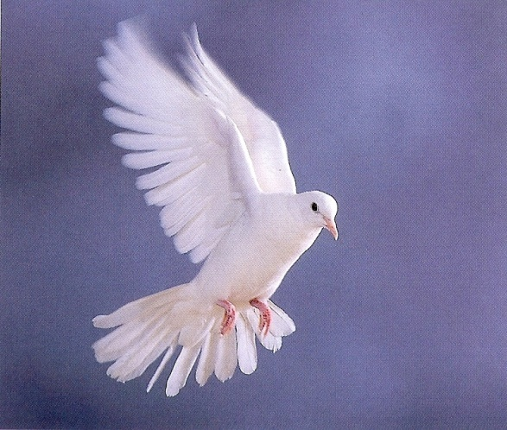
7. The Peace of Christ Verse 27
“Peace I leave with you, my peace I give unto you…let not your heart be troubled…”

Slide 46
The 7 symbols of the Holy Spirit are essential to us gaining an understanding of who He is, what He’s like and His ministry in our lives, the Church
and the World.

Slide 47
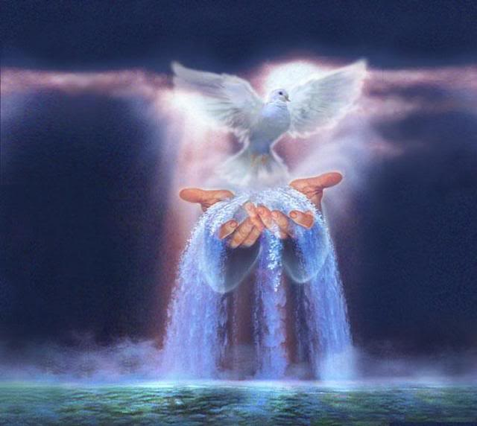
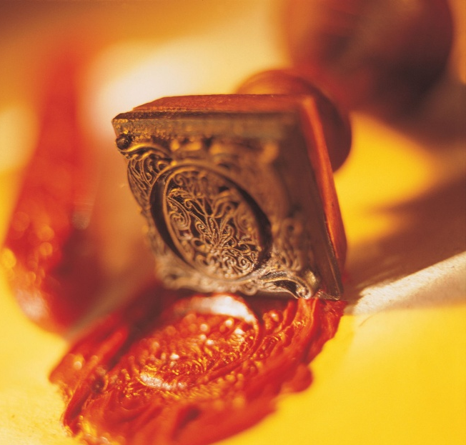
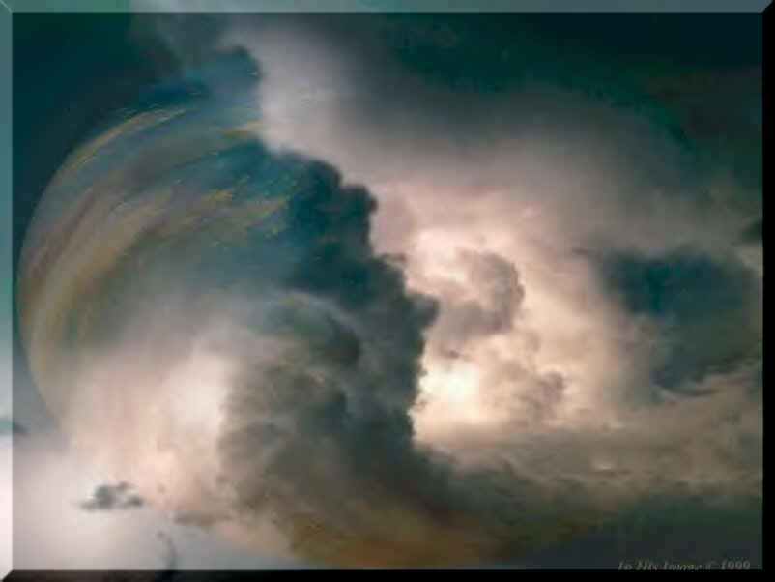
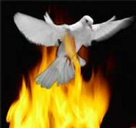

Slide 48
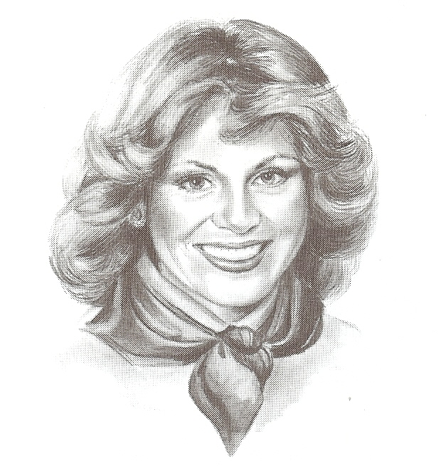
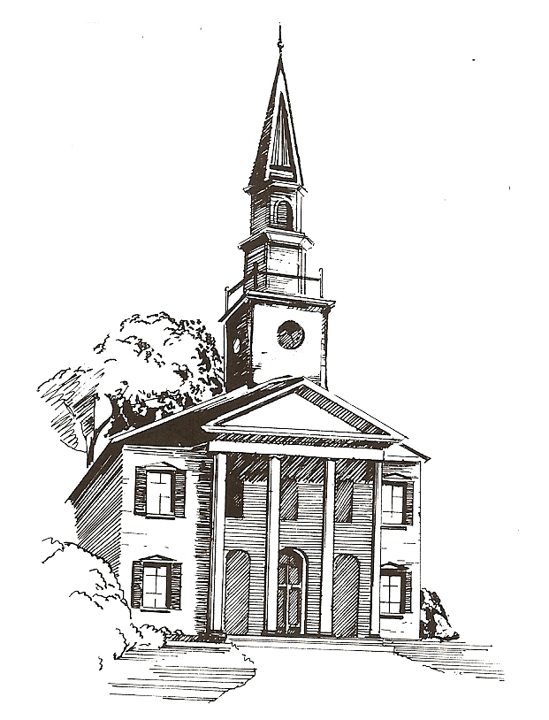
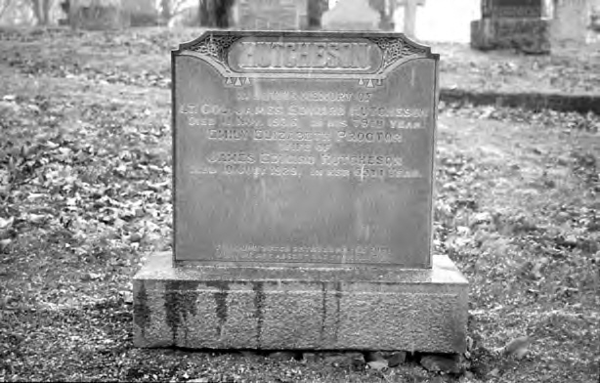
“The Spirit of life…The Spirit is life…The Spirit giveth life…”

Slide 49
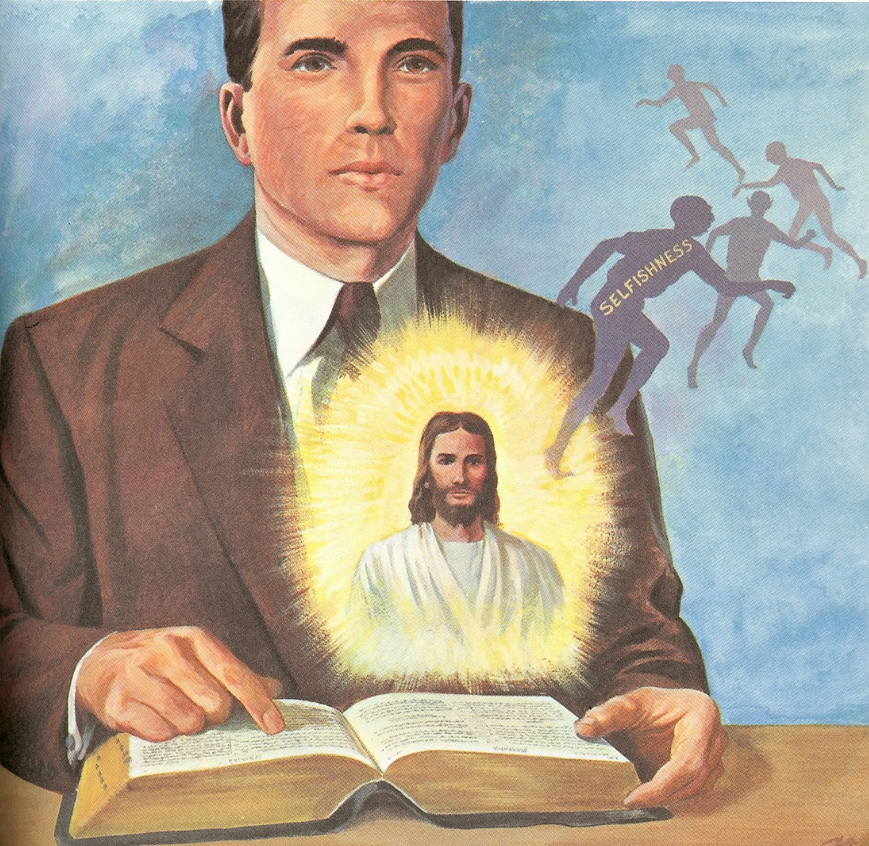
The Filling of the Holy Spirit

Slide 51
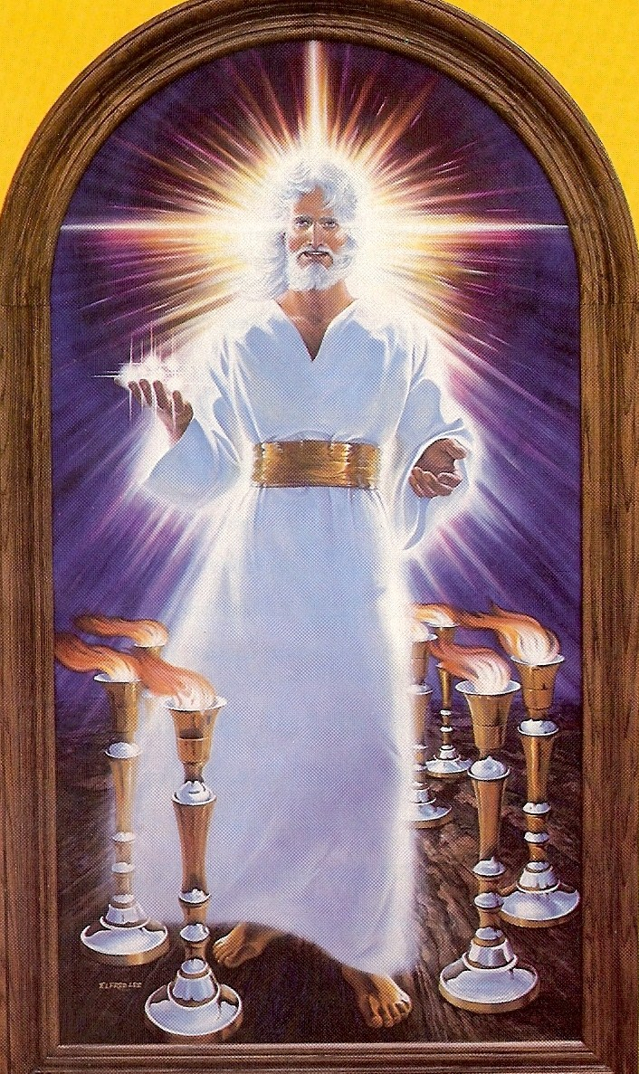
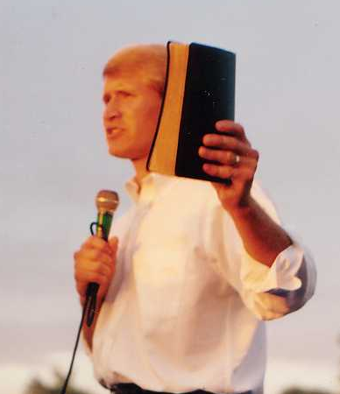
“These things saith he that hath the seven Spirits of God, and the seven stars.”

Slide 53
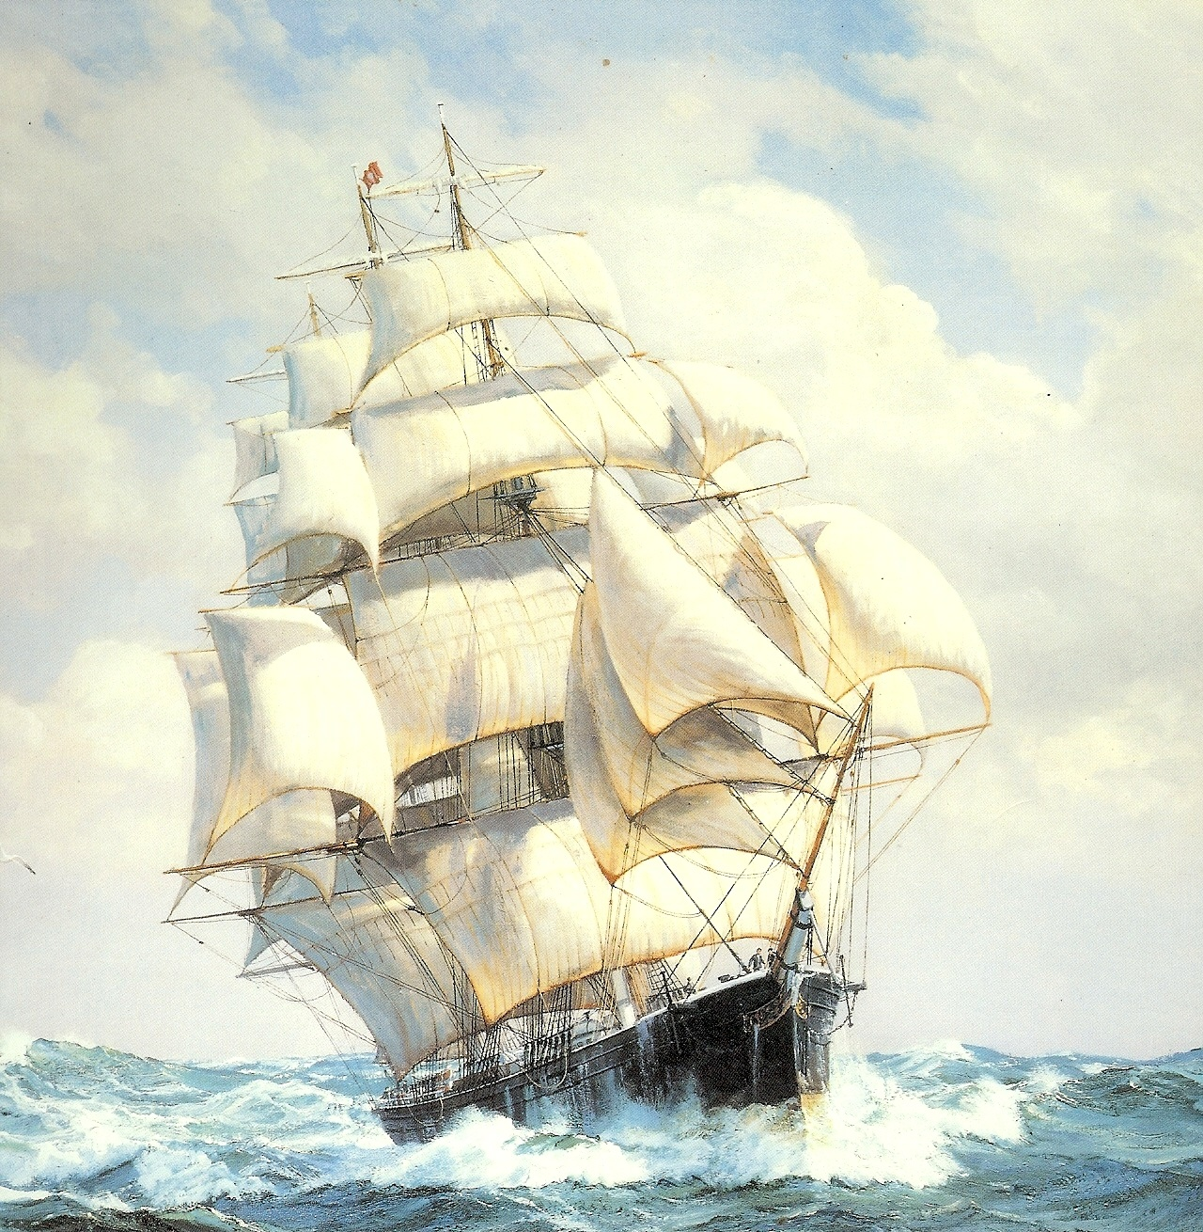
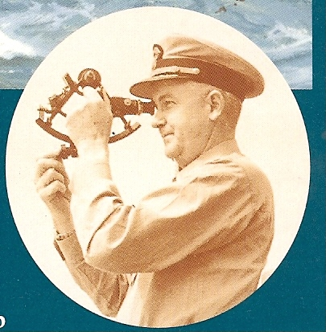
Pastors (Stars)
Stars give light in the darkness
Stars give direction
Stars give glory to God

Slide 54
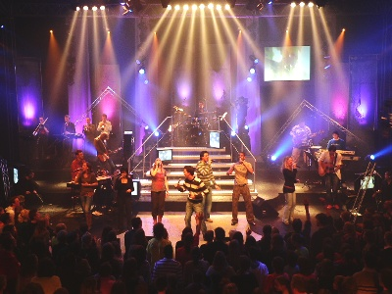
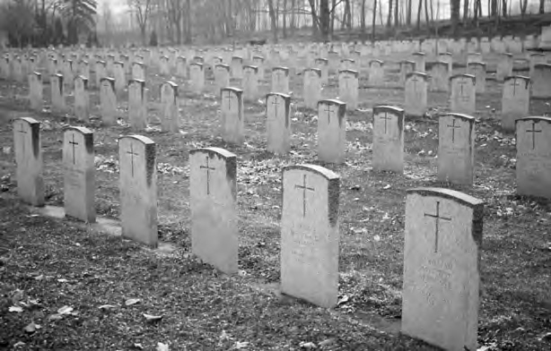
“I know thy works, that thou hast a name that thou livest, and art dead…”

Slide 55
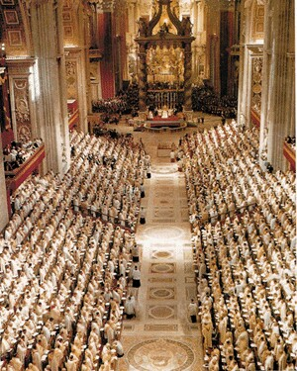
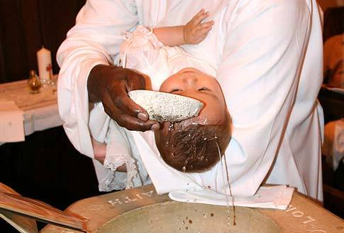
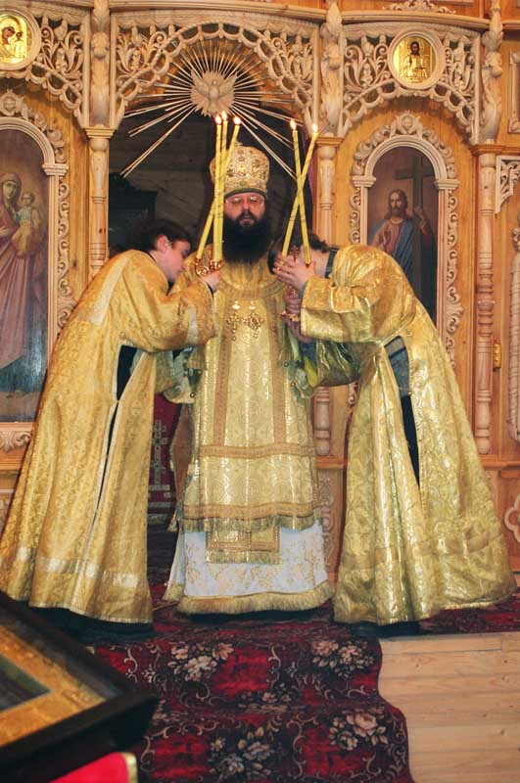
How to Kill the Working of the Holy Spirit in your Life and Church

Slide 56
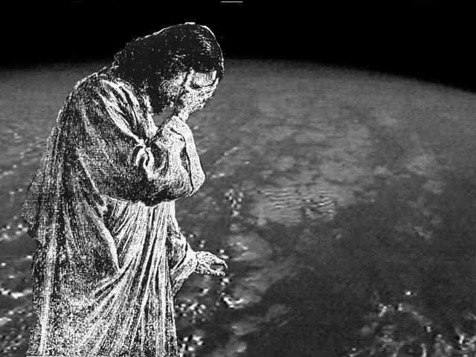
Proverbs 6:16-19
“These six things doth the LORD hate: yea, seven are an abomination unto him: A proud look, a lying tongue, and hands that shed innocent blood, An heart that deviseth wicked imaginations, feet that be swift in running to mischief, A false witness that speaketh lies, and he that soweth discord among brethren.”

Slide 58
“But she that liveth in pleasure is dead while she liveth.” I Tim. 5:6

Slide 60
“Serve Him with a perfect heart and with a willing mind: for the Lord searcheth all hearts, and understandeth all the imaginations of the thoughts: if thou seek Him, He will be found of thee; but if thou forsake Him, He will cast thee off forever. Take heed…” (I Chronicles 28:9)

Slide 61
“In the day when God shall judge the secrets of men by Jesus Christ.” (Romans 2:16)

Slide 62
Spiritual Report Card “I have not found thy works perfect before God…”

Slide 63
“strengthen the things which remain, that are ready to die…”
“Be watchful…”

Slide 64
Spiritual Work Out
Bible reading/Meditation/Memorization
Prayer
Faithful Church Attendance
Confession and Repentance of Sin
Witnessing
Tithing
Serving in your Local Church
Fellowship with God’s people

Slide 65
Remember
What you have received
What you have heard
Hold fast
Repent

Slide 66
“If therefore thou shalt not watch, I will come on thee as a thief, and thou shalt not know what hour I will come upon thee.”

Slide 67
“And every man that hath this hope in him purifieth himself, even as he is pure.” (I John 3:3)

Slide 68
“Thou hast a few names even in Sardis which have not defiled their garments.”

Slide 70
“Behold, I come as a thief. Blessed is he that watcheth, and keepeth his garments.” (Rev. 16:15) “And others save with fear, pulling them out of the fire; hating even the garment spotted (defiled) by the flesh.” (Jude 1:23)

Slide 71
“They shall walk with me in white: for they are worthy.”

Slide 72
“He that overcometh, the same shall be clothed in white raiment.”

Slide 73
“For whatsoever is born of God overcometh the world: and this is the victory that overcometh the world, even our faith. Who is he that overcometh the world, but he that believeth that Jesus is the Son of God?” (I John 5:4-5)

Slide 74
“I will not blot out his name out of the book of life…”

Slide 75
“I will confess his name before My Father, and before His angels.”

Slide 76
“He that hath an ear, let him hear what the Spirit saith unto the churches.”

