Slide 1
The Revelation of Jesus Christ
A study of the book
of Revelation

Slide 2
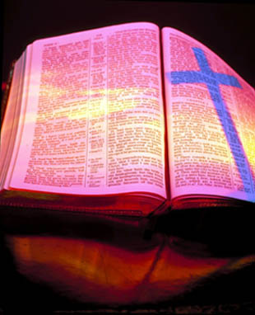
Revelation 20:1-6
“Satan Bound for 1000 Years”

Slide 3
“And I saw an angel come down from heaven, having the key of the bottomless pit and a great chain in his hand.”

Slide 4
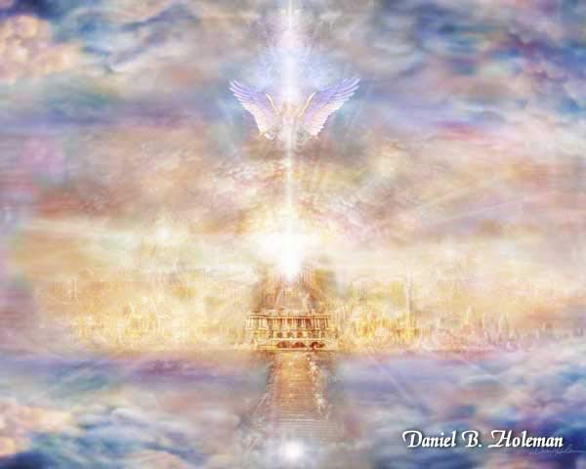
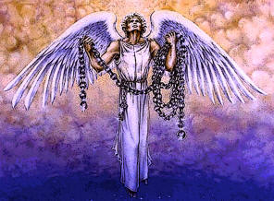

Slide 5
“And he laid hold on the dragon, that old serpent, which is the Devil, and Satan, and bound him a thousand years.”

Slide 6
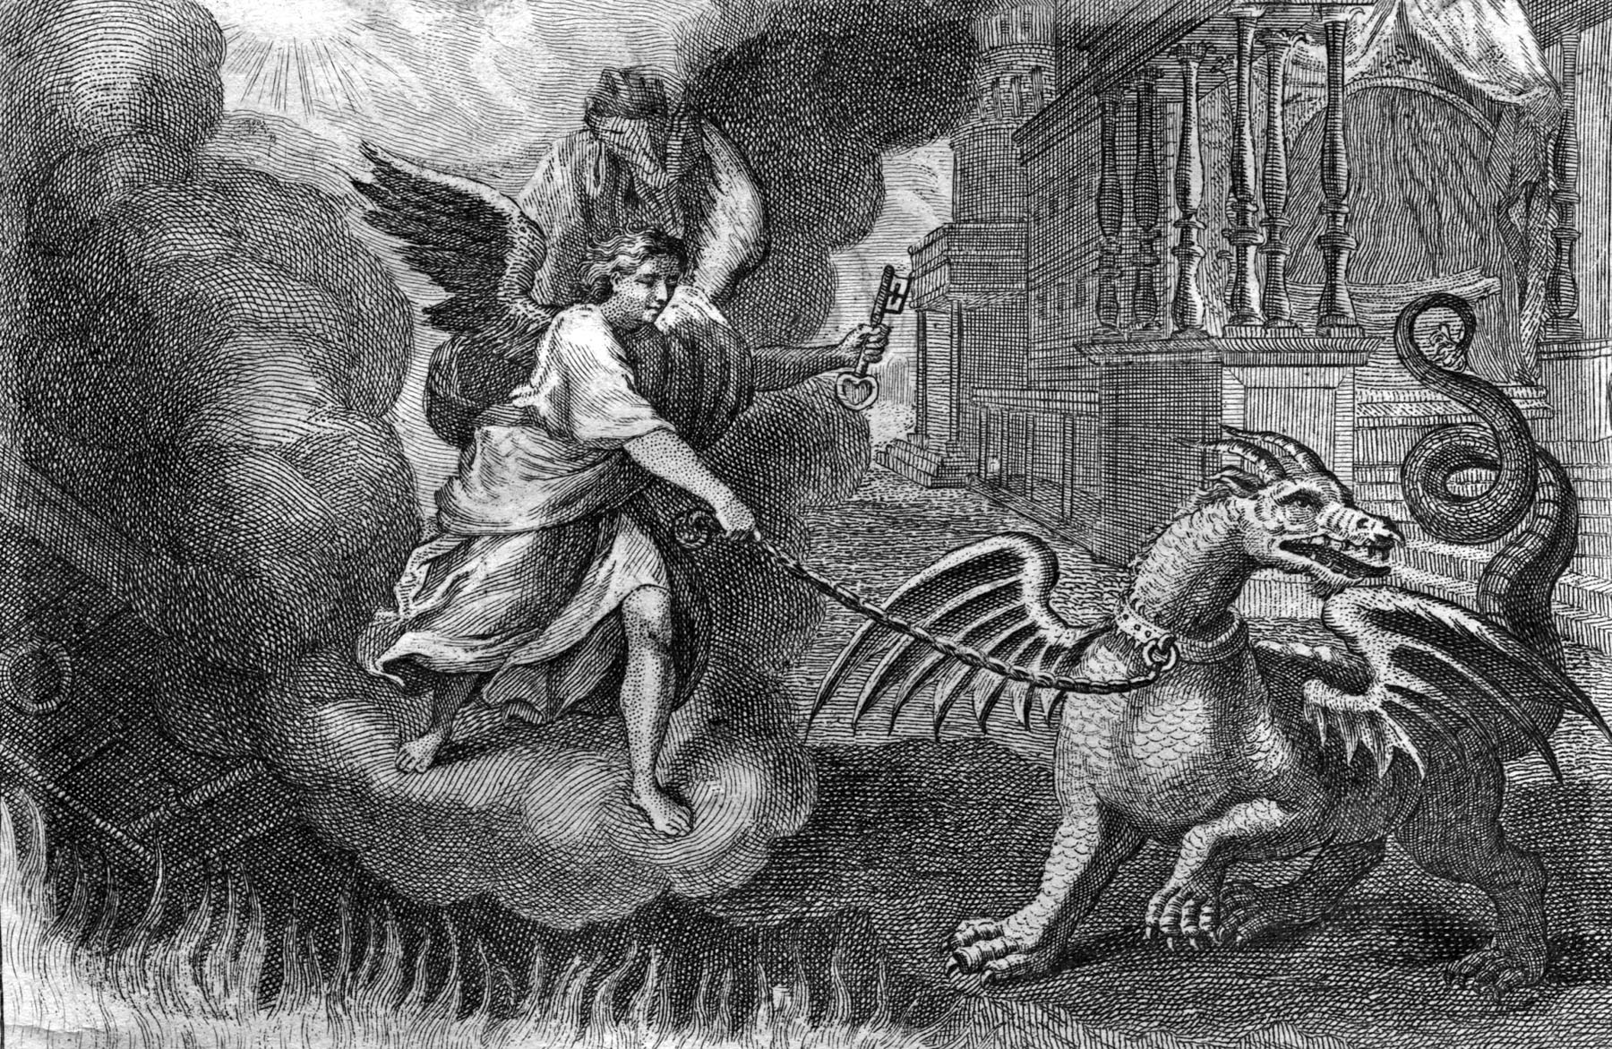

Slide 7
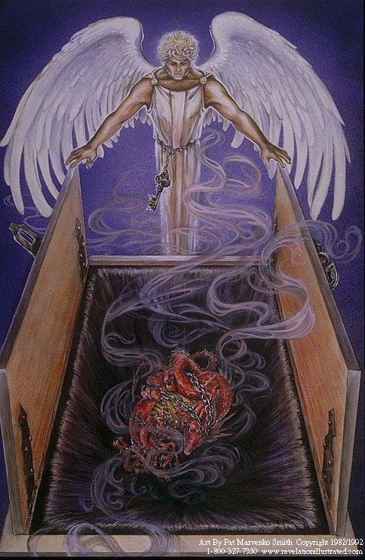
“And cast him into the bottomless pit, and shut him up, and set a seal upon him, that he should deceive the nations no more, till the thousand years should be fulfilled: and after that he must be loosed a little season.”

Slide 8
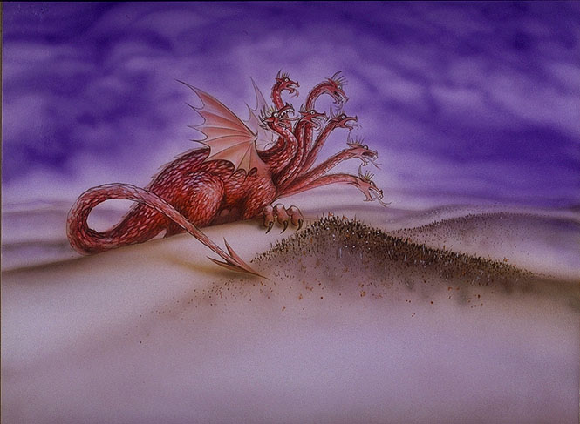
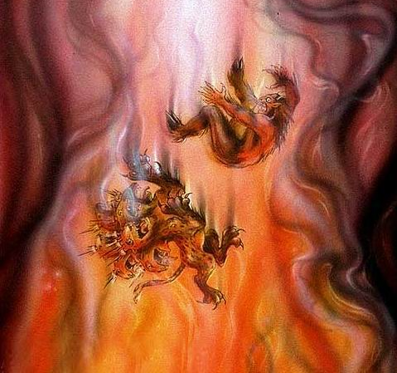
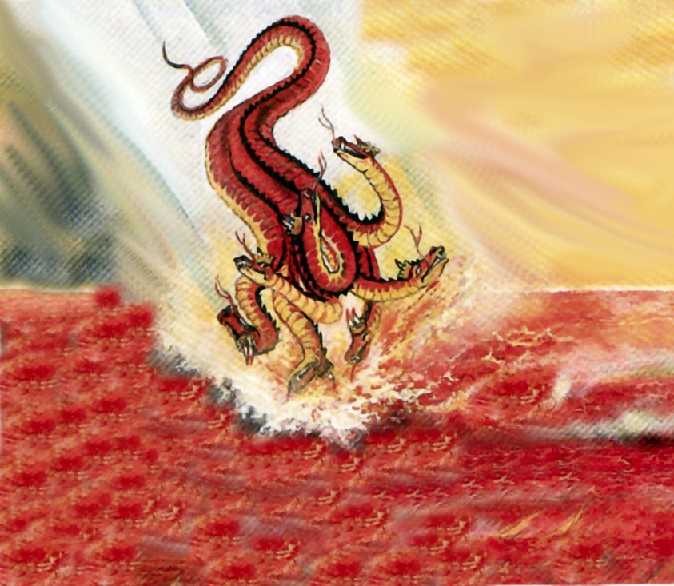
“And the devil that deceived them was cast into the lake of fire and brimstone, where the beast and the false prophet are, and shall be tormented day and night for ever and ever.”

Slide 9
“And I saw thrones, and they sat upon them, and judgment was given unto them.”

Slide 10
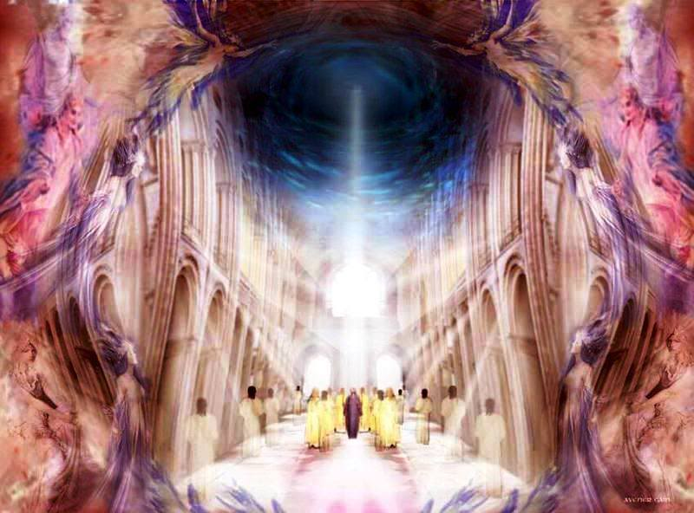
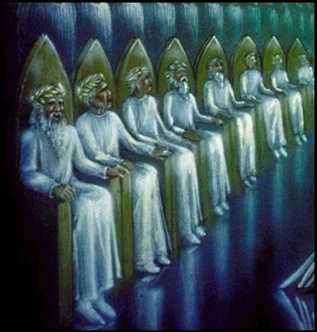

Slide 11
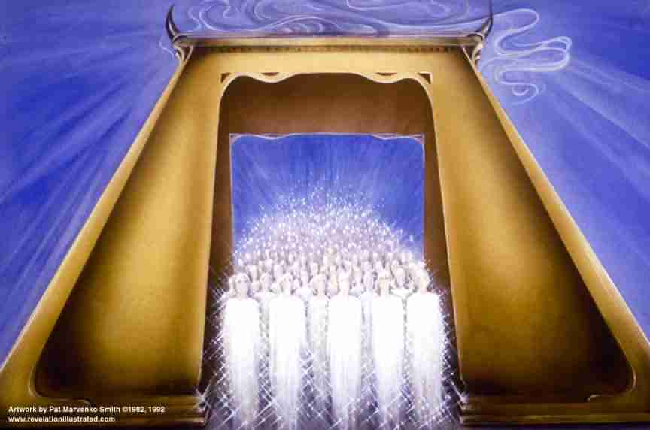
“And I saw the souls of them that were beheaded for the witness of Jesus, and for the word of God, and which had not worshipped the beast, neither his image, neither had received his mark upon their foreheads, or in their hands; and they lived and reigned with Christ a thousand years.”

Slide 12
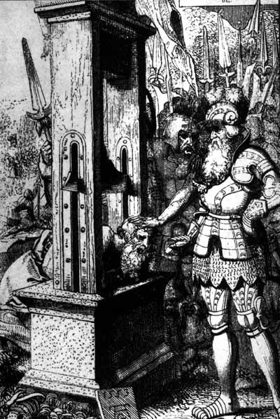
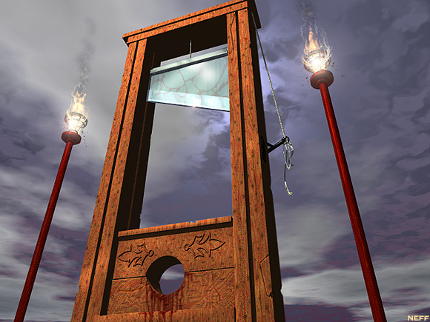
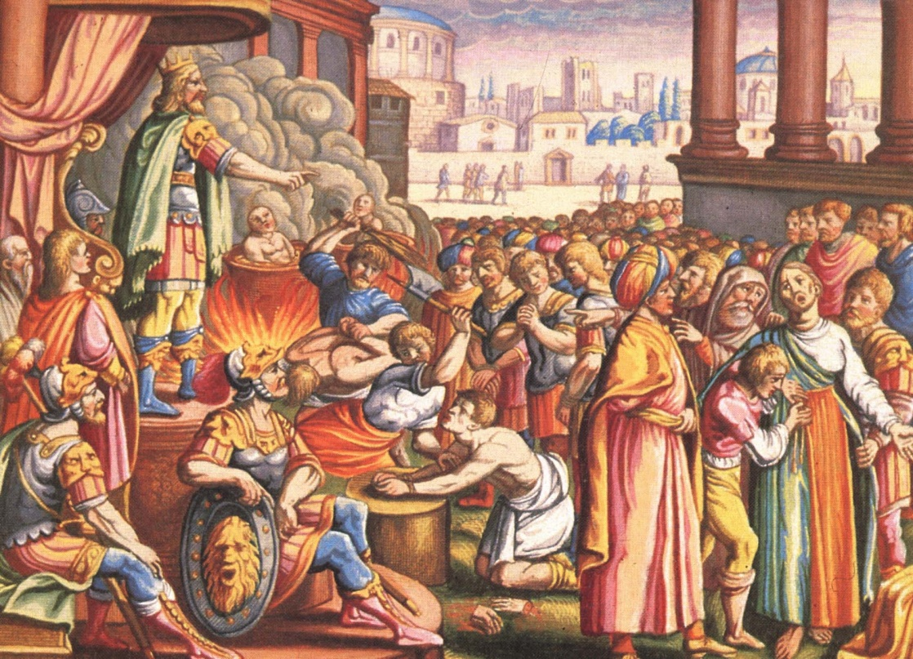
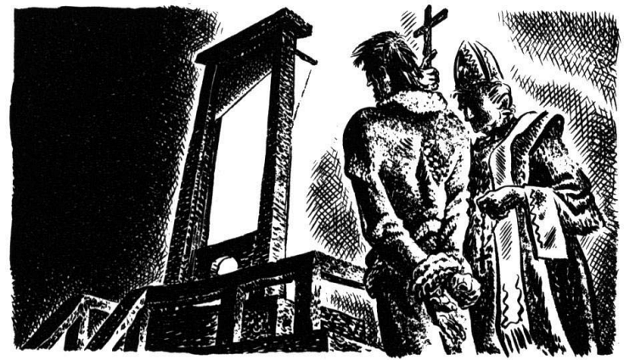
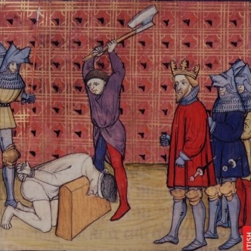
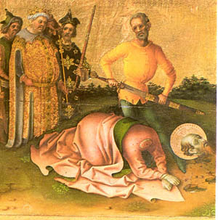

Slide 13
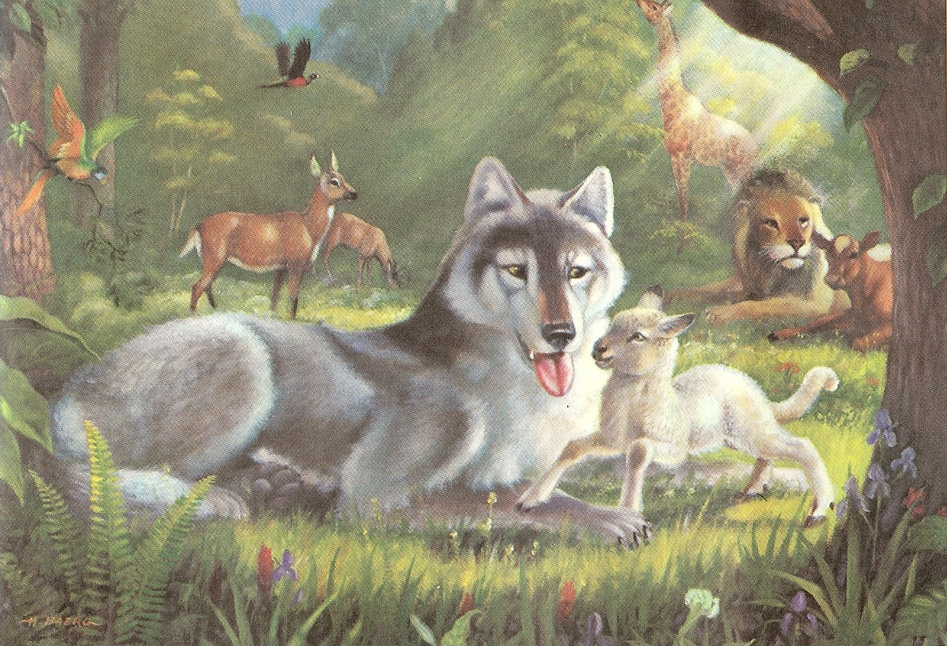
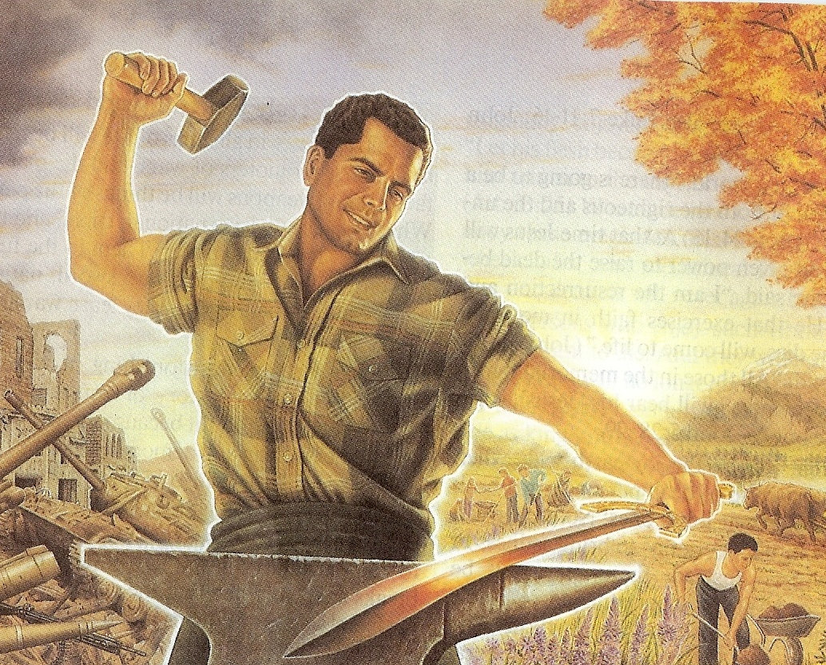
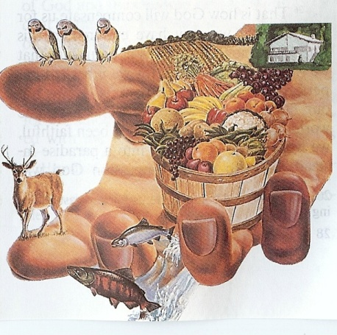
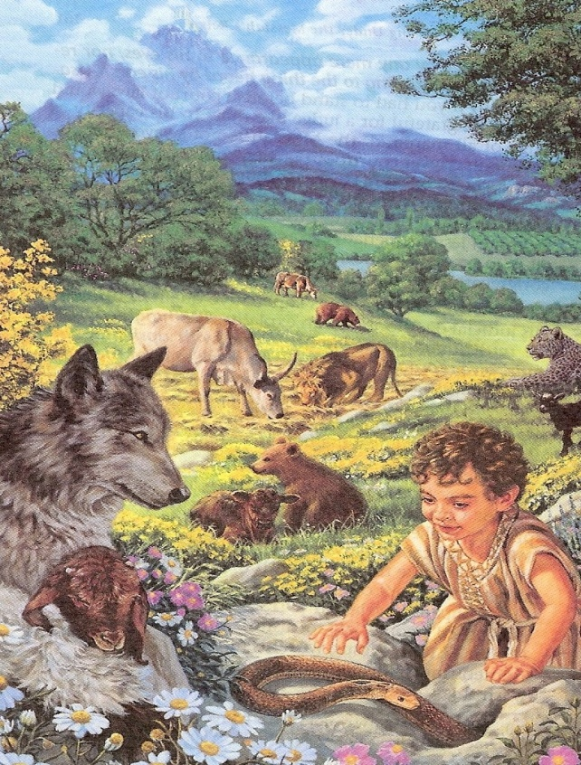
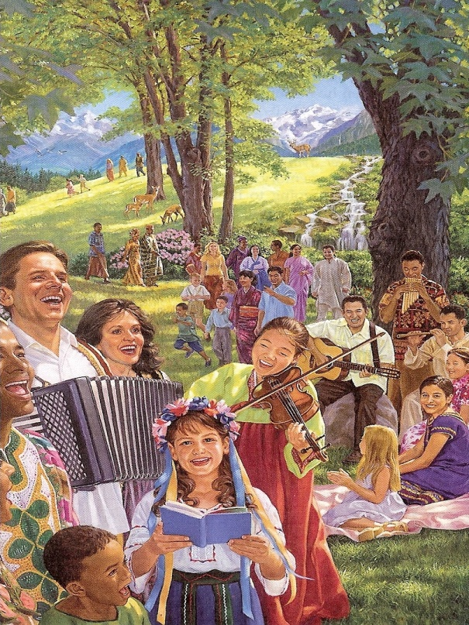
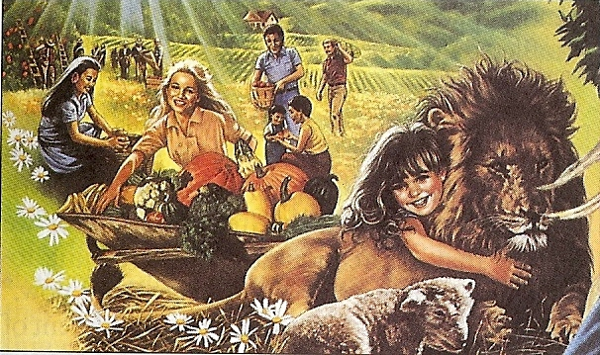
“And he shall judge among the nations, and shall rebuke many people: and they shall beat their swords into plowshares, and their spears into pruninghooks: nation shall not lift up sword against nation, neither shall they learn war any more.” (Isa. 2:4)

Slide 14
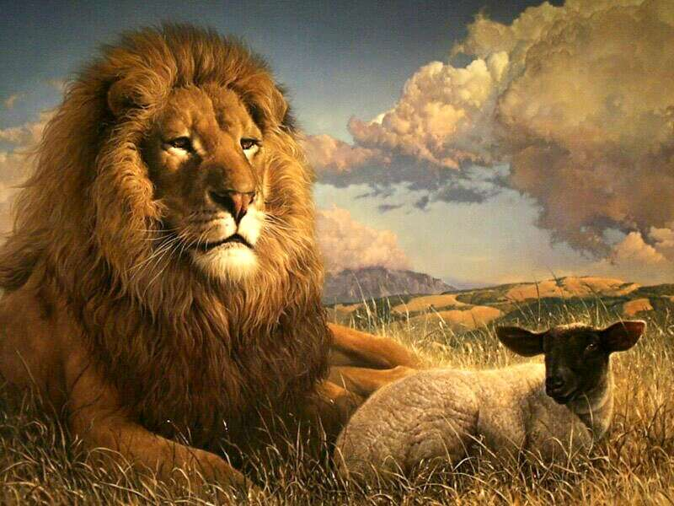
“The wolf also shall dwell with the lamb, and the leopard shall lie down with the kid; and the calf and the young lion and the fatling together; and a little child shall lead them. And the cow and the bear shall feed; their young ones shall lie down together: and the lion shall eat straw like the ox.” (Isa.11:6)

Slide 15
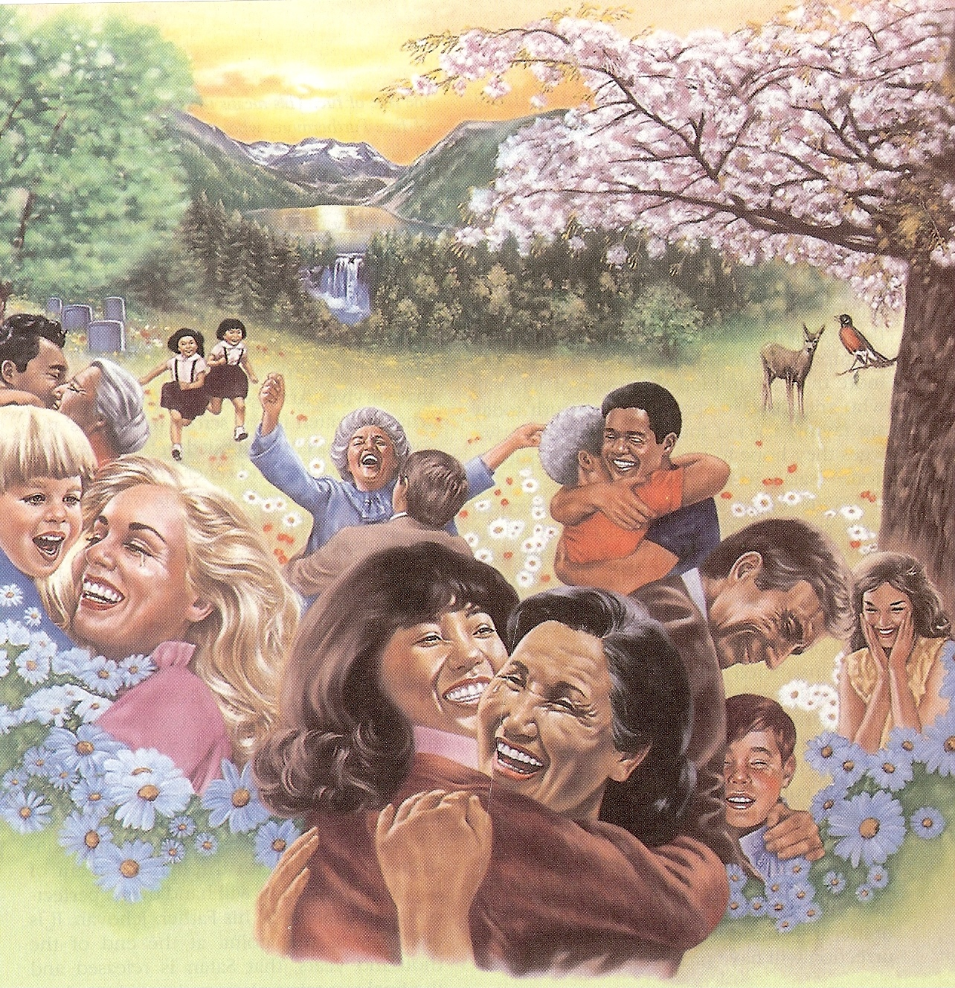
“The wilderness and the solitary place shall be glad for them; and the desert shall rejoice, and blossom as the rose.” (Isa. 35:1)

Slide 16
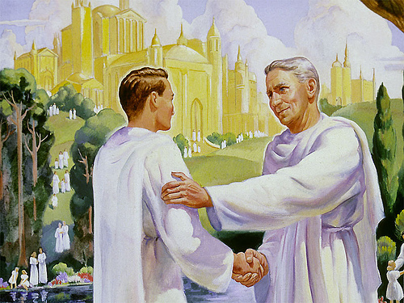
“Do ye not know that the saints shall judge the world?” (I Cor. 6:2)

Slide 17
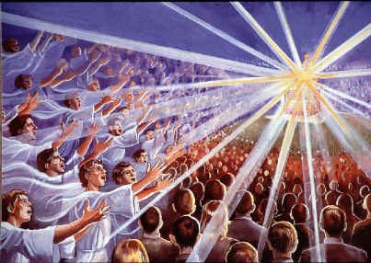
“…and (they) shall reign with him (Jesus) a thousand years.”

Slide 18
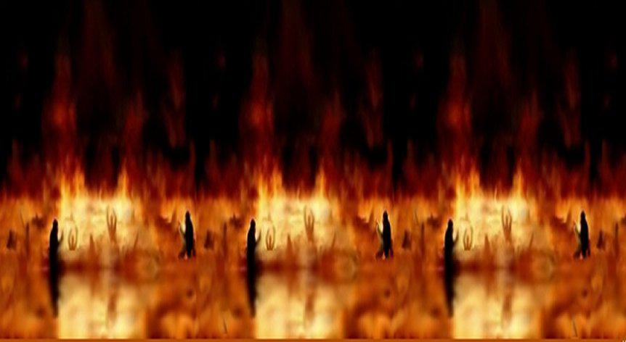
“But the rest of the dead (unbelievers) lived not again until the thousand years were finished.”

Slide 19
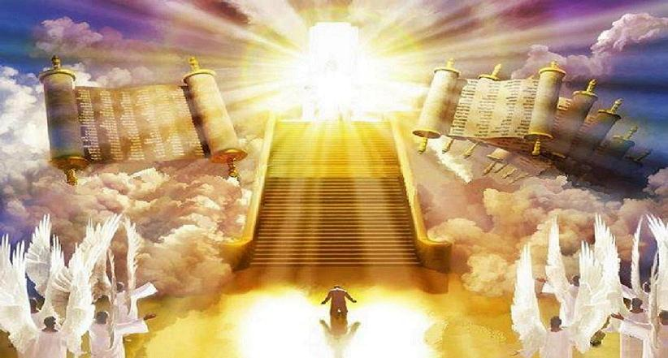
“Great White Throne Judgment” (Revelation 20:11-15)

Slide 20
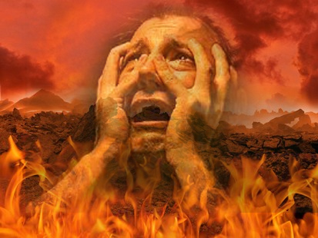

Slide 21
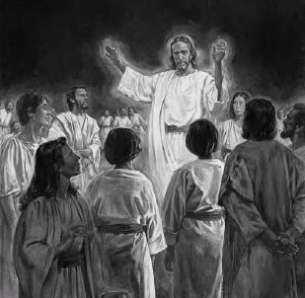
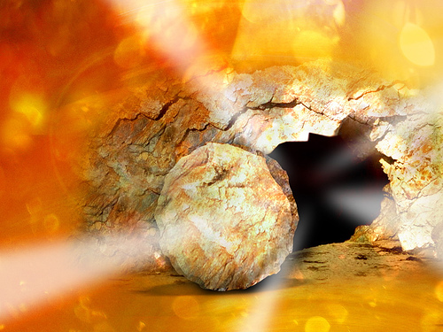
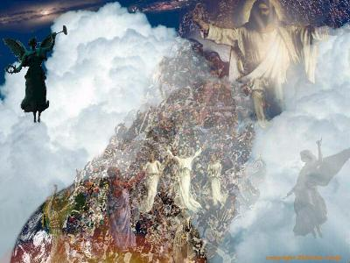
Three Phases of the First Resurrection
Old Testament and Tribulation Saints
Jesus Christ
Church Age Saints

Slide 22
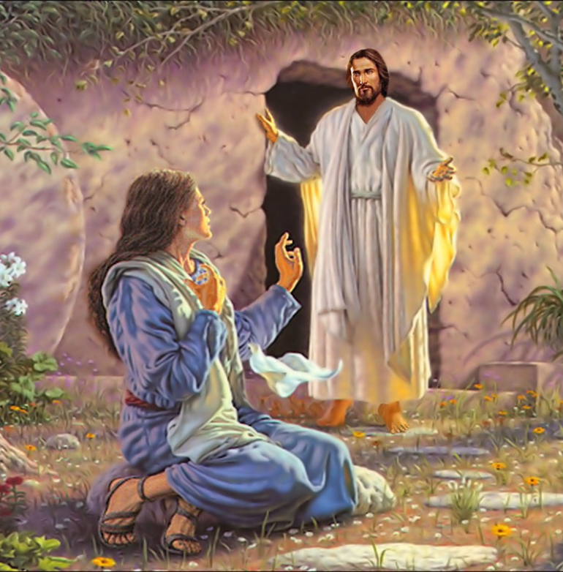
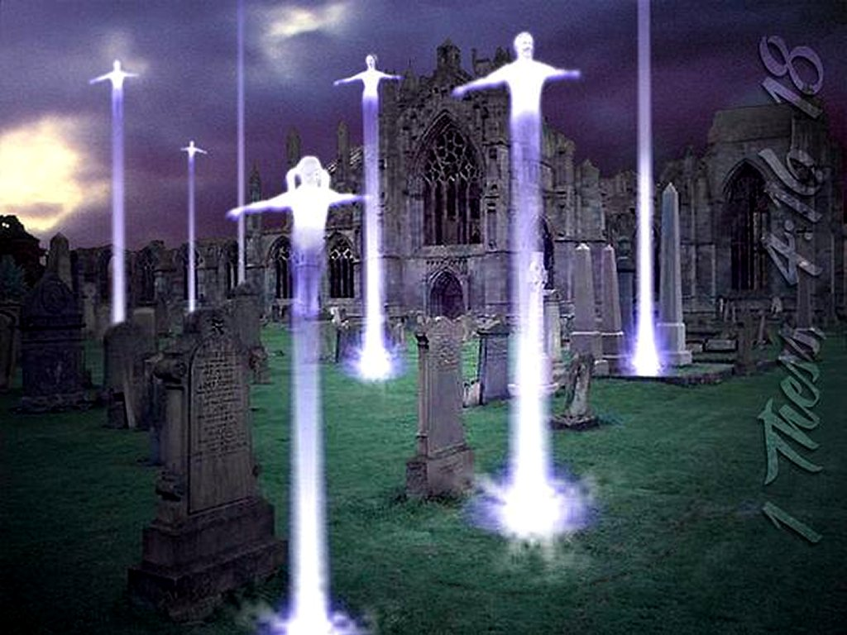
Resurrection of Jesus Christ – The first-fruits (I Corinthians 15:23)
Resurrection of the church – Dead in Christ Rapture – (I Thessalonians 4:16)
3. Resurrection of Old Testament saints and Tribulation saints – (Daniel 12:2, Isaiah 26:19)

Slide 23
“Blessed and holy is he that hath part in the first resurrection: on such the second death hath no power, but they shall be priests of God and of Christ, and shall reign with him a thousand years.”

Slide 24
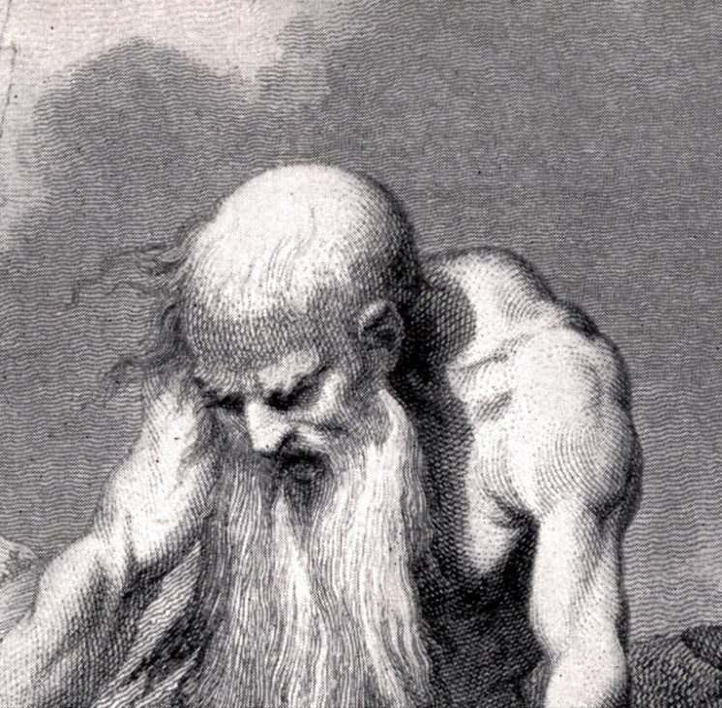
“For I know that my redeemer liveth, and that he shall stand at the latter day upon the earth.” (Job 19:25)

Slide 25
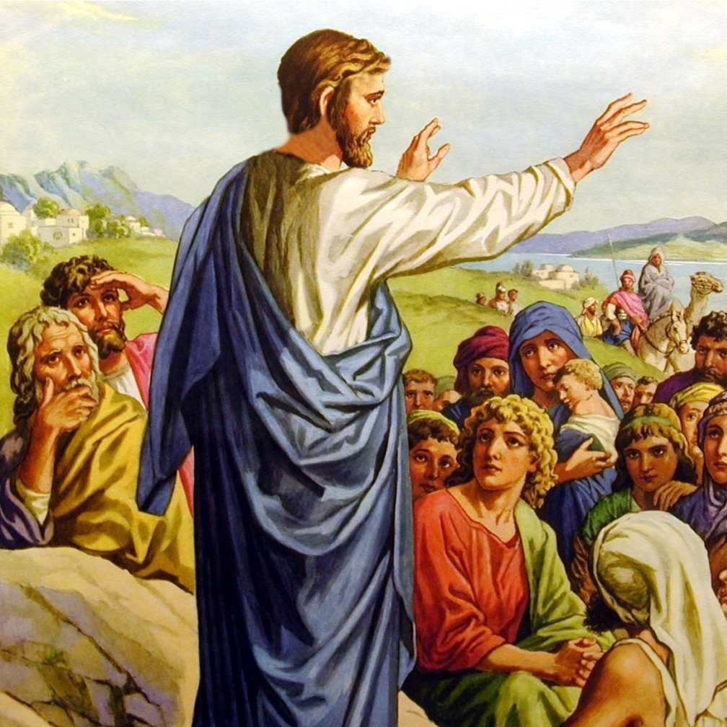
“For in the resurrection they neither marry, nor are given in marriage, but are as the angels of God in heaven. But as touching the resurrection of the dead, have ye not read that which was spoken unto you by God, saying, I am the God of Abraham, and the God of Isaac, and the God of Jacob? God is not the God of the dead, but of the living.” (Matt.22:30-33)

Slide 26
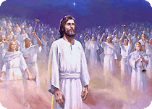
“Jesus said unto her, I am the resurrection, and the life: he that believeth in me, though he were dead, yet shall he live: And whosoever liveth and believeth in me shall never die. Believest thou this?”
(John 11:25-26)

Slide 27
(John 5:24-29)
“Verily, verily, I say unto you, He that heareth my word, and believeth on him that sent me, hath everlasting life, and shall not come into condemnation; but is passed from death unto life. Verily, verily, I say unto you, The hour is coming, and now is, when the dead shall hear the voice of the Son of God: and they that hear shall live. For as the Father hath life in
himself; so hath he given to the Son
to have life in himself;

Slide 28
And hath given him authority to execute judgment also, because he is the Son of man. Marvel not at this: for the hour is coming, in the which all that are in the graves shall hear his voice, And shall come forth; they that have done good, unto the resurrection of life; and they that have done evil, unto the resurrection of damnation.”

Slide 29
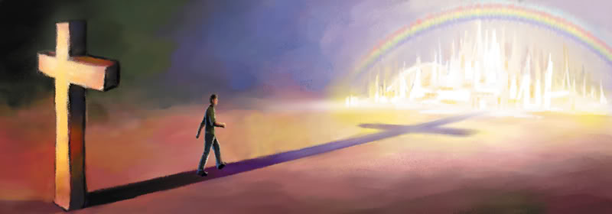
“That if thou shalt confess with thy mouth the Lord Jesus, and shalt believe in thine heart that God hath raised him from the dead, thou shalt be saved.” (Rom.10:9)

Slide 30
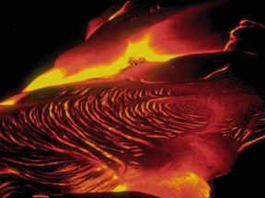
“But they shall be priest of God and of Christ, and shall reign with him a thousand years.”
“On such (believers) the Second Death hath no power…”
“And death and hell were cast into the lake of fire. This is the second death.”

Slide 31
Revelation 20:7-15
“The Great White Throne Judgment”

Slide 32
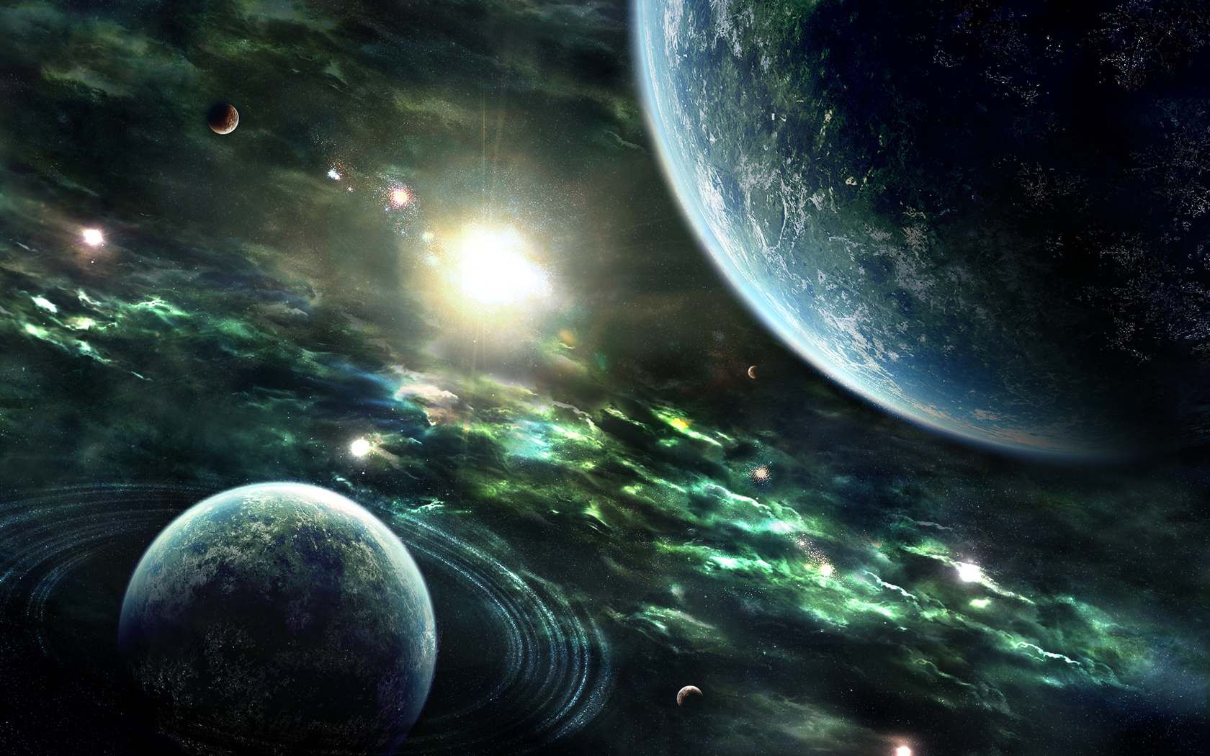
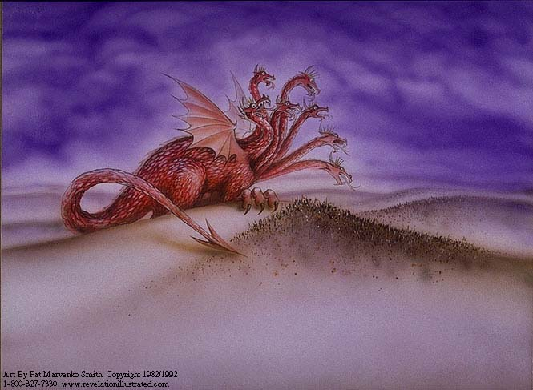
“And when the thousand years are expired, Satan shall
be loosed out of his prison.”

Slide 33
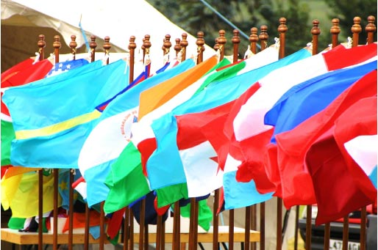
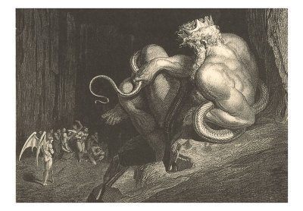
(Ezekiel 38)
“And shall go out to deceive the nations which are in the four quarters of the earth, Gog (ruler) and Magog (head), to gather them together to battle: the number of
whom is as the sand of the sea.”

Slide 34
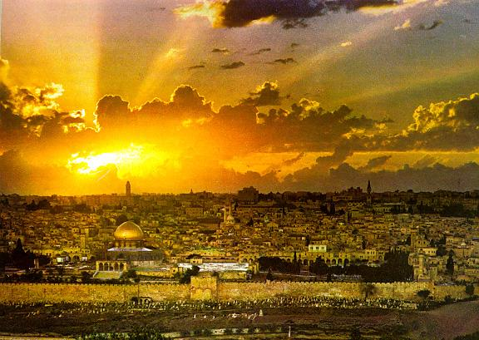
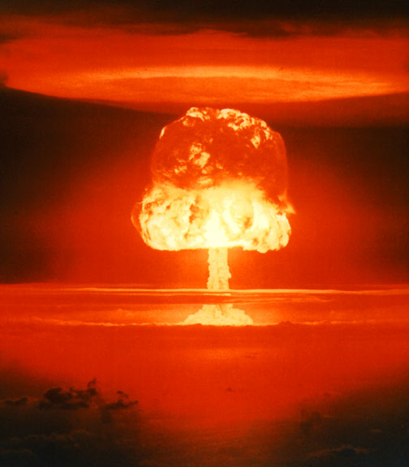
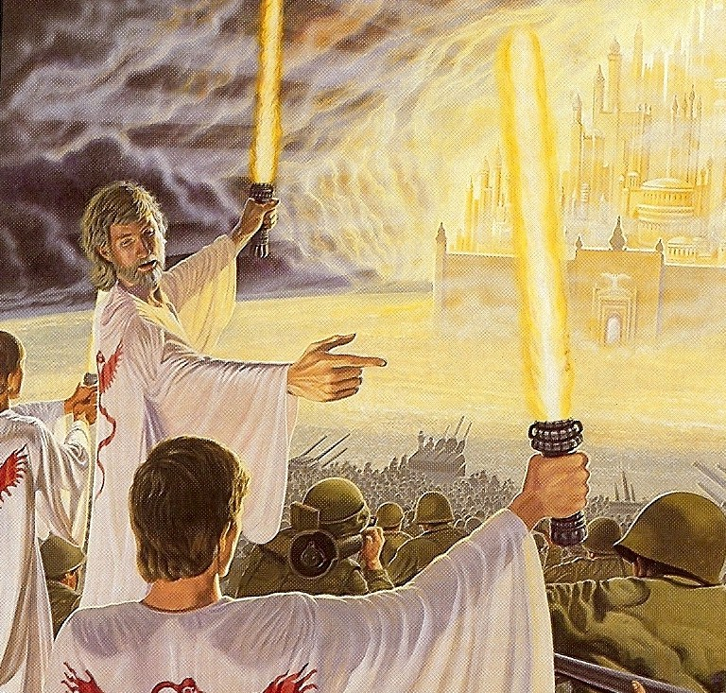
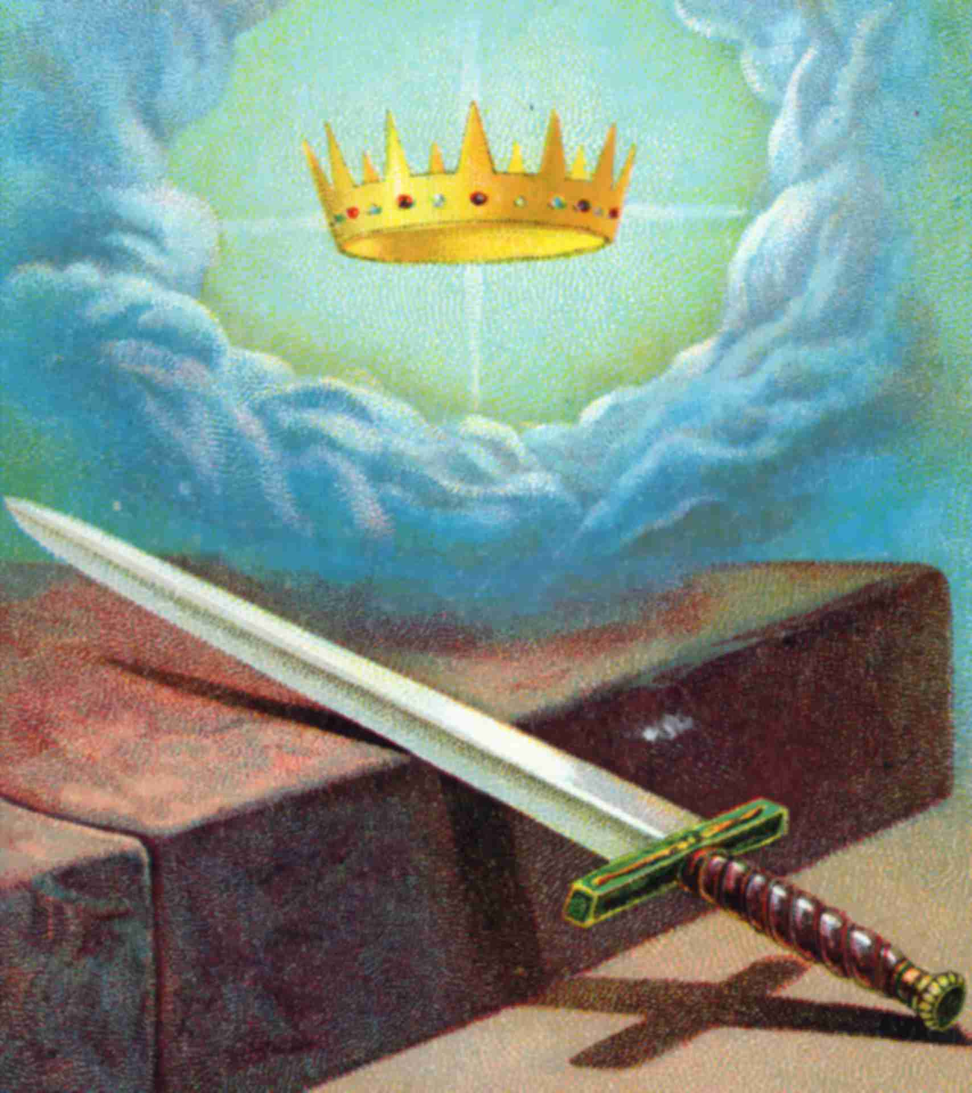
“And they went up on the breadth of the earth, and compassed the camp of the saints about, and the beloved city: and fire came down from God out of heaven, and devoured them.”
“Of his kingdom there shall be no end.”
“And he shall reign for ever and ever.”

Slide 35
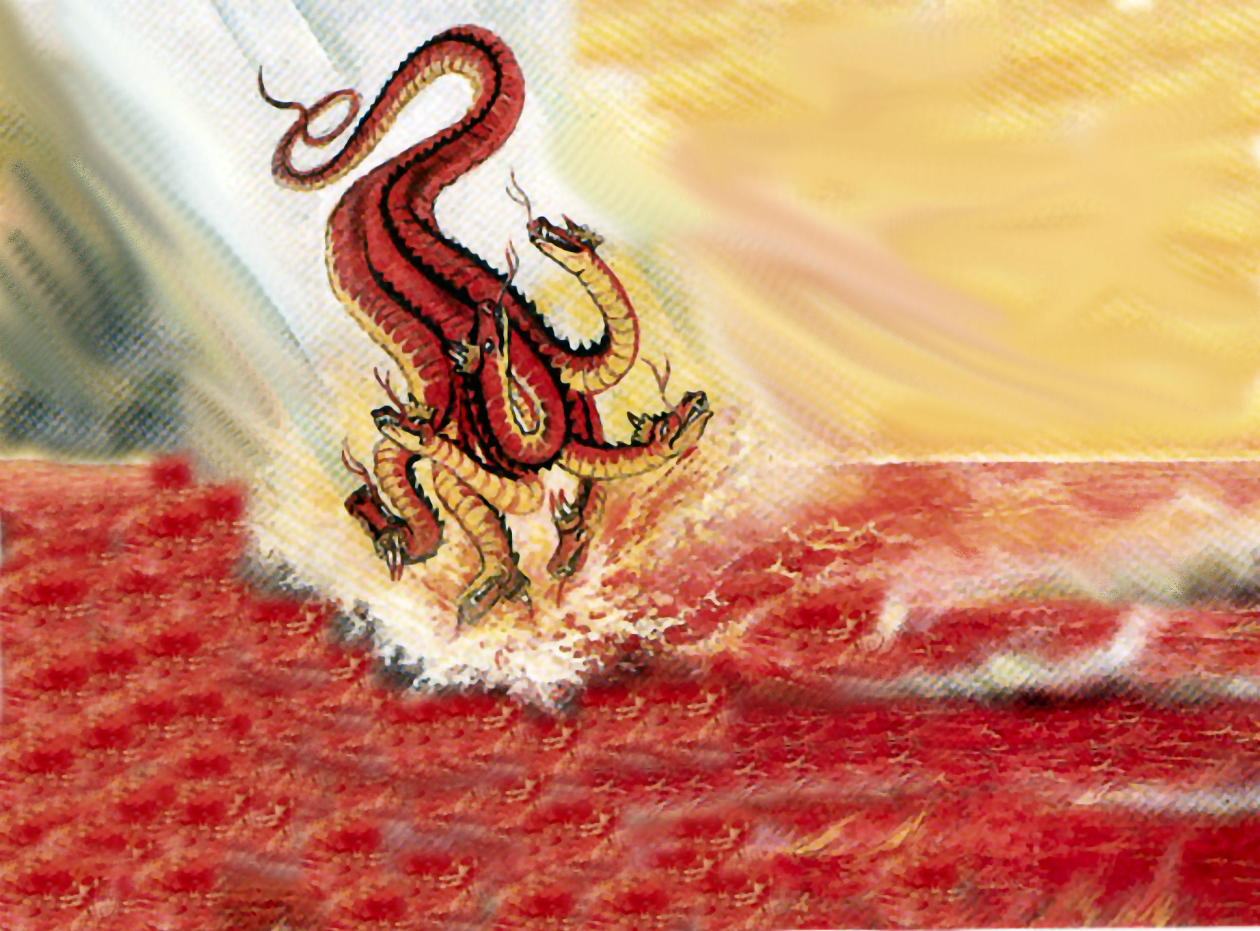
“And the devil that deceived them was cast into the lake of fire and brimstone, where the beast and the false prophet are, and shall be tormented day and night for ever and ever.”

Slide 36
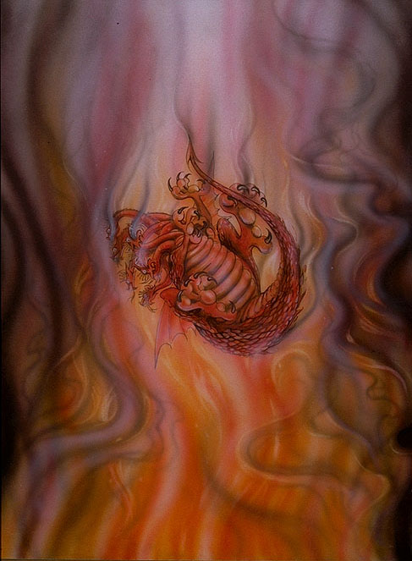
“Never shalt thou be any more.”
(Ezekiel 28:19)

Slide 37
The Great White Throne (Revelation 20:11-15)

Slide 38
“And as it is appointed unto men once to die, but after this the judgment” (Heb 9:27)

Slide 39
“And I saw the dead, small and
great, stand before God”

Slide 41
“And the books were opened…”

Slide 42
“And another book was opened, which is the book of life.”

Slide 43
“And the dead were judged out of those things which were written in the books.”

Slide 44
“But we are sure that the judgment of God is according to truth.”
“And thinkest thou this, O man
…that thou shalt escape the
judgment of God.”
“But a certain fearful looking for of judgment and fiery indignation, which shall devour the adversaries.”

Slide 45
“Fear God, and give glory to him; for the hour of his judgment is come.”
“For the Father judgeth no man, but hath committed all judgment unto the Son…And hath given him authority to execute judgment also, because he is the
Son of man.”

Slide 46
“These things saith the Son of God, who hath his eyes like unto a flame of fire.”
“His eyes were as a flame of fire.”

Slide 47
“A fiery stream issued and came forth from before him: thousand thousands ministered unto him, and ten thousand times ten thousand stood before him: the judgment was set, and the
books were opened.”
(Daniel 7:10)

Slide 48
“And the sea gave up the dead which were in it; and death and hell delivered up the dead which were in them: and they were judged every man according to their works.”

Slide 49
“And death and hell were cast into the lake of fire. This is the second death.”

Slide 50
“And whosoever was not found written in the book of life was cast into the lake of fire.”

Slide 51
Is your name in the book of life?

