Slide 1
The Revelation of Jesus Christ
A study of the book
of Revelation

Slide 2
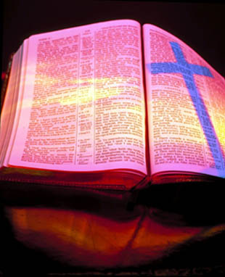
Revelation 14:1-20
“The harvest of the earth and the wrath and mercy of God”

Slide 3
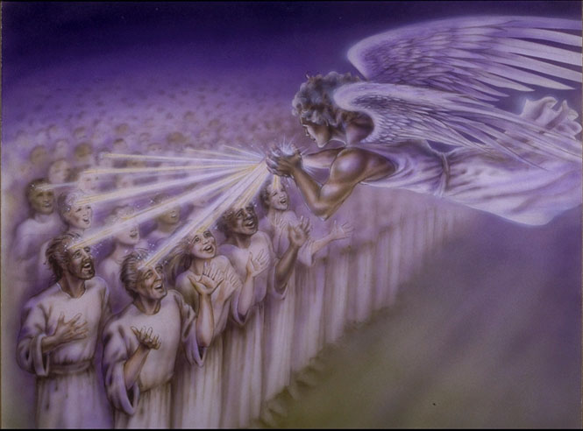
“And I looked, and, lo, a Lamb stood on the mount Sion, and with him an hundred forty and four thousand, having his Father's name written in their foreheads.”

Slide 4
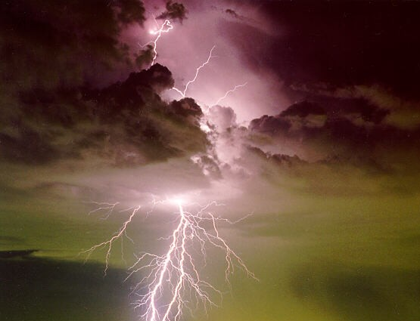
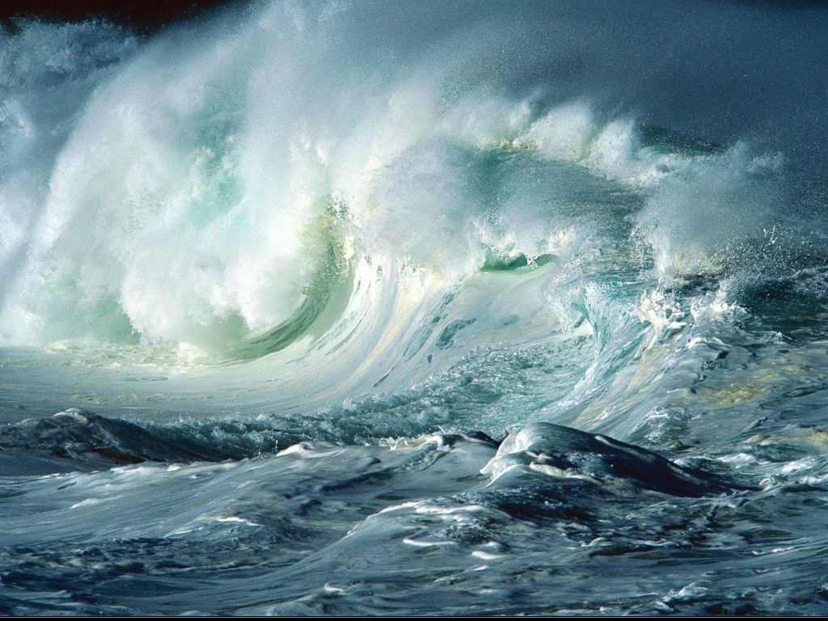
“And I heard a voice from heaven, as the voice of many waters, and as the voice of a great thunder.”

Slide 5
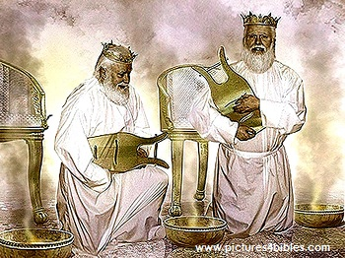
“…and I heard the voice of harpers harping with their harps.”

Slide 6
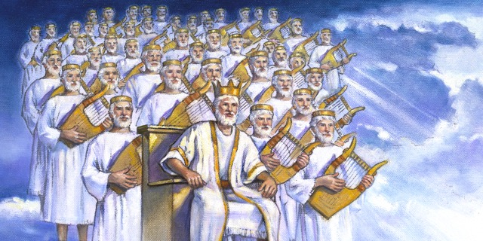
“And they sung as it were a new song before the throne, and before the four beasts, and the elders: and no man could learn that song but the hundred and forty and four thousand, which were redeemed from the earth.”

Slide 7
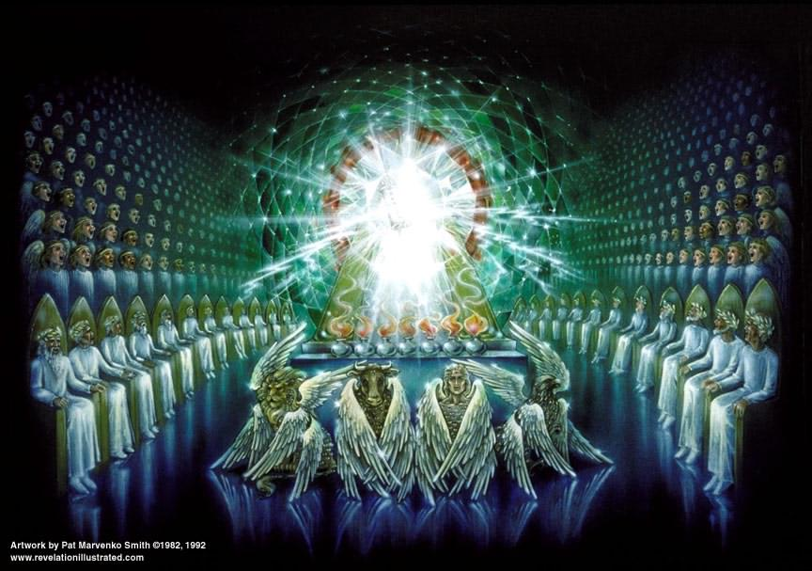

Slide 8
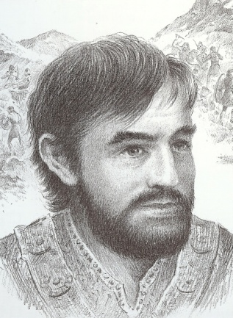
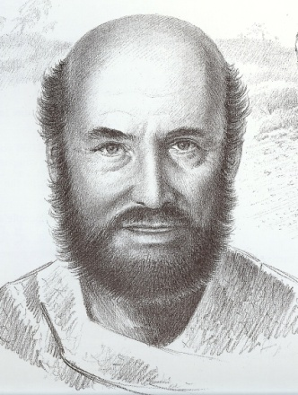
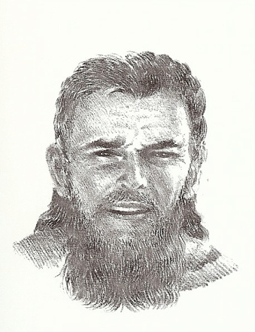
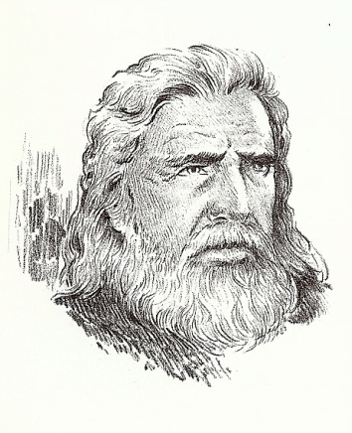
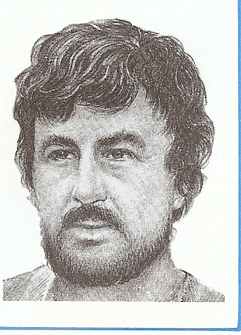
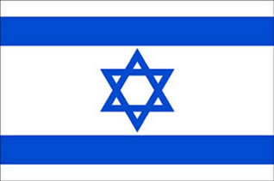
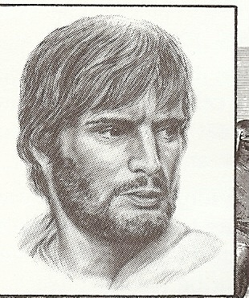
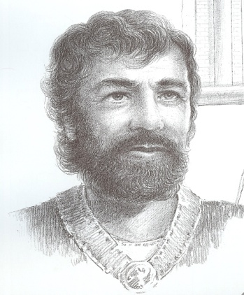
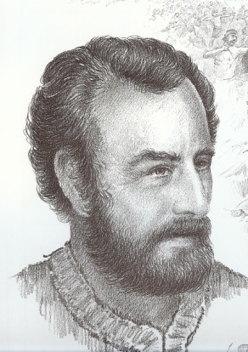
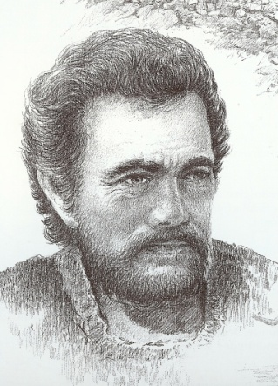
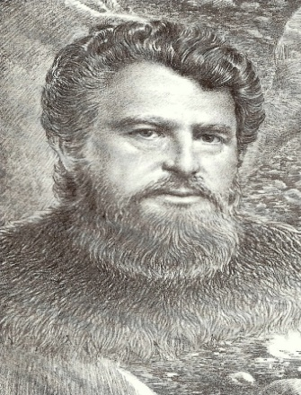
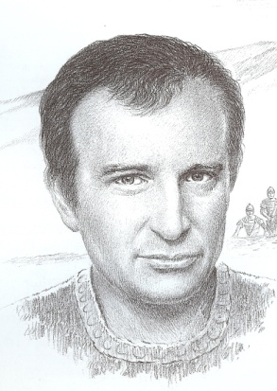
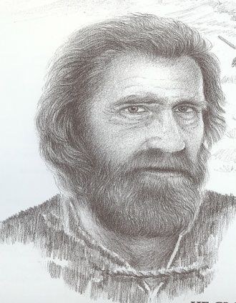

Slide 9
Who are these men from the Twelve Tribes of Israel?
Men who have received Christ as Lord and personal Savior after the rapture of the church – II Thessalonians 2:10-12
Men who have refused the mark of the beast – Revelation 20:4-6
Men who compose a special body of Jewish believers – 12 thousand from each tribe
Men who are called the servants of God – Revelation 7:3
Men who are dedicated to serve the Lord Jesus Christ totally during the tribulation period -

Slide 10
Spiritual men who are morally pure – Revelation 14:1, 4-5
They are redeemed
They are the “first fruits” to be saved
They possess the seal of God on their foreheads
They are virgins
They follow the Lamb of God where ever He leads them “The righteous are as bold as a lion”
No guile (deceit) is found in their mouth
They are without fault before God

Slide 11
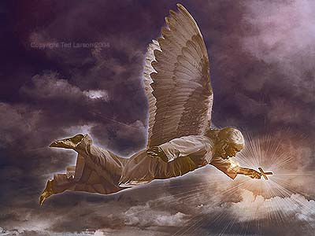
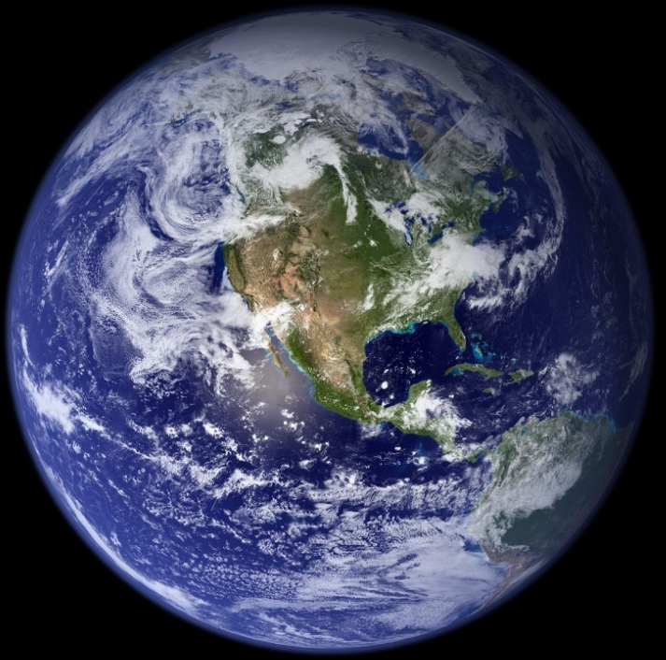
“And I saw another angel fly in the midst of heaven, having the everlasting gospel to preach unto them that dwell on the earth, and to every nation, and kindred, and tongue, and people.”

Slide 12
“Saying with a loud voice, Fear God, and give glory to him; for the hour of his judgment is come: and worship him that made heaven, and earth, and the sea, and the fountains of waters.”

Slide 14
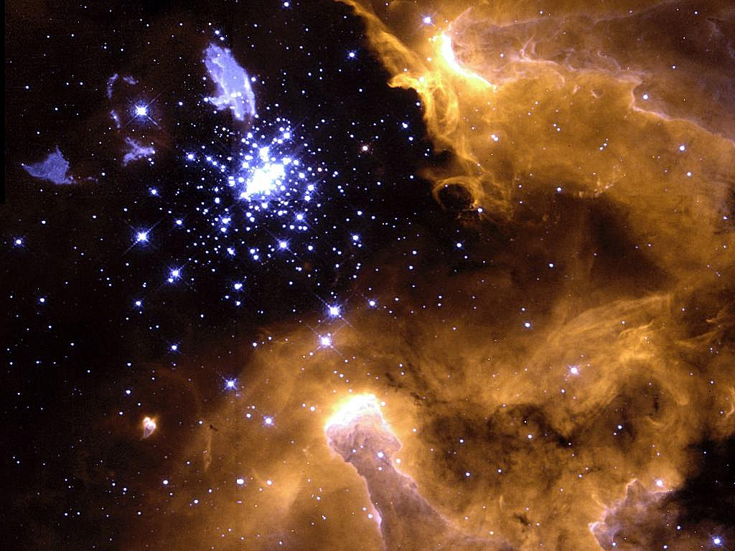
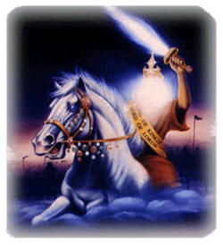
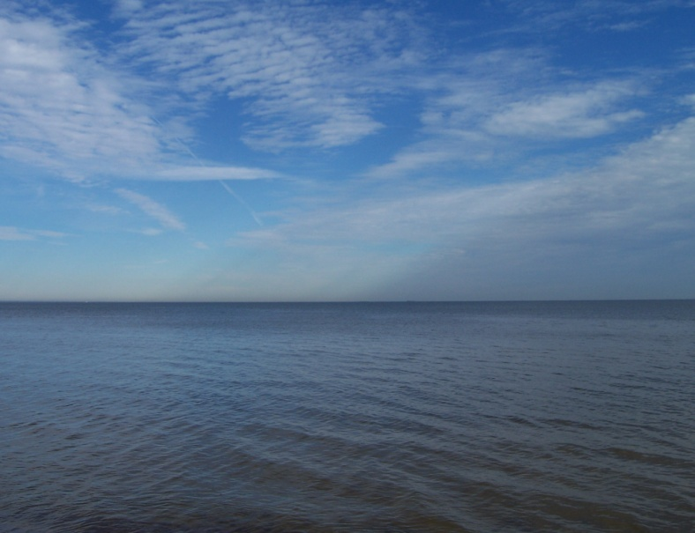
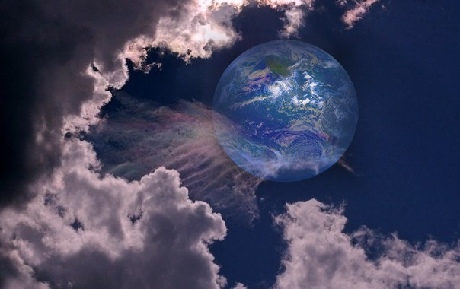
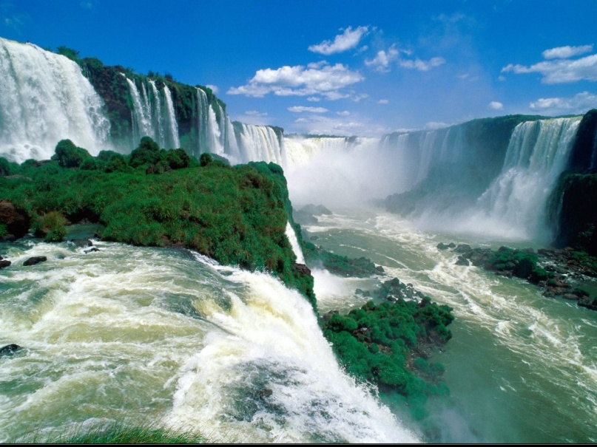
“Worship him that made heaven, and earth, and the sea, and the fountains of waters.”

Slide 15
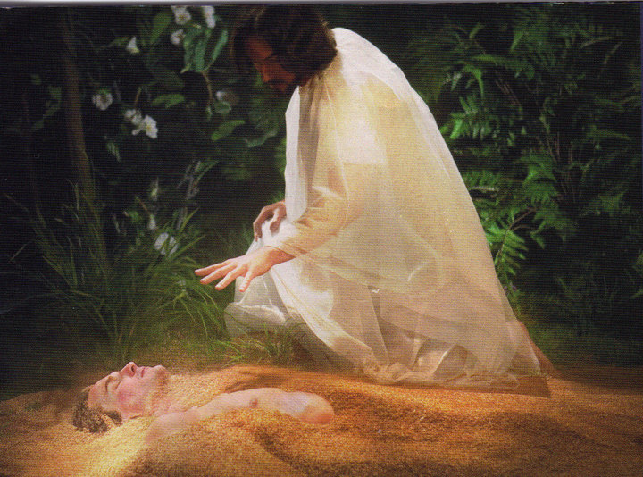
Worship Him
“Thou art worthy, O Lord, to receive glory and honour and power: for thou hast created all things, and for thy pleasure they are and were created.” (Rev. 4:11)

Slide 16
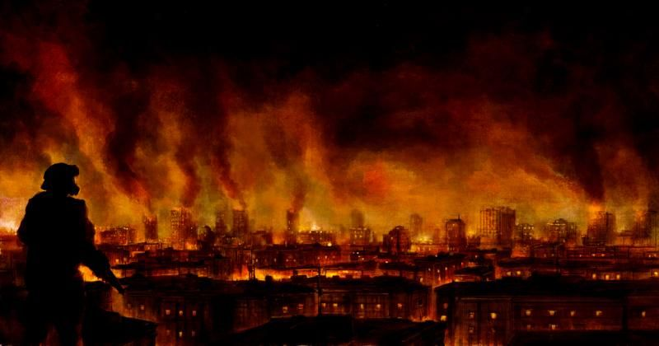
“And there followed another angel, saying, Babylon is fallen, is fallen, that great city.”

Slide 17
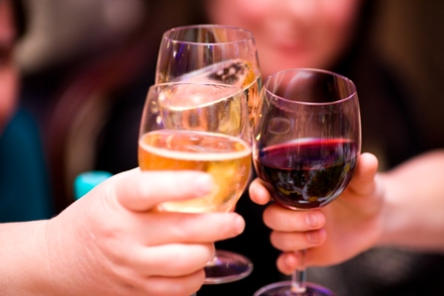
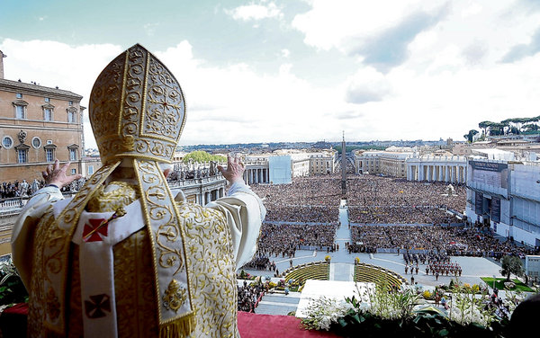
“…because she made all nations drink of the wine of the wrath of her fornication.”

Slide 18
Babylon Identified (Revelation 17:1-18)

Slide 19
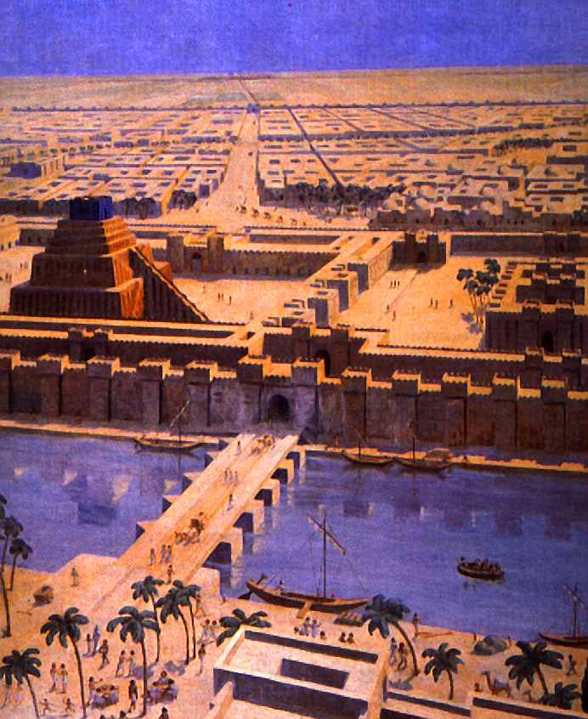
“Mystery, Babylon the Great, The Mother of Harlots and Abominations of the Earth.”

Slide 20
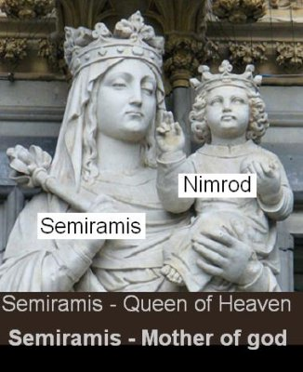
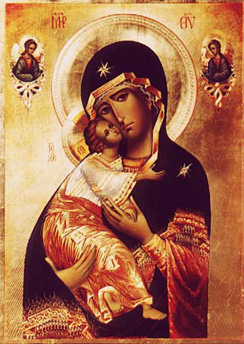
Nimrod Rebellion against God To Revolt against God

Slide 21
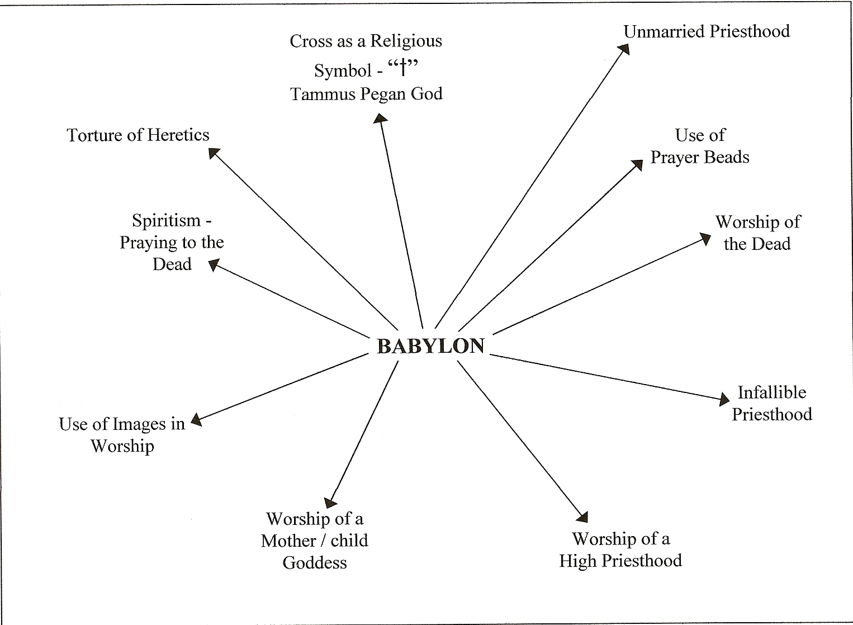
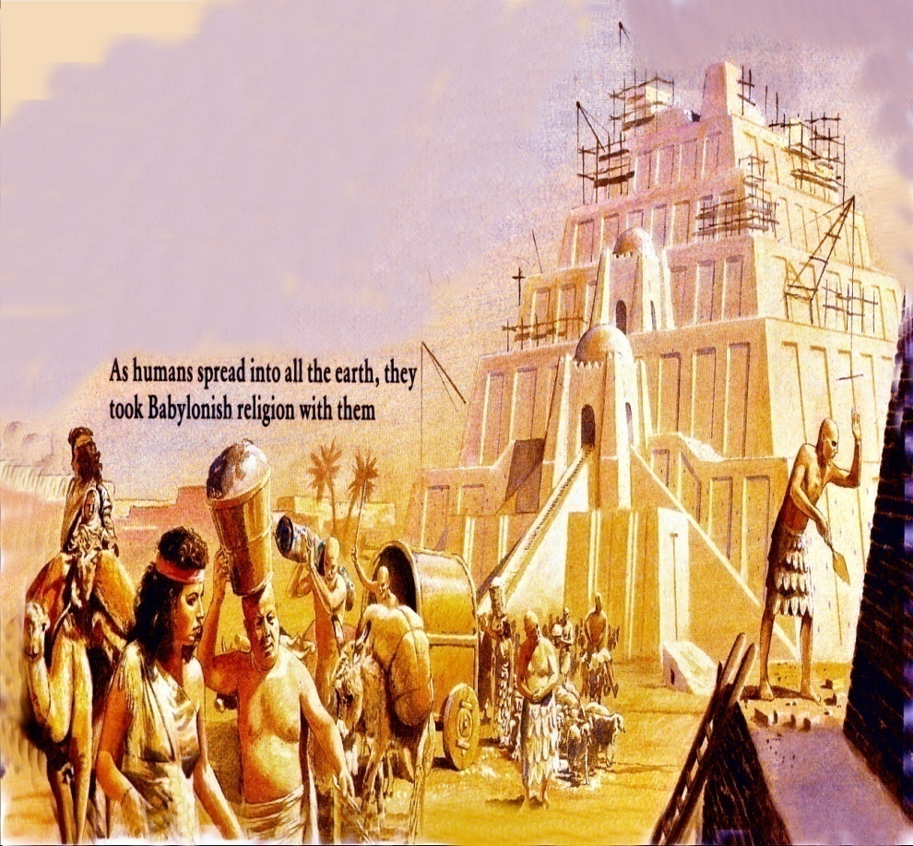

Slide 22
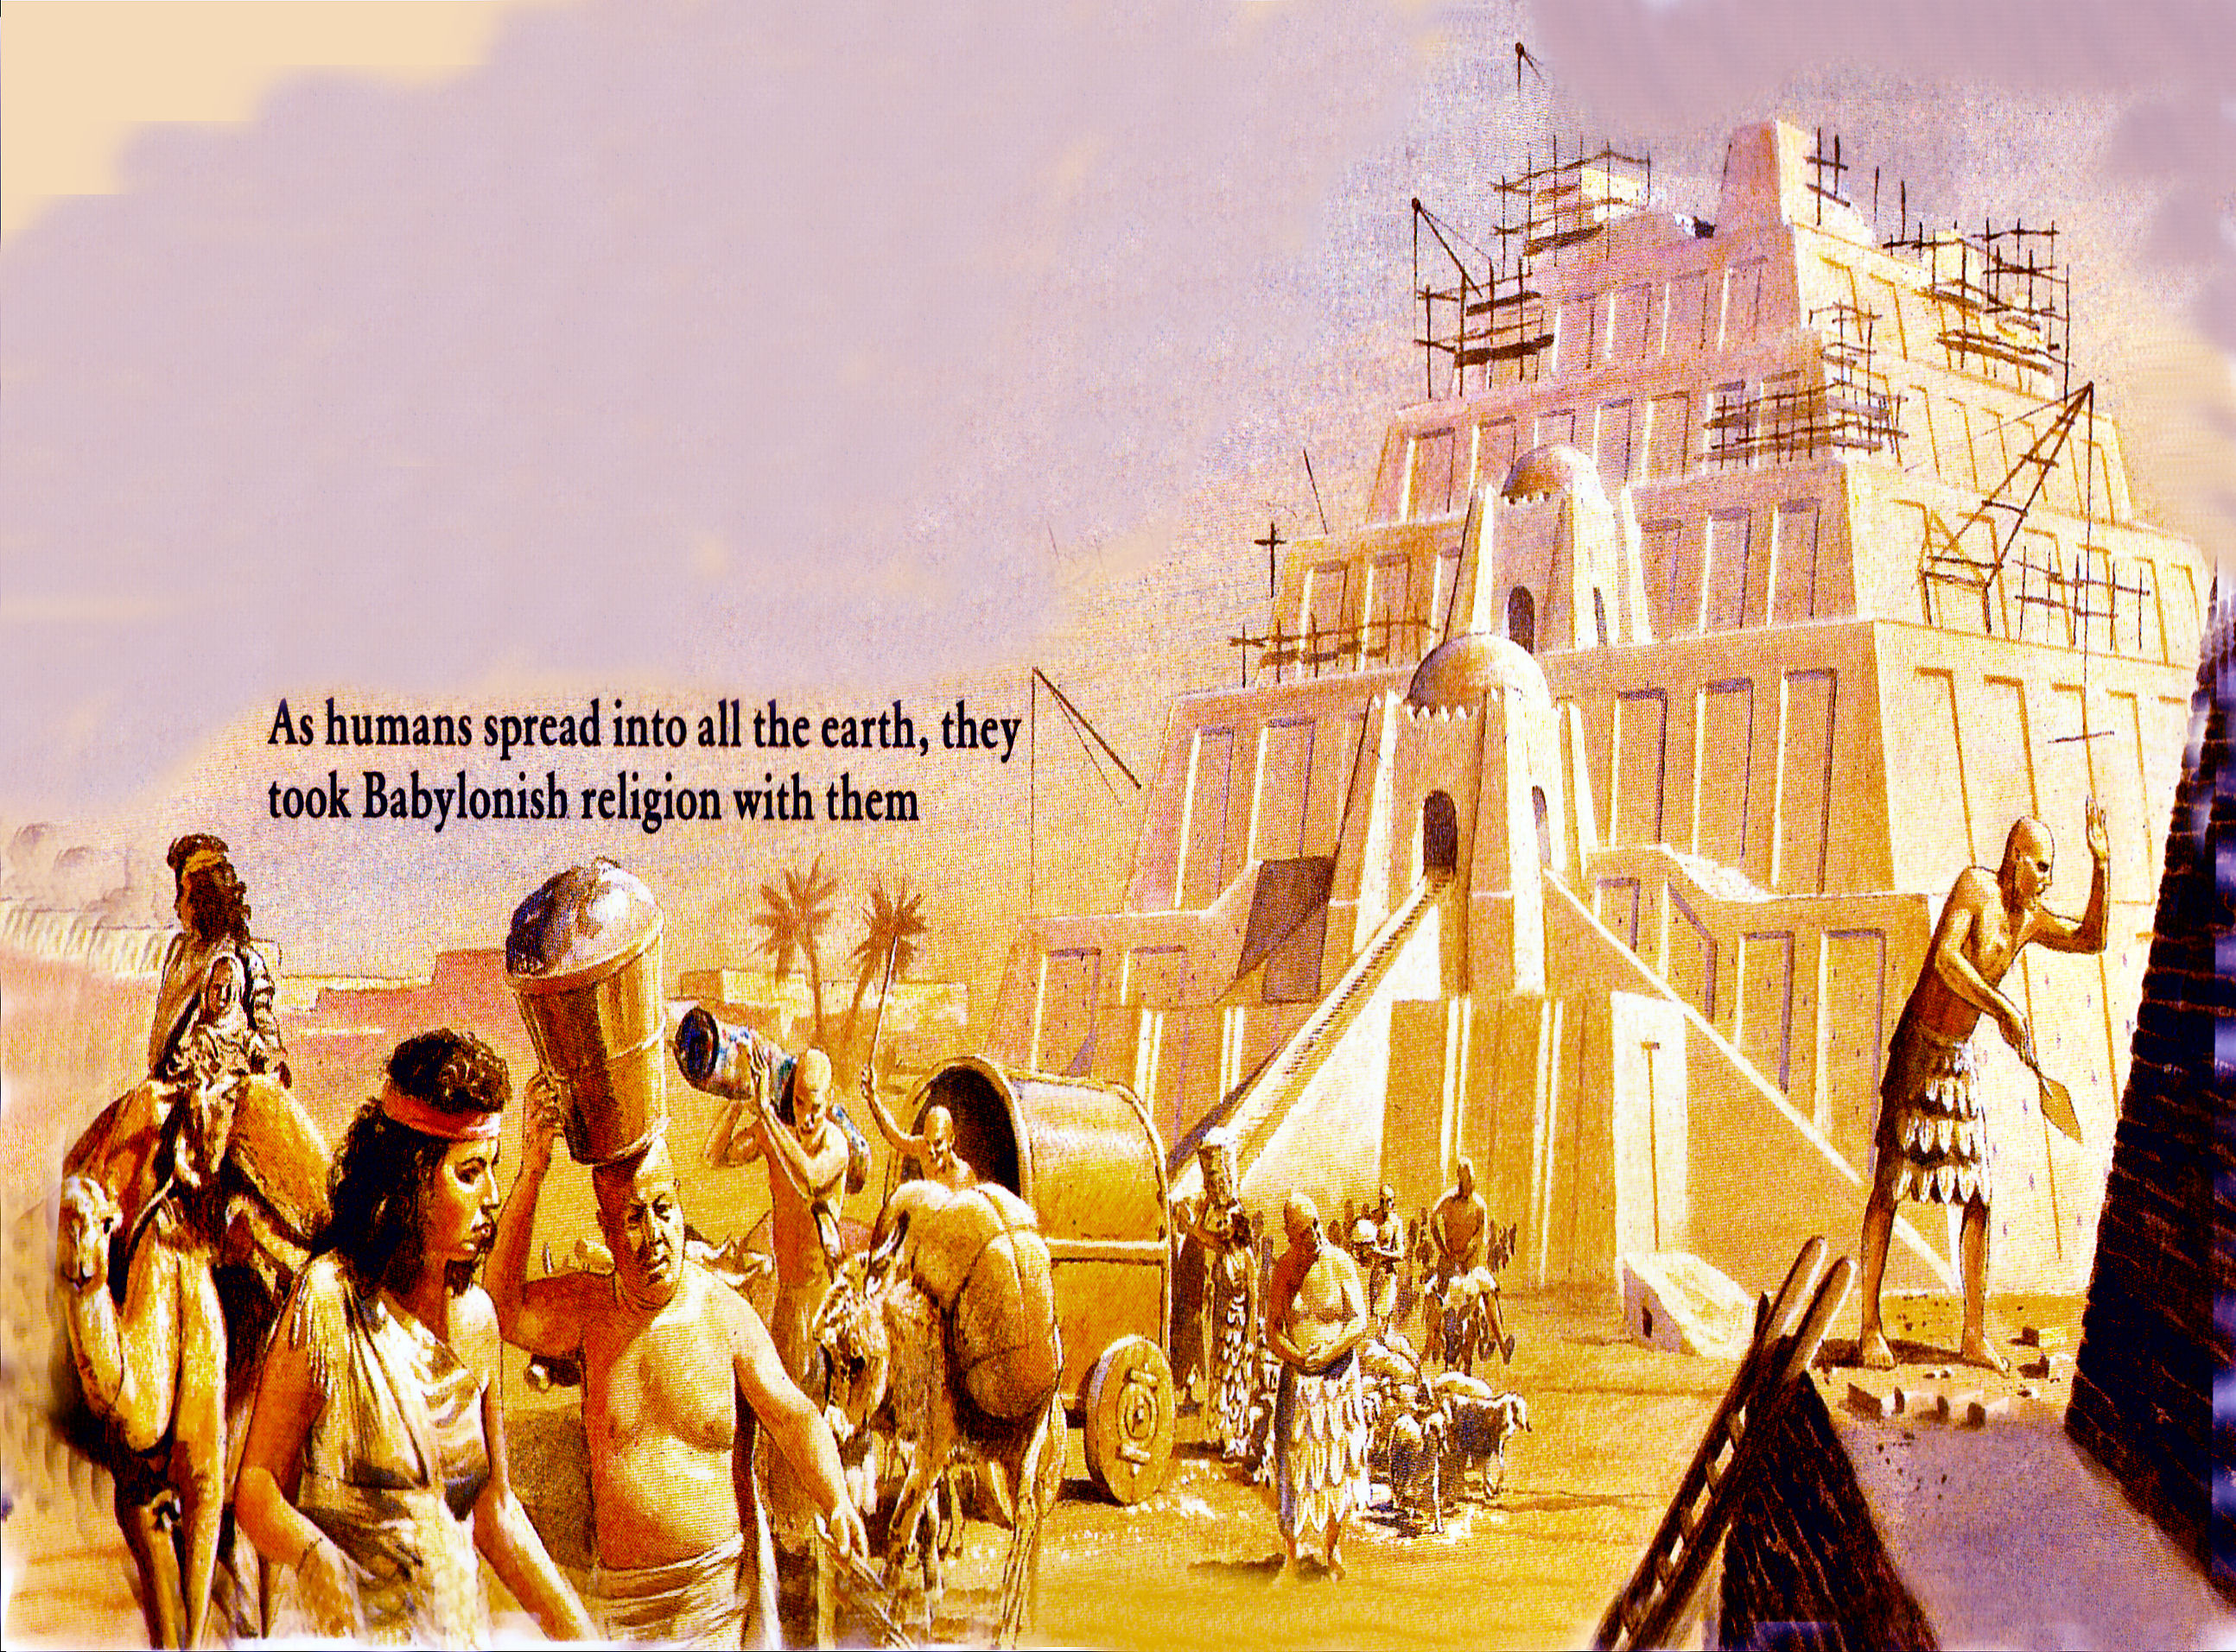

Slide 23
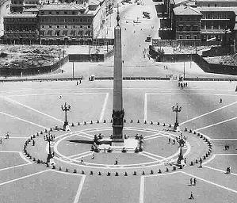
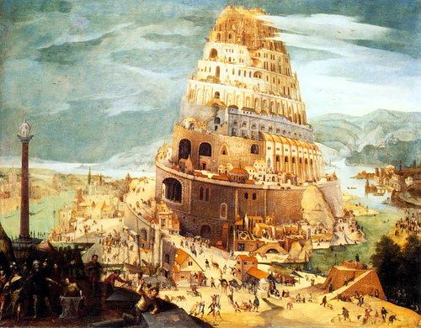
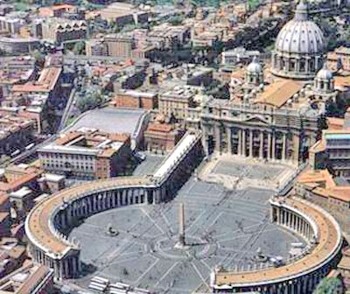

Slide 24
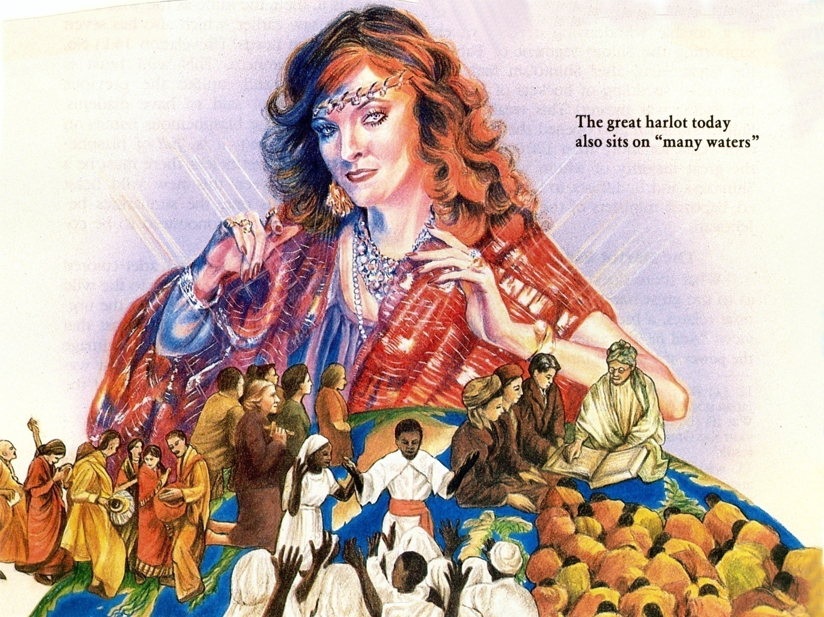
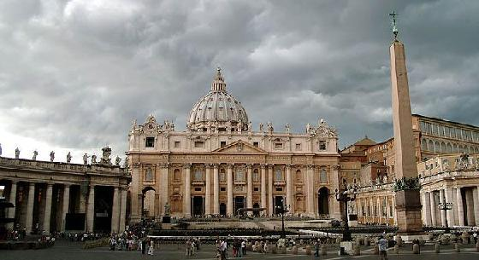
“And he said unto me, the waters which thou sawest, where the whore sitteth, and peoples, and multitudes, and nations and tongues.”
Catholic = Universal

Slide 25
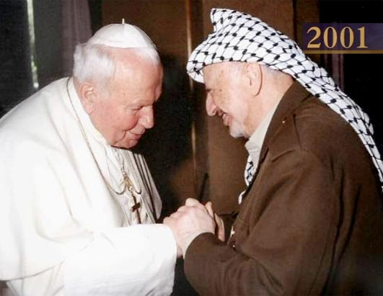
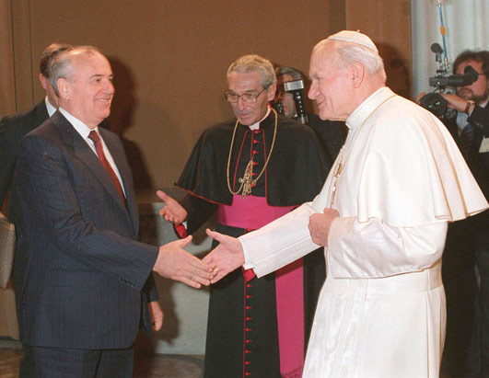
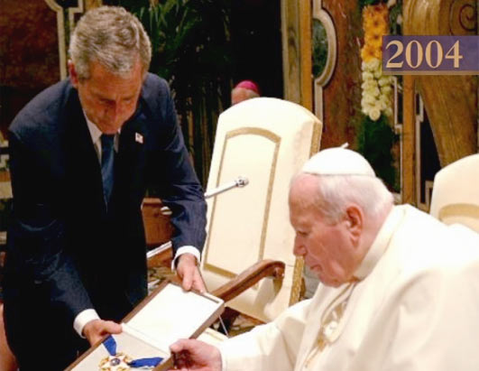
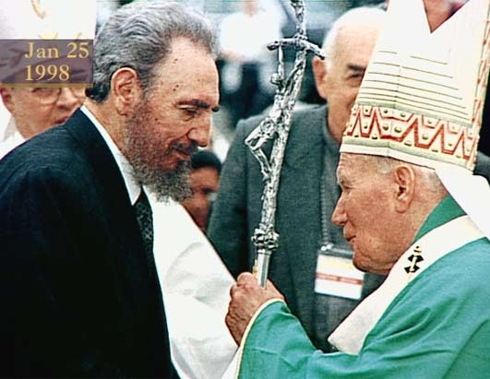
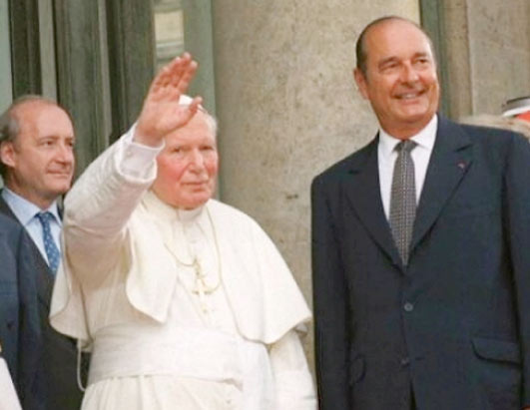
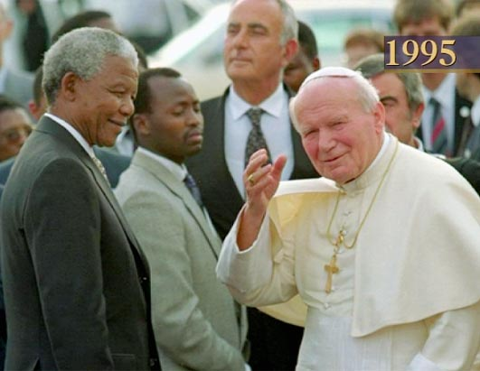
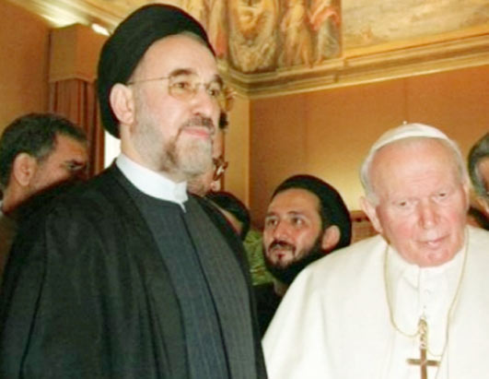
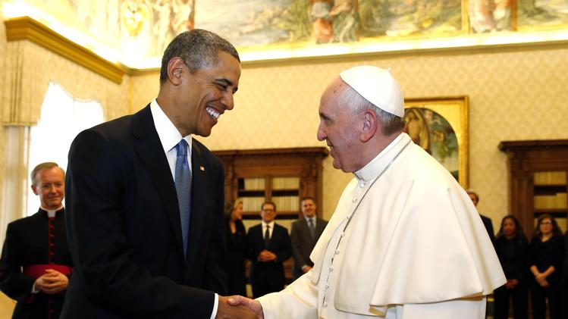
“With whom the kings of the earth have committed fornication.”

Slide 26
“…and the inhabitants of the earth have been made drunk with the wine of her fornication.”

Slide 27
“She made all nations drink of the wine of the wrath of her fornication.”

Slide 28
“So he carried me away in the spirit into the wilderness: and I saw a woman sit upon a scarlet coloured beast.” (Rev. 17:3)

Slide 29
Full of the names of blasphemy -
Seven heads – vs. 15
10 horns – vs. 12
Arrayed in purple and scarlet –
Decked with gold and precious stones and pearls –
Golden cup full of abominations and filthiness of her fornication -

Slide 30
The city of seven hills
“Seven heads

Slide 32
“The Ten Horns.”

Slide 33
“The ten horns which thou sawest are ten kings…these have one mind, and shall give their power and strength unto the beast (Anti-christ).”

Slide 34
“Arrayed in purple and scarlet color.”

Slide 35
“Decked with gold and precious stones and pearls.”

Slide 36
“Golden cup full of abominations and filthiness of her fornication.”

Slide 37
“Drunk with the blood of the saints.”

Slide 39
“And the Angel said unto me, I will tell thee the mystery of the woman, and of the beast that carrieth her, which hath the seven heads and ten horns.”

Slide 40
The Apostate Church “The identity of the great whore”
(Revelation 17:1-19:10)

Slide 41
Babylon Destroyed (Revelation 17:16, 19:1-5)

Slide 42
“And the ten horns which thou sawest upon the beast, these shall hate the whore, and shall make her desolate and naked, and shall eat her flesh, and burn her with fire. For God hath put in their hearts to fulfill his will, and to agree, and give their kingdom unto the beast, until the words of God shall be fulfilled.”(Revelation 17:16-17)

Slide 44
“And she shall be utterly burned with fire…” Revelation 18:8

Slide 45
“…the habitation of devils, and every foul spirit…”

Slide 46
“Her sins have reached unto heaven…”

Slide 47
“Babylon the great is fallen…”

Slide 48
“I heard a great voice of much people in heaven, saying, Alleluia…for He hath judged the great whore, which did corrupt the earth with her fornication, and hath avenged the blood of his servants at her hand…And her smoke rose up forever and ever.” (Revelation 19:1-3)
Heaven rejoices over the judgment of the whore

Slide 49
Revelation 14:9-13 “The Warning”

Slide 50
“And the third angel followed them, saying with a loud voice, If any man worship the beast and his image, and receive his mark in his forehead, or in his hand, The same shall drink of the wine of the wrath of God, which is poured out without mixture into the cup of his indignation; and he shall be tormented with fire and brimstone.”

Slide 51
Wrath of God

Slide 52
“And he shall be tormented with fire and brimstone in the presence of the holy angels, and in the presence of the Lamb: And the smoke of their torment ascendeth up for ever and ever: and they have no rest day nor night, who worship the beast and his image,
and whosoever receiveth the
mark of his name.”

Slide 53
“Here is the patience of the saints: here are they that keep the commandments of God, and the faith of Jesus. And I heard a voice from heaven saying unto me, Write, Blessed are the dead which die in the Lord from henceforth: Yea, saith the Spirit, that they may rest from their labours; and their works do follow them.”

Slide 54
Revelation 14:14-20 “The Harvest”

Slide 55
“And I looked, and behold a white cloud, and upon the cloud one sat like unto the Son of man, having on his head a golden crown, and in his hand a sharp sickle.”

Slide 57
“And another angel came out of the temple, crying with a loud voice to him that sat on the cloud, Thrust in thy sickle, and reap: for the time is come for thee to reap; for the harvest of the earth is ripe.”

Slide 58
“Thrust in thy sickle, and reap.”

Slide 59
“And he that sat on the cloud thrust in his sickle on the earth; and the earth was reaped.”

Slide 60
“And another angel came out of the temple which is in heaven, he also having a sharp sickle.”

Slide 62
“And another angel came out from the altar, which had power over fire; and cried with a loud cry to him that had the sharp sickle.”

Slide 64
“Thrust in thy sharp sickle, and gather the clusters of the vine of the earth; for her grapes are fully ripe.”

Slide 65
“And the angel thrust in his sickle into the earth, and gathered the vine of the earth, and cast it into the great winepress of the wrath of God.”

Slide 67
“Wherefore art thou red in thine apparel, and thy garments like him that treadeth in the winepress? I have trodden the winepress alone; I will tread them in mine anger, and trample them in my fury; and their blood shall be sprinkled upon my garments, and I will stain all my raiment.” (Isaiah 63:2-3)

Slide 68
3 Parables of the Harvest

Slide 69
Matthew 13:36-42

Slide 70
Matthew 13:47-50

Slide 71
Matthew 25:31-41

Slide 75
(Revelation 14:19-20) “And the angel thrust in his sickle into the earth, and gathered the vine of the earth, and cast it into the great winepress of the wrath of God. And the winepress was trodden without the city, and blood came out of the winepress, even unto the horse bridles, by the space of a thousand and six hundred furlongs.”

Slide 77
“And the winepress was trodden without the city, and blood came out of the winepress, even unto the horse bridles, by the space of a thousand and six hundred furlongs.” (Revelation 14:20)

Slide 78
The Harvest “Hell or the Kingdom?”

