Slide 1
The Revelation of Jesus Christ
A study of the book
of Revelation

Slide 2
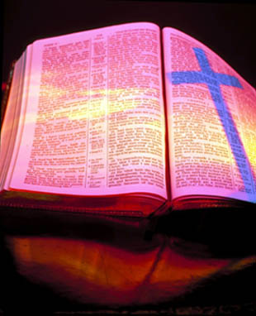
Revelation 11:1-19
“The Two Witnesses”

Slide 3
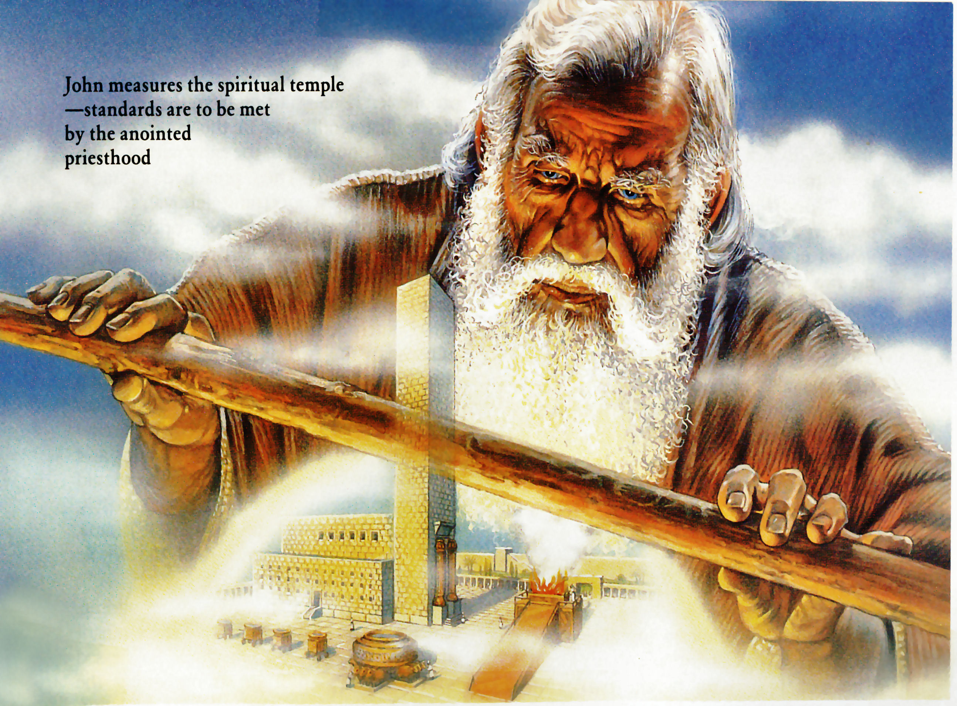
“And there was given me a reed like unto a rod: and the angel stood, saying...”
Revelation 11:1-19
“The Two Witnesses”

Slide 4
“Rise and measure the temple of God, and the alter, and them that worship therein.”

Slide 5
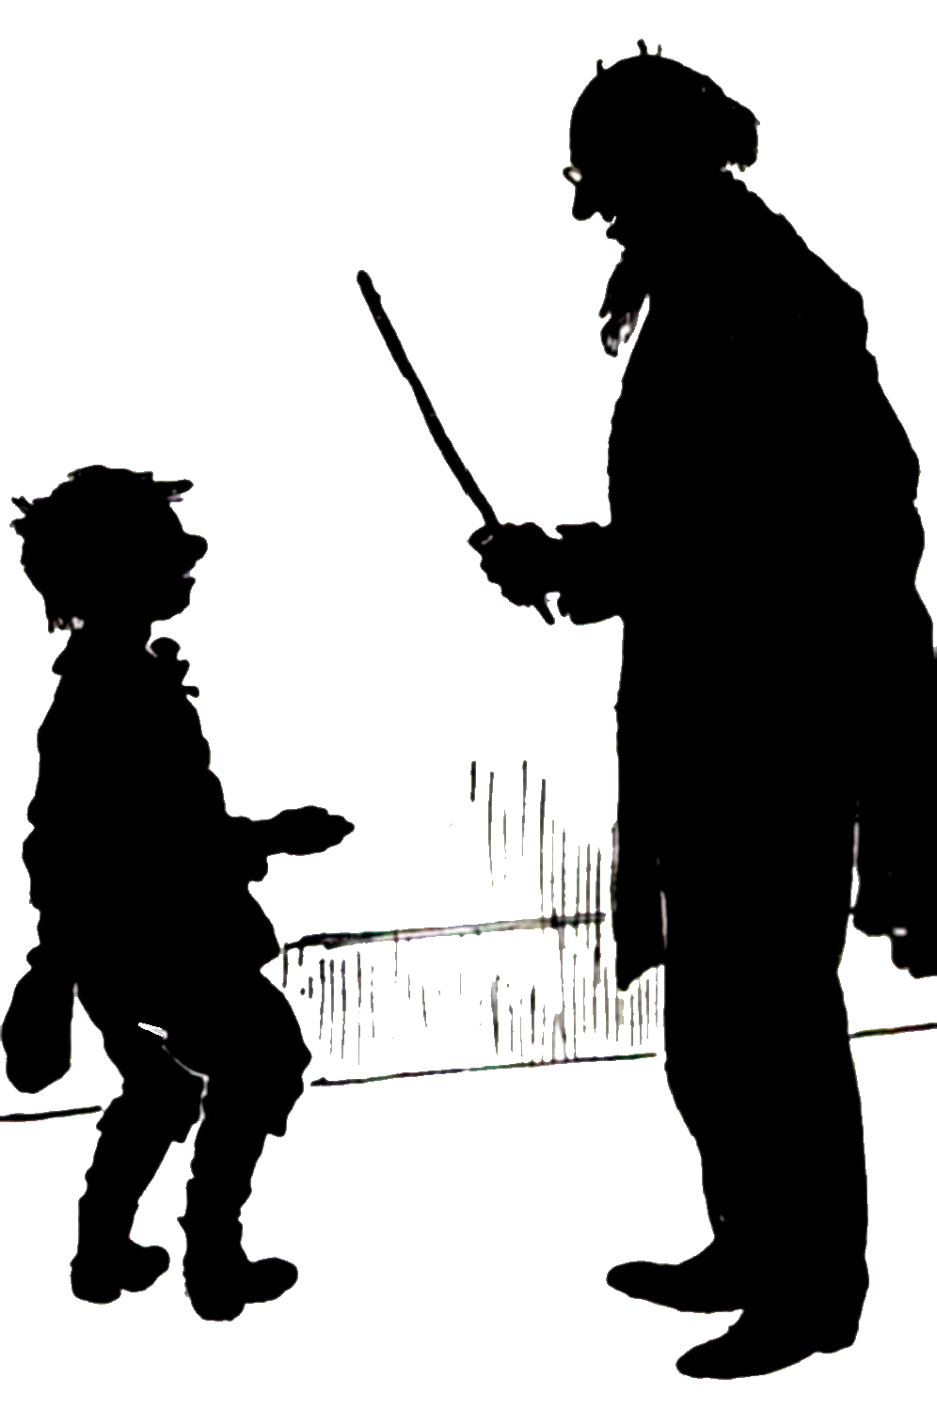
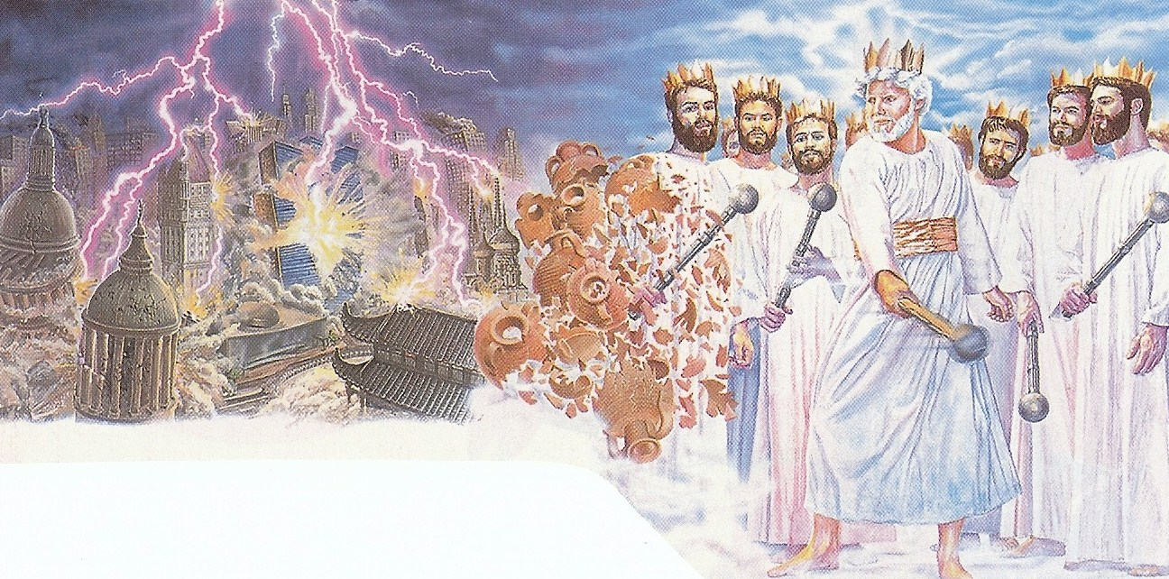
A rod can be used for punishment, correction and chastisement – II Samuel 7:14; 8:2; II Kings 21:13; Psalms 2:9; Isaiah 34:11

Slide 6
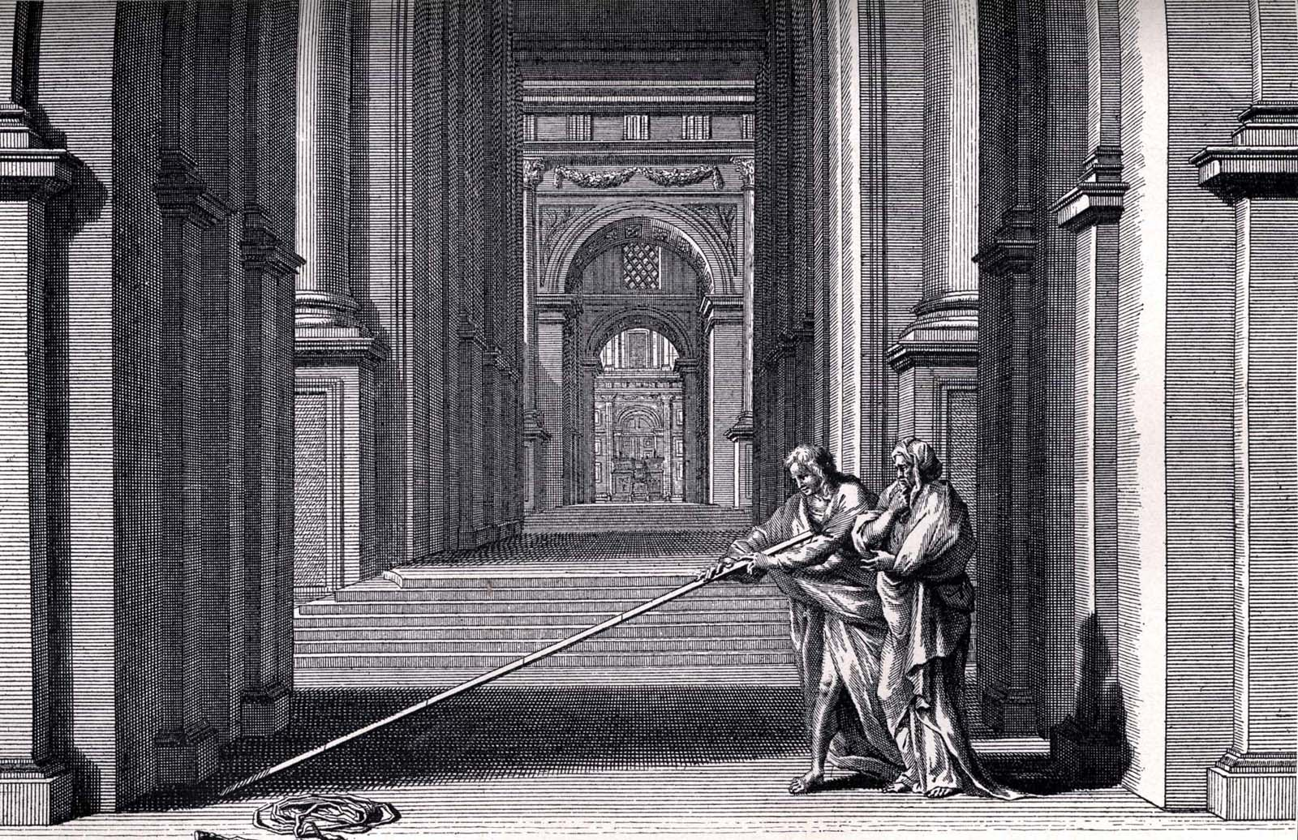
The rod can be used to measure a building for construction or for restoration, or it can be used to measure a place for preservation or protection – Zechariah 2:1-5
God is saying that He wants the true worshippers of God preserved and protected while the Anti-Christ and Gentile nations trod Jerusalem underfoot – Revelation 12:10-17

Slide 7
God is also saying that He wants a remnant of Jewish believers saved, protected, and preserved during the great tribulation – Romans 9-11
God also wants the temple preserved and protected because it will be the focal point of worship during the Millennial Kingdom – Ezekiel 41-43
It is into this temple that the Anti-Christ enters and presents himself as God and demands worship – Daniel 9:27, Matthew 24:15

Slide 8
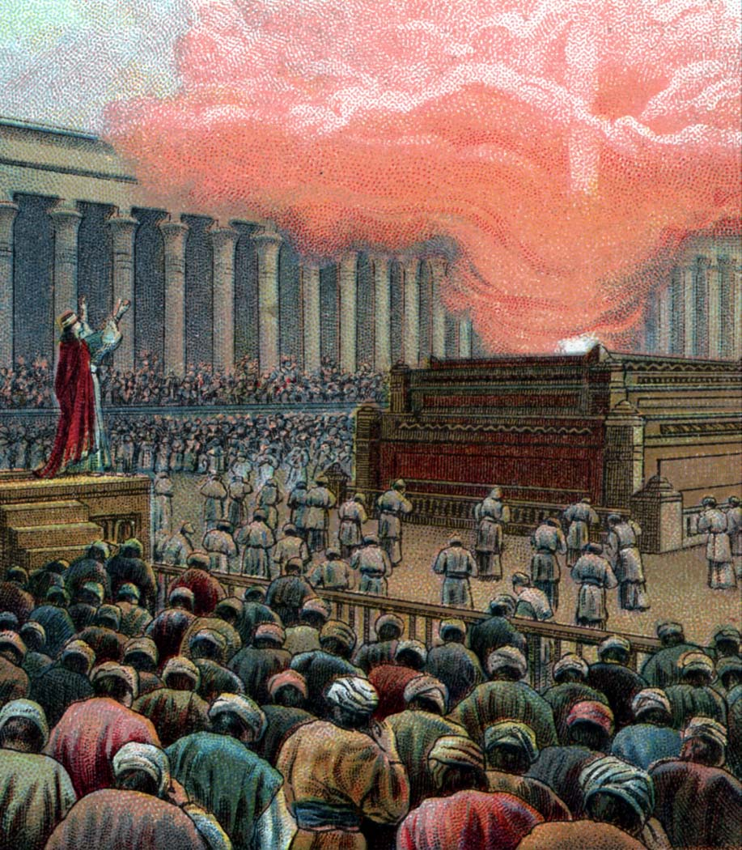
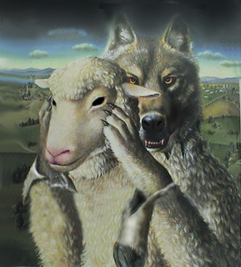
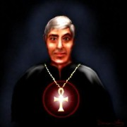
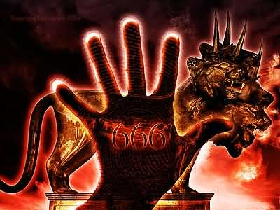
Abomination of Desolation
(II Thess. 2:1-12)

Slide 9
Abomination of Desolation
Magnifies himself above every God
Opposeth and exalteth himself above all that is called God
Sits in the temple of God showing himself that he is God
Breaks his covenant
Speaks great blasphemies
Blasphemes God’s name, His tabernacle and them that dwell in heaven

Slide 10
Speaks great words against the Most High
Speaks marvelous things against the God of gods
Worships Satan
Honors Satan
Pollutes the sanctuary
Causes sacrifices to cease
Forces people to worship Him
Forces people to take the mark in order to buy and sell
No regard for the God of his fathers, nor any god

Slide 11
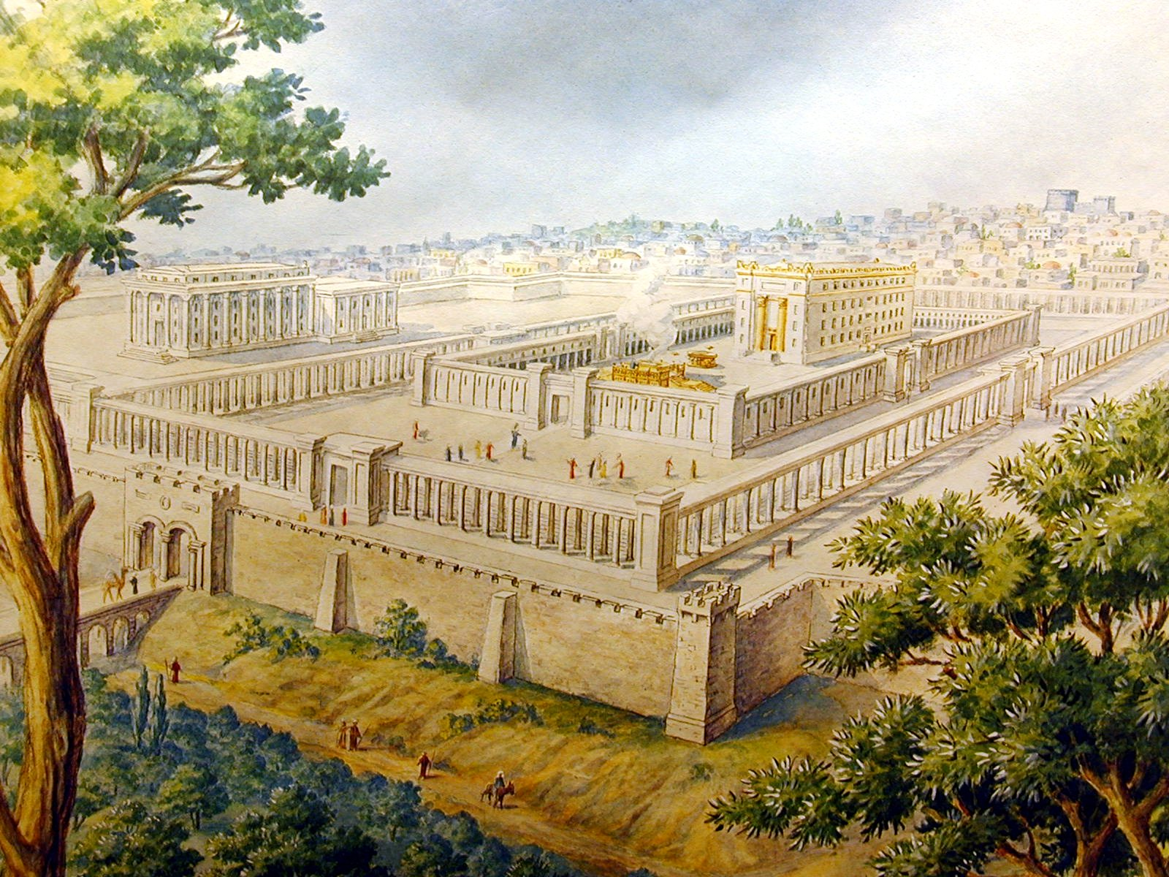
“But the court which is without the temple (Court of the Gentiles) leave out, and measure it not.”

Slide 12
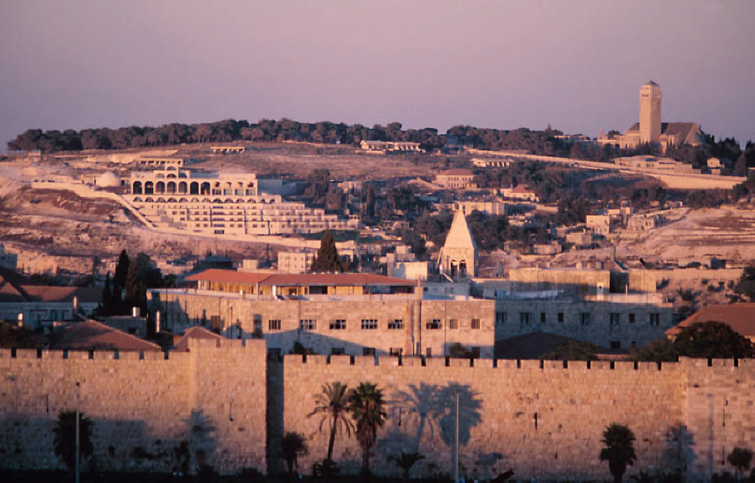
“And the Holy City shall they (Gentiles) tread under foot forty and two months.”
“Forty and two months.”
Daniel 7:25; 12:7 “A time, times, and the dividing of times.”
Revelation 11:3 “A thousand two hundred and threescore days.”
3 ½ years

Slide 13
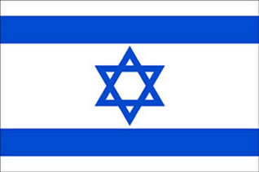
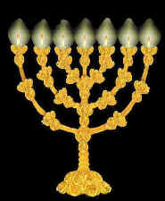
Israel’s relationship with God “His chosen people”
“For the LORD'S portion is his people; Jacob is the lot of his inheritance. He found him in
a desert land, and in the waste howling wilderness; he led him about, he instructed him, he kept him as the apple of his eye.”
(Deuteronomy 32:9-10)

Slide 15
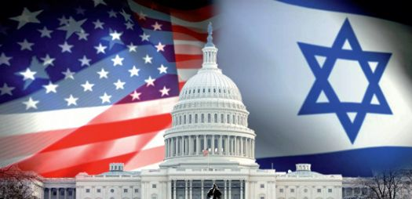
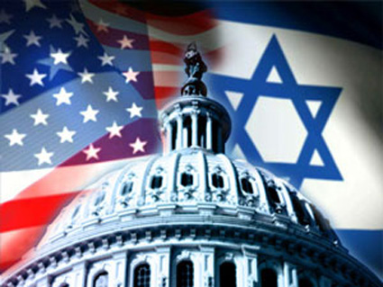
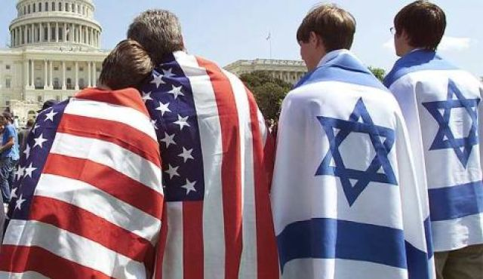
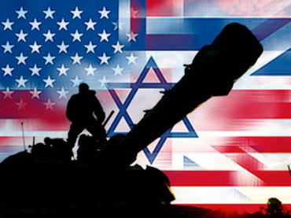
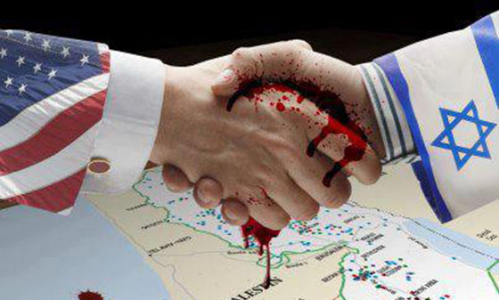
“And I will bless them that bless thee, and curse him that curseth thee: and in thee shall all families of the earth be blessed.” (Gen.12:3)

Slide 16
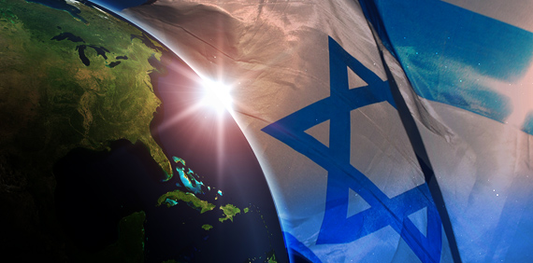
“For thou art an holy people unto the LORD thy God: the LORD thy God hath chosen thee to be a special people unto himself, above all people that are upon the face of the earth.”
(Deuteronomy 7:6)

Slide 17
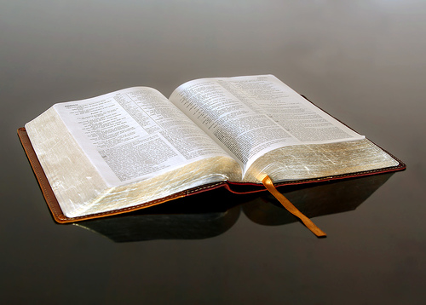
“I say then, Hath God cast away his people? God forbid. For I also am an Israelite, of the seed of Abraham, of the tribe of Benjamin. God hath not cast away his people which he foreknew...For I would not, brethren, that ye should be ignorant of this mystery, lest ye should be wise in your own conceits; that blindness in part is happened to Israel, until the fullness of the Gentiles be come in. And so all Israel shall be saved: as it is written, There shall come out of Sion the Deliverer, and shall turn away ungodliness from Jacob: For this is my covenant unto them, when I shall take away their sins.” (Romans 11:1-2a, 25-27)

Slide 18
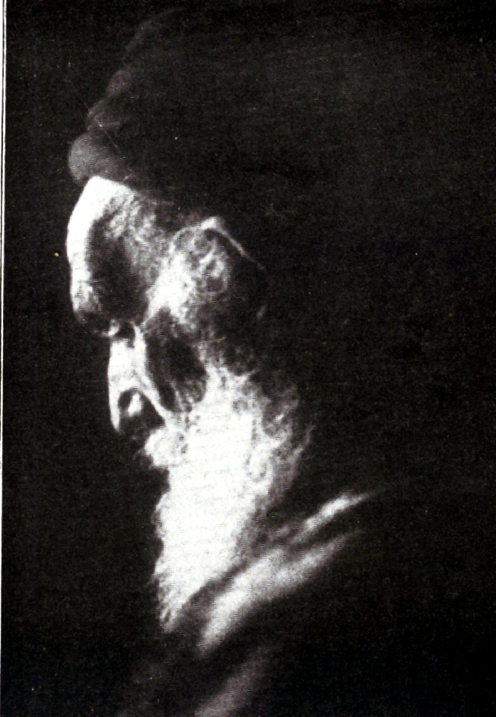
“And I will give them an heart to know me, that I am the LORD: and they shall be my people, and I will be their God: for they shall return unto me with their whole heart.”
(Jeremiah 24:7)

Slide 19
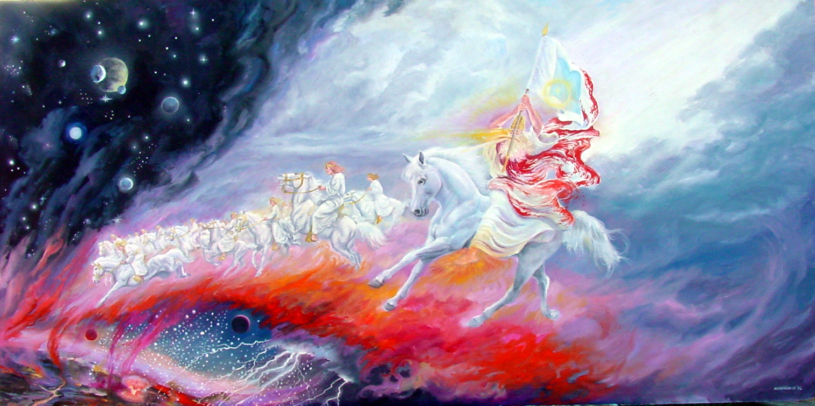
“Then shall the LORD go forth, and fight against those nations, as when he fought in the day of battle. And His feet shall stand in that day upon the mount of Olives, which is before Jerusalem on the east, and the mount of Olives shall cleave in the midst thereof toward the east and toward the west, and there shall be a very great valley; and half of the mountain shall remove toward the north, and half of it toward the south.”
(Zechariah 14:3)

Slide 20
“Why do the heathen rage, and the people imagine a vain thing? The kings of the earth set themselves, and the rulers take counsel together, against the LORD, and against his anointed, saying, Let us break their bands asunder, and cast away their cords from us. He that sitteth in the heavens shall laugh: the Lord shall have them in derision. Then shall he speak unto them in his wrath, and vex them in his sore displeasure. Yet have I set my king upon my holy hill of Zion.

Slide 21
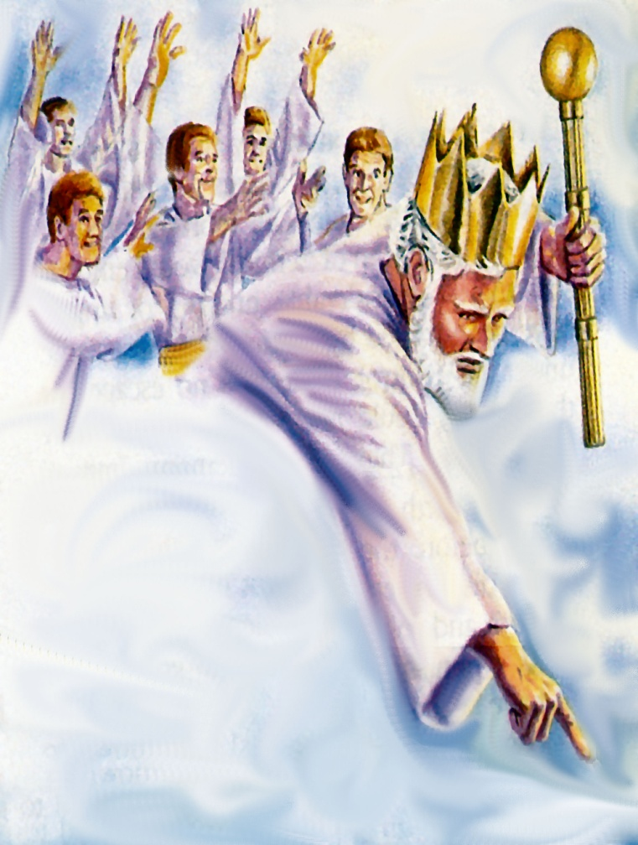
I will declare the decree: the LORD hath said unto me, Thou art my Son; this day have I begotten thee. Ask of me, and I shall give thee the heathen for thine inheritance, and the uttermost parts of the earth for thy possession.

Slide 22
Thou shalt break them with a rod of iron; thou shalt dash them in pieces like a potter's vessel.” (Psalms 2:1-9)

Slide 23
Revelation 11:3-9
“And I will give power unto my two witnesses, and they shall prophesy a thousand two hundred and threescore days, clothed in sackcloth…”

Slide 24
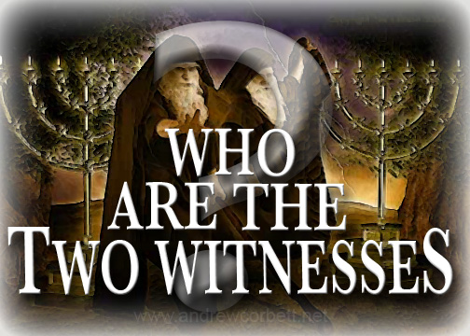

Slide 25
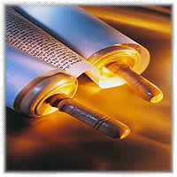
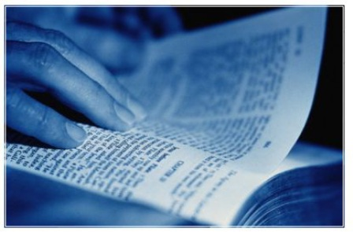
Who they are not!
Gospel

Slide 26
The Two Witnesses are Men
They have mouths to witness
They can breathe fire
They can stop the raining
They can turn water into blood
They can bring plagues upon the earth
They have bodies
Men attempt to kill them
They will eventually be killed by Satan and the Anti-Christ

Slide 27
“These (witnesses) are the two olive trees, and the two candlesticks standing before the God of the earth.”

Slide 28
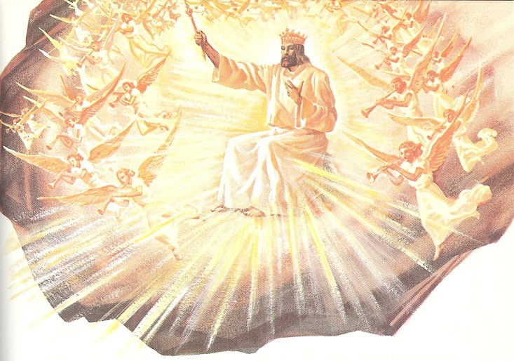
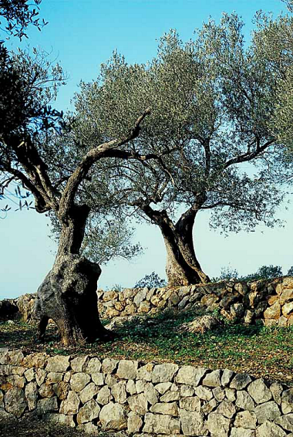
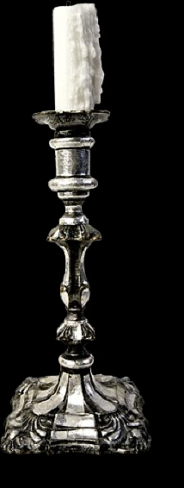
These Two Men are Like Olive Trees and Candlesticks Standing Before God
Strong and fruitful as olive trees
Shining forth as
the lights of
a candlestick

Slide 29
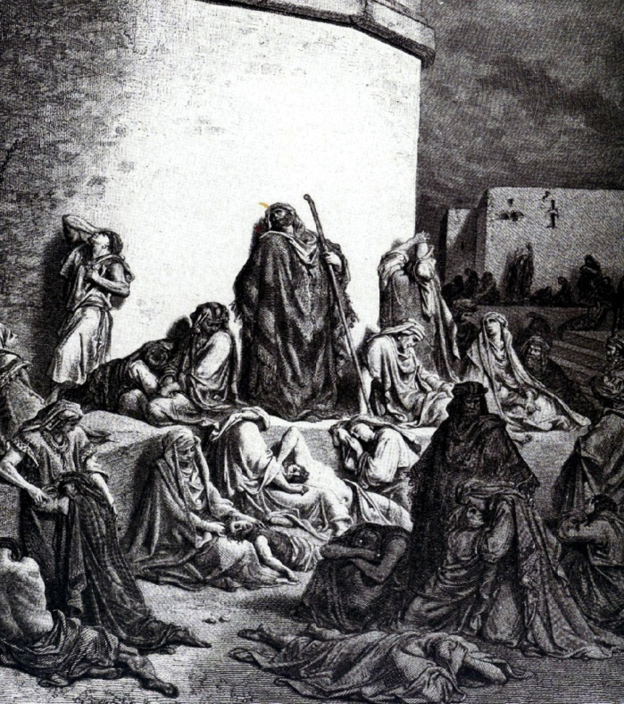
Their Clothing is Sackcloth
Sackcloth was a garment worn when one is expressing mourning and declaring the need of repentance – (Matthew 11:21; Luke 10:13)
They witness (forth tellers) of Christ and His message of salvation which has always been a message of faith and repentance – (Luke 13:5)

Slide 30
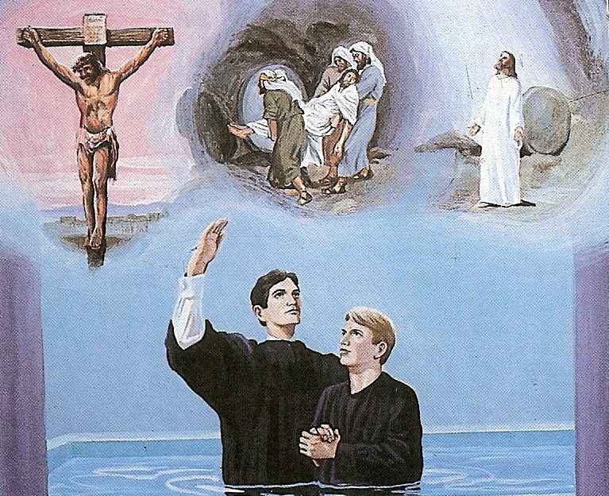
The Gospel
“And that repentance and remission of sins should be preached in his name among all nations, beginning at Jerusalem.” (Luke 24:47)

Slide 31
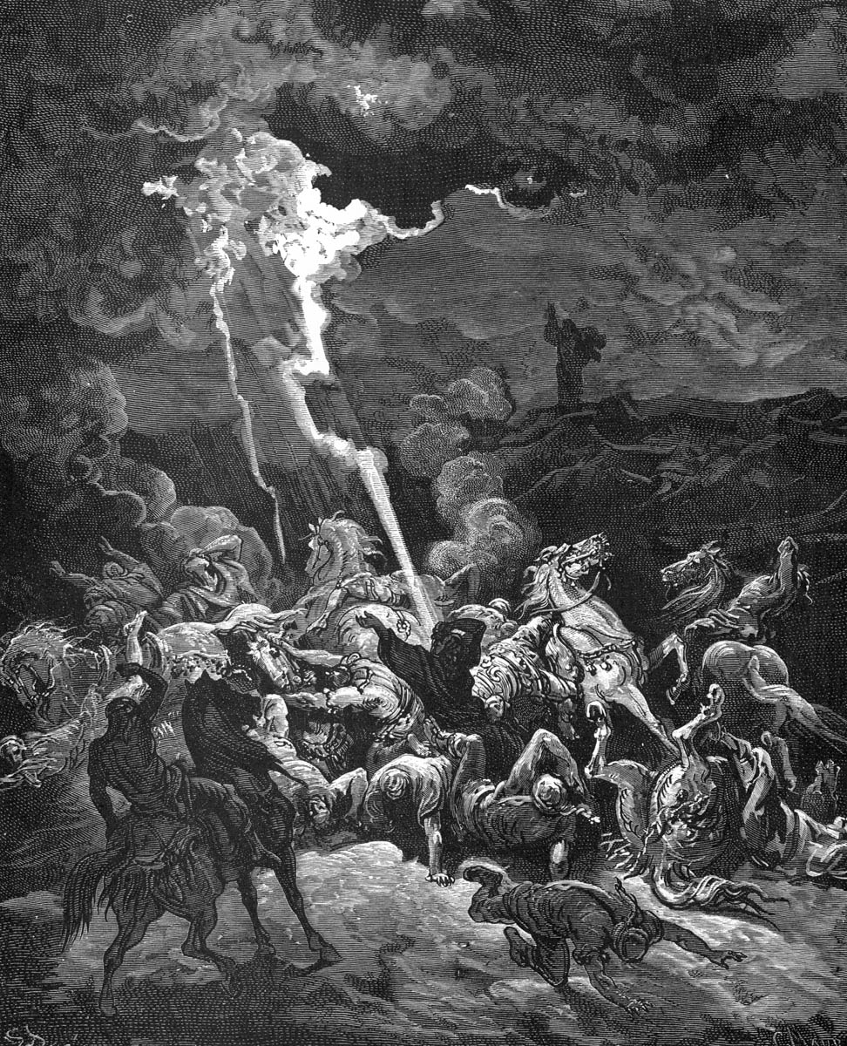
“But they mocked the messengers of God, and despised his words, and misused his prophets, until the wrath of the
LORD arose against his people till there was no remedy.”
(II Chronicles 36:16)

Slide 32
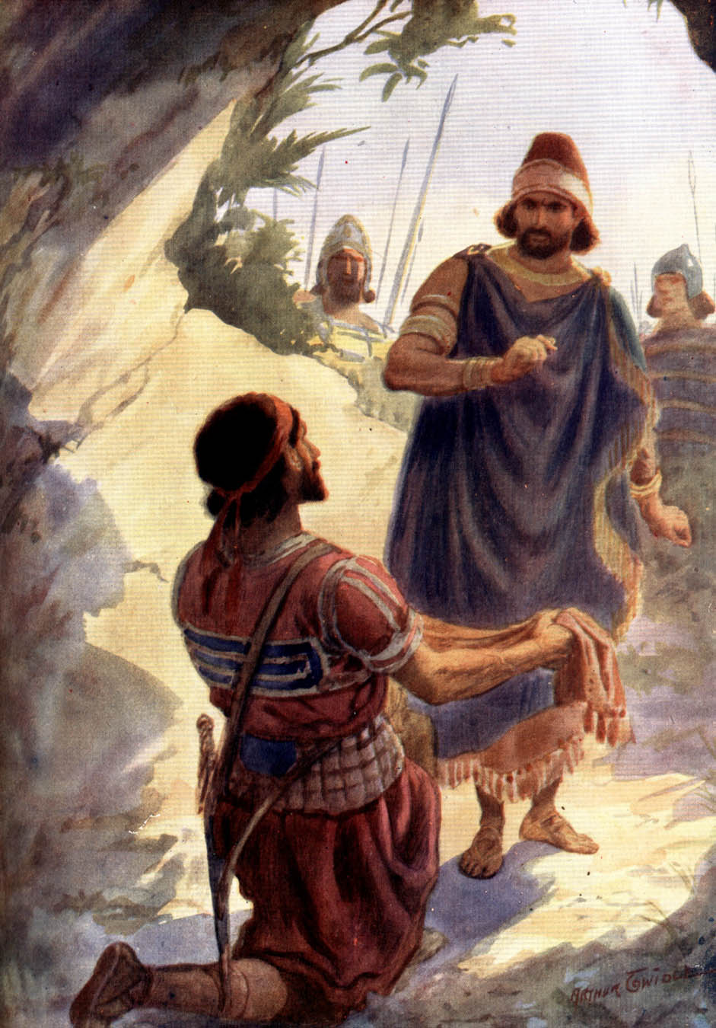
“For who can stretch forth his hand against the LORD'S anointed,
and be guiltless?”
(I Samuel 26:9)
“I will not put forth mine hand against my lord; for he is the LORD'S anointed.” (I Samuel 24:10)

Slide 33
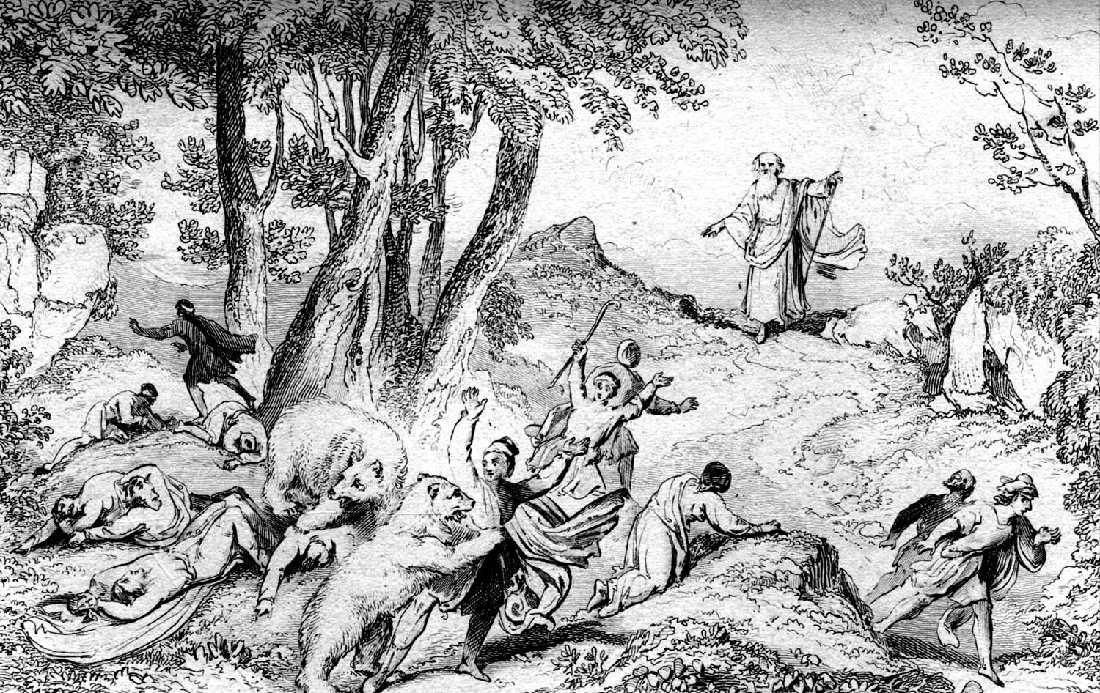
“How wast thou not afraid to stretch forth thine hand to destroy the LORD'S anointed?” (II Samuel 1:14)
“Touch not mine anointed, and do my prophets no harm.” (Psalms 105:15)
“Against an elder receive not an accusation, but before two or three witnesses.” (I Timothy 5:19)

Slide 34
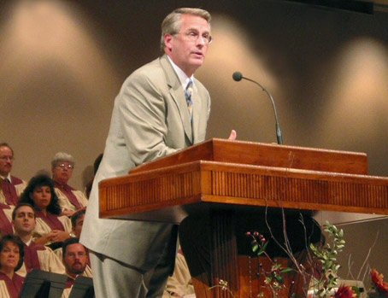
“And we beseech you, brethren, to know them which labour among you, and are over you in the Lord, and admonish you; And to esteem them very highly in love
for their work's sake. And be at
peace among yourselves.” (I Thessalonians 5:12-13)

Slide 35
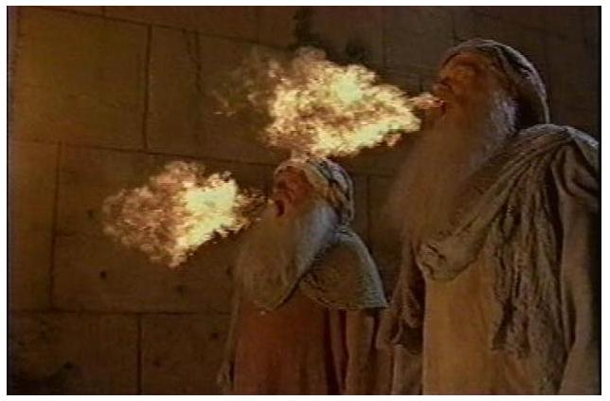
“And if any man will hurt them, fire proceedeth out of their mouth, and devoureth their enemies: and if any man will hurt them, he must in this manner be killed.”

Slide 36
“These have power to shut heaven, that it rain not in the days of their prophecy: and have power over waters to turn them to blood, and to smite the earth with all plagues, as often as they will.”

Slide 37
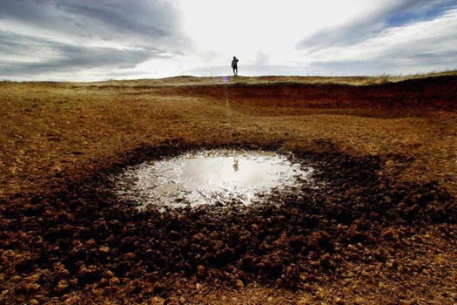
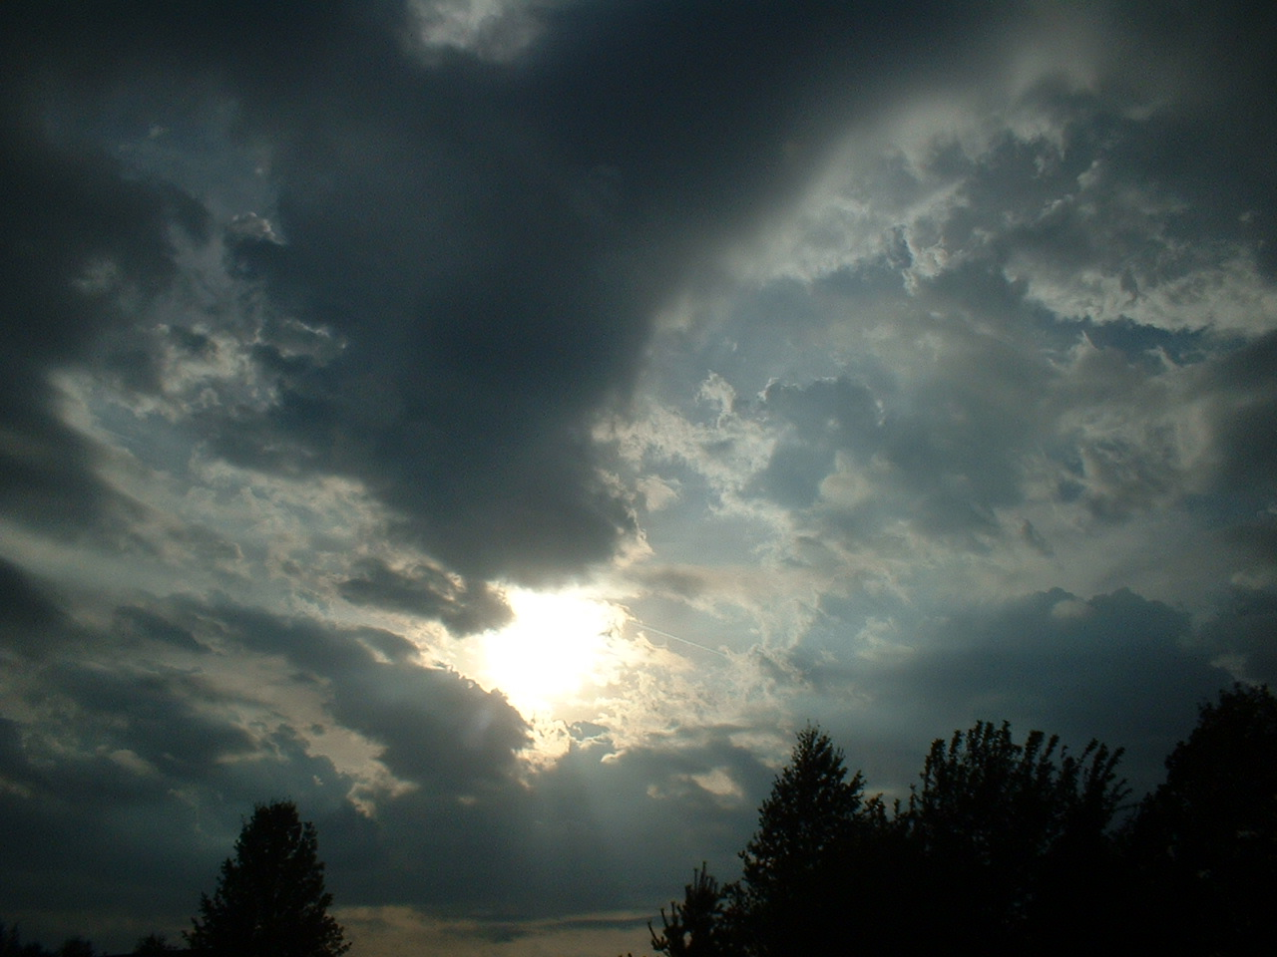
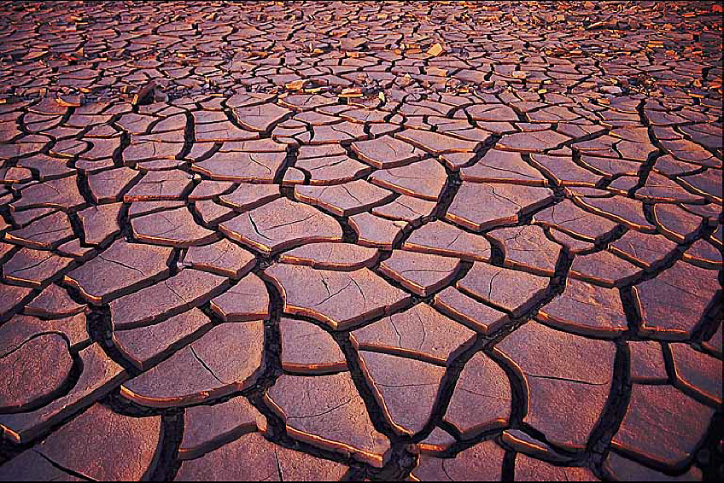

Slide 38
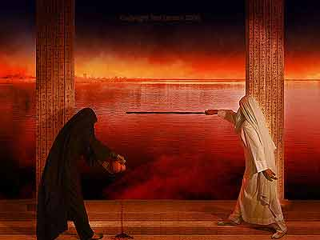

Slide 39
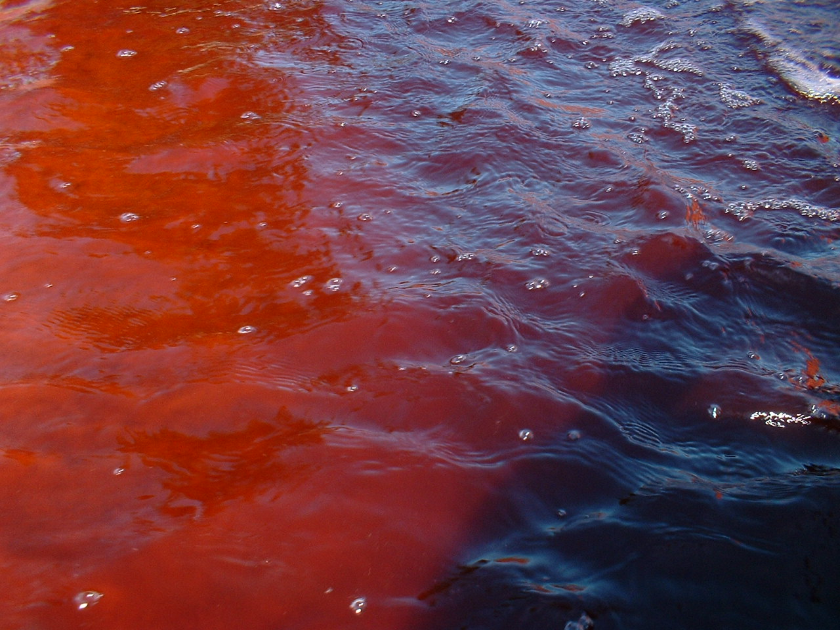
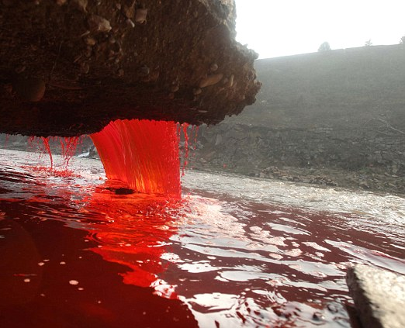
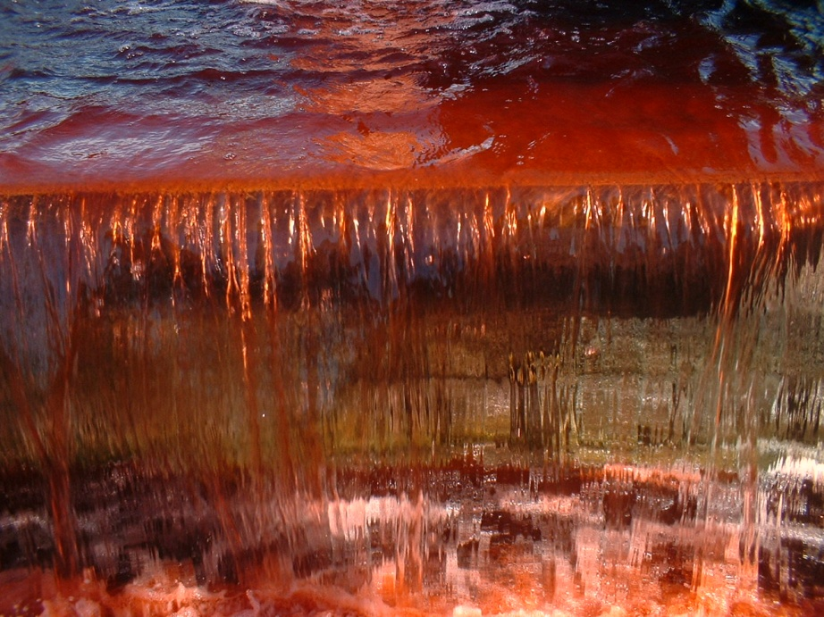
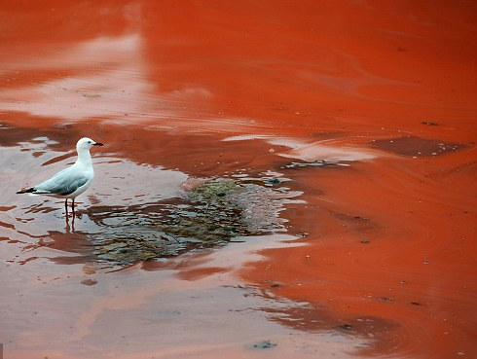
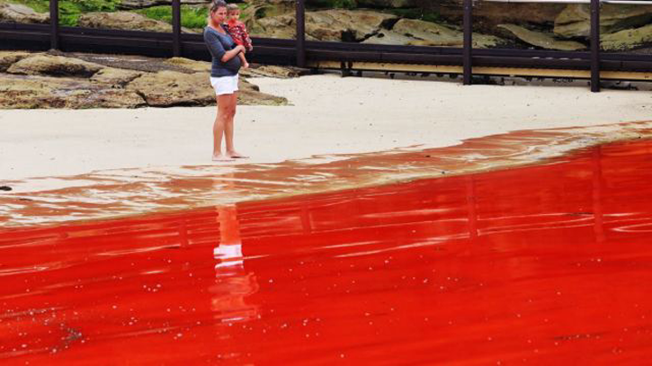

Slide 40
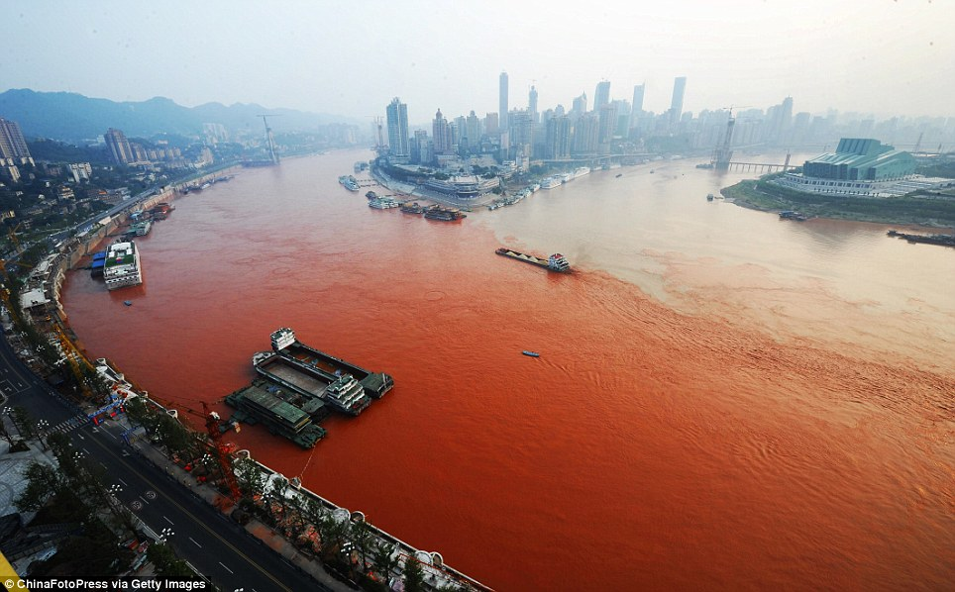

Slide 41
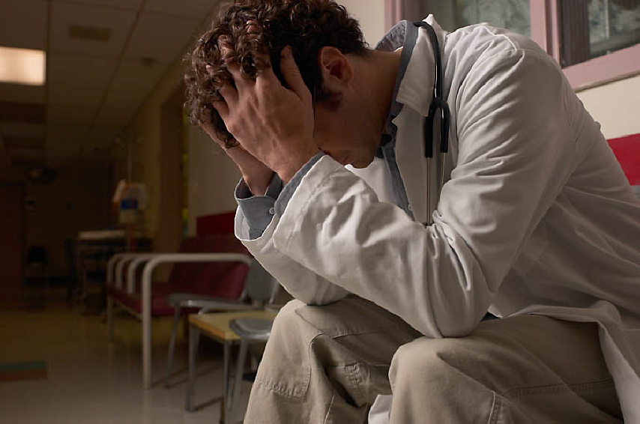
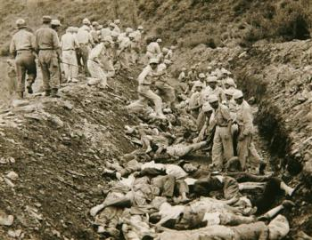
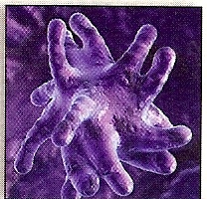
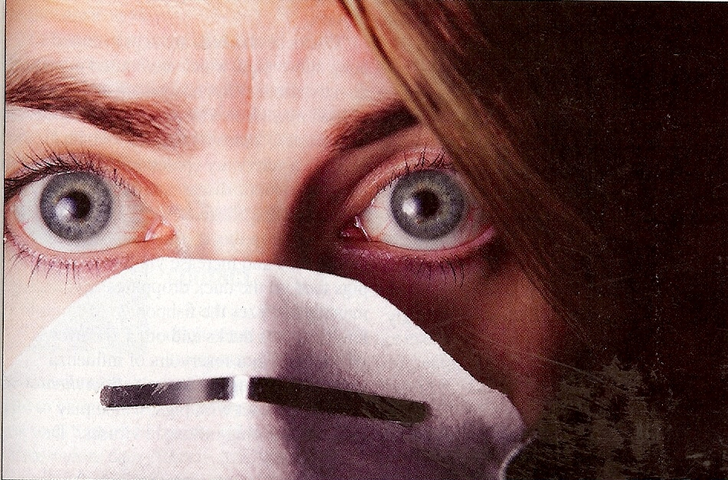
“Smite the earth with all plagues, as often as they will.”

Slide 43
“Behold, I will send you Elijah the prophet before the coming of the great and dreadful day of the Lord.”
(Malachi 4:6)

Slide 44
“And all the days of Enoch were three hundred sixty and five years: And Enoch walked with God: and he was not; for God took him.”
“By faith Enoch was translated that he should not see death; and was not found, because God had translated him: for before his translation he had this testimony, that he pleased God.”

Slide 45
“And when they shall have finished their testimony, the beast that ascendeth out of the bottomless pit shall make war against them, and shall overcome them, and kill them. And their dead bodies shall lie in the street of the great city, which spiritually is called Sodom and Egypt, where also our Lord was crucified.”

Slide 46
“The angel of the bottomless pit, whose name is Apollyon.”

Slide 47
Revelation 13:1

Slide 48
“And they of the people and kindreds and tongues and nations shall see their dead bodies three days and an half, and shall not suffer their dead bodies to be put in graves. And they that dwell upon the earth shall rejoice over them, and make merry, and shall send gifts one to another; because these two prophets tormented them that dwelt on the earth.”

Slide 51
“And after three days and an half the Spirit of life from God entered into them, and they stood upon their feet; and great fear fell upon them which saw them. And they heard a great voice from heaven saying unto them, Come up hither. And they ascended up to heaven in a cloud; and their enemies beheld them.”

Slide 53
“And the same hour was there a great earthquake, and the tenth part of the city fell, and in the earthquake were slain of men seven thousand: and the remnant were affrighted, and gave glory to the God of heaven.”

Slide 54
“The second woe is past; and, behold, the third woe cometh quickly.”

Slide 55
“And the seventh
angel sounded…”

Slide 56
“And there were great voices in heaven, saying…”

Slide 57
“The kingdoms of this world are become the kingdoms of our Lord, and of His Christ; and He shall reign for ever and ever.”

Slide 58
Sesis says – “The tense of the expression is that peculiar to prophetic language, which fixes upon a result yet future, or only beginning to be, as if already accomplished. Actually the change of rule, with Christ as King over all the earth, does not occur until the events recorded in chapters 12-18 have been fulfilled.”

Slide 59
“And the four and twenty elders, which sat before God on their seats, fell upon their faces, and worshipped God, Saying, We give thee thanks, O Lord God Almighty, which art, and wast, and art to come; because thou hast taken to thee thy great power, and hast reigned.”

Slide 61
“Thou hast taken to thee thy great power, and hast reigned…”

Slide 62
“And the nations were angry, and thy wrath is come, and the time of the dead, that they should be judged, and that thou shouldest give reward unto thy servants the prophets, and to the saints, and them that fear thy name, small and great; and shouldest destroy them which destroy the earth. {destroy the earth = corrupt the earth}.”

Slide 63
“And the nations were angry…”

Slide 64
“We will not have this man to reign over us.” (Luke 19:14)

Slide 65
“These have one mind, and shall give their power and strength unto the beast.”

Slide 66
“It is a fearful thing to fall into the hands of the living God.”
(Heb. 10:31)

Slide 67
The wrath of God will fall.
"He that believeth on the Son hath everlasting life: and he that believeth not the Son shall not see life; but the wrath of God abideth on him" (John 3:36).
"For the wrath of God is revealed from heaven against all ungodliness and unrighteousness of men, who hold the truth in unrighteousness" (Romans 1:18).
"But unto them that are contentious, and do not obey the truth, but obey unrighteousness, indignation and wrath" (Romans 2:8).
"Let no man deceive you with vain words: for because of these things cometh the wrath of God upon the children of disobedience" (Ephesians 5:6).

Slide 68
The dead will be judged.
"When the Son of man shall come in his glory, and all the holy angels with him, then shall he sit upon the throne of his glory: and before him shall be gathered all nations: and he shall separate them one from another, as a shepherd divideth his sheep from the goats" (Matthew 25:31-32)
"And as it is appointed unto men once to die, but after this the judgment" (Hebrews 9:27)
"The Lord knoweth how to deliver the godly out of temptation, and to reserve the unjust unto the day of judgment to be punished" (II Peter 2:9)

Slide 69
Those who destroy (corrupt) the earth will have their own lives destroyed.
"And to you who are troubled rest with us, when the Lord Jesus shall be revealed from heaven with his mighty angels, in flaming fire taking vengeance on them that know not God, and that obey not the gospel of our Lord Jesus Christ: who shall be punished with everlasting destruction from the presence of the Lord, and from the glory of his power" (II Thessalonians 1:7-9)
"These are wells without water, clouds that are carried with tempest; to whom the mist of darkness is reserved for ever" (II Peter 2:17)

Slide 70
"Behold, the Lord cometh with ten thousands of his saints, to execute judgment upon all, and to convince all that are ungodly among them of all their ungodly deeds which they have ungodly committed, and of all their hard speeches which ungodly sinners have spoken against him." (Jude 14-15)

Slide 71
(Rev.20:11-15)"And I saw a great white throne, and him that sat on it, from whose face the earth and the heaven fled away; and there was found no place for them.”

Slide 72
“And I saw the dead, small and great, stand before God; and the books were opened: and another book was opened, which is the book of life.”

Slide 73
“And the dead were judged out of those things which were written in the books, according to their works.”

Slide 74
“And the sea gave up the dead which were in it; and death and hell delivered up the dead which were in them: and they were judged every man according to their works. And death and hell were cast into the lake of fire. This is the second death.”

Slide 75
“And whosoever was not found written in the book of life was cast into the lake of fire.”

Slide 76
“And the temple of God was opened in heaven, and there was seen in his temple the ark of his testament: and there were lightnings, and voices, and thunderings, and an earthquake, and great hail.”

Slide 79
“He which testifieth these things saith, Surely I come quickly. Amen. Even so, come, Lord Jesus.” (Revelation 22:20)

