Slide 1
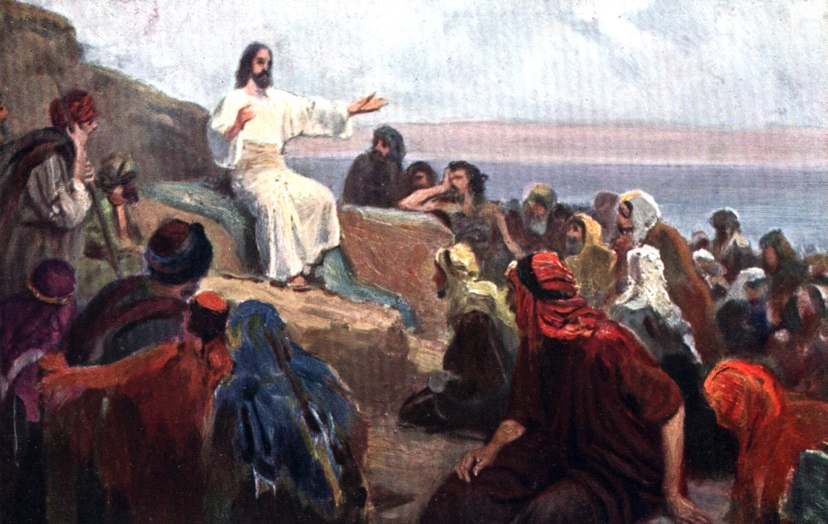
How to Walk with God “Removing the beam from your eyes”
(Part 2 of Part 4)

Slide 2
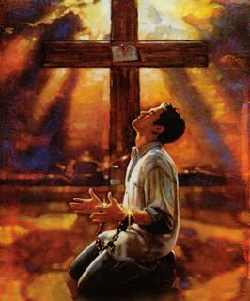
How to walk with God
“Brokenness”
(Part 1)
(Psalms 51:1-17)

Slide 3
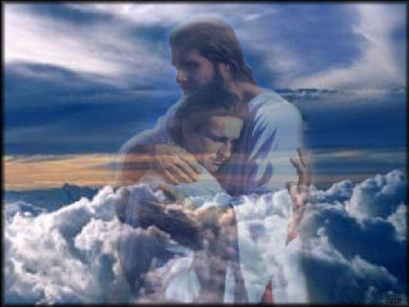
How to Walk with God
“The way of fellowship”
“Walking in the Light” (I John 1:3-7)
(Part 2)

Slide 4
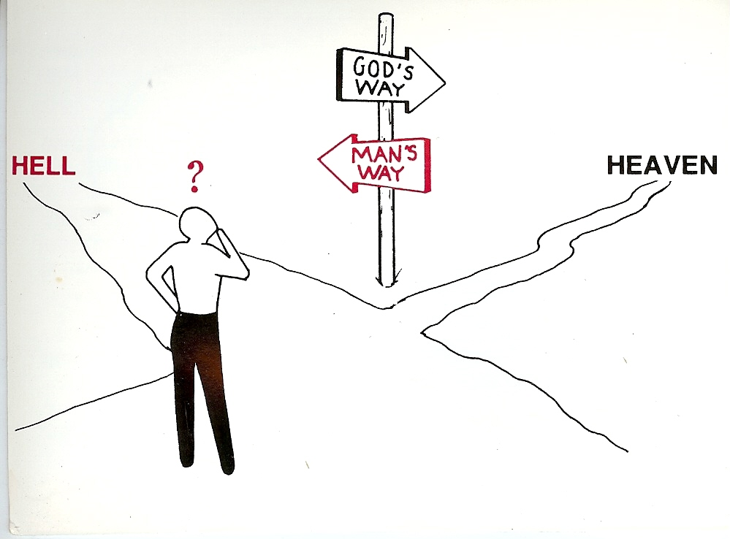
How to Walk with God “Walking on the Road of Holiness” (Part 3)
Unrighteousness
Righteousness

Slide 5
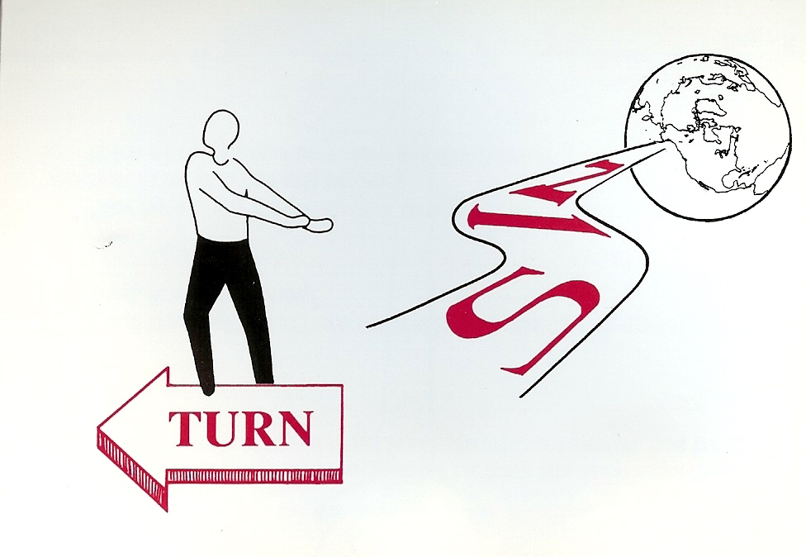
“And an highway shall be there, and a way, and it shall be called The way of holiness; the unclean shall not pass over it.”
(Isaiah 35:8)
Holiness

Slide 6
How to Walk with God “Removing the beam from our eyes”
(Part 2 of Part 4)

Slide 7
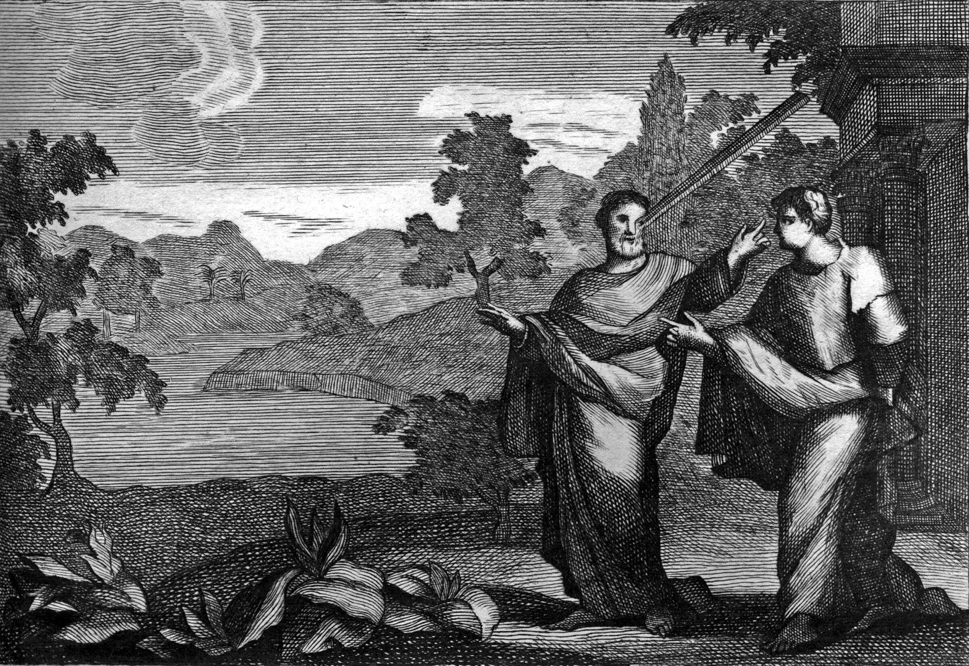
(Matthew 7:1-5)

Slide 8
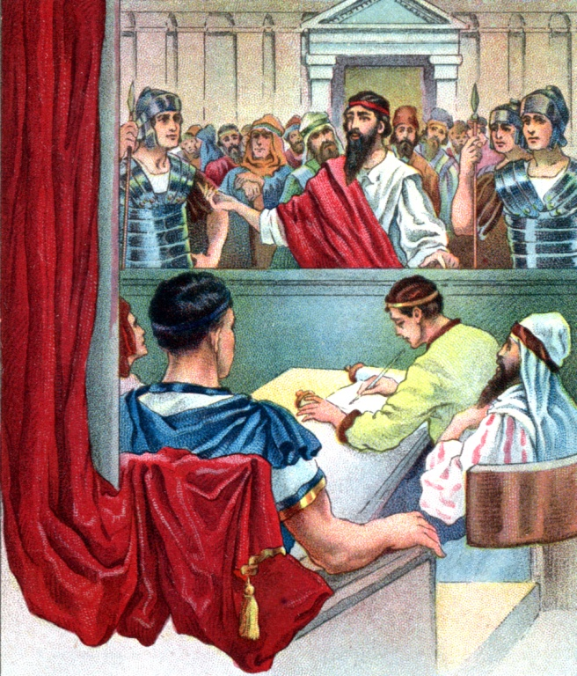
“Judge” Translated eight different ways in the KJV
Condemn
Determine
To decree
Call into question
Esteem
Sentence
Go to law
Ordain

Slide 9
Bad Sense
Good Sense
Criticize or condemn one another
“Judge not, and ye shall not be judged: condemn not, and ye shall not be condemned: forgive, and ye shall be forgiven.” Luke 6:37
Examine, approve, search out, to weigh thoroughly, to try
“Judge not according to the appearance, but judge righteous judgment.” John 7:24

Slide 10
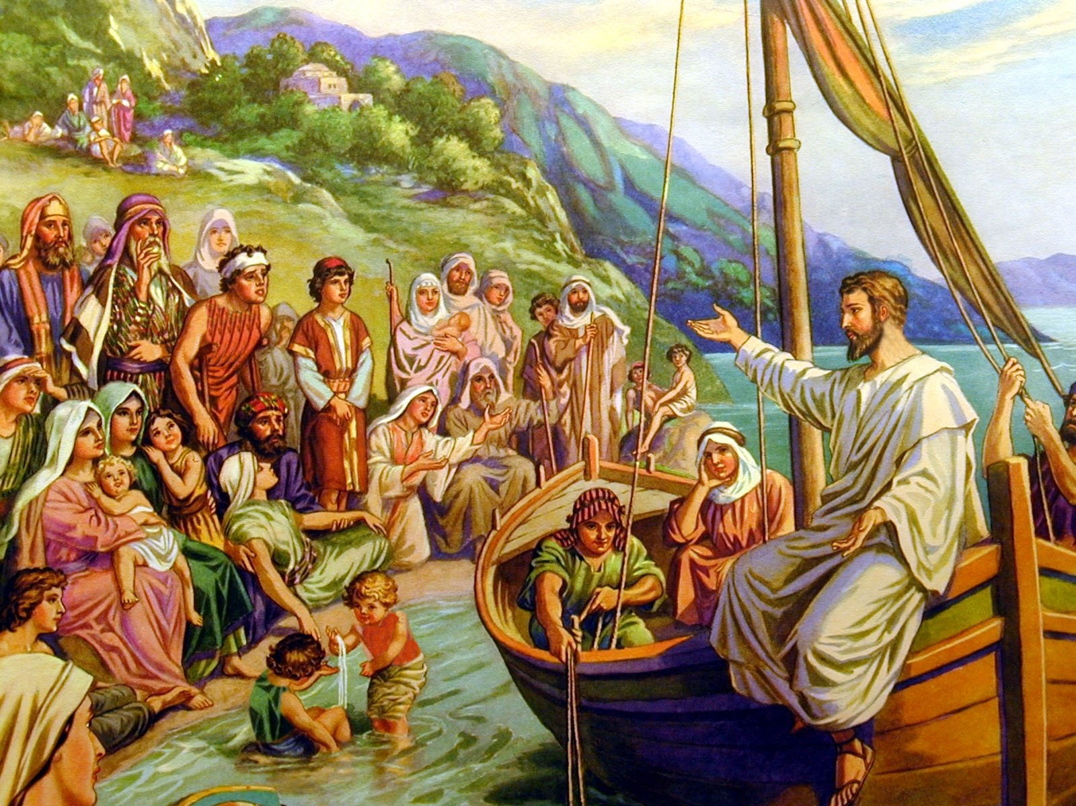
The Teachings of Jesus
“Judge Not” (Matthew 7:1-5)
Do not judge – vs. 1
Those who judge will be judged themselves – vs. 1-2
Those who judge fail to examine themselves – vs. 3
Those who judge are deceived about themselves – vs. 4
Those who judge are hypocrites – vs. 5

Slide 11
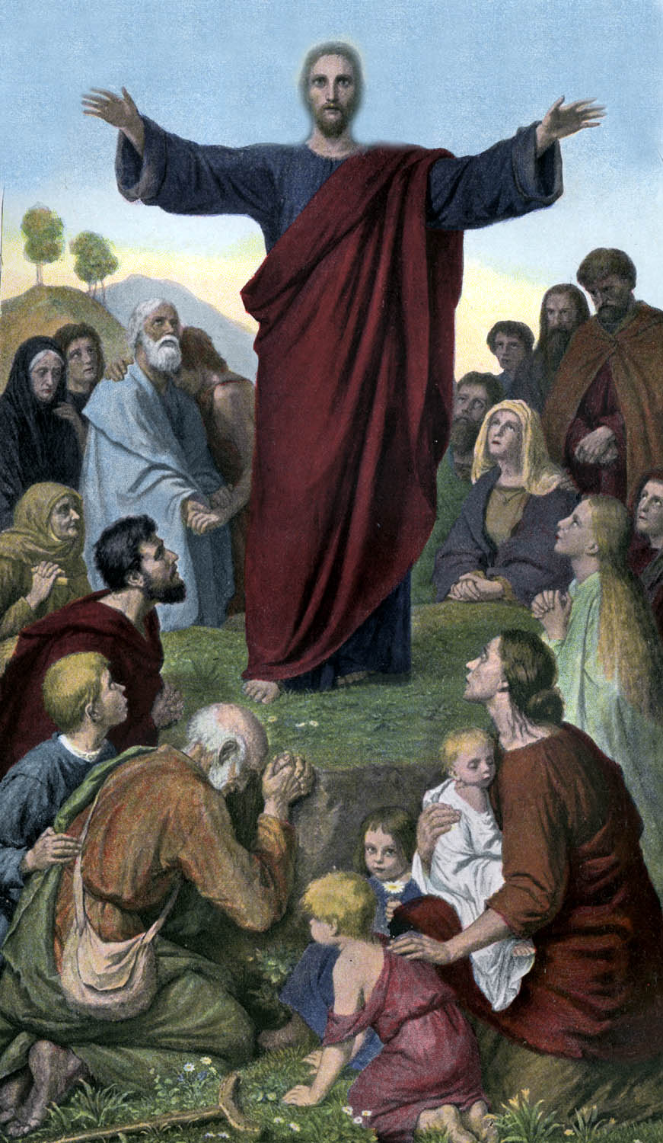
“Judge not, and ye shall not be judged: condemn not, and ye shall not be condemned.”

Slide 12
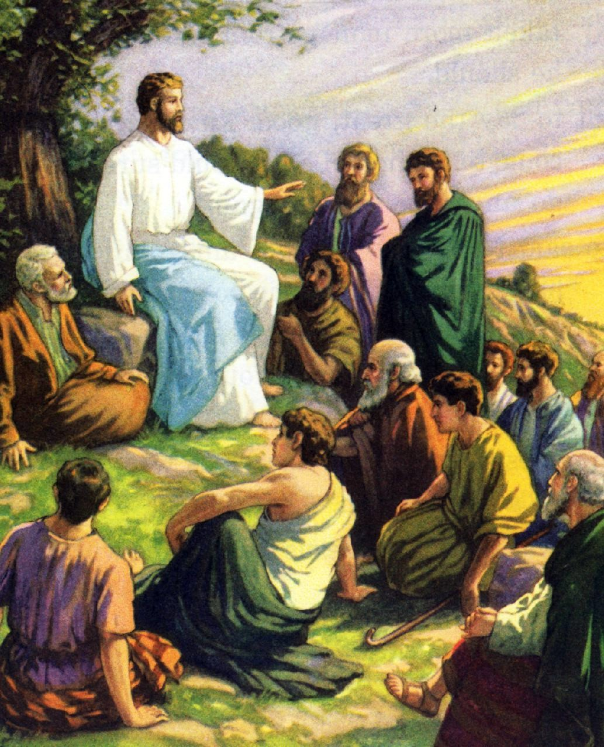
“Teaching them to observe all things whatsoever I have commanded you: and, lo, I am with you alway, even unto the end of the world.”

Slide 13
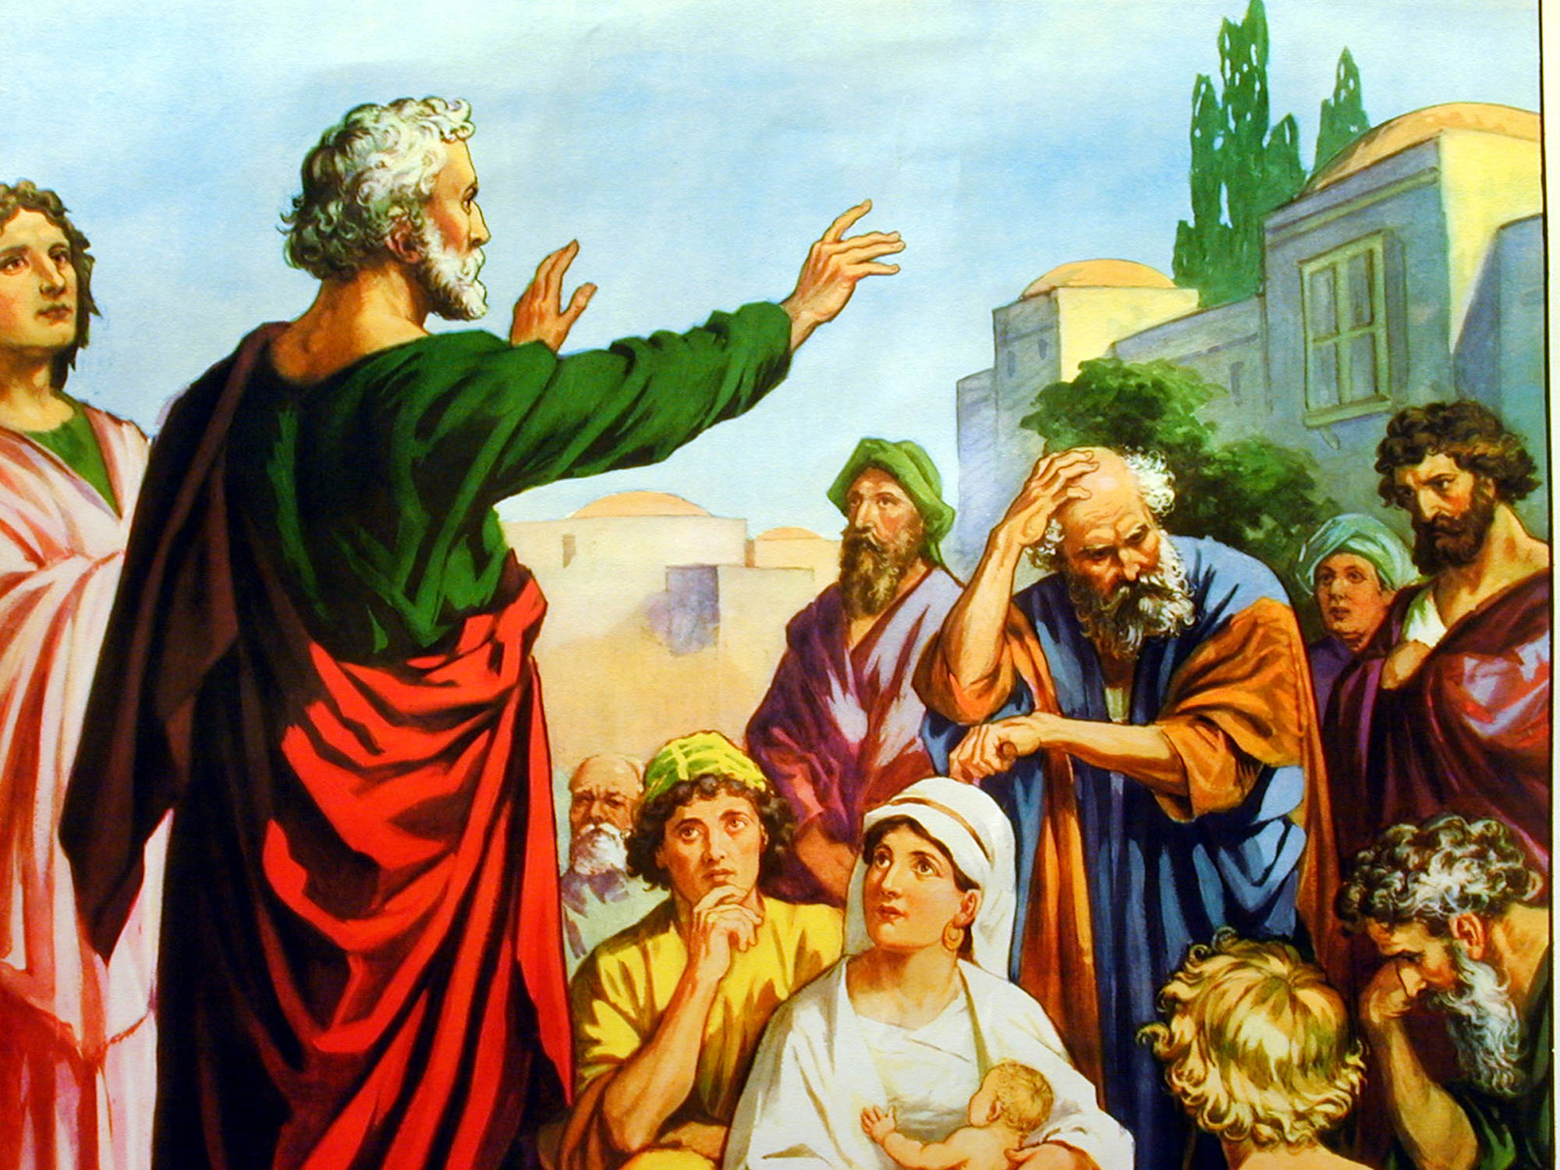
Romans 14:1-23
“Who art thou that judgest another…Let every man be fully persuaded in his own mind…But why dost thou judge thy brother? Or why dost thou set at nought thy brother? For we shall all stand before the judgment seat of Christ…So then every one of us shall give account of himself to God…Let us not therefore judge one another anymore…Let us therefore follow after the things which make for peace, and things wherewith one may edify another…
Destroy not the work of God…”

Slide 16
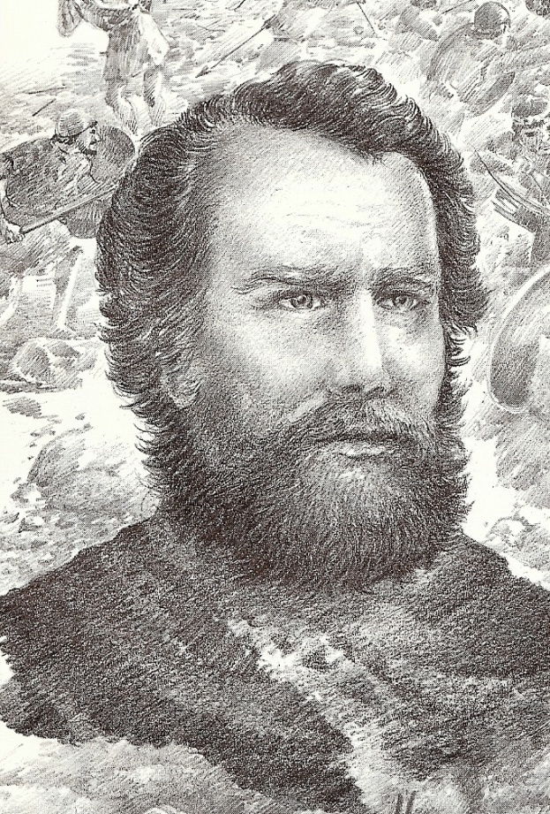
“Speak not evil one of another, brethren. He that speaketh evil of his brother, and judgeth his brother, speaketh evil of the law, and judgeth the law: but if thou judge the law, thou art not a doer of the law, but a judge. There is one lawgiver, who is able to save and to destroy: who art thou that judgest another?” (James 4:11-12)

Slide 17
“Let God be the judge and keep your nose in your own business!”

Slide 18
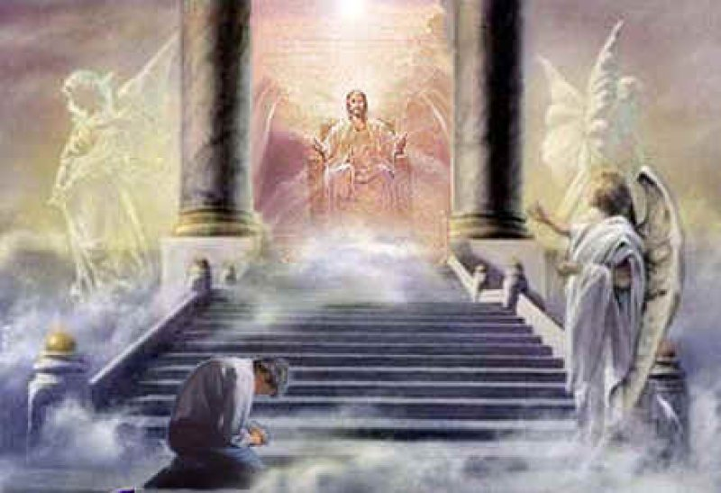
“But why dost thou judge thy brother? or why dost thou set at nought thy brother? for we shall all stand before the
judgment seat of Christ.”

Slide 19
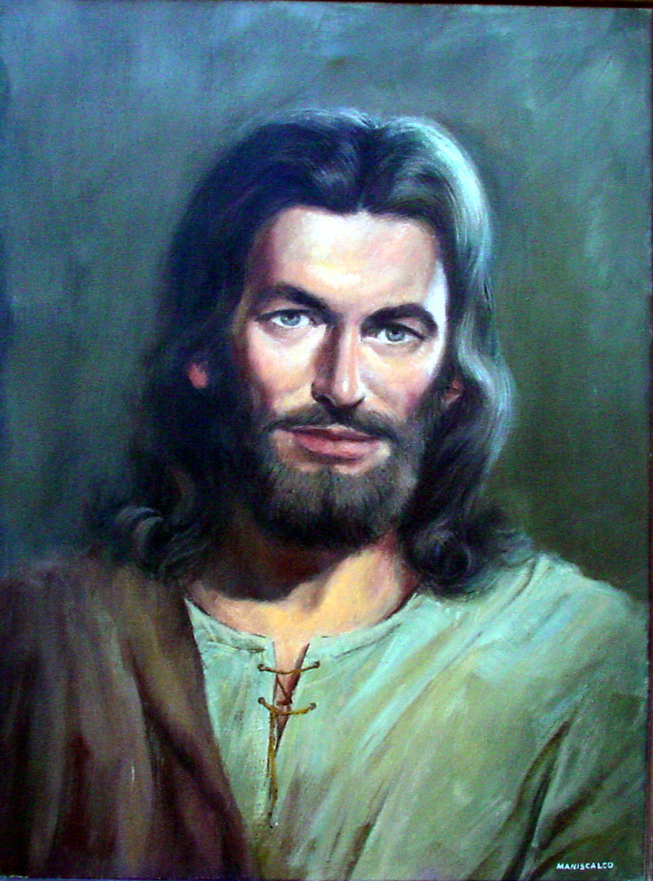
“Judge not according to the appearance, but judge righteous judgment.” (John 7:24 )

Slide 20
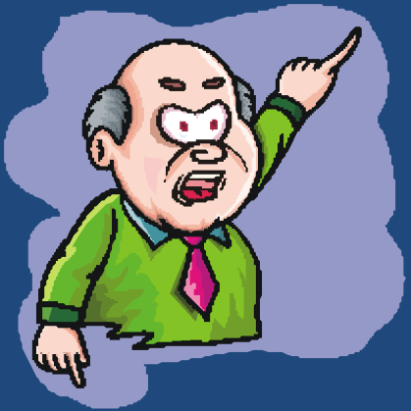
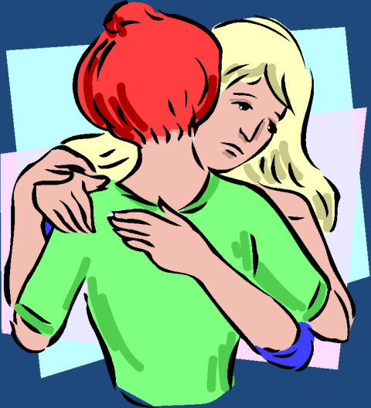
Understanding the Difference Between Discernment and Judgment
Discernment
To test, examine, discover, interpret, approve, prove, question, evaluate, scrutinize, investigate, search out, make a distinction, weigh, to try
Judgment
Critical judgmental spirit, pass sentence, mentally or judicially condemn

Slide 21
“Brethren, if a man be overtaken in a fault, ye which are spiritual, restore such an one in the spirit of meekness; considering thyself, lest thou also be tempted.” (Gal. 6:1)

Slide 22
Evidences of a Critical (judgmental) Spirit
Condemns others for visible problems, but fails to realize that their attitudes stem from the same root problems which they have not overcome – Rom. 2:1-2
Example =
Condemns others for covetousness and greed, yet we have a temporal focus in life.
Condemns others for moral impurity, yet we have lustful eyes and secret desires for immorality.

Slide 23
Condemns others for bitterness and rejection, yet they have an unloving, rejecting and bitter spirit towards the one whom they are condemning.
One who judges forms opinions on first impressions or hearsay, even though the evidence may be taken out of context – John 7:24, 51; James 4:11
One who judges will publicly expose those who he condemns. This causes others to condemn them for their unloving, prideful, and critical spirit – Luke 6:37

Slide 24
If a persons failure improves the opinion you have of yourself, you are judging.
If a persons failure decreases your concern for the faults you know you have, you are judging.
If a persons failure gives you a desire to see that person punished instead of restored, you are judging.
If a persons failure prompts you to review all of his past failures, you are judging.
If a persons failure causes you to feel that you cannot forgive them, you are judging.

Slide 25
Evidences of a Discerning Spirit
Thoroughly examines himself before evaluating the actions and attitudes of others – I Cor. 11:28-31; II Cor. 13:5
Checks the accuracy of all the facts before reaching a conclusion – I Cor. 2:15; I Thess. 5:21; I John 4:1
Deals as privately as possible with the problem – I Cor. 6:5-6
Detects a fault in another person, and is able to give clear direction for victory based on the principles of God’s Word – Gal. 6:1

Slide 26
Five Sins Committed by the Criticizer (Matthew 7:1-5)
Inconsistency – vs. 2
Self-righteousness – vs. 3
Spiritual blindness (self-deception) – vs. 3
Lack of Biblical love – vs. 4
Hypocrisy – vs. 5

Slide 27
A critical spirit may boost your own self-image.
Pointing out someone's faults and failures may make you look better in your own eyes.
Criticizing others may make you feel better about your own sins and failures.
Condemning others may be your way of lashing out and getting revenge – “He hurt me so I am going to hurt him…”
A judgmental attitude never helped or healed anyone – Luke 6:27-38; Romans 12:14-21

Slide 28
Ten Reasons Why We Should Never Judge Another Person
Every one falls and fails.
Only those without sin have the right to cast stones.
All the circumstances, facts and intents of the heart are seldom known.
Judging others usurps God’s authority.
The one who judges will be judged.

Slide 29
6. The one who judges will experience the judgment of God – “For he shall have judgment with out mercy, that hath showed no mercy.” (James 2:13)
7. Judging others drives them further away from God.
8. Judging others blinds a person to their own spiritual condition and defiles their conscience.
9. Judging makes you a hypocrite.
10. Judging others demonstrates to every one your pride.

Slide 30
“He hath shewed thee, O man, what is good; and what doth the LORD require of thee, but to do justly, and to love mercy, and to walk humbly with thy God.”
(Micah 6:8)

