Slide 1
How to Walk with God “Get the Word of God into you” (Psalms 119) (Part 10)

Slide 2
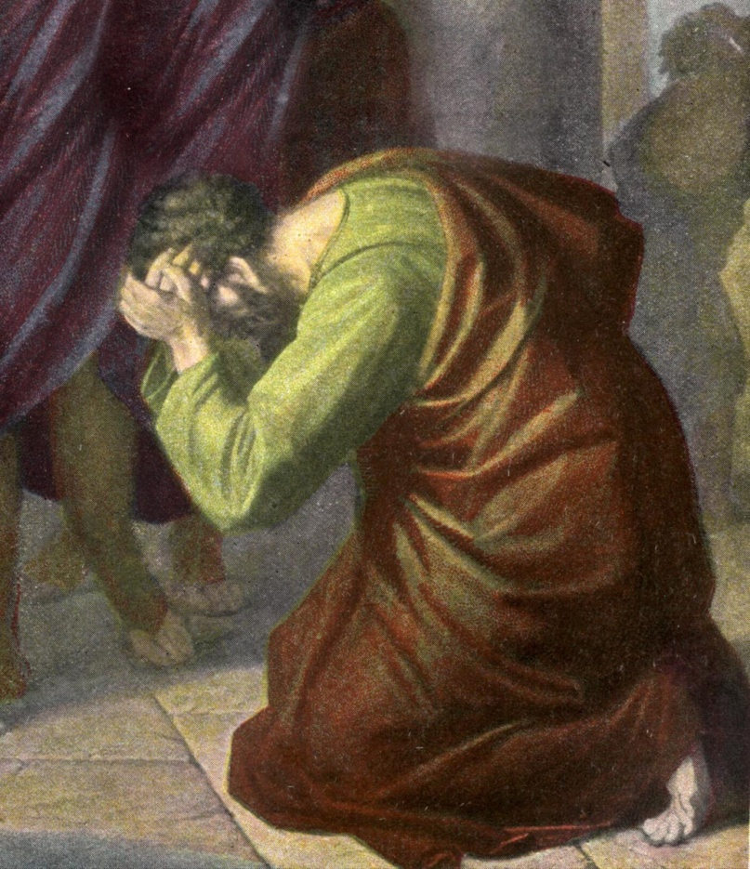
How to Walk with God “Brokenness” (Psalms 51:1-17) (Part 1)

Slide 3
“C” is a bent “I” “yet not I, but Christ…”

Slide 4
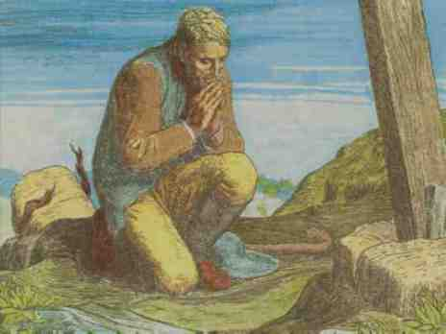
(Review)
Humility
Repentance
Dying to self
Yielding to God
Yielding personal rights
Living in obedience to the Word of God
Clearing of the conscience
Making restitution if necessary

Slide 5
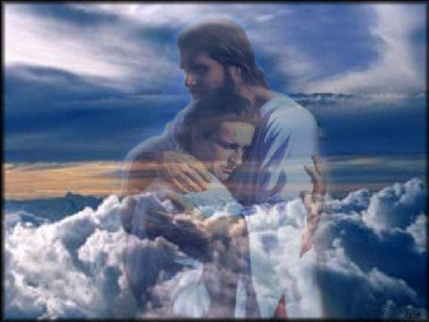
How to Walk with God
“The way of fellowship”
(Part 2)

Slide 6
“Truly our fellowship is with the Father, and with his
Son Jesus Christ.”
(I John 1:3)
“That ye might walk worthy of the Lord unto all pleasing, being fruitful in every good work, and increasing in the knowledge of God.”
(Col 1:10)

Slide 7
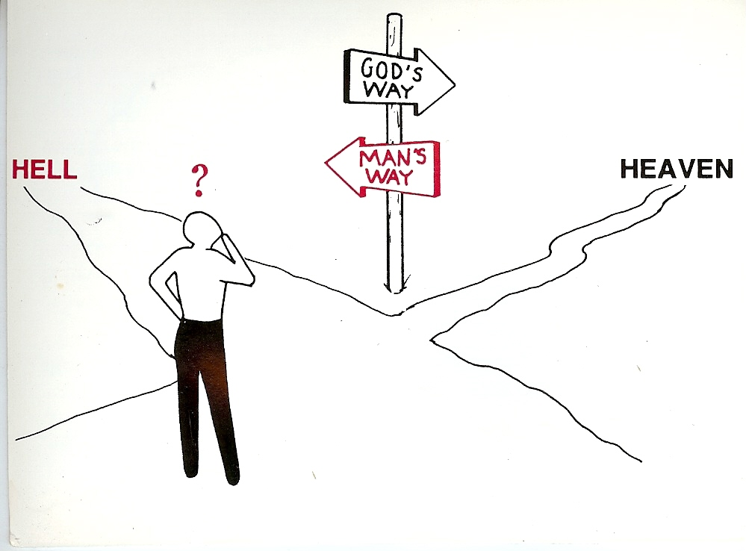
How to Walk with God “Walking on the road of Holiness” (Part 3)
Unrighteousness
Righteousness

Slide 8
Holiness
“And an highway shall be there, and a way, and it shall be called The way of holiness; the unclean shall not pass over it.”

Slide 9
“Having therefore these promises, dearly beloved, let us cleanse ourselves from all filthiness of the flesh and spirit, perfecting holiness in the fear of God.” “That he might sanctify and cleanse it with the washing of water by the word.” “Draw nigh to God, and he will draw nigh to you. Cleanse your hands, ye sinners; and purify your hearts, ye double minded.” “If we confess our sins, he is faithful and just to forgive us our sins, and to cleanse us from all unrighteousness.”

Slide 10
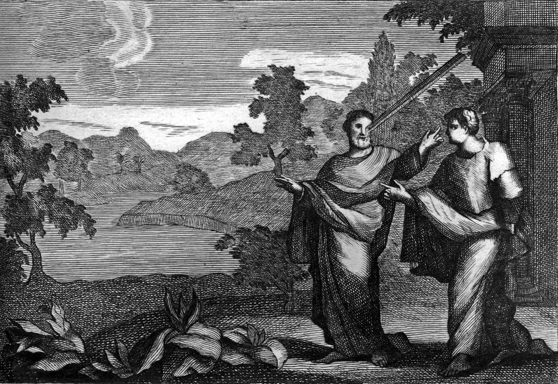
How to walk with God “Removing the beam from your eyes”
(Part 4)

Slide 11
How to Walk with God “Avoidance of Sin” and “Adherence to Biblical Standards” (Part 5)
“Whosoever committeth sin transgresseth also the law: for sin is the transgression of the law.”
(I John 3:4)

Slide 12
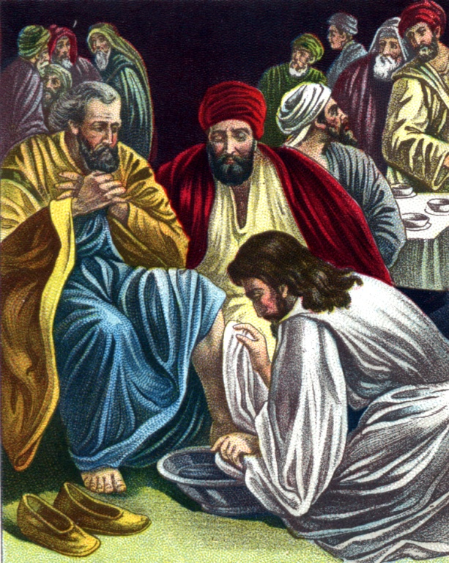
How to Walk with God “Becoming a Humble Servant” (Luke 22:24-30) (Part 6)

Slide 13
How to Walk with God “Make Prayer a Priority” (Part 7)
Luke 11:1-13, 18:1-14

Slide 14
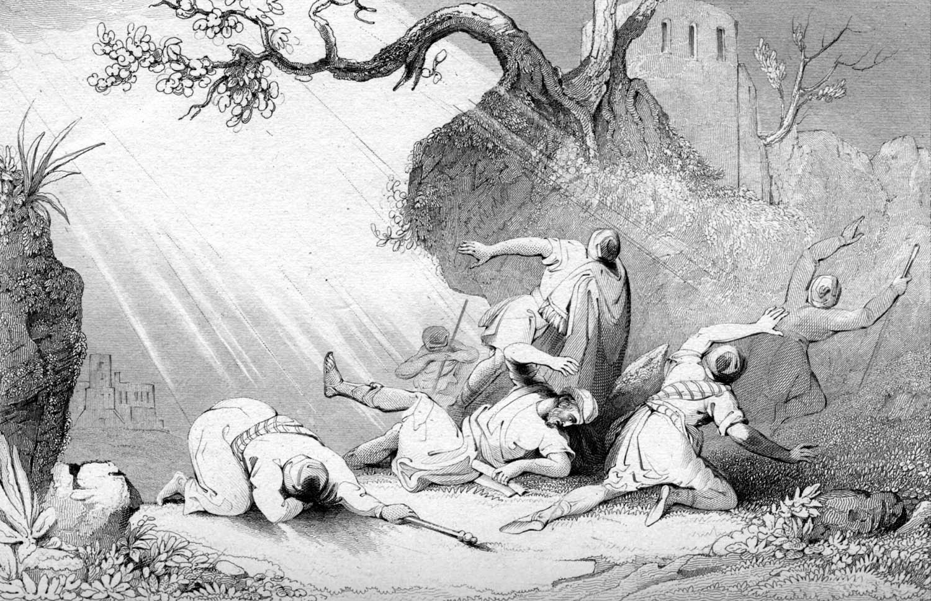
How to Walk with God “Living under the Lordship of Jesus Christ” (Part 8) “And he trembling and astonished said, Lord, what wilt thou have me to do?” (Acts 9:6)

Slide 15
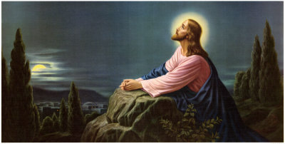
How to Walk with God “Getting Alone with God” (Part 9)
“And straightway Jesus constrained his disciples to get into a ship, and to go before him unto the other side, while he sent the multitudes away.
And when he had sent the multitudes away, he went up into a mountain apart to pray: and when the evening was come, he was there alone.” Matt. 14:22-23

Slide 16
How to Walk with God “Getting Alone with God” (Part 9)
“And straightway Jesus constrained his disciples to get into a ship, and to go before him unto the other side, while he sent the multitudes away.
And when he had sent the multitudes away, he went up into a mountain apart to pray: and when the evening was come, he was there alone.” Matt. 14:22-23

Slide 17
How to Walk with God “Get the Word of God into you” (Psalms 119) (Part 10)

Slide 19
One of the greatest problems facing the church today is that we have Christians who are under the teaching of the Word of God but they are not in it for themselves - “Study to shew thyself approved unto God, a workman that needeth not to be ashamed, rightly dividing the word of truth.” II Timothy 2:15
Being under the teaching of the Word of God should stimulate us not be a substitute for getting into the Word ourselves – (see Psalms 119)

Slide 20
Why Should I Study the Bible for Myself?
Commandment – Matthew 4:4
Growth – I Peter 2:2
Maturity – Hebrews 5:13-14
Guidance – II Timothy 3:16-17
Cleansing from sin – John 15:3; Ephesians 5:26
Victory over sin – Psalm 119:9
Wisdom – Psalms 1
Blessing – Revelation 1:3
Love for the Lord – I John 2:5

Slide 21
Getting into the Word for Yourself “Some simple suggestions”
Make time for Bible study – Ephesians 5:16
Ask for understanding – Psalms 119:18
Develop your own personal plan –
Read the Bible through in a year
Study a book of the Bible
Study passages
Study the life of Christ or other Bible charactors
Study subjects or topics
Invest in a good Bible computer program – (Power Bible CD)

Slide 22
Read with pen in hand (Jot down the following) –
What you have learned
How God has spoken to you
How God has encouraged you
How God has convicted you of sin
Repentance
Underline special passages
Write down cross references
Journal your spiritual life
Write down dates

Slide 23
Turn Bible reading into prayer – Psalms
If you are reading about holiness turn that into a personal prayer for holiness.
If you are reading about the glory of God take time to worship and praise Him for His power and great glory.
If you are reading about the consequences of sin ask God to produce within you a “Fear of the Lord.”
If you are reading about the good character of a Bible personality ask the Lord to develop that character in you.

Slide 24
Example (Psalms 15:4)
“He that sweareth to his own hurt, and changeth not.”
“Lord, I recall some promises I have made that, although painful, I need to keep. Forgive me, Lord, for breaking my commitment to _________.
Help me today to make that right, and to become the type of righteous person this psalm addresses.”

Slide 25
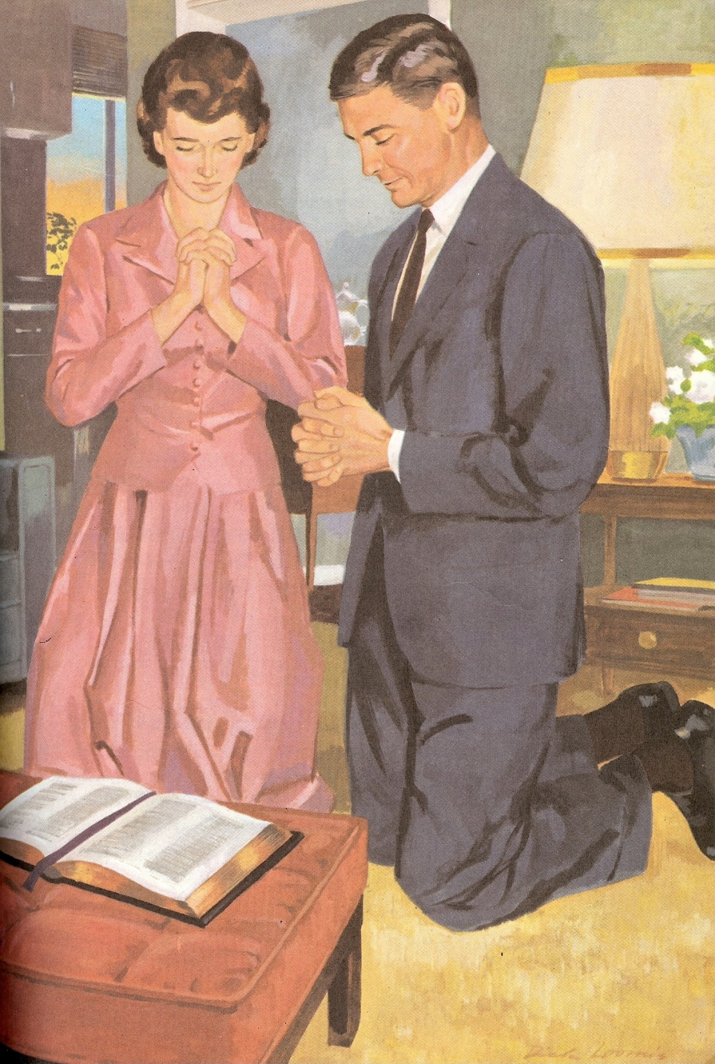
“Lord, I also want to pray for ___________, who is considering divorce and claims to be a Christian. Please bless him and lead him in the way of righteousness. Please give him courage to stay with his wife and give me an opportunity to talk with him and encourage him.”

Slide 26
Put into practice what you have learned
“This book of the law shall not depart out of thy mouth; but thou shalt meditate therein day and night, that thou mayest observe to do according to all that is written therein: for then thou shalt make thy way prosperous, and then thou shalt have good success.”
(Joshua 1:8)

