Slide 1
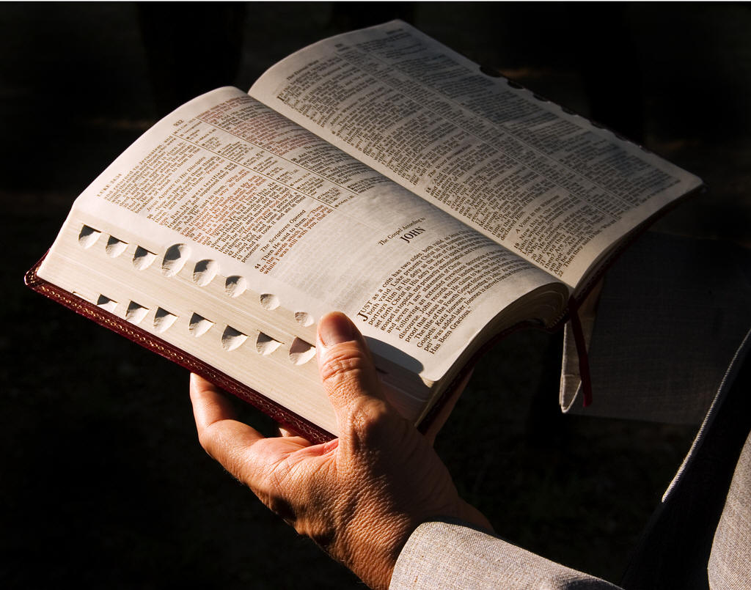
31 Biblical Life Principles that every believer should know

Slide 2
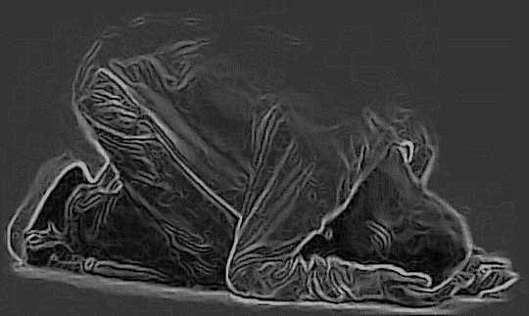
1. Our relationship with God is to be the highest priority in our lives - James 4:8 “Draw nigh to God, and he will draw nigh to you."

Slide 3
1 Chron. 22:19 “Now set your heart and your soul to seek the Lord your God.”
Isa. 58:2 "Yet they seek me daily, and delight to know my ways, as a nation that did righteousness, and forsook not the ordinance of their God: they ask of me the ordinances of justice; they take delight in approaching God.”
2 Chron. 26:5“And he (Uzziah) sought God in the days of Zechariah, who had understanding in the visions of God: and as long as he sought the LORD, God made him to prosper.”

Slide 4
A growing relationship with God will determine the impact of our lives on others 2 Chronicles 17:3-6“Now the Lord was with Jehoshaphat, because he walked in the former ways of his father David; he did not seek the Baals, but sought the God of his father, and walked in His commandments and not according to the acts of Israel. Therefore the Lord established the kingdom in his hand; and all Judah gave presents to Jehoshaphat, and he had riches and honor in abundance. And his heart took delight in the ways of the Lord.”

Slide 6
2. Obey God and leave all the consequences to Him – Deut. 11:27 "A blessing, if ye obey the commandments of the LORD your God, which I command you this day." 2 Cor.10:6 "And having in a readiness to revenge all disobedience, when your obedience is fulfilled."

Slide 8
3. God’s Word is an immovable anchor in the storms of life – Jer. 15:16 "Thy words were found, and I did eat them; and thy word was unto me the joy and rejoicing of mine heart." Heb. 6:19 "Which hope we have as an anchor of the soul, both sure and steadfast."

Slide 10
4. The awareness of God’s presence energizes us for our work – Heb. 13:5-6 "For he hath said, I will never leave thee, nor forsake thee. So that we may boldly say, The Lord is my helper, and I will not fear what man shall do unto me."

Slide 11
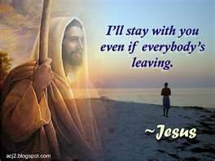

Slide 12
5. God does not require us to understand His will, just obey it, even if it seems unreasonable – Isa. 55:8-9 "For my thoughts are not your thoughts, neither are your ways my ways, saith the LORD. For as the heavens are higher than the earth, so are my ways higher than your ways, and my thoughts than your thoughts."

Slide 14
6. You reap what you sow, more than you sow, and later than you sow - Gal. 6:7 "Be not deceived; God is not mocked: for whatsoever a man soweth, that shall he also reap."

Slide 15
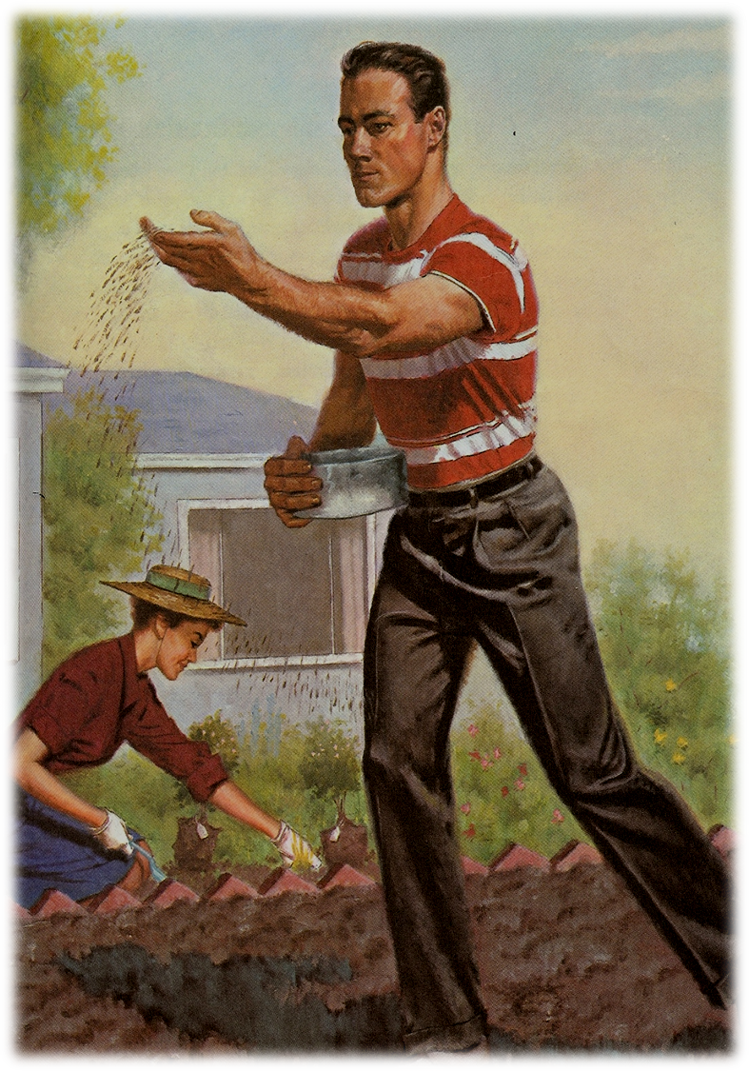
“Sow a thought, and you reap an act; Sow an act, and you reap a habit; Sow a habit, and you reap a character; Sow a character, and you reap a destiny.”

Slide 17
7. The dark moments of our life will last only so long as is necessary for God to accomplish His purpose in us – Rom. 8:28-29 “And we know that all things work together for good to them that love God, to them who are the called according to his purpose. For whom he did foreknow, he also did predestinate to be conformed to the image of his Son.”

Slide 18
Luke 22:42 “Father, if thou be willing, remove this cup from me: nevertheless not my will, but thine, be done.”

Slide 19
8. Fight all your battles on your knees and you win every time – 2 Chron. 20:15 "Thus saith the LORD unto you, Be not afraid nor dismayed by reason of this great multitude; for the battle is not yours, but God's." Psalms 34:4 "I sought the LORD, and he heard me, and delivered me from all my fears."

Slide 20
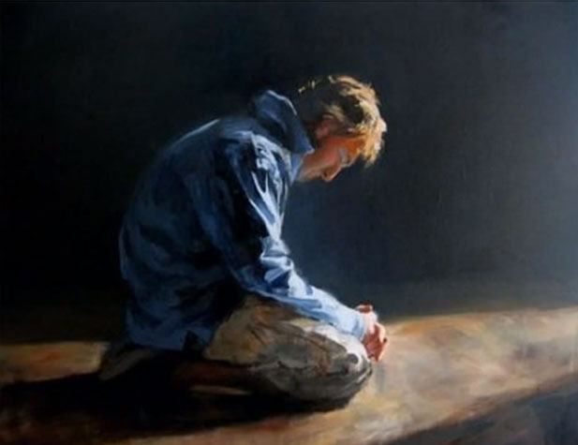

Slide 21
9. Trusting God means looking beyond what we can see to what God sees - 2 Cor. 4:18 "While we look not at the things which are seen, but at the things which are not seen: for the things which are seen are temporal; but the things which are not seen are eternal." (Wisdom = seeing life from God's perspective - James 3:15-17)

Slide 23
10. If necessary, God will move heaven and earth to show us His will - Rom. 8:14 "For as many as are led by the Spirit of God, they are the sons of God." Isa. 42:16 "I will lead them in paths that they have not known: I will make darkness light before them, and crooked things straight. These things will I do unto them."

Slide 24
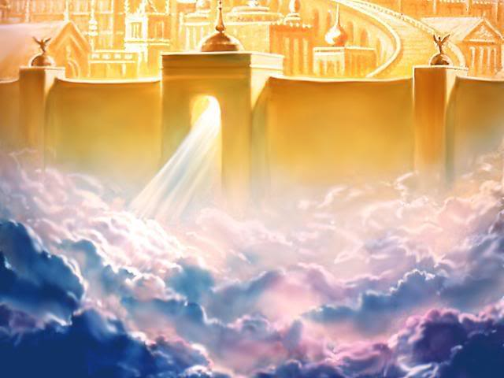

Slide 25
11. God assumes full responsibility for our needs when we obey Him - Psalms 34:9 "O fear the LORD, ye his saints: for there is no want to them that fear him." Phil. 4:19 "But my God shall supply all your need according to his riches in glory by Christ Jesus."

Slide 27
12. The Peace of God is the fruit of having oneness with God – Phil. 4:7 "And the peace of God, which passeth all understanding, shall keep your hearts and minds through Christ Jesus." Isa. 26:3 "Thou wilt keep him in perfect peace, whose mind is stayed on thee: because he trusteth in thee."

Slide 29
13. Listening to God is essential to walking with God – Matt. 11:15 "He that hath ears to hear, let him hear" 1 Sam. 3:9 "Speak, LORD; for thy servant heareth."

Slide 31
14. God acts on behalf of those who wait for Him – Prov. 20:22 "Wait on the LORD, and he shall save thee." Psalm 37:34 "Wait on the LORD, and keep his way, and he shall exalt thee."

Slide 33
15. Brokenness is God’s requirement for maximum usefulness – Psalms 51:17 "The sacrifices of God are a broken spirit: a broken and a contrite heart, O God, thou wilt not despise."

Slide 35
Prov. 29:23 “A man's pride shall bring him low: but honour shall uphold the humble in spirit.” Prov. 27:2 “Let another man praise thee, and not thine own mouth; a stranger, and not thine own lips.” Isa 57:15 “For thus saith the high and lofty One that inhabiteth eternity, whose name is Holy; I dwell in the high and holy place, with him also that is of a contrite and humble spirit, to revive the spirit of the humble, and to revive the heart of the contrite ones.”

Slide 36
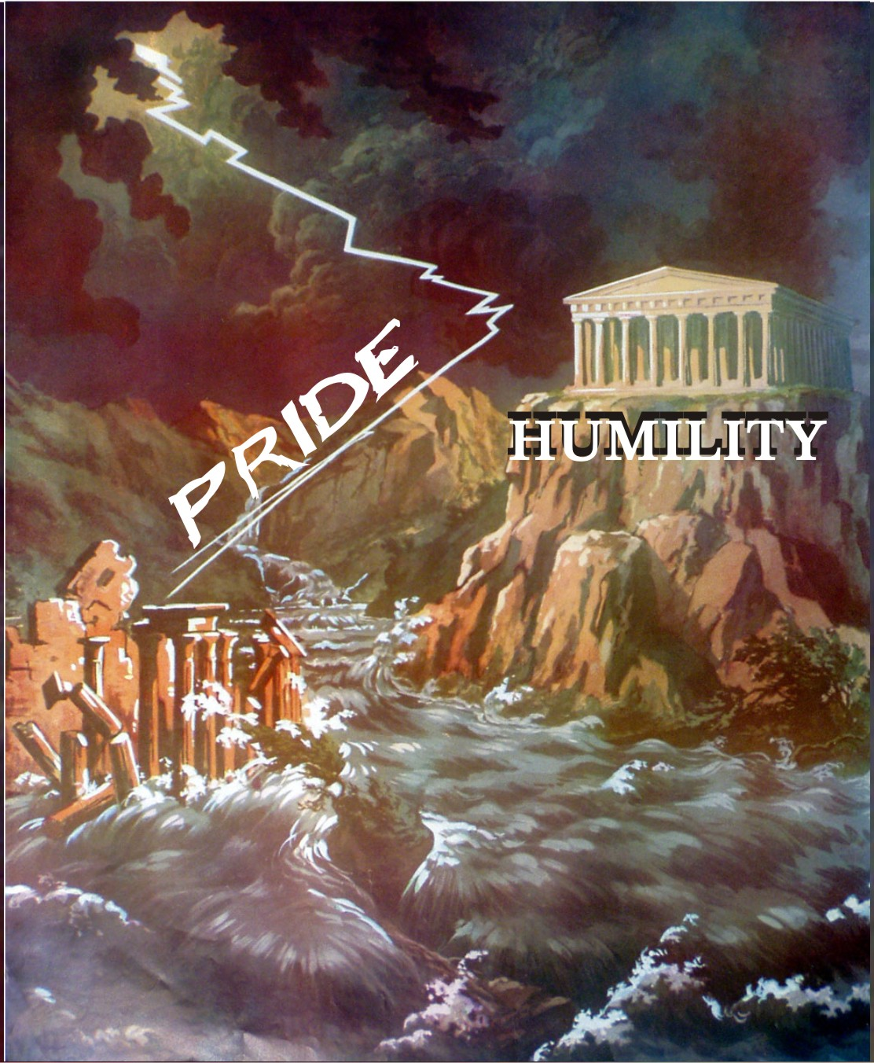
“For whosoever exalteth himself shall be abased; and he that humbleth himself shall be exalted.”

Slide 37
16. Whatever you acquire outside of God’s will eventually turns to ashes - 1 Cor. 3:12-15 "Now if any man build upon this foundation gold, silver, precious stones, wood, hay, stubble; Every man's work shall be made manifest: for the day shall declare it, because it shall be revealed by fire; and the fire shall try every man's work of what sort it is. If any man's work abide which he hath built thereupon, he shall receive a reward. If any man's work shall be burned, he shall suffer loss: but he himself shall be saved; yet so as by fire."

Slide 39
17. We stand strongest on our knees - Eph. 3:14 “For this cause I bow my knees unto the Father of our Lord Jesus Christ.” 1 Pet. 5:6 "Humble yourselves therefore under the mighty hand of God, that he may exalt you in due time." Isa 41:10 "Fear thou not; for I am with thee: be not dismayed; for I am thy God: I will strengthen thee; yea, I will help thee; yea, I will uphold thee with the right hand of my righteousness."

Slide 40
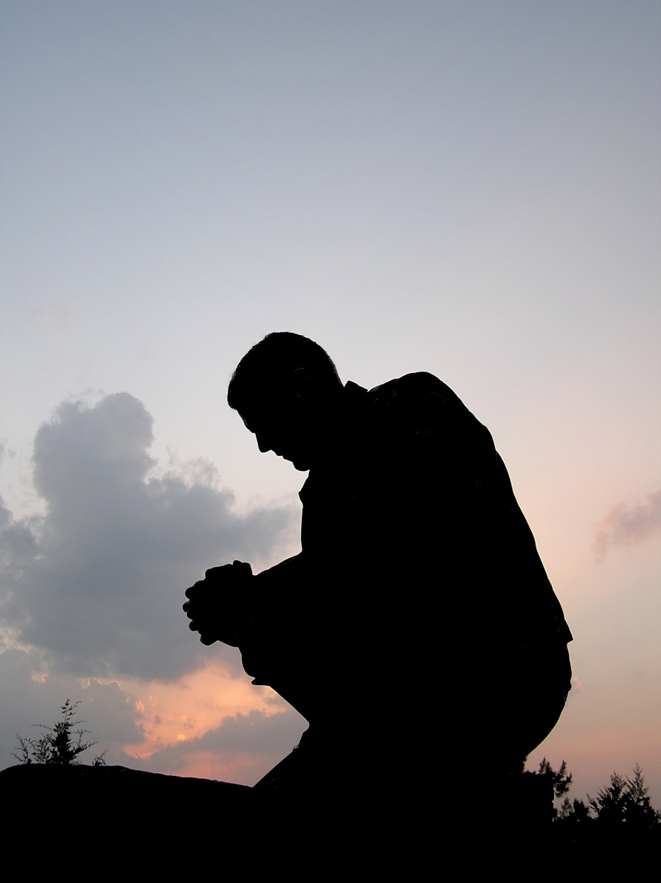
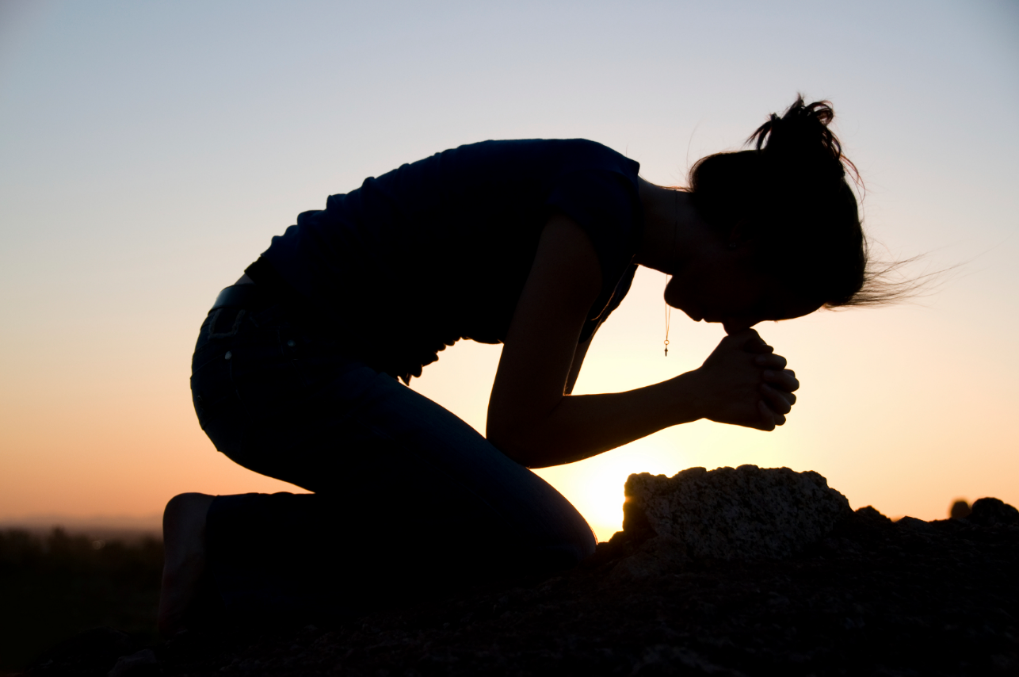
“Daniel, kneeled upon his knees three times a day, and prayed.”

Slide 41
18. As children of a sovereign God, we are never victims of our circumstances – Psalms 103:19 "The LORD hath prepared his throne in the heavens; and his kingdom ruleth over all." Rom. 8:28 "And we know that all things work together for good to them that love God."

Slide 43
19. Anything you hold too tightly, you will lose – Matt. 16:25-26 "For whosoever will save his life shall lose it: and whosoever will lose his life for my sake shall find it. For what is a man profited, if he shall gain the whole world, and lose his own soul? or what shall a man give in exchange for his soul?"

Slide 45
20. Disappointments are inevitable, discouragement is a choice - Psalms 34:19 "Many are the afflictions of the righteous: but the LORD delivereth him out of them all." 1 Sam. 30:6 "And David was greatly distressed; for the people spake of stoning him, because the soul of all the people was grieved: but David encouraged himself in the LORD his God."

Slide 47
21. Obedience always brings blessing - Deut. 11:27 "A blessing, if ye obey the commandments of the LORD your God, which I command you this day.” Job 36:11 “If they obey and serve him, they shall spend their days in prosperity, and their years in pleasures.”

Slide 49
22. To walk in the Spirit is to obey the initial promptings of the Spirit - Gal. 5:16, 25 "This I say then, Walk in the Spirit, and ye shall not fulfill the lust of the flesh...If we live in the Spirit, let us also walk in the Spirit." Rom. 8:14 "For as many as are led by the Spirit of God, they are the sons of God."

Slide 51
23. You can never out-give God – Luke 6:38 "Give, and it shall be given unto you; good measure, pressed down, and shaken together, and running over, shall men give into your bosom. For with the same measure that ye mete withal it shall be measured to you again." Prov. 3:9-10 "Honour the LORD with thy substance, and with the firstfruits of all thine increase: So shall thy barns be filled with plenty, and thy presses shall burst out with new wine."

Slide 52
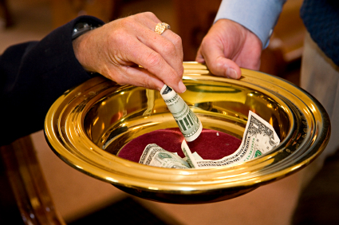

Slide 53
“Will a man rob God? Yet ye have robbed me. But ye say, Wherein have we robbed thee? In tithes and offerings. Ye are cursed with a curse: for ye have robbed me, even this whole nation. Bring ye all the tithes into the storehouse, that there may be meat in mine house, and prove me now herewith, saith the LORD of hosts, if I will not open you the windows of heaven, and pour you out a blessing, that there shall not be room enough to receive it.” (Malachi 3:8-10)

Slide 54
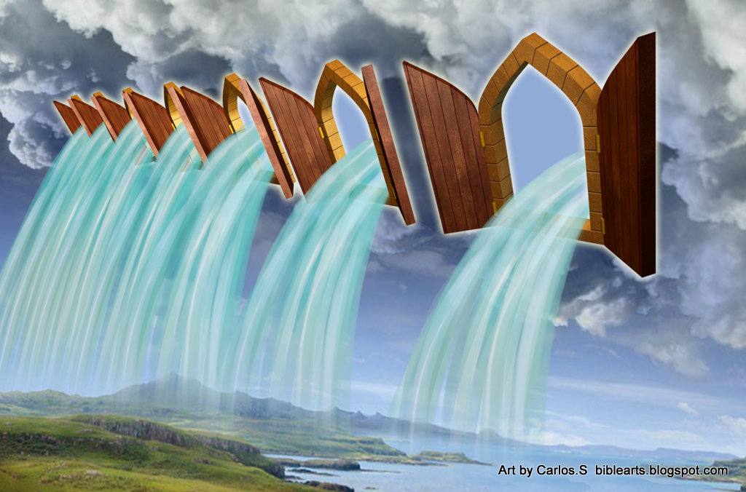

Slide 55
24. To live the Christian life is to allow Jesus to live His life in and through us - Gal. 2:20 "I am crucified with Christ: nevertheless I live; yet not I, but Christ liveth in me: and the life which I now live in the flesh I live by the faith of the Son of God, who loved me, and gave himself for me."

Slide 56
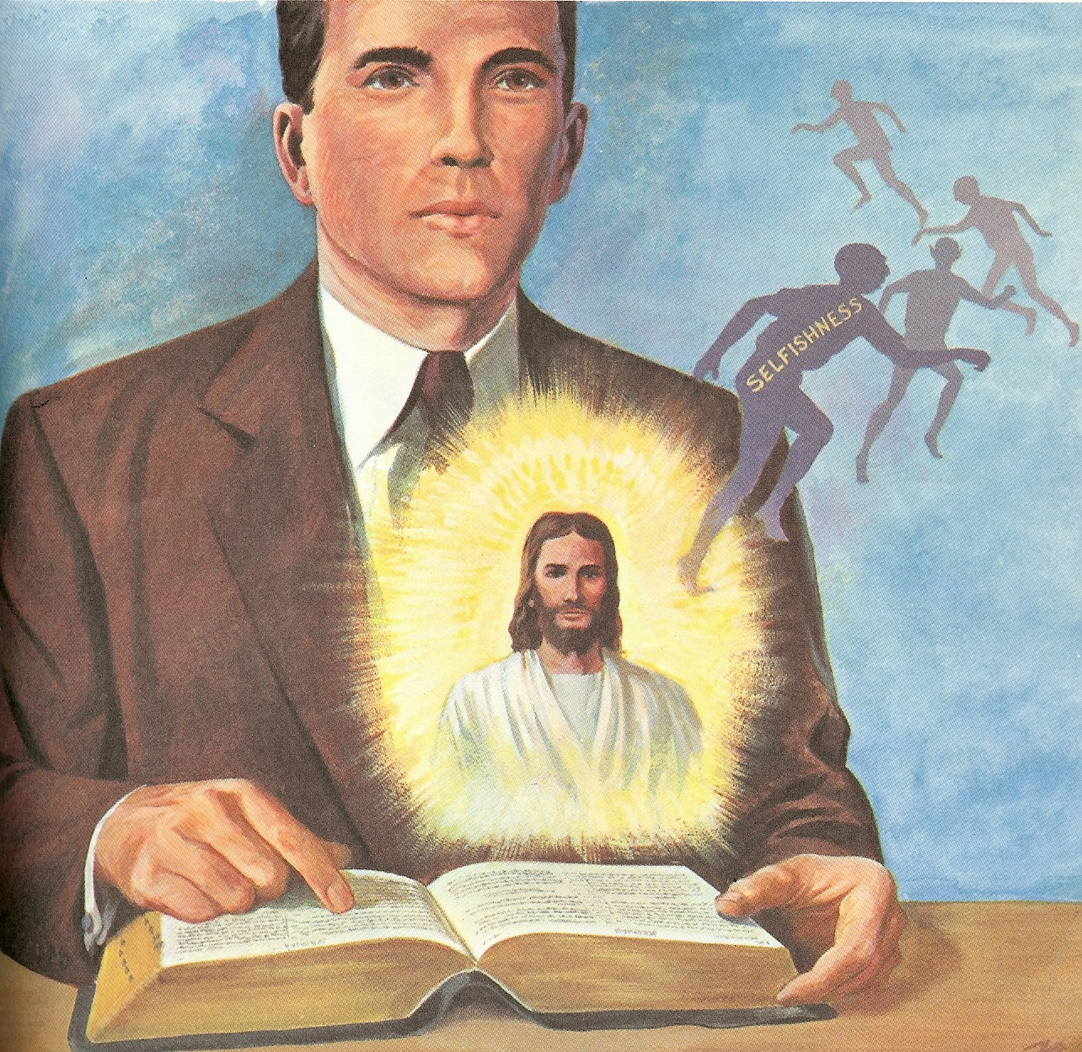
How to be Filled with the Holy Spirit

Slide 57
1. Purpose to live a holy life – I Thess. 4:1-8
2. Yield yourself to the Lord – Rom. 6,
12:1-2
3. Renew your mind daily – Eph. 4:23-24
4. Make no provision for the flesh – Rom.
13:14
5. Flee temptation – II Tim. 2:22
6. Resist Satan by continual submission to
God – Jam. 4:6-10
7. Do not give place to the devil – Eph. 4:
27-30 (bitterness, immorality, covetousness)

Slide 58
8. Keep you thought centered on things above – Phil. 4:6-8
9. Set your affections on things above – Col. 3:1-4
Keep your sin confessed – Prov. 28: 13-14
Keep your conscience clear – Acts 24:16
Obey the promptings of the Holy Spirit – Rom. 8:14

Slide 59
13. Avoid quenching and grieving the
Holy spirit – I Thess. 5:19, Eph. 4:25-31
14. Ask God to fill you with the Holy Spirit –
Luke 11:15
The Holy Spirit is called the “Spirit of Grace” Heb. 10:29
“God gives grace to the humble…”

Slide 61
25. God blesses us so that we might bless others – 1 Tim. 6:17-18 "Charge them that are rich in this world, that they be not highminded, nor trust in uncertain riches, but in the living God, who giveth us richly all things to enjoy; That they do good, that they be rich in good works, ready to distribute, willing to communicate."

Slide 62
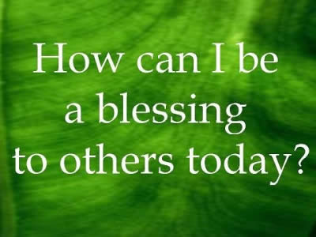

Slide 63
26. Adversity is a bridge to a deeper relationship with God - (Read the Psalms) Psalms 31:6-14 "I have hated them that regard lying vanities: but I trust in the LORD. I will be glad and rejoice in thy mercy: for thou hast considered my trouble; thou hast known my soul in adversities; And hast not shut me up into the hand of the enemy: thou hast set my feet in a large room. Have mercy upon me, O LORD, for I am in trouble: mine eye is consumed with grief, yea, my soul and my belly.

Slide 64
For my life is spent with grief, and my years with sighing: my strength faileth because of mine iniquity, and my bones are consumed. I was a reproach among all mine enemies, but especially among my neighbours, and a fear to mine acquaintance: they that did see me without fled from me. I am forgotten as a dead man out of mind: I am like a broken vessel. For I have heard the slander of many: fear was on every side: while they took counsel together against me, they devised to take away my life. But I trusted in thee, O LORD: I said, Thou art my God."

Slide 66
27. Prayer is life’s greatest time saver - Jeremiah 33:3 "Call unto me, and I will answer thee, and shew thee great and mighty things, which thou knowest not." Jam. 5:16 “The effectual fervent prayer of a righteous man availeth much.”

Slide 68
28. No Christian has ever been called to “go it alone” in his or her walk of faith – Heb 13:5 "I will never leave thee, nor forsake thee." Isa. 43:5 "Fear not: for I am with thee."

Slide 70
29. We learn more in our valley experiences than on our mountaintops - Psalms 119:71 "It is good for me that I have been afflicted; that I might learn thy statutes." Phil. 4:11 "I have learned, in whatsoever state I am, therewith to be content."

Slide 72
30. An eager anticipation of the Lord’s return keeps us living productively - Titus 2:13 "Looking for that blessed hope, and the glorious appearing of the great God and our Saviour Jesus Christ." 1 John 3:3 "And every man that hath this hope in him purifieth himself, even as he is pure."

Slide 73
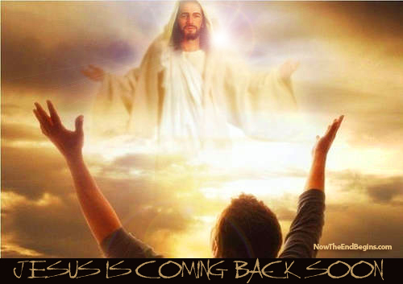

Slide 74
31. Our main goal and purpose in life to please the Lord – Rev. 4:11 "Thou art worthy, O Lord, to receive glory and honour and power: for thou hast created all things, and for thy pleasure they are and were created." 1 Thess. 4:1 "Furthermore then we beseech you, brethren, and exhort you by the Lord Jesus, that as ye have received of us how ye ought to walk and to please God, so ye would abound more and more."

Slide 75
Rom. 8:8 “So then they that are in the flesh cannot please God.” 1 Cor. 7:32 “But I would have you without carefulness. He that is unmarried careth for the things that belong to the Lord, how he may please the Lord.” 1 Thess. 4:1 “Furthermore then we beseech you, brethren, and exhort you by the Lord Jesus, that as ye have received of us how ye ought to walk and to please God, so ye would abound more and more.”

Slide 76
