Slide 1
How to Help your Husband be a Spiritual Leader
“And the LORD God said, It is not good that the man should be alone; I will make him an help meet for him.” (Genesis 2:18)

Slide 2
Husbands are given instruction by God to be the spiritual head of their home – I Cor. 11:2-3
Husbands are to provide direction with out being domineering – I Peter 5:1-4
Husbands are to provide leadership through personal example – Heb. 13:7, 17
Husbands are to provide protection without being possessive – I Thess. 2:7-11
Husbands are to provide basic needs without being materialistic – I Tim. 5:8, 6:6-8

Slide 3
Most husbands feel that they are inadequate and unqualified to assume the spiritual leadership.
Most husbands feel that their wives are better readers and students of the Bible.
It requires a major commitment and effort for most men to initiate a spiritual activity such as -
Prayer
Reading of Scripture
Family ministries
Faithful church attendance
Family discussion of spiritual things

Slide 4
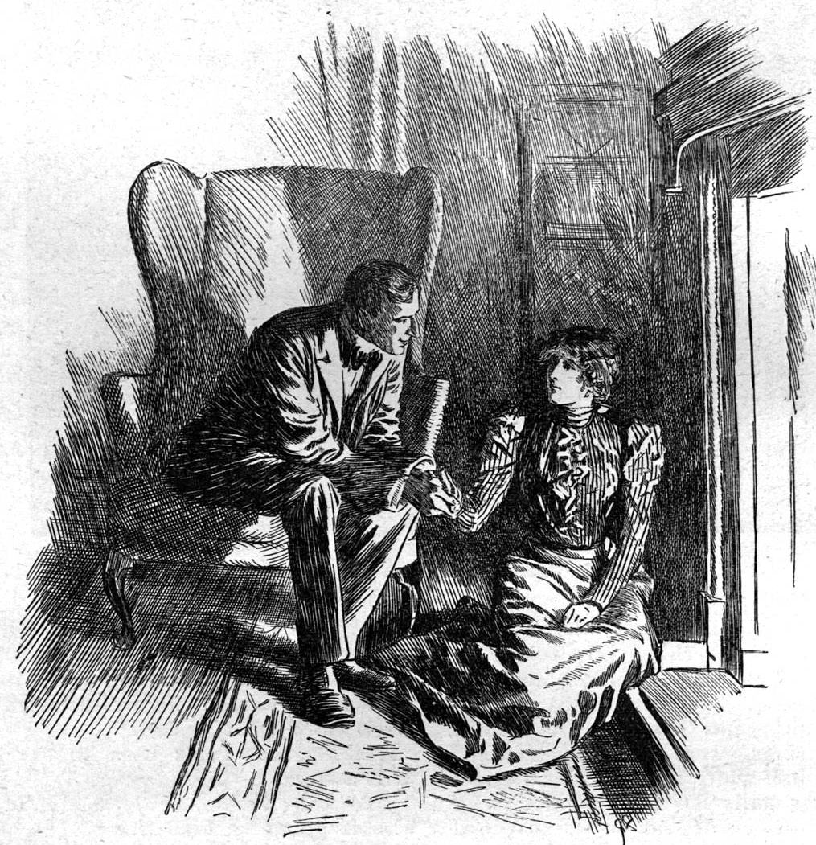
Therefore, it is the wife’s highest challenge and calling to be a loving helpmeet to him in this area!
The slightest resistance from the wife is often more than enough to discourage him from being the spiritual leader –
Because a man’s =
Identity
Goals
Finances
Priorities
Marriage
Children
Are all directly affected by the level of his spiritual leadership.

Slide 5
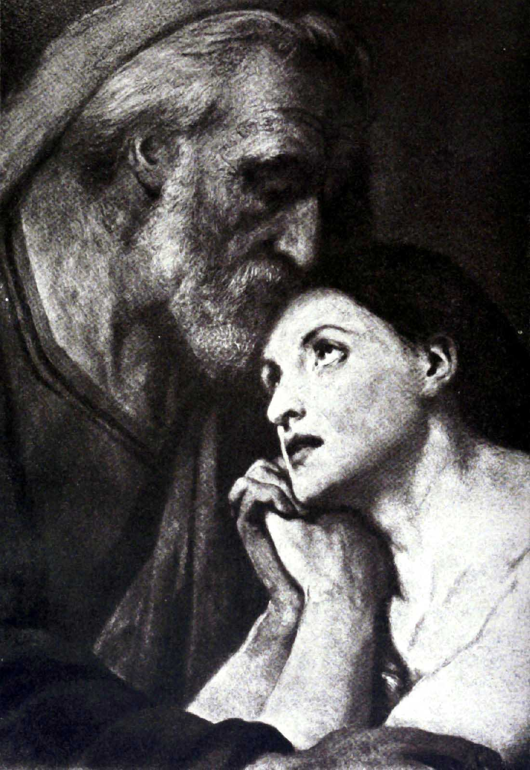
A leader is made by a follower –
Note: What is required to be a loyal follower?
Submission – Eph. 5:21-22
Humility – I Cor. 4:16
Commitment – Matt. 10:16-39
Servants spirit – Luke 22:23-27
Obedience – Titus 2:5
Sacrifice – Matt. 8:18-22
Meekness (yielding rights) – I Peter 3:4

Slide 6
2. A leader is strengthened and encouraged by respect – Eph. 5:33; I Peter 2:11-17
A respectful attitude opens the heart of the one in authority – II Sam. 9:6-11
The difficulty of showing respect –
Difficult to show reverence when you observe major character weaknesses.
God however wants us to look beyond the weakness and realize the God has given them the position through which He will bless and direct our lives – Deut. 28:1-2; I Tim. 2:2

Slide 7
A wife is to respect the God-ordained office of her husband even when his life does not measure up – I Peter 2:18-3:4
If a woman’s husband commands her to do evil, she would have to reject his command; but in so doing she must never be disrespectful – Acts 4:17-20; 5:27-29
The more a wife looks to her husband for direction, the more he will tend to seek the Lord for direction – I Cor. 14:35

Slide 8
3. A leader is motivated by a learner – I Cor. 14:33-35
Most men will rise to leadership when their wives come to them for direction.
Even if they do not feel qualified to meet the need, they will be motivated to go to others for help if they realize that their wife’s are depending on them for direction.
Note: This is where women make a serious mistake!
They do not go to their husbands -
They seek out counsel and advice from others -

Slide 9
Friends
Pastor
Bible teachers
Radio call in programs
Other respected leaders in the church
Other women
Note: The reason women do not go to their husband.
He will not know the answer
He is to busy
He is not concerned about spiritual things
He is not a Christian
He is a carnal Christian

Slide 10
The Benefits of Seeking Spiritual Direction from your Husband
You will be looking to your husband and not others for spiritual guidance – I Cor. 14:35
You will allow others to see that your husband is your spiritual leader – I Cor. 11:3
You will strengthen your marriage, not weaken it –
You will prevent yourself from becoming spiritually proud – I Cor. 8:1
You will be encouraging your husband to take the leadership in your marriage – Eph. 5:23
You will help him gain the confidence he needs -

Slide 11
Tactics Women use to Control their Husbands
Anger
Disagreement
Argument
Complaining
Stare
Disgust
Silence
Walking away
Sneering
Character attacks
Rejection
Rebellion

Slide 12
