Slide 1
Becoming Men and Women of Biblical Convictions

Slide 2
How to be an Effective Spiritual Leader
Become a Man of Strong Biblical Convictions

Slide 3
I Tim. 3:9 “Holding the mystery of the faith in a pure conscience.”
Tit. 1:9 “Holding fast the faithful word as he hath been taught, that he may be able by sound doctrine both to exhort and to convince the gainsayers.”
I Cor. 15:58 “Therefore, my beloved brethren, be ye stedfast, unmoveable, always abounding in the work of the Lord, forasmuch as ye know that your labour is not in vain in the Lord.”
Ps. 78:8 “A stubborn and rebellious generation; a generation that set not their heart aright, and whose spirit was not stedfast with God.”
II Thess. 2:15 “Therefore, brethren, stand fast, and hold the traditions which ye have been taught, whether by word, or our epistle.”

Slide 4
Jam. 1:8 “A double minded man is unstable in all his ways.”
II Pet. 3:16 “They that are unlearned and unstable wrest (pervert/twist), as they do also the other scriptures, unto their own destruction.”
I Thess. 3:8 “For now we live, if ye stand fast in the Lord.”
Eph. 4:14 “That we henceforth be no more children, tossed to and fro, and carried about with every wind of doctrine, by the sleight of men, and cunning craftiness, whereby they lie in wait to deceive.”

Slide 5
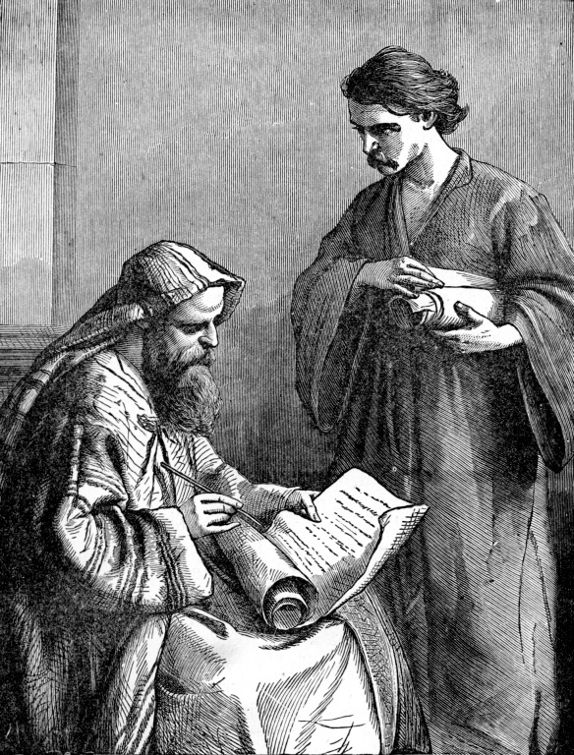
“And the things that thou hast heard of me among many witnesses, the same commit thou to faithful men, who shall be able to teach others also.”
(II Tim. 2:2)

Slide 6
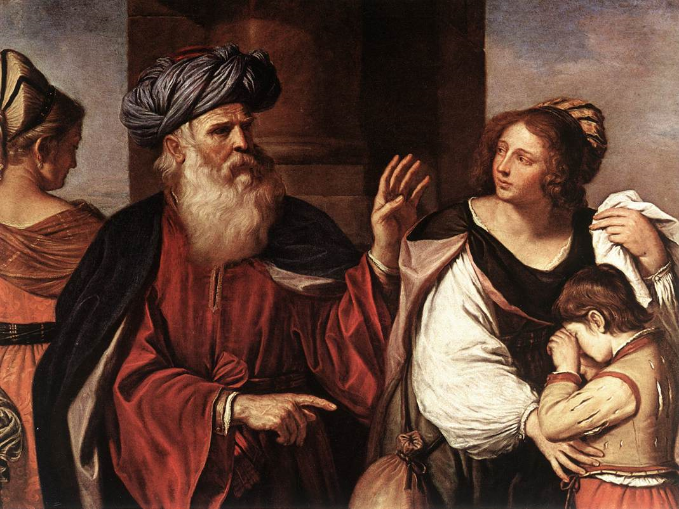
“For I know him, that he will command his children and his household after him, and they shall keep the way of the LORD,
to do justice and judgment; that the LORD may bring upon Abraham that which he hath spoken of him.”
(Gen. 18:19)

Slide 7
Every Christian husband knows that he is to be the spiritual leader of his family - I Corinthians 11:1-5; Ephesians 5:22-31; Colossians 3:18-21; I Peter 3:7
God established the husband’s headship - God created man first and gave him tasks to perform; then God created woman! “...I will make him an help meet for him...”
The Hebrew word for “help” means - To aid or assist. If Eve was created to “aid” Adam, it is logical that Adam held the position of headship. He was to provide direction, and Eve was to assist him - Genesis 2:18-3:16

Slide 8
Headship is established by personal convictions
What is a conviction - I Corinthians 15:58; Ephesians 4:14-15; 6:10-12; I Timothy 1:18-20; 3:9; 4:6-13; 6:12, 20; II Timothy 4:6-7
A conviction is a basic scriptural principle which we purpose to follow, whatever the cost! - Revelation 2:13
What is a preference?
A preference is the first choice a person would make in a given situation / not the only choice

Slide 9
The difference between a conviction and a preference -
Conviction does not change
Preference does
Conviction will be seen in daily living
Preference may not
Conviction will be consistent
Preference may vary

Slide 10
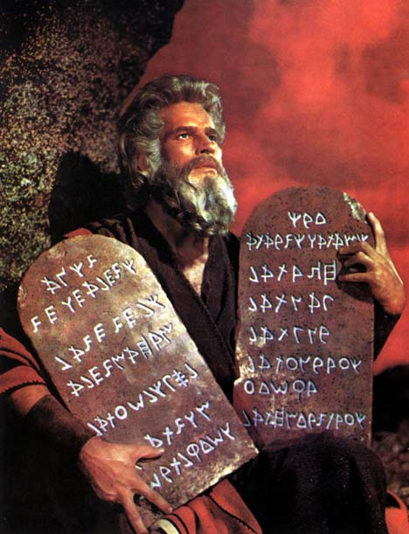
Ten Biblical convictions (Exodus 20) “The Ten Commandments”

Slide 11
Ten Commandments Basis of Ten Scriptural Convictions
“No other gods before me…”
“Do not make any graven images…nor serve them…”
“Do not take the name of the Lord thy God in vain…”
Rejecting inspiration makes a god of our intellect – Isa. 55:6-13
No man can serve two masters – Matt. 6:18-21
God’s reputation (name) is damaged by personal sin – Ps. 23:3; Matt. 5:14-16

Slide 12
Assembling together on the Lord’s day must not be forsaken – Heb. 10:24-25
Children will honor parents who bring them up in the discipline and instruction of the Lord – Deut. 6:4-8; Prov. 31:28
Causing a brother to stumble can destroy him spiritually – Rom. 14:10-23
“Remember the Sabbath day…”
“Honor thy Mother and Father…”
“Thou shalt not kill…”

Slide 13
“Thou shalt not commit adultery…”
“Thou shalt not steal…”
“Thou shalt not bear false witness…”
“Thou shalt not covet…”
Marriage covenant must not be defiled by lust – Heb. 13:4-5
Affections must be set on things above – Col. 3:1-2
Always speak the truth – Eph. 4:15
Contentment must be learned – I Tim. 6:6-10

Slide 14
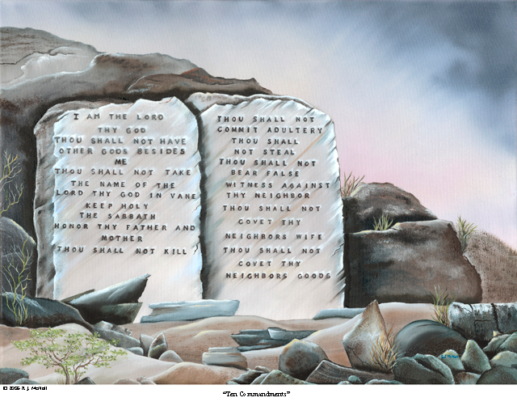
Ps. 19:7 “The law of the LORD is perfect…”

Slide 15
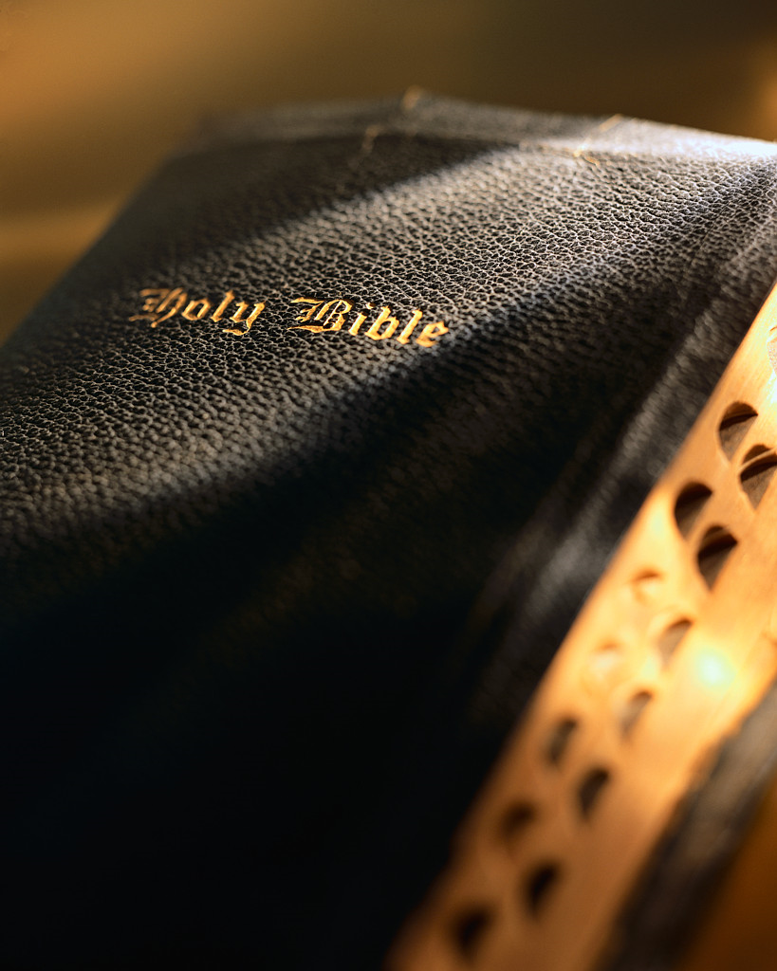
“No other gods before me…”
The Bible is the inspired Word of God and is the final authority for my life.
(Exod. 20:3; Ps. 138:2; Matt.4:4; II Tim. 3:16-17)

Slide 16
God's Word is the “incorruptible seed” Incorruptible = Does not perish. "The Word of God...lives and abides forever."
“The words of the Lord are pure words: as silver tried in a furnace of earth, purified seven times. Thou shalt keep them, O Lord, thou shalt preserve them from this generation forever…The counsel of the Lord standeth forever, the thoughts of his heart to all generations…His truth endureth to all generations…forever, O Lord, thy word is settled in heaven, thy faithfulness is unto all generations…The grass withereth, the flower fadeth, but the word of our God shall stand forever…but the word of the Lord endureth forever… Heaven and earth shall pass away, but my words shall not pass away…”

Slide 17
God Promised to Preserve
His Words
His Counsels
His Thoughts

Slide 18
“Do not make any graven images… nor serve them…”
My purpose in life is to seek the Lord with my whole heart and build my goals around His priorities. (Exodus 20:4-5; Psalms 119:2; Matthew 6:33; Philippians 3:8)

Slide 19
Idolatry
A sin deeply rooted in the human heart
"Dear children, keep yourselves from idols." I John 5:21
An idol occupies that place in our esteem, affections, thoughts, words, ways, dependence, reliance, worship and devotedness, which is due to God only?
Whatever is to us what the Lord alone should be, is to us an idol.

Slide 20
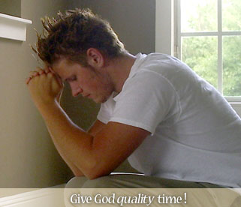
“Do not take the name of the Lord thy God in vain…”
My body is the living temple of God and must not be defiled by the lust of this world.
(Exodus 20:7; II Samuel 12:14; Daniel 1:8; Mark 7:21-23; I Corinthians 3:16-17)

Slide 21
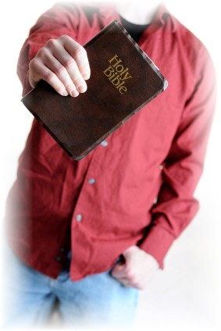
“For I am not ashamed…”
II Tim. 1:8 “Be not thou therefore ashamed of the testimony of our Lord.”
Tit 2:8 “Sound speech, that cannot be condemned; that he that is of the contrary part may be ashamed, having no evil thing to say of you.”
I Pet. 3:16 “Having a good conscience; that, whereas they speak evil of you, as of evildoers, they may be ashamed that falsely accuse your good conversation in Christ.”

Slide 22
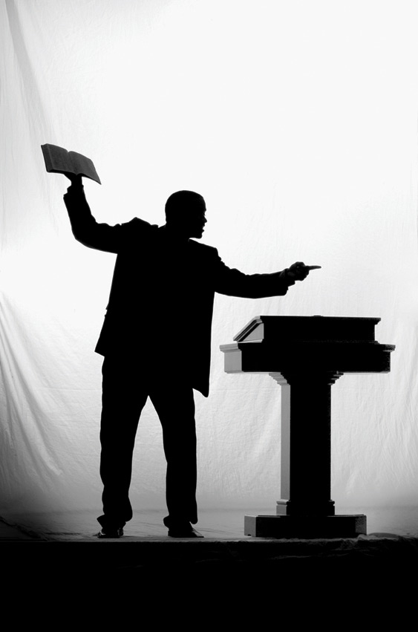
“Remember the Sabbath day…”
My Church must teach the foundational truths of the Bible and reinforce my basic convictions - Exodus 20:8; II Chronicles 7:14; Psalms 29:2; Matthew 7:15-16; II Corinthians 6:14-17
I will be faithful in attendance and service in my local church – Hebrews 10:24-25

Slide 23
“Honor thy Mother and Father…”
“Children, obey your parents in the Lord: for this is right. Honour thy father and mother; (which is the first commandment with promise;) That it may be well with thee, and thou mayest live long on the earth.” Eph. 6:1-2

Slide 24
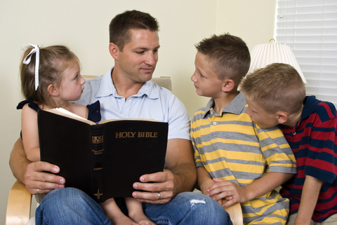
My children and grandchildren belong to God and it is my responsibility to teach them scriptural principles, Godly character, and basic convictions. (Exodus 20:12; Deuteronomy 6:6-7; 4:9; psalms 127:3; Matthew 19:14; Galatians 4:1-2)

Slide 25
“Thou shalt not kill…”
My activities must never weaken the Scriptural convictions of another Christian. (Exodus 20:13; Proverbs 28:10; Matthew 18:6; Romans 14:13)

Slide 26
“Thou shalt not commit adultery…”
My marriage is a life-long commitment to God and to my marriage partner. (Genesis 2:24; Exodus 20:14; Proverbs 6:32; Matthew 19:6; Romans 7:2-3)

Slide 27
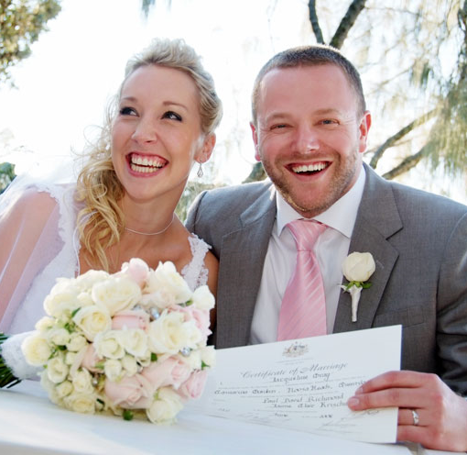
Marriage Vows
I __________take thee __________ to me my wedded wife, to have and to hole from this day forward, for better or for worse, for richer for poorer, in sickness and in health, to love and to cherish, till death do us part, according to God’s holy ordinance, and thereto I give my pledge.

Slide 28
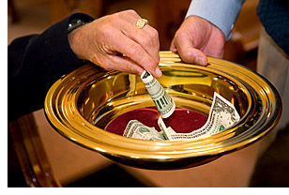
“Thou shalt not steal…”
My money is a trust from God and must be earned, managed and given according to Scriptural principles. (Exodus 20:17; Proverbs 15:6; Malachi 3:8; Luke 6:38; I Timothy 6:6-10)

Slide 29
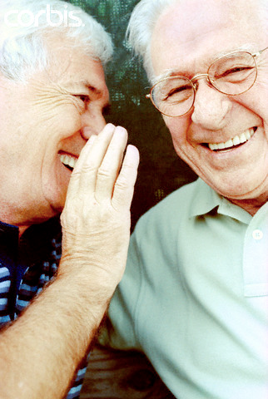
“Thou shalt not bear false witness…”
My words must always be truthful and in harmony with God’s Word. I will always seek be honest in all my business dealings. I will refrain from gossip, slander and spreading evil reports about others. (Exodus 18:20; Ephesians 4:13; Proverbs 10:18; II Corinthians 6:8)

Slide 30
“Let your speech be alway with grace,
seasoned with salt.”
(Col. 4:6)

Slide 31
“Thou shalt not covet…”
My affections must be set on things above, not on the things
of this world. (Exodus 20:17; Job 1:21; Matthew 6:20-21; Colossians 3:1-2)

Slide 32
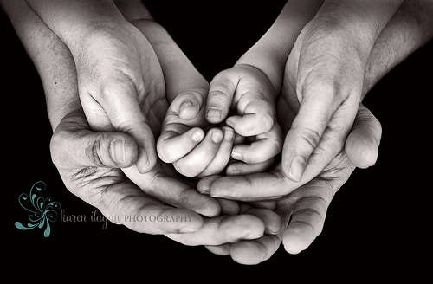
“And they that shall be of thee shall build the old waste places: thou shalt raise up the foundations of many generations; and thou shalt be called, The repairer of the breach, The restorer of paths to dwell in.”
(Isa. 58:12)

