Slide 1
II Corinthians 10:3-6
Stronghold
“False Ideas”
(John 8:44)
Ground
Surrendered
(Eph. 4:27)
Pride of Life
Immorality
(I Thess. 4:1-8)
Bitterness
(Heb. 12:15)
Temporal Values
(I Tim. 6:10)

Slide 2
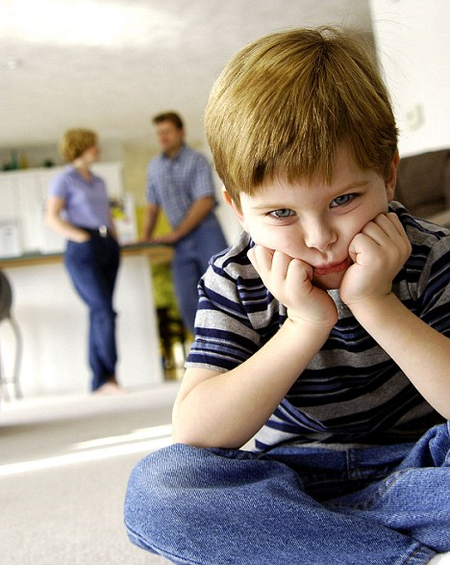
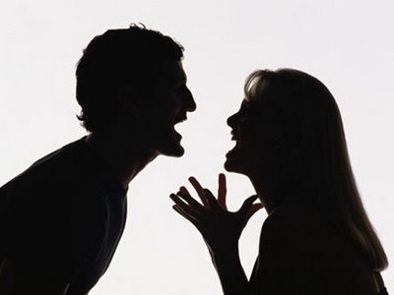
Removing Bitterness From Your Life and Home
“Wives, submit yourselves unto your own husbands, as it is fit in the Lord. Husbands, love your wives, and be not bitter against them. Children, obey your parents in all things: for this is well pleasing unto the Lord. Fathers, provoke not your children to anger, lest they be discouraged.”
(Colossians 3:18-21)

Slide 3
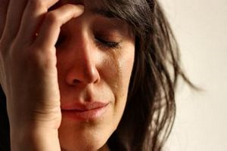
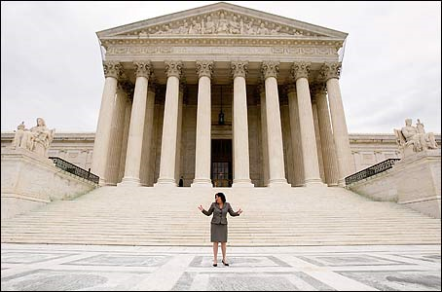
Definition of Bitterness
Greek (pikrihah) -
To undergo something painful or unpleasant, injury, grief, affliction, or trial.
To make fast, to fix, to fasten together, to build by fastening together - Meaning = “To build a case and stand against someone for revenge and for his or her destruction”

Slide 4
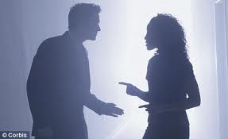
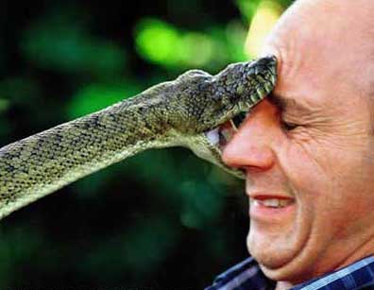
NOTE: The word is closely related to the word “Bite” - Galatians 5:15-17
“But if ye bite and devour one another, take heed that ye be not consumed one of another. This I say then, Walk in the Spirit, and ye shall not fulfil the lust of the flesh. For the flesh lusteth against the Spirit, and the Spirit against the flesh: and these are contrary the one to the other: so that ye cannot do the things that ye would.”

Slide 5
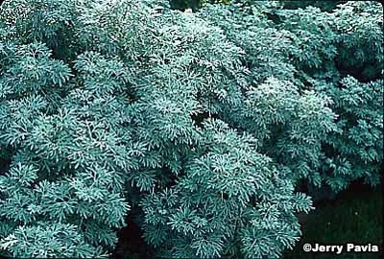
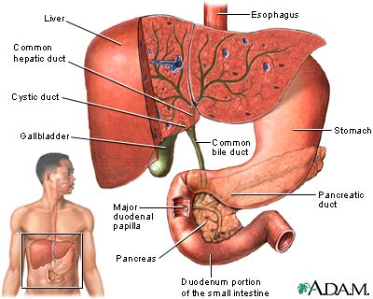
BIBLICAL DISCRIPTION OF BITTERNESS
Poison (James 3:8-10) = Makes a person deathly sick.
Wormwood (Lam. 3:15) = Strong smelling plant which has a very bitter and unpleasant taste.
Gall (Acts 8:23) = A bitter, slightly alkaline, yellowish-green fluid secreted from the liver and stored in the gall bladder (bile) / used in the Scriptures to refer to anything that is distasteful, unpleasant, and which causes vexation of spirit.

Slide 7
“Bitterness is simply the result of not seeing suffering from God’s perspective.”
If you want Christ’s power - You must first accept suffering - II Corinthians 12:7-10; Philippians 3:10
If you want Christ’s glory - You must welcome His suffering - Romans 8:17-18; I Peter 4:12-14
If you want to reign with Christ - You must be willing to suffer with Him and for Him - II Timothy 2:12

Slide 8
If you want to receive the crown of life - You must be willing to endure suffering - James 1:12
If you want to fulfill God’s calling - You must follow Christ’s example of suffering - I Peter 2:18-23
If you want to develop godly character - You must allow suffering to perfect you - I Peter 4:1-2; 5:10
If you want to be an effective witness and encouragement to others - You must respond correctly to suffering - II Corinthians 1:3-7
If you want your faith to increase - You must see suffering as a precious gift from God - I Peter 1:6-9

Slide 9
If you want to experience a close fellowship with God - You must commit your soul (mind / will / emotions) to Him as your faithful Creator - II Timothy 1:12; I Peter 4:19
If you are going to live godly in this present world - You must expect suffering - II Timothy 3:12
If you want to be counted as a worthy servant of God - You must count it all joy to suffer for His name - Philippians 1:29; II Thessalonians 1:5
If you want God’s full blessing upon your life - You must rejoice and be exceeding glad when called upon to suffer - Matthew 5:10-16

Slide 10
These are just a few purposes of suffering. If you do not see suffering from God’s perspective, you will become a bitter person!
(Hebrews 12:15)

Slide 11
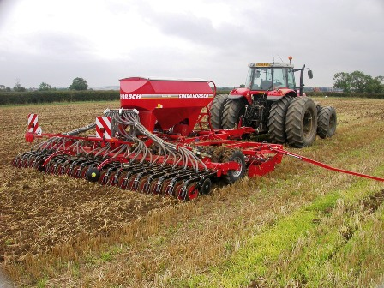
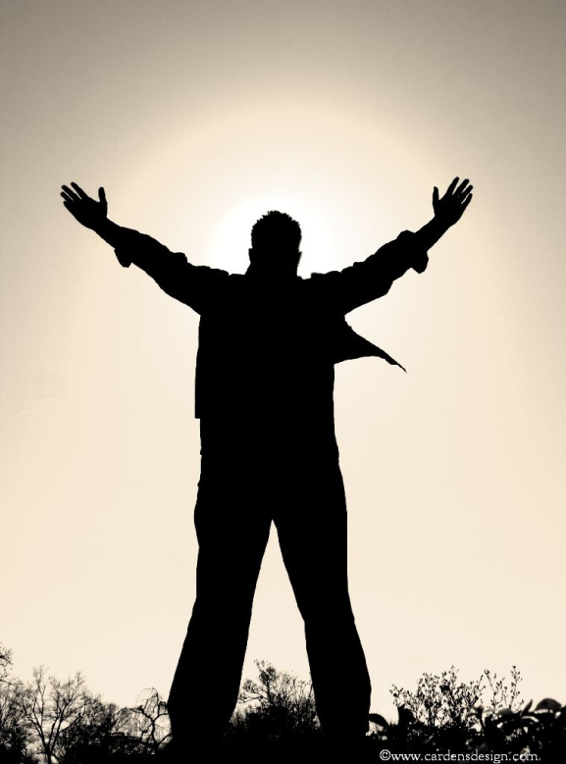
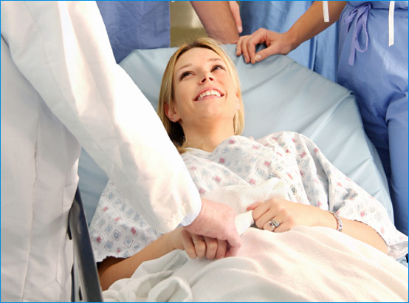
Suffering is the fertile soil into which God transplants every growing Christian - I Peter 5:10
Suffering is the motivation to take your eyes off temporal things so that you can see eternal realities - Philippians 3:8
Suffering is the pain that is required in order for true healing to take place - I Peter 4:1
Suffering is the confirmation that you have been chosen for special leadership with Christ in His Kingdom - II Timothy 2:12

Slide 12
(I Peter 5:10) “But the God of all grace, who hath called us unto his eternal glory by Christ Jesus, after that ye have suffered a while, make you perfect, stablish, strengthen, settle you.”
(Philippians 3:8 ) “Yea doubtless, and I count all things but loss for the excellency of the knowledge of Christ Jesus my Lord: for whom I have suffered the loss of all things, and do count them but dung, that I may win Christ.”
(I Peter 4:1) “Forasmuch then as Christ hath suffered for us in the flesh, arm yourselves likewise with the same mind: for he that hath suffered in the flesh hath ceased from sin.”
(II Timothy 2:12) “If we suffer, we shall also reign with him.”

Slide 13
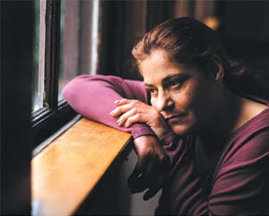
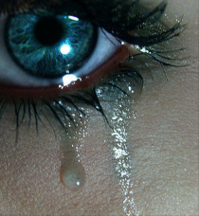
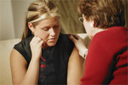
Recognizing Bitterness
Most people who are bitter do not recognize it as such, rather than admitting that they are bitter, they simply see themselves as having been -
> hurt
> disappointed
> offended

Slide 14
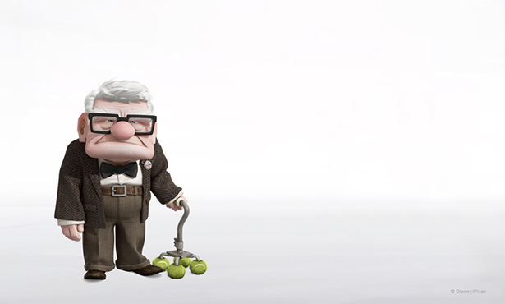
I am not bitter I am just…

Slide 15
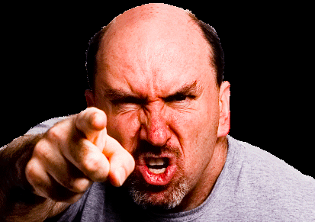
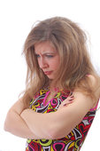
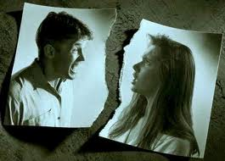
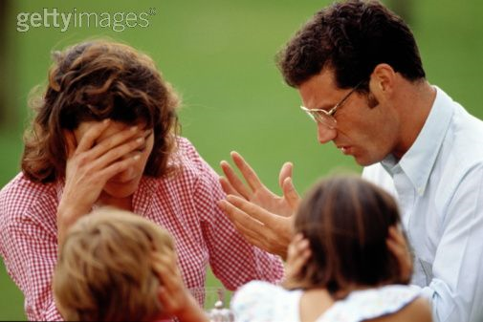
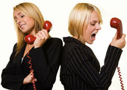
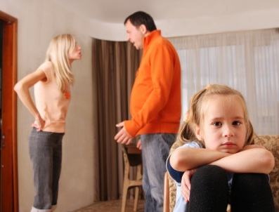
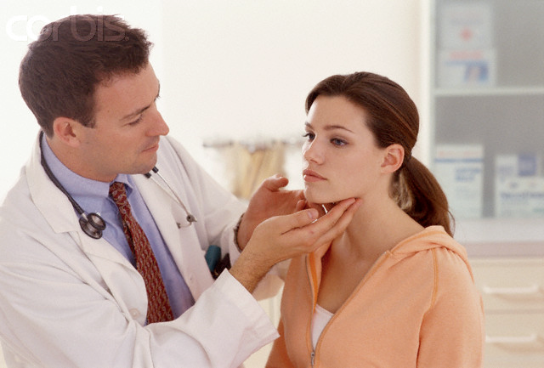
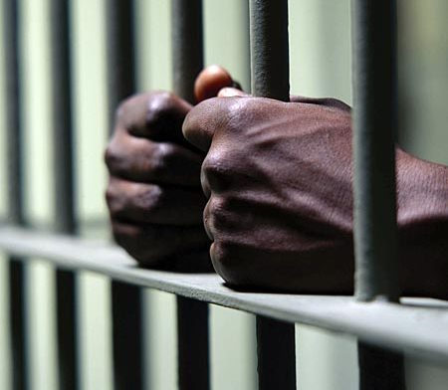
Angry – Col. 3:8
Jealous – James 3:14
Strife – I Tim. 6:4
Division – I Cor. 3:3
Arguing – Phil. 2:14
Complaining – Job 7:11
Unhappy – Gal. 5:22
Sick - Physical illness and disease – Prov. 13:12
Bondage (prison) – Matt. 18:21-35

Slide 16
Spiritual deception –
Note: It is common for a person who is bitter to think that he loves God and is in fellowship with God.
“If a man say, I love God, and hateth his brother, he is a liar: for he that loveth not his brother whom he hath seen, how can he love God whom he hath not seen. And this commandment have we from him, That he who loveth God love his brother also.” (I John 3:20-21)
“And when ye stand praying, forgive, if ye have ought against any: that your Father also which is in heaven may forgive you your trespasses.” (Mark 11:25)

Slide 17
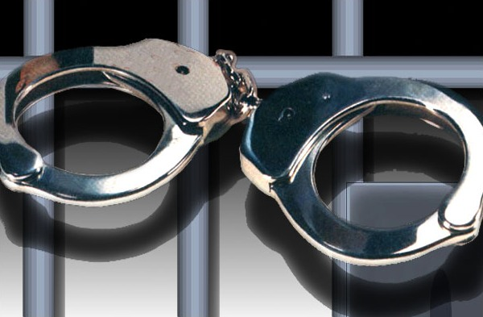
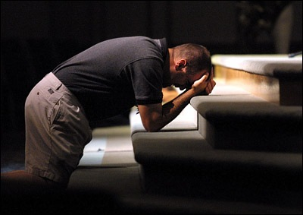
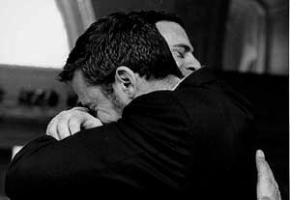
“Therefore if thou bring thy gift to the altar, and there rememberest that thy brother hath ought against thee; Leave there thy gift before the altar, and go thy way; first be reconciled to thy brother, and then come and offer thy gift. Agree with thine adversary quickly, whiles thou art in the way with him; lest at any time the adversary deliver thee to the judge, and the judge deliver thee to the officer, and thou be cast into prison.” (Matthew 5:21-23)

Slide 18
Steps to Overcoming Bitterness

Slide 19
1# Repent of Temporal Values
(II Corinthians 4:18; Ephesians 4:30-32; Acts 8:22 )
In order for a person to overcome bitterness you
must come to a place of repentance
1. Bitterness often reveals greed - Luke 12:13-15
2. Greed (covetousness) is identified as idolatry - Col.3:5
IDOLATRY - Expecting benefits from people or possessions which only God can give.
3. Bitterness is conquered when we look to the Lord for our reward - Col. 3:23-4:1
4. View temporal losses as spiritual gain - Phil. 3:7-8

Slide 20
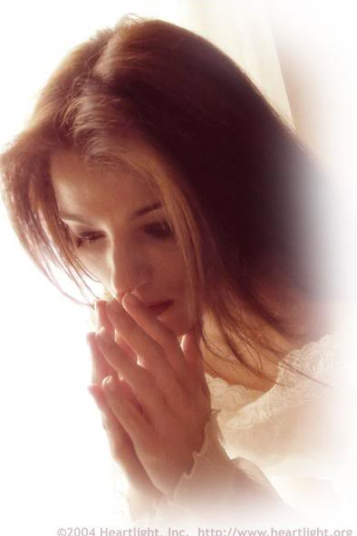
2# Thank God for allowing the offence (I Thessalonians 5:18-19)
1. Thank God not for the offense, but for His good purposes in allowing the offense - Romans 8:28
2. God is not responsible for the wrongdoing of those who have hurt us - James 1:13-14
3. God has promised to use the wrath of those who hurt us to benefit our life - Psalms 76:10

Slide 21
What Causes Ungratefulness?
1. Assuming that God owes us something -
Note: There is a prevailing attitude that God owes us a full, happy, and prosperous life. If something happens to hinder that or to cut a person’s life short God is blamed.
* Attitude of Job’s wife - Job 2:9
* Attitude of Job - Job 2:10; 13:15; 23:10
Note: If God gave us all that we deserve, none of us would be alive - Romans 6:23 “Wages of sin is death…”

Slide 22
“It is because of the Lord’s mercies that we are not consumed, His compassion’s fail not. They are new every morning: great is thy faithfulness.” (Lamentations 3:22-23)

Slide 23
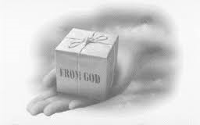
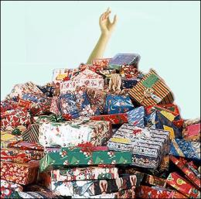
2. Focusing on what we thought we should have received rather than on what we have received - Philippians 4:6

Slide 24
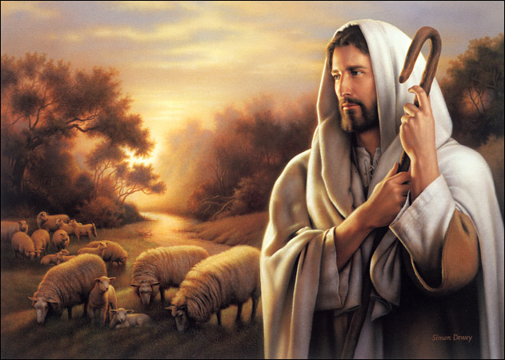
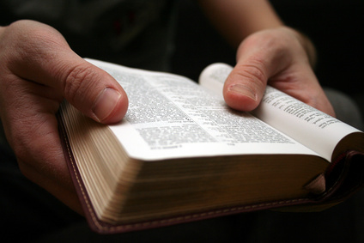
3# View your offender as “God’s Agent of Perfection”
An important basis
for forgiving your offender is seeing them not as people attacking you, but as those specially chosen by God to accomplish His perfect will and work in you.
(I Peter 5:6-11)

Slide 25
(I Peter 5:6-11) “Humble yourselves therefore under the mighty hand of God, that he may exalt you in due time: Casting all your care upon him; for he careth for you. Be sober, be vigilant; because your adversary the devil, as a roaring lion, walketh about, seeking whom he may devour:

Slide 26
Whom resist stedfast in the faith, knowing that the same afflictions are accomplished in your brethren that are in the world. But the God of all grace, who hath called us unto his eternal glory by Christ Jesus, after that ye have suffered a while, make you perfect, stablish, strengthen, settle you. To him be glory and dominion for ever and ever. Amen.”

Slide 27
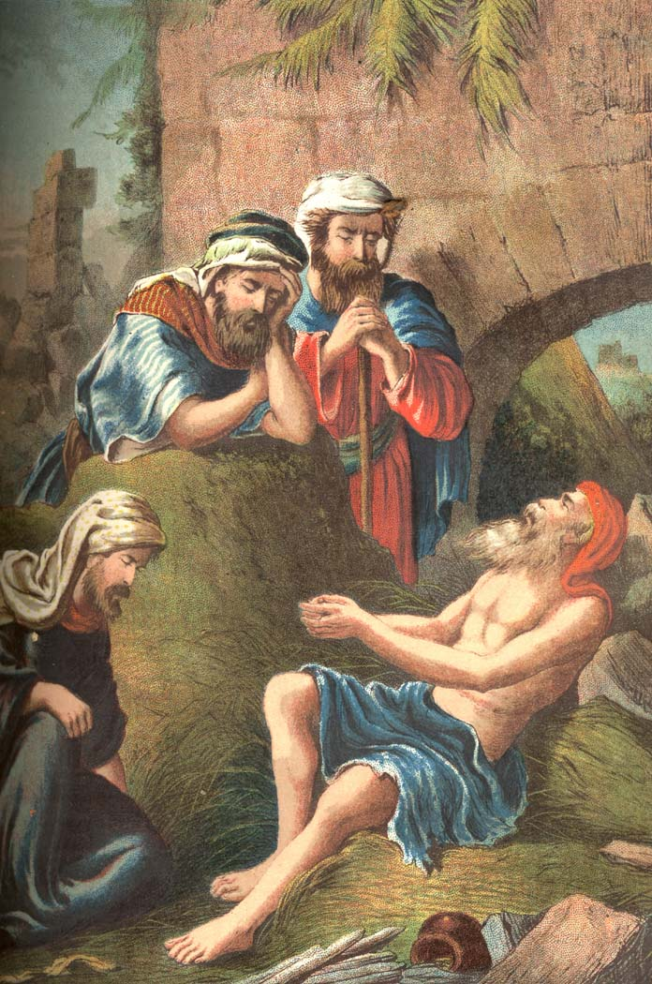
Job’s response when plundered Job 1:20-21
“And said, Naked came I out of my mother's womb, and naked shall I return thither: the LORD gave, and the LORD hath taken away; blessed be the name of the LORD. In all this Job sinned not, nor charged God foolishly.”

Slide 28
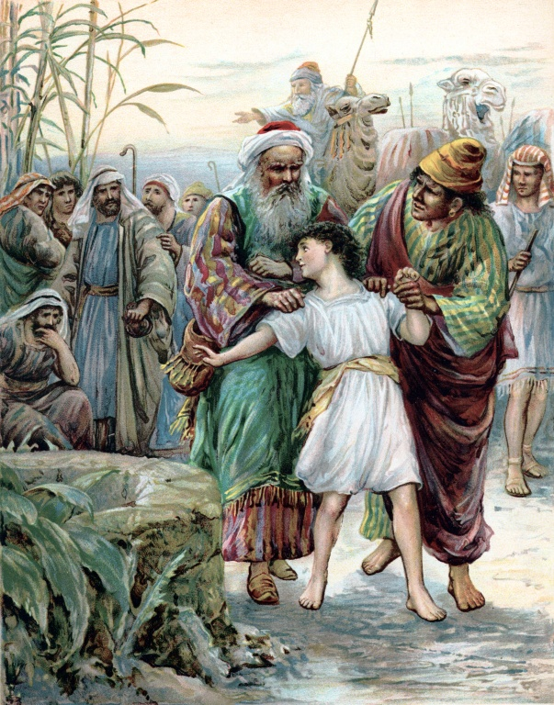
Joseph’s response when enslaved Genesis 50:20
“But as for you, ye thought evil against me; but God meant it unto good, to bring to pass, as it is this day, to save much people alive.”

Slide 29
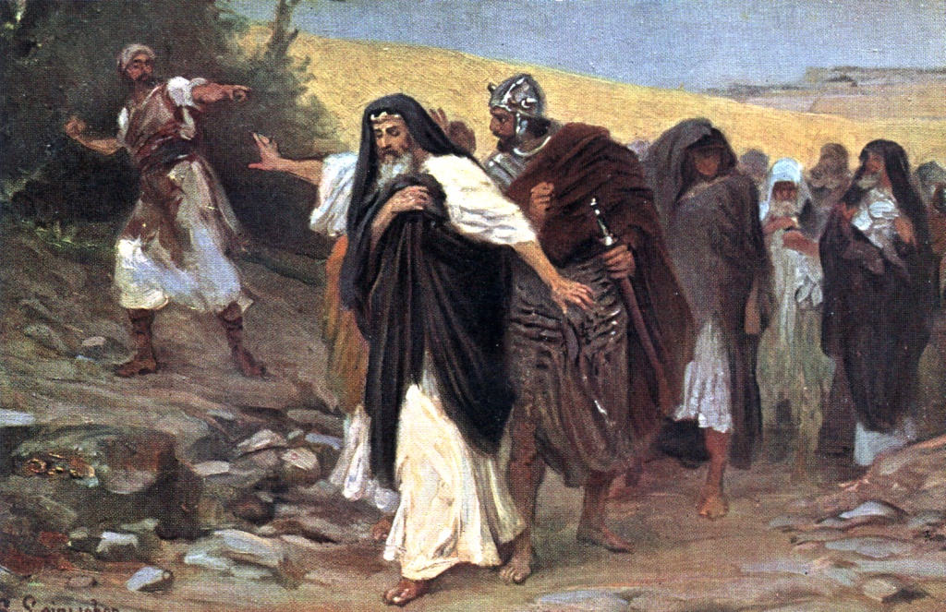
David’s response when reviled II Samuel 16:5-10
“And when king David came to Bahurim, behold, thence came out a man of the family of the house of Saul, whose name was Shimei… he came forth, and cursed still as he came. And he cast stones at David, and at all the servants of king David: and all the people and all the mighty men were on his right hand and on his left. And thus said Shimei when he cursed, Come out, come out, thou bloody man, and thou man of Belial…”

Slide 30
“Then said Abishai unto the king, Why should this dead dog curse my lord the king? let me go over, I pray thee, and take off his head… And David said…let him alone, and let him curse; for the LORD hath bidden him. It may be that the LORD will look on mine affliction, and that the LORD will requite me good for his cursing this day.”

Slide 31
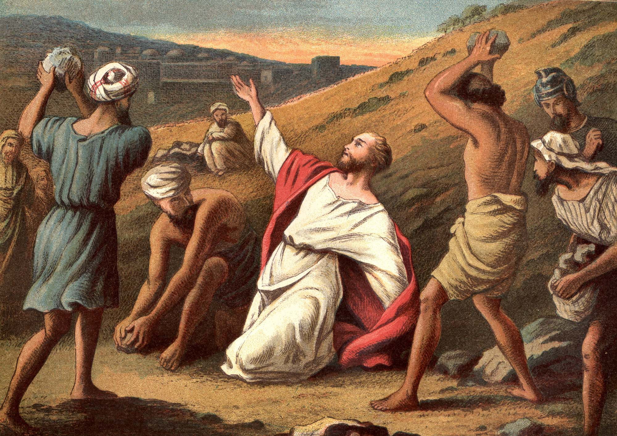
Stephen’s response when stoned Acts 7:60
“And he kneeled down, and cried with a loud voice, Lord, lay not this sin to their charge. And when he had said this, he fell asleep.”

Slide 32
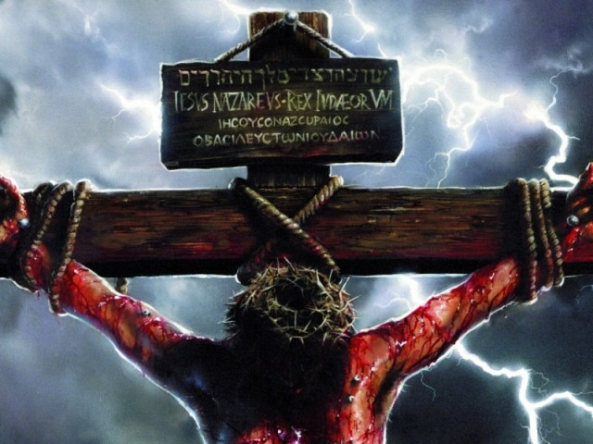
Christ’s response when crucified Luke 23:34
“And he kneeled down, and cried with a loud voice, Lord, lay not this sin to their charge. And when he had said this, he fell asleep.”

Slide 33
The results of viewing your offender as God’s agent of perfection Romans 8:28
You will see your offender as an instrument for good and not evil – Gen. 50:20
You will remove the possibility of being bitter towards your offender – James 3:11
You will be able to demonstrate the love of Christ to your offender - Luke 6:27-28

Slide 34
“View your offender as God’s agent of perfection.”
“See suffering from God’s perspective.”
“Repent of Temporal Values”
“Thank God for the Offence”

Slide 35
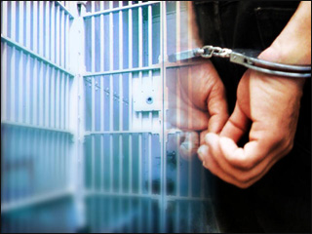

Slide 37
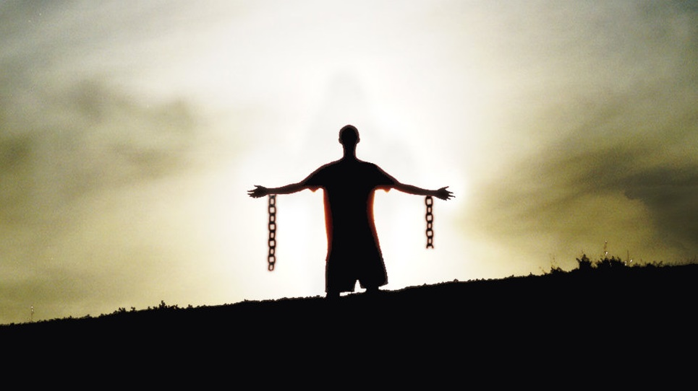

Slide 38
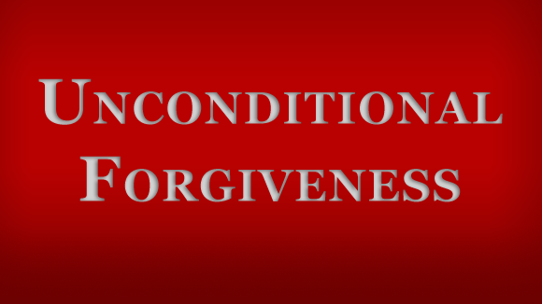
Next week

