Slide 1
The Doctrine of Man (Part 8)
His Present Day Condition
(Part 2)

Slide 4
Job 7:17 “What is man, that thou shouldest magnify him? and that thou shouldest set thine heart upon him?”
Job 15:14 “What is man, that he should be clean? and he which is born of a woman, that he should be righteous?”
Ps. 8:4 “What is man, that thou art mindful of him? and the son of man, that thou visitest him?”
Ps. 144:3 “LORD, what is man, that thou takest knowledge of him! or the son of man, that thou makest account of him!”
Heb. 2:6 “But one in a certain place testified, saying, What is man, that thou art mindful of him? or the son of man, that thou visitest him?”

Slide 5
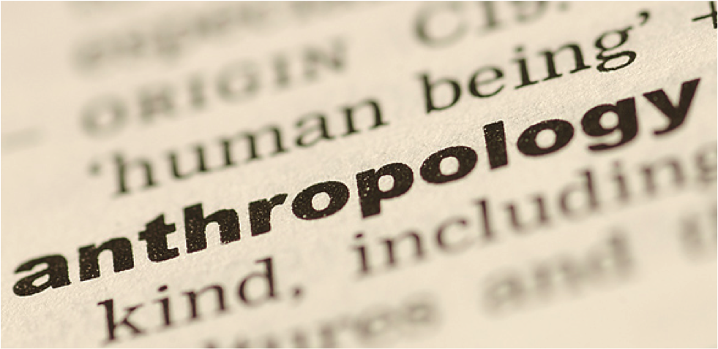

Slide 6
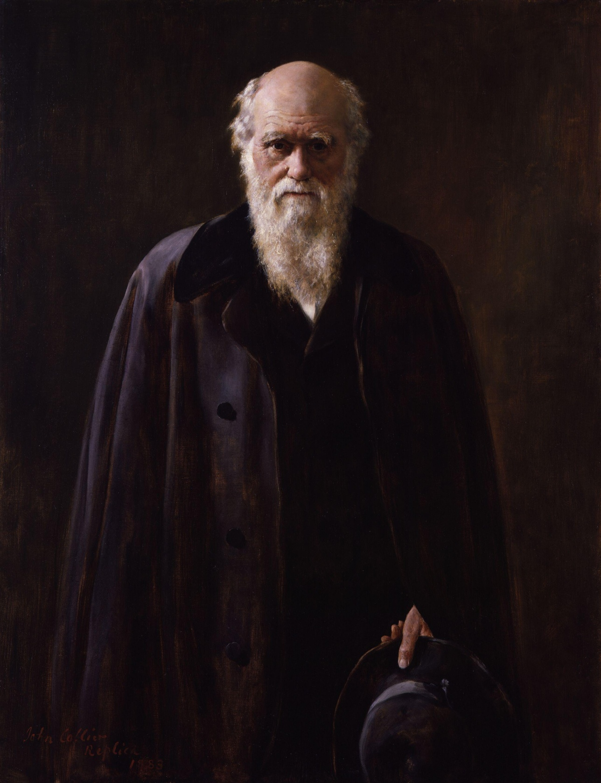

Slide 7
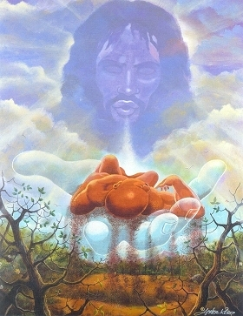
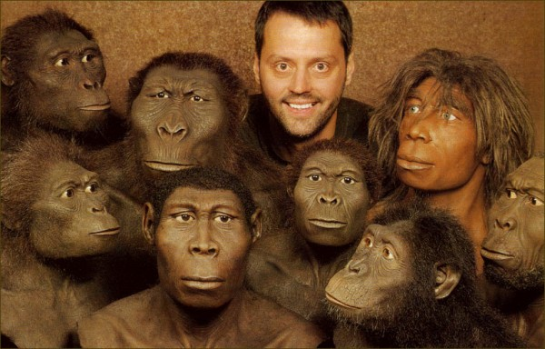

Slide 9
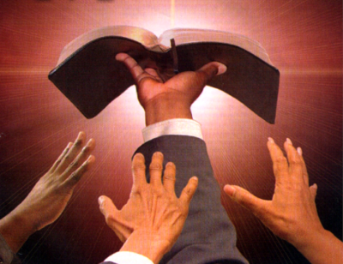
“Thy Word is Truth…”

Slide 11
"And God said, Let us make man in our image, after our likeness; and let them have dominion over the fish of the sea, and the fowl of the air, and over the cattle, and over all the earth, and over every creeping thing that creepeth upon the earth. So God created man in his own image, in the image of God created he him; male and female created he them" (Gen. 1:26, 27)

Slide 12
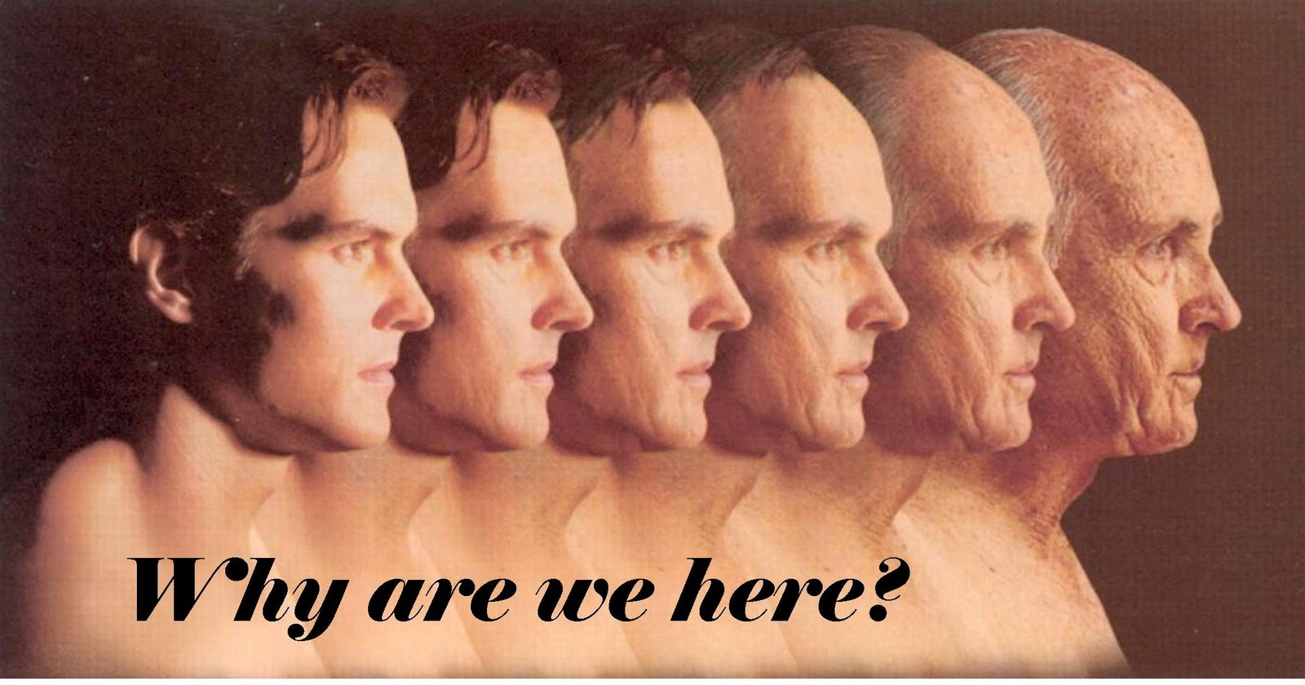

Slide 13
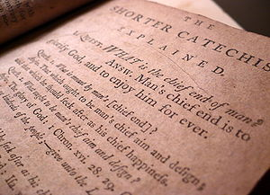

Slide 16
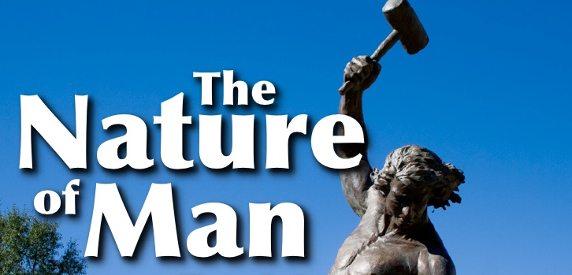

Slide 18
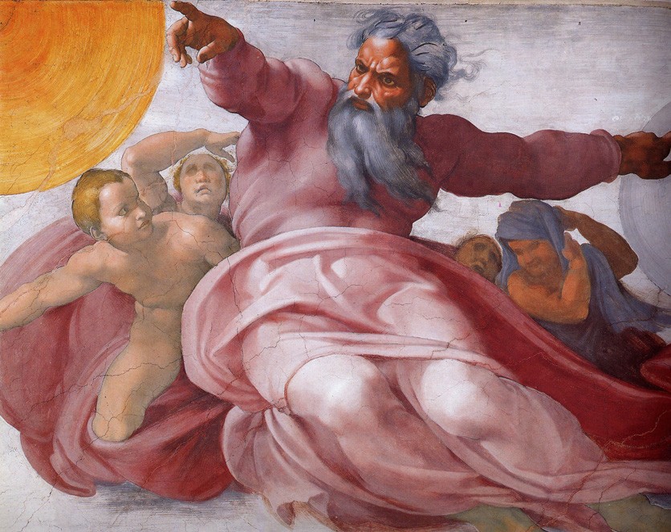
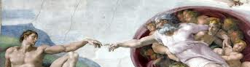
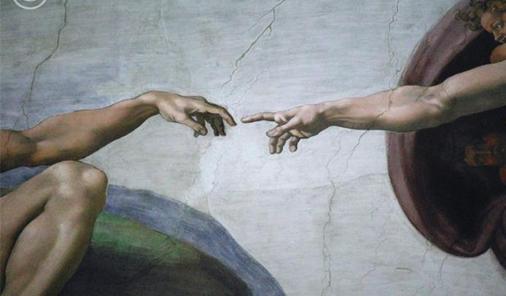
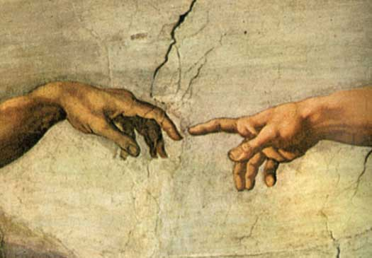
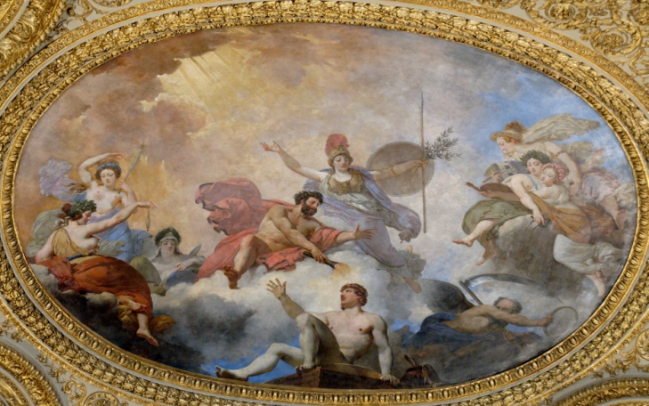
"And God said, Let us make man in our image, after our likeness; and let them have dominion over the fish of the sea, and the fowl of the air, and over the cattle, and over all the earth, and over every creeping thing that creepeth upon the earth. So God created man in his own image, in the image of God created he him; male and female created he them.” Gen. 1:26-27

Slide 19
Man’s Original Duties and Responsibilities

Slide 20
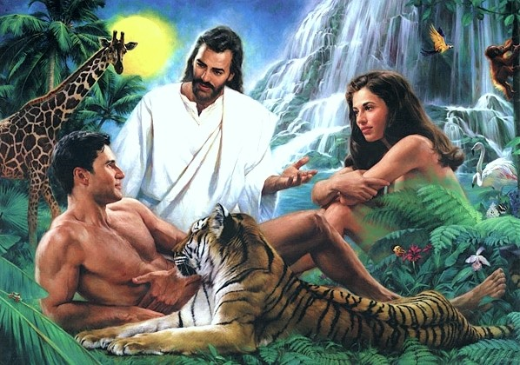
Why did God create man?

Slide 21
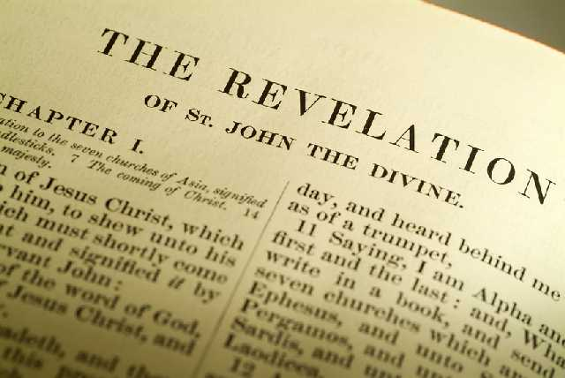
“Thou art worthy, O Lord, to receive glory and honour and power: for thou hast created all things, and for thy pleasure they are and were created.” (Rev. 4:11)

Slide 22
How do we bring pleasure to God?

Slide 23
The only way to bring pleasure to God is by fulfilling our God given duties and responsibilities.

Slide 24
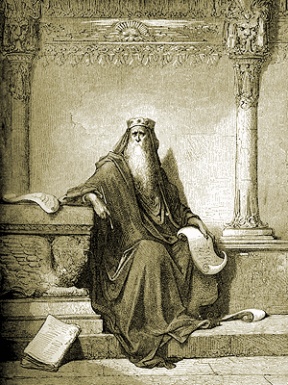
“Let us hear the conclusion of the whole matter: Fear God, and keep his commandments: for this is the whole duty of man.” (Eccl. 12:13)

Slide 25
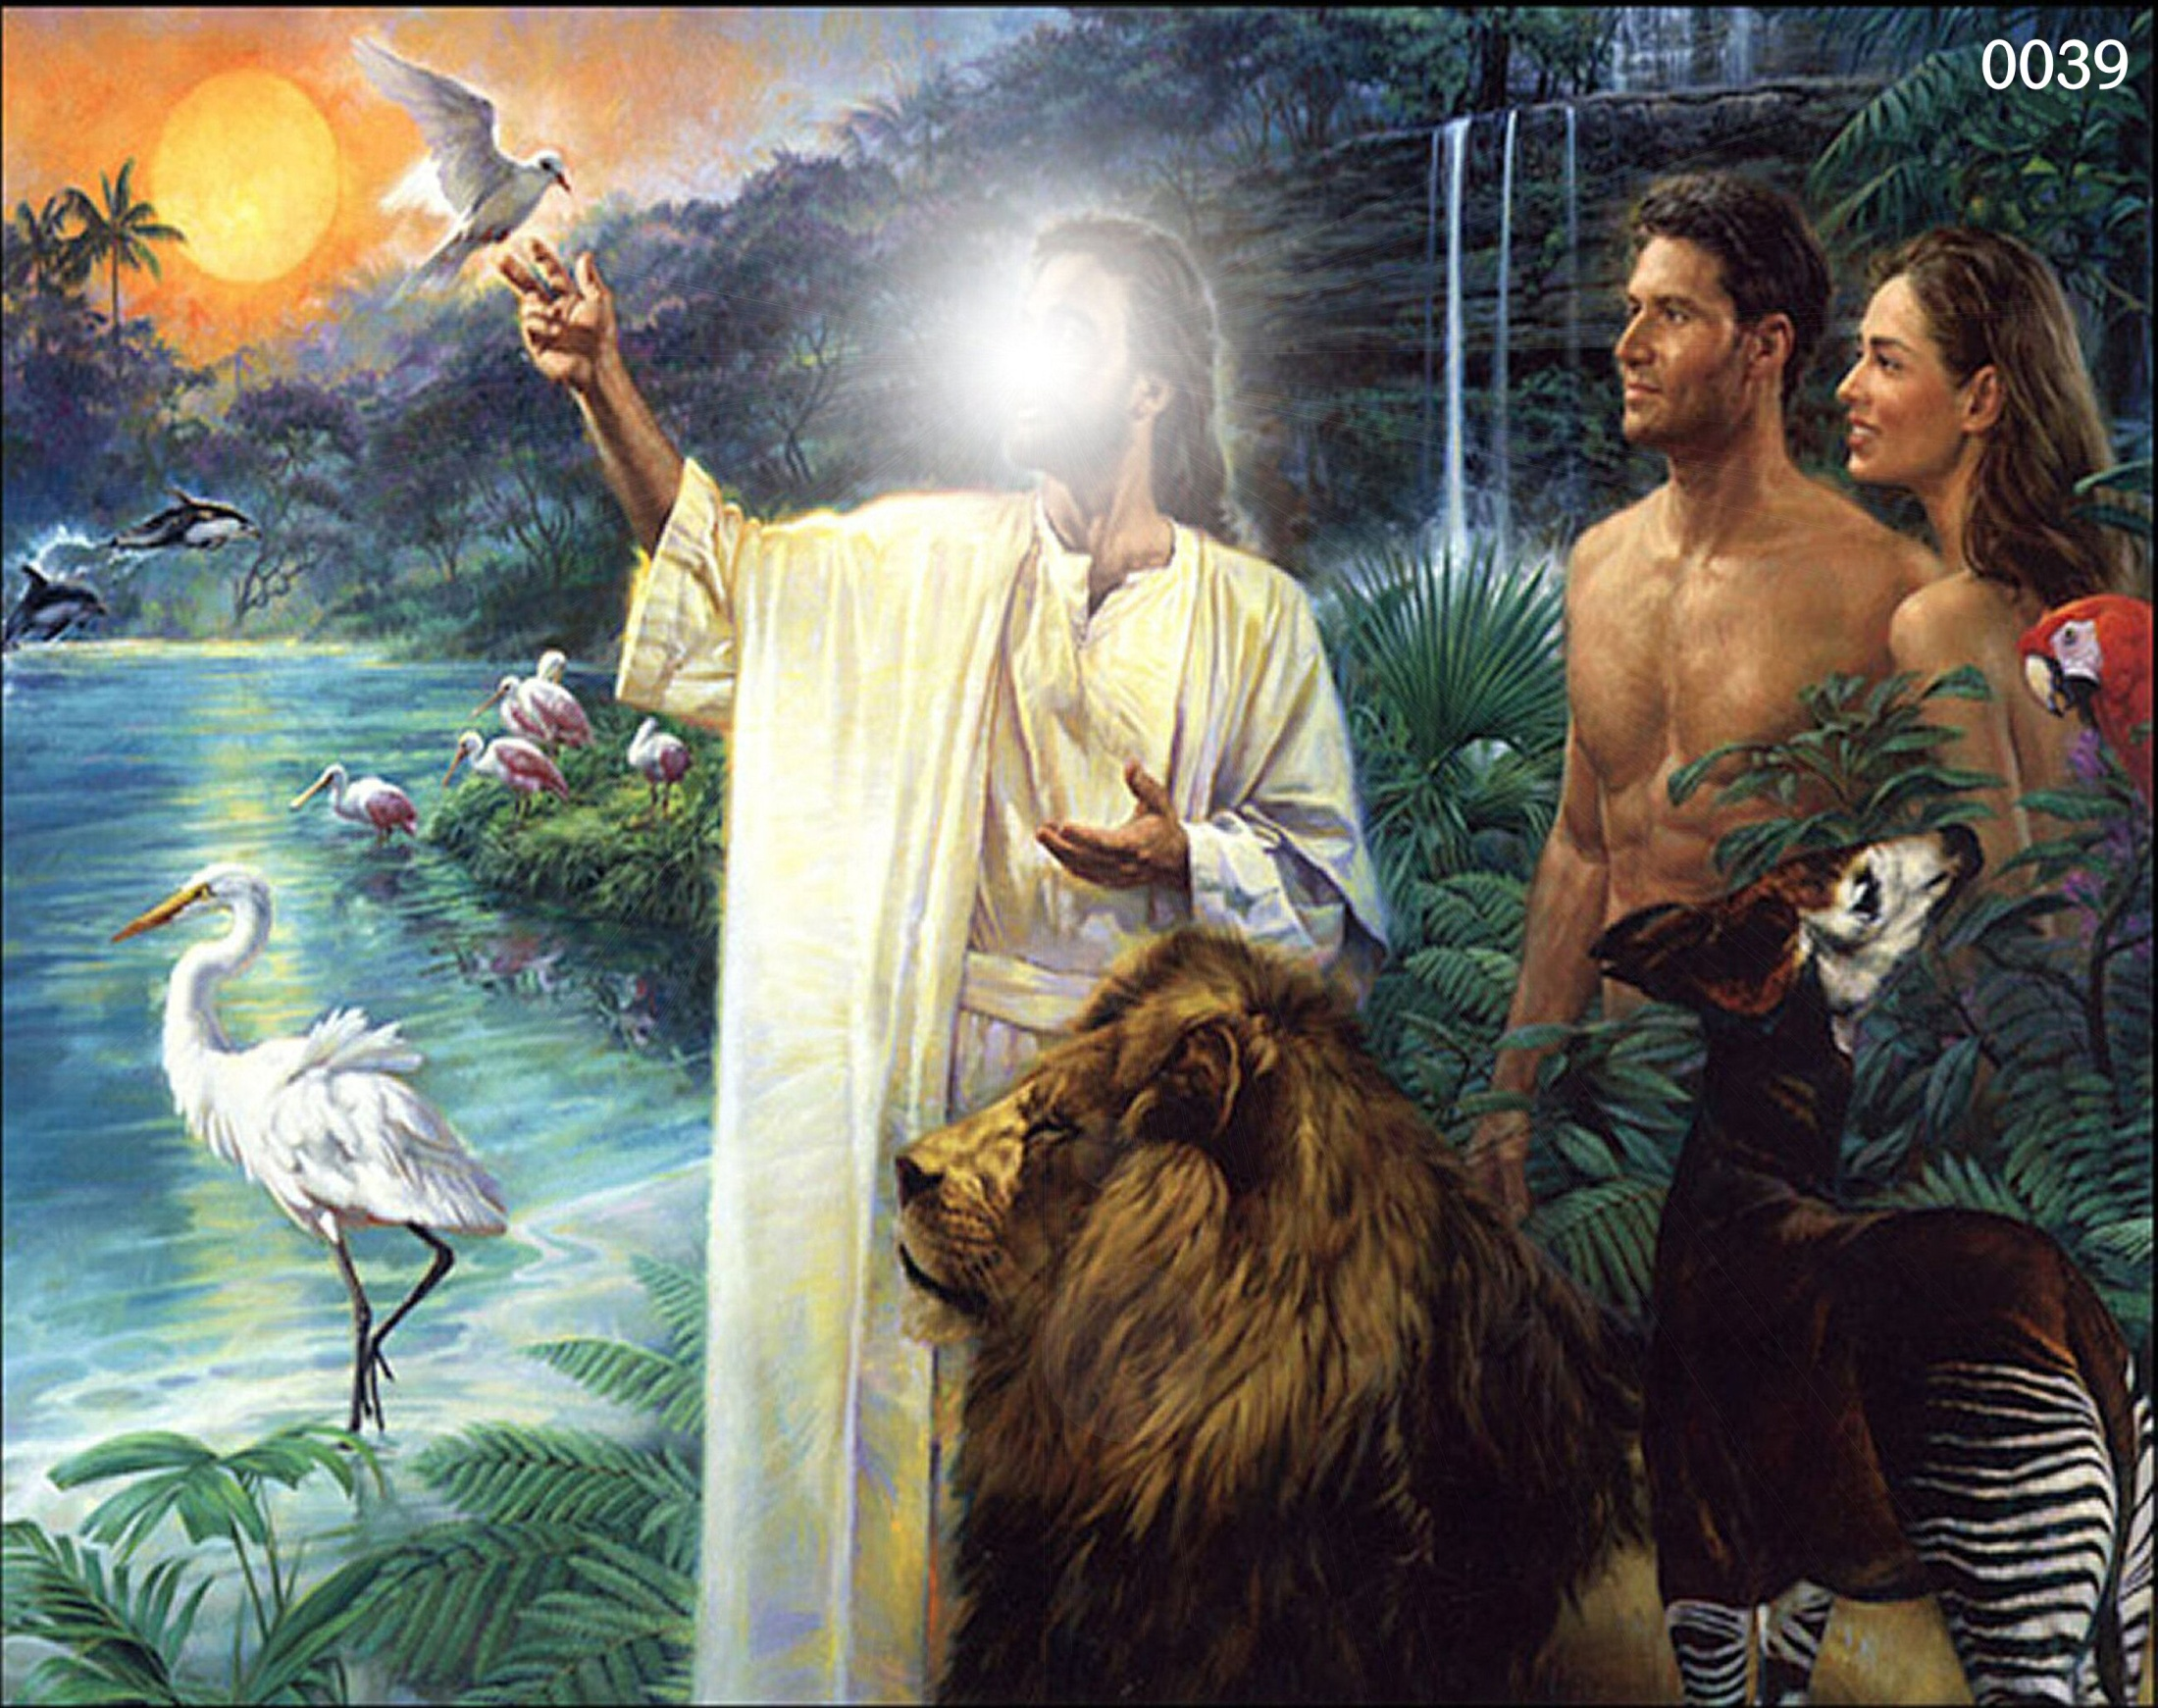

Slide 26
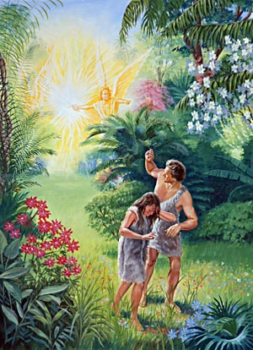
His Tragic Sin and Fall

Slide 27
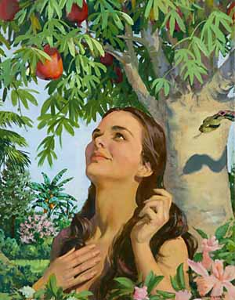
"Now the serpent was more subtile than any beast of the field which the Lord God had made. And he said unto the woman, Yea, hath God said, Ye shall not eat of every tree of the garden?" (Gen. 3:1).

Slide 28
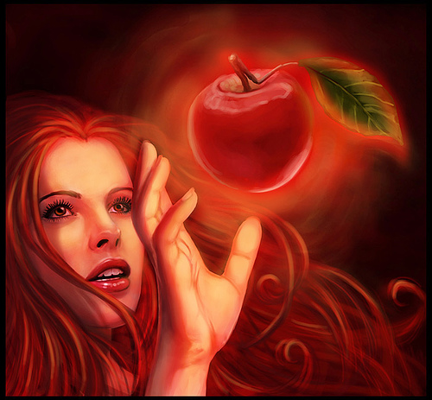
"And when the woman saw that the tree was good for food, and that it was pleasant to the eyes, and a tree to be desired to make one wise, she took of the fruit thereof and did eat…”

Slide 29
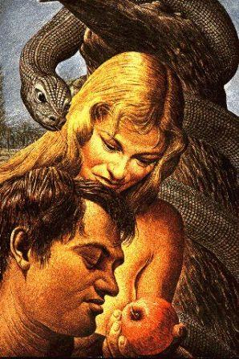
“…and gave also unto her husband with her; and he did eat."
(Gen. 3:6)

Slide 30
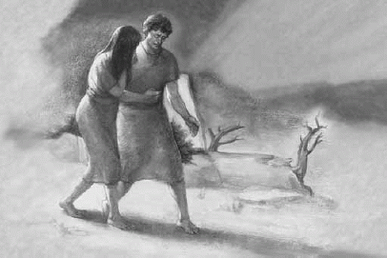
“The Consequences of the Fall”

Slide 31
A threefold sentence passed

Slide 32
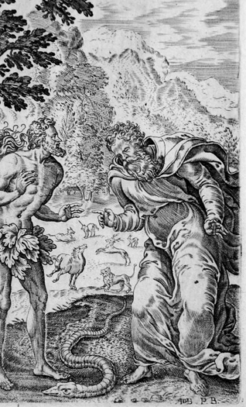
Judgment upon the Serpent

Slide 33
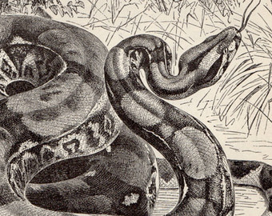
"And the Lord God said unto the serpent, Because thou hast done this, thou art cursed above all cattle, and above every beast of the field; upon thy belly shalt thou go, and dust shalt thou eat all the days of thy life." (Gen. 3:14)

Slide 34
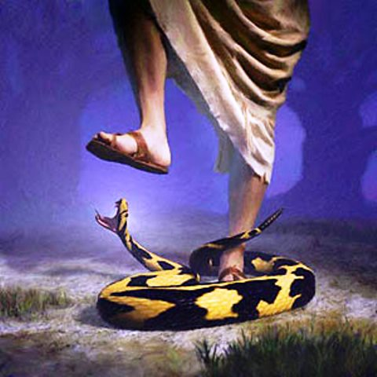
Judgment upon Satan

Slide 35
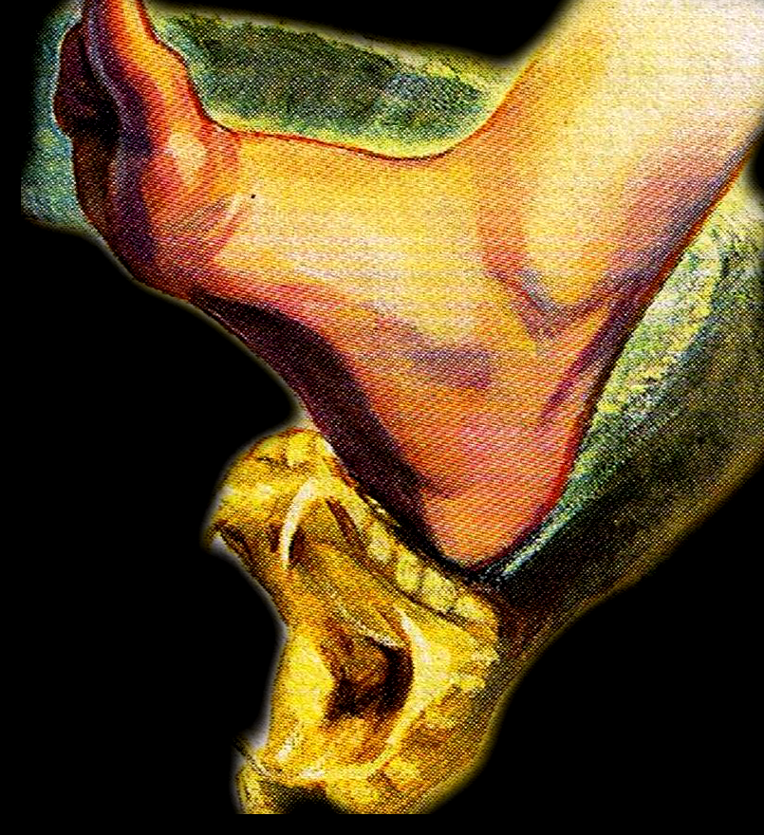
"And I will put enmity between thee and the woman, and between thy seed and her seed; it shall bruise (crush) thy head, and thou shalt bruise (strike) his heel" (Gen. 3:15)

Slide 36
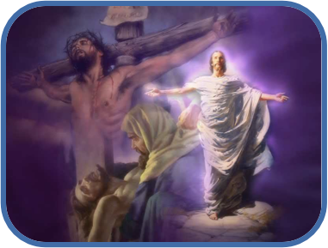
For in this verse we see no less than a thrilling prediction of the cross and the resurrection of the Savior’s and His great victory over Satan.

Slide 37
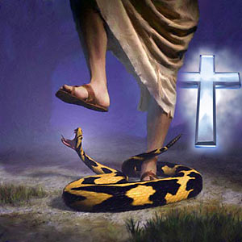

Slide 38
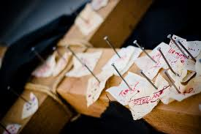
Colossians 2:13-15 “And you, being dead in your sins and the uncircumcision of your flesh, hath he quickened together with him, having forgiven you all trespasses; Blotting out the handwriting of ordinances that was against us, which was contrary to us, and took it out of the way, nailing it to his cross; And having spoiled principalities and powers, he made a shew of them openly, triumphing over them in it.”

Slide 39
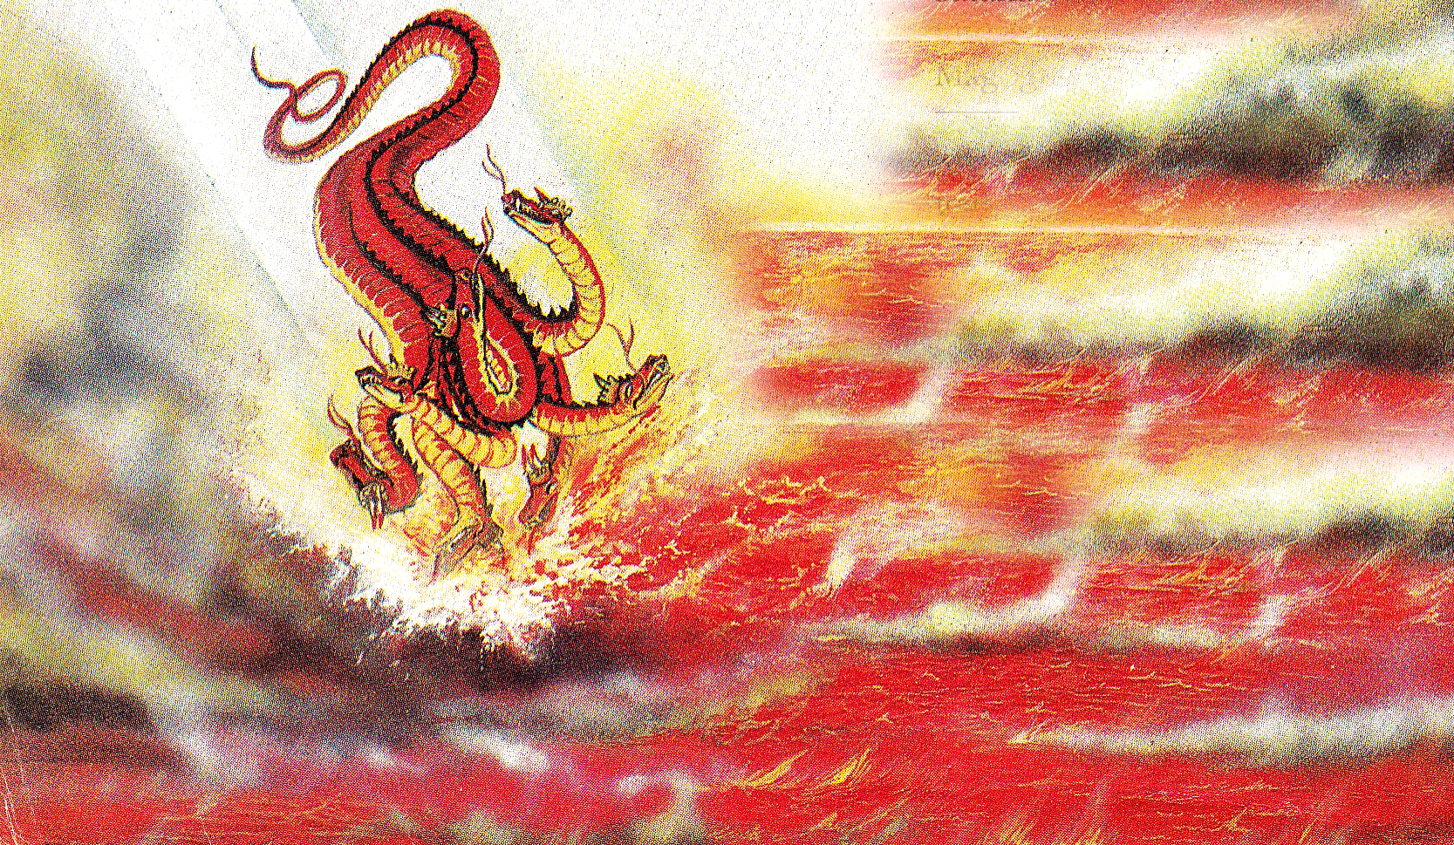
(Revelation 20:10)
“And the devil that deceived them was cast into the lake of fire and brimstone.”

Slide 40
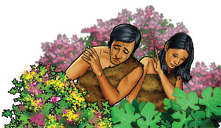
Judgment upon Adam and Eve (sevenfold sentence because of their sin)

Slide 41
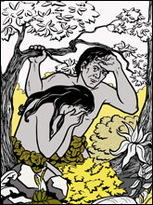
1# Guilt and Shame
"And the eyes of them both were opened, and they knew that they were naked; and they sewed fig leaves together, and made themselves aprons" (Gen. 3:7)

Slide 42
2# Fear
“And they heard the voice of the Lord God walking in the garden in the cool of the day: and Adam and his wife hid themselves from the presence of the Lord God amongst the trees of the garden. And the Lord God called unto Adam, and said unto him, Where art thou? And he said, I heard thy voice in the garden, and I was afraid, because I was naked; and I hid myself" (Gen. 3:8-10)

Slide 43
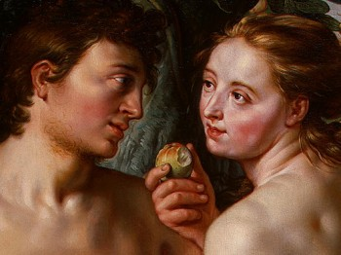
3# Discord
"And the man said, The woman whom thou gavest to be with me, she gave me of the tree, and I did eat.”"
(Gen. 3:12)

Slide 44
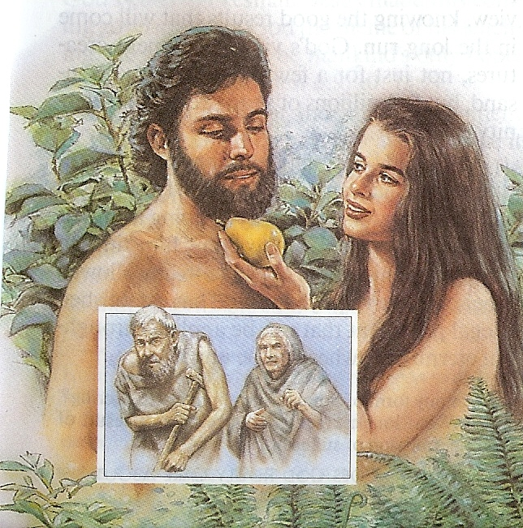
4# Death

Slide 45
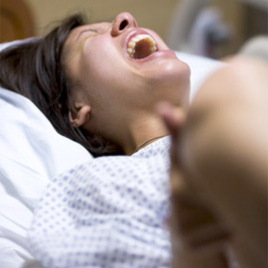
5# Suffering
"Unto the woman he said, I will greatly multiply thy sorrow and thy conception; in sorrow thou shalt bring forth children; and thy desire shall be to thy husband, and he shall rule over thee" (Gen. 3:16)

Slide 46
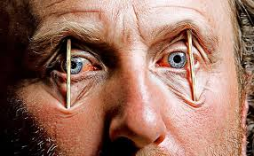
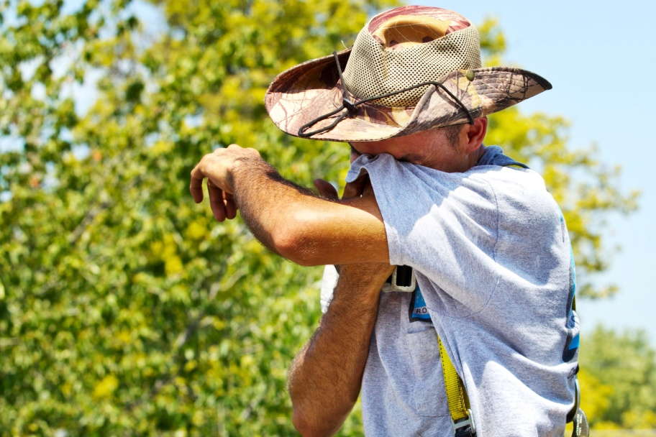
6# Weariness in labor

Slide 47
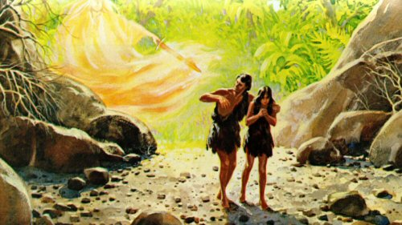
7# Separation from God

Slide 48
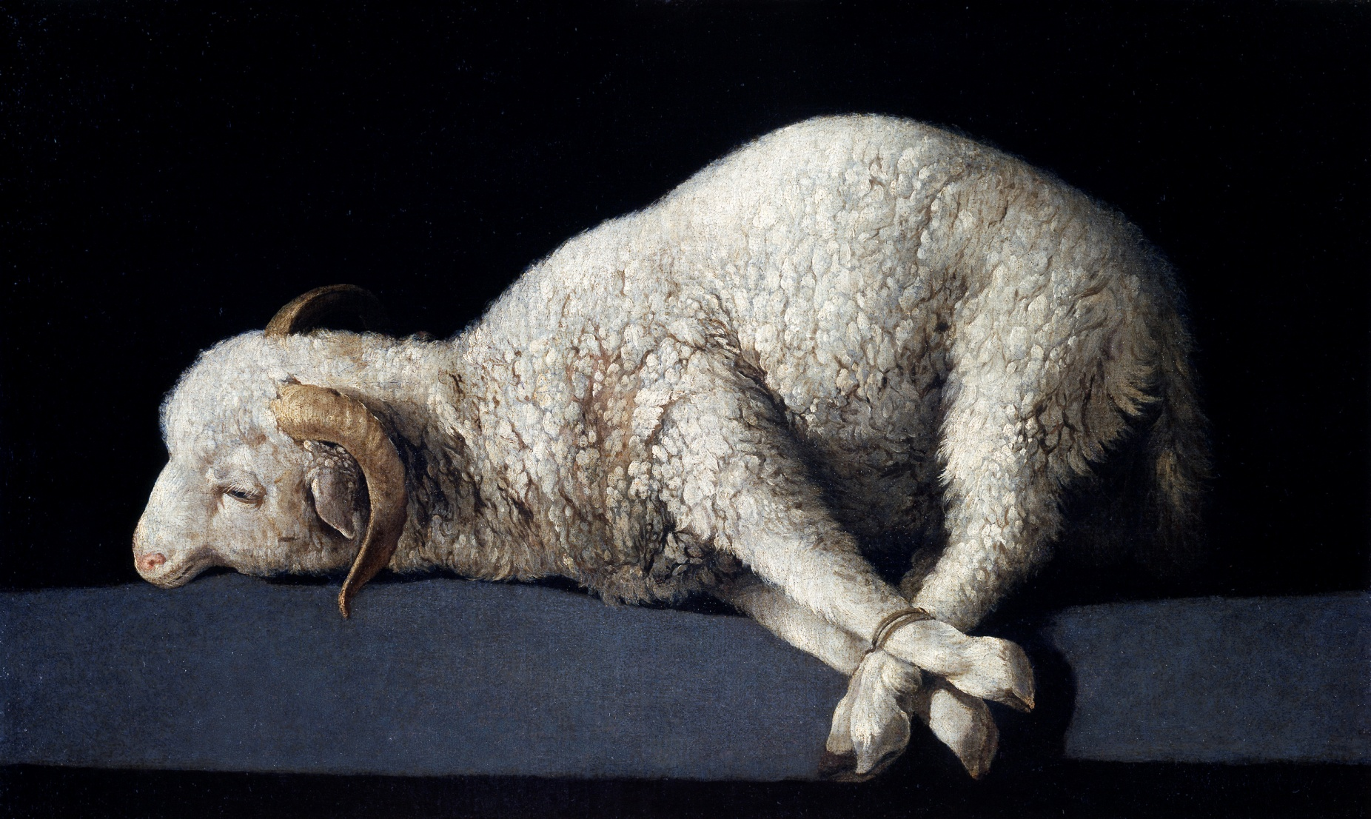
The innocent had to die for the guilty
The Remedy for the Fall

Slide 49
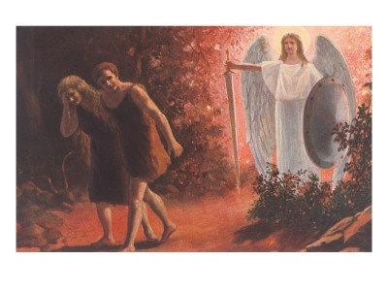
(Genesis 3:21) “Unto Adam also and to his wife did the LORD God make coats of skins, and clothed them.

Slide 50
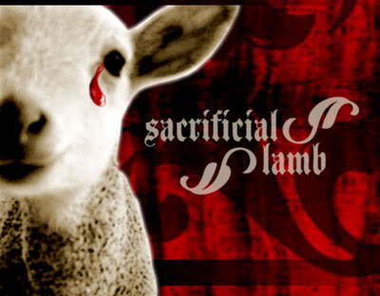
(Genesis 3:21) The first mention of the shedding of blood in the Bible.
“Without shedding of blood is no remission.” (Hebrews 9:22)

Slide 51
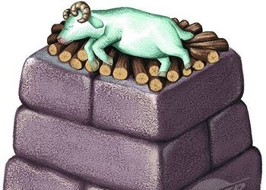
The Remedy for Man’s Sin
Sacrifice of the life of the innocent – “And Moses said, Thou must give us also sacrifices and burnt offerings, that we may sacrifice unto the LORD our God.”
Life Blood - “For the life of the flesh is in the blood: and I have given it to you upon the altar to make an atonement for your souls: for it is the blood that maketh an atonement for the soul.”

Slide 52
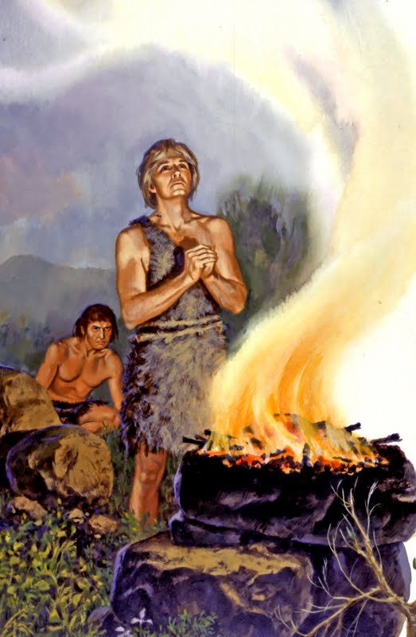
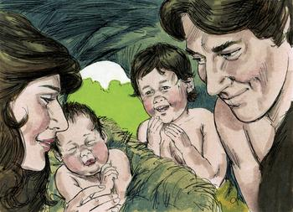
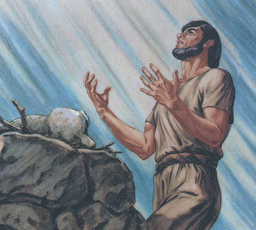

Slide 53
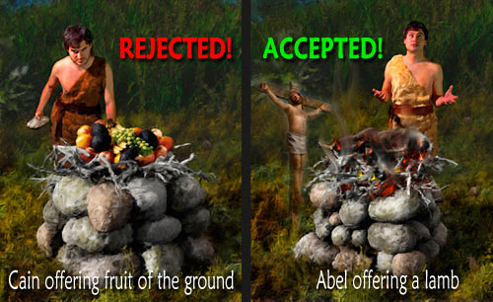
“And Abel, he also brought of the firstlings of his flock and of the fat thereof. And the LORD had respect unto Abel and to his offering: But unto Cain and to his offering he had not respect.” (Genesis 4:4-5)

Slide 54
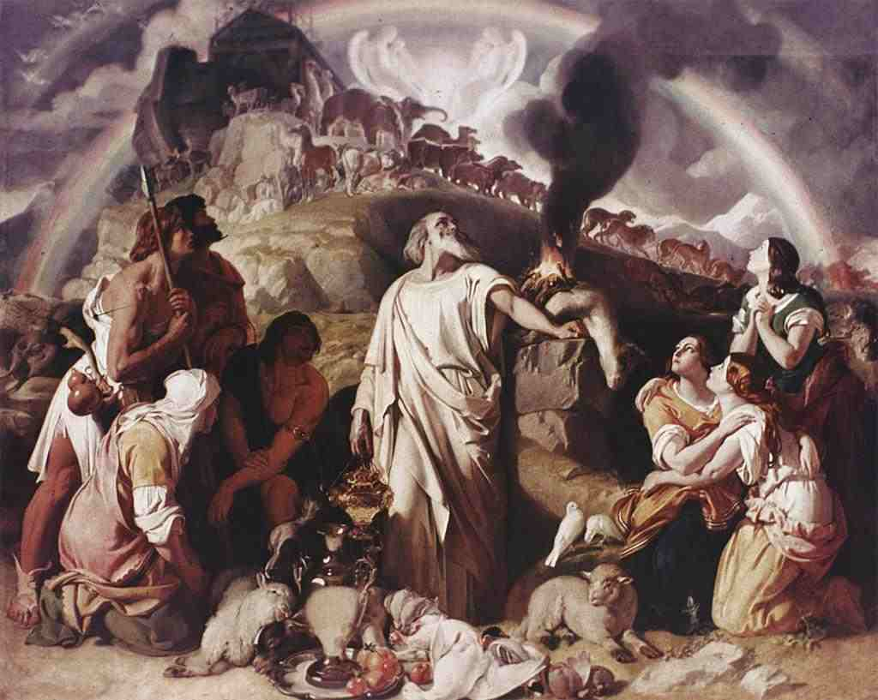

Slide 55
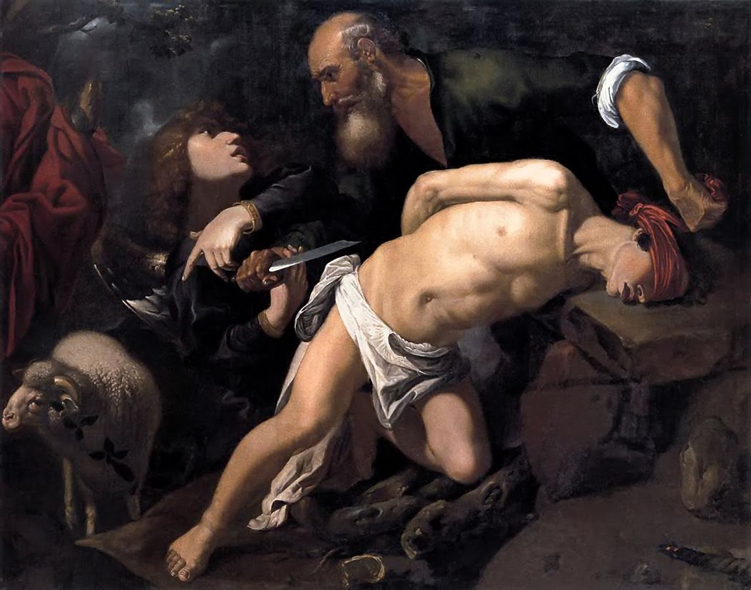

Slide 56
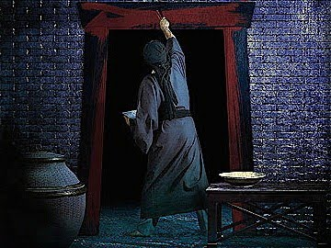

Slide 57
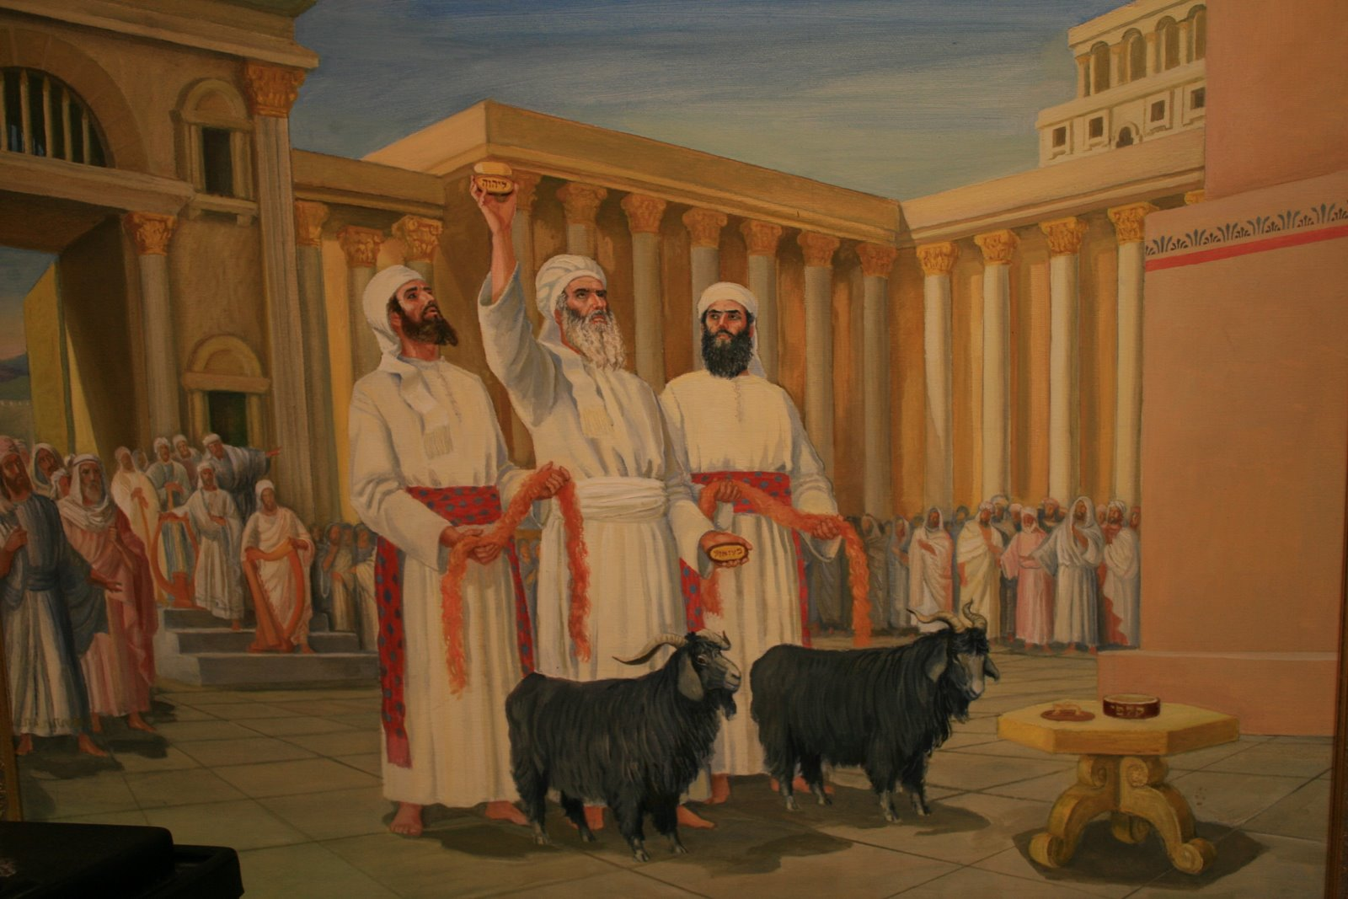

Slide 62
The Shed Blood of Christ
I John 1:7 - “…the blood of Jesus Christ his Son cleanseth us from all sin.”

Slide 64
Redemption
“In whom we have redemption through his blood, even the forgiveness of sins.” (Col 1:14)

Slide 65
Reconciliation
“And all things are of God, who hath reconciled us to himself by Jesus Christ, and hath given to us the ministry of reconciliation.” (II Cor. 5:18)

Slide 66
Remission
“To him (Jesus) give all the prophets witness, that through his name whosoever believeth in him shall receive remission of sins.”
(Acts 10:43)

Slide 67
Propitiation
“Whom God hath set forth to be a propitiation through faith in his blood, to declare his righteousness for the remission of sins.”
(Romans 3:25)

Slide 68
Justification
“Who was delivered for our offences, and was raised again for our justification...Therefore as by the offence of one judgment came upon all men to condemnation; even so by the righteousness of one the free gift came upon all men unto justification of life.”
(Romans 4:25, 5:18)

Slide 69
The Remedy for the Fall

Slide 70
Man’s Present-Day Condition
X

Slide 71
The Fatherhood of God by Henry Morris, Ph.D.
"For in him we live, and move, and have our being; as certain also of your own poets have said, For we are also his offspring." (Acts 17:28)
"The fatherhood of God and the brotherhood of man" is a false doctrine promoted for many years, by religious liberals.
The fact is, however, that God truly is the Father of all men, in the sense that He created them all. "Have we not all one father? hath not one God created us?" (Malachi 2:10).

Slide 72
Paul confirmed the same great truth to the pagan Gentiles. "God hath made of one blood all nations of men to dwell on all the face of the earth," and "we are the offspring of God" (Acts 17:26, 29).
The sad fact is, however, that men and women are actually "children of the wicked one" (Matthew 13:38) because of sin.
We can only become spiritual children of the heavenly Father by being born again through faith in Christ. “But as many as received him, to them gave he power to become the sons of God, even to them that believe on his name.” John 1:12

Slide 74
The Word of God divides all living men into three spiritual categories.
Natural man – I Cor. 2:14 “But the natural man receiveth not the things of the Spirit of God: for they are foolishness unto him: neither can he know them, because they are spiritually discerned.”
Spiritual man – Gal. 6:1 “Brethren, if a man be overtaken in a fault, ye which are spiritual, restore such an one in the spirit of meekness; considering thyself, lest thou also be tempted.”

Slide 75
Carnal man - I Cor. 3:1 “And I, brethren, could not speak unto you as unto spiritual, but as unto carnal, even as unto babes in Christ.”

Slide 77
“I the LORD search the heart, I try the reins…” Jer. 17:10

Slide 80
What does it mean to be Lost?
“For the Son of man is come to save that which was lost.” (Matt. 18:11)

Slide 81
The Word of God has many words and phrases that describe the spiritual condition of a person who has never been “born again” “enemy of God…child of the devil…dead in trespasses and sin…servant of sin…enslaved by the world, the flesh, and the devil…sinner…unrighteous…alienated from God…old man…separated from God and the promises of God…without Christ and without hope…far off…strangers…foreigners…appointed to wrath…blind…naked…under the power of Satan…ignorant…unprofitable…evil…under the curse of the Law…carnal…unclean…guilty…under the wrath of God and condemned…”

Slide 82
These are just a few of the words and phrases that describe the condition of an unsaved man.
“For as in Adam all die, even so in Christ shall all be made alive…And so it is written, The first man Adam was made a living soul; the last Adam was made a quickening spirit.”
(I Cor. 15:22, 45)

Slide 83
“For as in Adam all die…The wages of sin is death…”

Slide 84
“…even so in Christ shall all be made alive…”

Slide 85
The account of the conversion of Zacchaeus describes him before his conversion to Christ as a “Lost” man – vs. 10
Saved “for whosoever shall call upon the name of the Lord shall be saved…”
This is the condition of every person who has placed his faith in Jesus Christ as Lord and Savior.
A person who has not placed his faith in Jesus Christ as Lord and Savior = Lost “for my son was dead, and is alive…he was lost, and is found…”

Slide 86
What it does not mean to be lost?
It does not mean to simply be with out direction and purpose in life.
It does not mean to be confused about what you should do with your life.
It does not mean to be uncertain concerning what is the right or wrong thing to do in a situation.
It does not mean to be with out hope that things will get better.
It does not mean to be forsaken, unloved, and alone - not knowing what to do or who to turn to for help.

Slide 87
It does not mean to be in a bad situation with no way out.
It does not mean to have lost every thing of value – positions, reputation, relationships etc.
It does not mean to be in deep depression.
It does not mean to be fearful.
It does not mean to be caught is some controlling addiction from which you can not rescue your self.
It does not mean to have an emotional sinking feeling that things will never get better.

Slide 88
What it does mean to be lost?
The condition of being spiritually lost is the worst condition a person could ever be in!
The condition of being lost is a condition that every person is born into – Romans 3:9-19
The condition of being lost is described for us in the Word of God –
Described as a lost sheep (Matt. 10:6; Isa. 53; Luke 15:4)
Described as a blind person (II Cor. 4:3-4)
Described as a rebellious son (Luke 15:11-24)

Slide 90
The condition of being lost is defined by the word itself
Note: The Greek word for “lost” is (apollumi) and is translated several ways in the KJV –
To perish - “Lord, save us: we perish…it is not the will of the Father that one of these little ones should perish…He is not willing that any should perish…those that are saved and those that perish…carest thou not that we perish”

Slide 91
Those who are saved can never perish – “They shall never perish, neither shall any man pluck them out of my Fathers hand…he that believeth in him shall not perish, but have everlasting life”
To be destroyed -“Fear him who is able to destroy both soul and body in hell…he shall destroy the wicked…they were destroyed of the destroyer…He is able to save and to destroy…and with all deceivableness of unrghteousness in them that perish, because the received not the love of the truth that they might be saved, and for this cause shall send them strong delusion, that they shuold believe a lie. That they all might be damned who believed not the truth but had pleasure in unrighteousness…”

Slide 92
Those who are saved can not be destroyed – “For this purpose the Son of God was manifested, the he might destroy the works of the devil…through his death he destroyed him who had power over death; that is the devil. And delivered them who through fear of death were all their lifetime subject to bondage…”
To lose – “He that saveth his life shall lose it…he that loseth his life for my sake the same shall find it…”
Those who are saved can not lose – “And this is the Fathers will that of all which he hath given me I should lose nothing…”

Slide 93
What does it all mean? Those who are lost are those who are perishing, those who are being destroyed, those who are losing out on eternal life.

Slide 94
What can be done about the “lost” condition of man?
Jesus has come to seek and to save the lost – 3 parables make this very clear…
The lost sheep – Luke 15:1-7
The lost coin – Luke 15:8-10
The lost son – Luke 15:11-24

Slide 95
What can be done about the “lost” condition of man?
Preach the gospel to them – I Cor. 1:18-21
The gospel is the only thing that will open the eyes of a lost man – II Cor. 4:3-7
The gospel is the only thing that will produce faith in a lost man – Rom. 10:9-17

Slide 97
Rescue the Perishing
Rescue the perishing, care for the dying, Snatch them in pity from sin and the grave; Weep o'er the erring one, lift up the fallen, Tell them of Jesus, the mighty to save.
Though they are slighting Him, still He is waiting, Waiting the penitent child to receive; Plead with them earnestly, plead with them gently, He will forgive if they only believe.

Slide 98
Down in the human heart, crushed by the tempter, Feelings lie buried that grace can restore; Touched by a loving heart, wakened by kindness, Cords that are broken will vibrate once more.
Rescue the perishing, duty demands it Strength for your labor the Lord will provide; Back to the narrow way patiently win them, Tell the poor wand'rer a Savior has died.

Slide 99
Chorus:
Rescue the perishing, Care for the dying; Jesus is merciful, Jesus will save.

Slide 100
Call them to repentance and faith – The conversion of Zacchaeus
In the world’s estimation Zacchaeus was any thing but lost – He was very wealthy and respected. He had great power and influence “Chief”. He had all the pleasures and comforts of this life, yet he was a lost man who the Lord Jesus was seeking.
In Zacchaeus’s estimation he was empty, lonely and troubled in his heart – “he sought to see Jesus”
“But if form thence thou shalt seek the Lord thy God, thou shalt find him, if thou seek him with all thy heart and with all thy soul…seek ye the Lord while he may be found, call upon him while he is near…for it is time to seek the Lord…”

Slide 101
Zacchaeus had begun his spiritual journey of faith

Slide 102
He persevered in his attempt to see Jesus.
He humbled himself in order to do it.
He had begun to believe the reports he was hearing about Jesus.
He had a stirring of hope within him driving him to see Jesus.

Slide 103
In God’s estimation Zachaeus was lost and needed to be saved.
Jesus looked up and saw him – Jesus sees every man, no matter where he is.
Jesus knew what was in his heart.
Jesus called him by his name.
Jesus ask to be received.

Slide 104
What did Zachaeus have to do to be saved?
Zachaesus had to receive Christ invitation – “Behold I stand at the door and knock…”
Zachaesus had to act immediately – “Now is the accepted time, behold now is the day of salvation…”
Zachaesus had to repent of his sins and confess his need for a savior - “Repent ye therefore and be converted…”

Slide 105
He was desperate to see Jesus.
He received Jesus invitation.
He repented of his sins – desire to change his whole way of life.
He placed his faith is Christ.

