Slide 1
The Doctrine of Man (Part 4)
His Tragic Sin and Fall

Slide 4
Job 7:17 “What is man, that thou shouldest magnify him? and that thou shouldest set thine heart upon him?”
Job 15:14 “What is man, that he should be clean? and he which is born of a woman, that he should be righteous?”
Ps. 8:4 “What is man, that thou art mindful of him? and the son of man, that thou visitest him?”
Ps. 144:3 “LORD, what is man, that thou takest knowledge of him! or the son of man, that thou makest account of him!”
Heb. 2:6 “But one in a certain place testified, saying, What is man, that thou art mindful of him? or the son of man, that thou visitest him?”

Slide 6
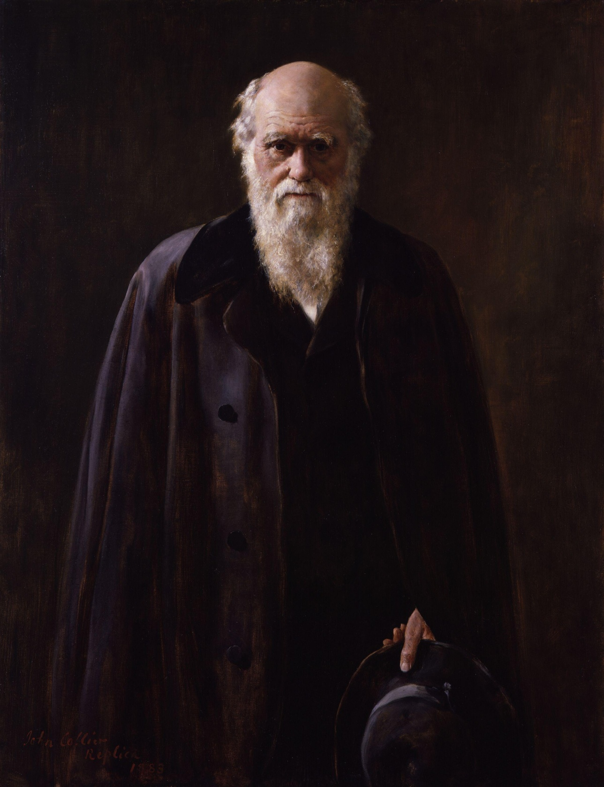

Slide 7
Rom. 1:21-24 “Because that, when they knew God, they glorified him not as God, neither were thankful; but became vain in their imaginations, and their foolish heart was darkened. Professing themselves to be wise, they became fools, And changed the glory of the uncorruptible God into an image made like to corruptible man, and to birds, and fourfooted beasts, and creeping things. Wherefore God also gave them up to uncleanness through the lusts of their own hearts, to dishonour their own bodies between themselves.”

Slide 8
(John 1:1-4)
“In the beginning was the Word, and the Word was with God, and the Word was God. The same was in the beginning with God. All things were made by him; and without him was not any thing made that was made. In him was life; and the life was the light of men.”

Slide 9
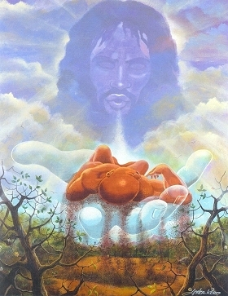
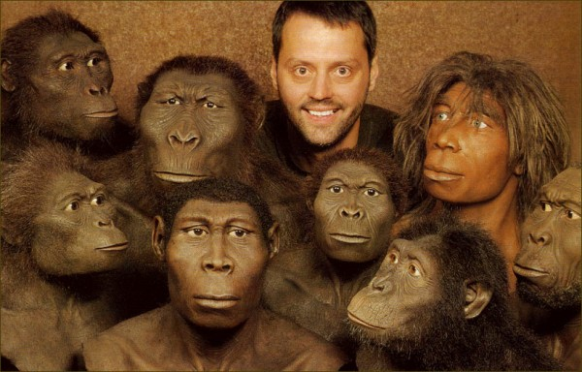

Slide 11
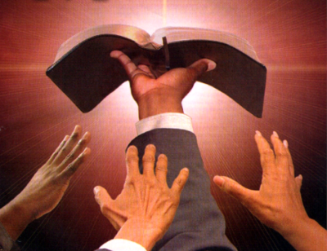
“Thy Word is Truth…”

Slide 12
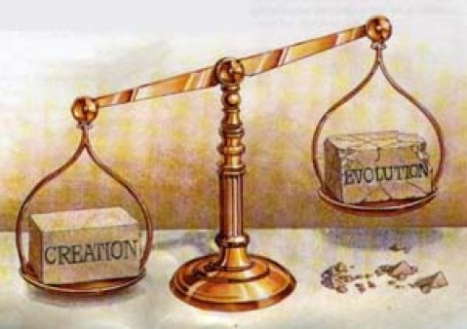

Slide 14
"And God said, Let us make man in our image, after our likeness; and let them have dominion over the fish of the sea, and the fowl of the air, and over the cattle, and over all the earth, and over every creeping thing that creepeth upon the earth. So God created man in his own image, in the image of God created he him; male and female created he them" (Gen. 1:26, 27)

Slide 15
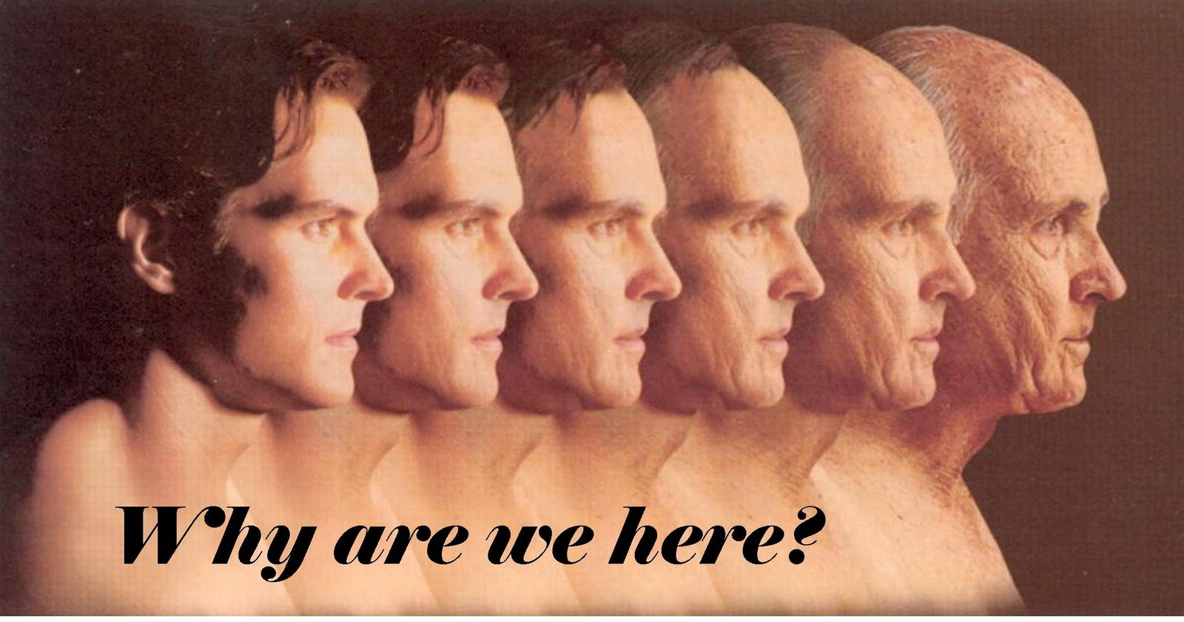

Slide 16
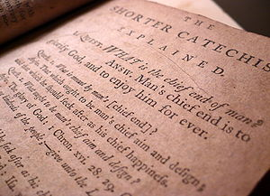

Slide 19
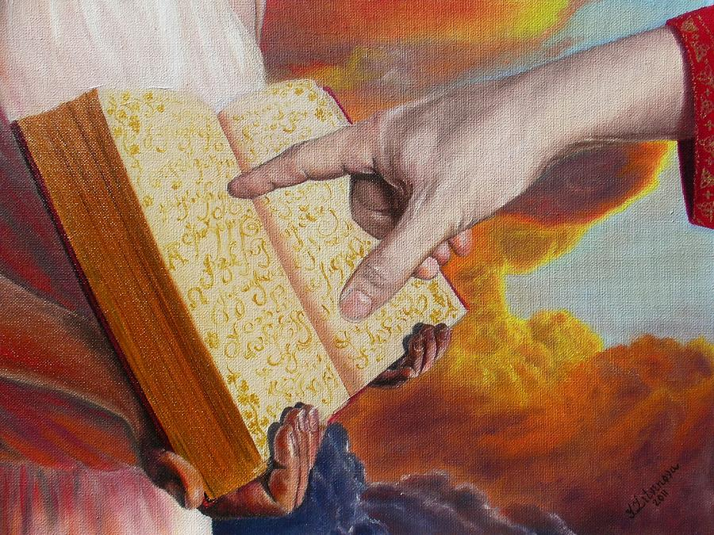
Rev. 20:15
“And whosoever was not found written in the book of life was cast into the lake of fire.”

Slide 20
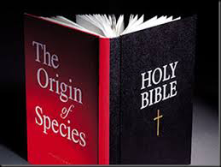

Slide 22
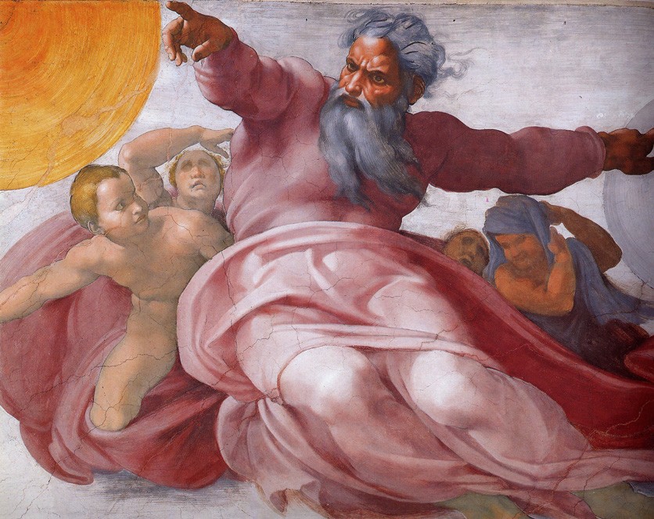
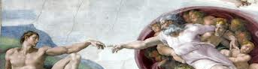
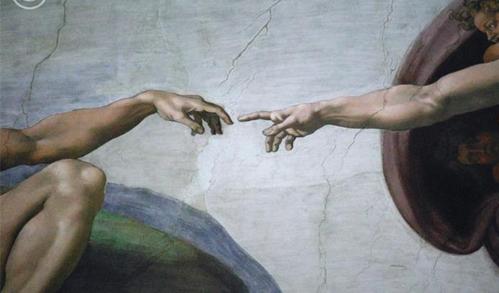
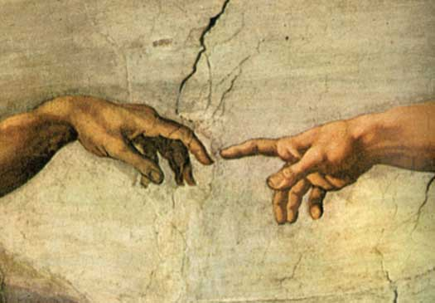
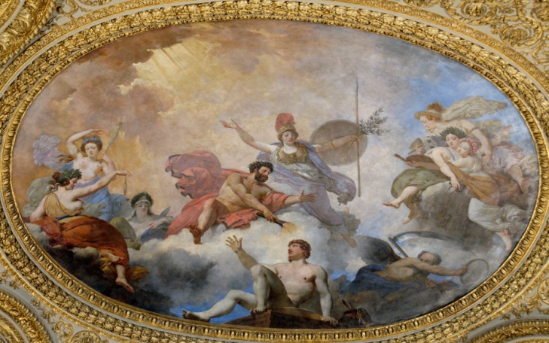
"And God said, Let us make man in our image, after our likeness; and let them have dominion over the fish of the sea, and the fowl of the air, and over the cattle, and over all the earth, and over every creeping thing that creepeth upon the earth. So God created man in his own image, in the image of God created he him; male and female created he them.” Gen. 1:26-27

Slide 23
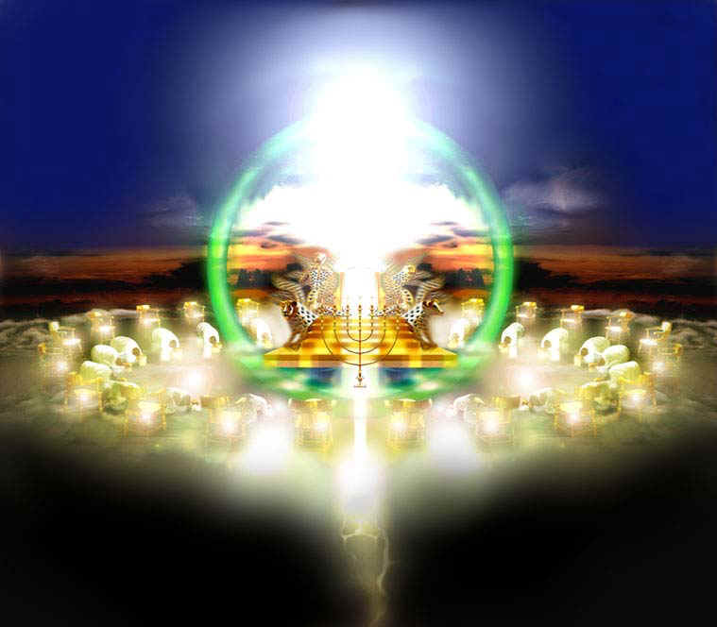
The expression "image of God" does not refer to physical likeness because "God is a spirit" (John 4:24) and He is “invisible” - (Col.1:15; I Tim.1:17).
“God is light and in Him is no darkness at all…” I John 1:5

Slide 24
If man does not bear the physical likeness and image of God, what likeness and image does he bear?

Slide 26
First, the truth about you is that you are creative because God is creative: "In the beginning God created the heavens and the earth" (Genesis 1:1).
The second truth about you is that you are spiritual because God is Spirit: "The Spirit of God was hovering over the waters" (Genesis 1:2).
A third truth about you is that you communicate because God communicates: "God said…” (Genesis 1:3).

Slide 27
A fourth truth about you is that you are intelligent because God is intelligent – Jude 1:25
A fifth truth about you is that you are relational because God is relational: “Let us make man in our image, in our likeness...It is not good for man to be alone…And they heard the voice of the LORD God walking in the garden in the cool of the day: and Adam and his wife hid themselves from the presence of the LORD God amongst the trees of the garden.”

Slide 28
A sixth truth about you is that you are morally responsible because God is a moral being (He is a Holy God) – Isa. 5:16 “But the LORD of hosts shall be exalted in judgment, and God that is holy shall be sanctified in righteousness.”
“Be ye holy for I am holy…” Because God is a moral being, we are to reflect his holy nature in our lives.

Slide 29
Use your creativity for the Glory of God – “Do all to the glory of God.”
Use your spiritual nature to seek the Lord – “If from thence thou shalt seek the LORD thy God, thou shalt find him, if thou seek him with all thy heart and with all thy soul.”
Use your communicative abilities to witness for the Lord – “Ye shall be witnesses of me…”
Use intelligence to serve the Lord – “So then with the mind I myself serve the law of God.”
Use your relationships to exalt the Lord – “Let us exalt his name together…”

Slide 30
6. Use your moral nature to seek after holiness - II Cor. 7:1“Having therefore these promises, dearly beloved, let us cleanse ourselves from all filthiness of the flesh and spirit, perfecting holiness in the fear of God.

Slide 32
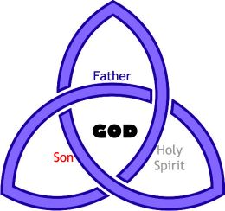
Three persons of the Godhead

Slide 33
Man is a trichotomous (three-part) being. That is, does he consist of body, soul and spirit?

Slide 35
The three elements of personality are
Intellect
Emotion
Will

Slide 36
Man’s Original Duties and Responsibilities

Slide 37
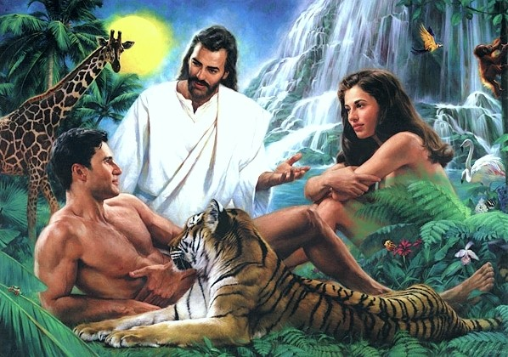
Why did God create man?

Slide 38
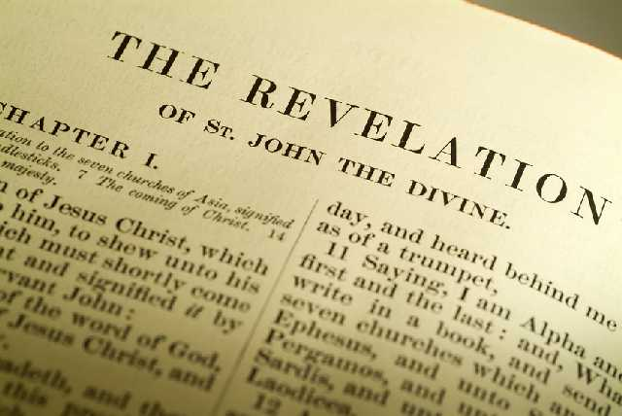
“Thou art worthy, O Lord, to receive glory and honour and power: for thou hast created all things, and for thy pleasure they are and were created.” (Rev. 4:11)

Slide 39
“Furthermore then we beseech you, brethren, and exhort you by the Lord Jesus, that as ye have received of us how ye ought to walk and to please God, so ye would abound more and more.” (I Thess. 4:1)

Slide 40
“So then they that are in the flesh cannot please God.” (Romans 8:8)

Slide 41
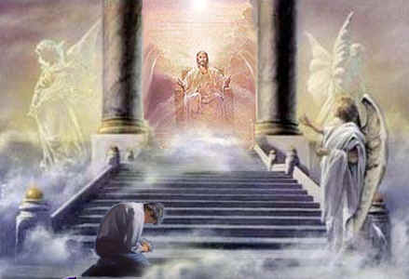

Slide 42
(II Corinthians 5:7-10)
“For we walk by faith, not by sight: We are confident, I say, and willing rather to be absent from the body, and to be present with the Lord. Wherefore we labour, that, whether present or absent, we may be accepted of him. For we must all appear before the judgment seat of Christ; that every one may receive the things done in his body, according to that he hath done, whether it be good or bad.”

Slide 43
How do we bring pleasure to God?

Slide 44
The only way to bring pleasure to God is by fulfilling our God given duties and responsibilities.

Slide 45
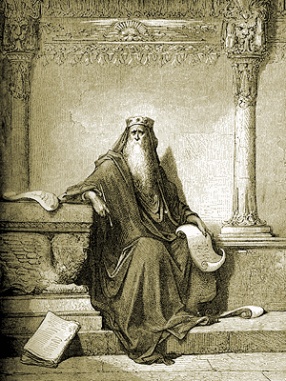
“Let us hear the conclusion of the whole matter: Fear God, and keep his commandments: for this is the whole duty of man.” (Eccl. 12:13)

Slide 46
Upon His creation of Man God gave Him the duties and responsibilities:

Slide 47
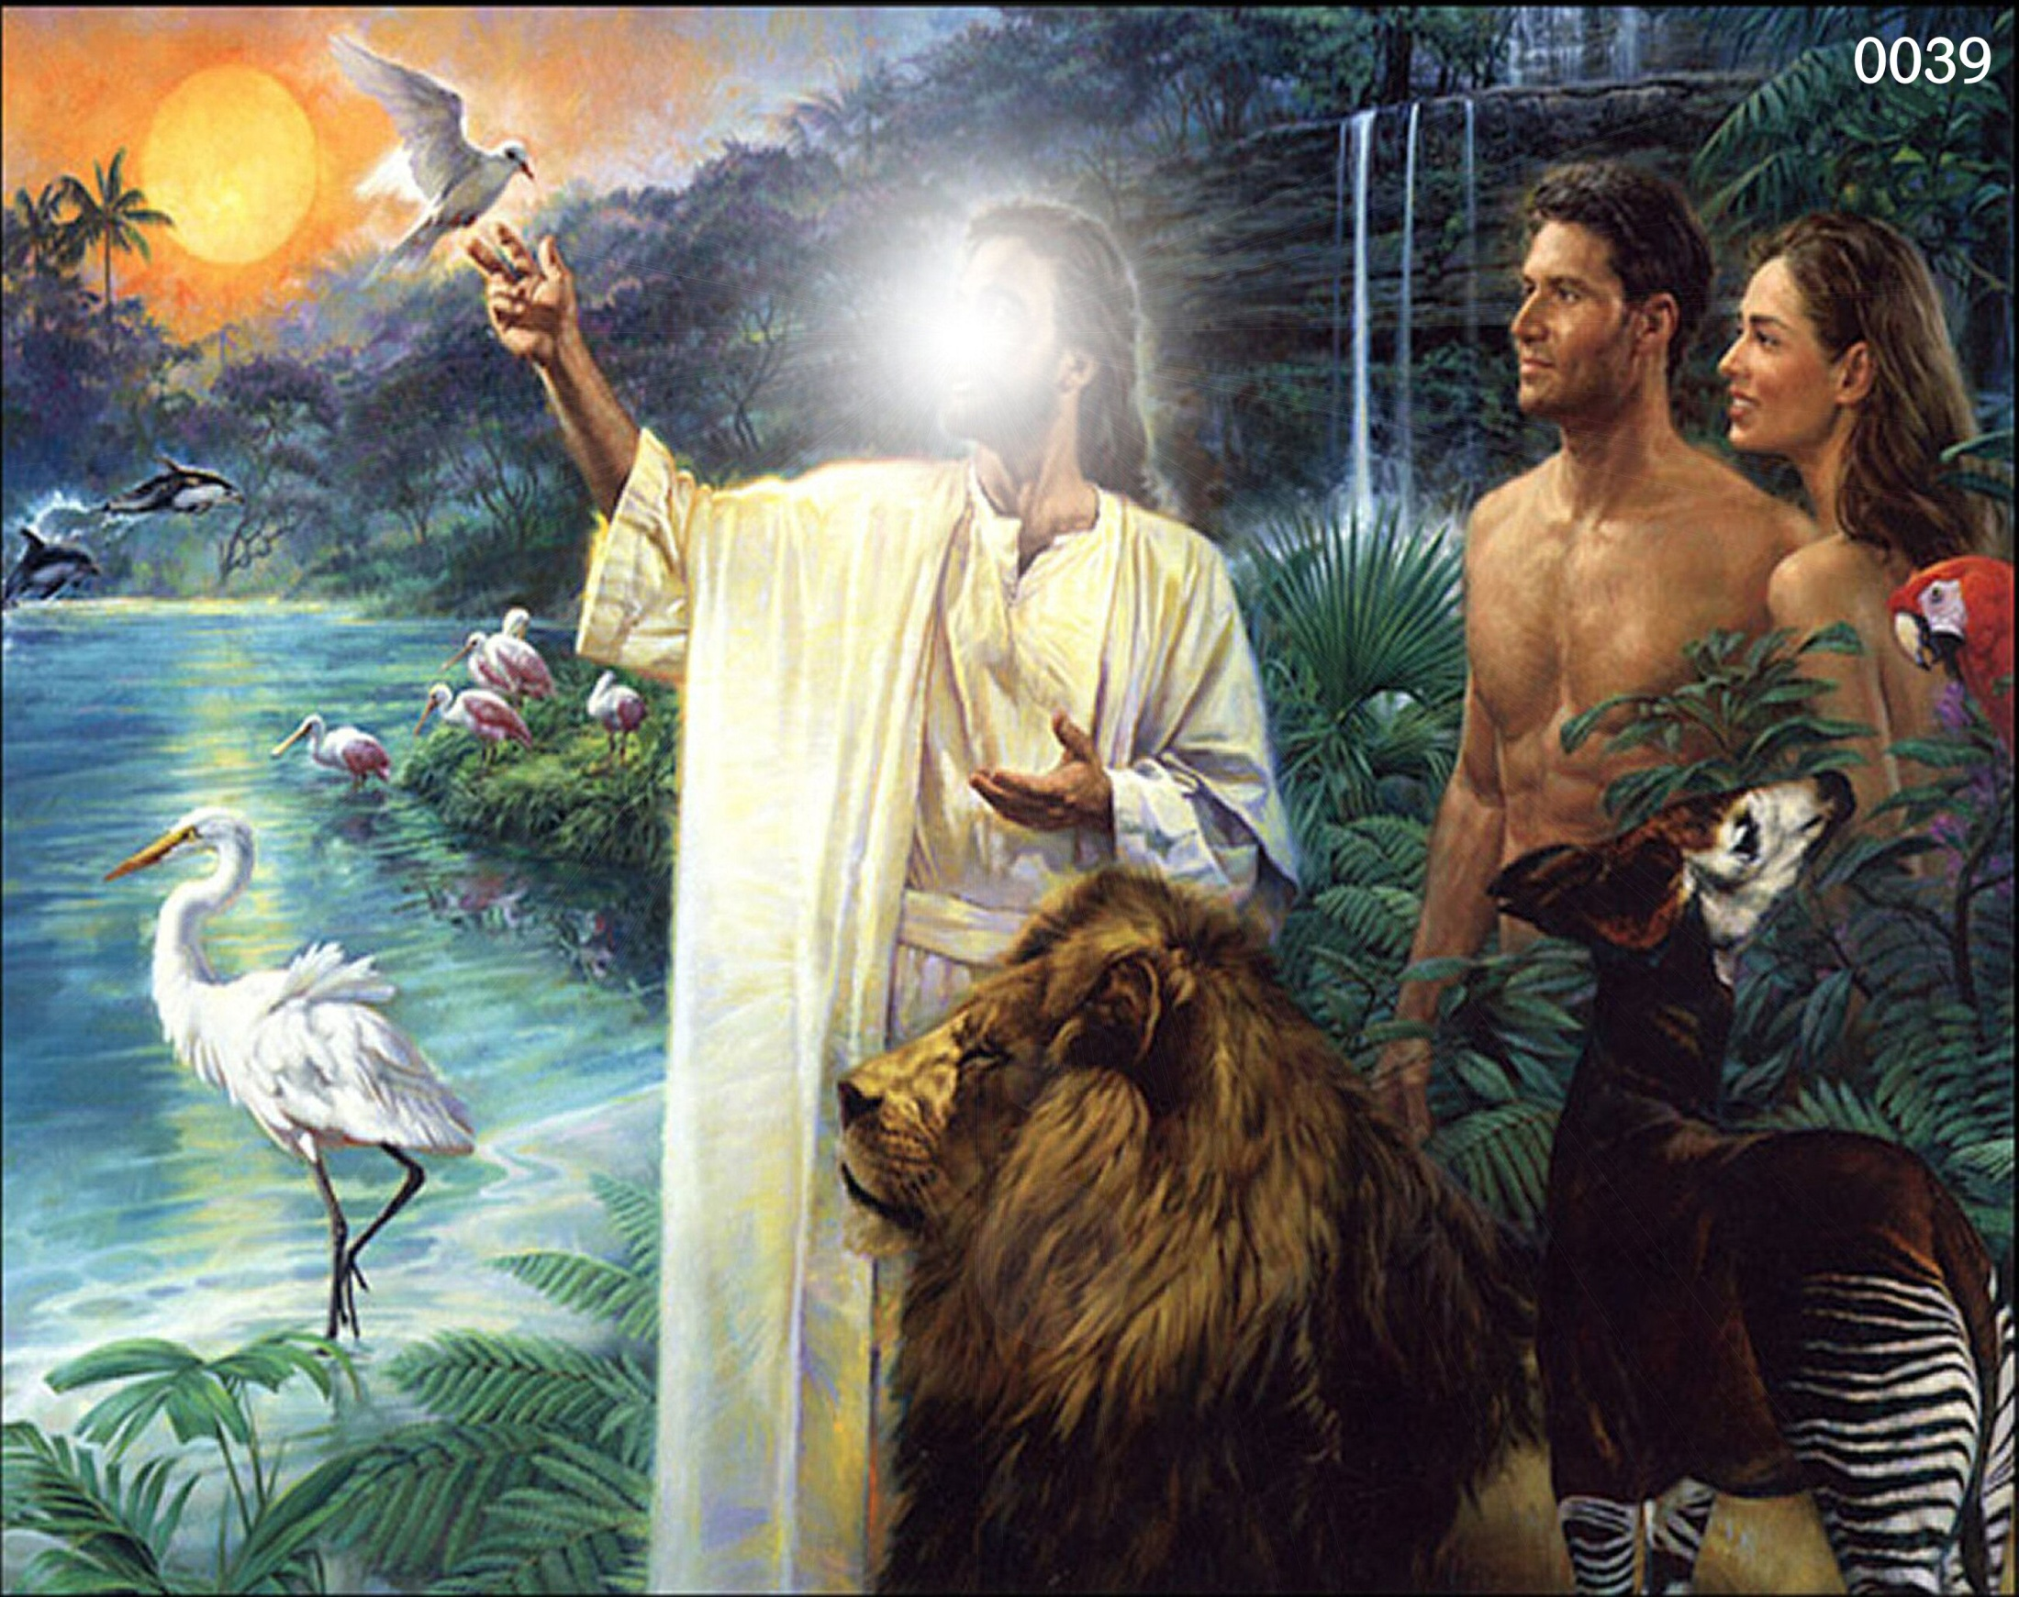

Slide 48
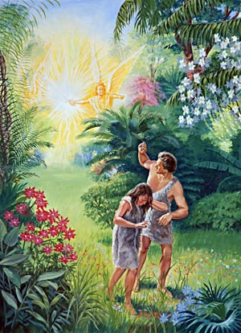
His Tragic Sin and Fall

Slide 49
The temptation that led to the fall
According to Gen. 3:1 Satan, working through the serpent, enticed Eve to disobey God and partake of the forbidden fruit.

Slide 50
"Now the serpent was more subtile than any beast of the field which the Lord God had made. And he said unto the woman, Yea, hath God said, Ye shall not eat of every tree of the garden?" (Gen. 3:1).

Slide 51
Satan’s approach to Eve
He begins by slyly doubting God’s Word, but soon is brazenly denying the Word of God.
“And he said unto the woman, Yea, hath God said, Ye shall not eat of every tree of the garden?”
"And the serpent said unto the woman, Ye shall not surely die" (Gen. 3:4)
What did God tell Adam?
(Genesis 2:16-17) “And the LORD God commanded the man, saying, Of every tree of the garden thou mayest freely eat: But of the tree of the knowledge of good and evil, thou shalt not eat of it: for in the day that thou eatest thereof thou shalt surely die.”

Slide 52
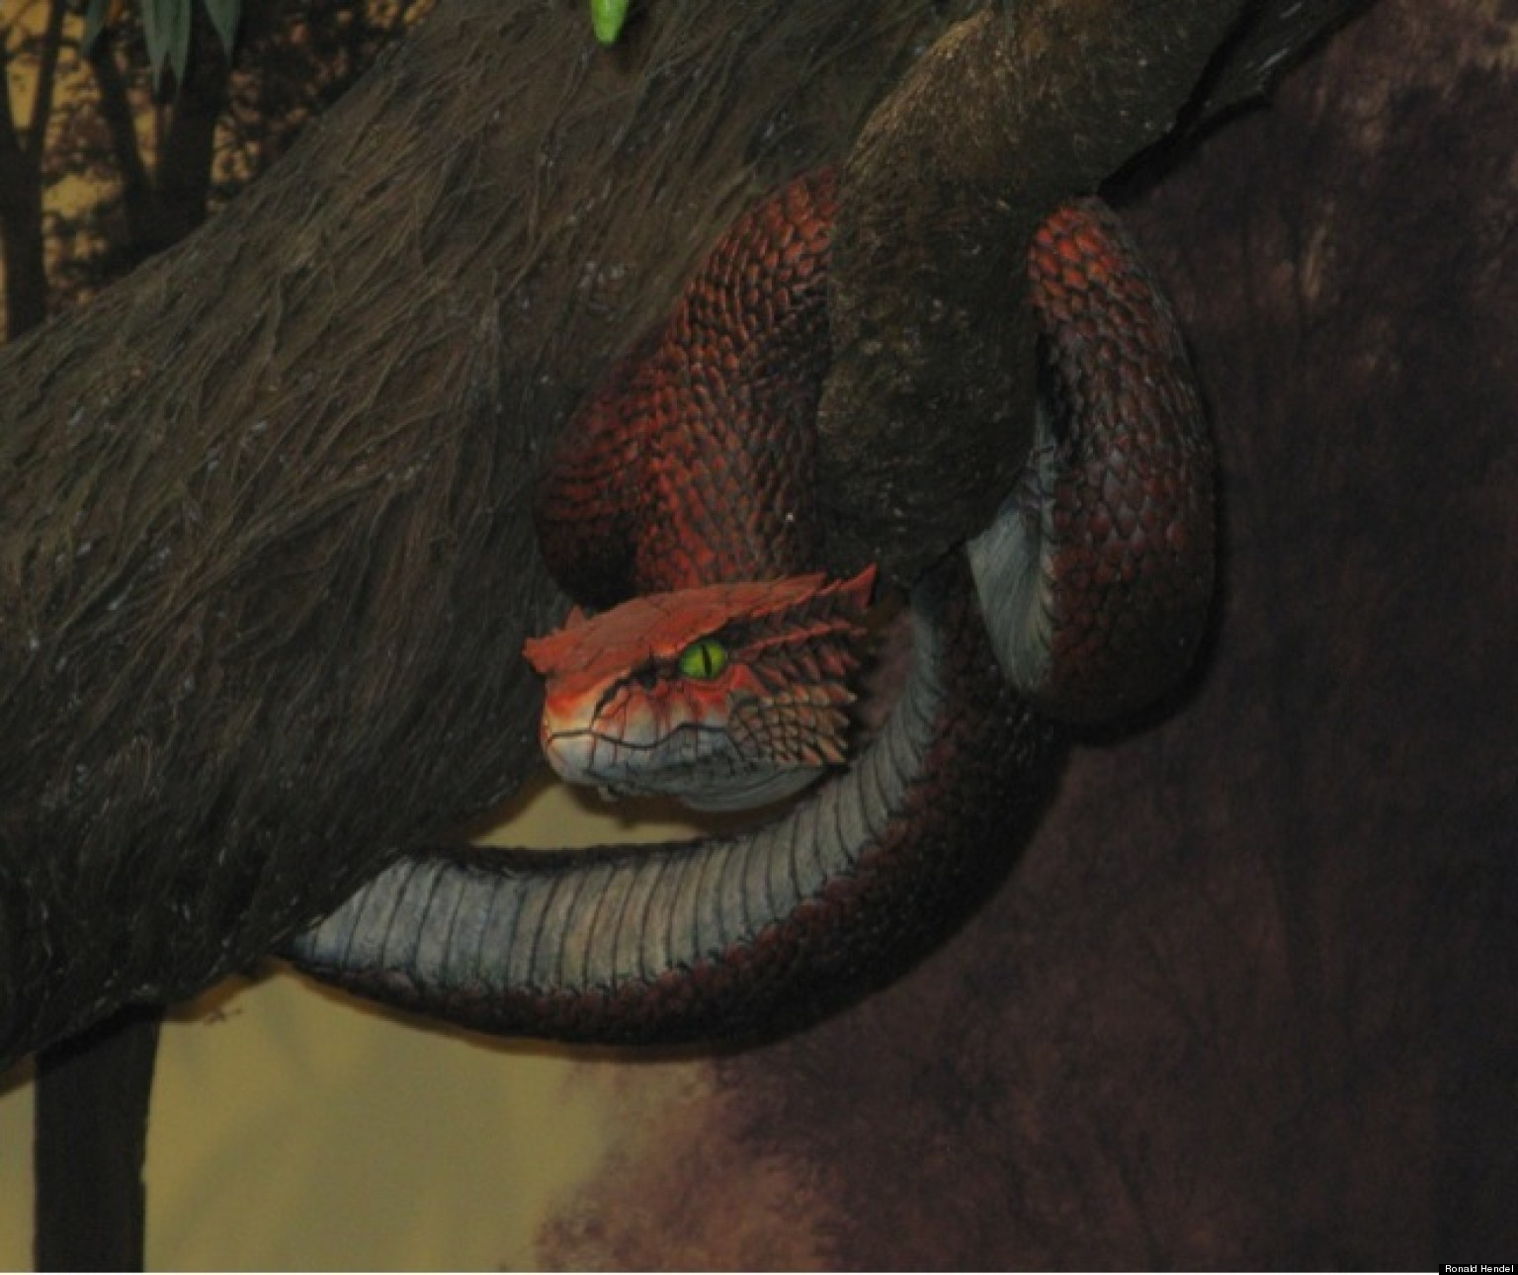
Don’t ever doubt the Word of God!

Slide 53
II Tim. 3:16 “All Scripture is given by inspiration of God, and is profitable for doctrine, for reproof, for correction, for instruction in righteousness.”

Slide 54
God has promised to preserve His word for all generations?
Ps. 12:6-7; 33:11; 100:5; 119:89; Isa. 40:8; I Peter 1:25
“The words of the Lord are pure words: as silver tried in a furnace of earth, purified seven times. Thou shalt keep them, O Lord, thou shalt preserve them from this generation forever…The counsel of the Lord standeth forever, the thoughts of his heart to all generations…His truth endureth to all generations…forever, O Lord, thy word is settled in heaven, thy faithfulness is unto all generations…The grass withereth, the flower fadeth, but the word of our God shall stand forever…but the word of the Lord endureth forever…”

Slide 55
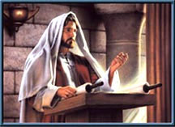
What did Jesus say about preservation?
Matt. 4:4; 5:18, 24:35; Luke 16:17; John 10:35
“For verily I say unto you. Till heaven and earth pass, one jot or one tittle shall in no wise pass from the law, till all be fulfilled…Heaven and earth shall pass away but my words shall not pass away…It is easier for heaven and earth to pass, than one tittle of the law to fail...The scriptures cannot be broken…”

Slide 57
“Thou shalt not add thereto nor diminish from it…add thou not unto his words…if any man shall add unto these things, God shall add unto him the plagues that are written in this book. And if any man shall tak away from the words of the book of this prophecy, God shall take away his part out of the book of life and out of the holy city from the things which are written in this book…”

Slide 58
The Word of God
"The Bible contains the mind of God, the state of man, the way of salvation, the doom of sinners, and the happiness of believers.
Its doctrines are holy, its precepts are binding, its histories are true, and its decisions are immutable. Read it to be wise, believe it to be safe, and practice it to be holy. It contains light to direct you, food to support you, and comfort to cheer you. It is the travelers map, the pilgrim's staff, the pilots compass, the soldiers sword, and the Christians charter.

Slide 59
Here paradise is restored, heaven opened, and hell disclosed. The Lord Jesus Christ is its grand object, our good its design, and the glory of God its end. Read it slowly, frequently, and prayerfully. Let it fill the memory, rule the heart, and guide the feet. It is a mine of wealth, a paradise of glory, and a river of pleasure. It is given you in life, will be opened in the judgment, and remembered forever. It involves the highest responsibility, will reward the highest labor, and will condemn all who trifle with its sacred contents." Author Unknown

Slide 61
Doubt leads to Denial

Slide 63
“How that they told you there should be mockers in the last time, who should walk after their own ungodly lusts.” Jude 1:18
“Knowing this first, that there shall come in the last days scoffers, walking after their own lusts…” II Peter 3:3

Slide 65
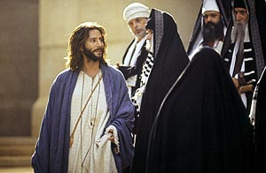
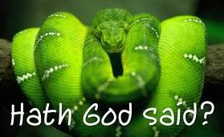
Doubt leads to Denial Denial leads to Rejection
“And he said unto them, Full well ye reject the commandment of God, that ye may keep your own tradition.” Mark 7:9

Slide 66
Doubt leads to Denial Denial leads to Rejection Rejection leads to Disobedience
Eph. 2:2 “Wherein in time past ye walked according to the course of this world, according to the prince of the power of the air, the spirit that now worketh in the children of disobedience.”
II Cor. 10:6 “And having in a readiness to revenge all disobedience, when your obedience is fulfilled.”

Slide 67
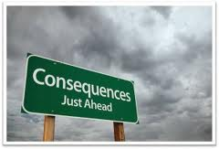
Doubt leads to Denial Denial leads to Rejection Rejection leads to Disobedience Disobedience leads to Consequences

Slide 69
(Galatians 6:7-8) “Be not deceived; God is not mocked: for whatsoever a man soweth, that shall he also reap. For he that soweth to his flesh shall of the flesh reap corruption; but he that soweth to the Spirit shall of the Spirit reap life everlasting.”

Slide 70
Eph 5:6 “Let no man deceive you with vain words: for because of these things cometh the wrath of God upon the children of disobedience.”
Col 3:6 “For which things' sake the wrath of God cometh on the children of disobedience.”
Heb 2:2 “For if the word spoken by angels was stedfast, and every transgression and disobedience received a just recompence of reward.”
Neh. 9:17 “And refused to obey, neither were mindful of thy wonders that thou didst among them; but hardened their necks, and in their rebellion appointed a captain to return to their bondage.”

Slide 71
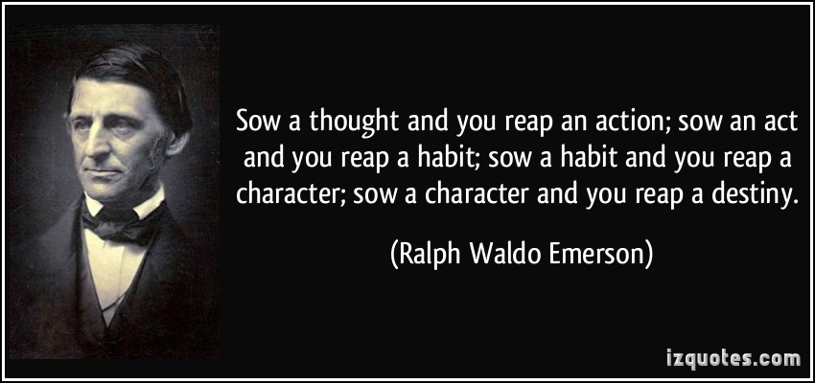

Slide 72
The Progression of Satan’s Temptation (James 1:12-16)
Vs. 13-16 “Let no man say when he is tempted, I am tempted of God: for God cannot be tempted with evil, neither tempteth he any man: But every man is tempted, when he is drawn away of his own lust, and enticed. Then when lust hath conceived, it bringeth forth sin: and sin, when it is finished, bringeth forth death. Do not err, my beloved brethren.”
Vs. 12 “Blessed is the man that endureth temptation…”

Slide 73
Six Deadly D’s of the Devil!
Desire – “Every man is tempted when he is drawn away in his own lust…”
Note: Jesus – “all points tempted like as we, yet without sin…”
“Lust of the flesh” – turn these stones into bread
“Lust of the eyes”- showeth him al the kingdoms of the world
“Pride of life”- cast thy self down
Deception – “and enticed…”
Deliberation – “then when lust is conceived…”
Disobedience – “it bringeth forth sin…”
Development – “and sin, when it is finished…”
Destruction – “bringeth forth death…”

Slide 74
The transgression that caused the fall
"And the woman said unto the serpent, We may eat of the fruit of the trees of the garden: But of the fruit of the tree which is in the midst of the garden, God hath said, Ye shall not eat of it, neither shall ye touch it, lest ye die“
(Gen. 3:2-3)

Slide 75
Eve commits two fatal mistakes
She adds to God’s Word (God did not say, "Neither shall ye touch it")
And then she takes from God’s Word (she omitted the original command, "Thou shalt surely die").
"But of the tree of knowledge of good and evil, thou shalt not eat of it: for in the day that thou eatest thereof thou shalt surely die" (Gen. 2:17)

Slide 76
Liberals take away from the Word of God - "For I testify unto every man that heareth the words of the prophecy of this book, If any man shall add unto these things, God shall add unto him the plagues that are written in this book: And if any man shall take away from the words of the book of this prophecy, God shall take away his part out of the book of life, and out of the holy city, and from the things which are written in this book" (Rev. 22:18-19)
Legalist add to the Word of God - "Every word of God is pure: he is a shield unto them that put their trust in him. Add thou not unto his words, lest he reprove thee, and thou be found a liar" (Prov. 30:5-6)

Slide 77
"And when the woman saw that the tree was good for food, and that it was pleasant to the eyes, and a tree to be desired to make one wise, she took of the fruit thereof and did eat…

Slide 78
Satan’s Threefold Temptation
Lust of the flesh – “…saw that the tree was good for food…”
Lust of the eyes – “…and that it was pleasant to the eyes…”
Pride of life – “…and a tree to be desired to make one wise…”
“She took of the fruit thereof, and did eat…”

Slide 79
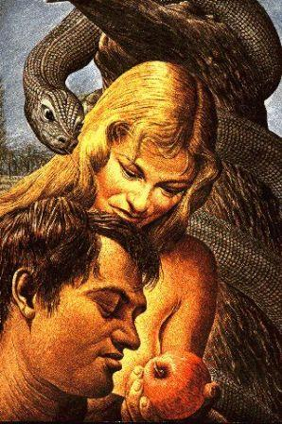
…and gave also unto her husband with her; and he did eat"
(Gen. 3:6)

Slide 80
(I Tim. 2:14) “And Adam was not deceived, but the woman being deceived was in the transgression.”

Slide 81
Why did Adam eat the fruit?
The Bible doesn't say why he ate but we do know he deliberately sinned, took the fruit and eat it.
Maybe he thought Eve was still "alive" when God said "you will surely die" and he decided it was ok to eat it.
Maybe she nagged him into taking a bite.
Maybe he didn't know which tree it came from.
Eve was deceived but Adam was not. This means that Adam to whom the command was given NOT to eat of the tree did so fully knowing what He was doing.

Slide 82
(Luke 14:26) “If any man come to me, and hate (to love less) not his father, and mother, and wife, and children, and brethren, and sisters, yea, and his own life also, he cannot be my disciple.”

Slide 83
(Matthew 10:37-39) “He that loveth father or mother more than me is not worthy of me: and he that loveth son or daughter more than me is not worthy of me. And he that taketh not his cross, and followeth after me, is not worthy of me. He that findeth his life shall lose it: and he that loseth his life for my sake shall find it.”

Slide 84
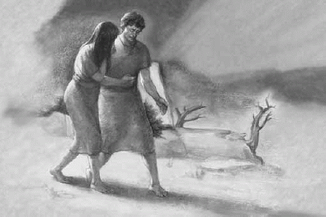
Next Week “The Consequences of the Fall”

