Slide 1
The Doctrine of Man (Part 1)
His Origin

Slide 3
Job 7:17 “What is man, that thou shouldest magnify him? and that thou shouldest set thine heart upon him?”
Job 15:14 “What is man, that he should be clean? and he which is born of a woman, that he should be righteous?”
Ps. 8:4 “What is man, that thou art mindful of him? and the son of man, that thou visitest him?”
Ps. 144:3 “LORD, what is man, that thou takest knowledge of him! or the son of man, that thou makest account of him!”
Heb. 2:6 “But one in a certain place testified, saying, What is man, that thou art mindful of him? or the son of man, that thou visitest him?”

Slide 5
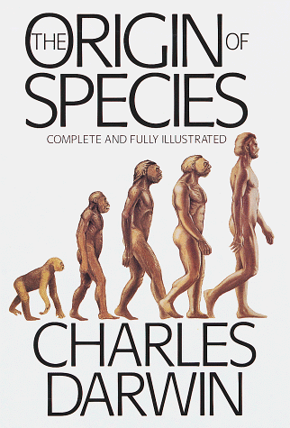
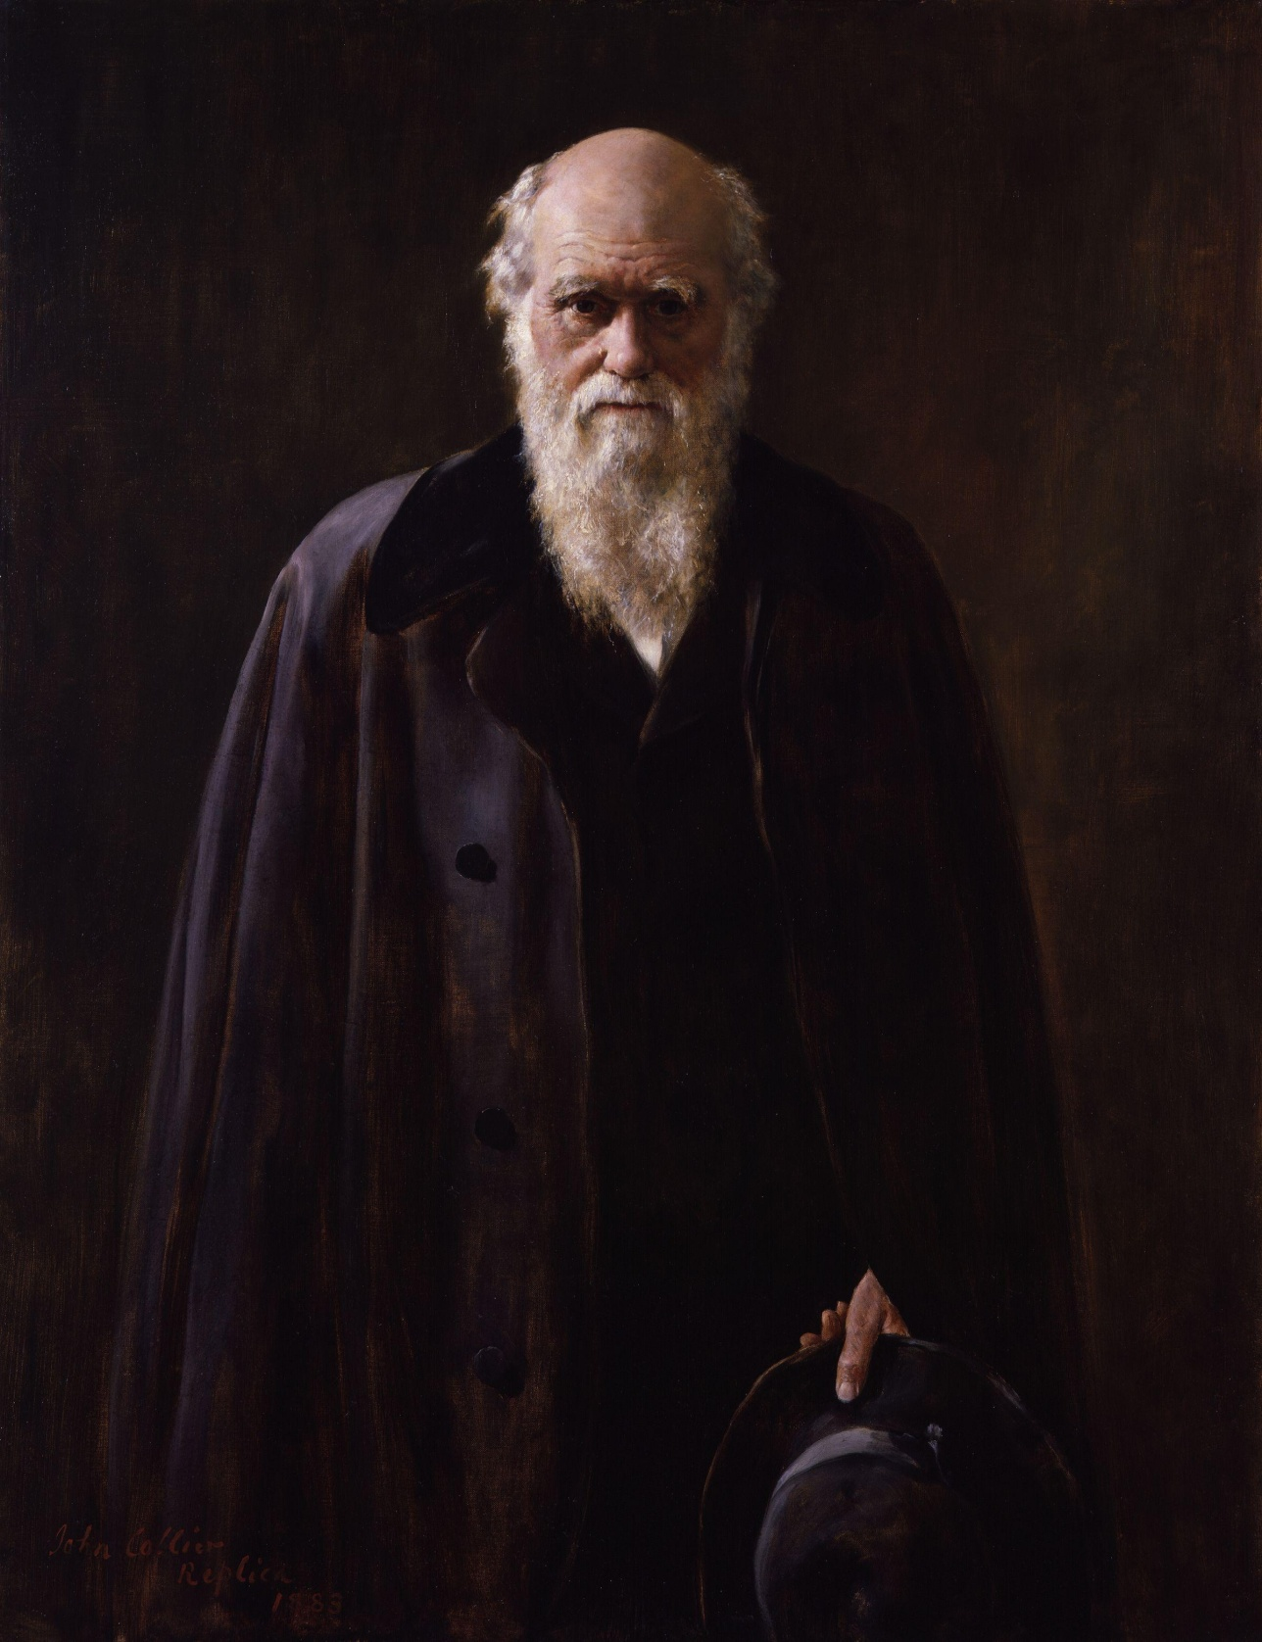

Slide 6
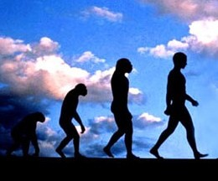

Slide 8
Col. 2:8
“Beware lest any man spoil you through philosophy and vain deceit, after the tradition of men, after the rudiments of the world, and not after Christ.”

Slide 9
II Cor. 11:3 "But I fear, lest by any means, as the serpent beguiled Eve through his subtilty, so your minds should be corrupted from the simplicity that is in Christ."

Slide 10
John 1:1-4
“In the beginning was the Word, and the Word was with God, and the Word was God. The same was in the beginning with God. All things were made by him; and without him was not any thing made that was made. In him was life; and the life was the light of men.”

Slide 11
John 3:19-20
“And this is the condemnation, that light is come into the world, and men loved darkness rather than light, because their deeds were evil (The depravity of man). For every one that doeth evil hateth the light, neither cometh to the light, lest his deeds should be reproved.”

Slide 12
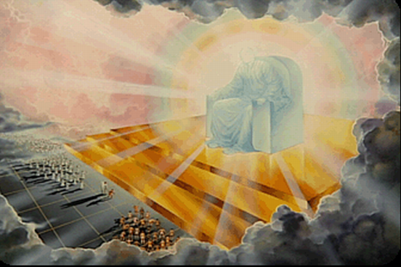

Slide 13
Rom. 1:21-24 “Because that, when they knew God, they glorified him not as God, neither were thankful; but became vain in their imaginations, and their foolish heart was darkened. Professing themselves to be wise, they became fools, And changed the glory of the uncorruptible God into an image made like to corruptible man, and to birds, and fourfooted beasts, and creeping things. Wherefore God also gave them up to uncleanness through the lusts of their own hearts, to dishonour their own bodies between themselves.”

Slide 15
I Cor. 3:19 “For the wisdom of this world is foolishness with God. For it is written, He taketh the wise in their own craftiness.”

Slide 16
Psalm 53:1 “The fool hath said in his heart, There is no God. Corrupt are they, and have done abominable iniquity: there is none that doeth good.”

Slide 18
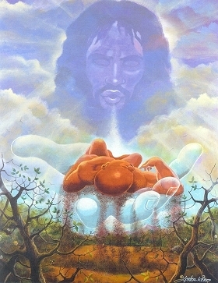
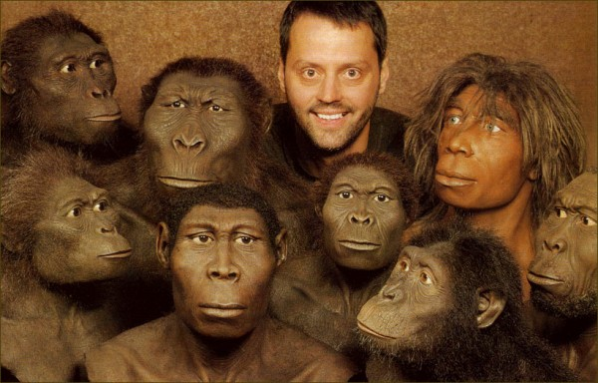

Slide 19
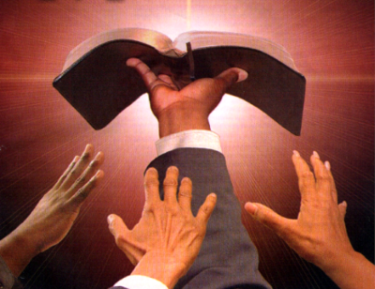
“Thy Word is Truth…”

Slide 21
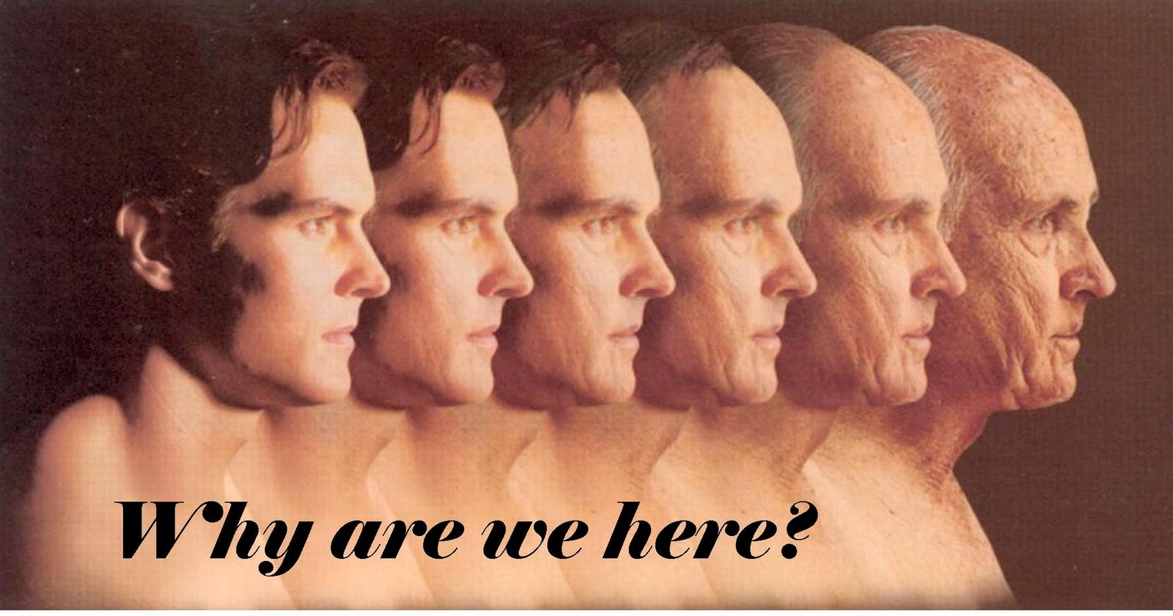

Slide 23
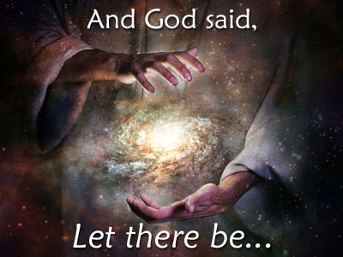

Slide 24
Day 1: Light and darkness/day and night
Day 2: Division of the Waters
Day 3: Dry land, the seas, and vegetation.
Day 4: The sun, the moon and the stars.
Day 5: Living creatures in the water, birds in the air.
Day 6: Land animals and man.
Day 7: God "rested".

Slide 25
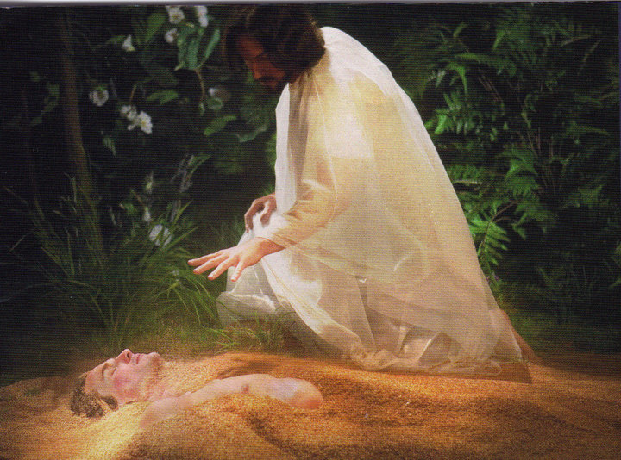

Slide 26
The Scientific Evidence For the Origin of Man

Slide 27
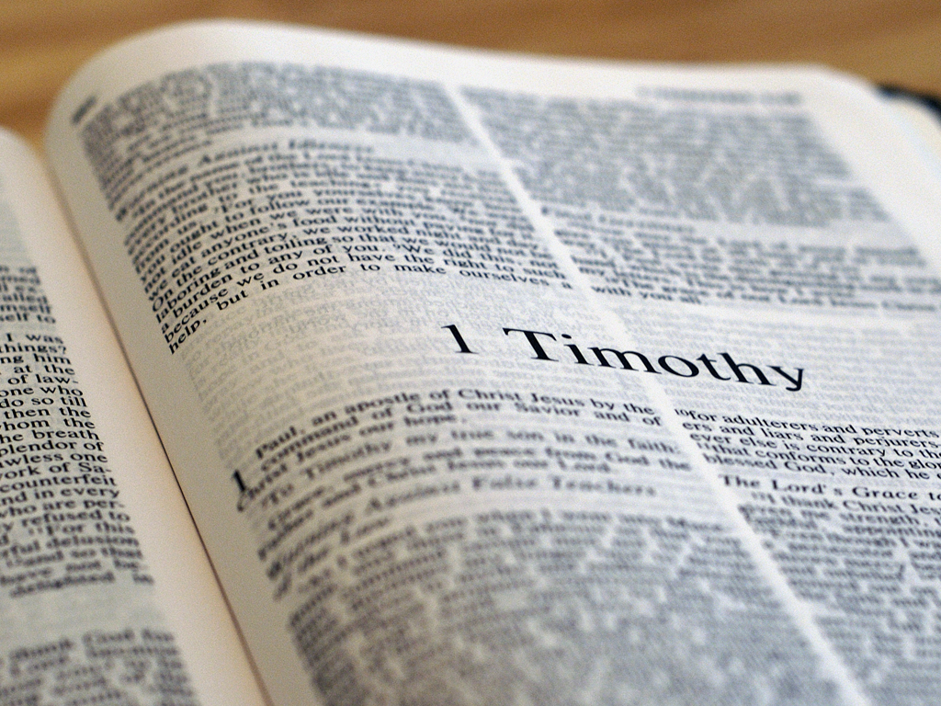
I Tim. 6:20
“O Timothy, keep that which is committed to thy trust, avoiding profane and vain babblings, and oppositions of
science falsely so called.”

Slide 29
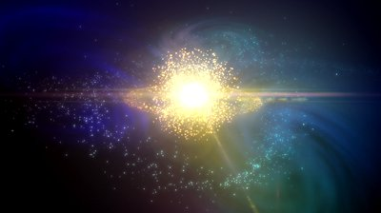
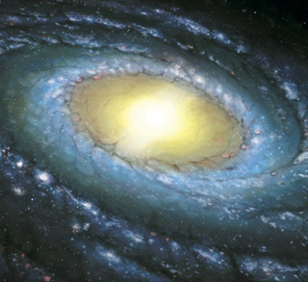

Slide 30
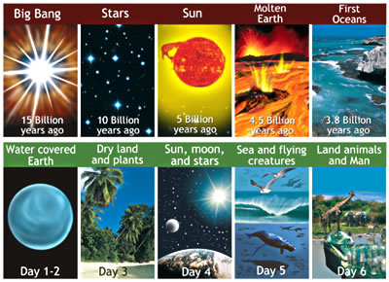

Slide 31
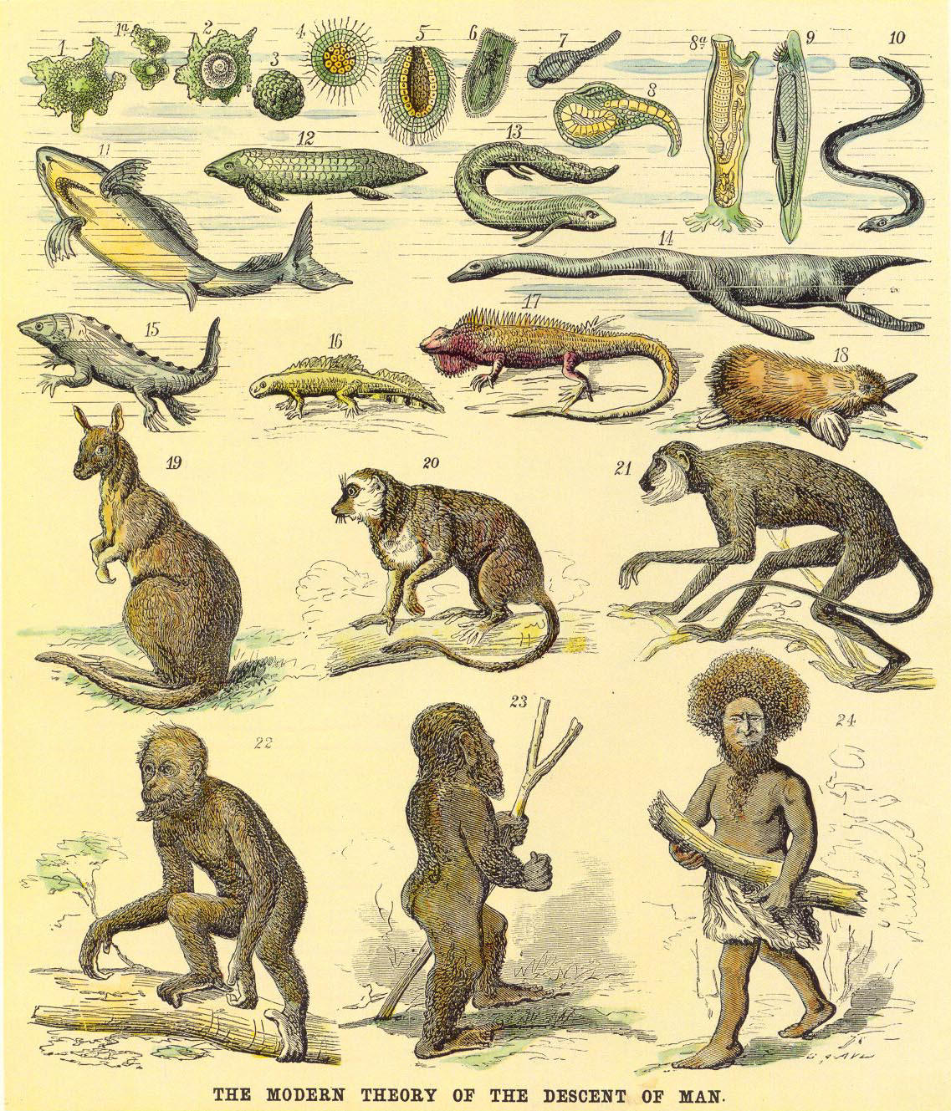

Slide 32
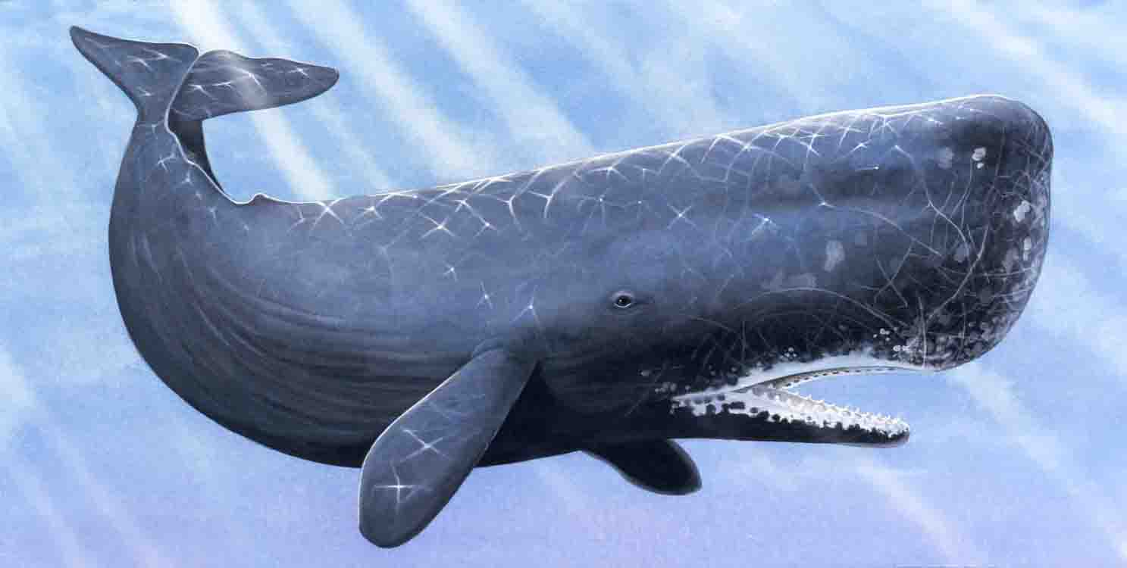

Slide 34
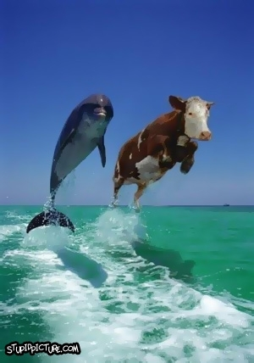

Slide 36
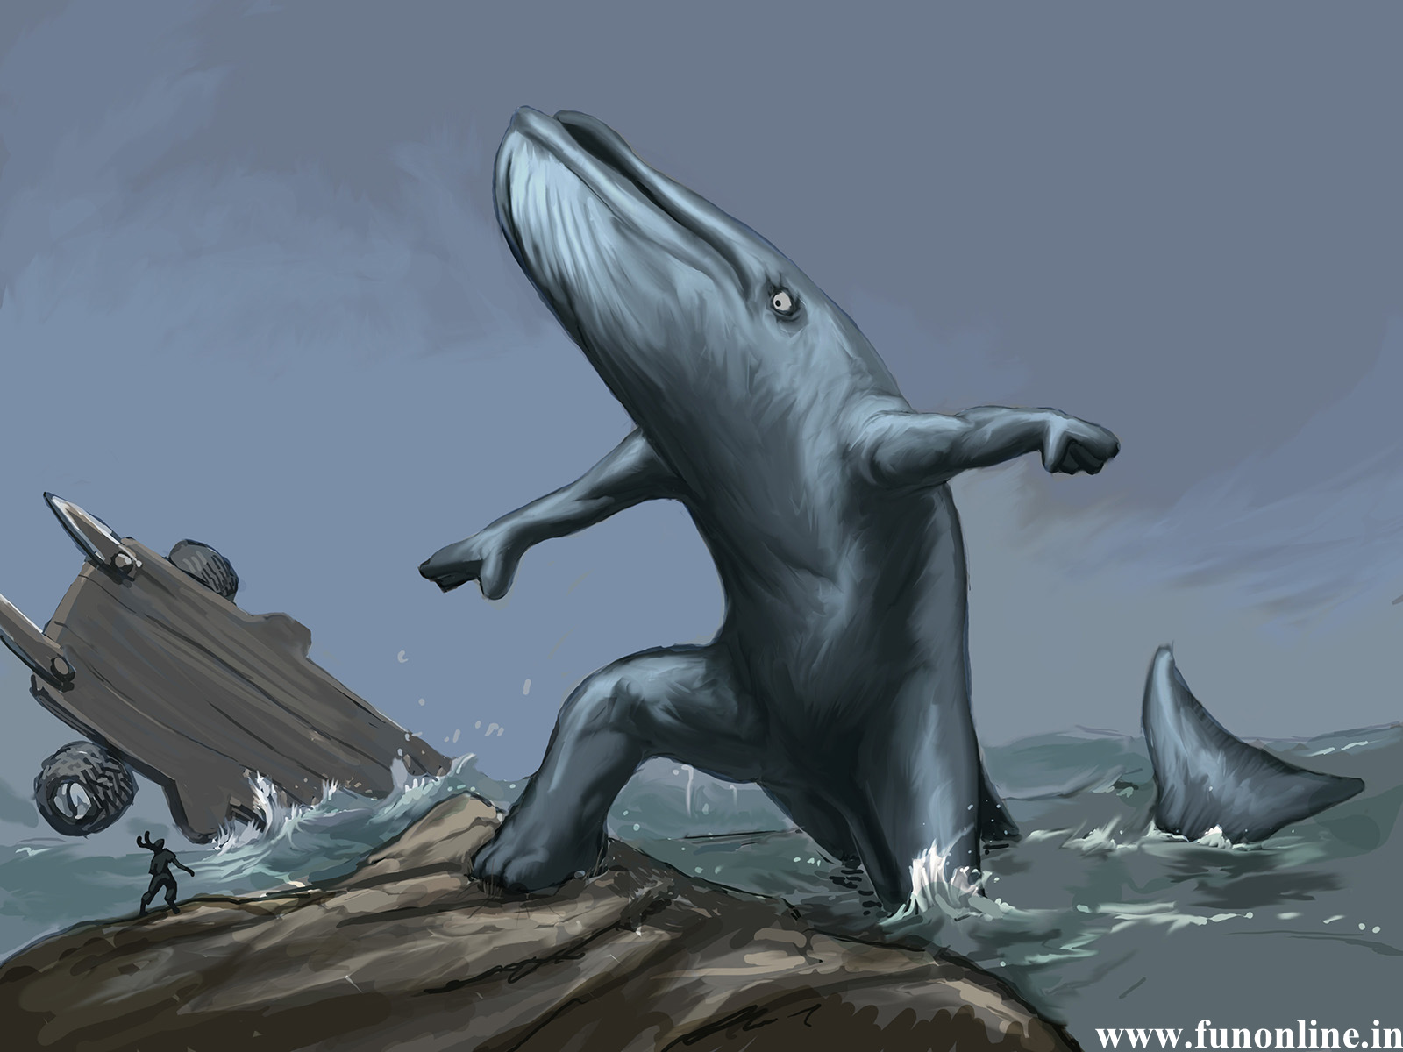

Slide 37
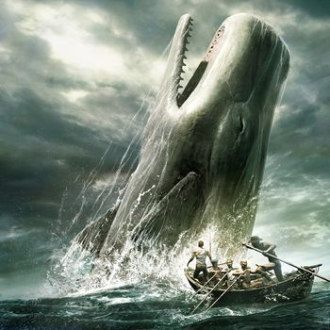

Slide 38
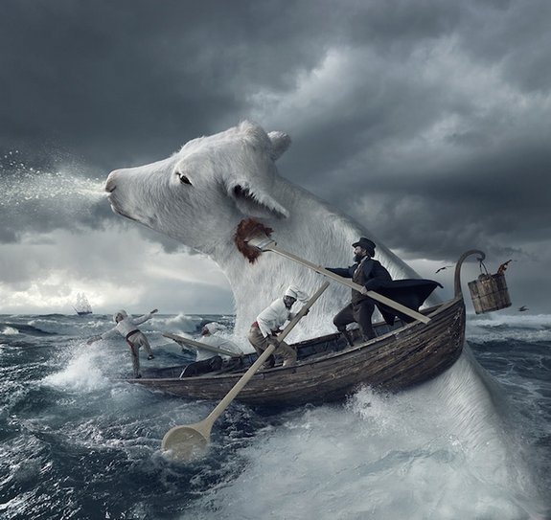

Slide 40
Genesis teaches that life began on dry land, while evolution says it began on some remote sea bottom (Gen. 1:11, 12).
Genesis declares that birds existed before insects, while evolution reverses this order (Gen. 1:20, 24).
Genesis states that birds and fish were created at the same time, but evolution says fish evolved hundreds of millions of years before birds developed (Gen. 1:21).

Slide 41
Genesis stresses (ten times) that the creatures created were to reproduce "after their kinds," while evolution teaches the slow ascent of all organisms.
Genesis says that Adam was made from the dust of the ground into the image of God, while evolution claims man descended from a sub-ape creature.
Genesis records woman’s coming from man’s side, while evolution teaches both man and woman developed simultaneously.
Genesis tells us that man was originally a vegetarian while evolution teaches us he was cannibalistic (Gen. 1:29).

Slide 42
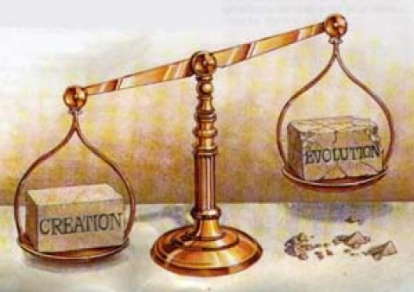

Slide 43
Atheistic Evolution
This theory holds that man is the accidental and random product of a series of chemical and biological events. Simply defined, evolution is that process by which all living organisms have developed from the simple to the more complex forms.
Needless to say, this theory is not only unscriptural, but nonsensical as well.

Slide 44
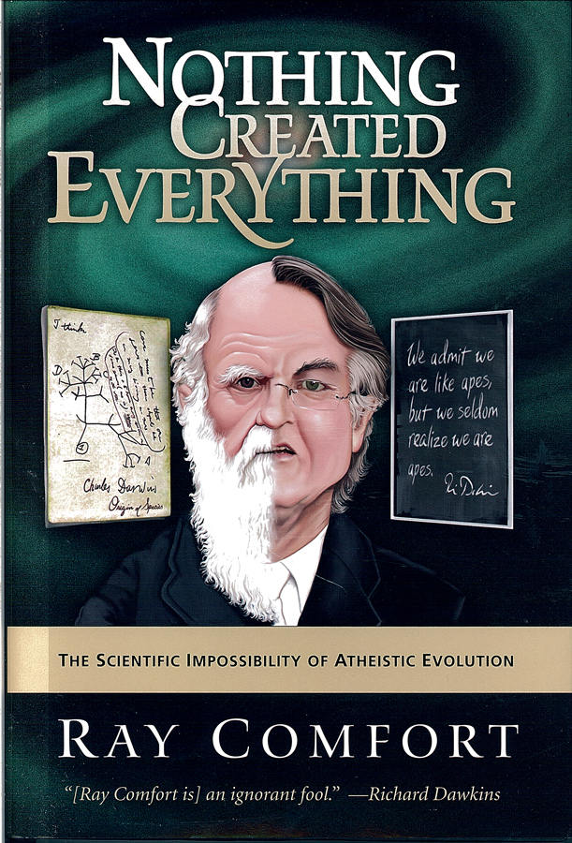

Slide 45
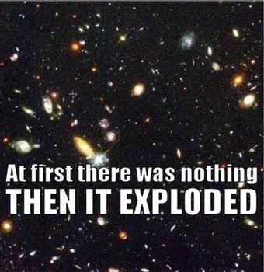

Slide 46
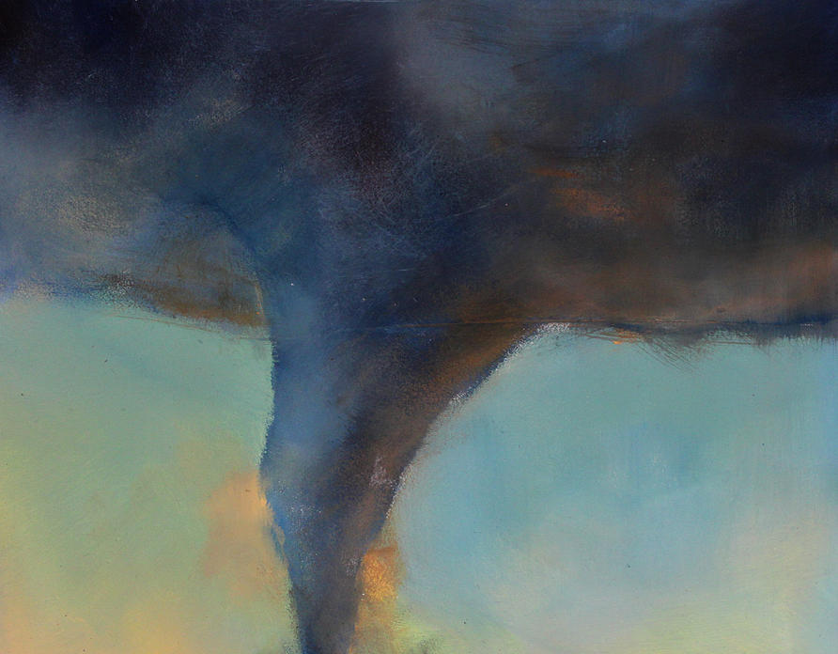

Slide 47
Theistic Evolution
This view teaches that there is one God, the Creator of matter, who chose the method of evolution to bring all things including man into their present
state of existence.

Slide 48
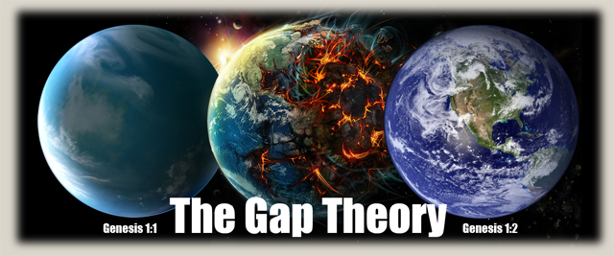

Slide 50
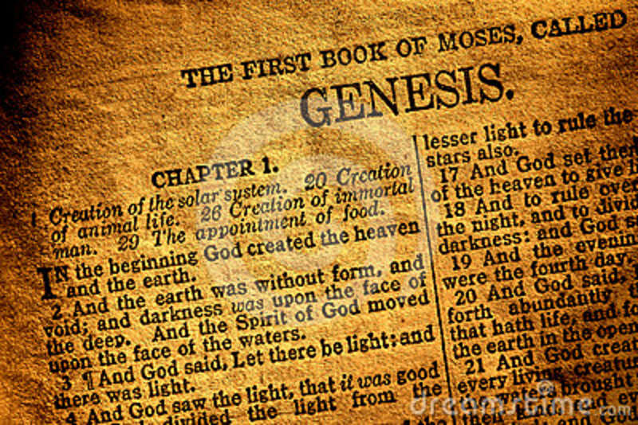
Theistic evolution as a method is clearly, strongly, and completely refuted by the Bible.

Slide 51
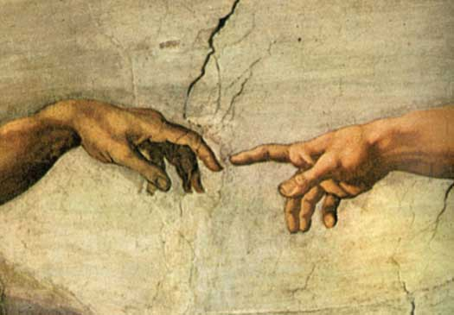
Special Creation
Man is a direct product from the hand of God and that the statements in Genesis 1 and 2 are to be taken literally.

Slide 52
Six Days
24 hour Days

Slide 53
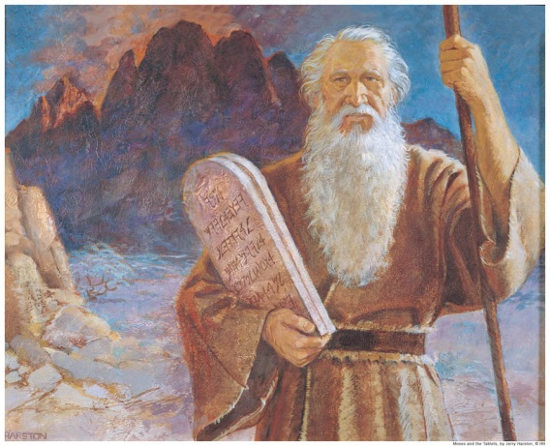
Moses at Mt. Sinai (Exod. 20:9-11) "Six days shalt thou labor, and do all thy work: But the seventh day is the sabbath of the Lord thy God: in it thou shalt not do any work, thou, nor thy son, nor thy daughter, thy manservant, nor thy maidservant, nor thy cattle, nor thy stranger that is within thy gates: For in six days the Lord made heaven and earth, the sea, and all that in them is, and rested the seventh day: wherefore the Lord blessed the sabbath day, and hallowed it"

Slide 55
"And God said, Let us make man in our image, after our likeness; and let them have dominion over the fish of the sea, and the fowl of the air, and over the cattle, and over all the earth, and over every creeping thing that creepeth upon the earth. So God created man in his own image, in the image of God created he him; male and female created he them" (Gen. 1:26, 27)

Slide 57
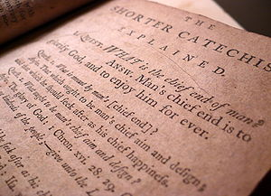

Slide 58
1. What is the chief end of man?
Man’s chief end is to glorify God, and to enjoy him forever.
2. What rule hath God given to direct us how we may glorify and enjoy him?
The Word of God, which is contained in the Scriptures of the Old and New Testaments, is the only rule to direct us how we may glorify and enjoy him.
3. What do the Scriptures principally teach?
The Scriptures principally teach, what man is to believe concerning God, and what duty God requires of man.

Slide 62
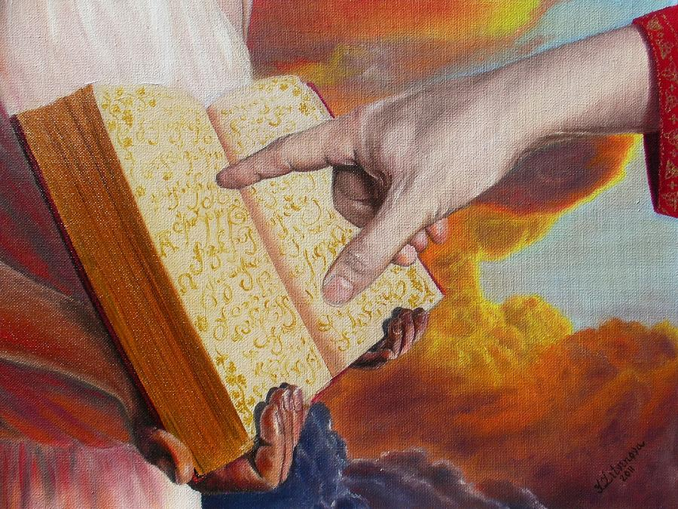
Rev. 20:15
“And whosoever was not found written in the book of life was cast into the lake of fire.”

Slide 63
Rev. 21:8
“But the fearful, and unbelieving, and the abominable, and murderers, and whoremongers, and sorcerers, and idolaters, and all liars, shall have their part in the lake which burneth with fire and brimstone: which is the
second death.”

Slide 64
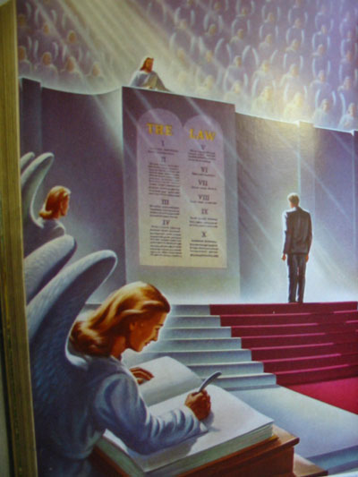
Heb 9:27
“And as it is appointed unto men once to die, but after this the judgment.”

Slide 65
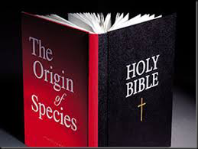

Slide 66
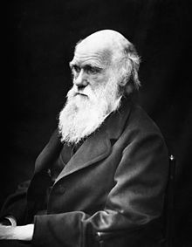
I have never been an atheist in the sense of denying the existence of a god, and that generally "an Agnostic would be the more correct description of my state of mind. For myself, I do not believe that there ever has been any revelation. As for a future life, every man must judge for himself between conflicting vague probabilities."

Slide 67
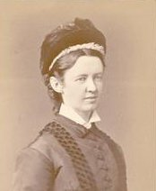
Elizabeth Cotton
THE LADY HOPE "STORY"

Slide 68
It was one of those glorious autumn afternoons, that we sometimes enjoy in England, when I was asked to go in and sit with the well known professor, Charles Darwin. He was almost bedridden for some months before he died. I used to feel when I saw him that his fine presence would make a grand picture for our Royal Academy; but never did I think so more strongly than on this particular occasion. He was sitting up in bed, wearing a soft embroidered dressing gown, of rather a rich purple shade. Propped up by pillows, he was gazing out on a far-stretching scene of woods and cornfields, which glowed in the light of one of those marvelous sunsets. His noble forehead and fine features seem to be lit up with pleasure as I entered the room.

Slide 69
He waved his hand toward the window as he pointed out the scene beyond, while in the other hand he held an open Bible, which he was always studying. "What are you reading now?" I asked as I seated myself beside his bedside. "Hebrews!" he answered - "still Hebrews. 'The Royal Book' I call it. Isn't it grand?" Then, placing his finger on certain passages, he commented on them. I made some allusions to the strong opinions expressed by many persons on the history of the Creation, its grandeur, and then their treatment of the earlier chapters of the Book of Genesis.

Slide 70
He seemed greatly distressed, his fingers twitched nervously, and a look of agony came over his face as he said: "I was a young man with unformed ideas. I threw out queries, suggestions, wondering all the time over everything, and to my astonishment, the ideas took like wildfire. People made a religion of them."

Slide 71
Then he paused, and after a few more sentences on "the holiness of God" and the "grandeur of this book," looking at the Bible which he was holding tenderly all the time, he suddenly said: "I have a summer house in the garden which holds about thirty people. It is over there," pointing through the open window. "I want you very much to speak there. I know you read the Bible in the villages. To-morrow afternoon I should like the servants on the place, some tenants and a few of the neighbors; to gather there. Will you speak to them?"

Slide 72
"What shall I speak about?" I asked. "Christ Jesus!" he replied in a clear, emphatic voice, adding in a lower tone, "and his salvation. Is not that the best theme? And then I want you to sing some hymns with them. You lead on your small instrument, do you not?" The wonderful look of brightness and animation on his face as he said this I shall never forget, for he added: "If you take the meeting at three o'clock this window will be open, and you will know that I am joining in with the singing." How I wished I could have made a picture of the fine old man and his beautiful surroundings on that memorable day!

Slide 73
II Peter 2:21
“For it had been better for them not to have known the way of righteousness, than, after they have known it, to turn from the holy commandment delivered unto them.”

