Slide 1
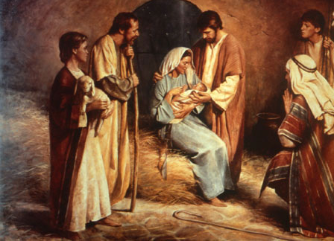
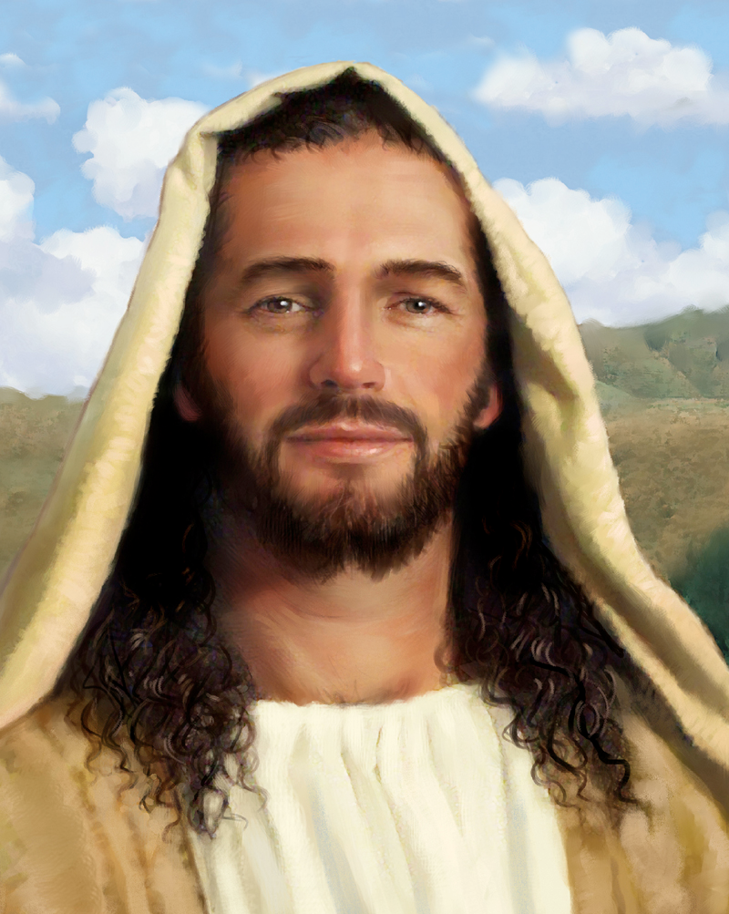
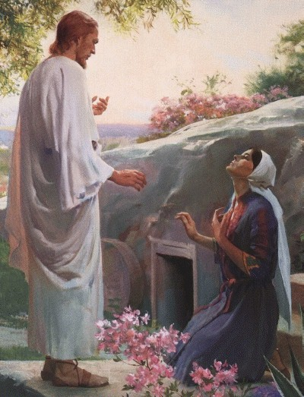
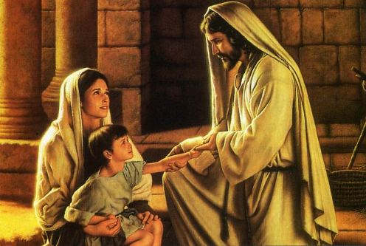
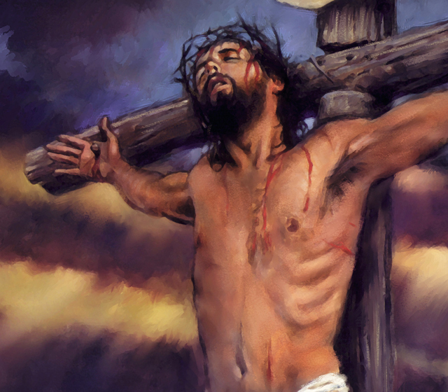
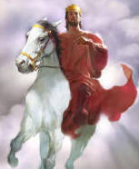
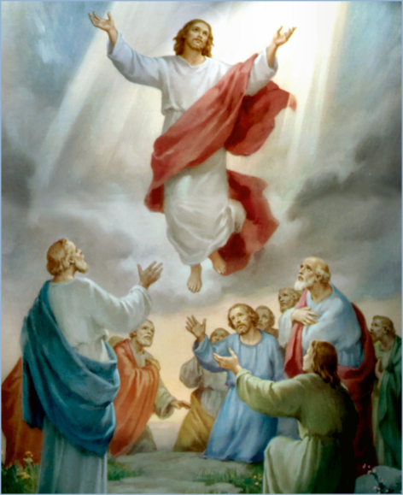
The Doctrine of Jesus Christ (Part 21)
The importance of the resurrection
and
The order of the resurrection

Slide 2
Review

Slide 4
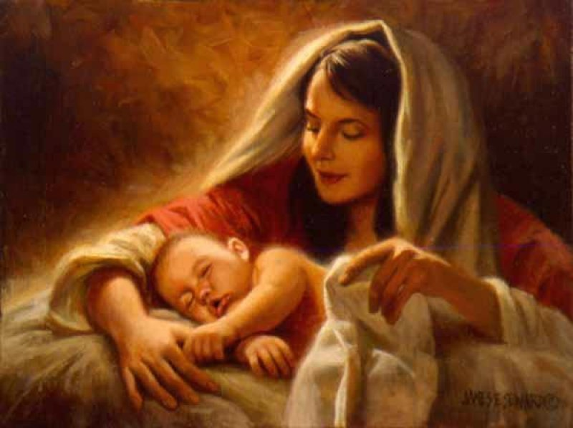
The Virgin Birth
“Behold, a virgin shall be with child, and shall bring forth a son, and they shall call his name Emmanuel, which being interpreted is, God with us.”
Matt. 1:23

Slide 6
Names and Titles of Jesus Christ

Slide 7
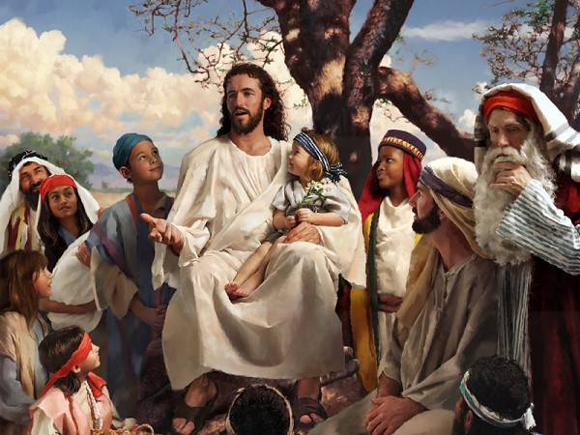
The Humanity of Jesus Christ

Slide 8
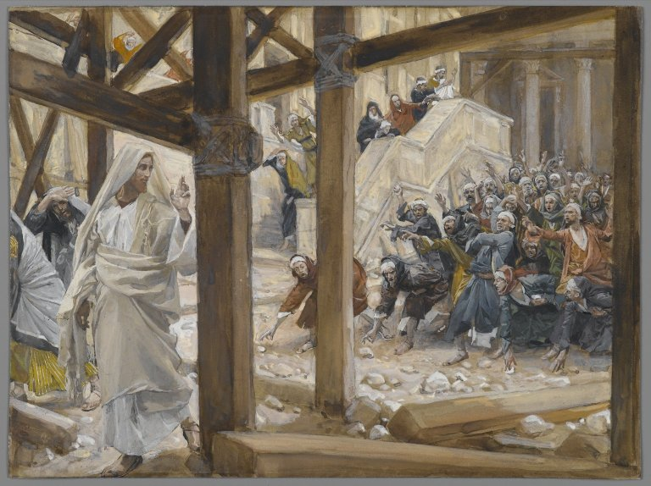
The Deity of Jesus Christ
(John 10:30-33)

Slide 9
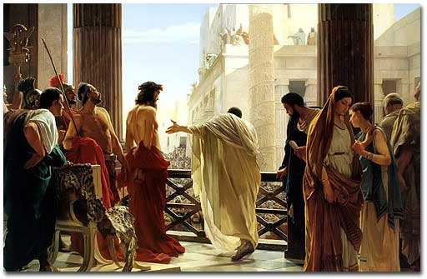
The Impeccability of Jesus Christ (John 18:38)

Slide 10
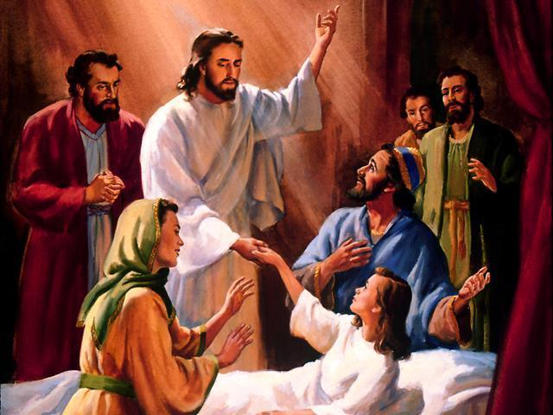
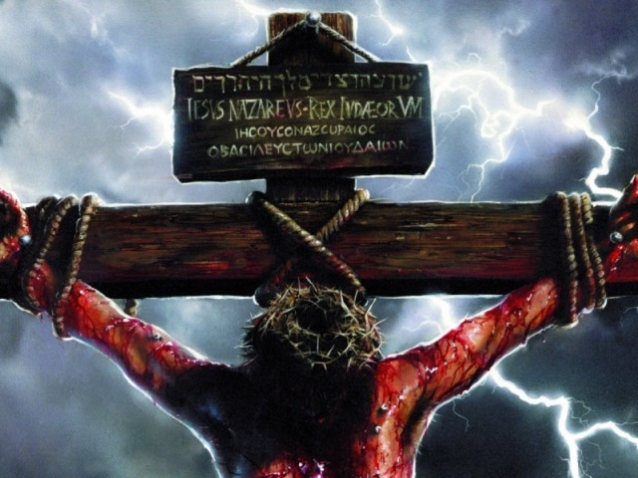
“For even the Son of man came not to be ministered unto, but to minister, and to give his life a ransom for many.” Mark 10:45
The Earthly Ministry of Jesus Christ

Slide 11
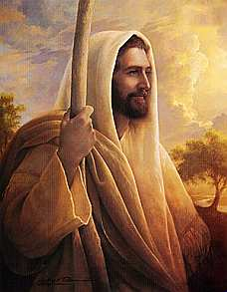
The Character of Jesus Christ
What kind of man was our Lord?
What were some of his characteristics?
zeal; compassion; meekness and gentleness; boldness and courage; love

Slide 12
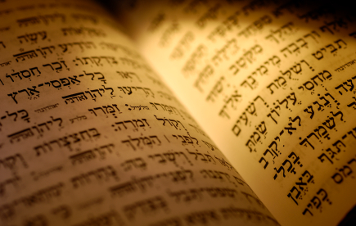
In the Old Testament three great offices were created by God to meet the spiritual and material needs of his chosen people.

Slide 13
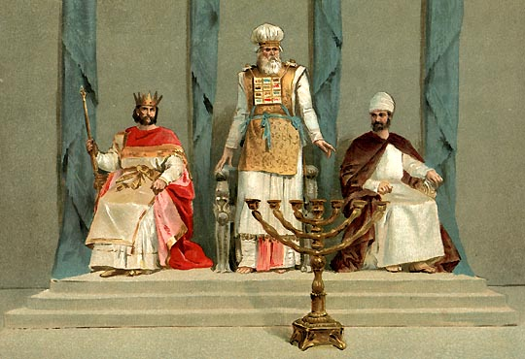
Jesus holds all three offices

Slide 14
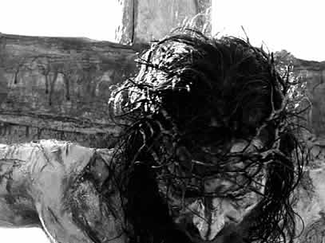
The Death of Jesus Christ

Slide 15
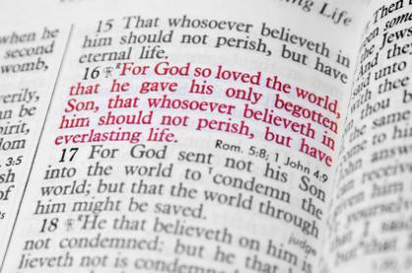

Slide 16
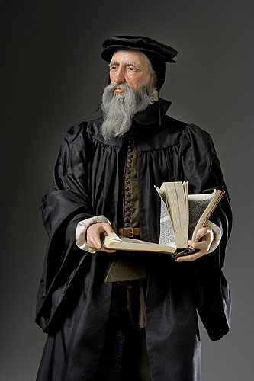
“Exposing the false Doctrine of Calvinism”
“I marvel that ye are so soon removed from him that called you into the grace of Christ unto another gospel …but there be some that trouble you, and would pervert the gospel of Christ. But though we, or an angel from heaven, preach any other gospel unto you than that which we have preached unto you, let him be accursed.” (Gal. 1:6-8)

Slide 17
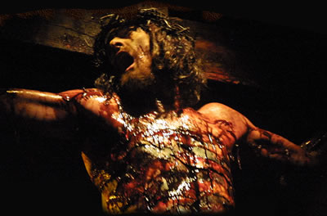
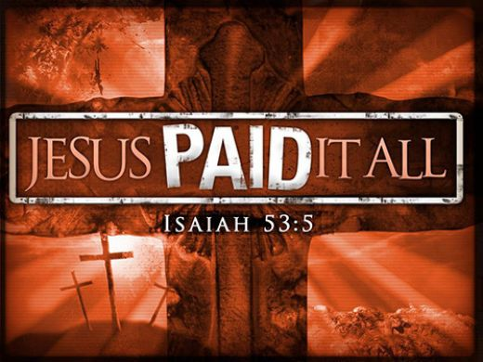
The Vicarious Atonement

Slide 18
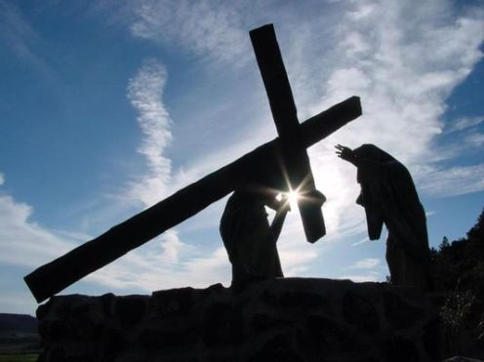
“Who his own self bare our sins in his own body on the tree.”
I Peter 2:24

Slide 19
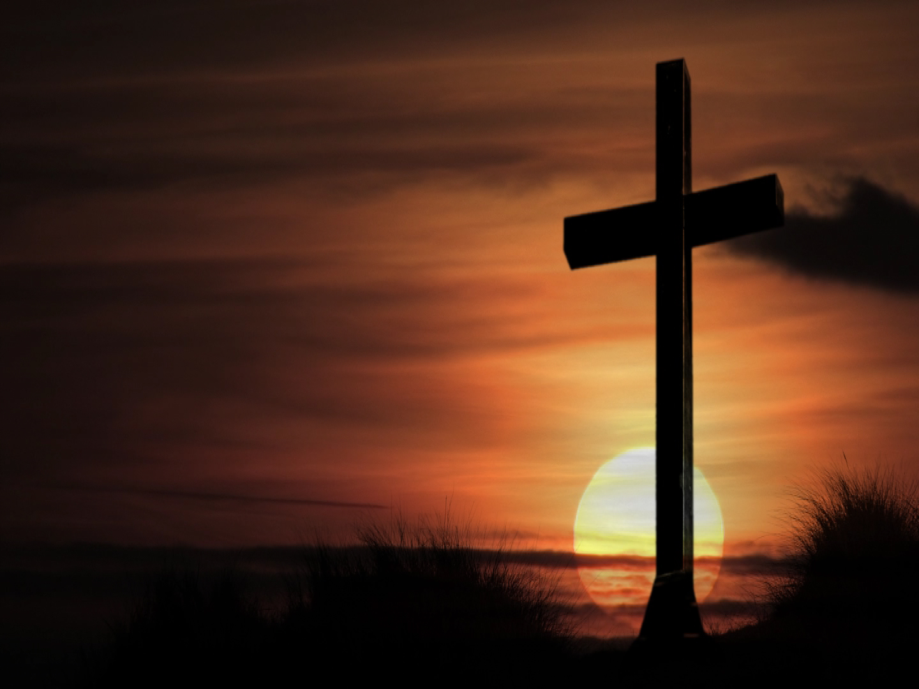
The results of the vicarious atonement
Redemption
Reconciliation
Justification
Sanctification
Glorification
Regeneration
Remission
Imputation
Propitiation
Forgiveness
Adoption
Ransom
Pardon
Eternal Salvation

Slide 20
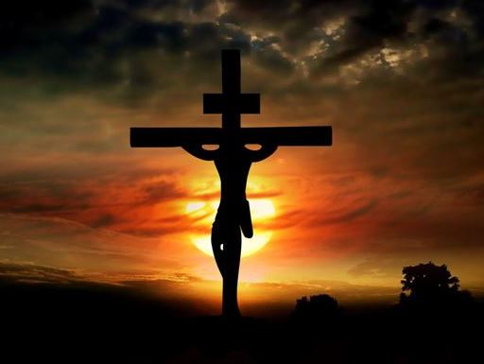
The seven last statements of Christ

Slide 21
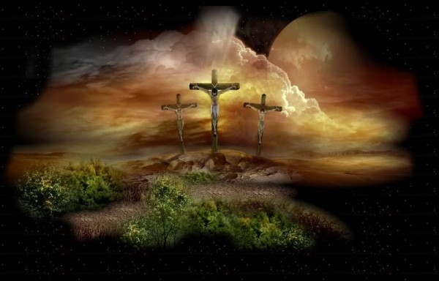
“Father, forgive them; for they know not what they do.”
“Today shalt thou be with me in paradise.”
“Woman, behold thy son! Then saith he to the disciple, Behold thy mother!”
“My God, my God, why hast thou forsaken me?”
“I thirst.”
“It is finished.”
“Father, into thy hands I commend my spirit.”

Slide 22
Christ descent into the heart of the earth

Slide 23
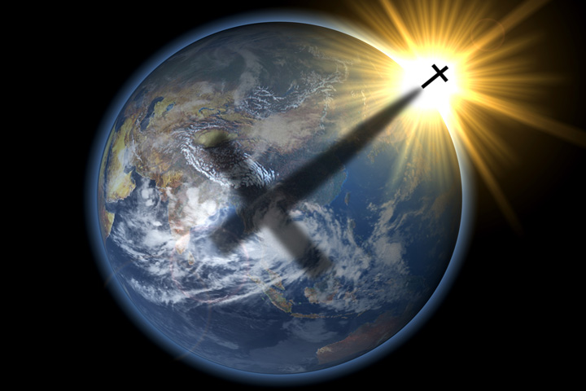
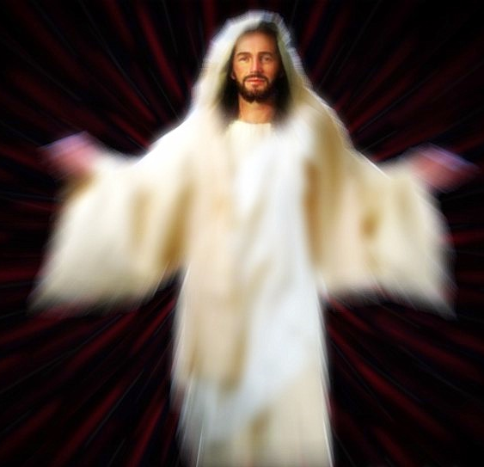

Slide 24
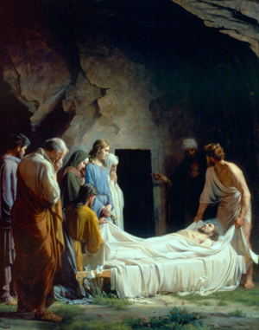
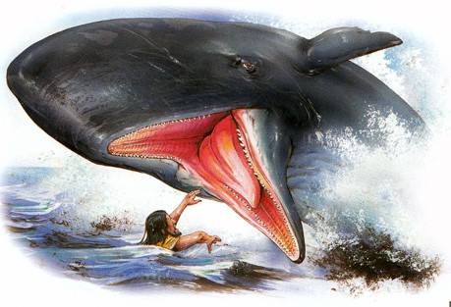
"For as Jonas was three days and three nights in the whale’s belly; so shall the Son of man be three days and three nights in the
heart of the earth."
Matt. 12:40

Slide 25
“For Christ also hath once suffered for sins, the just for the unjust, that he might bring us to God, being put to death in the flesh, but quickened by the Spirit: By which also he went and preached unto the spirits in prison; Which sometime were disobedient, when once the longsuffering of God waited in the days of Noah, while the ark was a preparing, wherein few, that is, eight souls were saved by water.” (I Peter 3:18-20)

Slide 26
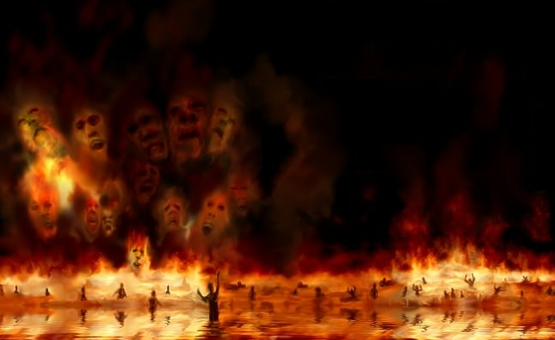
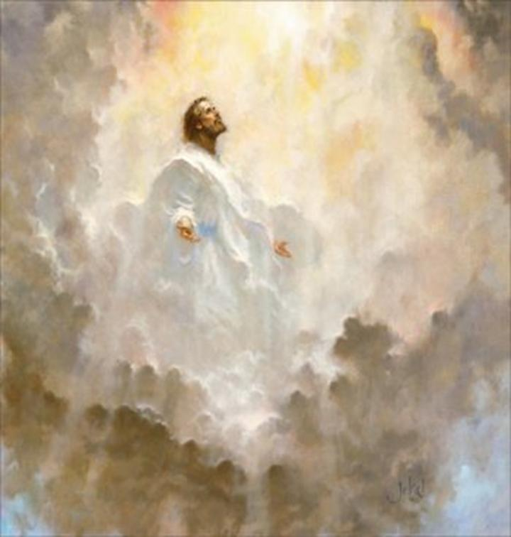
Torments
Paradise (Abraham's bosom)

Slide 27
“Wherefore he saith, When he ascended up on high, he led captivity captive, and gave gifts unto men. Now that he ascended, what is it but that he also descended first into the lower parts of the earth? He that descended is the same also that ascended up far above all heavens, that he might fill all things.” (Ephesians 4:8-9)

Slide 28
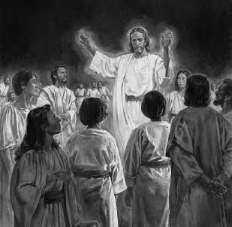

Slide 29
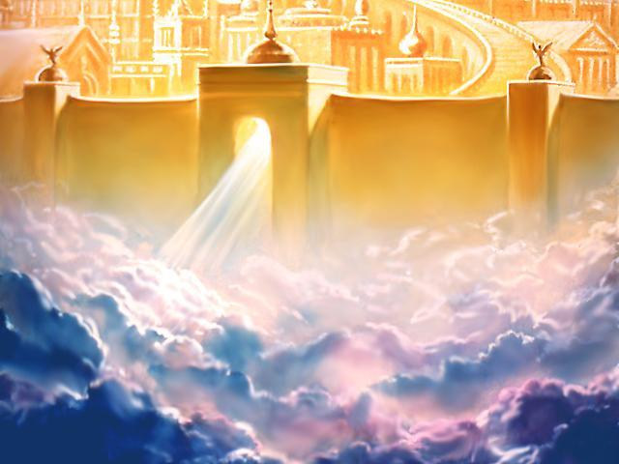
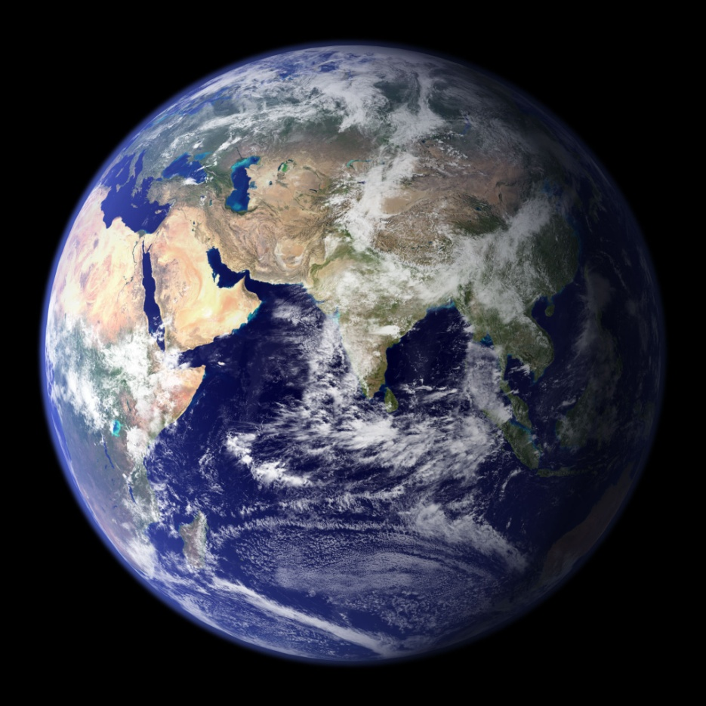

Slide 30
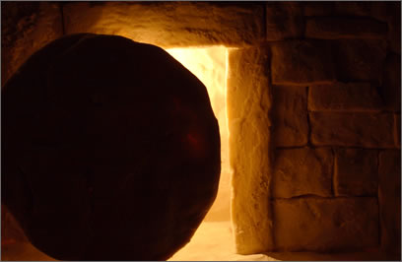
The Resurrection of Jesus Christ

Slide 31
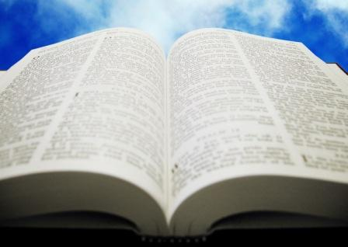
The Most Important Bible Doctrine (I Corinthians 15)
“And if Christ be not risen, then is our preaching vain, and your faith is also vain. Yea, and we are found false witnesses of God; because we have testified of God that he raised up Christ: whom he raised not up, if so be that the dead rise not. For if the dead rise not, then is not Christ raised: And if Christ be not raised, your faith is vain; ye are yet in your sins.”

Slide 32
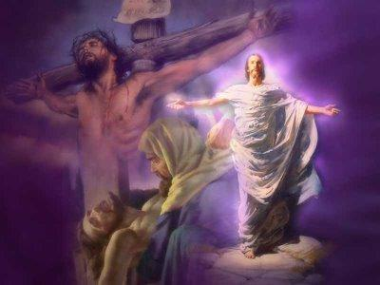
A person can not be saved unless they believer in the Resurrection of Jesus Christ.
“Repent ye, and believe the gospel.” (Mark 1:15)

Slide 33
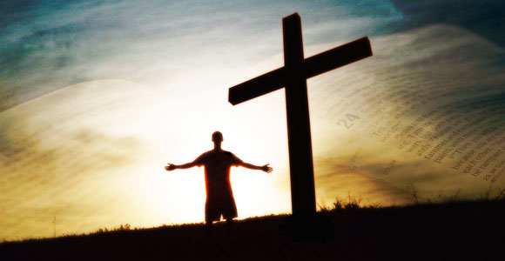
Romans 10:9
“That if thou shalt confess with thy mouth the Lord Jesus, and shalt believe in thine heart that God hath raised him from the dead, thou shalt be saved.”

Slide 34
The Infallible Proofs of the Resurrection
“The former treatise have I made, O Theophilus, of all that Jesus began both to do and teach, Until the day in which he was taken up, after that he through the Holy Ghost had given commandments unto the apostles whom he had chosen: To whom also he shewed himself alive after his passion by many infallible proofs, being seen of them forty days, and speaking of the things pertaining to the kingdom of God.” (Acts 1:1-3)

Slide 35
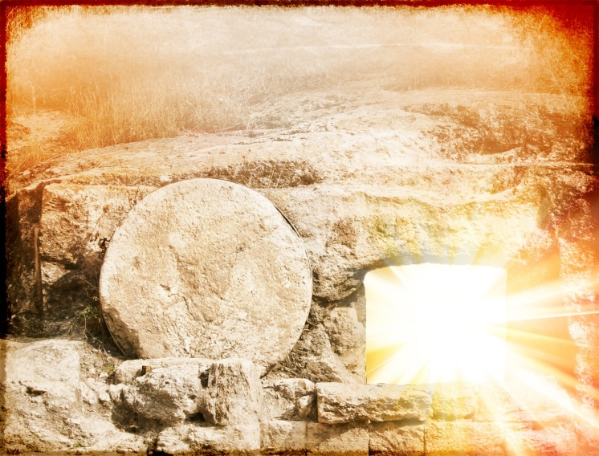
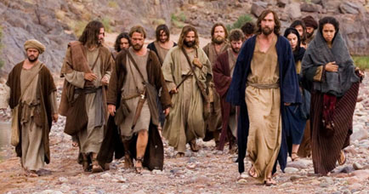
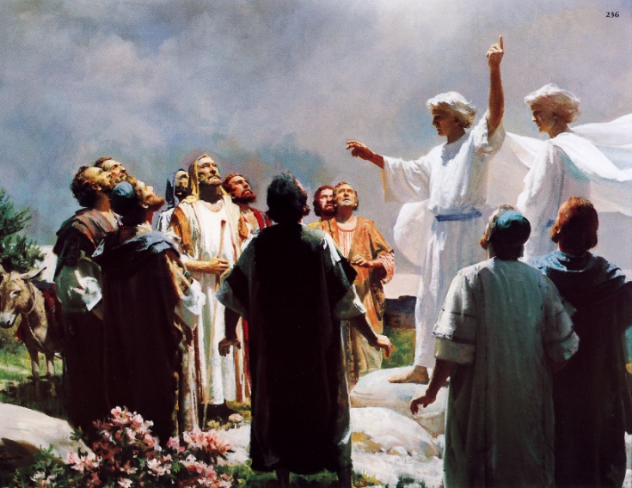
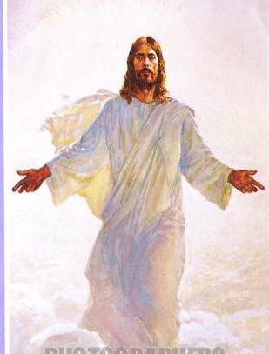
40 days

Slide 36
40 days

Slide 37
40 days
“…many infallible proofs.”

Slide 38
The proofs of the resurrection
The empty tomb - (Matthew 27:63-66)
The tremendous change in the lives of the disciples - (Acts 17:6)
The silence from both the Romans and Pharisees – (Matthew 28:1-15)
The change from Saturday to Sunday as the main day of worship – (I Corinthians 16:1-2)
The existence, growth persecution of the early church – (Acts 2:47)

Slide 39
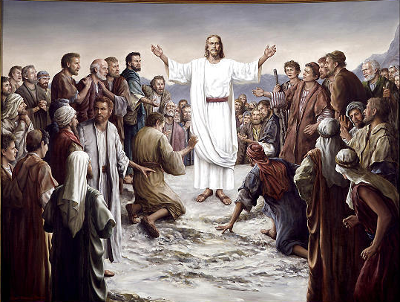
Seventeen appearances of Jesus after the resurrection

Slide 41
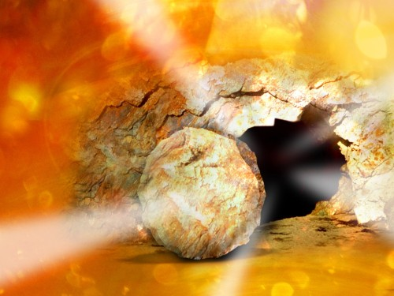
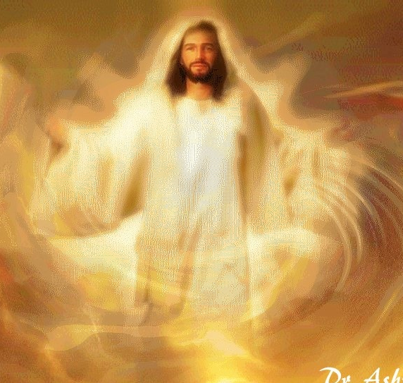
The importance of the resurrection

Slide 42
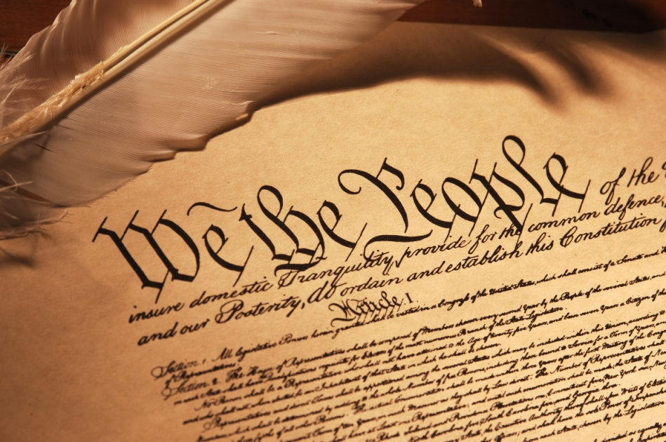
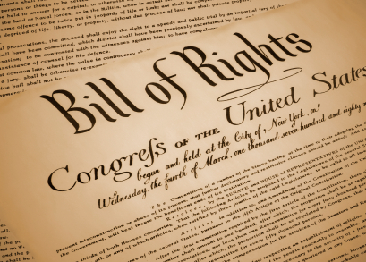
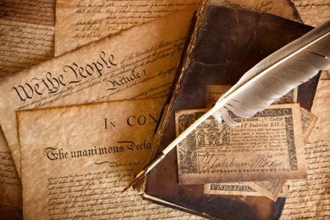
The Resurrection of Christ is the Constitution, Bill of Rights, and Declaration of Independence of the Christian faith.

Slide 43
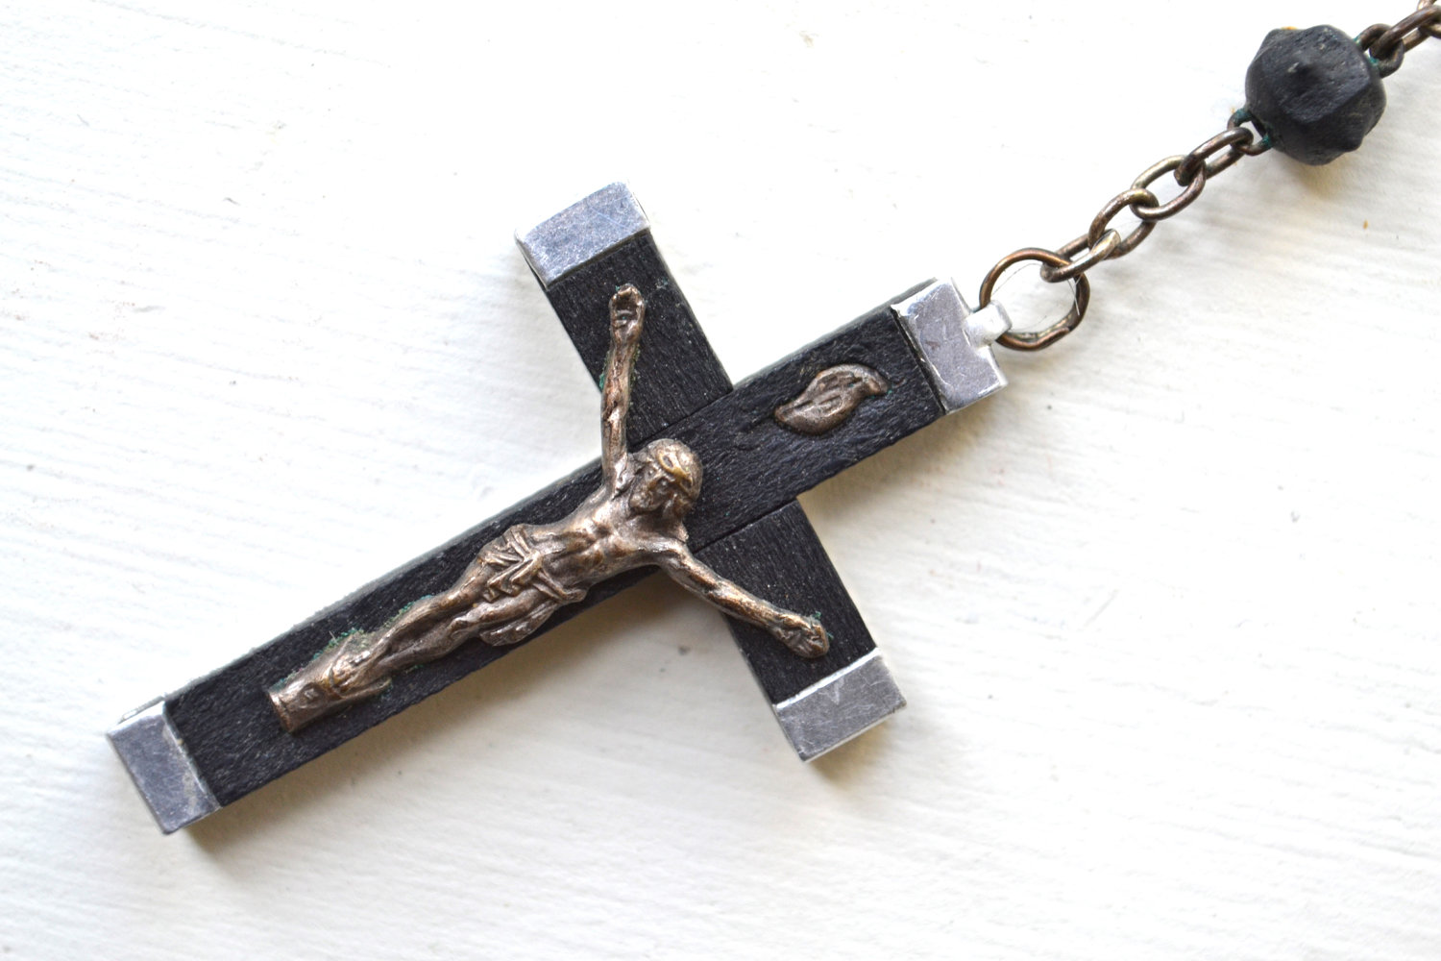
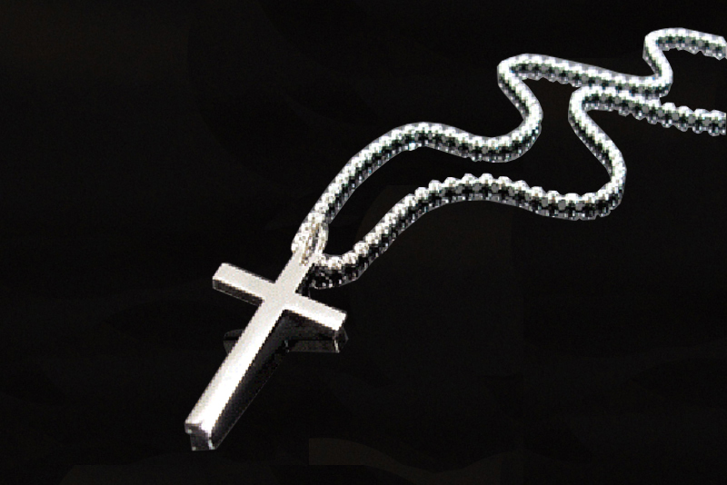
What is the sign of Chistianity?

Slide 44
The sign of Christianity is really not the cross, but an empty tomb.

Slide 46
If the resurrection is not true, we must accept six horrible conclusions
All gospel preaching has been, is now, and always will be, utterly and completely useless.
All past, present, and future faith is futile.
All gospel preachers liars.
All living Christians are still in their sins.
All departed Christians are in hell.
All reason and purpose for life itself is destroyed.

Slide 47
“But now is Christ risen from the dead.”
(I Cor. 15:20)

Slide 48
I Cor. 15:58 “Therefore, my beloved brethren, be ye stedfast, unmoveable, always abounding in the work of the Lord, forasmuch as ye know that your labour is not in vain in the Lord.”

Slide 49
The order of the resurrection (I Cor. 15:20-24)
²⁰ But now is Christ risen from the dead, and become the firstfruits of them that slept.
²¹ For since by man came death, by man came also the resurrection of the dead.
²² For as in Adam all die, even so in Christ shall all be made alive.
²³ But every man in his own order: Christ the firstfruits; afterward they that are Christ's at his coming.
²⁴ Then cometh the end, when he shall have delivered up the kingdom to God, even the Father; when he shall have put down all rule and all authority and power.

Slide 50
First fruits harvest (Leviticus 23)

Slide 51
Christ’s resurrection was the first fruits of the resurrections -
Before Israelites harvested their crops they were to bring a representative sample, called the first fruits, to the priests as an offering to the Lord (Lev. 23:10).
The full harvest could not be made until the first fruits were offered (Lev. 23:11-12).
That is the point of Paul's figure here. Christ's own resurrection was the first fruits of the resurrection "harvest" of the believing dead.

Slide 52
In His death and resurrection Christ made an offering of Himself to the Father on our behalf – Hebrews 7:27
The significance of the first fruits, however, not only was that they preceded the harvest but that they were a first installment of the harvest.
The fact that Christ was the first fruits therefore indicates that something else, namely the harvest of the rest of the crop, is to follow.

Slide 53
“Honour the LORD with thy substance, and with the firstfruits of all thine increase.” Prov. 3:9

Slide 54
Christ resurrection as the First Fruits does not mean that Christ was the first to rise from the dead

Slide 55
The resurrection of Christ is represented here as being the first of its kind, thus indicating that previous resurrections, were different then his resurrection.

Slide 56
Elijah resurrected the son of Zarephath's widow (I Kings 17:17-24)

Slide 57
Elisha resurrected the son of the Shunammite woman (II Kings 4:35)

Slide 58
A dead man comes back to life when he touches Elisha's bones (II Kings 13:21)

Slide 59
Jesus resurrects the widow's son (Luke 7:13-15)

Slide 60
Jesus raises Jairus' daughter from the dead (Matthew 9:25)

Slide 61
Jesus raises Lazarus from the dead (John 11:43-44)

Slide 62
Many saints resurrected at Jesus' crucifixion (Matthew 27:52-53)

Slide 63
These resurrections were on the order of restoring a dead mortal body to a living mortal body.
These people all were raised from the dead only to die again.
Christ in his resurrection shall never die again - “Knowing that Christ being raised from the dead dieth no more; death hath no more dominion over him.” Rom. 6:9
Those who follow Christ in resurrection shall never die – “Jesus said unto her, I am the resurrection, and the life: he that believeth in me, though he were dead, yet shall he live.” John 11:25

Slide 64
"Verily, verily, I say unto you, He that heareth my word, and believeth on him that sent me, hath everlasting life, and shall not come into condemnation; but is passed from death unto life" (John 5:24)

Slide 65
True resurrection carries with it Glorification
“And we know that all things work together for good to them that love God, to them who are the called according to his purpose. For whom he did foreknow, he also did predestinate to be conformed to the image of his Son, that he might be the firstborn among many brethren. Moreover whom he did predestinate, them he also called: and whom he called, them he also justified: and whom he justified, them he also glorified.” (Romans 8:28-30)

Slide 66
1. The resurrection of Christ - (Matt. 28:5-8)
2. The rapture of the church resurrection -
"For the Lord himself shall descend from heaven with a shout, with the voice of the archangel, and with the trump of God: and the dead in Christ shall rise first" (I Thess. 4:16)
"For this corruptible must put on in-corruption, and this mortal must put on immortality" (I Cor. 15:53)
3. The premillennial resurrection of Old Testament and Tribulation Saints - "And many of them that sleep in the dust of the earth shall awake, some to everlasting life, and some to shame and everlasting contempt" (Dan. 12:2)

Slide 68
"And I saw thrones, and they sat upon them, and judgment was given unto them (Church and Old Testament Saints): and I saw the souls of them that were beheaded for the witness of Jesus and for the word of God, and which had not worshipped the beast, neither his image, neither had received his mark upon their foreheads, or in their hands (Tribulation Saints), and they lived and reigned with Christ a thousand years. (But the rest of the dead (unbelieving) lived not again until the thousand years were finished.) This is the first resurrection. Blessed and holy is he that hath part in the first resurrection: on such the second death hath no power, but they shall be priests of God and of Christ, and shall reign with him a thousand years" (Rev. 20:4-6)

Slide 69
Christ will rule his Earthly Kingdom through three classes of resurrected administrators

Slide 70
Apostles and Church resurrected at the end of the church age (Rapture) – (Matt.19:29-29; I Cor. 15:51-58; I Thess. 4:13-18)
Old Testament saints who will be resurrected at the end of the Tribulation at the Second Coming of Christ (Revelation) – (Isa. 26:19; Dan. 12:2)
Tribulation Saints also resurrected at the Revelation of Jesus Christ – (Rev. 7:9-17, 20:4)

Slide 71
Church Saints

Slide 72
Tribulation Saints

Slide 73
Old Testament Saints

Slide 74
There are Two Resurrections
Resurrection of the saved
Resurrection of the lost
John 5:29 “And shall come forth; they that have done good (Saved), unto the resurrection of life; and they that have done evil (Lost), unto the resurrection of damnation.”

Slide 75
The First Resurrection has two parts
Rapture
New Testament Saints
Revelation
Old Testament and Tribulation Saints

Slide 76
“Who shall change our vile body, that it may be fashioned like unto his glorious body, according to the working whereby he is able even to subdue all things unto himself.” Phil. 3:21

Slide 77
II Corinthians 5:1-4

Slide 78
“For we know that if our earthly house of this tabernacle (mortal body) were dissolved,
Gen. 2:7 “And the LORD God formed man of the dust of the ground, and breathed into his nostrils the breath of life; and man became a living soul.”
Job 34:15 “All flesh shall perish together, and man shall turn again unto dust.”

Slide 79
we have a building of God, an house not made with hands, eternal in the heavens .
John 14:2-3 “In my Father's house are many mansions: if it were not so, I would have told you. I go to prepare a place for you. And if I go and prepare a place for you, I will come again, and receive you unto myself; that where I am, there ye may be also.”

Slide 80
For in this we groan, earnestly desiring to be clothed upon with our house which is from heaven.
Rom. 8:18-23 “For I reckon that the sufferings of this present time are not worthy to be compared with the glory which shall be revealed in us. For the earnest expectation of the creature waiteth for the manifestation of the sons of God...Because the creature itself also shall be delivered from the bondage of corruption into the glorious liberty of the children of God. For we know that the whole creation groaneth and travaileth in pain together until now. And not only they, but ourselves also, which have the firstfruits of the Spirit, even we ourselves groan within ourselves, waiting for the adoption, to wit, the redemption of our body.”

Slide 81
If so be that being clothed we shall not be found naked. For we that are in this tabernacle do groan, being burdened: not for that we would be unclothed, but clothed upon, that mortality might be swallowed up of life.”
I Cor. 15:55-57 “O death, where is thy sting? O grave, where is thy victory? The sting of death is sin; and the strength of sin is the law. But thanks be to God, which giveth us the victory through our Lord Jesus Christ.”

Slide 82
Millennial Kingdom (1000 years) “And they lived and reigned with Christ a thousand years.”
First Resurrection
Second Resurrection

Slide 83
The Second Resurrection (second death)
“But the rest of the dead (unbelievers) lived not again until the thousand years were finished.”

