Slide 1
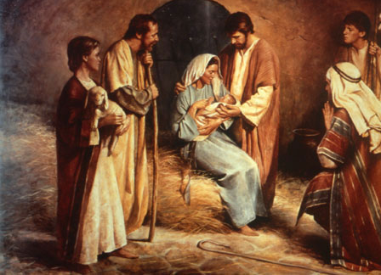
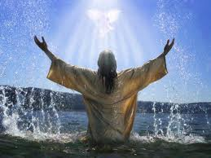
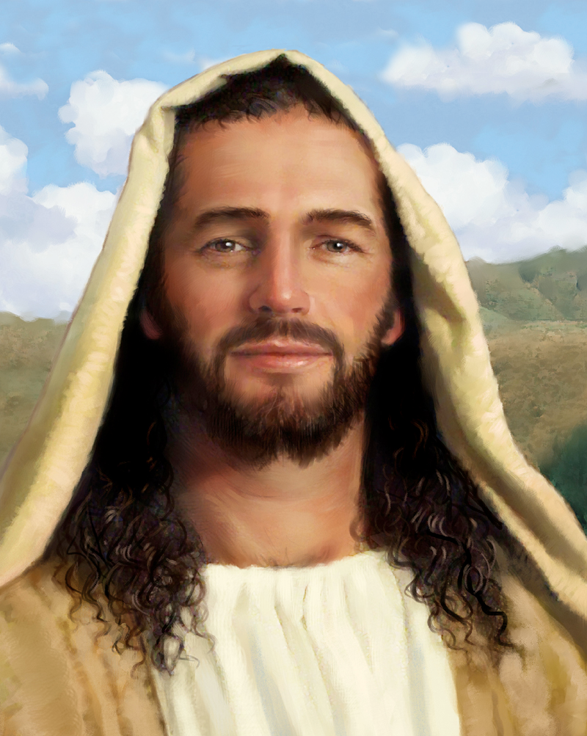
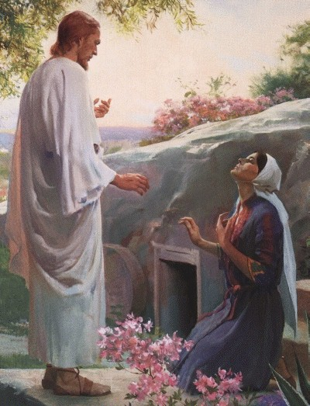
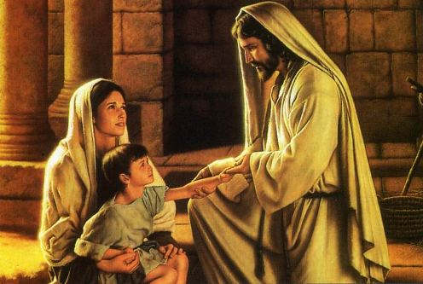
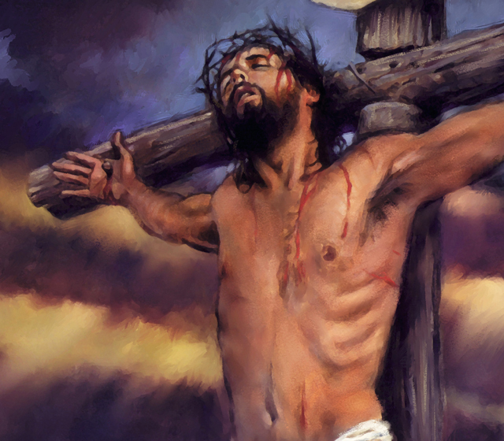
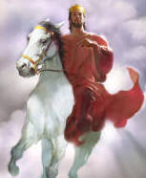
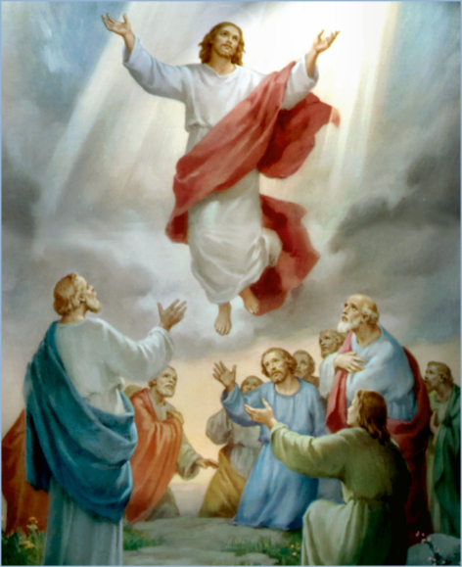
The Doctrine of Jesus Christ (Part 16)
The Death of Jesus Christ
“The results of the vicarious atonement"
(Part 4)

Slide 2
Review

Slide 4
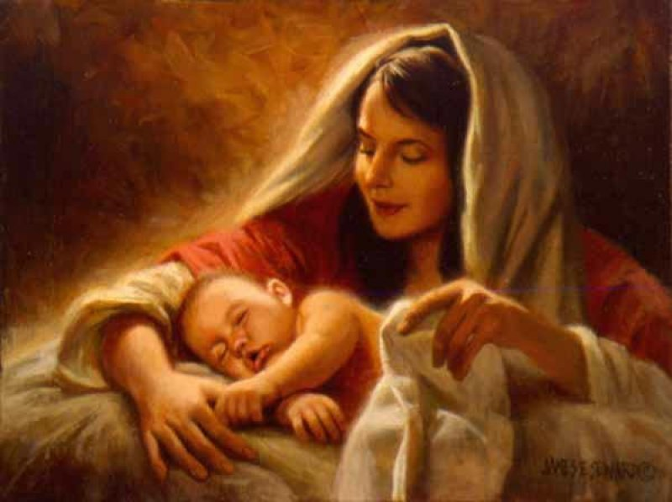
The Virgin Birth
“Behold, a virgin shall be with child, and shall bring forth a son, and they shall call his name Emmanuel, which being interpreted is, God with us.”
Matt. 1:23

Slide 5
The Incarnation of Christ
(John 1:1-14)
God the Son took upon himself the full nature of man and yet retain the full nature of God.

Slide 6
Names and Titles of Jesus Christ

Slide 7
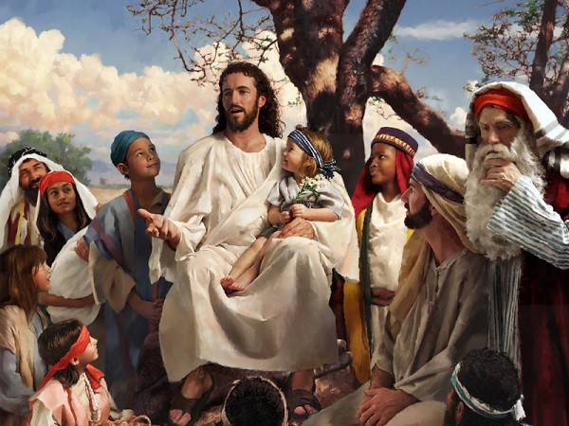
The Humanity of Jesus Christ

Slide 8
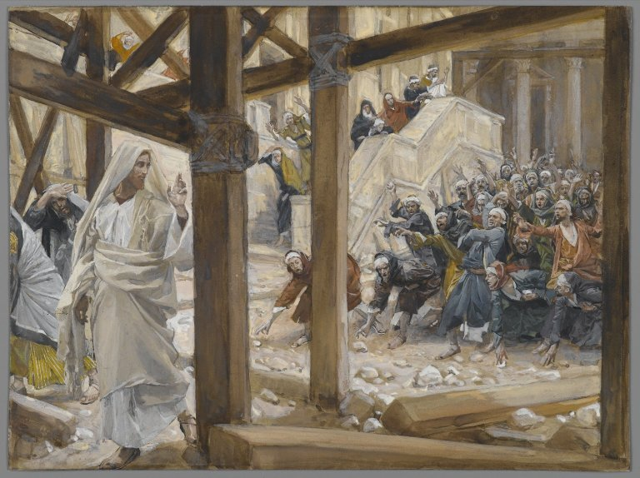
The Deity of Jesus Christ
(John 10:30-33)

Slide 9
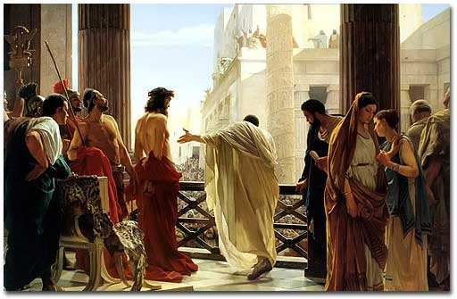
The Impeccability of Jesus Christ (John 18:38)

Slide 10
The Earthly Ministry of Jesus Christ

Slide 11
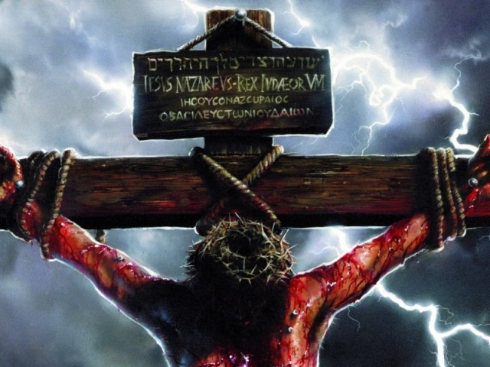
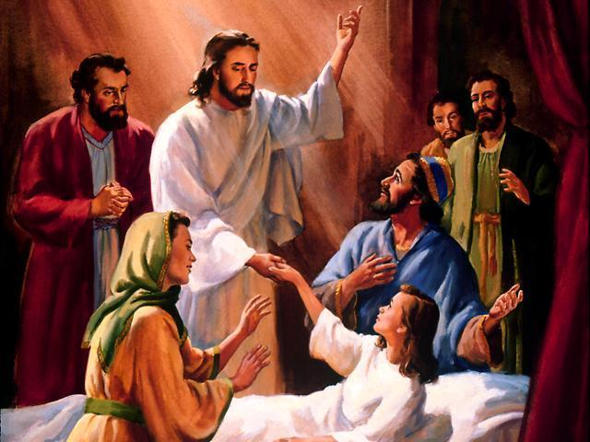
“For even the Son of man came not to be ministered unto, but to minister, and to give his life a ransom for many.” Mark 10:45

Slide 12
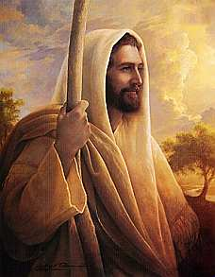
The Character of Jesus Christ
What kind of man was our Lord?
What were some of his characteristics?

Slide 13
The character of Christ
His zeal
His compassion
His meekness and gentleness
His boldness and courage
His love

Slide 14
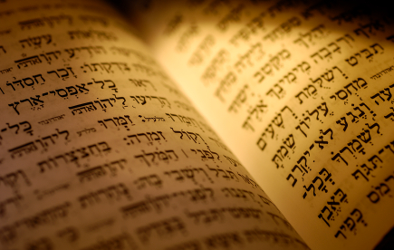
In the Old Testament three great offices were created by God to meet the spiritual and material needs of his chosen people.

Slide 15
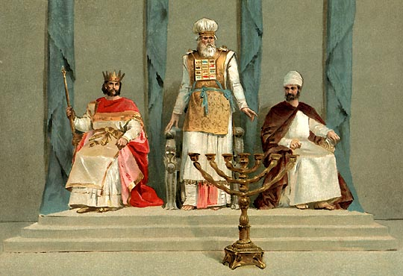
Jesus holds all three offices

Slide 16
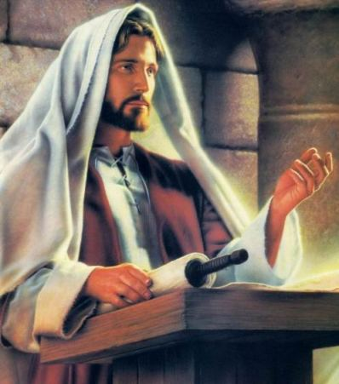

Slide 17
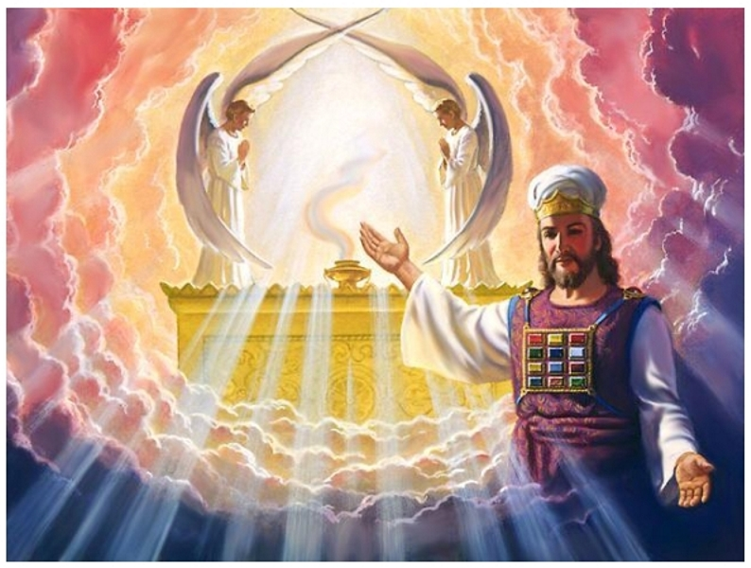

Slide 18
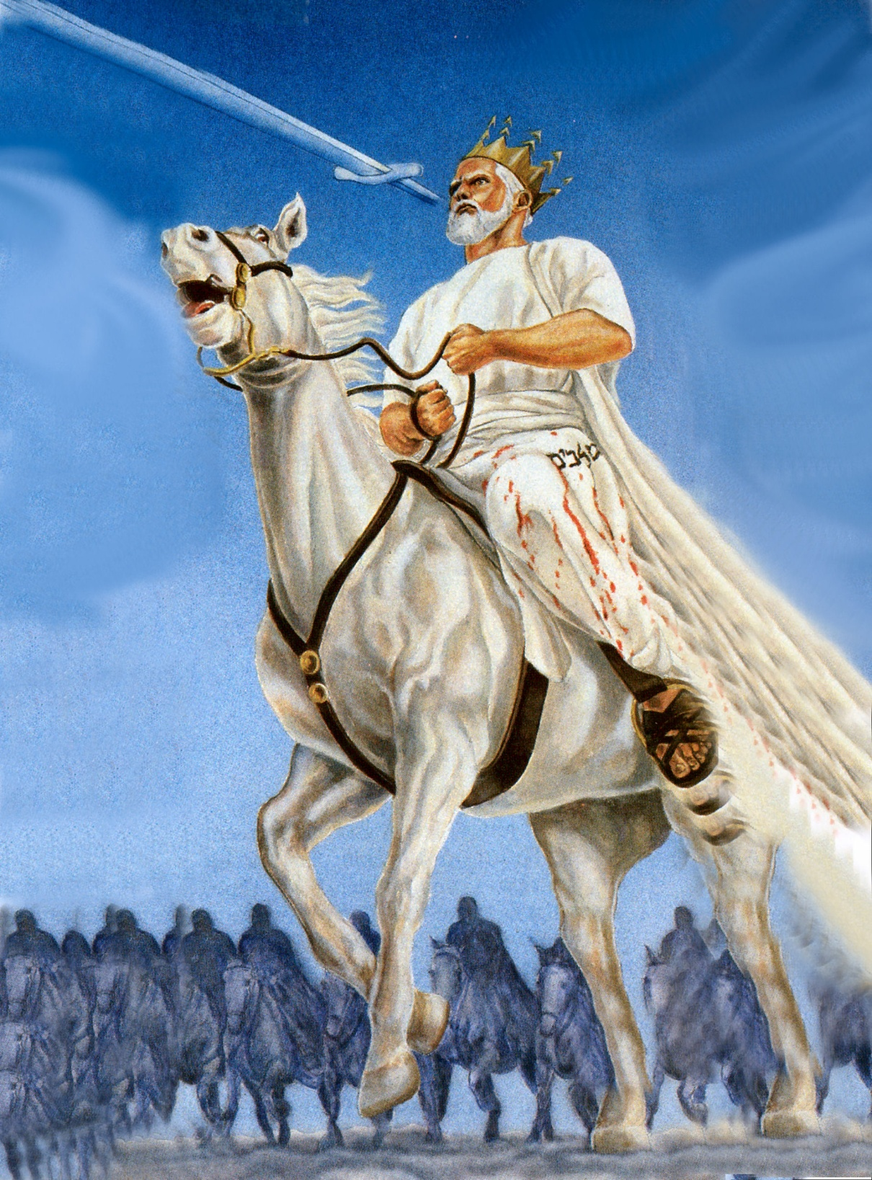

Slide 19
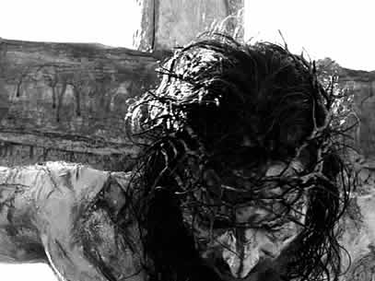
The Death of Jesus Christ

Slide 20
“For I delivered unto you first of all that which I also received, how that Christ died for our sins according to the scriptures; And that he was buried, and that he rose again the third day according to the scriptures.”
(I Cor. 15:3-5)

Slide 21
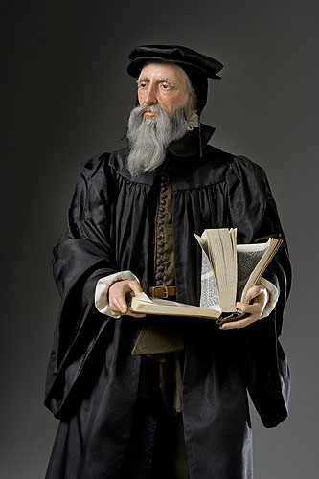
“Exposing the false Doctrine of Calvinism”
“I marvel that ye are so soon removed from him that called you into the grace of Christ unto another gospel …but there be some that trouble you, and would pervert the gospel of Christ. But though we, or an angel from heaven, preach any other gospel unto you than that which we have preached unto you, let him be accursed.” (Gal. 1:6-8)

Slide 22
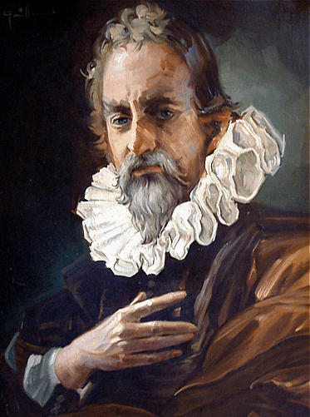
"We call predestination God’s eternal decree, by which He determined what He willed to become of each man. For all are not created in equal condition; rather, eternal life is ordained for some, eternal damnation for others."

Slide 23
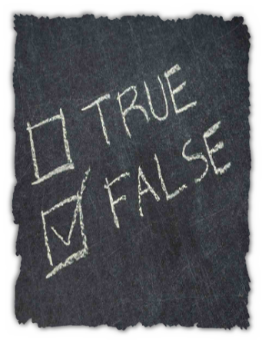
Calvinism teaches that some men are predestinated to Heaven and others are predestinated to Hell. It is strictly God’s choice and man can not change it.

Slide 24
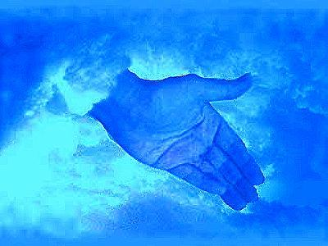
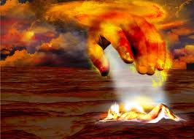
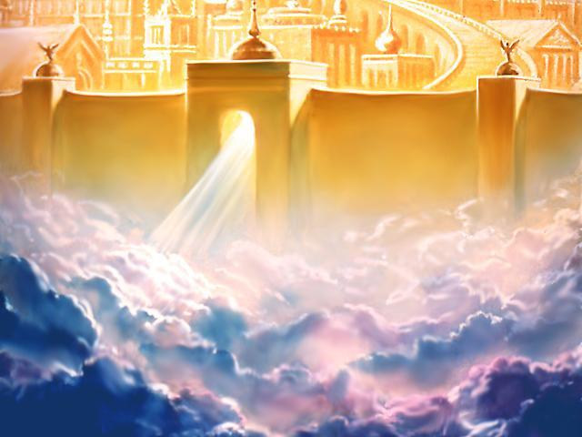
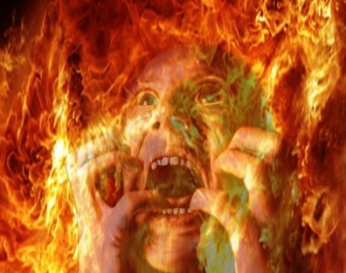

Slide 25
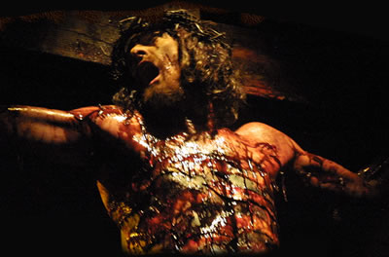
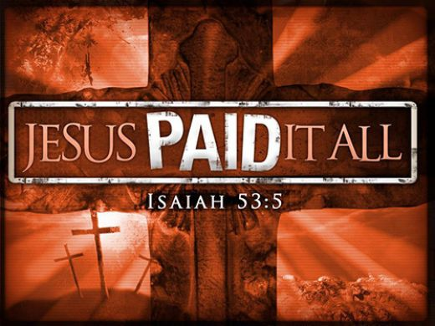
The Vicarious Atonement

Slide 26
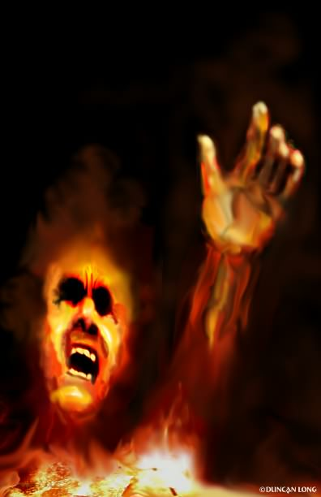
The word "vicarious" means substitute. Christ was a substitute for others in that He took their place and suffered their punishment.
Without Christ “vicarious death”, we are all going to die and spend an eternity in hell as payment for our sins (Rev. 20:14).

Slide 27
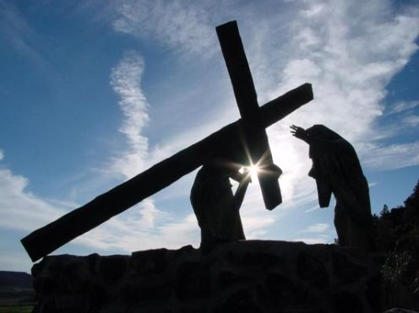
“Who his own self bare our sins in his own body on the tree.”
I Peter 2:24

Slide 28
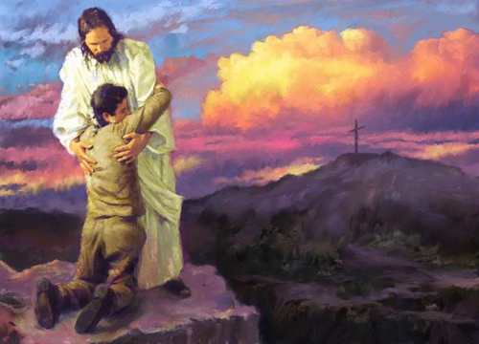
What are the results of the vicarious atonement for those that believe?
The “vicarious” death of Christ

Slide 29
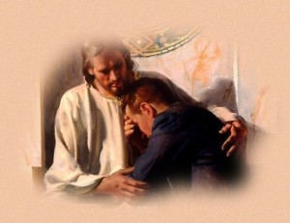
In relationship to repentant believing sinners (Acts 20:21)
Redemption

Slide 30
"In whom we have redemption through his blood, the forgiveness of sins, according to the riches of his grace" (Eph. 1:7)
The meaning of Redemption = Redemption is the English translation of the Greek word agorazo, meaning "to purchase in the marketplace."
In ancient times, it often referred to the act of buying a slave.
The Biblical use of redemption means Jesus Christ, through his sacrificial death, purchased believers from the slavery of sin and set them free from the penalty and bondage sin –Rom. 6-8

Slide 31
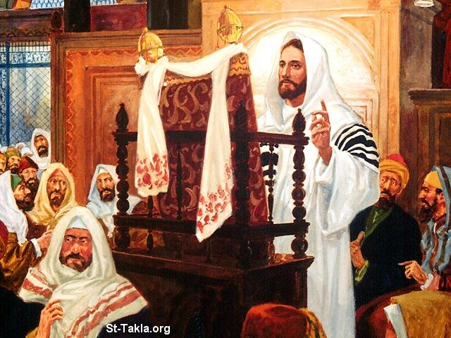
“The Spirit of the Lord is upon me, because he hath anointed me to preach the gospel to the poor; he hath sent me to heal the brokenhearted, to preach deliverance to the captives, and recovering of sight to the blind, to set at liberty them that are bruised.”
(Luke 4:18)

Slide 32
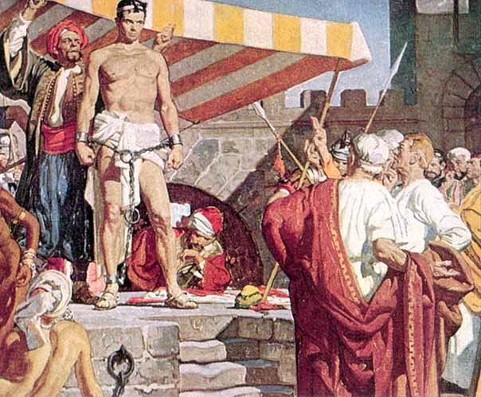
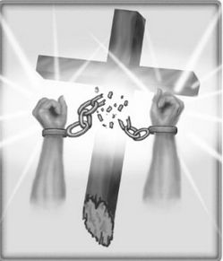
“Know ye not, that to whom ye yield yourselves servants to obey, his servants ye are to whom ye obey; whether of sin unto death, or of obedience unto righteousness? But God be thanked, that ye were the servants of sin,
but ye have obeyed from the heart that form of doctrine which was delivered you. Being then made free from sin, ye became the servants of righteousness.”
(Romans 6:16-18)

Slide 33
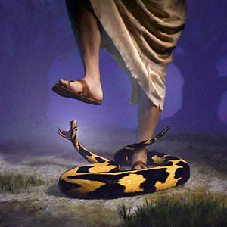
In relation to Satan
“And I will put enmity between thee and the woman, and between thy seed and her seed;
it (Christ) shall bruise (crush) thy head, and thou (Satan) shalt bruise his heel.”
(Gen. 3:15)
Destruction

Slide 34
"Forasmuch then as the children are partakers of flesh and blood, he also himself likewise took part of the same; that through death he might destroy him that had the power of death, that is, the devil" (Heb. 2:14)
"And having spoiled principalities and powers, he made a show of them openly, triumphing over them in it" (Col. 2:15)
"He that committeth sin is of the devil; for the devil sinneth from the beginning. For this purpose the Son of God was manifested, that he might destroy the works of the devil" (I John 3:8)

Slide 35
"And the great dragon was cast out, that old serpent, called the Devil, and Satan, which deceiveth the whole world: he was cast out into the earth, and his angels were cast out with him. And I heard a loud voice saying in heaven, Now is come salvation, and strength, and the kingdom of our God, and the power of his Christ: for the accuser of our brethren is cast down, which accused them before our God day and night. And they overcame him by the blood of the Lamb, and by the word of their testimony; and they loved not their lives unto the death" (Rev. 12:9-11)

Slide 36
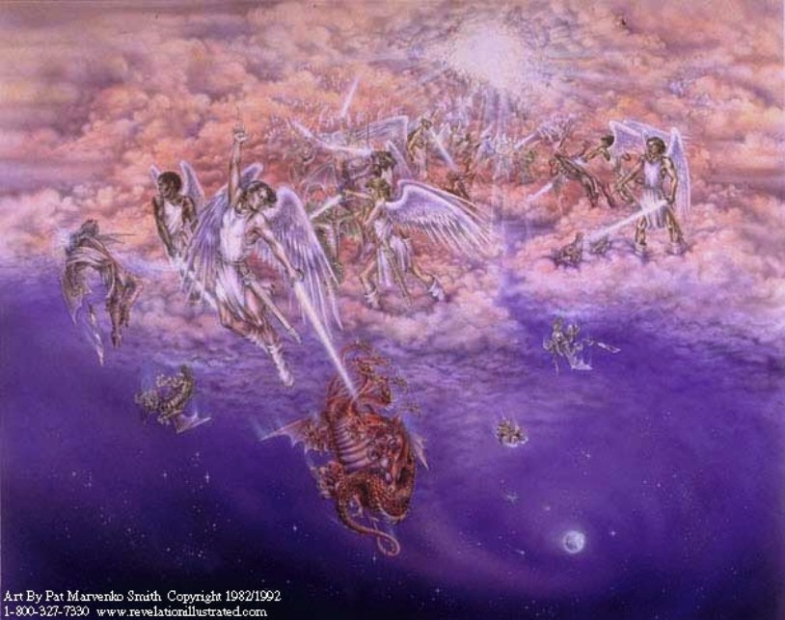

Slide 37
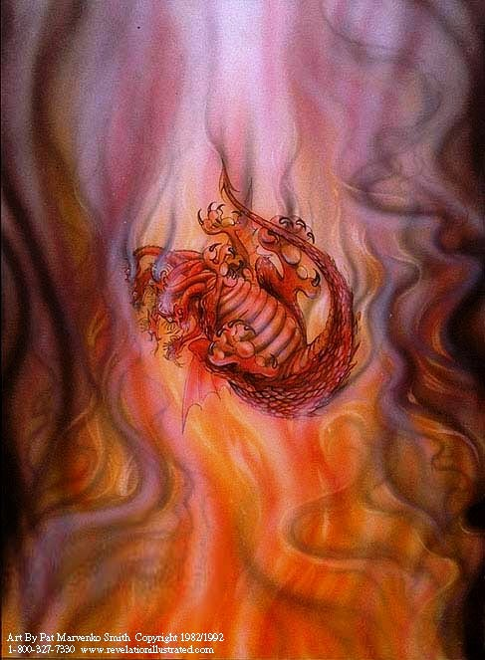
“And the devil that deceived them was cast into the lake of fire and brimstone.” Rev. 20:10

Slide 38
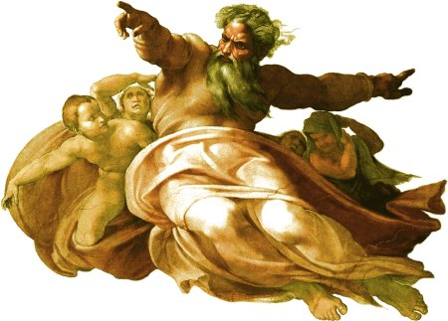
In relation to God

Slide 39
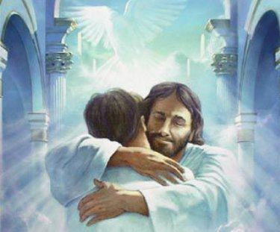
Reconciliation
“And you, that were sometime alienated and enemies in your mind by wicked works, yet now hath he reconciled In the body of his flesh through death, to present you holy and unblameable and unreproveable in his sight.” (Colossians 1:21-22)

Slide 40
Reconciliation = Bringing two opposing parties together in a peaceful relationship – “Therefore being justified by faith, we have peace with God through our Lord Jesus Christ.” Rom. 5:1
“And all things are of God, who hath reconciled us to himself by Jesus Christ, and hath given to us the ministry of reconciliation; To wit, that God was in Christ, reconciling the world unto himself, not imputing their trespasses unto them; and hath committed unto us the word of reconciliation.” II Cor. 5:18-19

Slide 41
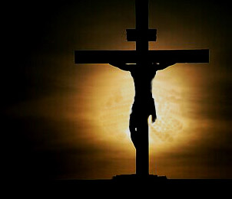
Justification “Being set free from the penalty of sin.”
Justification is a one-time legal act, wherein God deems the sinner righteous on the basis of Christ's righteousness.

Slide 42
Rom. 3:24 “Being justified freely by his grace through the redemption that is in Christ Jesus.”
Rom. 5:9 “Much more then, being now justified by his blood, we shall be saved from wrath through him.”
Rom. 5:16 “And not as it was by one that sinned, so is the gift: for the judgment was by one to condemnation, but the free gift is of many offences unto justification.”
Rom. 5:18 “Therefore as by the offence of one judgment came upon all men to condemnation; even so by the righteousness of one the free gift came upon all men unto justification of life.”

Slide 43
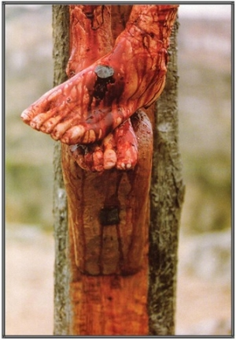
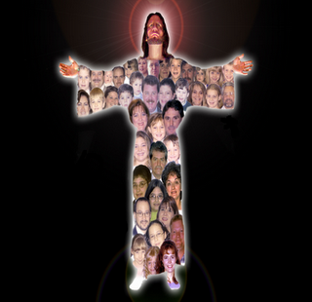
Sanctification
“By the which will we are sanctified through the offering of the body of
Jesus Christ once
for all.”
(Heb 10:10)
“But of him are ye in Christ Jesus, who of God is made unto us wisdom, and righteousness, and sanctification, and redemption.”
( I Cor. 1:30 )

Slide 44
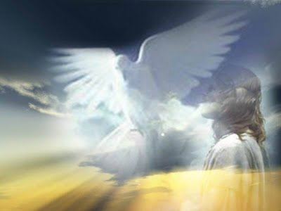
Positional Sanctification
II Thess. 2:13 “But we are bound to give thanks alway to God for you, brethren beloved of the Lord, because God hath from the beginning chosen you to salvation through sanctification of the Spirit and belief of the truth.”
I Pet. 1:2 “Elect according to the foreknowledge of God the Father, through sanctification of the Spirit.”

Slide 45
Personal Sanctification
I Thess. 4:3-4 “For this is the will of God, even your sanctification, that ye should abstain from fornication: That every one of you should know how to possess his vessel in sanctification and honour.”
I Pet. 3:15 “But sanctify the Lord God in your hearts.”

Slide 46
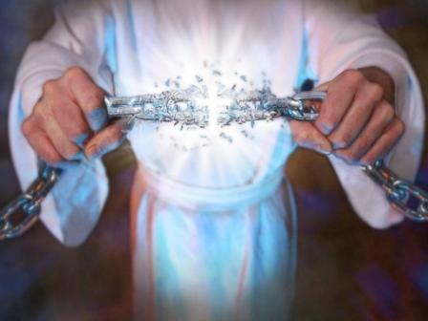
Being set free from the power of sin (Romans 6-8)

Slide 47
Glorification “Being set free from the presents of sin”
“And if children, then heirs; heirs of God, and joint-heirs with Christ; if so be that we suffer with him, that we may be also glorified together…Moreover whom he did predestinate, them he also called: and whom he called, them he also justified: and whom he justified, them he also glorified.”
(Rom. 8:17, 30)

Slide 48
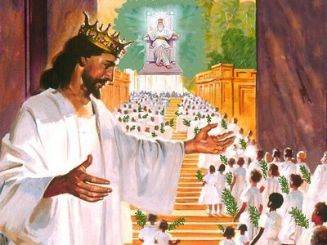
“Beloved, now are we the sons of God, and it doth not yet appear what we shall be: but we know that, when he shall appear, we shall be like him; for we shall
see him as he is.” (I John 3:2 )

Slide 49
Regeneration pal-ing-ghen-es-ee'-ah
pal'-in = New
ghen'-es-is = Beginning
Titus 3:5 “Not by works of righteousness which we have done, but according to his mercy he saved us, by the washing of regeneration, and renewing of the Holy Ghost.”
John 3:3 “Jesus answered and said unto him, Verily, verily, I say unto thee, Except a man be born again, he cannot see the kingdom of God.”

Slide 50
“Therefore if any man be in Christ, he is a new creature: old things are passed away; behold, all things are become new.” II Cor. 5:17
“And that ye put on the new man, which after God is created in righteousness and true holiness.” Eph 4:24
“Knowing this, that our old man is crucified with him, that the body of sin might be destroyed, that henceforth we should not serve sin.” Rom.6:6

Slide 51
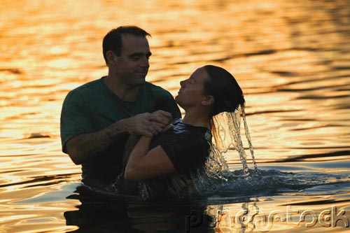

Slide 52
Remission
Matt. 26:28 “For this is my blood of the new testament, which is shed for many for the remission of sins.”
Rom. 3:25 “Whom God hath set forth to be a propitiation through faith in his blood, to declare his righteousness for the remission of sins that are past, through the forbearance of God.”
Heb. 9:22 “…and without shedding of blood is no remission.”

Slide 53
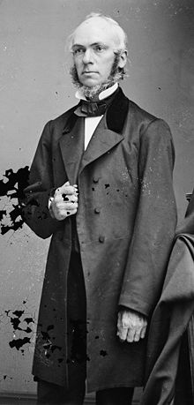
Remission (aphesis)
- remission (9) - forgiveness (6) - deliverance (1) - liberty (17)
1) Release from bondage or imprisonment
2) Forgiveness or pardon, of sins (letting them go as if they had never been committed), remission of the penalty

Slide 54
Imputation
I Cor. 15:22
I Pet. 2:24
II Cor. 5:21
Romans chapter 4-5

Slide 55
“What shall we say then that Abraham our father, as pertaining to the flesh, hath found? For if Abraham were justified by works, he hath whereof to glory; but not before God. For what saith the scripture? Abraham believed God, and it was counted unto him for righteousness. Now to him that worketh is the reward not reckoned of grace, but of debt. But to him that worketh not, but believeth on him that justifieth the ungodly, his faith is counted for righteousness. Even as David also describeth the blessedness of the man, unto whom God imputeth righteousness without works, Saying, Blessed are they whose iniquities are forgiven, and whose sins are covered. Blessed is the man to whom the Lord will not impute sin.”
(Romans 4:1-8)

Slide 56
“And the scripture was fulfilled which saith, Abraham believed God, and it was imputed unto him for righteousness:” James 2:23

Slide 57
Propitiation
KJV Study Bible - Propitiation is the act of God, motivated by His immense love, whereby He accepts the blood of Christ as the complete and satisfying sacrifice for all human sin, thus establishing a means of reconciliation between God and man. While the offering of the blood of Christ was a sufficient propitiation for the sins of the whole world (I John 2:2), the benefits of His sacrifice are available only to those who by faith accept this provision for sin.

Slide 58
(Romans 3:25) “Whom God hath set forth to be a propitiation through faith in his blood, to declare his righteousness for the remission of sins that are past, through the forbearance of God.”
(I John 2:2) “And he is the propitiation for our sins: and not for ours only, but also for the sins of the whole world.”
(I John 4:10) “Herein is love, not that we loved God, but that he loved us, and sent his Son to be the propitiation for our sins.”

Slide 59
Christ's death was a legal payment
The word propitiation signifies the removal of wrath by the offering of a gift.
Propitiation properly deals with the wrath of God – John 3:36 “He that believeth on the Son hath everlasting life: and he that believeth not the Son shall not see life; but the wrath of God abideth on him.”
The wrath of God is due to the legal requirements of punishing the sinner – Romans 3:23; 6:23

Slide 60
Forgiveness
Acts 26:18 “To open their eyes, and to turn them from darkness to light, and from the power of Satan unto God, that they may receive forgiveness of sins, and inheritance among them which are sanctified by faith.”
Eph 1:7 “In whom we have redemption through his blood, the forgiveness of sins, according to the riches of his grace.”
Col 1:14 “In whom we have redemption through his blood, even the forgiveness of sins.”

Slide 61
“When Jesus saw their faith, he said unto the sick of the palsy, Son, thy sins be forgiven thee. But there were certain of the scribes sitting there, and reasoning in their hearts, Why doth this man thus speak blasphemies? who can forgive sins but God only? And immediately when Jesus perceived in his spirit that they so reasoned within themselves, he said unto them, Why reason ye these things in your hearts? Whether is it easier to say to the sick of the palsy, Thy sins be forgiven thee; or to say, Arise, and take up thy bed, and walk?” Mark 2:5-9

Slide 62
“But that ye may know that the Son of man hath power on earth to forgive sins, (he saith to the sick of the palsy,) I say unto thee, Arise, and take up thy bed, and go thy way into thine house.” (Mark 2:10-11)

Slide 63
Adoption
Rom. 8:15 “For ye have not received the spirit of bondage again to fear; but ye have received the Spirit of adoption, whereby we cry, Abba, Father.”
Gal. 4:5 “To redeem them that were under the law, that we might receive the adoption of sons.”
Eph. 1:5 “Having predestinated us unto the adoption of children by Jesus Christ to himself.”

Slide 64
“For ye are all the children of God by faith in Christ Jesus.”
(Gal. 3:26)

Slide 65
Ransom
Ransom is the practice of holding a prisoner or item to extort money or property to secure their release, or it can refer to the sum of money involved.
Matt. 20:28 “…give his life a ransom for many.”
I Tim. 2:6 “Who gave himself a ransom for all.”
I Cor. 6:20 “For ye are bought with a price: therefore glorify God in your body, and in your spirit, which are God's.”

Slide 67
Pardon
A pardon is the forgiveness of a crime and the cancellation of the relevant penalty
Psalm 25:11 “For thy name's sake, O LORD, pardon mine iniquity; for it is great.”
Jer. 33:8 “And I will cleanse them from all their iniquity, whereby they have sinned against me; and I will pardon all their iniquities, whereby they have sinned, and whereby they have transgressed against me.”

Slide 68
“Blotting out the handwriting of ordinances that was against us, which was contrary to us, and took it out of the way, nailing it to his cross.” (Col. 2:14)

Slide 69
Eternal Salvation “And being made perfect, he became the author of eternal salvation unto all them that obey him.” Heb. 5:9
“And I give unto them eternal life; and they shall never perish, neither shall any man pluck them out of my hand.”
(John 10:28)

Slide 70
“And this is the record, that God hath given to us eternal life, and this life is in his Son. He that hath the Son hath life; and he that hath not the Son of God hath not life. These things have I written unto you that believe on the name of the Son of God; that ye may know that ye have eternal life, and that ye may believe on the name of the Son of God.”
(I John 5:11-13)
Daniel White
“I will not blot out his name out of the book of life.” (Rev. 3:5)

Slide 71
The results of the vicarious atonement
Redemption
Reconciliation
Justification
Sanctification
Glorification
Regeneration
Remission
Imputation
Propitiation
Forgiveness
Adoption
Ransom
Pardon
Eternal Salvation

