Slide 1
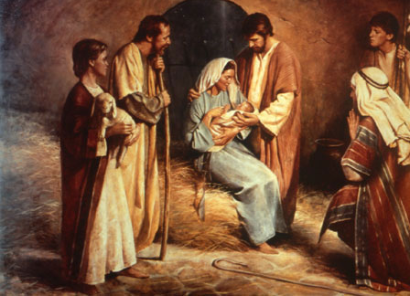
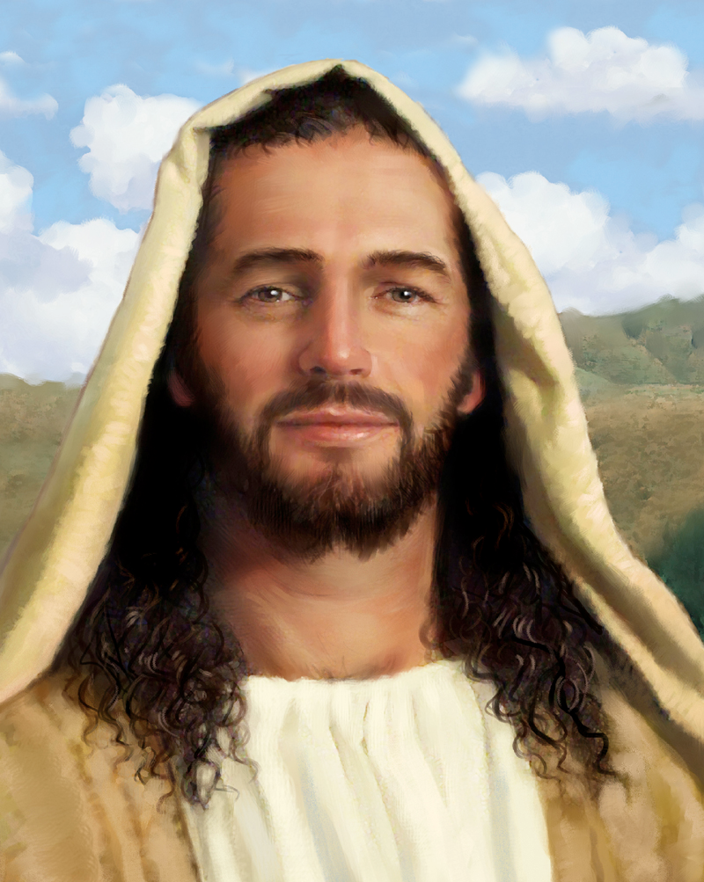
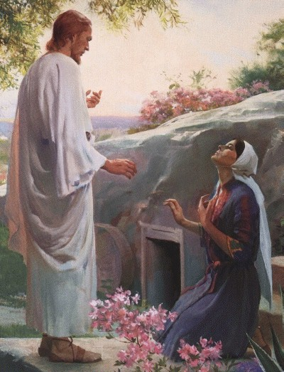
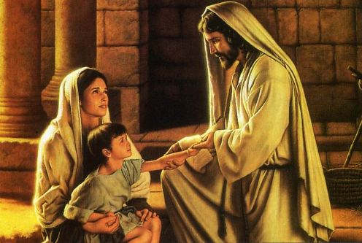
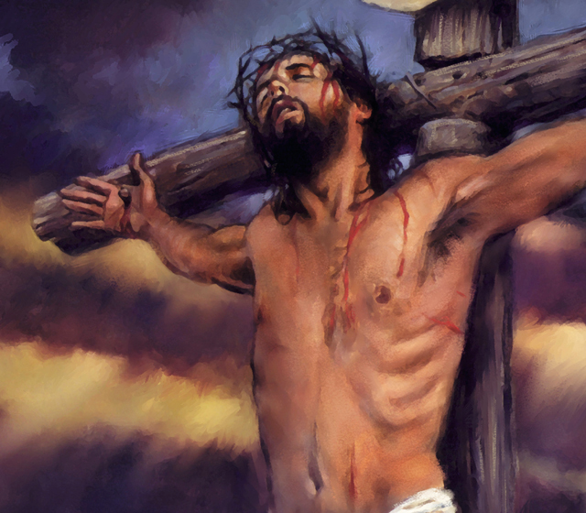
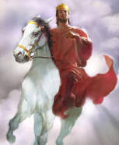
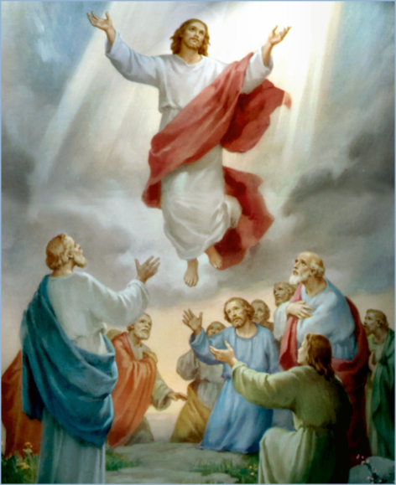
The Doctrine of Jesus Christ (Part 15)
The Death of Jesus Christ
“The vicarious atonement"
(Part 3)

Slide 2
Review

Slide 4
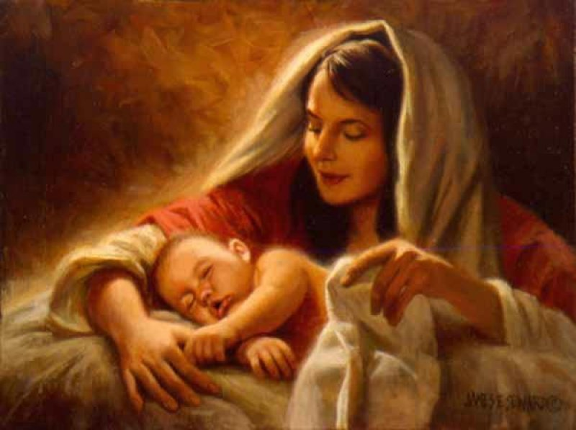
The Virgin Birth
“Behold, a virgin shall be with child, and shall bring forth a son, and they shall call his name Emmanuel, which being interpreted is, God with us.”
Matt. 1:23

Slide 5
The Incarnation of Christ
(John 1:1-14)
God the Son took upon himself the full nature of man and yet retain the full nature of God.

Slide 6
Names and Titles of Jesus Christ

Slide 7
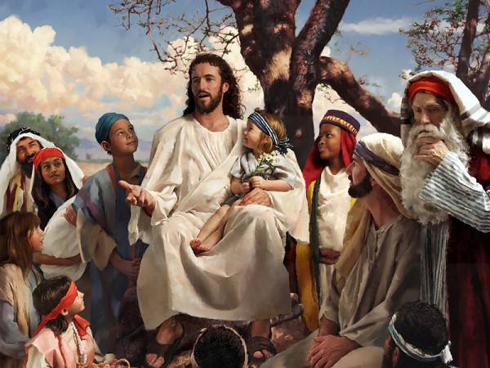
The Humanity of Jesus Christ

Slide 8
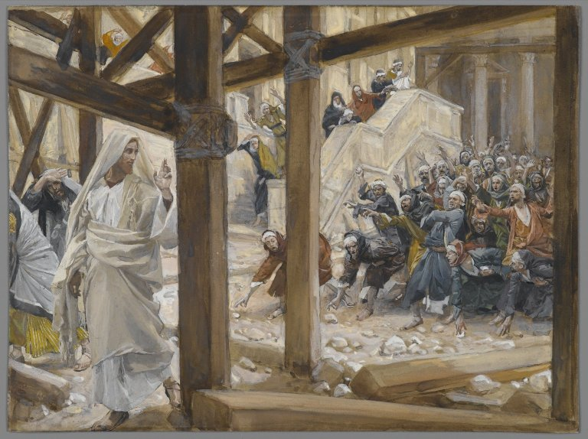
The Deity of Jesus Christ
(John 10:30-33)

Slide 9
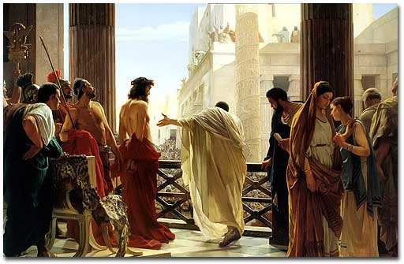
The Impeccability of Jesus Christ (John 18:38)

Slide 10
The Earthly Ministry of Jesus Christ

Slide 11
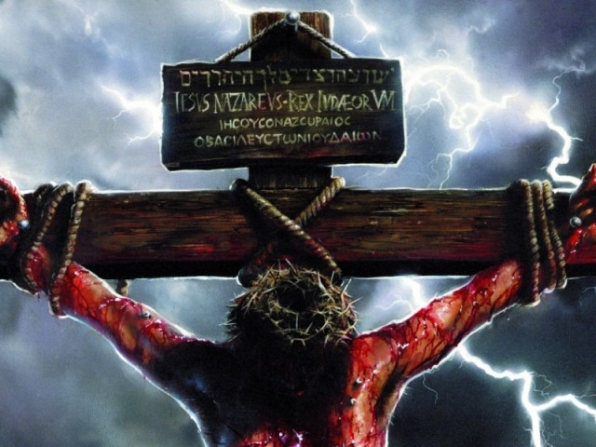
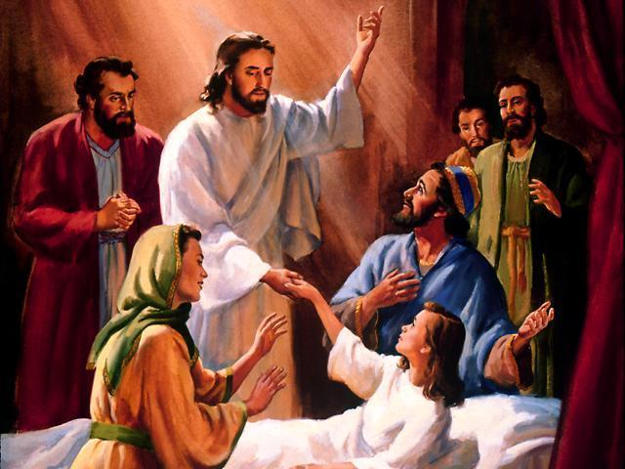
“For even the Son of man came not to be ministered unto, but to minister, and to give his life a ransom for many.” Mark 10:45

Slide 12
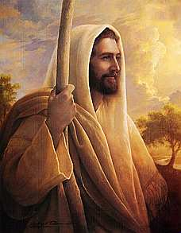
The Character of Jesus Christ
What kind of man was our Lord?
What were some of his characteristics?

Slide 13
The character of Christ
His zeal
His compassion
His meekness and gentleness
His boldness and courage
His love

Slide 14
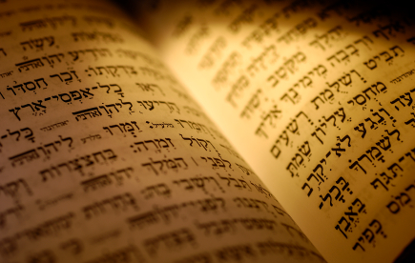
In the Old Testament three great offices were created by God to meet the spiritual and material needs of his chosen people.

Slide 15
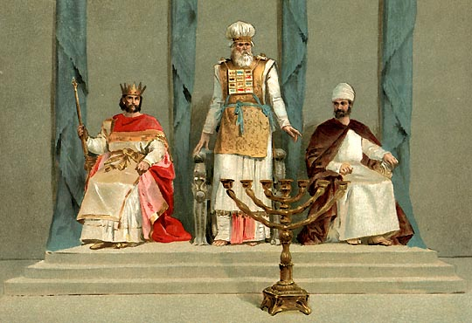
Jesus holds all three offices

Slide 16
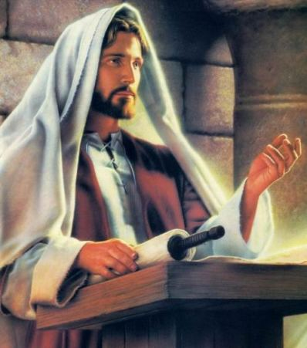

Slide 17
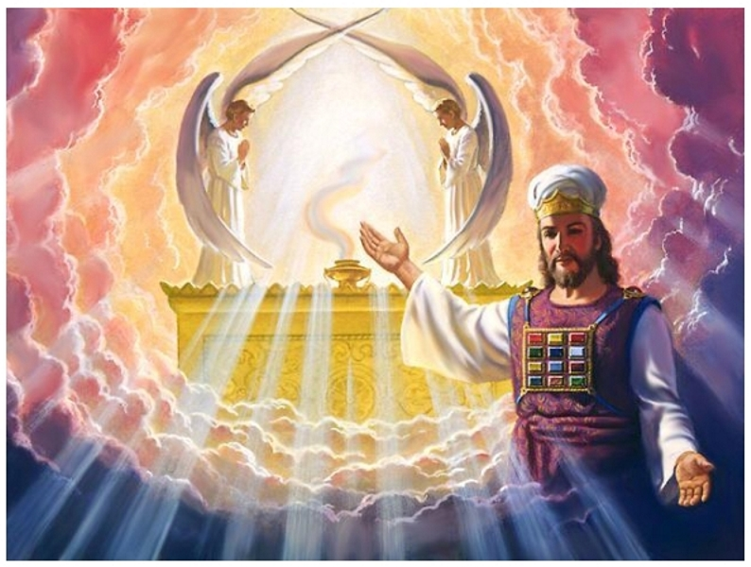

Slide 18
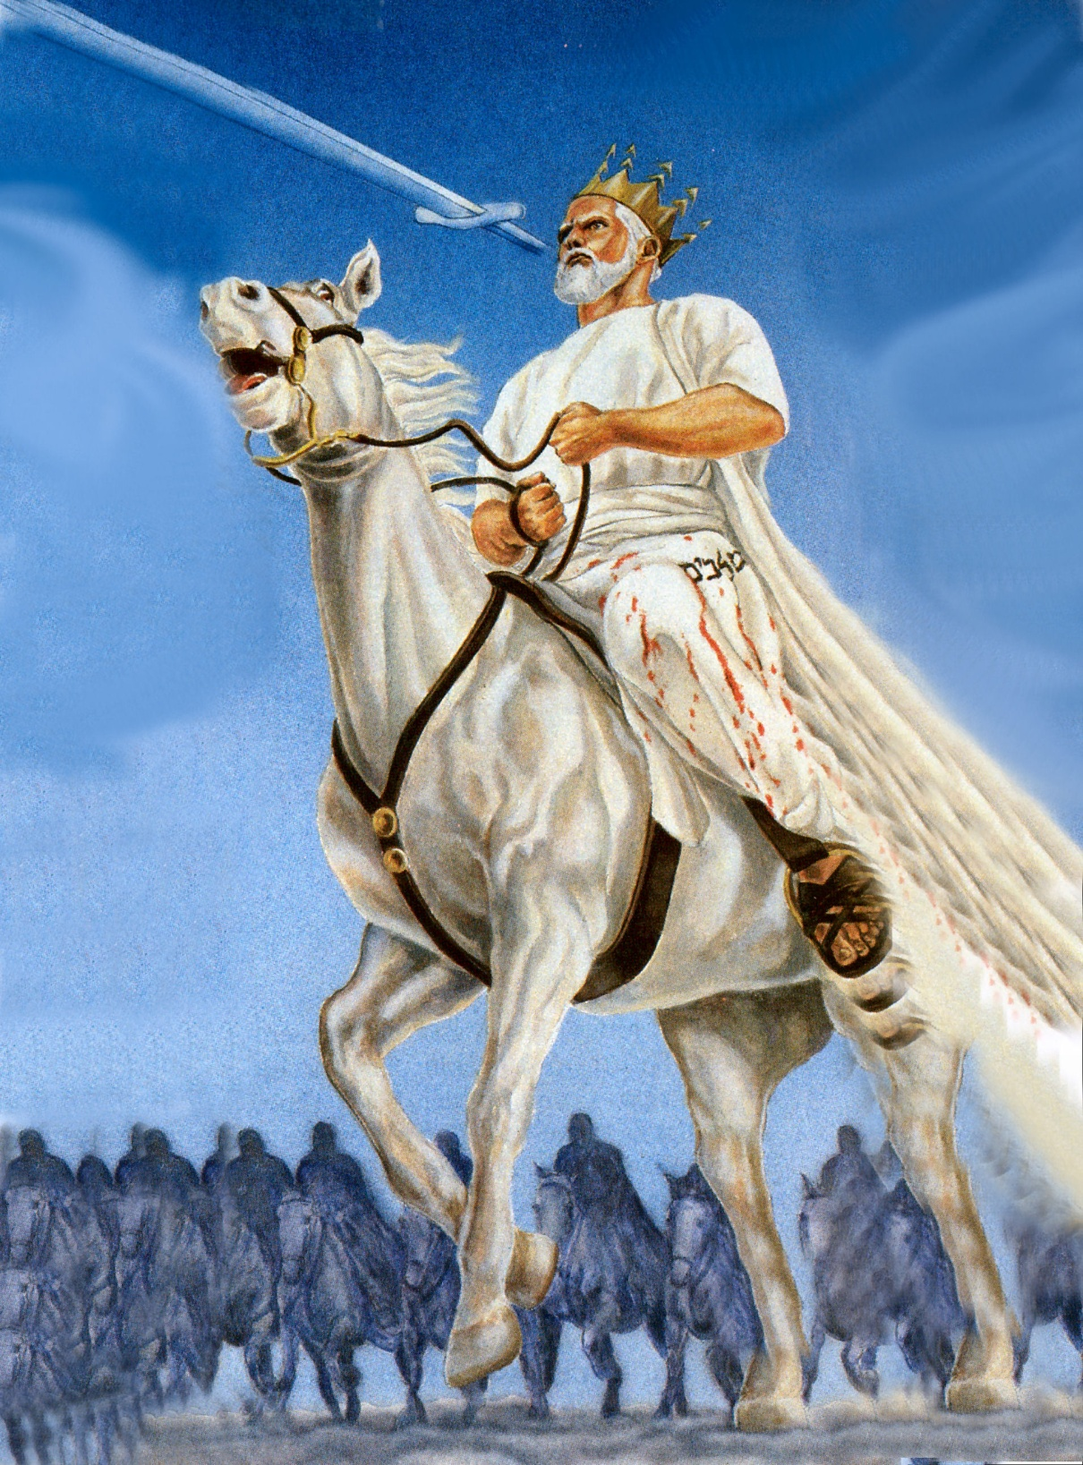

Slide 19
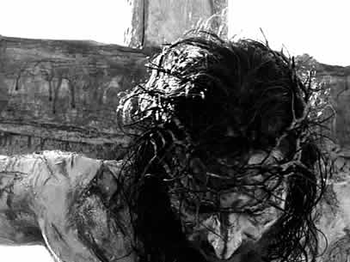
The Death of Jesus Christ

Slide 20
“For I delivered unto you first of all that which I also received, how that Christ died for our sins according to the scriptures; And that he was buried, and that he rose again the third day according to the scriptures.”
(I Cor. 15:3-5)

Slide 21
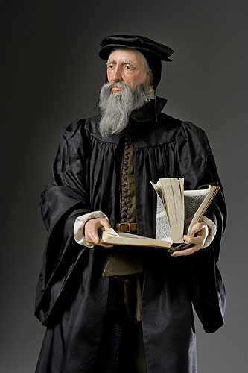
“Exposing the false Doctrine of Calvinism”
“I marvel that ye are so soon removed from him that called you into the grace of Christ unto another gospel …but there be some that trouble you, and would pervert the gospel of Christ. But though we, or an angel from heaven, preach any other gospel unto you than that which we have preached unto you, let him be accursed.” (Gal. 1:6-8)

Slide 22
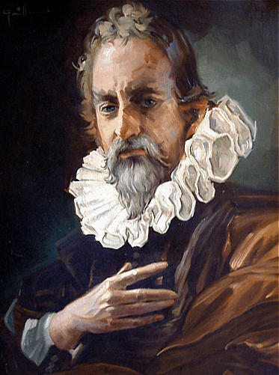
"We call predestination God’s eternal decree, by which He determined what He willed to become of each man. For all are not created in equal condition; rather, eternal life is ordained for some, eternal damnation for others."

Slide 23
Calvinism

Slide 24
Calvinism teaches that some men are predestinated to Heaven and others are predestinated to Hell. It is strictly God’s choice and man can not change it. In other words, the elect can not become non-elect and the non-elect can not become elect (saved). The non-elect are damned to hell with no chance of escaping. It is strictly God’s sovereign choice. Man has no will in the matter.

Slide 25
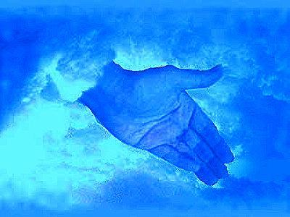
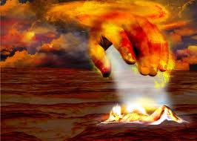
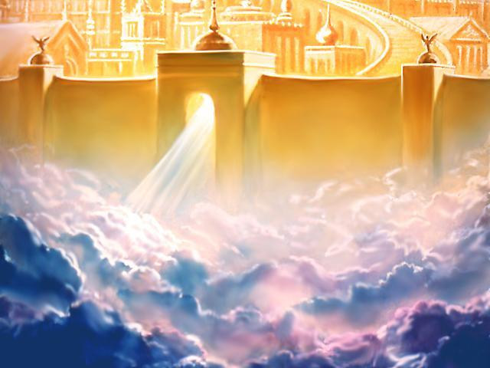
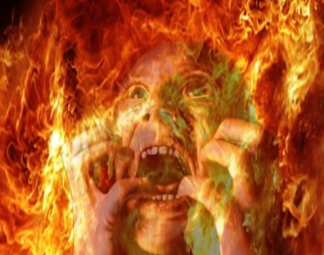

Slide 26
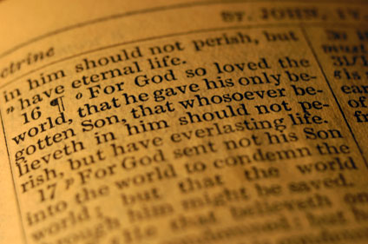

Slide 27
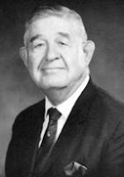
John Calvin, a great theologian, was right in saying that people are saved by grace alone and kept by grace alone. But the teaching that some people, by the foreordained plan of God, are predestined to be saved and some are predestined to be lost, and that their destinies were settled before they were born, is a wicked heresy contrary to the Bible, that dishonors God and has done incalculable harm.

Slide 28
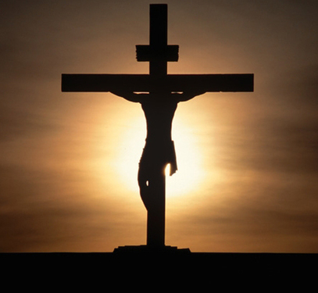
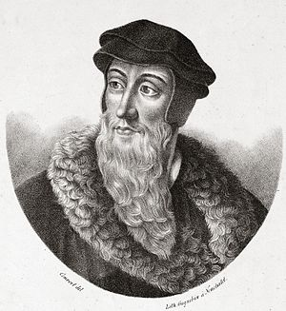
Calvary vs Calvinism
"For WHOSOEVER shall call upon the name of the Lord shall be saved.”
“Who will have all men to be saved.”
Rom. 10:13; I Tim. 2:4
“For all are not created in equal condition; rather, eternal life is ordained for some, eternal damnation for others.”

Slide 29
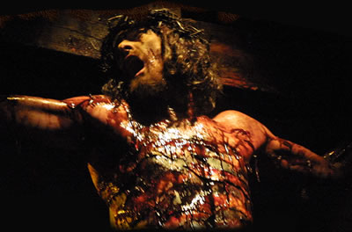
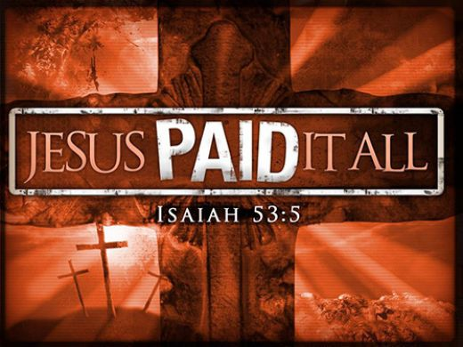
The Vicarious Atonement

Slide 30
The death of Christ has a prominent place in the New Testament. The last three days of our Lord’s earthly life occupy about one-fifth of the narratives in the four Gospels. If all the three and a half years of His public ministry had been written out as fully as the last three days, we would have a ‘Life of Christ’ of some 8400 pages!

Slide 31
The death of Christ is mentioned directly in the New Testament more than 175 times. Since there are 7,959 verses in the New Testament, this would mean that one out of every 53 verses refers to His death.

Slide 32
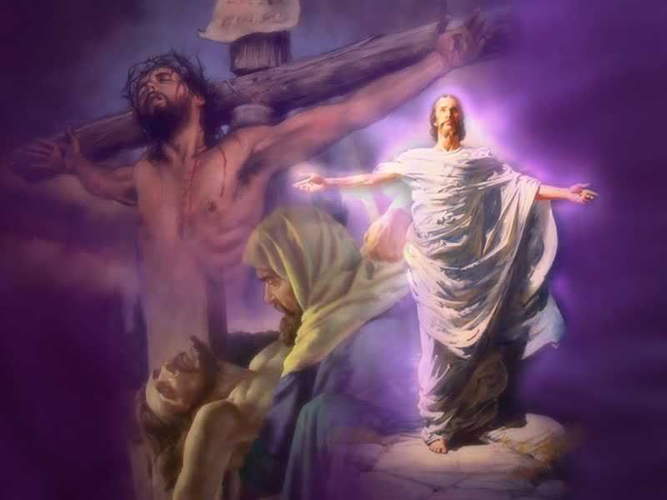
The death and resurrection of Christ is the most important doctrine in Christianity

Slide 33
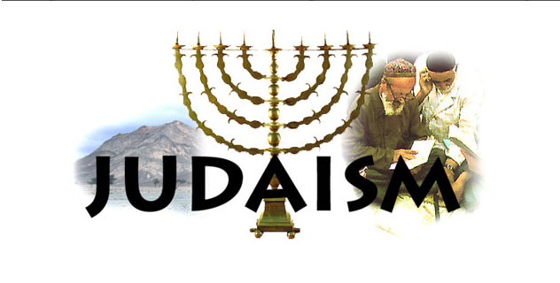
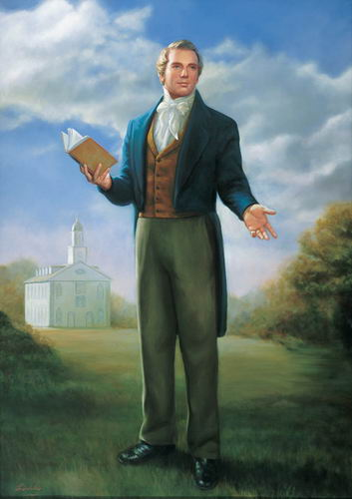
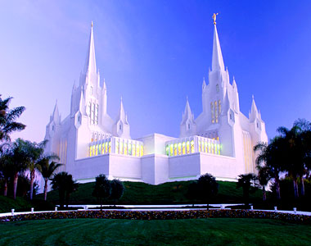
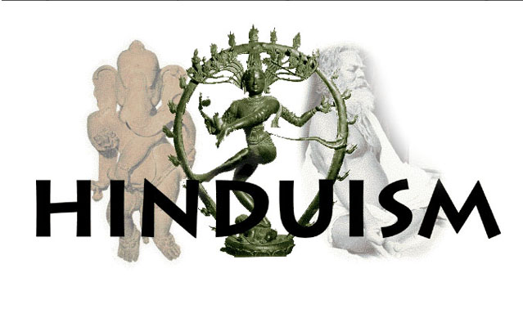
Other religions base their claim to recognition on the teaching of their founders; Christianity is distinguished from all of them by the importance it assigns to the death of its Founder.
Mormonism
Mormonism

Slide 34
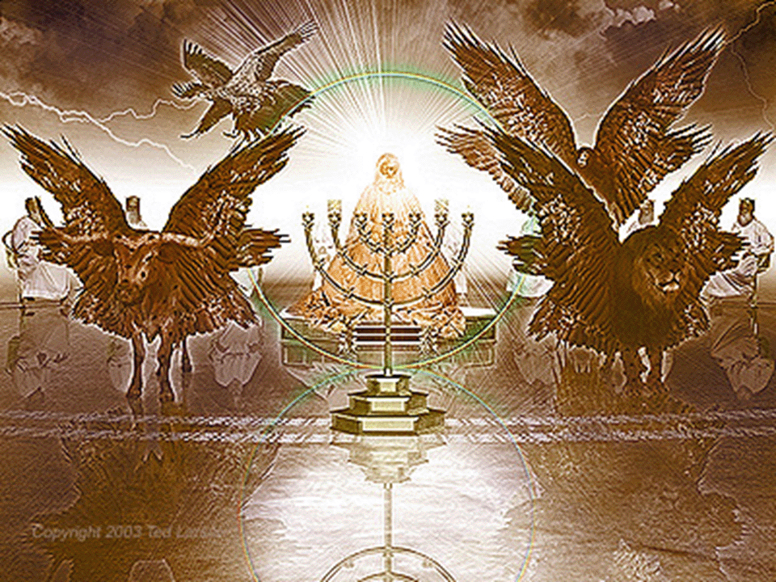
The death of Christ is the subject of supreme interest in heaven
The four living creatures (Seraphim's) and the twenty-four elders sang the song
of redemption along with all the redeemed saints in heaven
(Rev. 5:8-12)

Slide 35
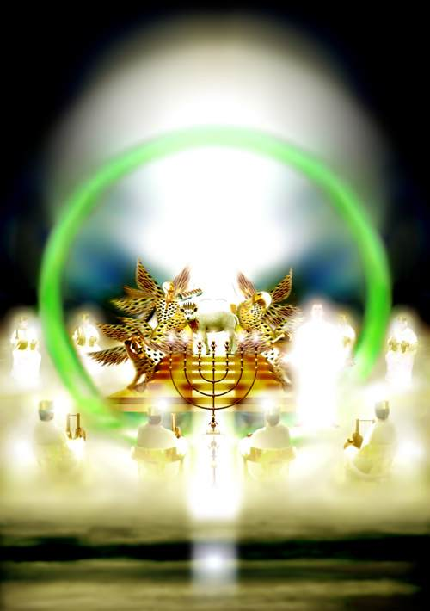
“And when he had taken the book, the four beasts and four and twenty elders fell down before the Lamb, having every one of them harps, and golden vials full of odours, which are the prayers of saints. And they sung a new song, saying, Thou art worthy to take the book, and to open the seals thereof: for thou wast slain, and hast redeemed us to God by thy blood out of every kindred, and tongue, and people, and nation…

Slide 36
And hast made us unto our God kings and priests: and we shall reign on the earth. And I beheld, and I heard the voice of many angels round about the throne and the beasts and the elders: and the number of them was ten thousand times ten thousand, and thousands of thousands; Saying with a loud voice, Worthy is the Lamb that was slain to receive power, and riches, and wisdom, and strength, and honour, and glory, and blessing.”

Slide 37
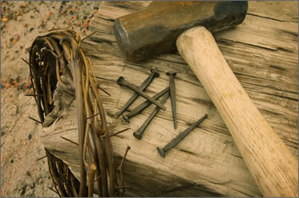
The Lord Jesus spoke of his death often
"Jesus answered and said unto them, Destroy this temple, and in three days I will raise it up" (John 2:19)
"And as Moses lifted up the serpent in the wilderness, even so must the Son of man be lifted up" (John 3:14)
"Saying, the Son of man must suffer many things, and be rejected of the elders, and chief priests and scribes, and be slain, and be raised the third day" (Luke 9:22)

Slide 38
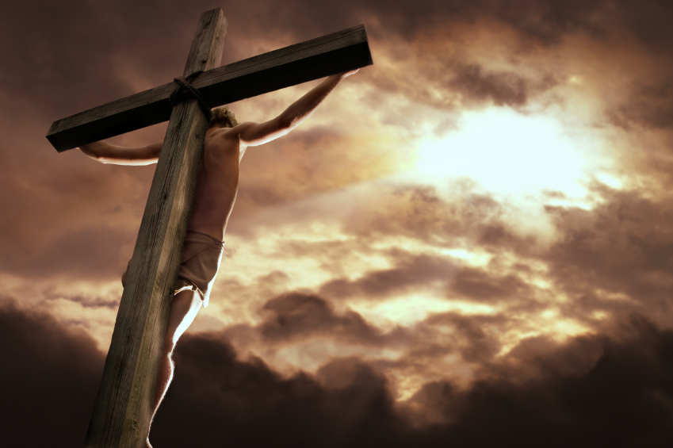
"And while they abode in Galilee, Jesus said unto them, The Son of man shall be betrayed into the hands of men: and they shall kill him, and the third day he shall be raised again. And they were exceeding sorry" (Matt. 17:22, 23)
"Therefore doth my Father love me, because I lay down my life, that I might take it again" (John 10:17)
"Saying, Behold, we go up to Jerusalem; and the Son of man shall be delivered unto the chief priests, and unto the scribes; and they shall condemn him to death, and shall deliver him to the Gentiles: and they shall mock him, and shall scourge him, and shall spit upon him, and shall kill him: and the third day he shall rise again" (Mark 10:33, 34)

Slide 39
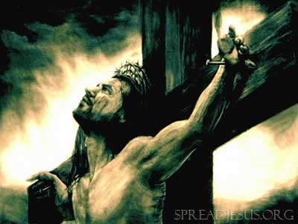
"She hath done what she could: she is come aforehand to anoint my body to the burying" (Mark 14:8)
"And I, if I be lifted up from the earth, will draw all men unto me" (John 12:32)
"Then saith Jesus unto them, All ye shall be offended because of me this night: for it is written, I will smite the shepherd, and the sheep of the flock shall be scattered abroad" (Matt. 26:31)

Slide 40
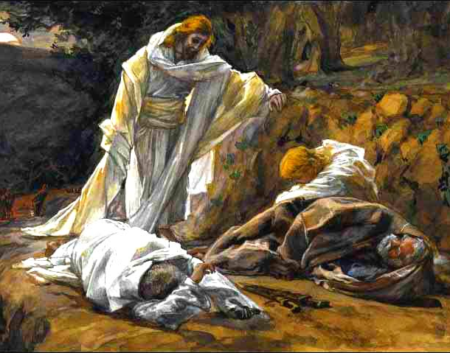
"Rise, let us be going: behold, he is at hand that doth betray me" (Matt. 26:46)
"Nevertheless I tell you the truth; It is expedient for you that I go away: for if I go not away, the Comforter will not come unto you; but if I depart, I will send him unto you" (John 16:7)

Slide 41
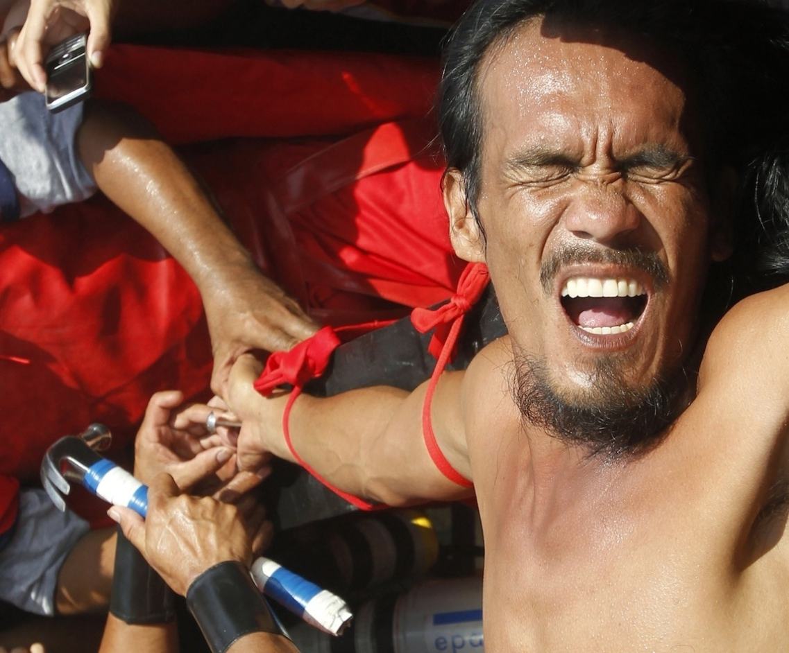
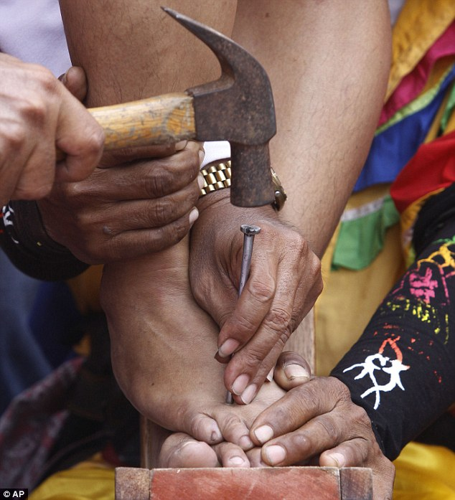
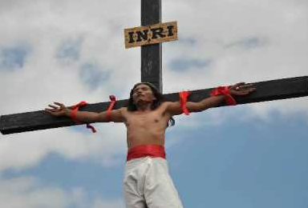
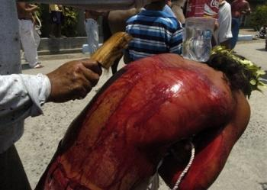
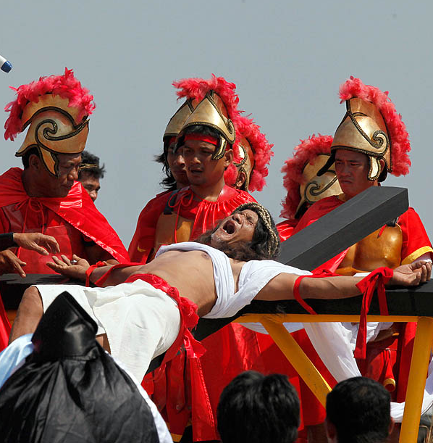
Christ substitutionary death on the cross “Vicarious Atonement”
The word "vicarious" means substitute

Slide 42
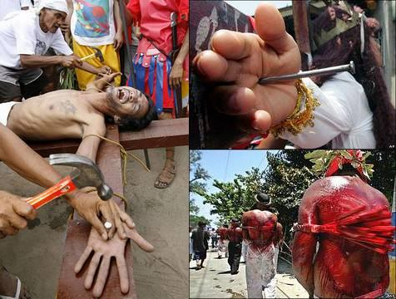
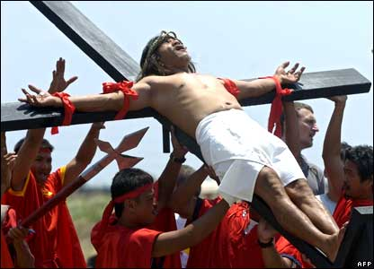

Slide 43
“Who his own self bare our sins in his own body on the tree.”
I Peter 2:24

Slide 44
The substitutionary atonement refers to Jesus Christ dying as a substitute for sinners “Died for our sins…Who died for us…Died for them…Died for all…For whom Christ died…Died for the ungodly…He died unto sin once.”
The Scriptures teach that all men are sinners - (Romans 3:9-23)
The penalty for our sinfulness is death - Romans 6:23 “For the wages of sin is death, but the gift of God is eternal life in Christ Jesus our Lord.”

Slide 45
Christ was a substitute (vicarious) for others in that He took their place and suffered their punishment.
Without Christ “vicarious death”, we would all die and spend an eternity in hell as payment for our sins (Rev. 20:14).

Slide 46
“And all things are of God, who hath reconciled us to himself by Jesus Christ, and hath given to us the ministry of reconciliation; To wit, that God was in Christ, reconciling the world unto himself, not imputing their trespasses unto them; and hath committed unto us the word of reconciliation. Now then we are ambassadors for Christ, as though God did beseech you by us: we pray you in Christ's stead, be ye reconciled to God. For he hath made him to be sin for us, who knew no sin; that we might be made the righteousness of God in him.” (II Corinthians 5:18-21)

Slide 47
“For even hereunto were ye called: because Christ also suffered for us, leaving us an example, that ye should follow his steps: Who did no sin, neither was guile found in his mouth: Who, when he was reviled, reviled not again; when he suffered, he threatened not; but committed himself to him that judgeth righteously: Who his own self bare our sins in his own body on the tree, that we, being dead to sins, should live unto righteousness: by whose stripes ye were healed.” (I Peter 2:21-24)

Slide 48
“For Christ also hath once suffered for sins, the just for the unjust, that he might bring us to God, being put to death in the flesh, but quickened by the Spirit.” (I Peter 3:18-19)

Slide 49
“But for us also, to whom it shall be imputed, if we believe on him that raised up Jesus our Lord from the dead; Who was delivered for our offences, and was raised again for our justification. Therefore being justified by faith, we have peace with God through our Lord Jesus Christ: By whom also we have access by faith into this grace wherein we stand, and rejoice in hope of the glory of God.” (Romans 4:24 - 5:2)

Slide 50
Abraham and Imputation
“What shall we say then that Abraham our father, as pertaining to the flesh, hath found? For if Abraham were justified by works, he hath whereof to glory; but not before God. For what saith the scripture? Abraham believed God, and it was counted unto him for righteousness. Now to him that worketh is the reward not reckoned of grace, but of debt. But to him that worketh not, but believeth on him that justifieth the ungodly, his faith is counted for righteousness.” (Romans 4:1-5)

Slide 51
Gal. 3:6 “Even as Abraham believed God, and it was accounted to him for righteousness.”
James 2:23 “And the scripture was fulfilled which saith, Abraham believed God, and it was imputed unto him for righteousness: and he was called the Friend of God.”
Rom. 4:22-24 “And therefore it was imputed to him for righteousness. Now it was not written for his sake alone, that it was imputed to him; But for us also, to whom it shall be imputed, if we believe on him that raised up Jesus our Lord from the dead.”

Slide 53
Jesus did what we could not. He took our place and bore our sins in his body on the cross (I Pet. 2:24) and made propitiation for our sins.

Slide 54
Propitiation
KJV Study Bible - Propitiation is the act of God, motivated by His immense love, whereby He accepts the blood of Christ as the complete and satisfying sacrifice for all human sin, thus establishing a means of reconciliation between God and man. While the offering of the blood of Christ was a sufficient propitiation for the sins of the whole world (I John 2:2), the benefits of His sacrifice are available only to those who by faith accept this provision for sin.

Slide 55
(Romans 3:25) “Whom God hath set forth to be a propitiation through faith in his blood, to declare his righteousness for the remission of sins that are past, through the forbearance of God.”
(I John 2:2) “And he is the propitiation for our sins: and not for ours only, but also for the sins of the whole world.”
(I John 4:10) “Herein is love, not that we loved God, but that he loved us, and sent his Son to be the propitiation for our sins.”

Slide 56
Christ's death was a legal payment
The word propitiation signifies the removal of wrath by the offering of a gift or payment.
Propitiation properly deals with the wrath of God – John 3:36 “He that believeth on the Son hath everlasting life: and he that believeth not the Son shall not see life; but the wrath of God abideth on him.”
The wrath of God is due to the legal requirements of punishing the sinner – Romans 3:23; 6:23

Slide 57
It was also a legal act whereby Christ fulfilled the law and lawfully paid the penalty of sin
“Think not that I am come to destroy the law, or the prophets: I am not come to destroy, but to fulfil.” Matt. 5:17

Slide 58
Not capable of sinning
The Impeccability of Jesus Christ

Slide 59
Three facts should be stated concerning the impeccability of Jesus Christ
1. He knew no sin -
"For he hath made him to be sin for us, who knew no sin; that we might be made the righteousness of God in him" (II Cor. 5:21)

Slide 60
2. He did no sin -
"Who did no sin, neither was guile found in his mouth" (I Pet. 2:22)
"For we have not an high priest which cannot be touched with the feeling of our infirmities; but was in all points tempted like as we are, yet without sin" (Heb. 4:15)
3. He had no sin -
"And ye know that he was manifested to take away our sins; and in him is no sin" (I John 3:5)

Slide 61
“Pilate saith unto him, What is truth? And when he had said this, he went out again unto the Jews, and saith unto them, I find in him no fault at all.” John 18:38

Slide 62
Guilt
Condemnation

Slide 63
“Now we know that what things soever the law saith, it saith to them who are under the law: that every mouth may be stopped, and all the world may become guilty before God. Therefore by the deeds of the law there shall no flesh be justified in his sight: for by the law is the knowledge of sin.”
(Rom. 3:19 -20)

Slide 64
There is no punishment without law and there is no law without punishment
“Because the law worketh wrath: for where no law is, there is no transgression.”
(Rom. 4:15)

Slide 65
“But we had the sentence of death in ourselves, that we should not trust in ourselves, but in God which raiseth the dead: Who delivered us from so great a death.” (II Cor. 1:9-10)

Slide 66
When a law is broken, punishment must accrue
“The sting of death is sin; and the strength of sin is the law. But thanks be to God, which giveth us the victory through our
Lord Jesus Christ.”
(I Corinthians 15:56-57)

Slide 67
“Moreover the law entered, that the offence might abound. But where sin abounded, grace did much more abound.” Rom. 5:20

Slide 68
“For what the law could not do, in that it was weak through the flesh, God sending his own Son in the likeness of sinful flesh, and for sin, condemned sin in the flesh.”
Rom. 8:3
“Christ hath redeemed us from the curse of the law, being made a curse for us.”
Gal. 3:13
“Blotting out the handwriting of ordinances that was against us, which was contrary to us, and took it out of the way, nailing it to his cross.”
Col 2:14

Slide 69
“There is therefore now no condemnation to them which are in Christ Jesus.” Rom. 8:1

Slide 70
The whole atoning work of Christ was a legal action where Jesus substituted himself for sinners and paid the legal requirement of the punishment of sin. (Propitiation)

Slide 71
The “vicarious” death of Christ as seen in the Old Testament

Slide 73
Genesis 22:13-14 “And Abraham lifted up his eyes, and looked, and behold behind him a ram caught in a thicket by his horns: and Abraham went and took the ram, and offered him up for a burnt offering in the stead of his son. And Abraham called the name of that place Jehovahjireh (the Lord will provide): as it is said to this day, In the mount of the LORD it shall be seen.”
The ram that was offered in place of Isaac was a substitutionary sacrifice which is exactly what "vicarious" means.

Slide 75
In Isaiah 53 we see a prophecy of the atoning work of Christ Notice the substitutionary language of Isaiah 53:5

Slide 76
The “vicarious” death of Christ was necessary for two main reasons
It was necessary because of God’s holiness (Lev. 11:44; Prov. 15:9)
It was necessary because of man’s sinfulness (Rom. 3:10-20)

Slide 77
The “vicarious” death of Christ
“But God commendeth his love toward us, in that, while we were yet sinners, Christ died for us.” (Rom. 5:8)

