Slide 1
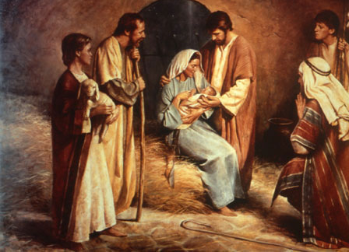
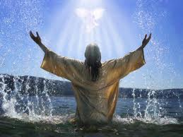
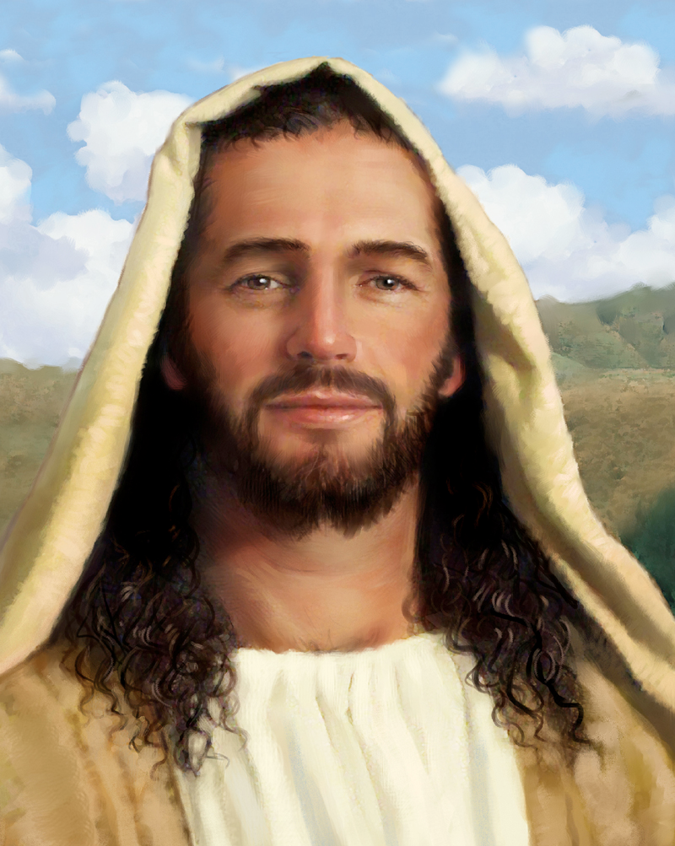
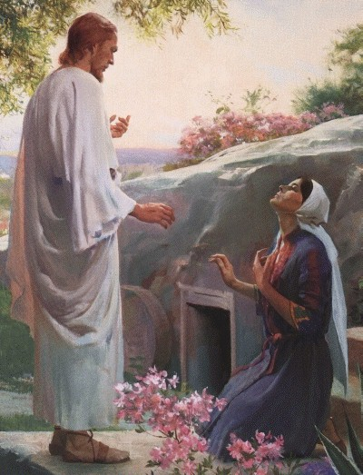
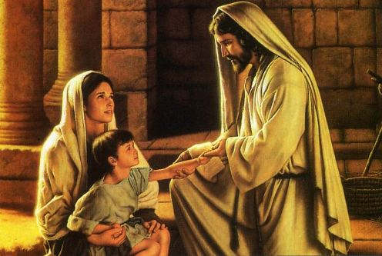
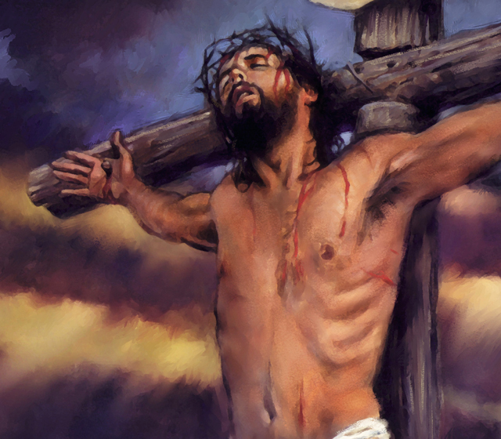
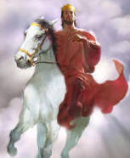
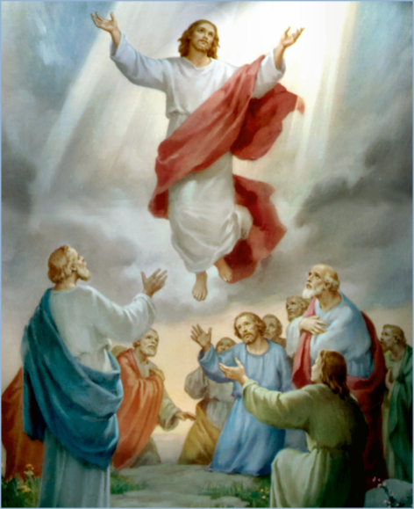
The Doctrine of Jesus Christ (Part 14)
The Death of Jesus Christ
“Exposing the false doctrine of Calvinism”
(Part 2)

Slide 2
No Review Tonight

Slide 3
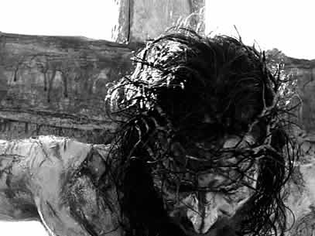
The Death of Jesus Christ

Slide 4
“For I delivered unto you first of all that which I also received, how that Christ died for our sins according to the scriptures; And that he was buried, and that he rose again the third day according to the scriptures.”
(I Cor. 15:3-5)

Slide 5
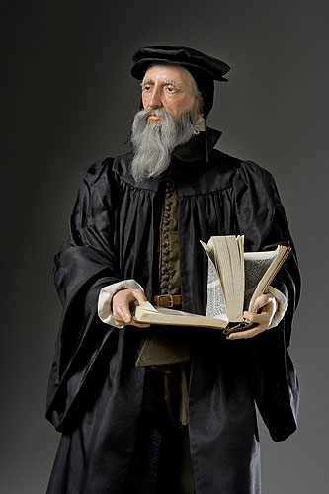
“Exposing the false Doctrine of Calvinism”
“I marvel that ye are so soon removed from him that called you into the grace of Christ unto another gospel …but there be some that trouble you, and would pervert the gospel of Christ. But though we, or an angel from heaven, preach any other gospel unto you than that which we have preached unto you, let him be accursed.” (Gal. 1:6-8)

Slide 6
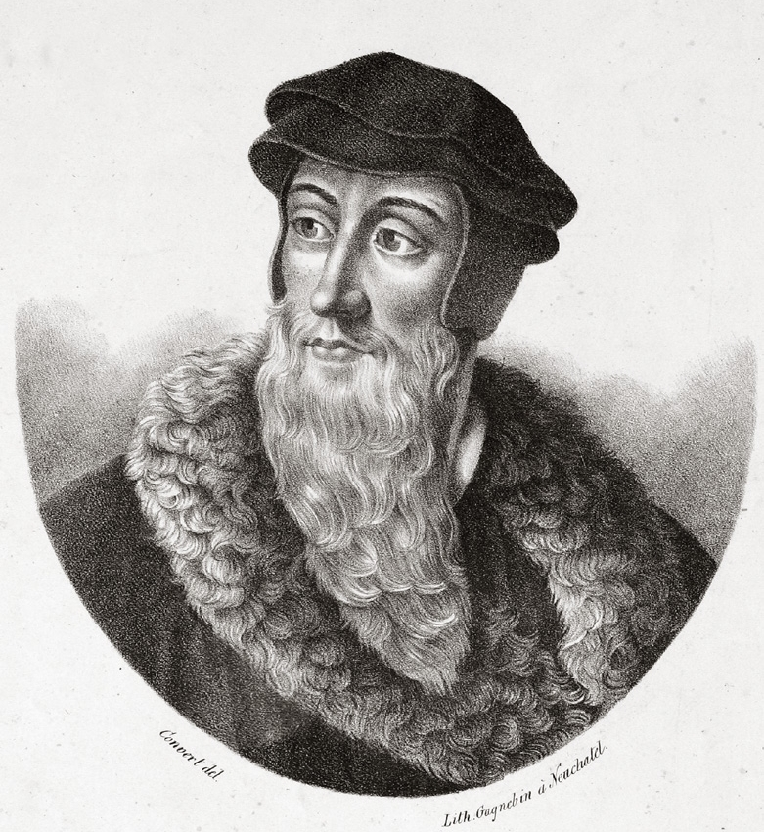
John Calvin (July 10, 1509 – May 27, 1564)

Slide 7
Born and raised Roman Catholic.
He was a Frenchman with a gifted intellect that his father thought would be best suited for the field of law.
Left law school and began to study Roman Catholic theology.
Calvin’s conversion was sudden.
His conversion took place in 1533.
“I failed to find peace in absolutions, penances, and intercessions of the church. By a sudden conversion, God subdued and reduced to submission my soul, which was more hardened against such things than one would expect of my youthful years…Like a flash of light, I realized in what an abyss of errors and chaos I was.”

Slide 8
Calvin broke with the Roman Church and was thrown in prison several times for his opposition to Roman Catholic doctrine.
Became the head of the evangelical party in France less than a year after his conversion.
Calvin witnessed his fellow evangelical's tongue cut out and men burned at the stake for their faith.
On one occasion Calvin was rescued from hanging, by several evangelicals who dragged him away.
In 1536, at the age of 27, he wrote the Institutes of the Christian Religion, the most influential book besides the Bible in the progress of the Reformation.

Slide 9
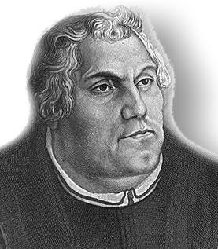
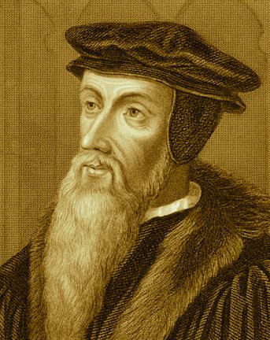
Influenced by the great Reformer Martin Luther (1483–1546) German Reformer
Calvin became a strong and out spoken opponent of Roman Catholic theology.
Major leader of the Protestant Reformation.
Opposed the Catholic churches teaching of “salvation through works” with his doctrine of “predestination.”
Man in his fallen state can in no way merit salvation.
Man is so completely and totally depraved that he possesses no ability (will) to receive the salvation of God apart from the regenerating work of the Holy Spirit.

Slide 10
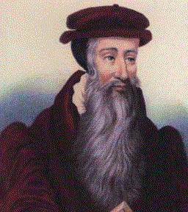
Regeneration is necessary before one can believe and receive the gospel. Regeneration is a result of believing and receiving the gospel – (Titus 3:5-9)
“Repent, and be baptized every one of you in the name of Jesus Christ for the remission of sins, and ye shall receive the gift of the Holy Ghost.” Acts 2:38

Slide 11
John Calvin was a minister in France during the Protestant Reformation. Calvin was important in forming Christian theory called Calvinism during the 1500's. Calvinism is a Protestant theological system and an approach to the Christian life. Today, it refers to the doctrines and practices of the Reformed churches of which Calvin was an early leader. It is best known for its doctrines of predestination and total depravity, stressing the absolute sovereignty of God. Calvin believed that that God willed eternal damnation for some people and salvation for others. A person’s eternal destination is predetermined.

Slide 12
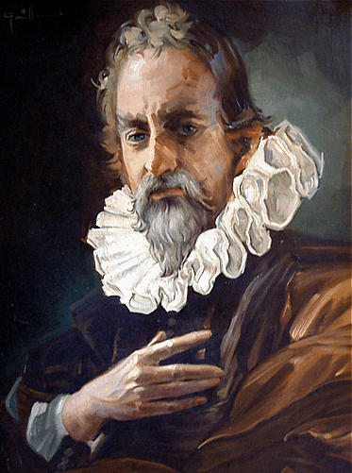
"We call predestination God’s eternal decree, by which He determined what He willed to become of each man. For all are not created in equal condition; rather, eternal life is ordained for some, eternal damnation for others."

Slide 13
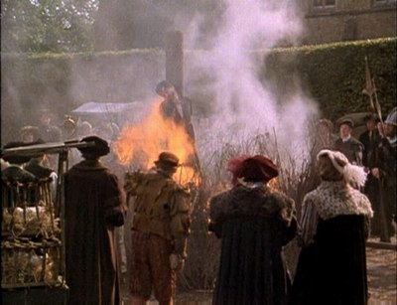
On October 27, 1553 John Calvin, the founder of Calvinism, had Michael Servetus, a protestant and respected Spanish physician, burned at the stake outside of Geneva for his doctrinal disagreements with Calvin.

Slide 14
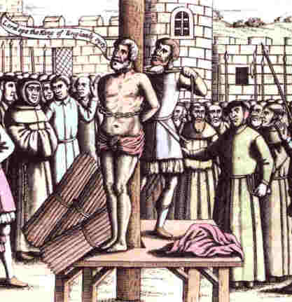
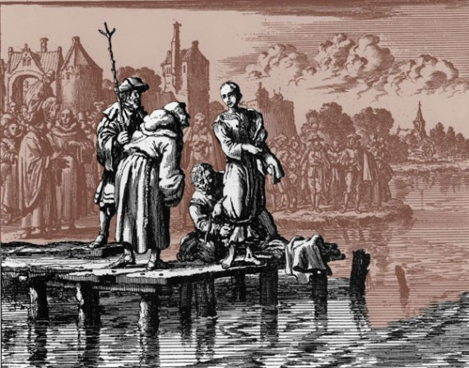
From 1541 to 1546, John Calvin caused 58 people to be executed and seventy six exiled. His victims ranged in age from 16 to 80. The most common capital offense was the opposition to infant baptism.

Slide 15
“…ye know that no murderer hath eternal life abiding in him...” I John 3:15

Slide 16
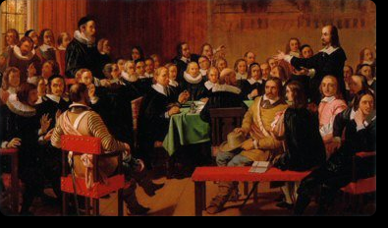
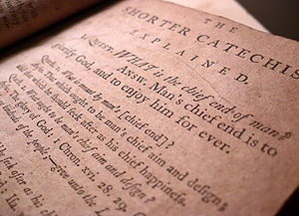
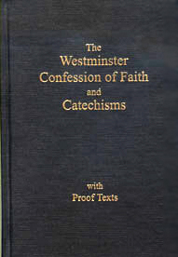
THE WESTMINSTER CONFESSION OF FAITH
God's Eternal Decree
Written in the 1646 by English
and Scottish clergymen

Slide 17
I. God from all eternity, did, by the most wise and holy counsel of His own will, freely, and unchangeably ordain whatsoever comes to pass.
II. Although God knows whatsoever may or can come to pass upon all supposed conditions; yet has He not decreed anything because He foresaw it as future, or as that which would come to pass upon such conditions.

Slide 18
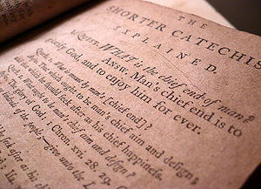
III. By the decree of God, for the manifestation of His glory, some men and angels are predestinated unto everlasting life; and others foreordained to everlasting death.

Slide 19
V. Those of mankind that are predestinated unto life, God, before the foundation of the world was laid, according to His eternal and immutable purpose, and the secret counsel and good pleasure of His will, has chosen, in Christ, unto everlasting glory, out of His mere free grace and love, without any foresight of faith.
“Elect according to the foreknowledge of God the Father.” I Peter 1:2
“For whom he did foreknow, he also did predestinate…” Rom. 8:29

Slide 20
VII. The rest of mankind God was pleased, according to the unsearchable counsel of His own will, whereby He extends or withholds mercy, as He pleases, for the glory of His sovereign power over His creatures, to pass by; and to ordain them to dishonor and wrath for their sin, to the praise of His glorious justice.

Slide 21
Calvinism

Slide 22
Calvinism teaches that some men are predestinated to Heaven and others are predestinated to Hell. It is strictly God’s choice and man can not change it. In other words, the elect can not become non-elect and the non-elect can not become elect (saved). The non-elect are damned to hell with no chance of escaping. It is strictly God’s sovereign choice. Man has no will in the matter.

Slide 23
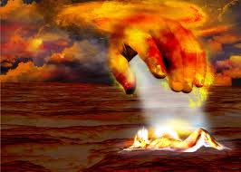
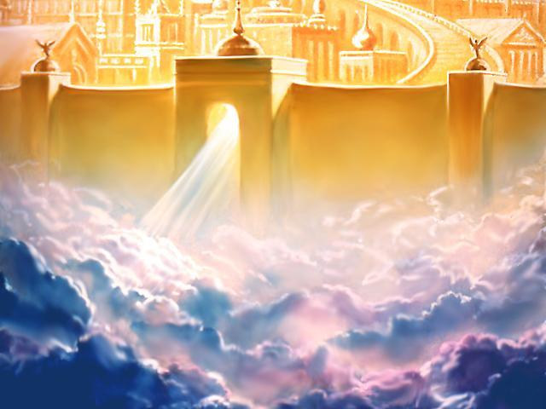
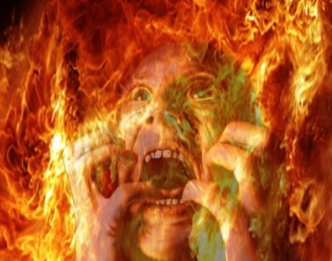

Slide 24
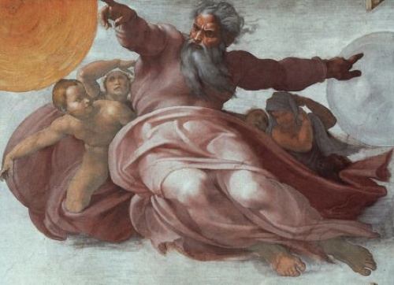
You are non-elect, doomed to hell with no choice on your part.
Is this the mercifully gracious God of the Bible or is this the false god of John Calvin?

Slide 25
What does predestination really mean?
Has the course of your life already been decided?
Has God determined the fate of all men in advance?
What about free moral agency?
Has God given man a free will or not?
Is every thing simply predestinated according to God’s sovereign will?
If this is true way are we to pray – “Thy will be done on earth as it is in heaven…”

Slide 26
Does God really predestinate, elect, chose and ordain some people to eternal damnation and others to eternal life?
ABSOLUTELY NOT!
Nobody is predestined to be saved, except as he chooses, of his own free will, to repent of sin and trust Christ for salvation.
No one is predestined ahead of time to go to Hell.
Christ died for the sins of the whole world.
God is not willing that any should perish.
Salvation is freely offered to “whosoever will.”

Slide 27
The Bible and Predestination

Slide 28
Rom. 8:29 “For whom he did foreknow, he also did predestinate to be conformed to the image of his Son.”
Rom. 8:30 “Moreover whom he did predestinate, them he also called: and whom he called, them he also justified: and whom he justified, them he also glorified.”
Foreknowledge – I Pet. 1:2 “Elect according to the foreknowledge of God the Father.”
Predestinated – Phil. 1:6 “Being confident of this very thing, that he which hath begun a good work in you will perform it until the day of Jesus Christ.”
Calling – II Thess. 2:14 “Whereunto he called you by our gospel.”
Justification – (Romans 5:1)
Glorification – (Romans 8:17)

Slide 29
Eph. 1:4-5 “According as he hath chosen us in him before the foundation of the world, that we should be holy and without blame before him in love: Having predestinated us unto the adoption of children by Jesus Christ to himself, according to the good pleasure of his will.”
Chosen to be “Holy and without blame…”
Predestinated “according to the good pleasure of his will…”
I Peter 2:9 “But ye are a chosen generation, a royal priesthood, an holy nation, a peculiar people; that ye should shew forth the praises of him who hath called you out of darkness into his marvellous light.”

Slide 30
“Make you perfect in every good work to do his will, working in you that which is wellpleasing in his sight, through Jesus Christ; to whom be glory for ever and ever.” Heb. 13:21

Slide 31
Eph. 1:11-13 “In whom also we have obtained an inheritance, being predestinated according to the purpose of him who worketh all things after the counsel of his own will: That we should be to the praise of his glory, who first trusted in Christ. In whom ye also trusted, after that ye heard the word of truth, the gospel of your salvation: in whom also after that ye believed, ye were sealed with that holy Spirit of promise.”
Predestinated – “To be to the praise of his glory.”
Heard the word - gospel of your salvation
Ye trusted and believed gospel – personal choice
Ye were sealed – eternal security

Slide 32
Predestination is not about who is going to heaven and who is going to hell.
Predestination in context - “For whom he did foreknow, he also did predestinate to be conformed to the image of his Son…being predestinated according to the purpose of him who worketh all things after the counsel of his own will: That we should be to the praise of his glory, who first trusted in Christ…According as he hath chosen us in him before the foundation of the world, that we should be holy and without blame before him in love.”

Slide 33
Predestination has nothing to do with our future having been pre-determined for us.
Our future is dependent on our decisions in life – (John 1:12)
If God predestined just one person to die an eternal death, we would have to throw out John 3:16.

Slide 34
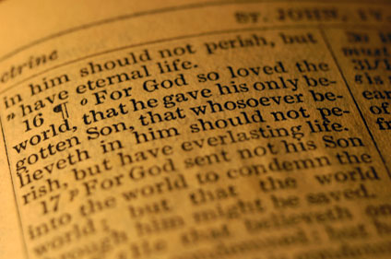

Slide 35
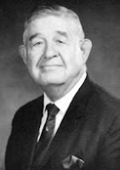
John Calvin, a great theologian, was right in saying that people are saved by grace alone and kept by grace alone. But the teaching that some people, by the foreordained plan of God, are predestined to be saved and some are predestined to be lost, and that their destinies were settled before they were born, is a wicked heresy contrary to the Bible, that dishonors God and has done incalculable harm.

Slide 36
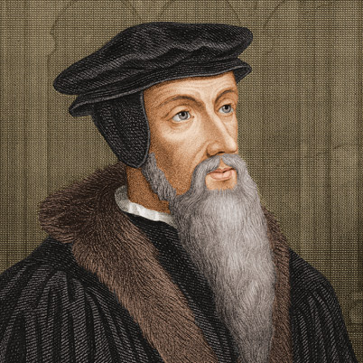
Tulip Theology
T for Total Depravity of the sinner
U for Unconditional Election
L for Limited Atonement
I for Irresistible Grace
P for Perseverance of the saints

Slide 37
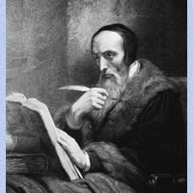
Total Depravity

Slide 38
Total Depravity - Sinners are totally depraved and so incapable of repentance except as God calls some selected individuals, and leaves others He has predestined for Hell, unable to repent.
"God...now commandeth all men every where to repent." (Acts 17:30)
Can anyone accuse God of commanding people to do what He has made it impossible for them to do?
In John 1:9 we are told about Jesus - "That (He) was the true Light, which lighteth every man that cometh into the world."
So every man in the world has enough light from God to be saved – see Romans chapter 1

Slide 39
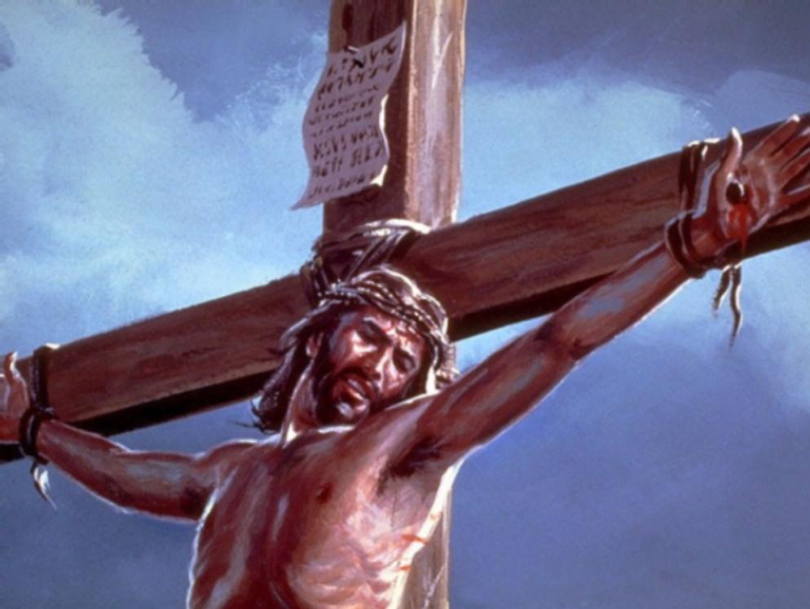
Jesus said, "And I, if I be lifted up from the earth, will draw all men unto me. This he said, signifying what death he should die."
If Jesus draws "all men" unto Himself, then any one
"all men”
can be saved.
(John 12:32-33)

Slide 40
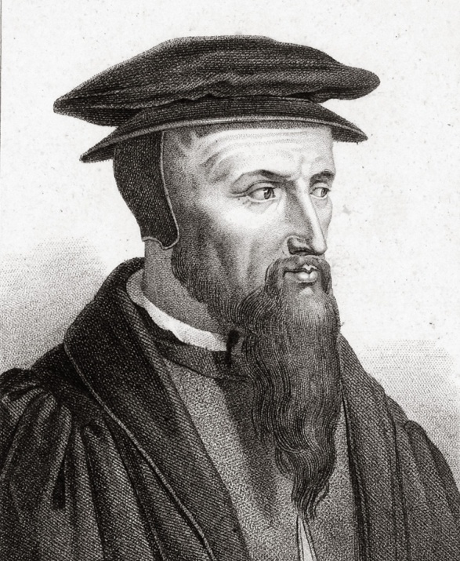
Unconditional Election

Slide 41
Unconditional Election – God chooses to give some people eternal life, without looking for anything good in them as a condition for loving and saving them.
Before any man or woman is born -- in fact, before the world was made -- God decided who would go to heaven and who would not. Before they did good or bad, God chose some to be His people and rejected others.
We agree only with the statement that God elects apart from any merit or human effort on our part, salvation is totally by Grace (salvation is not by works: Ephesians 2:8-10; Titus 3:5; Romans 4:5).

Slide 42
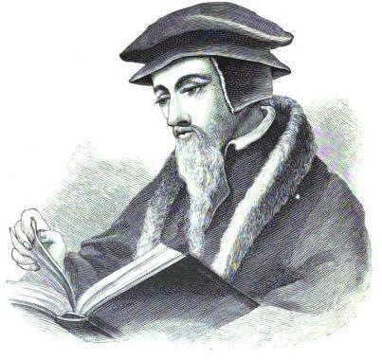
Limited Atonement

Slide 43
Limited Atonement - Christ did not die for all men. He made no provision for some men be saved.
Atonement (salvation) is limited to only the elect.
Christ died ONLY for the sins of the ELECT, and NOT for the sins of the non-elect.
This false teaching claims that God did not love all men enough to have Christ die for all, that His grace is limited.
There is no limited love or atonement in John 3:16.
I John 2:2 plainly says, "And he is the propitiation for our sins: and not for our's only, but also for the sins of the whole world." No limited atonement there.
"Behold the LAMB OF GOD, which TAKETH AWAY THE SIN OF THE WORLD." (John 1:29)

Slide 44
II COR. 5:19 REFUTES "LIMITED ATONEMENT -"To wit, that God was in Christ, RECONCILING THE WORLD UNTO HIMSELF, NOT IMPUTING THEIR TRESPASSES UNTO THEM; and hath committed unto us the word of reconciliation."
I TIM. 2:5-6 REFUTES "LIMITED ATONEMENT – “For there in one God, and one Mediator between God and men, the Man CHRIST JESUS, Who gave Himself a RANSOM FOR ALL, to be testified in due time.”
HEB. 2:9 REFUTES "LIMITED ATONEMENT - "But we see Jesus, who was made a little lower than the angels for the suffering of death, crowned with glory and honour; that he by the grace of God SHOULD TASTE DEATH FOR EVERY MAN."

Slide 45
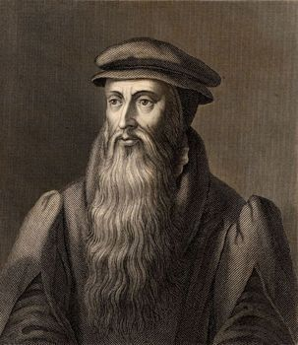
Irresistible Grace

Slide 46
Irresistible grace – The call of God to salvation cannot be resisted or opposed.
When the Holy Spirit draws a man to salvation that man can not resist.
Those who are predestinated, elected, called and chosen by God can not reject the offer of grace (salvation).
Rev. 3:20 “Behold, I stand at the door, and knock: if any man hear my voice, and open the door, I will come in to him, and will sup with him, and he with me.”
Matt. 23:37 “O Jerusalem, Jerusalem, thou that killest the prophets, and stonest them which are sent unto thee, how often would I have gathered thy children together, even as a hen gathereth her chickens under her wings, and ye would not.”

Slide 47
Acts 7:51 “Ye stiffnecked and uncircumcised in heart and ears, ye do always resist the Holy Ghost: as your fathers did, so do ye.”
Proverbs 1:24-25 “Because I have called, and ye refused; I have stretched out my hand, and no man regarded; But ye have set at nought all my counsel, and would none of my reproof: I also will laugh at your calamity; I will mock when your fear cometh.”
John 5:40 “And ye will not come to me, that ye might have life.”

Slide 48
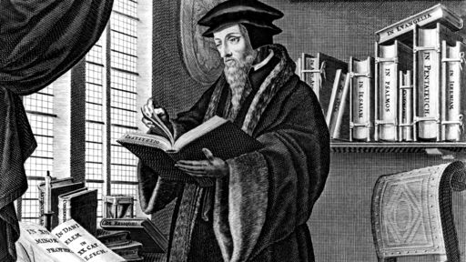
Perseverance of the Saints

Slide 49
Perseverance of the saints – The elect will persevere in faith and continue in grace to ultimate final salvation. – Matt. 24:13 “But he that shall endure unto the end, the same shall be saved.”
Eternal security is the preservation of the saints, NOT the perseverance of the saints.
Eternal salvation advocates believe that once a person is truly "born of God", or "regenerated" nothing in heaven or earth “…shall be able to separate (them) from the love of God.” (Romans 8:39)

Slide 50
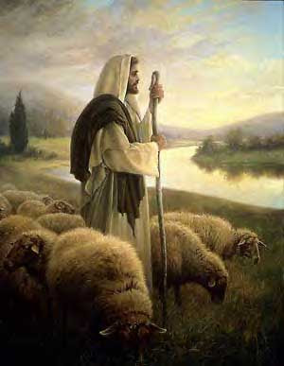
“My sheep hear my voice, and I know them, and they follow me: And I give unto them eternal life; and they shall never perish, neither shall any man pluck them out of my hand. My Father, which gave them me, is greater than all; and no man is able to pluck them out of my Father's hand.”
John 10:27-29

Slide 51
John 5:24 – ‘Verily, verily, I say unto you, He that heareth my word, and believeth on him that sent me, hath everlasting life, and shall not come into condemnation; but is passed from death unto life.”
II Tim. 1:12 – “For the which cause I also suffer these things: nevertheless I am not ashamed: for I know whom I have believed, and am persuaded that he is able to keep that which I have committed unto him against that day.”
Jude 1:1 “Jude, the servant of Jesus Christ, and brother of James, to them that are sanctified by God the Father, and preserved in Jesus Christ, and called.”

Slide 52
Calvinism is unscriptural, false doctrine. It tends to flourish in intellectual pride and in neglect of soul winning. It is Satan's effort to kill concern and compassion for lost souls and the mission outreach of the local Church . (Matthew 28:19-20) “Preach the gospel to every creature”

Slide 53
Mind of God
Predestinated
Elected
Called
Chosen
Ordained
Foreknow
Foreknowledge
Draw
Believe
Confess
Repent
Receive
Ask
Preach
Witness
Resist and reject
Free will of man
Sovereignty of God

Slide 54
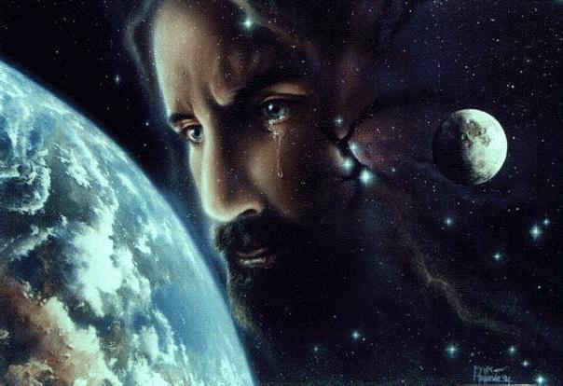
For whom did Christ die?
Every person

Slide 55
Christ death for all mankind

Slide 56
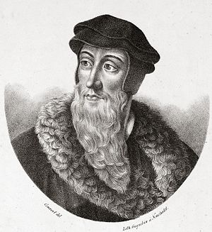
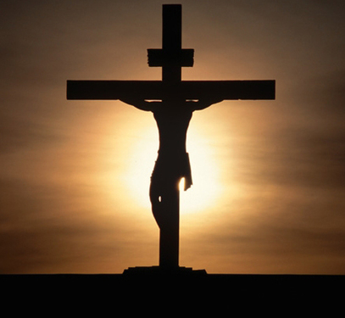
Calvary vs Calvinism
Romans 10:13, "For WHOSOEVER shall call upon the name of the Lord shall be saved."

Slide 57
"For God so loved the world, that he gave his only begotten Son, that whosoever believeth in him should not perish, but have everlasting life." (John 3:16)
"The next day John seeth Jesus coming unto him, and saith, Behold the Lamb of God, which taketh away the sin of the world." (John 1:29)
"And he is the propitiation for our sins: and not for ours only, but also for the sins of the whole world." (I John 2:2)

Slide 58
"For the grace of God that bringeth salvation hath appeared to all men." (Titus 2:11)
"The Lord is not slack concerning his promise, as some men count slackness; but is long-suffering to us-ward, not willing that any should perish, but that all should come to repentance." (II Pet. 3:9)
"Who gave himself a ransom for all, to be testified in due time." (I Tim. 2:6)

Slide 59
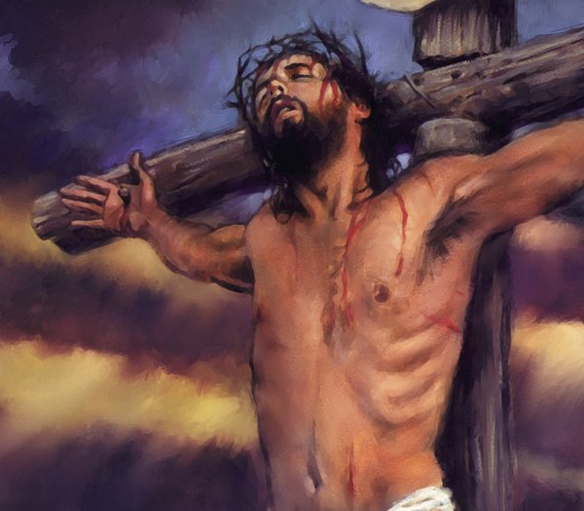
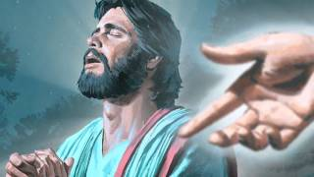
"But we see Jesus, who was made a little lower than the angels for the suffering of death, crowned with glory and honor; that he by the grace of God should taste death for every man." (Heb. 2:9)

Slide 60
"For therefore we both labor and suffer reproach, because we trust in the living God, who is the Savior of all men, specially of those that believe" (I Tim. 4:10)

Slide 61
(Luke 2:10-45) “And the angel said unto them, Fear not: for, behold, I bring you good tidings of great joy, which shall be to all people. For unto you is born this day in the city of David a Saviour, which is Christ the Lord.”
(Matthew 10:32) “Whosoever therefore shall confess me before men, him will I confess also before my Father which is in heaven.”
(Mark 16:15) “And he said unto them, Go ye into all the world, and preach the gospel to every creature.”

Slide 62
(John 3:16 - 17) “For God so loved the world, that he gave his only begotten Son, that whosoever believeth in him should not perish, but have everlasting life. For God sent not his Son into the world to condemn the world; but that the world through him might be saved.”
(John 12:32) “And I, if I be lifted up from the earth, will draw all men unto me.”
(Acts 2:21) “And it shall come to pass, that whosoever shall call on the name of the Lord shall be saved.”

Slide 63
(Romans 1:16) “For I am not ashamed of the gospel of Christ: for it is the power of God unto salvation to every one that believeth; to the Jew first, and also to the Greek.”
(Romans 5:18) “Therefore as by the offence of one judgment came upon all men to condemnation; even so by the righteousness of one the free gift came upon all men unto justification of life.”
(Romans 10:12-13) “For there is no difference between the Jew and the Greek: for the same Lord over all is rich unto all that call upon him. For whosoever shall call upon the name of the Lord shall be saved.”

Slide 64
(II Corinthians 5:19) “To wit, that God was in Christ, reconciling the world unto himself, not imputing their trespasses unto them; and hath committed unto us the word of reconciliation.”
(I Timothy 2:3-4) “For this is good and acceptable in the sight of God our Saviour; Who will have all men to be saved, and to come unto the knowledge of the truth.”
(Revelation 5:9) “And they sung a new song, saying, Thou art worthy to take the book, and to open the seals thereof: for thou wast slain, and hast redeemed us to God by thy blood out of every kindred, and tongue, and people, and nation.”

Slide 65
(Revelation 7:9) “After this I beheld, and, lo, a great multitude, which no man could number, of all nations, and kindreds, and people, and tongues, stood before the throne, and before the Lamb, clothed with white robes, and palms in their hands.”
(Revelation 22:17) “And the Spirit and the bride say, Come. And let him that heareth say, Come. And let him that is athirst come. And whosoever will, let him take the water of life freely.”

Slide 66
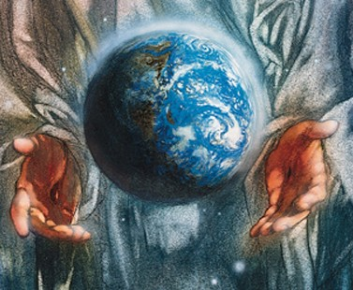
“There is no God else beside me; a just God and a Saviour; there is none beside me. Look unto me, and be ye saved, all the ends of the earth: for I am God, and there is none else. I have sworn by myself, the word is gone out of my mouth in righteousness, and shall not return, That unto me every knee shall bow, every tongue shall swear.” (Isaiah 45:21-23)

Slide 67
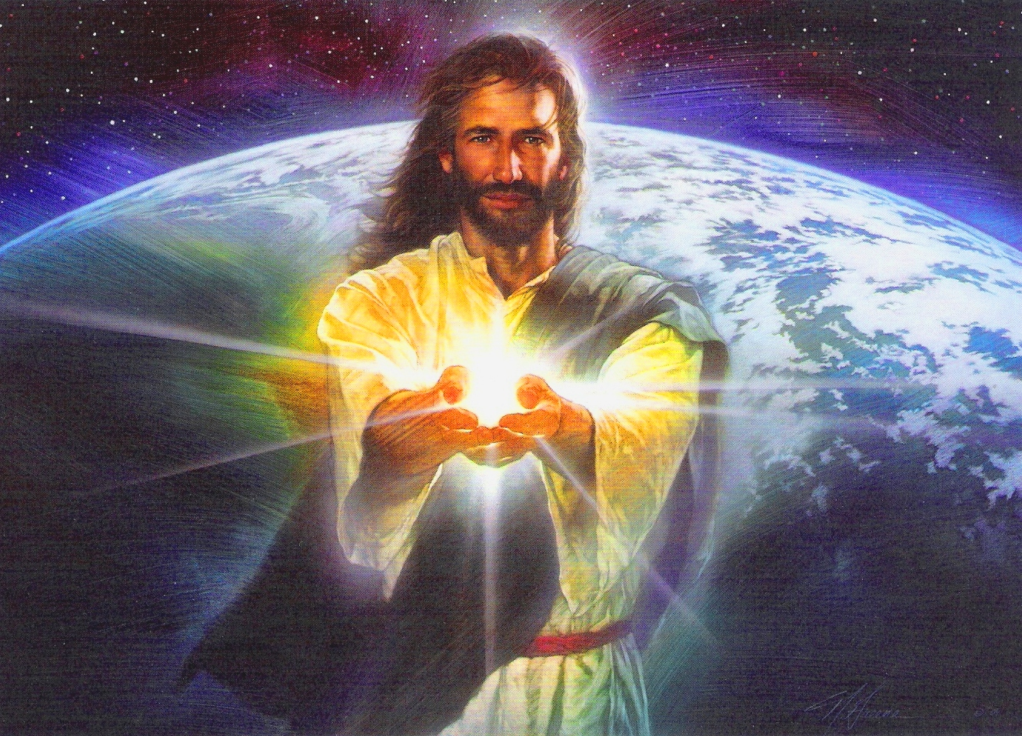

Slide 68
“I call heaven and earth to record this day against you, that I have set before you life and death, blessing and cursing: therefore choose life, that both thou and thy seed may live.” Deut. 30:19

Slide 69
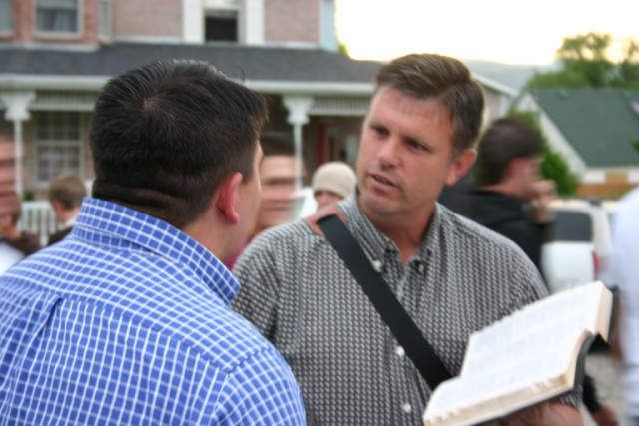
“To open their eyes, and to turn them from darkness to light, and from the power of Satan unto God, that they may receive forgiveness of sins, and inheritance among them which are sanctified by faith.” Acts 26:18

Slide 70
“We then, as workers together with him, beseech you also that ye receive not the grace of God in vain.”
(II Cor. 6:1)

