Slide 1
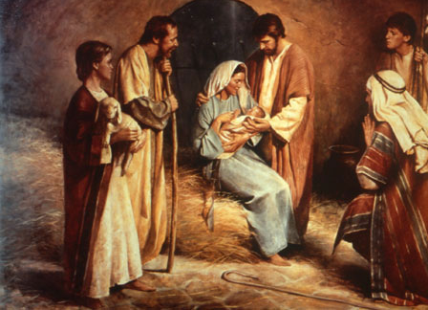
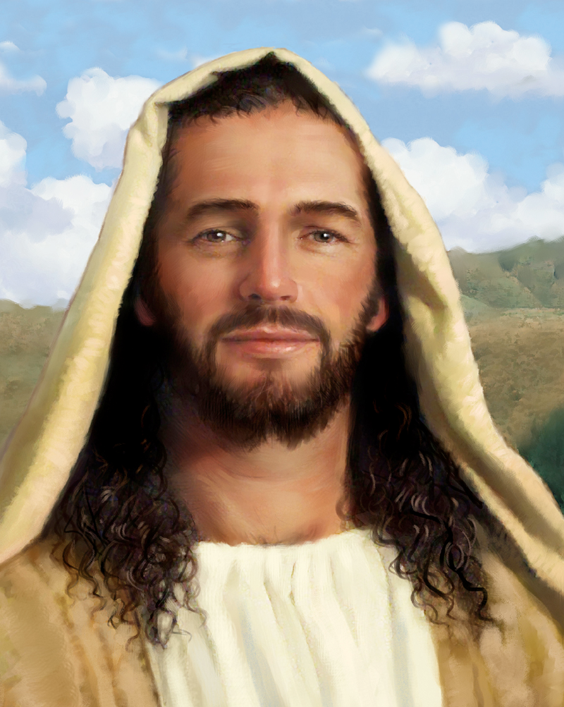
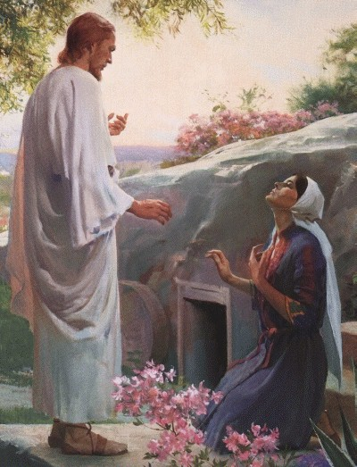
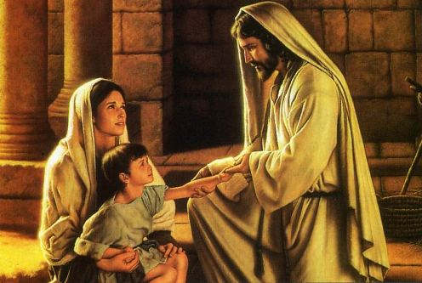
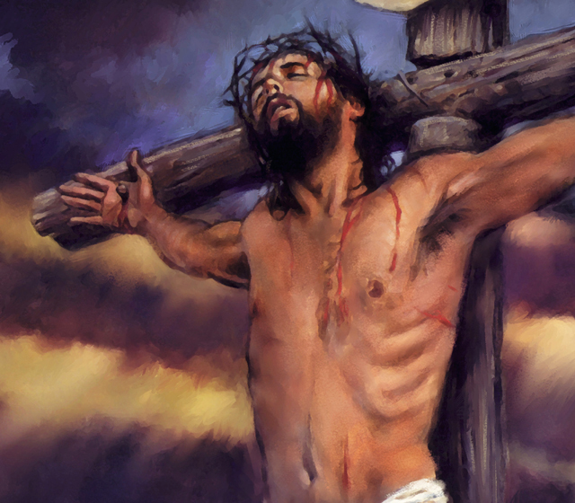
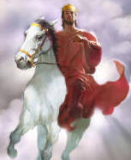
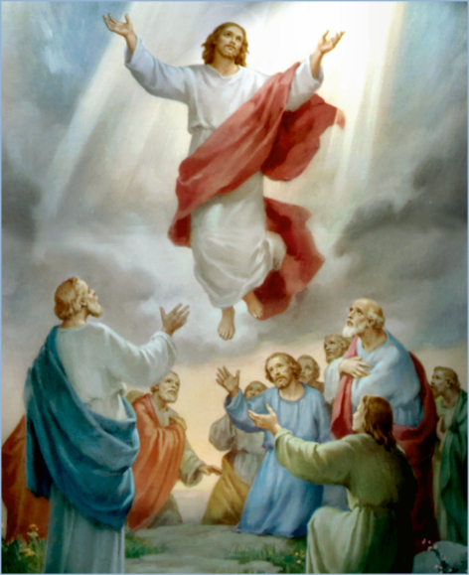
The Doctrine of Jesus Christ (Part 13)
The Death of Jesus Christ
(Part 1)

Slide 2
Review

Slide 4
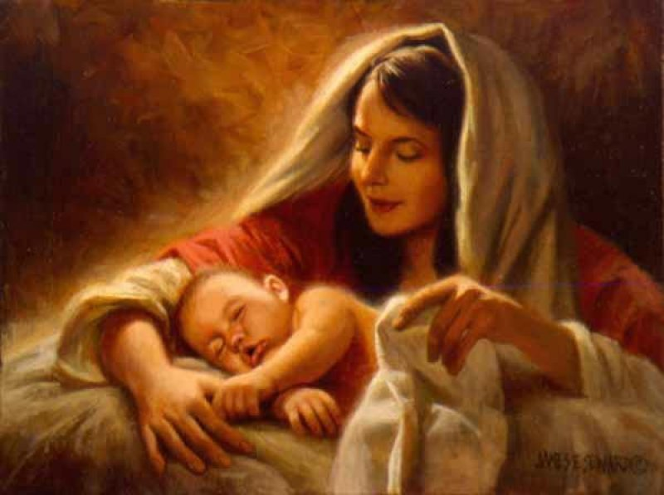
The Virgin Birth
“Behold, a virgin shall be with child, and shall bring forth a son, and they shall call his name Emmanuel, which being interpreted is, God with us.”
Matt. 1:23

Slide 5
The Incarnation of Christ
(John 1:1-14)
God the Son took upon himself the full nature of man and yet retain the full nature of God.

Slide 6
Names and Titles of Jesus Christ

Slide 7
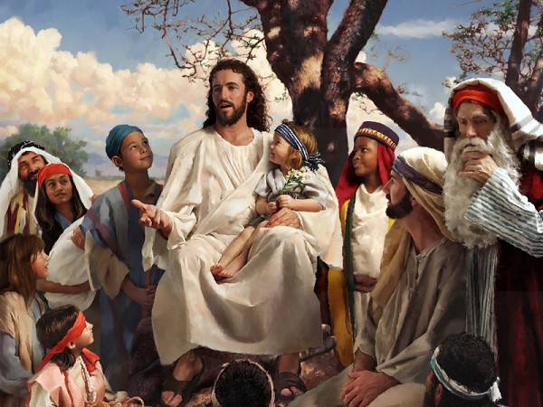
The Humanity of Jesus Christ

Slide 8
The Deity of Jesus Christ
“I and my Father are one. Then the Jews took up stones again to stone him. Jesus answered them, Many good works have I shewed you from my Father; for which of those works do ye stone me? The Jews answered him, saying, For a good work we stone thee not; but for blasphemy; and because that thou, being a man, makest thyself God.” (John 10:30-33)

Slide 9
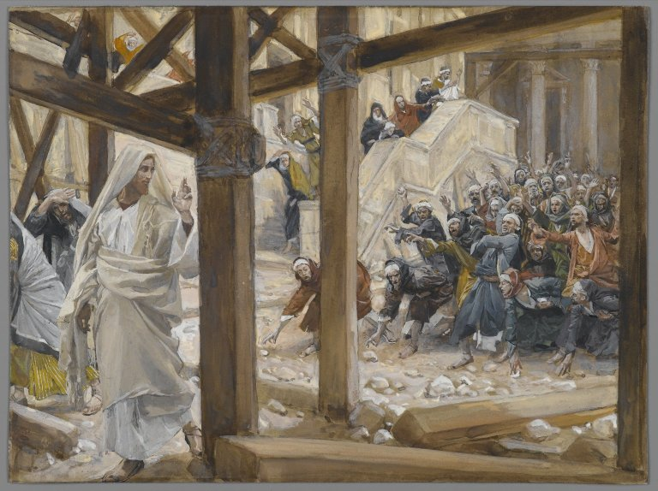

Slide 10
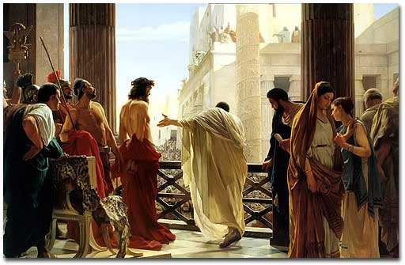
The Impeccability of Jesus Christ
“Pilate saith unto him, What is truth? And when he had said this, he went out again unto the Jews, and saith unto them, I find in him no fault at all.” John 18:38

Slide 11
Not capable of sinning
Impeccability

Slide 12
The Earthly Ministry of Jesus Christ

Slide 13
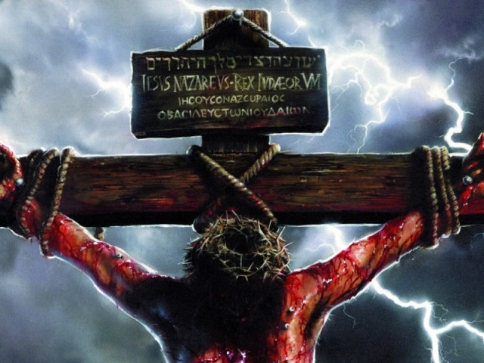
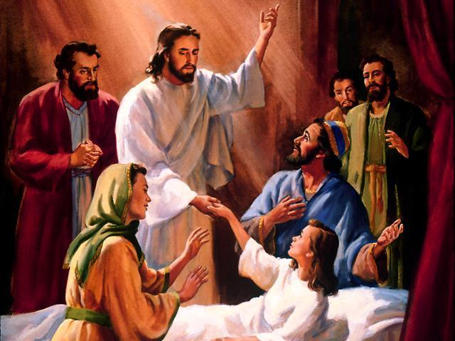
“For even the Son of man came not to be ministered unto, but to minister, and to give his life a ransom for many.” Mark 10:45

Slide 14
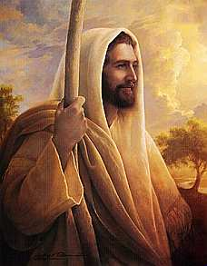
The Character of Jesus Christ
What kind of man was our Lord?
What were some of his characteristics?

Slide 15
The character of Christ
His zeal
His compassion
His meekness and gentleness
His boldness and courage
His love

Slide 16
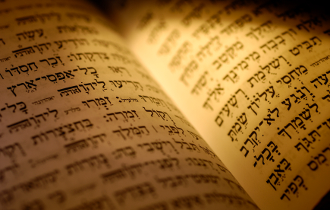
In the Old Testament three great offices were created by God to meet the spiritual and material needs of his chosen people.

Slide 17
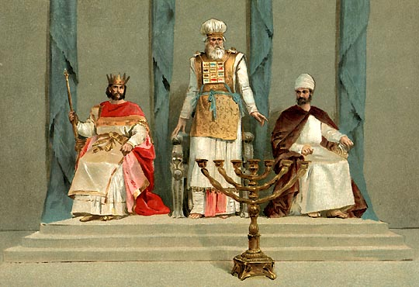
Jesus holds all three offices

Slide 18
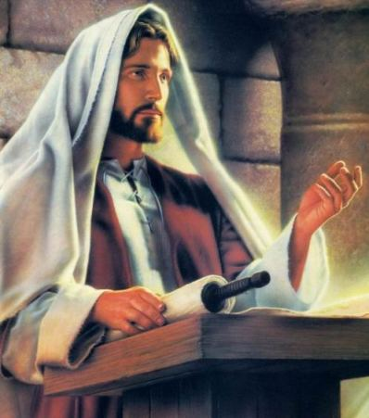

Slide 19
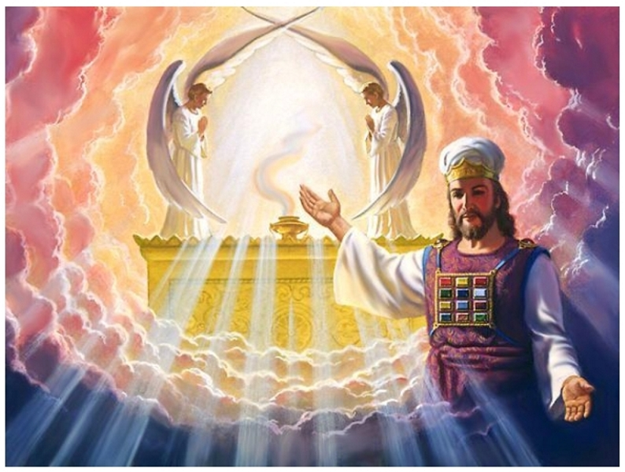

Slide 20
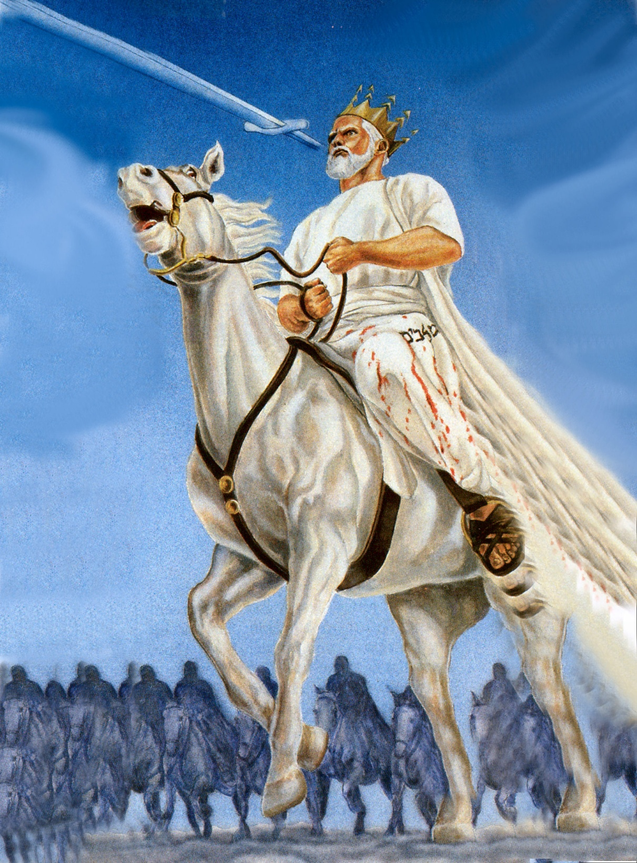

Slide 21
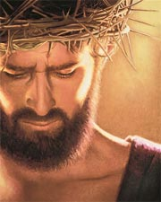
The Death of Jesus Christ

Slide 22
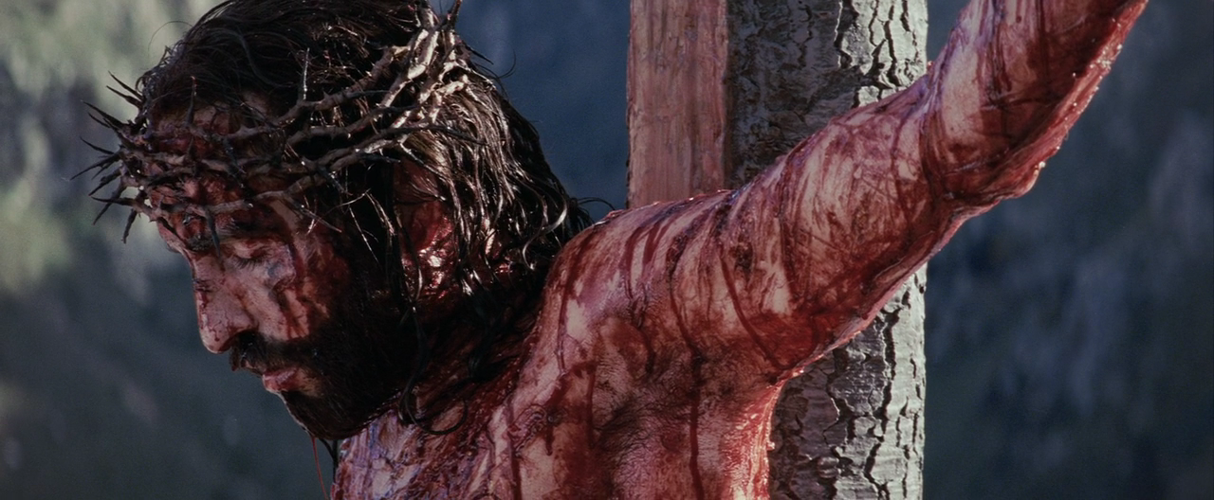
The murder of Israel’s Messiah, the killing of the Creator

Slide 23
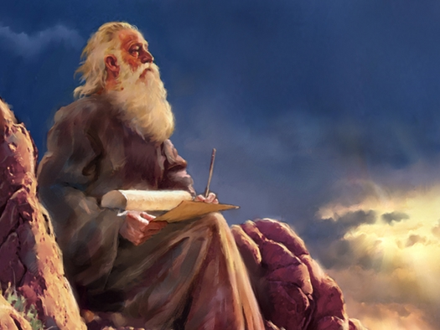
As pondered by the Old Testament Prophets
"Of which salvation the prophets have enquired and searched diligently, who prophesied of the grace that should come unto you: searching what, or what manner of time the Spirit of Christ which was in them did signify, when it testified beforehand the sufferings of Christ, and the glory that should follow."
(I Pet. 1:10-11)

Slide 24
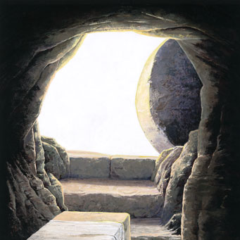
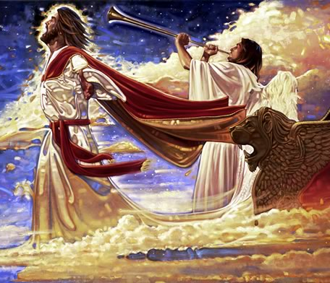
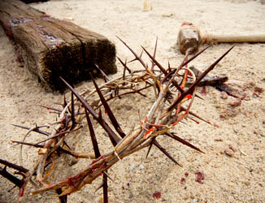
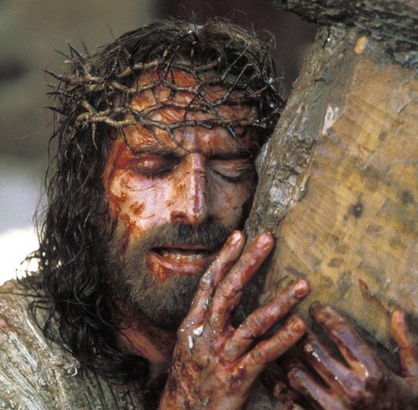

Slide 25
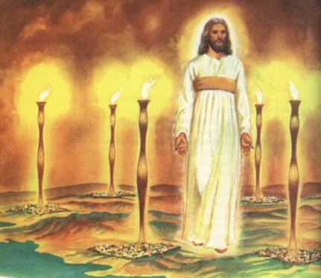

Slide 26
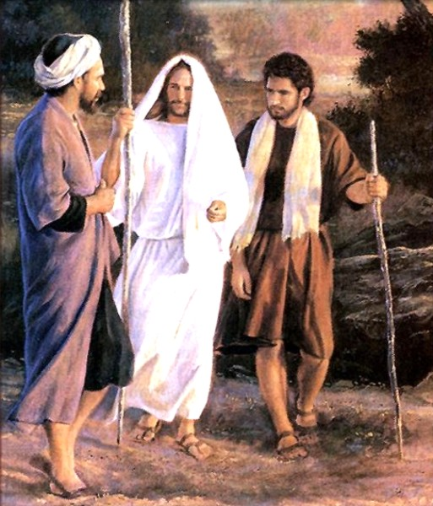
"Then he said unto them, O fools, and slow of heart to believe all that the prophets have spoken: Ought not Christ to have suffered these things, and to enter into his glory? And beginning at Moses and all the prophets, he expounded unto them in all the scriptures the things concerning himself." (Luke 24:25-27)

Slide 27
"Surely he hath borne our griefs, and carried our sorrows: yet we did esteem him stricken, smitten of God, and afflicted. But he was wounded for our transgressions, he was bruised for our iniquities: the chastisement of our peace was upon him; and with his stripes we are healed. All we like sheep have gone astray; we have turned every one to his own way; and the Lord hath laid on him the iniquity of us all. He was oppressed, and he was afflicted, yet he opened not his mouth: he is brought as a lamb to the slaughter, and as a sheep before her shearers is dumb, so he openeth not his mouth." (Isa. 53:4-7)

Slide 28
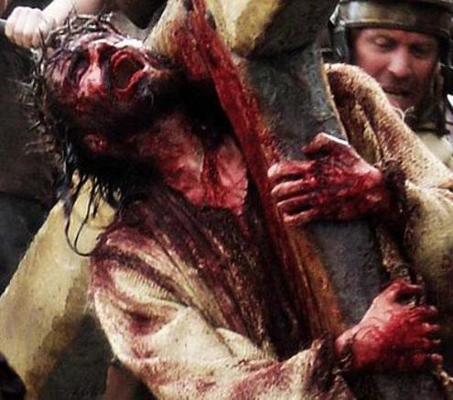
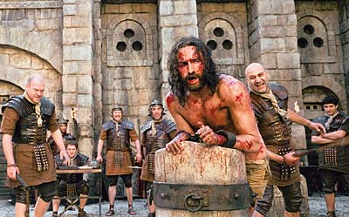
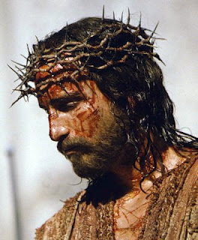
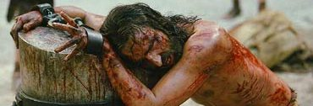
"I gave my back to the smiters, and my cheeks to them that plucked off the hair: I hid not my face from shame and spitting." (Isa. 50:6)

Slide 29
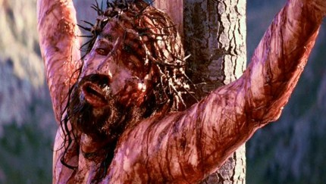
"My God, my God, why hast thou forsaken me? why art thou so far from helping me, and from the words of my roaring?" (Psalm 22:1)

Slide 30
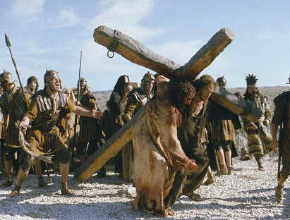
“All they that see me laugh me to scorn: they shoot out the lip, they shake the head, saying, He trusted on the Lord that he would deliver him: let him deliver him, seeing he delighted in him." (Psalm 22:6-8)

Slide 31
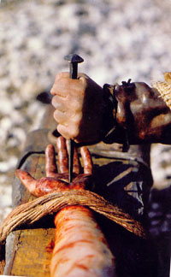
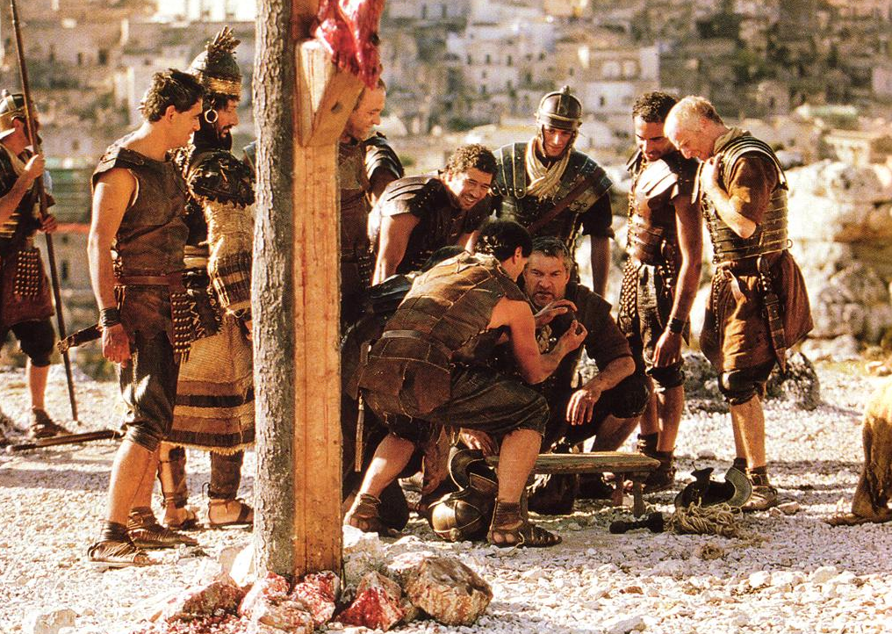
"For dogs have compassed me: the assembly of the wicked have inclosed me: they pierced my hands and my feet. I may tell all my bones: they look and stare upon me. They part my garments among them, and cast lots upon my vesture.”
(Palm 22:16-18)

Slide 32
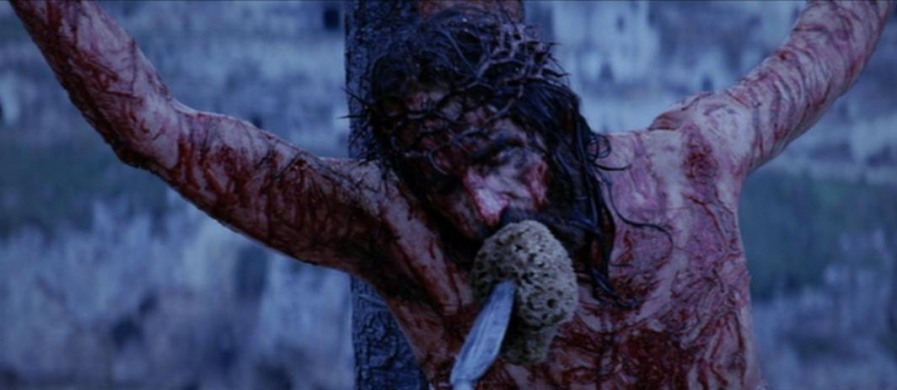
"They gave me also gall for my meat; and in my thirst they gave me vinegar to drink." (Psalm 69:21)

Slide 33
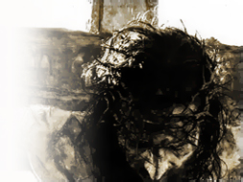
Gall - in KJV 07219 var ro'sh, roshe
A poisonous plant, probably the poppy, generally poison, venom of serpents.
Very bitter
Used as a sedative for pain
Usually mixed with wine vinegar
“They gave him vinegar to drink mingled with gall: and when he had tasted thereof, he would not drink.” Matt. 27:34

Slide 34
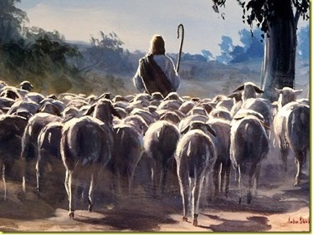
"Awake, O sword, against my shepherd, and against the man who is my fellow [equal], saith the Lord of hosts; smite the shepherd, and the sheep shall be scattered." (Zech. 13:7)

Slide 35
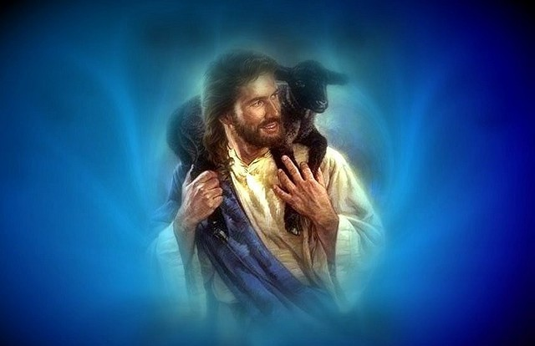
“I am the good shepherd: the good shepherd giveth his life for the sheep.” John 10:11

Slide 36
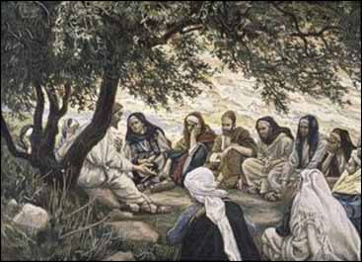
As pondered by the New Testament Apostles

Slide 37
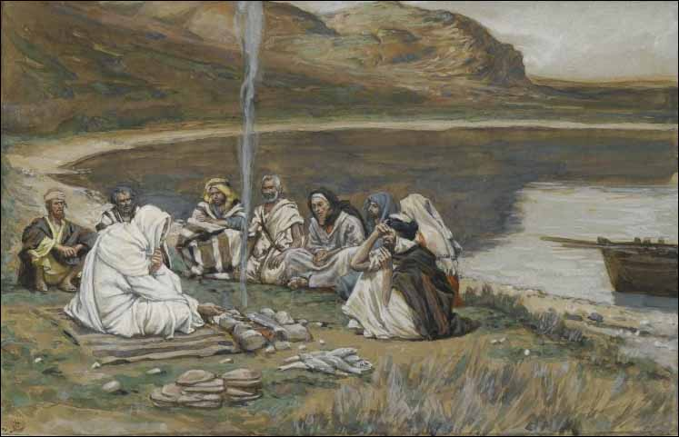
“And while they abode in Galilee, Jesus said unto them, The Son of man shall be betrayed into the hands of men: and they shall kill him, and the third day he shall be raised again. And they were exceeding sorry.”
(Matt. 17:22-23)

Slide 38
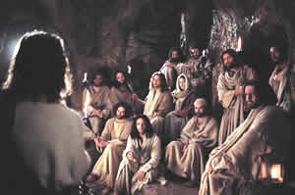
"A little while, and ye shall not see me: and again, a little while, and ye shall see me, because I go to the Father. Then said some of his disciples among themselves, What is this that he saith unto us, A little while, and ye shall not see me: and again a little while, and ye shall see me: and, Because I go to the Father?" (Jn. 16:16-17)

Slide 39
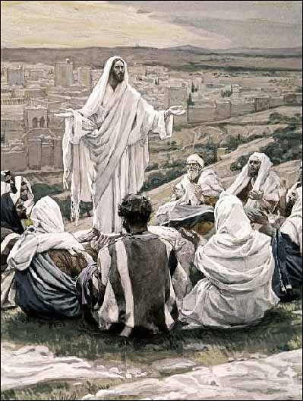
Jesus and the coming Kingdom

Slide 40
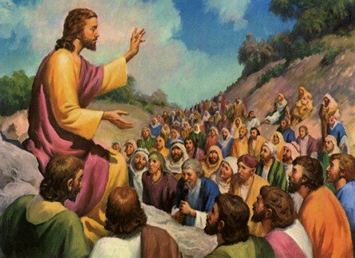
“Blessed are the poor in spirit: for theirs is the kingdom of heaven…Blessed are they which are persecuted for righteousness' sake: for theirs is the kingdom of heaven…Whosoever therefore shall break one of these least commandments, and shall teach men so, he shall be called the least in the kingdom of heaven: but whosoever shall do and teach them, the same shall be called great in the kingdom of heaven.”
(Matt. 5:3, 10, 19)

Slide 41
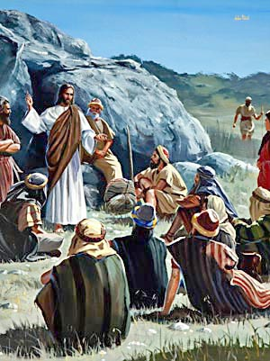
“Thy kingdom come. Thy will be done in earth, as it is in heaven.”
Matt. 6:10

Slide 42
(Luke 19:10-13) “For the Son of man is come to seek and to save that which was lost. And as they heard these things, he added and spake a parable, because he was nigh to Jerusalem, and because they thought that the kingdom of God should immediately appear. He said therefore, A certain nobleman went into a far country to receive for himself a kingdom, and to return. And he called his ten servants, and delivered them ten pounds, and said unto them, Occupy till I come.”
(see verse 14-27)

Slide 43
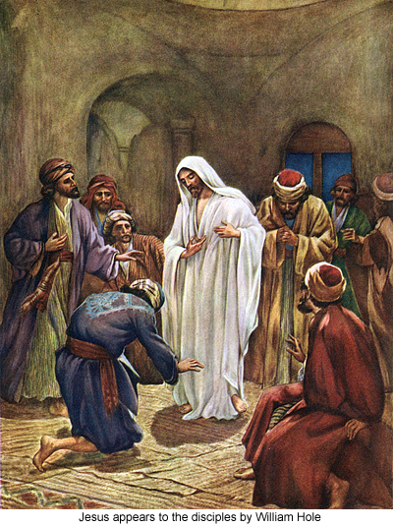
“When they therefore were come together, they asked of him, saying, Lord, wilt thou at this time restore again the kingdom to Israel?” Acts 1:6

Slide 44
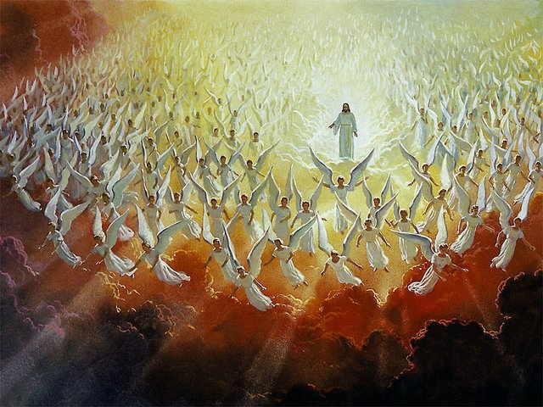
As pondered by the heavenly angels

Slide 45
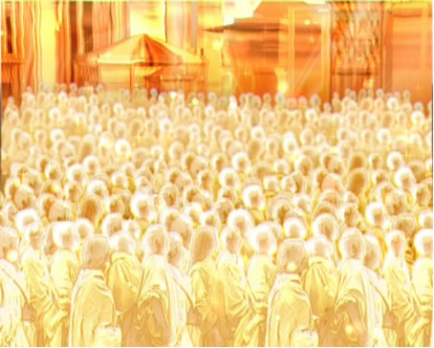
“And to make all men see what is the fellowship of the mystery, which from the beginning of the world hath been hid in God, who created all things by Jesus Christ: To the intent that now unto the principalities and powers in heavenly places might be known by the church the manifold wisdom of God, According to the eternal purpose which he purposed in Christ Jesus our Lord: In whom we have boldness and access with confidence by the faith of him.” (Ephesians 3:9-12)

Slide 46
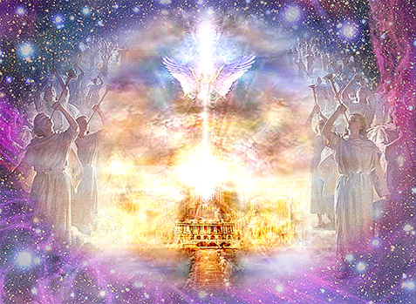
“Searching what, or what manner of time the Spirit of Christ which was in them did signify, when it testified beforehand the sufferings of Christ, and the glory that should follow. Unto whom it was revealed, that not unto themselves, but unto us they did minister the things, which are now reported unto you by them that have preached the gospel unto you with the Holy Ghost sent down from heaven; which things the angels desire to look into.” (I Peter 1:11-12)

Slide 47
For whom did Christ die?
It may be said that he died for the world, for every person.

Slide 48
His death for all mankind
"For God so loved the world, that he gave his only begotten Son, that whosoever believeth in him should not perish, but have everlasting life" (John 3:16)
"The next day John seeth Jesus coming unto him, and saith, Behold the Lamb of God, which taketh away the sin of the world" (John 1:29)
"And he is the propitiation for our sins: and not for ours only, but also for the sins of the whole world" (I John 2:2)

Slide 49
"For the grace of God that bringeth salvation hath appeared to all men" (Titus 2:11)
"But there were false prophets also among the people, even as there shall be false teachers among you, who privily shall bring in damnable heresies, even denying the Lord that brought them, and bring upon themselves swift destruction" (II Pet. 2:1)
"The Lord is not slack concerning his promise, as some men count slackness; but is long-suffering to us-ward, not willing that any should perish, but that all should come to repentance" (II Pet. 3:9)

Slide 50
"Who gave himself a ransom for all, to be testified in due time" (I Tim. 2:6)

Slide 51
"But we see Jesus, who was made a little lower than the angels for the suffering of death, crowned with glory and honor; that he by the grace of God should taste death for every man" (Heb. 2:9)

Slide 52
"For therefore we both labor and suffer reproach, because we trust in the living God, who is the Savior of all men, specially of those that believe" (I Tim. 4:10)

Slide 53
God’s universal offer of Salvation
Under the Old Covenant God dwelt with the nation of Israel and through the nation of Israel – His chosen people
(Deuteronomy 7:6) “For thou art an holy people unto the LORD thy God: the LORD thy God hath chosen thee to be a special people unto himself, above all people that are upon the face of the earth.”

Slide 54
Faith has always been a necessary requirement for salvation
Abraham - (Genesis 15:6) “And he believed in the LORD; and he counted it to him for righteousness.”
(Romans 4:1-5) “What shall we say then that Abraham our father, as pertaining to the flesh, hath found? For if Abraham were justified by works, he hath whereof to glory; but not before God. For what saith the scripture? Abraham believed God, and it was counted unto him for righteousness. Now to him that worketh is the reward not reckoned of grace, but of debt. But to him that worketh not, but believeth on him that justifieth the ungodly, his faith is counted for righteousness.”

Slide 55
The covenant established by the Mosaic Law implied that an Israelite had to have faith in the God of the Covenant if he were to receive the Salvation of the Lord.

Slide 56
“Therefore the LORD heard this, and was wroth: so a fire was kindled against Jacob, and anger also came up against Israel; Because they believed not in God,
and trusted not in his salvation.”
(Psalms 78:21-22)
“He came unto his own, and his own received him not. But as many as received him, to them gave he power to become the sons of God, even to them that believe on his name.”
(John 1:11-12)

Slide 57
(Romans 11)
Believing Gentiles (Church)
Olive tree
Unbelieving Israel

Slide 58
Salvation has never been exclusive
Under the Old Testament Covenant God made provision for the salvation of the Gentiles -
(Isaiah 45:21-23) “There is no God else beside me; a just God and a Saviour; there is none beside me. Look unto me, and be ye saved, all the ends of the earth: for I am God, and there is none else. I have sworn by myself, the word is gone out of my mouth in righteousness, and shall not return, That unto me every knee shall bow, every tongue shall swear.”

Slide 59
(Isaiah 42:6-7) “I the LORD have called thee in righteousness, and will hold thine hand, and will keep thee, and give thee for a covenant of the people, for a light of the Gentiles; To open the blind eyes, to bring out the prisoners from the prison, and them that sit in darkness out of the prison house.”
(Isaiah 49:6) “And he said, It is a light thing that thou shouldest be my servant to raise up the tribes of Jacob, and to restore the preserved of Israel: I will also give thee for a light to the Gentiles, that thou mayest be my salvation unto the end of the earth.”

Slide 60
(Isaiah 52:10) “The LORD hath made bare his holy arm in the eyes of all the nations; and all the ends of the earth shall see the salvation of our God.”
(Psalms 72:17-19) “His name shall endure for ever: his name shall be continued as long as the sun: and men shall be blessed in him: all nations shall call him blessed. Blessed be the LORD God, the God of Israel, who only doeth wondrous things. And blessed be his glorious name for ever: and let the whole earth be filled with his glory; Amen, and Amen.”

Slide 61
Under the New Covenant God deals with all men and through all men who believe.
“For there is no difference between the Jew and the Greek: for the same Lord over all is rich unto all that call upon him. For whosoever shall call upon the name of the Lord shall be saved.”
(Romans 10:12-13)

Slide 62
Hymn – Philip Bliss (1870)
“Whosoever will.”
“Whosoever heareth,” shout, shout the sound! Spread the blessed tidings all the world around; Spread the joyful news wherever man is found: “Whosoever will may come.”

Slide 63
Whosoever cometh need not delay, Now the door is open, enter while you may; Jesus is the true, the only Living Way: “Whosoever will may come.”

Slide 64
“Whosoever will,” the promise secure, “Whosoever will,” forever must endure; “Whosoever will,” ’tis life forevermore: “Whosoever will may come.”

Slide 65
Refrain: “Whosoever will, whosoever will,” Send the proclamation over vale and hill; tis a loving Father calls the wand’rer home: “Whosoever will may come.”

Slide 66
The clear teaching and authority of Scripture

Slide 67
(Luke 2:10-45) “And the angel said unto them, Fear not: for, behold, I bring you good tidings of great joy, which shall be to all people. For unto you is born this day in the city of David a Saviour, which is Christ the Lord.”
(Matthew 10:32) “Whosoever therefore shall confess me before men, him will I confess also before my Father which is in heaven.”
(Mark 16:15) “And he said unto them, Go ye into all the world, and preach the gospel to every creature.”

Slide 68
(John 3:16 - 4:15) “For God so loved the world, that he gave his only begotten Son, that whosoever believeth in him should not perish, but have everlasting life. For God sent not his Son into the world to condemn the world; but that the world through him might be saved.”
(John 12:32) “And I, if I be lifted up from the earth, will draw all men unto me.”
(Acts 2:21) “And it shall come to pass, that whosoever shall call on the name of the Lord shall be saved.”

Slide 69
(Acts 17:25-31) “And hath made of one blood all nations of men for to dwell on all the face of the earth, and hath determined the times before appointed, and the bounds of their habitation; That they should seek the Lord, if haply they might feel after him, and find him, though he be not far from every one of us…but now (God) commandeth all men every where to repent: Because he hath appointed a day, in the which he will judge the world in righteousness by that man whom he hath ordained; whereof he hath given assurance unto all men, in that he hath raised him from the dead.”

Slide 70
(Romans 1:16) “For I am not ashamed of the gospel of Christ: for it is the power of God unto salvation to every one that believeth; to the Jew first, and also to the Greek.”
(Romans 5:18) “Therefore as by the offence of one judgment came upon all men to condemnation; even so by the righteousness of one the free gift came upon all men unto justification of life.”
(Romans 10:12-13) “For there is no difference between the Jew and the Greek: for the same Lord over all is rich unto all that call upon him. For whosoever shall call upon the name of the Lord shall be saved.”

Slide 71
(II Corinthians 5:19) “To wit, that God was in Christ, reconciling the world unto himself, not imputing their trespasses unto them; and hath committed unto us the word of reconciliation.”
(I Timothy 2:3-4) “For this is good and acceptable in the sight of God our Saviour; Who will have all men to be saved, and to come unto the knowledge of the truth.”
(Revelation 5:9) “And they sung a new song, saying, Thou art worthy to take the book, and to open the seals thereof: for thou wast slain, and hast redeemed us to God by thy blood out of every kindred, and tongue, and people, and nation.”

Slide 72
(Revelation 7:9) “After this I beheld, and, lo, a great multitude, which no man could number, of all nations, and kindreds, and people, and tongues, stood before the throne, and before the Lamb, clothed with white robes, and palms in their hands.”
(Revelation 22:17) “And the Spirit and the bride say, Come. And let him that heareth say, Come. And let him that is athirst come. And whosoever will, let him take the water of life freely.”

Slide 73
“Then said he unto him, A certain man made a great supper, and bade many: And sent his servant at supper time to say to them that were bidden, Come; for all things are now ready. And they all with one consent began to make excuse. The first said unto him, I have bought a piece of ground, and I must needs go and see it: I pray thee have me excused. And another said, I have bought five yoke of oxen, and I go to prove them: I pray thee have me excused. And another said, I have married a wife, and therefore I cannot come.

Slide 74
So that servant came, and shewed his lord these things. Then the master of the house being angry said to his servant, Go out quickly into the streets and lanes of the city, and bring in hither the poor, and the maimed, and the halt, and the blind. And the servant said, Lord, it is done as thou hast commanded, and yet there is room. And the lord said unto the servant, Go out into the highways and hedges, and compel them to come in, that my house may be filled.” (Luke 14:16-23)

Slide 76
Next Weeks Lesson “Exposing the false Doctrine of Calvinism”
“I marvel that ye are so soon removed from him that called you into the grace of Christ unto another gospel …but there be some that trouble you, and would pervert the gospel of Christ. But though we, or an angel from heaven, preach any other gospel unto you than that which we have preached unto you, let him be accursed.” (Gal. 1:6-8)

