Slide 1
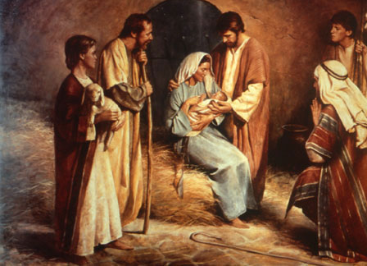
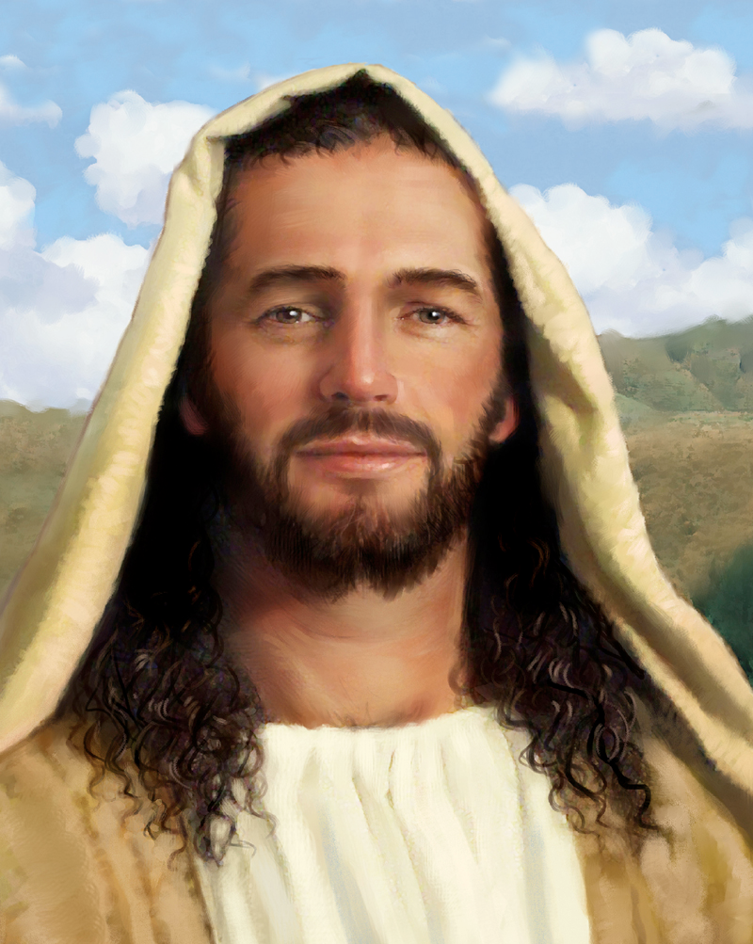
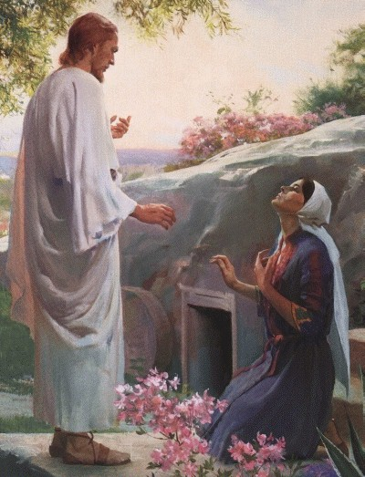
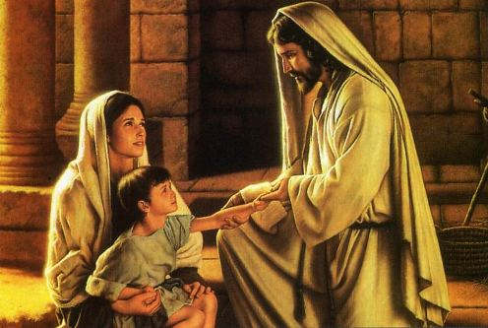
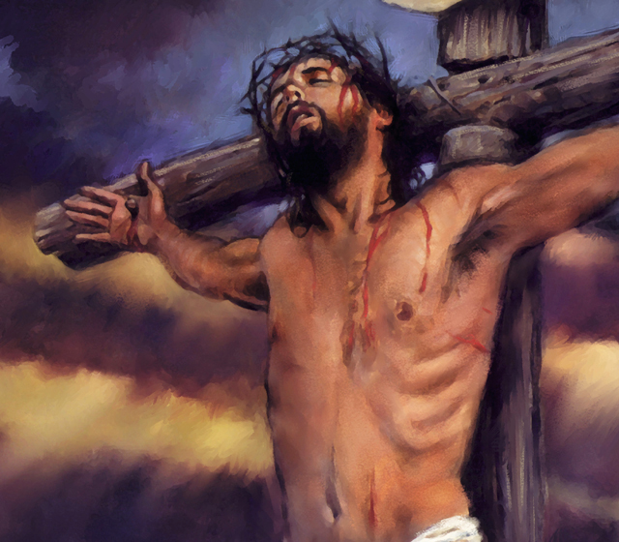
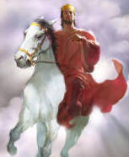
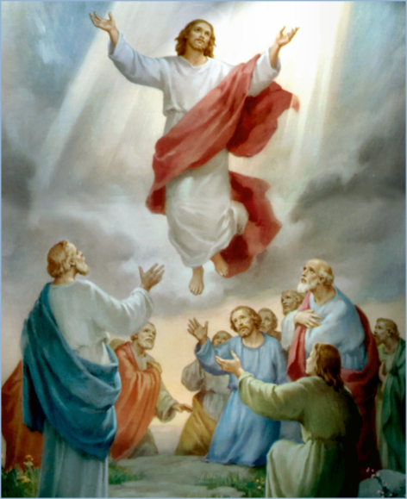
The Doctrine of Jesus Christ (Part 12)
The Office of Jesus Christ

Slide 2
Review

Slide 4
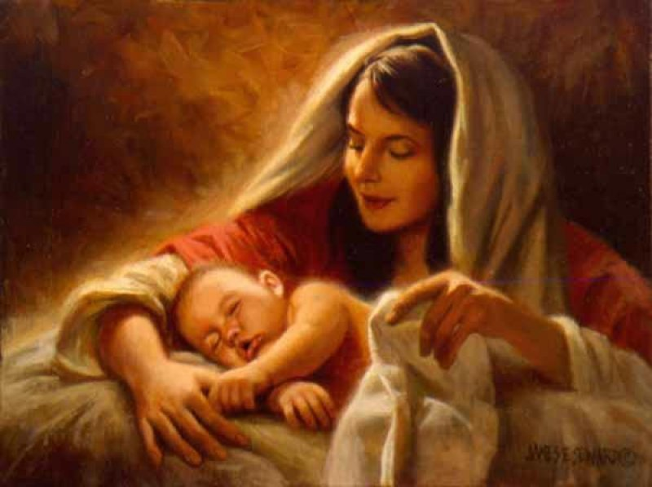
The Virgin Birth
“Behold, a virgin shall be with child, and shall bring forth a son, and they shall call his name Emmanuel, which being interpreted is, God with us.”
Matt. 1:23

Slide 5
The Incarnation of Christ
(John 1:1-14)
God the Son took upon himself the full nature of man and yet retain the full nature of God.

Slide 6
Names and Titles of Jesus Christ

Slide 7
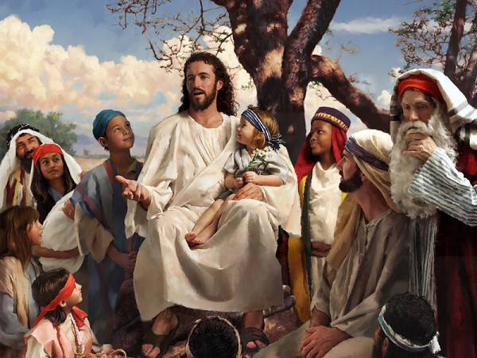
The Humanity of Jesus Christ

Slide 8
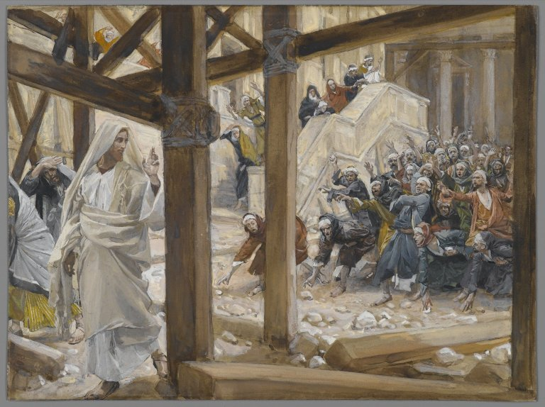
The Deity of Jesus Christ

Slide 9
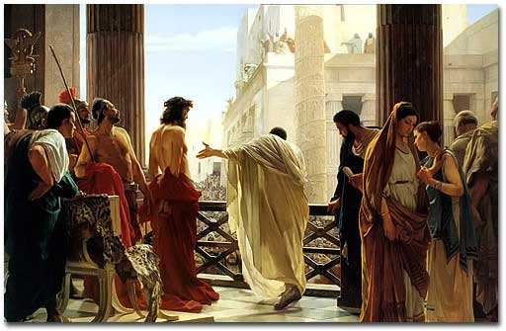
The Impeccability of Jesus Christ
“Pilate saith unto him, What is truth? And when he had said this, he went out again unto the Jews, and saith unto them, I find in him no fault at all.” John 18:38

Slide 10
Not capable of sinning
Impeccability

Slide 11
The Earthly Ministry of Jesus Christ

Slide 12
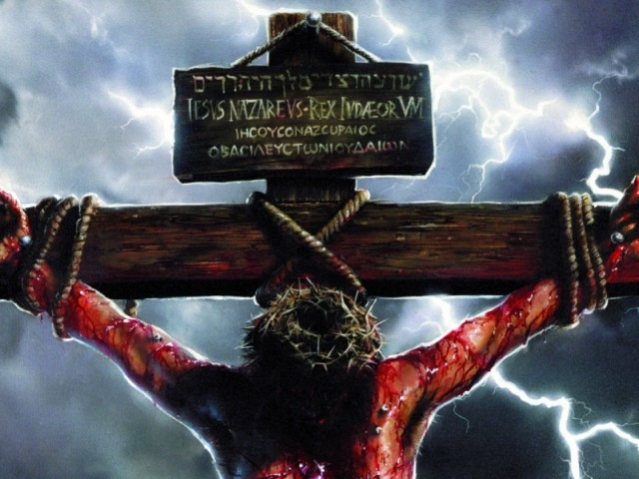
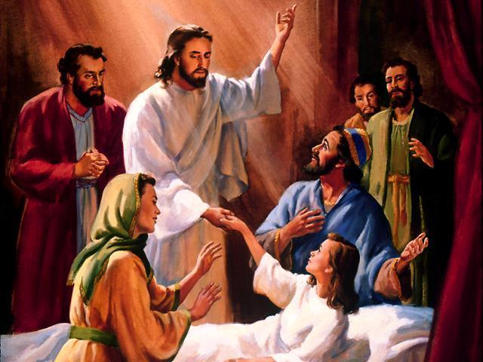
“For even the Son of man came not to be ministered unto, but to minister, and to give his life a ransom for many.” Mark 10:45

Slide 13
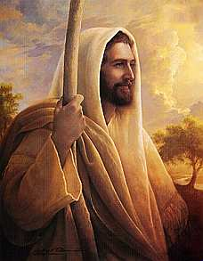
The Character of Jesus Christ
What kind of man was our Lord?
What were some of his characteristics?

Slide 14
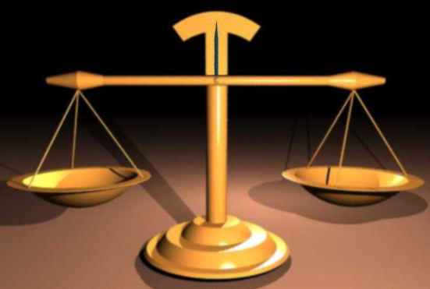
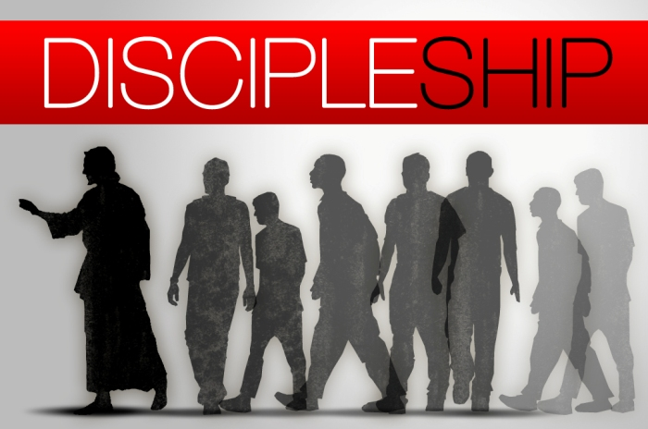
The character of Christ
His zeal
His compassion
His meekness and gentleness
His boldness and courage
His love

Slide 15
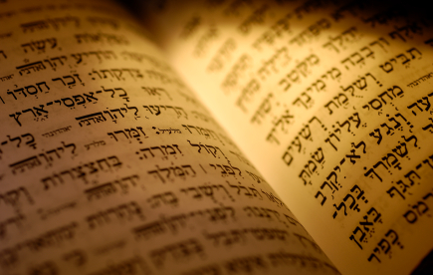
In the Old Testament three great offices were created by God to meet the spiritual and material needs of his chosen people.

Slide 16
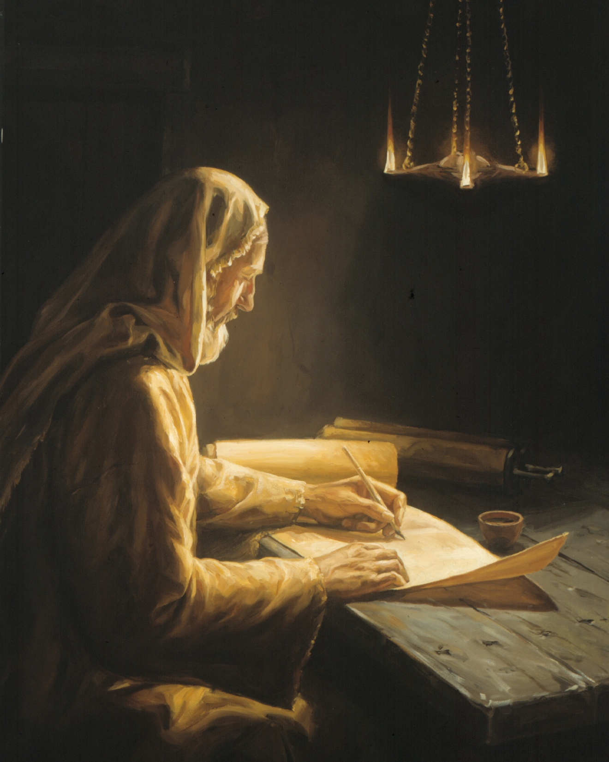

Slide 17
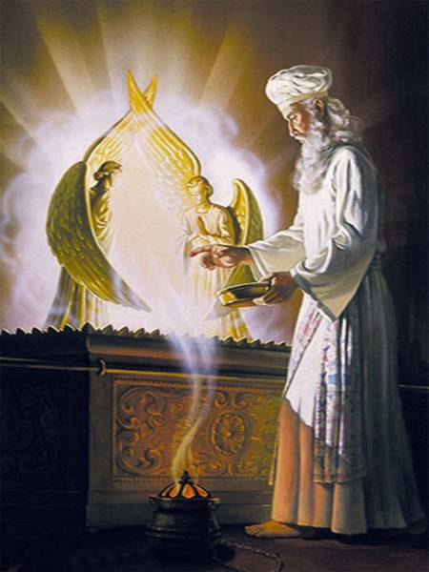

Slide 18
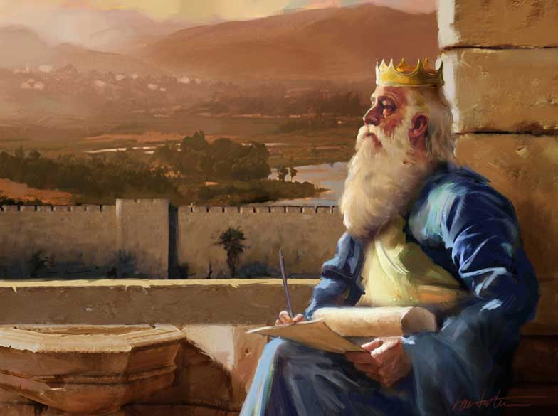

Slide 19
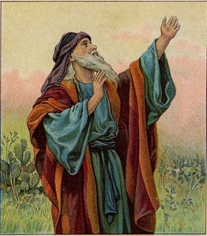
The office of the Prophet

Slide 20
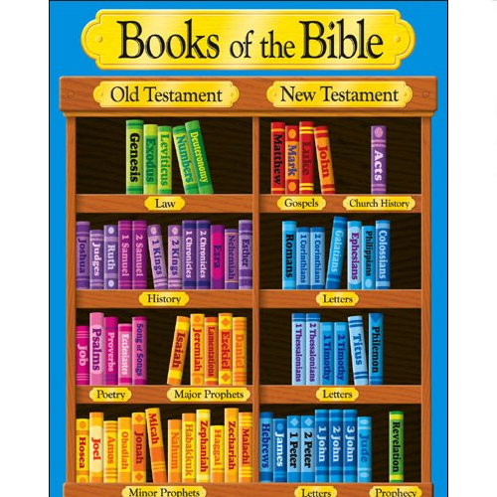

Slide 21
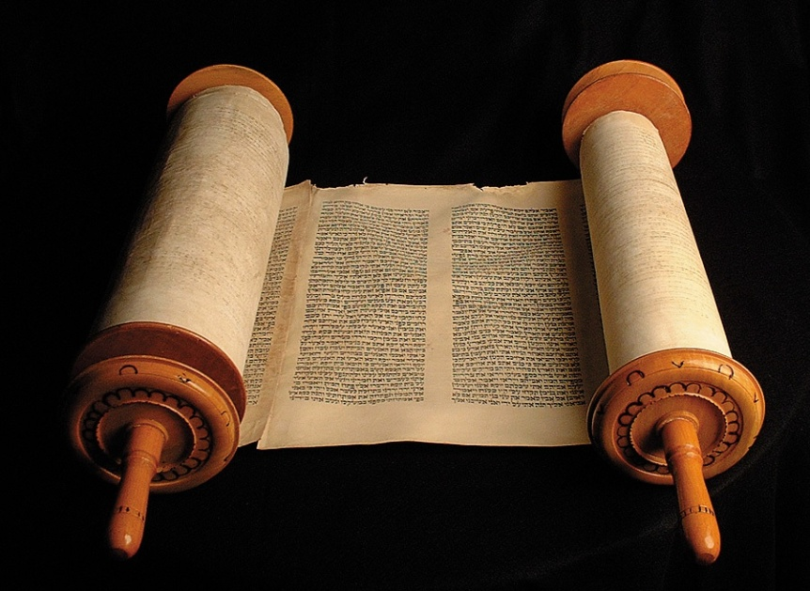
Prophetic books - 17 books
Major Prophets - Isaiah, Jeremiah, Lamentations, Ezekiel, Daniel Minor Prophets - Hosea, Joel, Amos, Obadiah, Jonah, Micah, Nahum, Habakkuk, Zephaniah, Haggai, Zechariah, Malachi.

Slide 22
The prophet, an individual who represented God before man
Prophets spoke on the behalf of God to the people of God - (Amos 3:6-8) “Shall a trumpet be blown in the city, and the people not be afraid? shall there be evil in a city, and the LORD hath not done it? Surely the Lord GOD will do nothing, but he revealeth his secret unto his servants the prophets. The lion hath roared, who will not fear? the Lord GOD hath spoken, who can but prophesy?”

Slide 23
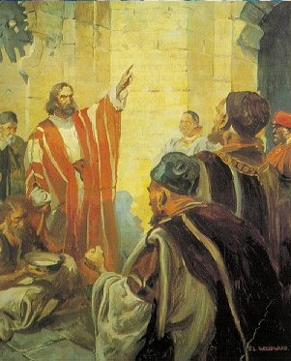
A prophet is a spokesperson for God.
The prophet admonishes, warns, directs, encourages, intercedes, teaches and counsels. He brings the word of God to the people of God and calls the people to respond.
“Saying, Touch not mine anointed, and do my prophets no harm.”
I Chr. 16:22

Slide 24
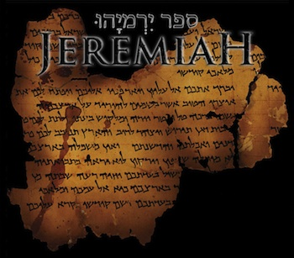
The prophets were the divine philosophers, the instructors, and the guides.
“For thou shalt go to all that I shall send thee, and whatsoever I command thee thou shalt speak….Therefore thou shalt speak all these words unto them; but they will not hearken to thee: thou shalt also call unto them; but they will not answer thee…Therefore thou shalt speak unto them this word; Thus saith the LORD God of Israel.”

Slide 25
Ministry of the Prophet
Prayer – Isa. 62:6
Receiving the Word of the Lord – Ezek. 3:1-11
Suffering rejection and persecution – Matt. 5:12
Leading God’s people in worship – Exod. 15:19-21
Encouragement – Hag. 1:13-15
Foretelling the future – II Kings 20:1-2
Giving direction and guidance – I Sam. 22:5
Interpreting dreams and visions – Dan. 2:1-8
Rebuke, Correction and Admonition – (book of Jeremiah)

Slide 26
Exposing wicked immoral leadership – I Kings 22:8
Pronouncing judgment - (book of Ezekiel)
Warning of danger – Acts 21:10-11
Being a watchman – Ezek. 33:1-11
Interpreting the signs of the times – Luke 12:54-56
Calling a nation to repentance – (book of Isaiah, Jeremiah, Ezekiel)
Anointing Godly leaders – I Kings 19:16
Advising kings and political rulers – II Sam. 7:1-17

Slide 27
Warning concerning False Prophets
Jeremiah 23:18 “For who hath stood in the counsel of the LORD, and hath perceived and heard his word? Who hath marked his word, and heard it?”
Jeremiah 23:21 “I have not sent these prophets, yet they ran: I have not spoken to them, yet they prophesied.”
Jeremiah 23:22 “But if they had stood in my counsel, and had caused my people to hear my words, then they should have turned them from their evil way, and from the evil of their doings.”

Slide 28
Isa. 30:10 “Which say to the seers, See not; and to the prophets, Prophesy not unto us right things, speak unto us smooth things, prophesy deceits.”
Jer. 5:31 “The prophets prophesy falsely, and the priests bear rule by their means; and my people love to have it so.”
Jer. 14:14 “Then the LORD said unto me, The prophets prophesy lies in my name: I sent them not, neither have I commanded them, neither spake unto them: they prophesy unto you a false vision and divination, and a thing of nought, and the deceit of their heart.”

Slide 29
Jer. 23:16 “Thus saith the LORD of hosts, Hearken not unto the words of the prophets that prophesy unto you: they make you vain: they speak a vision of their own heart, and not out of the mouth of the LORD.”
Jer. 23:25 “I have heard what the prophets said, that prophesy lies in my name, saying, I have dreamed, I have dreamed.”
Jer. 26:8 “Now it came to pass, when Jeremiah had made an end of speaking all that the LORD had commanded him to speak unto all the people, that the priests and the prophets and all the people took him, saying, Thou shalt surely die.”

Slide 30
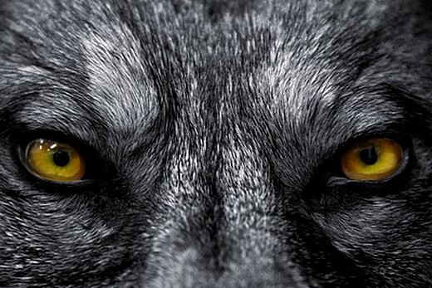
False Prophets increase when God’s People no longer desire to hear and apply the truth of God’s Word.

Slide 31
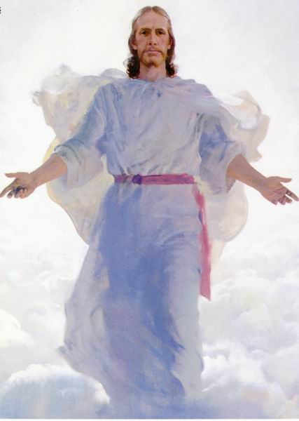
10 Signs of Christ Coming (Matthew 24:4-14)
Increase of false religion
False religious leaders
Famines, plagues and earthquakes
Persecution of Christians
Break up of the family / betrayal of
friends and family members
False prophets (teachers)
False Christ
Lawlessness / Rebellion
Spiritual apathy
World wide preaching of the Gospel

Slide 32
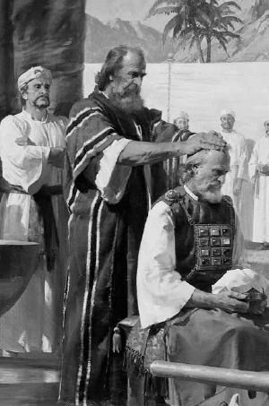
The office of the Priest

Slide 33
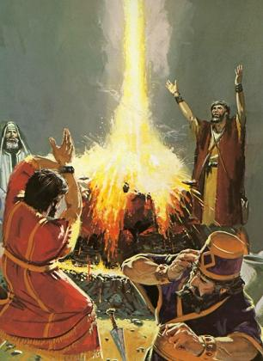
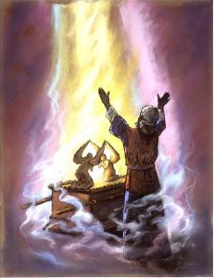
The priest, an individual who represented man before God
The prophet was an individual who represented God before man.
The priest was an individual who represented man before God.

Slide 34
Four main qualifications for the priesthood
He must be from the priestly tribe of Levi – Deut. 10:8
He must be taken from among men, a man with compassion for other men - Heb. 5:1-2
He must be chosen by God - Num. 16:5; Heb. 5:4
He must be consecrated to God - Lev. 21:6-7

Slide 35
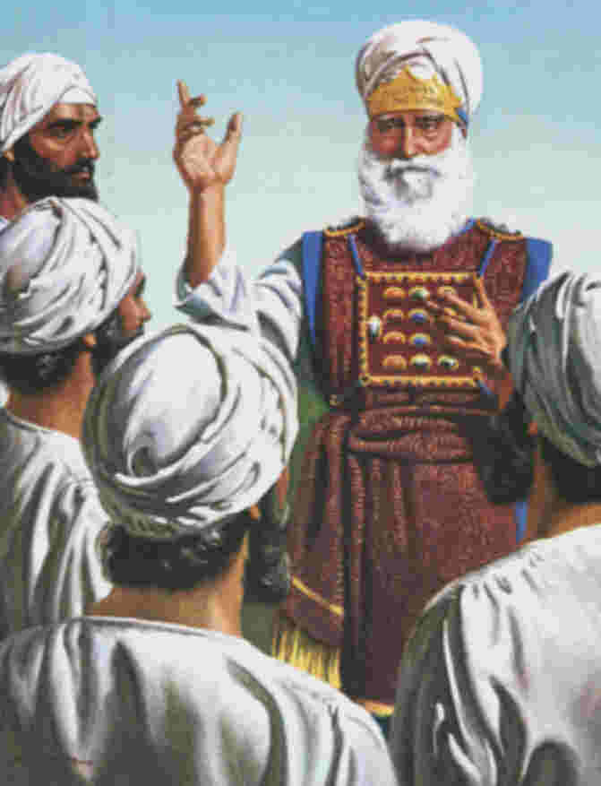
The privileges of the priests were greater than those who functioned in the other Levitical offices, and a distinction between the two is evident when the Scripture speaks of them as “the priests and the Levites” (I Kings 8:4; Ezra 2:70; John 1:19).

Slide 36
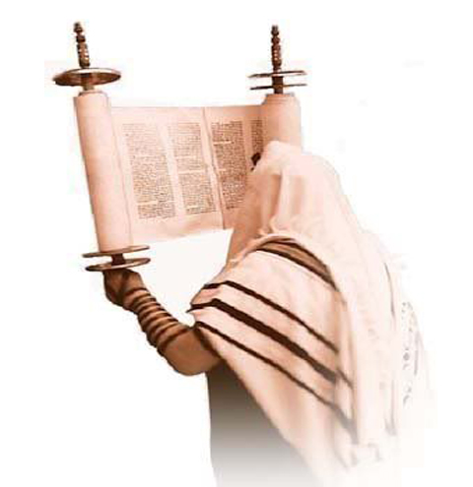
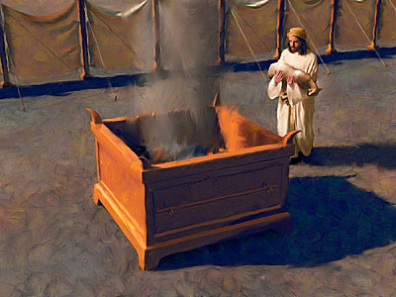
The priests could offer sacrifices for the people, burn incense on the altar, and teach the law.

Slide 37
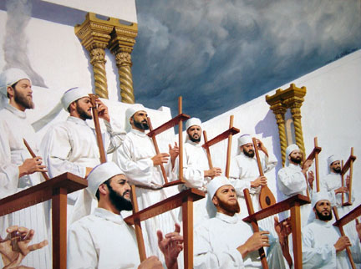
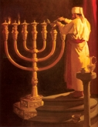
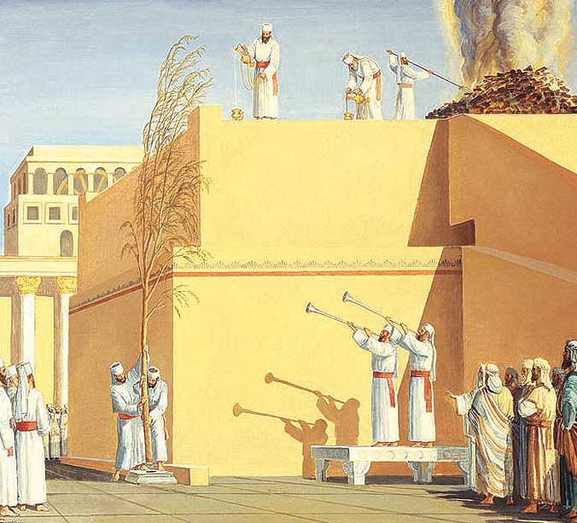
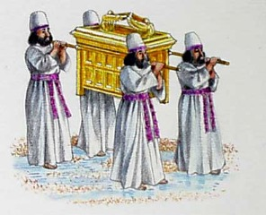
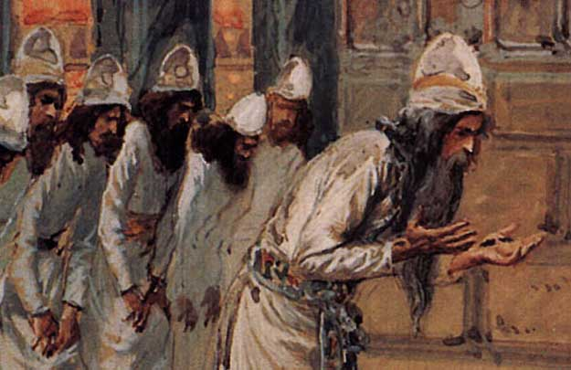
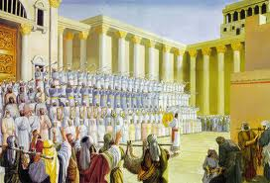
Other Levites were employed in more menial tasks, such as the housekeeping of the tabernacle, keeping oil in the lamps, transporting the Ark of the Covenant, taking down and setting up the tabernacle when moving, and related tasks in assisting the priests. (Num. 3:5–10; 18:1–7; I Chr. 23:27–32).

Slide 38
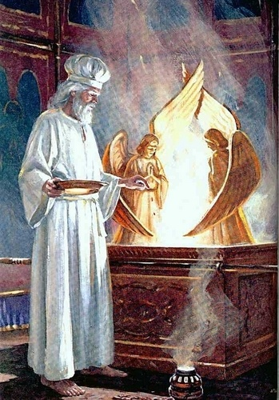
Main ministry of the priest was to offer sacrifices for sin and instructing the people in the Law of God.
“And the priest shall offer the one for a sin offering, and the other for a burnt offering, and make an atonement for him…And the priest shall bring them before the LORD, and shall offer his sin offering, and his burnt offering.” Num. 6:11, 16

Slide 39
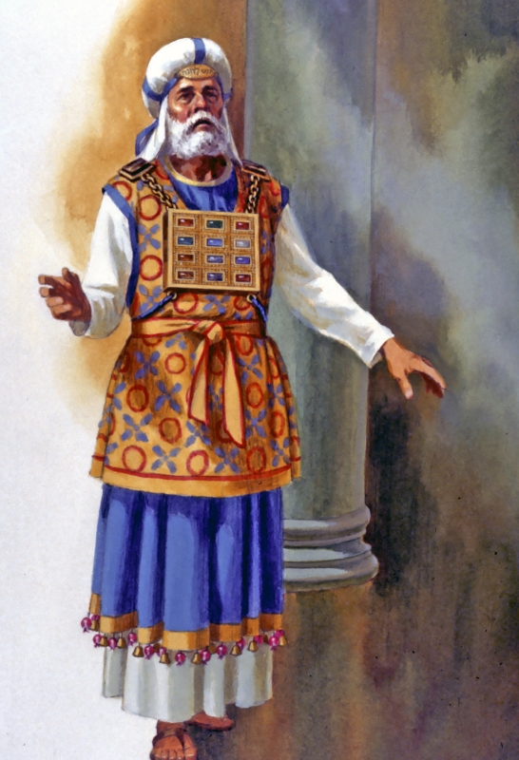
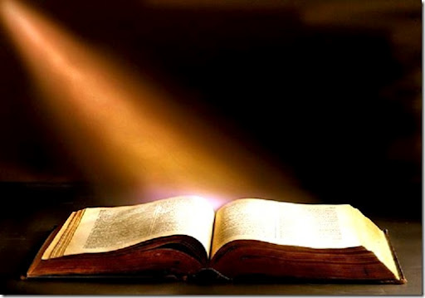
“Now for a long season Israel hath been without the true God, and without a teaching priest, and without law.”
II Chron. 15:3

Slide 40
Corruption within the Priesthood
Jer. 23:11 “For both prophet and priest are profane; yea, in my house have I found their wickedness, saith the LORD.”
Isa.28:7 “But they also have erred through wine, and through strong drink are out of the way; the priest and the prophet have erred through strong drink, they are swallowed up of wine, they are out of the way through strong drink; they err in vision, they stumble in judgment.”

Slide 41
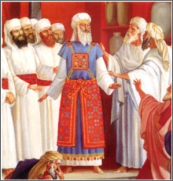
Jer. 6:13 “For from the least of them even unto the greatest of them every one is given to covetousness; and from the prophet even unto the priest every one dealeth falsely.”
See Malachi 1:6-2:9, 17

Slide 42
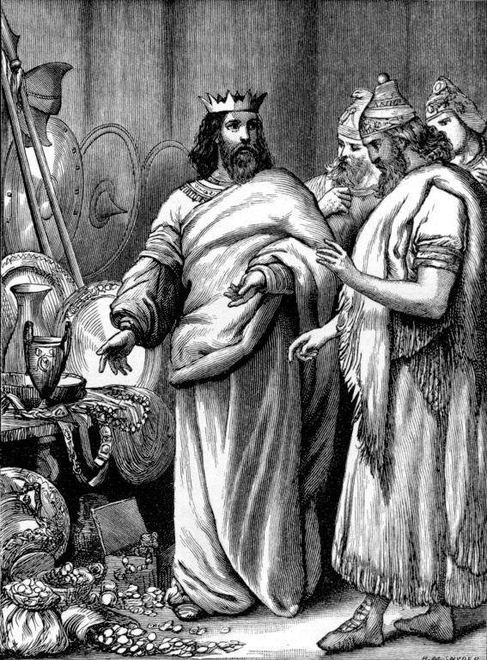
The office of the King

Slide 43
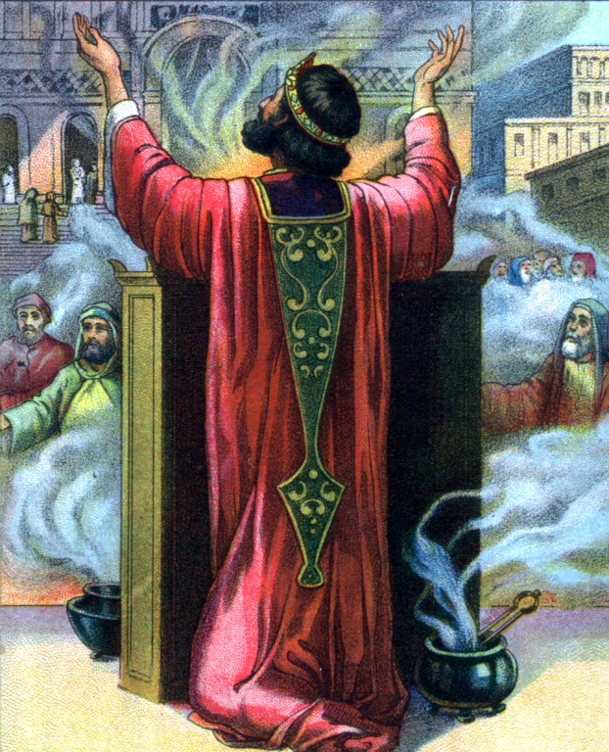
The King was individual who ruled over man for God
The prophet was an individual who represented God before man.
The priest was an individual who represented man before God.
The king was an individual who ruled over man for God.

Slide 44
Qualifications of a King
He was to come from the tribe of Judah - Gen. 49:10
He was to come from the seed of David - II Sam. 7:8-17
He was to be chosen by the God - Deut. 17:15 “Thou shalt in any wise set him king over thee, whom the LORD thy God shall choose: one from among thy brethren shalt thou set king over thee: thou mayest not set a stranger over thee, which is not thy brother.”
I Sam. 8:18 “And ye shall cry out in that day because of your king which ye shall have chosen you; and the LORD will not hear you in that day.”

Slide 45
The main function of the King
To study and know that Law of God – II Kings 23: 1-3
To seek the Lord through prayer and godly counselors – Daniel 9:3; Prov. 11:14
To rule over the people according to the Law of God – II Sam. 5-7
To enforce the Law of God – Ezra 7:21-26
To lead by personal example – I Kings 2:1-4
Always remember that God is King over all – Psalm 95:3

Slide 46
After the death of Solomon, the United Monarchy falls apart.
Jerusalem is the capital of Judah, the southern Kingdom, which is led by Rehoboam (Solomon’s son). Its inhabitants are the tribes of Judah, Benjamin.
Jeroboam (promoted by Solomon to be chief superintendent) leads a revolt of the northern tribes to form the Kingdom of Israel. The 10 tribes that make up Israel are Zebulun, Issachar, Asher, Naphtali, Dan, Menasseh, Ephraim, Reuben and Gad and Levi. The capital of Israel is Samaria.

Slide 47
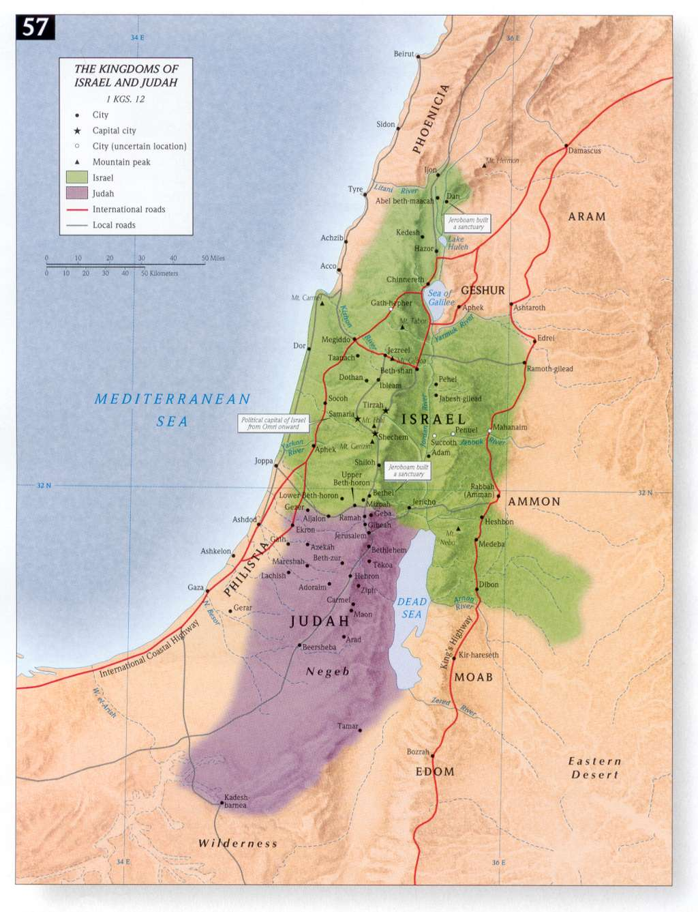

Slide 48
20 Evil Kings of Israel (Not one good King)
Jeroboam, bad, 930-909 BC
Nadab, bad, 909-908 BC
Baasha, bad, 908-886 BC
Elah, bad, 886-885 BC
Zimri, bad, 885 BC
Tibni, bad, 885-880 BC
Omri (overlap), extra bad, 885-874 BC
Ahab, the worst, 874-853 BC
Ahaziah, bad, 853-852 BC
Joram, bad mostly, 852-841 BC
Jehu, not good but better than the rest, 841-814 BC
Jehoahaz, bad, 814-798 BC
Joash, bad, 798-782 BC
Jeroboam II, bad, 793-753 BC
Zechariah, bad, 753 BC
Shallum, bad, 752 BC
Menahem, bad, 752-742 BC
Pekahiah, bad, 742-740 BC
Pekah (overlap), bad, 752-732 BC
Hoshea, bad, 732-722 BC

Slide 49
20 Evil and Good Kings of Judah (Only five good Kings)
Rehoboam, bad mostly, 933-916 BC
Abijah, bad mostly, 915-913 BC
Asa, GOOD, 912-872 BC
Jehoshaphat, GOOD, 874-850 BC
Jehoram, bad, 850-843 BC
Ahaziah, bad, 843 BC
Athaliah, devilish, 843-837 BC
Joash, Good mostly, 843-803 BC
Amaziah, Good mostly, 803-775 BC
Uzziah, Good mostly, 787-735 BC
Jotham, GOOD, 749-734 BC
Ahaz, wicked, 741-726 BC
Hezekiah, THE BEST, 726-697 BC
Manasseh, the worst, 697-642 BC
Amon, the worst, 641-640 BC
Josiah, THE BEST, 639-608 BC
Jehoahaz, bad, 608 BC
Jehoiakim, wicked, 608-597 BC
Jehoiachin, bad, 597 BC
Zedekiah, bad, 597-586 BC

Slide 50
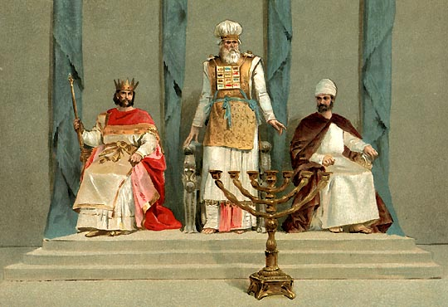
Jesus holds all three offices

Slide 51
Jesus the prophet (Represents God before man)
Matt. 13:57 “And they were offended in him. But Jesus said unto them, A prophet is not without honour, save in his own country, and in his own house.”
Matt. 21:11 “And the multitude said, This is Jesus the prophet of Nazareth of Galilee.”
Luke 7:39 “Now when the Pharisee which had bidden him saw it, he spake within himself, saying, This man, if he were a prophet, would have known who and what manner of woman this is that toucheth him: for she is a sinner.”

Slide 52
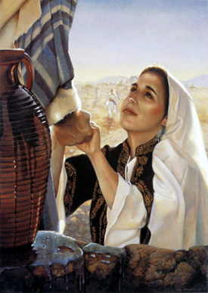
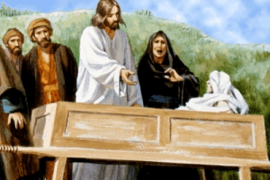
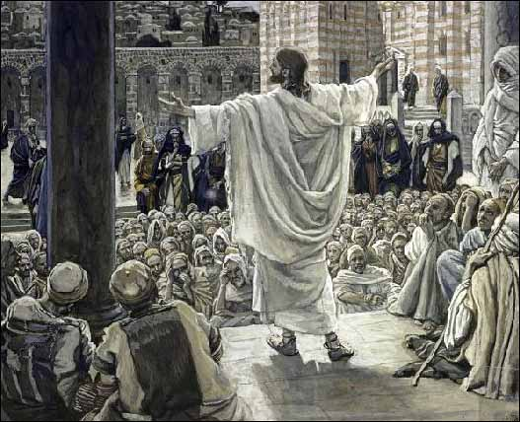
Jesus was recognized as a prophet
Samaritan woman - John 4:19
The people of Galilee - Luke 7:16
The people of Jerusalem - John 7:40
His enemies - Luke 22:64
The disciples on Emmaus Road - Luke 24:19

Slide 53
Deut. 18:15 “The Lord your God will raise up unto you a Prophet from the midst of you, of your brethren, like unto me; unto him shall you hear.”

Slide 54
Luke 24:19 “And he said unto them, What things? And they said unto him, Concerning Jesus of Nazareth, which was a prophet mighty in deed and word before God and all the people.”

Slide 55
Matt. 17:5
“This is my beloved Son, in whom I am well pleased; hear ye him.”

Slide 56
“His name is called The Word of God.”

Slide 57
Jesus the High Priest “Represents man before God”
He met the qualifications for the priestly office.
He was taken from among men, a man with compassion for other men - Heb. 5:1-2
He was be chosen by God - Num. 16:5
He was consecrated to God - Lev. 21:6-7
He was not from priestly tribe of Levi – Deut. 10:8

Slide 58
Jesus was from the tribe of Judah –
Matt. 2:6 “And thou Bethlehem, in the land of Juda, art not the least among the princes of Juda: for out of thee shall come a Governor, that shall rule my people Israel.”
Heb. 7:14 “For it is evident that our Lord sprang out of Juda; of which tribe Moses spake nothing concerning priesthood.”
Jesus priesthood superseded the Levitical priesthood –
Jesus was a priest after the order of Melchizedek -

Slide 59
Heb 5:6 “As he saith also in another place, Thou art a priest for ever after the order of Melchisedec.”
Heb 5:10 “Called of God an high priest after the order of Melchisedec.”
Heb 6:20 “Whither the forerunner is for us entered, even Jesus, made an high priest for ever after the order of Melchisedec.”
Heb 7:11 “If therefore perfection were by the Levitical priesthood, (for under it the people received the law,) what further need was there that another priest should rise after the order of Melchisedec, and not be called after the order of Aaron?”
Heb 7:17, 21 “For he testifieth, Thou art a priest for ever after the order of Melchisedec…For those priests were made without an oath; but this with an oath by him that said unto him, The Lord sware and will not repent, Thou art a priest for ever after the order of Melchisedec.”

Slide 60
“And Melchizedek King of Salem brought forth bread and wine: and he was the Priest of the most high God.”
Gen. 14:18
“The LORD hath sworn, and will not repent, Thou art a priest for ever after the order of Melchizedek.” Psalm 110:4

Slide 61
Heb 7:26 “For such an high priest became us, who is holy, harmless, undefiled, separate from sinners, and made higher than the heavens.”
Heb 8:1 “We have such an high priest, who is set on the right hand of the throne of the Majesty in the heavens.”
Heb 8:3 “For every high priest is ordained to offer gifts and sacrifices: wherefore it is of necessity that this man have somewhat also to offer.”
Heb 9:11 “But Christ being come an high priest of good things to come, by a greater and more perfect tabernacle, not made with hands, that is to say, not of this building.”

Slide 62
Melchizedek (Genesis 14)
King of Salem - Jerusalem
Priest of Salem – Jerusalem
Preceded the priesthood of the Levites
Abraham paid tithes to Melchizedek and was blessed by Melchizedek showing that Melchizedek was superior to Abraham and the tribe of Levi who would descend from Abraham.
Melchizedek is a type of Christ.
Christ had to be from the order of Melchizedek in order to be both priest and king!

Slide 63
Jesus is superior to the Old Testament Priesthood
Heb. 2:17 “Wherefore in all things it behoved him to be made like unto his brethren, that he might be a merciful and faithful high priest in things pertaining to God, to make reconciliation for the sins of the people.”
Heb. 4:14 “Seeing then that we have a great high priest, that is passed into the heavens, Jesus the Son of God, let us hold fast our profession.”
Heb. 4:15 “For we have not an high priest which cannot be touched with the feeling of our infirmities; but was in all points tempted like as we are, yet without sin.”

Slide 64
Heb. 9:11-12 “But Christ being come an high priest of good things to come, by a greater and more perfect tabernacle, not made with hands, that is to say, not of this building; Neither by the blood of goats and calves, but by his own blood he entered in once into the holy place, having obtained eternal redemption for us.”
Heb. 9:28 “So Christ was once offered to bear the sins of many; and unto them that look for him shall he appear the second time without sin unto salvation.”

Slide 65
Heb. 10:11-14
“And every priest standeth daily ministering and offering oftentimes the same sacrifices, which can never take away sins: But this man, after he had offered one sacrifice for sins for ever, sat down on the right hand of God…For by one offering he hath perfected for ever them that are sanctified.”

Slide 68
“Saying, Where is he that is born King of the Jews? for we have seen his star in the east, and are come to worship him.” Matt. 2:2

Slide 69
“And Jesus stood before the governor: and the governor asked him, saying, Art thou the King of the Jews? And Jesus said unto him, Thou sayest.” Matt. 27:11

Slide 70
“But Pilate answered them, saying, Will ye that I release unto you the King of the Jews? And Pilate answered and said again unto them, What will ye then that I shall do unto him whom ye call the King of the Jews?” Mark 15:9, 12

Slide 71
“And when they had platted a crown of thorns, they put it upon his head, and a reed in his right hand: and they bowed the knee before him, and mocked him, saying, Hail, King of the Jews! And set up over his head his accusation written, THIS IS JESUS THE KING OF THE JEWS.” Matt. 27:29, 37

Slide 72
Rev. 17:14 “These shall make war with the Lamb, and the Lamb shall overcome them: for he is Lord of lords, and King of kings: and they that are with him are called, and chosen, and faithful.” Rev. 19:16 “And he hath on his vesture and on his thigh a name written, KING OF KINGS, AND LORD OF LORDS.”

Slide 74
“And of his kingdom there shall be no end.”

