Slide 1
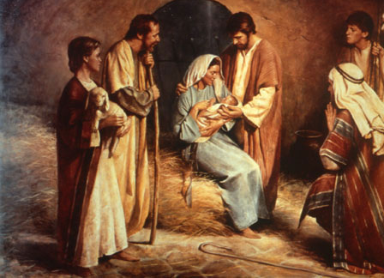
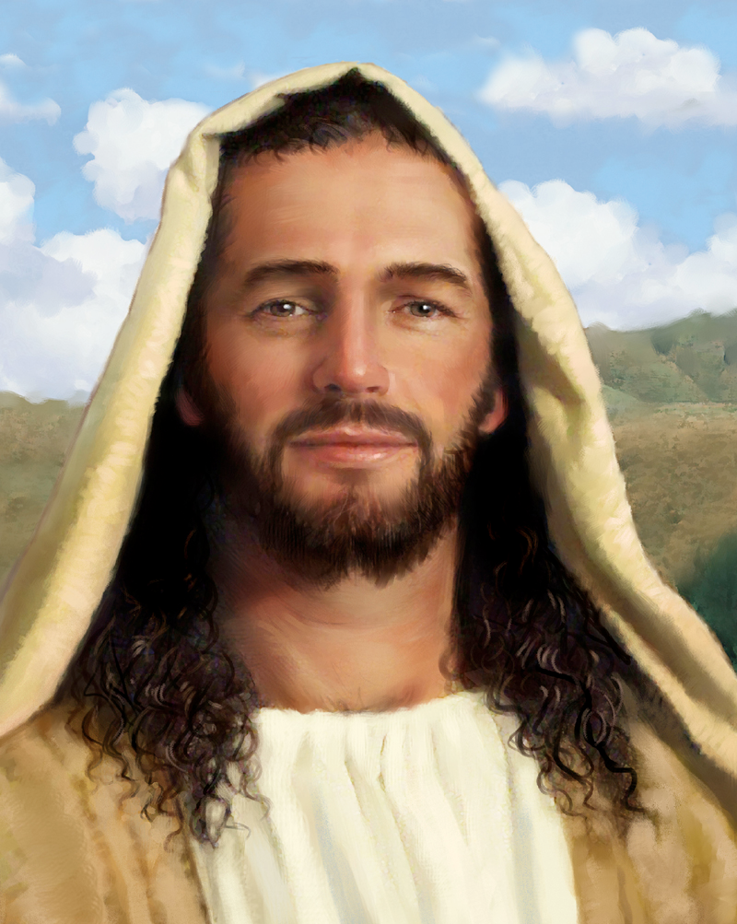
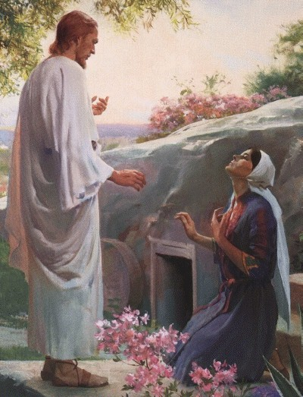
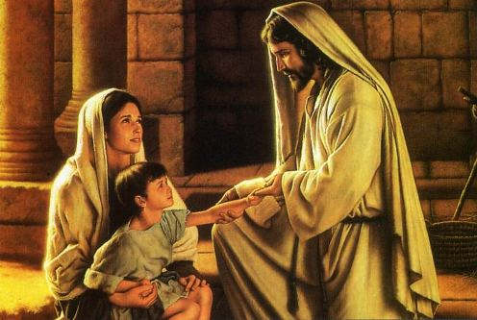
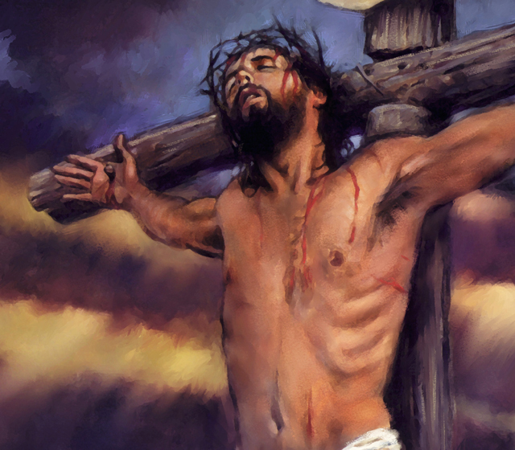
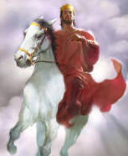
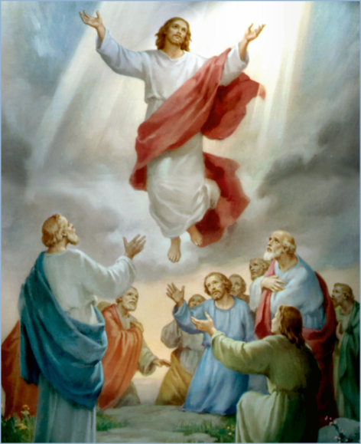
The Doctrine of Jesus Christ (Part 1)
Preexistence of Jesus Christ

Slide 2
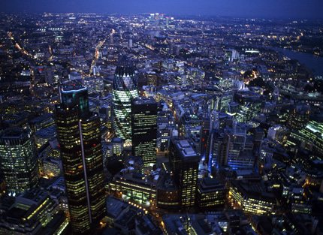
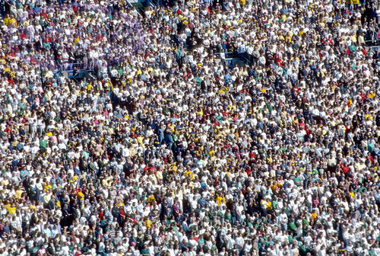
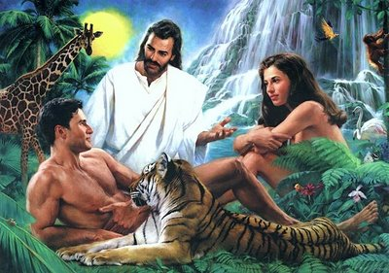
It has been estimated that some forty billion individuals have lived upon this earth since Adam.

Slide 3
World population reached 7 billion on October 31, 2011

Slide 4
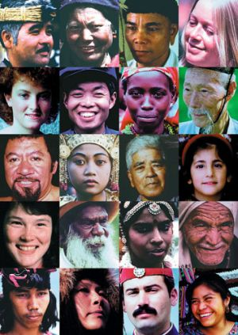
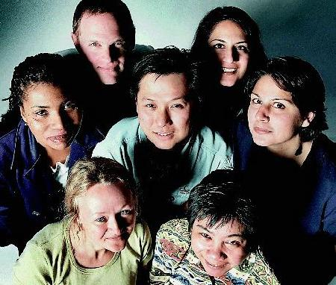
A contrast can be seen in this vast multitude of humanity. It includes black, white, red, brown, and yellow men.

Slide 5
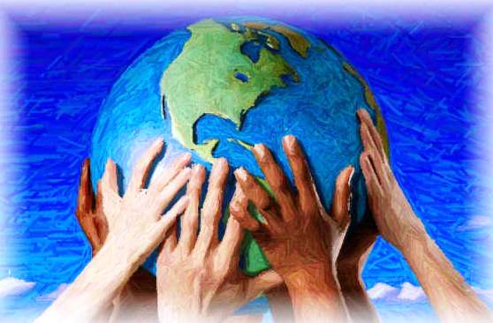
Man has explored and settled every corner of their earth.
Speaks dozens of languages.
Practice multitudes of religions.
Formulated numerous cultures.

Slide 6
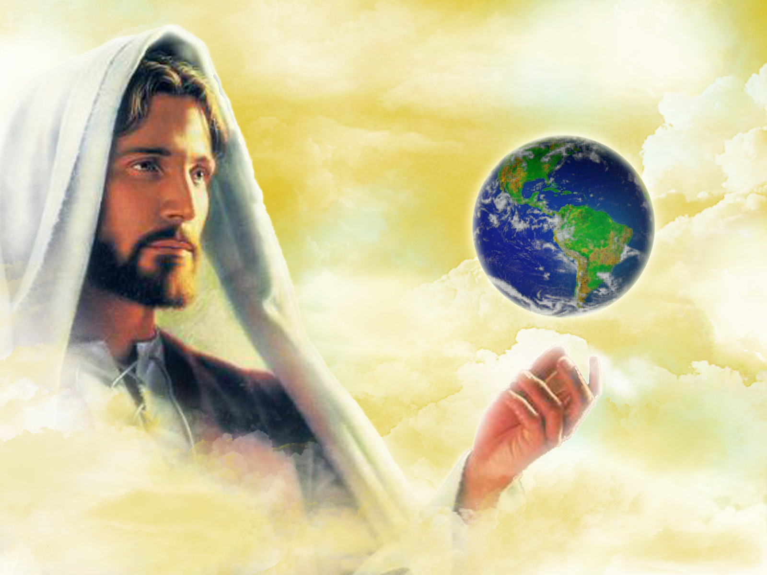
Every single human being shares one vital thing. His purpose of life down here and his eternal destiny afterward depends completely upon his personal relationship with the subject of this study, the Lord Jesus Christ.

Slide 7
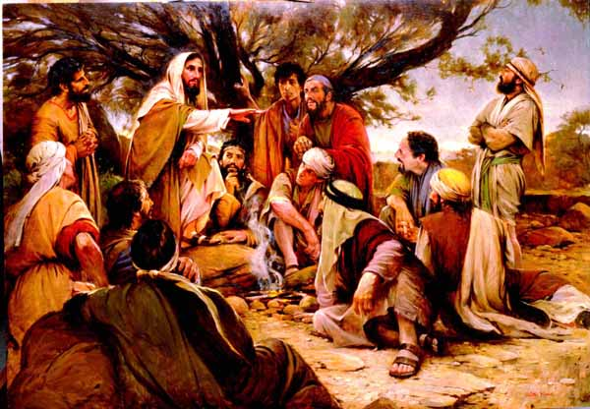
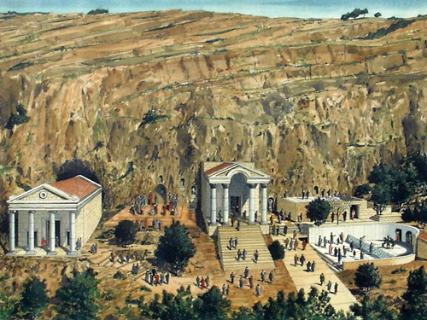

Slide 8
“When Jesus came into the coasts of Caesarea Philippi, he asked his disciples, saying, Whom do men say that I the Son of man am? And they said, Some say that thou art John the Baptist: some, Elias; and others, Jeremias, or one of the prophets He saith unto them, But whom say ye that I am? And Simon Peter answered and said, Thou art the Christ, the Son of the living God. And Jesus answered and said unto him, Blessed art thou, Simon Barjona: for flesh and blood hath not revealed it unto thee, but my Father which is in heaven. And I say also unto thee, That thou art Peter, and upon this rock I will build my church; and the gates of hell shall not prevail against it.”
Matthew 16:15-18

Slide 9
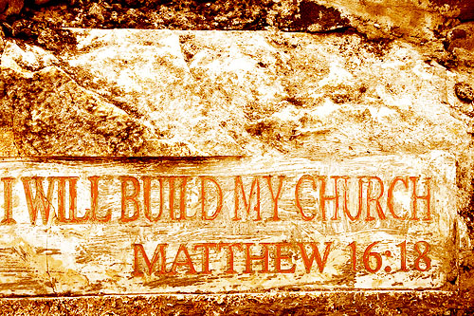

Slide 10
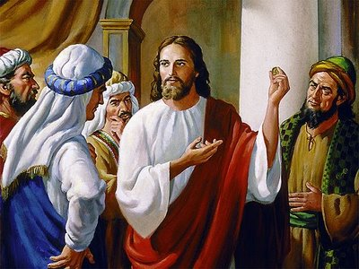
It is absolutely impossible to overemphasize the importance of the life of Jesus Christ.
The key question of the universe -
“What think ye of Christ?” Matthew 22:41-42

Slide 11
To the artist he is the altogether lovely One (Song of Sol. 5:16)
To the architect he is the chief Cornerstone (I Pet. 2:6)
To the astronomer he is the Sun of righteousness (Mal. 4:2)
To the baker he is the Bread of life (John 6:35)
To the banker he is the hidden treasure (Matt. 13:44)
To the builder he is the sure foundation (Isa. 28:16)
To the carpenter he is the door (John 10:7)
To the doctor he is the great Physician (Jer. 8:22)
To the educator he is the new and living way (Heb. 10:20)
To the farmer he is the sower and the Lord of harvest (Luke 10:2)

Slide 12
Who is Jesus Christ to you?
What does Jesus Christ mean to you?
Do you know Jesus Christ personally?

Slide 13
The Preexistence of Jesus Christ as God
It is possible (as some have done) to hold to Jesus’ preexistence without believing in his deity.
For example, the Jehovah Witness brazenly declares that Christ preexisted as Michael the archangel prior to Bethlehem.
But the Bible dogmatically declares both his preexistence and his deity.

Slide 14
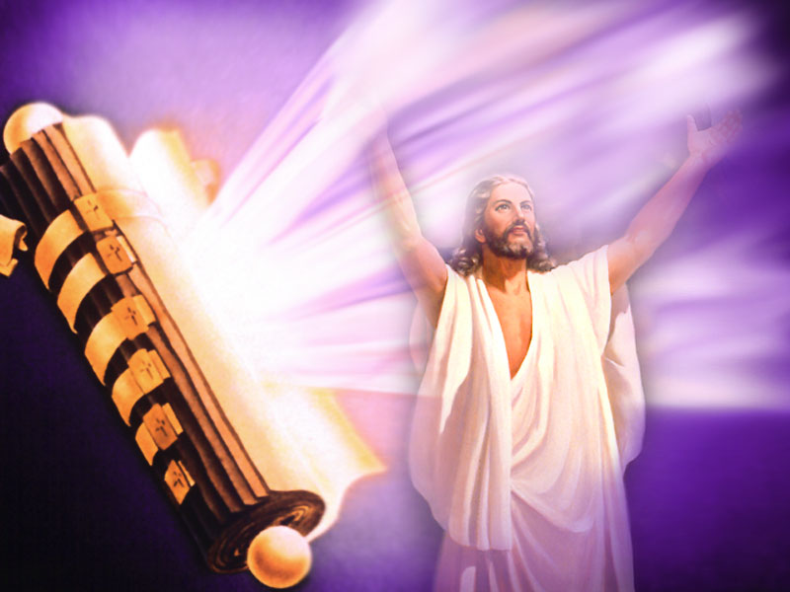
The fact of his divine preexistence

Slide 15
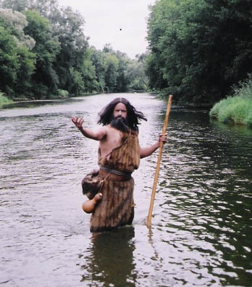
As taught by John the Baptist
"John bare witness of him, and cried, saying, This was he of whom I spake, He that cometh after me is preferred before me: for he was before me" (John 1:15)
According to Luke 1:36, John’s birth occurred six months prior to Christ’s birth, but John declares that "he was before me," a reference to Jesus’ preexistence.
(See also John 1:27, 30)

Slide 16
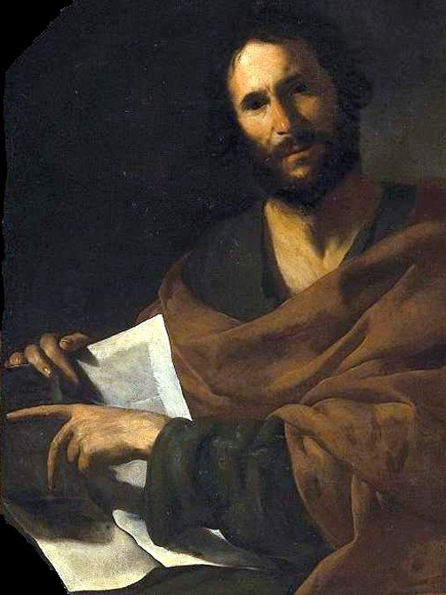
As taught by the Apostle John
"In the beginning was the Word, and the Word was with God, and the Word was God. All things were made by him…" (John 1:1-2)
"For the life was manifested, and we have seen it, and bear witness, and shew unto you that eternal life, which was with the Father, and was manifested unto us." (I John 1:2)
The Apostle John connects Jesus’ preexistence to his deity.

Slide 17
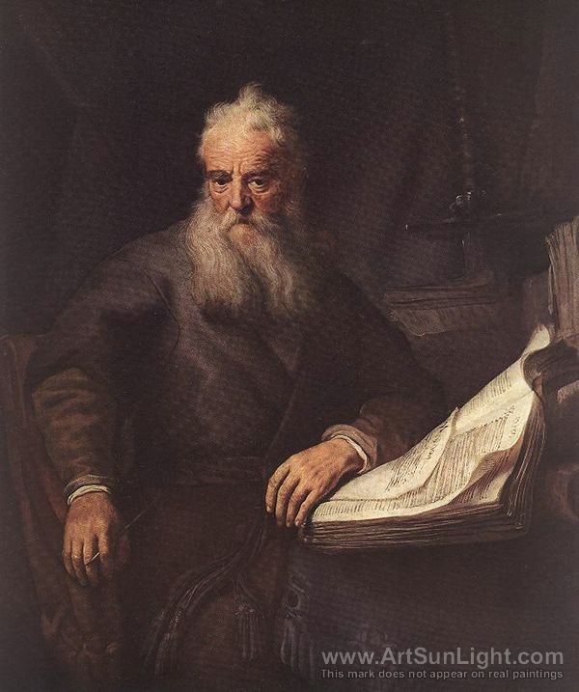
As taught by the Apostle Paul
"Who, being in the form of God, thought it not robbery to be equal with God: but made himself of no reputation, and took upon him the form of a servant, and was made in the likeness of men: and being found in fashion as a man, he humbled himself, and became obedient unto death, even the death
of the cross" (Phil. 2:6-8)

Slide 18
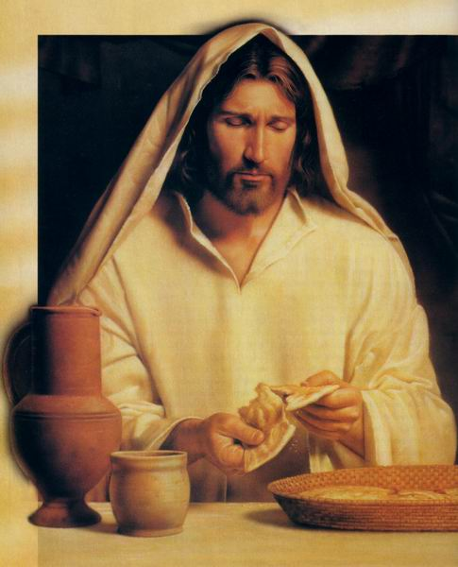
As taught by Christ himself
"For I came down from heaven, not to do mine own will, but the will of him that sent me" (John 6:38).
"I am the living bread which came down from heaven: if any man eat of this bread, he shall live for ever: and the bread that I will give is my flesh, which I will give for the life of the world. When Jesus knew in himself that his disciples murmured at it, he said unto them, Doth this offend you? (John 6:51, 61)

Slide 19
"Jesus said unto them, Verily, verily I say unto you, Before Abraham was, I am" (John 8:58)
"And now, O Father, glorify thou me with thine own self with the glory which I had with thee before the world was" (John 17:5)
Here Christ requests that the Father share his glory with the Son. But note the Father’s previous statement about his glory in Isaiah:
"I am the Lord: that is my name; and my glory will I not give to another..." (Isa. 42:8)

Slide 20
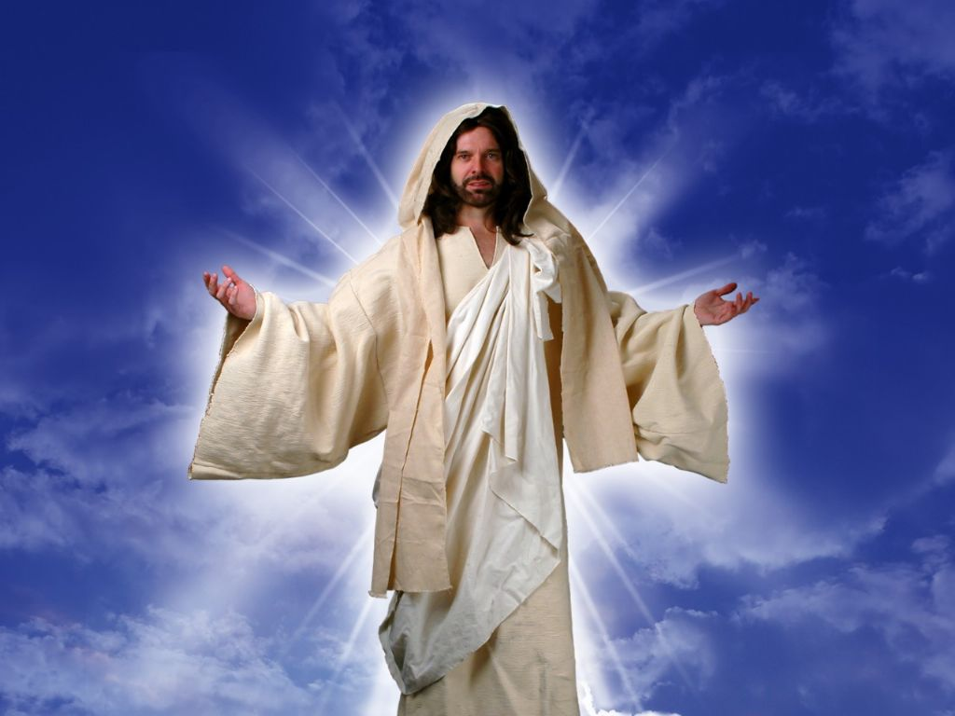
“ I and my Father are one…Then said they unto him, Where is thy Father? Jesus answered, Ye neither know me, nor my Father: if ye had known me, ye should have known my Father also…henceforth ye know him, and have seen him…he that hath seen me hath seen the Father…He that hateth me hateth my Father also…”

Slide 21
The student of Scripture is forced to conclude that either Christ was God indeed and had rightful claim to this glory, or he was an arrogant impostor demanding something the Father would never give him!

Slide 22
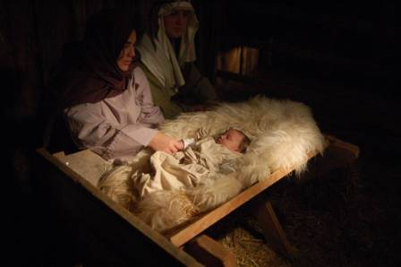
The activities of the divine preexistent Christ
What was the Savior doing prior to his Bethlehem appearance?

Slide 23
He was creating the universe
"All things were made by him; and without him was not any thing made that was made" (John 1:3)
"For by him were all things created, that are in heaven, and that are in earth, visible and invisible, whether they be thrones, or dominions, or principalities, or powers: all things were created by him, and for him" (Col. 1:16)
"Hath in these last days spoken unto us by his Son, whom he hath appointed heir of all things, by whom also he made the world...And, thou, Lord, in the beginning hast laid the foundation of the earth; and the heavens are the works of thine hands" (Heb. 1:2, 10)

Slide 24
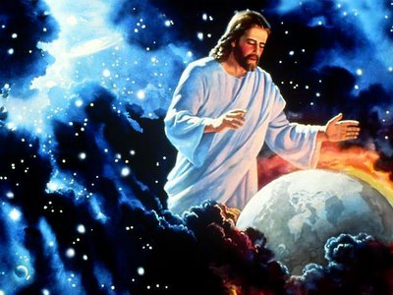

Slide 25
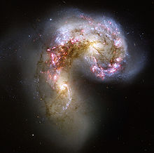
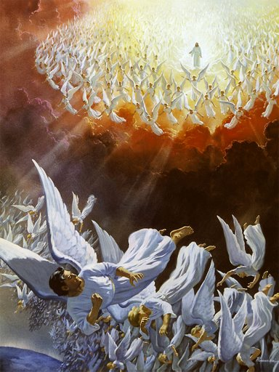
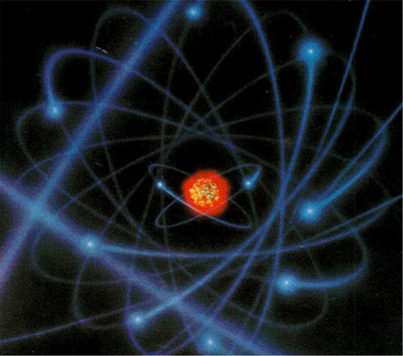
This creation included everything, from
electrons to galaxies, and from angels to man

Slide 26
He was controlling his created universe
"Who being the brightness of his glory, and the express image of his person, and upholding all things by the word of his power, when he had by himself purged our sins, sat down on the right hand of the Majesty on high" (Heb. 1:3)
"And he is before all things, and by him all things consist" (Col. 1:17)
Our Lord Jesus not only put all things together, but he continues to keep all things together.

Slide 27
He was communing with the Father
(John 17:11-24)

Slide 28
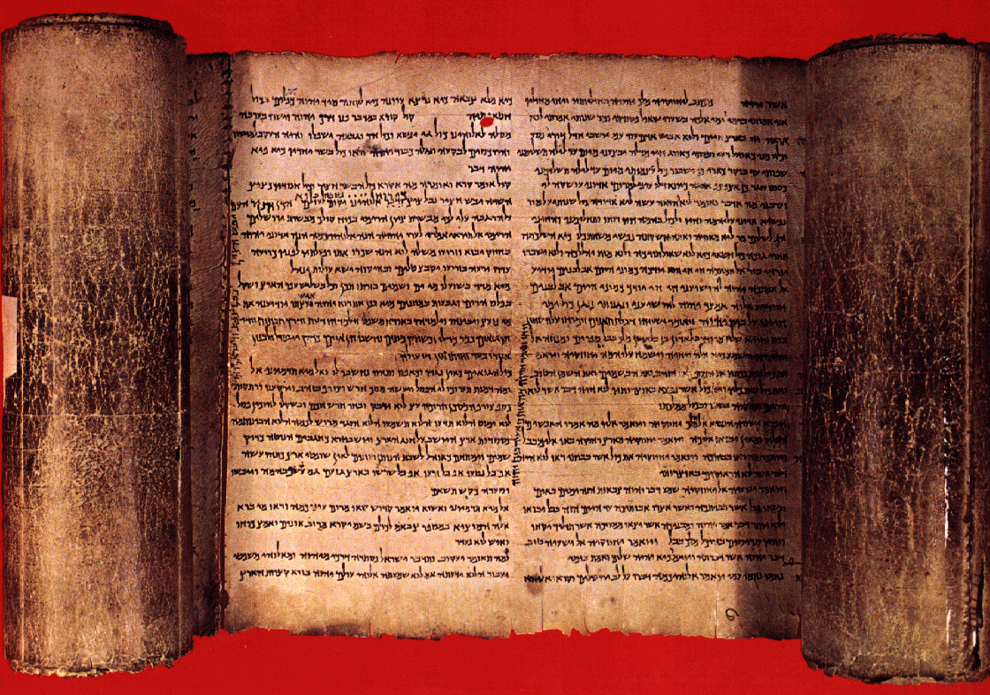
The Old Testament Appearances and Ministry of Jesus Christ
Theophany

Slide 29
The Old Testament records a number of theophanies. A theophany is a pre-Bethlehem appearance of Christ.

Slide 30
Next Week

