Slide 1
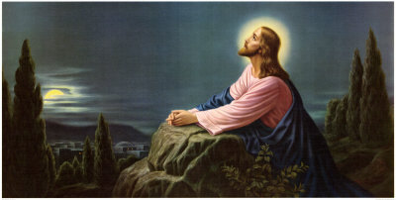
How to Walk with God “Getting Alone with God” (Part 9)
“And straightway Jesus constrained his disciples to get into a ship, and to go before him unto the other side, while he sent the multitudes away.
And when he had sent the multitudes away, he went up into a mountain apart to pray: and when the evening was come, he was there alone.” Matt. 14:22-23

Slide 2
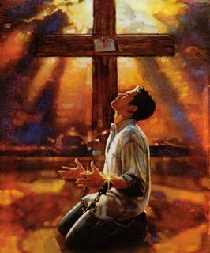
How to Walk with God
“Brokenness”
(Part 1)

Slide 3
“C” is a bent “I” “yet not I, but Christ…”

Slide 4
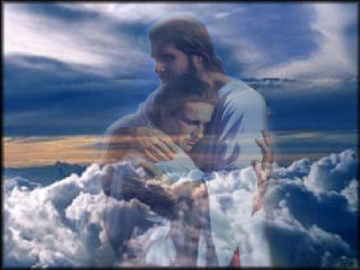
How to Walk with God
“The way of fellowship”
(Part 2)

Slide 5
“If we say that we have fellowship with him, and walk in darkness, we lie, and do not the truth.” (I John 1:6)
“But if we walk in the light, as he is in the light, we have fellowship one with another” (I John 1:7)

Slide 6
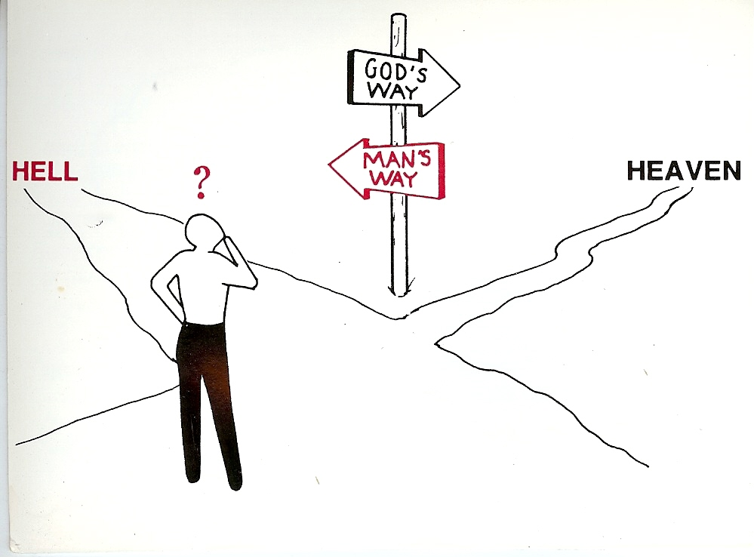
How to Walk with God “Walking on the Road of Holiness” (Part 3)
Unrighteousness
Righteousness

Slide 7
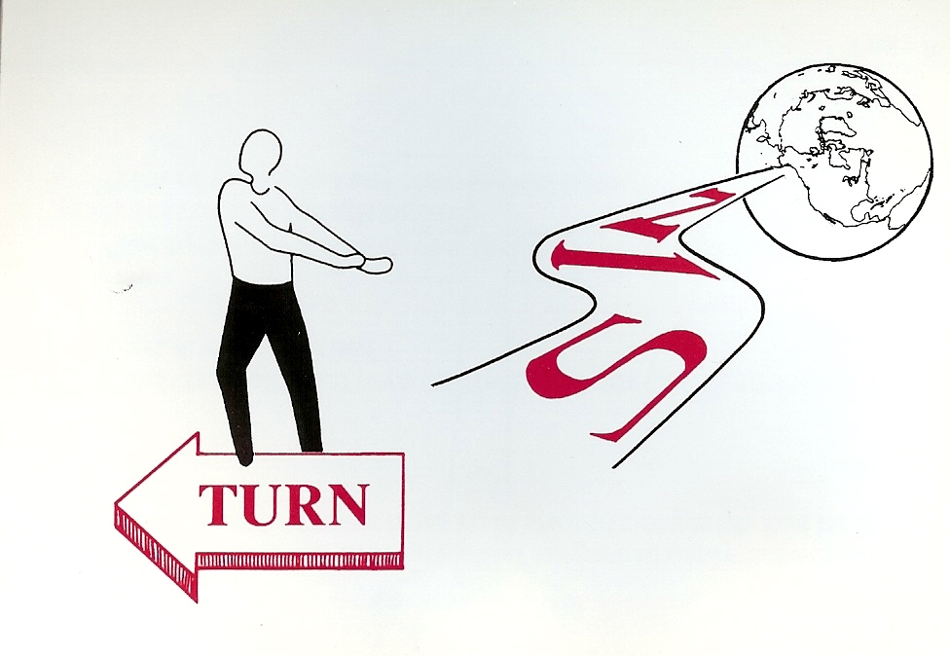
“And an highway shall be there, and a way, and it shall be called The way of holiness; the unclean shall not pass over it.”
(Isaiah 35:8)
Holiness

Slide 8
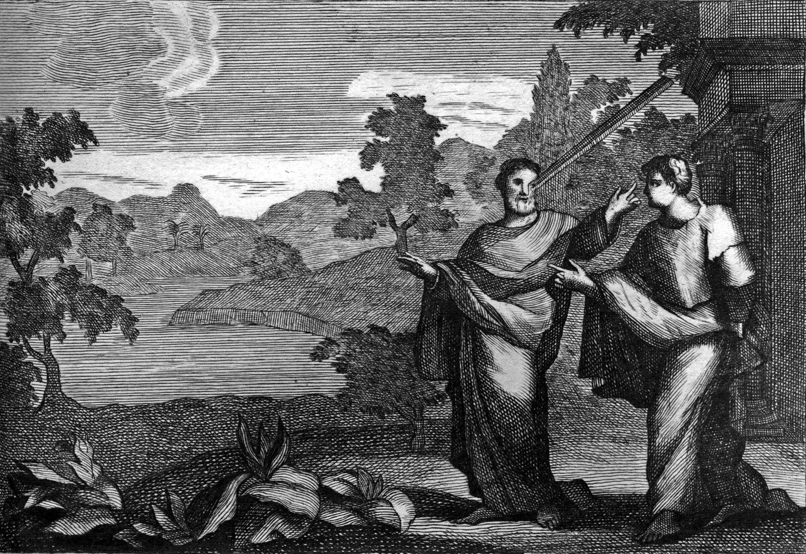
How to Walk with God “Removing the beam from your eyes”
(Part 4)

Slide 9
How to Walk with God “Avoidance of Sin” and “Adherence to Biblical Standards” (Part 5)
“Whosoever committeth sin transgresseth also the law: for sin is the transgression of the law.” (I John 3:4)

Slide 10
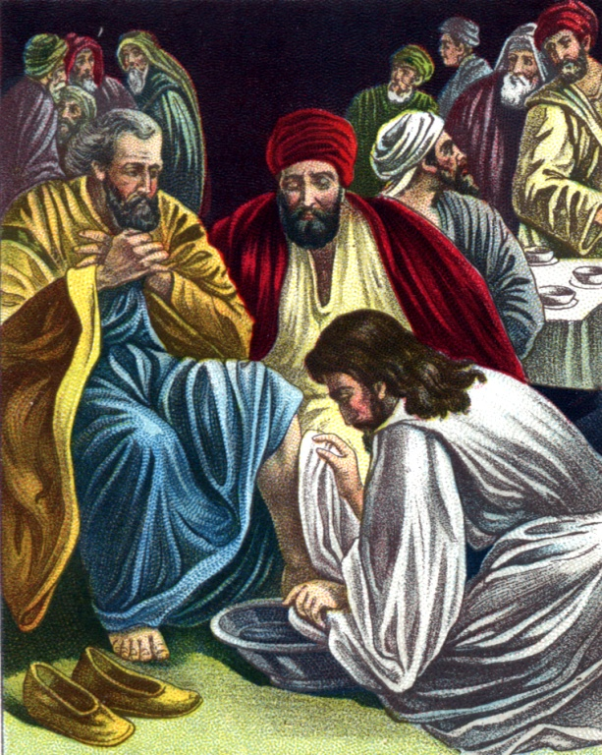
How to Walk with God “Becoming a Humble Servant” (Luke 22:24-30) (Part 6)

Slide 11
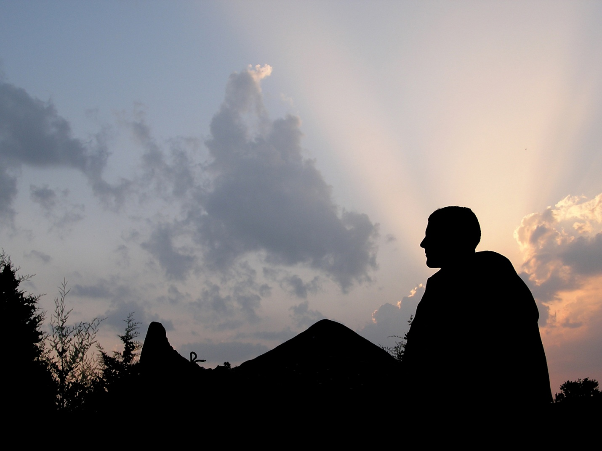
How to Walk with God “Make Prayer a Priority” (Part 7)
Luke 11:1-13, 18:1-14

Slide 12
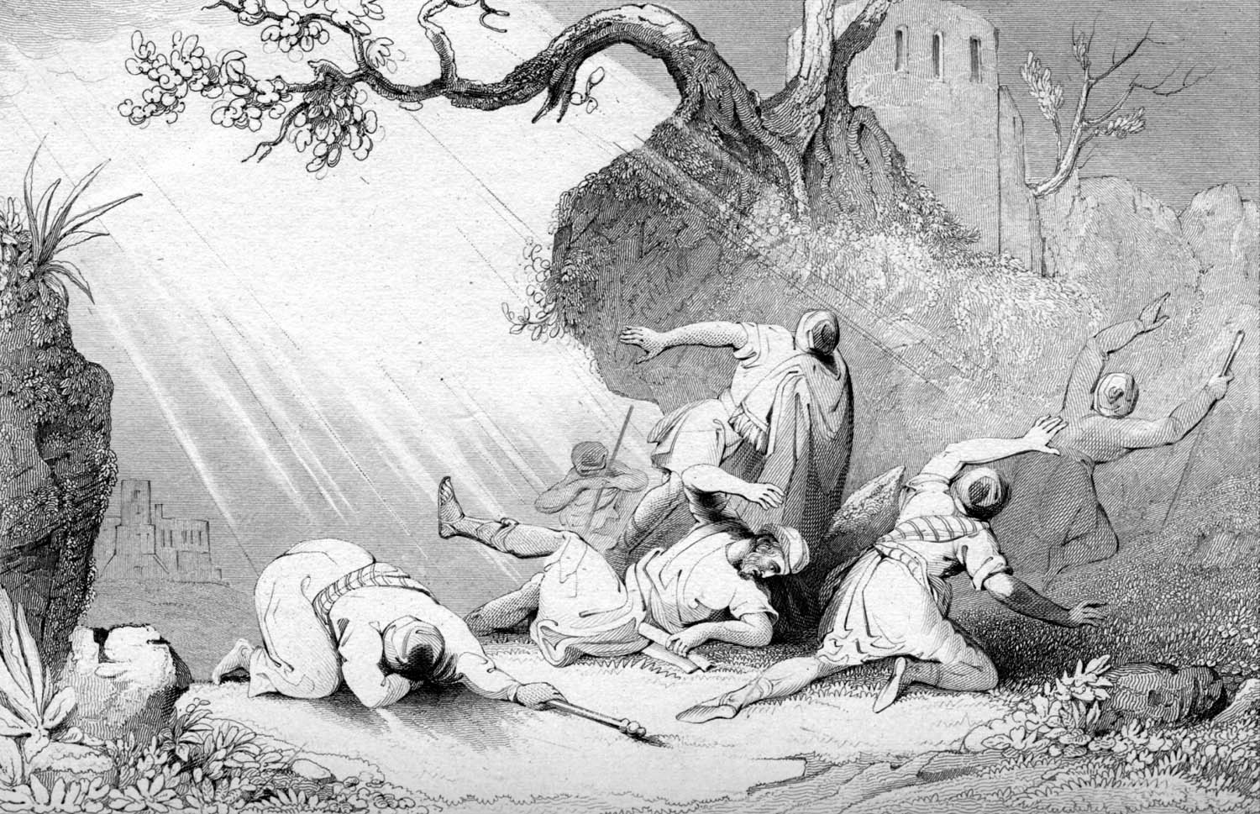
How to Walk with God “Living under the Lordship of Jesus Christ” (Part 8) “And he trembling and astonished said, Lord, what wilt thou have me to do?” (Acts 9:6)

Slide 13
How to Walk with God “Getting Alone with God” (Part 9)
“And straightway Jesus constrained his disciples to get into a ship, and to go before him unto the other side, while he sent the multitudes away.
And when he had sent the multitudes away, he went up into a mountain apart to pray: and when the evening was come, he was there alone.” Matt. 14:22-23

Slide 14
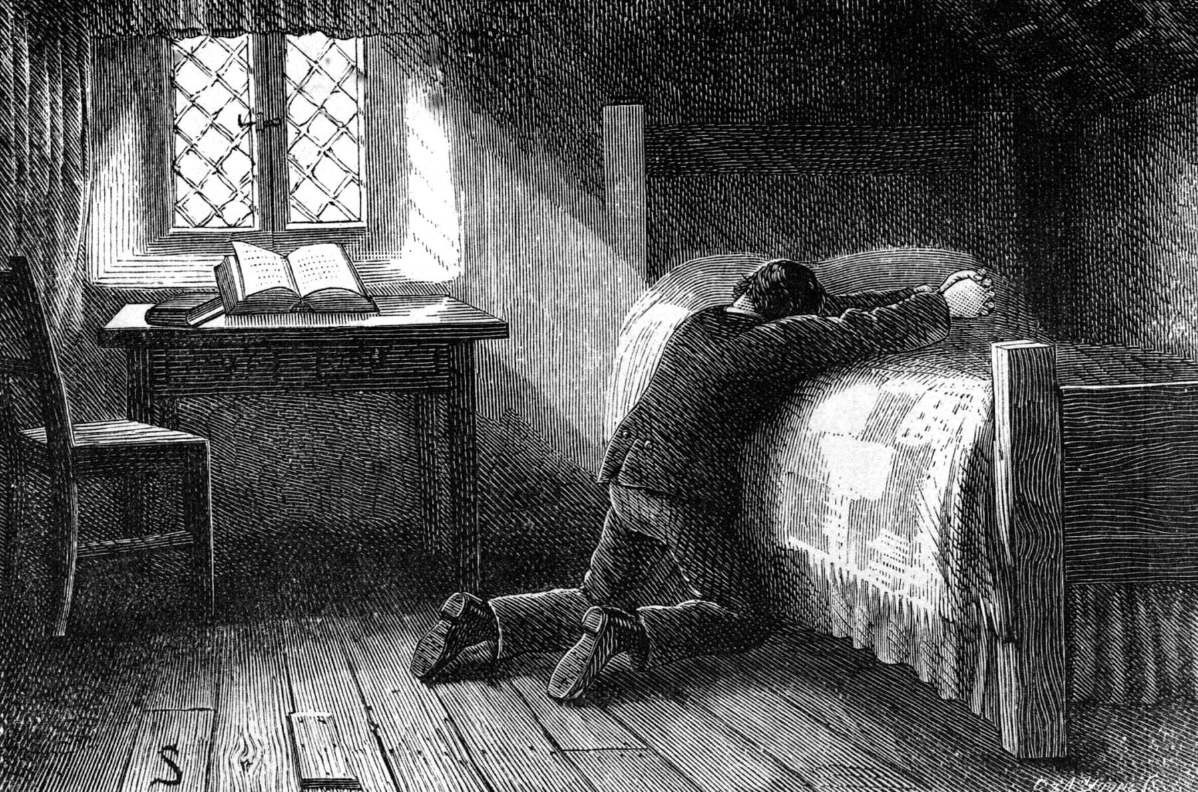
Getting alone with God is something that every Christian desperately need to do on a regular basis – Ps 73:28 “But it is good for me to draw near to God.”
Having a place where you can quiet your heart and hear from the Lord is so important in our spiritual growth and understanding of God -
Psalm 4:4 “Stand in awe, and sin not: commune with your own heart upon your bed, and be still.”
Ps 46:10 Be still, and know that I am God.”
Very few believers take the time needed to just get along with God – Psalm 32:7 “Thou art my hiding place; thou shalt preserve me from trouble; thou shalt compass me about with songs of deliverance.”

Slide 15
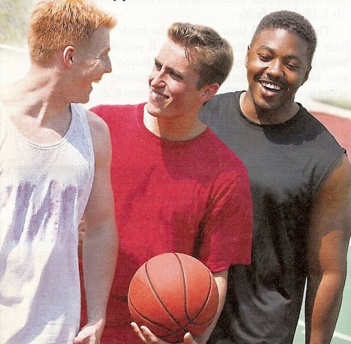
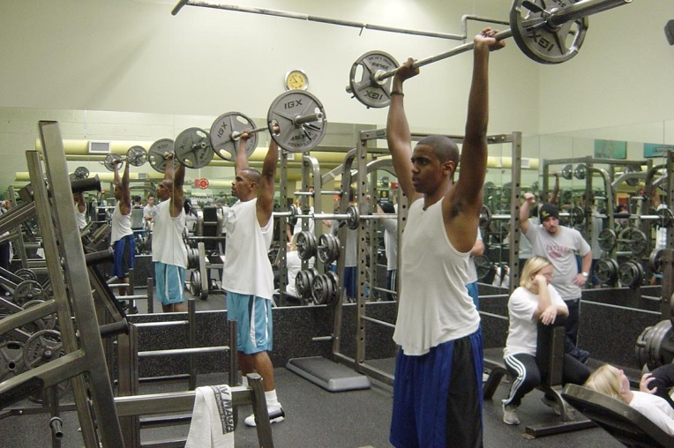
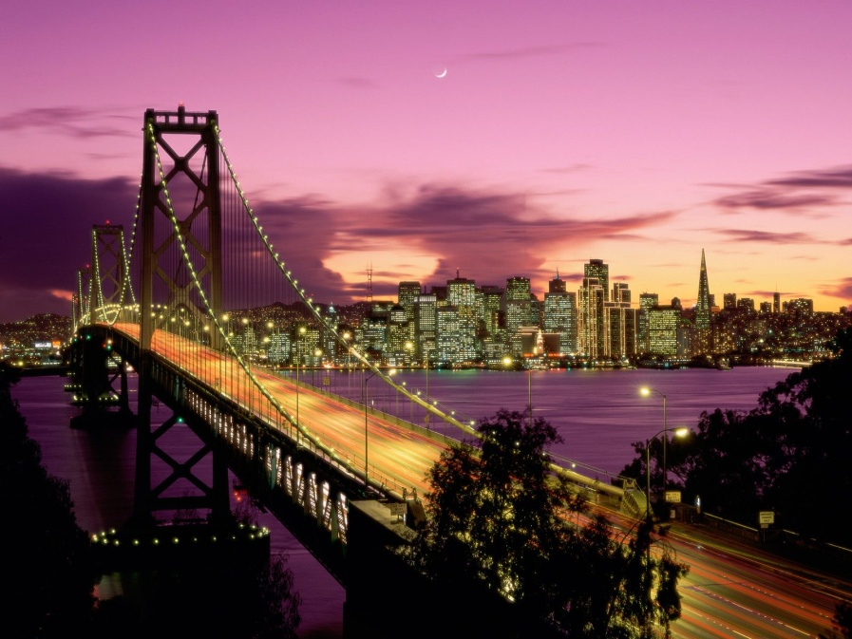
Excuses
I have to many things to do
I have places to go
I have people to see

Slide 16
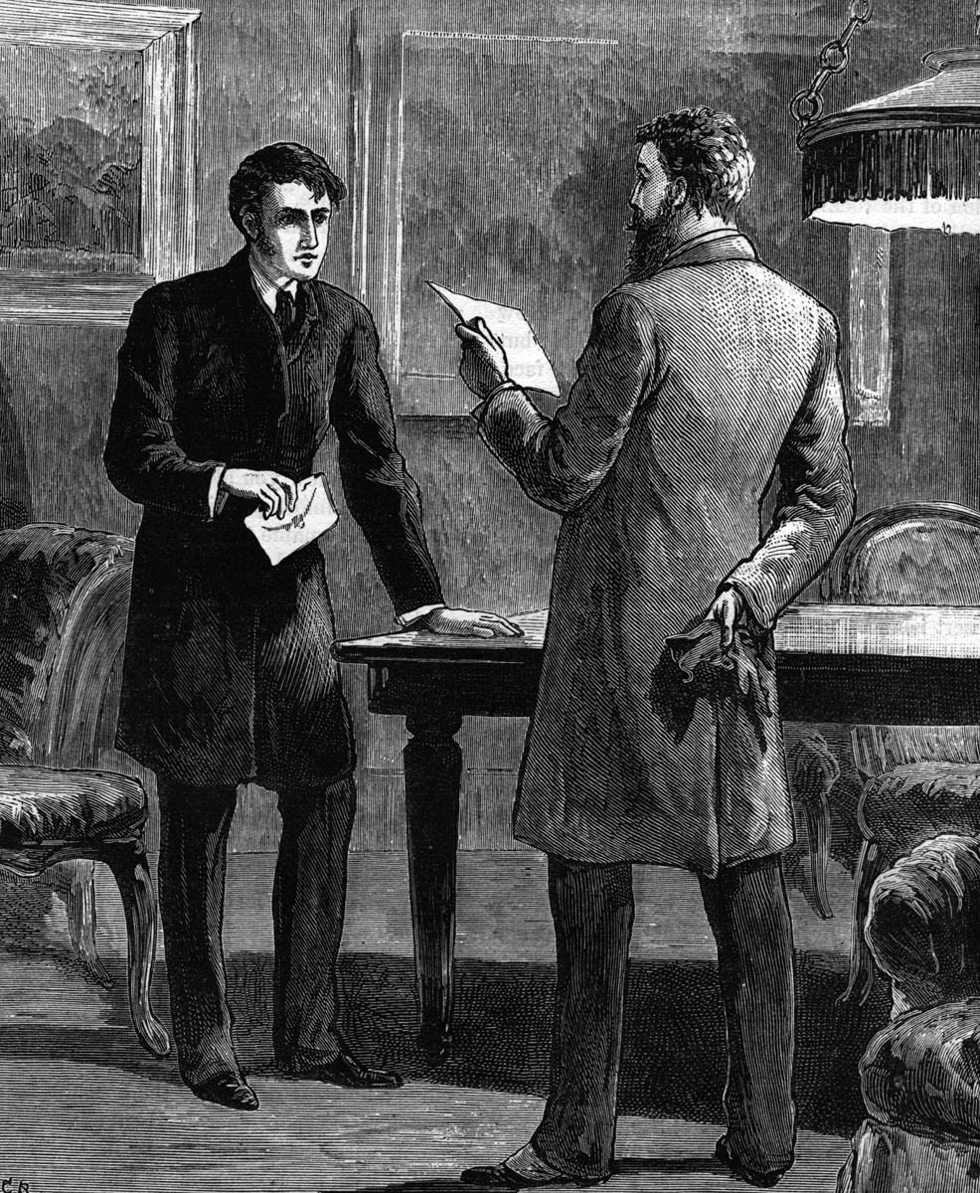
Famous Quotes
Hard work is good for the soul
The early bird catches the worm
Idle mind is the devil’s workshop
Never stand still
Don’t let the grass grow under your feet
Are you working hard of hardly working?

Slide 17
Productivity and activity is important – “Whatsoever thy hand findeth to do, do it with all your might…” “If a man does not work neither should he eat…” “If a man provide not for his own household he hath denied the faith…”
Hard work and productivity can however become an idol – “keep yourselves from idols…covetousness which is idolatry…”
If you are two busy to shut down your plans and programs and hear from God, you are two busy.
If you are two busy to faithfully attend church where you can hear from God you are two busy!!! “Forsake not…”

Slide 18
Is God asking you to get off the freeway and take an exit ramp, slow down and find a parking area?
“Come unto me all ye that labor and are heavy laden, and I will give you rest…take my yoke upon you and learn of me; for I am meek and lowly in heart: and ye shall find rest unto your souls…”

Slide 19
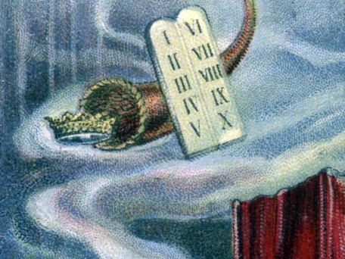
Along with a Strong Work Ethic is a Strong Rest Ethic “Sabbath”
God built this ethic into creation itself when He took one day in seven to cease from labor – “Thus the heavens and the earth were finished, and all the host of them. And on the seventh day God ended his work, which he had made; and he rested on the seventh day from all his work, which he had made. And God blessed the seventh day, and sanctified it: because that in it he had rested from all his work which God created and made…”

Slide 20
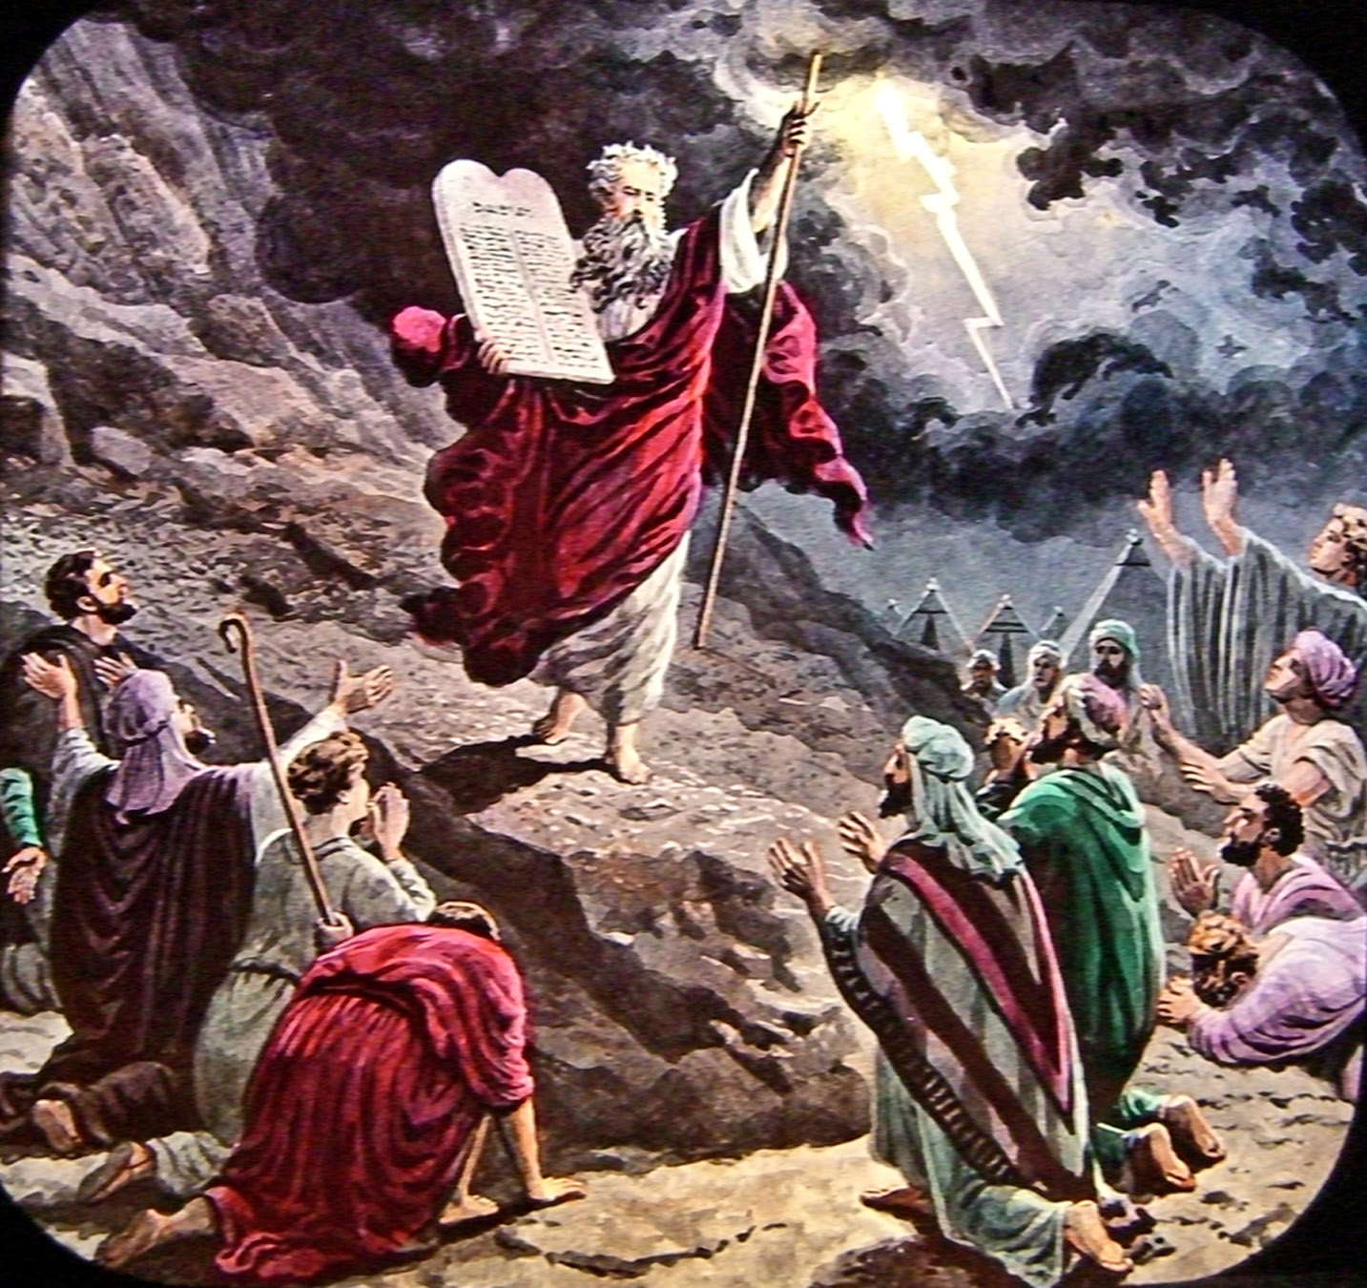
God extended this ethic to man in order that man may experience fellowship with God and refreshment of the soul –
“Remember the Sabbath day and keep it holy. Six days shalt thou labor and do all thy work. But the seventh day is the Sabbath of the Lord thy god: in it thou shalt not do any work, thou, nor thy son, nor thy daughter, they manservant, nor thy maidservant, no thy cattle, no thy stranger that is within thy gates. For in six days the Lord made the heaven and earth, the sea and all that in them is, and rested the seventh day: wherefore the Lord blessed the Sabbath day and hallowed it…”

Slide 21
Secret to a healthy soul is not the discontinuance of hard work but the regularly pausing from work to get alone with God.
One of the greatest deterrents to revival is busyness – “For thus saith the high and lofty one that inhabiteth eternity, whose name is Holy; I dwell in the high and holy place, with him also that is of a contrite and humble spirit, to revive the spirit of the humble, and to revive the heart of the contrite ones…wilt thou not revive us again that thy people may rejoice in thee?”

Slide 22
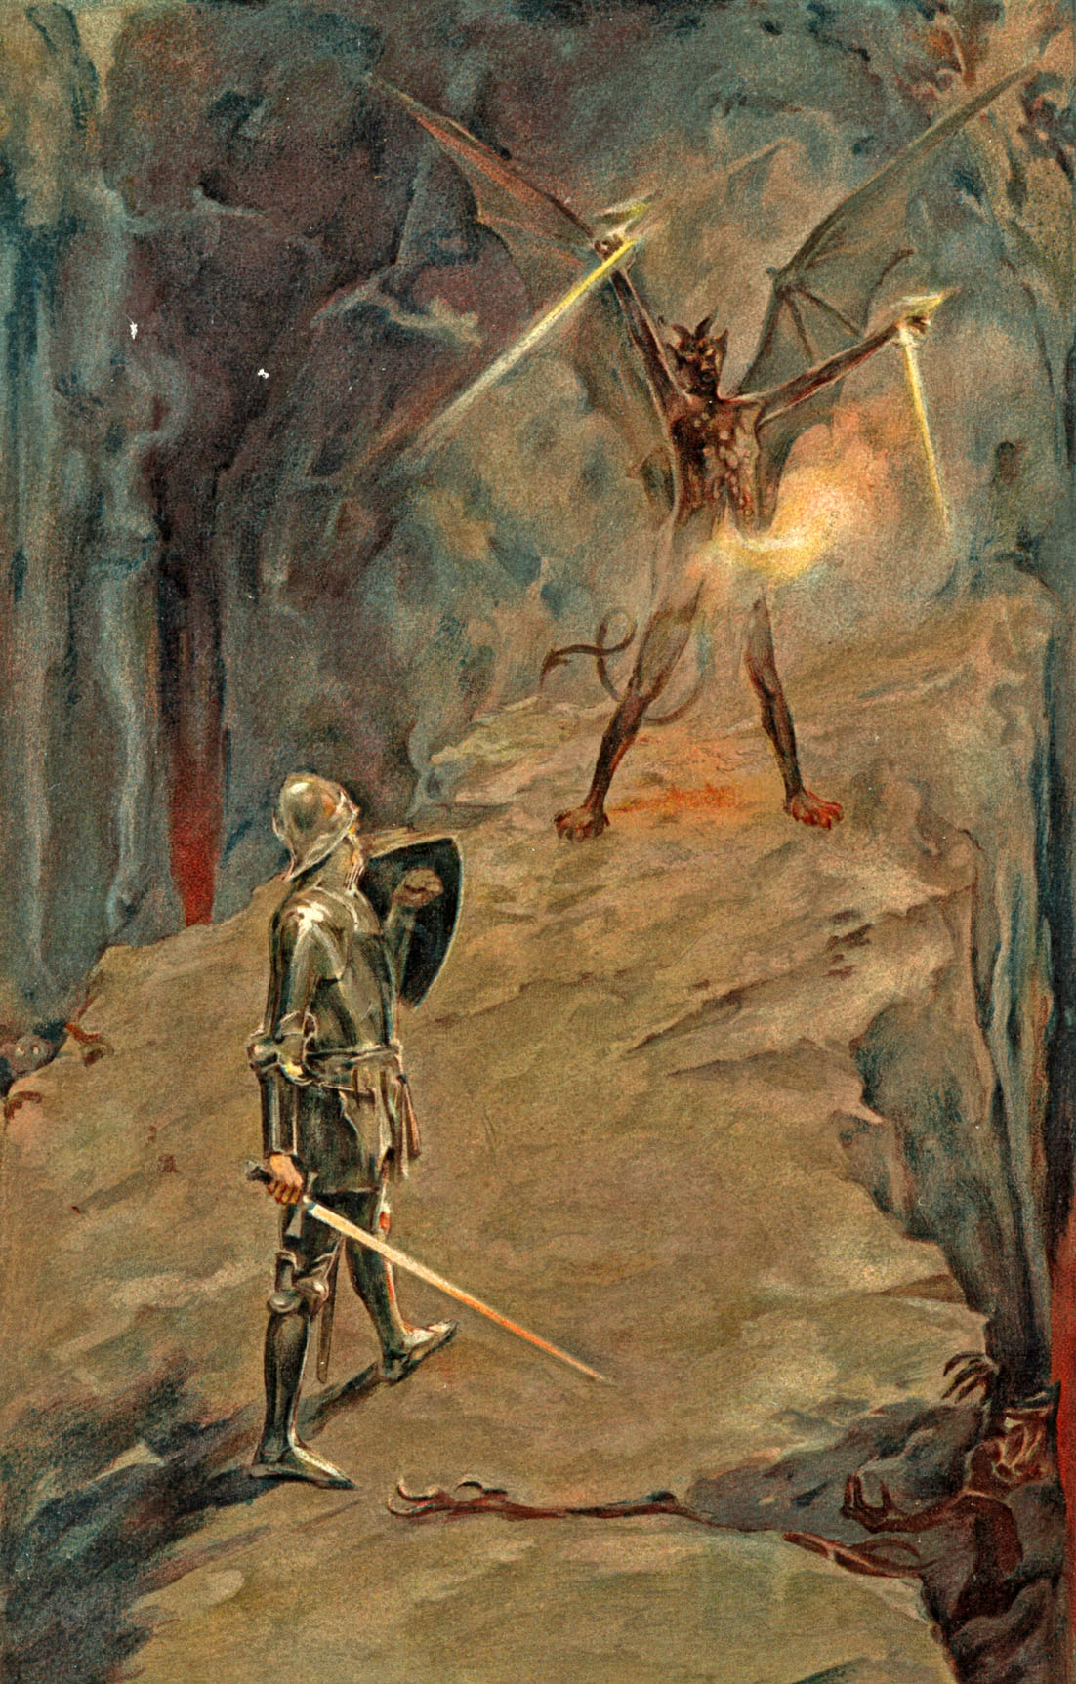
Enemy doesn’t have to destroy us just distract us!
He simply entangles us in the affairs of this life – “No man that warreth entangleth himself with the affairs of this life.” II Tim. 2:4

Slide 23
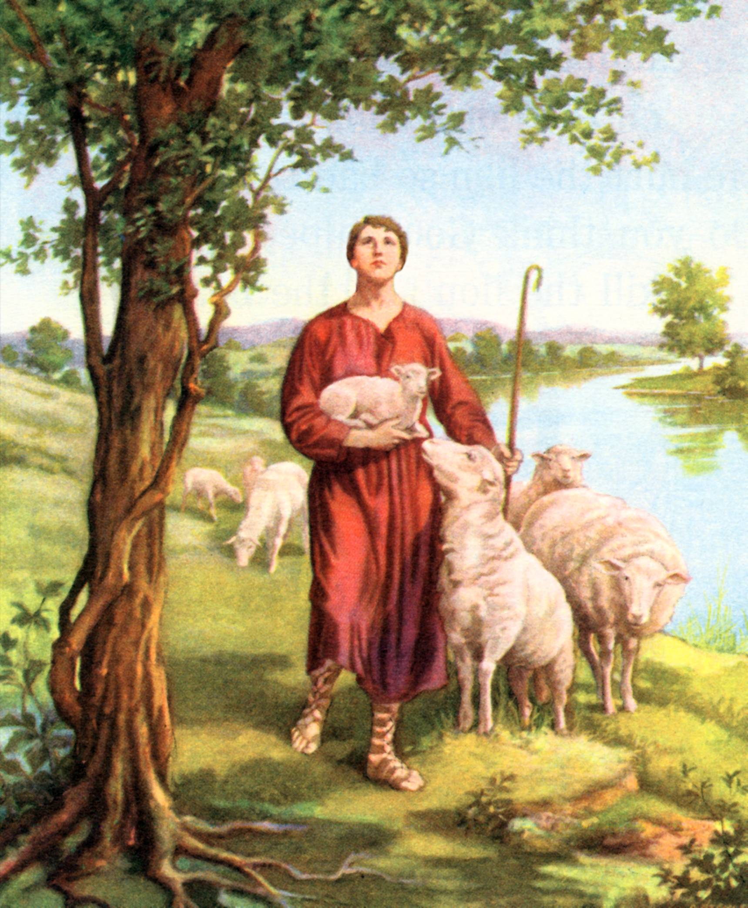
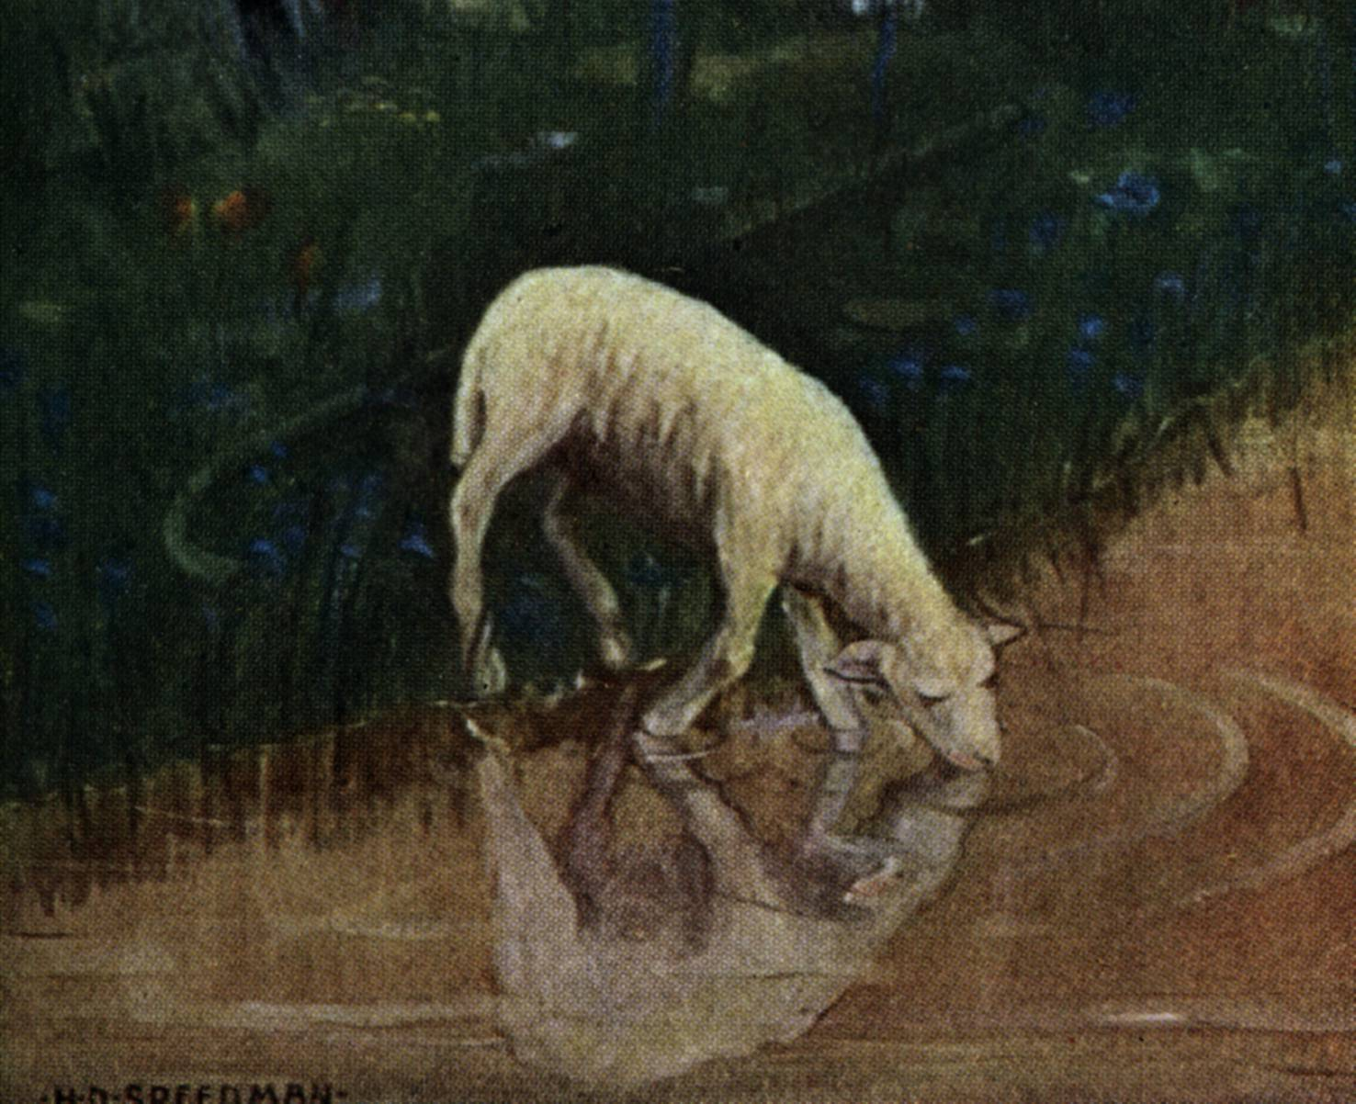
“He leadeth me besides still waters, he restoreth my soul.”

Slide 24
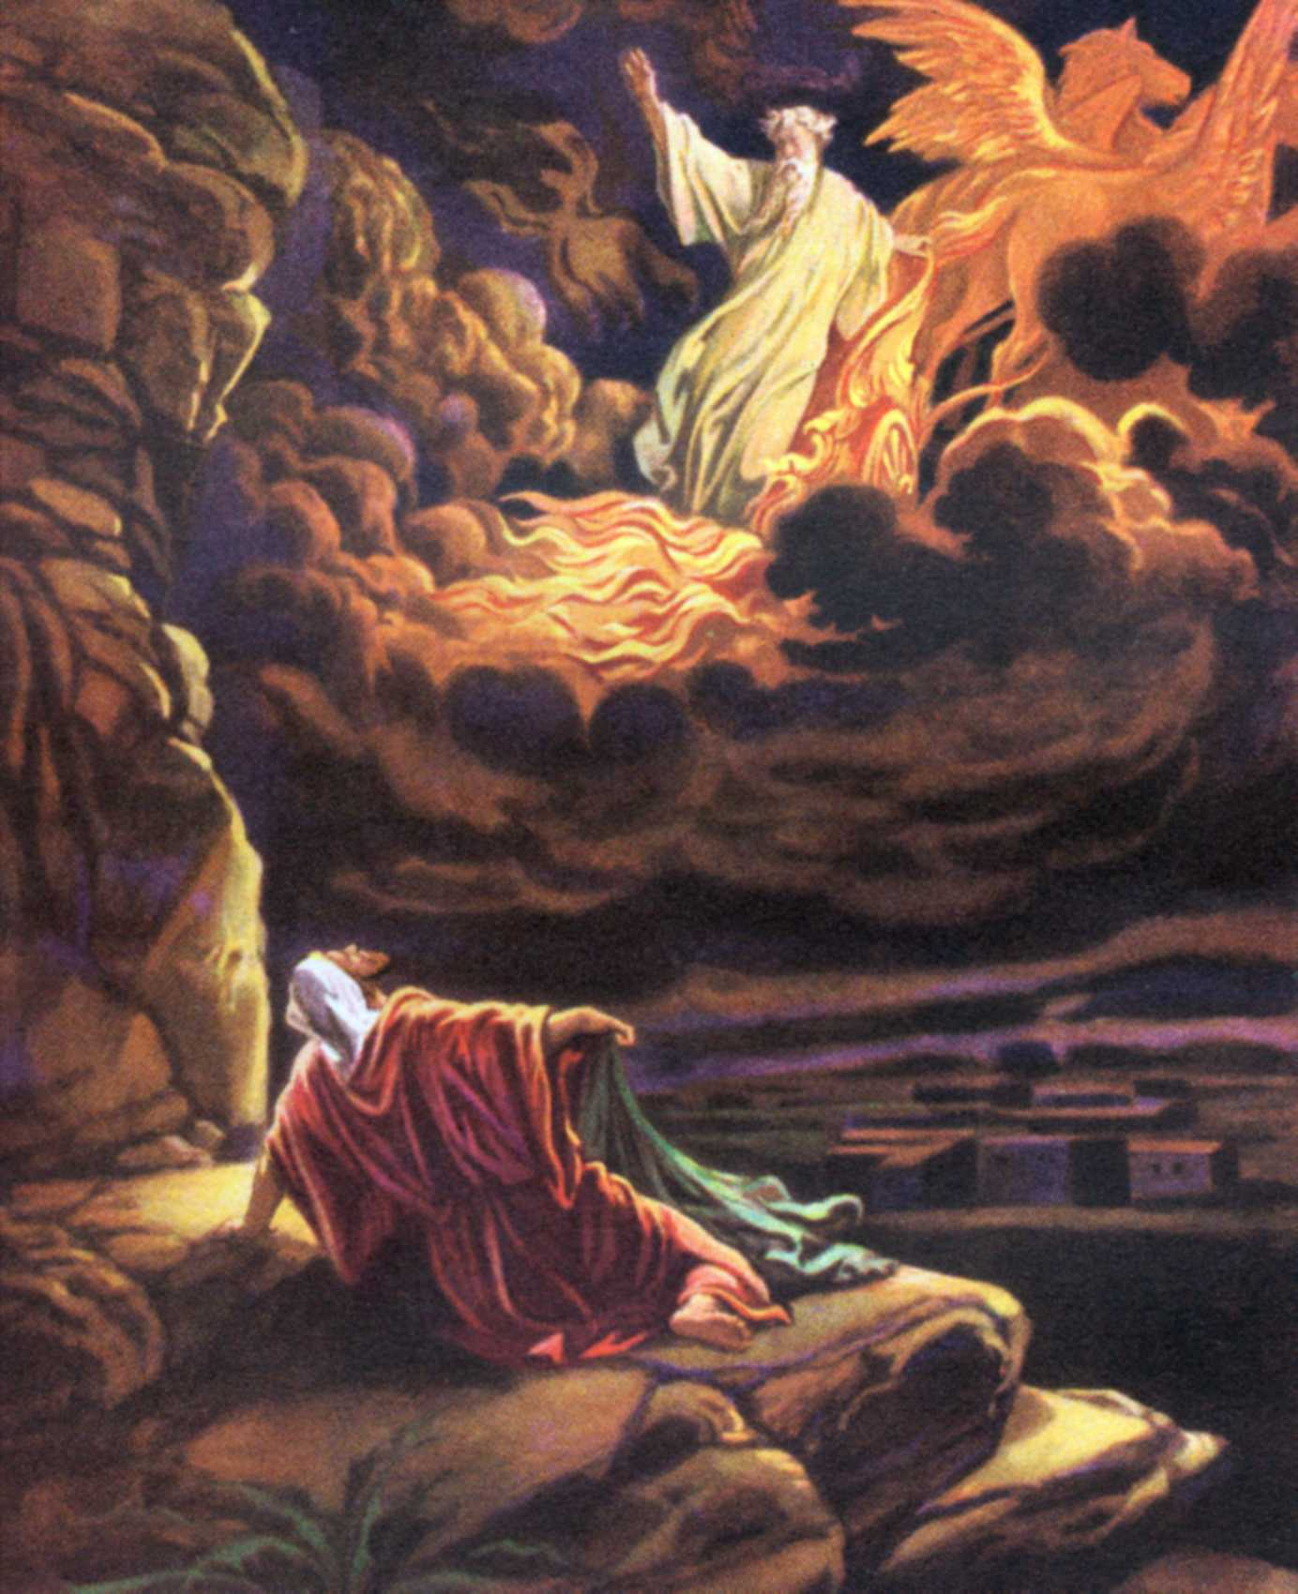
“And he said, Go forth, and stand upon the mount before the LORD. And, behold, the LORD passed by, and a great and strong wind rent the mountains, and brake in pieces the rocks before the LORD; but the LORD was not in the wind: and after the wind an earthquake; but the LORD was not in the earthquake: And after the earthquake a fire; but the LORD was not in the fire: and after the fire a still small voice. And it was so, when Elijah heard it, that he wrapped his face in his mantle, and went out, and stood in the entering in of the cave…

Slide 25
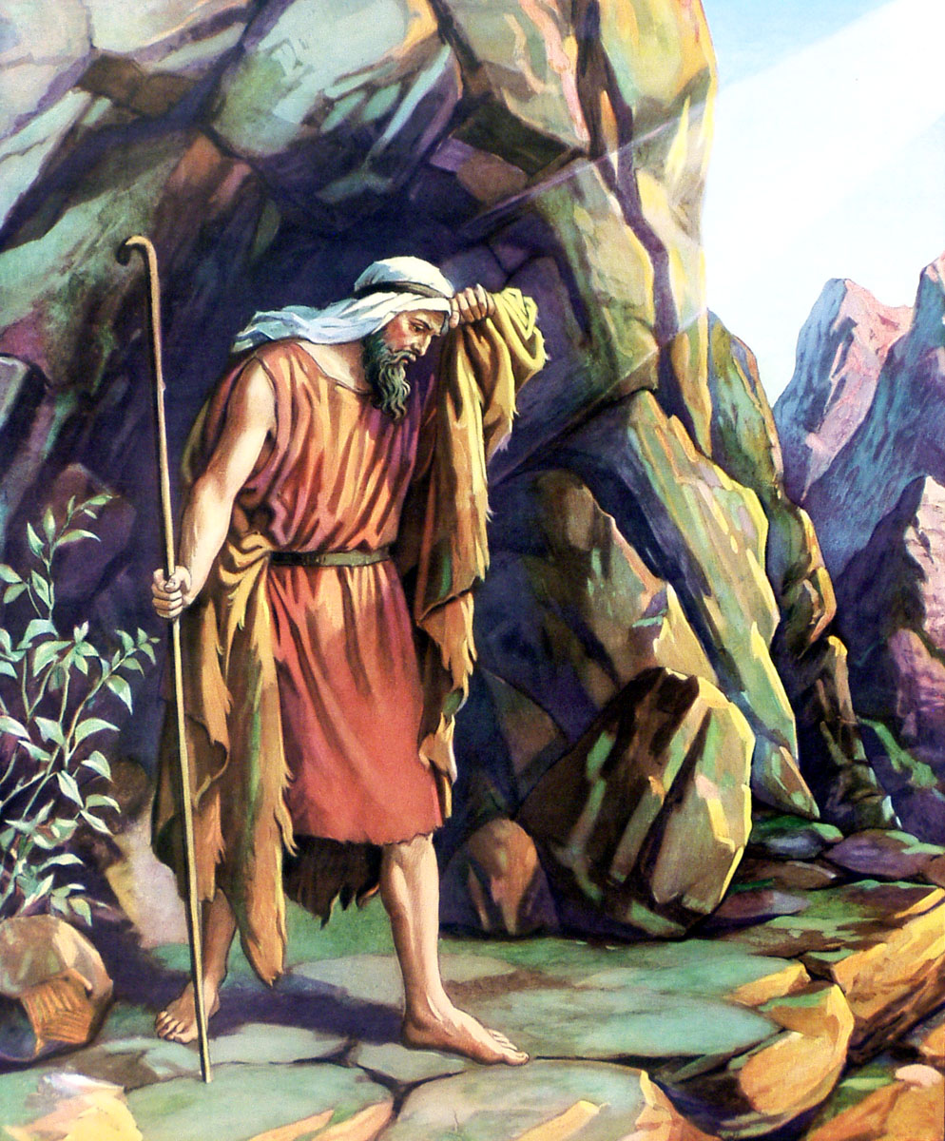
“And, behold, there came a voice unto him, and said, What doest thou here, Elijah?”

Slide 26
Push the Pause Button
Withdraw to a lonely place to be with God -
Take Time
To Read
To Pray
To Listen

Slide 27
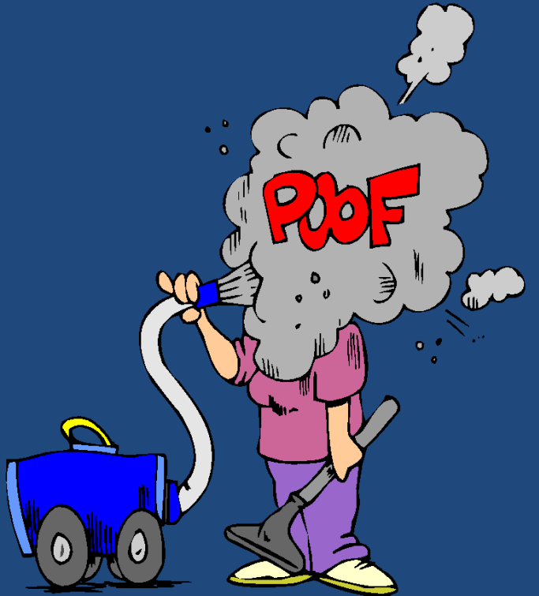
Spiritual Growth and Strength Cannot be Cultivated in a Vacuum of Communion with God

Slide 28
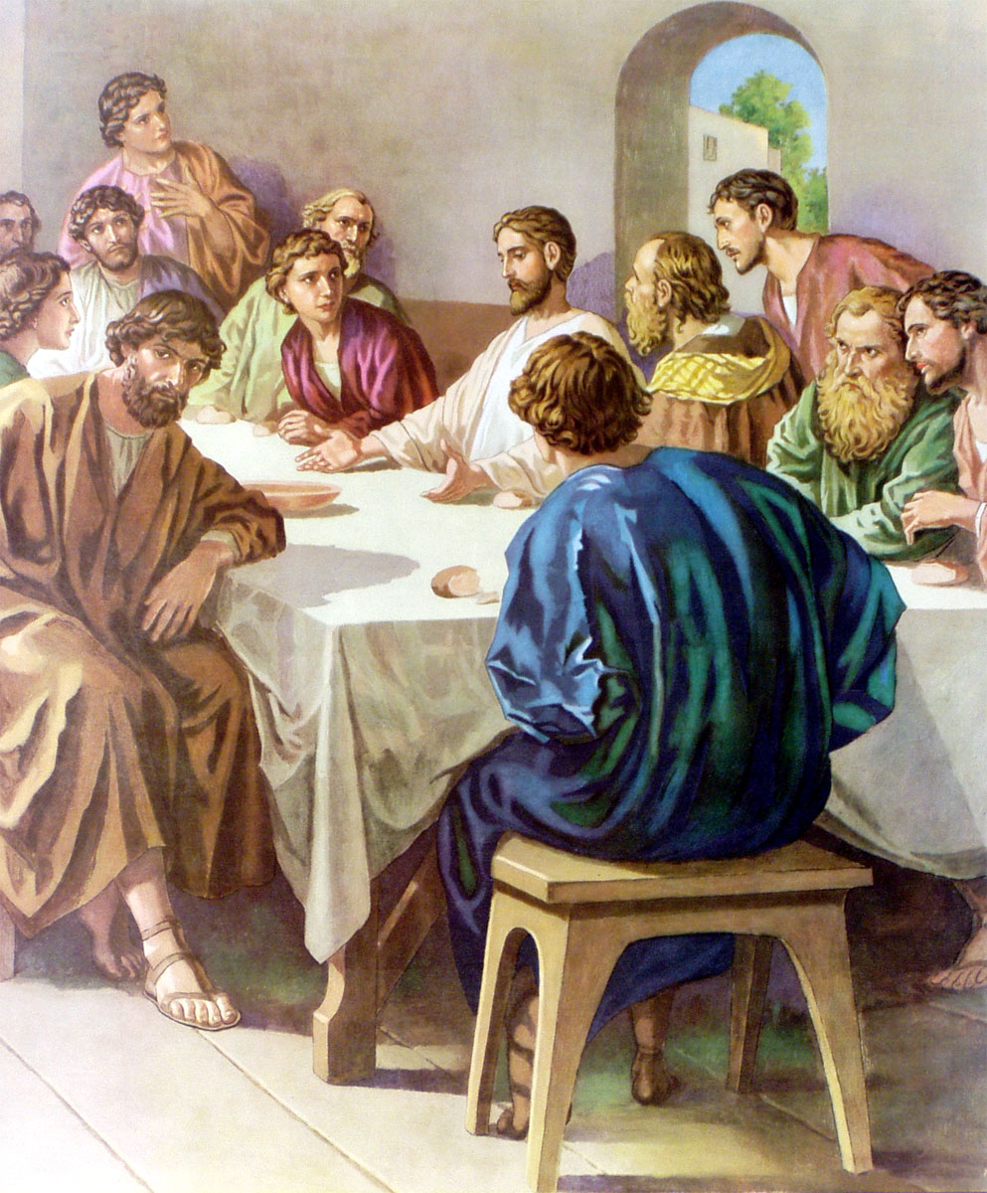
“The cup of blessing which we bless is it not the communion of the blood of Christ? The bread which we break is it no the communion of the body of Christ….”

Slide 29
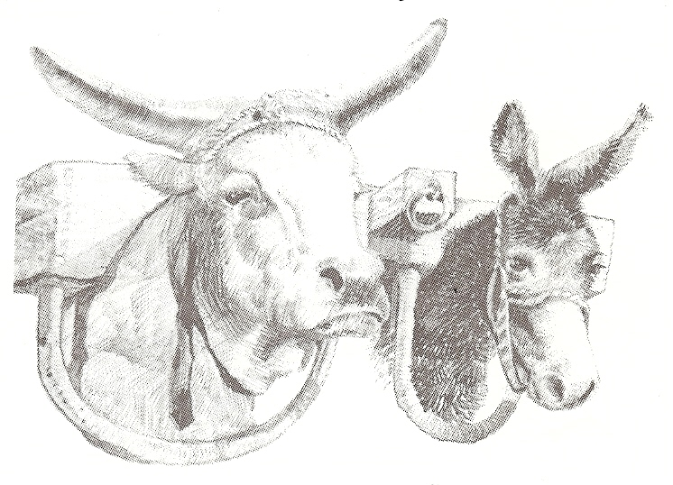
“Be not unequally yoked together with unbelievers: for what fellowship hath righteousness with unrighteousness? And what communion hath light with darkness…The grace of the Lord Jesus Christ and the love of God and the communion of the Holy Ghost be with you all. Amen…”

Slide 30
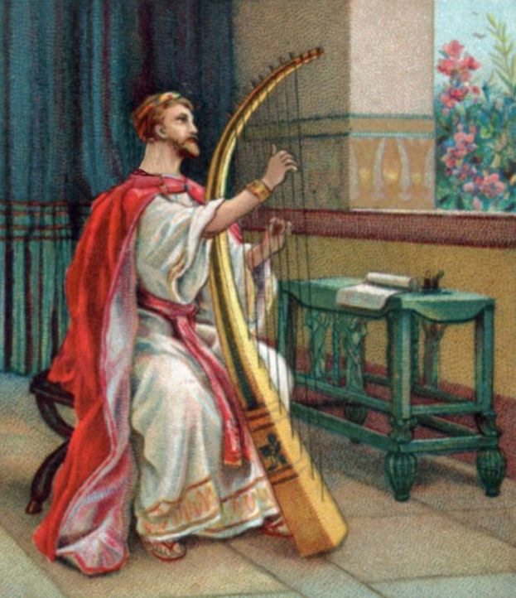
“Hear my prayer O God and give ear to the words of my mouth…even and morning and at noon will I pray and cry aloud and he shall hear my voice…Here my voice O God, in my prayer preserve my life…Hear my prayer O Lord, give ear to my supplications: in thy faithfulness answer me…”

Slide 31
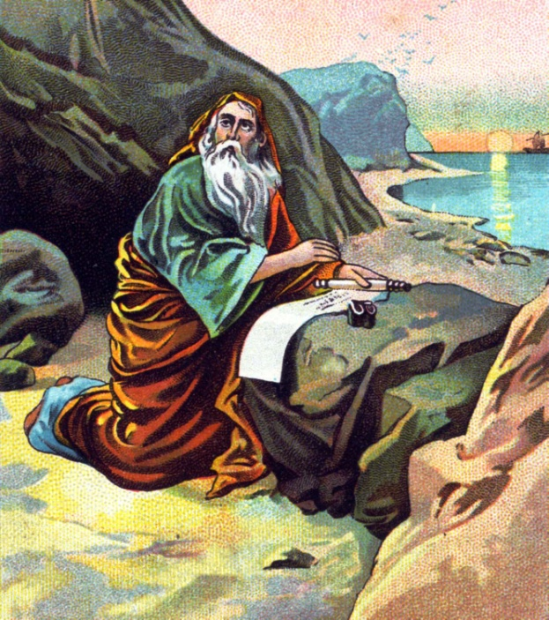
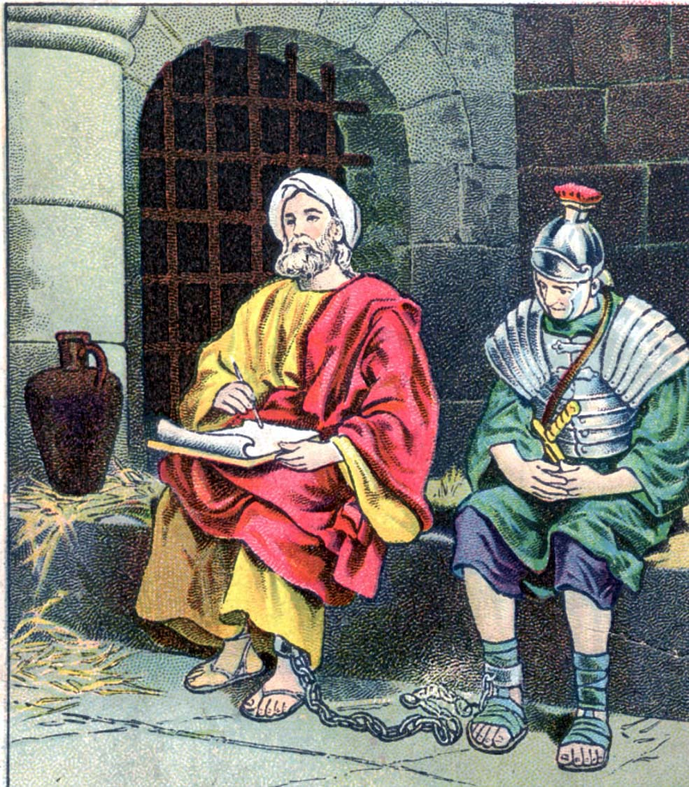
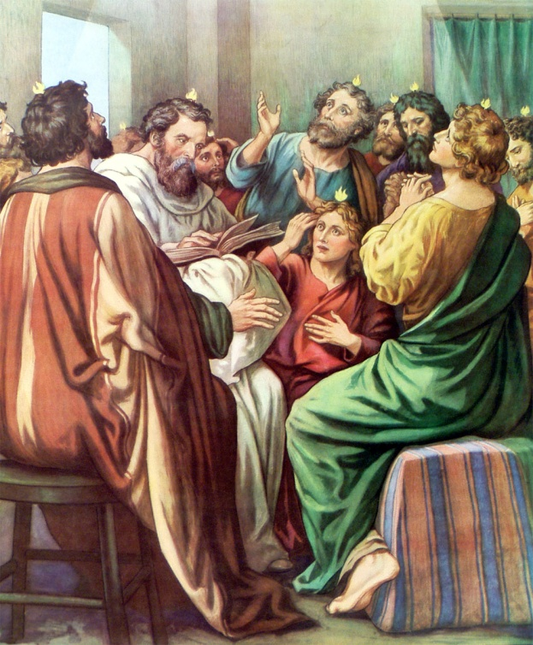
John received the Revelation of Jesus Christ while exiled on the island of Patmos.
Paul wrote the majority of his epistles while in prison or under house arrest.
The most powerful outpouring of the Holy Spirit in the New Testament began with the believers who were gathered in an upper room waiting – (Read Acts 1:4-14, 2:1-3)

Slide 32
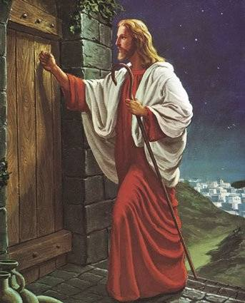
Could it be that the missing ingredient in our churches today is not more activity, but a lack of holy cessation? Perhaps God is waiting for us to stop long enough to make time for Him.

Slide 33
God still honors this promise today
“Draw near to God and he will draw near to you…”
Find that – quite place / quite time / quite heart – take time to listen, pray and hear from God – experience His presence in your life –
“Seek the Lord while he may be found…seek his face and his strength continually…set your heart and soul to seek the Lord…prepare your heart to seek the Lord…they that seek the Lord shall not want any good thing…it is time to seek the Lord…Woe to them that go down into Egypt for help; and stay on horses, and trust in chariots, because they are many, and in horsemen, because they are very strong; but they look not unto the Holy one of Israel, neither seek the Lord…if you seek me ye shall find me…”

