Slide 1
How to Walk with God “Avoidance of Sin” and “Adherence to Biblical Standards” (Part 5)
“Whosoever committeth sin transgresseth also the law: for sin is the transgression of the law.” (I John 3:4)

Slide 2
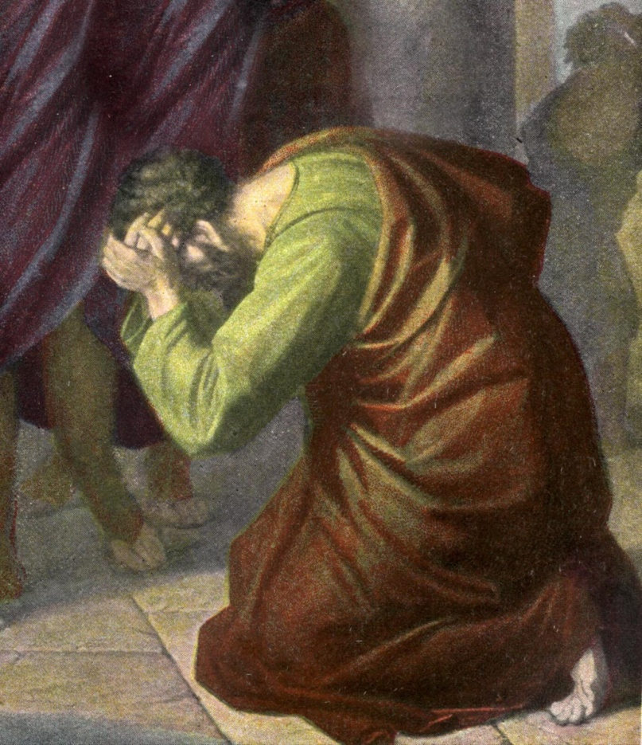
How to Walk with God “Brokenness” (Psalms 51:1-17) (Part 1)

Slide 3
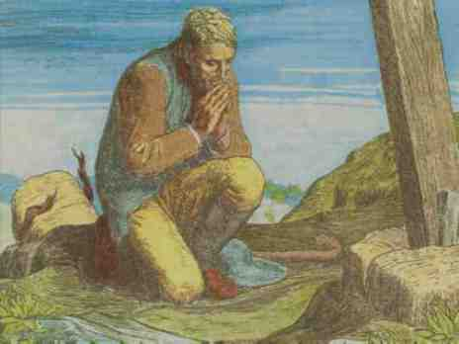
“C” is a bent “I” “yet not I, but Christ…”

Slide 4
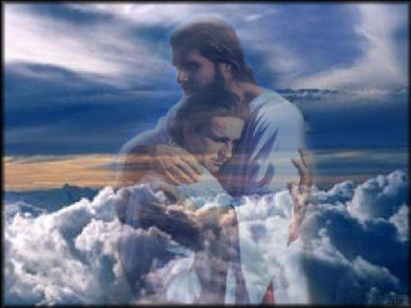
How to Walk with God
“The way of fellowship”
(Part 2)

Slide 5
“If we say that we have fellowship with him, and walk in darkness, we lie, and do not the truth.” (I John 1:6)
“If we walk in the light as he is in the light we have fellowship.” (I John 1:7)

Slide 6
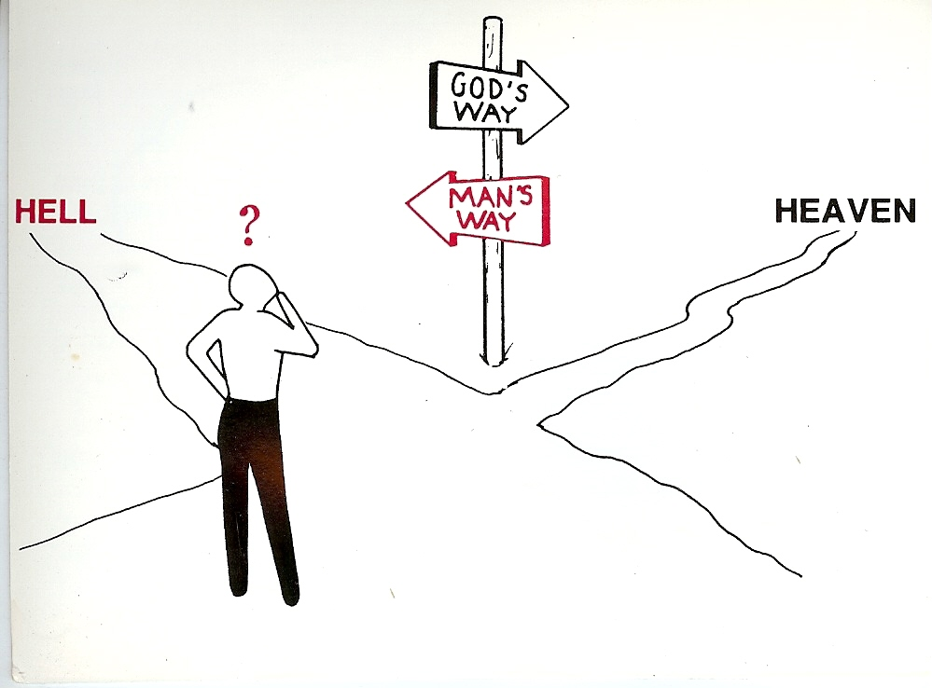
How to Walk with God “Walking on the Road of Holiness” (Part 3)
Unrighteousness
Righteousness

Slide 7
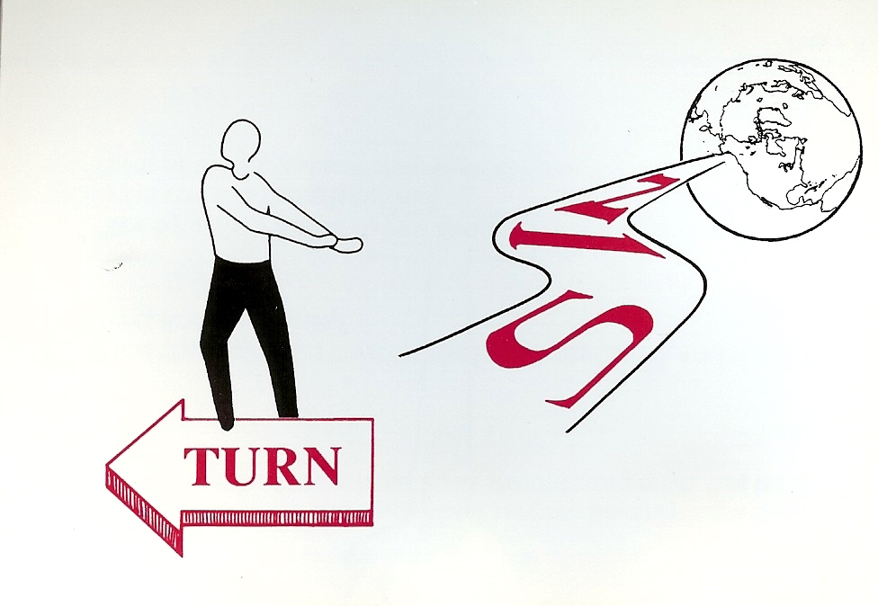
(Isaiah 35:8)
Holiness
“And an highway shall be there, and a way, and it shall be called The way of holiness; the unclean shall not pass over it.”

Slide 8
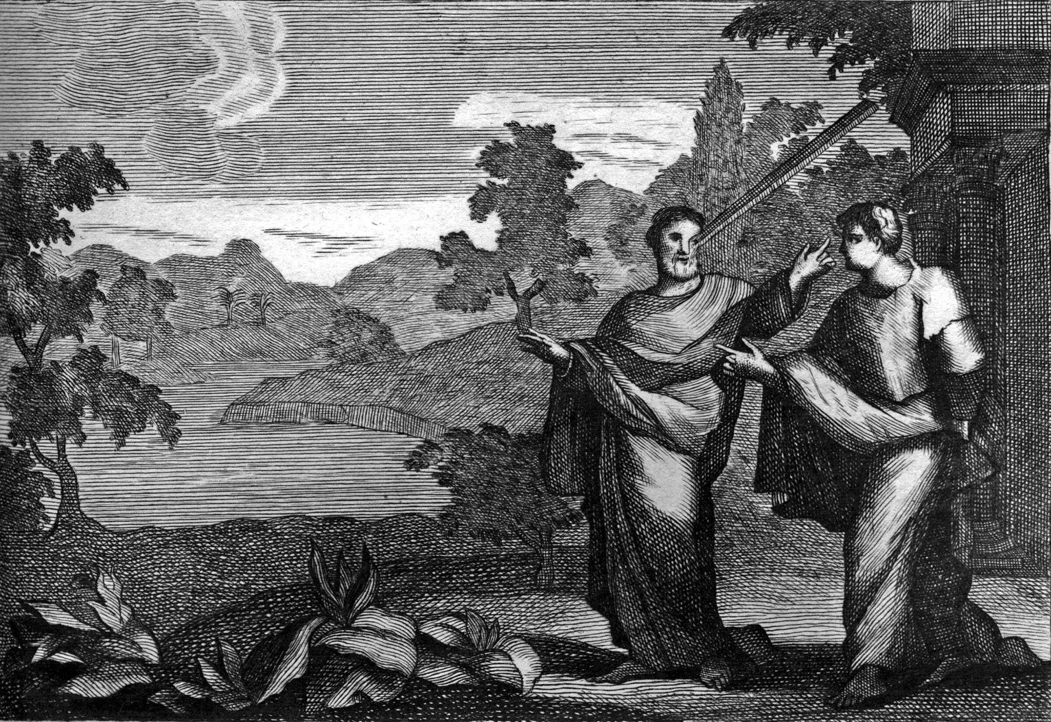
How to walk with God “Removing the beam from your eyes”
(Part 4)

Slide 9
How to Walk with God “Avoidance of Sin” and “Adherence to Biblical Standards” (Part 5)
“Whosoever committeth sin transgresseth also the law: for sin is the transgression of the law.” (I John 3:4)

Slide 10
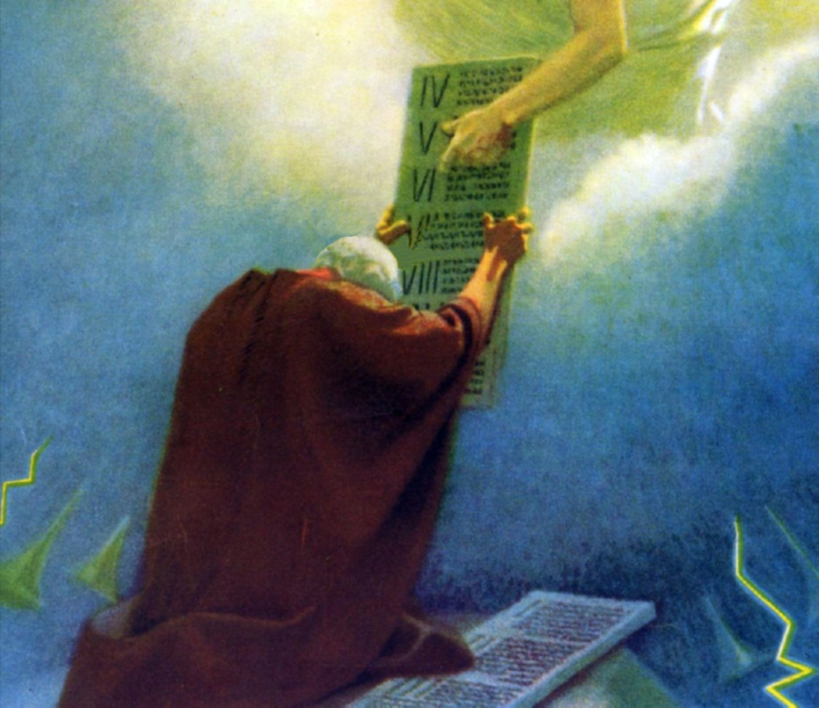
“I had not known sin, but by the law: for I had not known lust, except the law had said, Thou shalt not covet…Wherefore the law is holy, and the commandment holy, and just, and good…For we know that the law is spiritual: but I am carnal, sold under sin.”
(Romans 7:7-14)

Slide 11
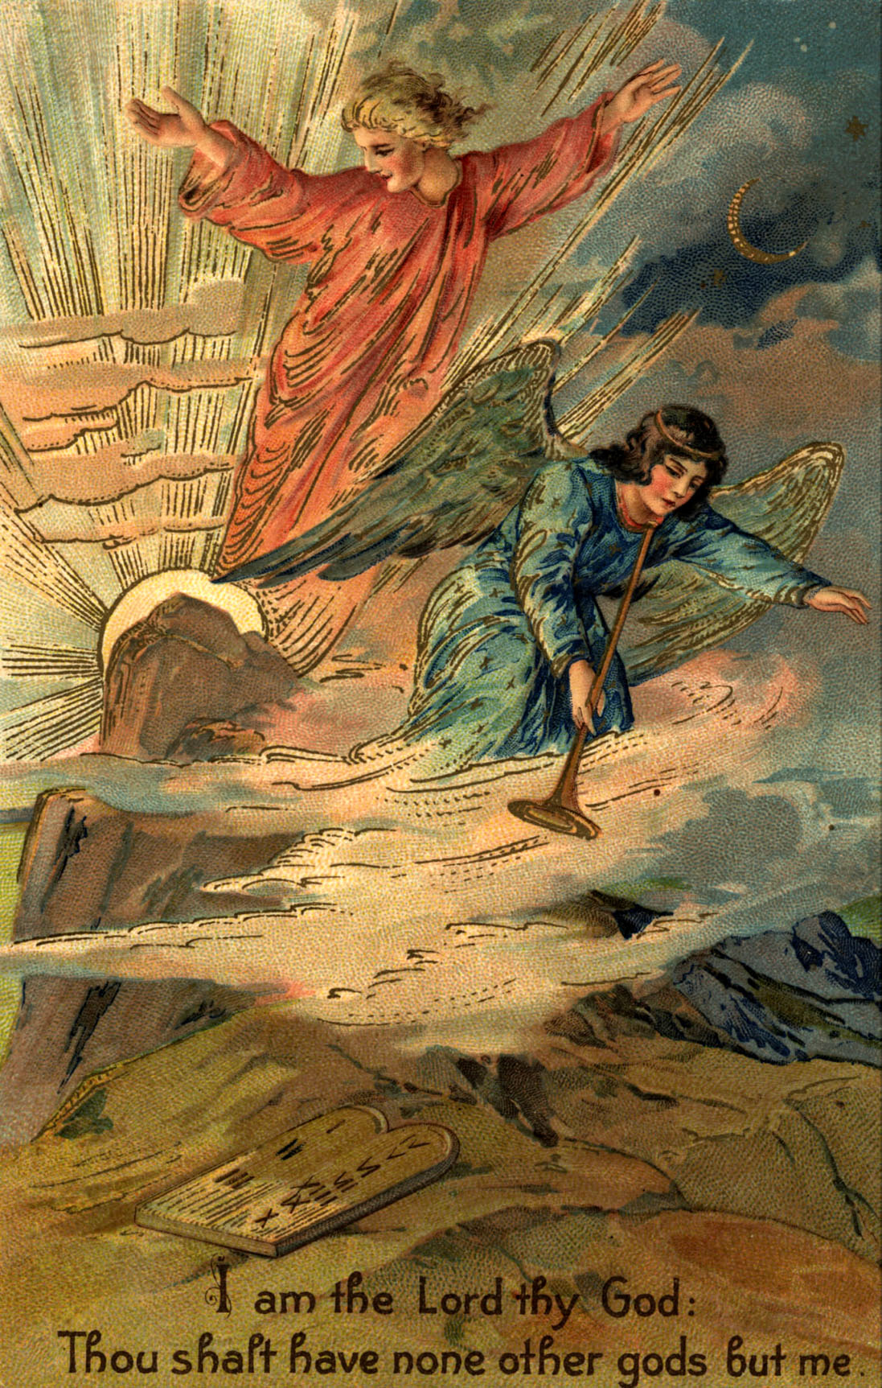
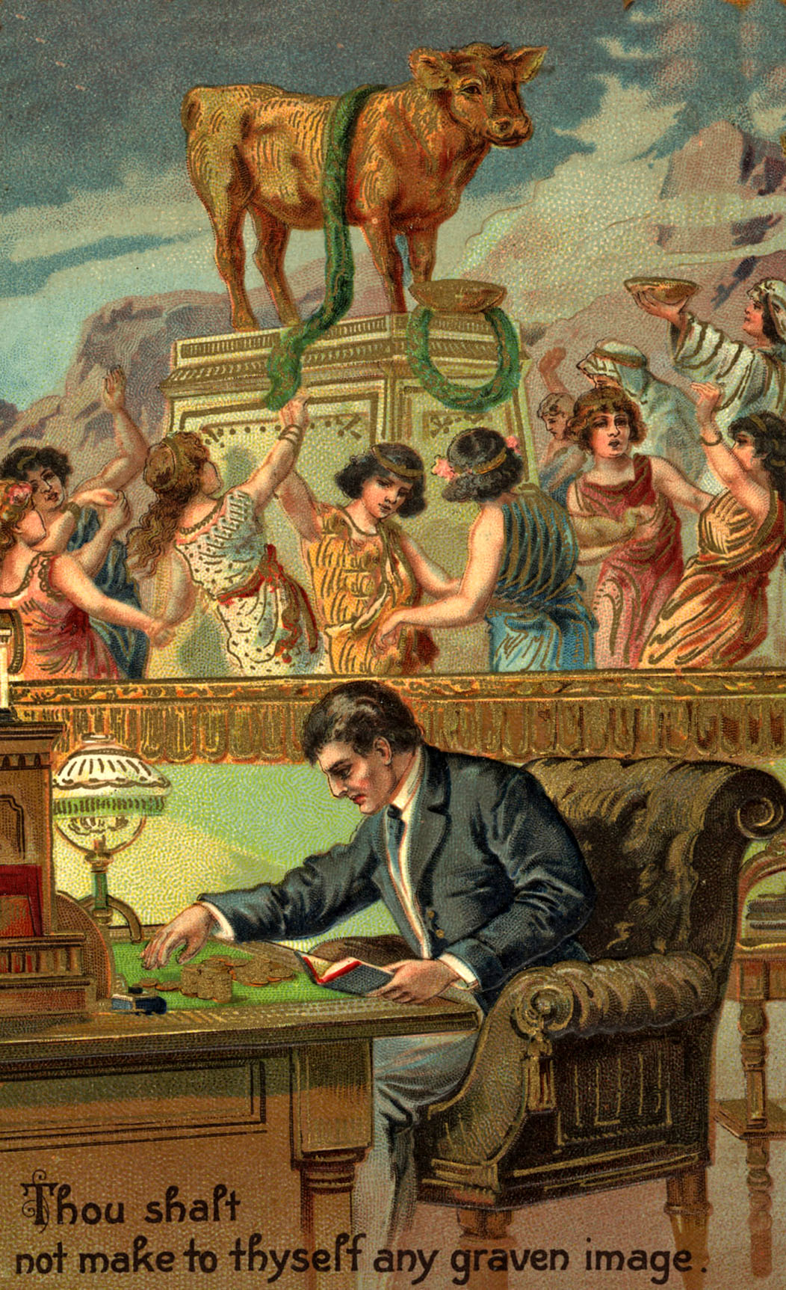

Slide 12
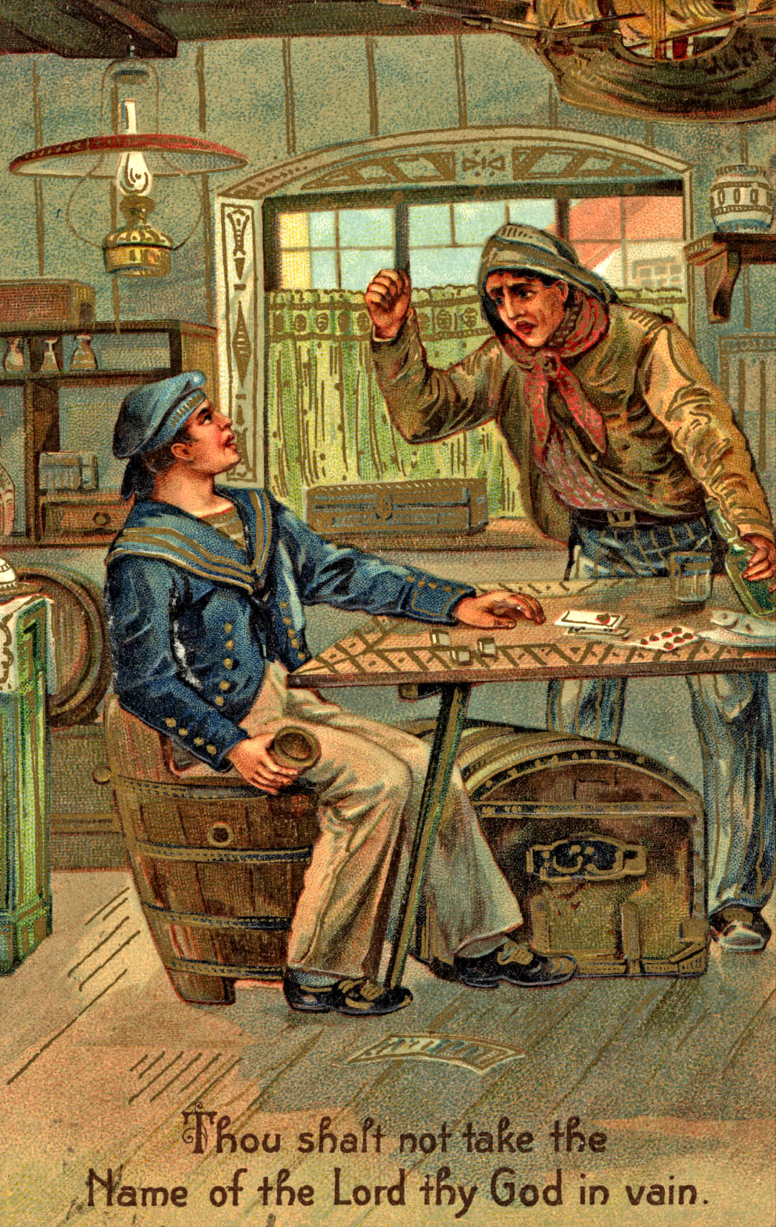
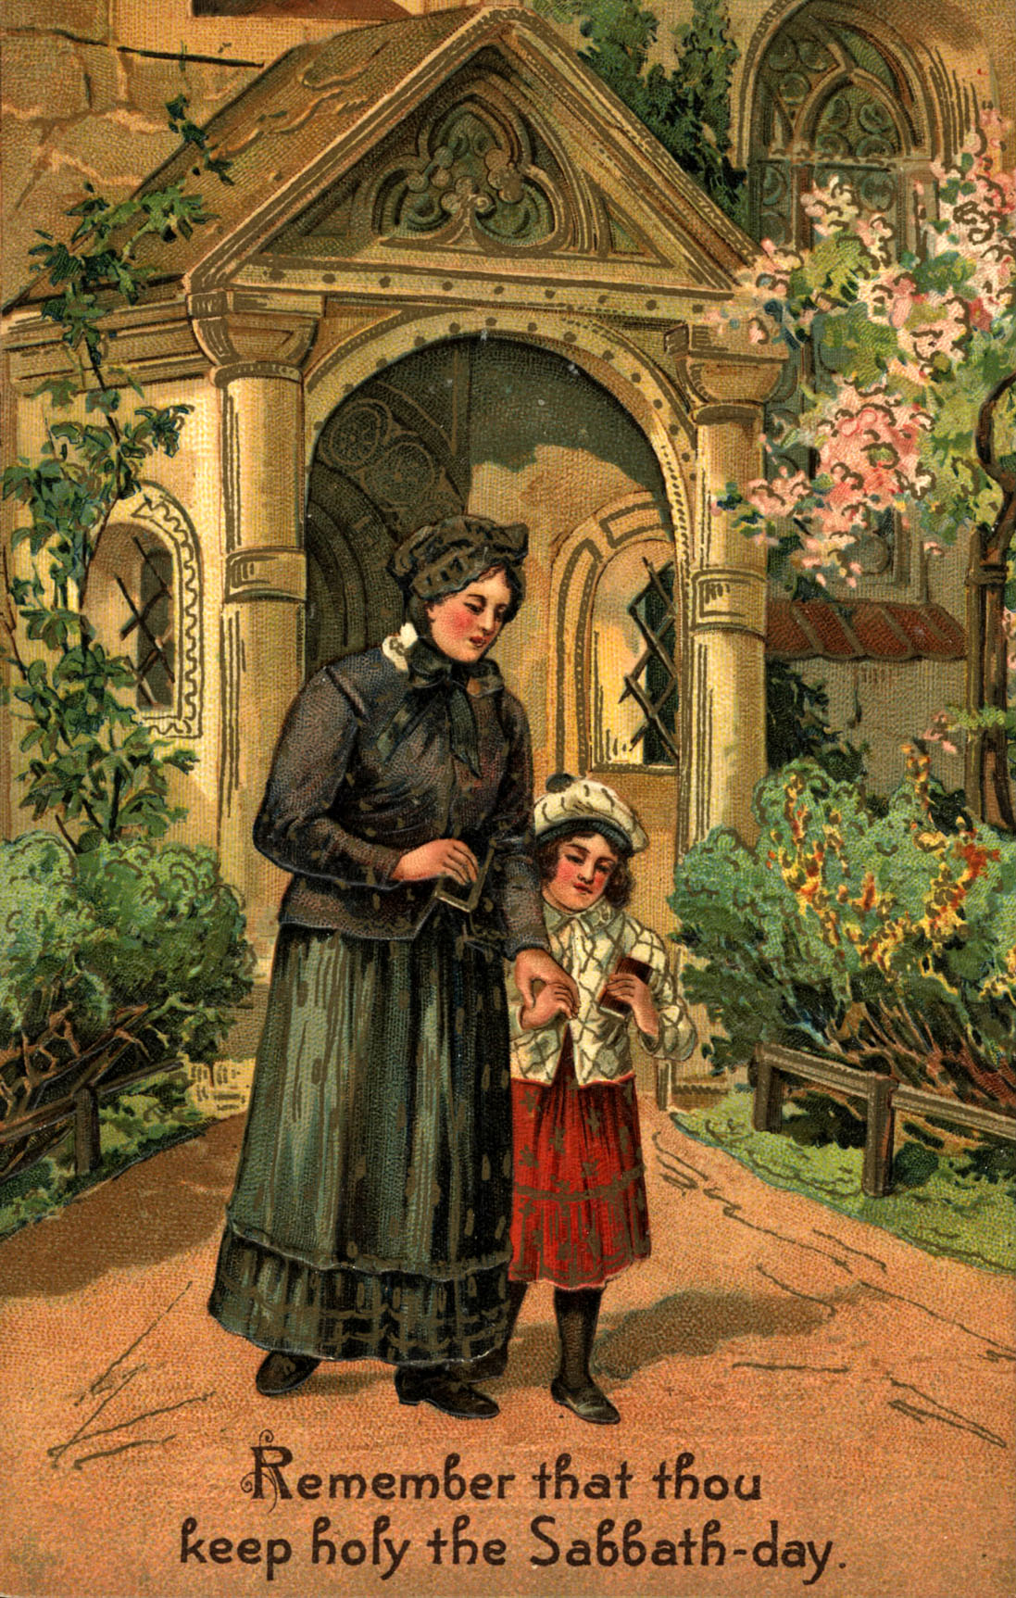

Slide 13
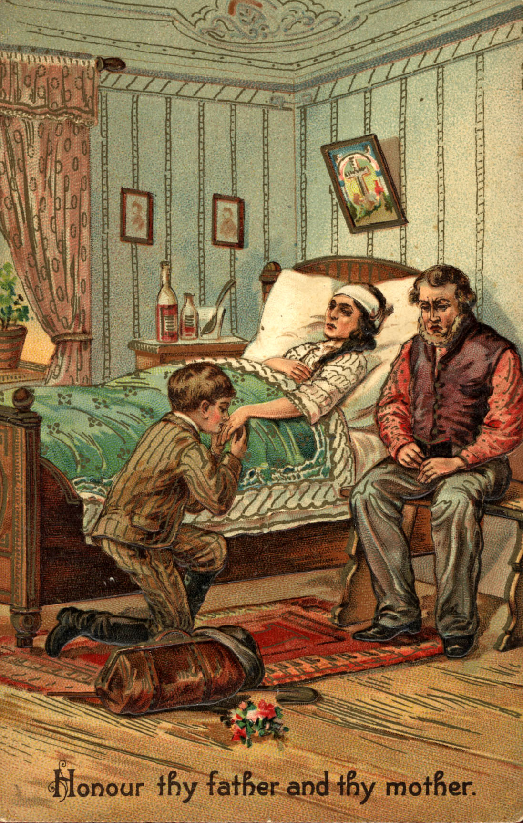
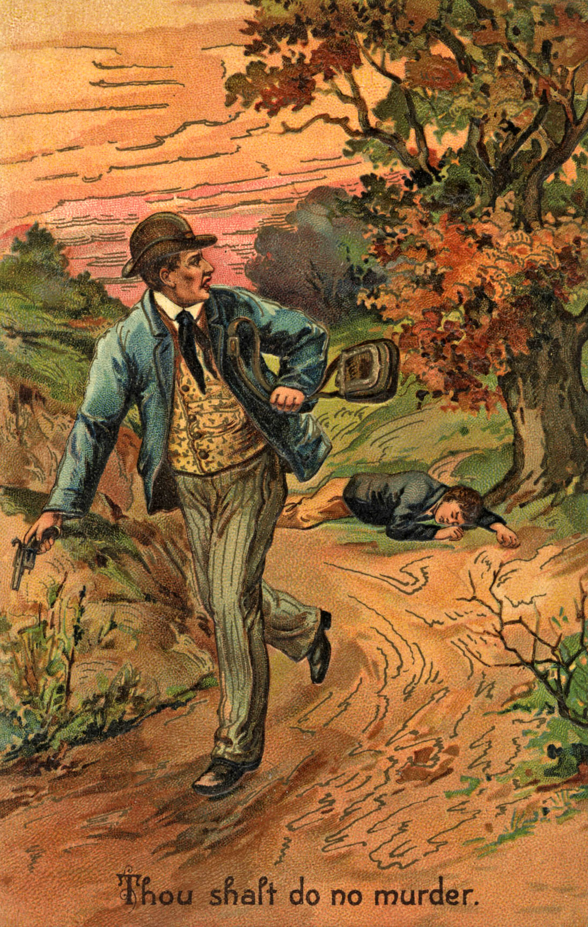

Slide 14
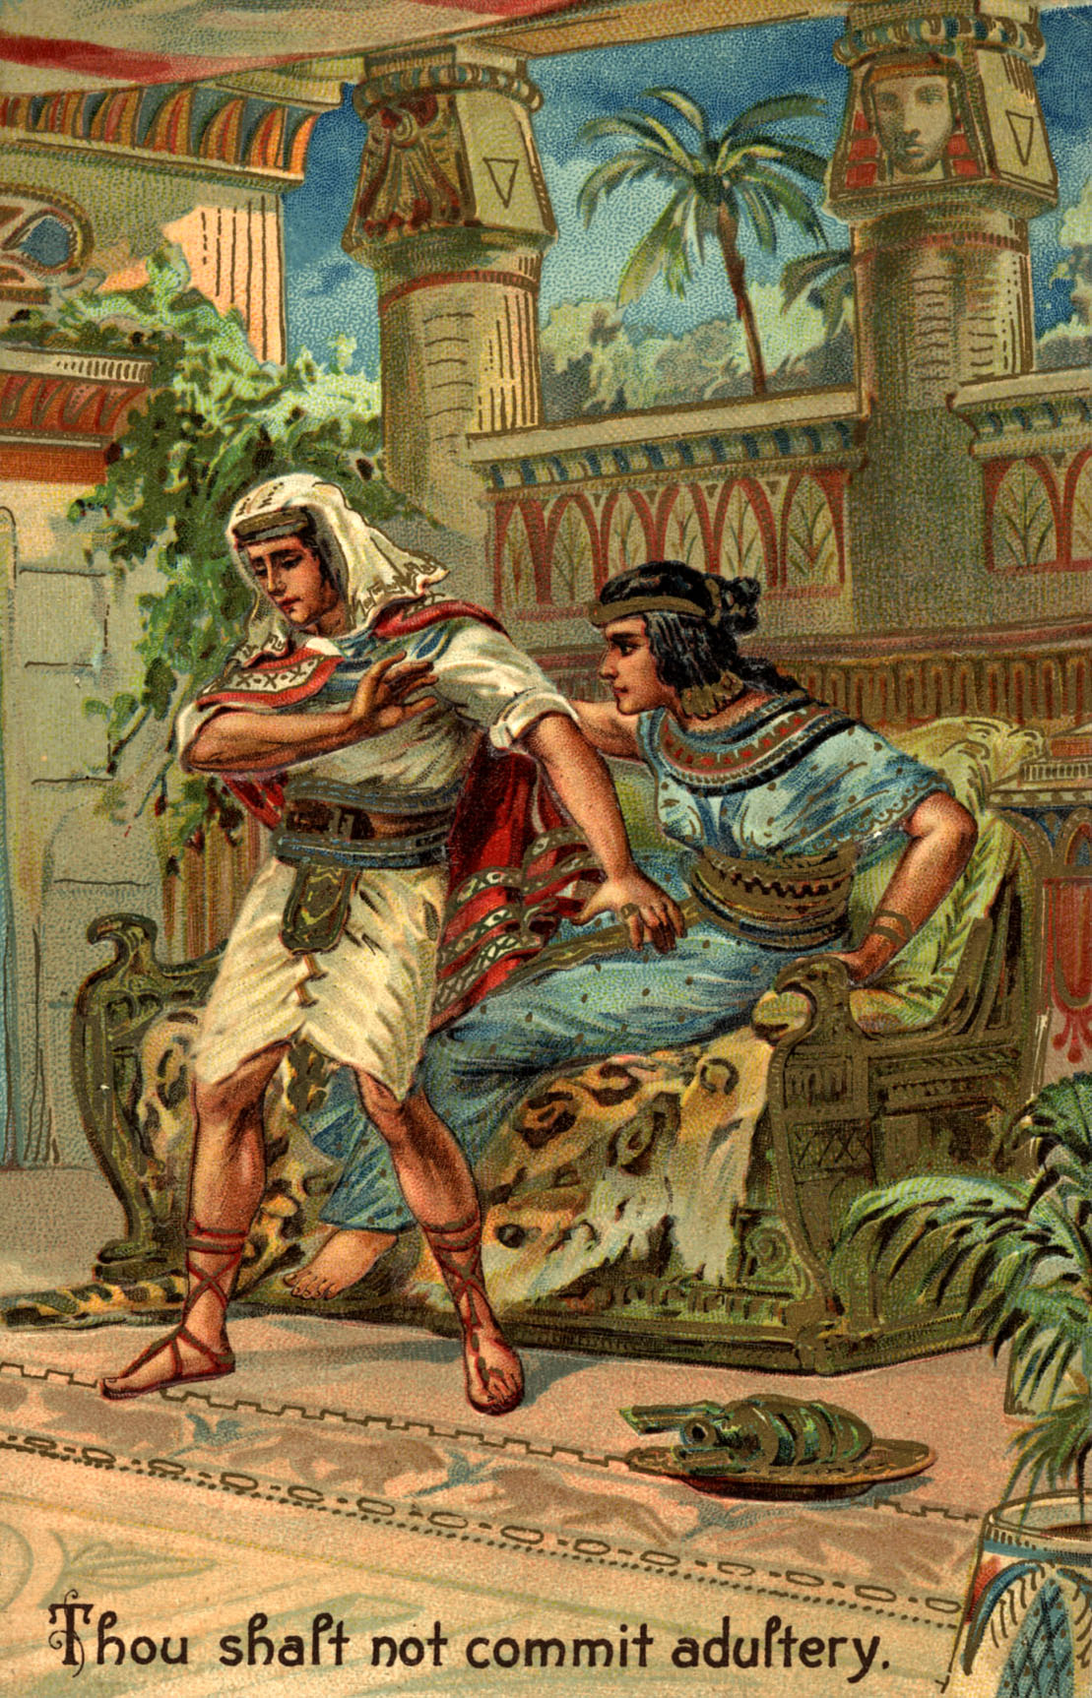
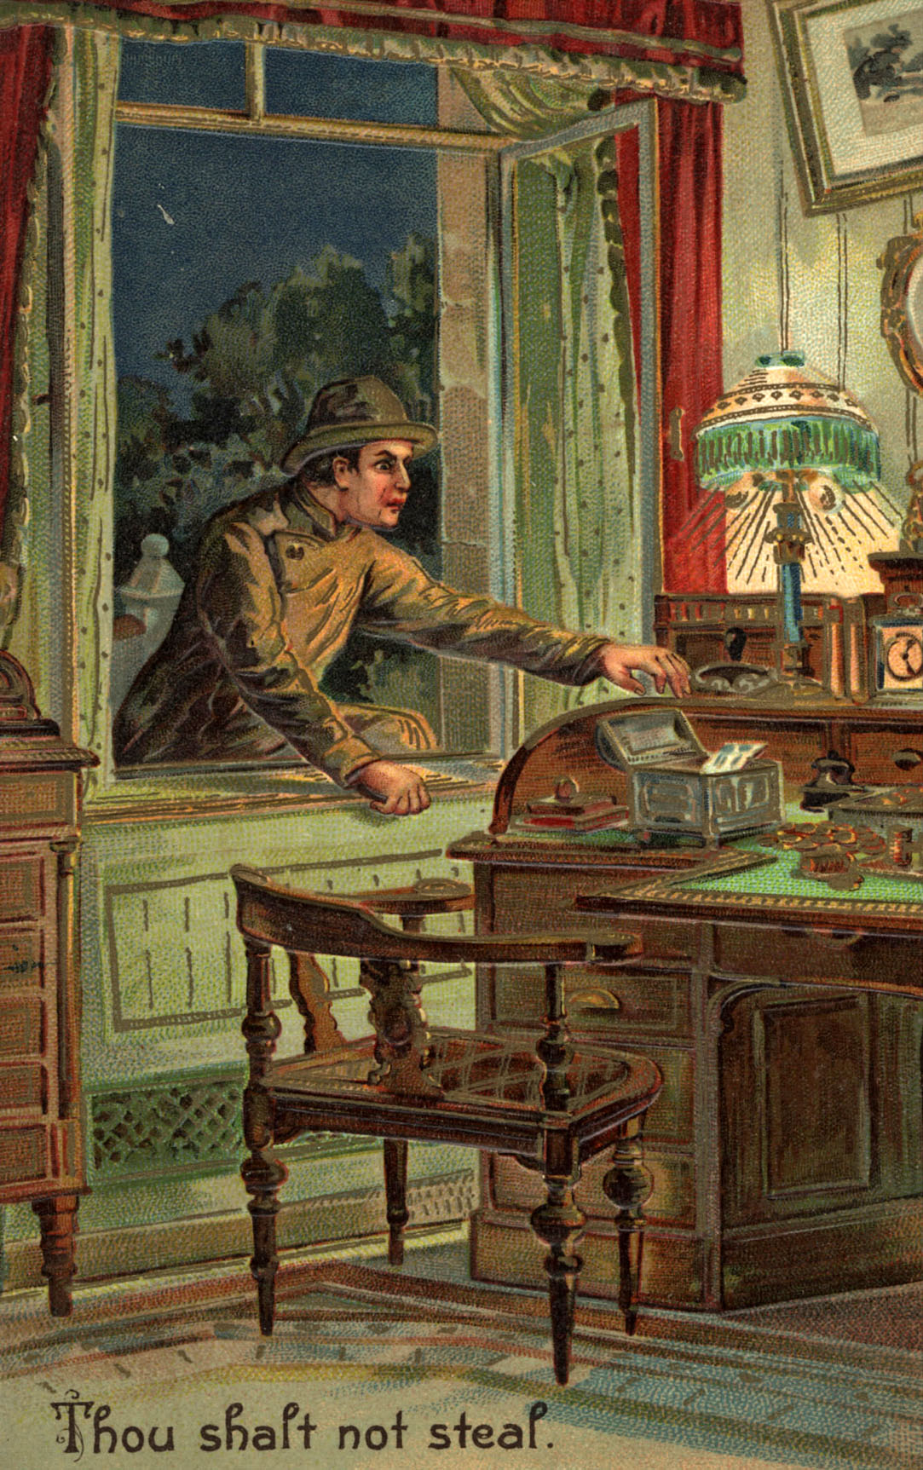

Slide 15
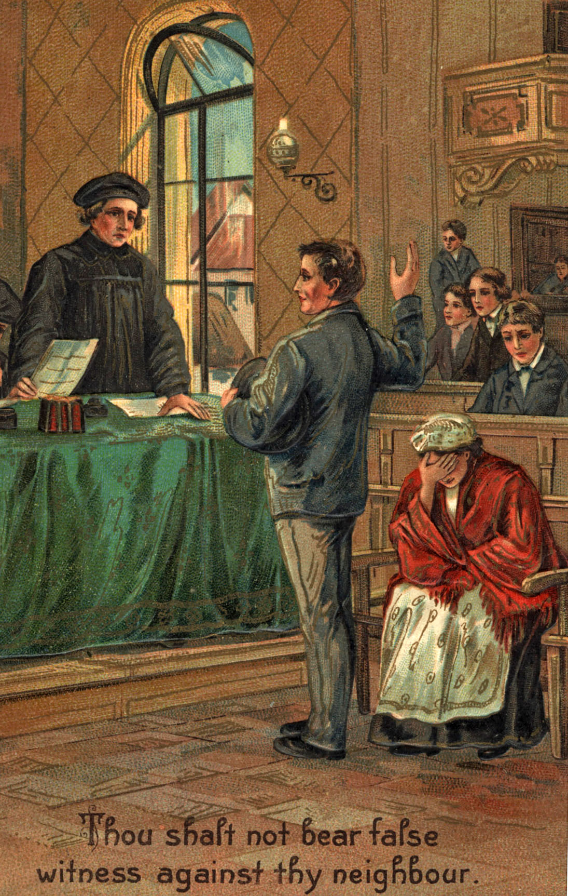
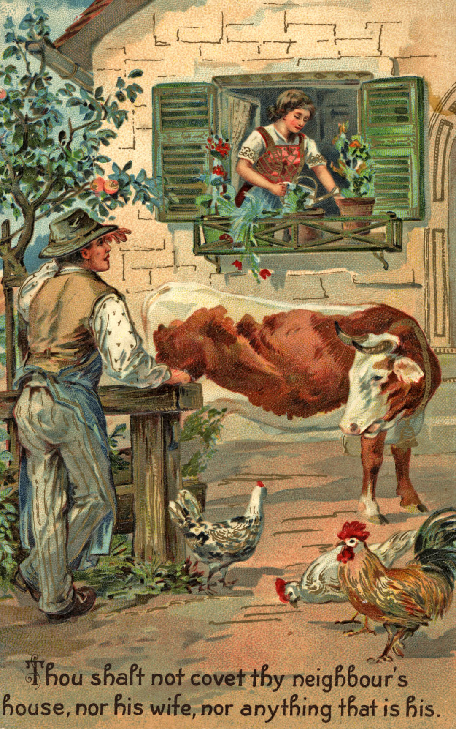

Slide 16
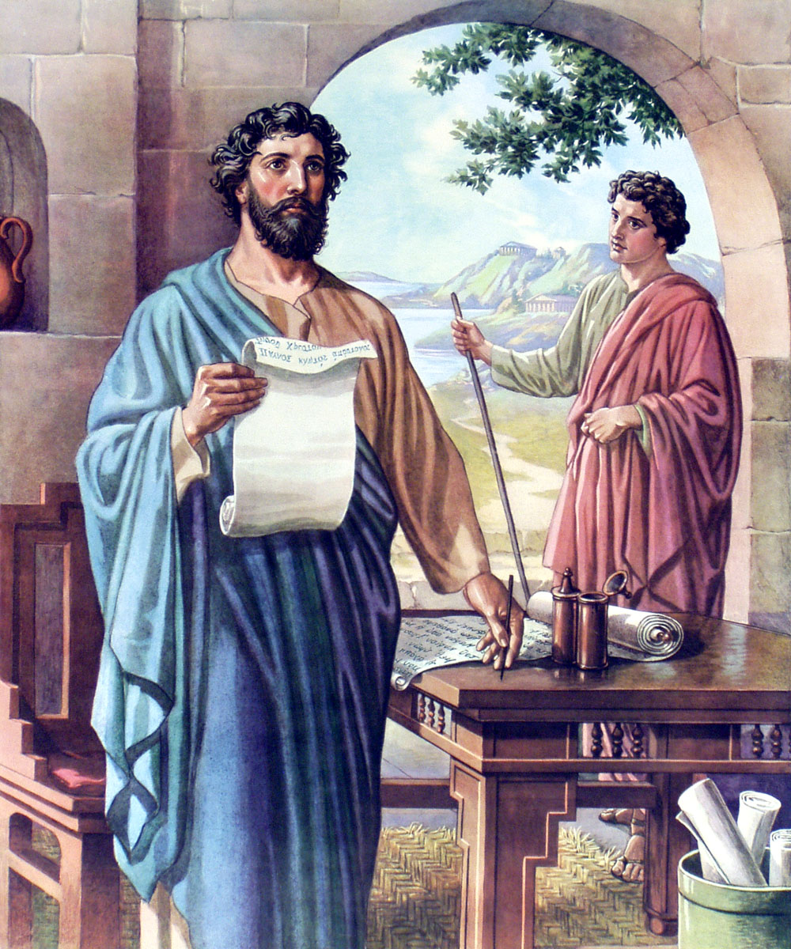
Avoidance List “Teaching us that, denying ungodliness and worldly lusts, we should live soberly, righteously, and godly, in this present world.” (Titus 2:12)
Romans 1:28-31
Galatians 5:19-21
Ephesians 5:1-8

Slide 17
Adherence List “Developing Biblical Standards”
“I press toward the mark for the prize of the high calling of God in Christ Jesus. Let us therefore, as many as be perfect, be thus minded: and if in any thing ye be otherwise minded, God shall reveal even this unto you. Nevertheless, whereto we have already attained, let us walk by the same rule, let us mind the same thing. Brethren, be followers together of me, and mark them which walk so as ye have us for an ensample.” (Philippians 3:14-17)

Slide 19
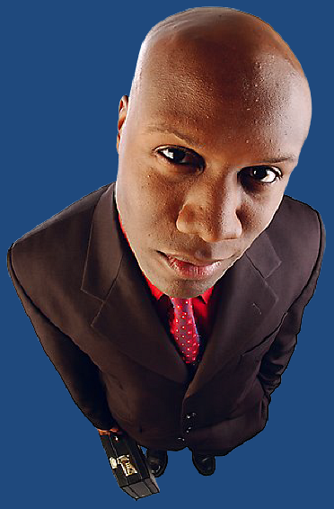
Two Dangers to Avoid “Spiritual Pride”
Developing a critical and condemning spirit towards those who do not hold to Biblical standards –
“I thank thee, that I am not as other men are, extortioners, unjust, adulterers, or even as this publican. I fast twice in the week, I give tithes of all that I possess.” – Luke 18:11

Slide 20
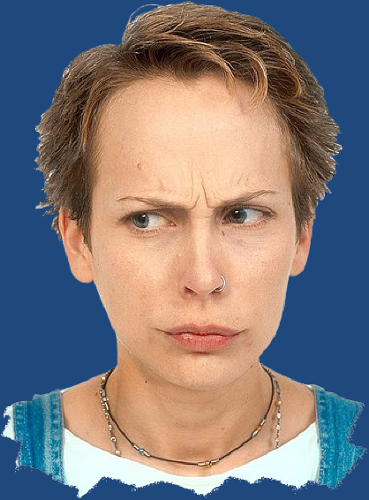
Developing a critical and condemning spirit towards those who do have Biblical standards –
Calling them legalistic -
Becoming very critical of them -
Mocking (making fun) of them -
“Let him eschew evil, and do good; let him seek peace, and ensue it. For the eyes of the Lord are over the righteous, and his ears are open unto their prayers: but the face of the Lord is against them that do evil. And who is he that will harm you, if ye be followers of that which is good?

Slide 21
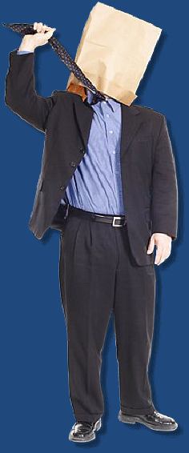
But sanctify the Lord God in your hearts: and be ready always to give an answer to every man that asketh you a reason of the hope that is in you with meekness and fear: Having a good conscience; that, whereas they speak evil of you, as of evildoers, they may be ashamed that falsely accuse your good conversation in Christ. For it is better, if the will of God be so, that ye suffer for well doing than for evil doing…

Slide 22
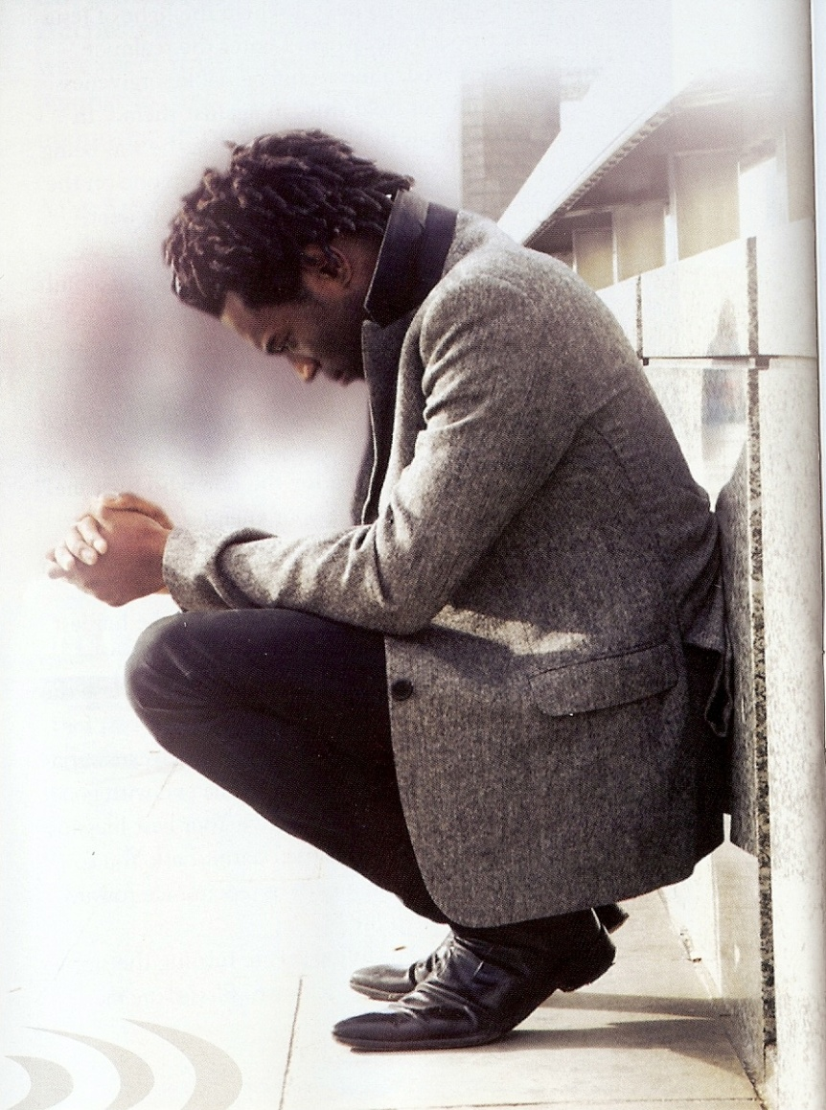
But and if ye suffer for righteousness' sake, happy are ye: and be not afraid of their terror, neither be troubled…Having your conversation honest among the Gentiles: that, whereas they speak against you as evildoers, they may by your good works, which they shall behold, glorify God in the day of visitation.”
(I Peter 3:15-16; 2:12)

Slide 23
The Slipping of Biblical Standards
“Sin is a sin is a monster of such awful mien
As to be hated needs but to be seen;
But seen too often, familiar with face,
We, first endure, then pity, then embrace.”
“Prove all things; hold fast that which is good.” (I Thess. 5:21)
“Remember therefore how thou hast received and heard, and hold fast.” (Rev. 3:3)

Slide 24
Biblical Separation (Ezra 10:8-11; II Corinthians 6:14-7:1)
The word (separation) means = To set or put apart; to divide; to sever; to withdraw from; to come apart; to cease to associate; to divide from the rest; to become disconnected; to place a difference between.
The Word of God makes it very clear that God has called us to live a life of separation - John 17:14-20; I Thessalonians 4:7; James 4:4; I Peter 1:15

Slide 25
1. Is it distinctly forbidden by the Lord?
I Timothy 5:22
2. Is there any appearance of evil?
I Thessalonians 5:21-23
3. Is there any way this activity can glorify God?
I Corinthians 10:31
4. Is it of the world? I John 2:15-17
5. Would the Lord Jesus have participated in it?
I Peter 2:21-22

Slide 26
6. Can you be free to do it when you remember that God the Holy Spirit dwells within you? Ephesians 4:30
Would you like to be found doing it when the Lord returns? I John 2:18-3:4
Is it fitting conduct for a child of God? Ephesians 4:1
9. What effect will my participation or conduct have on others around me?

Slide 27
Will it be a good example? - Philippians 3:15-2; I Timothy 4:12
Will it bring the lost to Christ? - I Peter 2:11-12; 3:15-17
Will it cause another Christian to stumble? - Romans 14:13; I Corinthians 10:32-33
10. Is there any doubt in my mind about it?
Romans 14:23

Slide 28
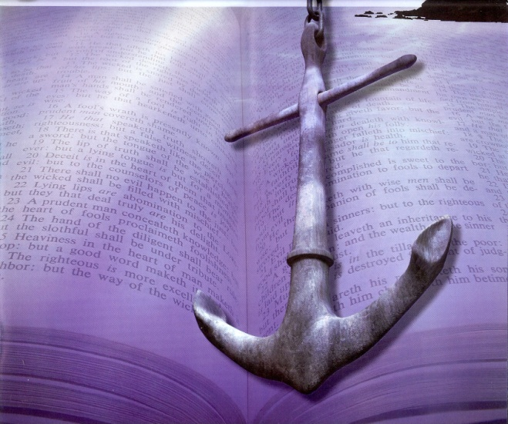
Sinful “Worldliness” (I John 2:15)
Revival

Slide 29
“Furthermore then we beseech you, brethren, and exhort you by the Lord Jesus, that as ye have received of us how ye ought to walk and to please God, so ye would abound more and more. For ye know what commandments we gave you by the Lord Jesus. For this is the will of God, even your sanctification, that ye should abstain from fornication: That every one of you should know how to possess his vessel in sanctification and honour; Not in the lust of concupiscence, even as the Gentiles which know not God: That no man go beyond and defraud his brother in any matter: because that the Lord is the avenger of all such, as we also have forewarned you and testified. For God hath not called us unto uncleanness, but unto holiness. He therefore that despiseth, despiseth not man, but God, who hath also given unto us his holy Spirit.” (I Thess. 4:1-8)

Slide 30
Dress Standards
GOD’S STANDARD
Modest Dress
(I Timothy 2:9)
Adequate Dress
(Genesis 3:21)
Appropriate Dress
(I Corinthians 6:19-20)
SATAN’S STANDARD
Sensual Dress
(Proverbs 7:10)
Sloppy Dress
(Proverbs 24:30)
Wrong Symbolism
(I John 2:15-17)

Slide 31
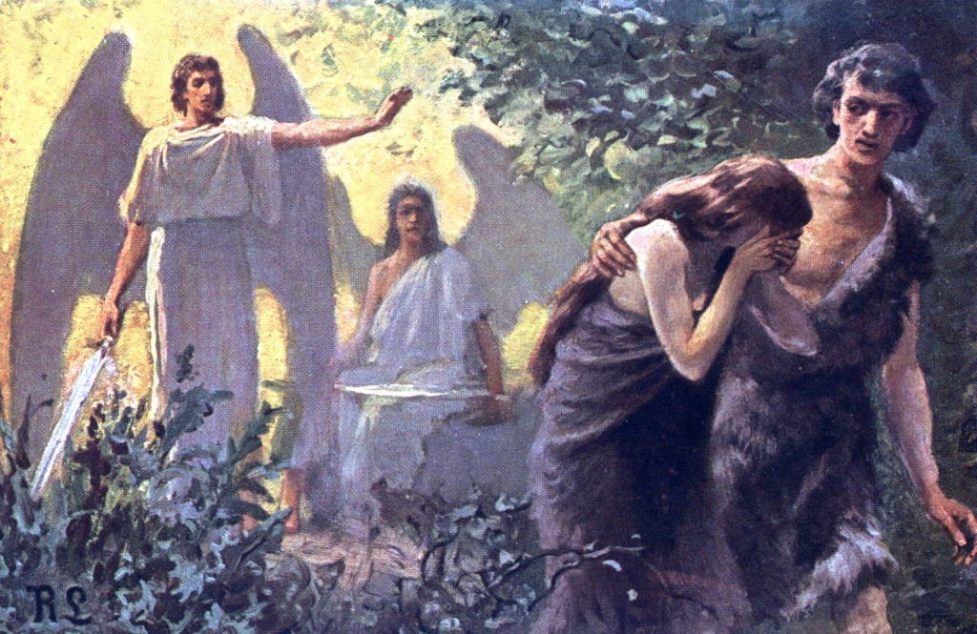
God designed clothing with modesty in mind – Gen. 3:21
The Hebrew word for “Coats” according to Wilson’s Old Testament word studies means - a garment with sleeves, covering the entire body from the neck to below the knees, seldom to the ankles.
Modest dress draws attention to the face or countenance not the body!

Slide 32
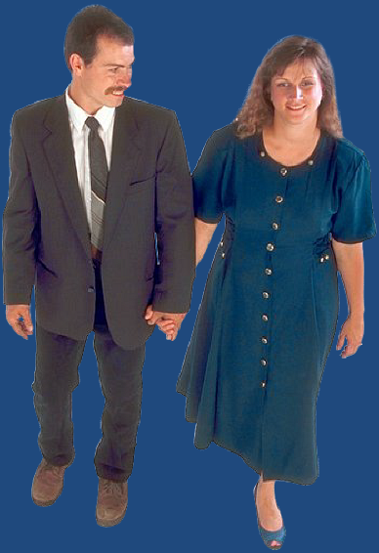
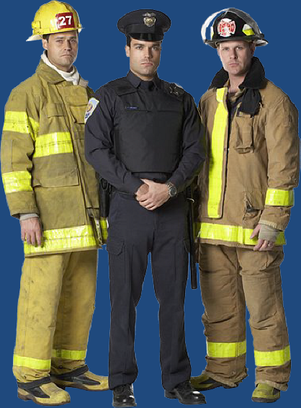
God’s Design for Clothing
Protection
Office
Modesty
Distinction

Slide 33
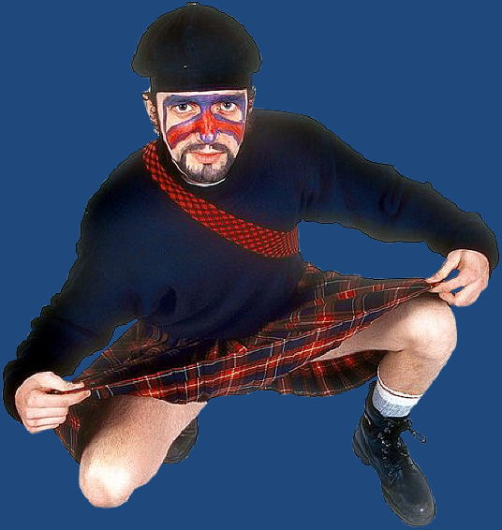
“The woman shall not wear that which pertaineth unto a man neither shall a man put on a woman’s garment: for all that do so are an abomination unto the Lord…”
(Deut. 22:5)

Slide 34
What Falls into the Biblical Category of an Abomination?
“Were they ashamed when they had committed abominations? Nay, they were not at all ashamed, neither could they blush.” (Jeremiah 6:15)
Homosexuality
Worship of false gods
Worship of Idols
The froward (a deceitful, perverse and crooked person)
One who soweth discord among brethren

Slide 35
Turning away your ear from hearing the Law
Worshiping God according to the commandments of men and religious traditions
Witchcraft / Sorcery / All forms of Occult practices
All forms of sexual immorality
Wickedness and unrighteousness
Proud heart
False balance
Lying tongue
Scorner
Abomination (69) Abominations (74)

Slide 36
Rebellion
“Sexual Revolution”
Abandonment of Traditional Christian Values
Feminist Movement
Homosexual
(I Samuel 15:23)
Unisex

Slide 37
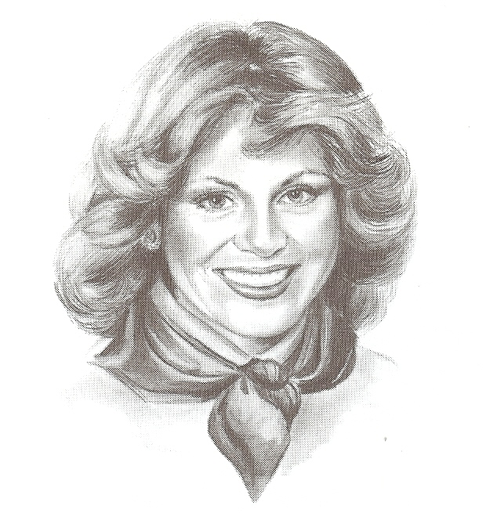
Things that Draw Attention to the Countenance
Hair style -
“But if a woman have long hair, it is a glory to her: for her hair is give her for a covering.” I Corinthians 11:15
Earrings
Bows
Scarves
Short necklace
Pins
Flower
Loose fitting clothes

Slide 38
What Draws the Attention of Men’s Eyes to a Woman’s Body? (I Peter 3:1-4)
Short dresses
Low necklines
Sheer fabrics
Open slits
Form fitting pants
Tight fitting shirts
Tight fitting dresses
Words on shirts
Color placement
Excessive dress

Slide 39
I Timothy 2:9-10
“I will...in like manner also, that women (adult women) adorn themselves in modest apparel, with shamefacedness (decency - modesty which is rooted in moral excellence) and sobriety (propriety, proper - sound judgment. Sobriety is the habitual inner self-government on all passions and desires which would arouse temptation).”

Slide 40
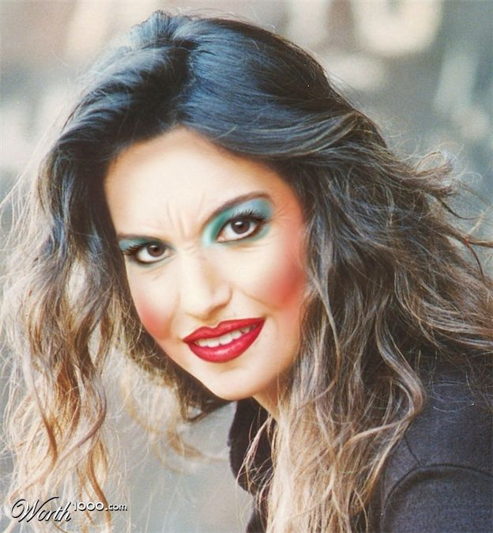
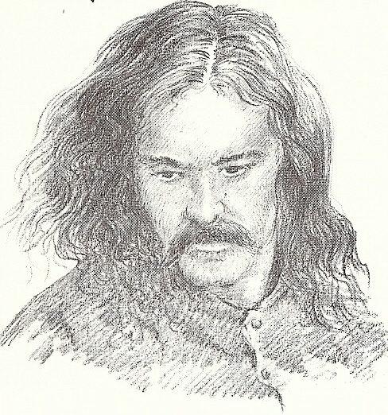
Appropriate Dress in Church “House of God / House of the Lord”
“That thou mayest know how thou oughtest to behave thyself in the house of God, which is the church of the living God, the pillar and ground of the truth.” I Tim. 3:15
Dress effects attitude
Dress reflects attitude
Dress must be appropriate and respectful
Dress must not be worldly
Dress must not be defrauding

Slide 41
Things We Allow to Slip in Our Lives
Version of the Bible
Entertainment
Music
TV watching
Computer usage
Video games
Friendships
Relationships
Good work ethic
Health care/Diet
Dating relationships
Bible reading
Prayer life
Daily confession
Church attendance
Church involvement
Giving
Witnessing
Standards

Slide 42
“Therefore we ought to give the more earnest heed to the things which we have heard, lest at any time we should let them slip.” (Hebrews 2:1)

Slide 43
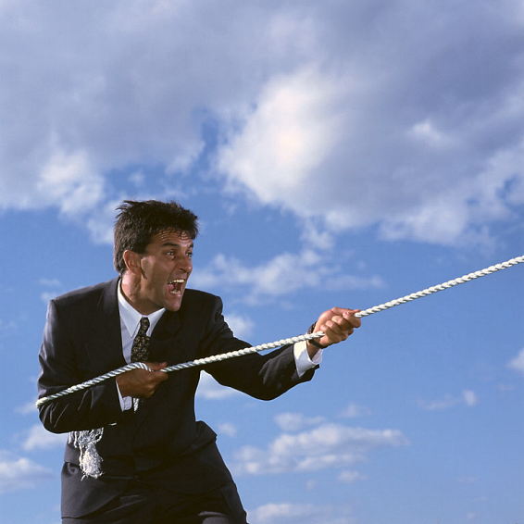
“Therefore, my beloved brethren, be ye
steadfast, unmovable...” (I Cor. 15:58)
“Hold fast till I come.” (Rev. 2:25)

