Slide 1
The Doctrine of the Holy Spirit
(The Symbols of the Holy Spirit)
Part 4

Slide 3
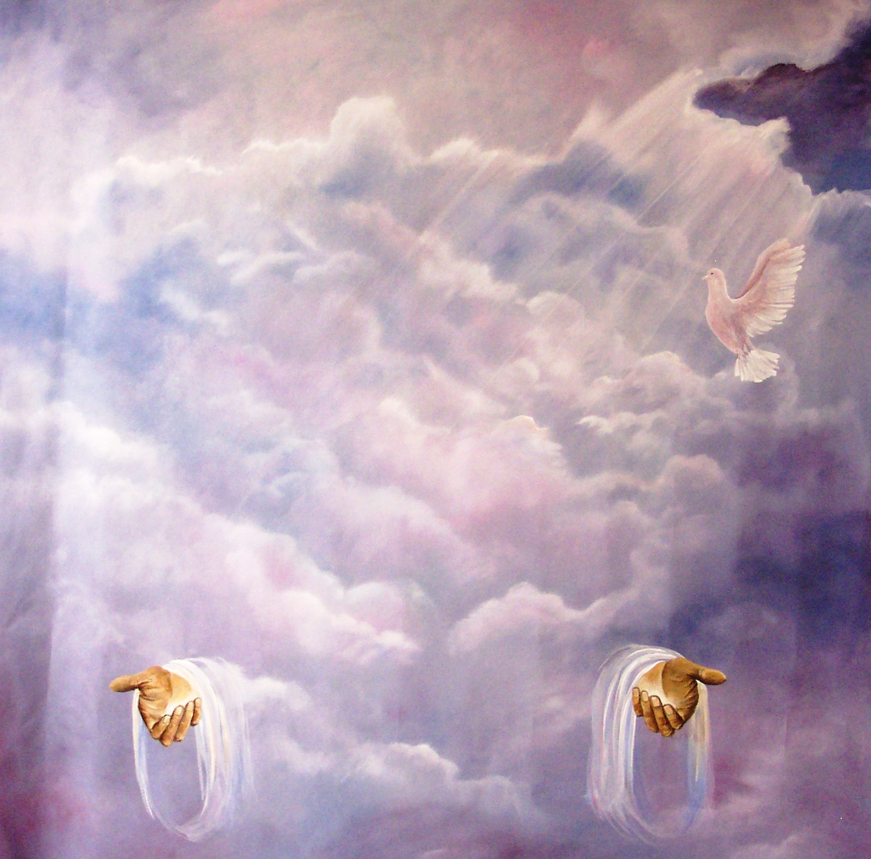
“Then Peter said unto them, Repent, and be baptized every one of you in the name of Jesus Christ for the remission of sins, and ye shall receive the gift of the Holy Ghost.” (Acts2:38)

Slide 4
In the New Testament alone there are some 261 passages which refer to the Holy Spirit. He is mentioned 56 times in the Gospels, 57 times in the book of Acts, 112 times in the Pauline epistles, and 36 times in the remaining New Testament. Total = 522

Slide 6
Because the Holy Spirit is Person you can have a personal relationship with him
Romans 8:14 “For as many as are led by the Spirit of God, they are the sons of God.”

Slide 8
I John 5:7-8 “For there are three that bear record in heaven, the Father, the Word, and the Holy Ghost: and these three are one. And there are three that bear witness in earth, the Spirit, and the water, and the blood: and these three agree in one.”

Slide 9
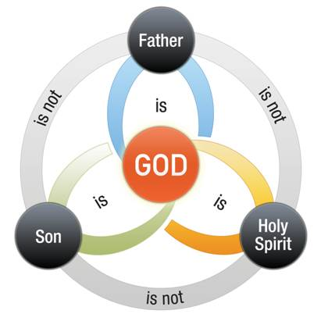

Slide 11
Spirit of God
Spirit of Christ
Eternal Spirit
Spirit of Truth
Spirit of Grace
Spirit of Glory
Spirit of Life
Spirit of Wisdom and Revelation
Spirit of Comfort
Spirit of Promise
Spirit of Holiness
Spirit of Adoption
Holy Ghost
Seven Spirits of God

Slide 12
The symbols of the Holy Spirit become essential to our gaining an understanding of who He is, what He’s like and His ministry in our lives, the Church
and the World.

Slide 13
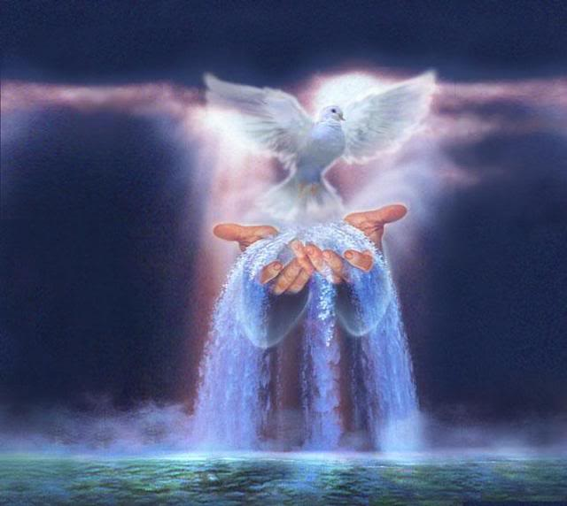
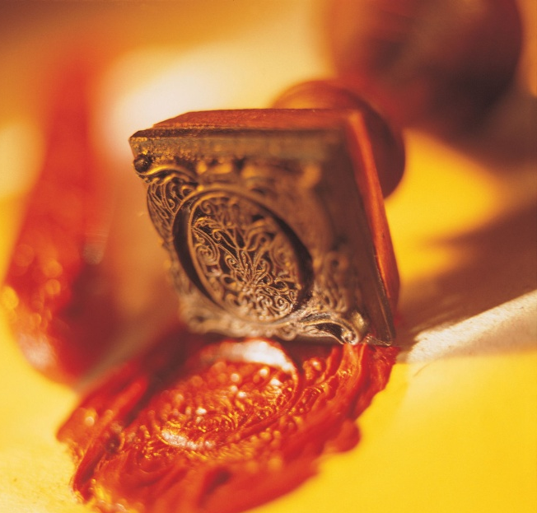
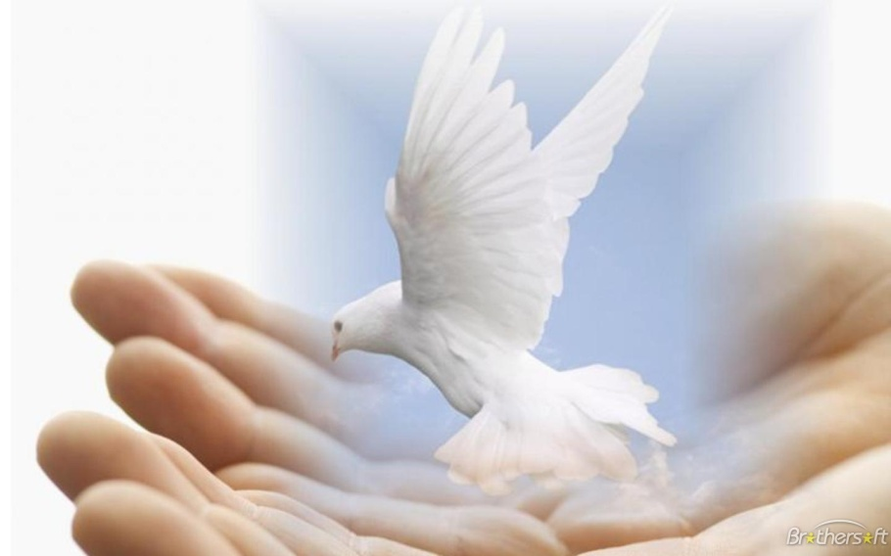
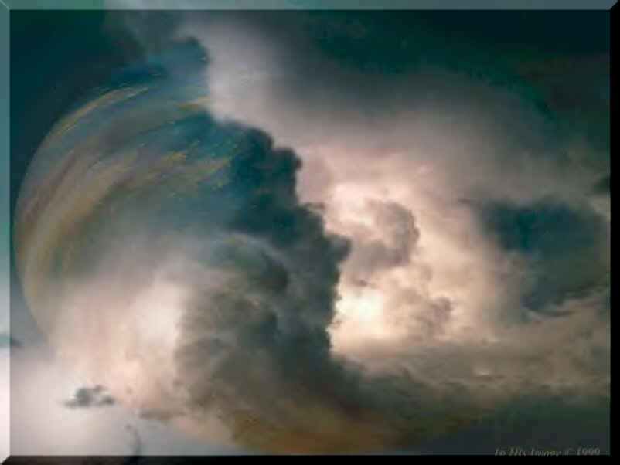
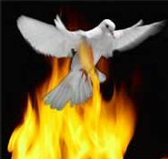

Slide 14
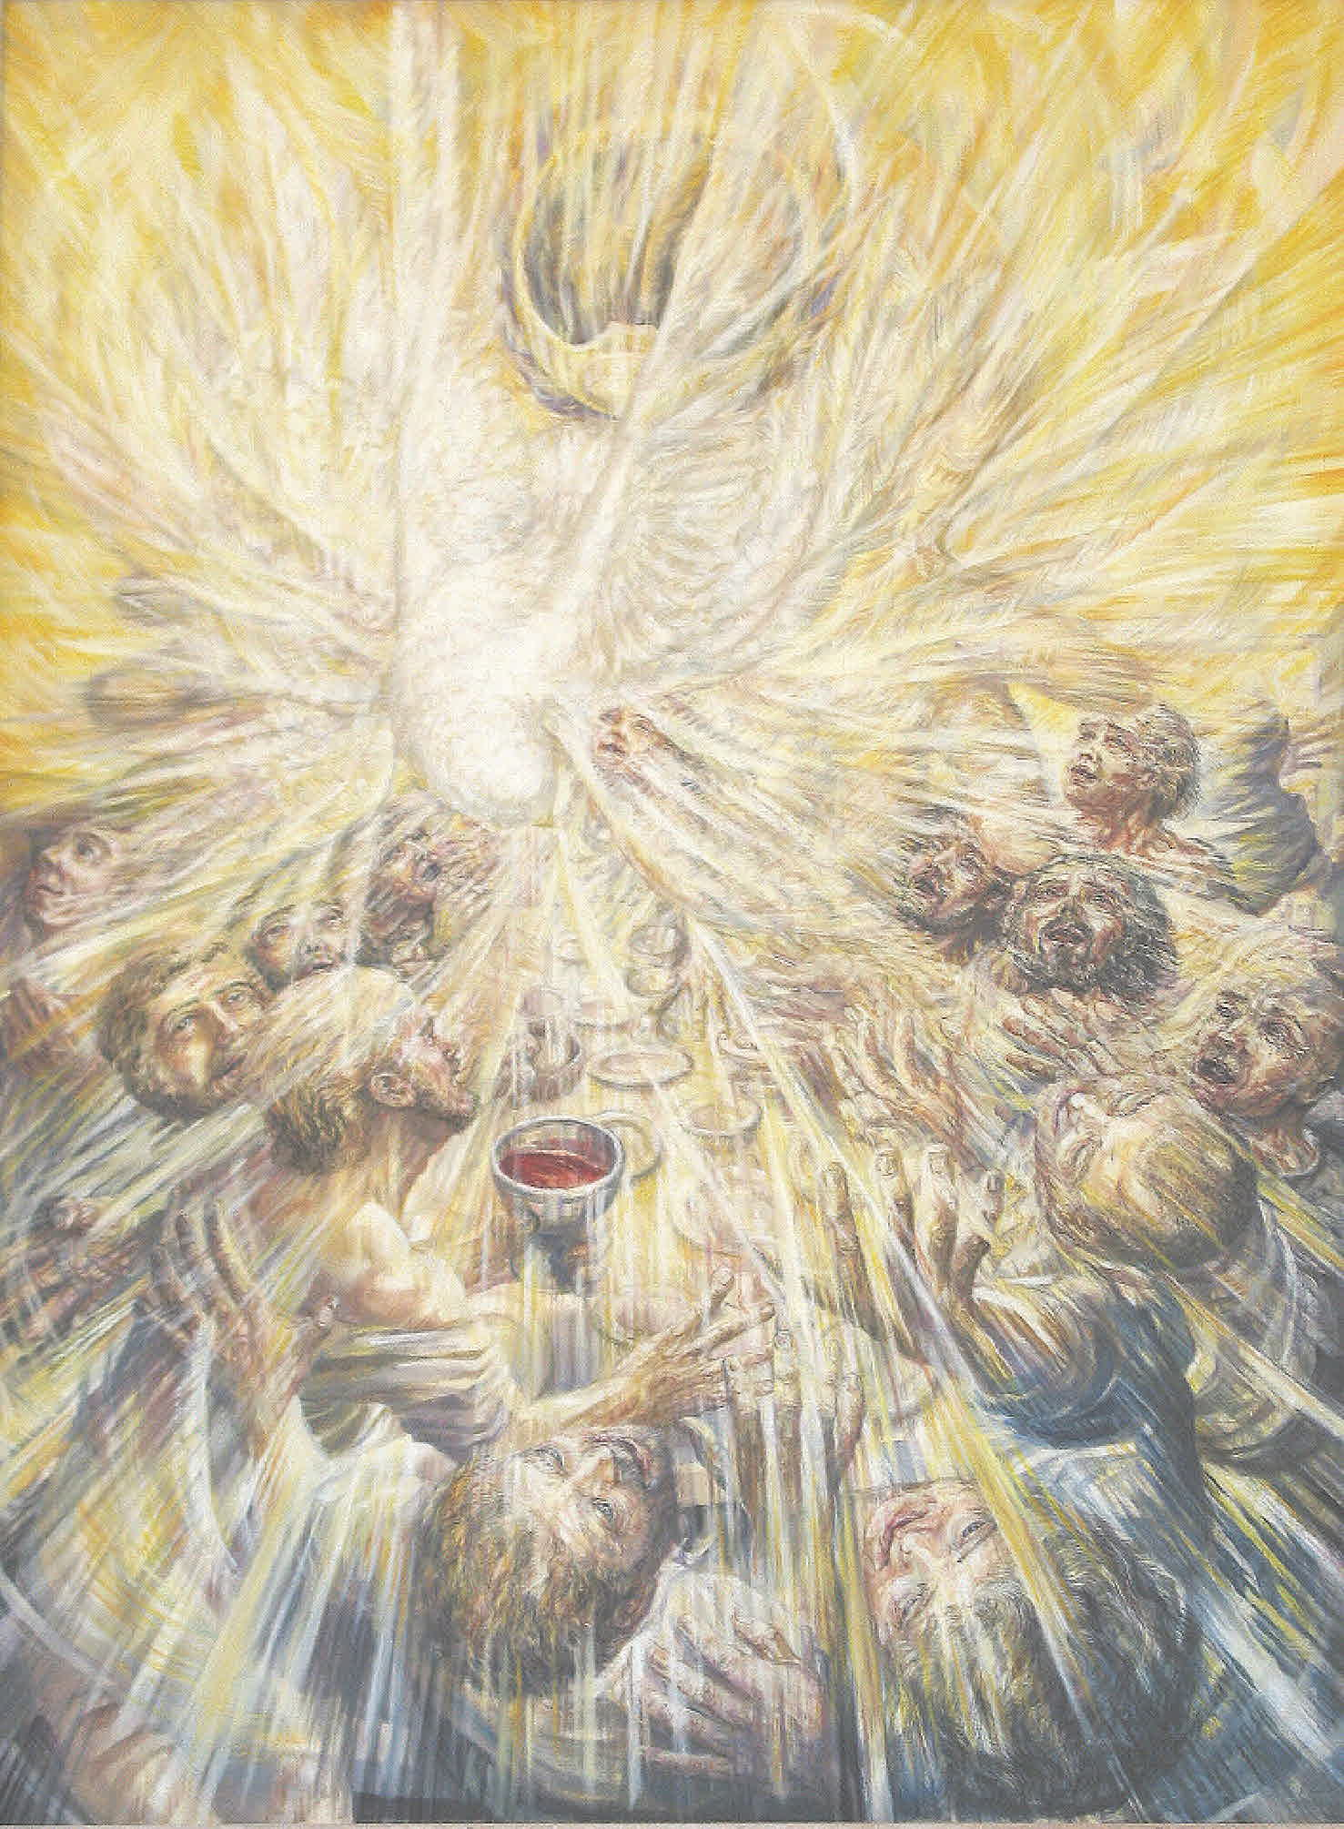
Tonight’s Message
The Holy Spirit
as Wind
“And suddenly there came a sound from heaven as of a rushing mighty wind, and it filled all the house where they were sitting.”
(Acts 2:2)

Slide 15
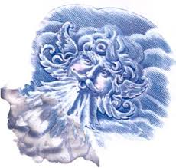
Wind
Indicating unseen power.
"The wind bloweth where it listeth, and thou hearest the sound thereof, but canst not tell whence it cometh, and whither it goeth: so is every one that is born of the Spirit" (John 3:8)
"And when the day of Pentecost was fully come, they were all with one accord in one place. And suddenly there came a sound from heaven as of a rushing mighty wind, and it filled all the house where they were sitting" (Acts 2:1-2)

Slide 16
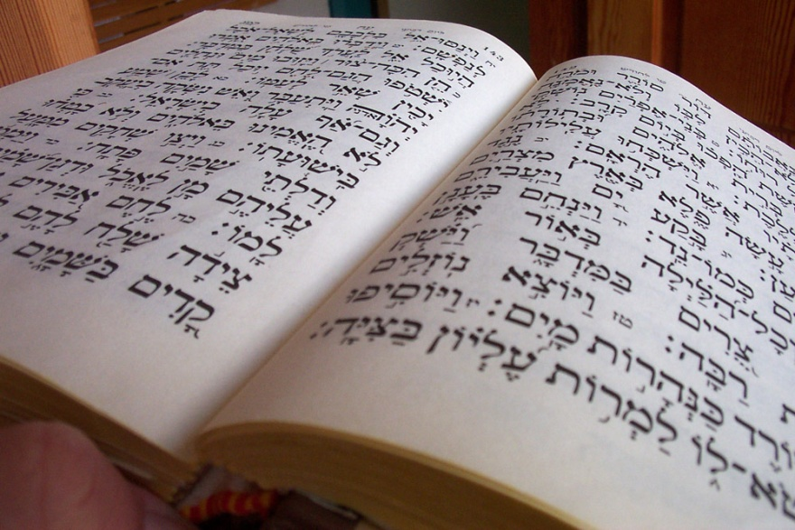
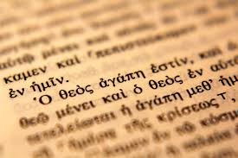
The word spirit in both Hebrew and Greek means “breath” or “wind.” Both breath and wind are appropriate images for the Holy Spirit.

Slide 17
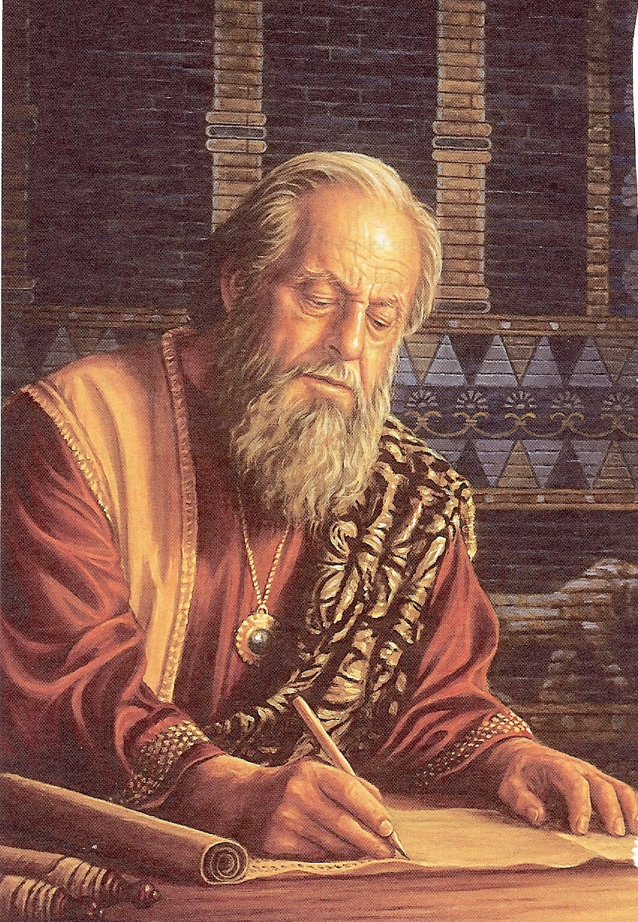
Inspiration
“We have also a more sure word of prophecy…Knowing this first, that no prophecy of the scripture is of any private interpretation. For the prophecy came not in old time by the will of man: but holy men of God spake as they were moved by the Holy Ghost.

Slide 18
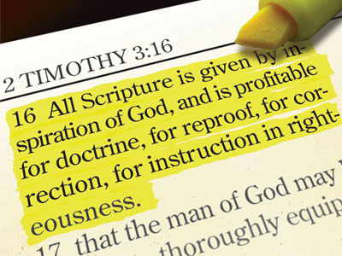
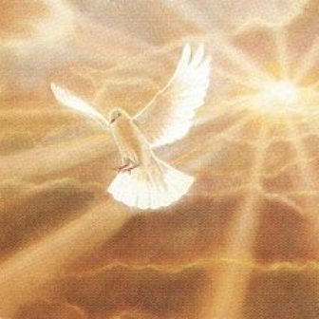
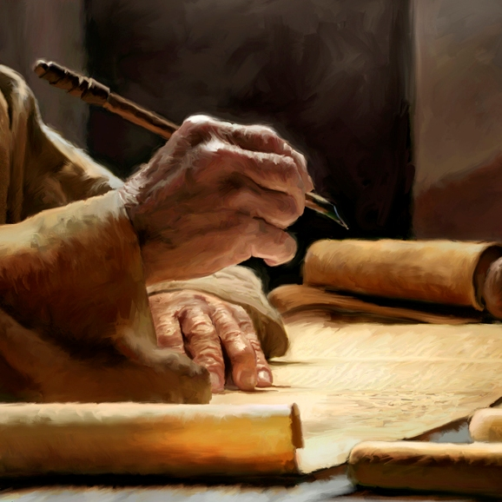

Slide 19
Inspiration literally, it means “God-breathed” and expresses the concept of exhalation by God. More accurately, it emphasizes that Scripture is the product of the breath of God. The Scriptures are not something breathed into by God, rather, the Scriptures have been breathed out by God.

Slide 20
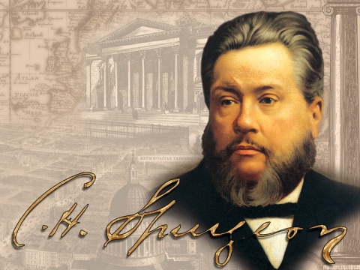
Spurgeon
“The Bible is the writing of the living God: Each letter was penned with an Almighty finger; each word in it dropped from the everlasting lips; each sentence was dictated by the Holy Spirit…”

Slide 22
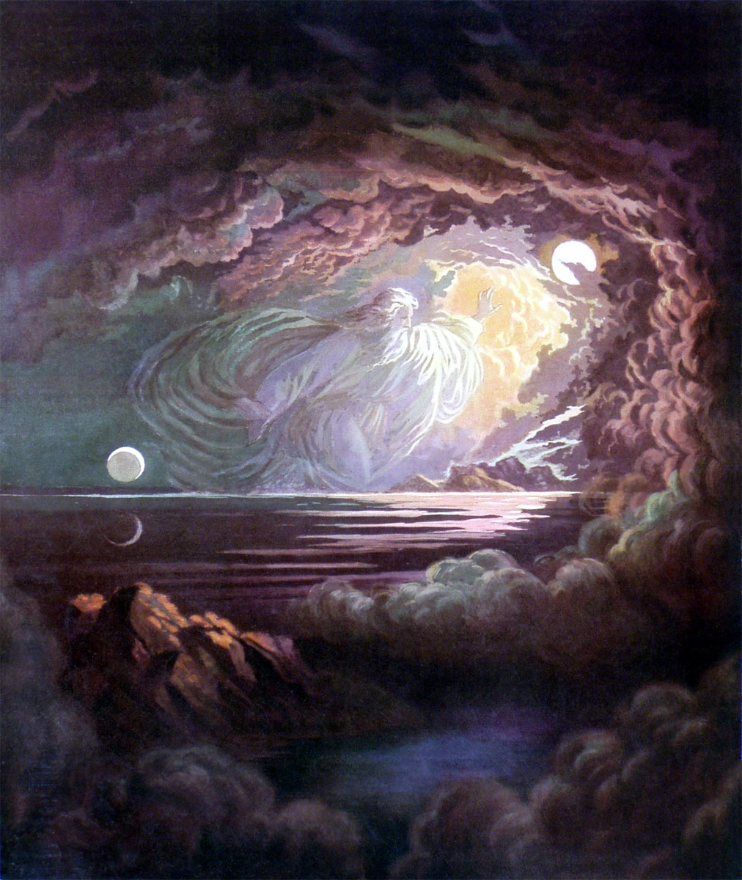
Creation

Slide 23
Wind is the first representation of
God’s Spirit found in the Bible:
“In the beginning God created the heavens and the earth. And the earth was without form, and void; and darkness was upon the face of the deep. And the spirit of God moved upon the face of the waters.”
(Genesis 1:1-2)

Slide 24
Gen. 2:7 “And the LORD God formed man of the dust of the ground, and breathed into his nostrils the breath of life; and man became a living soul.”
Gen. 6:17 “And, behold, I, even I, do bring a flood of waters upon the earth, to destroy all flesh, wherein is the breath of life, from under heaven; and every thing that is in the earth shall die.”
Gen. 7:15 “And they went in unto Noah into the ark, two and two of all flesh, wherein is the breath of life.”
Gen. 7:22 “All in whose nostrils was the breath of life.”

Slide 25
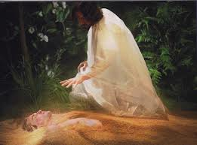

Slide 26
Job 12:10 “In whose hand is the soul of every living thing, and the breath of all mankind.”
Job 33:4 “The Spirit of God hath made me, and the breath of the Almighty hath given me life.”
Psalm 33:6 “By the word of the LORD were the heavens made; and all the host of them by the breath of his mouth.”
Isa 42:5 “Thus saith God the LORD, he that created the heavens, and stretched them out; he that spread forth the earth, and that which cometh out of it; he that giveth breath unto the people upon it, and spirit to them that walk therein.”

Slide 27
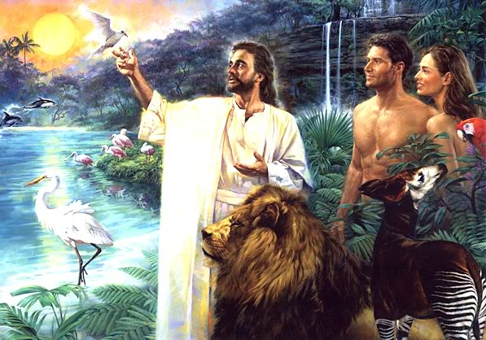

Slide 28
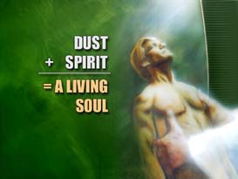
Ezek. 37:5 “Thus saith the Lord GOD unto these bones; Behold, I will cause breath to enter into you, and ye shall live.”
Acts 17:25 “Neither is worshipped with men's hands, as though he needed any thing, seeing he giveth to all life, and breath, and all things.”

Slide 29
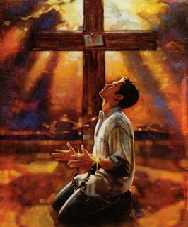
Salvation
“…the Spirit giveth life.”
(II Cor. 3:6)

Slide 31
I Cor. 15:22 “For as in Adam all die, even so in Christ shall all be made alive.”
Eph. 2:1 “And you hath he quickened, who were dead in trespasses and sins.”
Eph. 2:5 “Even when we were dead in sins, hath quickened us together with Christ, (by grace ye are saved).”
Titus 3:5 “Not by works of righteousness which we have done, but according to his mercy he saved us, by the washing of regeneration, and renewing of the Holy Ghost.”

Slide 32
At the moment of salvation another creation, a new creation takes place in the heart and life of the believer. “Therefore,” the apostle Paul wrote, “if any man be in Christ he is a new creature: old things are passed away; behold, all things are become new.” (II Corinthians 5:17).

Slide 33
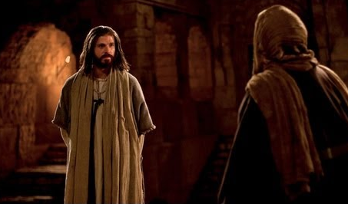
John 3:1-17

Slide 34
Consider several properties of the wind

Slide 35
Wind is moving air, and this fresh air is needed continually for life itself. Even seeds often require wind for their dispersal and subsequent growth. Similarly, the Holy Spirit is the presence of God, the source for all life “Spirit of life.”
Wind has no material shape or form. It is invisible; we cannot see the source or the destination of wind. It is a mysterious, unseen force. Nevertheless, its presence is felt and its effects seen – John 3:8
Likewise, the unseen Holy Spirit can be experienced in a refreshing way. His presence is displayed in the work he does in human lives by transforming, sanctifying, encouraging, comforting and teaching – Acts 3:19

Slide 36
Wind is a powerful force. It cannot be stopped or controlled by people. Likewise, the Holy Spirit is not subject to human control. The moving of the Holy Spirit is God at work – John 3:8
There is great variety in the wind. It may be a soft whisper gently rustling the leaves on the trees, or it may be a hurricane uprooting trees.
Likewise, the Holy Spirit may gently bring a person to Christ, such as a little child raised in a Christian home (II Tim. 3:15), or he may work in some dramatic way to bring conviction and conversion to the hardened sinner (Acts 9:1-31).

Slide 37
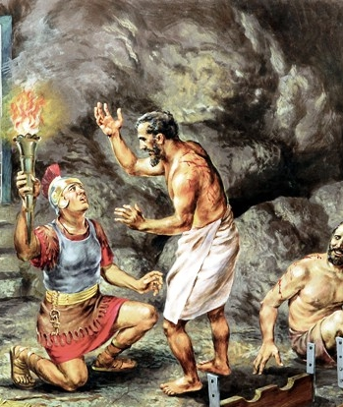
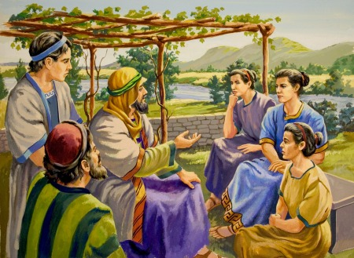
Acts 16:14-30
Contrast Lydia, whose heart the Lord opened (verse 14), and the jailer, who needed an earthquake to jar him to his spiritual sense (verse 30).
In both cases, the Holy Spirit did the regenerating work.

Slide 38
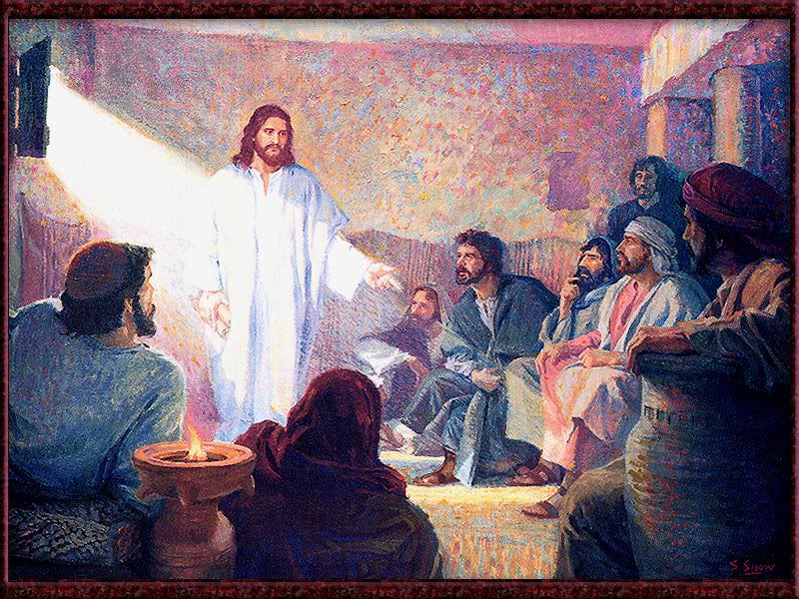
“And when he had said this, he breathed on them, and saith unto them,
Receive ye the Holy Ghost.” (John 20:22)

Slide 39
“And, behold, I send the promise of my Father upon you: but tarry ye in the city of Jerusalem, until ye be endued with power from on high.” (Luke 24:49)

Slide 40
“And when the day of Pentecost was fully come, they were all with one accord in one place. And suddenly there came a sound from heaven as of a rushing mighty wind, and it filled all the house where they were sitting. And there appeared unto them cloven tongues like as of fire, and it sat upon each of them. And they were all filled with the Holy Ghost, and began to speak with other tongues, as the Spirit gave them utterance…And how hear we every man in our own tongue, wherein we were born?” (Acts 2:1-4, 8)

Slide 41
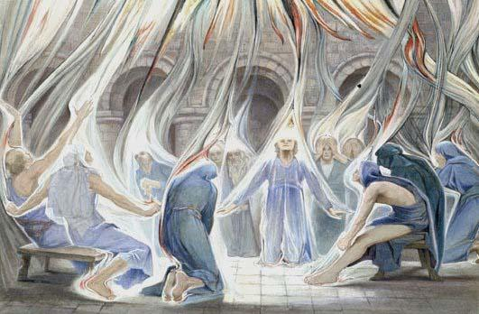

Slide 42
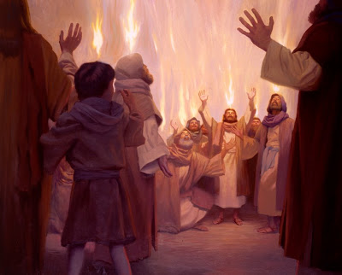

Slide 43
Upon receiving the indwelling presents of the Holy Spirit the disciples were given the gifts of the Spirit to carry on the work of the ministry upon earth.
Who is given a spiritual gift? (Romans 12:1-8; I Corinthians 12-14; Ephesians 4:7-16; I Peter 4:10-11)

Slide 44
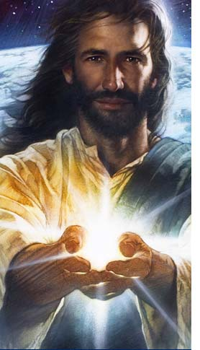
Every believer is given a spiritual gift.
Spiritual gifts are received at the time of salvation.
When we are born, we possess certain natural abilities.
When we are born spiritually, God takes these natural abilities and along with our spiritual gift turns them into the means by which He can work through us supernaturally.

Slide 45
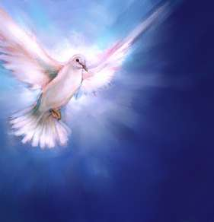
What is a spiritual gift?
A spiritual gift is the “Manifold grace of God” (I Peter 4:10)
It is given to Christians enabling them to serve their church, the world and Christ through the divine enablement of the Holy Spirit – (I Corinthians 12:1-27)

Slide 46
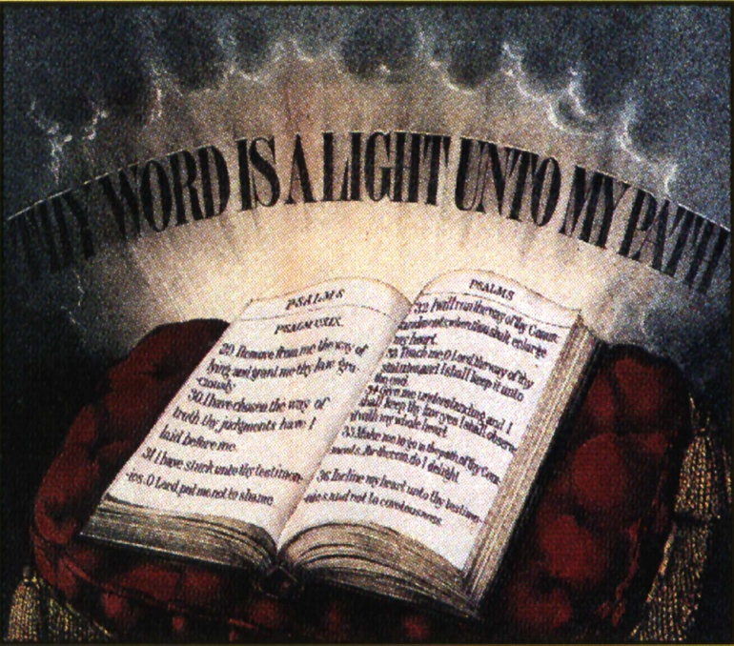
“Now concerning spiritual gifts, brethren, I would not have you ignorant.” (I Corinthians 12:1)

Slide 47
"Wherefore he saith, When he ascended up on high, he led captivity captive, and gave gifts unto men....And he gave some, apostles; and some, prophets; and some, evangelists; and some, pastors and teachers; For the perfecting of the saints, for the work of the ministry, for the edifying of the body of Christ" (Eph. 4:8, 11-12). "But ye shall receive power, after that the Holy Ghost is come upon you: and ye shall be witnesses unto me both in Jerusalem, and in all Judaea, and in Samaria, and unto the uttermost part of the earth" (Acts 1:8). "And what is the exceeding greatness of his power to us-ward who believe, according to the working of his might power [Holy Spirit], Which he wrought in Christ, when he raised him from the dead, and set him at his own right hand in the heavenly places" (Eph. 1:19-20).

Slide 48
Seven Motivational Gifts (Romans 12:3-8)
Prophet
Server
Teacher
Exhorter
Giver
Organizer
Mercy

Slide 49
How to discover your spiritual gift
Receive God’s gift of Salvation.
Submit yourself to the Lord’s will.
Study the spiritual gifts.
Pray for wisdom.
Ask for counsel.
Examine you personal desires and interest.
Evaluate your ability.
Discern your motives in helping others.
Identify what Christians irritate you.

Slide 50
The rewards of knowing your spiritual gift
Valuable to your Church the body of Christ – “Minister the same one to another…”
You will achieve a deeper level of self-worth and purpose in life – (Ephesians 4:10)
As you use your gift you will experience personal fulfillment and a deep sense of joy – (I Timothy 4:14-16)
Concentrating on your gift will achieve maximum fruitfulness – (II Timothy 1:6)

Slide 51
Next Week

Slide 52
“John answered, saying unto them all, I indeed baptize you with water; but one mightier than I cometh, the latchet of whose shoes I am not worthy to unloose: he shall baptize you with the Holy Ghost and with fire:Whose fan is in his hand, and he will throughly purge his floor, and will gather the wheat into his garner; but the chaff he will burn with fire unquenchable.” Luke 3:16-17

