Slide 1
The Doctrine of the Holy Spirit
(The Symbols of the Holy Spirit)
Part 6

Slide 3
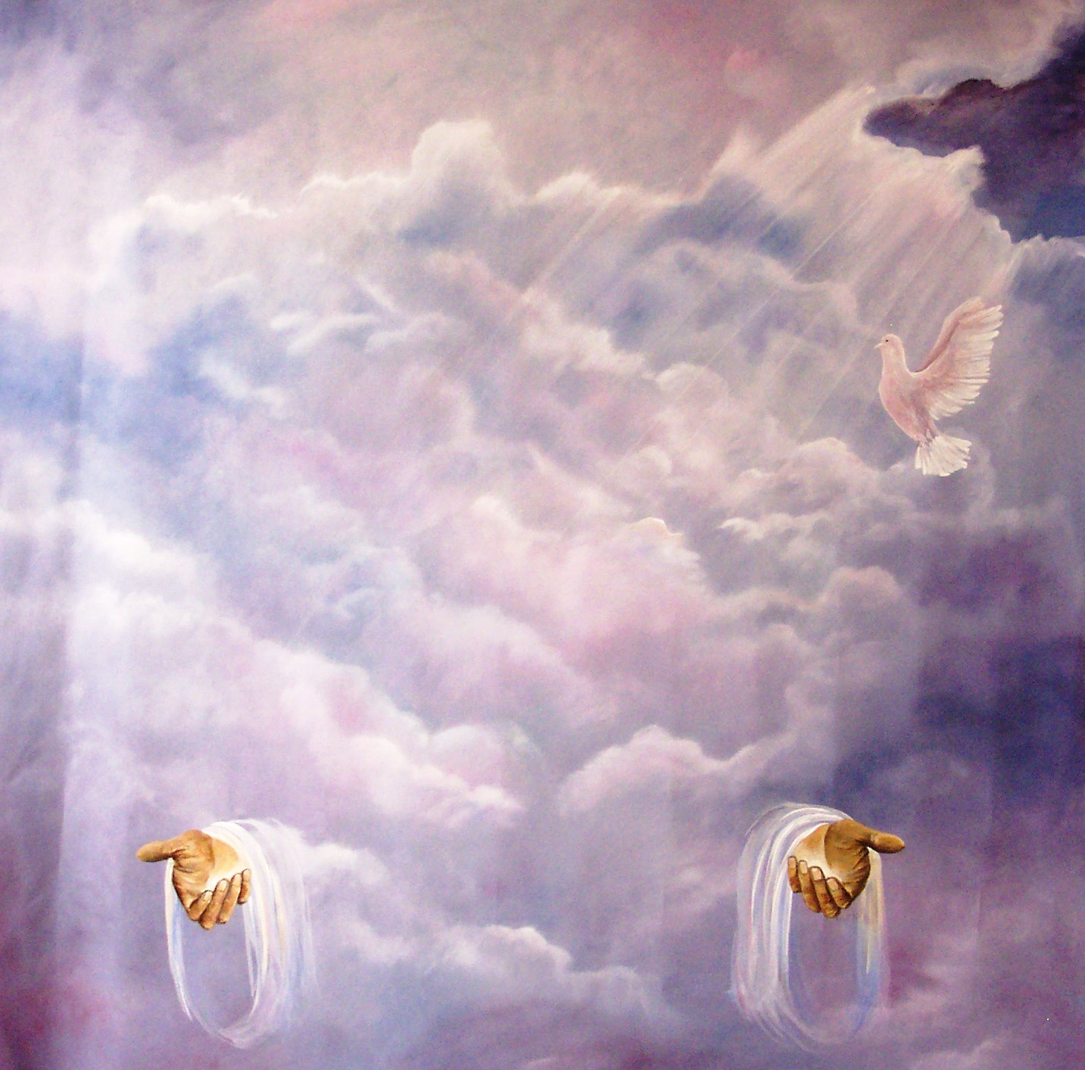
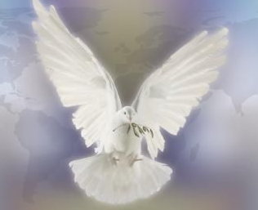
“Then Peter said unto them, Repent, and be baptized every one of you in the name of Jesus Christ for the remission of sins, and ye shall receive the gift of the Holy Ghost.” (Acts2:38)

Slide 4
In the New Testament alone there are some 261 passages which refer to the Holy Spirit. He is mentioned 56 times in the Gospels, 57 times in the book of Acts, 112 times in the Pauline epistles, and 36 times in the remaining New Testament. Total = 522

Slide 6
Because the Holy Spirit is Person you can have a personal relationship with him
Romans 8:14 “For as many as are led by the Spirit of God, they are the sons of God.”

Slide 8
I John 5:7-8 “For there are three that bear record in heaven, the Father, the Word, and the Holy Ghost: and these three are one. And there are three that bear witness in earth, the Spirit, and the water, and the blood: and these three agree in one.”

Slide 9
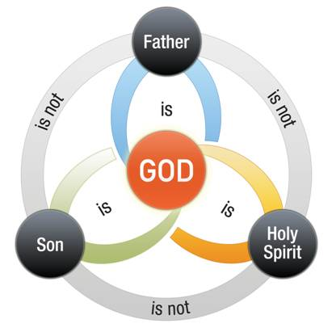

Slide 11
Spirit of God
Spirit of Christ
Eternal Spirit
Spirit of Truth
Spirit of Grace
Spirit of Glory
Spirit of Life
Spirit of Wisdom and Revelation
Spirit of Comfort
Spirit of Promise
Spirit of Holiness
Spirit of Adoption
Holy Ghost
Seven Spirits of God

Slide 12
The symbols of the Holy Spirit become essential to our gaining an understanding of who He is, what He’s like and His ministry in our lives, the Church
and the World.

Slide 13
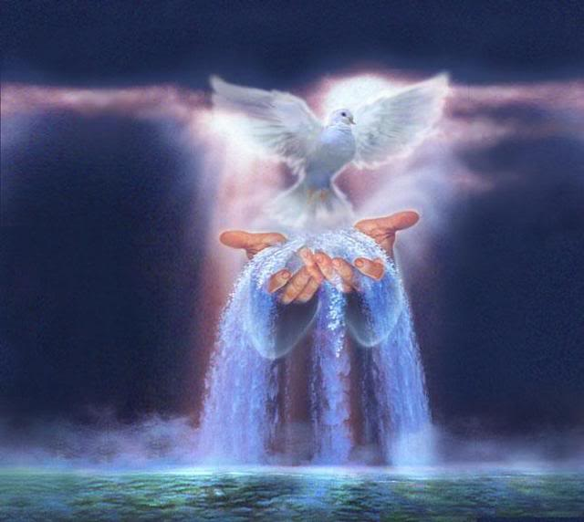
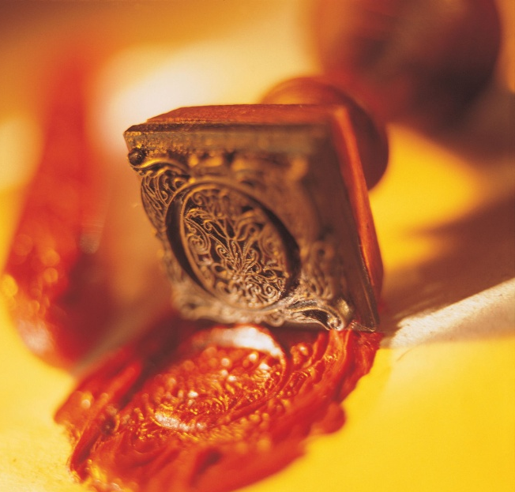
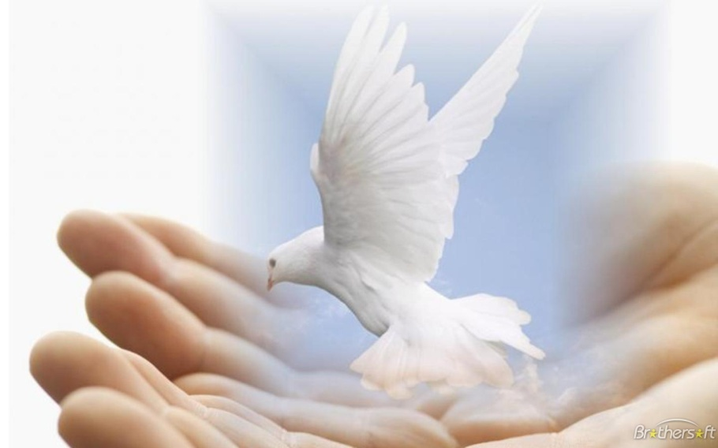
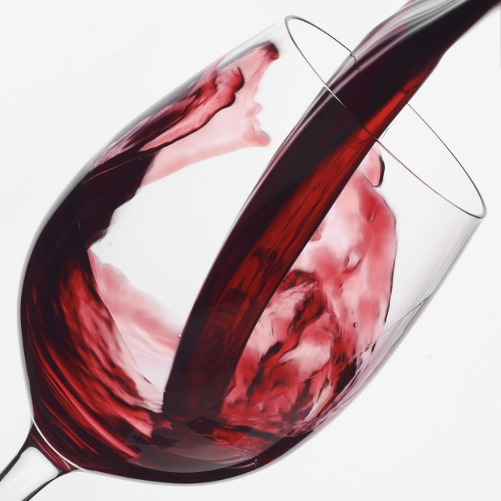
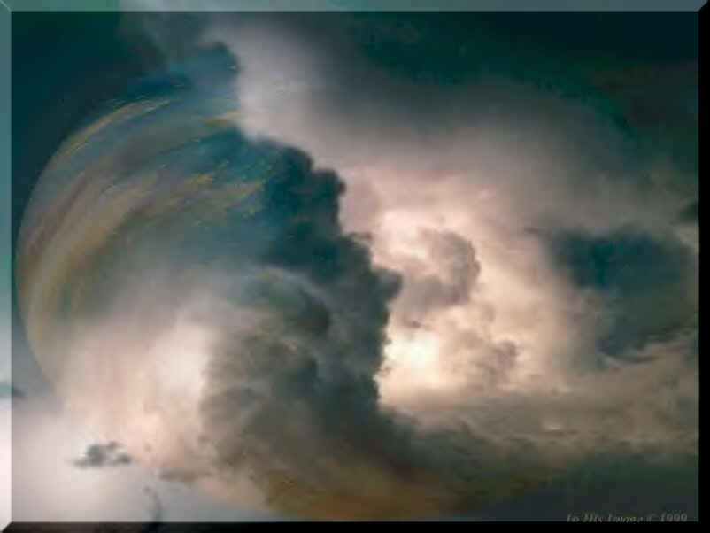
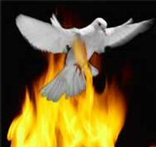

Slide 14
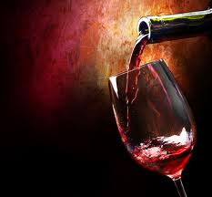
Wine is one of the most unusual symbols relating to the Holy Spirit.

Slide 15
In three crucial passages in the New Testament, a comparison is drawn between the effects of wine and the effects of the Holy Spirit.

Slide 16
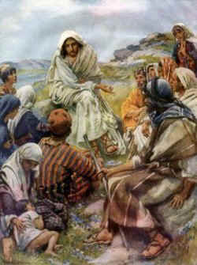
When Jesus warned against putting new wine in old wineskins (Matthew 9:16‑17), He was teaching that the Gospel when received would result in new wine (Holy Spirit) being poured not into old vessels (old wine skins) but into new vessels redeemed by the Grace of God.
Old wine skins (an unredeemed person) could never receive the indwelling presents of the
Holy Spirit.

Slide 17
“No man putteth a piece of new cloth unto an old garment, for that which is put in to fill it up taketh from the garment, and the rent is made worse. Neither do men put new wine into old bottles: else the bottles break, and the wine runneth out, and the bottles perish: but they put new wine into new bottles, and both are preserved.”

Slide 18
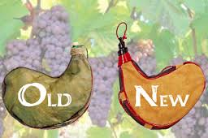
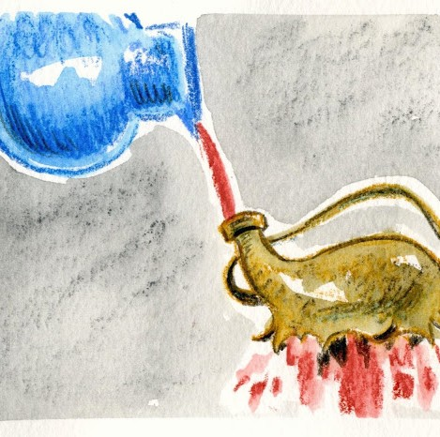

Slide 19
Titus 3:5 “Not by works of righteousness which we have done, but according to his mercy he saved us, by the washing of regeneration, and renewing of the Holy Ghost.”
Regeneration is the spiritual transformation in a person, brought about by the indwelling presents of the Holy Spirit – I Cor. 3:16
Regeneration brings the individual from being spiritually dead to become a spiritually alive human being – Eph. 2:1-10
Regeneration is another way of speaking about the new birth or the second birth or being born again – John 3:1-18

Slide 20
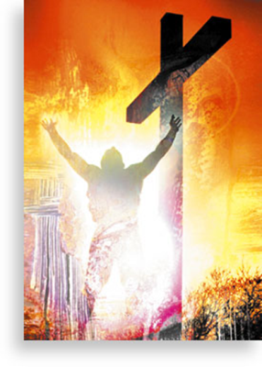
Romans 6:1-14

Slide 21
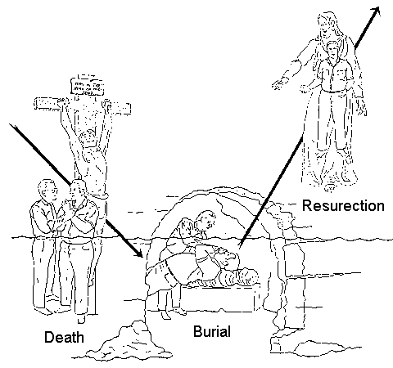

Slide 27
Galatians 2:20 “I am crucified with Christ: nevertheless I live; yet not I, but Christ liveth in me: and the life which I now live in the flesh I live by the faith of the Son of God, who loved me, and gave himself for me.”

Slide 28
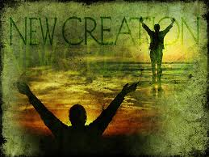
“Therefore if any man be in Christ, he is a new creature: old things are passed away; behold, all things are become new.”
II Cor. 5:17

Slide 30
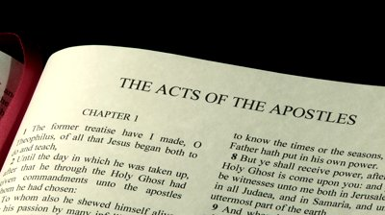

Slide 31
On the day of Pentecost in Acts 2, the Holy Spirit came in great force on the assembly of believers. Certain supernatural signs accompanied the descent of the Spirit.
The sound like a rushing wind.
The appearance of something like tongues of fire.
The miraculous ability to speak in other tongues for the proclamation of gospel.

Slide 32
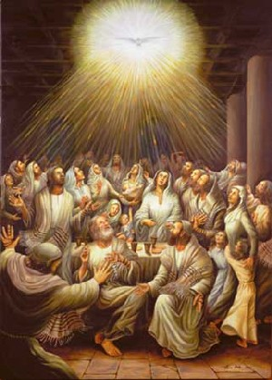

Slide 33
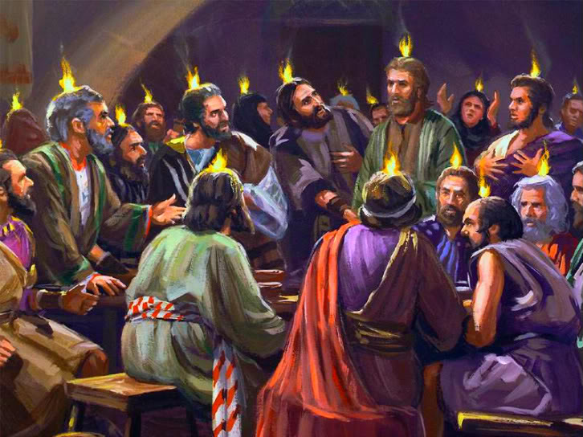

Slide 34
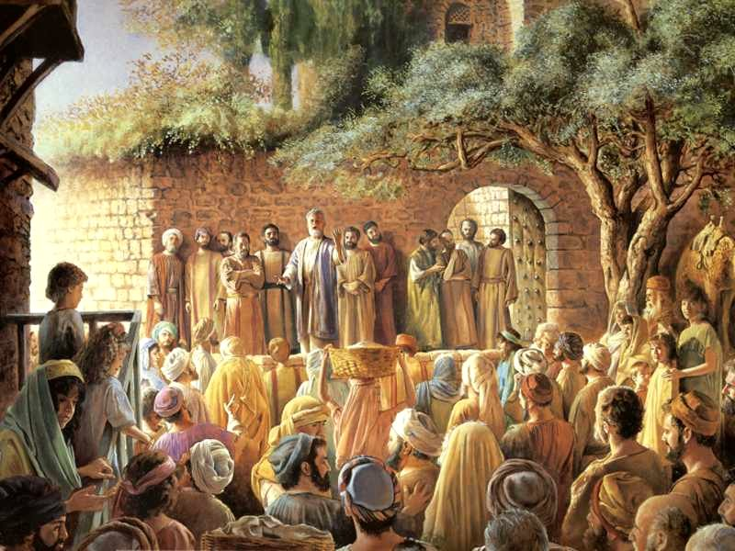

Slide 35
It was this manifestation (of the Holy Spirit) that captured the attention of the multitudes of Jews who had gathered in Jerusalem for Pentecost. They were stunned to hear relatively uneducated men from Galilee speak fluently in foreign languages they had never known before.

Slide 36
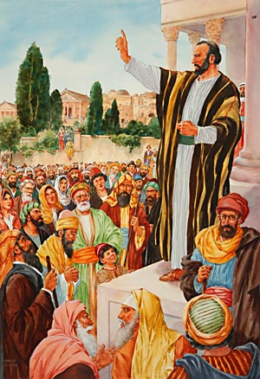
The disciples spoke in at least fifteen different languages or dialects that day. No one could deny that something unusual had happened.

Slide 37
As is often the case when unbelievers encounter the work of God, they try to explain it in purely natural terms. They thought the disciples had been drinking too much and were simply babbling under the influence of alcohol.

Slide 38
The first words of Peter’s sermon confirm this fact (Acts 2:15) “For these are not drunken, as ye suppose, seeing it is but the third hour of the day (nine in the morning)!” He went on to say that what had happened was a fulfillment (partially) of Joel 2:28‑32, which predicted an outpouring of God’s Spirit in the “last days."

Slide 39
For the purposes of our study, note that unbelievers confused the coming of the Spirit with the controlling power of wine.

Slide 41
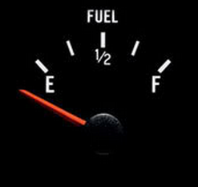
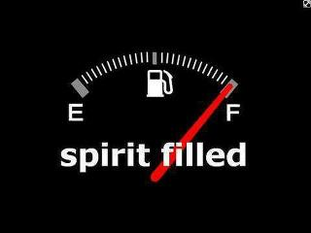

Slide 42
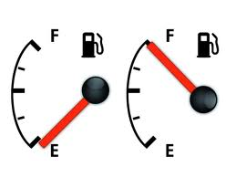

Slide 44
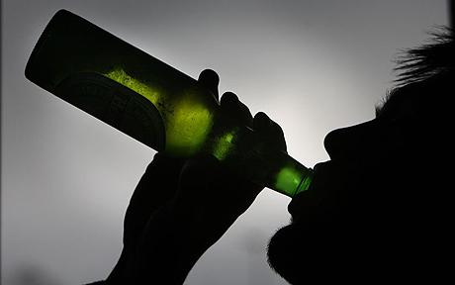
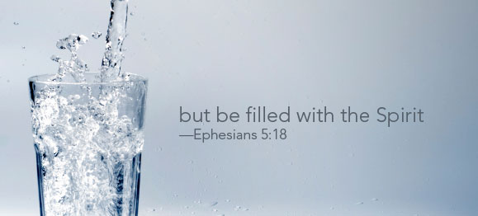
The Comparison

Slide 45
What precisely is the point of comparison between wine and the Holy Spirit? Doubtless the issue is influence or control. A person under the influence of wine experiences altered behavior. He or she may say or do things he or she would not ordinarily do.

Slide 47
Emotions may be heightened for a brief period, causing the person to experience anger followed quickly by joy followed quickly by depression. If the person drinks enough wine, his or her mental ability will be affected and decision‑making radically altered.

Slide 48
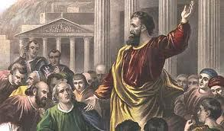
Likewise, the filling of the Holy Spirit produces a change in behavior. In the Book of Acts, once-timid fearful disciples became flaming evangelists for Jesus Christ.

Slide 49
In Ephesians 5:19‑21, Paul mentioned three practical results of the filling of the Spirit: 1# Singing 2# A thankful heart 3# An attitude of submission The last result is most significant because true submission always involves giving up your right to be in control.

Slide 50
When we submit from the heart, we are saying, “I don’t have to have my way all the time.” Only a heart touched by the Holy Spirit can maintain such an attitude in every relationship of life.

Slide 51
The Comparison is a Control Issue

Slide 52
The filling of the Holy Spirit is compared to being drunk with wine in excess - Ephesians 5:18
The reason for the comparison is simple - A drunk person is under the control of alcohol, he thinks, speaks, and acts in ways that are not natural when he is sober.
Likewise a Christian who is filled with the Spirit will think, speak, and act in ways that are not natural for him.

Slide 53
The command to be filled with the spirit
The verb "be filled" in the original text of Ephesians 5:18 is in the present tense in the Greek.
This means = continuous action.
In other words it could read - "keep on being filled with the spirit. . ."

Slide 54
As Christians we are to pursue the "filling of the Holy Spirit at all times"
1. The Filling of the Holy Spirit is a repeated experience -
Believers were filled with the Spirit at Pentecost (Acts 2:4).
These same believers experienced another filling in (Acts 4:31).
Paul was filled with the Spirit shortly after his conversion (Acts 9:17).
Several years later he was filled with the Spirit again (Acts 13:9).

Slide 55
To be Filled with the Holy Spirit is to be controlled by the Holy Spirit (wine).
The word filled is found three other times in the Scriptures in which it means controlled –
Filled with Fear - Luke 5:26
Filled with madness - Luke 6:6-11
Filled with Sorrow - John 16:6

Slide 56
Next Week

