Slide 1
The Doctrine of the Holy Spirit (Part 3)
(The Names and Titles
of the Holy Spirit)

Slide 3
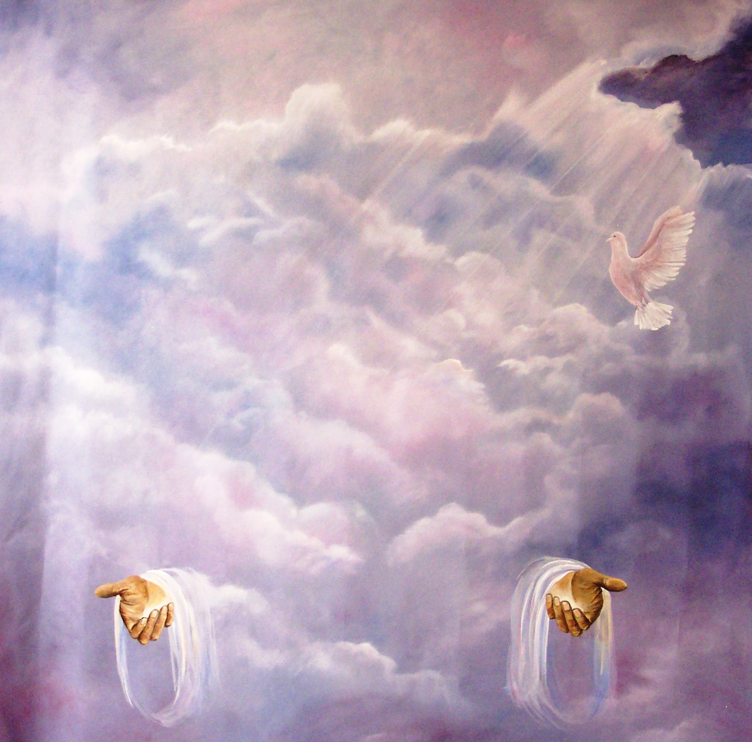
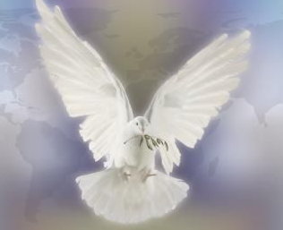
“Then Peter said unto them, Repent, and be baptized every one of you in the name of Jesus Christ for the remission of sins, and ye shall receive the gift of the Holy Ghost.” (Acts2:38)

Slide 4
In the New Testament alone there are some 261 passages which refer to the Holy Spirit. He is mentioned 56 times in the Gospels, 57 times in the book of Acts, 112 times in the Pauline epistles, and 36 times in the remaining New Testament. Total = 522

Slide 6
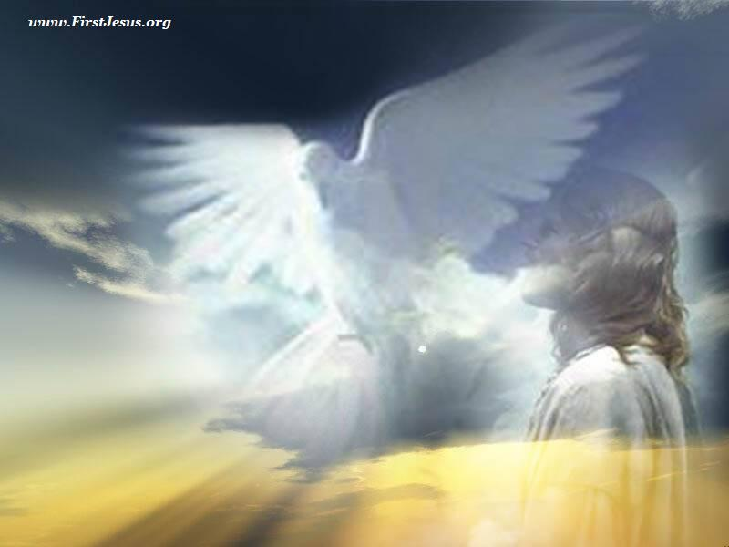
He has a mind – Romans 8:26-28
He has knowledge of God's mind – I Cor. 2:10-16
He is our Teacher - I John 2:26-27
He has a will - I Cor. 12:11
He forbids - Acts 16:6-7
He permits - Acts 16:10
He speaks - Acts 8:29
He loves - Rom. 15:30
He produces fruit in the life of the believer – Gal. 5:22
He grieves - Eph. 4:30
He prays - Rom. 8:26
He comforts - John 14:16

Slide 7
Because the Holy Spirit is Person you can have a personal relationship with him
Romans 8:14 “For as many as are led by the Spirit of God, they are the sons of God.”

Slide 8
“If we live in the Spirit, let us also walk
in the Spirit.” (Gal. 5:25)

Slide 9
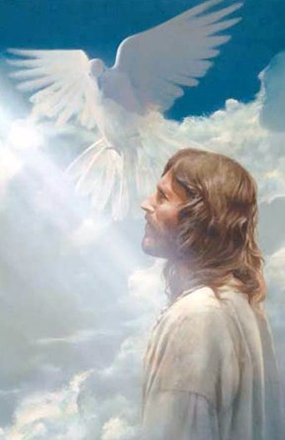
The Deity of the Holy Spirit

Slide 10
He is omnipotent - (Gen. 1:2)
He is omniscient – (I Cor. 2:10-11)
He is omnipresent – (Psalm 139:7)
He is eternal – (Heb. 9:14)
He is called God – (Acts 5:3-4)
He is equal with the Father and the Son – (Matt. 3:16-17)
He is declared to be God by Jesus – (John 14:16, 26, 15:26)
He is declared to be God by Paul – (Eph. 2:18; II Cor. 13:14; Rom. 8:2-3)
He is declared to be God by Peter – (I Peter 1:2, 4:14)
He is declared to be God in the book of Acts – (Acts 2:33)

Slide 12
I John 5:7-8 “For there are three that bear record in heaven, the Father, the Word, and the Holy Ghost: and these three are one. And there are three that bear witness in earth, the Spirit, and the water, and the blood: and these three agree in one.”

Slide 14
Tonight’s Message
(The Names and Titles of the Holy Spirit)

Slide 15
Often in the Scripture one may learn much about someone simply by studying the names and titles given to that person.
So it is with the Holy Spirit. The fourteen names and titles ascribed to him provide much insight into his true nature and ministry.

Slide 16
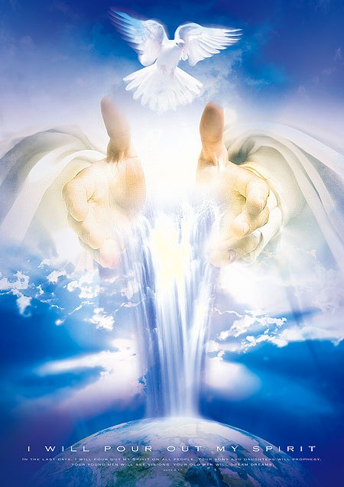
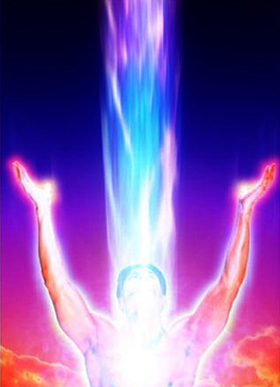
1. The Spirit of God
"Know ye not that ye are the temple of God, and that the Spirit of God dwelleth in you?"
(I Cor. 3:16)

Slide 17
“But Peter said, Ananias, why hath Satan filled thine heart to lie to the Holy Ghost…thou hast not lied unto men, but unto God.” (Acts 5:3-4)

Slide 18
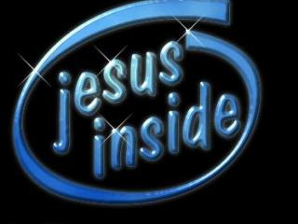
2. The Spirit of Christ
"But ye are not in the flesh, but in the Spirit, if so be that the Spirit of God dwell in you. Now if any man have not the Spirit of Christ, he is none of his“
(Rom. 8:9)
“I am crucified with Christ: nevertheless I live; yet not I, but Christ liveth in me: and the life which I now live in the flesh I live by the faith of the Son of God, who loved me, and gave himself for me.” (Gal. 2:20)

Slide 19
“But we all, with open face beholding as in a glass the glory of the Lord, are changed into the same image from glory to glory, even as by the Spirit of the Lord.” (II Cor. 3:18)

Slide 20
How does the indwelling Spirit of Christ conform us to the image of Christ?
God’s goal is for the believer to be “conformed” to the image of Christ – Rom. 8:28-29
The Holy Spirit is working within the believer to transform him into the likeness of Christ – Rom. 12:1-2
The outward man is being transformed by the inward working of the Holy Spirit – II Cor. 4:15-17
We are conformed to the image of Christ in holiness – I Peter 1:5-16

Slide 21
The Holy Spirits Perfecting Work “Make you perfect in every good work to do his will, working in you that which is wellpleasing in his sight, through Jesus Christ; to whom be glory for ever and ever.” (Heb 13:21)
(Holy Spirit’s tools of perfection)

Slide 22
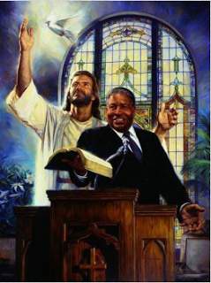
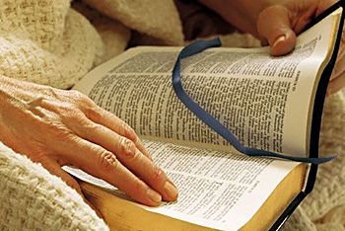
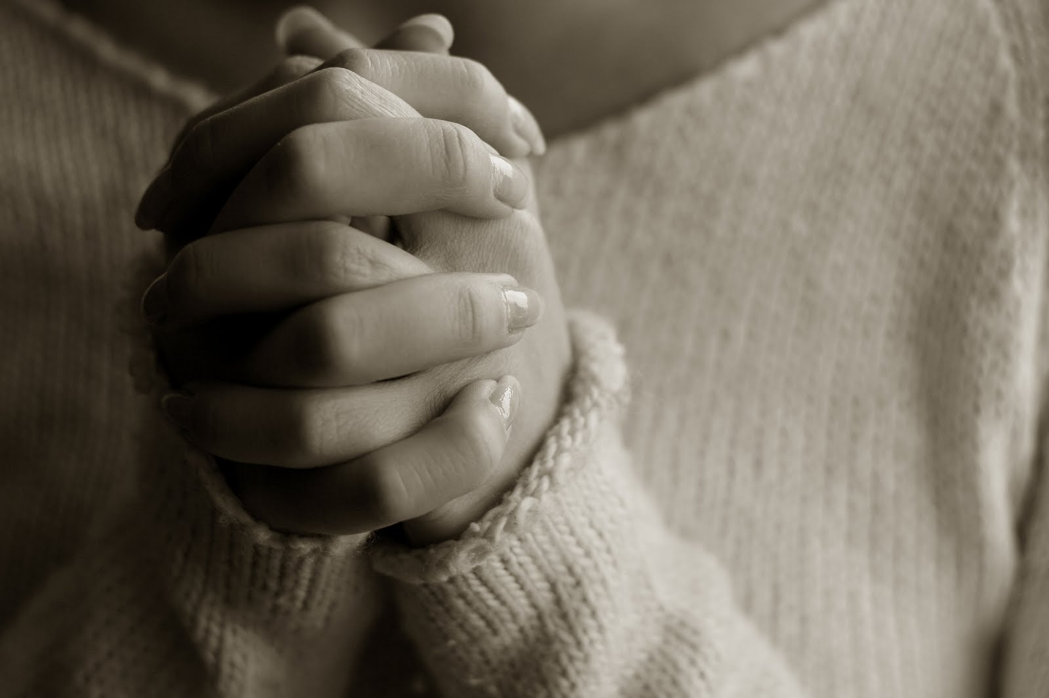
Suffering, trials and adversity – (James 1:3-5; I Peter 1:6-7; 5:10)
Preaching – (Col. 1:28)
Body of Christ the Church – (Eph. 4:11-16)
Scripture – (Heb. 5:11-14)
Prayer - (Col. 4:12)

Slide 23
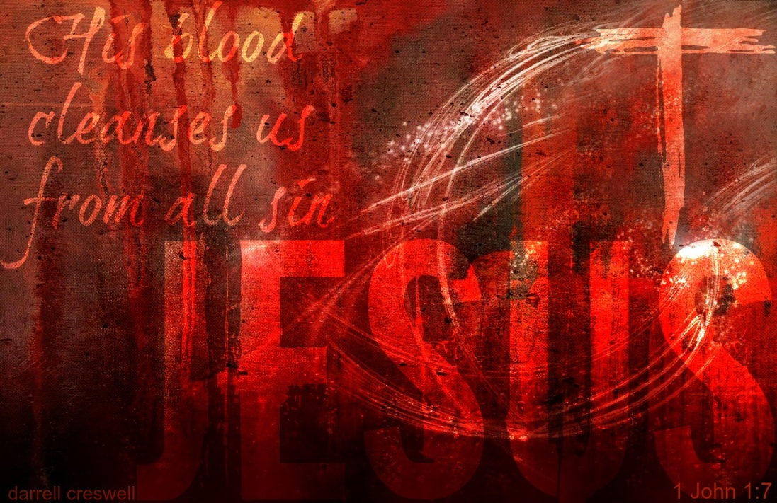
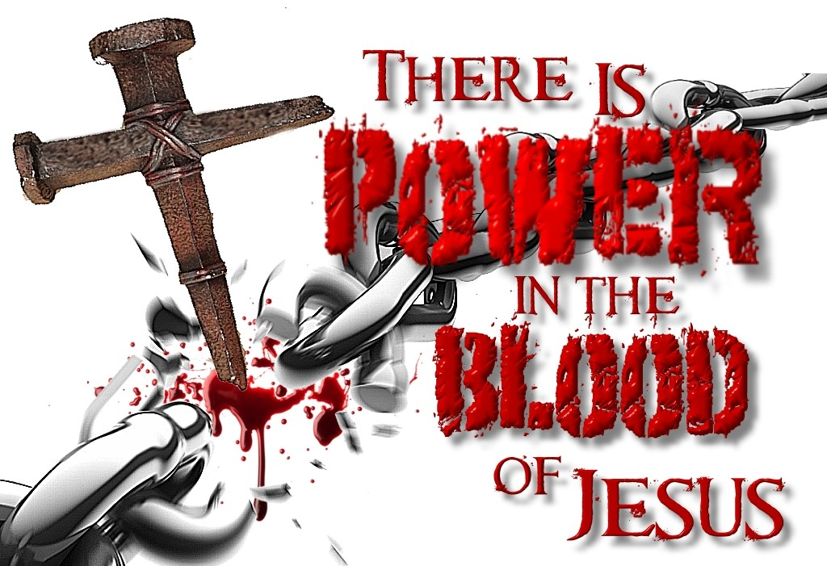
3. The Eternal Spirit
"How much more shall the blood of Christ, who through the eternal Spirit offered himself without spot to God, purge your conscience from dead works to serve the living God?" (Heb. 9:14)

Slide 24
“The eternal God is thy refuge, and underneath are the everlasting arms.”
(Deut. 33:27)
Now unto the King eternal, immortal, invisible, the only wise God, be honour and glory forever and ever. Amen. (I Timothy 1:17)

Slide 25
4. The Spirit of Truth
“Howbeit when he, the Spirit of truth, is come, he will guide you into all truth: for he shall not speak of himself; but whatsoever he shall hear, that shall he speak: and he will show you things to come.”
(John 16:13)

Slide 26
The illumination of the Holy Spirit
Illumination is the process by which God's Holy Spirit enables us to understand God’s Word and apply it to our lives.
Psalm 119:18 “Open thou mine eyes, that I may behold wondrous things out of thy law.”

Slide 27
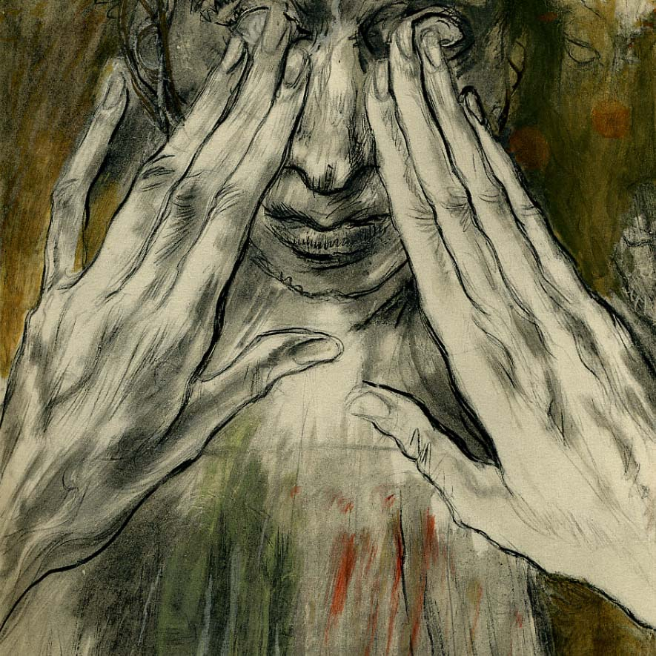
There is a wonderful change that takes place when a person accepts Jesus as Lord and Savior.
Acts 26:18 “To open their eyes, and to turn them from darkness to light, and from the power of Satan unto God, that they may receive forgiveness of sins.”

Slide 28
Illumination is the ministry of the Holy Spirit in the life of the believer helping him to understand and apply the truth of the Bible to his daily life

Slide 30
John 16:12-15 “Howbeit when he, the Spirit of truth, is come, he will guide you into all truth: for he shall not speak of himself; but whatsoever he shall hear, that shall he speak: and he will shew you things to come. He shall glorify me: for he shall receive of mine, and shall shew it unto you. All things that the Father hath are mine: therefore said I, that he shall take of mine, and shall shew it unto you.”
I Cor. 2:10 “But God hath revealed them unto us by his Spirit: for the Spirit searcheth all things, yea, the deep things of God.”
I John 2:27 “But the anointing which ye have received of him abideth in you, and ye need not that any man teach you: but as the same anointing teacheth you of all things, and is truth, and is no lie, and even as it hath taught you, ye shall abide in him.”

Slide 31
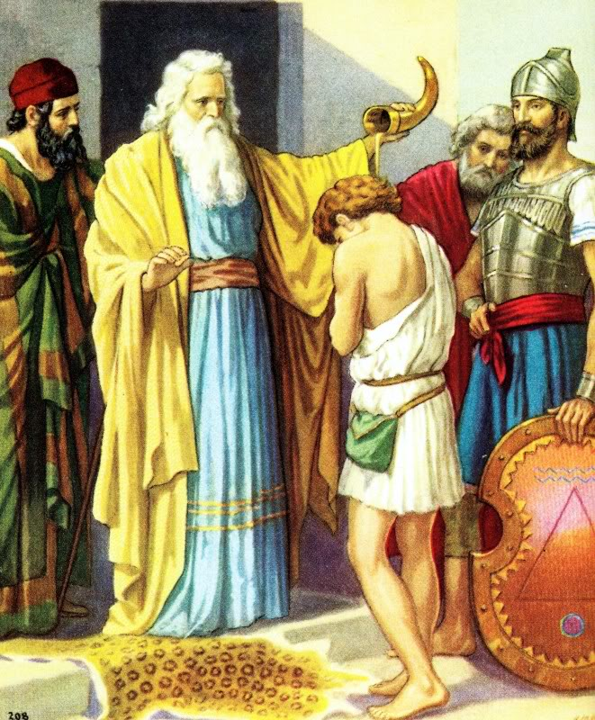

Slide 32
The work of illumination is unique to believers
I Cor. 2:12-15 “Now we have received, not the spirit of the world, but the spirit which is of God; that we might know the things that are freely given to us of God. Which things also we speak, not in the words which man's wisdom teacheth, but which the Holy Ghost teacheth; comparing spiritual things with spiritual. But the natural man receiveth not the things of the Spirit of God: for they are foolishness unto him: neither can he know them, because they are spiritually discerned.”

Slide 33
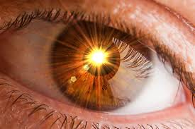
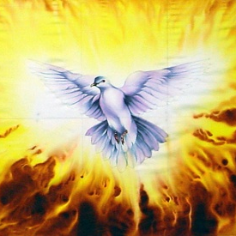
“The eyes of your understanding being enlightened; that ye may know what is the hope of his calling, and what the riches of the glory of his inheritance in the saints.” (Eph. 1:18)

Slide 34
Backslider

Slide 35
II Peter 1:8-11
“For if these things be in you, and abound, they make you that ye shall neither be barren nor unfruitful in the knowledge of our Lord Jesus Christ. But he that lacketh these things is blind, and cannot see afar off, and hath forgotten that he was purged from his old sins. Wherefore the rather, brethren, give diligence to make your calling and election sure: for if ye do these things, ye shall never fall: For so an entrance shall be ministered unto you abundantly into the everlasting kingdom of our Lord and Saviour Jesus Christ.”

Slide 36
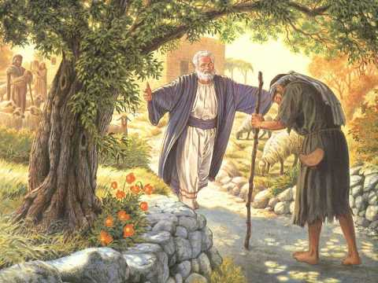

Slide 38
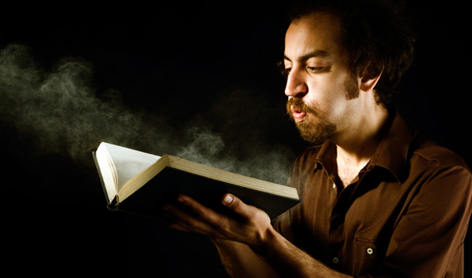

Slide 39
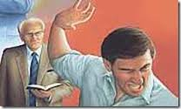
5. The Spirit of Grace
“Of how much sorer punishment, suppose ye, shall he be thought worthy, who hath trodden under foot the Son of God, and hath counted the blood of the covenant, wherewith he was sanctified, an unholy thing, and hath done despite unto the Spirit of grace?”
(Heb. 10:29)

Slide 40
Three Types of Biblical Grace
1) Saving grace - Eph 2:8 “For by grace are ye saved through faith; and that not of yourselves: it is the gift of God.”
2) Strengthening grace – I Cor. 15:10 “But by the grace of God I am what I am: and his grace which was bestowed upon me was not in vain; but I laboured more abundantly than they all: yet not I, but the grace of God which was with me.”
3) Sustaining grace – II Cor. 12:9 “And he said unto me, My grace is sufficient for thee: for my strength is made perfect in weakness. Most gladly therefore will I rather glory in my infirmities, that the power of Christ may rest upon me.”

Slide 41
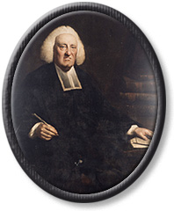
6. The Spirit of Glory
"If ye be reproached for the name of Christ, happy are ye: for the Spirit of glory and of God resteth upon you: on their part he is evil spoken of, but on your part he is glorified" (I Pet. 4:14)
The Spirit of Glory – “That is, the glorious Spirit of God, who is glorious in himself, in the perfections of his nature, being possessed of the same glorious divine essence with the Father and Son.”
John Gill (23 November 1697 – 14 October 1771) was an English Baptist pastor

Slide 42
The Father of Glory...The Lord of Glory...The Spirit of Glory
"For this cause I also, having heard of the faith in the Lord Jesus which is among you, and which ye shew toward all the saints, cease not to give thanks for you, making mention of you in my prayers; that the God of our Lord Jesus Christ, the Father of glory, may give unto you a spirit of wisdom and revelation in the knowledge of him" (Eph. 1:15)
"My brethren, hold not the faith of our Lord Jesus Christ, the Lord of glory, with respect of persons" (James 2:1)
"If ye be reproached for the name of Christ, happy are ye: for the Spirit of glory and of God resteth upon you: on their part he is evil spoken of, but on your part he is glorified" (I Pet. 4:14)

Slide 44
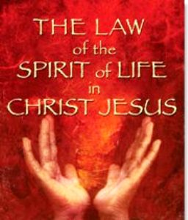
7. The Spirit of Life
"For the law of the Spirit of life in Christ Jesus hath made me free from the law of sin and death" (Rom. 8:2)

Slide 45
“Law of the Spirit of life” The Holy Spirit is called “The Spirit of life” because He reveals the way of salvation in Christ, quickening dead sinners making them alive in Christ – (Eph. 2:1-10) After salvation He guides believers in discovering the abundant life in Christ – (John 10:10, 16:13) Through out a believers spiritual life the Holy Spirit supports life through the spiritual nourishment received through the Word of God – (I Peter 2:2; Eph. 5:26; Job 23:12)

Slide 46
“But his delight is in the law of the LORD” (Psalm 1:2)

Slide 47
8. The Spirit of Wisdom and Revelation
"That the God of our Lord Jesus Christ, the Father of glory, may give unto you the Spirit of wisdom and revelation (enlightenment, manifestation, to reveal) in the knowledge of him (Jesus)" (Eph. 1:17)

Slide 48
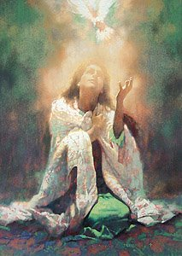
9. The Comforter
"But the Comforter, which is the Holy Ghost, whom the Father will send in my name, he shall teach you all things, and bring all things to your remembrance, whatsoever I have said unto you."
(John 14:26)

Slide 49
Holy Spirit is our Comforter
The Greek word translated "Comforter" is "Parakletos" as found in John 14:16, 26; 15:26; and 16:7.
Once, it is translated "advocate" (I John 2:1).
Meaning - one called to the side of another, one who runs to our side and picks us up, helper, defender, encourager, counselor, exhorter.

Slide 50
10. The Spirit of Promise
"And, being assembled together with them, commanded them that they should not depart from Jerusalem, but wait for the promise of the Father, which, saith he, ye have heard of me. For John truly baptized with water; but ye shall be baptized with the Holy Ghost not many days hence"
(Acts 1:4-5)

Slide 51
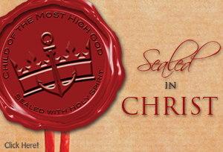
“In whom ye also trusted, after that ye heard the word of truth, the gospel of your salvation: in whom also after that ye believed, ye were sealed with that holy Spirit of promise.” (Eph. 1:13)

Slide 52
11. The Spirit of Adoption
"For ye have not received the spirit of bondage again to fear; but ye have received the Spirit of adoption, whereby we cry, Abba, Father.“
(Rom. 8:15)

Slide 53
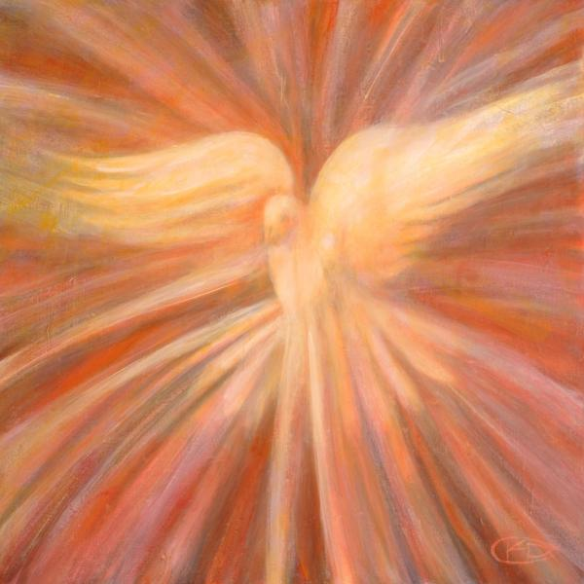
12. The Spirit of Holiness
"And declared to be the Son of God with power, according to the Spirit of holiness, by the resurrection from the dead" (Rom. 1:4)
The Holy Spirit
(Acts 1:5, 8; 2:1-4)

Slide 54
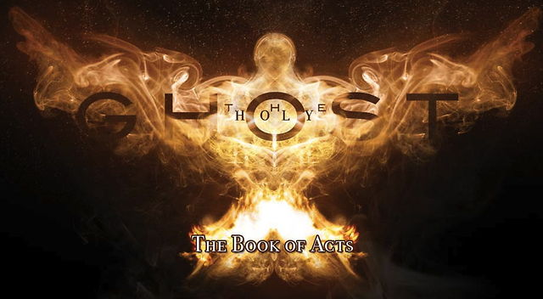
13. The Holy Ghost
“But ye shall receive power, after that the Holy Ghost is come upon you.” (Acts 1:8)
The Holy Spirit is called the “Holy Ghost”
89 times in the New Testament.

Slide 55
John 3:8 “The wind bloweth where it listeth, and thou hearest the sound thereof, but canst not tell whence it cometh, and whither it goeth: so is every one that is born of the Spirit.”
Acts 2:2 “And suddenly there came a sound from heaven as of a rushing mighty wind, and it filled all the house where they were sitting.”
Depicts His power and His guidance which cannot be seen, but can be felt.

Slide 56
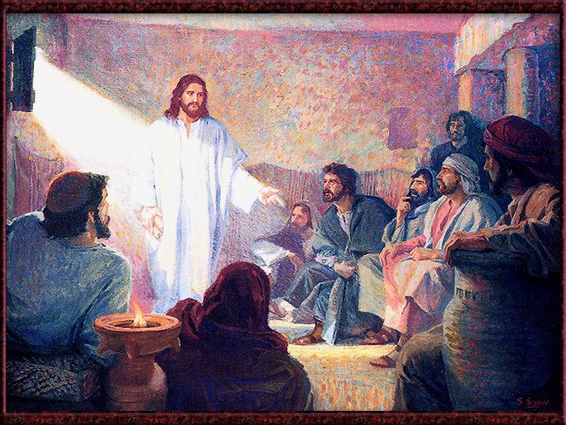
“And when he had said this, he breathed on them, and saith unto them,
Receive ye the Holy Ghost.” (John 20:22)

Slide 57
“And, behold, I send the promise of my Father upon you: but tarry ye in the city of Jerusalem, until ye be endued with power from on high.” (Luke 24:49)

Slide 58
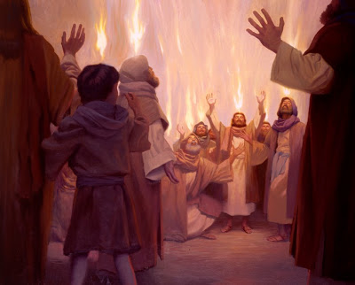

Slide 59
14. The Seven Spirits of God
Rev. 1:4 “John to the seven churches which are in Asia: Grace be unto you, and peace, from him which is, and which was, and which is to come; and from the seven Spirits which are before his throne.”
Rev. 3:1 “And unto the angel of the church in Sardis write; These things saith he that hath the seven Spirits of God, and the seven stars; I know thy works, that thou hast a name that thou livest, and art dead.”
Rev. 4:5 “And out of the throne proceeded lightnings and thunderings and voices: and there were seven lamps of fire burning before the throne, which are the seven Spirits of God.”

Slide 60
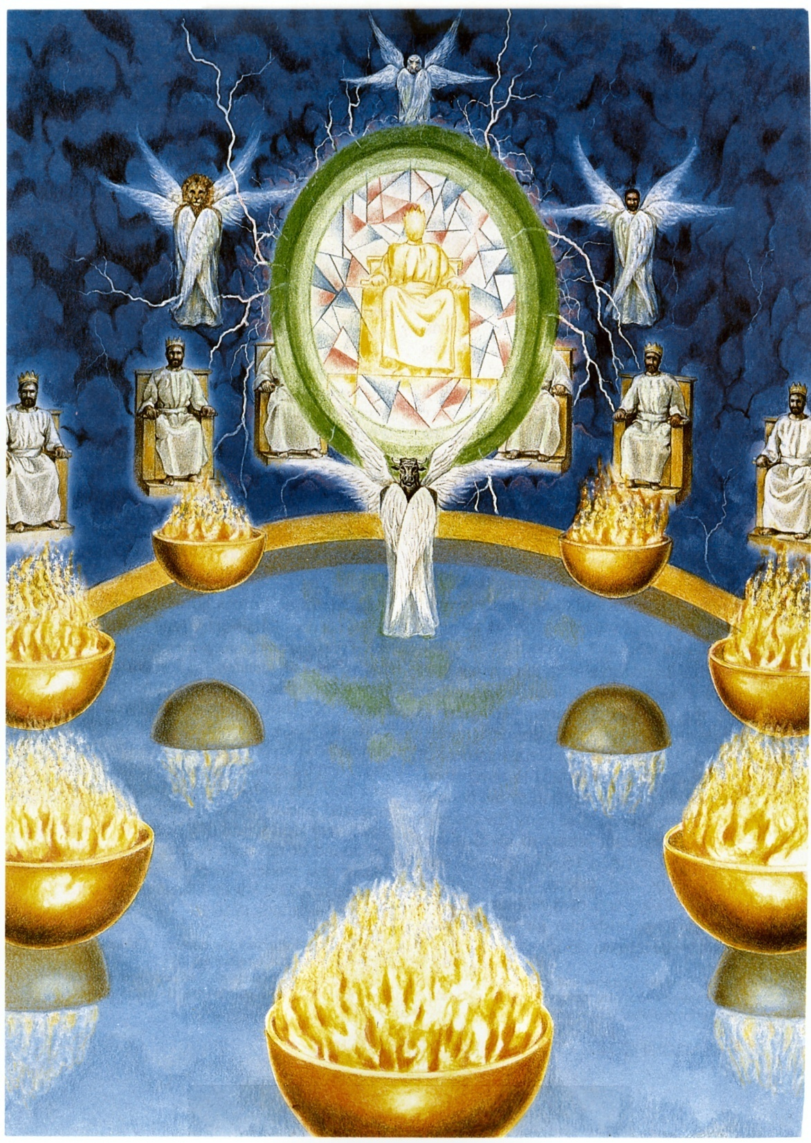
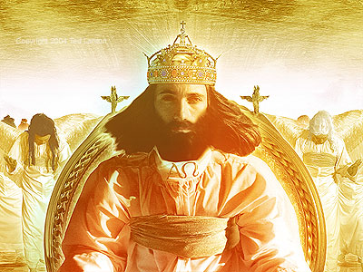
The Seven Spirits of God (Revelation 4:1-11; Isaiah 11:2)
Spirit of the Lord
Spirit of wisdom
Spirit of understanding
Spirit of counsel
Spirit of might (power)
Spirit of knowledge
Spirit of the fear of the Lord

Slide 61
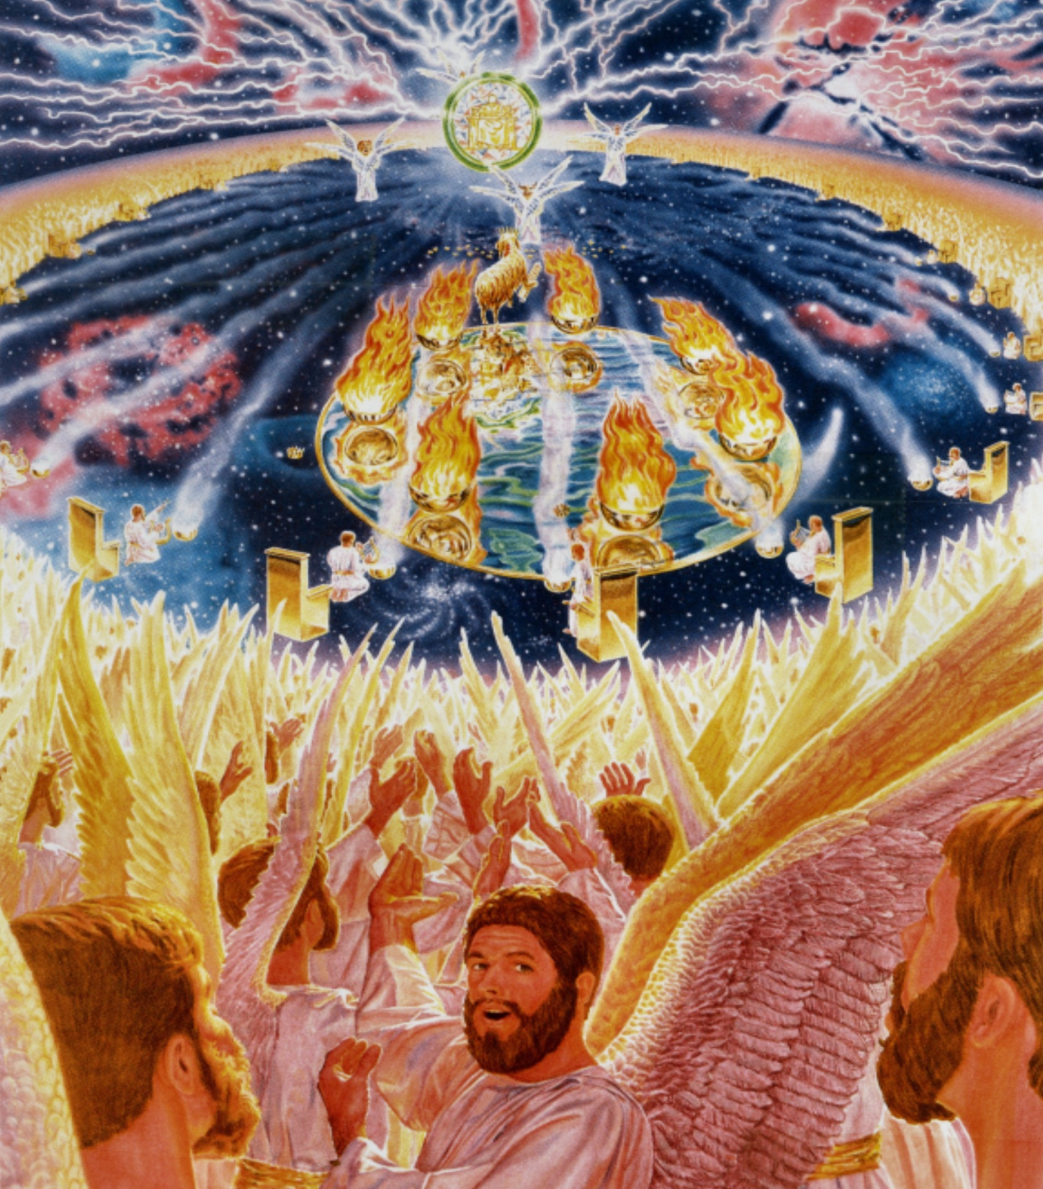
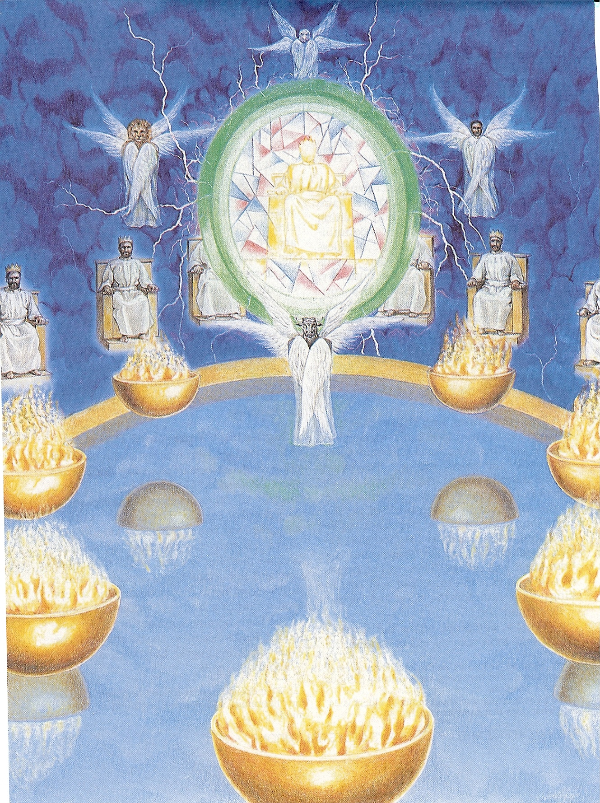
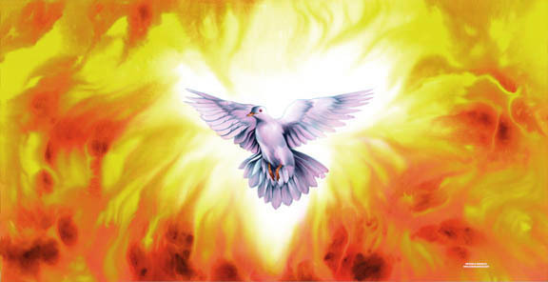

Slide 63
Spirit of God
Spirit of Christ
Eternal Spirit
Spirit of Truth
Spirit of Grace
Spirit of Glory
Spirit of Life
Spirit of Wisdom and Revelation
Spirit of Comfort
Spirit of Promise
Spirit of Holiness
Spirit of Adoption
Holy Ghost
Seven Spirits of God

