Slide 1
The Doctrine of the Holy Spirit (Part 2)
(The Deity of the Holy Spirit)

Slide 3
Review

Slide 4
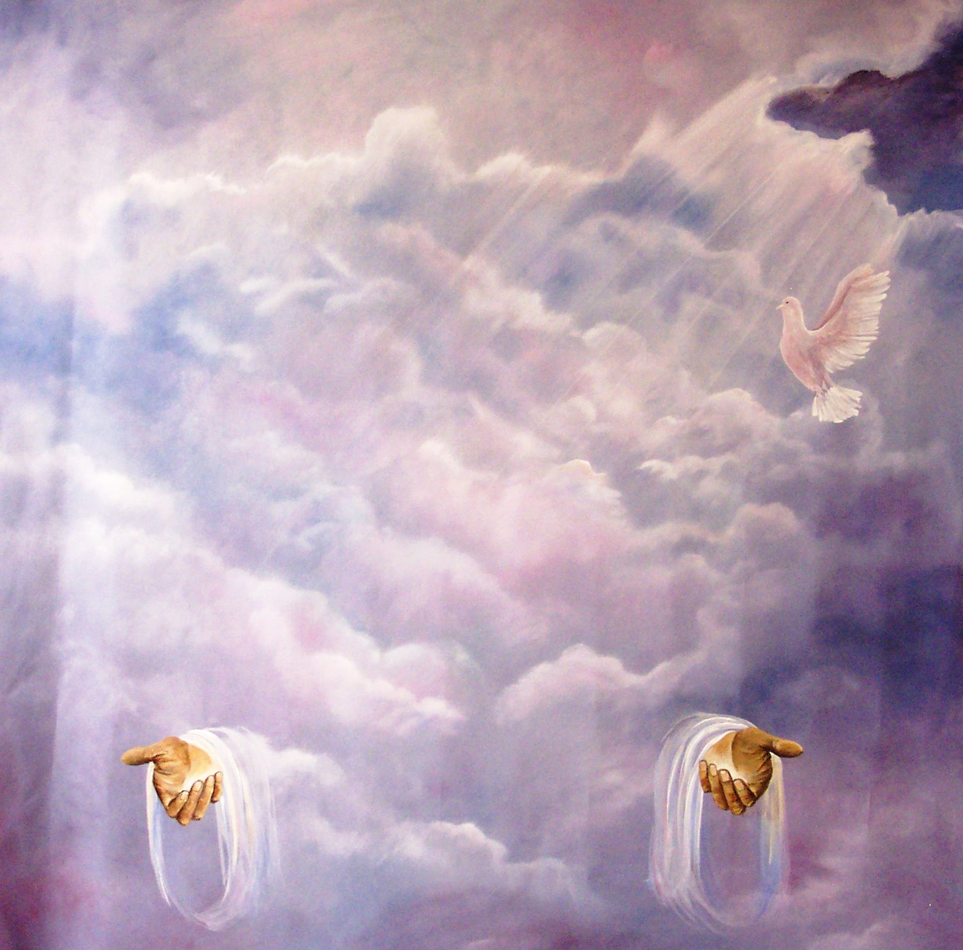
“Then Peter said unto them, Repent, and be baptized every one of you in the name of Jesus Christ for the remission of sins, and ye shall receive the gift of the Holy Ghost.” (Acts2:38)

Slide 5
In the New Testament alone there are some 261 passages which refer to the Holy Spirit. He is mentioned 56 times in the Gospels, 57 times in the book of Acts, 112 times in the Pauline epistles, and 36 times in the remaining New Testament. Total = 522

Slide 7
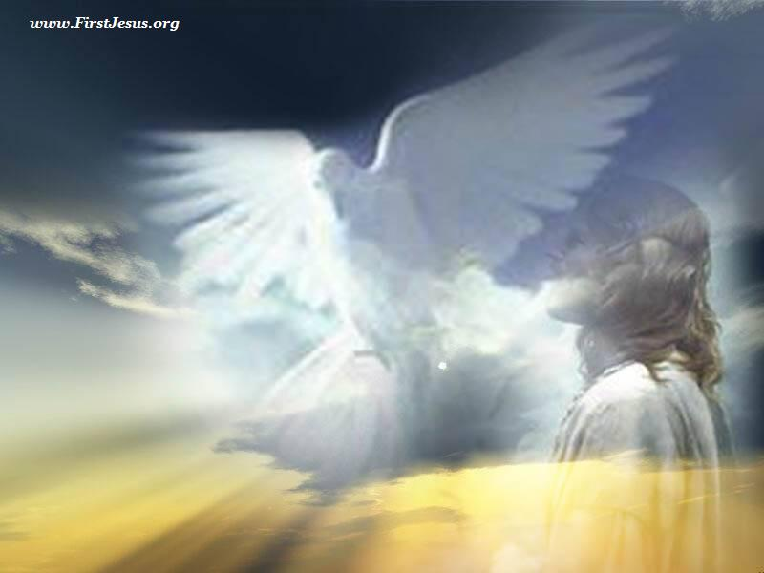
He has a mind – Romans 8:26-28
He has knowledge of God's mind – I Cor. 2:10-16
He is our Teacher - I John 2:26-27
He has a will - I Cor. 12:11
He forbids - Acts 16:6-7
He permits - Acts 16:10
He speaks - Acts 8:29
He loves - Rom. 15:30
He produces fruit in the life of the believer – Gal. 5:22
He grieves - Eph. 4:30
He prays - Rom. 8:26
He comforts - John 14:16

Slide 8
Because the Holy Spirit is Person you can have a personal relationship with him
Romans 8:14 “For as many as are led by the Spirit of God, they are the sons of God.”

Slide 9
“Know ye not that ye are the temple of God, and that the Spirit of God dwelleth in you?” (I Cor. 3:16)

Slide 10
“He therefore that despiseth, despiseth not man, but God, who hath also given unto us his holy Spirit.” I Thess. 4:8
“Having therefore these promises, dearly beloved, let us cleanse ourselves from all filthiness of the flesh and spirit, perfecting holiness in the fear of God.” II Cor. 7:1

Slide 11
“If a man therefore purge himself from these, he shall be a vessel unto honour, sanctified, and meet for the master's use, and prepared unto every good work.” (II Tim. 2:21)

Slide 12
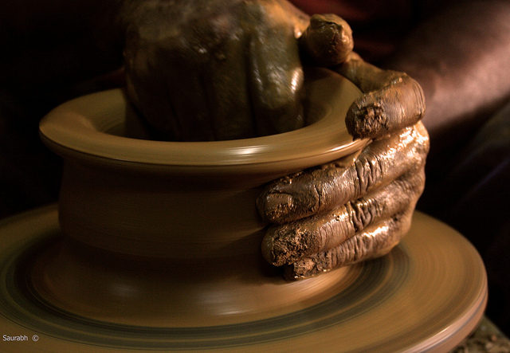

Slide 13
“If we live in the Spirit, let us also walk
in the Spirit.” (Gal. 5:25)

Slide 14
Tonight’s Message

Slide 15
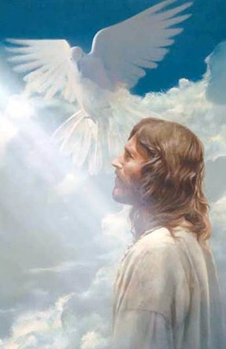
The Deity of the Holy Spirit

Slide 16
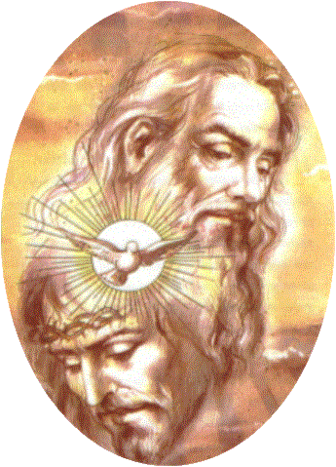
The Holy Spirit possesses all the same Attributes as the Father and the Son

Slide 17
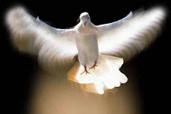
He is omnipotent
"And the earth was without form, and void; and darkness was upon the face of the deep. And the Spirit of God moved upon the face of the waters" (Gen. 1:2)

Slide 18
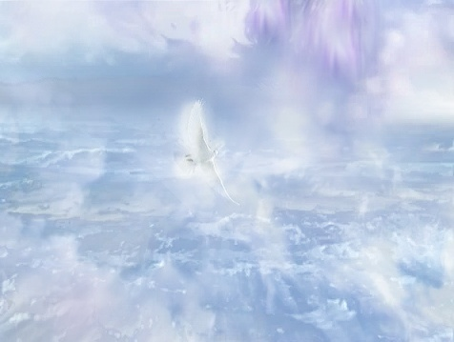

Slide 19
He is omniscient
"But God hath revealed them unto us by his Spirit: for the Spirit searcheth all things, yea, the deep things of God. For what man knoweth the things of a man, save the spirit of man which is in him? even so the things of God knoweth no man, but the Spirit of God" (I Cor. 2:10-11)

Slide 20
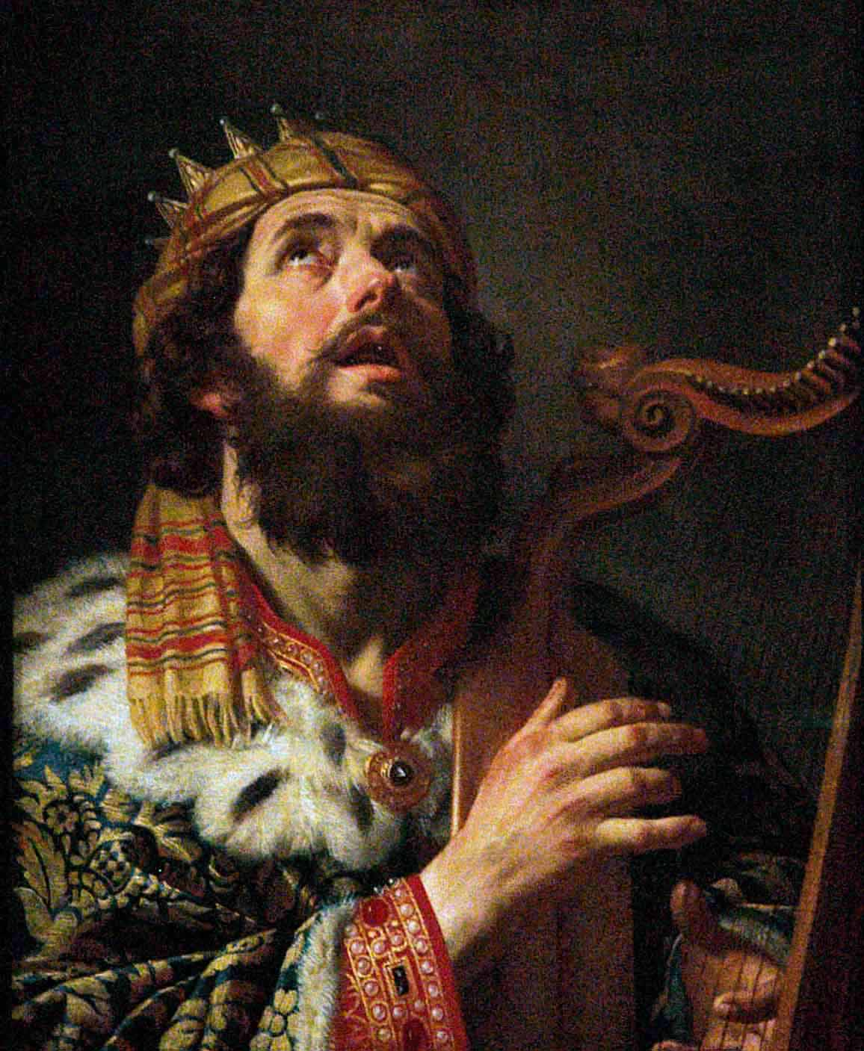
He is omnipresent
"Whither shall I go from thy Spirit? or whither shall I flee from thy presence?" (Psalm 139:7)
In this Psalm, David concludes it was impossible for him to escape God’s Spirit.
This was true even if he ascended to the heights, descended into the depths, traveled across the sea, or surrounded himself with darkness.

Slide 21
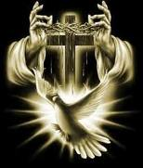
He is eternal
"How much more shall the blood of Christ, who through the eternal Spirit offered himself without spot to God, purge your conscience from dead works to serve the living God?" (Heb. 9:14)

Slide 22
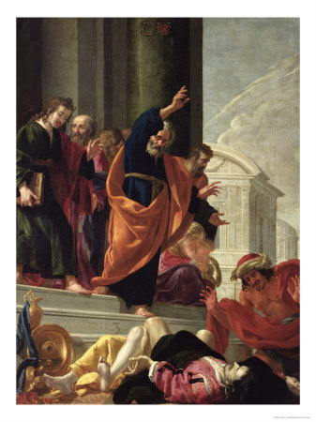
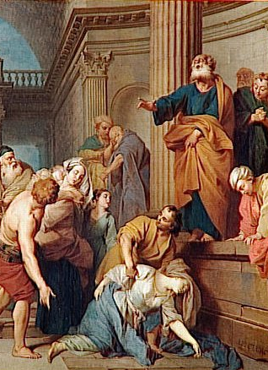
He is called God
"But Peter said, Ananias, why hath Satan filled thine heart to lie to the Holy Ghost, and to keep back part of the price of the land? While it remained, was it not thine own? and after it was sold, was it not in thine own power? why hast thou conceived this thing in thine heart? thou hast not lied unto men, but unto God"
(Acts 5:3-4)

Slide 23
The Holy Spirit is equal with
the Father and the Son
While the Holy Spirit does indeed occupy a place of submission in the Trinity, he is nevertheless equal with the Father and Son in all their divine attributes. His perfect equality with the Father and Son is demonstrated through the following New Testament examples.

Slide 24
As seen in the baptismal experience of Christ
"And Jesus, when he was baptized, went up straightway out of the water: and, lo, the heavens were opened unto him, and he saw the Spirit of God descending like a dove, and lighting upon him: And lo a voice from heaven, saying, This is my beloved Son, in whom I am well pleased" (Matt. 3:16-17)

Slide 25
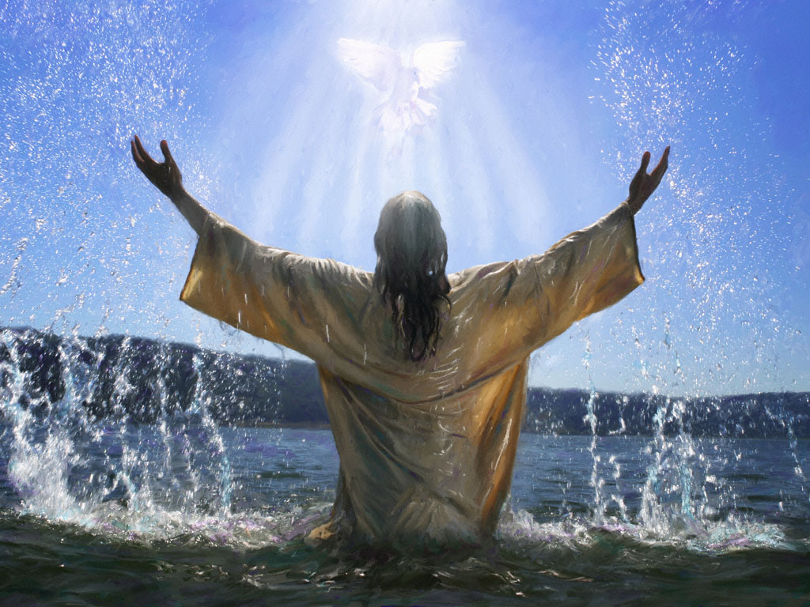

Slide 26
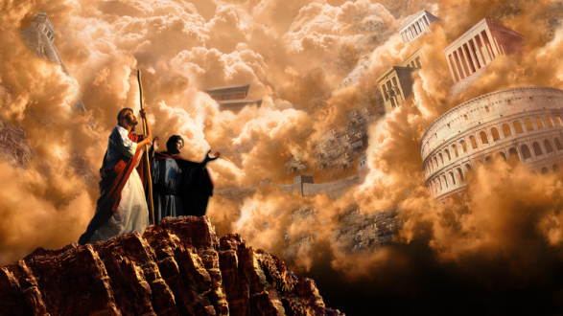
As seen in the temptation of Christ

Slide 27
“Then was Jesus led up of the Spirit into the wilderness to be tempted of the devil. And when he had fasted forty days and forty nights, he was afterward ahungered. And when the tempter came to him, he said, If thou be the Son of God, command that these stones be made bread. But he answered and said, It is written, Man shall not live by bread alone, but by every word that proceedeth out of the mouth of God. Then the devil taketh him up into the holy city, and setteth him on a pinnacle of the temple, and saith unto him, If thou be the Son of God, cast thyself down: for it is written, He shall give his angels charge concerning thee: and in their hands they shall bear thee up, lest at any time thou dash thy foot against a stone. Jesus said unto him, It is written again, Thou shalt not tempt the Lord thy God" (Matt. 4:1-7)

Slide 28
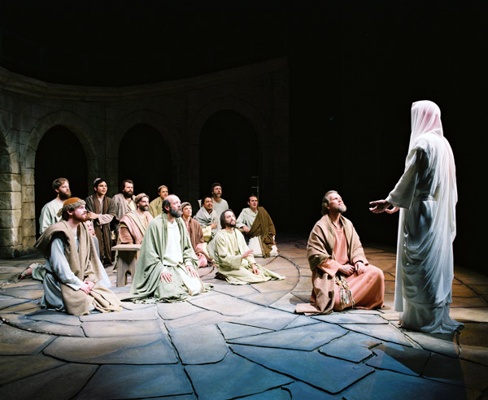
As declared by Jesus in the upper room

Slide 29
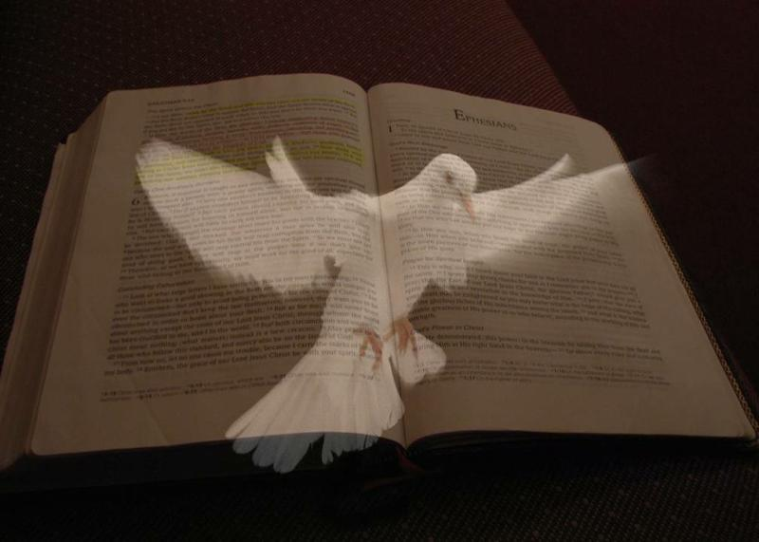
John 14:16 “And I will pray the Father, and he shall give you another (another of the very same kind) Comforter, that he may abide with you for ever.”
John 14:26 “But the Comforter, which is the Holy Ghost, whom the Father will send in my name, he shall teach you all things, and bring all things to your remembrance, whatsoever I have said unto you.”
John 15:26 “But when the Comforter is come, whom I will send unto you from the Father, even the Spirit of truth, which proceedeth from the Father, he shall testify of me.”
John 16:7 “Nevertheless I tell you the truth; It is expedient for you that I go away: for if I go not away, the Comforter will not come unto you; but if I depart, I will send him unto you.”

Slide 31
Holy Spirit is our Comforter
The Greek word translated "Comforter" is "Parakletos" as found in John 14:16, 26; 15:26; and 16:7.
Once, it is translated "advocate" (I John 2:1).
Meaning - one called to the side of another, one who runs to our side and picks us up, helper, defender, encourager, counselor, exhorter.

Slide 33
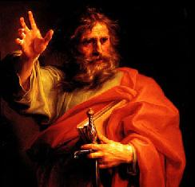
As declared by Paul
"For through him we both have access by one Spirit unto the Father" (Eph. 2:18)
"The grace of the Lord Jesus Christ, and the love of God, and the communion of the Holy Ghost, be with you all. Amen" (II Cor. 13:14)
"For the law of the Spirit of life in Christ Jesus hath made me free from the law of sin and death. For what the law could not do, in that it was weak through the flesh, God sending his own Son in the likeness of sinful flesh, and for sin, condemned sin in the flesh" (Rom. 8:2-3)

Slide 34
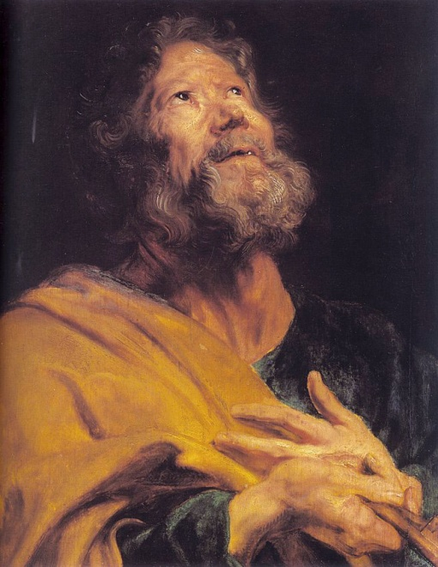
As declared by Peter
"Elect according to the foreknowledge of God the Father, through sanctification of the Spirit, unto obedience and sprinkling of the blood of Jesus Christ: Grace unto you, and peace, be multiplied" (I Pet. 1:2)
"If ye be reproached for the name of Christ, happy are ye; for the Spirit of glory and of God resteth upon you: on their part he is evil spoken of, but on your part he is glorified" (I Pet. 4:14)

Slide 35
As declared in the book of Acts
"Therefore being by the right hand of God exalted, and having received of the Father the promise of the Holy Ghost, he hath shed forth this, which ye now see and hear" (Acts 2:33)

Slide 36
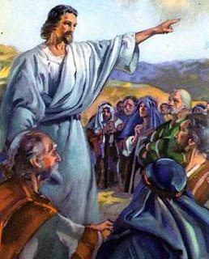
As declared by Jesus on the Mount of Olives
"Go ye therefore, and teach all nations, baptizing them in the name of the Father, and of the Son, and of the Holy Ghost: Teaching them to observe all things whatsoever I have commanded you: and, lo, I am with you alway, even unto the end of the end of the world. Amen"
(Matt. 28:19-20)

Slide 38
I John 5:7-8 “For there are three that bear record in heaven, the Father, the Word, and the Holy Ghost: and these three are one. And there are three that bear witness in earth, the Spirit, and the water, and the blood: and these three agree in one.”

Slide 39
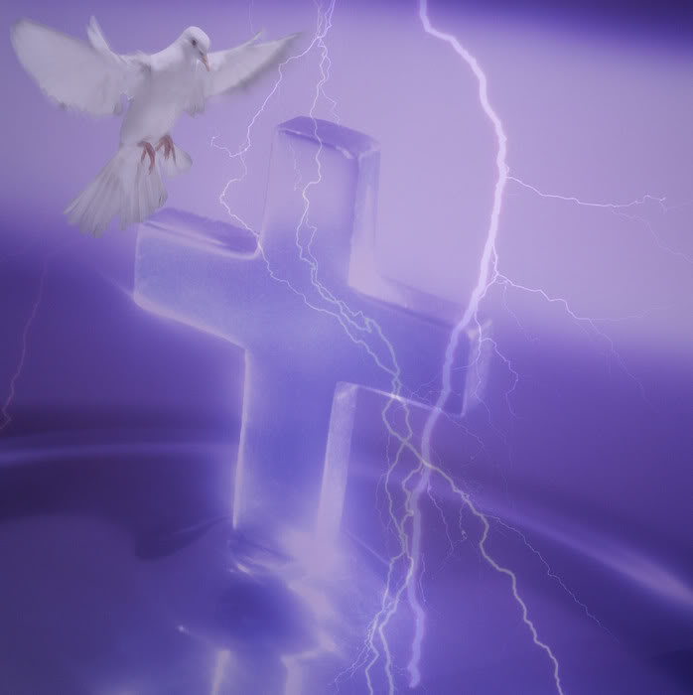
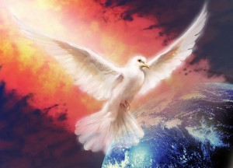
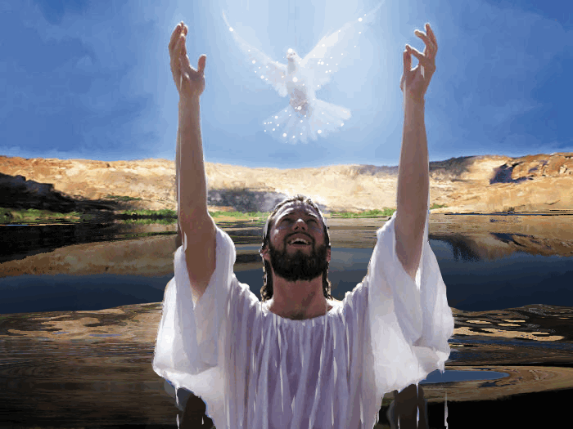
1. There is the witness of the Spirit -
2. There is the witness of the water or the baptism of Jesus Christ -
3. There is the witness of the blood or the cross and death of Jesus Christ -

Slide 40
