Slide 1
The Filling of the Holy Spirit (Part 2) (Galatians 5:22-23)

Slide 2
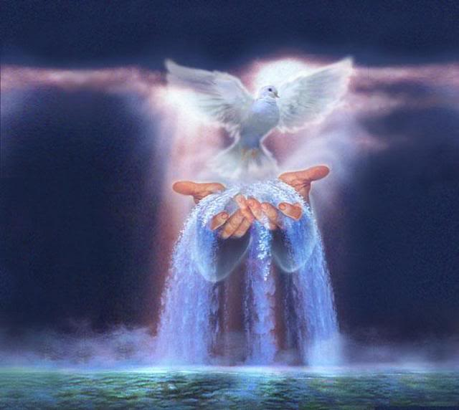
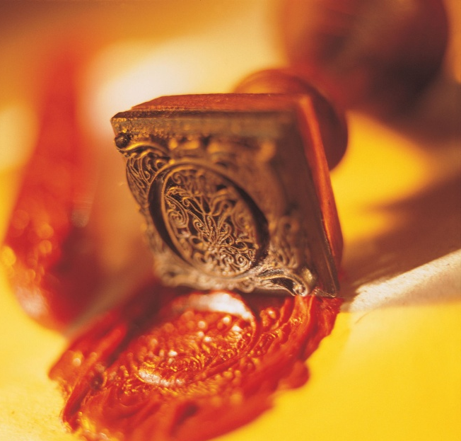
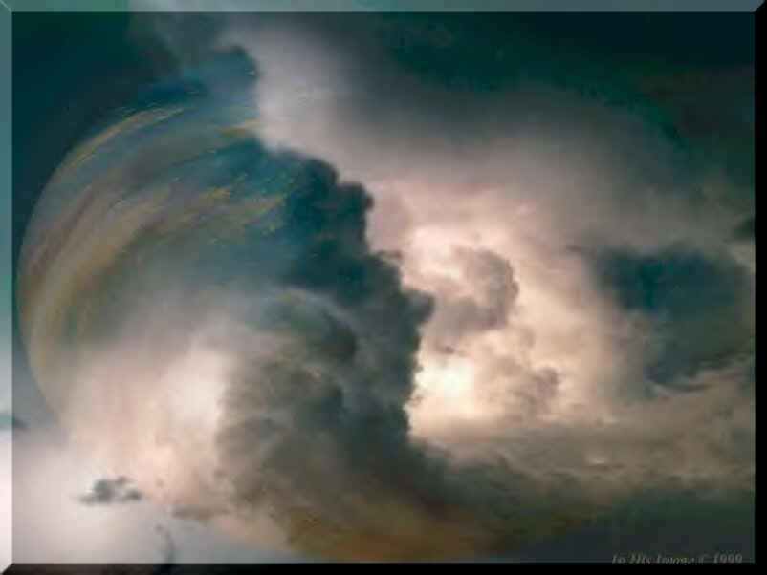
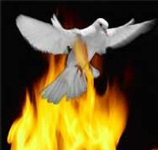

Slide 4
Wine a symbol of the filling of the Holy Spirit.

Slide 5
The Comparison

Slide 6
The Comparison is a Control Issue

Slide 7
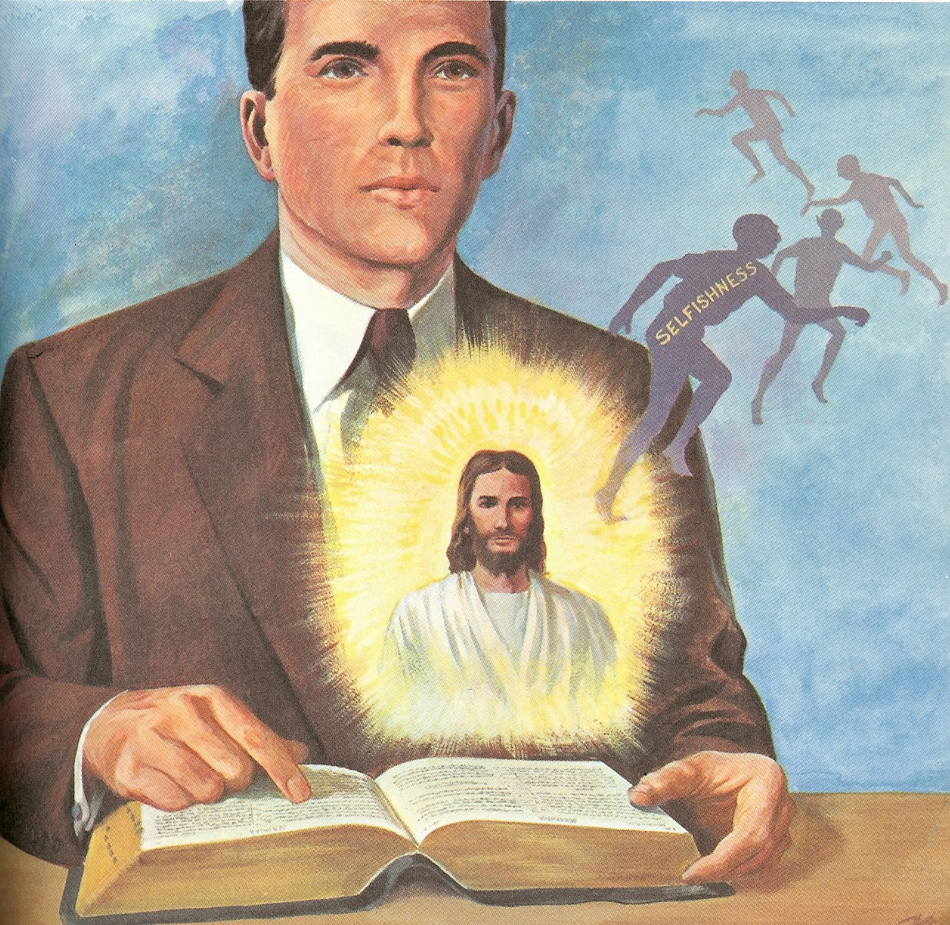
How to be Filled with the Holy Spirit

Slide 8
1. Purpose to live a holy life – I Thess. 4:1-8
2. Yield yourself to the Lord – Rom. 6,
12:1-2
3. Renew your mind daily – Eph. 4:23-24
4. Make no provision for the flesh – Rom.
13:14
5. Flee temptation – II Tim. 2:22
6. Resist Satan by continual submission to
God – Jam. 4:6-10
7. Do not give place to the devil – Eph. 4:
27-30 (bitterness, immorality, covetousness)

Slide 9
8. Keep you thought centered on things above – Phil. 4:6-8
9. Set your affections on things above – Col. 3:1-4
Keep your sin confessed – Prov. 28: 13-14
Keep your conscience clear – Acts 24:16
Obey the promptings of the Holy Spirit – Rom. 8:14

Slide 10
13. Avoid quenching and grieving the
Holy spirit – I Thess. 5:19, Eph. 4:25-31
14. Ask God to fill you with the Holy Spirit –
Luke 11:15
The Holy Spirit is called the “Spirit of Grace” Heb. 10:29
“God gives grace to the humble…”

Slide 13
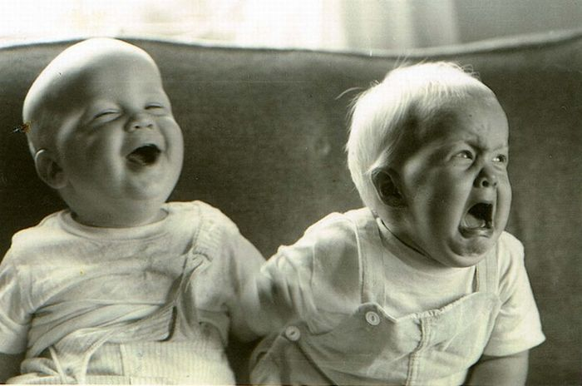
The test of spirit-filling is how well you responded to sources of irritation (Matthew 5:1-16)

Slide 14
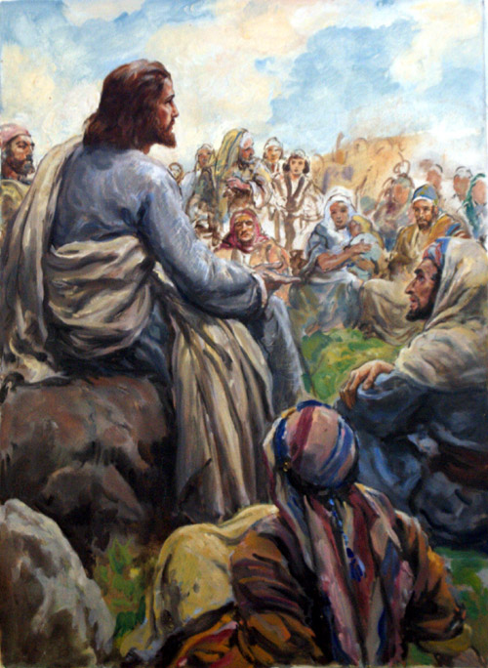
(Matthew 5:1-16)
Poor in spirit
Mourn
Meek
Hunger and Thirst
Merciful
Pure in heart
Peacemakers
Persecuted

Slide 15
(I Peter 2:18-23) “Servants, be subject to your masters with all fear; not only to the good and gentle, but also to the froward. For this is thankworthy, if a man for conscience toward God endure grief, suffering wrongfully. For what glory is it, if, when ye be buffeted for your faults, ye shall take it patiently? but if, when ye do well, and suffer for it, ye take it patiently, this is acceptable with God.

Slide 16
For even hereunto were ye called: because Christ also suffered for us, leaving us an example, that ye should follow his steps: Who did no sin, neither was guile found in his mouth: Who, when he was reviled, reviled not again; when he suffered, he threatened not; but committed himself to him that judgeth righteously.”

Slide 17
Follow Christ’s example
Submit to God – James 4:7
Resist the Devil – I Pet. 5:9
Ask God to fill you with His Holy Spirit – Luke 11:13

Slide 19
Overcoming anger by Yielding Personal Rights
Jesus Christ is our example to look to concerning personal rights and how to yield those rights.
We are to follow Christ’s example - I Peter 2:21-23
We are to have Christ’s attitude - Philippians 2:5-8
Christ yielded His right to wealth - I Corinthians 2:9; Revelation 21:10-11, 18-19, 23; 22:1-2
Christ yielded His right to a Good Reputation - Mark 3:1-6; Luke, 7:38-50; John 1:46; 8:41

Slide 20
Christ yielded His right to be served - John 13:3-5, 12-15
Christ yielded His right to Physical Comforts - Matthew 8:20; Mark 1:32-35
Christ yielded His right to make His own Decisions - John 6:38; Luke 22:42 “. . . I came . . . not to do my own will, but the will of Him that sent me . . . not my will, but thine be done. . .”

Slide 21
Transferring Ownership of all we have to the Lordship of Jesus Christ - Rom. 12:1-2
Christ’s ownership of His entire creation - Colossians 1:16-17
God’s ownership over our lives - I Corinthians 6:19-20

Slide 23
A fundamental truth of Scripture is the principle of Stewardship
A steward is one who manages the property of another – I Corinthians 4:1-2
As God’s stewards we own nothing - He does!!!
The proper view of the Christian should be that which Job had - Job 1:21

Slide 24
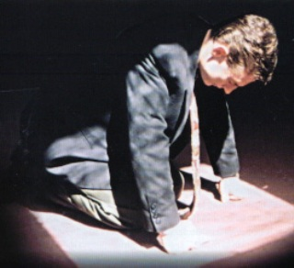
How to Submit to God
Thank God for it – I Thess. 5:24
Determine if you caused it – Matt. 5:23-24
Develop character through it – Rom. 5:5:3-4
Love your offender – Luke 6:27-28

Slide 25
Wrong Response to Irritations
Hold it in (bitterness)
Blame others
Defend yourself
Resist the grace of God

Slide 26
Symptoms of Anger
Impatience
Raising voice
Angry look
Silence
Harshness
Name calling
Violence
Flushed face
Sarcasm
Cursing
Dilated pupils
Mocking
Ridicule
Tight jaw
Grinding of teeth
Rejection

Slide 27
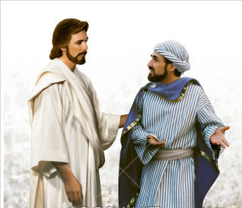
“Deliver him to the tormentors…So likewise shall my heavenly Father do also unto you, if ye from your heart forgive not every one his brother their trespasses.”

Slide 28
Steps to Resolve Anger
Accept responsibility for your anger – Col. 3:8
See your anger through your victim’s eyes – Gal. 5:15
Act quickly to correct past offenses – Matt. 5:22-23
Ask forgiveness for your anger – “I was wrong will you please forgive me.”

Slide 29
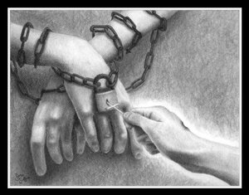
Fully forgive your offender – Matt. 18:21-25
Realize the benefits – Rom. 8:28-30
Yield your rights to God – I Cor. 6:19-20
Establish accountability with a godly friend – Prov. 27:17

