Slide 1
The Doctrine of the Holy Spirit
(The Symbols of the Holy Spirit)
“The Spirit filled life”

Slide 2
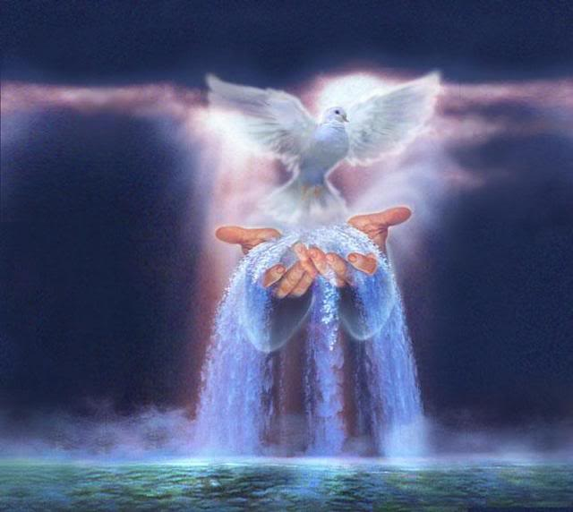
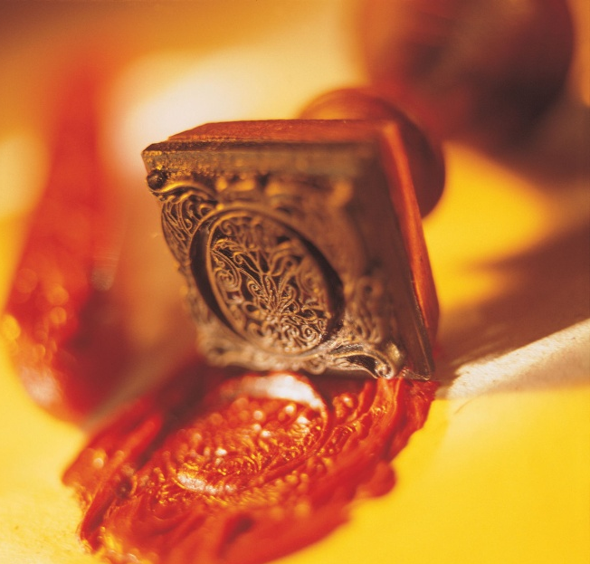
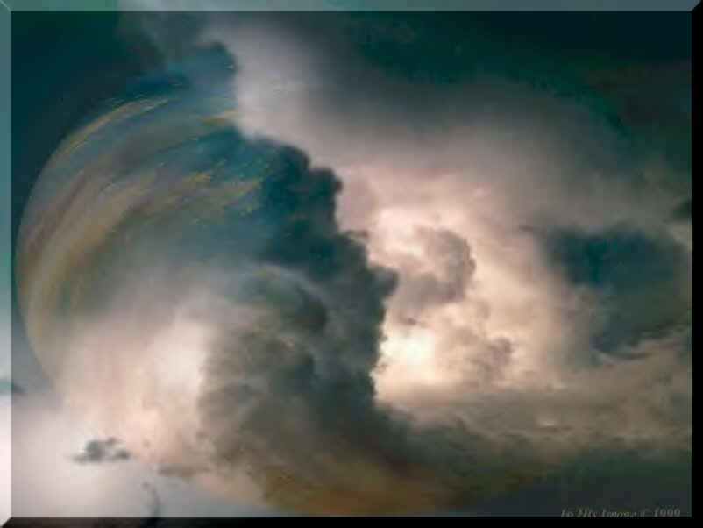
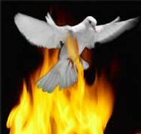

Slide 3
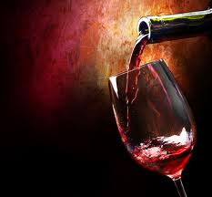
Wine is one of the most unusual symbols relating to the Holy Spirit.

Slide 6
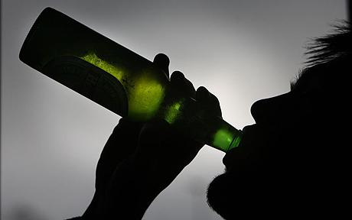
The Comparison

Slide 7
What precisely is the point of comparison between wine and the Holy Spirit? Doubtless the issue is influence or control. A person under the influence of wine experiences altered behavior. He or she may say or do things he or she would not ordinarily do.

Slide 8
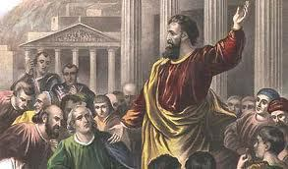
Likewise, the filling of the Holy Spirit produces a change in behavior. In the Book of Acts, once-timid fearful disciples became flaming evangelists for Jesus Christ.

Slide 9
The Comparison is a Control Issue

Slide 10
The filling of the Holy Spirit is compared to being drunk with wine in excess - Ephesians 5:18
The reason for the comparison is simple - A drunk person is under the control of alcohol, he thinks, speaks, and acts in ways that are not natural when he is sober.
Likewise a Christian who is filled with the Spirit will think, speak, and act in ways that are not natural for him.

Slide 11
In Ephesians 5:19‑21, Paul mentioned three practical results of the filling of the Spirit: 1# Singing 2# A thankful heart 3# An attitude of submission The last result is most significant because true submission always involves giving up your right to be in control.

Slide 12
The command to be filled with the spirit
The verb "be filled" in the original text of Ephesians 5:18 is in the present tense in the Greek.
This means = continuous action.
In other words it could read - "keep on being filled with the spirit. . ."

Slide 13
As Christians we are to pursue the "filling of the Holy Spirit at all times"
1. The Filling of the Holy Spirit is a repeated experience -
Believers were filled with the Spirit at Pentecost (Acts 2:4).
These same believers experienced another filling in (Acts 4:31).
Paul was filled with the Spirit shortly after his conversion (Acts 9:17).
Several years later he was filled with the Spirit again (Acts 13:9).

Slide 14
To be Filled with the Holy Spirit is to be controlled by the Holy Spirit (wine).
The word filled is found three other times in the Scriptures in which it means controlled –
Filled with Fear - Luke 5:26
Filled with madness - Luke 6:6-11
Filled with Sorrow - John 16:6

Slide 15
Next Week

Slide 16
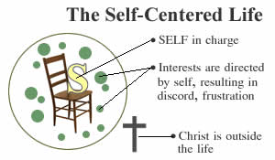

Slide 17
The Filling of the Holy Spirit
(Ephesians 5:18)

Slide 18
Of all the aspects of the person and work of the Holy Spirit none is more vital to the Christian’s growth and maturity than the filling of the Holy Spirit –
The filling of the Holy Spirit is the means by which He controls the attitude and behavior of believers, performing His ministries through them – “…to the glory of God!”

Slide 19
The Word of God Divides Believers into Two Categories
(I Cor. 3:1-3)

Slide 20
The Carnal Believer’s Characteristics
He lives according to the desires of his own flesh.
He is controlled by - “The lust of the flesh…
lust of the eyes and the pride of life…”
Self is on the throne of his life / The Lordship of Christ over his life has been rejected – “Whosoever ye yield your selves servants to obey his servants ye are to whom ye obey…”

Slide 21
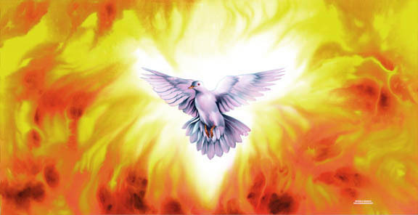
He has grieved (Eph. 4:30) and quenched (I Thess. 5:19) the ministry of the Holy Spirit in his life.
It is only when the Holy Spirit fills (controls) a believer that he can work in and through the life of that believer – “I am crucified with Christ…Christ liveth in me…”

Slide 23
Baptizes us into the body of Christ – “for by one spirit are baptized…”
Indwells us – “temple of the Holy Spirit”
Seals us unto the day of redemption – Eph. 1:13-14
Earnest – a down payment, a pledge – II Cor. 5:5
Imparts to us spiritual gifts which enable us (equips us) to effectively serve the Lord - I Peter 4:10 “gifts of the spirit”

Slide 24
Guides us into all truth – John 16:13
Teaches us as we study the Word of God
– “called the anointing” I John 2:27
Reveals Biblical truth to us – I Cor. 2:10
Empowers us to serve the Lord – Acts1:8
Imparts to us and through us the love of
God – Rom. 5:5
Conforms us into the image of Christ –
II Cor. 3:18
Gives us the assurance of our salvation –
Rom. 8:16

Slide 25
Comforts us – John 14:16
Produces His fruit in and through us –
Gal. 5:22-23
Strengthens us in our inner man – Eph.
3:16
Prompts us – Rom. 8:14
Puts His words in our mouth – Matt.13:11

Slide 26
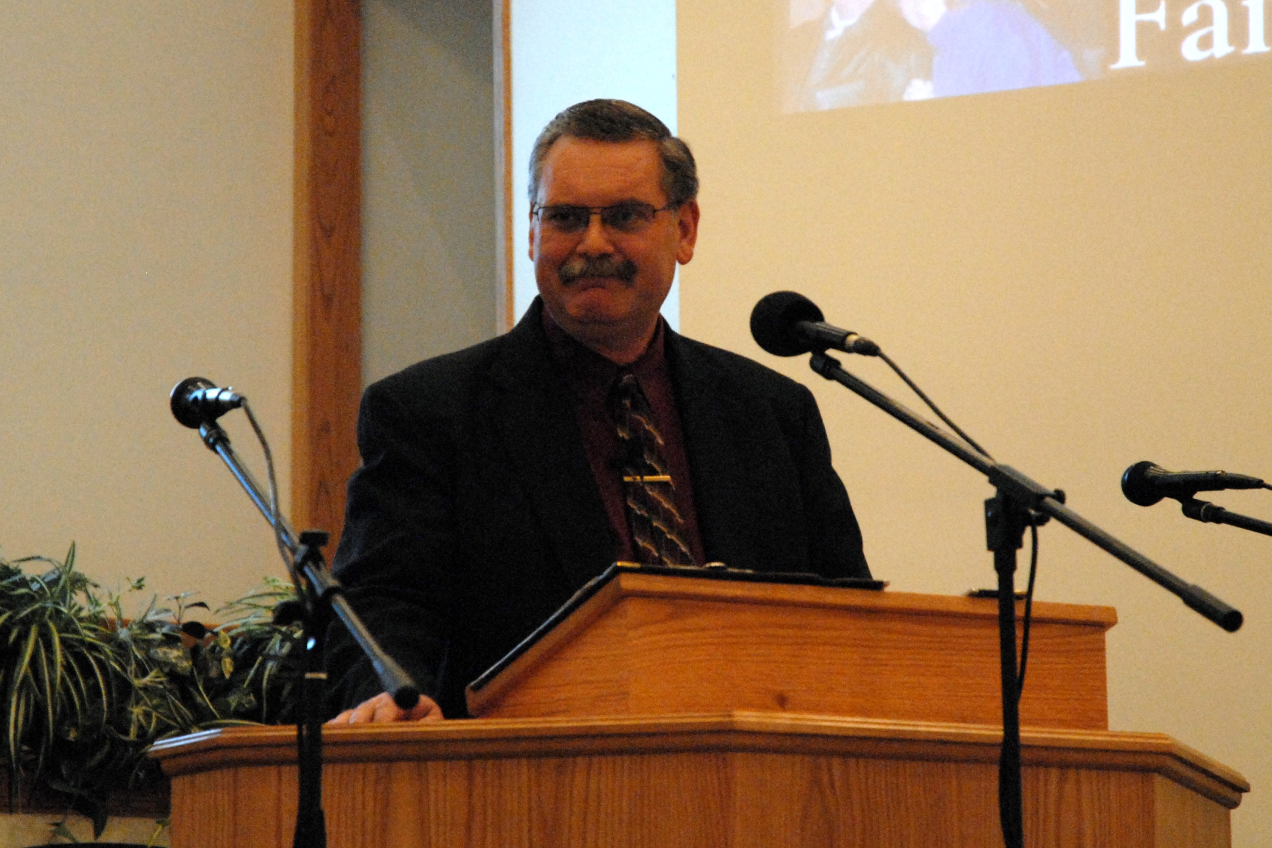

Slide 27
A carnal believer is not able to enjoy of these ministries of the Holy Spirit.
The fruit that he bears is just the opposite of the fruit of the Spirit!

Slide 28
“Now the works of the flesh are manifest, which are these; Adultery, fornication, uncleanness, lasciviousness, Idolatry, witchcraft, hatred, variance (quarrel, wrangling, contention, debate, strife), emulations (jealousy, malice, envy), seditions (dissension, division, disunity) heresies, envyings, murders, drunkenness, revellings, and such like” (Galatians 5:19-21)

Slide 30
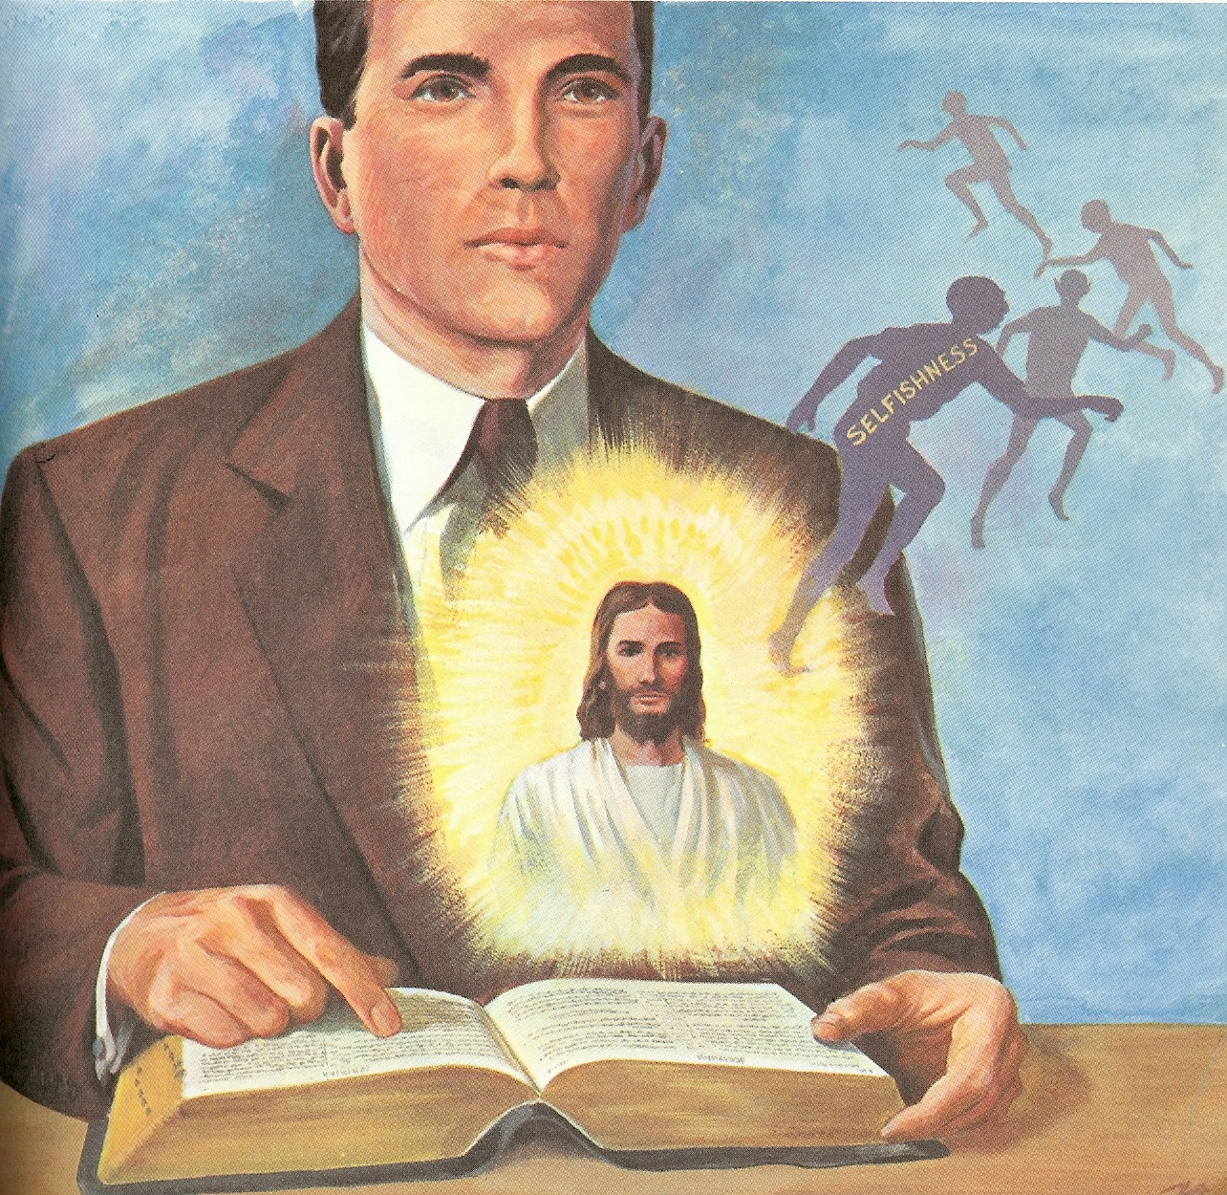
The Spiritual Believer’s Characteristics
Carnality and Spirituality
are Opposites
Rom. 7:14-23
Gal. 5:16-17, 22-23

Slide 32
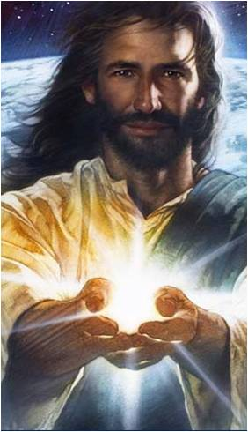
Every Christian experiences this inner struggle between the flesh and the spirit. But who controls you is a matter of personal choice – Jesus said “Shall not I give the Holy Spirit to them that ask…”
(When was the last time you asked the Holy Spirit to fill you?)

Slide 34
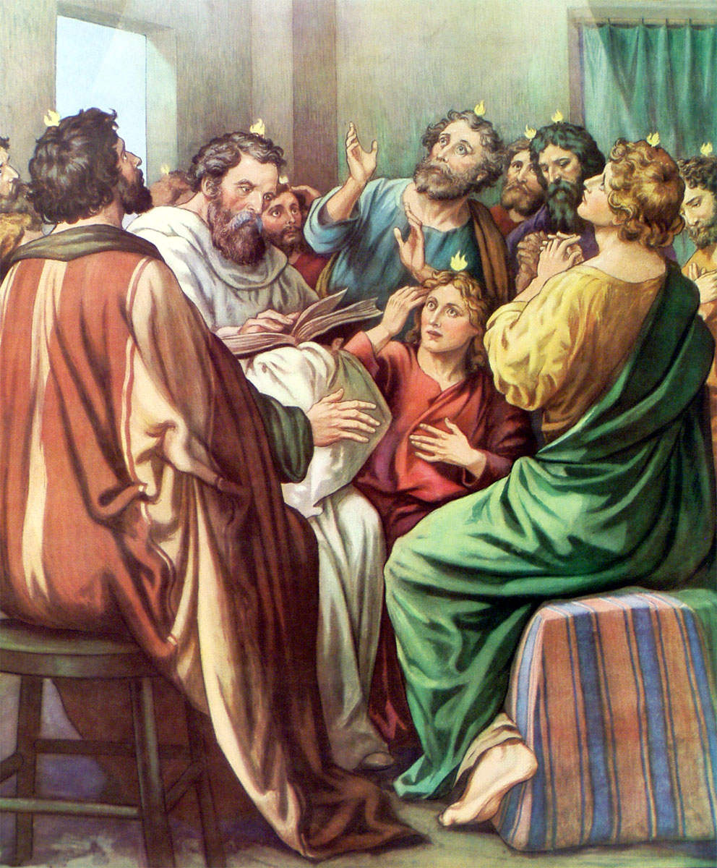
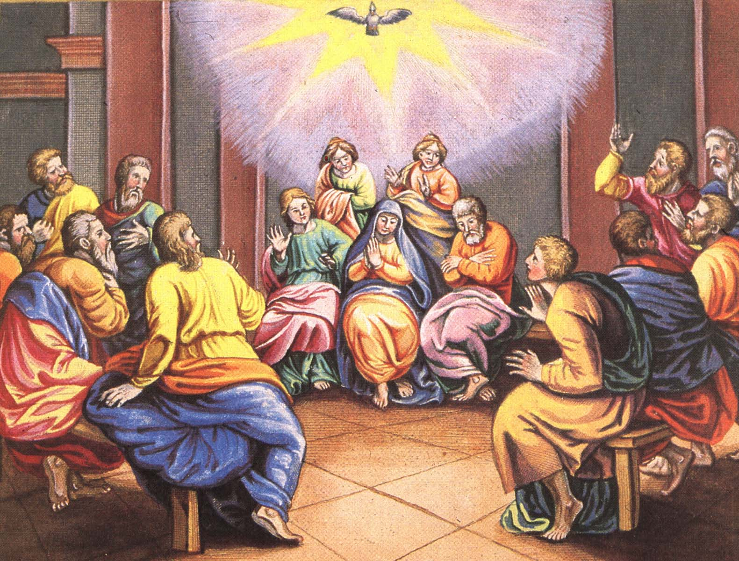
How to be Filled with the Holy Spirit

Slide 35
Purpose to live a holy life – I Thess. 4:1-8
Yield yourself to the Lord – Rom. 6, 12:1-2
Renew your mind daily – Eph. 4:23-24
Make no provision for the flesh – Rom. 13:14
Flee temptation – II Tim. 2:22
Resist Satan by continual submission to God – James 4:6-10

Slide 36
Do not give place to the devil – Eph. 4:27–31 (bitterness, immorality, covetousness)
Keep your thoughts centered on things pure and lovely – Phil. 4:6-8
Set your affections on things above – Col. 3:1-4
Keep sin confessed – Prov. 28:13-14
Keep your conscience clear – Acts 24:16
Obey the promptings of the Holy Spirit – Rom. 8:14

Slide 37
Avoid quenching and grieving the Holy Spirit – I Thess. 5:19, Eph. 4:25-31
Ask God to fill you with the Holy Spirit – Luke 11:15
Note: The Holy Spirit is called the “Spirit of Grace” in Heb. 10:29 “God gives grace to the humble…”

Slide 38
“God gives grace to the humble…”
To whom does God give grace?

Slide 39
The Filling of the Holy Spirit
is to be Sought (pursued) by
Every Believer
We are never commanded to be indwelt, sealed or baptized with the Spirit.
This happened the moment you received Christ as your personal Savior.
We are however commanded to be “filled with the Spirit…”

Slide 40
“Be not drunk with wine…”
“Be filled with the Spirit…”

