Slide 1
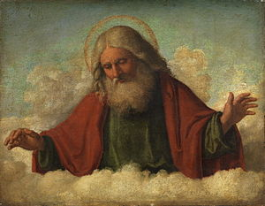
The Doctrine of the Father
“The Fatherhood of God”
(Part 3)

Slide 2
REVIEW

Slide 3
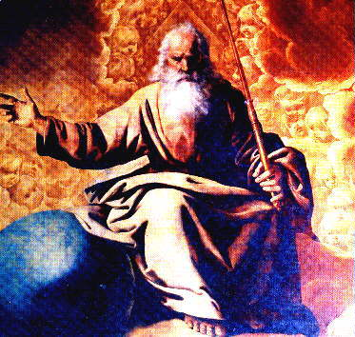
He is the Father (source) of all life

Slide 4
“For by him were all things created, that are in heaven, and that are in earth, visible and invisible, whether they be thrones, or dominions, or principalities, or powers: all things were created by him, and for him.” Colossians 1:16

Slide 5
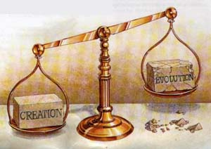

Slide 6
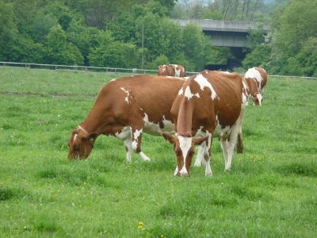
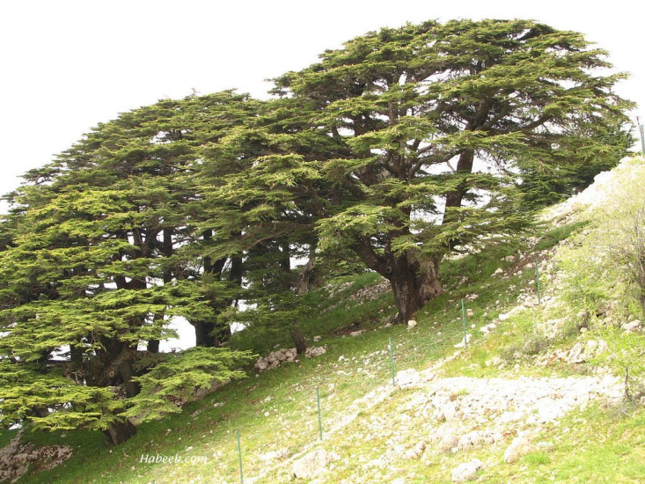
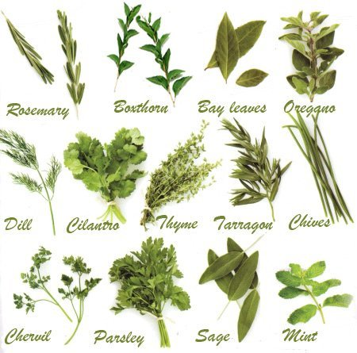
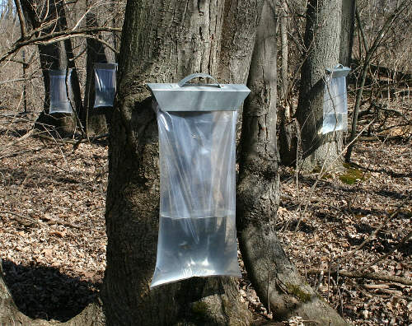
He tends and cares for the Vegetation of the Earth (Psalm 104:14, 16)

Slide 7
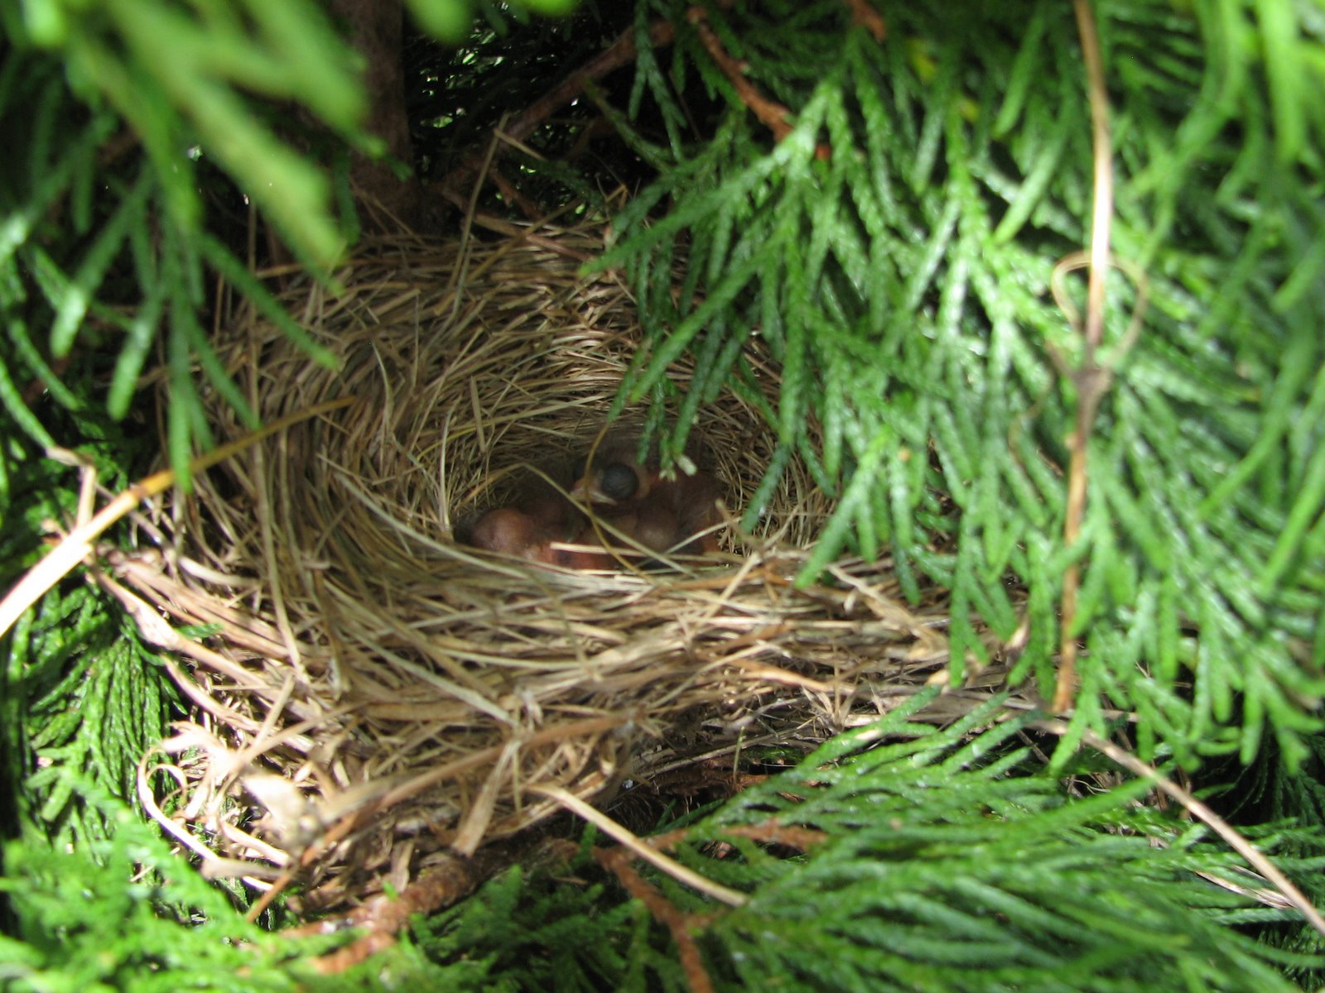
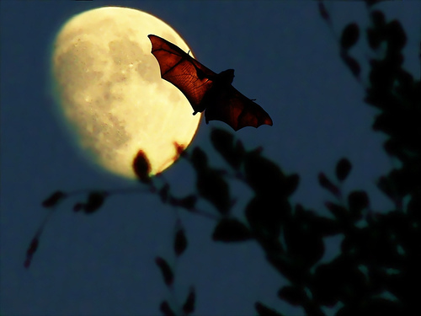
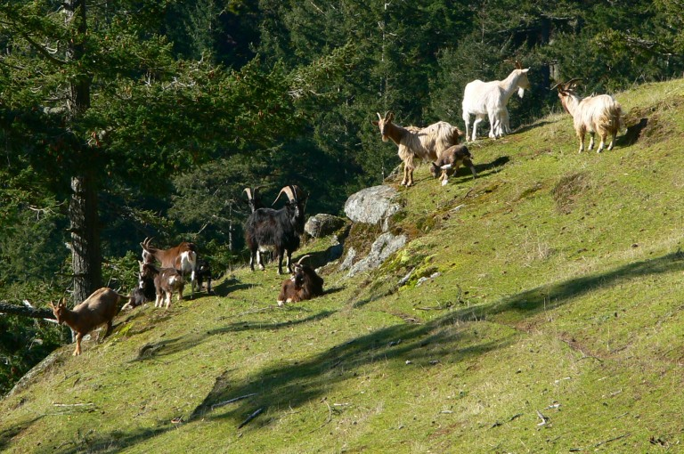
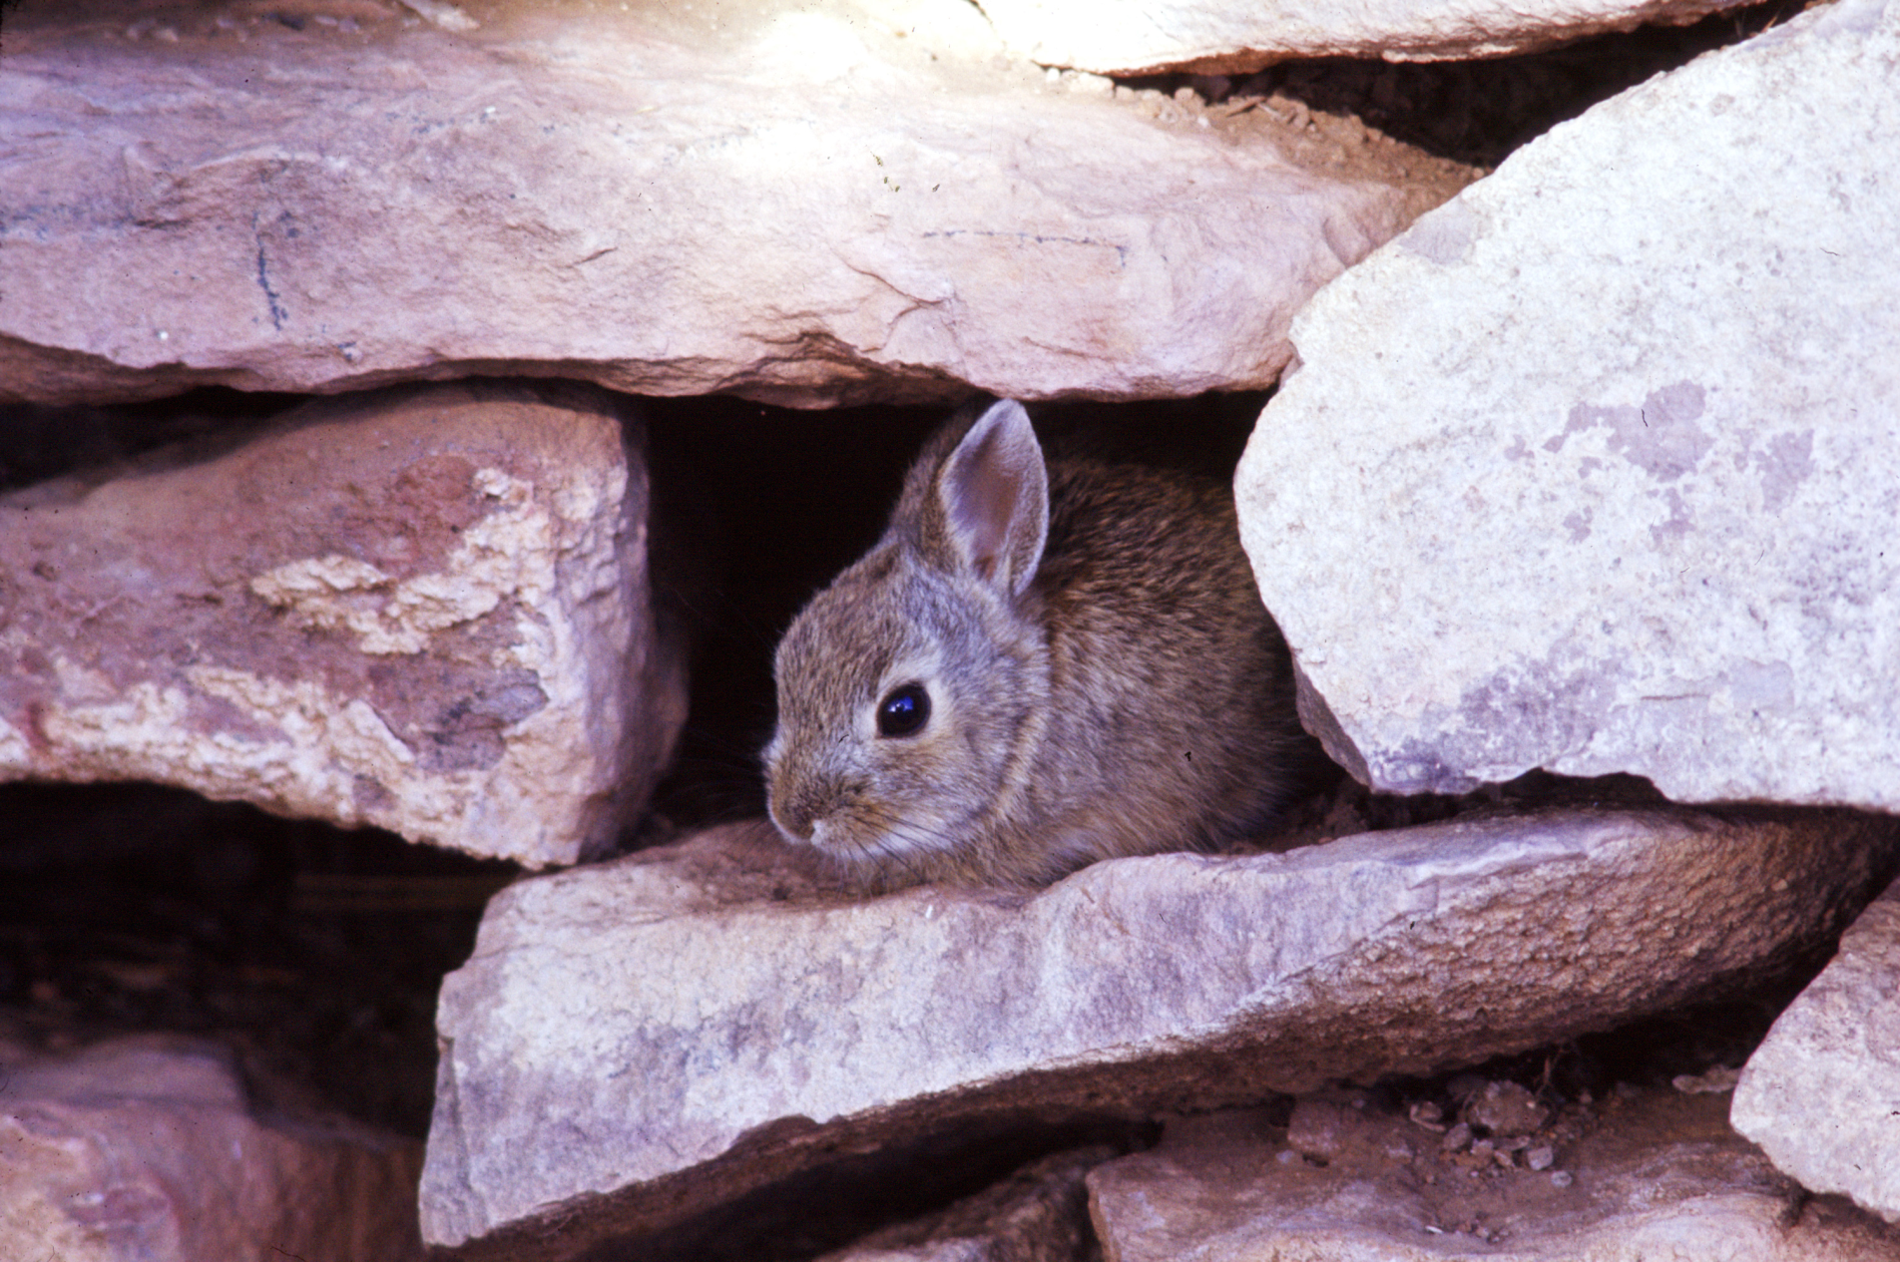
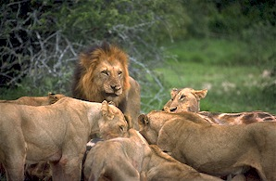
He tends and cares for all the Birds and Animals in the World (Psalm 104:18, 20, 21, 27)

Slide 8
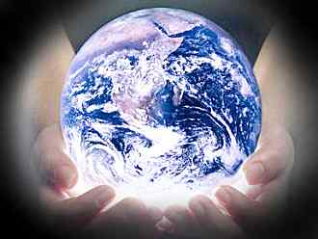
He tends and cares for the Weather (Jer. 51:16)

Slide 9
He tends and cares for the Seasons (Gen. 8:22)

Slide 10
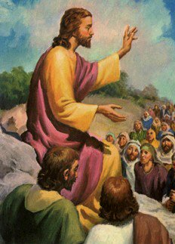
"And why take ye thought for raiment? Consider the lilies of the field, how they grow; they toil not, neither do they spin: And yet I say unto you, That even Solomon in all his glory was not arrayed like one of these. Wherefore, if God so clothe the grass of the field, which today is, and tomorrow is cast into the oven, shall he not much more clothe you, O ye of little faith?" (Matt. 6:28-30)

Slide 11
Why was man created?

Slide 12
Love God
“And thou shalt love the Lord thy God with all thy heart, and with all thy soul, and with all thy mind, and with all thy strength: this is the first commandment.” Mark 12:30

Slide 13
Worship God
“But the hour cometh, and now is, when the true worshippers shall worship the Father in spirit and in truth: for the Father seeketh such to worship him.” John 4:23

Slide 14
Fellowship with God
“That which we have seen and heard declare we unto you, that ye also may have fellowship with us: and truly our fellowship is with the Father, and with
his Son Jesus Christ.”
I John 1:3

Slide 15
Serve God
“And thou, Solomon my son, know thou the God of thy father, and serve him with a perfect heart and with a willing mind: for the LORD searcheth all hearts, and understandeth all the imaginations of the thoughts: if thou seek him, he will be found of thee; but if thou forsake him, he will cast thee off for ever.”
I Chro. 28:9

Slide 16
Glorify God
“Let your light so shine before men, that they may see your good works, and glorify your Father which is in heaven.” Matt. 5:16

Slide 17
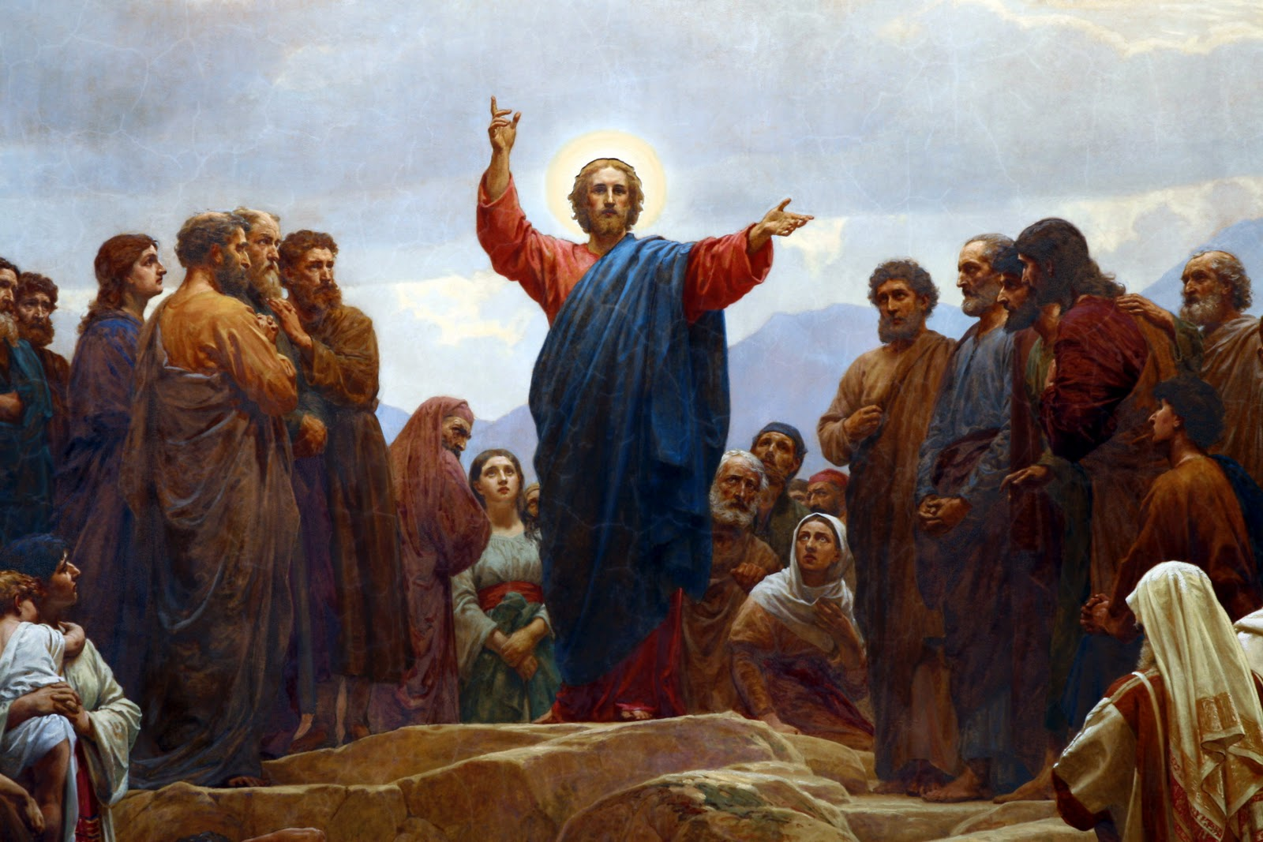
He is the Father of the Lord Jesus
During his earthly ministry Jesus spoke more about the Father than any other subject. He is mentioned by the Savior over 200 times during his earthly ministry.

Slide 18
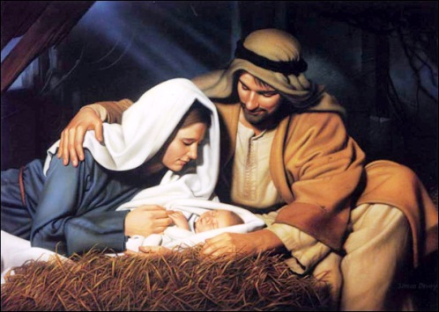
The Father sent his Son (Gal. 4:4)

Slide 19
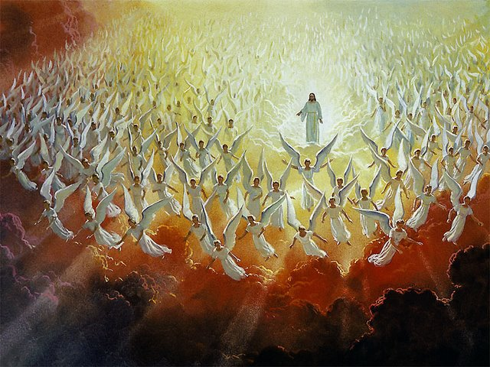
The Father commanded the angels to worship his Son
“When he bringeth in the first begotten into the world, he saith, And let all the angels of God worship him" (Heb. 1:6; see also Luke 2:8-15)

Slide 20
He sealed his Son
It means to set or mark with a seal in order to confirm, attest , to authenticate.
To prove one’s testimony, that he is what he professes to be.
"Labour not for the meat which perisheth, but for that meat which endureth unto everlasting life, which the Son of man shall give unto you: for
him hath God the
Father sealed"
(John 6:27)

Slide 21
He bore witness to his Son
“And lo a voice from heaven, saying, This is my beloved Son, in whom I am well pleased.” Matt. 3:17

Slide 22
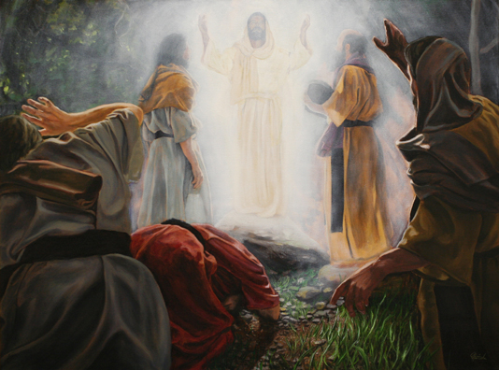
He delighted in his Son
"While he yet spake, behold, a bright cloud overshadowed them: and behold a voice out of the cloud, which said, This is my beloved Son, in whom I am well pleased; hear ye him"
Matt. 17:5

Slide 23
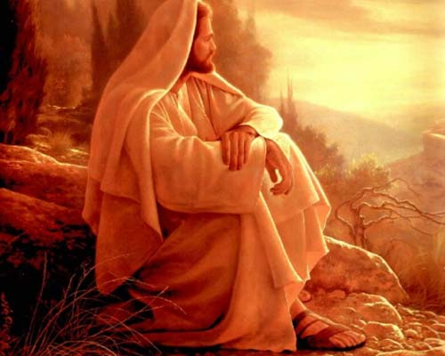
He was totally satisfied by his Son
“And he that sent me is with me: the Father hath not left me alone; for I do always those things that please him.”
John 8:29

Slide 24
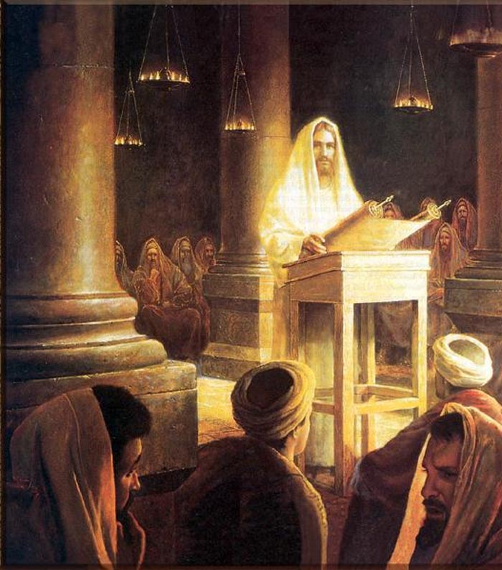
He spoke through his son (John 8:28)

Slide 25
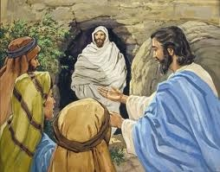
He listened to his Son (John 11:41-42)

Slide 26
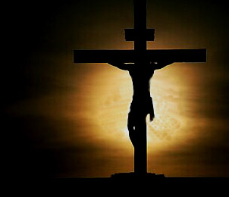
He offered his Son (Rom. 8:32)

Slide 27
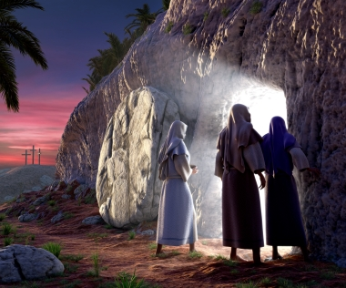
He raised his Son (Gal. 1:1)

Slide 28
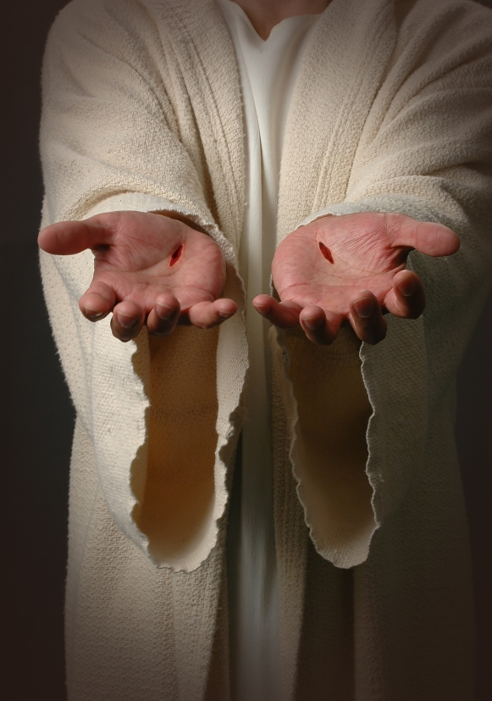
He loved (and loves) his Son (John 10:17)

Slide 29
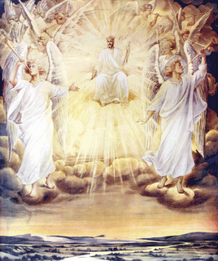
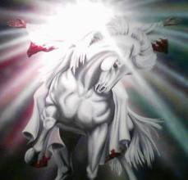
He honored (and honors) his Son
"Jesus answered, If I honour myself, my hour is nothing: it is my Father that honoureth me; of whom ye say, that he is your God"
John 8:54

Slide 30
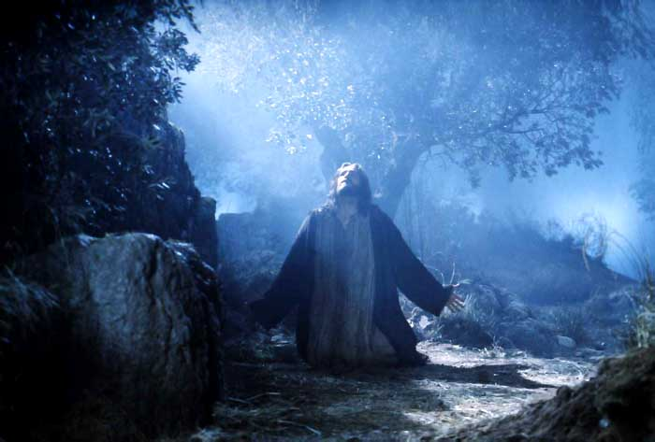
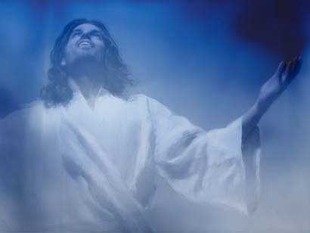
He glorified his Son (John 17:1, 5)

Slide 31
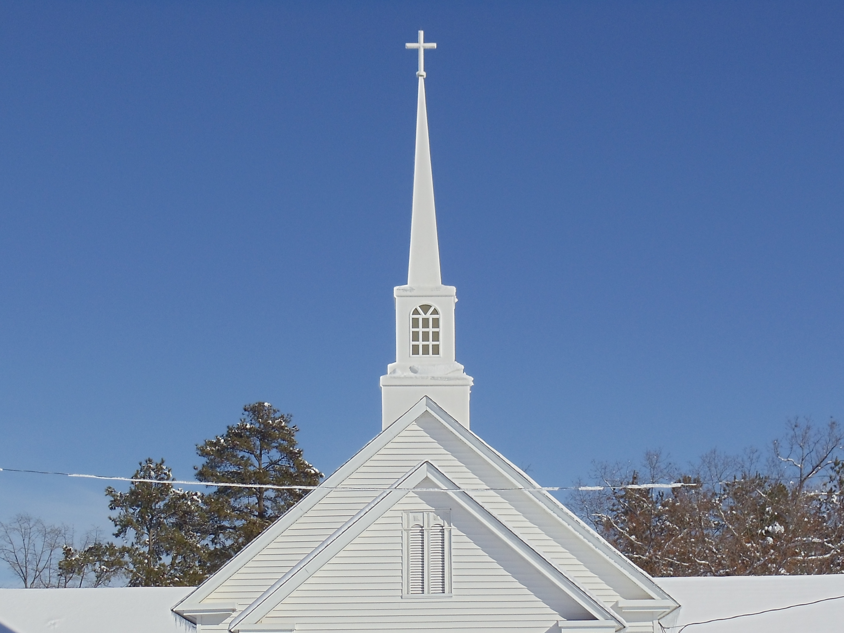
He makes his Son head of the church (Eph. 1:22; Col. 1:18)

Slide 32
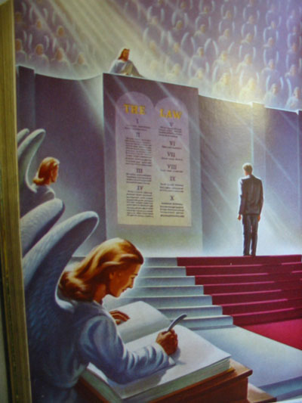
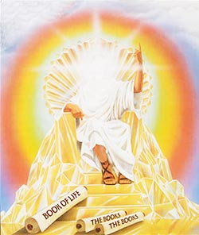
He commits all judgment unto his Son (John 5:22, 27)

Slide 33
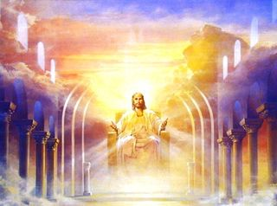
He exalts his Son (Phil. 2:9-11)

Slide 34
He Is the Father of All Believers
While God is the Creator of all men (Gen. 1:27; Eccl. 12:1; Acts 17:24-26)
He is the Father only of believers - "Behold, what manner of love the Father hath bestowed upon us, that we should be called the sons of God: therefore the world knoweth us not, because it knew him not. Beloved, now are we the sons of God, and it doth not yet appear what we shall be: but we know that, when he shall appear, we shall be like him; for we shall see him as he is." (I John 3:1-2)

Slide 35
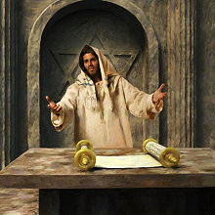
“Ye are of your father the devil, and the lusts of your father ye will do. He was a murderer from the beginning, and abode not in the truth, because there is no truth in him. When he speaketh a lie, he speaketh of his own: for he is a liar, and the father of it.”
John 8:44

Slide 36
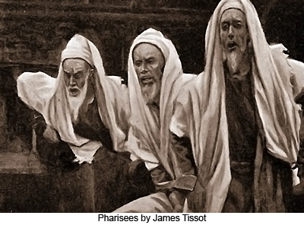
“Then said the Jews unto him, Now we know that thou hast a devil. Abraham is dead, and the prophets; and thou sayest, If a man keep my saying, he shall never taste of death… Then took they up stones to cast at him: but Jesus hid himself, and went out of the temple, going through the midst of them, and so passed by.” John 8:52, 59

Slide 37
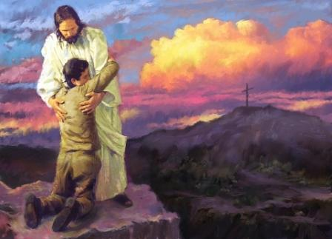
A person only becomes a child of God by receiving Jesus as personal Savior and Lord
“But as many as received him, to them gave he power to become the sons of God, even to them that believe on his name.” John 1:12

Slide 38
The Fatherhood of God and the Universal Brotherhood of Man
What is this doctrine?
It assumes that God is the Father of all men, therefore making us all brothers and sisters in this one creator, regardless of your personal religion or beliefs (Universal Sonship / Salvation).
The doctrine of the Fatherhood of God and the Universal Brotherhood of Man is false and dangerous doctrine.
It defies Scriptures such as John1:12, John 14:6
It denies the unique role of Jesus as the ONLY Savior -

Slide 39
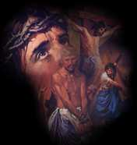
“Neither is there salvation in any other: for there is none other name under heaven given among men, whereby we must be saved.”
Act 4:12

Slide 40
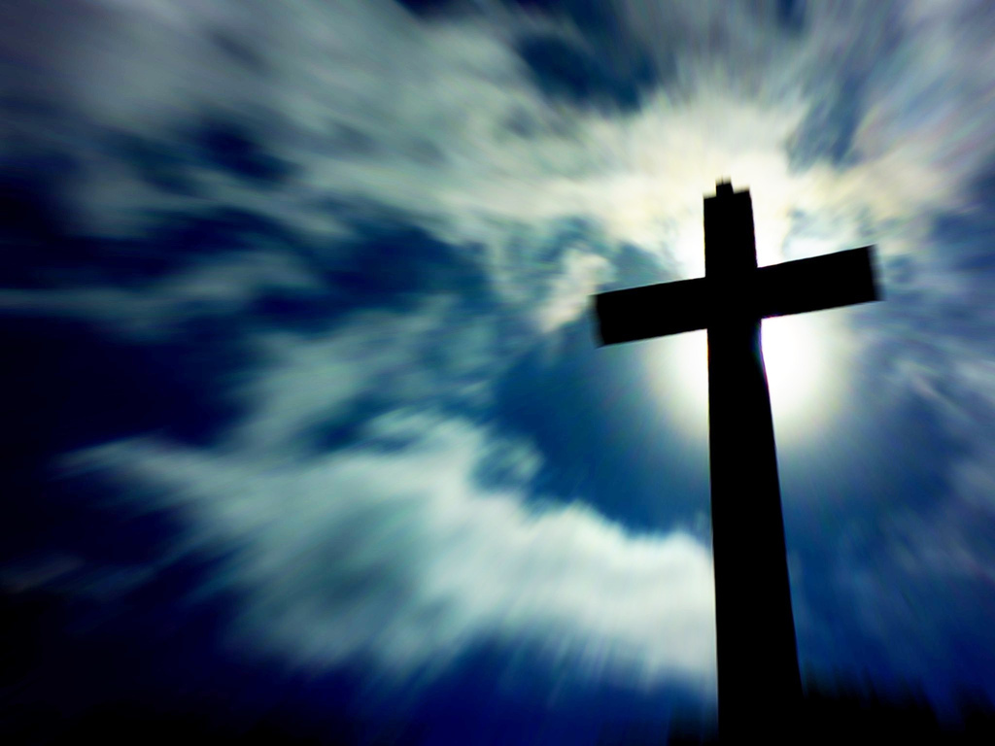
“For ye are all the children of God by
faith in Christ Jesus.” Gal. 3:26

Slide 41
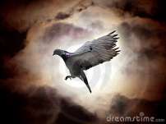
Every believer is to see himself as a Child of God and God as his Father
“The Spirit itself beareth witness with our spirit, that we are the children of God.” Rom. 8:16

Slide 42
Our Father will provide all of our needs
“Ask, and it shall be given you; seek, and ye shall find; knock, and it shall be opened unto you: For every one that asketh receiveth; and he that seeketh findeth; and to him that knocketh it shall be opened. Or what man is there of you, whom if his son ask bread, will he give him a stone? Or if he ask a fish, will he give him a serpent? If ye then, being evil, know how to give good gifts unto your children, how much more shall your Father which is in heaven give good things to them that ask him?” Matt. 7:7-11

Slide 43
We are to Glorify our Father
“Let your light so shine before men, that they may see your good works, and glorify your Father which is in heaven.” Matt. 5:16

Slide 44
We are to Please our Father
“Furthermore then we beseech you, brethren, and exhort you by the Lord Jesus, that as ye have received of us how ye ought to walk and to please God, so ye would abound more and more.” I Thess. 4:1

Slide 45
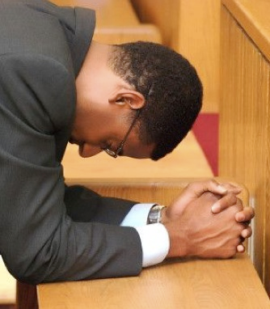
We are to try to be like our Father
“Be ye therefore perfect, even as your Father which is in heaven is perfect.” Matt. 5:48

Slide 46
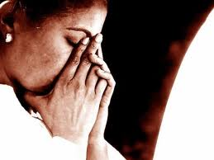
We are to spend time talking to our Father
“But thou, when thou prayest, enter into thy closet, and when thou hast shut thy door, pray to thy Father which is in secret; and thy Father which seeth in secret shall reward thee openly.” Matt. 6:6

Slide 47
We are to address our prayers to our Father
“And he said unto them, When ye pray, say, Our Father which art in heaven, Hallowed be thy name. Thy kingdom come. Thy will be done, as in heaven, so in earth.”
Luke 11:2

Slide 48
Our Father answers our Prayers
“Again I say unto you, That if two of you shall agree on earth as touching any thing that they shall ask, it shall be done for them of my Father which is in heaven.” Matt. 18:19

Slide 49
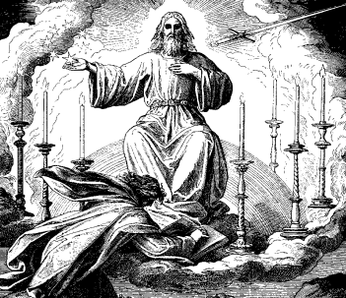
Our Father knows our needs even before we ask
“Your Father knoweth what things ye have need of, before ye ask him.” Matt. 6:8

Slide 50
We are to spend time listening to our Father
“While it is said, To day if ye will hear his voice, harden not your hearts.” Heb. 3:15

Slide 51
Our Father watches over us
“Are not two sparrows sold for a farthing? and one of them shall not fall on the ground without your Father. But the very hairs of your head are all numbered. Fear ye not therefore, ye are of more value than many sparrows.” Matthew 10:29-31

Slide 52
Our Father will reward us for our works
Jesus - “Thy Father which seeth in secret shall reward thee openly…For the Son of man shall come in the glory of his Father with his angels; and then he shall reward every man according to his works…Great is your reward in heaven…”

Slide 53
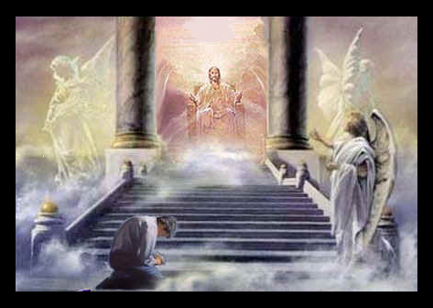
Our Father will not reward us for works done with the wrong motives
“Take heed that ye do not your alms before men, to be seen of them: otherwise ye have no reward of your Father which is in heaven.” Matt. 6:1

Slide 54
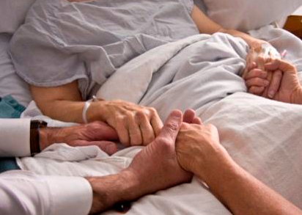
We receive grace, mercy and peace from our Father
“Grace be with you, mercy, and peace, from God the Father, and from the Lord Jesus Christ, the Son of the Father, in truth and love.”
II John 1:3

Slide 55
We have consolation and hope because of the Father’s love for us
“Now our Lord Jesus Christ himself, and God, even our Father, which hath loved us, and hath given us everlasting consolation and good hope through grace.” II Thess. 2:16

Slide 56
Consolation - Comfort received by a person after a loss or disappointment.
Hope - is the emotional state, the opposite of which is despair, which promotes the belief in a positive outcome related to events and circumstances in one's life.

Slide 57
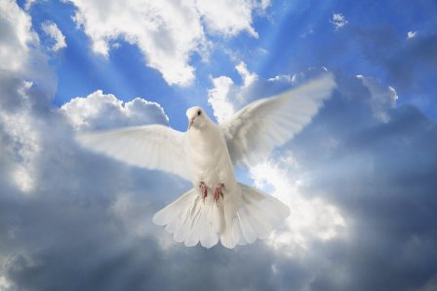
The indwelling presents of the Holy Spirit is a gift from our Father
“But when the Comforter is come, whom I will send unto you from the Father, even the Spirit of truth, which proceedeth from the Father, he shall testify of me.”
John 15:26

Slide 58
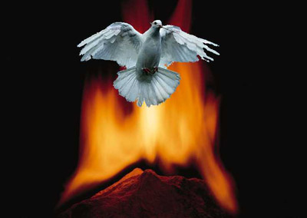
Our Father fills us with the Holy Spirit when we ask
“If ye then, being evil, know how to give good gifts unto your children: how much more shall your heavenly Father give the Holy Spirit to them that ask him?”
Luke 11:13

Slide 59
Our Father dwells within us through the Holy Spirit
“But when they deliver you up, take no thought how or what ye shall speak: for it shall be given you in that same hour what ye shall speak. For it is not ye that speak, but the Spirit of your Father which speaketh in you.” Matthew 10:19-20

Slide 60
“One Lord, one faith, one baptism, One God and Father of all (Believers), who is above all, and through all, and in you all.”
Eph. 4:5-6

Slide 61
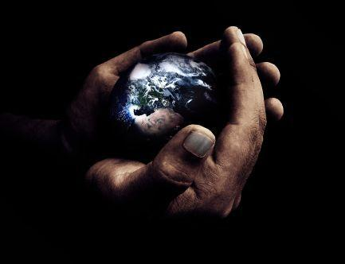
We are eternally secure in our Father’s hand
“My Father, which gave them me, is greater than all; and no man is able to pluck them out of my Father's hand.” John 10:29

Slide 62
The Father has a special love for those who keep his commandments
“He that hath my commandments, and keepeth them, he it is that loveth me: and he that loveth me shall be loved of my Father, and I will love him, and will manifest myself to him. Jesus answered and said unto him, If a man love me, he will keep my words: and my Father will love him, and we will come unto him, and make our abode with him. He that loveth me not keepeth not my sayings: and the word which ye hear is not mine, but the Father's which sent me.” John 14:21-24

Slide 63
Our Father desires us all to be one
“That they all may be one; as thou, Father, art in me, and I in thee, that they also may be one in us: that the world may believe that thou hast sent me.” John 17:21

Slide 64
As children of the Father we are to live a life separated from this evil world
“Wherefore come out from among them, and be ye separate, saith the Lord, and touch not the unclean thing; and I will receive you, And will be a Father unto you, and ye shall be my sons and daughters, saith the
Lord Almighty.”
II Cor. 6:17-18

Slide 65
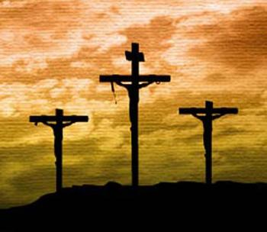
“Who gave himself for our sins, that he might deliver us from this present evil world, according to the will of God and our Father.” Gal. 1:4

Slide 66
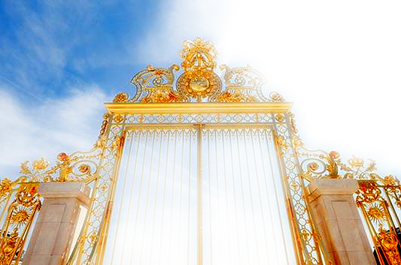
Our Father blesses us with all spiritual blessings
“Blessed be the God and Father of our Lord Jesus Christ, who hath blessed us with all spiritual blessings in heavenly places in Christ.” Eph. 1:3

Slide 67
We have access to the Father at any time through Christ and the ministry of the Holy Spirit
“For through him (Jesus) we both have access by one Spirit (Holy Spirit) unto the Father. Now therefore ye are no more strangers and foreigners, but fellowcitizens with the saints, and of the household of God.” Eph. 2:18-19

Slide 68
Every thing good we have received came from our Father’s hand
“Every good gift and every perfect gift is from above, and cometh down from the Father of lights, with whom is no variableness, neither shadow of turning.” Jam. 1:17

Slide 69
Our loving Father chastens his children
“For whom the Lord loveth he chasteneth, and scourgeth every son whom he receiveth. If ye endure chastening, God dealeth with you as with sons; for what son is he whom the father chasteneth not? But if ye be without chastisement, whereof all are partakers, then are ye bastards, and not sons. Furthermore we have had fathers of our flesh which corrected us, and we gave them reverence…

Slide 70
shall we not much rather be in subjection unto the Father of spirits, and live? For they verily for a few days chastened us after their own pleasure; but he for our profit, that we might be partakers of his holiness. {after...: or, as seemed good, or, meet to them} Now no chastening for the present seemeth to be joyous, but grievous: nevertheless afterward it yieldeth the peaceable fruit of righteousness unto them which are exercised thereby.” Heb. 12:6-11

Slide 71
We should have a holy fear of our Father
‘But as he which hath called you is holy, so be ye holy in all manner of conversation; Because it is written, Be ye holy; for I am holy. And if ye call on the Father, who without respect of persons judgeth according to every man's work, pass the time of your sojourning here in fear.”
I Peter 1:15-17

Slide 72
Our Father desires our fellowship
“That which we have seen and heard declare we unto you, that ye also may have fellowship with us: and truly our fellowship is with the Father, and with his Son Jesus Christ. And these things write we unto you, that your joy may be full. This then is the message which we have heard of him, and declare unto you, that God is light, and in him is no darkness at all. If we say that we have fellowship with him, and walk in darkness, we lie, and do not the truth…

Slide 73
But if we walk in the light, as he is in the light, we have fellowship one with another, and the blood of Jesus Christ his Son cleanseth us from all sin. If we say that we have no sin, we deceive ourselves, and the truth is not in us. If we confess our sins, he is faithful and just to forgive us our sins, and to cleanse us from all unrighteousness.” I John 1:3-9

Slide 74
We can have a very close and personal relationship with our Father
“For ye have not received the spirit of bondage again to fear; but ye have received the Spirit of adoption, whereby we cry, Abba, Father.”
Rom. 8:15

Slide 75
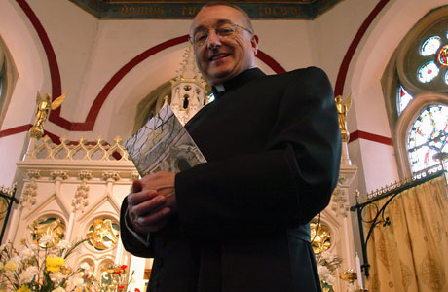
We are to call no man Father except our earthly and heavenly Father
“And call no man your father upon the earth: for one is your Father, which is in heaven.” Matt. 23:9

Slide 76
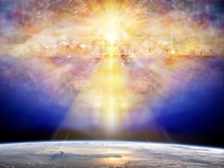
Our Father is going to give us a kingdom
“Fear not, little flock; for it is your Father's good pleasure to give you the kingdom.”
Luke 12:32

Slide 77
One day we will live forever in our Father’s kingdom
“Then shall the righteous shine forth as the sun in the kingdom of their Father.” Matt. 13:43

Slide 78
We should be so thankful to be a child of God
“Giving thanks unto the Father, which hath made us meet to be partakers of the inheritance of the saints in light.”
Col. 1:12

Slide 79
“Jesus saith unto him, I am the way, the truth, and the life: no man cometh unto the Father, but by me.”

Slide 80
Accepting the Doctrine of the Fatherhood of God will result in
Freedom from fear – Rom. 8:15
Freedom from worry – Phil. 4:6
Freedom from doubt – Matt. 21:21
Confidence – Prov. 3:26
Boldness – Phil. 1:20
Faith – Eph. 6:23
Love – John 15:10

