Slide 1
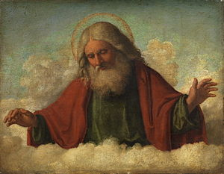
The Doctrine of the Father
“The Fatherhood of God”
(Part 2)

Slide 2
REVIEW

Slide 3
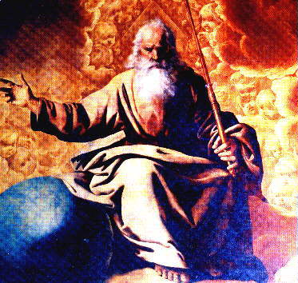
He is the Father (source) of all life

Slide 4
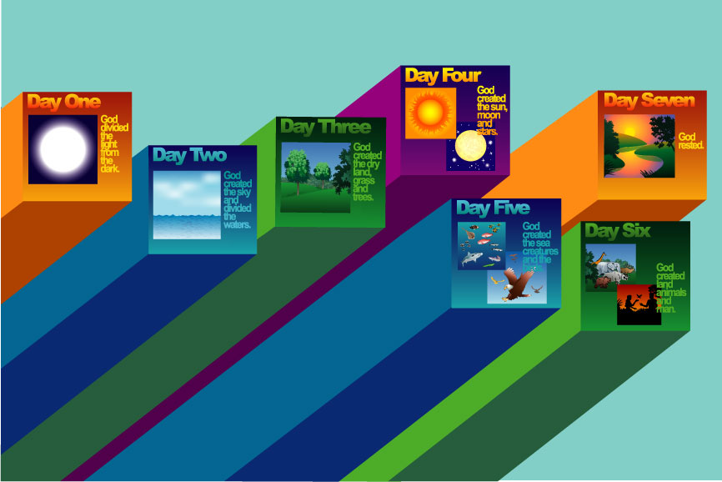
“For by him were all things created, that are in heaven, and that are in earth, visible and invisible, whether they be thrones, or dominions, or principalities, or powers: all things were created by him, and for him.” Colossians 1:16

Slide 5
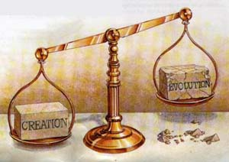

Slide 6
“Because that which may be known of God is manifest in them; for God hath shewed it unto them. For the invisible things of him from the creation of the world are clearly seen, being understood by the things that are made, even his eternal power and Godhead; so that they are without excuse…

Slide 7
Because that, when they knew God, they glorified him not as God, neither were thankful; but became vain in their imaginations, and their foolish heart was darkened. Professing themselves to be wise, they became fools, And changed the glory of the uncorruptible God into an image made like to corruptible man, and to birds, and fourfooted beasts, and creeping things. Wherefore God also gave them up to uncleanness through the lusts of their own hearts, to dishonour their own bodies between themselves.” (Romans 1:19-24 )

Slide 8
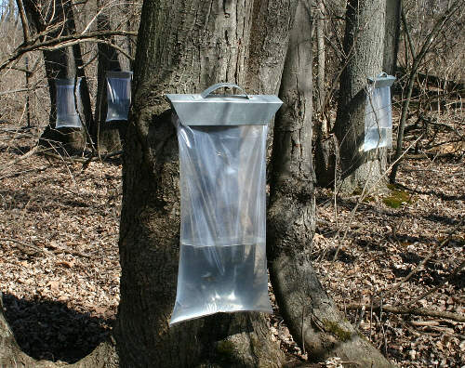
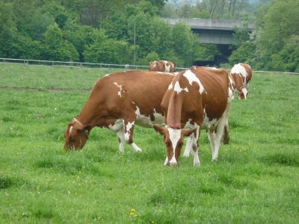
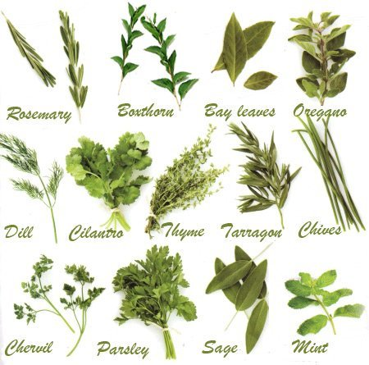
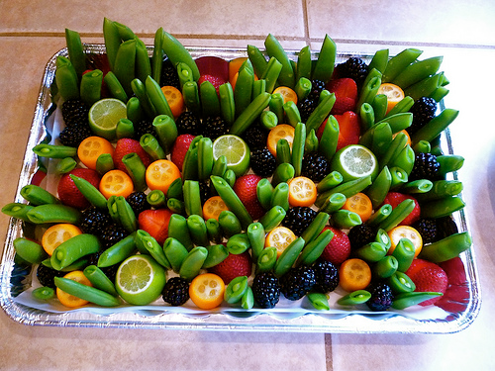
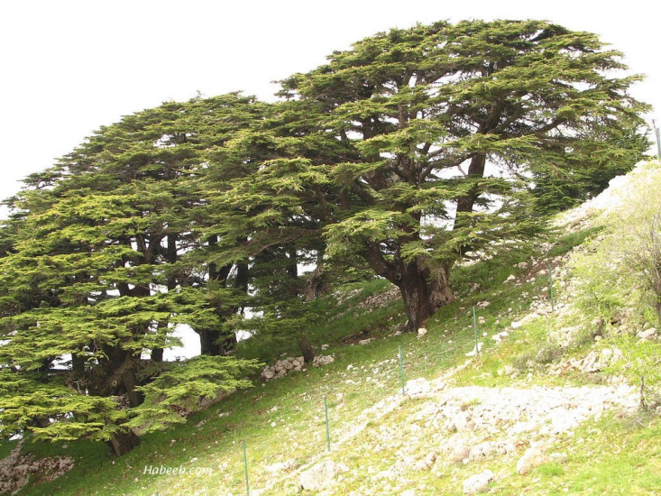
He tends and cares for the Vegetation of the Earth
"He causeth the grass to grow for the cattle, and herb for the service of man: that he may bring forth food out of the earth...The trees of the Lord are full of sap; the cedars of Lebanon, which he hath planted" (Psalm 104:14, 16)

Slide 9
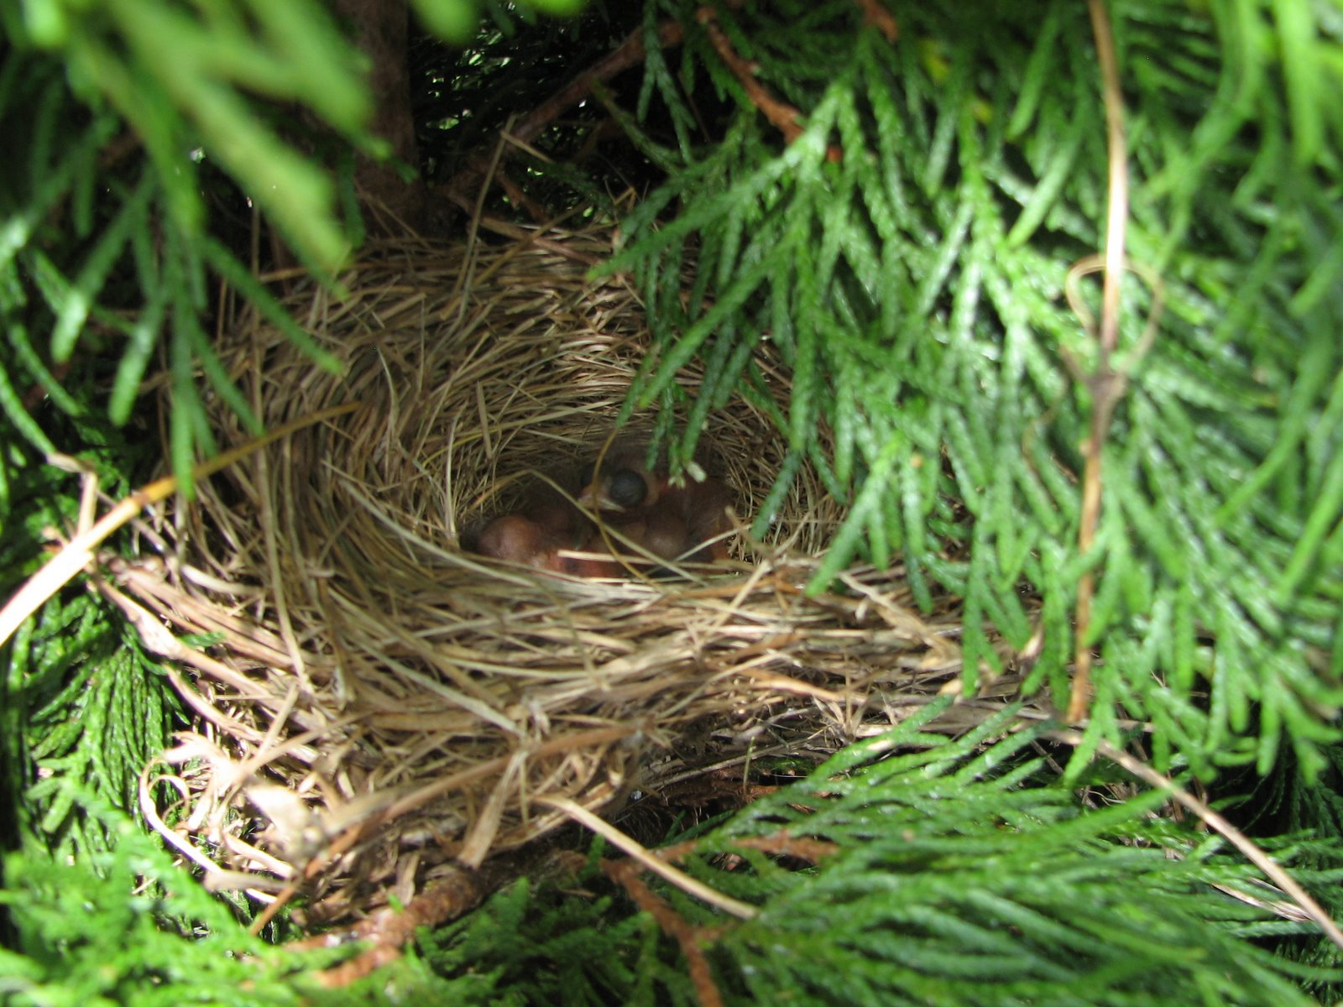
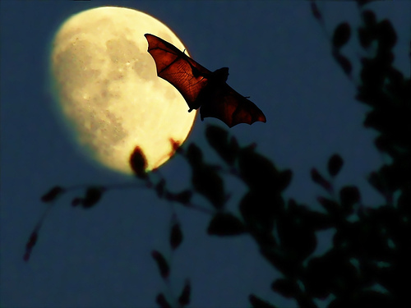
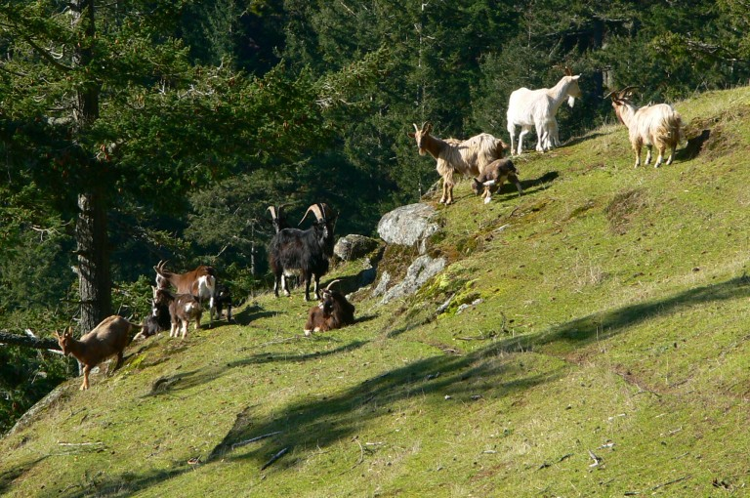
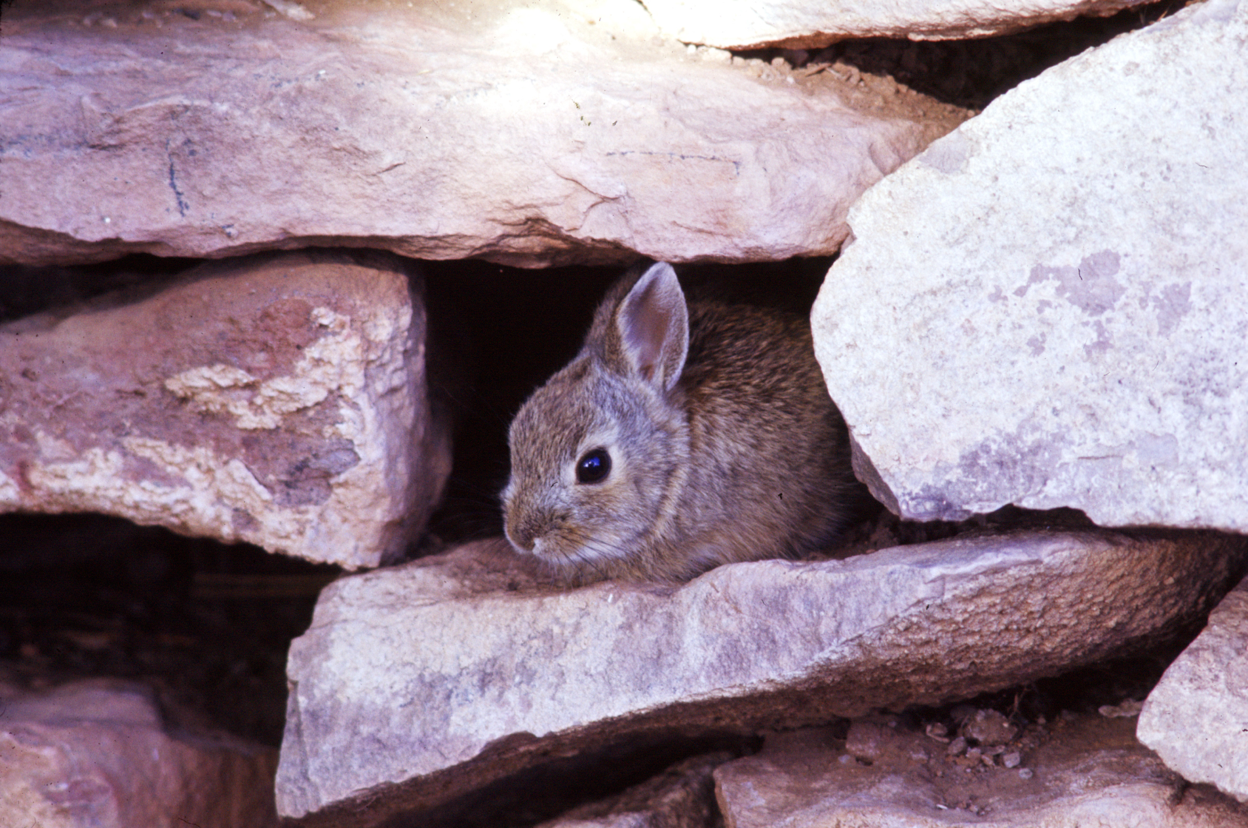
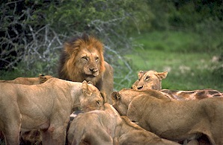
He tends and cares for all the Birds and Animals in the World (Psalm 104:18, 20, 21, 27)

Slide 10
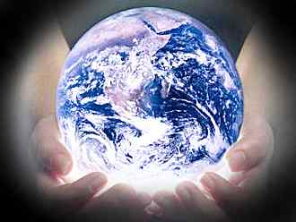
He tends and cares for the Weather

Slide 11
“When he uttereth his voice, there is a multitude of waters in the heavens; and he causeth the vapours to ascend from the ends of the earth: he maketh lightnings with rain, and bringeth forth the wind out of his treasures.”
Jer. 51: 16

Slide 12
He tends and cares for the Seasons

Slide 13
"While the earth remaineth, seedtime and harvest, and cold and heat, and summer and winter, and day and night shall not cease." (Gen. 8:22)

Slide 14
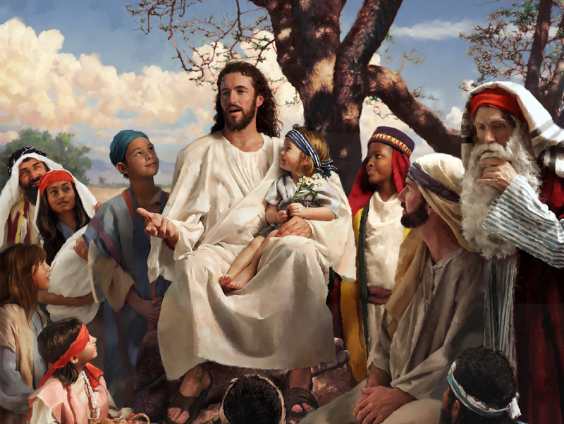
"Behold the fowls of the air: for they sow not, neither do they reap, nor gather into barns; yet your heavenly Father feedeth them. Are ye not much better than they?"
(Matt. 6:26)

Slide 15
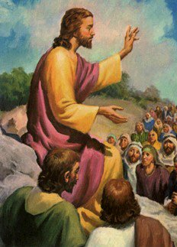
"And why take ye thought for raiment? Consider the lilies of the field, how they grow; they toil not, neither do they spin: And yet I say unto you, That even Solomon in all his glory was not arrayed like one of these. Wherefore, if God so clothe the grass of the field, which today is, and tomorrow is cast into the oven, shall he not much more clothe you, O ye of little faith?" (Matt. 6:28-30)

Slide 16
Why was man created?

Slide 17
Love God
“And thou shalt love the Lord thy God with all thy heart, and with all thy soul, and with all thy mind, and with all thy strength: this is the first commandment.” Mark 12:30

Slide 18
Worship God
“But the hour cometh, and now is, when the true worshippers shall worship the Father in spirit and in truth: for the Father seeketh such to worship him.” John 4:23

Slide 19
Fellowship with God
“That which we have seen and heard declare we unto you, that ye also may have fellowship with us: and truly our fellowship is with the Father, and with
his Son Jesus Christ.”
I John 1:3

Slide 20
Serve God
“And thou, Solomon my son, know thou the God of thy father, and serve him with a perfect heart and with a willing mind: for the LORD searcheth all hearts, and understandeth all the imaginations of the thoughts: if thou seek him, he will be found of thee; but if thou forsake him, he will cast thee off for ever.”
I Chro. 28:9

Slide 21
Glorify God
“Let your light so shine before men, that they may see your good works, and glorify your Father which is in heaven.” Matt. 5:16

Slide 22
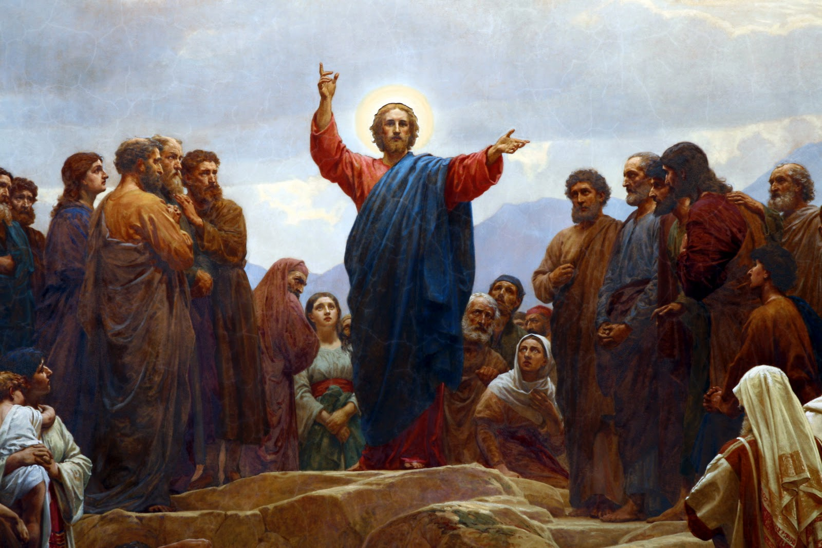
He is the Father of the Lord Jesus
During his earthly ministry Jesus spoke more about the Father than any other subject. He is mentioned by the Savior over 200 times during his earthly ministry.

Slide 23
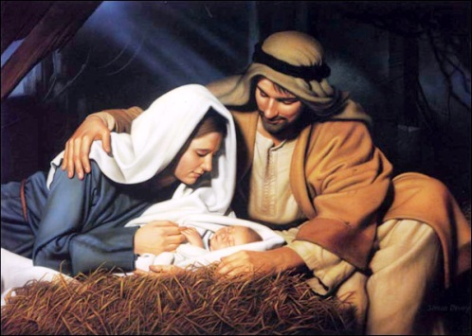
The Father sent his Son
"But when the fulness of the time was come, God sent forth his Son, made of a woman" (Gal. 4:4)
"Then said Jesus to them again, peace be unto you: as my Father hath sent me, even so send I you" (John 20:21)
"And we have seen and do testify that the Father sent the Son to be the Saviour of the world" (I John 4:14)

Slide 24
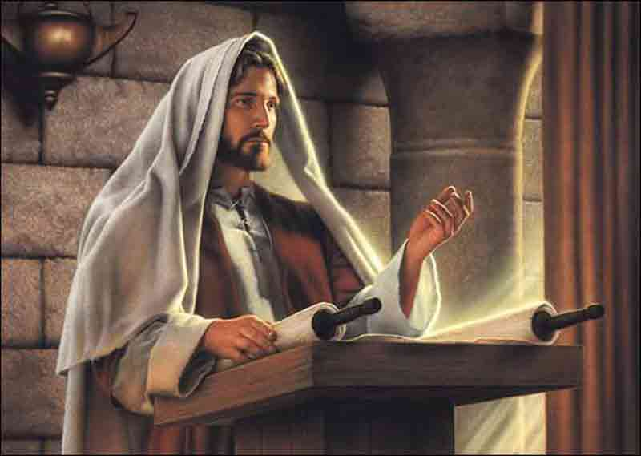
Isaiah 61:1-2

Slide 25
“The Spirit of the Lord is upon me, because he hath anointed me to preach the gospel to the poor; he hath sent me to heal the brokenhearted, to preach deliverance to the captives, and recovering of sight to the blind, to set at liberty them that are bruised, To preach the acceptable year of the Lord. And he closed the book, and he gave it again to the minister, and sat down. And the eyes of all them that were in the synagogue were fastened on him.” (Luke 4:18-20)

Slide 26
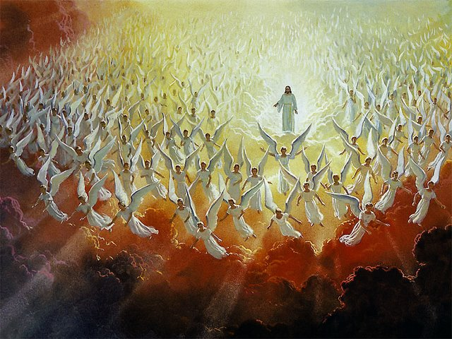
The Father commanded the angels to worship his Son
“When he bringeth in the first begotten into the world, he saith, And let all the angels of God worship him" (Heb. 1:6; see also Luke 2:8-15)

Slide 27
He sealed his Son
It means to set or mark with a seal in order to confirm, attest , to authenticate.
To prove one’s testimony, that he is what he professes to be.
"Labour not for the meat which perisheth, but for that meat which endureth unto everlasting life, which the Son of man shall give unto you: for
him hath God the
Father sealed"
(John 6:27)

Slide 28
Eph. 1:13-14 “In whom ye also trusted, after that ye heard the word of truth, the gospel of your salvation: in whom also after that ye believed, ye were sealed with that holy Spirit of promise, Which is the earnest of our inheritanceuntil the redemption of the purchased possession, unto the praise of his glory.”
We are “marked” with God’s Spirit as our “seal” until we are glorified:

Slide 29
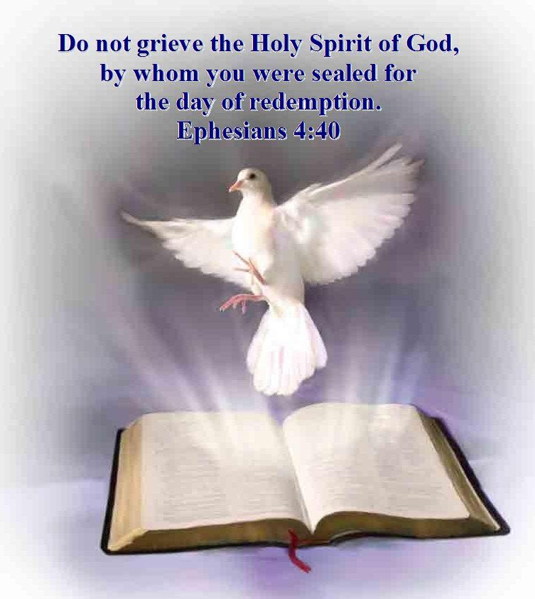
“And grieve not the holy Spirit of God, whereby ye are sealed unto the day of redemption.” Eph. 4:30

Slide 30
He bore witness to his Son
“And lo a voice from heaven, saying, This is my beloved Son, in whom I am well pleased.” Matt. 3:17

Slide 31
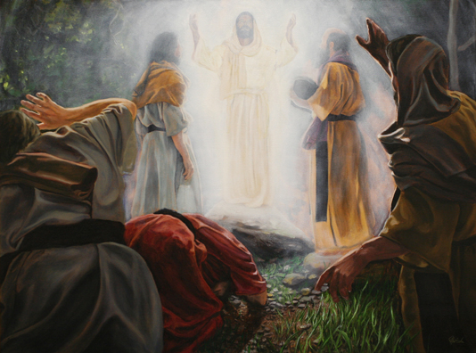
He delighted in his Son
"While he yet spake, behold, a bright cloud overshadowed them: and behold a voice out of the cloud, which said, This is my beloved Son, in whom I am well pleased; hear ye him"
Matt. 17:5

Slide 32
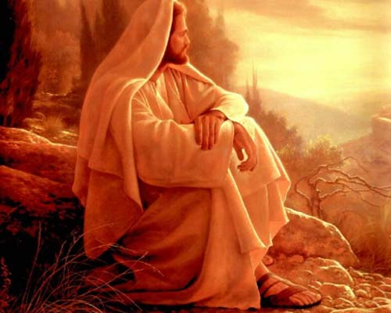
He was totally satisfied by his Son
“And he that sent me is with me: the Father hath not left me alone; for I do always those things that please him.”
John 8:29

Slide 33
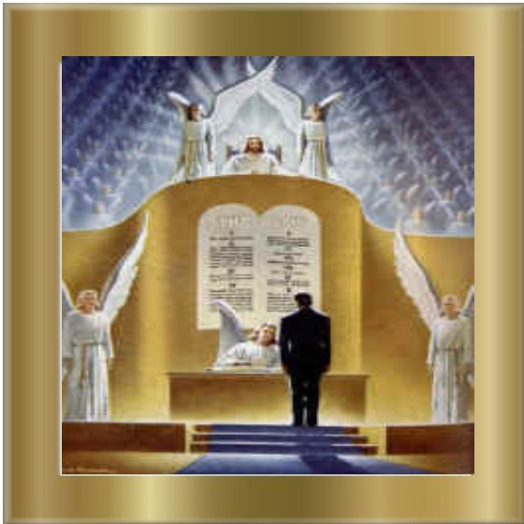
“Wherefore we labour, that, whether present or absent, we may be accepted (well-pleasing) of him. For we must all appear before the judgment seat of Christ; that every one may receive the things done in his body, according to that he hath done, whether it be good or bad.” II Corinthians 5:9-10

Slide 34
He spoke through his son
“Then said Jesus unto them, When ye have lifted up the Son of man, then shall ye know that I am he, and that I do nothing of myself; but as my Father hath taught me, I speak these things” John 8:28
“Believest thou not that I am in the Father, and the Father in me? the words that I speak unto you I speak not of myself: but the Father that dwelleth in me” John 14:10
“This is my beloved Son, in whom I am well pleased; hear ye him” Matt. 17:5

Slide 35
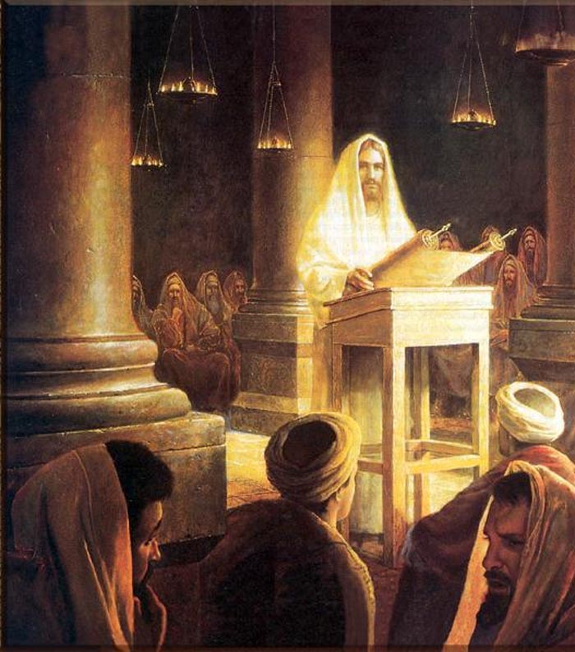

Slide 36
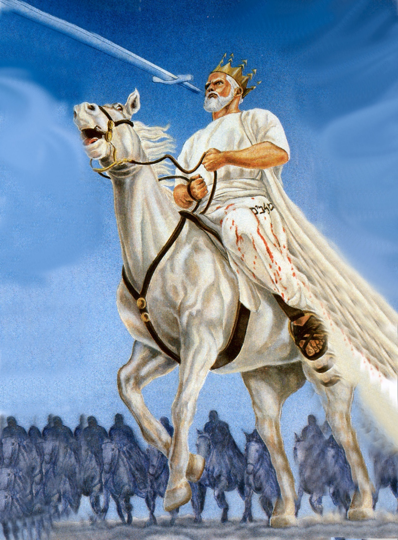
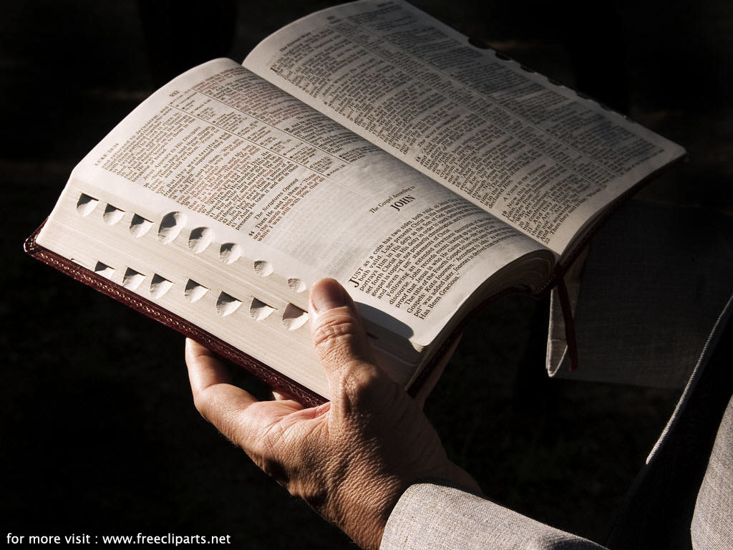
“And he was clothed with a vesture dipped in blood: and his name is called The Word of God.” Rev. 19:13

Slide 37
“God, who at sundry times (various times) and in divers manners (in many ways, method or form) spake in time past unto the fathers by the prophets, Hath in these last days spoken unto us by his Son, whom he hath appointed heir of all things, by whom also he made the worlds; Who being the brightness of his glory, and the express image of his person, and upholding all things by the word of his power, when he had by himself purged our sins, sat down on the right hand of the Majesty
on high.” Hebrews 1:1-3

Slide 38
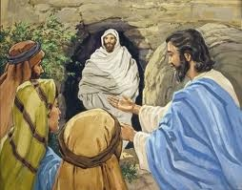
He listened to his Son
"Then they took away the stone from the place where the dead was laid. And Jesus lifted up his eyes, and said, Father, I thank thee that thou hast heard me. And I knew that thou hearest me always: but because of the people which stand by I said it, that they may believe that thou hast sent me"
John 11:41-42

Slide 39
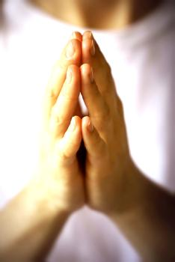
Pray in Jesus Name
“And whatsoever ye shall ask in my name, that will I do, that the Father may be glorified in the Son…If ye shall ask any thing in my name, I will do it…Ye have not chosen me, but I have chosen you, and ordained you, that ye should go and bring forth fruit, and that your fruit should remain: that whatsoever ye shall ask of the Father in my name, he may give it you... Verily, verily, I say unto you, Whatsoever ye shall ask the Father in my name, he will give it you.”

Slide 40
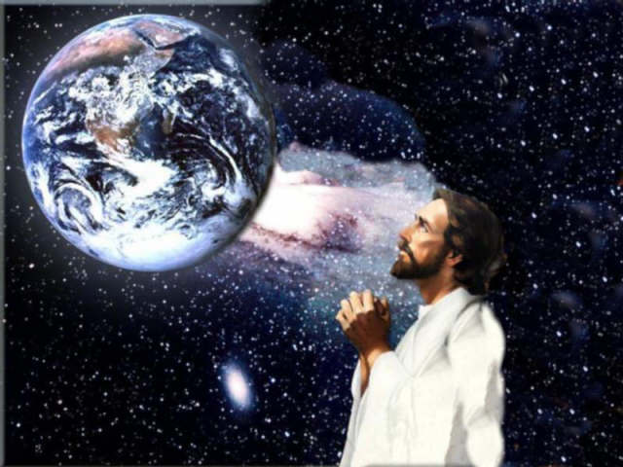
“Wherefore he is able also to save them to the uttermost that come unto God by him, seeing he ever liveth to make intercession for them.” Heb 7:25 “For there is one God, and one mediator between God and men, the man Christ Jesus.” I Tim. 2:5

Slide 41
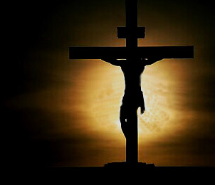
He offered his Son
"He that spared not his own Son, but delivered him up for us all, how shall he not with him also freely give us all things?” Rom. 8:32
"In this was manifested the love of God toward us, because that God sent his only begotten Son into the world, that we might live through him. Herein is love, not that we loved God, but that he loved us, and sent his Son to be the propitiation for our sins" I John 4:9-10

Slide 42
Propitiation – The act of God, motivated by His immense love, whereby He accepts the blood of Christ as the complete and satisfying sacrifice for all our sin, thus establishing a means of reconciliation between God and man.

Slide 43
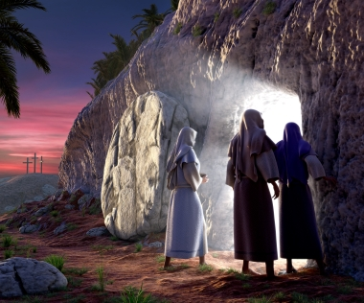
He raised his Son
"Paul, an apostle, not of men, neither by man, but by Jesus Christ, and God the Father, who raised him from the dead“
Gal. 1:1

Slide 44
“And if Christ be not raised, your faith is vain; ye are yet in your sins.” I Cor. 15:17

Slide 45
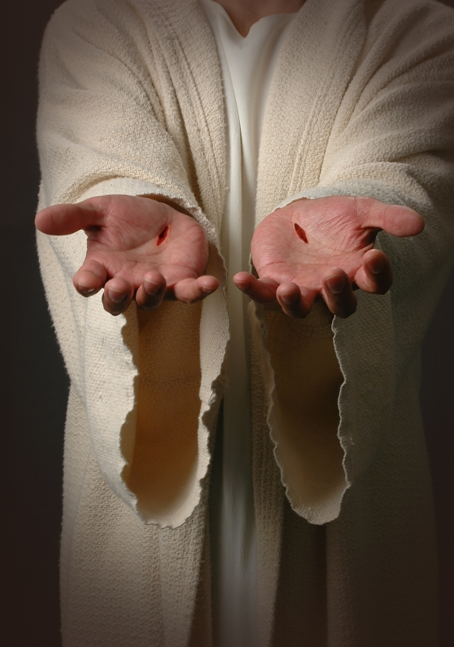
He loved (and loves) his Son
"Therefore doth my Father love me, because I lay down my life, that I might take it again"
John 10:17

Slide 46
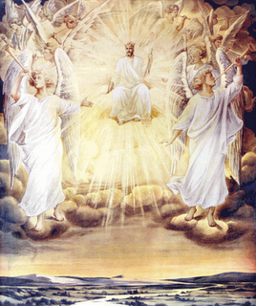
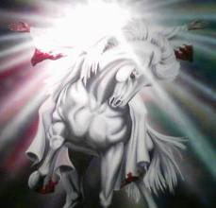
He honored (and honors) his Son
"Jesus answered, If I honour myself, my hour is nothing: it is my Father that honoureth me; of whom ye say, that he is your God"
John 8:54

Slide 47
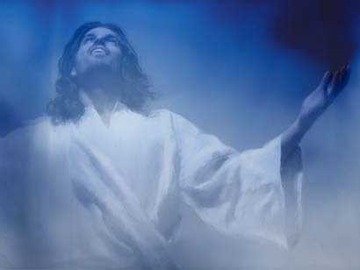
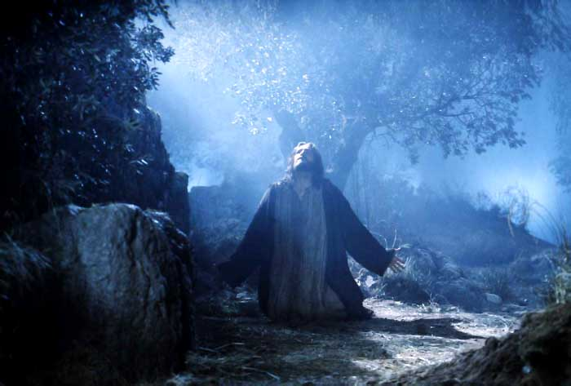
He glorified his Son
"These words spake Jesus, and lifted up his eyes to heaven, and said, Father, the hour is come; glorify thy Son, that thy Son also may glorify thee.... And now, O Father, glorify thou me with thine own self with the glory which I had with thee before the world was" John 17:1, 5

Slide 48
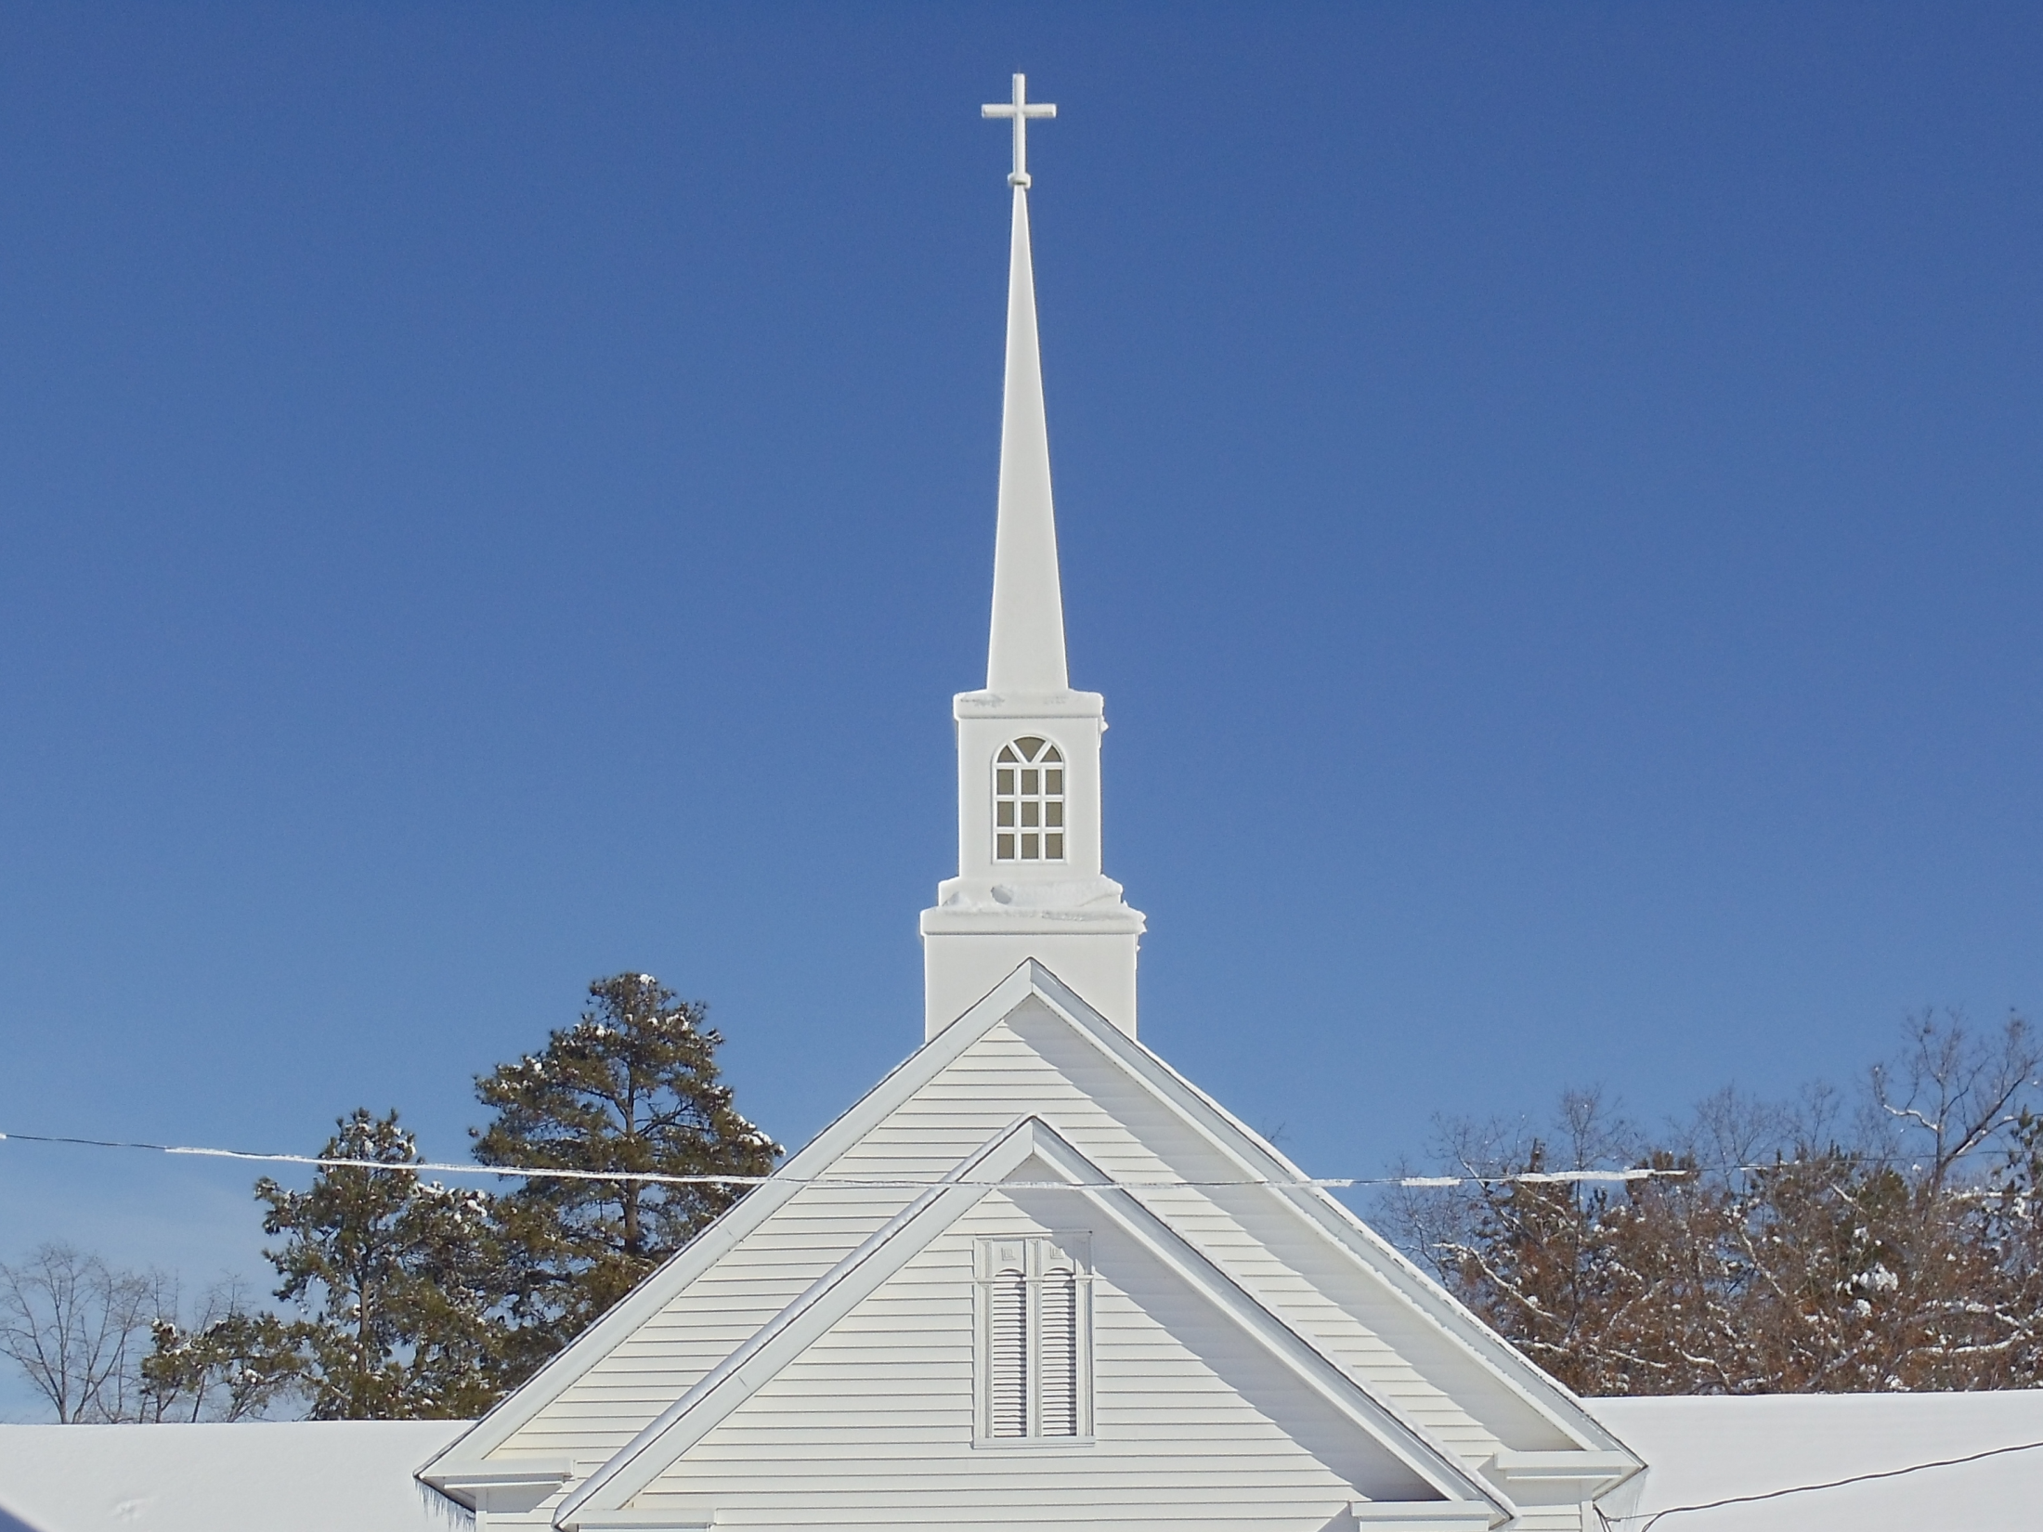
He makes his Son head of the church
“And hath put all things under his feet, and gave him to be the head over all things to the church.” Eph. 1:22
“For the husband is the head of the wife, even as Christ is the head of the church: and he is the saviour of the body.” Eph 5:23
“And he is the head of the body, the church: who is the beginning, the firstborn from the dead; that in all things he might have the preeminence.” Col 1:18

Slide 49
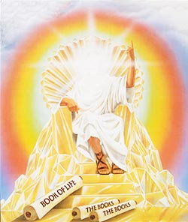
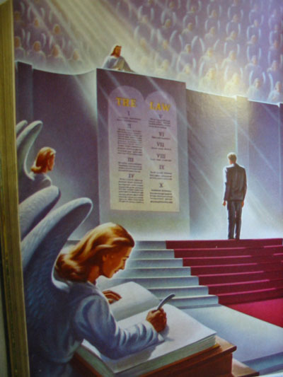
He commits all judgment unto his Son
"For the Father judgeth no man, but hath committed all judgment unto the Son....And hath given him authority to execute judgment also, because he is the Son of man" John 5:22, 27

Slide 50
He exalts his Son
“Wherefore God also hath highly exalted him, and given him a name which is above every name: That at the name of Jesus every knee should bow, of things in heaven, and things in earth, and things under the earth; and that every tongue should confess that Jesus Christ is Lord, to the glory of God the Father.”
Phil. 2:9-11

Slide 51
