Slide 1
The inherent characteristics, quality's
and features of God
(Part 11)

Slide 2
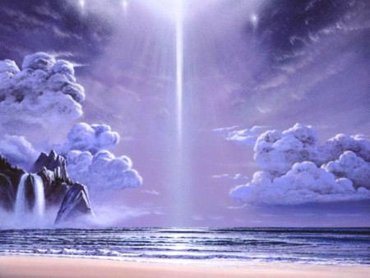
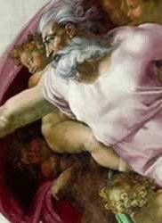
21 Attributes / Perfections of God

Slide 3
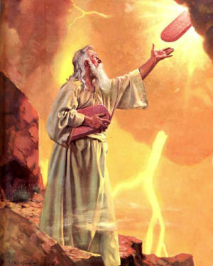
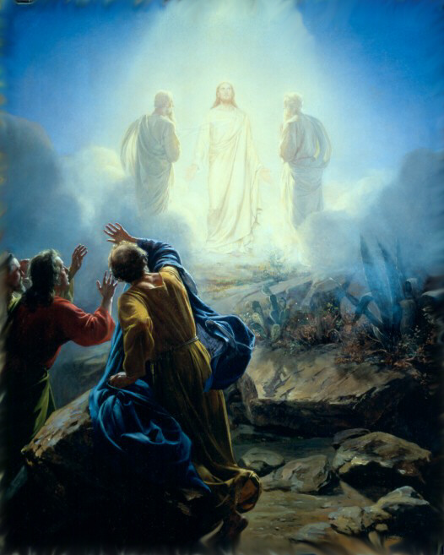
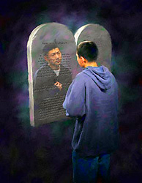
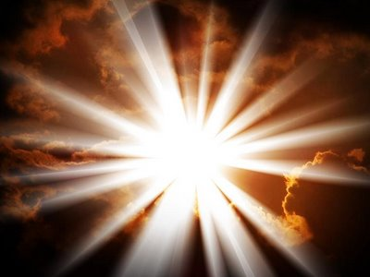
“But we all, with open face beholding as in a glass the glory of the Lord, are changed into the same image from glory to glory, even as by the Spirit of the Lord.” II Cor. 3:18

Slide 4
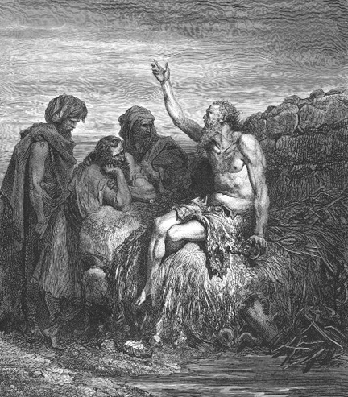
God is incomprehensible
“Canst thou by searching find out God? canst thou find out the Almighty unto perfection? It is as high as heaven; what canst thou do? deeper than hell; what canst thou know? The measure thereof is longer than the earth, and broader than the sea.” Job 11:7-9

Slide 5
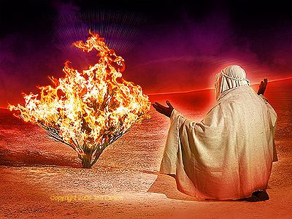
God is self-existent
"And Moses said unto God, Behold, when I come unto the children of Israel, and shall say unto them, The God of your fathers hath sent me, What is his name? What shall I say unto them? And God said unto Moses, I AM THAT I AM: and he said, Thus shalt thou say unto the children of Israel, I AM hath sent me unto you.”
Exodus 3:13-14

Slide 6
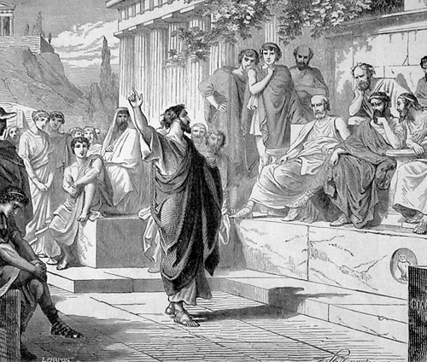
God is self-sufficient
“Neither is worshipped with men's hands, as though he needed any thing, seeing he giveth to all life, and breath, and all things.” Acts 17:25

Slide 7
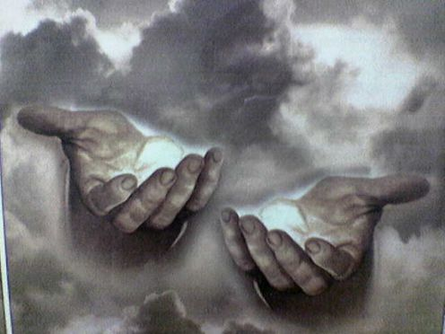
God is eternal
"The eternal God is thy refuge, and underneath are the everlasting arms: and he shall thrust out the enemy from before thee.” Deuteronomy 33:27

Slide 8
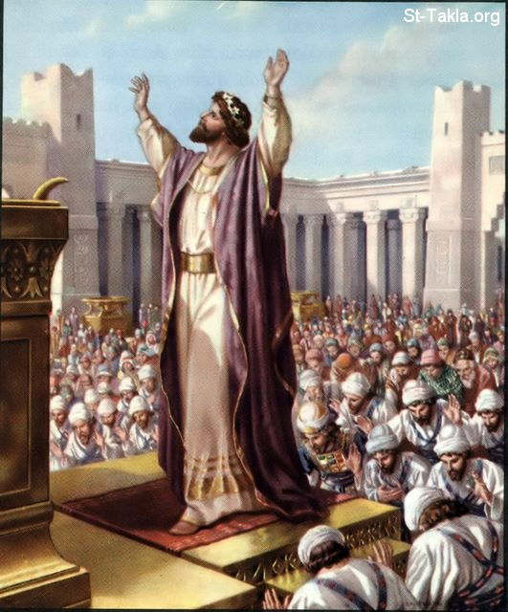
God is infinite
"And Solomon stood before the altar of the Lord in the presence of all the congregation of Israel, and spread forth his hands toward heaven: And he said…Behold, the heaven and heaven of heavens cannot contain thee; how much less this house that I have builded?”
I Kings 8:22, 23, 27

Slide 9
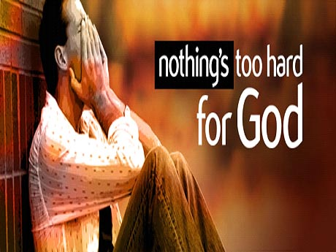
God is omnipotent
"Is any thing too hard for the Lord?” (Genesis 18:14)

Slide 10
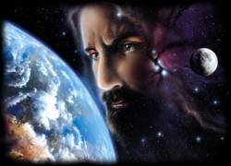
God is omnipresent
"Whither shall I go from thy spirit? or whither shall I flee from thy presence? If I ascend up into heaven, thou art there: if I make my bed in hell, behold, thou art there. If I take the wings of the morning, and dwell in the uttermost parts of the sea; even there shall thy hand lead me, and thy right hand shall hold me.”
Psalm 139:7-11

Slide 11
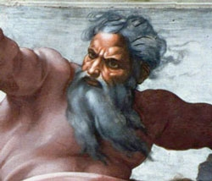
God is omniscient
"Great is our Lord, and of great power: his understanding is infinite.“ Psalm 147:5

Slide 12
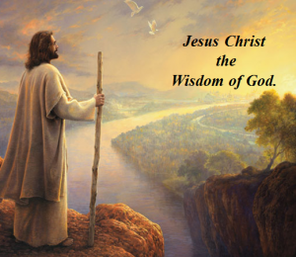
God is all wise
"To the only wise God our Saviour, be glory and majesty, dominion and power, both now and ever. Amen.” Jude 1:25

Slide 13
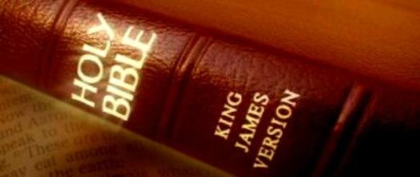
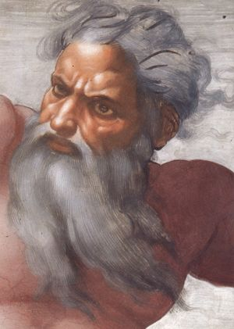
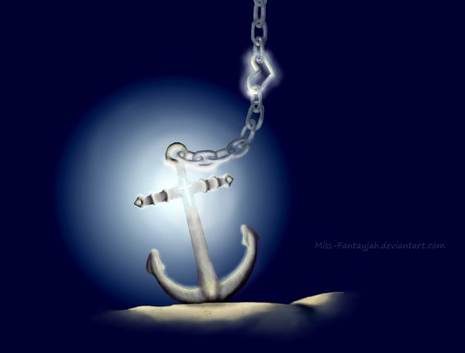
God is immutable “For I am the Lord, I change not.” Malachi 3:6
Hebrews 6:17-18

Slide 14
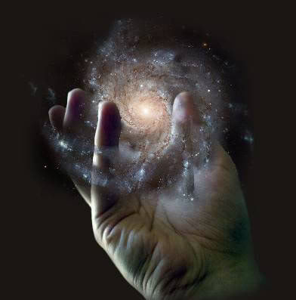
God is sovereign
"Remember the former things of old: for I am God, and there is none else; I am God, and there is none like me, declaring the end from the beginning, and from ancient times the things that are not yet done, saying, My counsel shall stand, and I will do all my pleasure: yes, I have spoken it, I will also bring it to pass; I have purposed it, I will also do it.” Isaiah 46:9-11

Slide 15
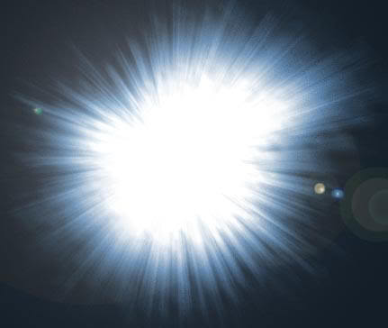
God is light
"This then is the message which we have heard of him, and declare unto you, that God is light, and in him is no darkness at all…But if we walk in the light, as he is in the light, we have fellowship one with another, and the blood of Jesus Christ his Son cleanseth us from all sin.” I John 1:5,7

Slide 16
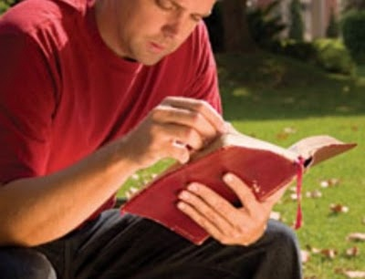
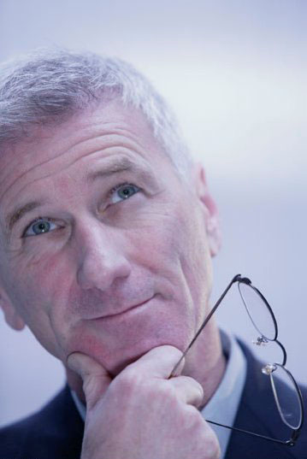
God is inscrutable
“For my thoughts are not your thoughts, neither are your ways my ways, saith the LORD. For as the heavens are higher than the earth, so are my ways higher than your ways, and my thoughts than your thoughts.” Isa. 55:8-9

Slide 17
God is faithful

Slide 18
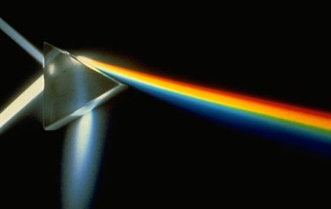
God is holy
God
wise, immutable, sovereign, inscrutable, light, faithful, incomprehensible, self-existence, self-sufficient, eternal, infinite, omnipotent, omnipresent, omniscient, righteousness, just, true, good, merciful, gracious, love
Holiness

Slide 19
God is just and righteous
“There is no God else beside me; a just God and a Saviour; there is none beside me.”
Isa. 45:21
“For the righteous God trieth the hearts and reins.”
Psalm 7:9

Slide 20
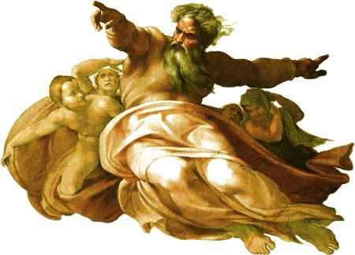
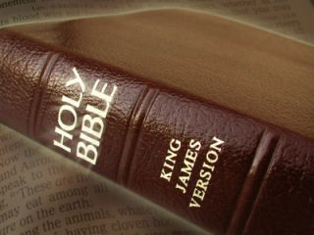
God is true
"And this is life eternal, that they might know thee the only true God, and Jesus Christ, whom thou hast sent.”
John 17:3
“Sanctify them through thy truth: thy word is truth.” John 17:17

Slide 21
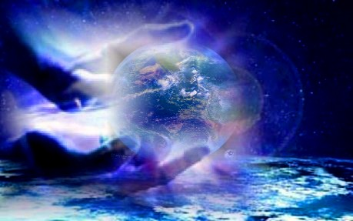
God is good
"Oh that men would praise the Lord for his goodness, and for his wonderful works to the children of men!” Psalm 107:8

Slide 22
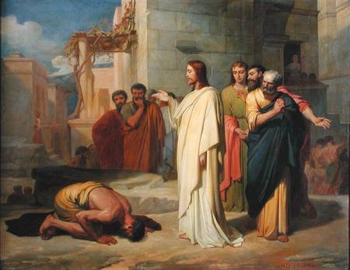
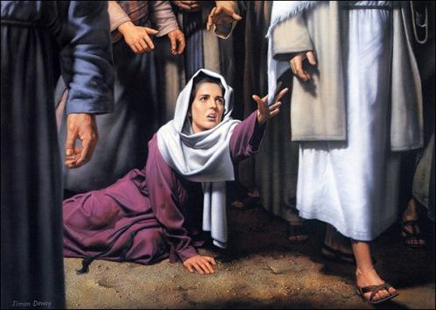
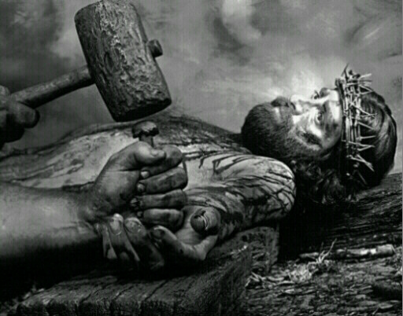
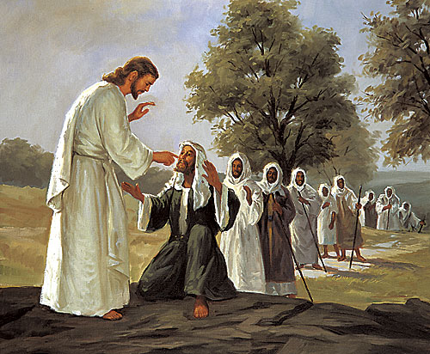
God is merciful
Psalm 136
“His mercy endureth forever…”

Slide 23
God is incomprehensible
God is self-existence
God is self-sufficient
God is eternal
God is infinite
God is omnipotent
God is omnipresent
God is omniscient
God is all wise
God is immutable
God is sovereign
God is light
God is inscrutable
God is faithful
God is holy
God is just and righteous
God is true
God is good
God is merciful

Slide 24
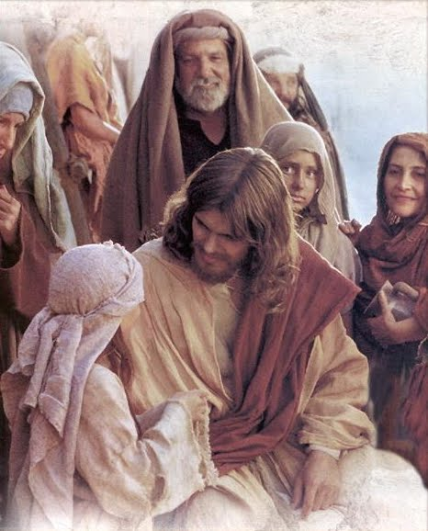
God is gracious
“He hath made his wonderful works to be remembered: the Lord is gracious and full of compassion.” Psalm 111:4

Slide 25
I Peter 2:3 "If so be ye have tasted that the Lord is gracious."
I Peter 5:10 “But the God of all grace, who hath called us unto his eternal glory by Christ Jesus, after that ye have suffered a while, make you perfect, stablish, strengthen, settle you.”
The very simple definition of this attribute is - “The unmerited favor of God.”
God doing for us what we can not do for ourselves – Eph 3:20 “Now unto him that is able to do exceeding abundantly above all that we ask or think, according to the power that worketh in us.”

Slide 26
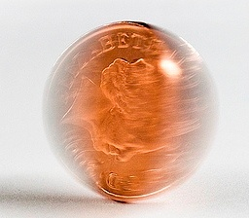
Grace
Mercy
“Gracious is the Lord, and righteous; yea, our God is merciful.” Psalm 116:5

Slide 27
It is helpful at this point to contrast mercy with grace.
God’s mercy allows him to withhold merited punishment – Psalm 89:14
God’s grace allows Him to freely bestow unmerited favor – Ezra 9:8
Mercy is not getting what we deserve, namely, hell – Rev. 20:13-14
Grace is getting what we do not deserve, namely, heaven – Rev. 21:1-4

Slide 28
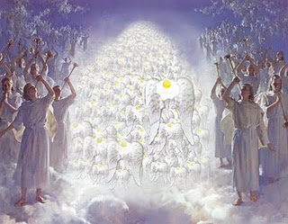
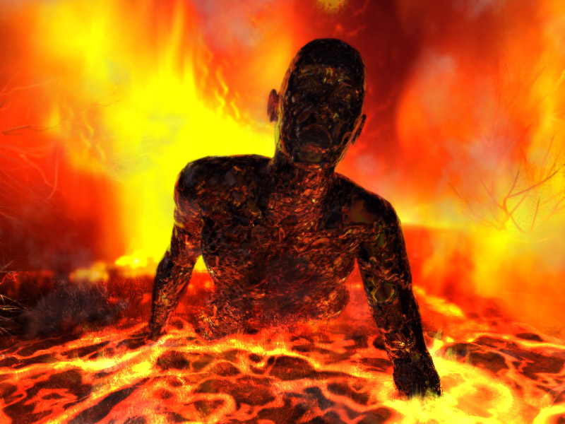
Mercy
Grace

Slide 29
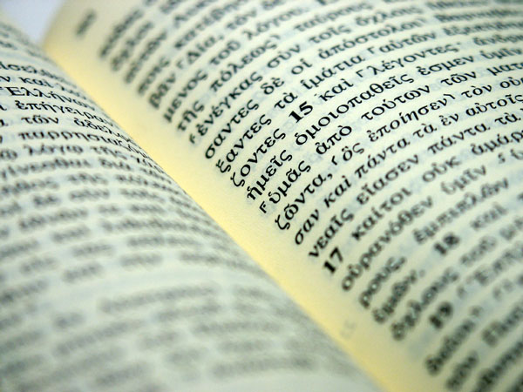
God’s grace is seen through all dispensations in history
Old Testament
New Testament

Slide 30
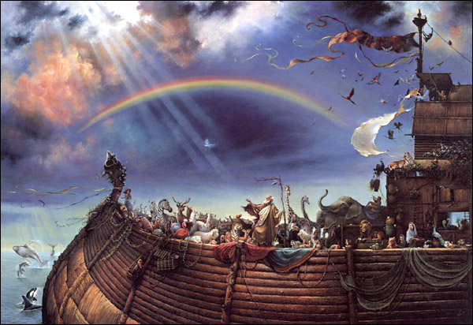
It is first mentioned on the eve of the first universal world destruction (Gen. 6:8)
“But Noah found grace in
the eyes of the LORD.”

Slide 31
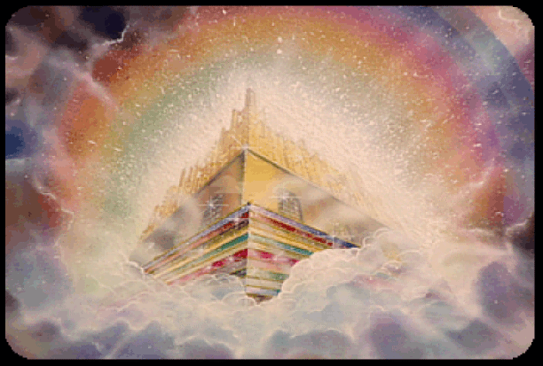
The last reference occurs in Scripture’s final verse (Rev. 22:21)
“The grace of our Lord Jesus Christ
be with you all. Amen.”

Slide 32
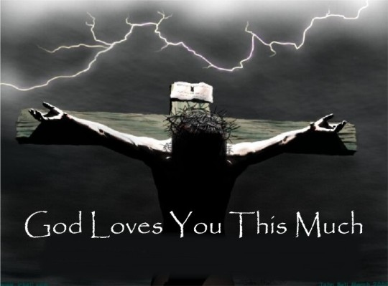
God’s grace was incarnate in Christ (John 1:17)
“For the law was given by Moses, but
grace and truth came by Jesus Christ.”

Slide 33
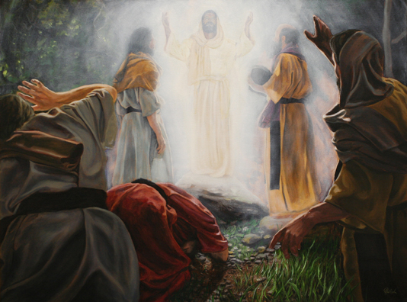
“And the Word was made flesh, and dwelt among us, (and we beheld his glory, the glory as of the only begotten of the Father,) full of
grace and truth.”
John 1:14

Slide 34
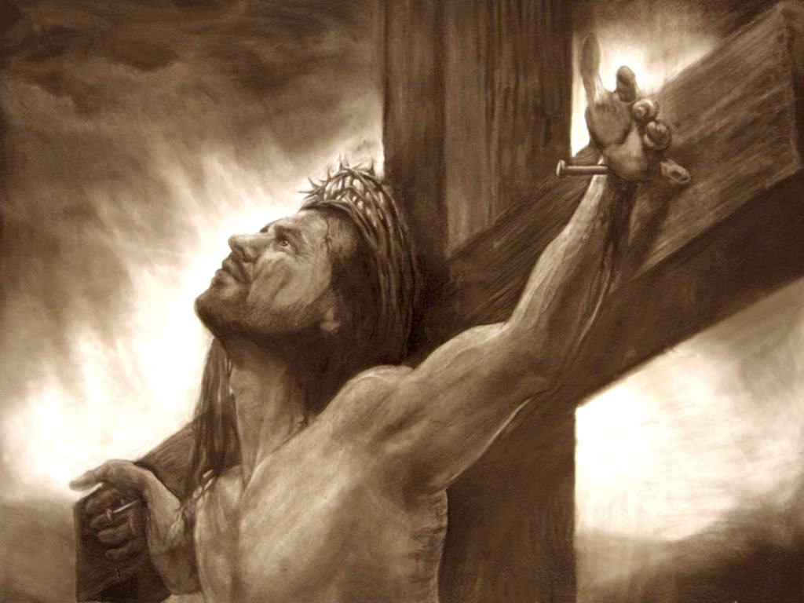
“For the grace of God that bringeth salvation hath appeared to
all men.”
Titus 2:11

Slide 35
God’s grace is greater than man’s sin (Romans 5:20)
"Moreover the law entered, that the offence might abound. But where sin abounded, grace did much more abound."
Grace greater than our sin

Slide 36
Marvelous grace of our loving Lord, Grace that exceeds our sin and our guilt! Yonder on Calvary’s mount outpoured, There where the blood of the Lamb was spilled.

Slide 37
Sin and despair, like the sea waves cold, Threaten the soul with infinite loss; Grace that is greater, yes, grace untold, Points to the refuge, the mighty cross.

Slide 38
Dark is the stain that we cannot hide. What can avail to wash it away? Look! There is flowing a crimson tide, Brighter than snow you may be today.

Slide 39
Marvelous, infinite, matchless grace, Freely bestowed on all who believe! You that are longing to see His face, Will you this moment His grace receive?

Slide 40
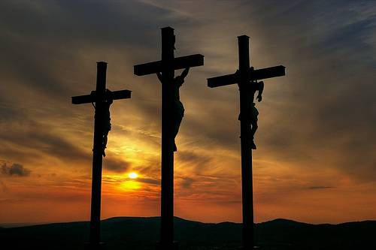
God’s grace was displayed at Calvary
“For ye know the grace of our Lord Jesus Christ, that, though he was rich, yet for your sakes he became poor, that ye through his poverty might be rich.”
(II Cor. 8:9)

Slide 41
God’s grace makes the sinner what he is (II Cor. 12:9)
"But by the grace of God I am what I am…”
I Corinthians 15:10

Slide 42
“Three kinds of Grace”
1. Saving Grace – Eph. 2:8-10 God giving underserved, forgiveness, acceptance and favor to sinners.
I Peter 1:10 “Of which salvation the prophets have enquired and searched diligently, who prophesied of the grace that should come unto you…”
The “Grace” that the Old Testament prophets prophesied of was Jesus Christ – John 1:1-17

Slide 43
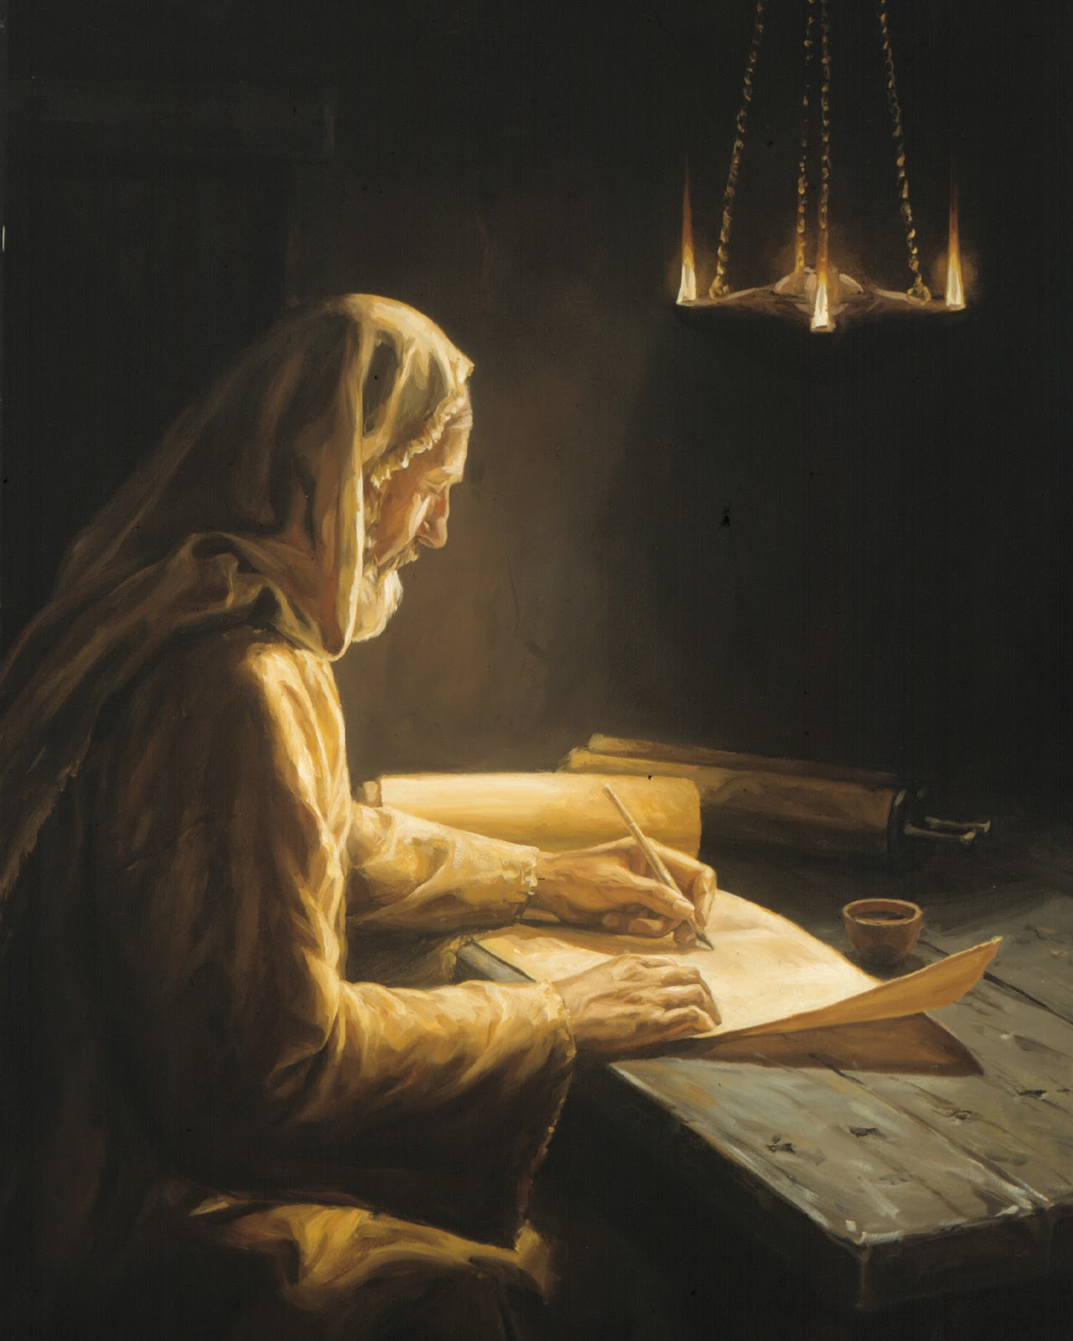
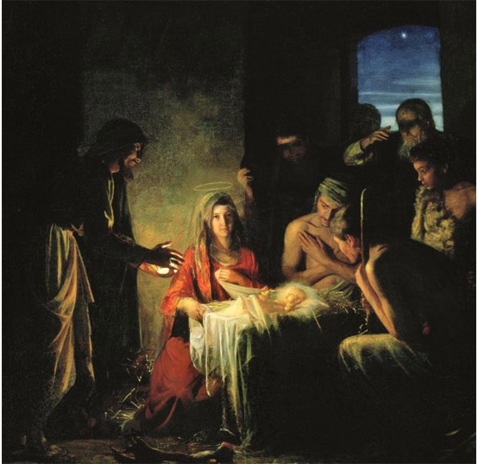
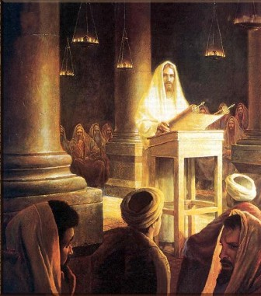
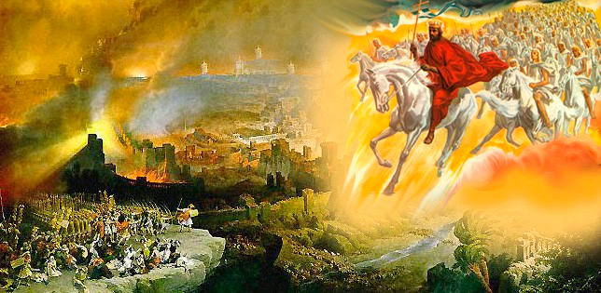
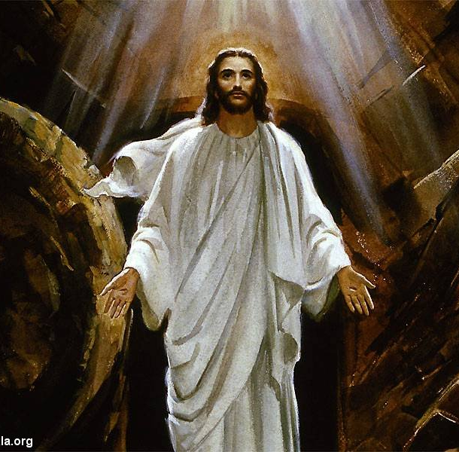
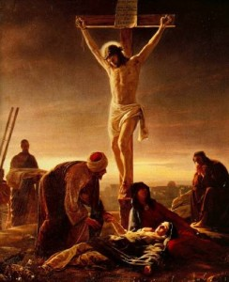

Slide 44
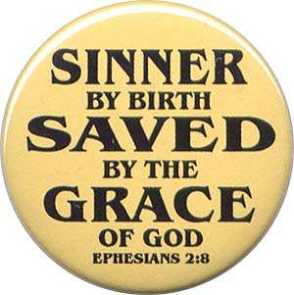
The “Grace of God” has been revealed to all men – “For the Grace of God that bringeth salvation hath appeared to all men…” Titus 2:11
“But we see Jesus, who was made a little lower than the angels for the suffering of death, crowned with glory and honour; that he by the grace of God should taste death for every man.” Heb 2:9

Slide 45
The “Grace of God” is the only means of salvation – “But we believe that through the grace of the Lord Jesus Christ we shall be saved…Being justified freely by his grace through the redemption that is in Christ Jeus…Who hath saved us and called us with a holy calling, not according to our works but according to his own purpose and grace…That being justified by his grace, we should be made heirs according to the hope of eternal life.”

Slide 46
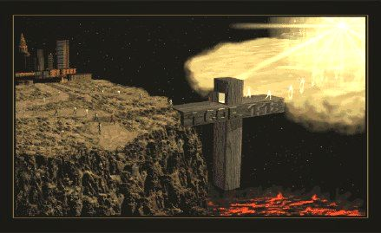
Grace

Slide 47
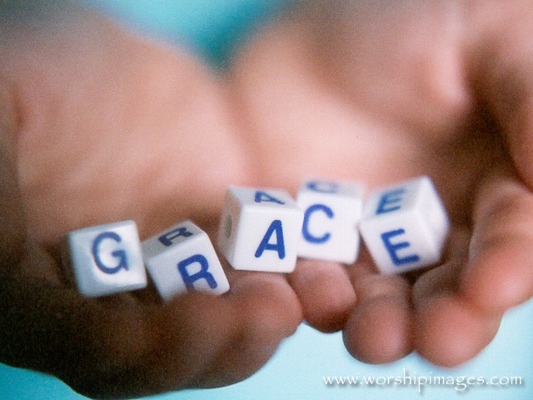
“ I do not frustrate the grace of God: for if righteousness come by the law, then Christ is dead in vain.”
Gal. 2:21

Slide 48
2. Sustaining grace – God giving strength to endure hardship
“For this thing I besought the Lord thrice, that it might depart from me. And he said unto me, My grace is sufficient for thee: for my strength is made perfect in weakness. Most gladly therefore will I rather glory in my infirmities, that the power of Christ may rest upon me. Therefore I take pleasure in infirmities, in reproaches, in necessities, in persecutions, in distresses for Christ's sake: for when I am weak, then am I strong.” II Cor. 12:8-10

Slide 49
“God resisteth the proud, and giveth grace to the humble. Humble yourselves therefore under the mighty hand of God, that he may exalt you in due time: Casting all your care upon him; for he careth for you. Be sober, be vigilant; because your adversary the devil, as a roaring lion, walketh about, seeking whom he may devour: Whom resist stedfast in the faith, knowing that the same afflictions are accomplished in your brethren that are in the world. But the God of all grace, who hath called us unto his eternal glory by Christ Jesus, after that ye have suffered a while, make you perfect, stablish, strengthen, settle you. To him be glory and dominion for ever and ever. Amen.”
I Peter 5:5-11

Slide 50
3. Strengthening grace – God giving the ability to accomplish his will
“But by the grace of God I am what I am: and his grace which was bestowed upon me was not in vain; but I laboured more abundantly than they all: yet not I, but the grace of God which was with me.” I Cor. 15:10
“For it is God which worketh in you both to will and to do of his good pleasure.”
Phil. 2:13

Slide 51
“Be strong in the grace that is in Christ Jesus…”

Slide 52
“For our rejoicing is this, the testimony of our conscience, that in simplicity and godly sincerity, not with fleshly wisdom, but by the grace of God, we have had our conversation in the world, and more abundantly to you-ward.” II Cor. 1:12
“Moreover, brethren, we do you to wit of the grace of God bestowed on the churches of Macedonia.” II Cor. 8:1

Slide 53
“To the praise of the glory of His grace, wherein he hath made us accepted in the beloved.” Eph. 1:6

