Slide 1
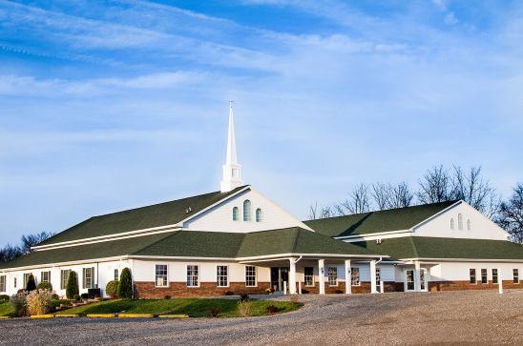
The Doctrine of the Church
The History, Growth, and Character of the Various New Testament Churches

Slide 2
I Corinthians 10:11
"Now all these things happened unto them for ensamples: and they are written for our admonition, upon whom the ends of the world are come."
Here, Paul refers to Old Testament events. But we may with Scriptural justification apply these same words to the events recorded for us in the New Testament.

Slide 3
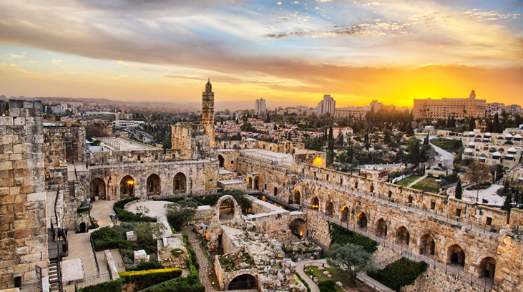
The church in Jerusalem

Slide 4
Began at Pentecost (Acts 2:47) with at least 3120 (Acts 2:41)
Was pastored by James, the half-brother of Christ (Acts 15:13)
Performed many wonders and signs (Acts 2:43; 5:12-16)
Had all things in common (Acts 2:44, 45; 4:32-35)
Was in one accord (Acts 2:46)
Spent a good deal of time in prayer (Acts 2:42; 3:1; 4:24; 12:5-17)
Witnessed at every opportunity (Acts 3:12; 4:5; 5:42; 4:33)
Radiated Jesus (Acts 4:13; 6:15)
Was kept pure by God (had standards) (Acts 5:1-11; 8:18-24)
Grew constantly (Acts 2:47; 5:14; 4:4; 12:24)

Slide 5
Endured persecution (Acts 4:1-3; 4:21; 5:17-41; 7:54-60; 8:1-3; 12:1-4)
Appointed deacons (Acts 6:1-7)
Practiced baptism and the Lord’s Supper (Acts 2:41, 46)
Sent forth missionaries (Acts 8:5, 14; 11:22; 13:1-3; 15:22)
Held the important meeting on circumcision (Acts 15)
Was Spirit-led (Acts 2:1-18; 4:31; 13:2-4; 15:28)
Preached the word (Acts 2:16-36; 3:13-26; 5:42; 6:4; 7:1-53)
Contended for the faith (Acts 15:1-21)
Apparently later compromised with the Judaizers (Acts 21:18-25)

Slide 6
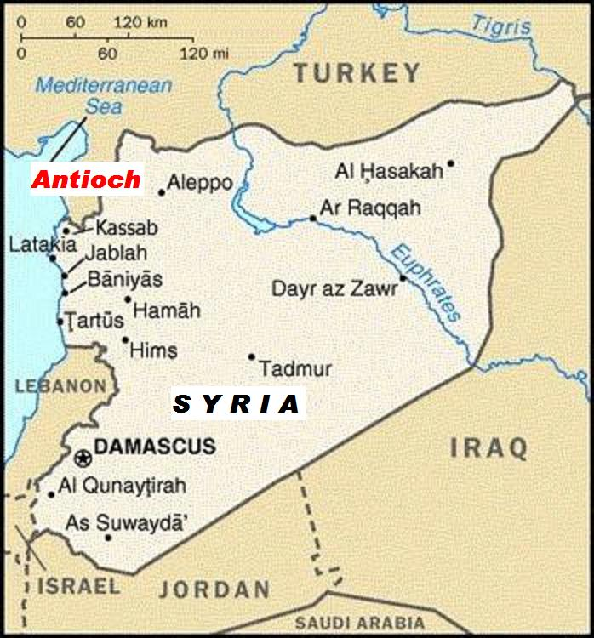
The church in Antioch of Syria

Slide 7
Was founded during that persecution period which followed the martyrdom of Stephen (Acts 11:19)
Experienced a great growth (Acts 11:21)
The Jerusalem church sent Barnabas to "check it out" (Acts 11:22)
He became the first pastor (Acts 11:23)
Added many to the church at this time (Acts 11:24)
Barnabas then called Saul as associate pastor (Acts 11:25)
Here both would work for a year (Acts 11:26)

Slide 8
Was where believers were first called Christians (Acts 11:26)
Took up a large love offering for the needy believers in Jerusalem (Acts 11:30)
Was the home church of the first two Christian missionaries (Paul and Barnabas) (Acts 13:1-3; 14:26)
Later became their headquarters, both after their first missionary trip (Acts 14:26) and following the Jerusalem Council (Acts 15:35)
Silas was from this church (Acts 15:34)
Was where Paul set Peter straight on matters of legalism (Gal. 2:11)

Slide 9
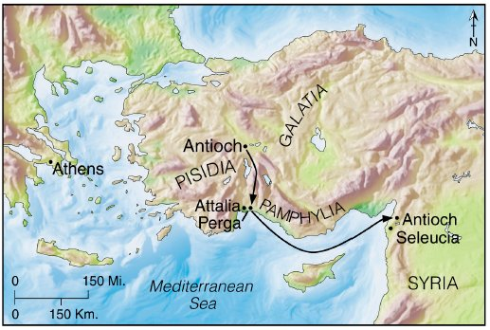
The church in Antioch of Pisidia

Slide 10
Was begun by Paul during his first missionary trip (Acts 13:14)
Was where he preached his first recorded sermon (Acts 13:16)
Was formed from the converts coming out of this meeting (Acts 13:43)
Paul turned from the Jews (Acts 13:46)
Paul relates his heavenly calling as a light to the Gentiles (Acts 13:47)

Slide 11
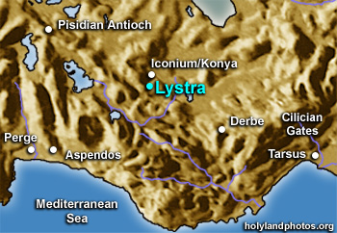
The church in Lystra

Slide 12
Was organized during Paul’s first missionary trip (Acts 14:6)
Was where he healed the impotent man (Acts 14:10)
This led to his being almost worshiped (Acts 14:11)
Paul was stoned (Acts 14:19; 2 Tim. 3:11)
Was where Paul picked up Timothy during his second missionary trip (Acts 16:1-3)

Slide 13
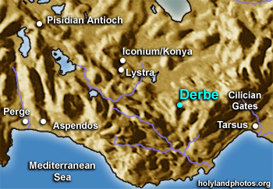
The church in Derbe

Slide 14
(Acts 14:21-22)
“And when they had preached the gospel to that city (Derbe), and had taught many, they returned again to Lystra, and to Iconium, and Antioch, {had taught many: Gr. had made many disciples} Confirming the souls of the disciples, and exhorting them to continue in the faith, and that we must through much tribulation enter into the kingdom of God.”

Slide 15
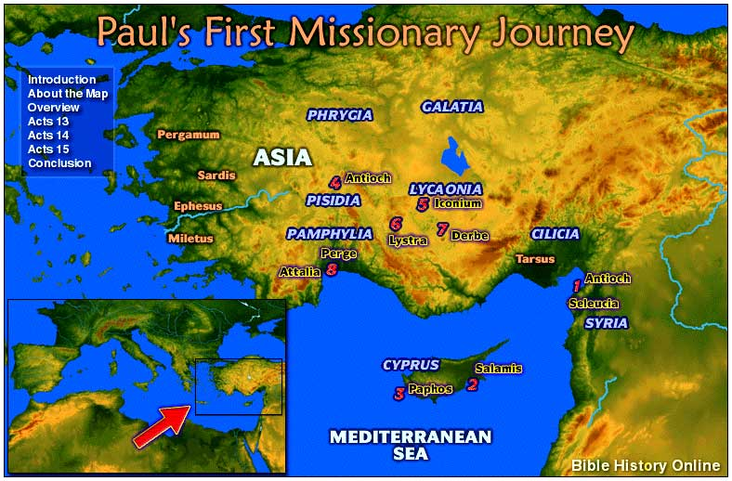
The church in Iconium

Slide 16
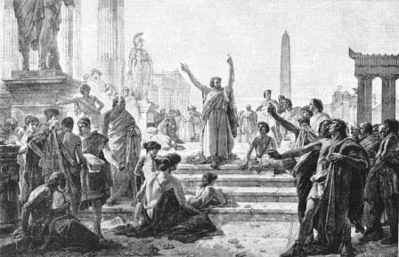
Paul led many to Christ here during his first trip (Acts 14:2)
He also worked great signs and wonders (Acts 14:3)
He was driven out by the unbelieving Jews and Gentiles (Acts 14:5)

Slide 17
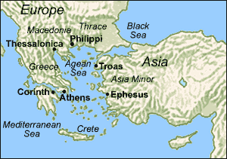
The church in Philippi

Slide 18
Paul organized a church in the home of a woman convert named Lydia (Acts 16:15-40)
A demon-possessed girl was his next convert (Acts 16:18)
She was followed by the Philippian jailor (Acts 16:33)
Paul later wrote a letter to this church (Phil. 1:1)
Timothy ministered to this church (Phil. 2:19)
Had sent Epaphroditus to minister to Paul while the apostle was in prison (Phil. 2:25)
Was in danger of legalism (Phil. 3:1-3)
Paul writes and asks "true yokefellow" to help two quarreling church women named Euodias and Syntyche (Phil. 4:1-3)
Helped to supply the material needs of Paul (Phil. 4:15-18)

Slide 19
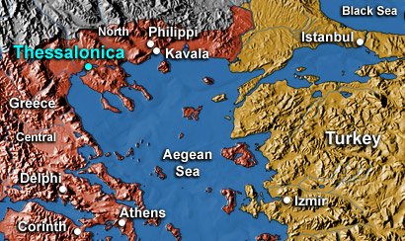
The church in Thessalonica

Slide 20
Was founded during Paul’s second missionary trip (Acts 17:1)
Witnessed a great harvest of souls (Acts 17:4)
Paul is accused of turning the world upside down (Acts 17:6)
In spite of their zeal, they were not good Bible students (Acts 17:6)
Later Paul wrote two letters to this church (1 Thess. 1:1; 2 Thess. 1:1)
The believers had a reputation for witnessing (1 Thess. 1:8)
They were persecuted by the unbelieving Jews because of their faith (1 Thess. 2:14)
Timothy ministered to this church (1 Thess. 3:1-2)
Had some lazy members (2 Thess. 3:10)
Had some busybodies (2 Thess. 3:11)
Had some disobedient members (2 Thess. 3:14-15)

Slide 21
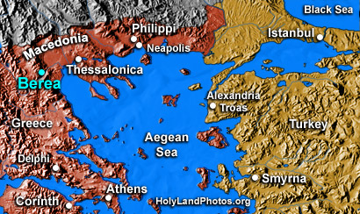
The church in Berea

Slide 22
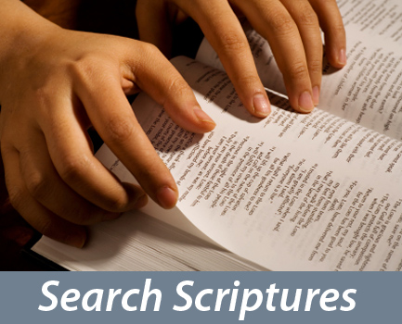
This church was commended for its knowledge of and love for the Word of God (Acts 17:11)

Slide 23
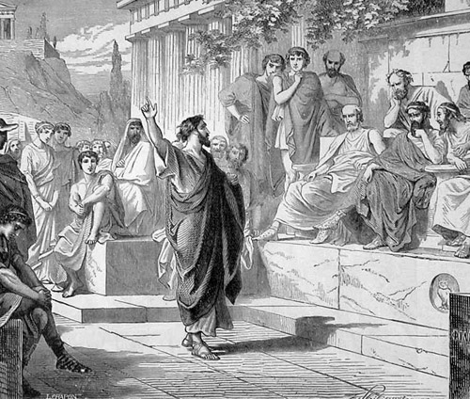
The church in Athens

Slide 24
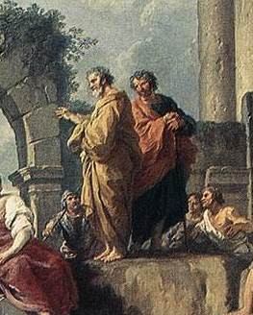
It is not certain whether a local assembly came into being after Paul’s sermon on Mars Hill, but if so, a convert named Dionysius probably led the church. (Acts 17:34)

Slide 25
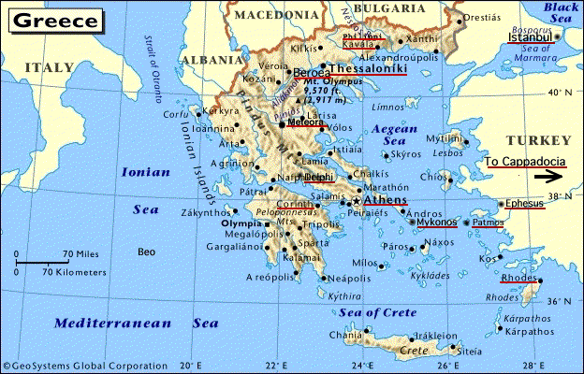
The church in Corinth

Slide 26
Was founded during Paul’s second trip (Acts 18:1)
Aquila and Priscilla aided in this (Acts 18:2)
The chief ruler of the Jewish synagogue, a man named Crispus, was one of Paul’s first converts (Acts 18:8)
His successor, Sosthenes, was also later evidently saved (compare Acts 18:17 with 1 Cor. 1:1)
Paul stayed eighteen months (Acts 18:11)
Paul wrote several letters of correction to this church (1 Cor. 5:9; 2 Cor. 10:9, 10), two of which are included in the New Testament (1 Cor. 1:2; 2 Cor. 1:1)

Slide 27
Experienced almost total confusion in matters relating to:
Baptism (1 Cor. 1:12-17)
Earthly wisdom (1 Cor. 1:26)
Carnality and strife (1 Cor. 3:1-3)
Judging others unfairly (1 Cor. 4:7)
Immorality (1 Cor. 5:1)
Taking other believers to court (1 Cor. 6:1-4)
Marriage (1 Cor. 7:1)
Christian liberty (1 Cor. 8-9)
The Lord’s Table (1 Cor. 11:17-34)
Spiritual gifts (1 Cor. 12-14)
The doctrine of the resurrection (1 Cor. 15)
Tithing (1 Cor. 16)

Slide 29
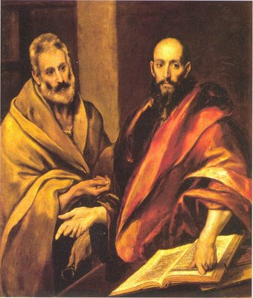
Was later pastored by Apollos who was discipled by Paul (1 Cor. 3:6)

Slide 30
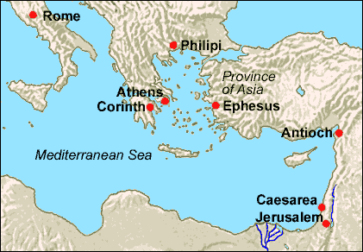
The church in Ephesus

Slide 31
Was founded during Paul’s second trip (Acts 18:19)
May pastored by Apollos, Timothy, and the Apostle John.
Paul wrought many miracles there and saw much fruit (Acts 19:11-41)
Books of witchcraft, sorcery and magic were burned.
The magnificence of the false goddess Diana was greatly diminished.
Paul went soul-winning door-to-door (Acts 20:17-21)

Slide 32
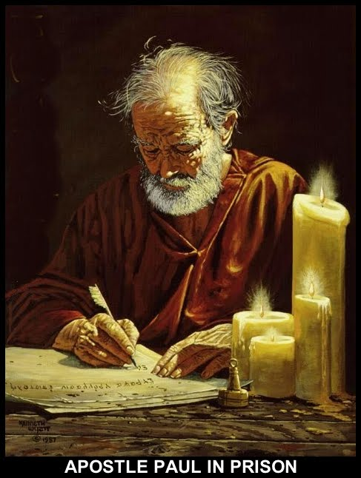
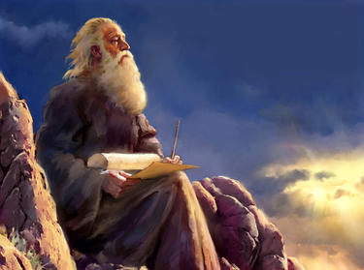
Was the only Christian church ever to receive letters from two New Testament writers. Paul wrote Ephesians to them (Eph. 1:1), and John the apostle would later direct a portion of Revelation to them (Rev. 2:1-7). According to John’s letter, this church:

Slide 33
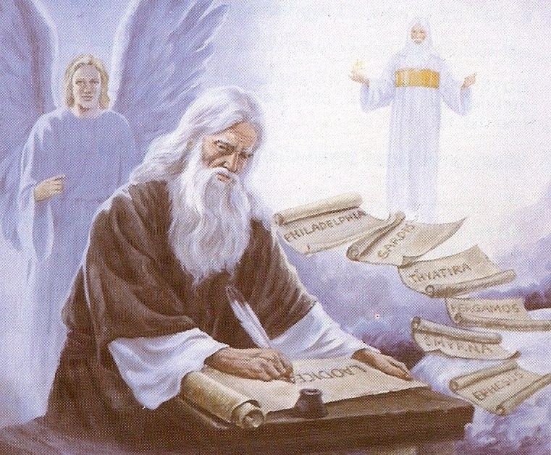
Worked hard and possessed patience.
Had high church standards.
Suffered for Christ.
Had left their first love.
Needed to remember, repent, and return to Christ, else their candlestick be removed.
Hated the deeds of the licentious Nicolaitans.

Slide 34
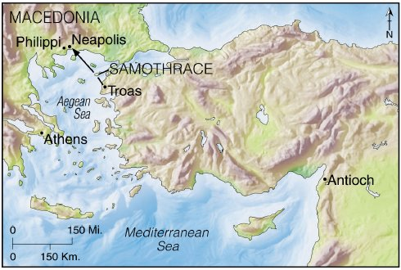
The church in Troas

Slide 35
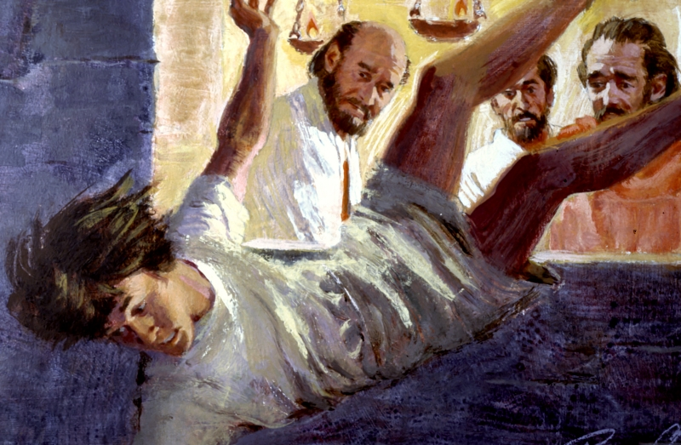
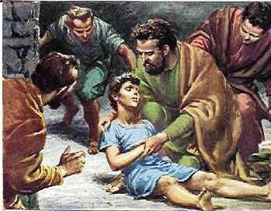
Here Paul raised up Eutychus, a believer who had gone asleep during Paul’s sermon and had fallen down from the third loft of the building (Acts 20:7-12)

Slide 36
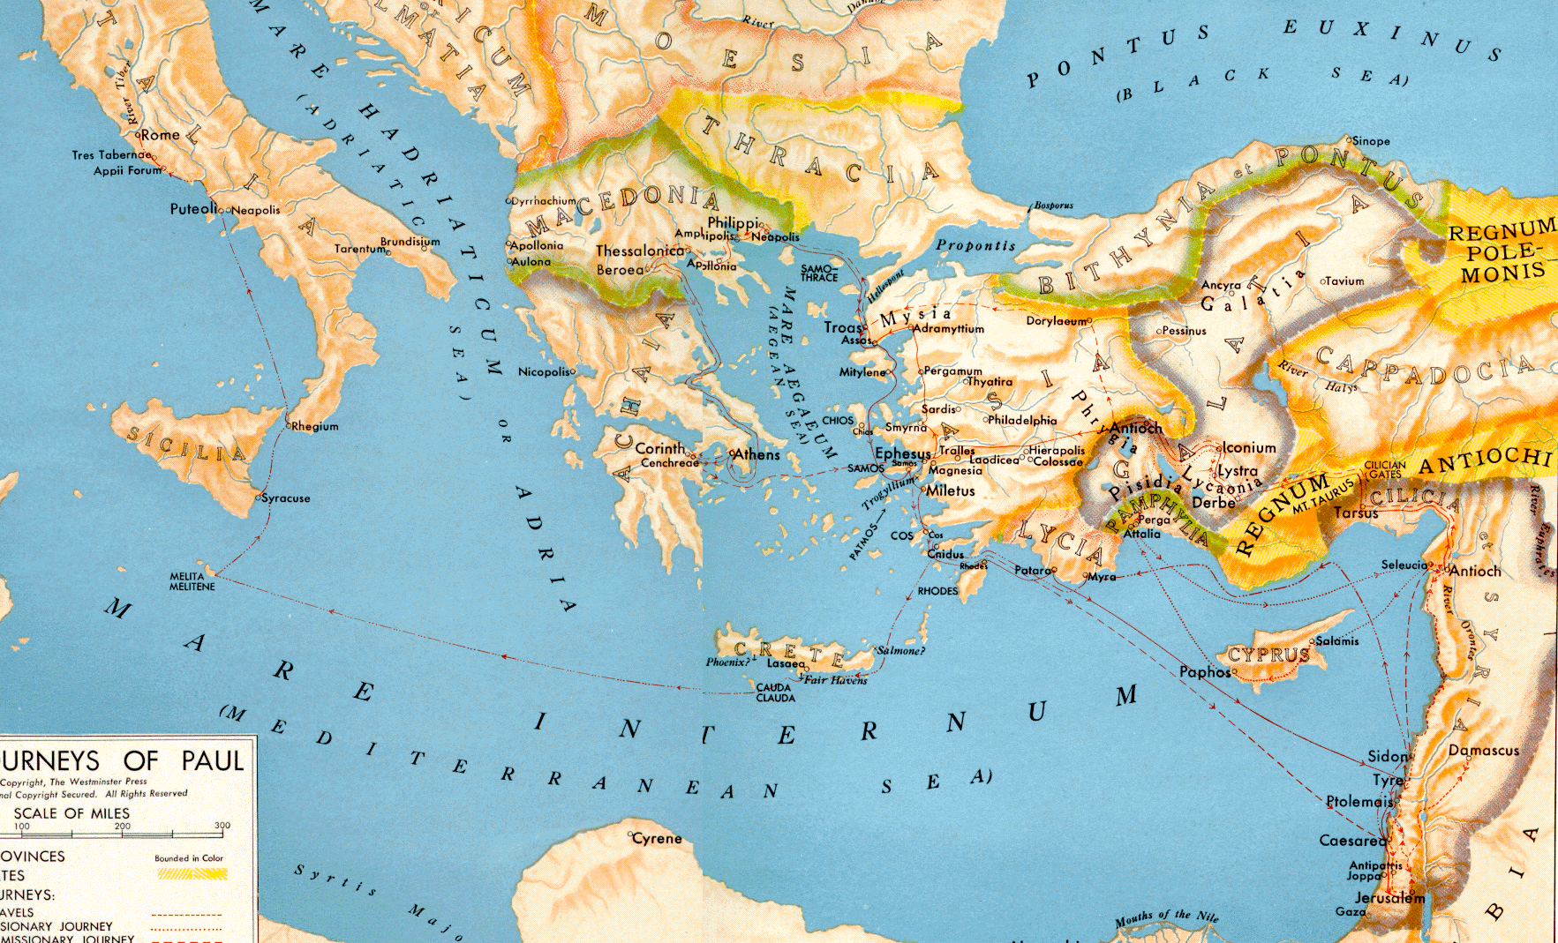
The church in Rome

Slide 37
The origin and founder of this church is unknown.
Priscilla and Aquila labored there and a local church met in their home (Rom. 16:3-5)
Had a good testimony throughout all the land (Rom. 1:8)
Paul mentions more personal friends here than in any other New Testament book he wrote.
The names of some twenty-six individuals may be counted in Romans 16

Slide 38
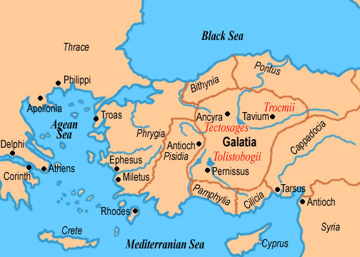
The church’s in Galatia

Slide 39
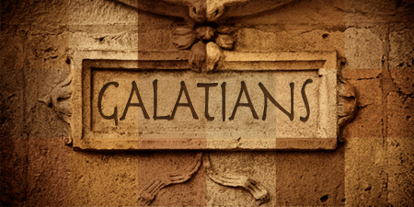
Various local churches in Galatia were organized by Paul during his first trip.
Had all apparently fallen victim to the legalistic Judaizers, who would continually challenged Paul’s gospel of grace (Gal. 1:6-9)
The New Testament epistle Galatians was written to these churches (Gal. 3:1)

Slide 40
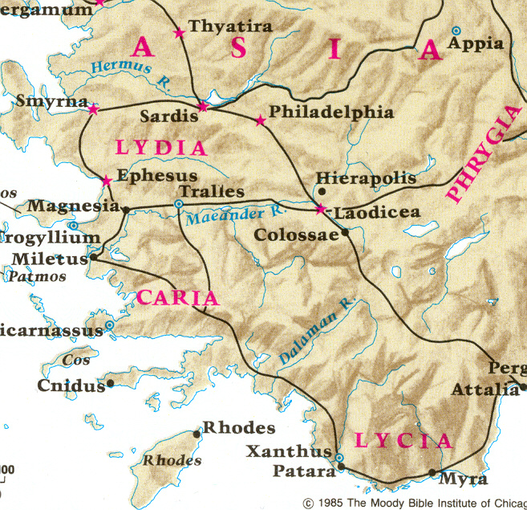
The church in Colosse

Slide 41
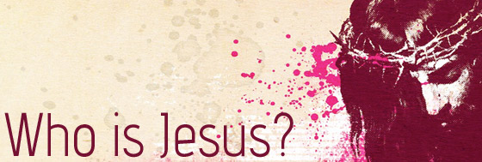
Was founded by Epaphras during Paul’s third trip (Col. 2:1; 1:7, 12-13)
Philemon and Onesimus attended this church (Col. 4:9; Philemon 1:1-2)
Main theme of Colossians is the person and work of Jesus Christ and the believers position in Christ.
Paul commanded the Colossian epistle to be read to the Laodicean church and the one he wrote them to be read to the Colossian church (Col. 4:16)

Slide 42
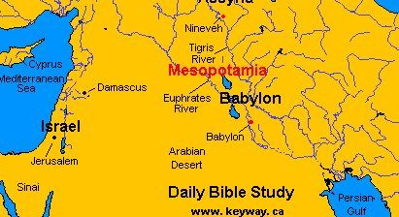
The church in Babylon (1 Peter 5:13)

Slide 43
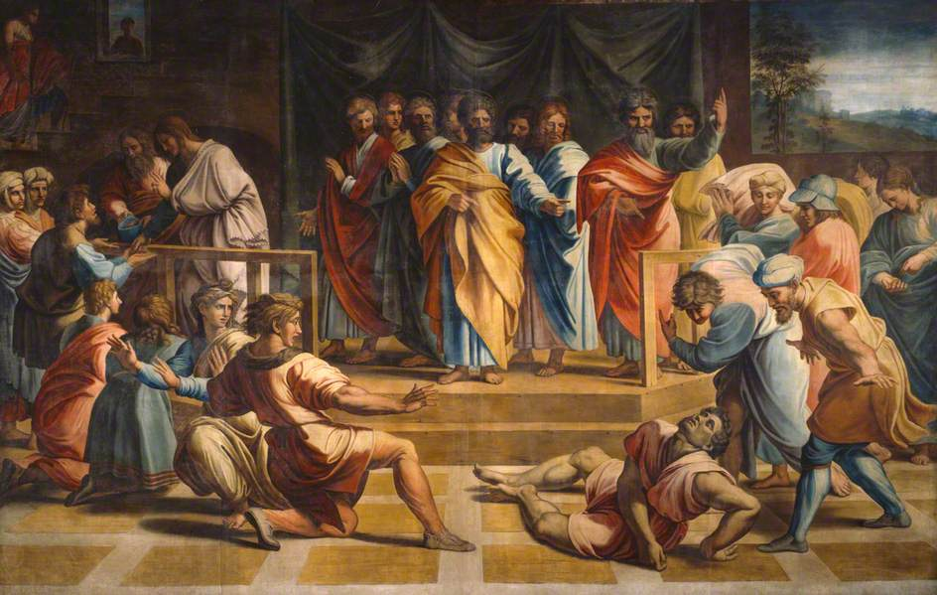
Was filled with suffering believers (1 Pet. 1:6)
Some of this suffering was due to sin (1 Pet. 4:15-17)
“But let none of you suffer as a murderer, or as a thief, or as an evildoer, or as a busybody in other men's matters.”

Slide 44
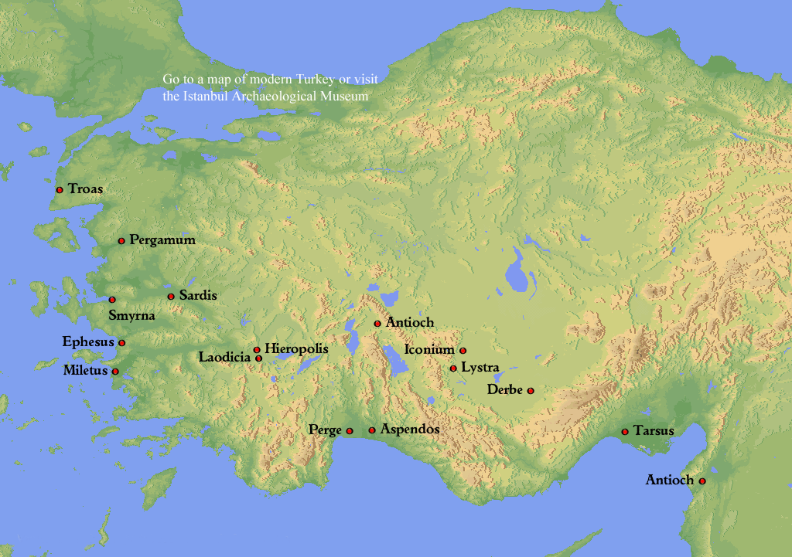
The church in Smyrna (Rev. 2:8-11)

Slide 45
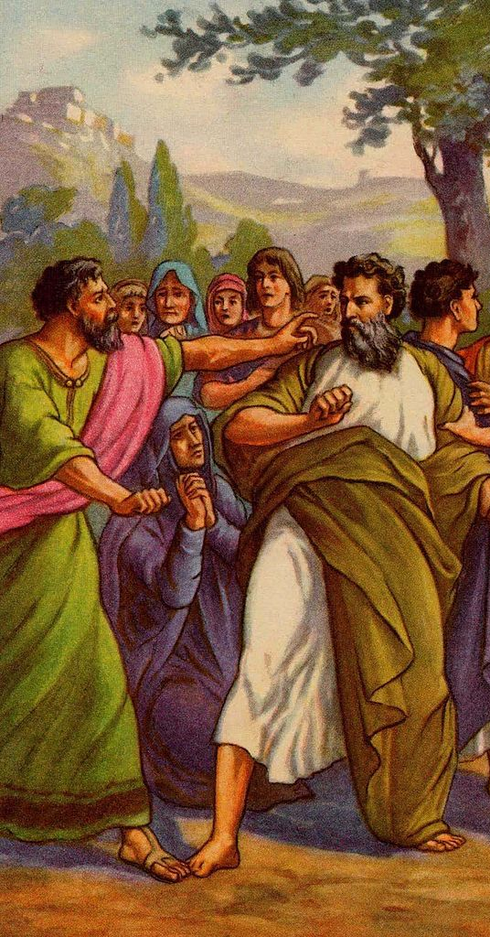
Had suffered much for Christ.
Had been slandered by those from the synagogue of Satan.
Satan had imprisoned some of them.

Slide 46
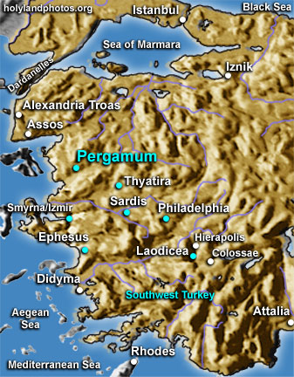
The church in Pergamos (Rev. 2:12-17)

Slide 47
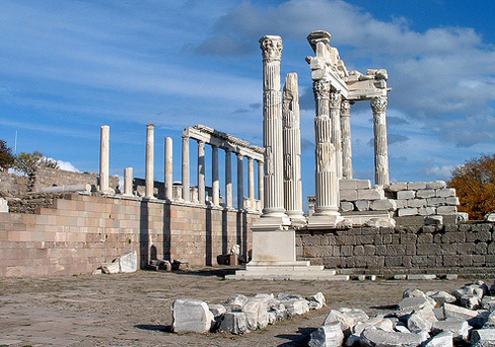
Was located in the very center of satanic worship.
Had nevertheless remained loyal to Christ in spite of martyrdom.
Members were, however, tolerating some in the church who were guilty of sexual sins.
They were also tolerating those who held the doctrine of the Nicolaitans.

Slide 48
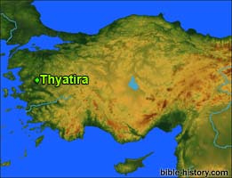
The church in Thyatira (Rev. 2:18-29)

Slide 49
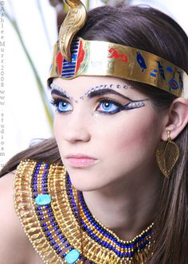
Had performed many good deeds.
But they permitted a false prophetess named Jezebel to teach that sexual sin was not a serious matter.

Slide 50
The church in Sardis (Rev. 3:1-6)

Slide 51
Had a reputation that they were alive, but they were spiritually dead.
Was to strengthen that which was ready to die.

Slide 52
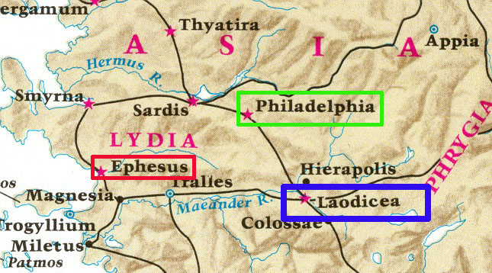
The church in Philadelphia (Rev. 3:7-13)

Slide 53
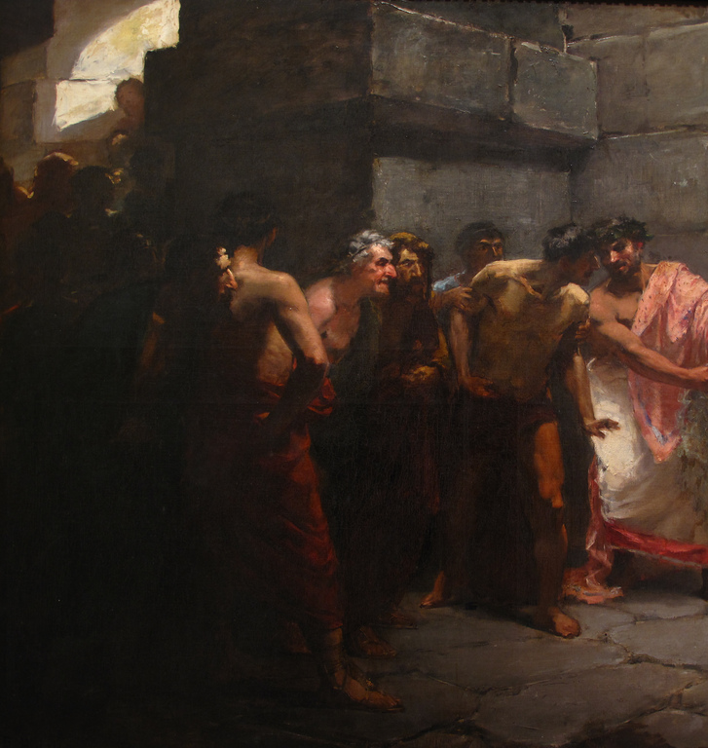
Small in number but they were spiritually strong.
Faithfull to the Lord during server persecution.

Slide 54
The church in Laodicea (Rev. 3:14-20)

Slide 55
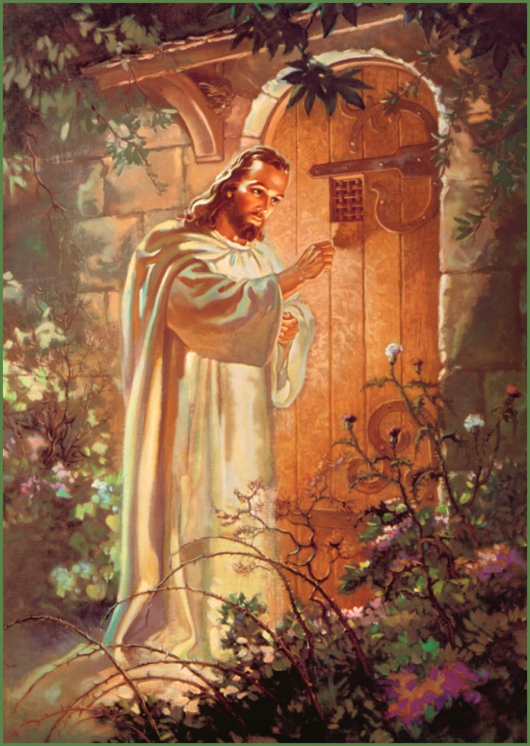
One the worst church’s mentioned in the New Testament.
Believers were neither hot nor cold.
Bragged about their wealth, claiming they had need of nothing, but in reality were wretched, miserable, poor, blind, and naked.
God admonished them to totally repent and allow him to reenter and once again fellowship with them.

Slide 56
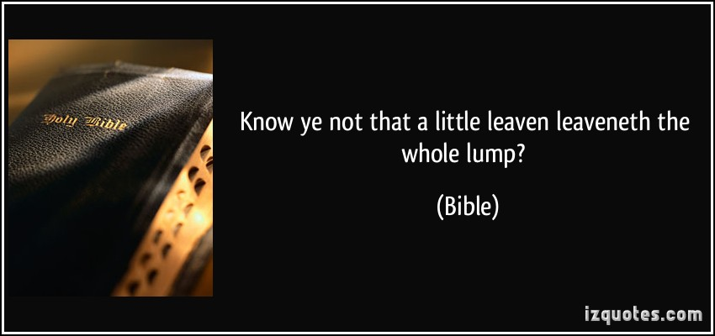
The character of the local church is the sum-total of the character of its members.

Slide 57
