Slide 1
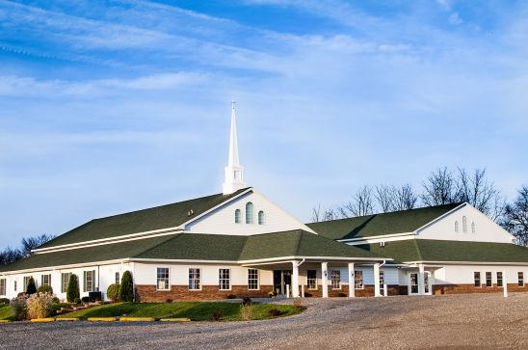
The Doctrine of the Church (Part 14)
Church Membership

Slide 3
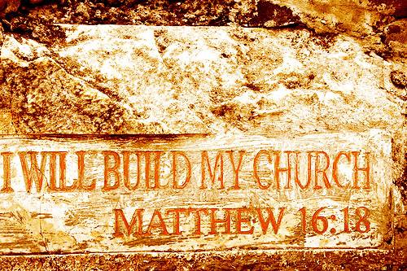

Slide 4
“…and the gates of hell shall not prevail against it.”

Slide 5
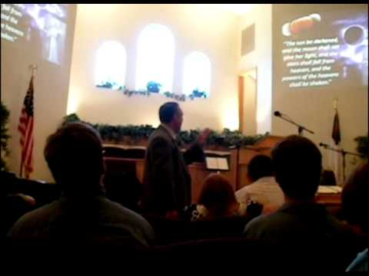
The Meaning of the Word "Church."
Thus, the literal meaning is - a call out assembly.
A called out Assembly of Baptized Believers gathered together for – Acts2:42; Phil. 3:3
1. Doctrine
2. Fellowship
3. Breaking of Bread
4. Prayers
5. Worship

Slide 6
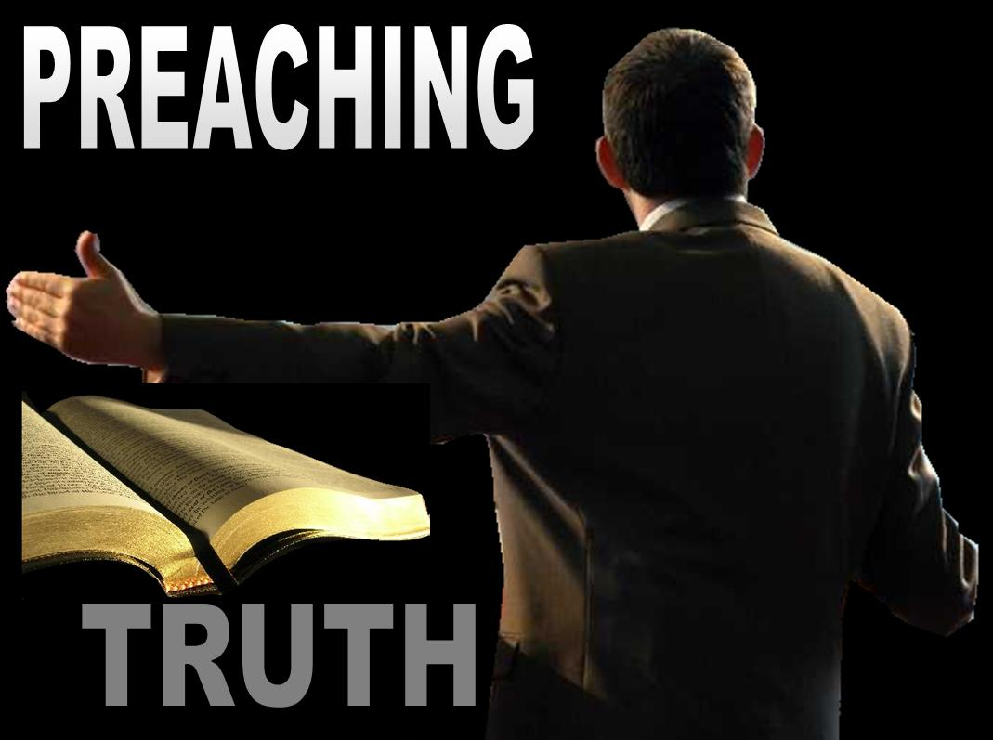

Slide 7
The Origin of the Church “When and where did the church actually begin?”

Slide 8
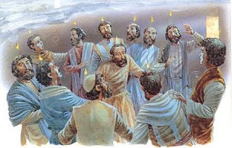
The Church begin on the Day of Pentecost

Slide 9
The Nature of the Church
“The characteristics or inherent features of the Church”

Slide 11
“Thou art worthy, O Lord, to receive glory and honour and power: for thou hast created all things, and for thy pleasure they are and were created.” (Rev. 4:11)

Slide 12
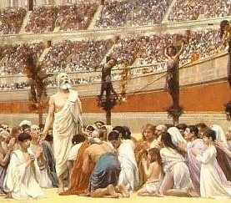
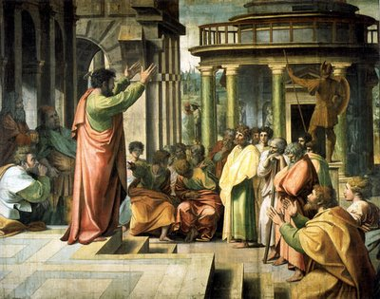
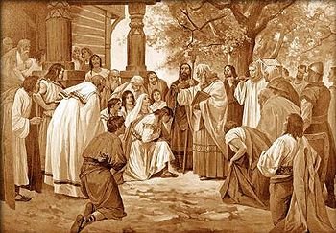
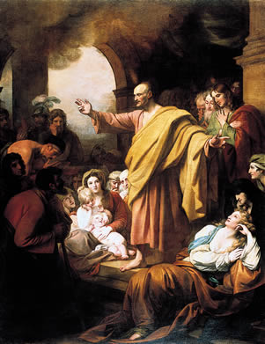
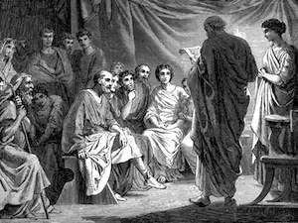
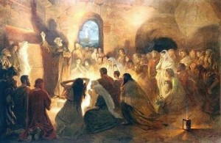
The History, Growth, and Character of the Various New Testament Churches.

Slide 13
The Six Symbols of the Church

Slide 14
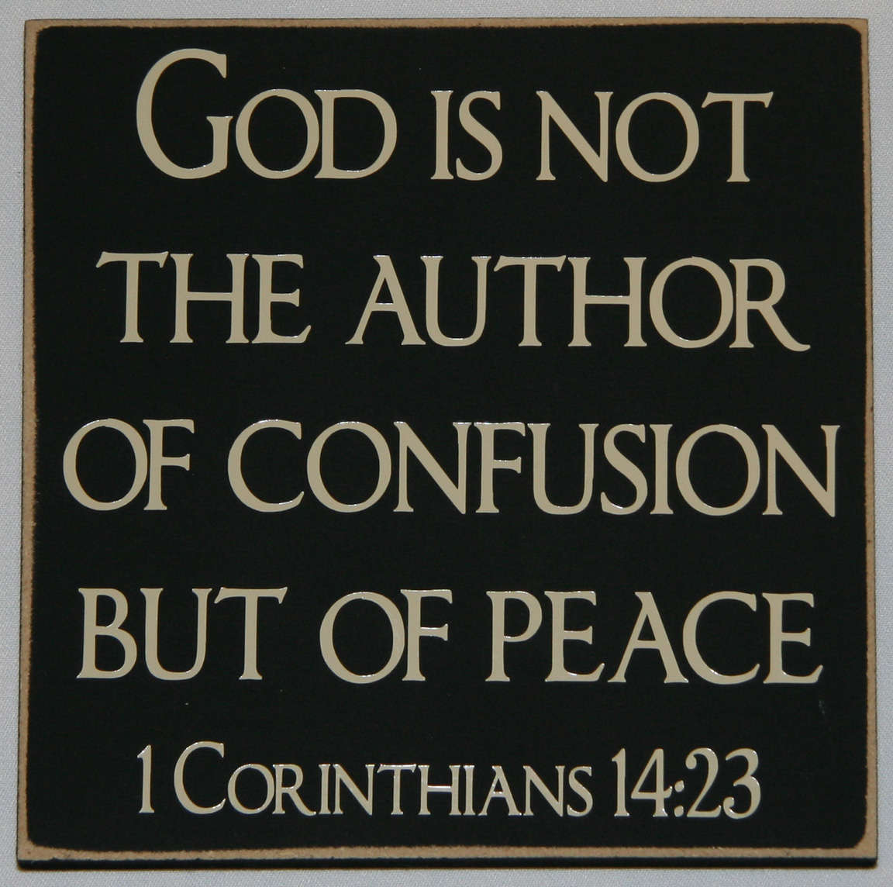
The Organization of the Church

Slide 15
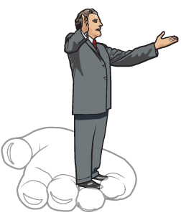
The New Testament Church had Officers
(Philippians 1:1) “Paul and Timotheus, the servants of Jesus Christ, to all the saints in Christ Jesus which are at Philippi, with the bishops and deacons.”

Slide 16
God’s methods vs. Our man’s of Building the church of Jesus Christ

Slide 17
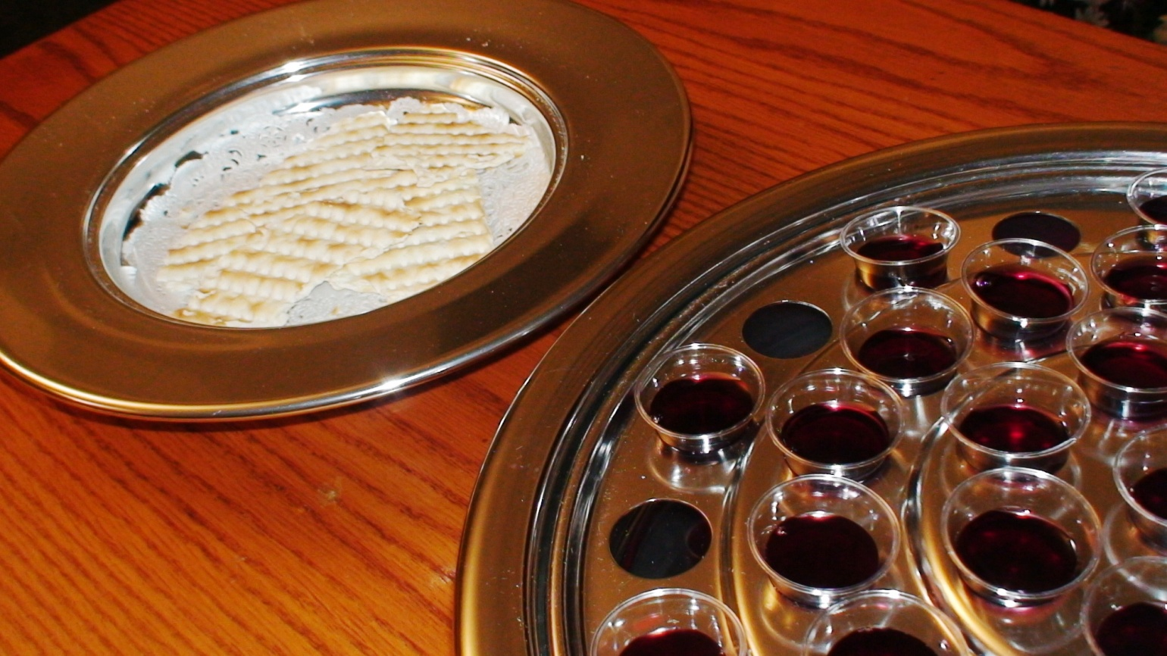
The Lord’s Supper The Scriptures describing the Lord’s Supper - Matthew 26:26-30; Mark 14:22-26; Luke 22:17-20; John 6:51, 53-56; 1 Corinthians 11:23-34.

Slide 18
Baptism “Go ye, therefore, and teach all nations, baptizing them in the name of the Father, and of the Son, and of the Holy Ghost” (Matt. 28:19)

Slide 20
Many of God’s people just do not understand the importance of the Local Church, commitment to a Local church (church membership) or faithful church attendance.
The word “Church” appears 114 times in the New Testament
Greek (ekklesia) = “An assembly of people called out”
99 times the word “Church” is used in reference to particular local churches
7 times in reference to the “Universal Church”
8 times in reference to the “Local Church” in general not a particular church
107 Local / 7 Universal

Slide 21
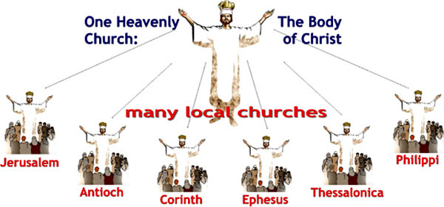
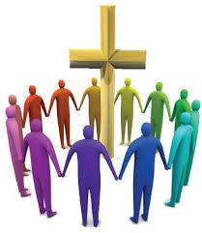
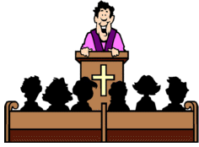
Universal Church / Invisible Body of Christ
Local Church / Visible Body of Christ

Slide 22
Most, professing Christians will readily proclaim – “All scripture is given by inspiration of God, and is profitable for doctrine, for reproof, for correction, for instruction in righteousness..."
We believe that Scripture is our only rule for faith and practice.
We claim that the Word of God provides God inspired direction for our lives – Ps. 119:105
Where does the Bible talk about placing your membership in a local congregation?
Where is “local church membership” taught and emphasized in the New Testament?

Slide 23
Church membership is taught in the Bible
1Cor. 12:12 “For as the body is one, and hath many members, and all the members of that one body, being many, are one body: so also is Christ.”
1Cor. 12:18 “But now hath God set the members every one of them in the body, as it hath pleased him.”
1Cor. 12:20 “But now are they many members, yet but one body.”
1Cor. 12:22 “Nay, much more those members of the body, which seem to be more feeble, are necessary.”
1Cor. 12:23 “And those members of the body, which we think to be less honourable, upon these we bestow more abundant honour; and our uncomely parts have more abundant comeliness.”

Slide 24
1Cor. 12:25 “That there should be no schism in the body; but that the members should have the same care one for another.”
1Cor. 12:26 “And whether one member suffer, all the members suffer with it; or one member be honoured, all the members rejoice with it.”
1Cor. 12:27 “Now ye are the body of Christ, and members in particular.”
Rom. 12:4 “For as we have many members in one body, and all members have not the same office.”
Rom.12:5 “So we, being many, are one body in Christ, and every one members one of another.”

Slide 25
In a day when commitment is a rare commodity, it should come as no surprise that church membership is such a low priority to so many believers. Sadly, it is not uncommon for Christians to move from church to church, never submitting themselves to a Pastor and never committing themselves to a group of fellow believers.

Slide 26
To neglect—or to refuse—to join a church as a formal member, however, reflects a misunderstanding of the believer’s responsibility to the body of Christ.
It also cuts one off from the many blessings and opportunities that flow from this commitment.
It is essential for every Christian to understand what church membership is and why it matters.

Slide 27
The Definition of Church Membership
When an individual is saved, he becomes a member of the body of Christ (1 Cor. 12:13).
Because he is united to Christ and the other members of the body in this way, he is therefore qualified to become member of a local expression of that body.
Pattern set forth in the book of Acts = Saved, baptized and became members of the Local Church in which they were baptized.

Slide 28
In the early church, coming to Christ was coming to the church.
The idea of experiencing salvation without belonging to a local church is foreign to the New Testament.
When individuals repented and believed in Christ, they were baptized and added to the church (Acts 2:41, 47; 5:14; 16:5).
More than simply living out a private commitment to Christ, these believers joined together formally with other believers in a local assembly and devoted themselves to the apostles’ doctrine (teaching), fellowship, the breaking of bread, and prayer (Acts 2:42).

Slide 29
In the book of Acts, much of the terminology fits only with the concept of formal church membership.
Phrases such as =
“the whole congregation” (6:5)
“the church in Jerusalem” (8:1)
“the disciples” in Jerusalem (9:26)
“in every church” (14:23)
“the whole church” (15:17)
“the elders of the church” in Ephesus (20:17)

Slide 30
In Acts 6:1-6, we see the selection of Deacons took place in order to address a specific problem and accusation that arose in the local church.
All these passages suggest recognizable church membership with well-defined boundaries (also see 1 Cor. 5:4; 14:23; and Heb. 10:25).
In Romans 16:1-16, we see a list of those who were members of the church of Rome.

Slide 31
To become a member of a church is to formally commit oneself to an identifiable, local body of believers who have joined together for specific, divinely ordained purposes.
These purposes include =
Receiving instruction from God’s Word (1 Tim. 4:13; 2 Tim. 4:2)
Serving and edifying one another through the proper use of spiritual gifts (Rom. 12:3-8; 1 Cor. 12:4-31; 1 Pet. 4:10-11)
Participating in the ordinances (Luke 22:19; Acts 2:38-42)
Proclaiming the gospel to those who are lost (Matt. 28:18-20).

Slide 32
In addition, when one becomes a member of a church, he submits himself to the care and the authority of the biblically qualified Pastor that God has placed over that assembly.

Slide 33
Pastoral authority only extends to the members of the Local church
(Hebrews 13:7) “Remember them which have the rule over you, who have spoken unto you the word of God: whose faith follow, considering the end of their conversation.”
(Hebrews 13:17) “Obey them that have the rule over you, and submit yourselves: for they watch for your souls, as they that must give account, that they may do it with joy, and not with grief: for that is unprofitable for you.”

Slide 34
Scripture teaches that believers are to submit to their Pastor.
The question for each believer is, “Who is your Pastor?”
The one who has refused to join a local church and entrust himself to the care and the authority of a Pastor has no Spiritual leader.
For that person, obedience to Hebrews 13:17 is impossible.
To put it simply, this verse implies that every believer knows to whom he must submit, which assumes clearly defined church membership.

Slide 35
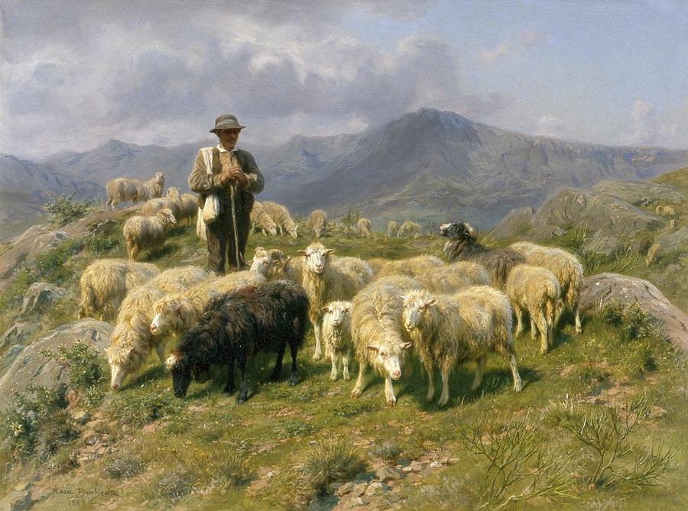
Pastors are to shepherd God’s people (Acts 20:28; 1 Pet. 5:2), to labor diligently among them (1 Thess. 5:12), to have charge over them (1 Thess. 5:12; 1 Tim. 5:17), and to keep watch over their souls (Heb. 13:17). Scripture teaches that the Pastor will give an account to God for the individuals allotted to their charge (Heb. 13:17; 1 Pet. 5:3).

Slide 36
Those responsibilities require that there be a distinguishable, mutually understood membership in the local church. Pastors can shepherd the people and give an account to God for their spiritual well-being only if they know who they are; they can provide oversight only if they know those for whom they are responsible; and they can fulfill their duty to shepherd the flock only if they know who is part of the flock and who is not.

Slide 37
The Pastor of a church is not responsible for the spiritual well-being of every individual who visits the church or who attends sporadically. Rather, they are primarily responsible to shepherd those who have submitted themselves to the care and the authority of the Pastor, and this can only be done through church membership.

Slide 38
The epistles of the New Testament were written to local churches.
In the case of the few written to individuals—such as Philemon, Timothy and Titus—these individuals were leaders in churches.
There is also evidence in the New Testament that there was a list of members that grew as people were saved, baptized and added to the church - (Acts 2:41, 47; 5:14; 16:5).
In fact, when a believer moved to another city, his church often wrote a letter of commendation to his new church (Acts 18:27; Rom. 16:1; Col. 4:10; 2 Cor. 3:1-2).

Slide 39
The church membership is required for Church Discipline

Slide 40
In Matthew 18:15-17, Jesus outlines the way the church is to seek the restoration of a believer who has fallen into sin.
Four-step process –
1. First, when a brother sins, he is to be confronted privately by a single individual (v. 15).
2. If he refuses to repent, that individual is to take one or two other believers along to confront him again (v. 16).
3. If the sinning brother refuses to listen to the two or three, they are then to tell it to the church (v. 17).
4. If there is still no repentance, the final step is to put the person out of the assembly (v. 17; see 1 Cor. 5:1-13).

Slide 41
The exercise of church discipline according to Matthew 18 and other passages (1 Cor. 5:1-13; 1 Tim. 5:20; Titus 3:10-11) presupposes that the church knows who its members are.

Slide 42
Church discipline won’t work if local church membership doesn’t exist.

Slide 43
The exhortation to mutual edification requires church membership
(Hebrews 10:25) “Not forsaking the assembling of ourselves together, as the manner of some is; but exhorting one another: and so much the more, as ye see the day approaching.”
The one another's of the Bible -

Slide 44
Love one another: John 13:34-35; 15:12, 17; Romans 12:10; 13:8; 14:13; 1 Thessalonians 3:12; 4:9; 2 Thessalonians 1:3; 1 Peter 1:22; 1 John 3:11, 3:22; 4:8; 23; 4:7, 11-12; 2 John 1:5
Serve one another: Galatians 5:13; 21; Philippians 2:3; 1 Peter 4:9; 5:5
Accept one another: Romans 15:7, 14
Strengthen one another: Romans 14:19
Help one another: Hebrews 3:13; 10:24
Care for one another: Galatians 6:2
Forgive one another: Ephesians 4:32; Colossians 3:13
Encourage one another: Romans 14:19; 15:14; Colossians 3:16; 1 Thessalonians 5:11; Hebrews 3:13; 10:24-25

Slide 45
Submit to one another: Ephesians 5:21; 1 Peter 5:5
Commit to one another: 1 John 3:16
Admonish one another: Romans 5:14; Colossians 3:16
Provoke one another on toward love and good deeds: Hebrews 10:24
Meet with one another: Hebrews 10:25
Agree with one another: 1 Corinthians 16:20
Be concerned for one another: Hebrews 10:24
Be humble to one another in love: Ephesians 4:2
Be compassionate to one another: Ephesians 4:32
Do not be consumed by one another Galatians 5:14-15
Do not anger one another: Galatians 5:26
Do not lie to one another: Colossians 3:9
Do not grumble to one another: James 5:9
Give preference to one another: Romans 12:10

Slide 46
Be at peace with one another: Romans 12:18
Sing to one another: Ephesians 5:19
Be of the same mind to one another: Romans 12:16; 15:5
Comfort one another: 1 Thessalonians 4:18; 5:11
Be kind to one another: Ephesians 4:32
Live in peace with one another: 1 Thessalonians 5:13
Bear one another's burdens: Galatians 6:2
Build trust with one another: 1 John 1:7
Be devoted to one another: Romans 12:10
Be patient with one another: Ephesians 4:2; Colossians 3:13
Be interested in one another: Philippians 2:4
Be accountable to one another: Ephesians 5:21
Confess to one another: James 5:16
Live in harmony with one another: Romans 12:16

Slide 47
Do not be conceited to one another: Romans 13:8
Do not pass judgment on one another: Romans 14:13; 15:7
Do not slander one another: James 4:11
Instruct one another: Romans 16:16
Greet one another: Romans 16:16; 1 Corinthians 1:10; 2 Corinthians 13:12

Slide 48
Mutual edification can only take place in the context of the corporate body of Christ. Exhortations to this kind of ministry presuppose that believers have committed themselves to other believers in a specific local assembly. Church membership is simply the formal way to make that commitment.

Slide 49
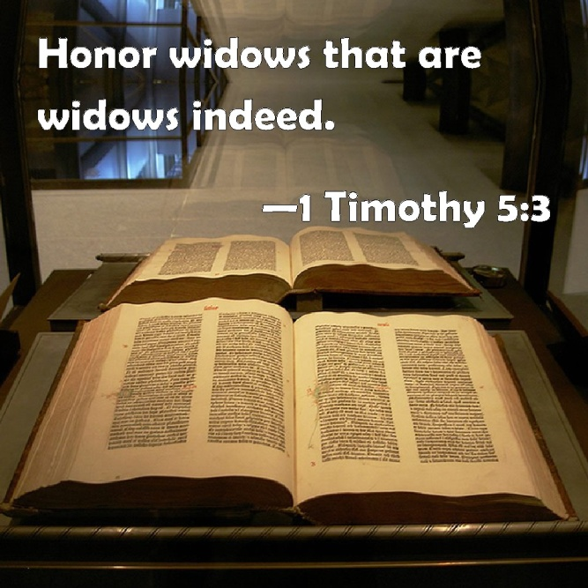
Support of needy Widows requires church membership
In 1 Timothy 5:3-16, we see a clear teaching on how to handle widows in the church.
In this text we see criteria for who would or would not qualify for Ephesus’s widow care program.
Widows who were qualified to be supported had to be faithful members in good standing.

Slide 50
Review The Biblical basis for church membership can be seen in…
(1) The example of the early church
(2) The existence of church leadership – Pastors/Deacons
(3) The exercise of church discipline
(4) The exhortation to mutual edification
(5) The support of “Widow indeed”

Slide 51
What’s the bottom line? Local church membership is a question of biblical obedience, not personal preference.

