Slide 1
Has God Preserved His Word? (Part 2)

Slide 2
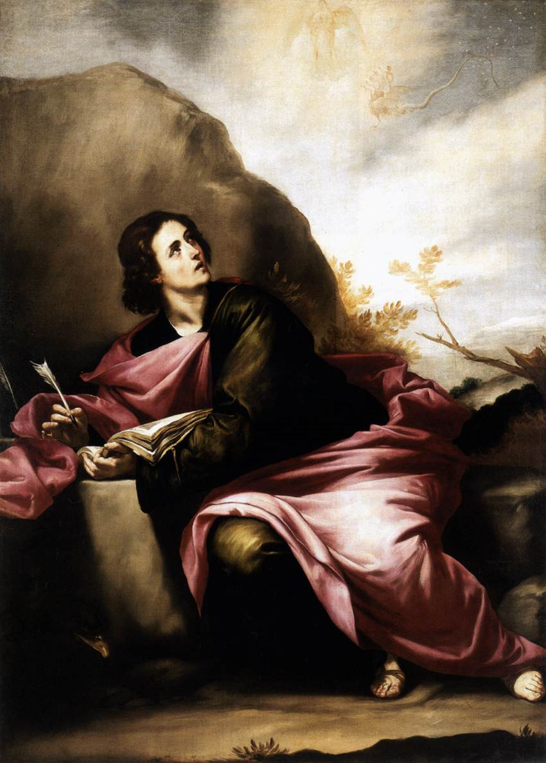
How Did God Write the Bible?
Revelation
(From God to Man)
Note: Ten times in the New Testament the Bible is referred as “The revelation of God…”
“Revelation of the mysteries of God…Revelation of the Lord Jesus Christ…Revelation of the will of God…Revelation of the knowledge of God…Revelation of the righteousness judgments of God…”

Slide 3
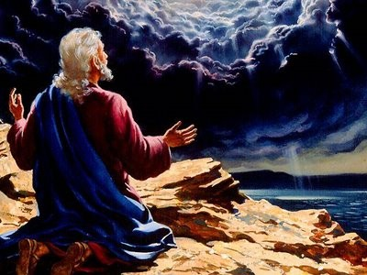
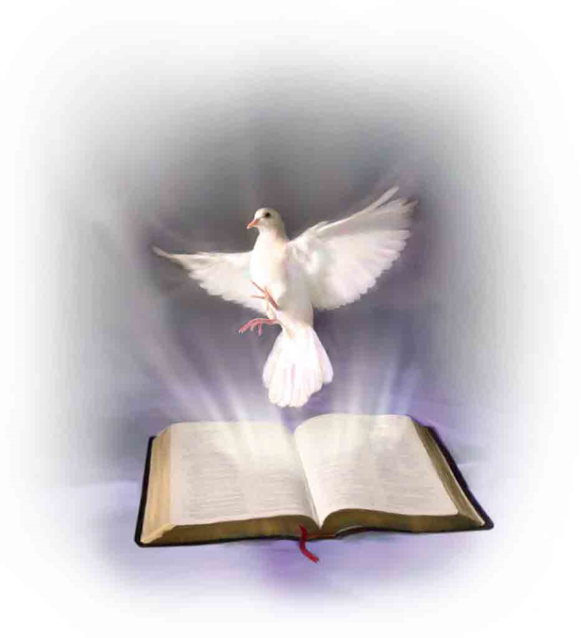
Paul the penman of 14 of the 27 New Testament books said
“But I certify you, brethren, that the gospel which was preached of me is not after man. For I neither received it of man, neither was I taught it, but by the revelation of Jesus Christ…” (Gal. 1:12-13)
“How that by revelation he made known unto me the mystery. Whereby when ye read, ye may understand my knowledge in the mystery of Christ. Which in other ages was not made known unto the sons of men, as it is now revealed unto his holy apostles and prophets by the Spirit…” (Eph. 3:3-4)

Slide 4
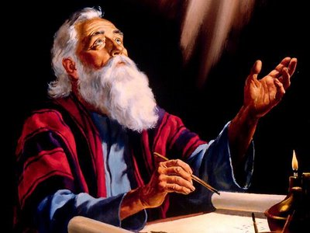
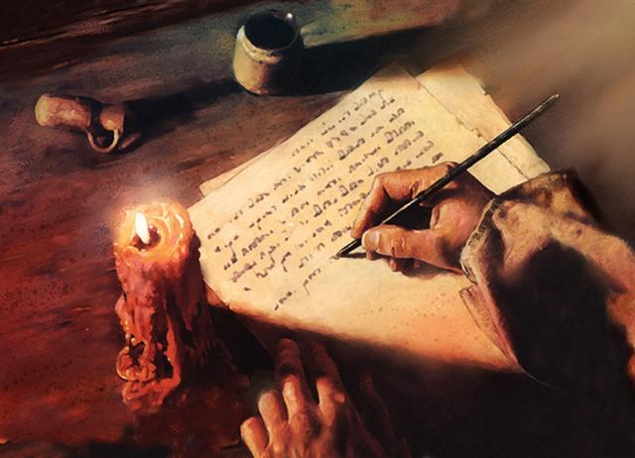
Inspiration
(From man to paper)
II Tim. 3:16 “All scripture is given by inspiration of God.”
Job 32:8 “The inspiration of the Almighty giveth them understanding.”

Slide 5
What did Jesus say about inspiration – John 17:17 ; John 5:46-47; Luke 16:31; Matt. 4:4
“Thy word is truth…For had ye believed Moses ye would have believed me: for he wrote of me. But if ye believe not his writings, how shall ye believe my words…And he said unto him, if they hear not Moses and the prophets, neither will they be persuaded, though one rose from the dead…Man shall not live by bread alone, but by every word that proceedeth out of the mouth of God.”

Slide 6
We believe in the plenary inspiration of the Bible –
Plenary inspiration = Full/Complete II Tim. 3:16 “All Scripture is given by inspiration of God, and is profitable for doctrine, for reproof, for correction, for instruction in righteousness.”
“All the Bible is inspired, every word is breathed out by God…” (From Gen. 1:1 – Rev. 22:21)

Slide 7
Jesus said - “Man shall not live by bread alone, but by every word that proceedeth out of the mouth of God…”
Solomon said – “Every word of God is pure…” (Prov. 30:5)
We believe in the word-for-word inspiration of Scripture. We do not believe that god simply inspired “thoughts” or “concepts”.
Scripture means = The actual writings of God

Slide 8
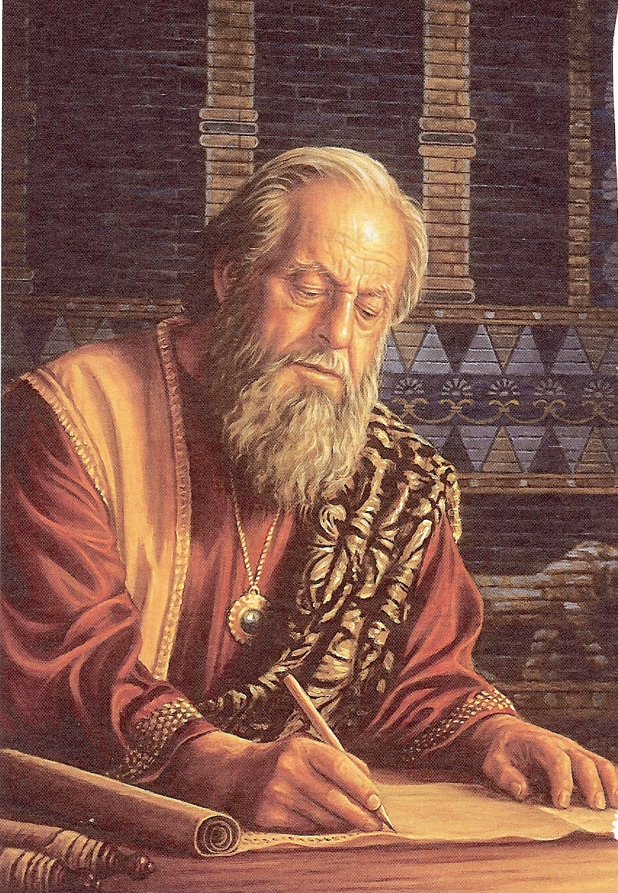
We believe in the verbal inspiration of the Bible -
Verbal inspiration has to do with the actual formation and use of the words themselves.
“Verbal” concept of inspiration contends that the Spirit of God guided the holy writers to record the very words of God.
God used the background, personalities, talents of the holy writers, nonetheless divine supervision was present so that the exact messages that God intended was recorded in the Scriptures.

Slide 9
God has promised to preserve His word for all generations?
Ps. 12:6-7; 33:11; 100:5; 119:89; Isa. 40:8 I Peter 1:25
“The words of the Lord are pure words: as silver tried in a furnace of earth, purified seven times. Thou shalt keep them, O Lord, thou shalt preserve them from this generation forever…The counsel of the Lord standeth forever, the thoughts of his heart to all generations…His truth endureth to all generations…forever, O Lord, thy word is settled in heaven, thy faithfulness is unto all generations…The grass withereth, the flower fadeth, but the word of our God shall stand forever…but the word of the Lord endureth forever…”

Slide 10
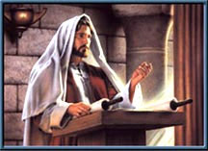
What did Jesus say about preservation?
Matt. 4:4; 5:18, 24:35; Luke 16:17; John 10:35
“For verily I say unto you. Till heaven and earth pass, one jot or one tittle shall in no wise pass from the law, till all be fulfilled…Heaven and earth shall pass away but my words shall not pass away…It is easier for heaven and earth to pass, than one tittle of the law to fail...The scriptures cannot be broken…”

Slide 11
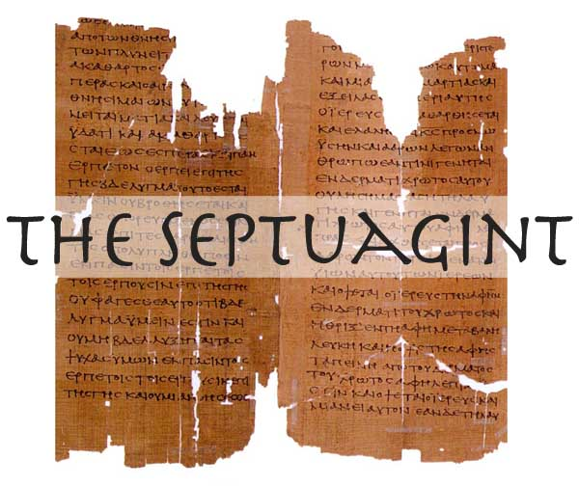
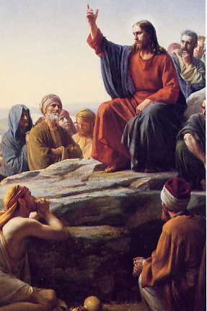
Can a translation of the Scriptures be considered the “inspired Word of God?”
Answer: When Jesus quoted from the Old Testament (35 times) he quoted from a Greek translation of the Old Testament.

Slide 12
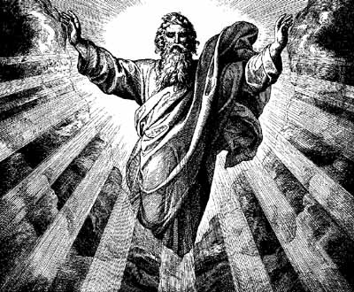
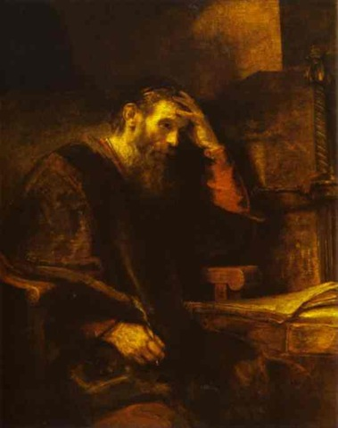
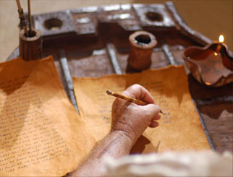
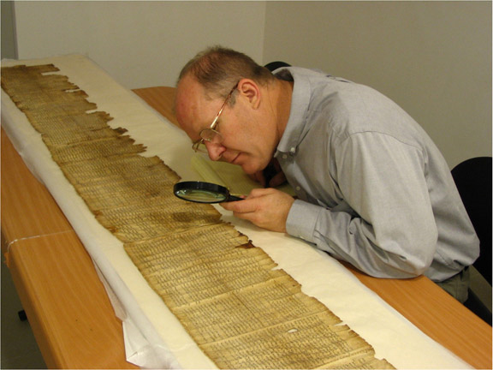
Revelation
Inspiration
Preservation
Illumination
Matt.16:10--17 ; John 16:13;
Eph. 1:17-18; II Cor. 4:1-6

Slide 13
“For flesh and blood hath not revealed it unto thee, but my Father which is in heaven…The Holy Ghost, he shall teach you all things and bring all things to your remembrance…When the Spirit of Truth is come he will guide you into all truth…that the God of our Lord Jesus Christ the Father of glory may give unto you the spirit of wisdom and revelation in the knowledge of him. The eyes of your understanding being enlightened…But God hath revealed them unto us by his Spirit for the spirit searches all things yea the deep things of God.

Slide 14
Now we have received not the spirit of the world, but the Spirit which is of God: that we might know the things that are freely given to us of God. Which things also we speak not in the words which man’s wisdom teaceth, but which the Holy Ghost teacheth; comparing spiritual things with spiritual…If our gospel be hid it is hid to them that are lost. In whom the god of this world hath blinded the minds of that which believe not…For God commanded the light to shine out of darkness hath shined in our hearts to give the light of the knowledge of the glory of God in the face of Jesus Christ…Hereby know we the spirit of truth and the spirit of error.”

Slide 15
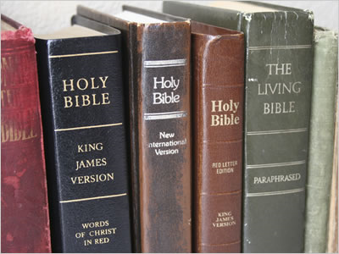
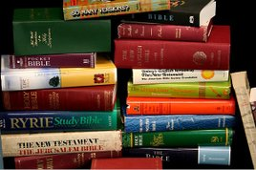
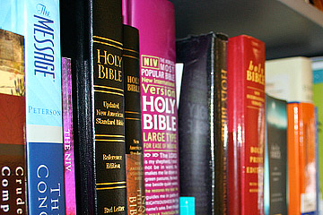
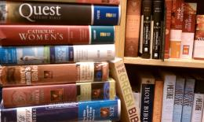
In What Version Has God Preserved His Word?
450 Versions of the English Bible

Slide 16
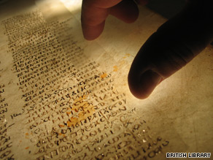
This is the wrong question.
The question should be in what text has God preserved His Word?

Slide 17
There are two basic text in existence
Traditional text
Masoretic text (Hebrew)
Byzantine text (Greek)
Majority text – 5000 copies/1200 fragments
98% of the 6200 copies are in 100% agreement
Received text
Textus Receptus
Westcott and Hort text
Alexandrian text
Vaticanus text/Roman Catholic manuscripts
Minority text – 500 copies and about 200 fragments
Ancient text – Older is not necessary better!
Inferior text

Slide 18
The traditional manuscripts were treasured, copied and saved by the early Christians – As the early Christians fled because of persecution they fled north into the Byzatine empire – Syria and Asia Minor (Greece, Europe, Turkey) they took the word of God with them.
5,604 places the WH disagrees with the TR.
9,970 places words were added, subtracted and changed.
Over 3000 places where the copies are in disagreement.
Westcott and Hort made over 10,000 alterations to the text.
Published in 1881

Slide 19
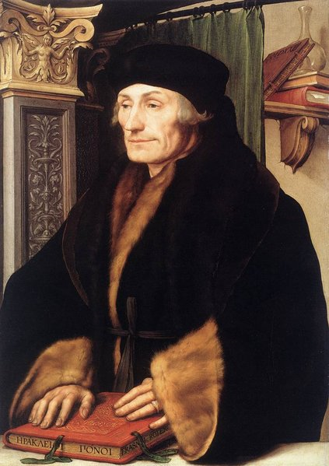
In 1516 these manuscripts were compiled by Erasmus (European scholar who was considered one of the greatest scholars of all times)
It became known as the “Textus Receptus” or “The Received Text” because the church received it as the preserved word of God.
All Modern English Versions of the Bible come from the WH text not the TR.
Result of modern versions - Doctrinal and moral perversion
Worldliness
Compromise
Carnality
The NIV most popular version differs from the King James Bible in 65,000 places.

Slide 20
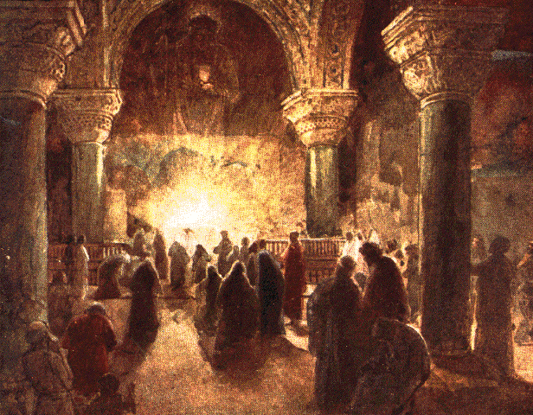
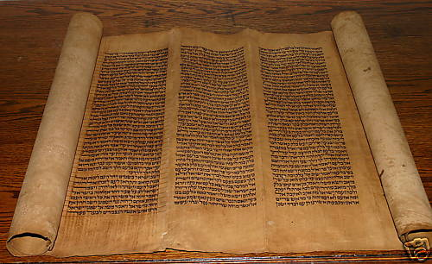
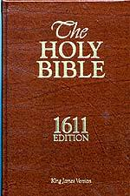
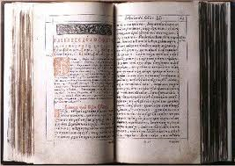
“The Word of our God shall stand forever…”

Slide 21
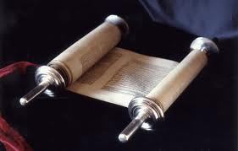
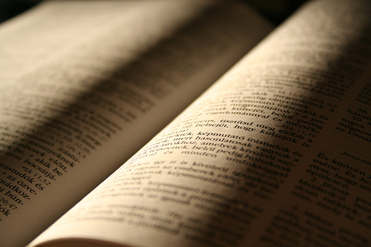
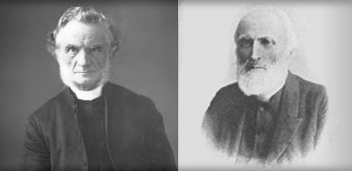
First Century Church
“The words of the Lord are pure words: as silver tried in a furnace of earth, purified seven times. Thou shalt keep them, O Lord, thou shalt preserve them from this generation forever.”
1881

Slide 22
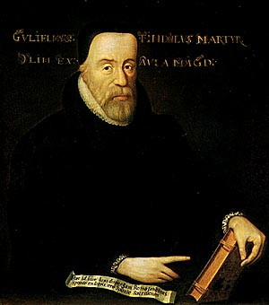
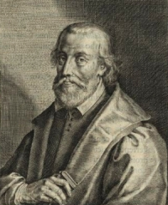
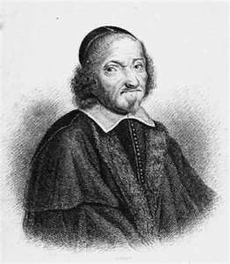
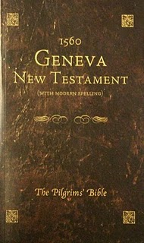
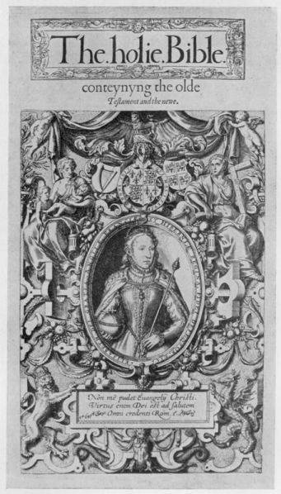
English Bibles Translated from the Textus Receptus
152l William Tyndale’s New Testament
1537 The Matthews Bible (Thomas Matthews)
1539 Great Bible (Miles Coverdale)
1560 Geneva Bible (Laurence Tomson) – this was the Bible used by William Shakespeare, John Bunyan, Puritans and the Pilgrims who settled in America
1568 Bishops Bible (produced under the authority of the established Church of England)

Slide 23
It was in 1604 the a group of Puritans under the leadership of Dr. John Reynolds (president of Corpus Christi College in Oxford) appealed to King James that a new translation of the Bible be undertaken.
NIV 2011 is much worse.
The goal of the new NIV 2011 is a universal Bible.
Satan's goal is to funnel existing religions into a one-world religion.
New NIV is a gender-neutral Bible and has been praised and accepted by many homosexual organizations.

Slide 24
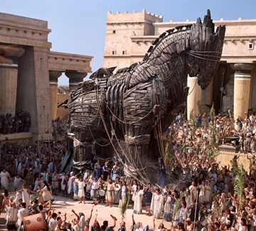
King James appointed six groups of men (54 scholars) to translate the Bible into English from the original Hebrew and Greek . They were the best scholars in the original languages and masters of literally style that the world has ever known – Each group of six check each others work.
Zondervan Publishers are OWNED by Harper Collins, who also publishes The Satanic Bible and The Joy of Gay Sex.

Slide 25
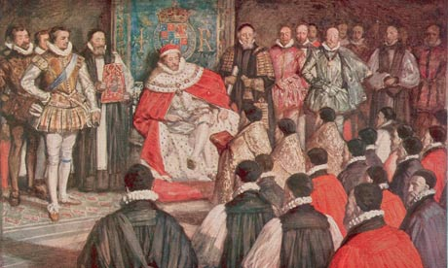
1611 the first addition of the KJV Bible was completed.
No other translation has had the impact on
the world as the KJV
Bible has had.

Slide 27
Has the KJV been Revised?
The KJV available today may not look the same as what was originally published in 1611, but it really is, once you make allowances for four kinds of changes:
Proofreading (typos).
Printing or type (font changes).
Orthographic (spelling changes).
Changes in punctuation.
All of these changes resulted in different editions not revisions!

Slide 28
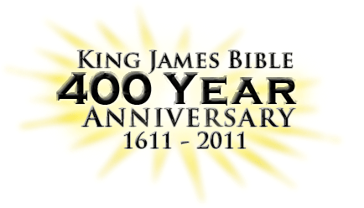
Second printing of the original KJV edition (still in 1611)
Third printing edition 1631
Forth printing edition 1762
Fifth printing edition 1769
Hebrews 6:10 (1611) -"For God is not vnrighteous, to forget your worke and labour of loue, which yee haue shewed toward his Name, in that yee haue ministred to the Saints, and doe minister.“
Hebrews 6:10 “For God is not unrighteous to forget your work and labour of love, which ye have shewed toward his name, in that ye have ministered to the saints, and do minister.”

Slide 29
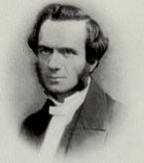
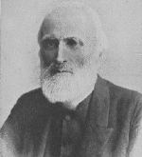
Westcott and Hort
“Fathers of the Modern Bible”
"I reject the word infallibility of Holy Scriptures overwhelmingly.”
"He (Jesus) never speaks of Himself directly as God, but the aim of His revelation was to lead men to see God in Him."
Called the TR “vile”
Discredited the TR
Believed that the Bible was no different then the works of Shakespeare or Plato
Did not believe in the inspiration of Scripture
"Evangelicals seem to me perverted.”

Slide 30
Westcott
Hort
"(John) does not expressly affirm the identification of the Word with Jesus Christ."
"Hell is not the place of punishment of the guilty, it is the common abode of departed spirits."
"We have no sure knowledge of future punishment.”
“The book which has most engaged me is Darwin. It is a book that one is proud to be contemporary with... My feeling is strong that the theory is unanswerable."

Slide 31
Westcott
Hort
"No one now, I suppose, holds that the first three chapters of Genesis, for example, give a literal history. I could never understand how anyone reading them with open eyes could think they did."
Member of the Hermes Club and the Ghostly Guild (spiritist societies)
Member of the Hermes Club and the Ghostly Guild (spiritist societies)
Believed that Christ was a created being to be worshipped with Mary his mother.
Denied the Trinity
Did not believe in the reality of angels.

Slide 32
Westcott
Hort
Did not believe that Genesis 1-3 should be taken literally.
“I never read an account of a miracle but I seem instinctively to feel its improbability.”
“The second coming of Jesus Christ is not a physical coming but a spiritual coming. He is coming' to us now.”
"Certainly nothing can be more unscriptural than Christ’s bearing our sins and sufferings to His death; but indeed that is only one aspect of an almost universal heresy.”
“I believe Baptismal Regeneration is the most important of doctrines.”

Slide 33
Westcott
Hort
“Heaven to be a state and not a literal place.”
"I suppose I am a communist by nature."
Did not believe in the literal second coming of the Lord Jesus Christ
Did not believe in the Lord Jesus Christ's literal 1,000-year reign on earth.
“Baptism assures us that we are children of God, members of Christ and His body, and heirs of the heavenly kingdom.”
"I dare not prophesy about America, but I cannot say that I see much as yet to soften my deep hatred of democracy in all its forms."

Slide 34
It is hard to imagine, after reading what these two men believed, how any Christian that believes the fundamentals of the faith could align himself with the likes of these two characters. However, every person choosing a modern version over the King James Bible does just that. He aligns himself with two men who despised the very things that true Christians hold sacred.

Slide 35
The church of Jesus Christ quickly rejected the Westcott and Hort text and considered it inferior, less credible, full of deletions and additions. It was not until the 1960’s that it begin to be used as the text from which all new versions are now translated.

Slide 36
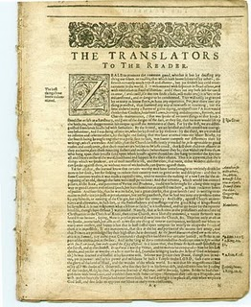
The Translators of the King James Version

Slide 37
The King James Bible and its 400 years of spiritual fruit, show forth what the translators bore of the unquenched Spirit’s fruit. The translators were the top achievers in England at that time, academically, and it appears, spiritually as well. They had risen to positions as college Presidents or deans, heads of schools, or departments of Greek or Hebrew language.

Slide 38
They were not only preachers, pastors, doctors, scholars, and linguists, but they had surpassed, thousands of men with similar training during a time when speaking Greek, Latin, Hebrew and foreign languages was common
for university students.

Slide 39
Their exceptional God-given abilities, coupled with diligence and an abiding walk with the Lord, set them at the pinnacle of an academic environment where school children were educated at a level above that of many of today’s university students.

Slide 40
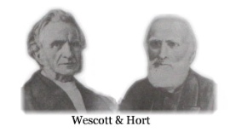
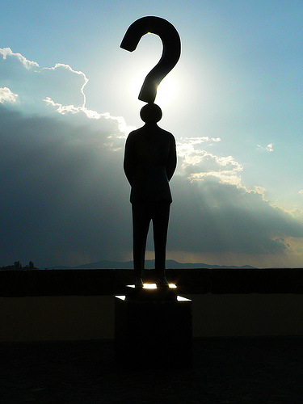
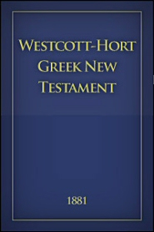
Gathered their manuscripts from the Vatican, Cathedral at Sinai, and Alexandria Egypt

Slide 41
The Word of God
"The Bible contains the mind of God, the state of man, the way of salvation, the doom of sinners, and the happiness of believers.
Its doctrines are holy, its precepts are binding, its histories are true, and its decisions are immutable. Read it to be wise, believe it to be safe, and practice it to be holy. It contains light to direct you, food to support you, and comfort to cheer you. It is the travelers map, the pilgrim's staff, the pilots compass, the soldiers sword, and the Christians charter.

Slide 42
Here paradise is restored, heaven opened, and hell disclosed. The Lord Jesus Christ is its grand Object, our good its design, and the glory of God its end. Read it slowly, frequently, and prayerfully. Let it fill the memory, rule the heart, and guide the feet. It is a mine of wealth, a paradise of glory, and a river of pleasure. It is given you in life, will be opened in the judgment, and remembered forever. It involves the highest responsibility, will reward the highest labor, and will condemn all who trifle with its sacred contents." Author Unknown

Slide 43
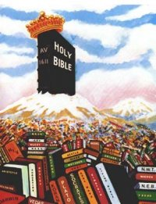
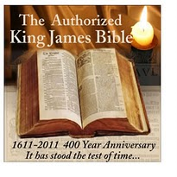

Slide 44
