Slide 4
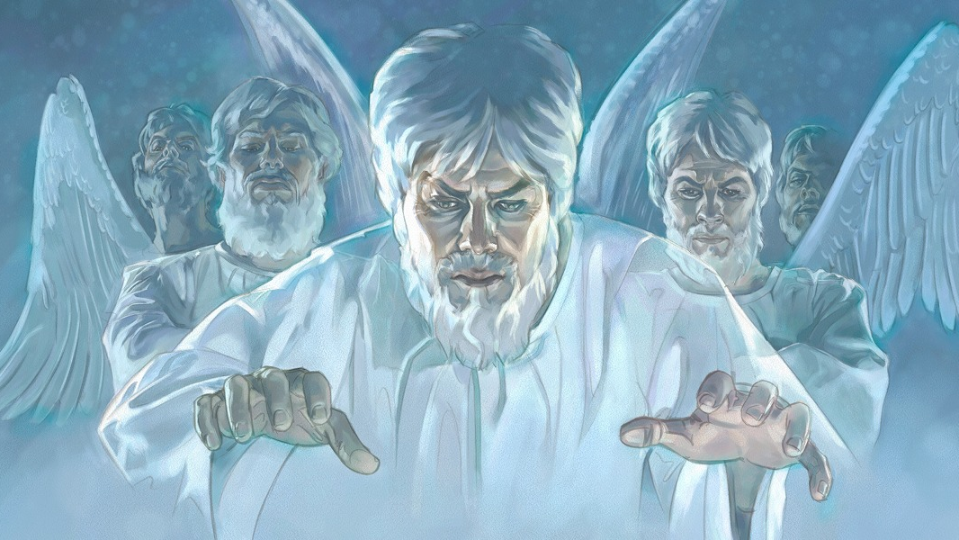
Evil Angels

Slide 5
“Nay, in all these things we are more than conquerors through him that loved us. For I am persuaded, that neither death, nor life, nor angels, nor principalities, nor powers, nor things present, nor things to come, Nor height, nor depth, nor any other creature, shall be able to separate us from the love of God, which is in Christ Jesus our Lord.” (Romans 8:37-39)
“And the great dragon was cast out, that old serpent, called the Devil, and Satan, which deceiveth the whole world: he was cast out into the earth, and his angels were cast out with him.” (Revelation 12:9)

Slide 6
What have we learned so far?
Satan is a Fallen Angel
Devils/Demons are Fallen Angels
Fallen Angels have names
Fallen Angels can speak
Fallen Angels are highly intelligent
Fallen Angels are able to formulate a systematic Satanic centered system of theology
Fallen Angels possess great ability and strength

Slide 7
What have we learned so far?
Fallen Angels are very active in the world
Fallen Angels oppose God’s purpose
Fallen Angels execute Satan’s plan and program
Fallen Angels can possess individuals
Fallen Angels disseminate false doctrine
Fallen Angels can afflict human beings in many different ways
Fallen Angels can cause insanity
Fallen Angels can cause suicidal tendencies

Slide 8
What have we learned so far?
Fallen Angels can cause blindness and deafness
Fallen Angels can cause muteness
Fallen Angels can cause immorality
Fallen Angels can cause addiction
Fallen Angels can cause mental and physical illness
Fallen Angels can cause physical self mutilation

Slide 10
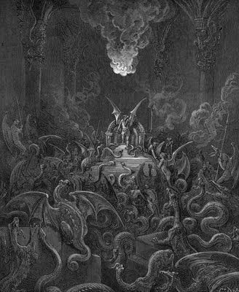
The organization and ranks of fallen angels

Slide 11
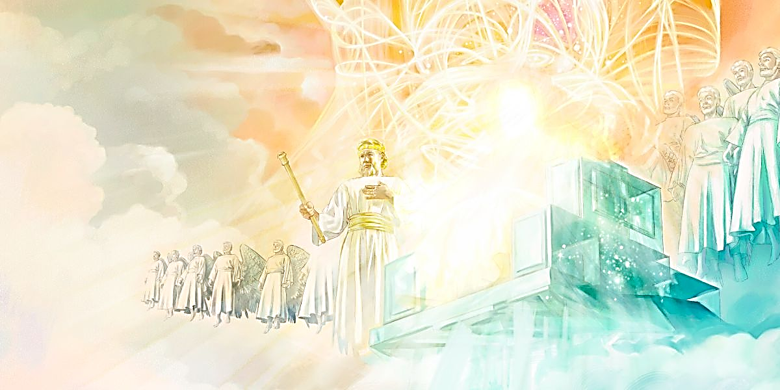
Ruling Angels

Slide 12
Ten Ranks of Good Angels

Slide 13
Archangels - The word “archangel” comes from a Greek word meaning "chief angel or an angel of high rank."
Princes - Royal ruler subject to a king or emperor
Cherubims - Powerful heavenly beings surrounding the throne
Seraphims – One of the highest order of the celestial beings
Thrones - Seats of authority
Authorities - A magistrate, potentate, monarch or ruler
Principalities - Ruler over a jurisdictional area
Dominions - A territory of sovereign control
Powers - Delegated authority, jurisdiction, strength
Might - Powerful, forceful, strong

Slide 14
Ranks of Fallen Angels

Slide 15
(Ephesians 6:12) “For we wrestle not against flesh and blood, but against principalities, against powers, against the rulers of the darkness of this world, against spiritual wickedness in high places.”

Slide 16
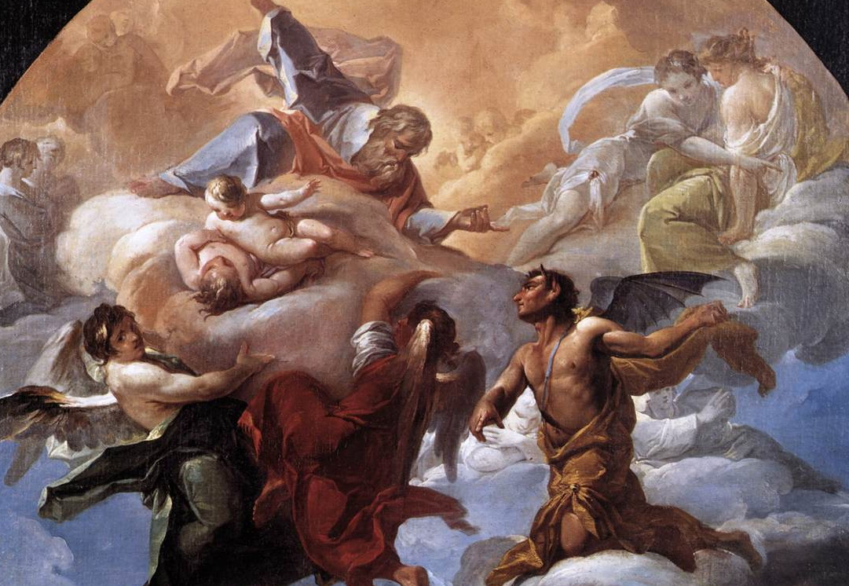
Satan’s Rank as
a Fallen Angels

Slide 17
“But when the Pharisees heard it, they said, This fellow doth not cast out devils, but by Beelzebub the prince of the devils. And Jesus knew their thoughts, and said unto them, Every kingdom divided against itself is brought to desolation; and every city or house divided against itself shall not stand: And if Satan cast out Satan, he is divided against himself; how shall then his kingdom stand? And if I by Beelzebub cast out devils, by whom do your children cast them out? therefore they shall be your judges. But if I cast out devils by the Spirit of God, then the kingdom of God is come unto you. Or else how can one enter into a strong man's house, and spoil his goods, except he first bind the strong man? and then he will spoil his house. He that is not with me is against me; and he that gathereth not with me scattereth abroad.” (Matthew 12:24-30)

Slide 18
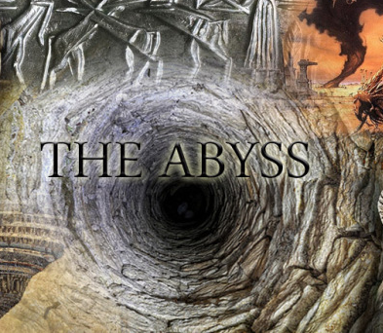
“And they had a king over them, which is the angel of the bottomless pit, whose name in the Hebrew tongue is Abaddon, but in the Greek tongue hath his name Apollyon.” (Revelation 9:1-3)

Slide 19
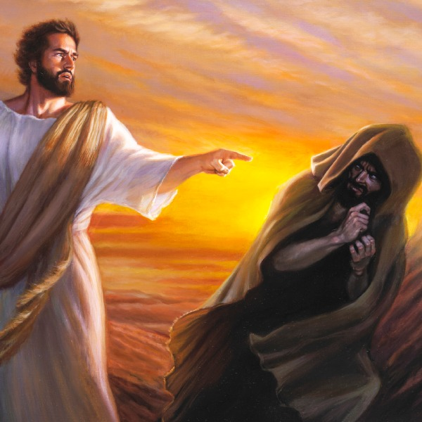
Eph. 2:2 “Wherein in time past ye walked according to the course of this world, according to the prince of the power of the air, the spirit that now worketh in the children of disobedience.”
2 Cor. 4:4 “In whom the god of this world hath blinded the minds of them which believe not.”
John 12:31 “Now is the judgment of this world: now shall the prince of this world be cast out.”
Eph. 6:12 “For we wrestle not against flesh and blood, but against principalities, against powers, against the rulers of the darkness of this world, against spiritual wickedness in high places.”

Slide 20
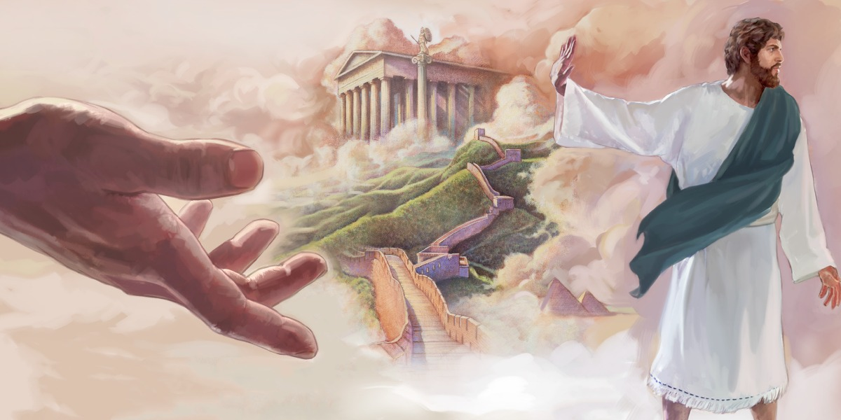
Beelzebub the prince of the devils
king
Prince of the power of the air
Ruler of the darkness
Angel of the bottomless pit
god of this world
The prince of this world

Slide 21
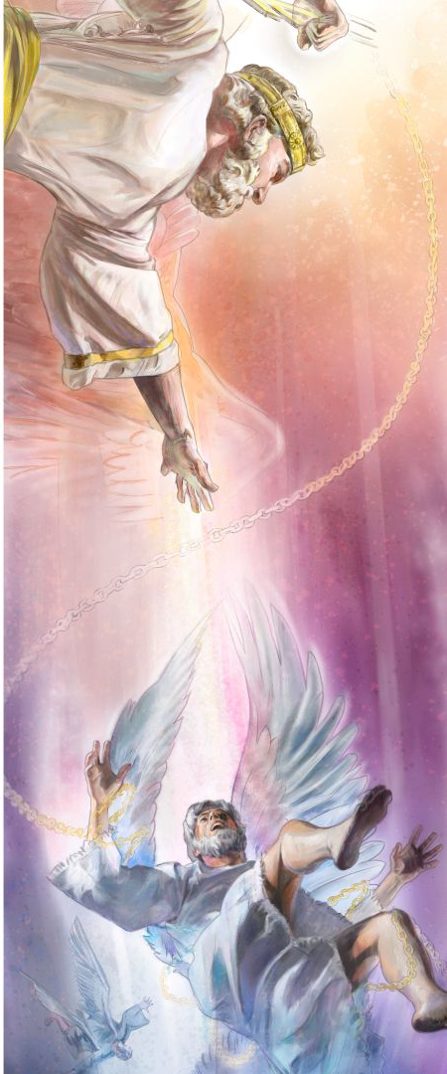
(Ephesians 6:12) “For we wrestle not against flesh and blood, but against.” 1# Principalities - Ruler over a jurisdictional area 2# Powers - Delegated authority, jurisdiction, strength 3# Rulers of the darkness of this world – World rulers 4# Spiritual wickedness in high places – Places of highest rank / Heavenly places

Slide 22
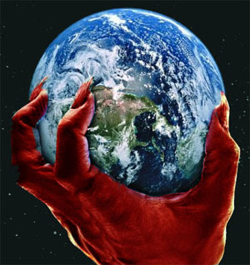
The following passages indicate that Satan’s kingdom of evil fallen angels is well organized

Slide 23
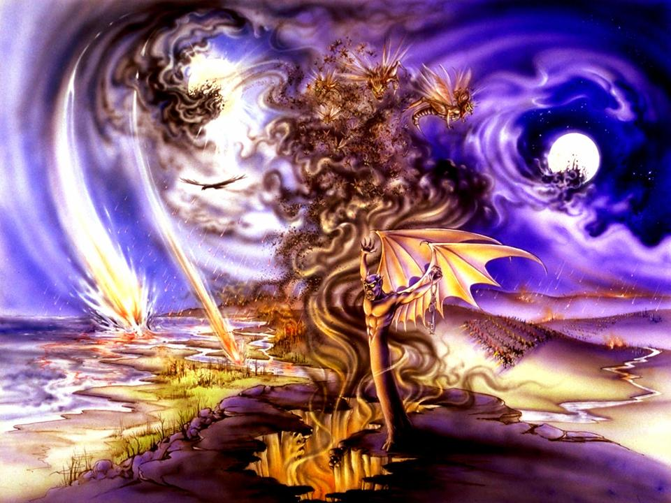
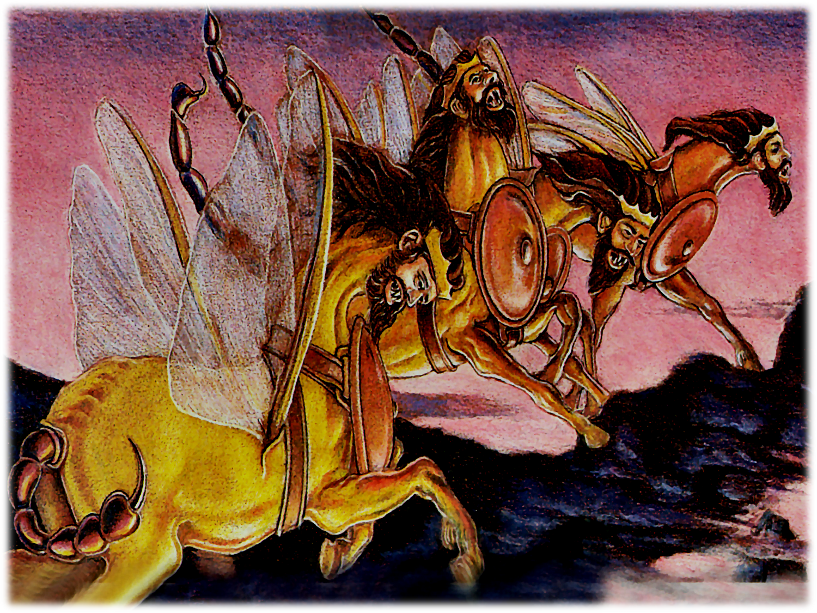
The bottomless pit is under the control of an angel called Abaddon (in the Hebrew) and Apollyon (in the Greek; Rev. 9:11).

Slide 24
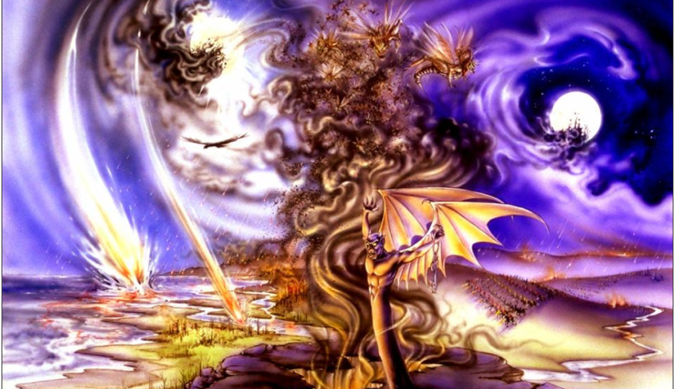
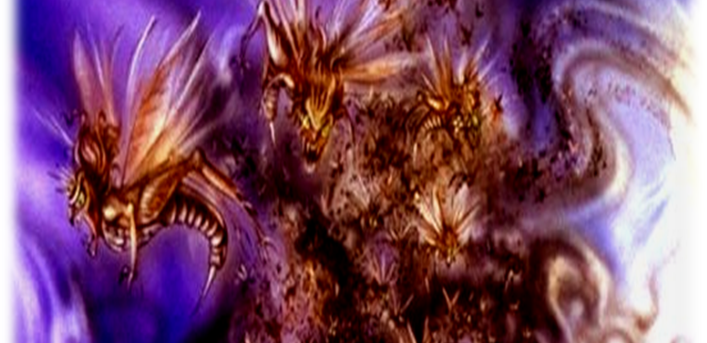
“And they had a king over them, which is the angel of the bottomless pit, whose name in the Hebrew tongue is Abaddon, but in the Greek tongue hath his name Apollyon.”

Slide 25
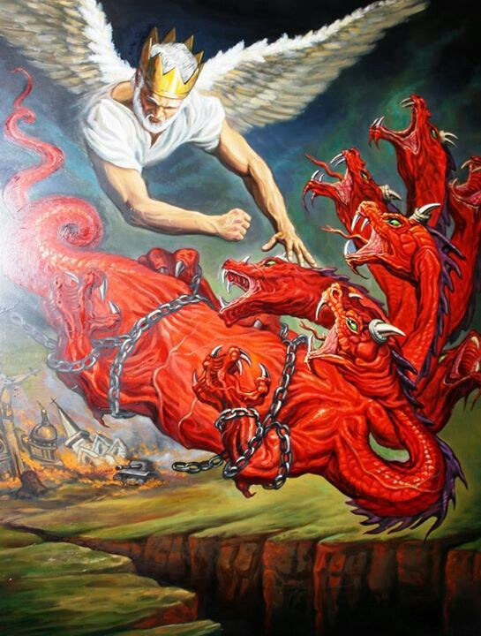
(Revelation 20:1-3) “And I saw an angel come down from heaven, having the key of the bottomless pit and a great chain in his hand. And he laid hold on the dragon, that old serpent, which is the Devil, and Satan, and bound him a thousand years, And cast him into the bottomless pit, and shut him up, and set a seal upon him, that he should deceive the nations no more, till the thousand years should be fulfilled: and after that he must be loosed a little season.”

Slide 26
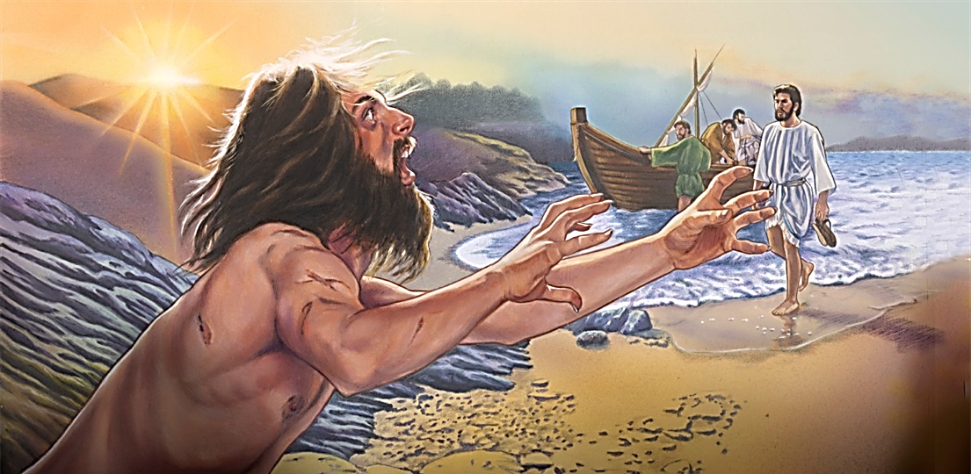
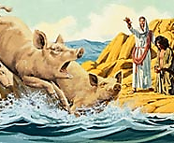
A wicked angel named Legion headed up a large group of fallen angels that had possessed the maniac of Gadara (Mark 5:9).

Slide 27
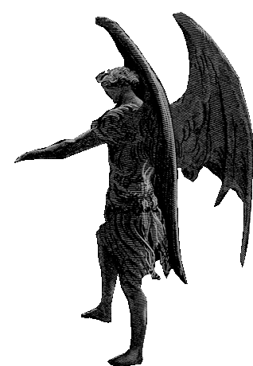
“Loose the four angels which are bound in the great river Euphrates.”

Slide 28
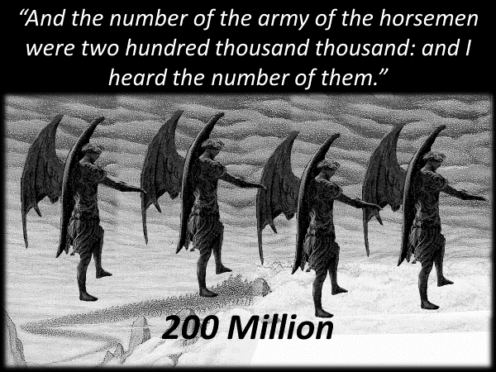
Four military angels will lead a hellish army 200 million demon spirits during the latter part of the tribulation killing 1/3 of the worlds population (Rev. 9:15).

Slide 29
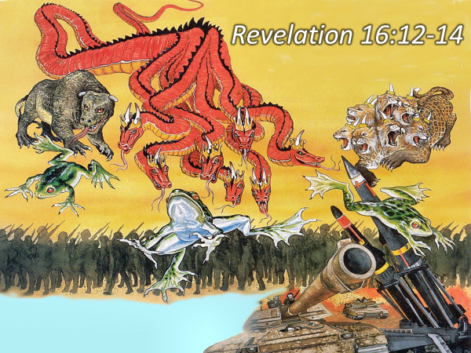
Three fallen angels organize the events which lead to the Battle of Armageddon.

Slide 30
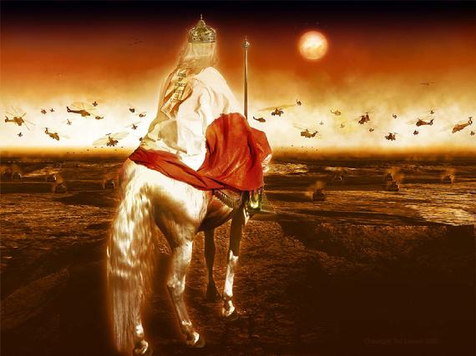
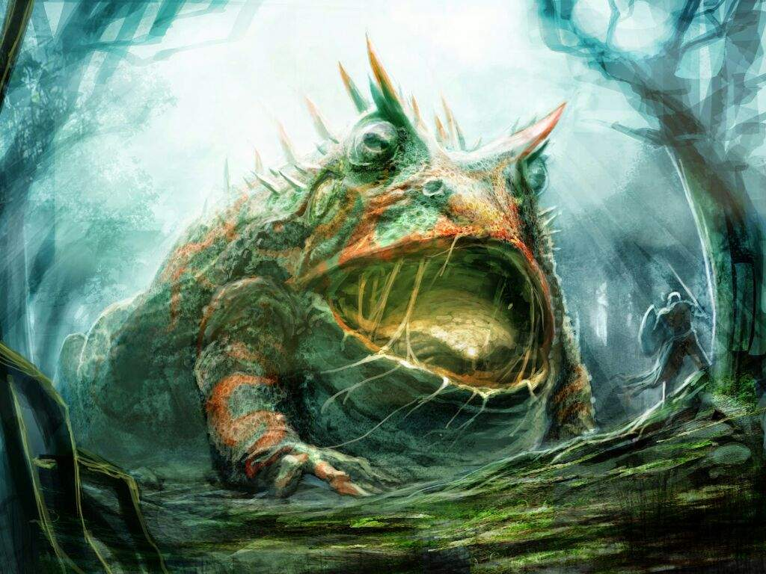
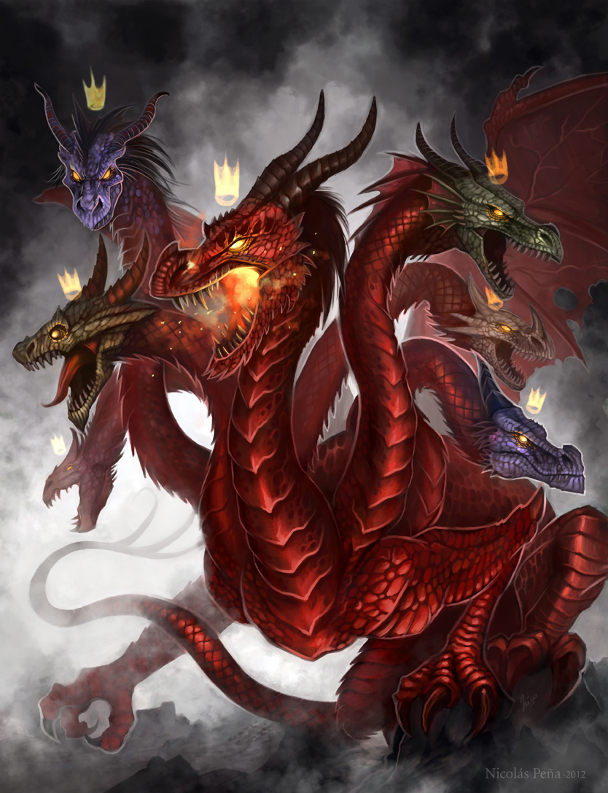
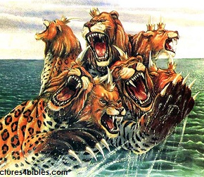
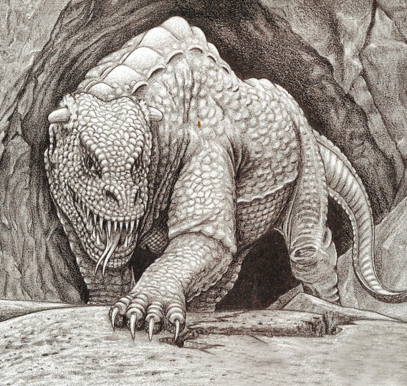
“And I saw three unclean spirits like frogs come out of the mouth of the dragon, and out of the mouth of the beast, and out of the mouth of the false prophet. For they are the spirits of devils, working miracles, which go forth unto the kings of the earth and of the whole world, to gather them to the battle of that great day of God Almighty.”

Slide 31
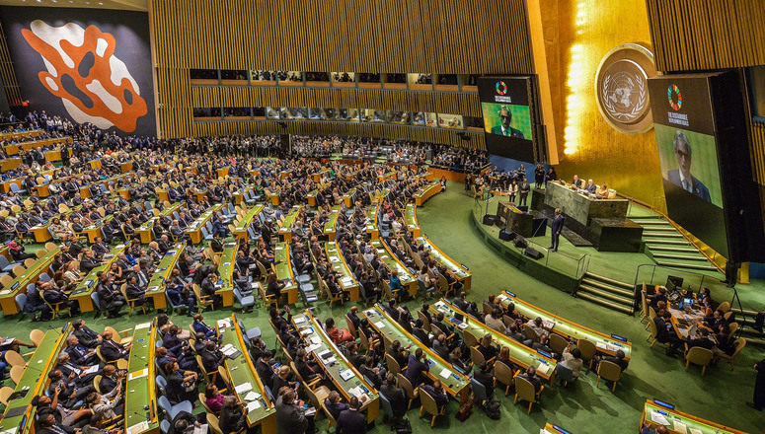
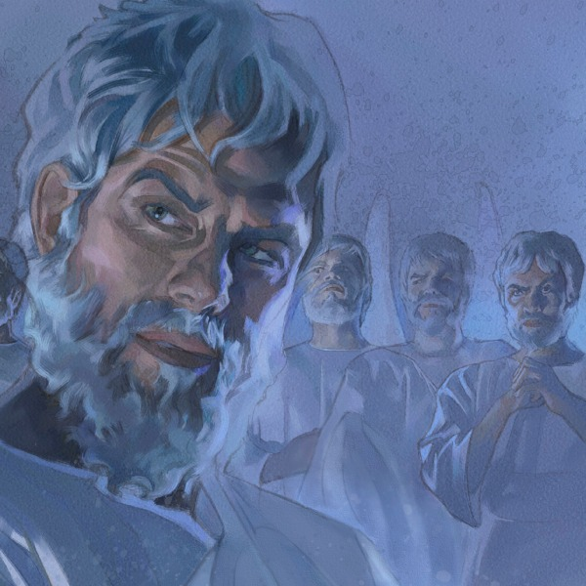
There are evil angels who rule over the nations of this world (Dan. 10:13).

Slide 32
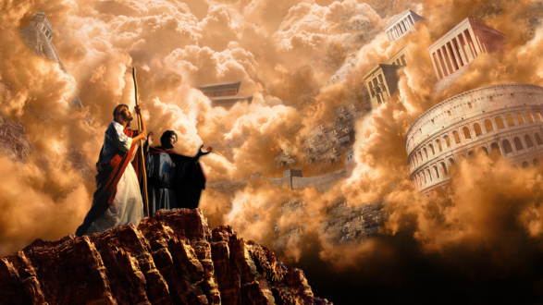
Satan has Kingdoms

Slide 33
“And the devil, taking him up into an high mountain, shewed unto him all the kingdoms of the world in a moment of time. And the devil said unto him, All this power will I give thee, and the glory of them: for that is delivered unto me; and to whomsoever I will I give it. If thou therefore wilt worship me, all shall be thine. And Jesus answered and said unto him, Get thee behind me, Satan: for it is written, Thou shalt worship the Lord thy God, and him only shalt thou serve.” (Luke 4:5-8)

Slide 34
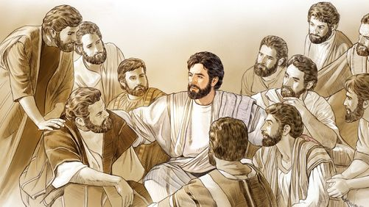
Mark 16:15-20 “The Believers Authority In Christ” 15 And he said unto them, Go ye into all the world, and preach the gospel to every creature. 16 He that believeth and is baptized shall be saved; but he that believeth not shall be damned. 17 And these signs shall follow them that believe; In my name shall they cast out devils; they shall speak with new tongues; 18 They shall take up serpents; and if they drink any deadly thing, it shall not hurt them; they shall lay hands on the sick, and they shall recover.

Slide 35
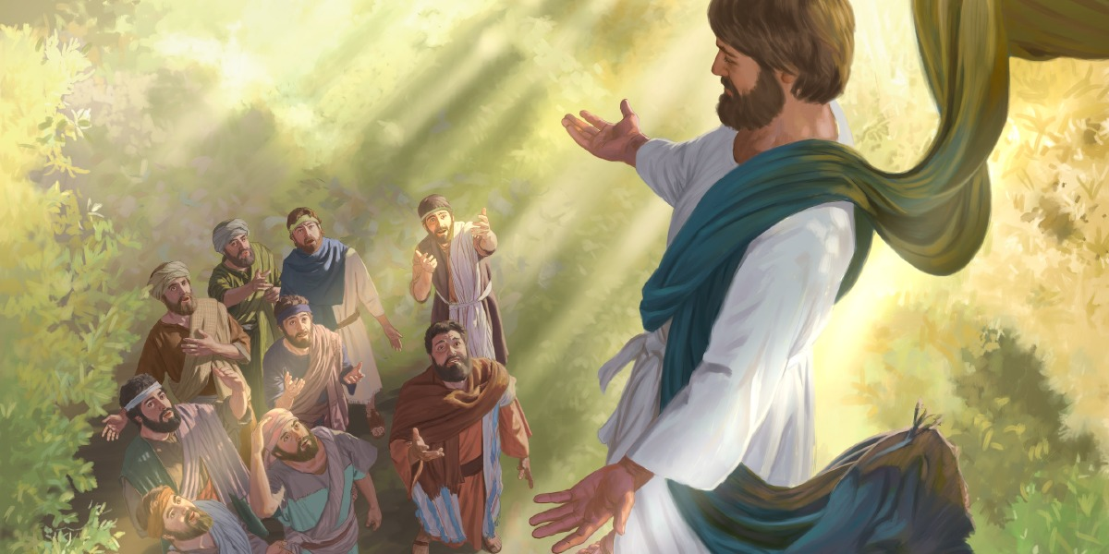
19 So then after the Lord had spoken unto them, he was received up into heaven, and sat on the right hand of God.

Slide 36
20 And they went forth, and preached every where, the Lord working with them, and confirming the word with signs following. Amen.

Slide 37
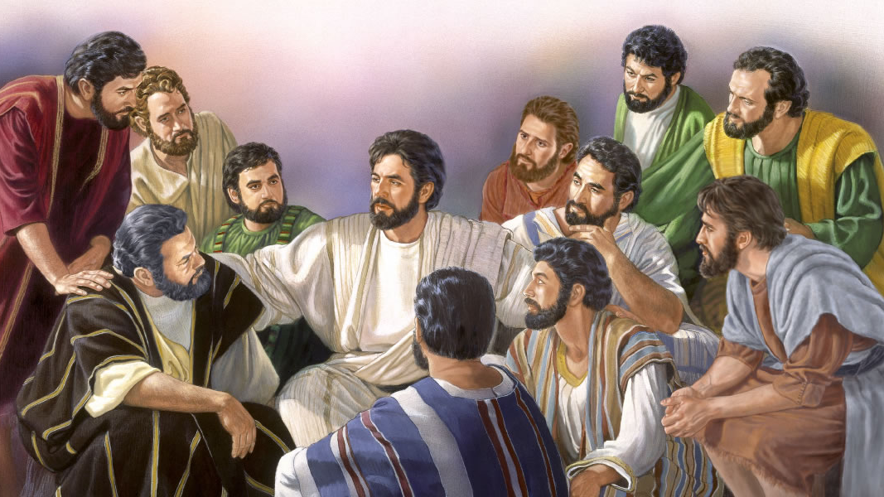
Matthew 10:1 “And when he had called unto him his twelve disciples, he gave them power against unclean spirits, to cast them out.”
Mark 6:7 “And he called unto him the twelve, and began to send them forth by two and two; and gave them power over unclean spirits.”
Luke 9:1 “Then he called his twelve disciples together, and gave them power and authority over all devils.”
Luke 10:19 “Behold, I give unto you power to tread on serpents and scorpions, and over all the power of the enemy.”
Mark 6:13 “And they cast out many devils.”

Slide 38
1 John 2:13 “I write unto you, fathers, because ye have known him that is from the beginning. I write unto you, young men, because ye have overcome the wicked one. I write unto you, little children, because ye have known the Father.”
1 John 2:14 “I have written unto you, fathers, because ye have known him that is from the beginning. I have written unto you, young men, because ye are strong, and the word of God abideth in you, and ye have overcome the wicked one.”

Slide 39
Luke 9:49 “And John answered and said, Master, we saw one casting out devils in thy name; and we forbad him, because he followeth not with us.”
John 17:15 “I pray not that thou shouldest take them out of the world, but that thou shouldest keep them from the evil.”
Acts 8:7 “For unclean spirits, crying with loud voice, came out of many that were possessed with them: and many taken with palsies, and that were lame, were healed.”
Acts 19:12 “So that from his body were brought unto the sick handkerchiefs or aprons, and the diseases departed from them, and the evil spirits went out of them.”
2 Corinthians 10:4 “For the weapons of our warfare are not carnal, but mighty through God to the pulling down of strong holds.”

Slide 40
Acts 26:18 “To open their eyes, and to turn them from darkness to light, and from the power of Satan unto God, that they may receive forgiveness of sins, and inheritance among them which are sanctified by faith that is in me.”
James 4:7 “Submit yourselves therefore to God. Resist the devil, and he will flee from you.”
Ephesians 4:27 “Neither give place to the devil.”
Ephesians 6:11 “Put on the whole armour of God, that ye may be able to stand against the wiles of the devil.”
Romans 16:20 “And the God of peace shall bruise Satan under your feet shortly. The grace of our Lord Jesus Christ be with you. Amen.”

Slide 41
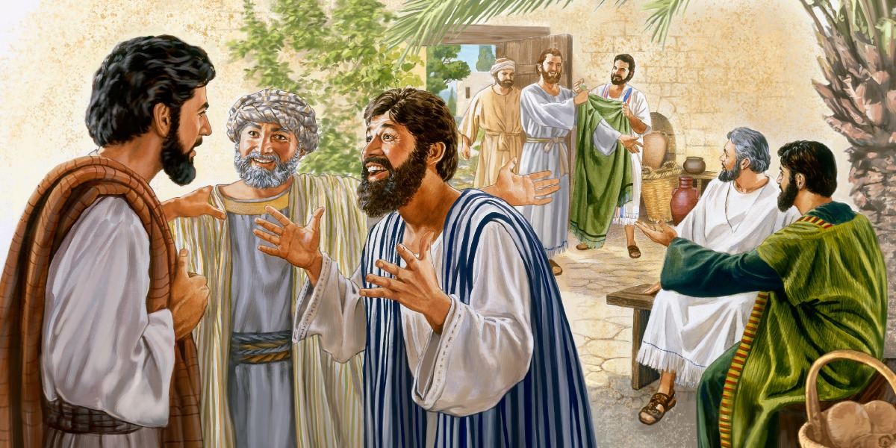
“And the seventy returned again with joy, saying, Lord, even the devils are subject unto us through thy name.” (Luke 10:17)

Slide 42
“And he said unto them, I beheld Satan as lightning fall from heaven.” (Luke 10:18)

Slide 43
“Behold, I give unto you power to tread on serpents and scorpions, and over all the power of the enemy: and nothing shall by any means hurt you.” (Luke 10:19)

Slide 44
“Notwithstanding in this rejoice not, that the spirits are subject unto you; but rather rejoice, because your names are written in heaven.” (Luke 10:20)

