Slide 3
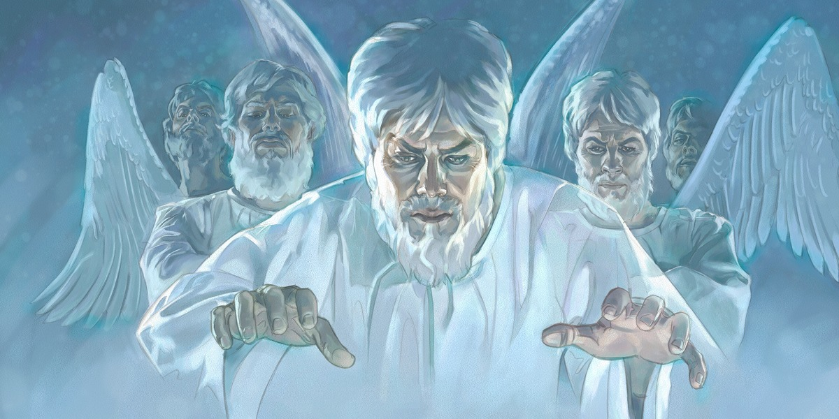
Evil Angels

Slide 4
“Nay, in all these things we are more than conquerors through him that loved us. For I am persuaded, that neither death, nor life, nor angels, nor principalities, nor powers, nor things present, nor things to come, Nor height, nor depth, nor any other creature, shall be able to separate us from the love of God, which is in Christ Jesus our Lord.” (Romans 8:37-39)

Slide 5
“Nay, in all these things we are more than conquerors through him that loved us. For I am persuaded, that neither death, nor life, nor angels, nor principalities, nor powers, nor things present, nor things to come, Nor height, nor depth, nor any other creature, shall be able to separate us from the love of God, which is in Christ Jesus our Lord.” (Romans 8:37-39)
“And there was war in heaven: Michael and his angels fought against the dragon; and the dragon fought and his angels.” (Revelation 12:7)

Slide 6
“Nay, in all these things we are more than conquerors through him that loved us. For I am persuaded, that neither death, nor life, nor angels, nor principalities, nor powers, nor things present, nor things to come, Nor height, nor depth, nor any other creature, shall be able to separate us from the love of God, which is in Christ Jesus our Lord.” (Romans 8:37-39)
“And the great dragon was cast out, that old serpent, called the Devil, and Satan, which deceiveth the whole world: he was cast out into the earth, and his angels were cast out with him.” (Revelation 12:9)

Slide 7
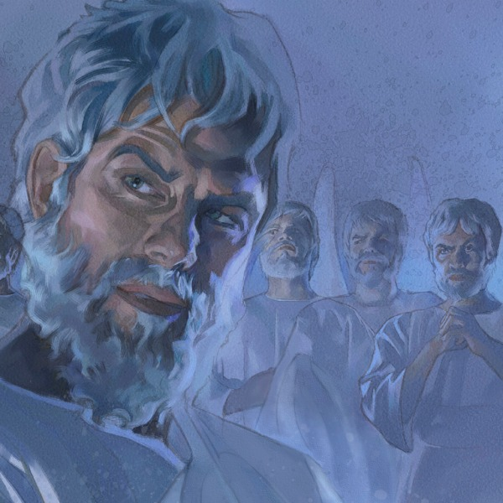
Satan is a fallen Angel

Slide 9
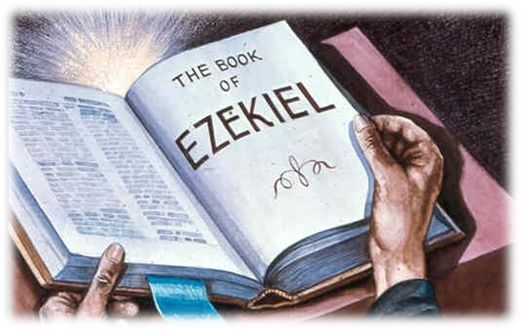
28:12-19

Slide 10
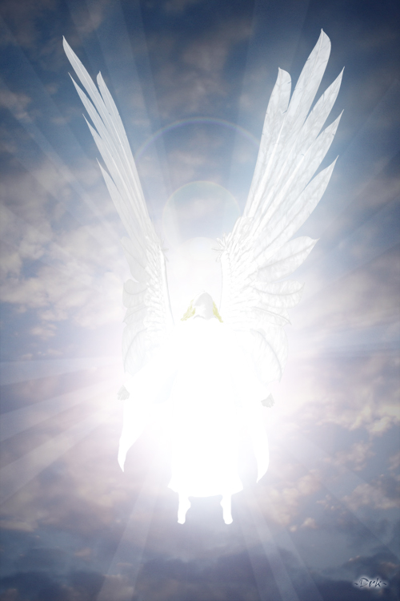
"Son of man, take up a lamentation upon the king of Tyrus, and say unto him, Thus saith the Lord God; Thou sealest up the sum, full of wisdom, and perfect in beauty.”

Slide 11
“Thou hast been in Eden the garden of God.”

Slide 12
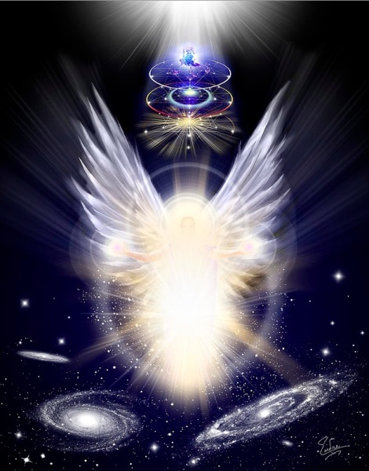
“Every precious stone was thy covering, the sardius, topaz, and the diamond, the beryl, the onyx, and the jasper, the sapphire, the emerald, and the carbuncle, and gold.”

Slide 13
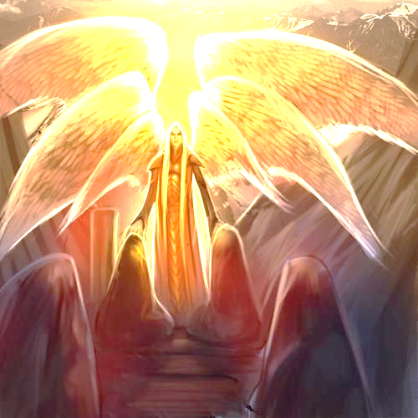
“The workmanship of thy tabrets and of thy pipes was prepared in thee in the day that thou wast created.”

Slide 14
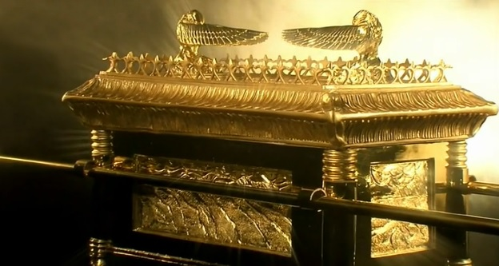
“Thou art the anointed cherub that covereth; and I have set thee so.”

Slide 15
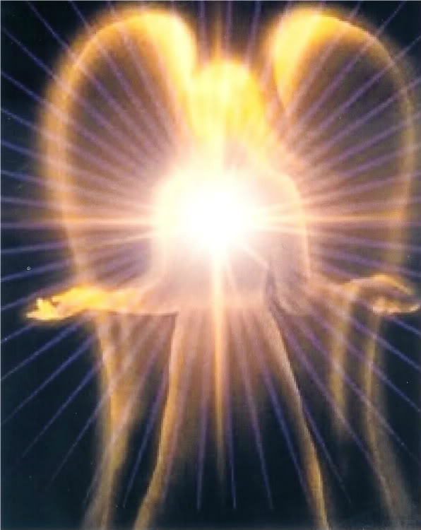
“Thou wast upon the holy mountain of God; thou hast walked up and down in the midst of the stones of fire.”

Slide 16
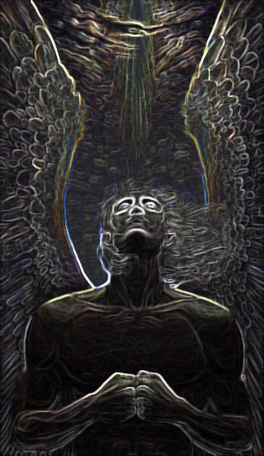
“Thou wast perfect in thy ways from the day that thou wast created, till iniquity was found in thee.”

Slide 17
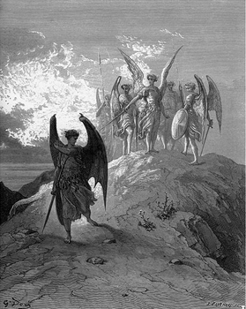
“By the multitude of thy merchandise they have filled the midst of thee with violence, and thou hast sinned: therefore I will cast thee as profane out of the mountain of God: and I will destroy thee, O covering cherub, from the midst of the stones of fire.”

Slide 18
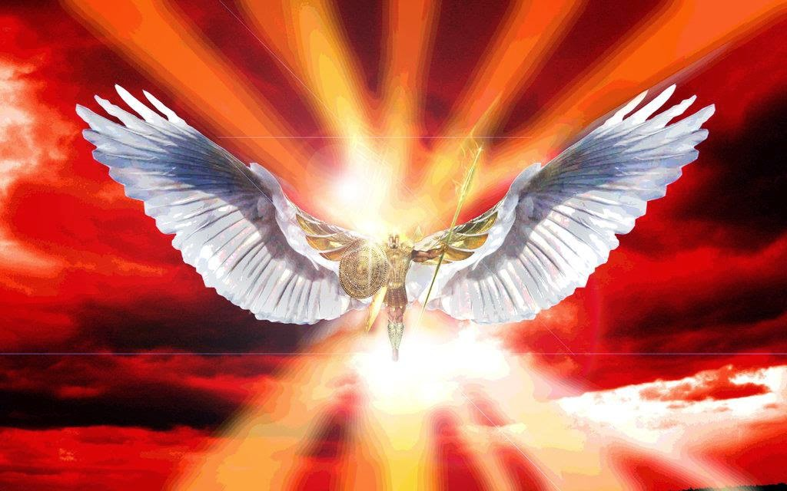
“Thine heart was lifted up because of thy beauty, thou hast corrupted thy wisdom by reason of thy brightness.”

Slide 19
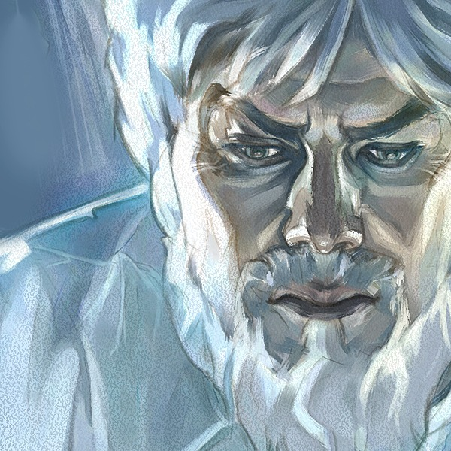
“I will cast thee to the ground, I will lay thee before kings, that they may behold thee.”

Slide 20
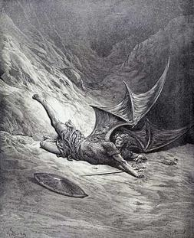
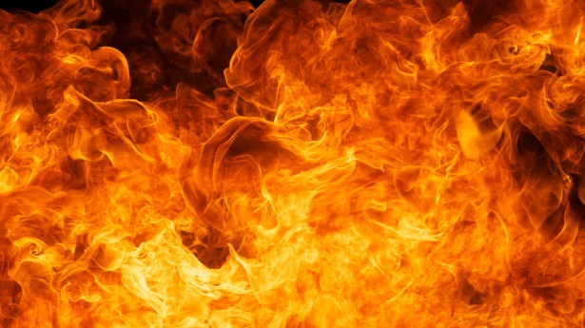
“Thou hast defiled thy sanctuaries by the multitude of thine iniquities, by the iniquity of thy traffick; therefore will I bring forth a fire from the midst of thee, it shall devour thee, and I will bring thee to ashes upon the earth in the sight of all them that behold thee. All they that know thee among the people shall be astonished at thee: thou shalt be a terror, and never shalt thou be any more.”

Slide 21
(Revelation 20:10)
“And the devil that deceived them was cast into the lake of fire and brimstone, where the beast and the false prophet are, and shall be tormented day and night for ever and ever.”

Slide 22
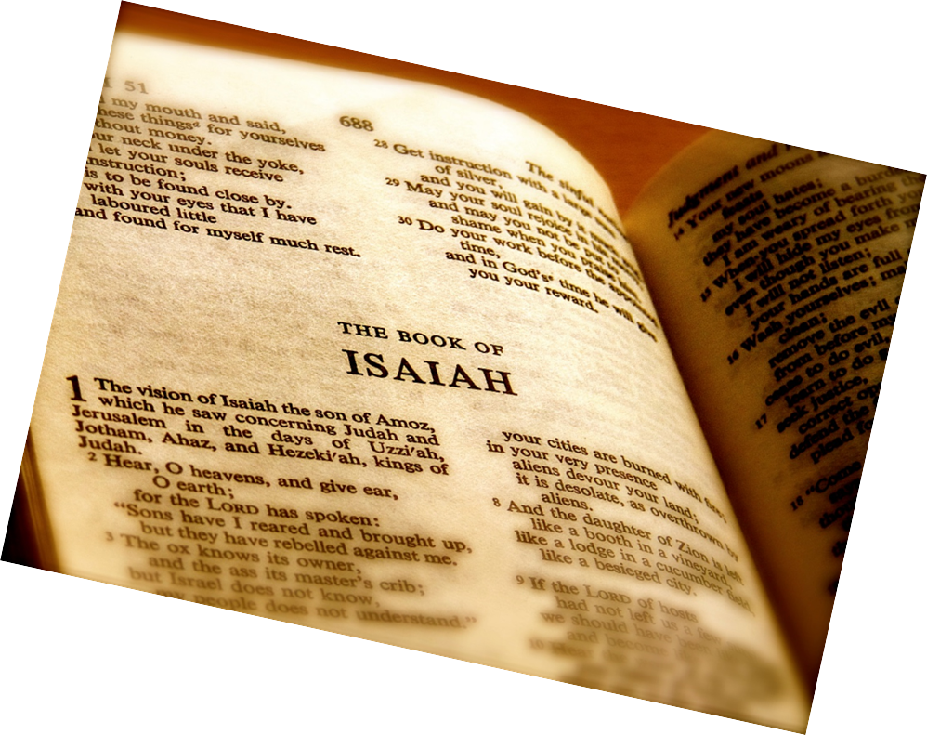
Satan’s origin and fall as recorded by Isaiah (Isaiah 14:12-14)

Slide 23
"How art thou fallen from heaven, O Lucifer, son of the morning! how art thou cut down to the ground, which didst weaken the nations! For thou hast said in thine heart, I will ascend into heaven, I will exalt my throne above the stars of God: I will sit also upon the mount of the congregation, in the sides of the north: I will ascend above the heights of the clouds; I will be like the most High."

Slide 24
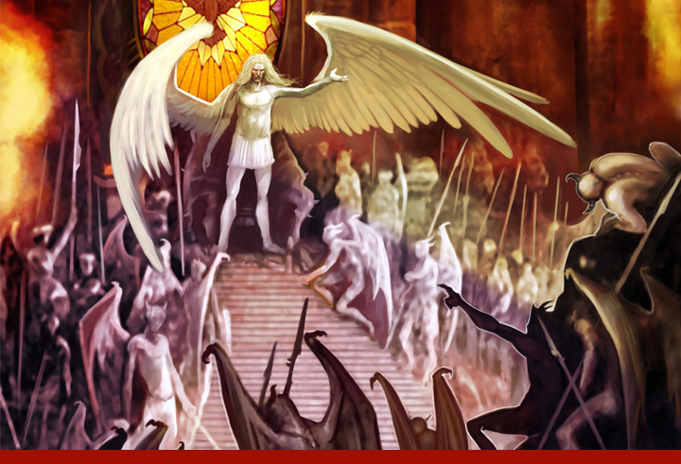
“How art thou fallen from heaven, O Lucifer, son of the morning!”

Slide 25
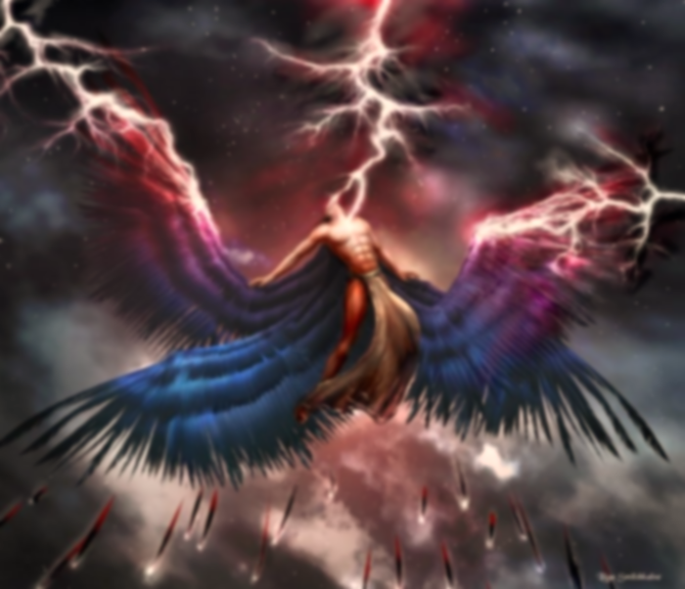
“And he said unto them, I beheld Satan as lightning fall from heaven.”
(Luke 10:18)

Slide 26
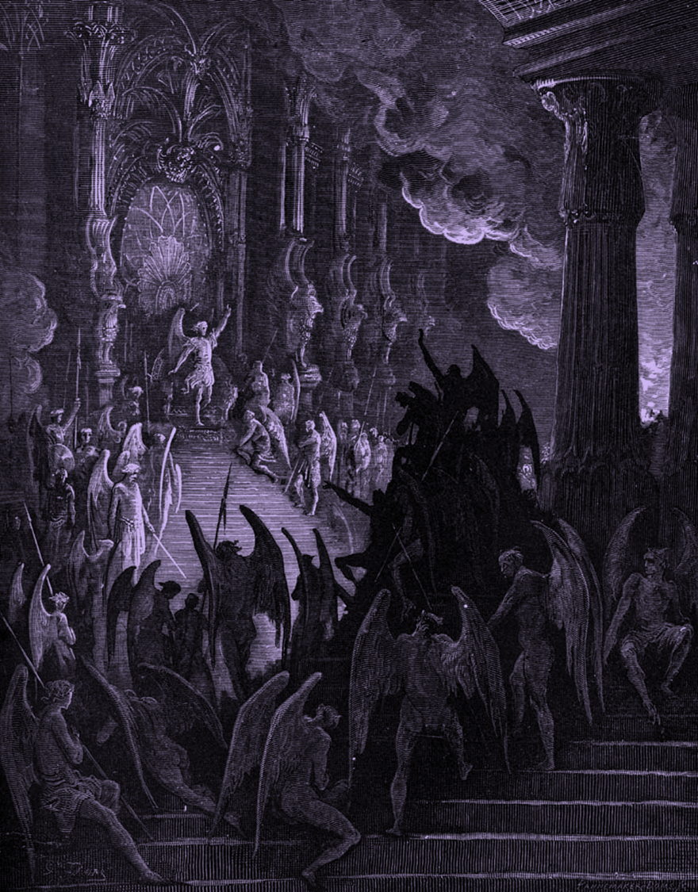
“Tail drew a third part of the stars of heaven, and did cast them to the earth…”
Stars of heaven = Fallen angels
1/3 followed Satan in his rebellion
Isaiah 14:12-15; Ezekiel 28:12-16; 2 Peter 2:4; Jude 6

Slide 27
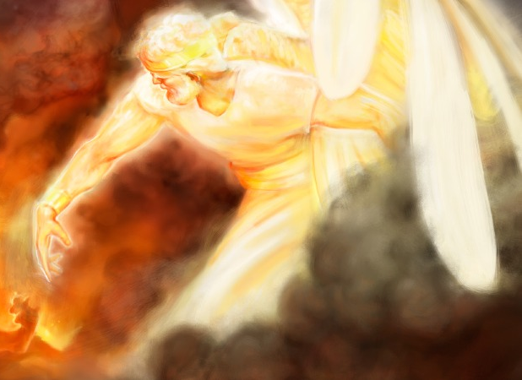
Lucifer
"shining one, light bearer"

Slide 28
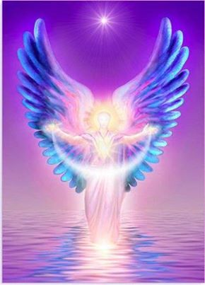
“And no marvel; for Satan himself is transformed into an angel of light.” (2 Cor. 11:14)

Slide 29
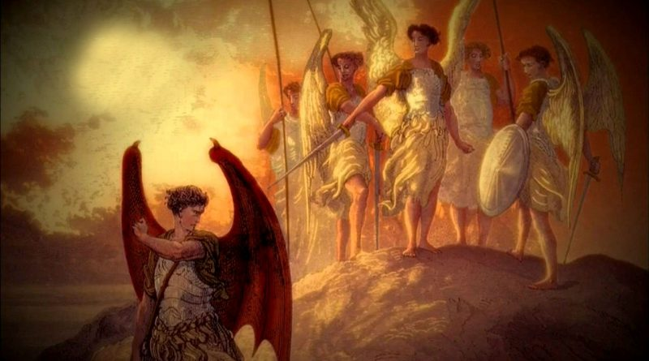
“How art thou cut down to the ground, which didst weaken the nations!”

Slide 30
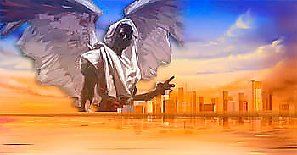
(2 Cor. 4:4) “In whom the god of this world hath blinded the minds of them which believe not, lest the light of the glorious gospel of Christ, who is the image of God, should shine unto them.”

Slide 31
“For thou hast said in thine heart…”
I will ascend into heaven - Obviously Satan had the third heaven in mind here, the very abode of God.
I will exalt my throne above the stars of God - A reference to angels. Satan desired the worship of angels.
I will sit also upon the mount of the congregation, in the sides of the north - Lucifer sought to enter God’s "executive office" somewhere in the north and sit on His throne.
I will ascend above the heights of the clouds - This may well refer to that special Shekinah glory of God.
I will be like the most High - He wanted to be like El-Elyon. This name literally means, "the strongest strong one."

Slide 32
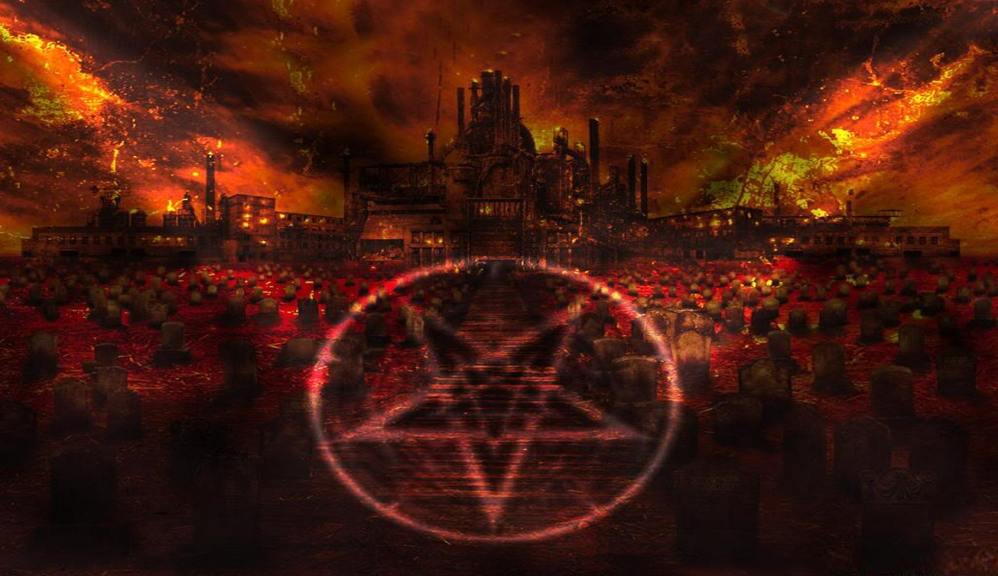
(Isaiah 14:15-17) “Yet thou shalt be brought down to hell, to the sides of the pit. They that see thee shall narrowly look upon thee, and consider thee, saying, Is this the man that made the earth to tremble, that did shake kingdoms; That made the world as a wilderness, and destroyed the cities thereof; that opened not the house of his prisoners?”

Slide 33
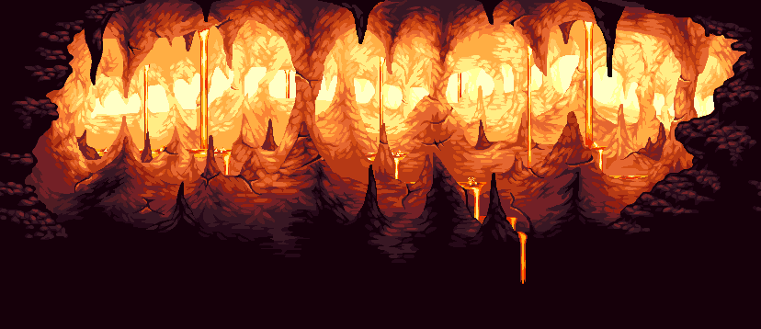
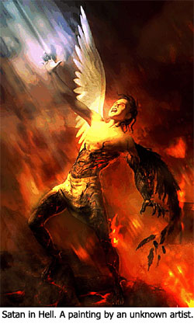
“…never shalt thou [be] any more.”

Slide 34
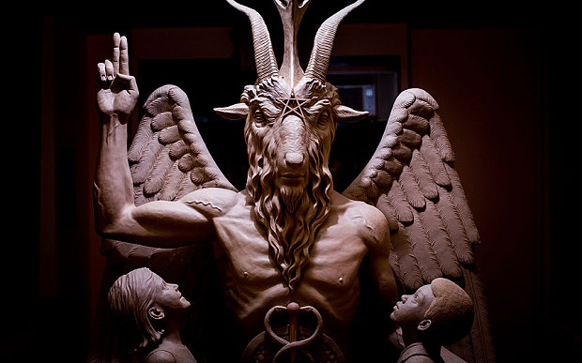
The Names of Satan gives insight into his evil character.

Slide 35
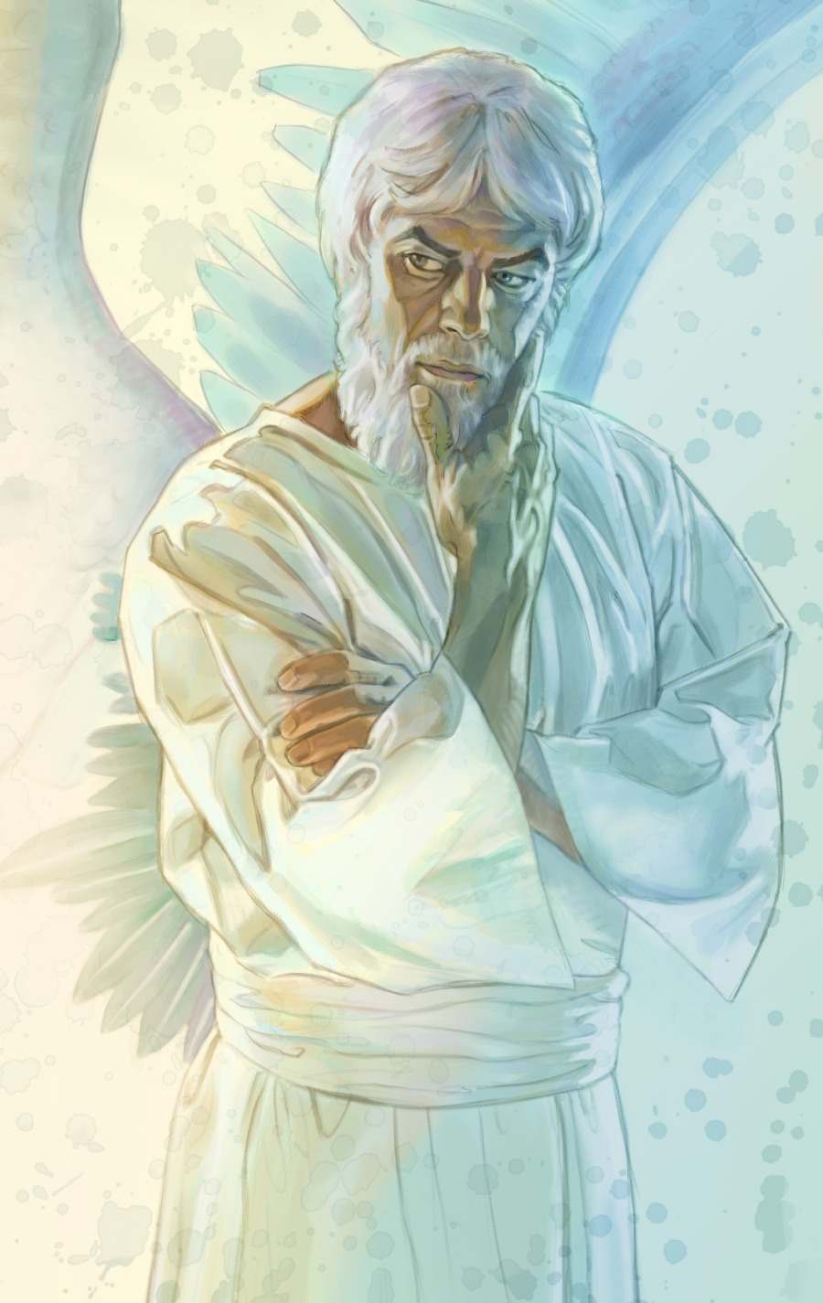
Satan (adversary): used some fifty-two times
The devil (slanderer): used thirty-five times
The prince of the power of the air
The God of this age
The king of death
The prince of this world
The ruler of darkness
Leviathan (one who dwells in the sea of humanity)
Lucifer (light bearer, shining one)
A roaring lion

Slide 36
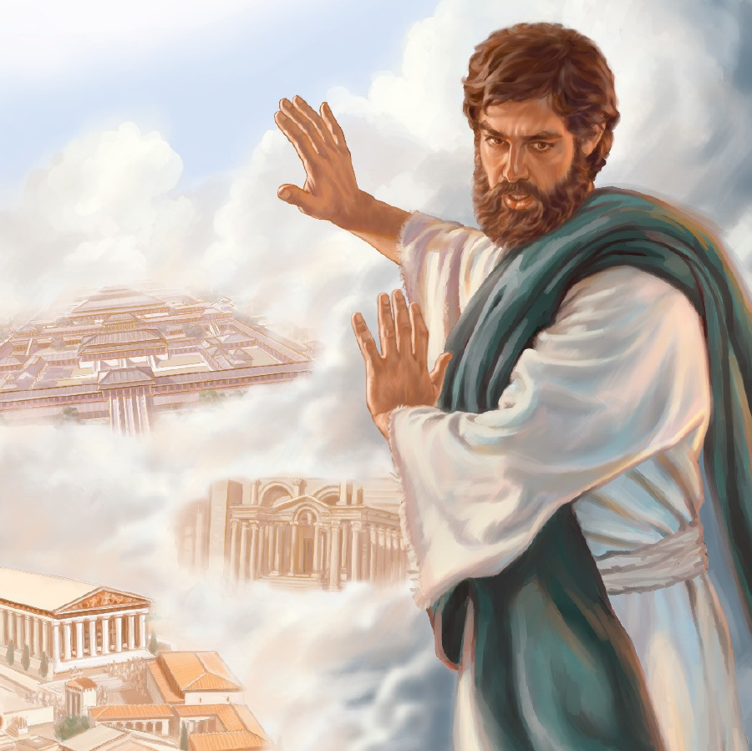
Abaddon (destroyer)
Angel of the bottomless pit
King of the bottomless pit
Anointed Cherub
Evil one
Father of lies
Lawless one
Old Serpent
Adversary
Thief
A murderer

Slide 37
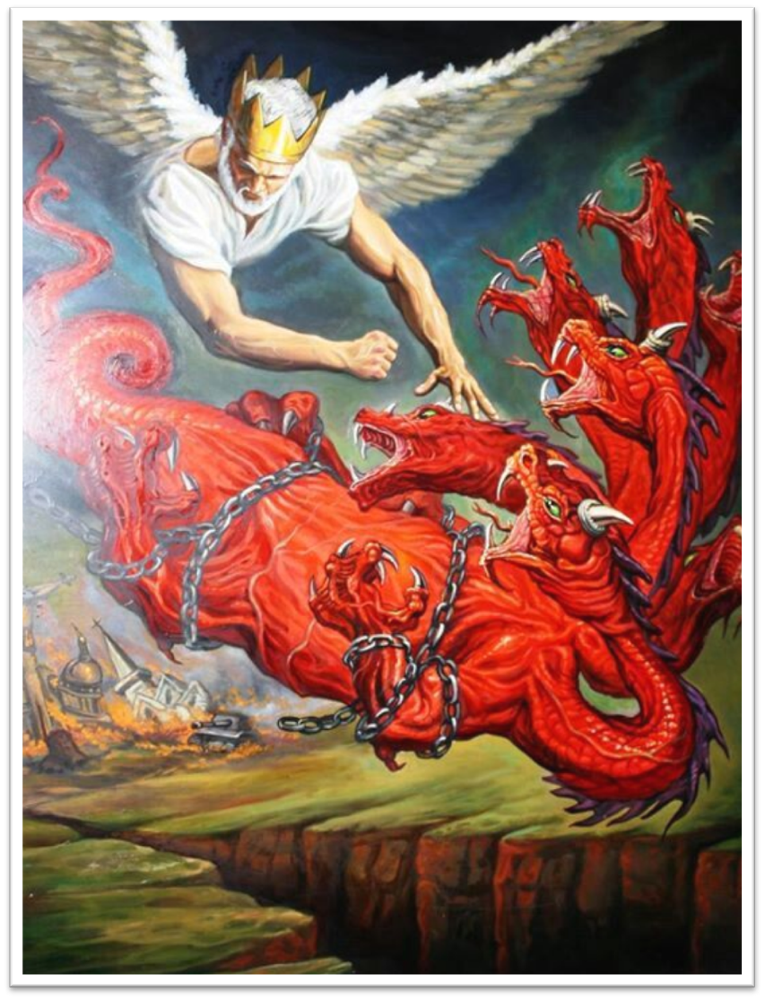
The dragon
The deceiver
Apollyon (destroyer)
Beelzebub (prince of demons)
Belial (vileness, ruthlessness)
The wicked one
The tempter
The accuser of the brethren
An angel of light
A liar
The enemy

Slide 38
(1 John 4:4) “Ye are of God, little children, and have overcome them: because greater is he that is in you, than he that is in the world.”

Slide 39
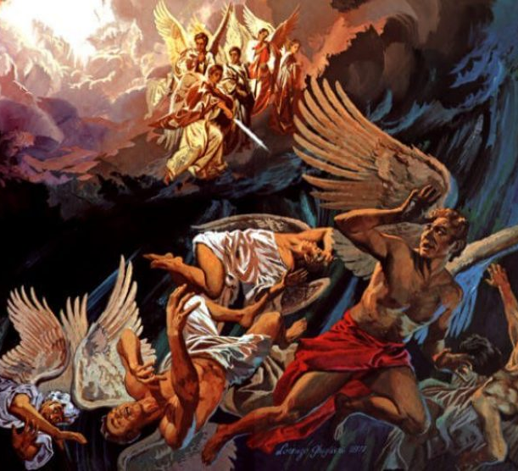
The Names of Fallen Angels

Slide 40
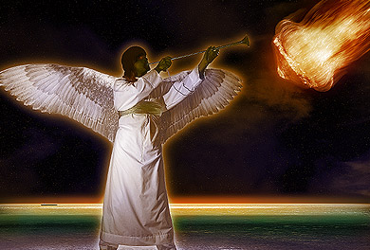
(Revelation 9) “And the fifth angel sounded, and I saw a star fall from heaven unto the earth: and to him was given the key of the bottomless pit.”

Slide 41
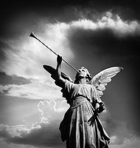
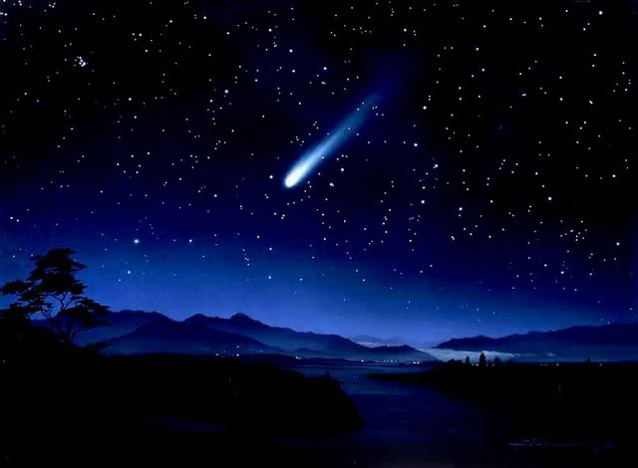
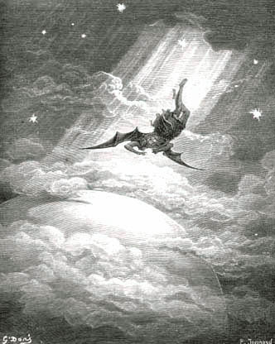
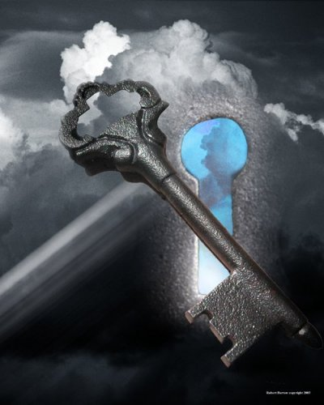
Jesus – “I beheld Satan as lightning fall from heaven.” (Luke 10:18)
Isaiah – “How art thou fallen from heaven, O Lucifer, son of the morning.” (Isaiah 14:12)

Slide 42
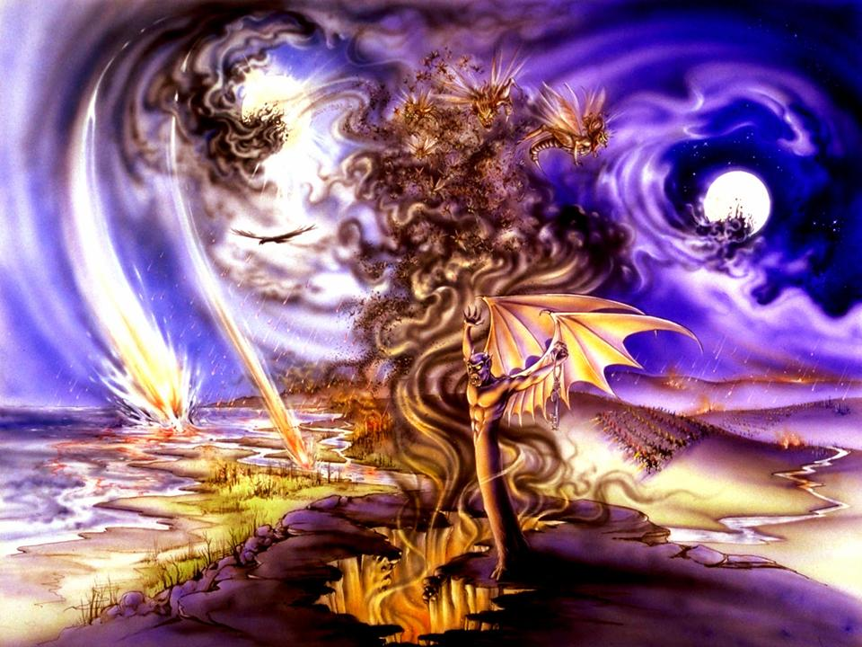

Slide 43
The Bottomless Pit “The Abyss”
The place where demons dreaded to go – Luke 8:31
The place where angels which kept not their first estate, but left their own habitation are reserved in everlasting chains under darkness waiting the day of judgment – Jude 6
The location of the “pit” is in the “lower parts of the earth” – Ephesians 4:9

Slide 44
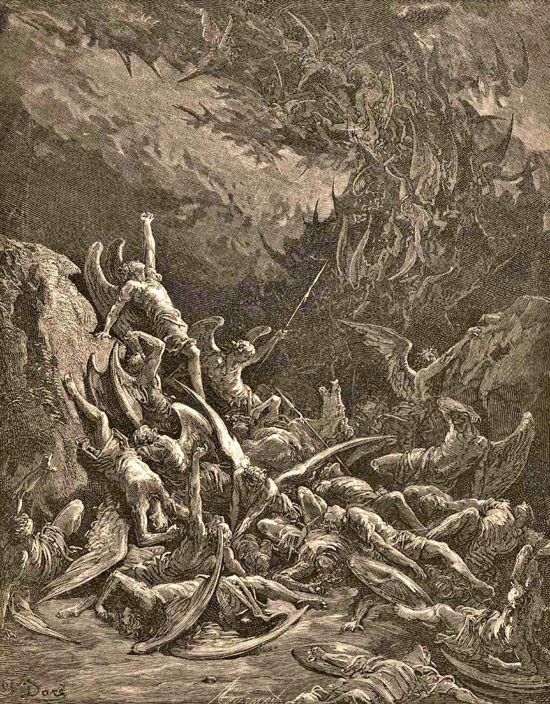
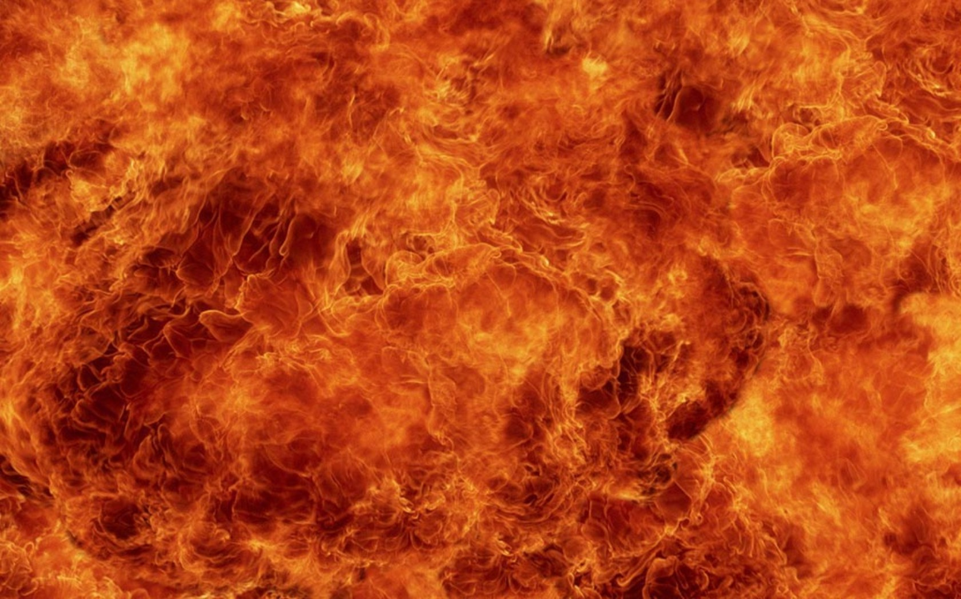
“For if God spared not the angels that sinned, but cast them down to hell (tartarus), and delivered them into chains of darkness, to be reserved unto judgment.” (II Peter 2:4)

Slide 45
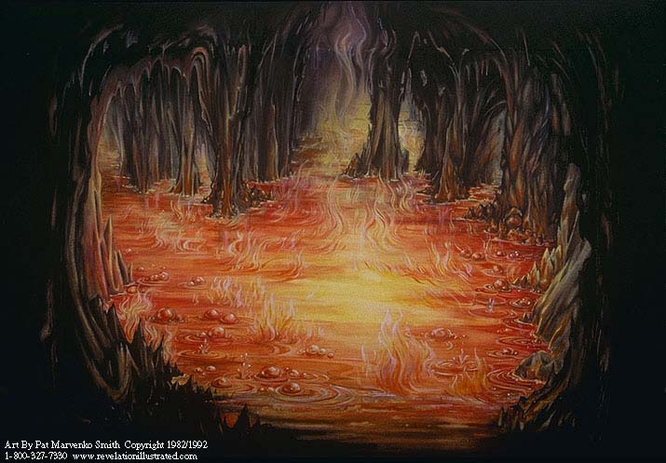
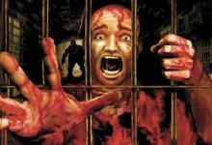
“And they shall be gathered together, as prisoners are gathered in the pit, and shall be shut up in the prison…” (Isa. 24:22)

Slide 46
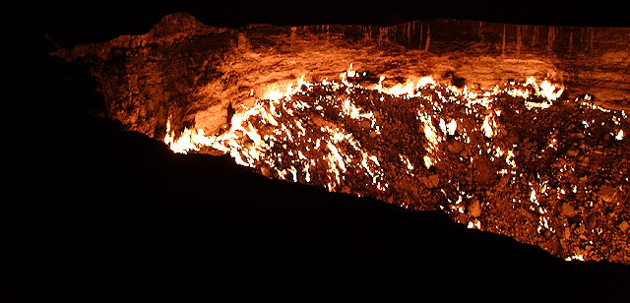
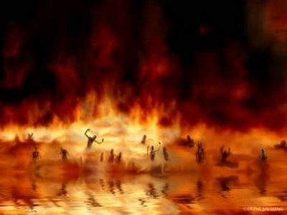
“Cast him down to hell with them that descend into the pit.” (Ezek. 31:16)

Slide 47
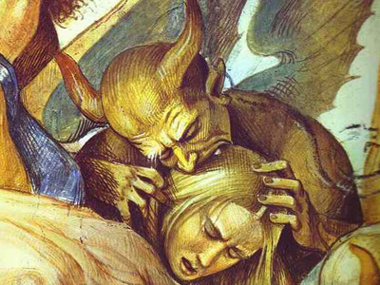
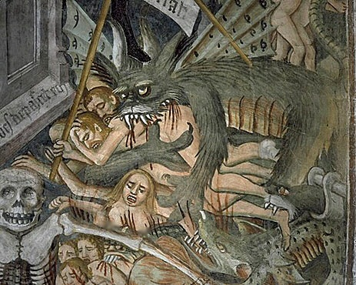
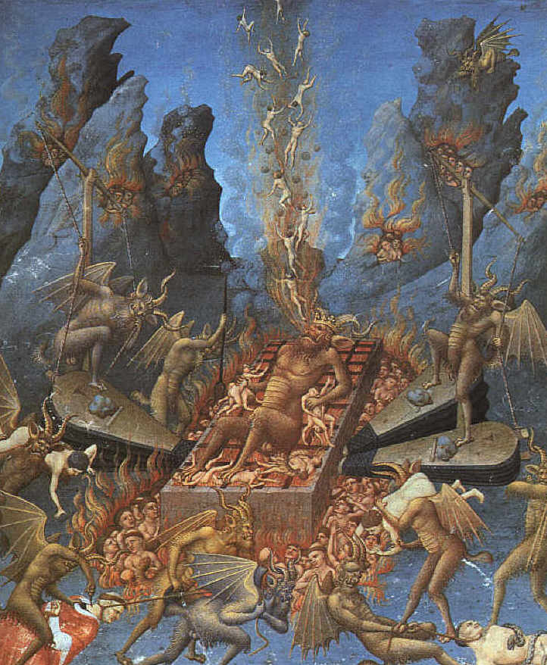
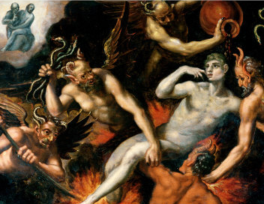
“For a fire is kindled in mine anger, and shall burn unto the lowest hell…They shall be burnt with hunger, and devoured with burning heat, and with bitter destruction: I will also send the teeth of beasts upon them, with the poison of serpents…” (Deut. 32)

Slide 48
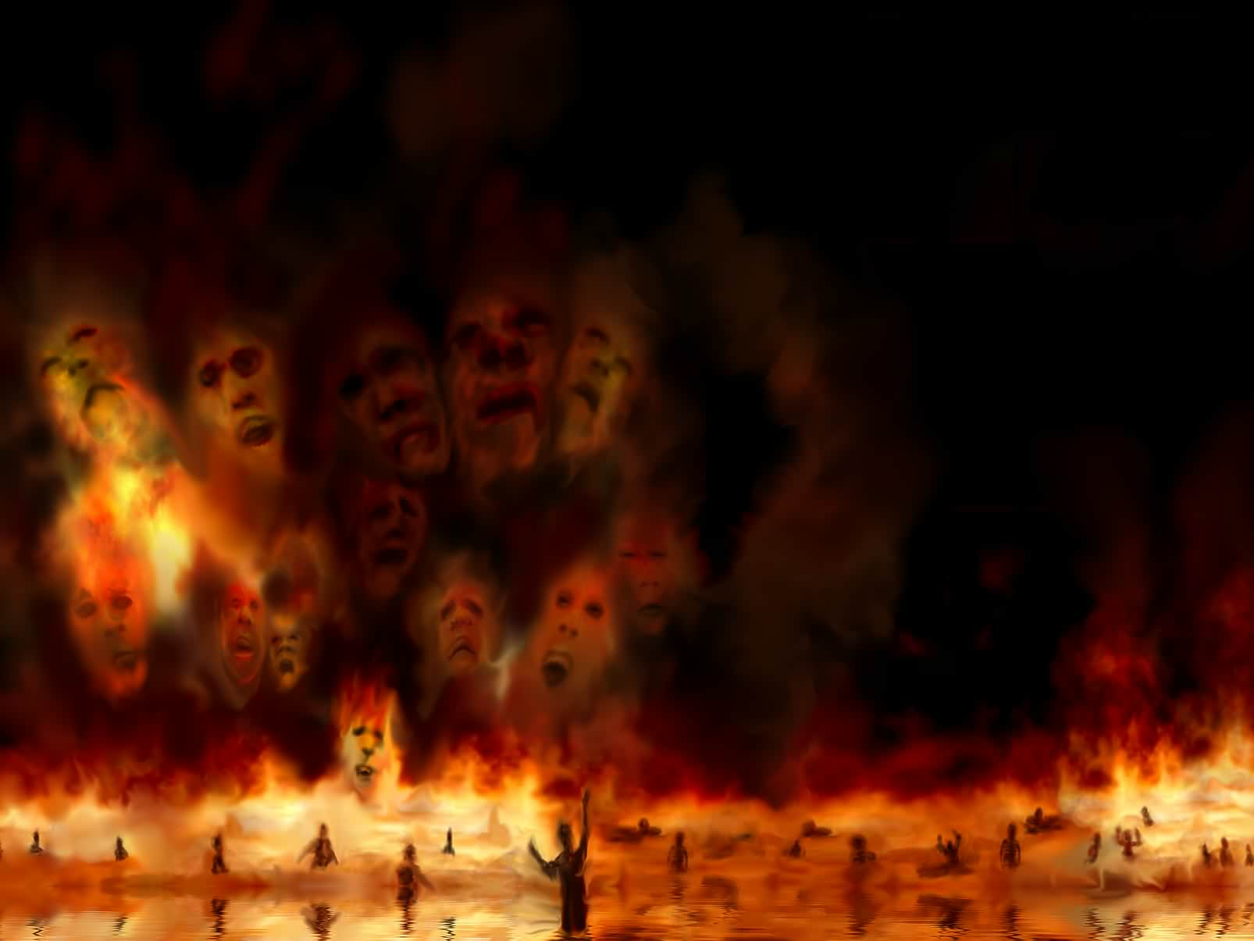
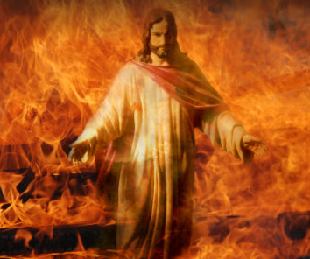
After Christ’s death He descended into the lower parts of the earth and preached unto the spirits in prison (I Peter 3:19)

Slide 49
Apollyon = Destroyer

Slide 50
“And the shapes of the locusts were like unto horses prepared unto battle; and on their heads were as it were crowns like gold, and their faces were as the faces of men. And they had hair as the hair of women, and their teeth were as the teeth of lions. And they had breastplates, as it were breastplates of iron; and the sound of their wings was as the sound of chariots of many horses running to battle.”

Slide 51
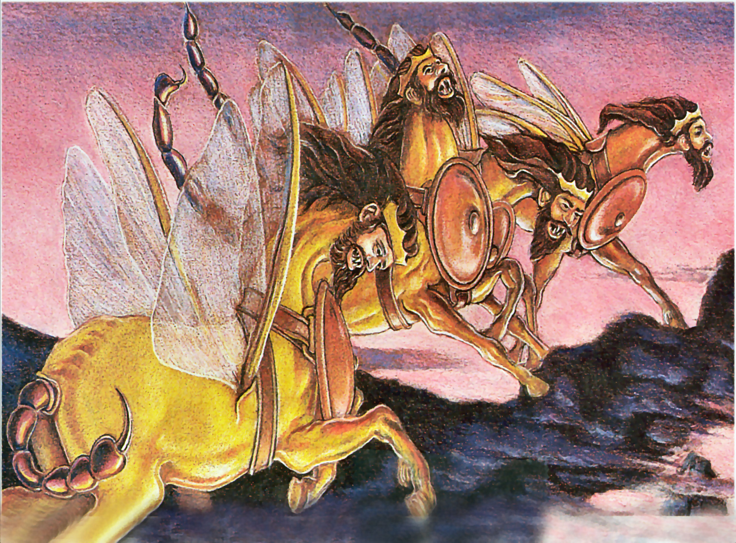
Horses prepared for battle – Ready to attack
Crowns of gold – Authority and power
Faces of men – Intelligence
Hair as the hair of women – Seduce and ensnare
Teeth as a lion – Fierce, cruel and devouring
Breastplates as of iron – Indestructible
Wings that sound like many chariots rushing to battle – Terrifying
Tails like a scorpion – Sting of extreme pain

Slide 52
“And there came out of the smoke locusts upon the earth: and unto them was given power, as the scorpions of the earth have power. And it was commanded them that they should not hurt the grass of the earth, neither any green thing, neither any tree; but only those men which have not the seal of God in their foreheads. And to them it was given that they should not kill them, but that they should be tormented five months: and their torment was as the torment of a scorpion, when he striketh a man.”

Slide 53
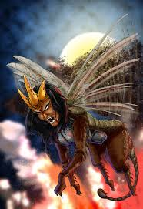

Slide 54
“And they had tails like unto scorpions, and there were stings in their tails: and their power was to hurt men five months. And they had a king over them, which is the angel of the bottomless pit, whose name in the Hebrew tongue is Abaddon, but in the Greek tongue hath his name Apollyon. One woe is past; and, behold, there come two woes more hereafter.”

Slide 56
“And they had a king over them, which is the angel of the bottomless pit, whose name in the Hebrew tongue is Abaddon, but in the Greek tongue hath his name Apollyon…One woe is past; and, behold, there come two woes more hereafter.”

Slide 58
(Luke 8:26-40) “And they arrived at the country of the Gadarenes, which is over against Galilee. And when he went forth to land, there met him out of the city a certain man, which had devils long time, and ware no clothes, neither abode in any house, but in the tombs. When he saw Jesus, he cried out, and fell down before him, and with a loud voice said, What have I to do with thee, Jesus, thou Son of God most high? I beseech thee, torment me not. For he had commanded the unclean spirit to come out of the man. For oftentimes it had caught him: and he was kept bound with chains and in fetters; and he brake the bands, and was driven of the devil into the wilderness.”

Slide 60
“And Jesus asked him, saying, What is thy name? And he said, Legion: because many devils were entered into him. And they besought him that he would not command them to go out into the deep. And there was there an herd of many swine feeding on the mountain: and they besought him that he would suffer them to enter into them. And he suffered them. Then went the devils out of the man, and entered into the swine: and the herd ran violently down a steep place into the lake, and were choked.”

Slide 62
“When they that fed them saw what was done, they fled, and went and told it in the city and in the country. Then they went out to see what was done; and came to Jesus, and found the man, out of whom the devils were departed, sitting at the feet of Jesus, clothed, and in his right mind: and they were afraid.”

Slide 63
“They also which saw it told them by what means he that was possessed of the devils was healed. Then the whole multitude of the country of the Gadarenes round about besought him to depart from them; for they were taken with great fear: and he went up into the ship, and returned back again.”

Slide 64
“Now the man out of whom the devils were departed besought him that he might be with him: but Jesus sent him away, saying, Return to thine own house, and shew how great things God hath done unto thee. And he went his way, and published throughout the whole city how great things Jesus had done unto him.”

Slide 65
“And it came to pass, that, when Jesus was returned, the people gladly received him: for they were all waiting for him.”

Slide 66
Devils/Demons – found 55 times in the Word of God.
The devil’s angels (Matt. 25:41; Rev. 12:9)
The angels which kept not their first estate (2 Pet. 2:4; Jude 6)
Familiar spirits (Deut. 18:11; Isa. 8:10; 19:3)
Unclean spirits (Matt. 10:1; Mark 1:27; 3:11; 5:13; Acts 5:16)
Evil spirits (Luke 7:21; Acts 19:12-13)
Seducing spirits (1 Tim. 4:1)
Wicked spirits (Luke 11:26)

Slide 67
Fall Angels/Demons can speak
"Let us alone; what have we to do with thee, thou Jesus of Nazareth? Art thou come to destroy us? I know thee, who thou art: the Holy One of God...Thou art Christ, the Son of God." (Luke 4:34, 41)
"What have I to do with thee, Jesus, thou Son of God most high? I beseech thee, torment me not." (Luke 8:28)
"Art thou come here to torment us before the time?" (Matt. 8:29)
"Send us into the swine, that we may enter into them." (Mark 5:12)
"Jesus I know, and Paul I know; but who are ye?" (Acts 19:15)
"Thou art the Son of God." (Mark 3:11)

Slide 68
Fallen Angels/Demons possess intelligence
They know who Jesus is - (Luke 4:34) “Saying, Let us alone; what have we to do with thee, thou Jesus of Nazareth? art thou come to destroy us? I know thee who thou art; the Holy One of God.”
They know of future damnation - (Matthew 8:29) “And, behold, they cried out, saying, What have we to do with thee, Jesus, thou Son of God? art thou come hither to torment us before the time?”

Slide 69
They know the saved from the unsaved "Jesus I know, and Paul I know; but who are ye?" (Acts 19:15)
(Revelation 9:1-4) “And the fifth angel sounded, and I saw a star fall from heaven unto the earth: and to him was given the key of the bottomless pit. And he opened the bottomless pit; and there arose a smoke out of the pit, as the smoke of a great furnace; and the sun and the air were darkened by reason of the smoke of the pit. And there came out of the smoke locusts upon the earth: and unto them was given power, as the scorpions of the earth have power. And it was commanded them that they should not hurt the grass of the earth, neither any green thing, neither any tree; but only those men which have not the seal of God in their foreheads.”

Slide 70
They are able to formulate a systematic Satanic centered system of theology - (1 Timothy 4:1-2) “Now the Spirit speaketh expressly, that in the latter times some shall depart from the faith, giving heed to seducing spirits, and doctrines of devils; Speaking lies in hypocrisy; having their conscience seared with a hot iron.”

Slide 71
Fallen Angels/Demons possess great ability and strength

Slide 72
“Then Pharaoh also called the wise men and the sorcerers: now the magicians of Egypt, they also did in like manner with their enchantments. For they cast down every man his rod, and they became serpents: but Aaron's rod swallowed up their rods.” (Exodus 7:11-12)

Slide 73
“But the prince of the kingdom of Persia withstood me one and twenty days: but, lo, Michael, one of the chief princes, came to help me.” (Daniel 10:13)

Slide 74
“And when he was come out of the ship, immediately there met him out of the tombs a man with an unclean spirit, Who had his dwelling among the tombs; and no man could bind him, no, not with chains: Because that he had been often bound with fetters and chains, and the chains had been plucked asunder by him, and the fetters broken in pieces: neither could any man tame him.” (Mark 5:2-4)

Slide 75
“And one of the multitude answered and said, Master, I have brought unto thee my son, which hath a dumb spirit; And wheresoever he taketh him, he teareth him: and he foameth, and gnasheth with his teeth, and pineth away: and I spake to thy disciples that they should cast him out; and they could not. He answereth him, and saith, O faithless generation, how long shall I be with you? how long shall I suffer you? bring him unto me.”

Slide 76
“And they brought him unto him: and when he saw him, straightway the spirit tare him; and he fell on the ground, and wallowed foaming. And he asked his father, How long is it ago since this came unto him? And he said, Of a child. And ofttimes it hath cast him into the fire, and into the waters, to destroy him: but if thou canst do any thing, have compassion on us, and help us. Jesus said unto him, If thou canst believe, all things are possible to him that believeth.”

Slide 77
“And straightway the father of the child cried out, and said with tears, Lord, I believe; help thou mine unbelief. And the spirit cried, and rent him sore, and came out of him: and he was as one dead; insomuch that many said, He is dead. But Jesus took him by the hand, and lifted him up; and he arose.” (Mark 9:17-27)

Slide 78
“Then certain of the vagabond Jews, exorcists, took upon them to call over them which had evil spirits the name of the Lord Jesus, saying, We adjure you by Jesus whom Paul preacheth. And there were seven sons of one Sceva, a Jew, and chief of the priests, which did so. And the evil spirit answered and said, Jesus I know, and Paul I know; but who are ye? And the man in whom the evil spirit was leaped on them, and overcame them, and prevailed against them, so that they fled out of that house naked and wounded.” (Acts 19:13-16)

Slide 80
(Revelation 9:13-20) “And the sixth angel sounded, and I heard a voice from the four horns of the golden altar which is before God, Saying to the sixth angel which had the trumpet.”

Slide 81
“Loose the four angels which are bound in the great river Euphrates.”

Slide 83
Time of their judgment (1 hour, 1 day, 1 month, 1 year)
The purpose of their judgment is to kill 1/3 of the population of the earth.

Slide 84
200 Million
“And the number of the army of the horsemen were two hundred thousand thousand: and I heard the number of them.”

Slide 85
“And thus I saw the horses in the vision, and them that sat on them, having breastplates of fire, and of jacinth, and brimstone: and the heads of the horses were as the heads of lions; and out of their mouths issued fire and smoke and brimstone.”

Slide 86
Breastplates – Protected and indestructible
Heads like lions – Furious and devouring
Mouth that spits fire – Full of wrath and furry
Tails like serpents – Poisonous strikes and deadly wound
“Their power is in their mouth and in their tails...”

Slide 87
“By these three was the third part of men killed, by the fire, and by the smoke, and by the brimstone, which issued out of their mouths. For their power is in their mouth, and in their tails: for their tails were like unto serpents, and had heads, and with them they do hurt.”

Slide 88
Prepared for an hour, and a day, and a month, and a year = 397 days and 1 hour
Kill 1/3 part of men
The 6th trumpet, combined with the 4th seal (6:8) has now reduced the population of the earth to ½ its pre-tribulation level.

Slide 90
“And the rest of the men which were not killed by these plagues yet repented not of the works of their hands, that they should not worship devils, and idols of gold, and silver, and brass, and stone, and of wood: which neither can see, nor hear, nor walk: Neither repented they of their murders, nor of their sorceries, nor of their fornication, nor of their thefts.”

Slide 91
What have we learned tonight?
Demons are fallen angels
They have names
They can speak
They are highly intelligent
They are able to formulate a systematic Satanic centered system of theology
They possess great ability and strength

