Slide 2
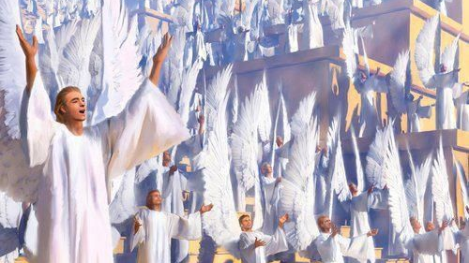
“Likewise, I say unto you, there is joy in the presence of the angels of God over one sinner that repenteth.” (Luke 15:10)

Slide 3
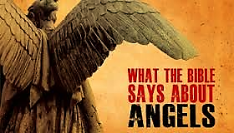

Slide 5
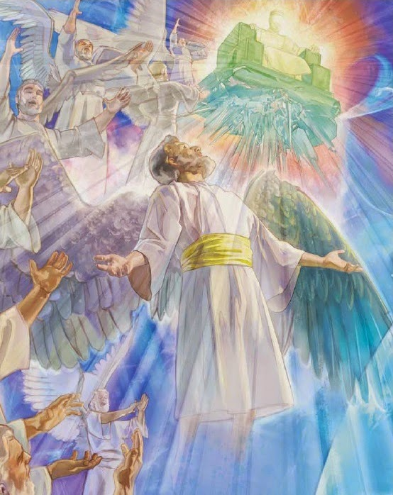
Angels in the Word of God
Angels are mentioned in 34 books of the Bible for a total of 281 times (106 times in the Old Testament and 174 in the New Testament).

Slide 6
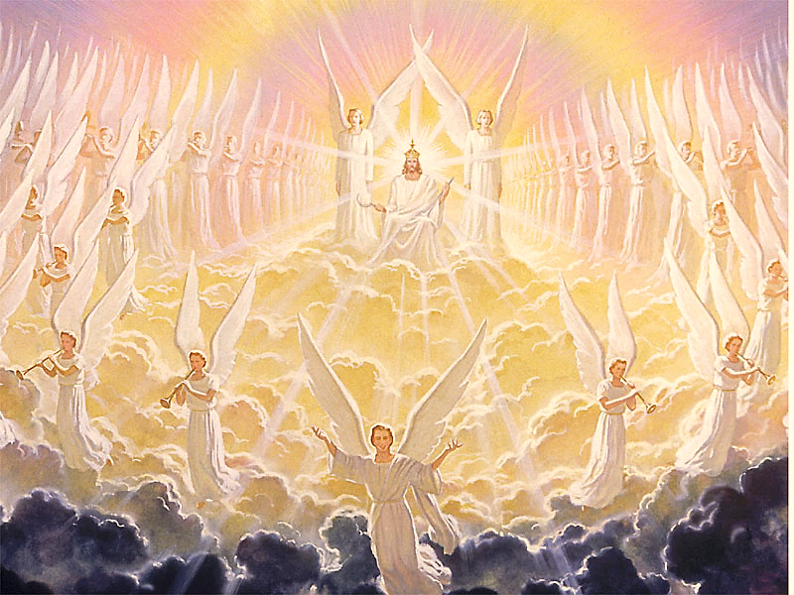
Their Origin
Angels, like everything else in this universe, were created by God the Father through Jesus Christ in the power of the Holy Spirit.
(See Genesis 1:1, 2; 2:1; Nehemiah 9:6; John 1:1-3; Ephesians 3:9; Colossians 1:16.)
The method of their origin - Angels, like man, were created by a special act of God.
Each angel is therefore a direct creation from God.

Slide 7
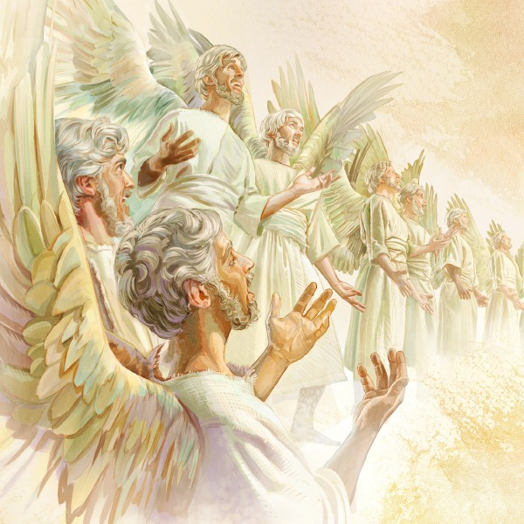
“Praise ye him, all his angels: praise ye him, all his hosts…for he commanded, and they were created.” (Psalms 148:2-5)

Slide 8
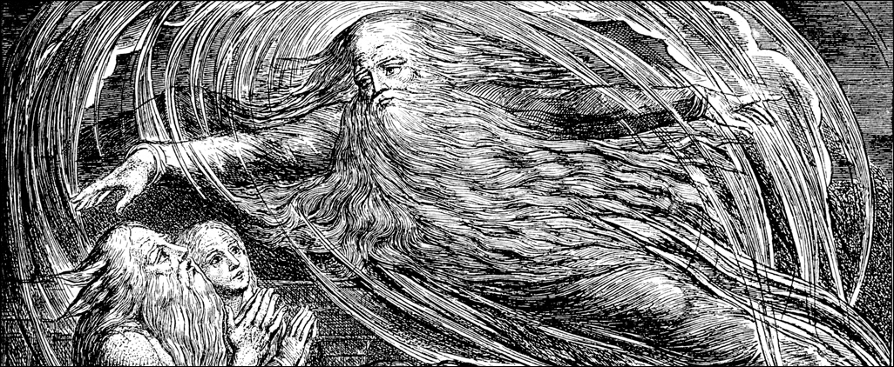
The time of their origin/creation
"Then the Lord answered Job out of the whirlwind, and said...Where wast thou when I laid the foundations of the earth? Declare, if thou hast understanding when the morning stars sang together, and all the sons of God shouted for joy?" (Job 38:1, 4, 7).
In these verses God declares that creation of angels took place prior to the creation of the earth.

Slide 9
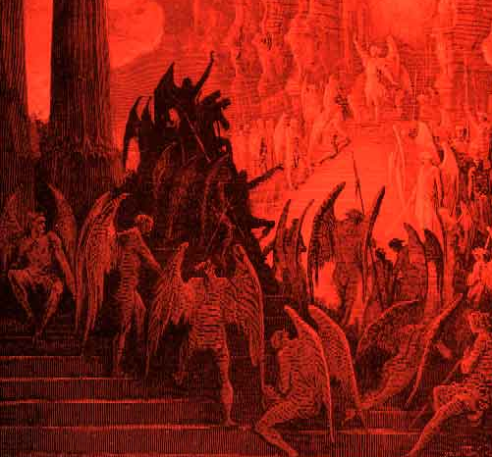
Evil Angels (Demons)

Slide 10
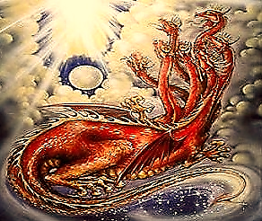
“His (Satan’s) tail drew a third part of the stars of heaven, and did cast them to the earth…” (Revelation 12:4)

Slide 11
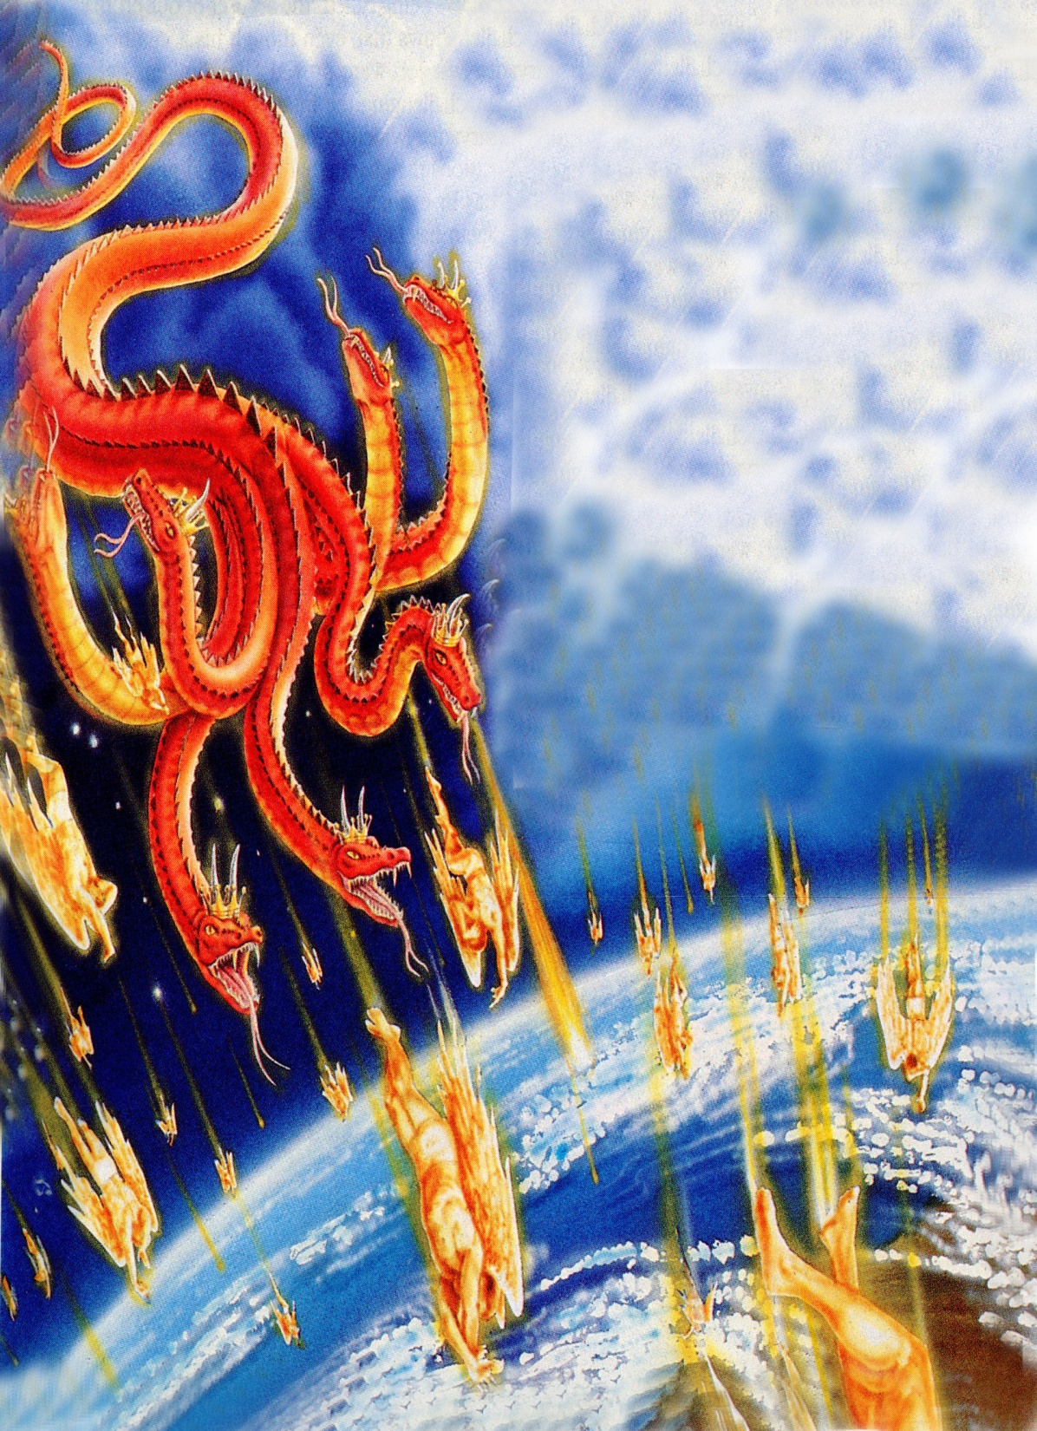
“And did cast them to the earth…”

Slide 12
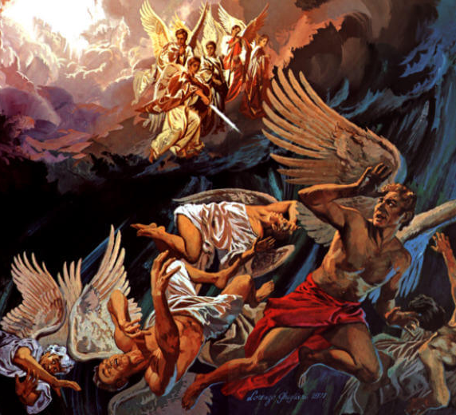
“And there was war in heaven: Michael and his angels fought against the dragon; and the dragon fought and his angels, And prevailed not; neither was their place found any more in heaven. And the great dragon was cast out, that old serpent, called the Devil, and Satan, which deceiveth the whole world: he was cast out into the earth, and his angels were cast out with him.” (Revelation 12:7-9)

Slide 13
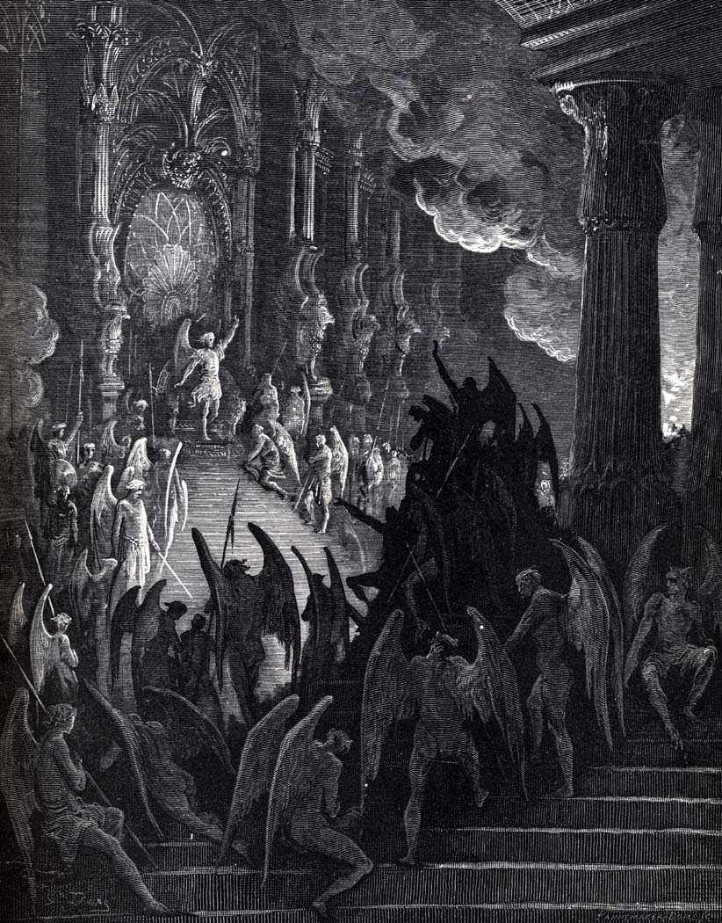
“And the angels which kept not their first estate, but left their own habitation.” Jude 1:6
“For if God spared not the angels that sinned, but cast [them] down to hell.” 2 Peter 2:4

Slide 14
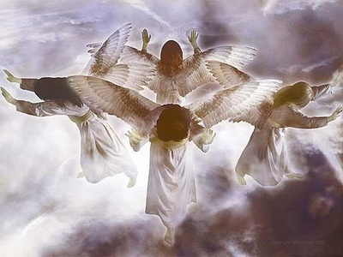
The Purpose of their Creation
"For by him were all things created, that are in heaven, and that are in earth, visible and invisible, whether they be thrones, or dominions, or principalities, or powers: all things were created by him, and for him" (Col. 1:16)
"Thou art worthy, O Lord, to receive glory and honour and power: for thou hast created all things, and for thy pleasure they are and were created" (Rev. 4:11)

Slide 15
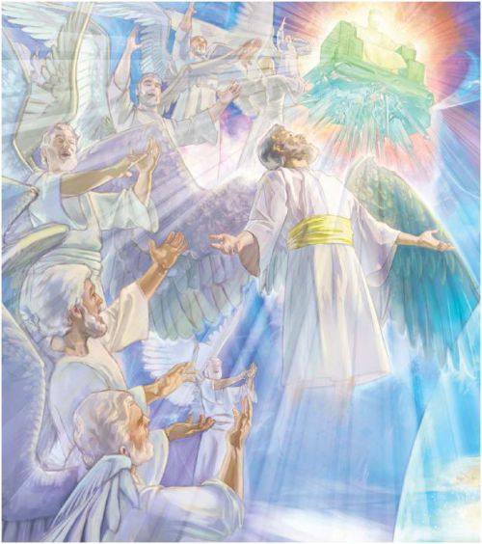
Angels were Created
to Worship God
“And let all the angels of God worship him.” (Hebrews 1:6)

Slide 16
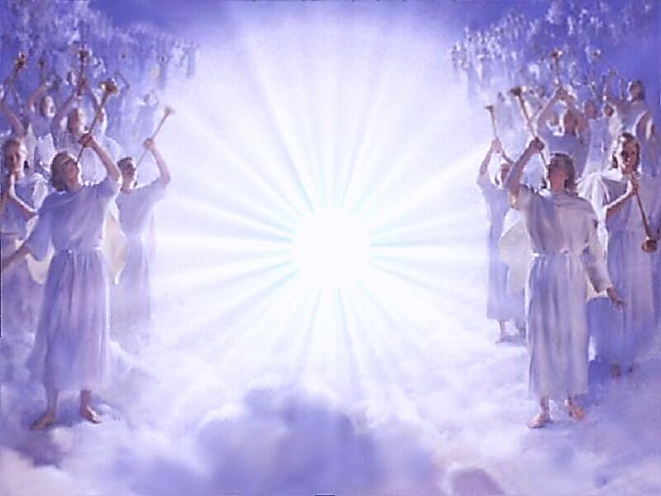
“Bless the LORD, ye his angels, that excel in strength, that do his commandments, hearkening unto the voice of his word.” (Psalm 103:20)
Angels were Created to Serve and Obey God

Slide 17
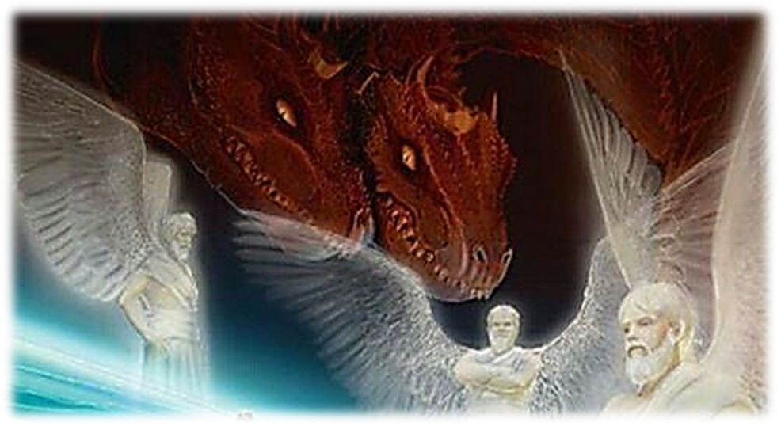
Angels were Created to Minister to Man
Psalms 34:7 “The angel of the LORD encampeth round about them that fear him, and delivereth them.”
Hebrews 13:2 “Be not forgetful to entertain strangers: for thereby some have entertained angels unawares.”
Psalm 91:11 “For he shall give his angels charge over thee, to keep thee in all thy ways.”

Slide 18
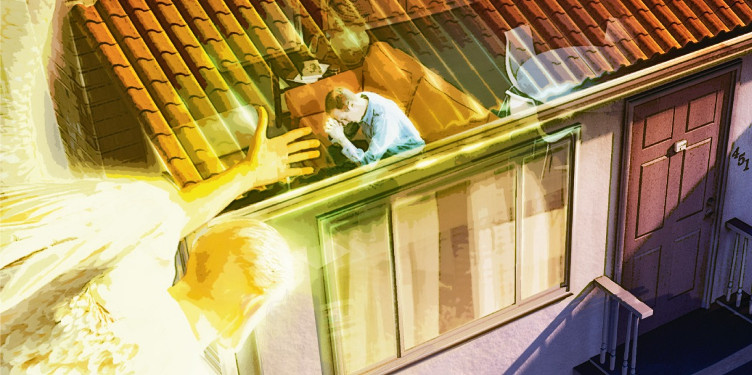
“Are they not all ministering spirits, sent forth to minister for them who shall be heirs of salvation?”
(Hebrews 1:14)

Slide 19
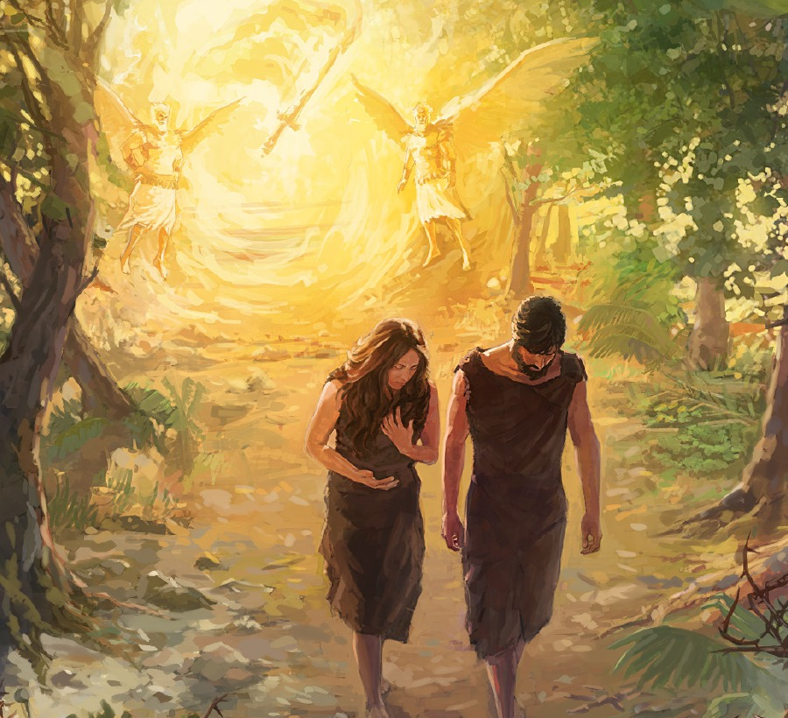
“Who maketh his angels spirits; his ministers a flaming fire” (Psalm 104:4)

Slide 20
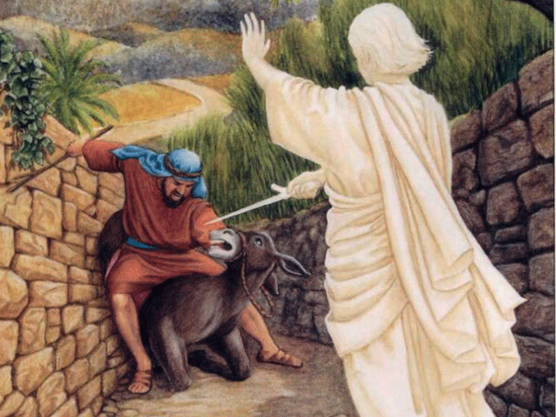

Slide 21
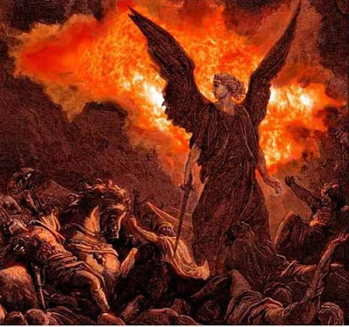
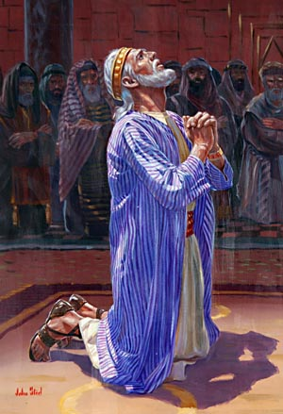
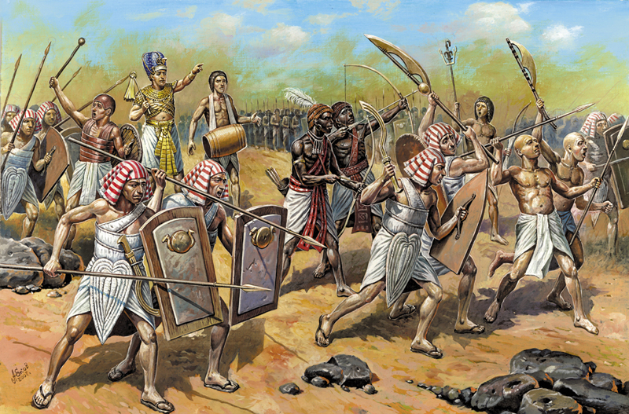
Angels both good and evil were used by God through out the Bible as instruments of judgment.
“For I will defend this city to save it for mine own sake, and for my servant David's sake. Then the angel of the LORD went forth, and smote in the camp of the Assyrians a hundred and fourscore and five thousand (185,000): and when they arose early in the morning, behold, they were all dead corpses.” (Isaiah 37:35-36)

Slide 22
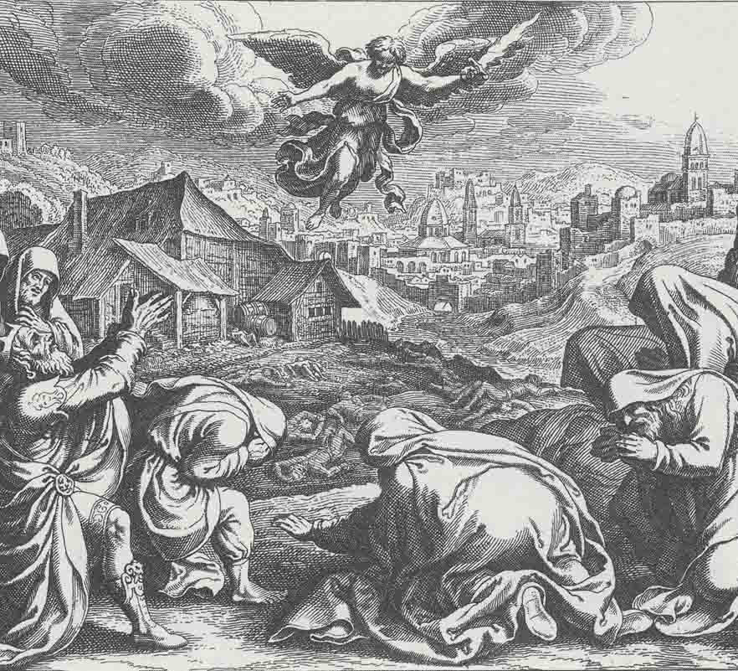
“And God sent an angel unto Jerusalem to destroy it: and as he was destroying, the LORD beheld, and he repented him of the evil, and said to the angel that destroyed, It is enough, stay now thine hand. And the angel of the LORD stood by the threshingfloor of Ornan the Jebusite. And David lifted up his eyes, and saw the angel of the LORD stand between the earth and the heaven, having a drawn sword in his hand stretched out over Jerusalem. Then David and the elders of Israel, who were clothed in sackcloth, fell upon their faces.” (1 Chronicles 21:15-16)

Slide 23
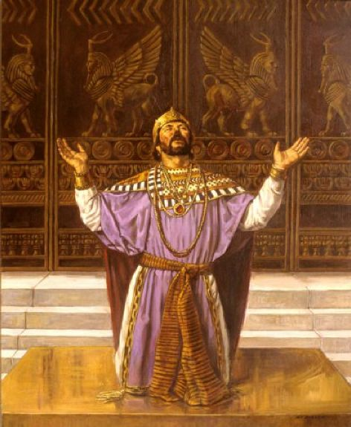
“Let them be confounded and put to shame that seek after my soul: let them be turned back and brought to confusion that devise my hurt. Let them be as chaff before the wind: and let the angel of the LORD chase them. Let their way be dark and slippery: and let the angel of the LORD persecute them.” (Psalms 35:4-6)

Slide 24
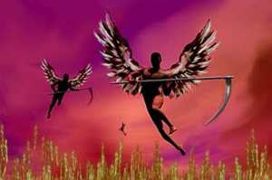
“And I looked, and behold a white cloud, and upon the cloud one sat like unto the Son of man, having on his head a golden crown, and in his hand a sharp sickle. And another angel came out of the temple, crying with a loud voice to him that sat on the cloud, Thrust in thy sickle, and reap: for the time is come for thee to reap; for the harvest of the earth is ripe. And he that sat on the cloud thrust in his sickle on the earth; and the earth was reaped.” (Revelation 14:14-16)

Slide 25
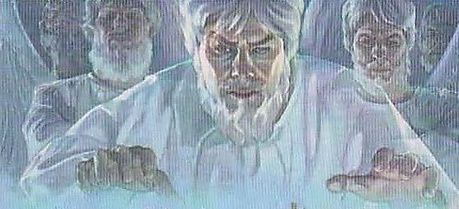
“To deliver such an one unto Satan for the destruction of the flesh.” (1 Corinthians 5:5)

Slide 26
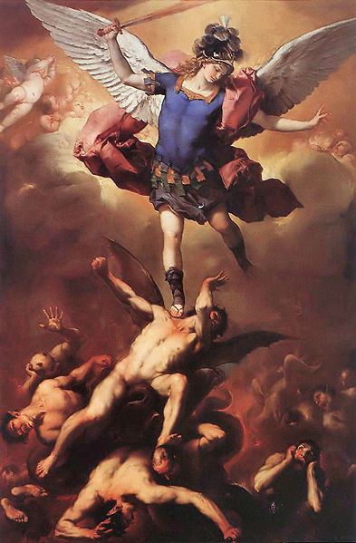
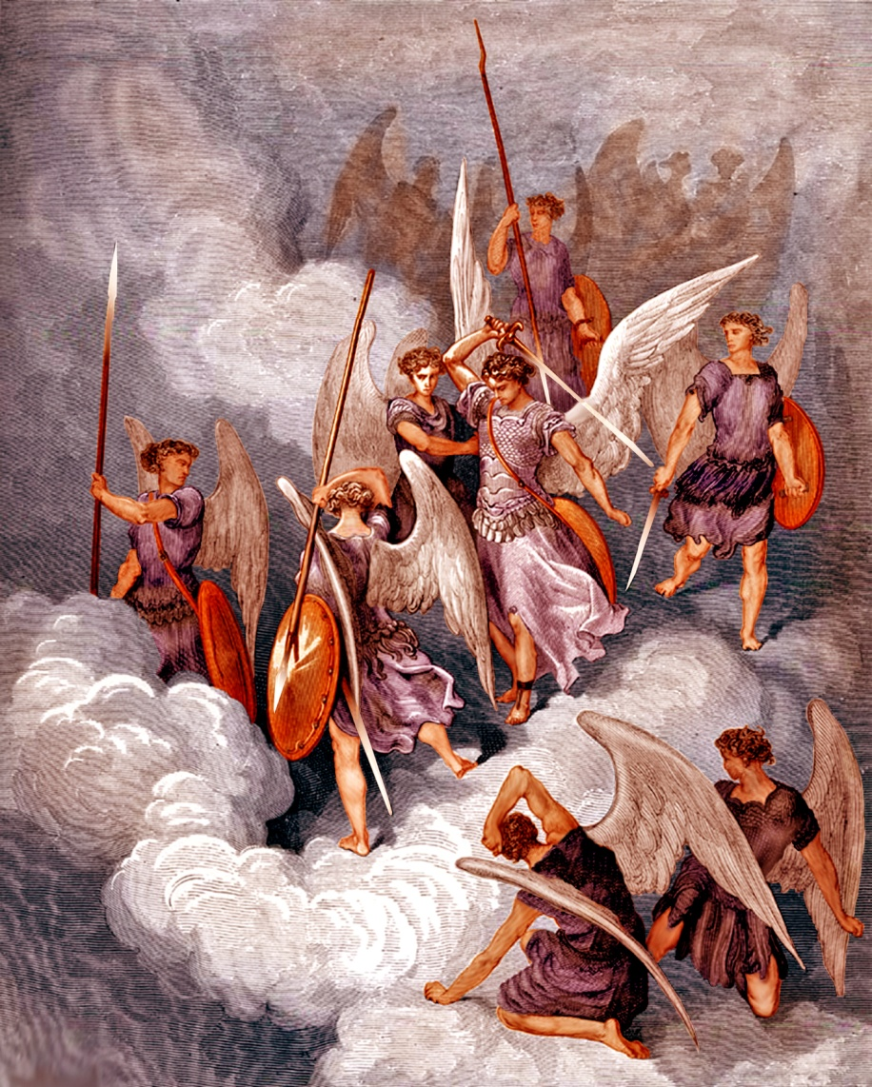
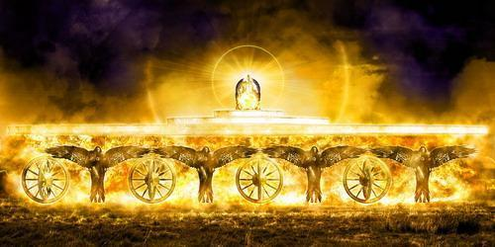
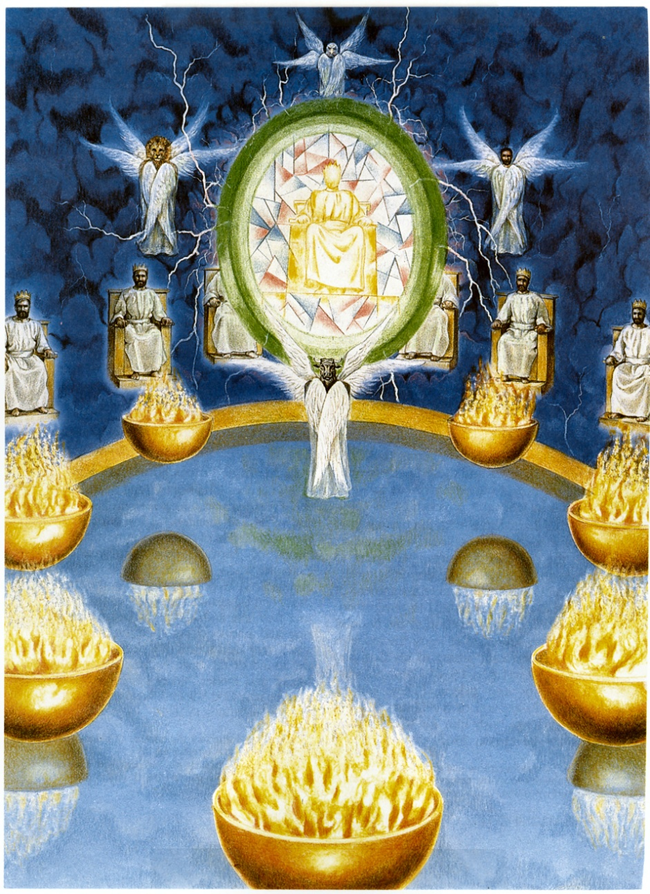
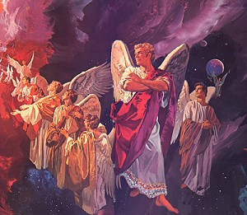
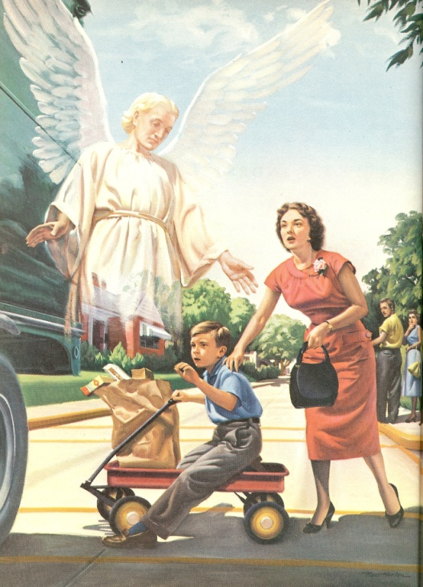
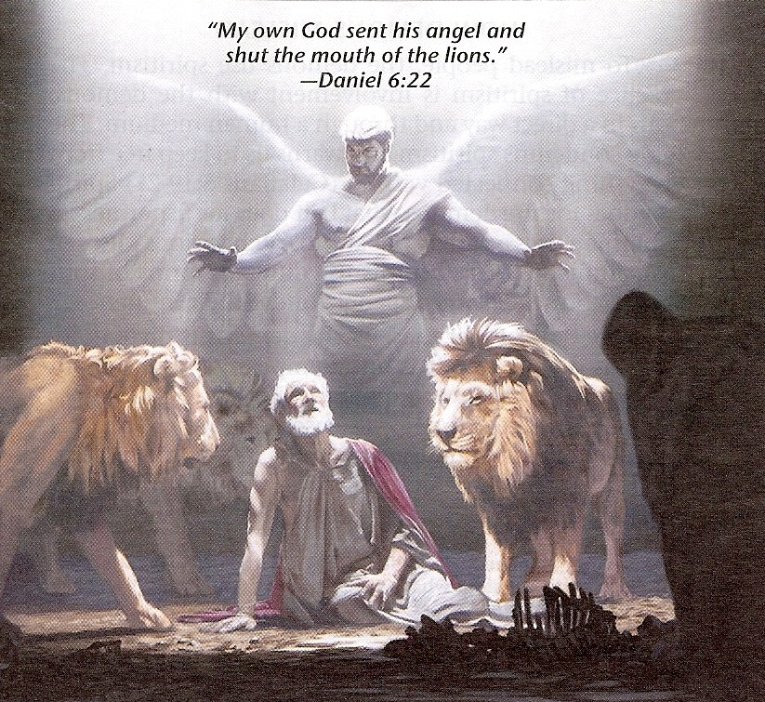
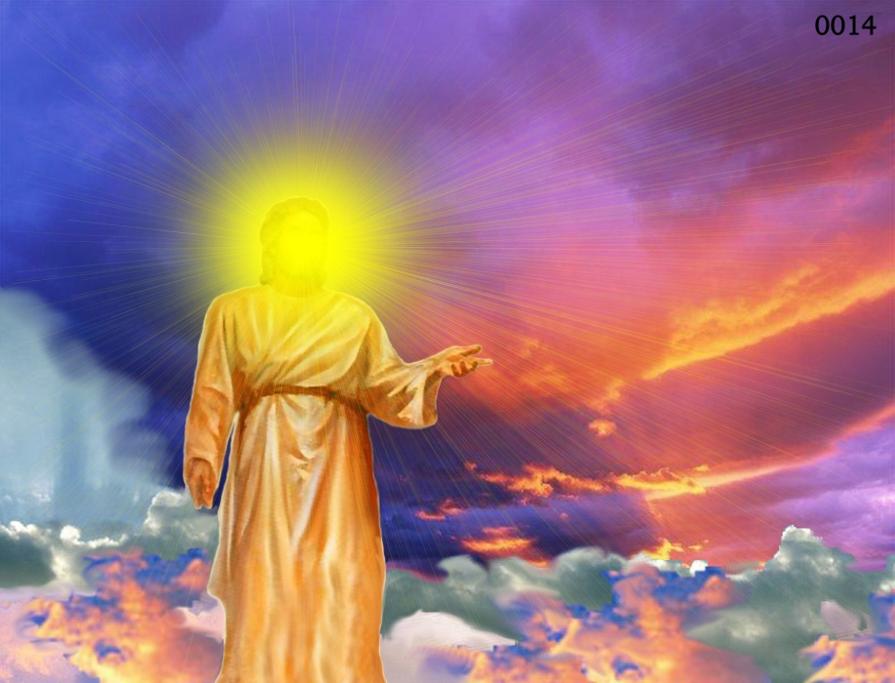
Different Types of Angels
Archangels – Michael and Gabriel
Cherubim's – Ezekiel 1:4-28
Seraphim’s – Isaiah 6:1-7
Ruling angels – I Peter 3:22
Guarding angels – Hebrews 1:14
Angel of the Lord – Zechariah 3:1-10

Slide 29
The Nature of Angels

Slide 30
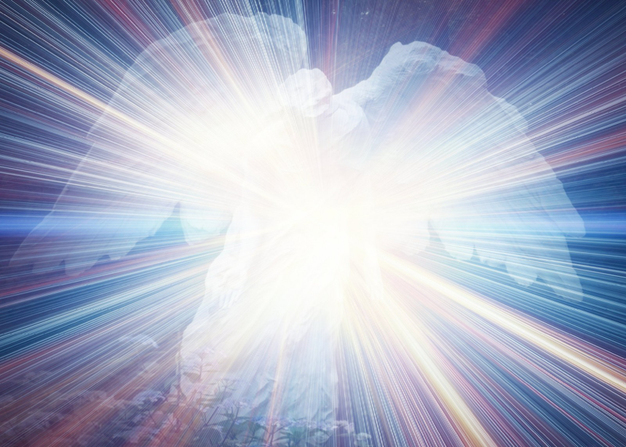
Angels are spirit beings (Psalms 104:4; Heb. 1:7, 14)
(Psalms 104:4) “Who maketh his angels spirits…”
(Hebrews 1:7, 14) “And of the angels he saith, Who maketh his angels spirits…Are they not all ministering spirits, sent forth to minister for them who shall be heirs of salvation?”

Slide 31
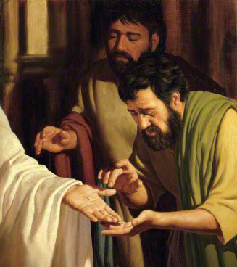
We are informed by Christ himself that spiritual beings do not possess flesh and bone
“Behold my hands and my feet, that it is I myself: handle me, and see; for a spirit hath not flesh and bones, as ye see me have.” (Luke 24:39)

Slide 32
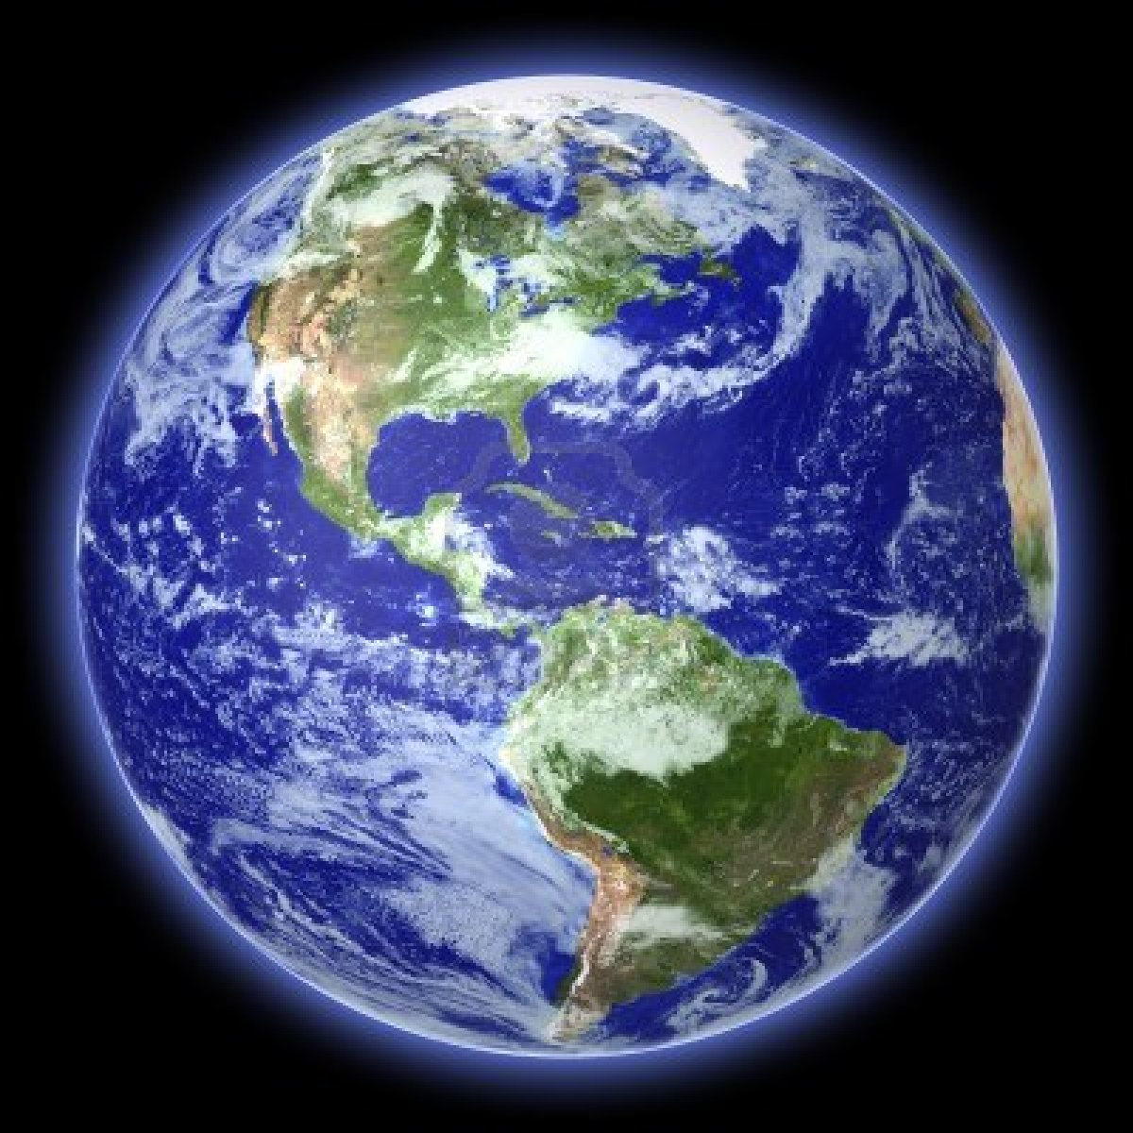
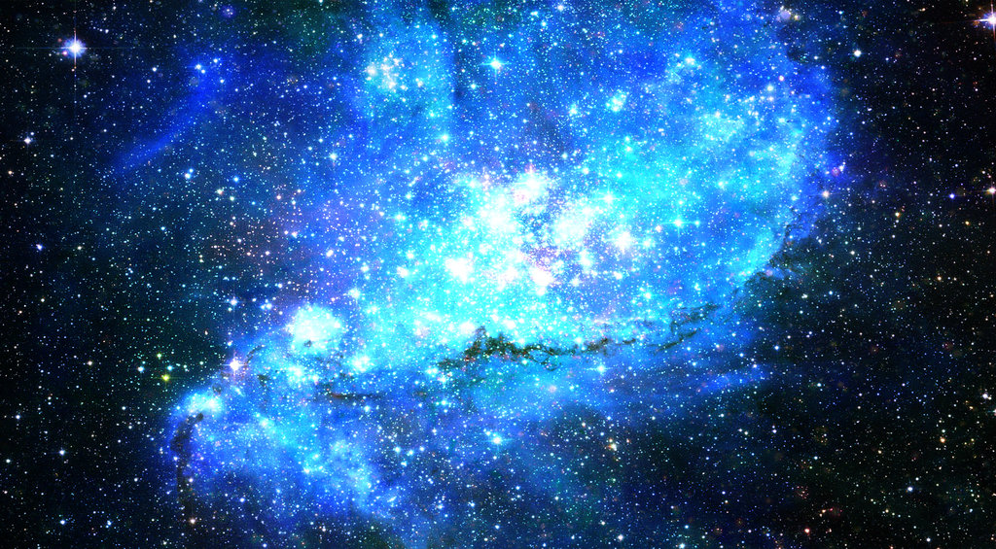
Does this mean that angels do not have any kind of body?
“There are also celestial bodies, and bodies terrestrial: but
the glory of the celestial is one, and the glory of the
terrestrial is another.” (1 Corinthians 15:40)
Celestial = pertaining to the sky or heaven, to the universe beyond the earth’s atmosphere
Terrestrial = relating to the earth or its inhabitants

Slide 33
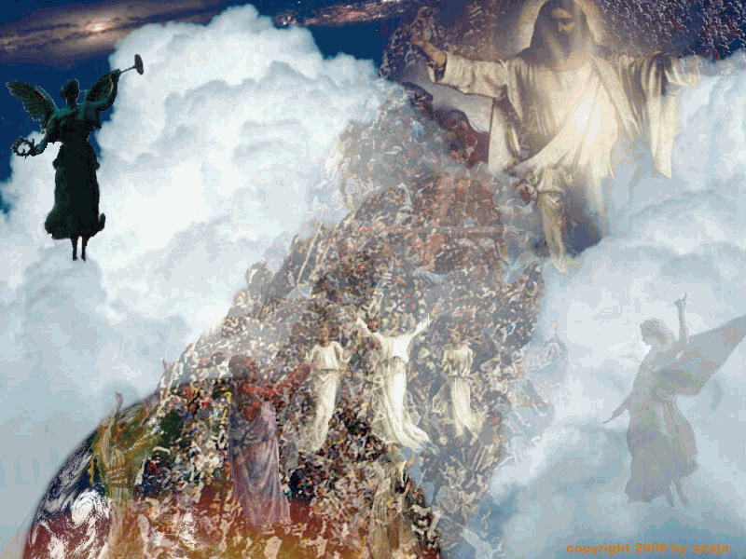

Slide 34
(1 Corinthians 15:41-58) “There is one glory of the sun, and another glory of the moon, and another glory of the stars: for one star differeth from another star in glory. So also is the resurrection of the dead. It is sown in corruption; it is raised in incorruption: It is sown in dishonour; it is raised in glory: it is sown in weakness; it is raised in power: It is sown a natural body; it is raised a spiritual body. There is a natural body, and there is a spiritual body. And so it is written, The first man Adam was made a living soul; the last Adam was made a quickening spirit. Howbeit that was not first which is spiritual, but that which is natural; and afterward that which is spiritual. The first man is of the earth, earthy: the second man is the Lord from heaven. As is the earthy, such are they also that are earthy: and as is the heavenly, such are they also that are heavenly. And as we have borne the image of the earthy, we shall also bear the image of the heavenly. Now this I say, brethren, that flesh and blood cannot inherit the kingdom of God; neither doth corruption inherit incorruption.

Slide 35
Behold, I shew you a mystery; We shall not all sleep, but we shall all be changed, In a moment, in the twinkling of an eye, at the last trump: for the trumpet shall sound, and the dead shall be raised incorruptible, and we shall be changed. For this corruptible must put on incorruption, and this mortal must put on immortality. So when this corruptible shall have put on incorruption, and this mortal shall have put on immortality, then shall be brought to pass the saying that is written, Death is swallowed up in victory. O death, where is thy sting? O grave, where is thy victory? The sting of death is sin; and the strength of sin is the law. But thanks be to God, which giveth us the victory through our Lord Jesus Christ. Therefore, my beloved brethren, be ye stedfast, unmoveable, always abounding in the work of the Lord, forasmuch as ye know that your labour is not in vain in the Lord.”

Slide 36
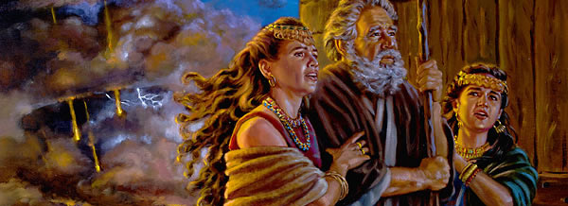
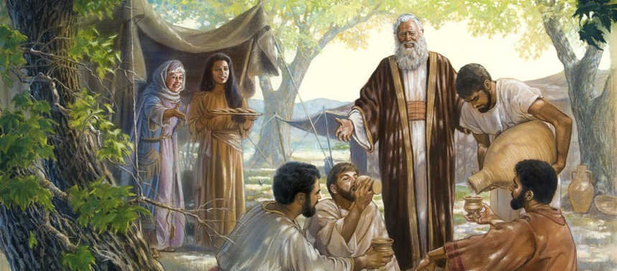
On two specific occasions angels are described as visible and partaking of physical food
(Gen. 18:1-8; 19:1-3)

Slide 37
On another occasion an angel applies physical force
“And, behold, the angel of the Lord came upon him, and a light shined in the prison: and he smote Peter on the side, and raised him up, saying, Arise up quickly. And his chains fell off from his hands. And the angel said unto him, Gird thyself, and bind on thy sandals. And so he did. And he saith unto him, Cast thy garment about thee, and follow me. And he went out, and followed him; and wist not that it was true which was done by the angel; but thought he saw a vision.” (Acts 12:7-8)

Slide 38
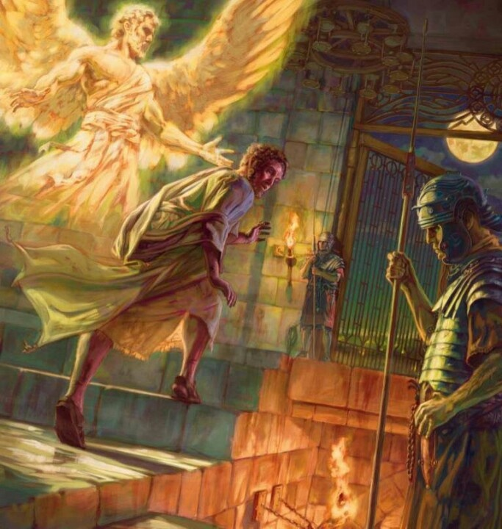

Slide 39
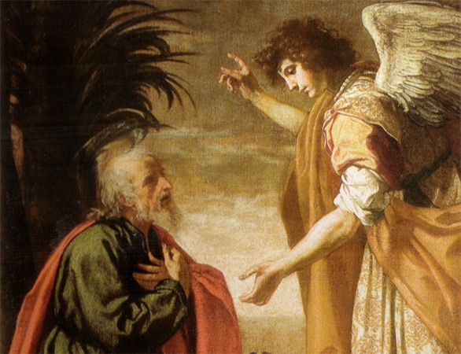
While on rare occasion angels do manifest themselves, their normal practice is to remain invisible.
(Col. 2:18) warns us not to “worship angels.”
One basic reason for this is to prevent men from worshiping them.
(Rom. 1:18-32)

Slide 40
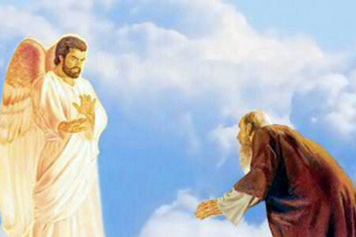
(Revelation 19:10) “And I fell at his feet to worship him. And he said unto me, See thou do it not: I am thy fellowservant, and of thy brethren that have the testimony of Jesus: worship God: for the testimony of Jesus is the spirit of prophecy.”
(Revelation 22:8-9) “And I John saw these things, and heard them. And when I had heard and seen, I fell down to worship before the feet of the angel which shewed me these things. Then saith he unto me, See thou do it not: for I am thy fellowservant, and of thy brethren the prophets, and of them which keep the sayings of this book: worship God.”

Slide 41
Angels are innumerable
God, of course, knows their number, but they are presented to men as uncountable - "But ye are come unto Mount Zion, and unto the city of the living God, the heavenly Jerusalem, and to an innumerable company of angels" (Heb. 12:22)
There may be as many angels as there are stars in the heavens, for angels are associated with the stars (Job 38:7; Ps. 148:1-3; Rev. 9:1, 2; 12:3, 4, 7-9).
If this be so, there would exist untold trillions of these heavenly beings.

Slide 42
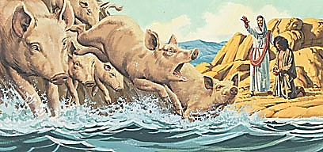
A hint of the huge number of angels can be seen in Mark 5:9 where Satan could afford to give over 6,000 of his fallen angels to torment one poor lunatic.

Slide 43
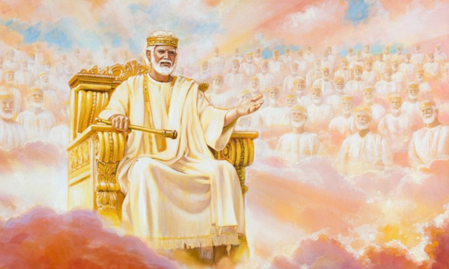
"I beheld till the thrones were cast down, and the Ancient of days did sit, whose garment was white as snow, and the hair of his head like the pure wool: his throne was like the fiery flame, and his wheels as burning fire. A fiery stream issued and came forth from before him: thousand thousands ministered unto him, and ten thousand times ten thousand stood before him: the judgment was set, and the books were opened" (Daniel 7:9, 10)

Slide 44
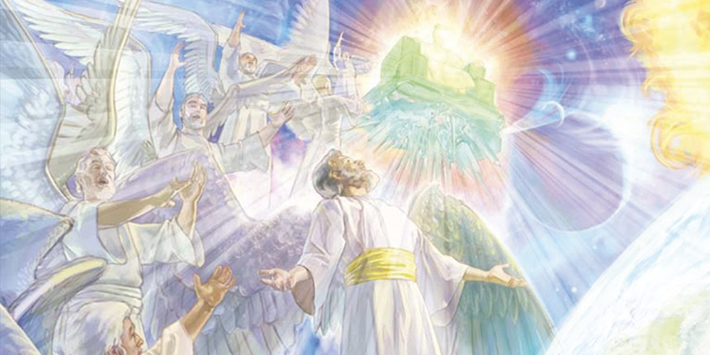
"And I beheld, and I heard the voice of many angels round about the throne... and the number of them was ten thousand times ten thousand, and thousands of thousands" (Rev. 5:11).

Slide 45
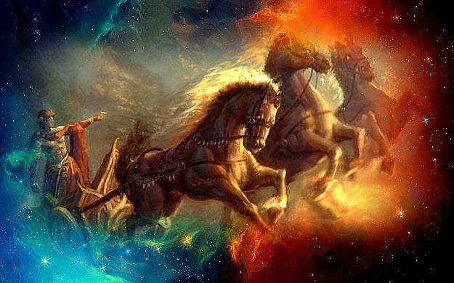
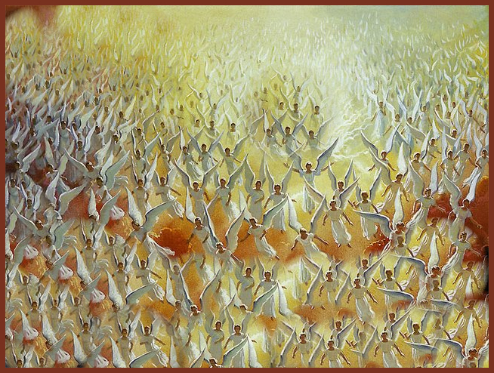
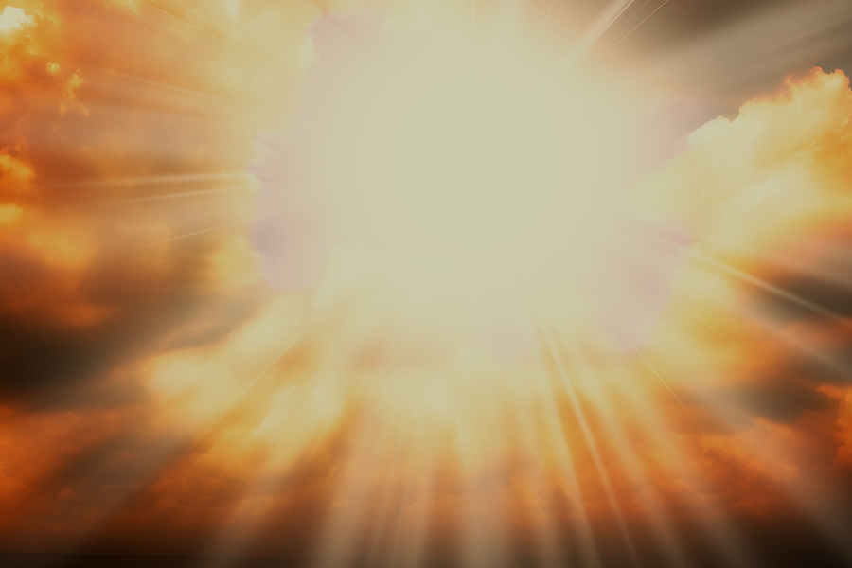
"The chariots of God are twenty thousand, even thousands of angels" (Psalms 68:17).

Slide 46
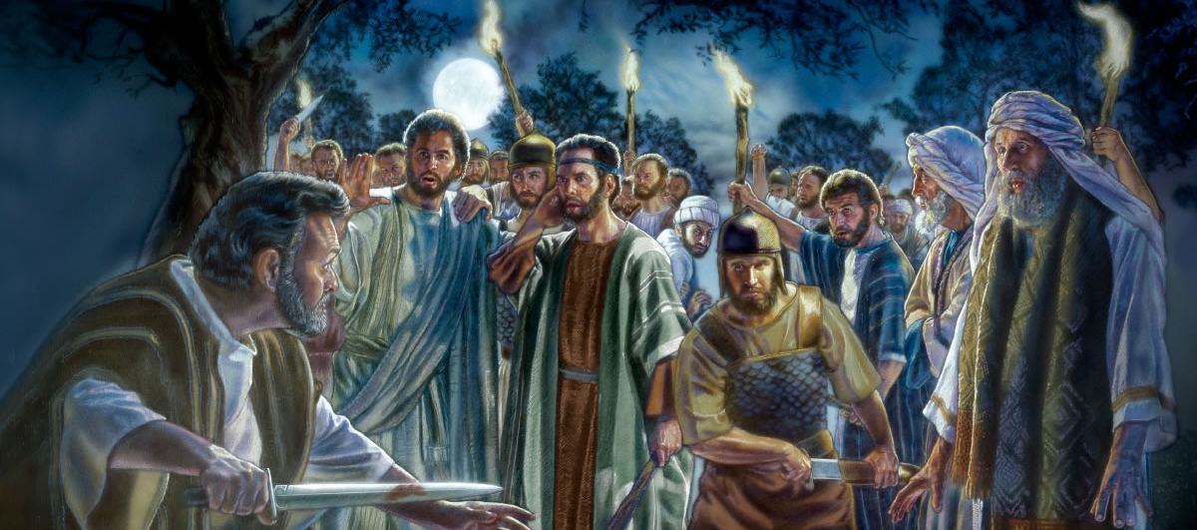
"Thinkest thou that I cannot now pray to my Father, and he shall presently give me more than twelve legions (72,000) of angels?" (Matthew 26:53)

Slide 47
Our interaction with Angels in Heaven

Slide 48
“That in the ages to come he might shew the exceeding riches of his grace in his kindness toward us through Christ Jesus" (Ephesians 2:7)

Slide 49
“But God, who is rich in mercy, for his great love wherewith he loved us, Even when we were dead in sins, hath quickened us together with Christ, And hath raised us up together, and made us sit together in heavenly places in Christ Jesus: That in the ages to come he might shew the exceeding riches of his grace in his kindness toward us through Christ Jesus. For by grace are ye saved through faith; and that not of yourselves: it is the gift of God: Not of works, lest any man should boast. For we are his workmanship, created in Christ Jesus unto good works, which God hath before ordained that we should walk in them.” (Ephesians 2:4-10)

Slide 50
(1 Peter 1:10-12) “Of which salvation the prophets have enquired and searched diligently, who prophesied of the grace that should come unto you: Searching what, or what manner of time the Spirit of Christ which was in them did signify, when it testified beforehand the sufferings of Christ, and the glory that should follow. Unto whom it was revealed, that not unto themselves, but unto us they did minister the things, which are now reported unto you by them that have preached the gospel unto you with the Holy Ghost sent down from heaven; which things the angels desire to look into.”
There is little doubt that much of this display of God’s saving grace will be for the benefit of angels.
Thus, if their number is indeed as large as it appears, then each redeemed sinner will have a huge congregation of angels to testify to of God’s grace.

Slide 52
Angels possess separate and individual personalities, probably no two alike. (They possess three necessary features required in personality)
Angels possess intelligence - Daniel 9:21-22 “Yea, whiles I was speaking in prayer, even the man Gabriel, whom I had seen in the vision at the beginning, being caused to fly swiftly, touched me about the time of the evening oblation. And he informed me, and talked with me, and said, O Daniel, I am now come forth to give thee skill and understanding.”

Slide 53
Angels possess emotion -
They have desire - (1 Pet. 1:12) “…which things (salvation) the angels desire to look into.”
They display joy - (Job 38:7) “When the morning stars (angels) sang together, and all the sons of God (angels) shouted for joy?” (Luke 2:13) “And suddenly there was with the angel a multitude of the heavenly host praising God, and saying, Glory to God in the highest, and on earth peace, good will toward men.”

Slide 54
Evil angels cohabited with women (Genesis 6)
“And it came to pass, when men began to multiply on the face of the earth, and daughters were born unto them, That the sons of God saw the daughters of men that they were fair; and they took them wives of all which they chose…There were giants in the earth in those days; and also after that, when the sons of God came in unto the daughters of men, and they bare children to them, the same became mighty men which were of old, men of renown. And GOD saw that the wickedness of man was great in the earth, and that every imagination of the thoughts of his heart was only evil continually.”

Slide 55
“And it repented the LORD that he had made man on the earth, and it grieved him at his heart. And the LORD said, I will destroy man whom I have created from the face of the earth; both man, and beast, and the creeping thing, and the fowls of the air; for it repenteth me that I have made them. But Noah found grace in the eyes of the LORD.”

Slide 56
Angels posses a will - Jude 1:6 “And the angels which kept not their first estate, but left their own habitation, he hath reserved in everlasting chains under darkness unto the judgment of the great day.” 2 Peter 2:4 “For if God spared not the angels that sinned, but cast them down to hell.”

Slide 57
The Fall of Satan Five foolish and fatal “I will’s” of the devil (Isaiah 14:12-14)
I will ascend into heaven
I will exalt my throne above the stars of God
I will sit also upon the mount of the congregation, in the sides of the north
I will ascend above the heights of the clouds
I will be like the most High

Slide 58
“His (Satan’s) tail drew a third part of the stars of heaven, and did cast them to the earth…” (Revelation 12:4)
Stars of heaven = Fallen angels
1/3 followed Satan in his rebellion
Isaiah 14:12-15; Ezekiel 28:12-16; 2 Peter 2:4; Jude 6

Slide 59
From that point on the faithful angels are referred to as holy and elect angels (Mark 8:38; 1 Tim. 5:21), while the fallen angels are known as the devil’s angels (Matt. 25:41; Rev. 12:9).

Slide 60
Can fallen angels repent and be forgiven?
No, fallen angels cannot repent.
They have been given over to their sinful rebellion – (Psalms 78:49 )
Repentance is something granted by God to people (2 Timothy 2:25) and is part of the work of salvation.
No where are we told that God grants to fallen angels “repentance unto salvation.”
Angels cannot comprehend, understand or experience “salvation” – (see 1 Peter 1:12)
Fallen angels cannot repent, be saved, and spend eternity with God - "For if God spared not the angels that sinned, but cast them down to hell…” (2 Peter 2:4)
They knew God in the spiritual realm, rejected him, and will face their just punishment – (Matt. 25:41)

Slide 61
“Then shall he say also unto them on the left hand, Depart from me, ye cursed, into everlasting fire, prepared for the devil and his angels.”

Slide 62
Are angels in heaven still able to commit sin today?
Matt. 25:31 “When the Son of man shall come in his glory, and all the holy angels with him, then shall he sit upon the throne of his glory.”
Mark 8:38 “Whosoever therefore shall be ashamed of me and of my words in this adulterous and sinful generation; of him also shall the Son of man be ashamed, when he cometh in the glory of his Father with the holy angels.”
Luke 9:26 “For whosoever shall be ashamed of me and of my words, of him shall the Son of man be ashamed, when he shall come in his own glory, and in his Father's, and of the holy angels.”
Rev. 14:10 “The same shall drink of the wine of the wrath of God, which is poured out without mixture into the cup of his indignation; and he shall be tormented with fire and brimstone in the presence of the holy angels, and in the presence of the Lamb.”

Slide 63
Angels are (because of Adam’s fall) superior to men. (Psalm 8:4, 5; Hebrews 2:6-11.)
Angels are stronger than men - "Bless the Lord, ye his angels, that excel in strength, that do his commandments hearkening unto the voice of his word" (Psalms 103:20) "...the Lord Jesus shall be revealed from heaven with his mighty angels" (2 Thess. 1:7) "Whereas angels, which are greater in power and might..." (2 Pet. 2:11).

Slide 64
Angels are smarter than men - (Daniel 9:21-22) “Yea, whiles I was speaking in prayer, even the man Gabriel, whom I had seen in the vision at the beginning, being caused to fly swiftly, touched me about the time of the evening oblation. And he informed me, and talked with me, and said, O Daniel, I am now come forth to give thee skill and understanding.” (Daniel 10:14) “Now I am come to make thee understand what shall befall thy people in the latter days: for yet the vision is for many days.”

Slide 65
Angels are swifter than men - "Yea, while I was speaking in prayer... Gabriel... being caused to fly swiftly, touched me" (Dan. 9:21) "And I saw another angel fly in the midst of heaven..." (Rev. 14:6).
Being spirit beings it appears that they unbounded by the laws of gravity and time.

Slide 66
They are, however, inferior to God
They are not omnipresent - (Dan. 10:12).
They are not omnipotent - (Dan. 10:13; Jude 9).
They are not omniscient - (Matt. 24:36).

Slide 67
“All things were created by him, and for him.”

