Slide 1
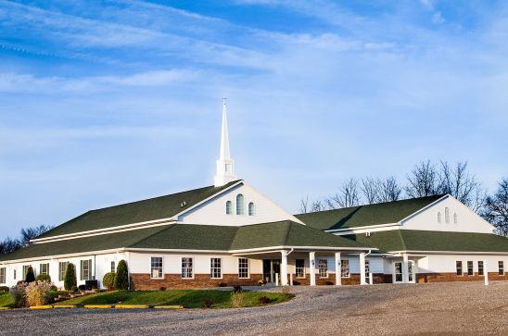
The Doctrine of the Church
The Power of the Church
“The Filling of the Holy Spirit”

Slide 3
The Doctrine of the Church
The Meaning of the Word “Church”

Slide 4
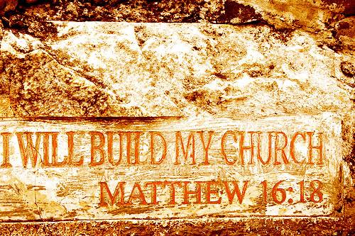

Slide 5
The Meaning of the Word "Church."
The Greek word in the New Testament for our English word "church" is ekklesia. It is derived from the verb ekkaleo. The compound ek means "out," and kaleo means "to call or summon an assembly."
Thus, the literal meaning is "to call out assembly.“
The Doctrine of the Church is call (Ecclesiology).
I Cor. 1:9 “God is faithful, by whom ye were called unto the fellowship of his Son Jesus Christ our Lord.”

Slide 6
A called out Assembly of Baptized Believers gathered together for –
1. Doctrine
2. Fellowship
3. Breaking of Bread
4. Prayers
5. Worship
Acts2:42 “And they continued stedfastly in the apostles' doctrine and fellowship, and in breaking of bread, and in prayers.”
Psalm 29:2 “Give unto the LORD the glory due unto his name; worship the LORD in the beauty of holiness.” (Worship - found 40 times in the New Testament)

Slide 7
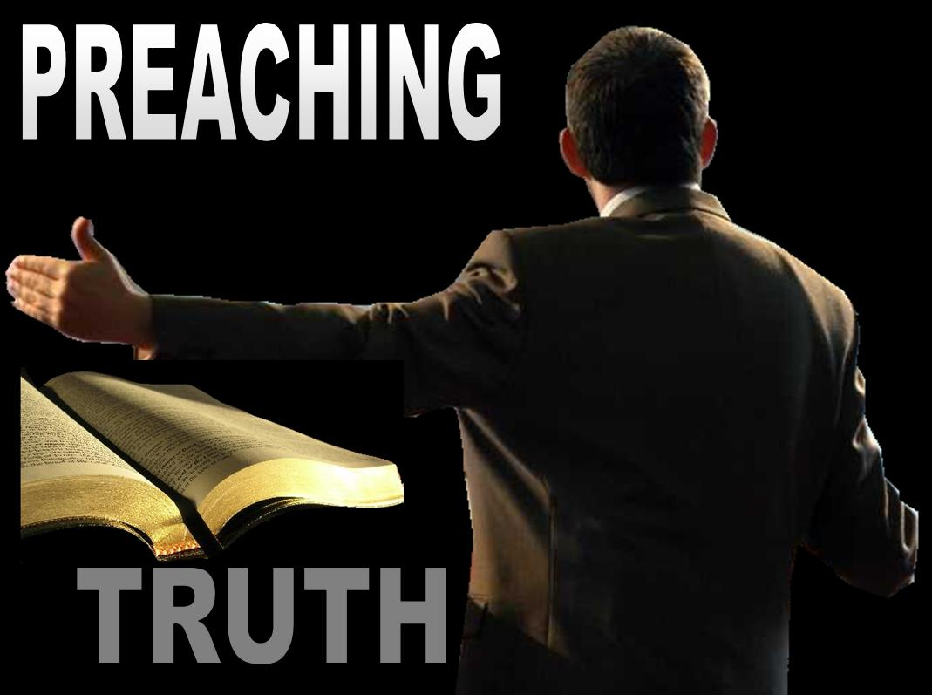

Slide 8
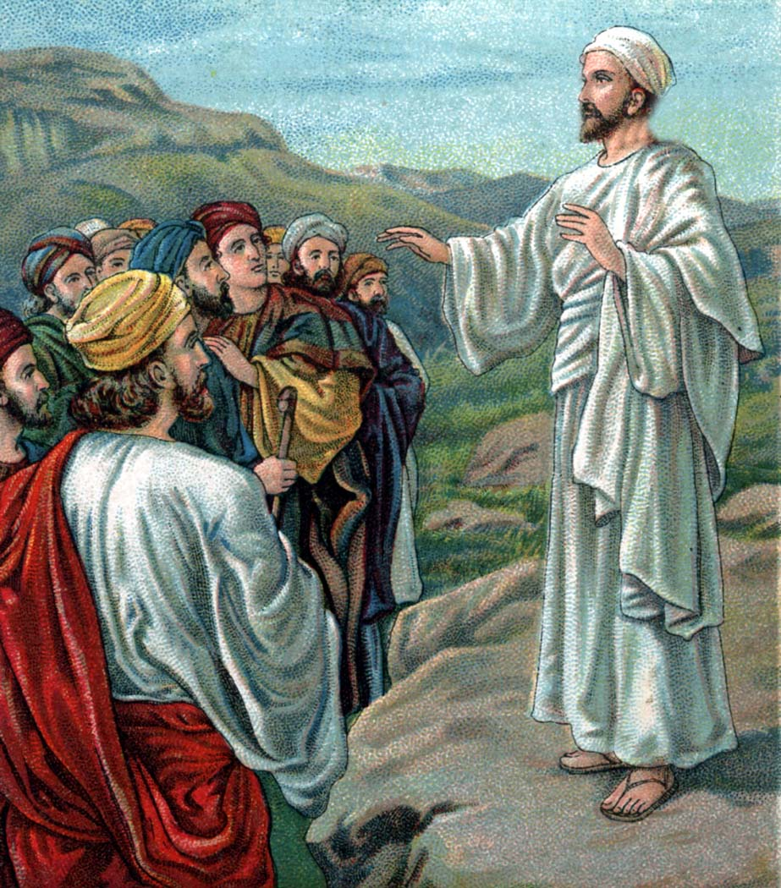
“I will build my church…”
“All power is given unto me in heaven and in earth. Go ye therefore, and teach all nations, baptizing them in the name of the Father, and of the Son, and of the Holy Ghost. Teaching them to observe all things whatsoever I have commanded you.”

Slide 9
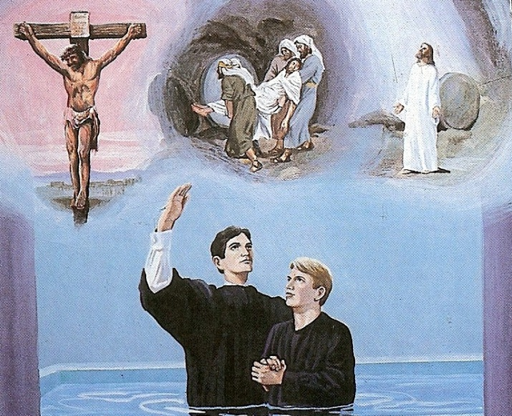
Evangelize
Baptize
Stabilize

Slide 10
The Importance of the Local Church
The word “Church” appears 114 times in the New Testament
Greek (ekklesia) = “An assembly of people called out”
99 times the word “Church” is used in reference to particular local churches
7 times in reference to the “Universal Church”
8 times in reference to the “Local Church” in general not a particular church
108 Local / 7 Universal

Slide 11
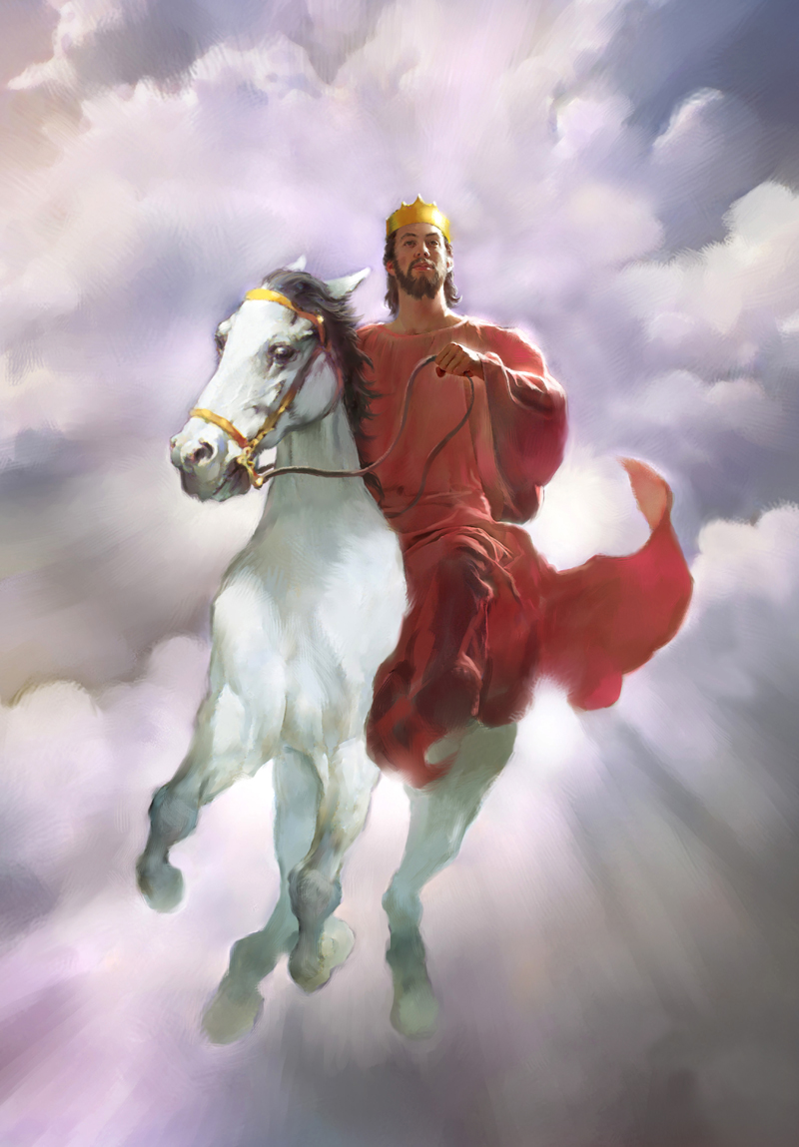
“Not forsaking the assembling of
our selves together…and so much the more as ye see the day approaching.” (Hebrews 10:25)

Slide 12
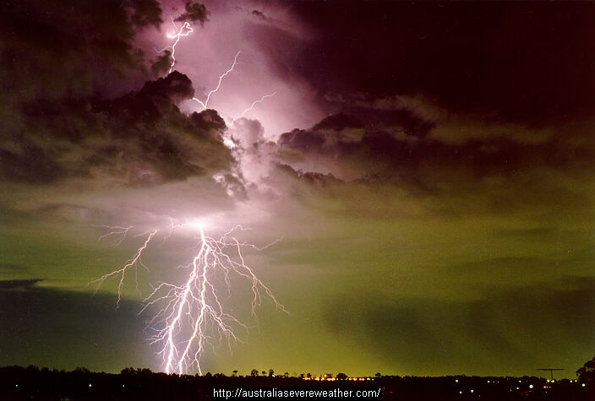
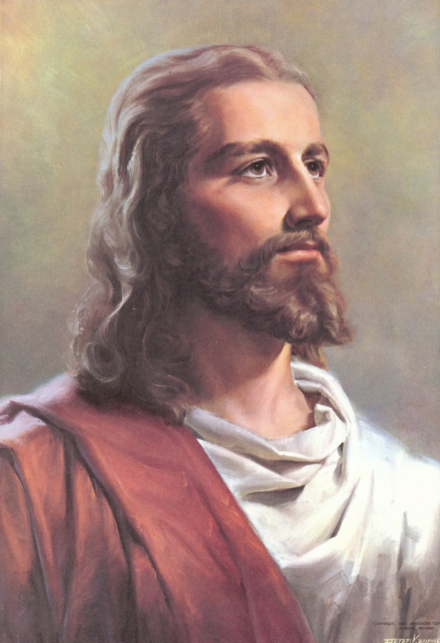
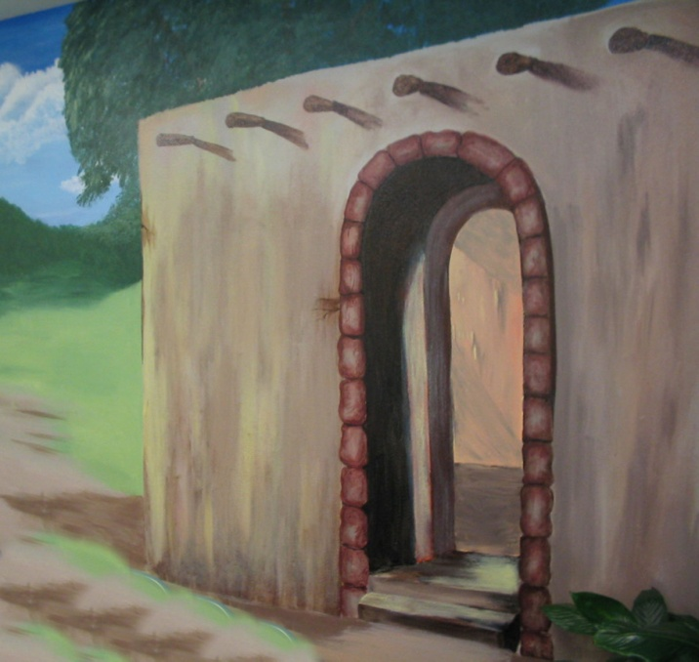
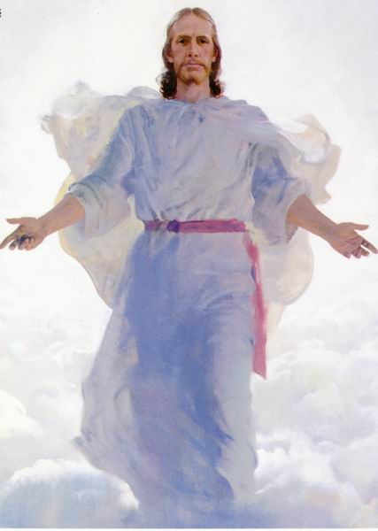
“So likewise ye, when ye shall see all these things, know that it is near, even at the door.”

Slide 13
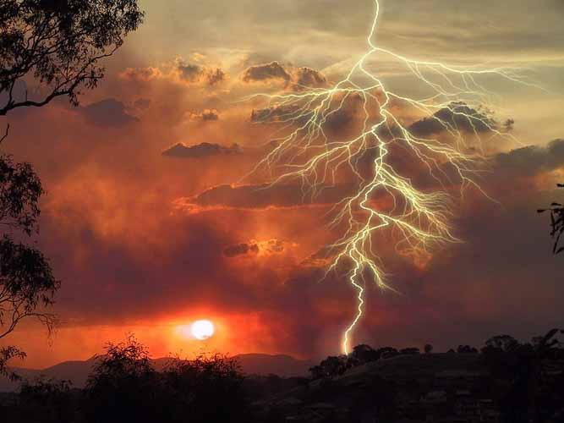
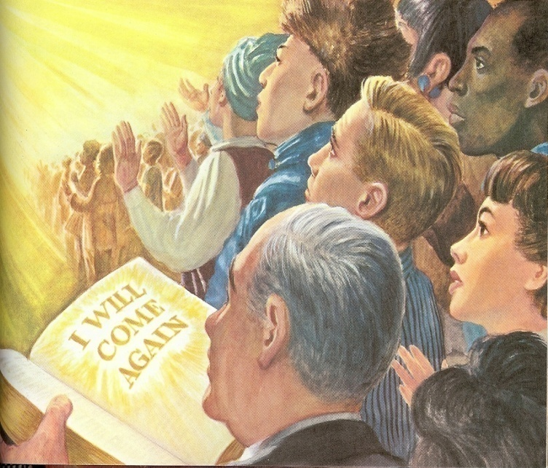
“When these things begin to come to pass, then look up… for your redemption draweth nigh.”

Slide 14
The Doctrine of the Church
The Origin of the Church
“When and where did the church actually begin?”

Slide 16
Several different views

Slide 17
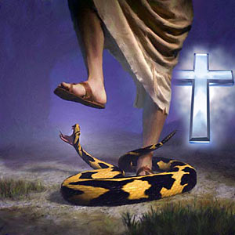
The Church begin with Adam Genesis 3
In this view it is taught that Adam and Eve believed the promise of God that the seed of the serpent would indeed bruise the heel of the woman, but that the woman’s seed would crush the serpent’s head...then it may be asserted that they constituted the first Christian church.

Slide 18
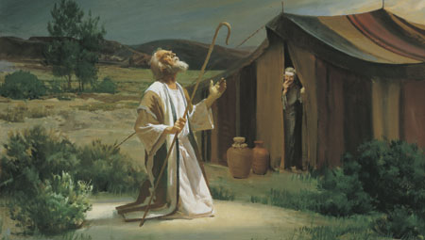
The Church began with Abraham Genesis 12
This is the position is held by covenant theologians. The logic behind this view is the belief that as Israel once functioned as God’s church in the Old Testament, so the church now functions as God’s Israel in the New Testament.
Covenant theology teaches that the church has become God’s elect people, as Israel once was.

Slide 19
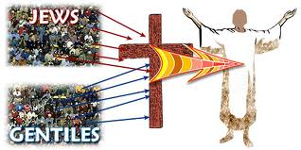
Three Groups of People
(I Corinthians 10:32) “Give none offence, neither to the Jews (Israel), nor to the Gentiles, nor to the church of God.”
Church

Slide 20
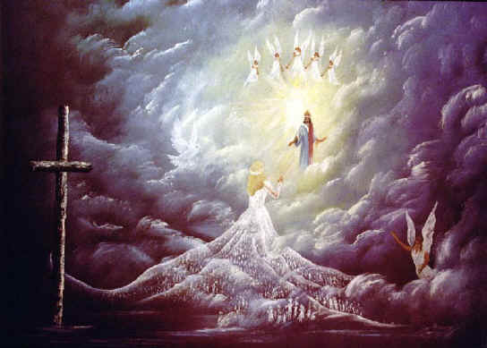
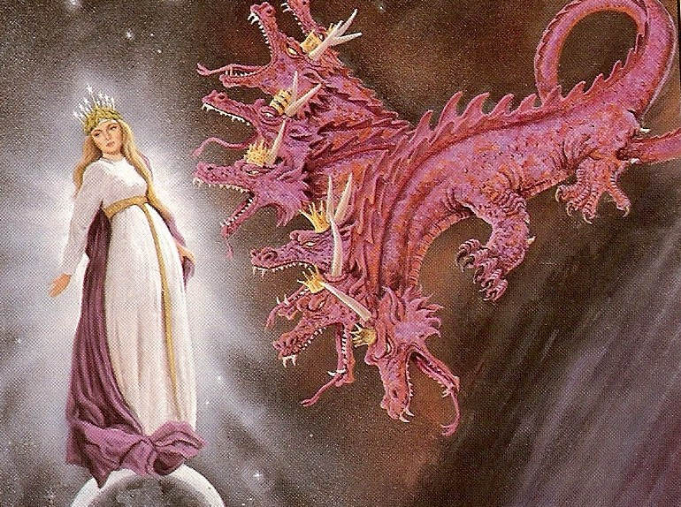
The Church is not Israel.

Slide 21
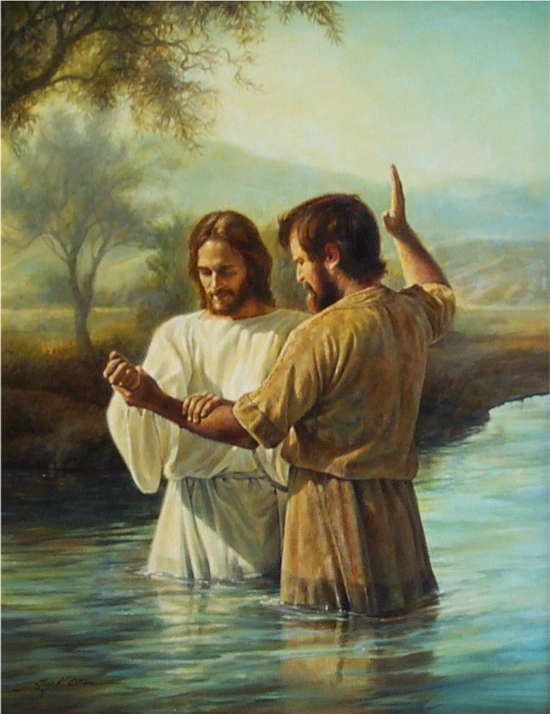
The Church began with John the Baptist Matthew 3

Slide 22
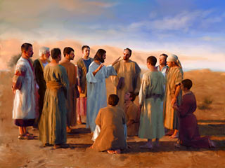
The Church began with Christ
There four different time periods are advocated by those who believe it began with the Savior.

Slide 23
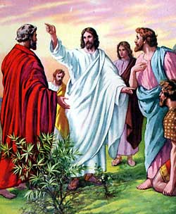
1# At the call of the twelve apostles in Matthew 10
“And are built upon the foundation of the apostles and prophets, Jesus Christ himself being the chief corner stone.” Eph. 2:20

Slide 24
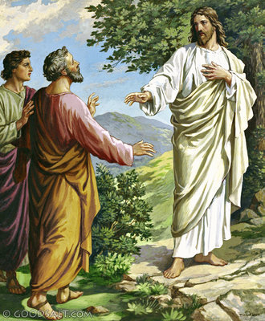
2# At Peter’s confession Matthew 16
Advocates of this position place the church at this point for the simple reason that it is first mentioned by Christ here.
(See Matt. 16:18)

Slide 25
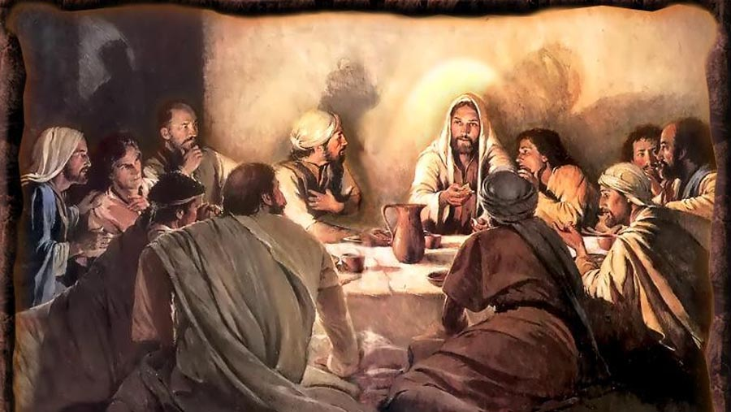
3# At the Last Supper Matthew 26
Those who defend this view point out that it was at this time that Christ instituted the ordinance of the Lord’s Supper, indicating the church now existed.

Slide 26
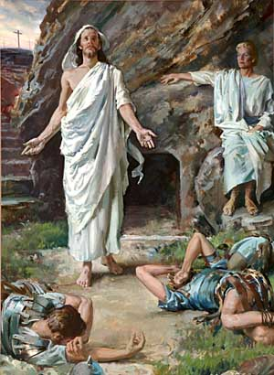
4# At the resurrection of Jesus Christ

Slide 27
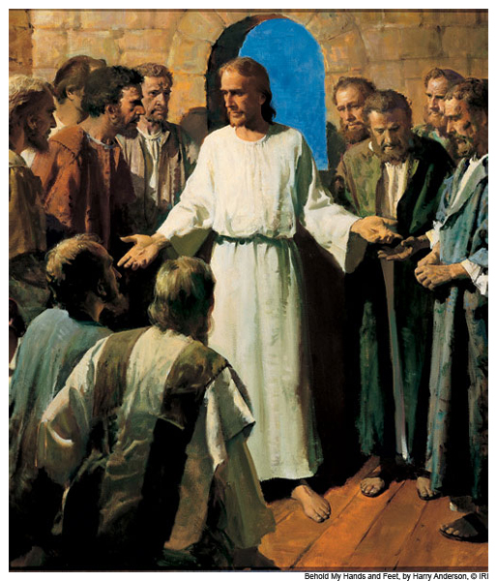
"Then said Jesus to them again, Peace be unto you: as my Father hath sent me, even so send I you. And when he had said this, he breathed on them, and saith unto them, Receive ye the Holy Ghost" (John 20:21-22)
Here it is argued that the final element necessary for the completion of the promised church is now given, namely, the Person and power of the Holy Spirit.

Slide 28
The indwelling of the Holy Spirit did not happen until the day of Pentecost
(Luke 24:48-50)
“And ye are witnesses of these things (resurrection). And, behold, I send the promise of my Father upon you: but tarry ye in the city of Jerusalem, until ye be endued with power from on high. And he led them out as far as to Bethany, and he lifted up his hands, and blessed them.”

Slide 29
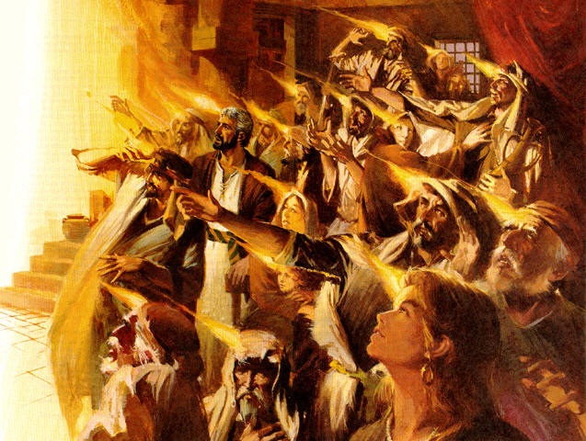
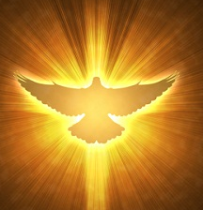
The Promise of the Father

Slide 30
(Acts 1:3-11)
“To whom also he shewed himself alive after his passion by many infallible proofs, being seen of them forty days, and speaking of the things pertaining to the kingdom of God: And, being assembled together with them, commanded them that they should not depart from Jerusalem, but wait for the promise of the Father, which, saith he, ye have heard of me. For John truly baptized with water; but ye shall be baptized with the Holy Ghost not many days hence. When they therefore were come together, they asked of him, saying, Lord, wilt thou at this time restore again the kingdom to Israel? And he said unto them, It is not for you to know the times or the seasons, which the Father hath put in his own power.

Slide 31
But ye shall receive power, after that the Holy Ghost is come upon you: and ye shall be witnesses unto me both in Jerusalem, and in all Judaea, and in Samaria, and unto the uttermost part of the earth. {power...: or, the power of the Holy Ghost coming upon you} And when he had spoken these things, while they beheld, he was taken up; and a cloud received him out of their sight. And while they looked stedfastly toward heaven as he went up, behold, two men stood by them in white apparel; Which also said, Ye men of Galilee, why stand ye gazing up into heaven? this same Jesus, which is taken up from you into heaven, shall so come in like manner as ye have seen him go into heaven.”

Slide 32
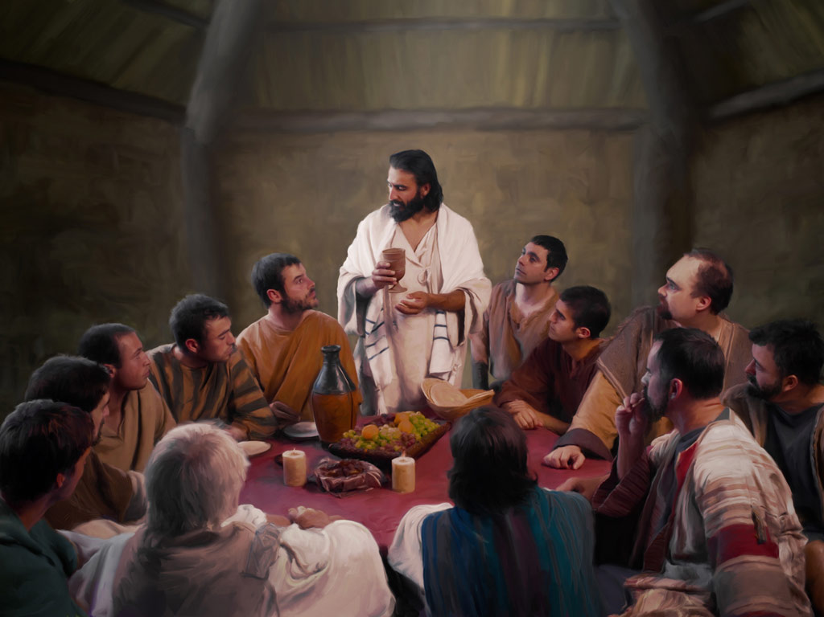
“But when the Comforter is come, whom I will send unto you from the Father, even the Spirit of truth, which proceedeth from the Father, he shall testify of me…Nevertheless I tell you the truth; It is expedient for you that I go away: for if I go not away, the Comforter will not come unto you; but if I depart, I will send him unto you.” (John 15:26, 16:7)

Slide 33
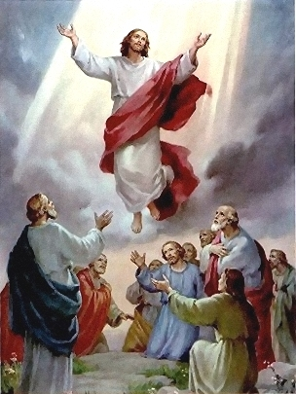
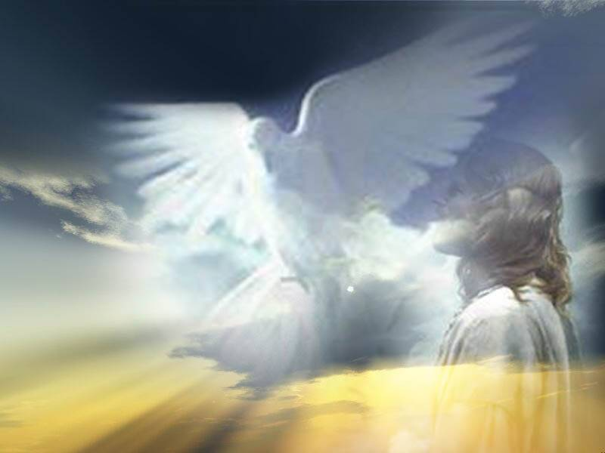

Slide 34
The Church began on the Day of Pentecost
The day of Pentecost marked the beginning of the church for the following reasons.

Slide 35
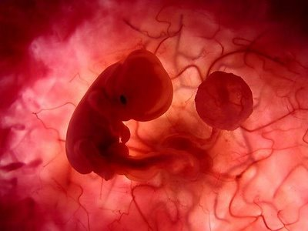
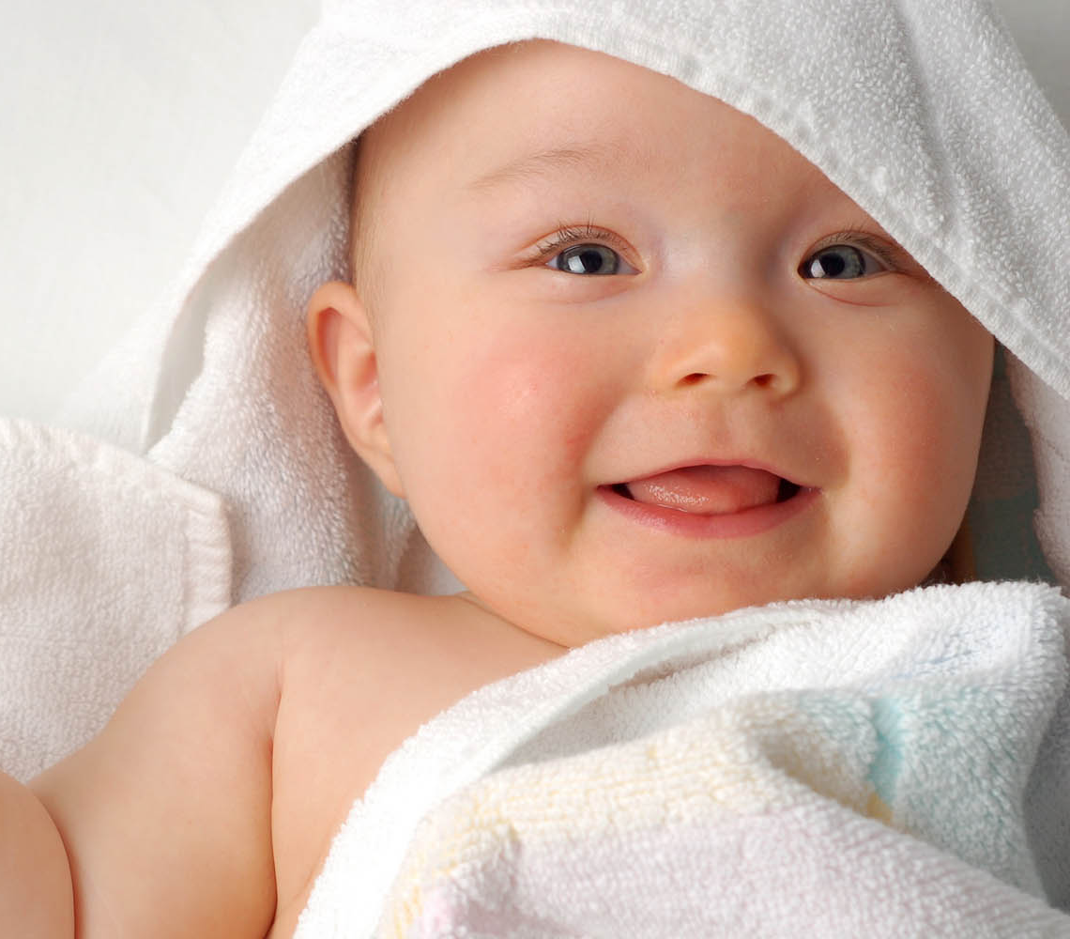
“And when it was day, he called unto him his disciples: and of them he chose twelve, whom also he named apostles.”
(Luke 6:13)
“And when the day of Pentecost was fully come, they were all with one accord in one place. And suddenly there came a sound from heaven as of a rushing mighty wind, and it filled all the house where they were sitting.” (Acts 2:1-2)

Slide 36
The Lord spoke of the Church as being future in Matthew 16:18

Slide 37
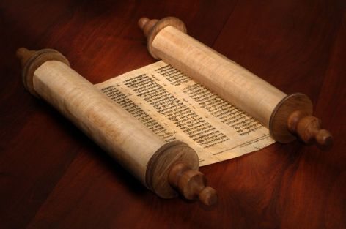
This clearly means that the church did not exist in Old Testament times.

Slide 38
The resurrection and ascension of Christ are essential to the existence and functioning of the church
The church is built on the resurrection of Jesus Christ - (Eph. 1:19-20; I Cor. 15)
Acts 4:33 “And with great power gave the apostles witness of the resurrection of the Lord Jesus.”
I Cor. 15:14 “And if Christ be not risen, then is our preaching vain, and your faith is also vain.”
Acts 20:7 “And upon the first day of the week, when the disciples came together to break bread, Paul preached unto them.”

Slide 39
The giving of spiritual gifts is required for the churches operation (Rom. 12; I Cor. 12; Eph. 4)

Slide 40
(Ephesians 4:8-12)
“Wherefore he saith, When he ascended up on high, he led captivity captive, and gave gifts unto men. Now that he ascended, what is it but that he also descended first into the lower parts of the earth? He that descended is the same also that ascended up far above all heavens, that he might fill all things. And he gave some, apostles; and some, prophets; and some, evangelists; and some, pastors and teachers; For the perfecting of the saints, for the work of the ministry, for the edifying of the body of Christ.”

Slide 41
Christ decent into the heart of the earth
"For as Jonas was three days and three nights in the whale’s belly; so shall the Son of man be three days and three nights in the heart of the earth"
(Matt. 12:40)

Slide 42
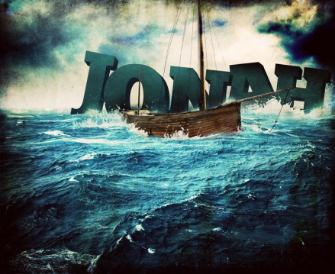

Slide 43
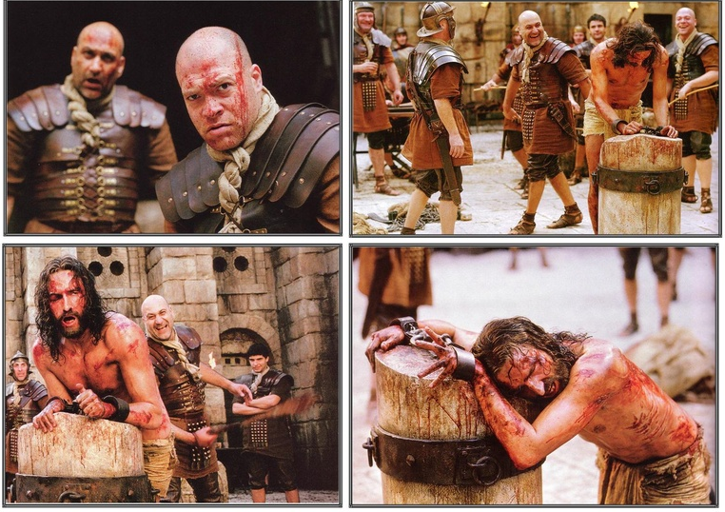
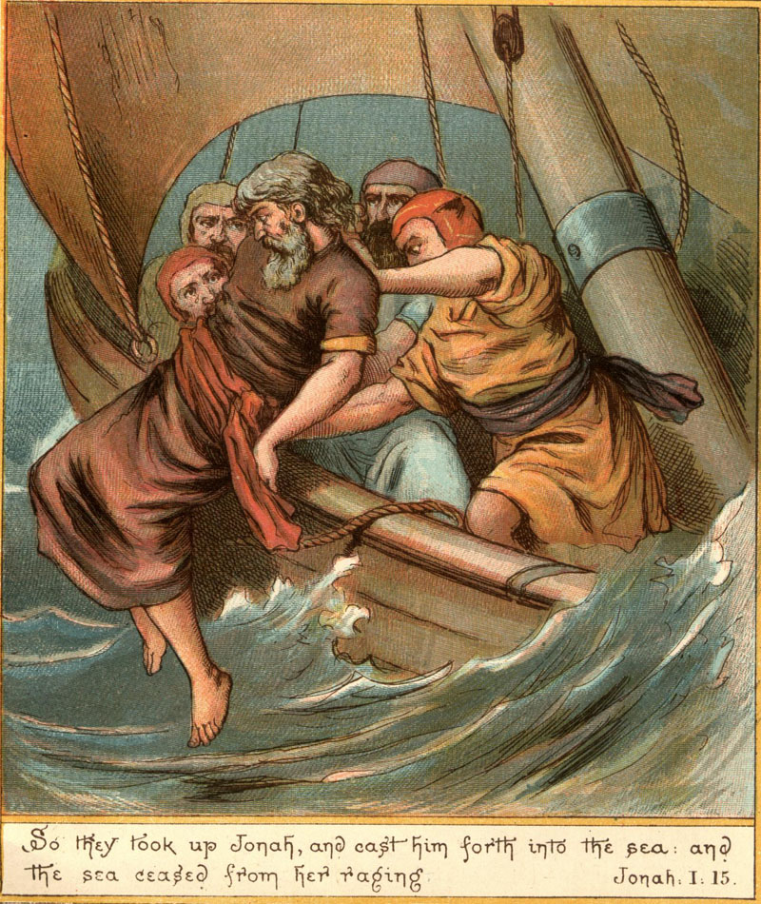

Slide 44
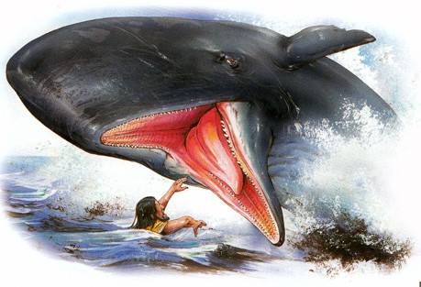
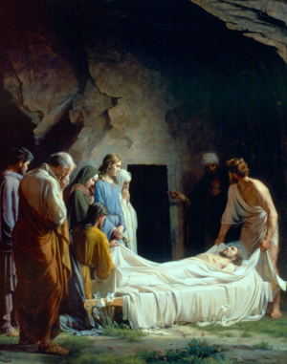

Slide 45
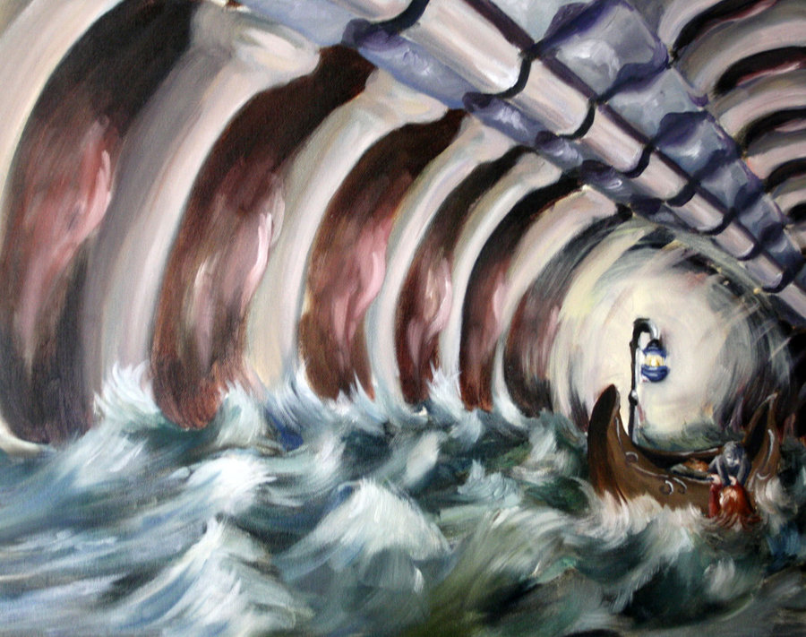
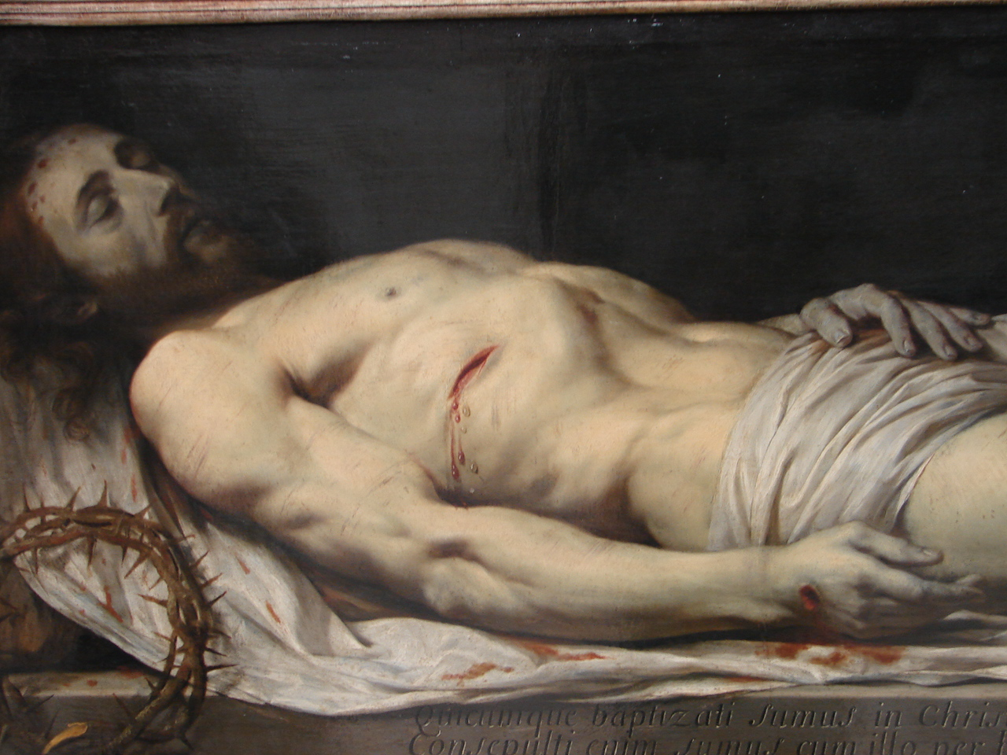
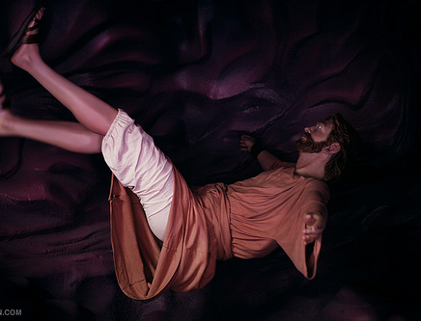

Slide 46
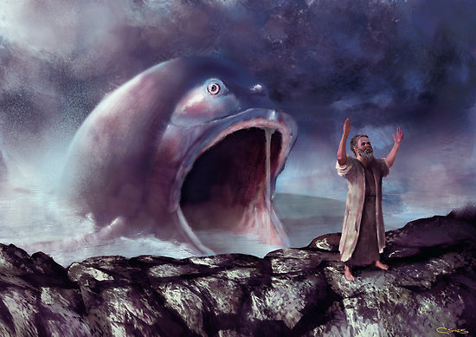
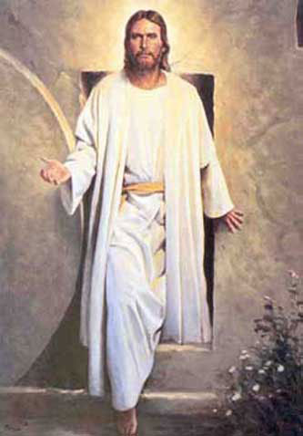

Slide 47
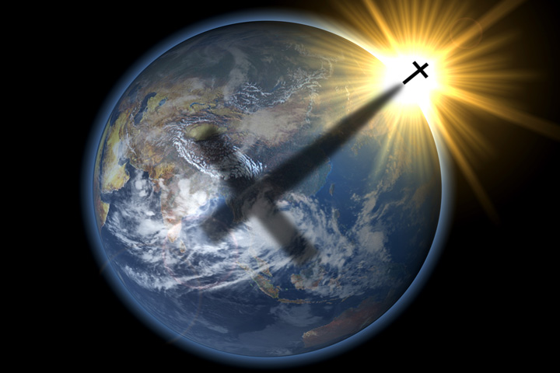
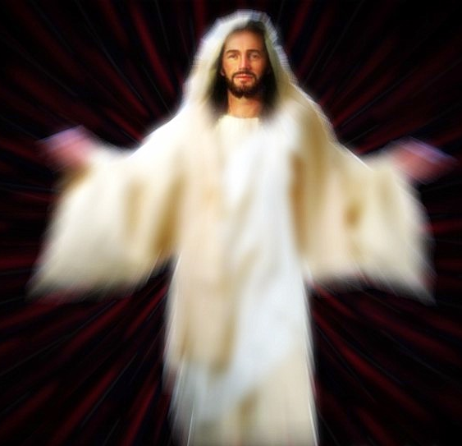

Slide 48
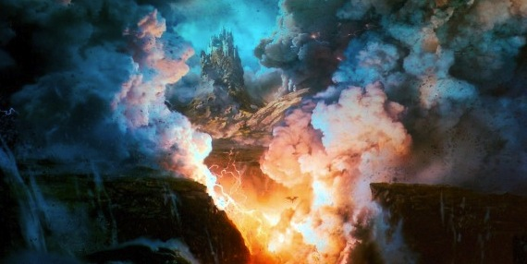
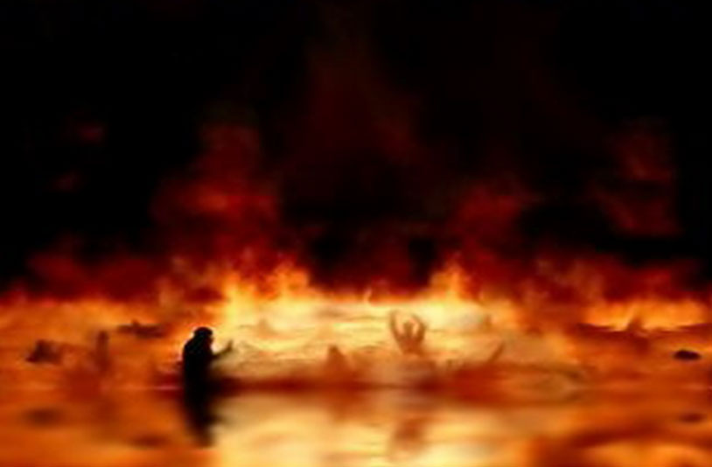
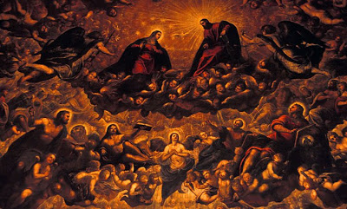
Hebrew word Sheol and the Greek word Hades
“Place of the departed dead”

Slide 49
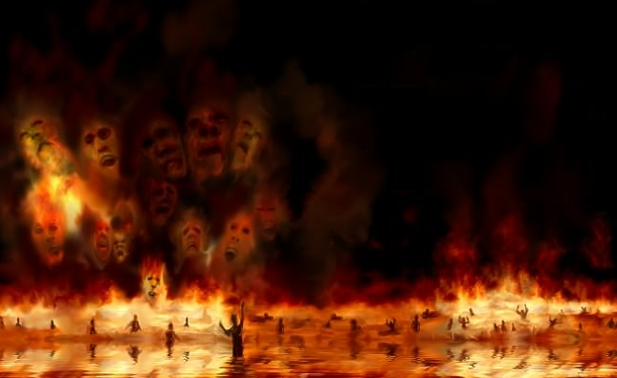
Torments
Paradise (Abraham's bosom)

Slide 50
“For Christ also hath once suffered for sins, the just for the unjust, that he might bring us to God, being put to death in the flesh, but quickened by the Spirit: By which also he went and preached unto the spirits in prison.” (I Peter 3:18-19)

Slide 51
Jesus victoriously proclaimed His triumph over sin and death to the spirits which were in prison (v.19-20)

Slide 52
“Wherefore he saith, When he ascended up on high, he led captivity captive…”

Slide 53
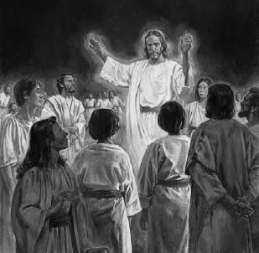

Slide 54
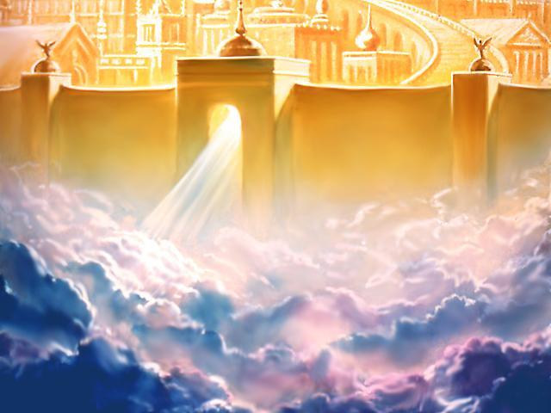

Slide 55
“And He (Christ) gave gifts unto men…for the perfecting of the saints, for the work of the ministry, for the edifying of the body of Christ.” (Ephesians 4:8-13)

Slide 56
“Now concerning spiritual gifts, brethren, I would not have you ignorant.” (I Corinthians 12:1)

Slide 57
“As every man hath received the gift, even so minister the same one to another, as good stewards of the manifold grace of God.”

Slide 58
What is a spiritual gift?
A spiritual gift is the “Manifold grace of God” (I Peter 4:10)
It is given to Christians enabling them to serve their church, the world and Christ through the divine enablement of the Holy Spirit – (I Corinthians 12:1-27)

Slide 60
The giving of gifts to the church took place after the resurrection and ascension of Christ (Acts 1-2)

Slide 61
“God also bearing them witness, both with signs and wonders, and with divers miracles, and gifts of the Holy Ghost, according to his own will?” (Heb. 2:4; see Acts 2:22, 43)

Slide 62
The principal evidence that the Church began on the day of Pentecost concerns the baptizing work of the Holy Spirit.

Slide 63
Jesus declared that this particular and distinctive ministry of the Spirit was still future just before his ascension –
Acts 1:5 “For John truly baptized with water; but ye shall be baptized with the Holy Ghost not many day hence…”

Slide 64
It was on the day of Pentecost that this first occurred - Acts 2; 11:15-16

Slide 65
What is it that Spirit Baptism does?
The answer to this is found in - I Corinthians 12:13
The Baptism of the Holy Spirit places the believer in the body of Christ (the church) – I Corinthians 12:27
Since this is the only way to enter the body of Christ and since this work of the Spirit first occurred on the day of Pentecost, then the conclusion is obvious that the Church, the body of Christ, began on the day of Pentecost

Slide 66
Why is this important?

Slide 67
“Not by might, nor by power, but by my spirit, saith the LORD of hosts.” Zec. 4:6

Slide 68
“Except the LORD build the house, they labor in vain that build it.” (Psalm 127:1)

Slide 69
The Filling of the Holy Spirit
Ephesians 5:18

Slide 70
Of all the aspects of the person and work of the Holy Spirit none is more vital to the Christian’s growth and maturity than the filling of the Holy Spirit –
The filling of the Holy Spirit is the means by which He controls the attitude and behavior of believers, performing His ministries through them – “…to the glory of God!”

Slide 72
The Word of God Divides Believers into Two Categories
(I Cor. 3:1-3)

Slide 73
The Carnal Believer’s Characteristics
He lives according to the desires of his own flesh.
He is controlled by - “The lust of the flesh…
lust of the eyes and the pride of life…”
Self is on the throne of his life / The Lordship of Christ over his life has been rejected – “Whosoever ye yield your selves servants to obey his servants ye are to whom ye obey…”

Slide 74
He has grieved (Eph. 4:30) and quenched (I Thess. 5:19) the ministry of the Holy Spirit in his life.
When the Holy Spirit fills (controls) a believer He works in and through the life of that believer – “I am crucified with Christ…Christ liveth in me…”

Slide 75
Baptizes us into the body of Christ – “for by one spirit are baptized…”
Indwells us – “temple of the Holy Spirit”
Seals us unto the day of redemption – Eph. 1:13-14
Earnest – a down payment, a pledge – II Cor. 5:5
Imparts to us spiritual gifts which enable us (equips us) to effectively serve the Lord - I Peter 4:10 “gifts of the spirit”

Slide 76
Guides us into all truth – John 16:13
Teaches us as we study the Word of God
– “called the anointing” I John 2:27
Reveals Biblical truth to us – I Cor. 2:10
Empowers us to serve the Lord – Acts1:8
Imparts to us and through us the love of
God – Rom. 5:5
Conforms us into the image of Christ –
II Cor. 3:18
Gives us the assurance of our salvation –
Rom. 8:16

Slide 77
Comforts us – John 14:16
Puts His words in our mouth – Matt.
13:11
Strengthens us in our inner man – Eph.
3:16
Prompts us – Rom. 8:14
Produces His fruit in and through us –
Gal. 5:22-23

Slide 78
A carnal believer is not able to enjoy of these ministries of the Holy Spirit.
The fruit that he bears is just the opposite of the fruit of the Spirit!

Slide 79
The Spiritual Believer’s Characteristics
Carnality and Spirituality
are Opposites
Gal. 5:16-17
Rom. 7:14-23

Slide 80
Every Christian experiences this inner struggle between the flesh and the spirit. But who controls you is a matter of personal choice – Jesus said “Shall not I give the Holy Spirit to them that ask…”
(When was the last time you asked the Holy Spirit to fill you?)

Slide 81
How to be Filled with the Holy Spirit

Slide 82
Purpose to live a holy life – I Thess. 4:1-8
Yield yourself to the Lord – Rom. 6, 12:1-2
Renew your mind daily – Eph. 4:23-24
Make no provision for the flesh – Rom. 13:14
Flee temptation – II Tim. 2:22
Resist Satan by continual submission to God – James 4:6-10

Slide 83
Do not give place to the devil – Eph. 4:27–31 (bitterness, immorality, covetousness)
Keep your thoughts centered on things pure and lovely – Phil. 4:6-8
Set your affections on things above – Col. 3:1-4
Keep sin confessed – Prov. 28:13-14
Keep your conscience clear – Acts 24:16
Obey the promptings of the Holy Spirit – Rom. 8:14

Slide 84
Avoid quenching and grieving the Holy Spirit – I Thess. 5:19, Eph. 4:25-31
Ask God to fill you with the Holy Spirit – Luke 11:15
Note: The Holy Spirit is called the “Spirit of Grace” in Heb. 10:29 - “God gives grace to the humble…”

Slide 85
Spirit Filling is Likened
unto Being Drunk
(Eph. 5:18)
A drunken person is under the control of alcohol and will think, speak and act in ways that are not natural when he is sober.

Slide 86
The symbols of the Holy Spirit become essential to our gaining an understanding of who He is, what He’s like and His ministry in our lives, the Church
and the World.

Slide 89
Wine a symbol of the filling of the Holy Spirit.

Slide 90
The Comparison

Slide 91
The Comparison is a Control Issue

Slide 92
The Filling of the Holy Spirit
is to be Sought (pursued) by
Every Believer
We are never commanded to be indwelt, sealed or baptized with the Spirit.
This happened the moment you received Christ as your personal Savior.
We are however commanded to be “filled with the Spirit…”

